Slide 1




Search for the decay of the Higgs boson into $b\overline{b}$ pair in VH channel with the ATLAS detector
Faig Ahmadov
Joint Institute for Nuclear Research
Institute of Physics, ANAS
11-18 June 2018
VII Annual Scientific Conference of Young Scientists and Specialists of JINR
“Alushta-2018”
Notes:
9/9/16

Slide 2
Overview
Higgs boson
Analysis methods
The 2015-2016 data analysis results
Expected results from full Run-II
Conclusion
2
Notes:
9/9/16

Slide 3
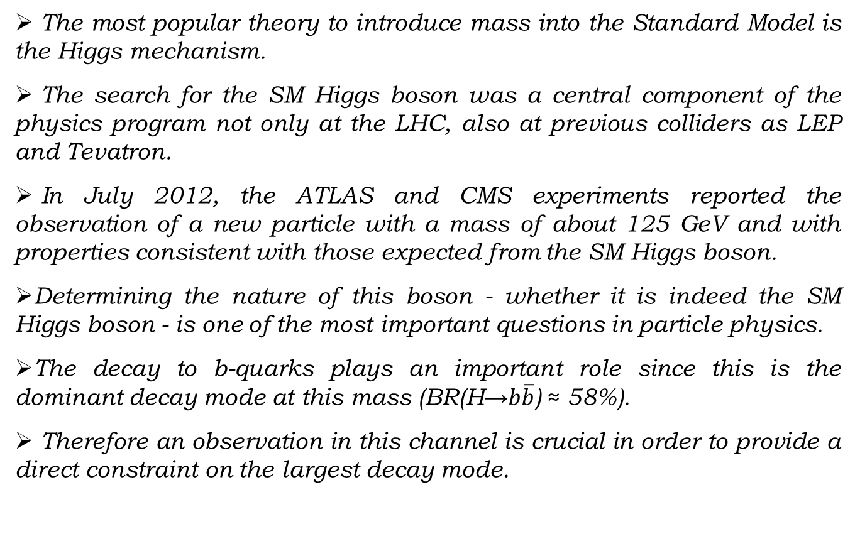
Higgs boson
The most popular theory to introduce mass into the Standard Model is the Higgs mechanism.
The search for the SM Higgs boson was a central component of the physics program not only at the LHC, also at previous colliders as LEP and Tevatron.
In July 2012, the ATLAS and CMS experiments reported the observation of a new particle with a mass of about 125 GeV and with properties consistent with those expected from the SM Higgs boson.
Determining the nature of this boson - whether it is indeed the SM Higgs boson - is one of the most important questions in particle physics.
The decay to b-quarks plays an important role since this is the dominant decay mode at this mass (BR(H→$b\overline{b}$) ≈ 58%).
Therefore an observation in this channel is crucial in order to provide a direct constraint on the largest decay mode.
3
Notes:
9/9/16

Slide 4
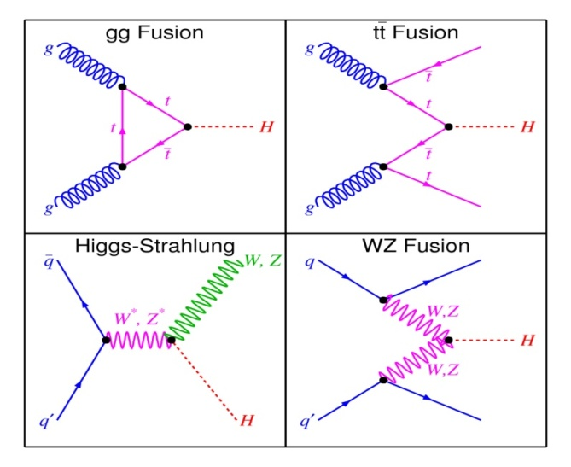
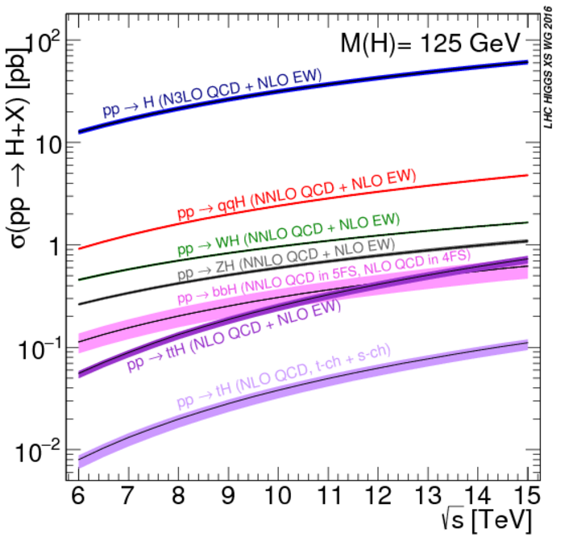
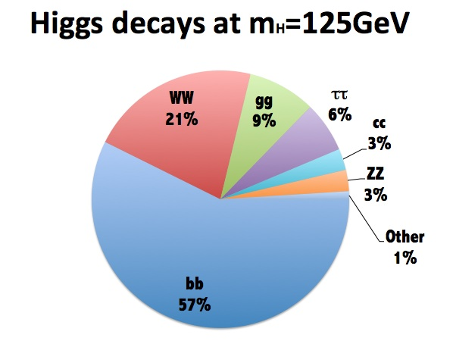
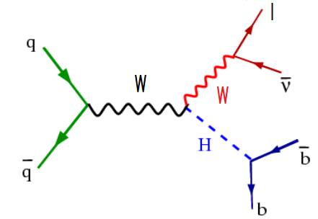
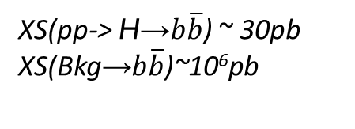
Production & decay channels
Higgs boson production XS as a function of the CoM energy.
XS(pp-> H→$b\overline{b}$) ~ 30pb
XS(Bkg→$b\overline{b}$)~10⁶pb
The leptonic decays of the vector boson, W or Z can be used for triggering and background reduction purposes.
4
Notes:
9/9/16

Slide 5
Analysis methods
The methods are used for data analysis:
Multivariate - analyze (MVA) data with more than one variable and take into account relation between them (for main result);
Cut-flow - which based on some kinematic variables and the best cuts for them (for cross-check).
In this analysis used two MVA techniques:
Boosted Decision Tree (BDT) and Neural Network (NN).
5
Notes:
9/9/16

Slide 6

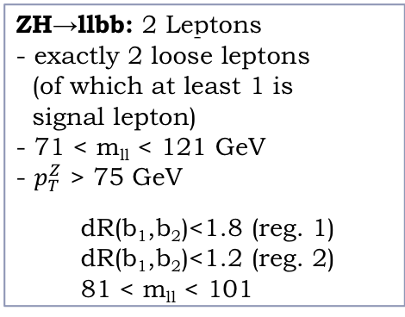
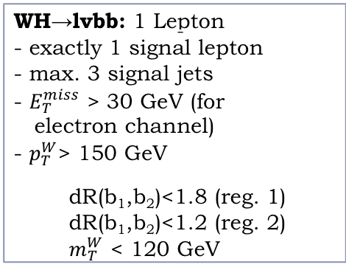
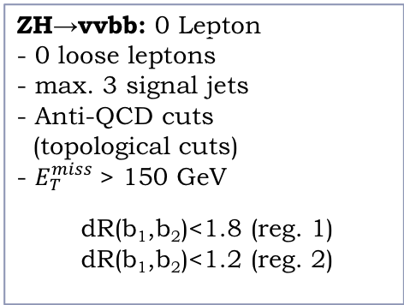
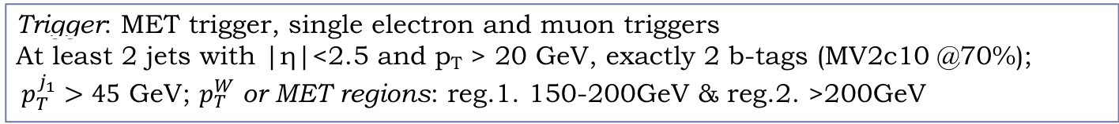
V(H→ $b\overline{b}$) event selection
Event preselection
Object selection:
Electron selection
Muon selection
Jet selection (b-jet selection)
Neutrino selection (Missing transverse energy)
Final event selection
Trigger: MET trigger, single electron and muon triggers
At least 2 jets with |η|<2.5 and p_{T} > 20 GeV, exactly 2 b-tags (MV2c10 @70%);
$p_{T}^{j_{1}}>45$ GeV; $p_{T}^{W}$ or MET regions: reg.1. 150-200GeV & reg.2. >200GeV
ZH→vvbb: 0 Lepton
- 0 loose leptons
- max. 3 signal jets
- Anti-QCD cuts
(topological cuts)
- $E_{T}^{miss}$> 150 GeV
  dR(b₁,b₂)<1.8 (reg. 1)
  dR(b₁,b₂)<1.2 (reg. 2)
WH→lvbb: 1 Lepton
- exactly 1 signal lepton
- max. 3 signal jets
- $E_{T}^{miss}$ > 30 GeV (for
electron channel)
- $p_{T}^{W}$> 150 GeV
  dR(b₁,b₂)<1.8 (reg. 1)
  dR(b₁,b₂)<1.2 (reg. 2)
  $m_{T}^{W}$ < 120 GeV
ZH→llbb: 2 Leptons
- exactly 2 loose leptons
(of which at least 1 is
signal lepton)
- 71 < m_{ll} < 121 GeV
- $p_{T}^{Z}$ > 75 GeV
  dR(b₁,b₂)<1.8 (reg. 1)
  dR(b₁,b₂)<1.2 (reg. 2)
  81 < m_{ll} < 101
6
Notes:
9/9/16

Slide 7
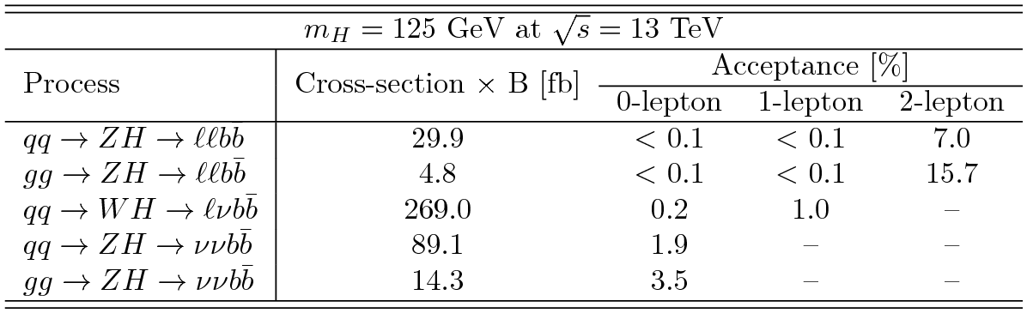
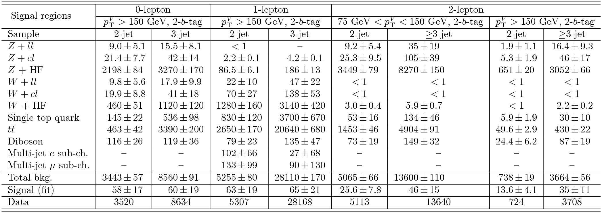
XS, acceptance and yields
7
Notes:
7

Slide 8
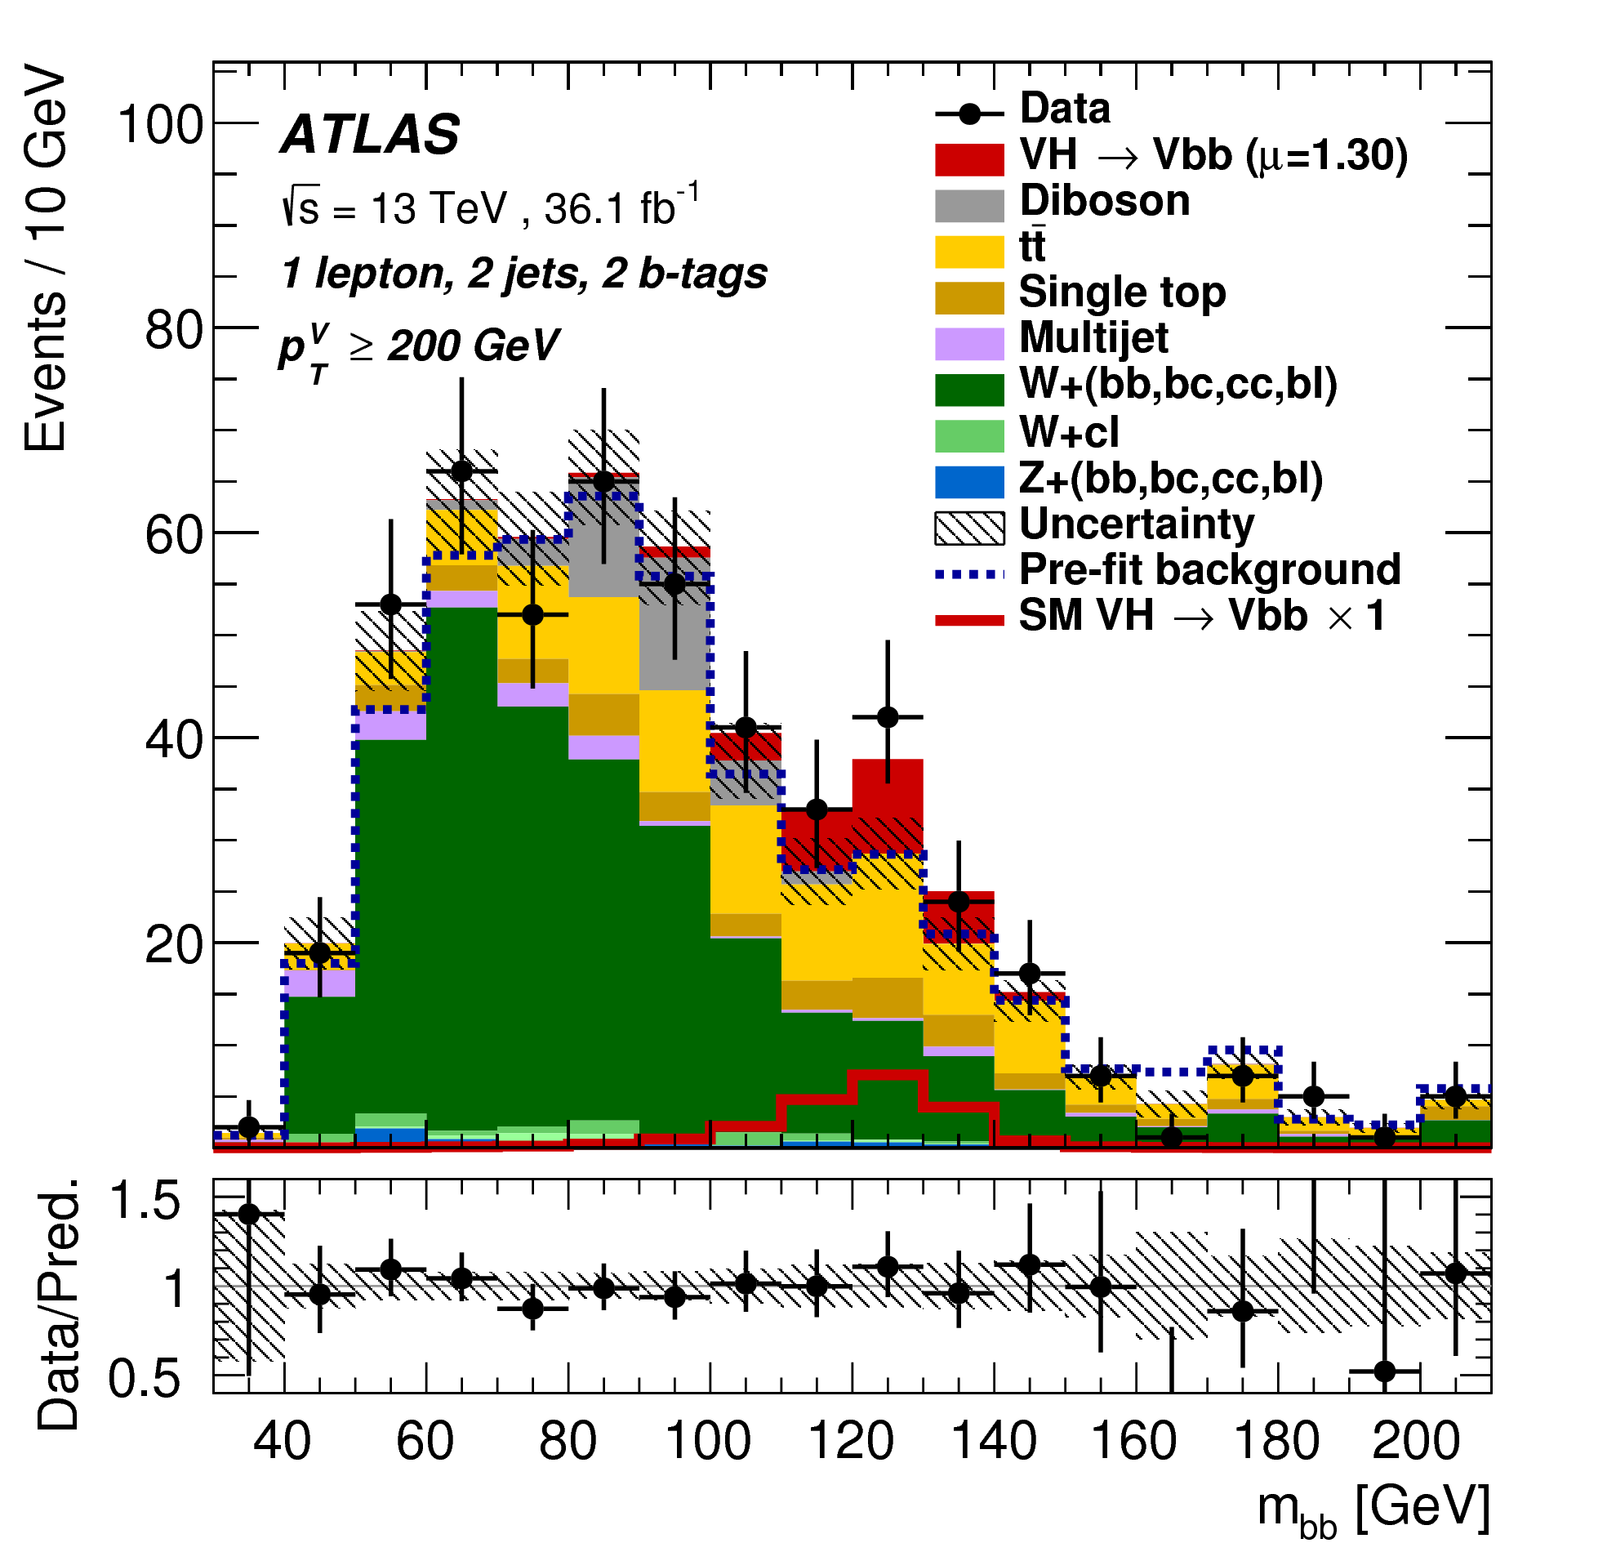
Cut-flow output
Agreement between data and estimated background is observed within the uncertainties
8

Slide 9
BDT response
Good separation of signal and background events in the BDT
9
Notes:
9

Slide 10
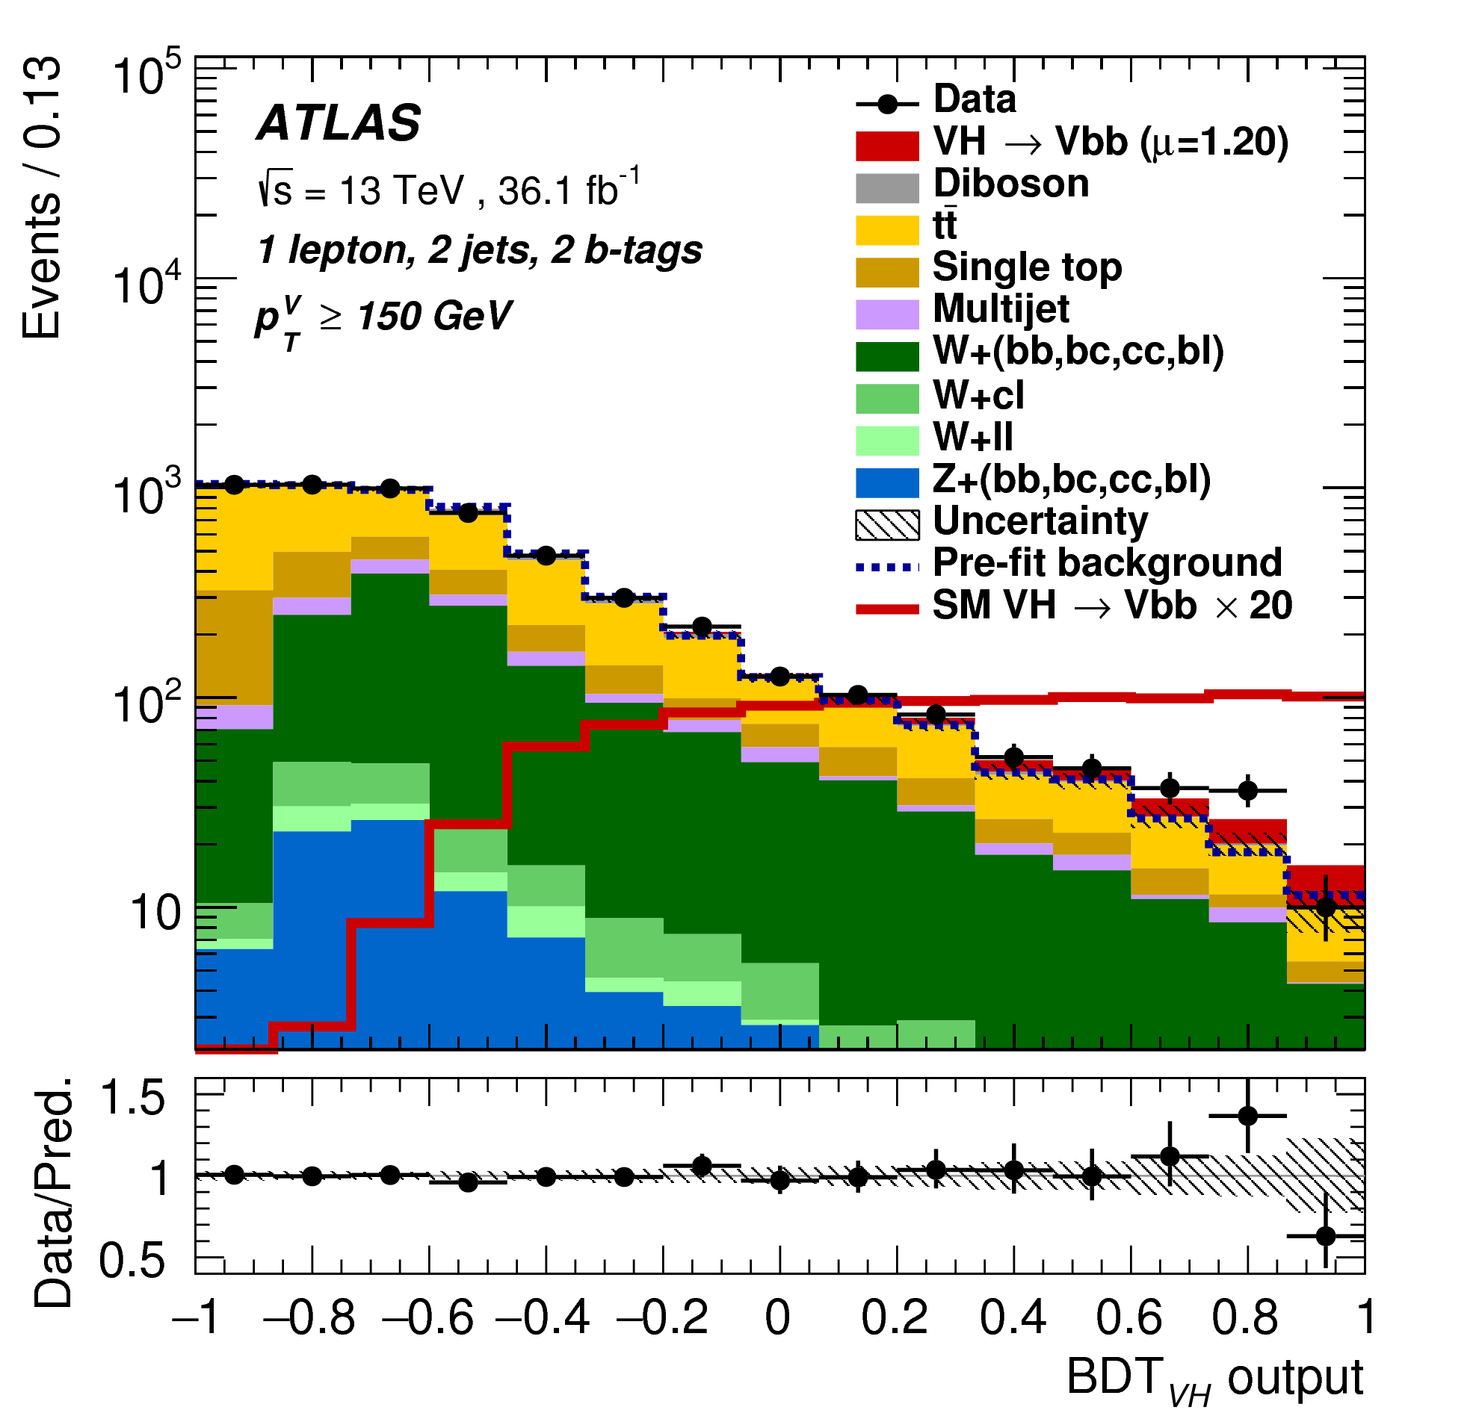
BDT output
The BDT output post-fit distributions in the 1-lepton channel for 2-b-tag events, in the 2-jet categories in the high p_{T}V region.
10

Slide 11
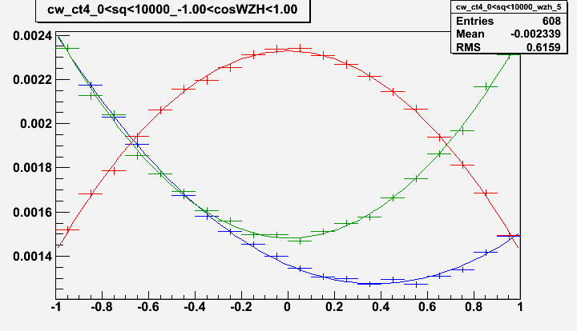
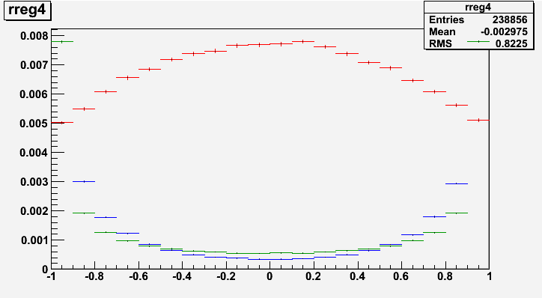
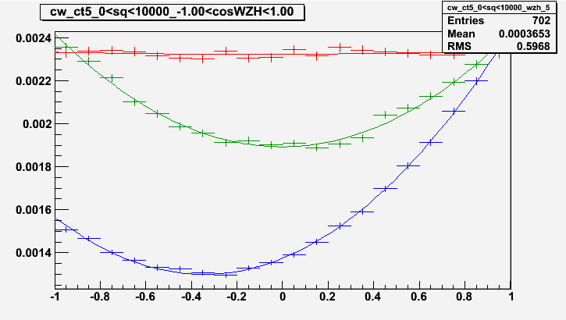


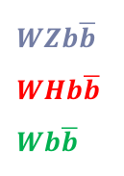
Some new variables in NN
Some useful angles
ℓ¯
W⁻ rest
frame
WH
c.m.s.
W⁻
ν
θ*
q
$$\overline{q}$$
b
H
$WZb\overline{b}$
$$WHb\overline{b}$$
$$Wb\overline{b}$$
θ_{b}
H rest
frame
$$\overline{b}$$
cosθ_{e}*
cosθ_{w}
cosθ_{b}*
11

Slide 12
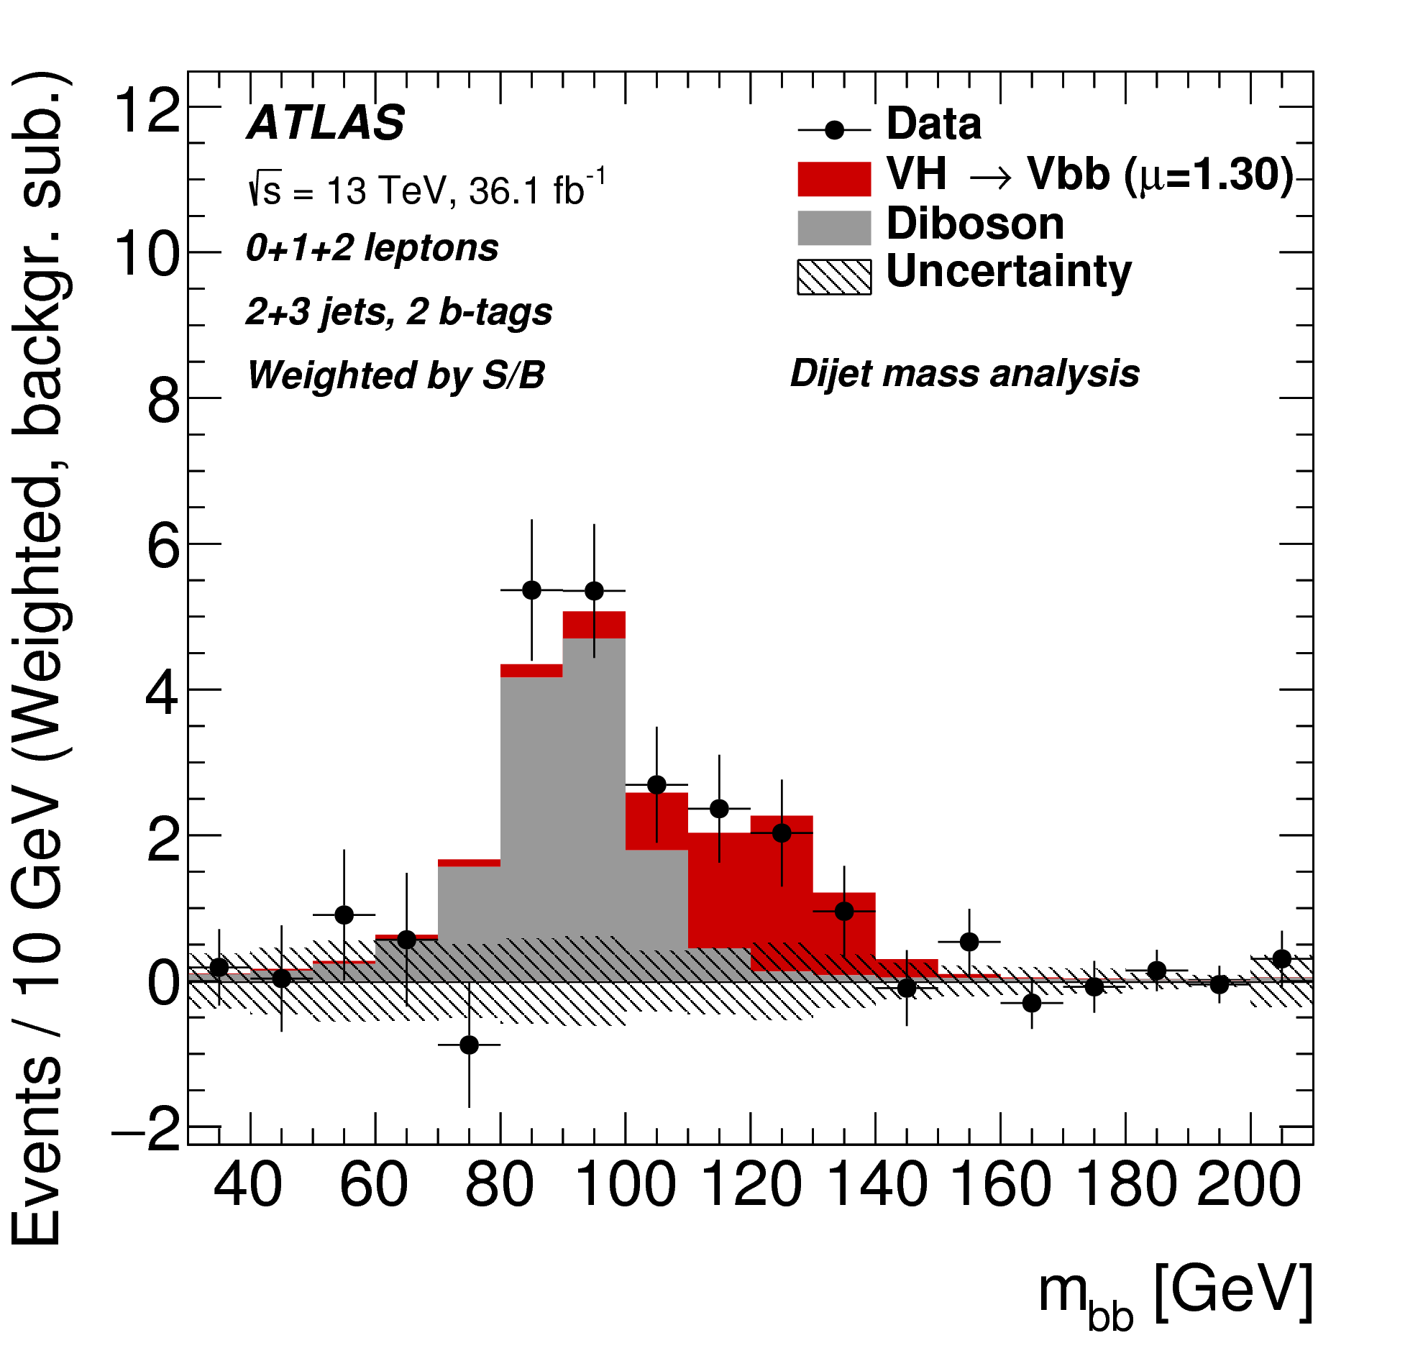

Cut-Flow result
The cut-flow method of the analysis was applied to the experimental data at 13 TeV for crosscheck and revealed excess of the observed (expected) events over the expected background from the Standard Model is 3.5σ (2.8σ) and for the µ found
12

Slide 13
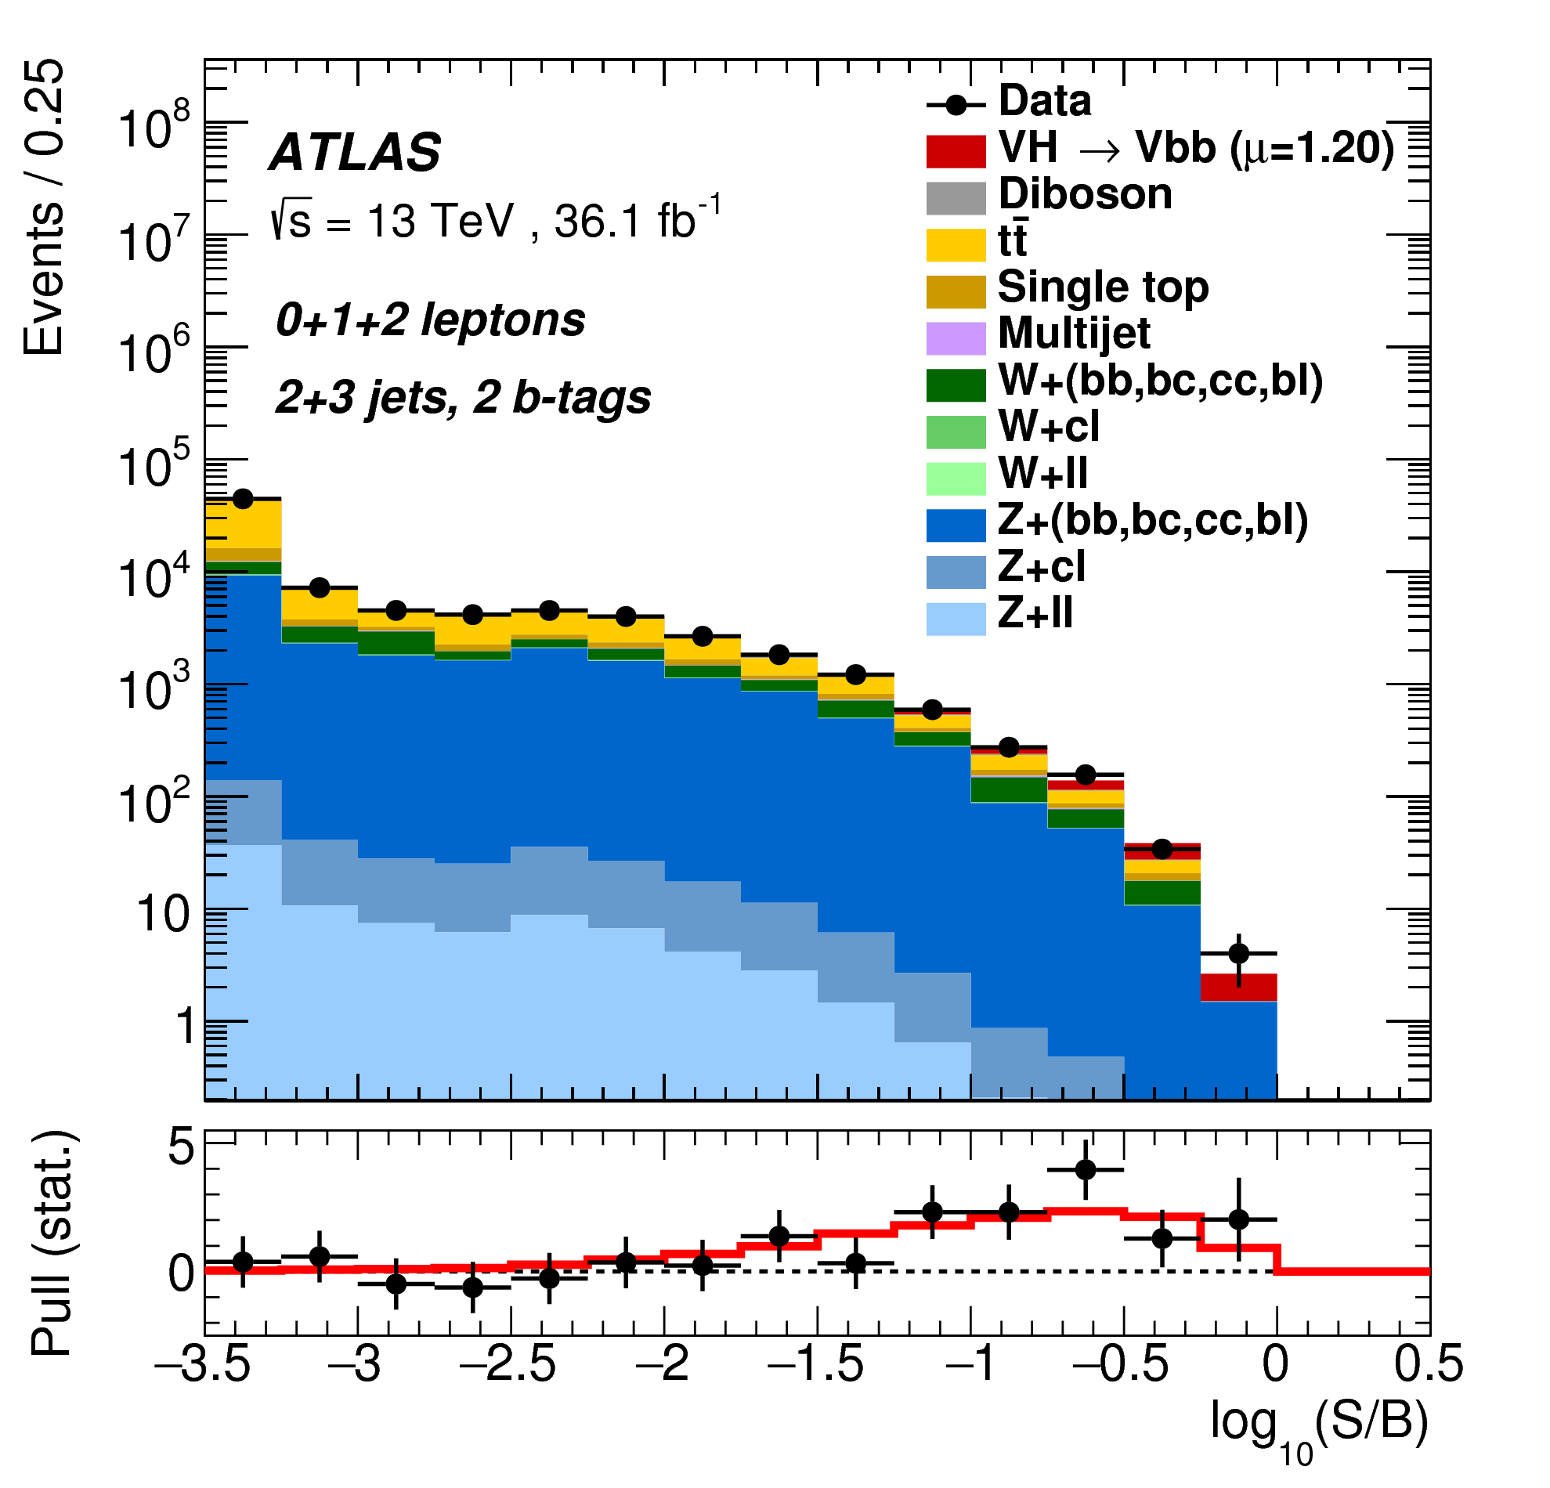

MVA result
For the Higgs boson mass of 125 GeV, the observation corresponds to an excess with a significance of 3.5σ, to be compared to an expectation of 3.0σ.
For the fitted value of the signal strength parameter is
Event yields as a function of log(S/B) for data, background and a Higgs boson signal with m_{H}=125GeV.
13

Slide 14
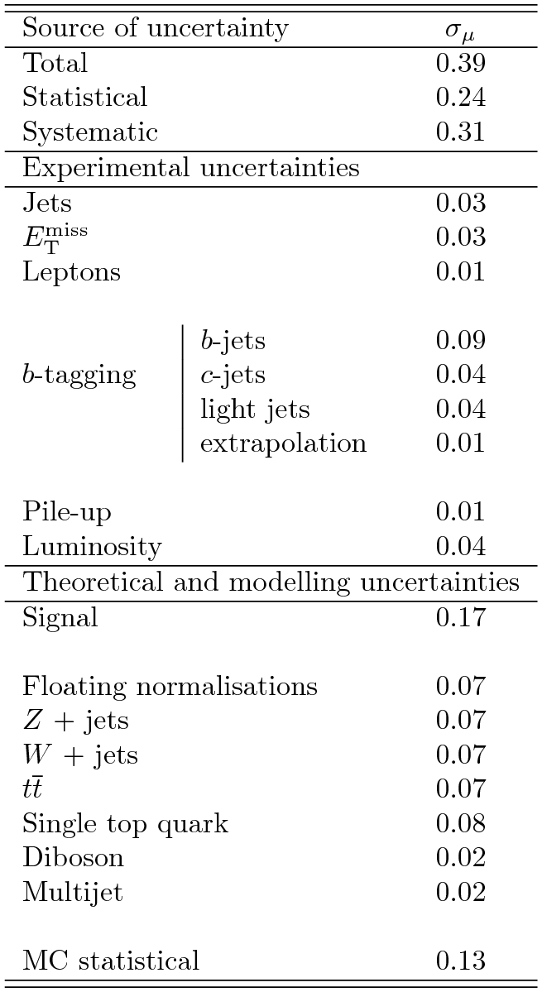
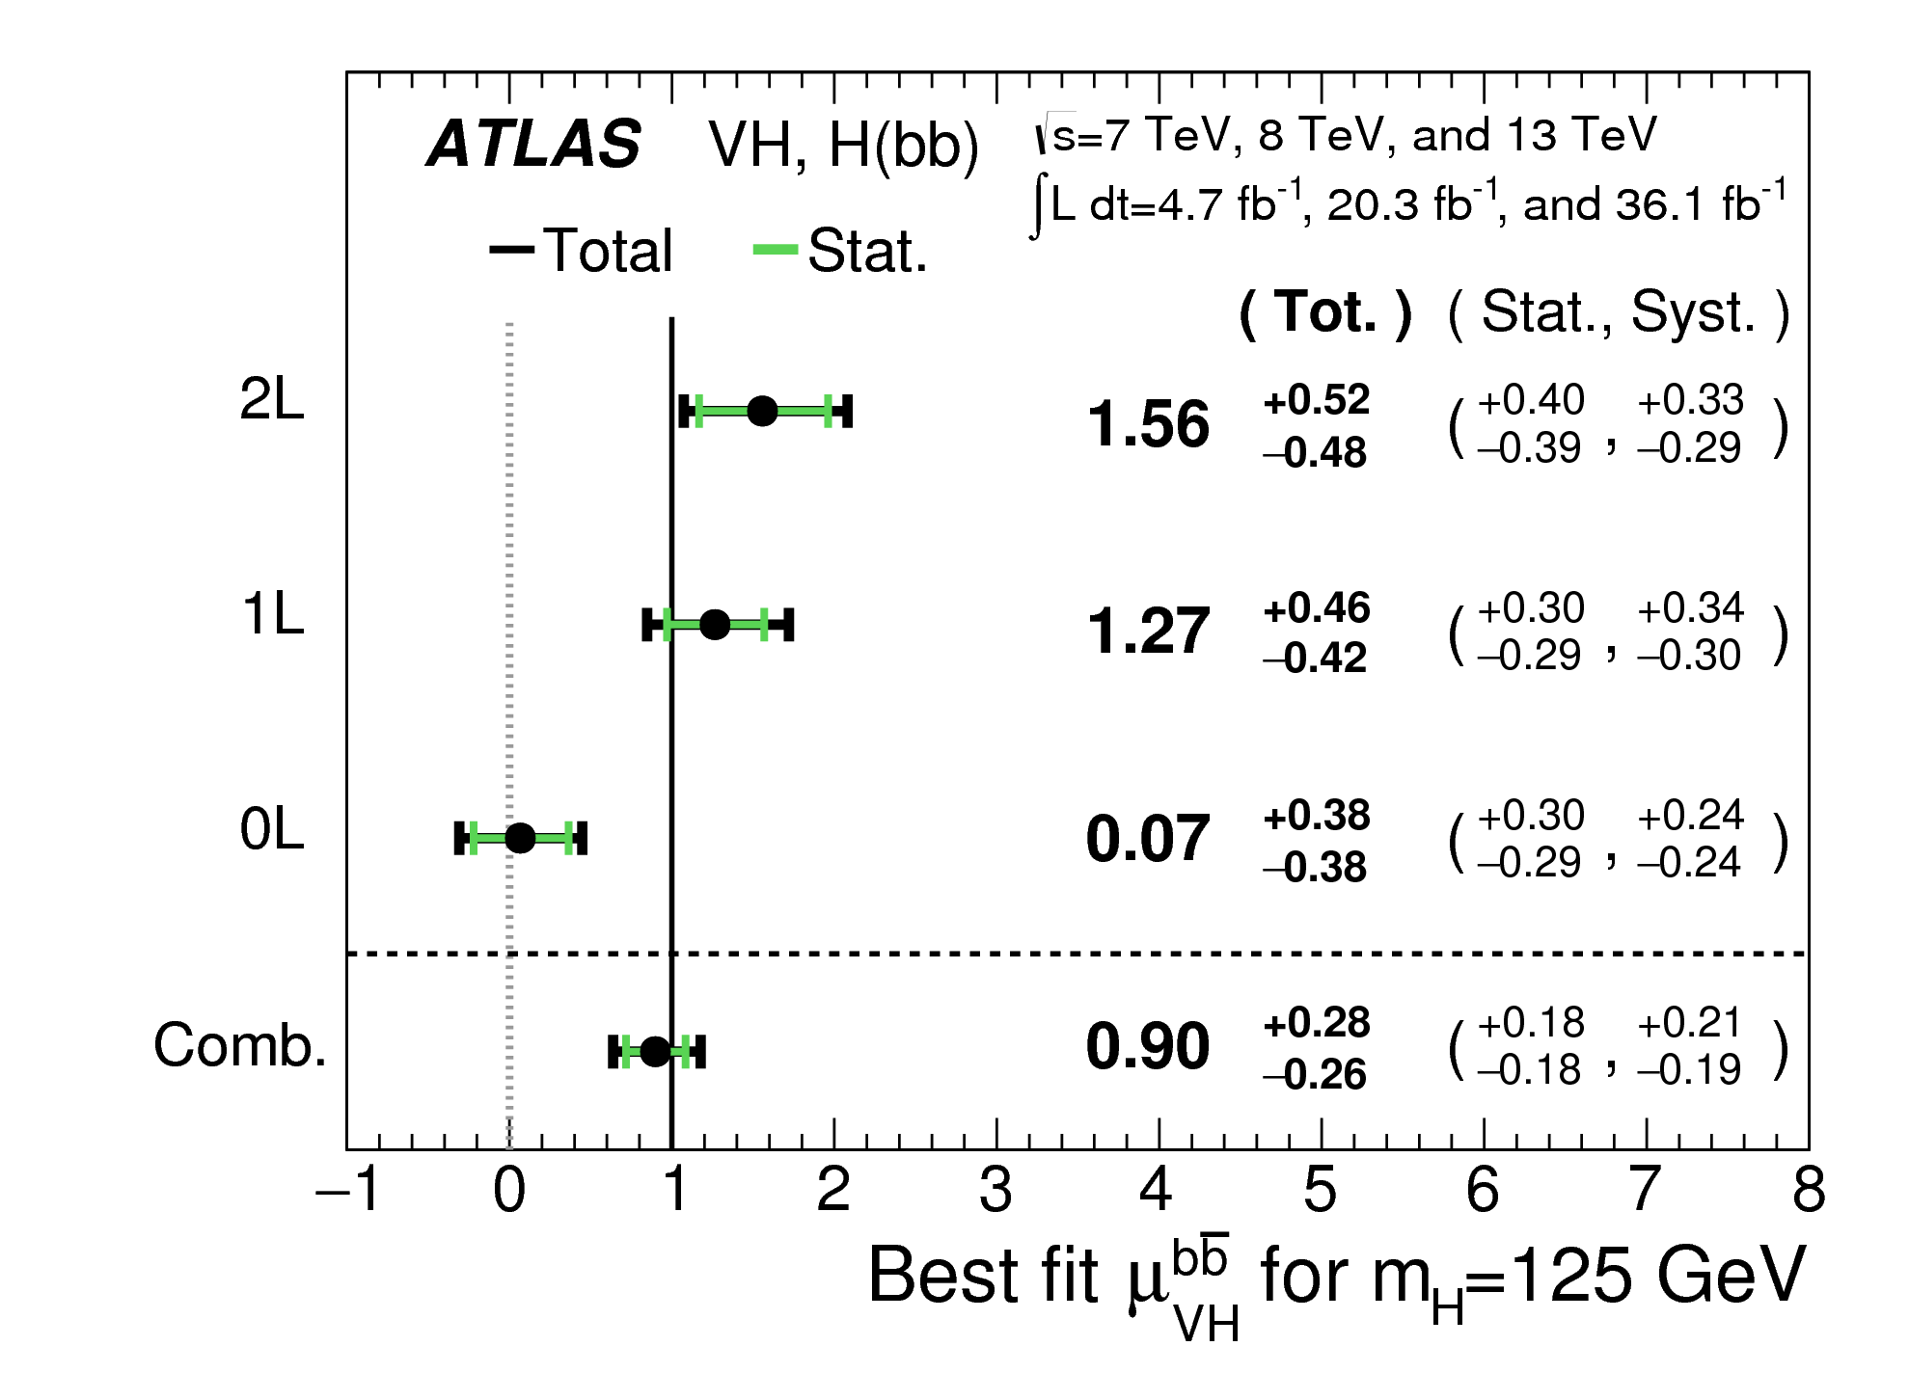
Run-1 + Run-2
14

Slide 15
Expected results from full Run-II
Two times more data in full 13TeV datasets L=80fb⁻¹;
Reasonable agreement between data and MC in full 13TeV data;
Signal efficiency can be improved by adding the new variables;
Expected some other improvements;
Processing of data collected in 2017 (43.8fb⁻¹) continues;
We are aiming for 5σ significance in later summer 2018.
15
Notes:
15

Slide 16

Conclusions
For the Higgs boson with a mass of 125GeV, an excess of events over the expected background from other Standard Model processes is found with an observed significance of 3.5 standard deviations, compared to an expectation of 3.0 standard deviations.
The result of the search for the SM Higgs boson based on Run 2 data is combined with previous results based on the full Run 1 dataset. An excess over the expected SM background is observed, with a significance of 3.6σ compared to an expectation of 4.0σ.
The measured signal strength with respect to the SM expectation is found to be $µ=0.90±0.18{(stat.)}_{−0.19}^{+0.21}(syst.)$
This excess indicates the existence of the decay of the Higgs boson into $b\overline{b}$ quarks and for its production in association with a vector boson.
16
Notes:
16

Slide 17
Thank You!
Notes:
17

