Slide 1
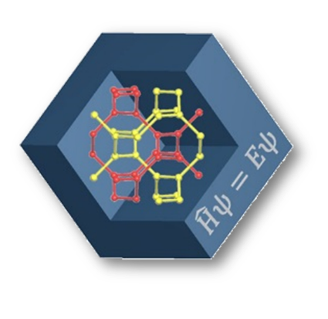
DFT-based study of the disordered solid electrolytes
Samara Center for Theoretical Materials Science
Roman Eremin^{1,2}, Pavel Zolotarev¹
¹Samara Center for Theoretical Materials Science, Samara University, Samara, Russia
²Samara Center for Theoretical Materials Science, Samara State Technical University, Samara, Russia

Slide 2
Motivation

Slide 3
Cathode materials
Anode (graphite)
Cathode (LiMeO₂)
100%
75%
50%
25%
0%

Slide 4
Purpose and Tasks
Modeling of the properties of the cathode materials during deintercalation
Sampling of the configurational spaces of disordered structure
Calculations of the structure – energy relations
-1 ball
-3 balls
-2 balls

Slide 5
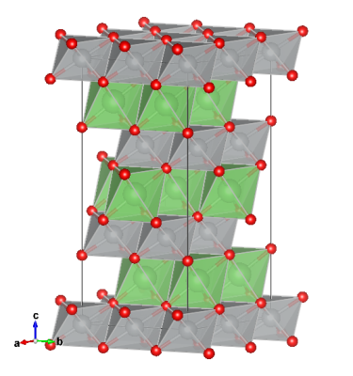
Cathode materials: DFT models
LiNiO₂ (S.G. R-3m)
-1 ball
…
-2 balls
…
12 balls
-3 balls
-12 balls
…
…
…

Slide 6
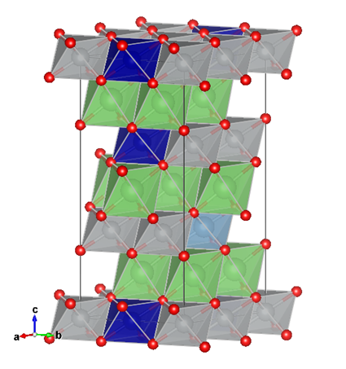
Cathode materials: doping
LiNiO₂ (S.G. R-3m)
DOPED
-1 ball
…
-2 balls
…
12 balls
-3 balls
-12 balls
…
…
…

Slide 7
Cathode materials: doping
Compositional/configurational space sampling
DFT-based structure relaxation (variable models, Bader analysis, etc.)
Structure-energy relations (charge distribution)
R. A. Eremin, P. N. Zolotarev, O. Y. Ivanshina and I. A. Bobrikov, Li(Ni,Co,Al)O2 Cathode Delithiation: A Combination of Topological Analysis, Density Functional Theory, Neutron Diffraction, and Machine Learning Techniques, J. Phys. Chem. C, 2017, 121, 28293−28305.

Slide 8
Solid electrolytes
Anode
Solid electrolyte
Cathode

Slide 9
Solid electrolytes: modeling
Modeling approaches
Dynamics
Classical molecular dynamics
Quantum molecular dynamics
Transition states
Nudged elastic band method (NEB)
Monte Carlo modeling
Force field setting
Slow (even for a small system)
All inequivalent transitions to be considered
No information on the transition states
Kinetic and dynamic MC

Slide 10
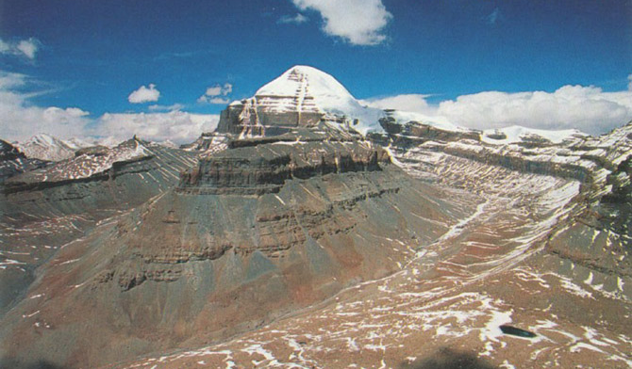
Nudged elastic band method

Slide 11
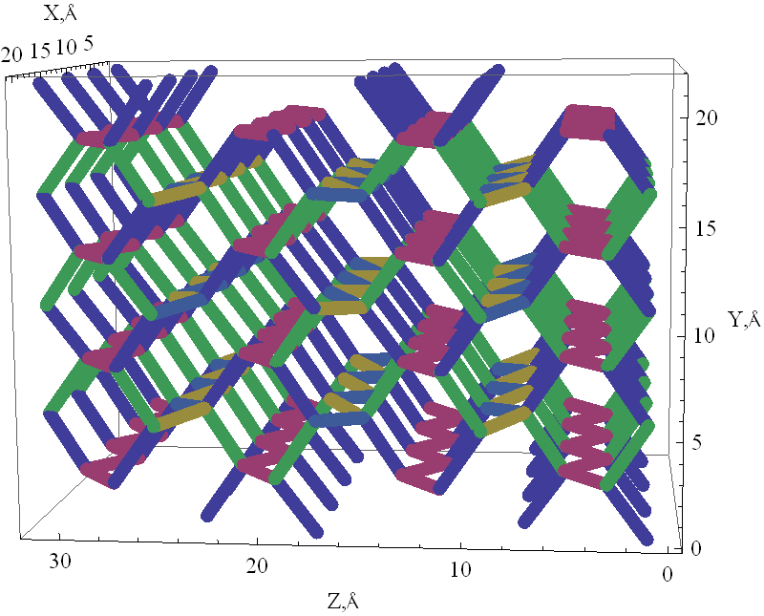
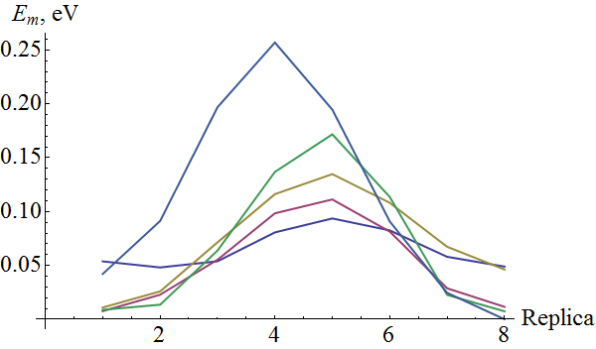
Solid electrolytes: KFeO₂
KFeO₂, 4-2-2 supercell
KFeO₂, pathways
A
A
B
B
C
G
H
C
G
H
D
D
E
F
E
F
I
J
I
J
R_{AB} = 3.37778 Å
R_{CD} = 3.39415 Å
R_{EF} = 3.41299 Å
R_{GH} = 3.41472 Å
R_{IJ} = 3.42567 Å
NEB

Slide 12
Solid electrolytes: doping effect
KFe_{1-x}Ti_{x}O₂
N. V. Proskurnina, V. I. Voronin, G. S. Shekhtman, L. N. Maskaeva, N. A. Kabanova, A. A. Kabanov and V. A. Blatov, Ionic Conductivity in Ti-Doped KFeO2: Experiment and Mathematical Modeling, J. Phys. Chem. C, 2017, 121, 21128–21135.

Slide 13
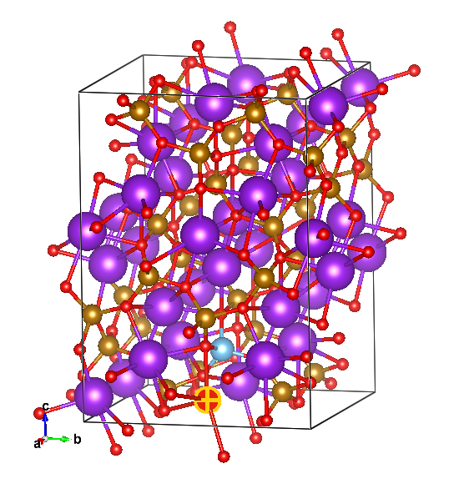
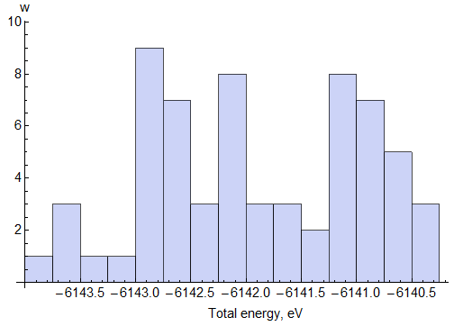
K_{1-x}Fe_{1-x}Ti_{x}O₂: configurational space
x ≈ 0.03
64 configurations

Slide 14
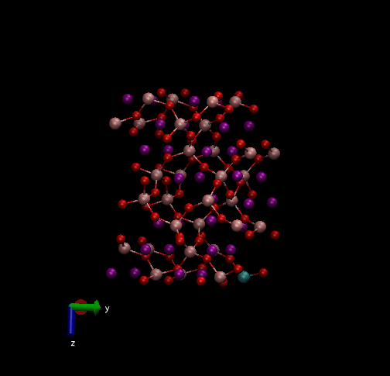
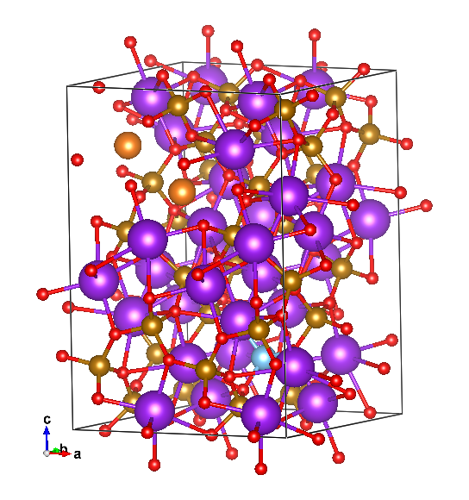
K_{1-x}Fe_{1-x}Ti_{x}O₂: space of pathways
x ≈ 0.03
128 transitions

Slide 15
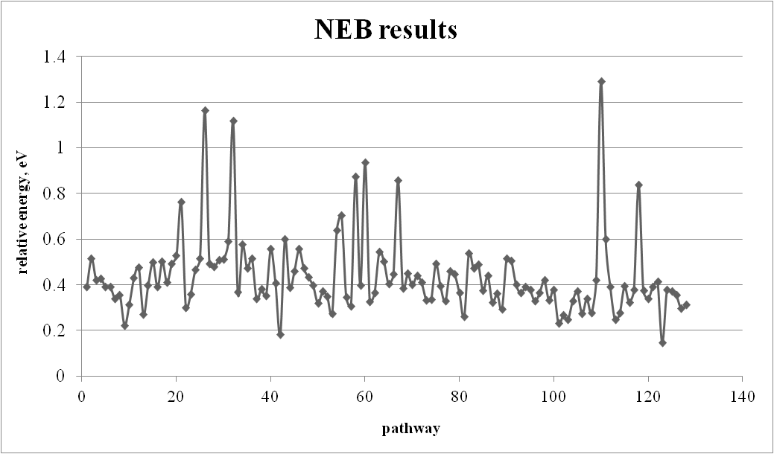
K_{1-x}Fe_{1-x}Ti_{x}O₂: space of pathways
128 transitions

Slide 16
How to…
… analyze the obtained results?
… go further with respect to dopant content?

Slide 17
Acknowledgements
We are obliged to computational facilities of Samara University:
‘Sergey Korolev’ and
‘Zeolite’ (Samara Center for Theoretical Materials Science).
This study was supported by
the Russian Federation Government (project No.3.6588.2017/9.10) and
Russian Foundation for Basic Research (project No.18-33-00477).
Thank you for your attention!

