Slide 1

Simulations of the magnet for compact superconducting cyclotron SC200 commissioning.
POPOV D., KARAMYSHEVA G., MALININ V., KARAMYSHEV O.

Slide 2
Abstract
Modern packages for the design and simulation of cyclotron magnet systems, such as Tosca, CST Studio, Comsol, etc., combined with recent hardware of a high performance allow us to simulate magnet corrections called the ‘shimming’. That means a significant part of the commissioning stage could be performed in ‘virtual reality’. This can substantially decrease the duration of the shimming procedure and the amount of the material wasted on the shimming of the real magnet, and additionally it provides a field of high-precision.

Slide 3
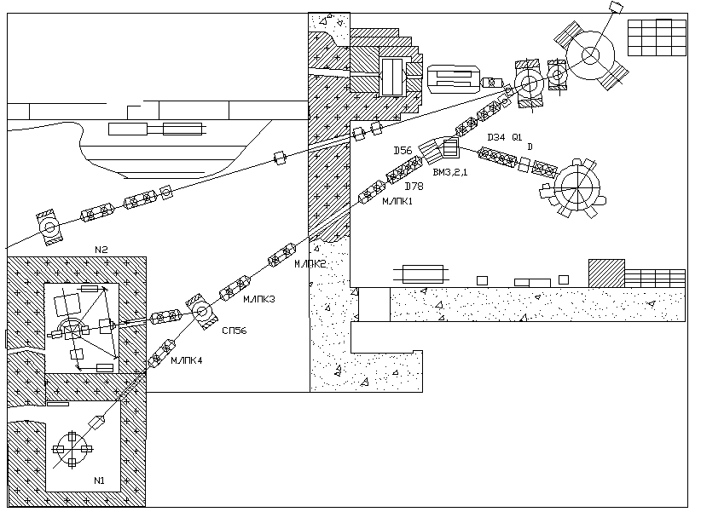
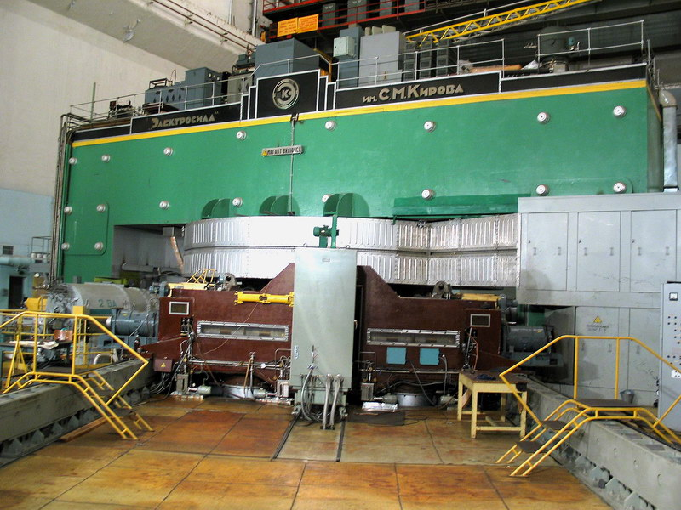
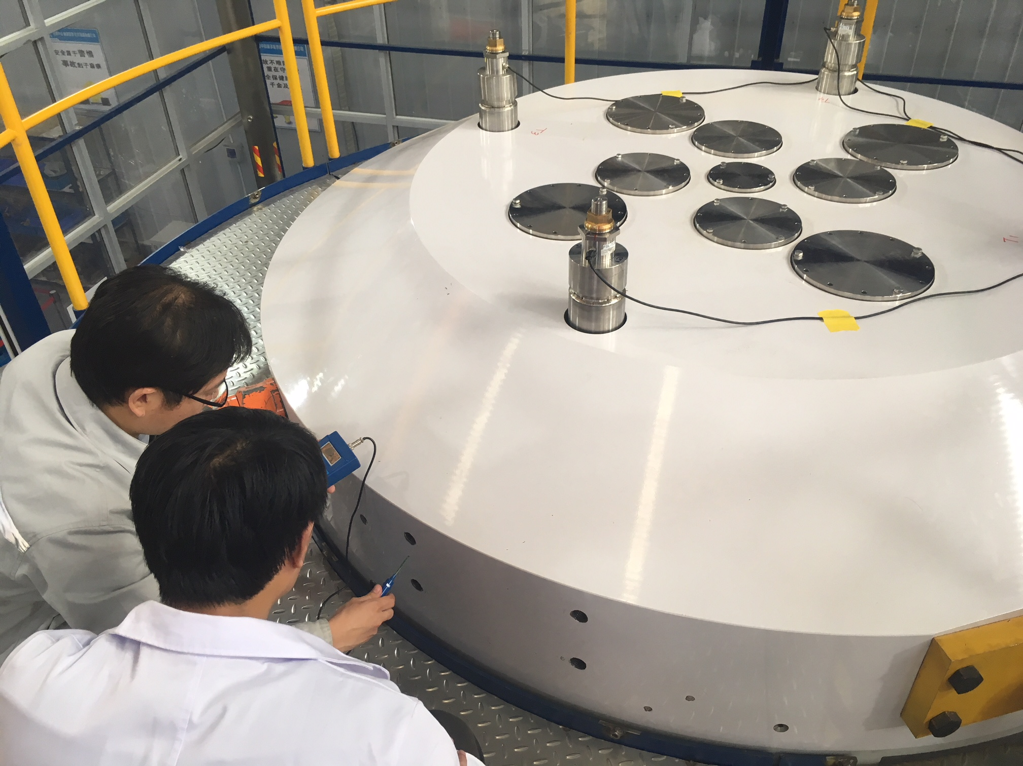
JINR MEDICAL TECHNICAL COMPLEX with the future SC202 cyclotron
It is planned to manufacture two cyclotrons in China : one will operate in Hefei cyclotron medical center, the other will replace Phasotron in Medico-technical center JINR Dubna and will be used to treat cancer with protons.
SC202
Dubna, “Phasotron”.
Originally built in 1949,
modernized in 1984

Slide 4
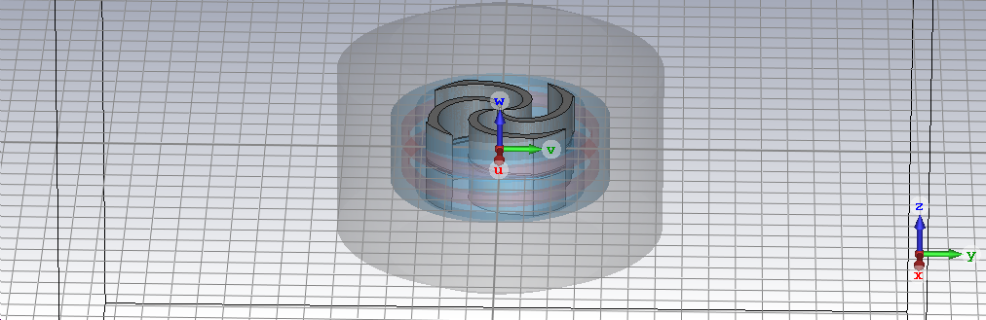
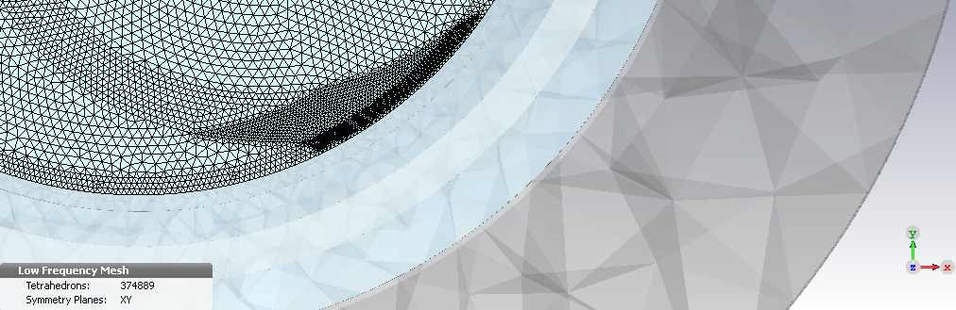
SC202 magnet design
Computer model of the magnet
3D magnet simulation is the most important part when it comes to the development of an isochronous superconducting cyclotron as it defines the particle motion in the accelerator.
Working diagram
Magnet modelling goes hand in hand with beam dynamics modeling.
Meshed model

Slide 5
About the accuracy of the simulations
Also the accuracy of the simulations has been increased and the numerical error is lower than 0.1 Gauss. This accuracy, of course, cannot be achieved in production, however when accuracy of the model is much lower than accuracy of manufacturing, it becomes possible to simulate tolerances and errors and the major weak spots that would help on the production stage.

Slide 6
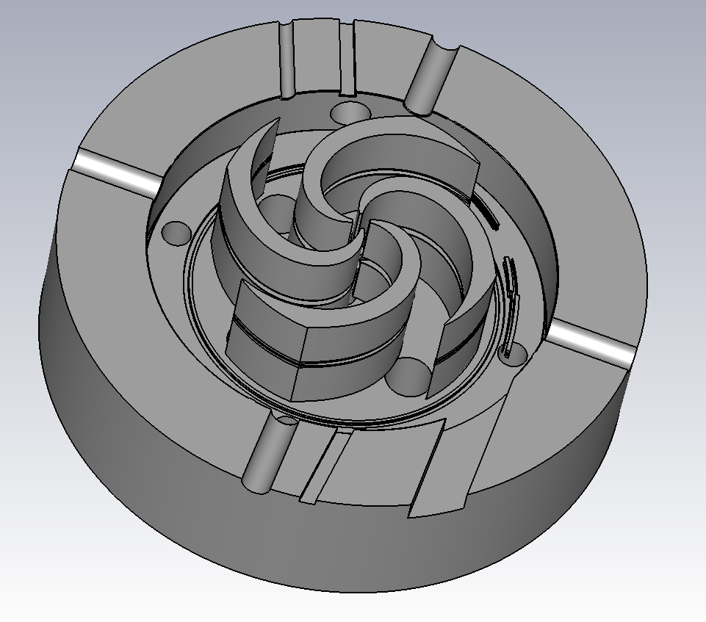
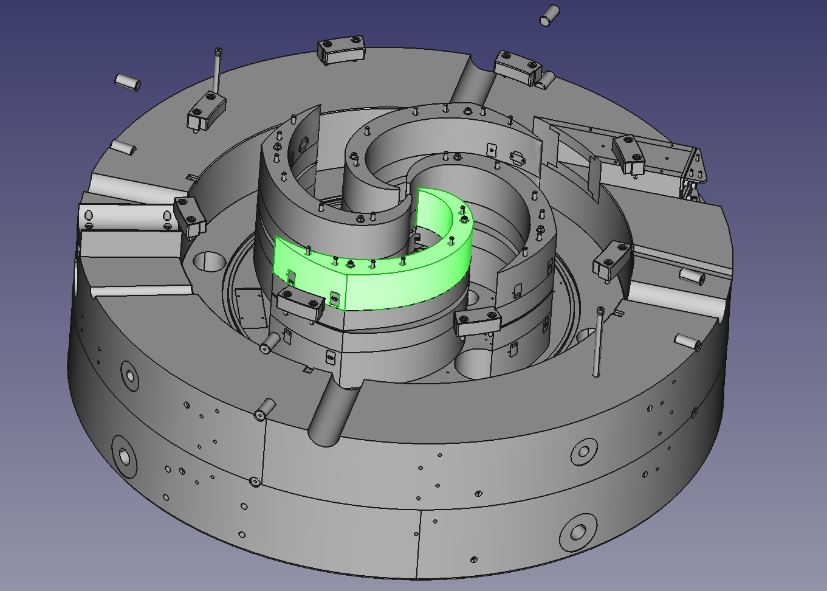
Manufactured Model
Due to physical limitations and the necessity of engineering restrictions, the model put into production significantly differs from a simulated one.
Ambition to achieve several contradictory goals:
  Smooth and isochronous magnetic field
  Easy way to disassemble and shimm the sectors
  Solid attachment against strong magnetic fields
at first resulted into 4-partition sector design, then 3 parts (BCD) were merged into one.
Accidental mistake called ‘Zig-Zag’ in the process of the smoothing was made.
Simulated model
Manufactured model

Slide 7
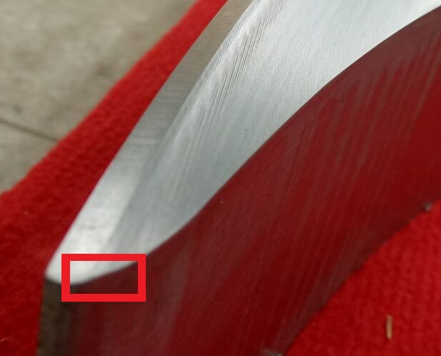
The ‘Zig-Zag’ Flaw
It is about 300 microns deviation in the gap curve.
Two separate models with especially neat geometry in the Zig-Zag region were made, simulated, and the results were compared.
Apart from the great deviation in the mean field, its maximum was displaced on 500 microns. It has a drastic influence on the extraction trajectory and needs to be corrected.
Possible solutions are under discussion: cutting the gap, increasing field.

Slide 8
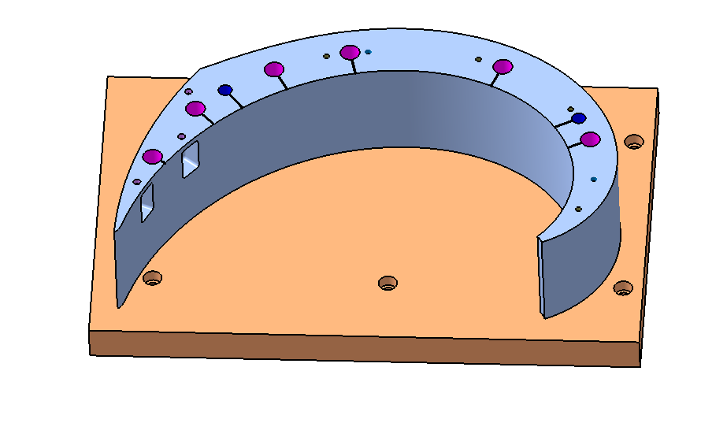
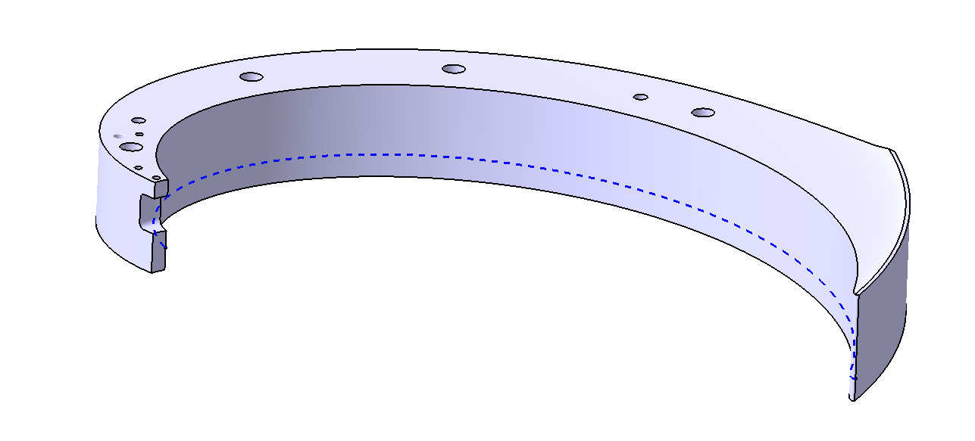
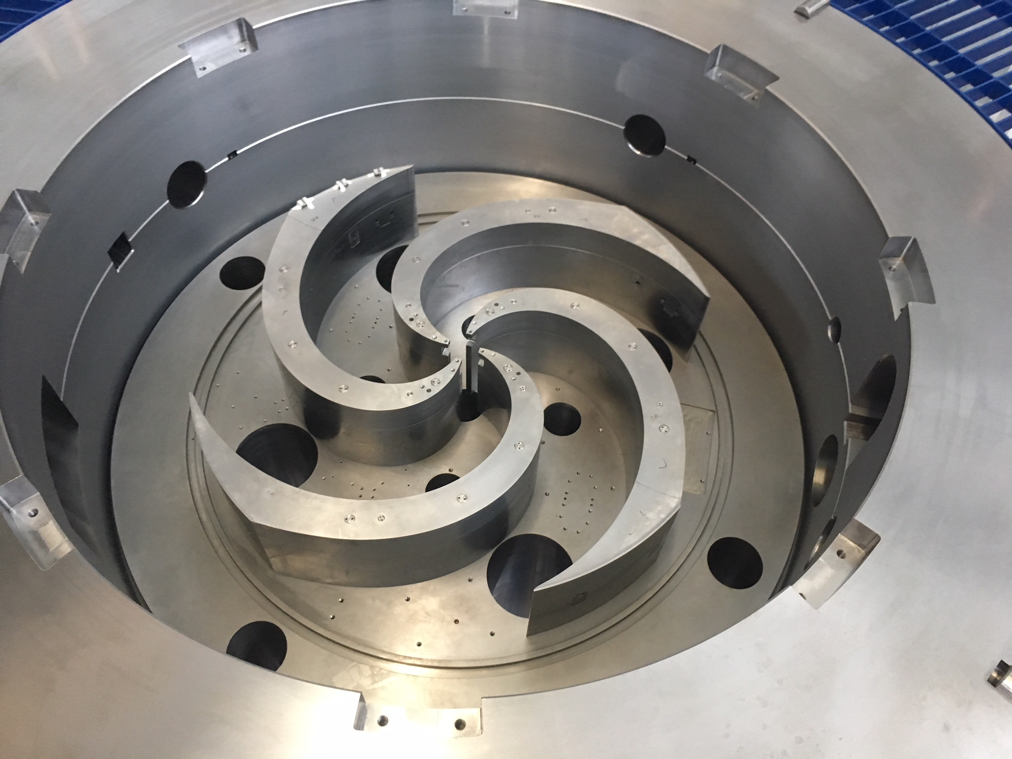
Sector Partition
Every sector consists of two parts: A and BCD, combined between themselves and the yoke by screws of medium carbon steel 1045 covered with plugs to avoid field distortions.
It was manufactured with 2 degrees azimuthal reserve for the following shimming.
All parts were produced and measured along the numerous amounts of lines and points, deviation from the manufactured model didn’t exceed 50 microns.
A
BCD
（final point）
（start point）

Slide 9
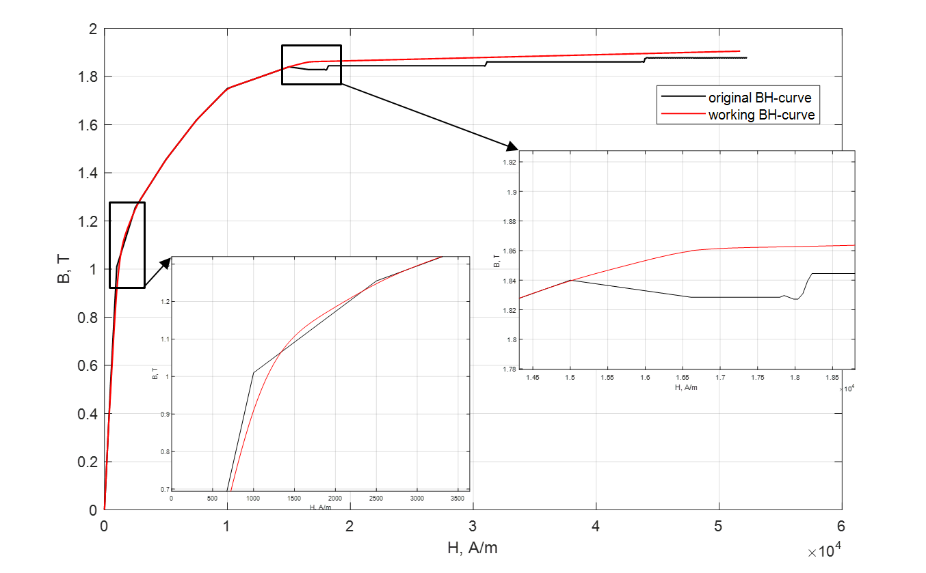
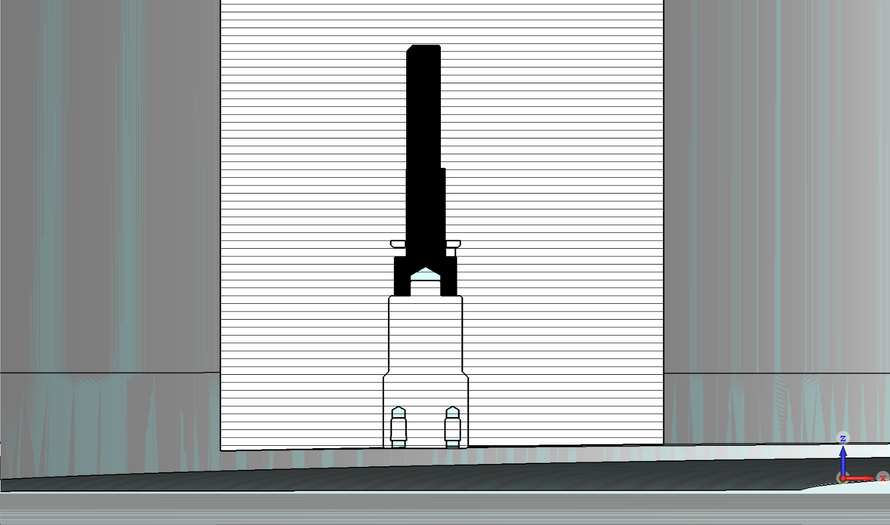
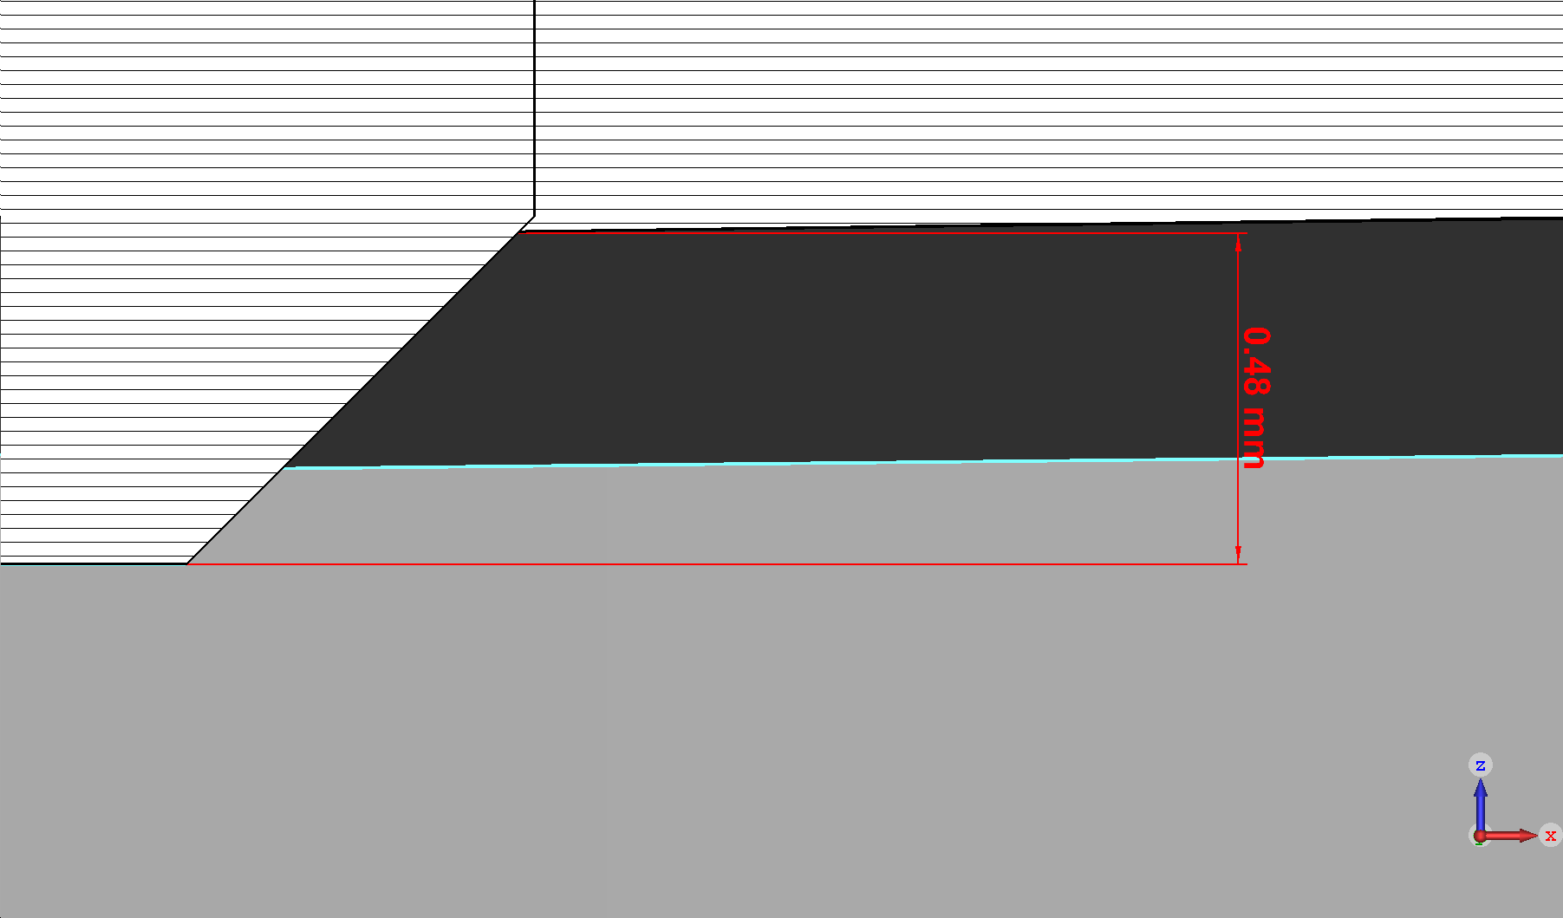
Screw Simulation
Measured BH-curve of steel1045 was brought to the proper shape, i.e. the faulty part was replaced and extended until 7T by a physically realistic one, and then the curve was smoothed for a better processing by CST studio.
A plug and a screw from the middle of the sector were inserted into the simulated model.
The plug turned out to be extruded on about 500 microns, so 3 models were created: without a plug, with a plug, with cut plug for no extrusion to be.

Slide 10
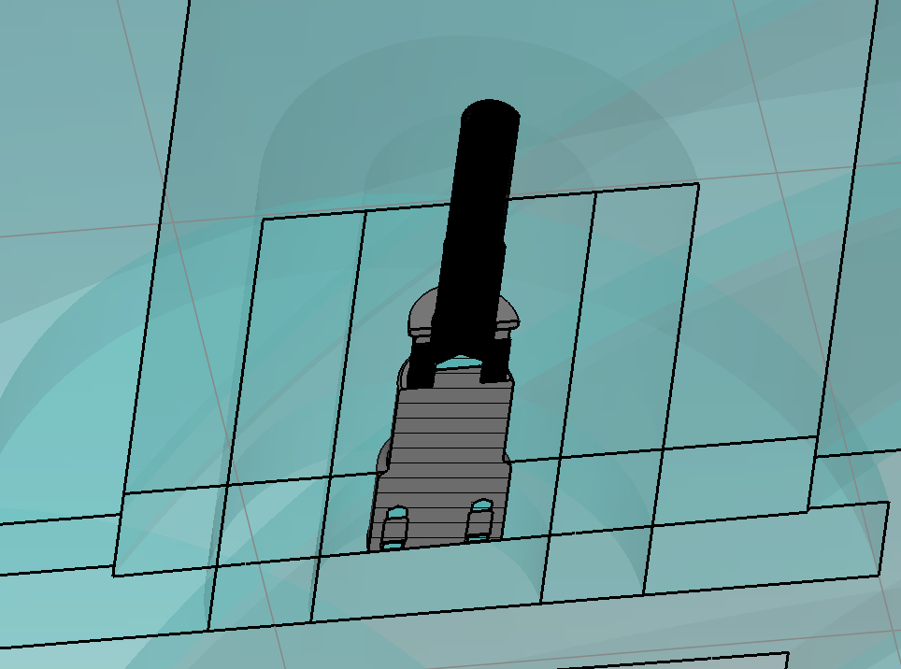
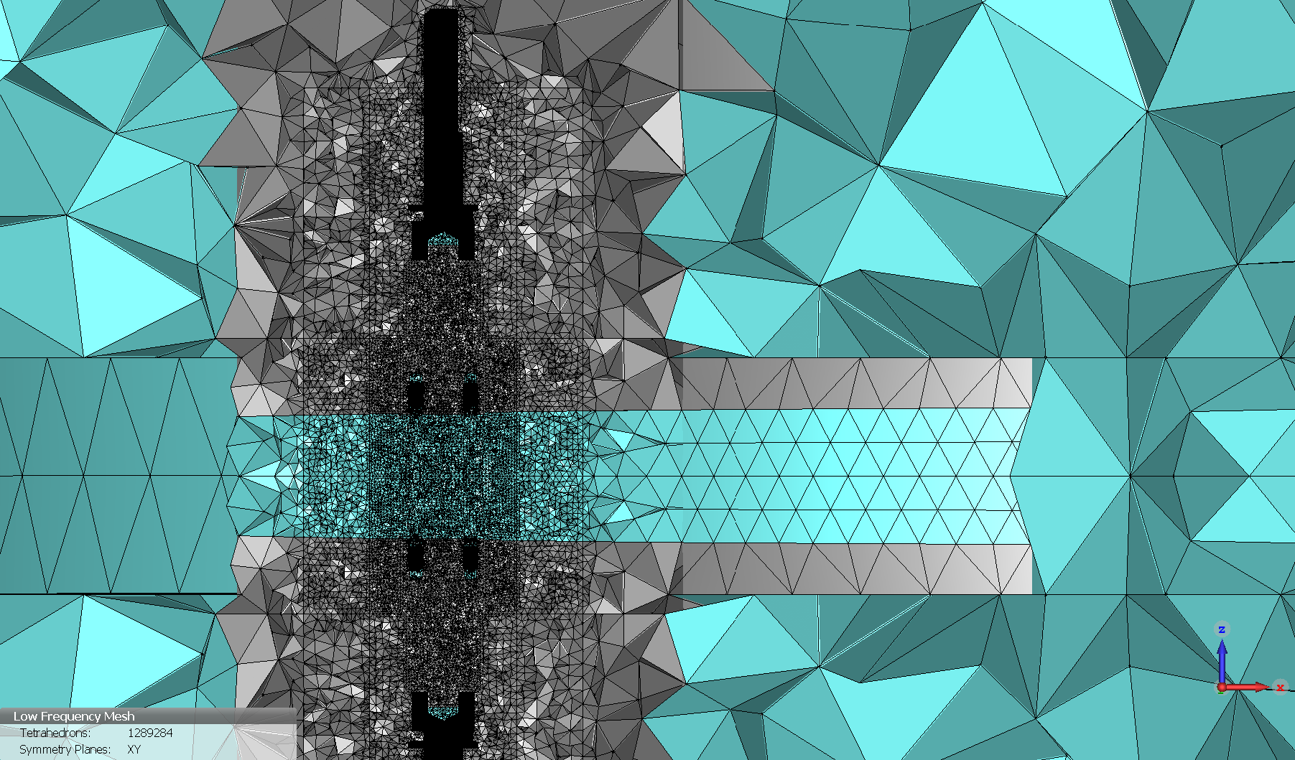
Screw Simulation
Different phantom shapes around the screw were created for better meshing. Around 75% of the mesh elements were concentrated in the screw and its surroundings.
The models were simulated, the results were processed.

Slide 11
Screw Simulation
The Cartesian maps were extracted to assess the maximum positive deviation for the extruded plug (MPos) and the maximum negative deviation for the cut plug (MNeg), so that MPos=95.7 Gs, MNeg=-29 Gs. Cylindrical maps were also extracted and evaluated, the influence on the mean field was estimated. As you can see, the deviation of mean field floats around 2 Gs, but in the case of the cut plug, the influence is much more smoother and more monotonous.

Slide 12
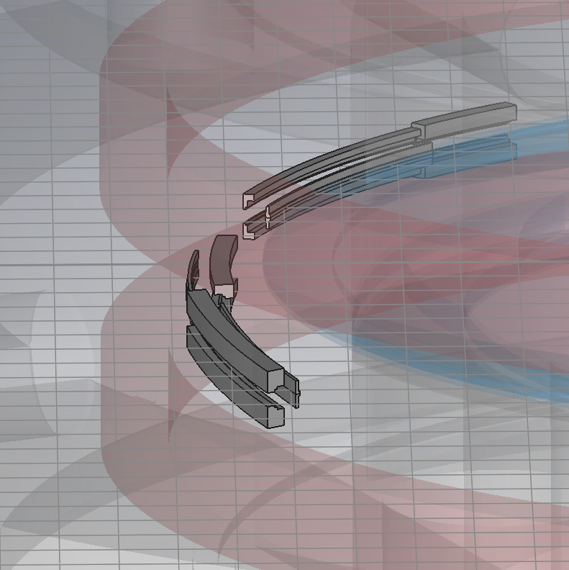
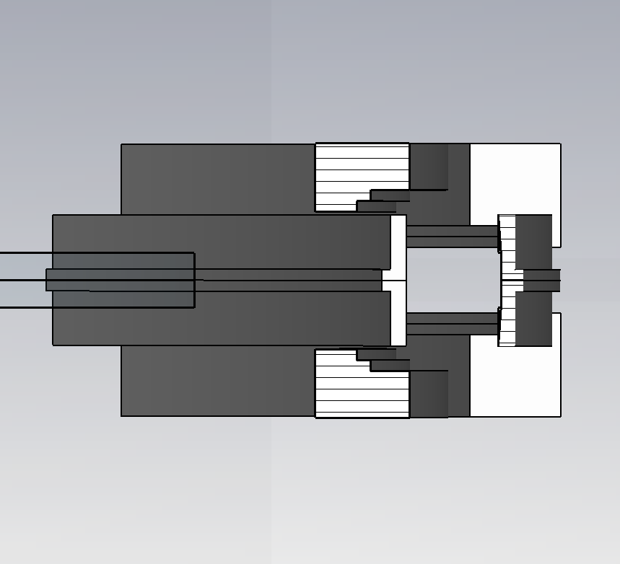
Magnetic Correctors
MC’s are under development and their effect is also evaluated.

Slide 13
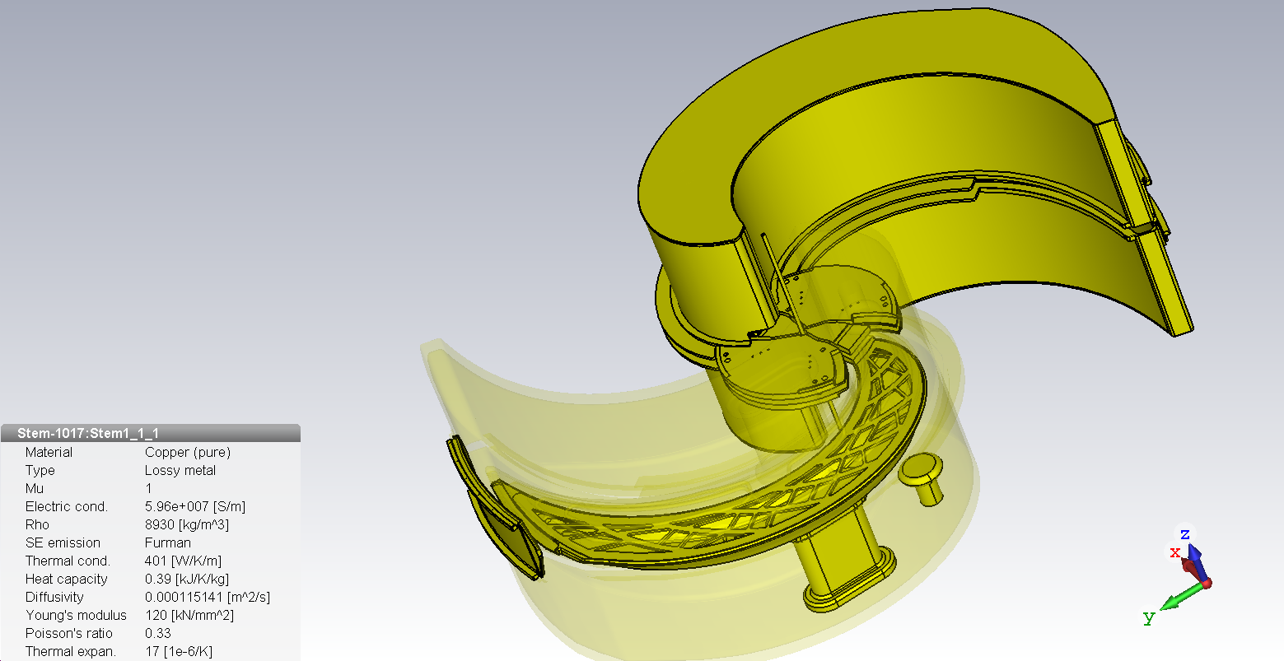
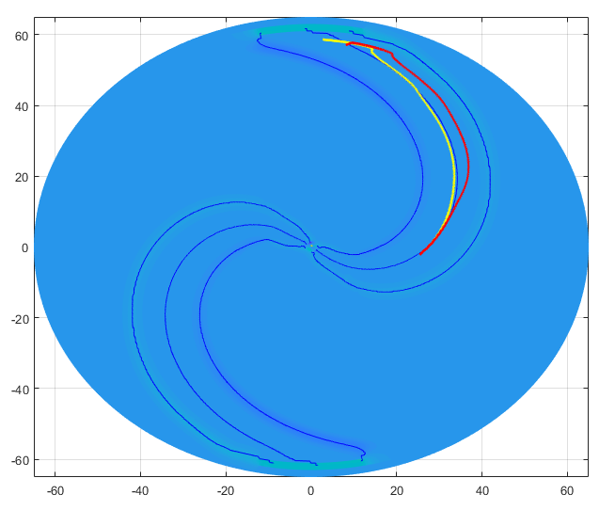
Magnetic Corrections
After being launched, the RF system produces a significant alternating magnetic field, this field ‘slows down’ the phase of the beam and needs to be taken into consideration.

Slide 14
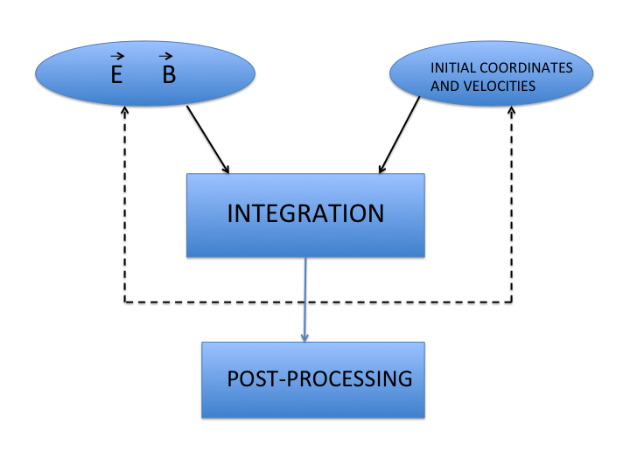
Beam dynamics simulations
Beam dynamics simulation solves the system of differential equations of particle motion with field maps from FEM (finite element method) codes or field measurements with different initial coordinates and velocities.
The fourth-order Runge–Kutta method

Slide 15
Motion of charged particles in electromagnetic fields
Systems of differential equations of motion of charged particles in an electromagnetic field are derived from the Newton-Lorentz equations:
In cyclotrons, it is most convenient to use the azimuth angle as a variable.
So the representation of the equations of motion with an independent variable azimuth angle is widely used in the design of cyclotrons.

Slide 16
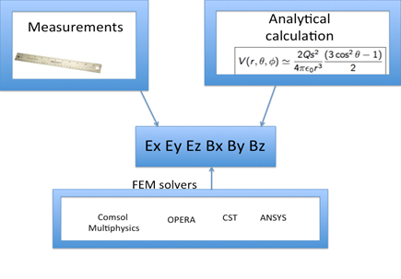
Representation of the electromagnetic field
2D
When particle trajectories are being calculated, an electromagnetic field can be specified analytically, in the form of a field map obtained as a result of measurements (2D maps) or as a result of model calculations (3D field maps).
2D, 3D

Slide 17
Motion of charged particles in an electromagnetic field.
E-Field
B-Field
Up to 30 GB
The representation in the form of a 3D field map is obviously the most acceptable for calculations of beam dynamics, but maps can be huge when high accuracy is needed.

Slide 18
Radial component of magnetic field in the median plane as a function of the radius (different curves correspond to different values of the azimuth angle).
Theoretically, the components Bϕ и Br are equal to zero in the median plane, the presence of components indicates an error value, that is ±0.03 Gs in the extraction zone.

Slide 19
Black curves - the deviation of the magnetic field from the average value in valleys (minimum points), green lines - deviation from the average value in sectors (maximum points).
The four-sector structure of the magnet makes it possible to estimate the accuracy of the model calculation by comparing the magnetic field for identical parts of the magnet sectors (calculation in the 360-degree model).

Slide 20
Using of 2D field map in median plane for beam dynamics simulations.
3D particle tracking ensures us that there is no problem with particle motion, however in order to study non-linear resonances and define the conditions of their appearances we have performed simulations with a 2D field map in the median plane used to perform particle tracking. This is a traditional method and it is widely used in cyclotron physics. In the median plane of the cyclotron only vertical component exists (due to symmetry) and other components of the magnetic field can be calculated by:
The formulas are presented for a cylindrical coordinate system, which is most suitable for cyclotrons. It is important to be able to calculate all derivatives for correct beam dynamics simulations during research and development and, especially on the commissioning stage, when the real magnetic field will be measured only on the median plane.

Slide 21
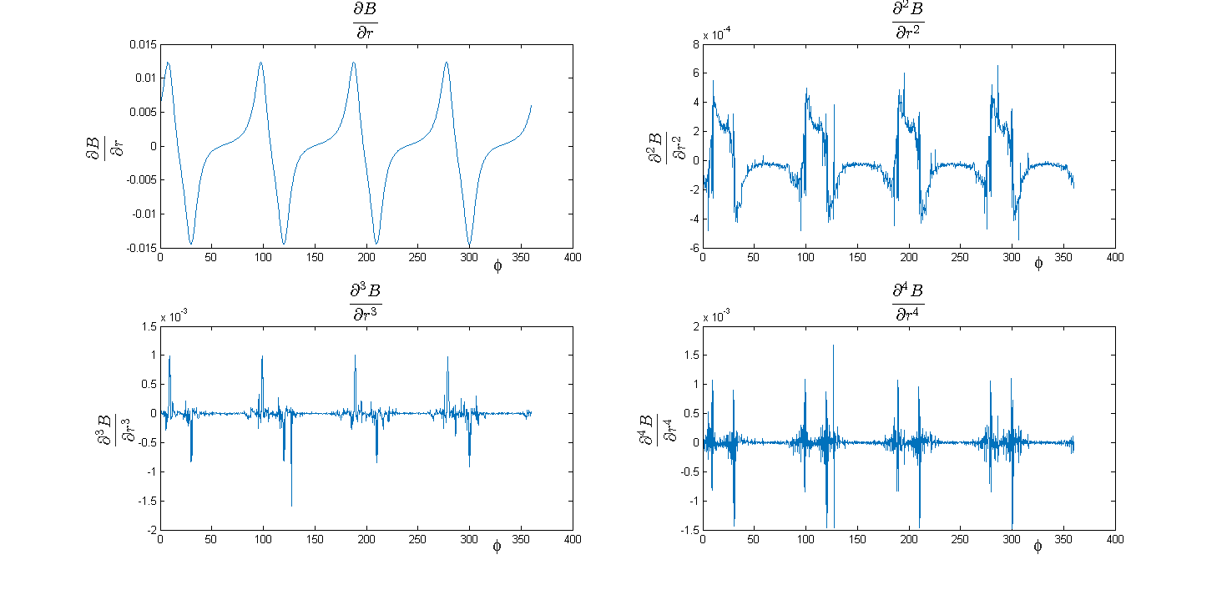
Derivatives of the magnetic field in the median plane taken without smoothing algorithms.
The biggest problem of these calculations is that the derivatives must be taken using the measured or calculated field map, which already contains errors. Special mathematical algorithms were developed in order to obtain smooth and realistic derivatives of the magnetic field on the median plane.

Slide 22
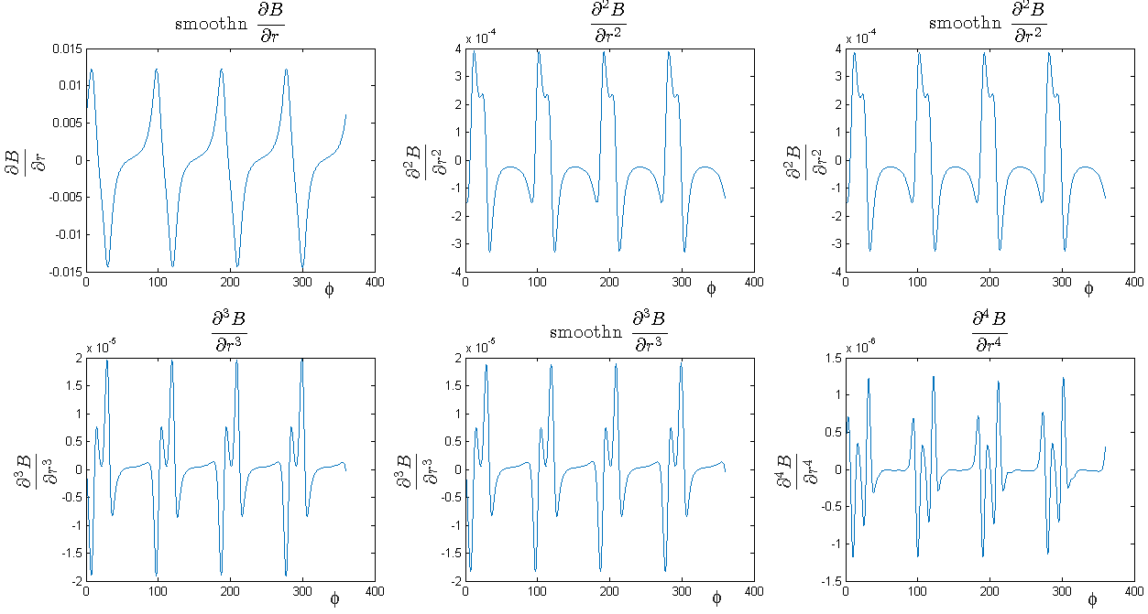
Derivatives of the magnetic field in the median plane taken with smoothing algorithms.
Such results were obtained by combining fitting of the field map by spline surface together with smoothing algorithms.
Developed software creates 3D field maps which can be used for beam dynamics simulations.

Slide 23
Using Fourier analysis
As you can see on the picture, due to the symmetrical design of the yoke, the magnetic field in the median plane is a periodical function from the angle, with 4 periods in it. As almost every periodical function, it can be represented as a Fourier series, which in its turn allows us to perform several useful things:
We can “shut down”(exclude) harmonics(Fourier terms) which are not divisible by 4, except for the first and the zero ones, of course. This allows us:
  To improve the field map by omitting mistakes and representing it through an analytic function.
  To assess the error of the simulation. Because in a perfect simulation, the “shut down” harmonics should equal zero, so their sum would be the error we are looking for.
The Fourier series is easy to differentiate without any significant loss, so all of the angle derivatives(which is half of all) do not require the smoothing mentioned above.

Slide 24
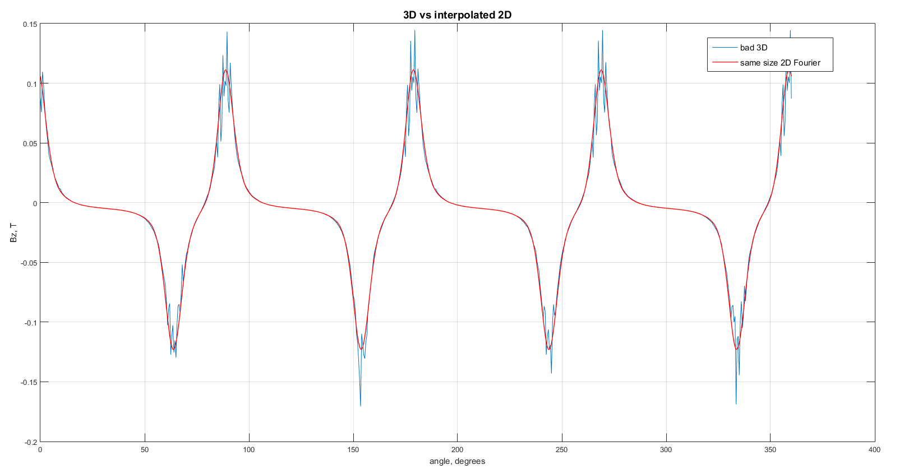
Two and a half methods, two and a half packages.
So, bottom line: we have 2.5 ways to get a 3D map of the magnetic field:
Straightforward one: we obtain a raw 3D field map from the simulation. It takes time and resources, you need to simulate the final design and prove that the other methods are right.
Using Maxwell’s equations on a 2D map in the median plane and some interpolation with smoothing.
Same as previous, but this time we apply Fourier analysis where it’s possible.
These approaches were coded in MATLAB and performed on three packages: CST, TOSCA and COMSOL. The results were adequate.

Slide 25
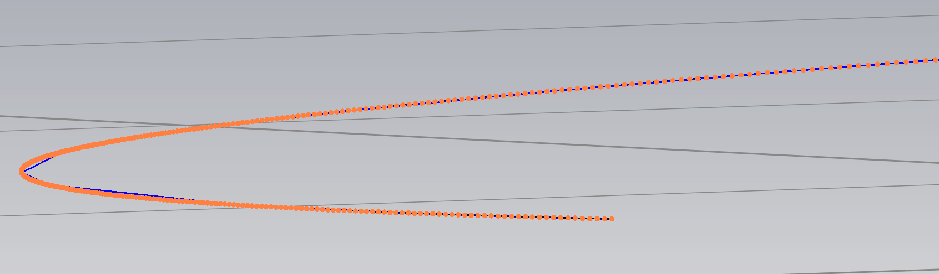
Sector Spirality Shimming
The spiral curves of the manufactured sectors were measured, smoothed and processed into MATLAB, then a model with a precise spiral and gap geometry of the real sectors was created. The step of every curve is 250 microns, and its error is less than 50 microns. The model was simulated, beam dynamic simulation conducted, frequency was obtained.
Recently, the working current was decreased by 1% of the expected, but sectors are made with 2-degree azimuthal reserve. Therefor, our ongoing task is field isochronization, which means keeping frequency in the range of 5 KHz and bringing it down to 45 MHz. This could be achieved by changing spiral geometry and repeating the calculations till the desired result is found. The approaches mentioned before help greatly reduce the time spent on this procedure terrifically.

Slide 26
Conclusion
A full range of works for estimating small corrections to the magnetic field was conducted:
Mistakes of the production were assessed.
The implementation of the small parts was calculated. Some of them were shimmed.
The influence of the RF-system was taken into consideration.
Special scripts were written. A great and comfortable environment for sector spiratlity shimming was produced.
The main goal to reach field coincidence less than 1 Gs can be achieved.

