Slide 1
On the theoretical description of polymers glass transition
in a wide range of cooling rates
V.L. Aksenov, T.V. Tropin, J.W.P. Schmelzer, C. Schick
Frank Laboratory of Neutron Physics, Joint Institute for Nuclear Research, Dubna, Russia
Institute of Physics, University of Rostock, Rostock, Germany
Bogoliubov Laboratory of Theoretical Physics, Joint Institute for Nuclear Research, Dubna, Russia
National Research Center “Kurchatov Institute”, Moscow. Russia
Colloquium on Non-equilibrium phenomena in strongly correlated systems,
II International Workshop on Simulations of HIC 4 NICA energies, 16-19 April 2018, JINR, Dubna, Russia

Slide 2
Outline
Introduction
Definition of the glass transition and description of its common characteristics and properties.
Experiments
Calorimetric measurements of the kinetics of polymers glass transition in an exceptionally wide range of cooling rates. Problem formulation.
Theoretical methods
Description of certain theoretical methods of modeling the glass transition kinetics with respect to given problem.
Modeling results
The results of modeling of the experimental curves in a wide range of cooling/heating rates.
Conclusions

Slide 3
Introduction

Slide 4
The glass transition
Time of systems relaxation to thermodynamic equilibrium grows
exponentially as temperature is decreased.
Notes:
Glasses belong to a well-known state of matter (Tabor,1991): glasses are easily designed with desired mechanical or optical properties on an industrial scale, and they are widely present in our daily life. Yet, a deep microscopic understanding of the glassy state of matter remains a challenge for condensed matter physicists.

Slide 5
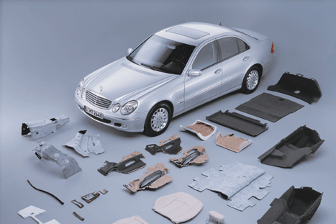


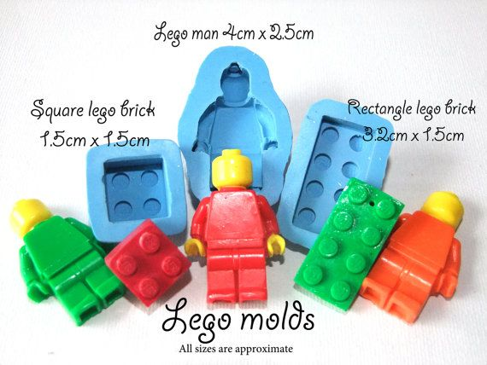
Glassy state around us

Slide 6
Glass transition is characterized by the relaxation process with the following properties:
Non-exponentiality
Non-linearity
History dependent
Notes:
Rapid cooling

Slide 7
Time relaxation of a property in the GT range
Instantaneous (isostructural) P change
Relaxational P change
Isothermal relaxation in response to an single (instantaneous) temperature step
Notes:
Rapid cooling

Slide 8
Non-exponentiality in the glass transition
Notes:
Rapid cooling

Slide 9
Nonlinearity of the glass transition
The shape of the curves reflecting relaxation after temperature step change depends on the value and sign of ∆T.
Notes:
Rapid cooling

Slide 10
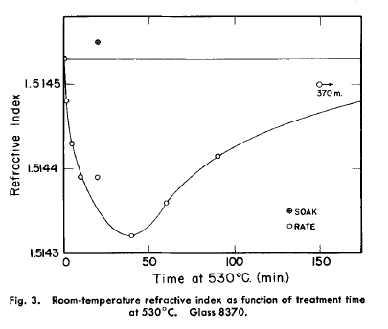
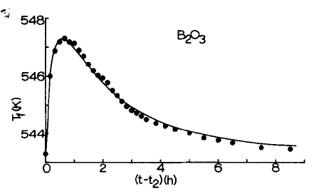
Memory effect
t₁: T₀=583.2 K → T₁=498.7 K
t₂: T₁=498.7 K → T₂=543.4 K
“Rate” and “Soak” samples have the refractive index corresponding to T=530ºC
Non-exponential relaxation
Spectrum effect
“Memory” effect:
Influence of past heat treatment on the future behavior of the system.
Ritland, H. N. (1956). Limitations of the Fictive Temperature Concept. Journal of the American Ceramic Society, 39(12), 403–406.
Boesch L.,A., Napolitano P.B., Macedo P.B., Journal of the American Ceramic Society, 1970, 53, 148.
Notes:
Rapid cooling

Slide 11
Typical time-evolution experiments
Isothermal relaxation in response to an single (instantaneous) temperature step
Linear temperature change: cooling/heating in the glass transition interval
Notes:
Rapid cooling

Slide 12
Glass properties
P – enthalpy, volume, …
Linear cooling/heating!
dP/dT – heat capacity, thermal expansion coefficient, …
Notes:
Rapid cooling

Slide 13
Experiments

Slide 14
Investigating glass transition experimentally
Electrical conductivity methods ρ(T)
Viscosity measurements
η(T)
Dielectric methods
ε'(T), ε''(T)
Experimental
methods
Dilatometric methods
V(T) or α(T)
The most common method available to determine T_{g} is the Differential Scanning Calorimetry (DSC).
Glass transition measured as a step change in the heat flow curve.
Several experimental techniques are available for the investigations of glass transition.
Dynamic mechanical analysis E'(T),E''(T)
Calorimetric methods
C_{p}(T), C_{p}''(T)
Notes:
Dynamic mechanical analysis (DMA) measures the response of a material to an applied oscillatory strain (or stress) and analyses the dependence of this response on temperature and frequency. The GT is identified from DMA data in three different ways: as a sharp decrease in the storage modulus, E’, and as two peaks respectively in the loss modulus, E’’, and in the tanδ.

Slide 15
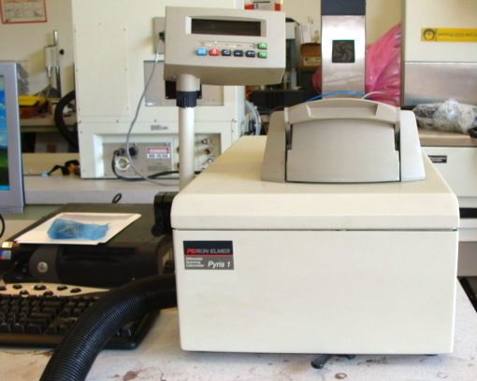

DSC measurements
Perkin Elmer Pyris 1 DSC
Measurement scheme:
C1 – cooling at a certain cooling rate, q;
H1 – reheating at 0.5 K/s, measurement: C_{p}^{H1};
C2 – cooling at 0.5 K/s;
H2 – reheating at 0.5 K/s, measurement: C_{p}^{H2};
Range of cooling rates covered:
5*10⁻⁶K/s – 2 K/s
Measurements by Dr. Schick’s group, Rostock
Tropin, T. V., Schulz, G., Schmelzer, J. W. P., Schick, C. (2015). Journal of Non-Crystalline Solids, 409, 63–75.

Slide 16
DSC measurements
Example of a single experimental data set and its treatment:
Tropin, T. V., Schulz, G., Schmelzer, J. W. P., Schick, C. (2015). Journal of Non-Crystalline Solids, 409, 63–75.

Slide 17
Cooling rates range
~2-3 orders of magnitude
5*10⁻⁶ K/s
2 K/s
Conventionally experimentally and theoretically
covered cooling rate ranges…
Tropin, T. V., Schulz, G., Schmelzer, J. W. P., Schick, C. (2015). Journal of Non-Crystalline Solids, 409, 63–75.

Slide 18
DSC measurements: current work
Final set of experimentally measured curves.
Tropin, T. V., Schulz, G., Schmelzer, J. W. P., Schick, C. (2015). Heat capacity measurements and modeling of polystyrene glass transition in a wide range of cooling rates. Journal of Non-Crystalline Solids, 409, 63–75.

Slide 19
General task
Consider available theoretical methods for description of glass transition;
Discuss the possibilities of application of these methods to modeling of modern experimental results.
Notes:
Rapid cooling

Slide 20
Theoretical methods

Slide 21
Theoretical modeling
Methods for modeling kinetics of GT
  Concept of the fictive temperature
  Relaxational theory by Volkenstein and Ptitsyn
  Free-volume models
  Tool-Narayanaswamy-Moynihan method
  Adam-Gibbs theory
  Kovacs-Aklonis-Hutchinson-Ramos method
  Configurational entropy approaches
  Application of irreversible thermodynamics
  Mode-coupling theory
  Random first-order transitions theory
T.V. Tropin, J.W.P. Schmelzer, V.L. Aksenov, “Modern aspects of the kinetic theories of glass transition” // Phys. Uspekhi, 59 42-66 2016

Slide 22
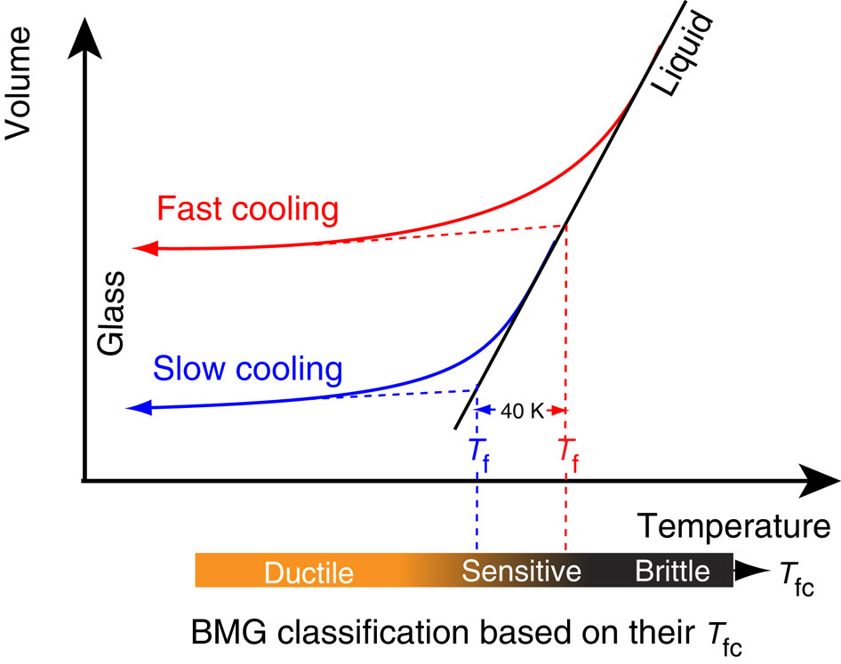
Fictive temperature concept
Fictive temperature T_{f}
– structural parameter
Fictive temperature – a structural parameter characterizing
the non-equilibrium state of the system
(in respect to the corresponding equilibrium state!).
Tool, A. Q. (1946). “Relation Between Inelastic Deformability and Thermal Expansion of Glass in Its Annealing Range” // Journal of the American Ceramic Society, 29(9), 240–253. doi:10.1111/j.1151-2916.1946.tb11592.x
Notes:
Rapid cooling

Slide 23
Fictive temperature concept
T_{f}(T) → systems properties evolution
- a common reduced function
- liquid state
- glassy state
Can be connected with C_{p}, α, …
Simple equation for T_{f} evolution:
Account for non-linearity:
The expression for relaxation time governs the character of glass transition.

Slide 24
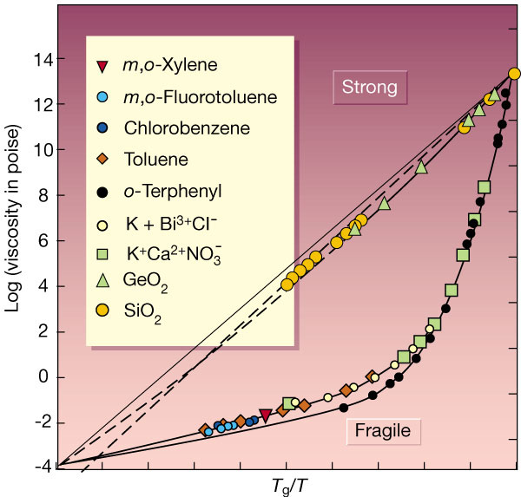
Relaxation laws: different for different glasses
Angell, C. A. Formation of glasses from liquids and biopolymers. Science 267, 1924–35 (1995).

Slide 25
Relaxation laws
Arrhenius-type relaxation:
Vogel-Fulcher-Tammann relaxation law:
Extended non-linear law:
The Adam-Gibbs theory:
“Strong”-type glasses!
“Fragile” glasses

Slide 26
TNM method
Account for non-exponentiality,
Describe the memory effect.
Three general assumptions:
1. A single non-exponential mechanism with constant activation energy.
2. Fixed shape of the equilibrium response function.
3. Linear relation between “cause” and “effect”.
- the reduced time
Narayanaswamy, O. S. (1971) “A Model of Structural Relaxation in Glass” // Journal of the American Ceramic Society, 54(10), 491–498. doi:10.1111/j.1151-2916.1971.tb12186.x
Notes:
The systems response will be linear in the reduced time-scale:

Slide 27
TNM method
Systems response is linear in the reduced time-scale!
Assuming the stretched-exponential response of the system:
We arrive at the final expression:
For an arbitrary temperature history.
Narayanaswamy, O. S. (1971) “A Model of Structural Relaxation in Glass” // Journal of the American Ceramic Society, 54(10), 491–498. doi:10.1111/j.1151-2916.1971.tb12186.x

Slide 28
Basing on irreversible thermodynamics
Structural parameter:
Number of unnocupied sites per one mole ξ
Notes:
As a structural parameter, a fictive temperature Tf is usually introduced. which indeed represents an attempt to associate the equilibrium state at T = Tf to the out-ofequilibriumstate
at the actual temperature T. This approach, intensively tested in dilatometric
and calorimetric experiments, is able to describe the structural relaxation mechanism fairly
well, even if some problems have been evidenced, especially in polymeric systems [2].

Slide 29
Basing on irreversible thermodynamics
Configurational part of thermodynamic functions and parameters:

Slide 30
Model of glass transition
Equilibrium value ξ=ξ_{e} can be obtained from equation:
Kinetics of systems relaxation to equilibrium are governed by the equation:

Slide 31
Basing on irreversible thermodynamics
With one structural order parameter, the kinetics of systems relaxation to equilibrium:
ξ - structural order parameter;
ξ_{e} - value of structural order parameter at equilibrium state of system;
τ - systems relaxation time to equilibrium;
System parameters,
cooling/heating rates
Entropy production
Heat capacity
Volume, enthalpy, viscosity,…
J.W.P. Schmelzer, I.S. Gutzow, Glasses and Glass Transition, WILEY-VCH, Berlin-Weinheim, 2011;
J. Möller, I. Gutzow, J.W.P. Schmelzer // J. Chem. Phys. 125, 094505/13, 2006;
T.V. Tropin, J.W.P. Schmelzer, C. Schick // J. Non-Cryst. Solids 357, 1291-1309, 2011;

Slide 32
Mode coupling theory
Equation for the dynamical correlation function for a one-component liquid:
M(k,τ) – memory kernel for the present particles
at temperature T.
S(k)=F(k,0) – static structure factor.
One of the consequences:
Time-temperature superposition principle:
MCT failures: T_{c}>T_{g}.
→Go beyond “simple” MCT. Account for hopping, etc.
→Generalized MCT, four-point correlations, etc.
Schematic model:
Leutheusser, E. (1984). Dynamical model of the liquid-glass transition. Physical Review A, 29(5), 2765–2773.
Bengtzelius, U., Gotze, W., Sjolander, A. (2000). Dynamics of supercooled liquids and the glass transition. Journal of Physics C: Solid State Physics.
Notes:
Исходной точкой ТВМ является уравнение для динамического структурного фактора F(k,t) для однокомпонентной жидкости.
В (29) для точного описания динамики системы необходимо задать M(k,τ) – ядро памяти для частиц заданной массы при данной температуре, а также статический структурный фактор S(k)=F(k,0). Базовым предположением ТВМ является замыкание в выражении для M(k,τ) на автокорреляционные функции плотности, F(k,t), в квадратичной форме [83]. В итоге, зная S(k) для рассматриваемой жидкости, можно численными методами получать решение уравнения (29).
Временная зависимость приведенной корреляционной функции также носит интересный характер, представленный на Рис. 3. Для разных температур наблюдается три режима: начальная быстрая релаксация до плато, определяемого значением k₀, медленная релаксация возле плато, режим β-релаксации, и структурная релаксация в режиме α-релаксации.

Slide 33
Modeling results

Slide 34
Single conventional DSC measurement
~5 mg PS sample in a cooling/heating experiment with
q=10 K/min
The fit of the cooling-heating curve with a common theoretical method.

Slide 35
Extended q-range
Simple common experiment:
q_{cooling}=q_{heating}~1-10 K/min
Extend the range of q!
q_{cooling}=q_{heating}
q_{cooling} changes
q_{heating}=const

Slide 36
General case: wide q range
Modeling the q_{cooling}=q_{heating} case in a wide range
(irreversible thermodynamics approach).
Tropin, T. V., Schmelzer, J. W. P., & Schick, C. (2011). On the dependence of the properties of glasses on cooling and heating rates I. Entropy, entropy production and glass transition temperature. Journal of Non-Crystalline Solids, 357(4), 1291–1302.
Tropin, T. V, Schmelzer, J. W. P., & Schick, C. (2011). On the dependence of the properties of glasses on cooling and heating rates II. Prigogine-Defay ratio, fictive temperature and fictive pressure. Journal of Non-Crystalline Solids, 357(4), 1303–1309.
Notes:
Rapid cooling

Slide 37
Results for the wide q-range
Glass transition temperature dependence on q_{cooling}=q_{heating}
Tropin, T. V., Schmelzer, J. W. P., & Schick, C. (2011). On the dependence of the properties of glasses on cooling and heating rates I. Entropy, entropy production and glass transition temperature. Journal of Non-Crystalline Solids, 357(4), 1291–1302.
Tropin, T. V, Schmelzer, J. W. P., & Schick, C. (2011). On the dependence of the properties of glasses on cooling and heating rates II. Prigogine-Defay ratio, fictive temperature and fictive pressure. Journal of Non-Crystalline Solids, 357(4), 1303–1309.
Notes:
Rapid cooling

Slide 38
Results for the wide q-range
Glass transition temperature dependence on q_{cooling}=q_{heating}
Tropin, T. V., Schmelzer, J. W. P., & Schick, C. (2011). On the dependence of the properties of glasses on cooling and heating rates I. Entropy, entropy production and glass transition temperature. Journal of Non-Crystalline Solids, 357(4), 1291–1302.
Tropin, T. V, Schmelzer, J. W. P., & Schick, C. (2011). On the dependence of the properties of glasses on cooling and heating rates II. Prigogine-Defay ratio, fictive temperature and fictive pressure. Journal of Non-Crystalline Solids, 357(4), 1303–1309.
Notes:
Rapid cooling

Slide 39
General case: Width of the GT interval
Schmelzer, J. W. P., & Tropin, T. V. (2013). Dependence of the width of the glass transition interval on cooling and heating rates. The Journal of Chemical Physics, 138(3), 034507
Notes:
Rapid cooling

Slide 40
Results for the wide q-range
Heat capacity behavior at different q_{cooling}=q_{heating}
Tropin, T. V., Schmelzer, J. W. P., & Schick, C. (2011). On the dependence of the properties of glasses on cooling and heating rates I. Entropy, entropy production and glass transition temperature. Journal of Non-Crystalline Solids, 357(4), 1291–1302.
Tropin, T. V, Schmelzer, J. W. P., & Schick, C. (2011). On the dependence of the properties of glasses on cooling and heating rates II. Prigogine-Defay ratio, fictive temperature and fictive pressure. Journal of Non-Crystalline Solids, 357(4), 1303–1309.
Notes:
Rapid cooling

Slide 41
Comparison with experiment, q_{heating}=const
Modeling of experimental curves with common parameters fails.
Tropin, T. V., Schulz, G., Schmelzer, J. W. P., & Schick, C. (2015). Heat capacity measurements and modeling of polystyrene glass transition in a wide range of cooling rates. Journal of Non-Crystalline Solids, 409, 63–75. https://doi.org/10.1016/j.jnoncrysol.2014.11.001
Notes:
Rapid cooling

Slide 42
Modeling parameters
During modeling, a number of parameter arises:
  β - non-exponentiality parameter
  x – non-linearity parameter
  τ₀ - basic time of relaxation
  A – activation energy
  T₀,T∞ – reference temperature
  …
On average, 4 parameters are required to fit experimental curves.
Some of the parameters are correlated.
Estimated while fitting.
Can be obtained from experiments – T_{g}(q), η(T),…

Slide 43
TNM/AG model: fit all curves
Possible solution: parameters optimization
A general drawback: τ₀,A significantly modified.
Tropin, T. V., Schulz, G., Schmelzer, J. W. P., & Schick, C. (2015).. Journal of Non-Crystalline Solids, 409, 63–75.

Slide 44




TNM/AG method: fit each curve
$$τ_{0}^{1},β_{1}$$
$$τ_{0}^{2},β_{2}$$
$$τ_{0}^{3},β_{3}$$
τ₀(q),β(q) dependence.
$$τ_{0}^{0},β_{0}$$
For reference 0.5 K/s cycle!
Other solution: vary τ₀ and β with q_{cooling}.
Tropin, T. V., Schulz, G., Schmelzer, J. W. P., & Schick, C. (2015).. Journal of Non-Crystalline Solids, 409, 63–75.

Slide 45
AG model: extrapolation
to q=5*10⁻⁶ K/s
The dependence of varied model parameters, β and τ₀, on cooling rate q for each of AG expressions for relaxation time.
Linear extrapolation attempt…
Tropin, T. V., Schulz, G., Schmelzer, J. W. P., & Schick, C. (2015).. Journal of Non-Crystalline Solids, 409, 63–75.

Slide 46
AG model: extrapolation results
Comparison of experimental curve (q=5∙10⁻⁶ K/s) with modeled curves obtained after extrapolation.
Tropin, T. V., Schulz, G., Schmelzer, J. W. P., & Schick, C. (2015).. Journal of Non-Crystalline Solids, 409, 63–75.

Slide 47
General problem: q_{cooling}<<q_{heating}.
Polystyrene parameters,
q_{heating}=5000 K/s
Similar problems modeling methods meet for other rate ranges and substances.
Tropin, T. V., Schulz, G., Schmelzer, J. W. P., & Schick, C. (2018) Scaling of relaxation processes (submitted).

Slide 48
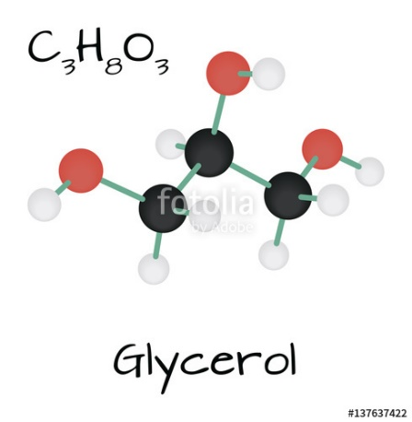
General problem: q_{cooling}<<q_{heating}.
Glycerol
glass transition,
literature parameters.
Similar problems modeling methods meet for other rate ranges and substances.
Tropin, T. V., Schulz, G., Schmelzer, J. W. P., & Schick, C. (2018) Scaling of relaxation processes (submitted).

Slide 49
Conclusions
Description of glass transition kinetics presents a modern challenge in the field of the theory of condensed state of matter.
The presently applied models are not capable of fitting the DSC curves with a single set of model parameters. Variation of two model parameters dramatically enhances the quality of the fits;
To progress in the quality of curve fitting additional assumptions must be introduced and consequently applied;

