Slide 1

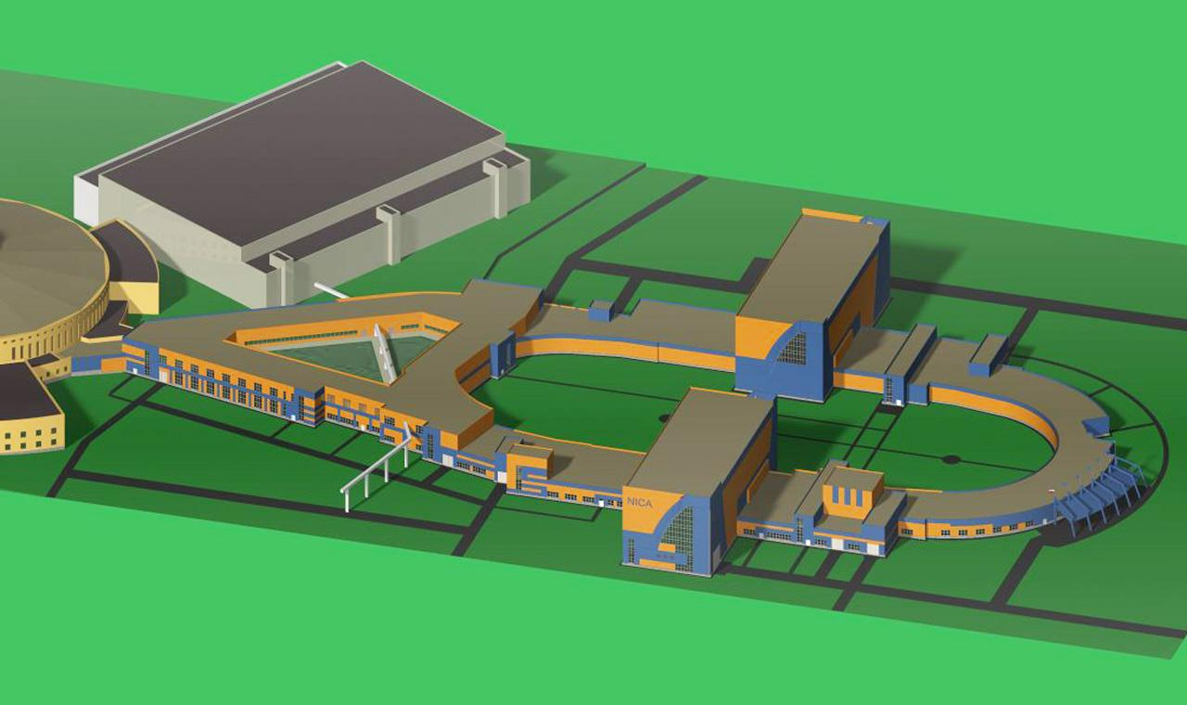
NICA accelerator complex
NICA: Nuclotron based Ion Collider fAcility

Slide 2

General information
NICA is an international project
realizing by international intergovernmental organization –
the Joint Institute for Nuclear Research
and brings the efforts of 18 member states and 6 associated countries.
Project NICA started as a part of the JINR Roadmap for 2009-2016
was described in the JINR 7-years Program.
It was approved by Scientific Council of JINR and
the Committee of Plenipotentiaries of JINR in 2009.
NICA is a flagship project of JINR presently.
In 2016 between RF and JINR was signed a contract
presuming start of operation of basic configuration of the NICA complex in 2020.
In 2017 the project was included into ESFRI road map.
Project web-site: http://nica.jinr.ru/

Slide 3
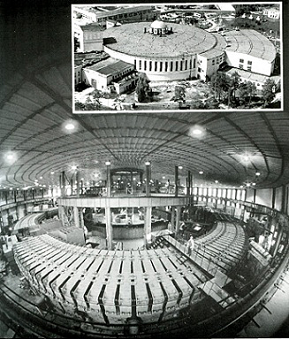
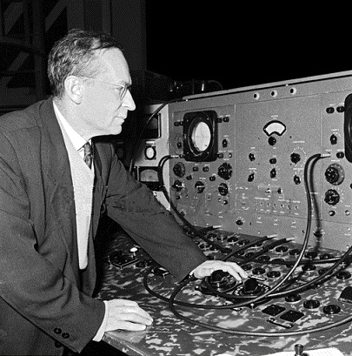
Relativistic nuclear physics
End of 60-th – acceleration of ions
70-th – observation of nuclear cumulative effect
V.I. Veksler
A.M.Baldin

Slide 4
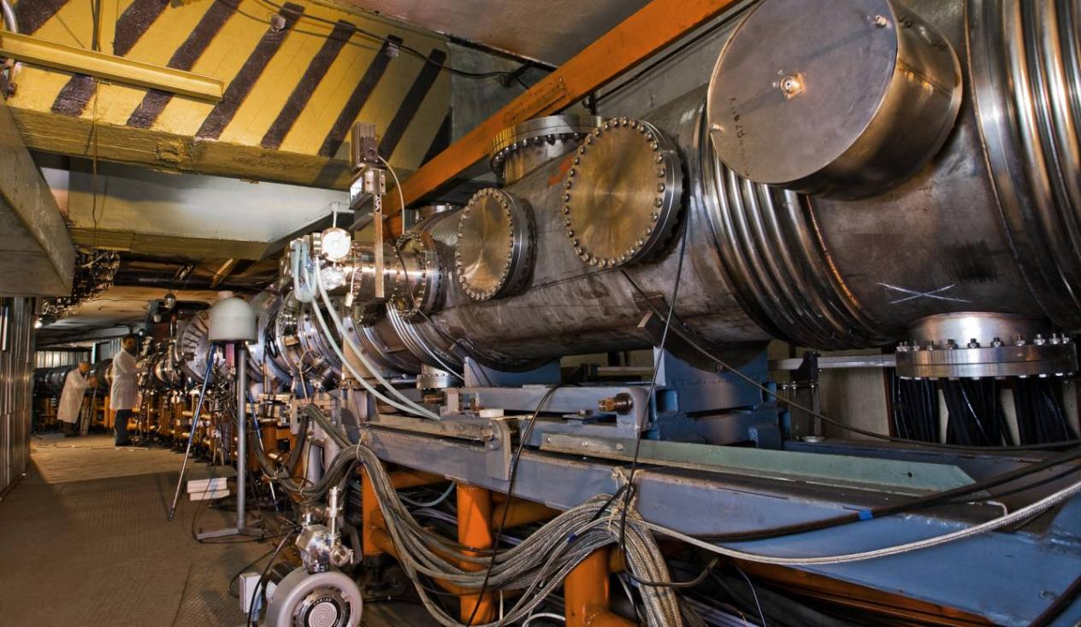
First Superconducting heavy ion accelerator
Nuclotron – Superconducting Synchrotron
operation since 1993

Slide 5
The primary purpose of the NICA construction
The project comprises experimental studies of fundamental character
in the fields of the following directions:
Relativistic nuclear physics;
- Spin physics in high and middle energy range of interacting particles;
- Radiobiology.
Applied researches based on particle beams generated at NICA
are dedicated to development of novel technologies in material science,
environmental problems resolution, energy generation,
particle beam therapy and others.
Education program is one of the first priority activities at JINR,
as formulated in JINR Roadmap.
The proposed NICA facility offers various possibilities for teaching
and qualification procedures including practice at experimental set ups,
preparation of diploma works, PhD, and doctoral theses.

Slide 6
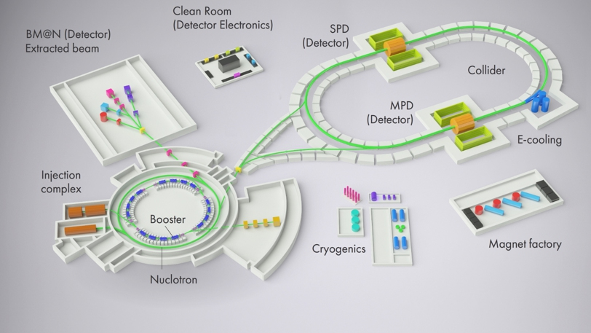
The NICA complex includes:
- Set of accelerators providing the particle beams for fixed target and collider experiments,
- Experimental facilities,
- Line for assembling and cryogenic testing of SC-magnets,
- Workshops for construction of the detector elements,
- NICA innovation center,
- Required infrastructure.

Slide 7
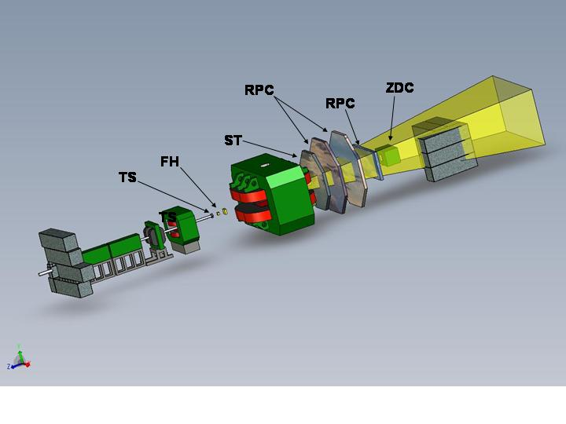
Main experimental facilities
Baryonic Matter at Nuclotron (BM@N) –
fixed target experiment at the Nuclotron extracted beams
which main goals are investigations of strange / multi-strange hyperon,
hypernuclei production and short range correlations.

Slide 8
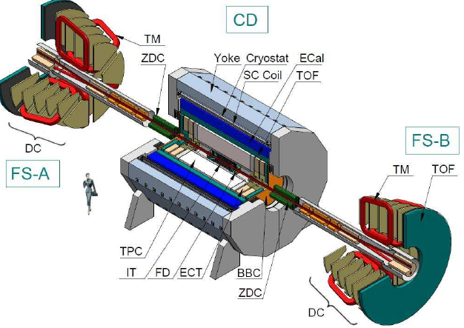
Main experimental facilities
Multi Purpose Detector (MPD)
aiming to study of hot and dense strongly interacting matter in heavy ion (up to Au)
collisions at the centre-of-mass energy range of max baryonic density (up to 11 GeV).

Slide 9
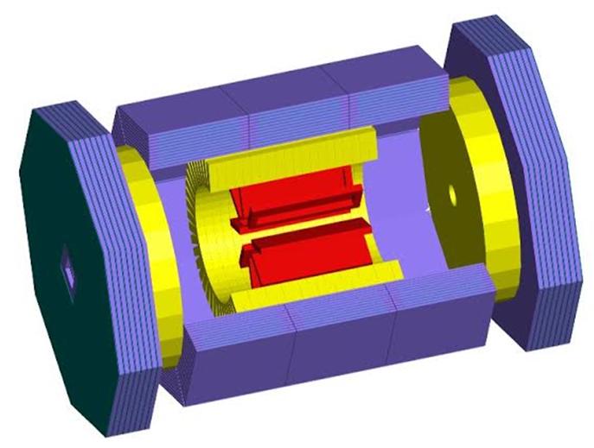
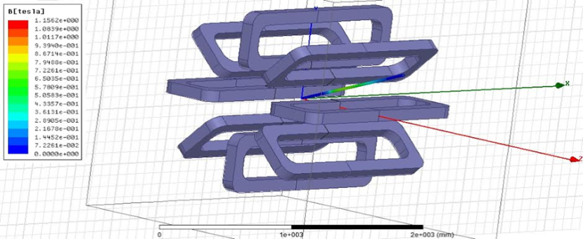
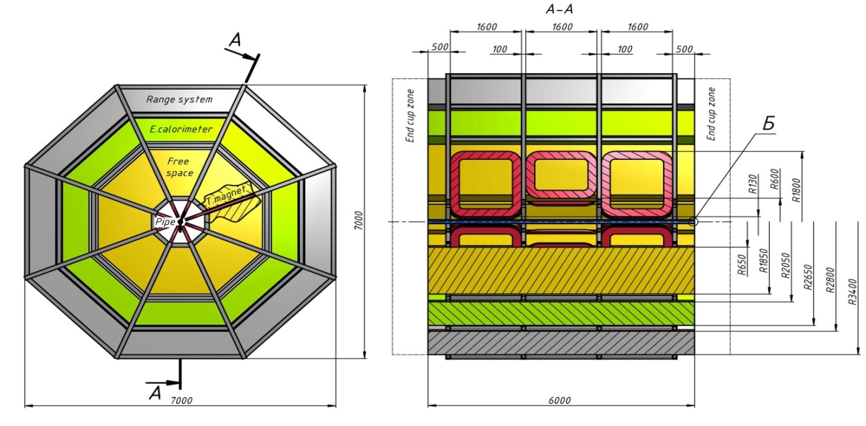
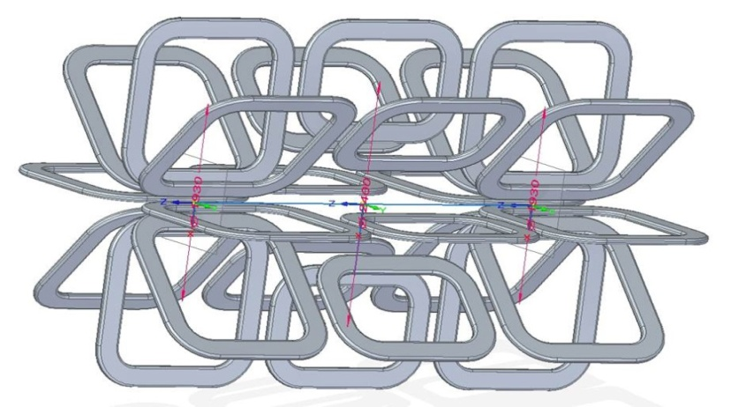
Main experimental facilities
Spin Physics Detector (SPD) aiming to study of spin physics with colliding beams
of polarized deuterons and protons at the energies up to 27 GeV (for protons).

Slide 10
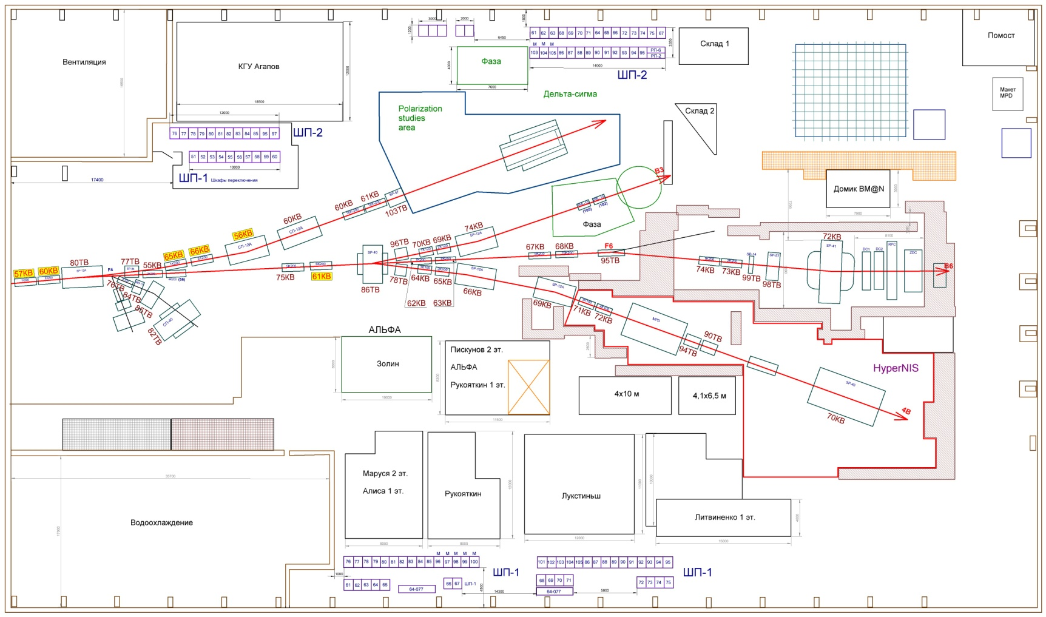
Main experimental facilities
Area for radiobiology and applied research
is under development in the existing experimental building.
BM@N
Bld.205

Slide 11
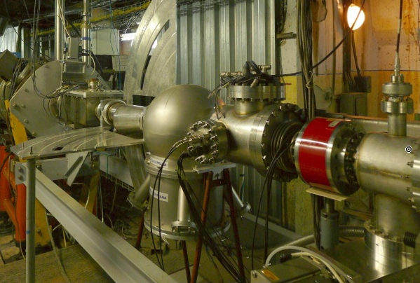
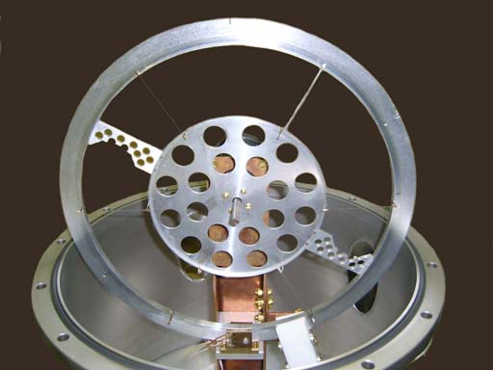
Main experimental facilities
The Nuclotron internal target station equipped with six different targets:
wire, strip and film with material from hydrogen to tungsten dedicated
for particle physics, spin physics, relativistic atomic physics experiments.

Slide 12
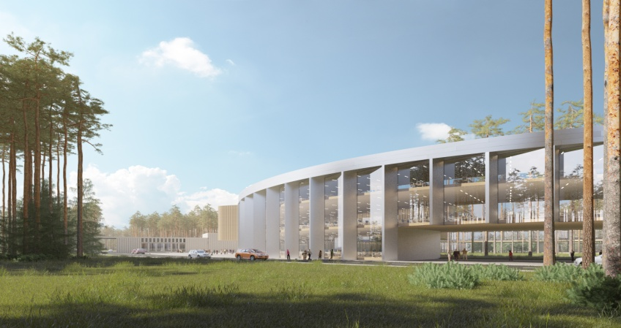
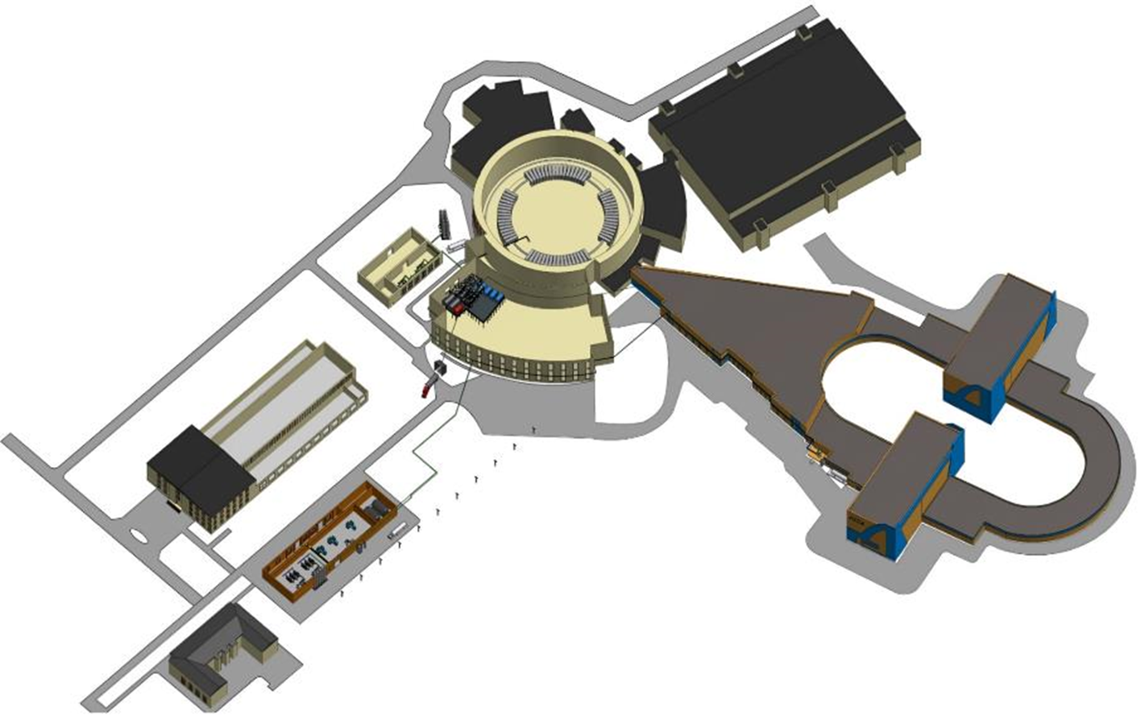
New buildings of the NICA complex
Collider building
NICA innovation center
New compressor hall building

Slide 13
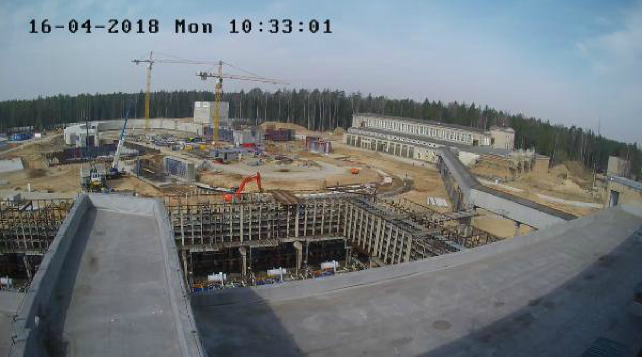
New buildings of the NICA complex
Collider building
http://nucloweb.jinr.ru/nucloserv/205corp.htm

Slide 14

NICA innovation center
New buildings of the NICA complex
- cluster of JINR computer center dedicated to collect and process
the data from NICA detectors,
500 offices for scientists,
laboratory rooms for preparation of experimental equipment
and fast analysis of results,
conference hall

Slide 15
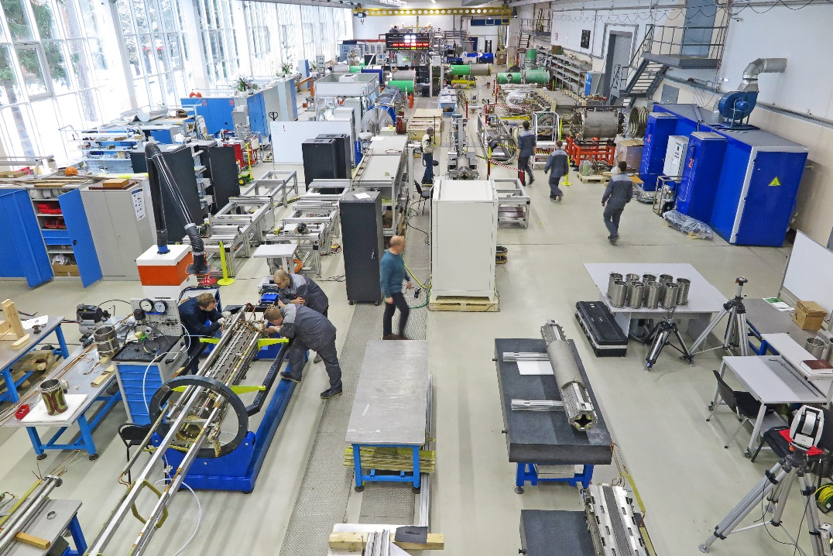
Line for assembling and cryogenic testing of SC-magnets
Main production areas:
Incoming inspection zone
SC cable production hall
SC coils production hall
Area for assembling the magnets
Area for the magnetic measurements under the room temperature
Leakage test area
Area for mounting the SC-magnets inside cryostats
Cryogenic tests bench
450 magnets for NICA and FAIR projects

Slide 16
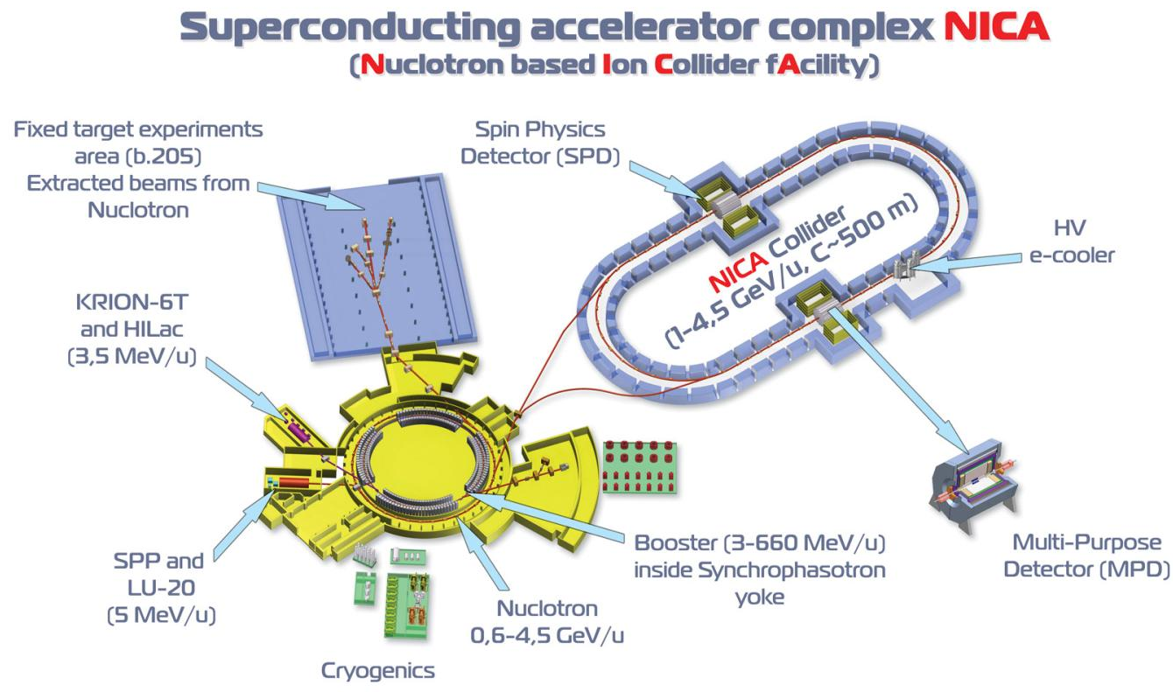
NICA accelerators

Slide 17
NICA accelerators
Main accelerator of the NICA complex is the Nuclotron –
superconducting ion synchrotron at magnetic rigidity of about 42 T·m
equipped with two injection chains: for heavy and for light ions.
Injection chain for heavy ions consists of:
the ion source (KRION-6N), heavy ion linear accelerator (HILac),
superconducting booster synchrotron (Booster) and required beam transport lines.
Injection chain for light ions includes:
Laser ion source (LIS), Source of polarized ions (SPI), Duoplasmatron,
RFQ accelerator as a foreinjector, Drift tube linac of Alvarec type (LU-20)
and required beam transport lines.
The collider experiments will be provided at two storage rings
with two interaction points (IP).

Slide 18
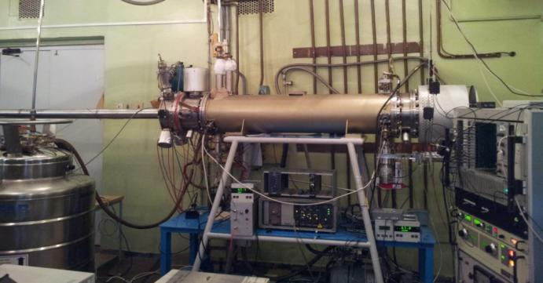
NICA accelerators
Injection chain for heavy ions
Cryogenic heavy ion source KRION
of Electron String Ion Source (ESIS) type
provides up to 2.5·10⁹ Au³¹⁺ particles per cycle
at repetition frequency up to 10 Hz

Slide 19
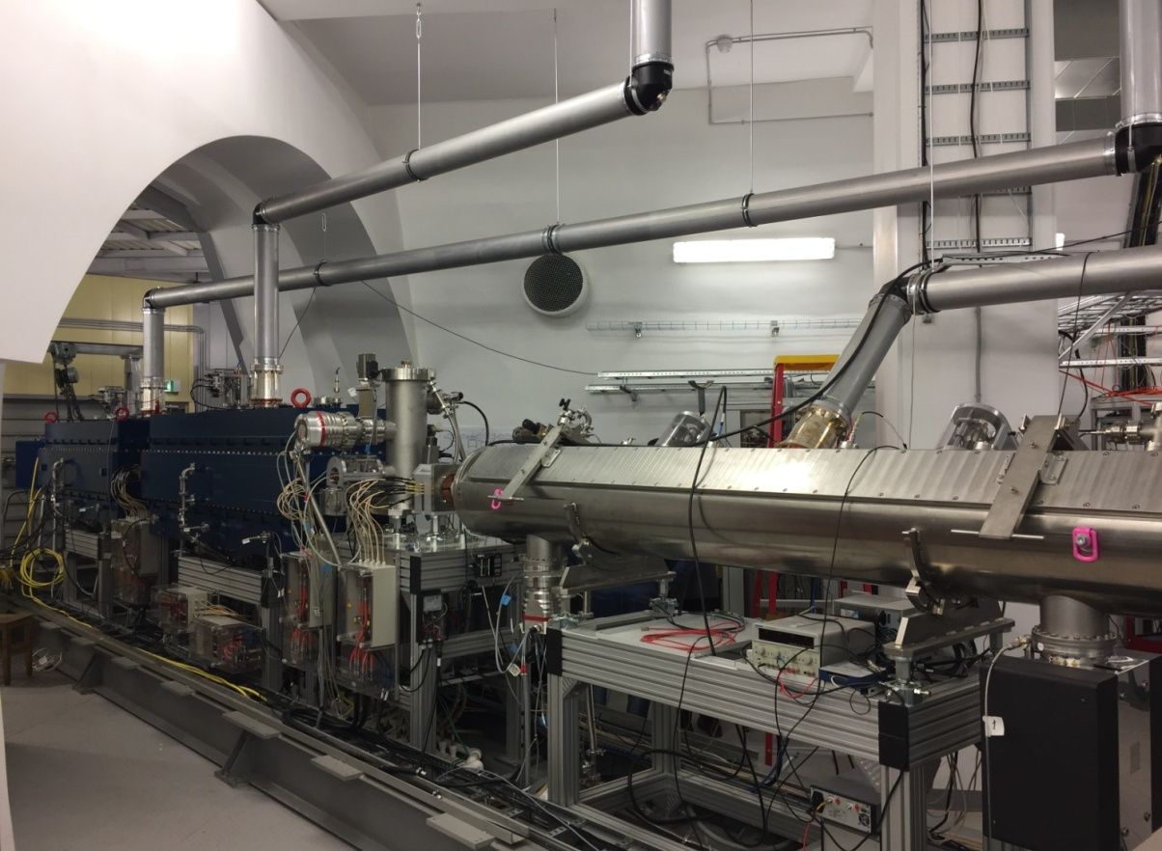
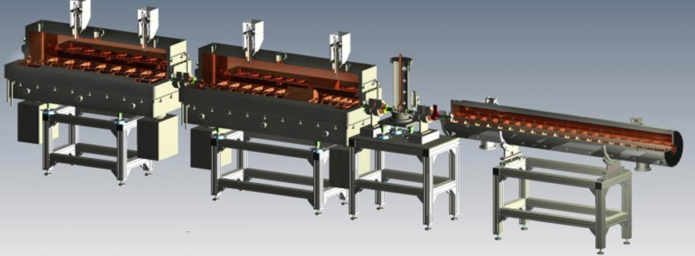
NICA accelerators
Injection chain for heavy ions
Heavy ion linear accelerator (HILac)
First in Russia
high current (10 mA) heavy ion Linac
(designed and constructed in Germany)
First Linac with transistor RF amplifier
(fabricated in Australia)
3.2 MeV/u, Au³¹⁺, 10 mA

Slide 20
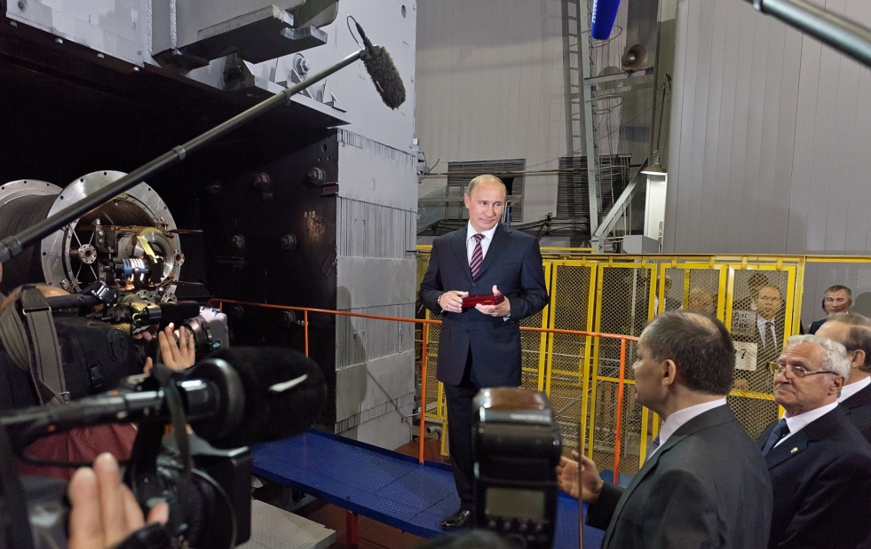
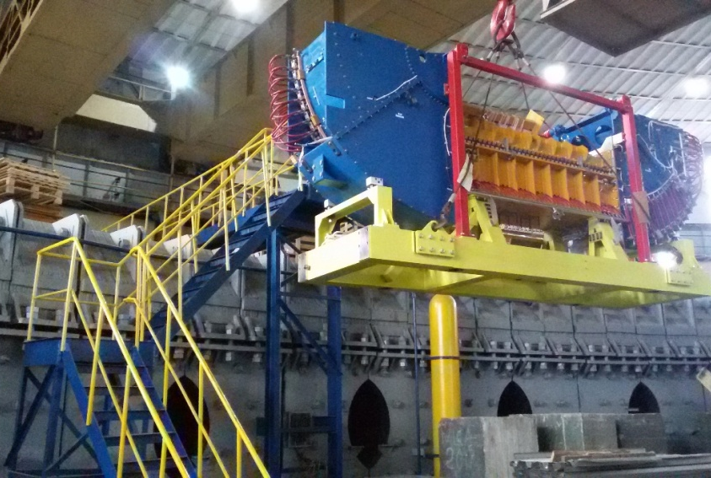
NICA accelerators
Injection chain for heavy ions
The Booster should accelerate ions up to 600 MeV/u (for ions with Z/A = 1/3).
The magnetic ring of 211 m long is placed inside the window of the Synchrophasotron yoke.
To provide the required beam quality the Booster is equipped with electron cooling system.
5 July 2011
2018

Slide 21
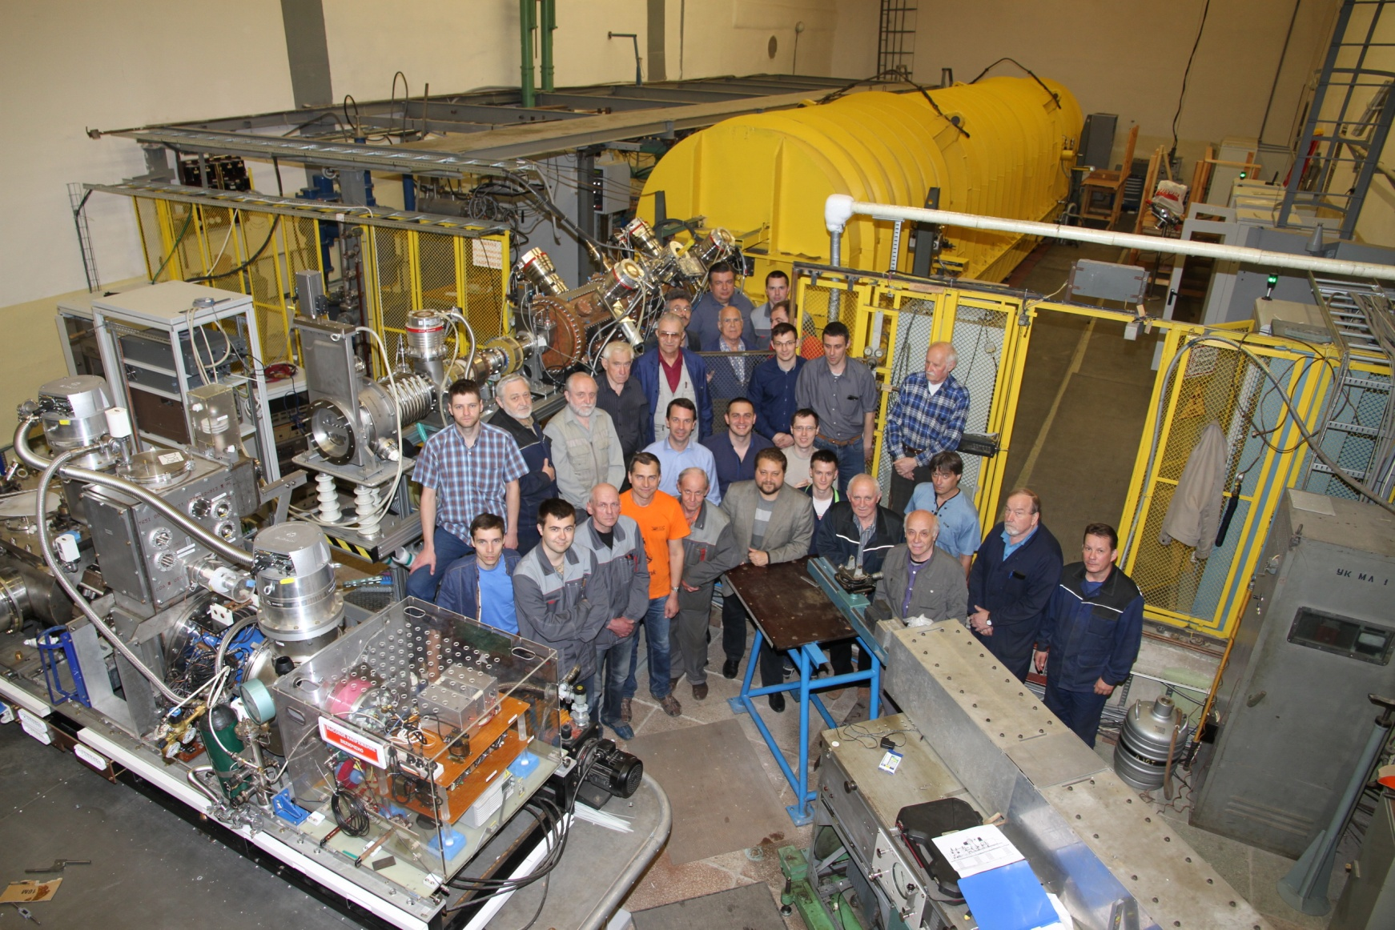
NICA accelerators
Injection chain for light ions
LU20
RFQ
SPI
LIS

Slide 22
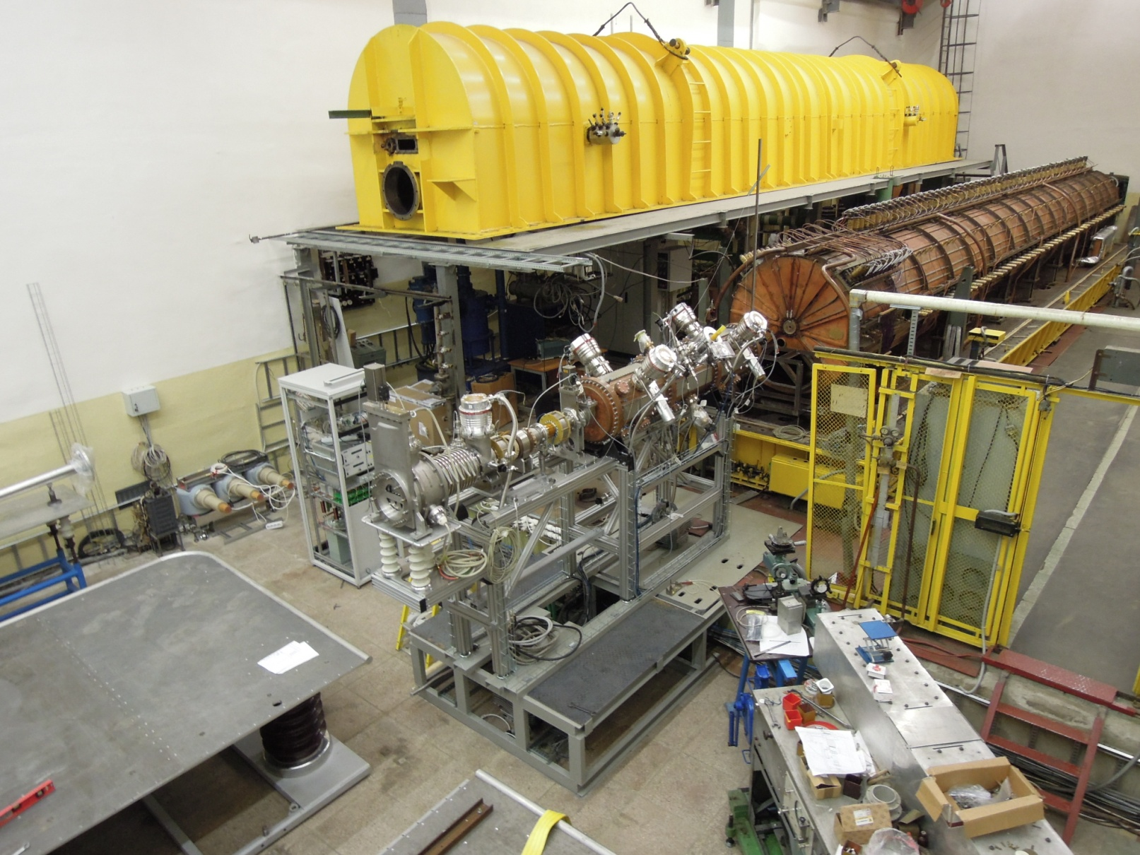
NICA accelerators
Injection chain for light ions

Slide 23
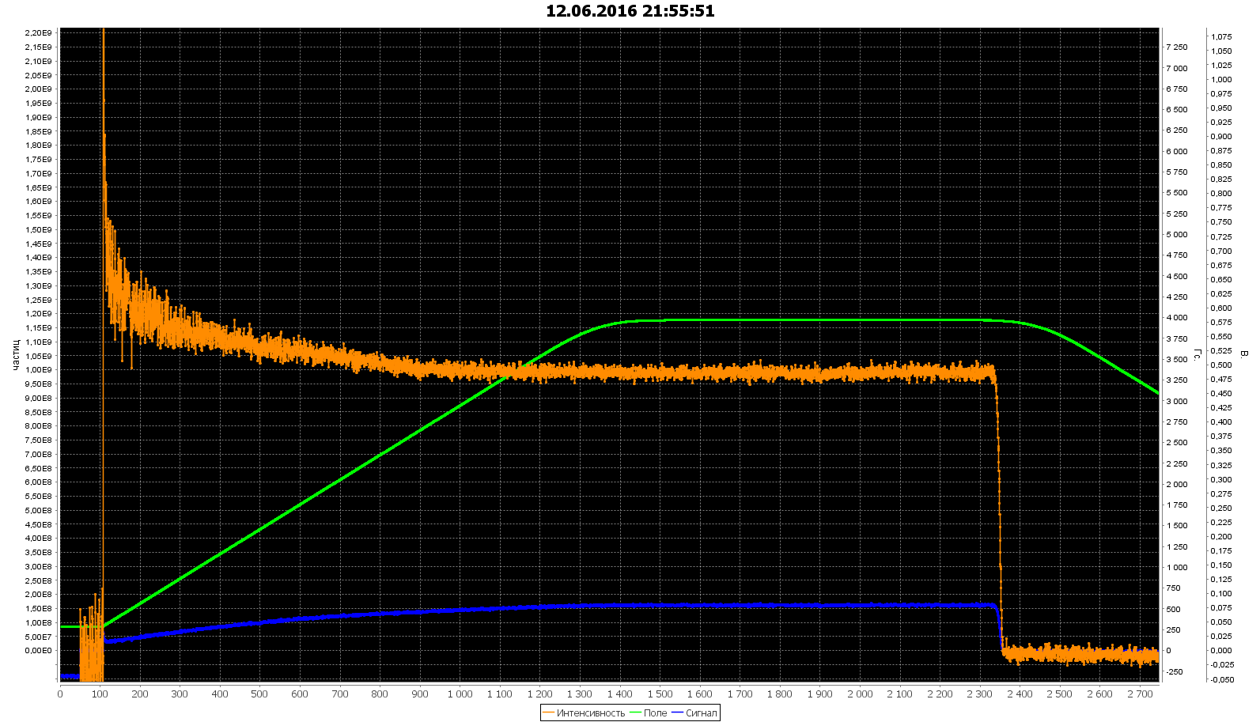
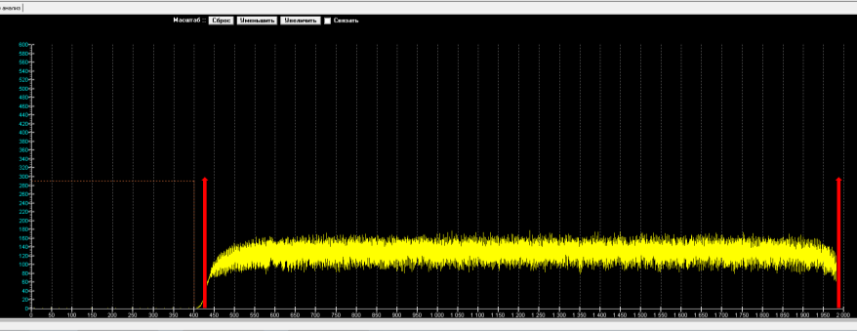
NICA accelerators
Nuclotron
Nuclotron provides now
performance of experiments
on accelerated proton
and ion beams
(up to Xe⁴²⁺, A=124)
with energies up to 6 GeV/u
(Z/A = 1/2) 4.5 GeV/u for Au
Deuteron energy 750 MeV/u, intensity 10⁹
Slow extraction system: beam spill up to 20 s

Slide 24
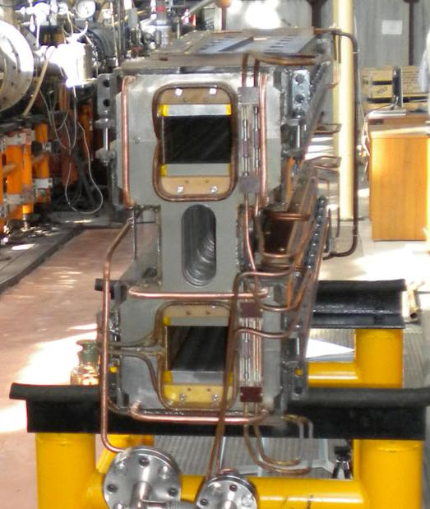
NICA accelerators
Collider
The Collider ring 503.04 m long has a racetrack shape and is based on double-aperture (top-to-bottom)
superconducting magnets at maximum dipole field 1.8 T;
The major parameters of the NICA Collider are the following:
- magnetic rigidity = 45 T·m;
ion kinetic energy range from 1 GeV/u to 4.5 GeV/u for Au⁷⁹⁺;
energy of polarized deuterons is 6 GeV/u, protons – 12 GeV,
- vacuum in a beam chamber: 10⁻¹¹ Torr;
- zero beam crossing angle at IP;
- 9 m space for detector allocations at IP’s;
Average luminosity 10²⁷ cm⁻²·s⁻¹ for gold ion collisions at √s_{NN} = 9 GeV.
The luminosity in the polarized mode is up to 10³² cm⁻²·s⁻¹.

Slide 25
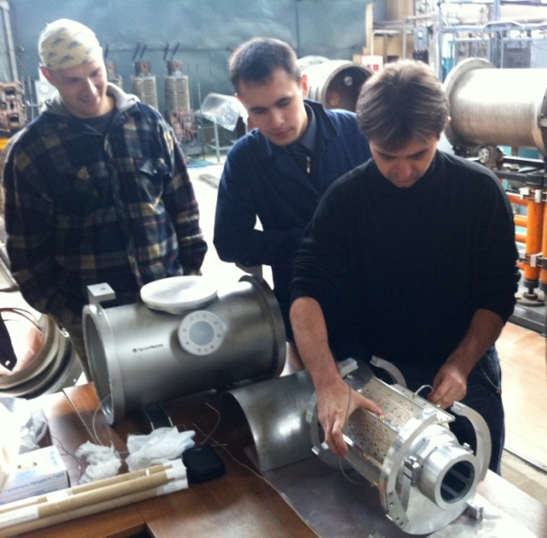
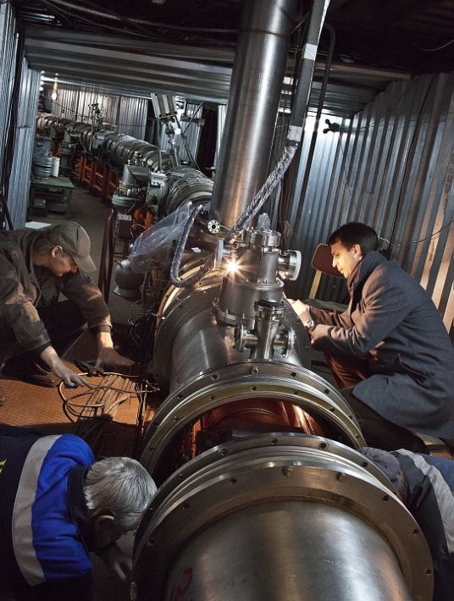
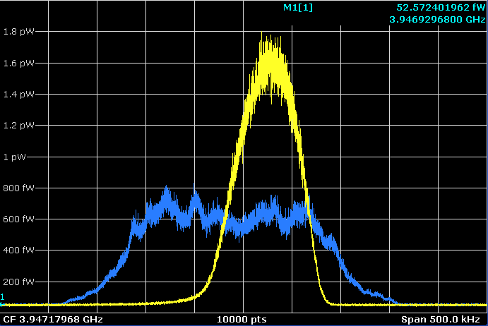
NICA accelerators
Collider
Stochastic cooling system
Successive test at the Nuclotron 2013

Slide 26
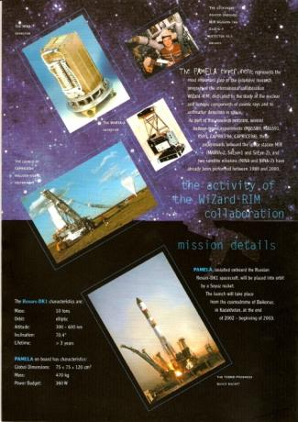
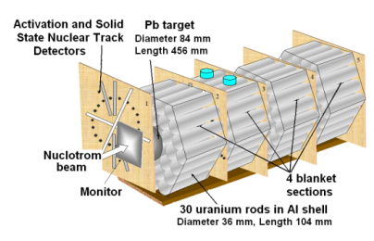
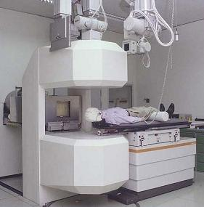
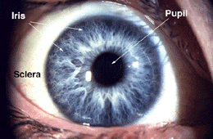
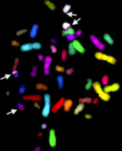
Innovations based on NICA technologies
Transmutaion of nuclear fuel waste
Testing of space craft elements and electronics
Design and Development of accelerator and detector technologies for medicine
Radiobiology
and medicine
Notes:
V.Kekelidze
16.04.2018
26
В интересах развития космической отрасли проводятся исследования радиационной стойкости компонентов микроэлектроники в условиях жесткого облучения.
Еще более важным является изучение воздействия космического излучения на живые организмы. Эффективно воссоздать эти условия на Земле можно на пучках ускорителя ионов Нуклотрон, что было продемонстрировано в тестовых экспериментах.
Пучки синхротрона Нуклотрон позволяют проводить исследования по программам трансмутации радиоактивных отходов и ядерной энергетике подкритических систем.
На пучках ускорительного комплекса NICA может быть создан современный центр радиационной терапии и, прежде всего, терапии онкологических заболеваний. Широкий спектр ускоряемых частиц и широкий диапазон их энергии позволяют обеспечить необходимые параметры излучения для лечения самых различных видов злокачественных опухолей. Немаловажно, что можно организовать работу центра без ущерба для научной программы проекта NICA.
На пучках действующего ионного источника и линейного ускорителя Нуклотрона в ЛФВЭ ведутся работы по созданию нано- и микроструктур в различных материалах. Путем бомбардировки ионами создаются микропоры, позднее заполняемые наночастицами – композитными, ферромагнитными, парамагнитными.

Slide 27
NICA: Education
Realization of the NICA experimental program presumes construction and
a few consequent upgrades of large accelerator complex during 15 – 20 years.
Within this period high level specialists will be educated in the following fields:
Industrial electronics
Vacuum technique
RF engineering
Accelerator physics and technique
Superconducting magnetic systems
Cryogenics
Automatic control systems
Particle detectors
Radiation safety

Slide 28
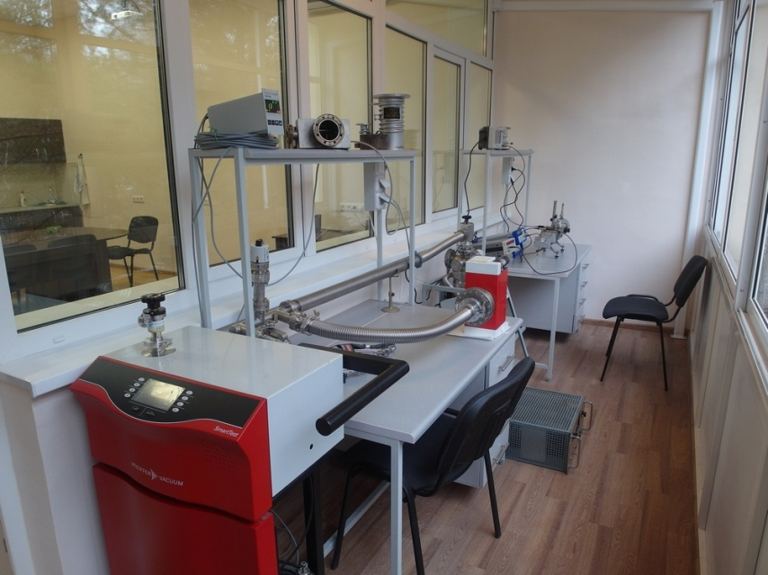
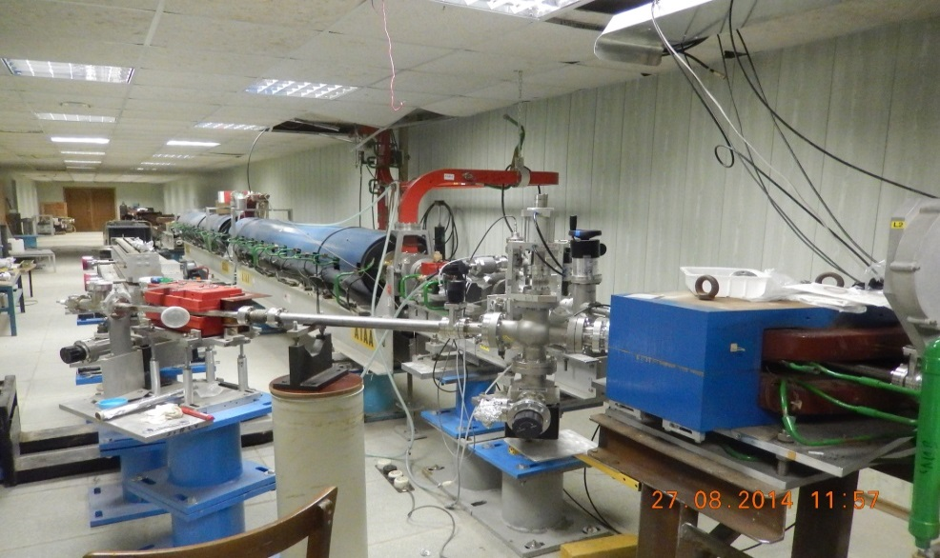
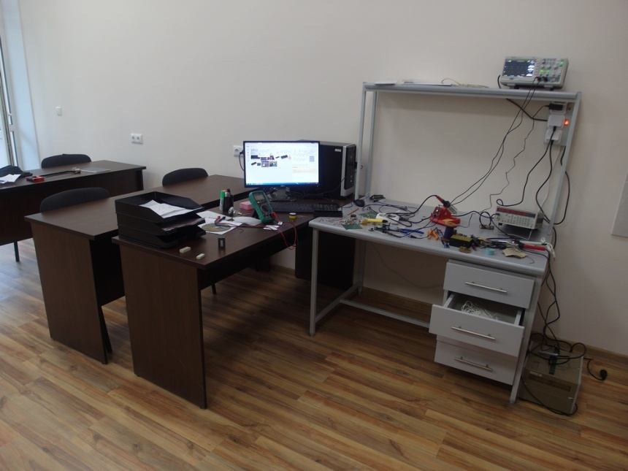
JINR University Center
Practice in:
Vacuum technique
RF engineering
Industrial electronics
Radiation safety
Linear accelerators
Free electron lasers
First international student team got the practice in July 2015

Slide 29

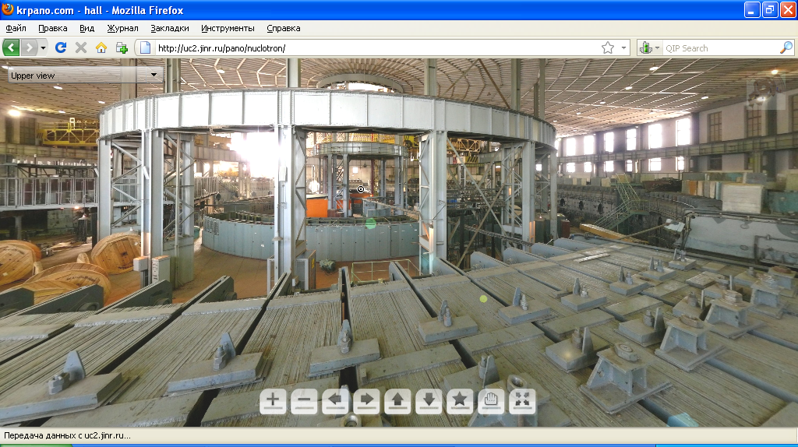
Virtual excursions
http://uc2.jinr.ru/pano/nuclotron/

Slide 30
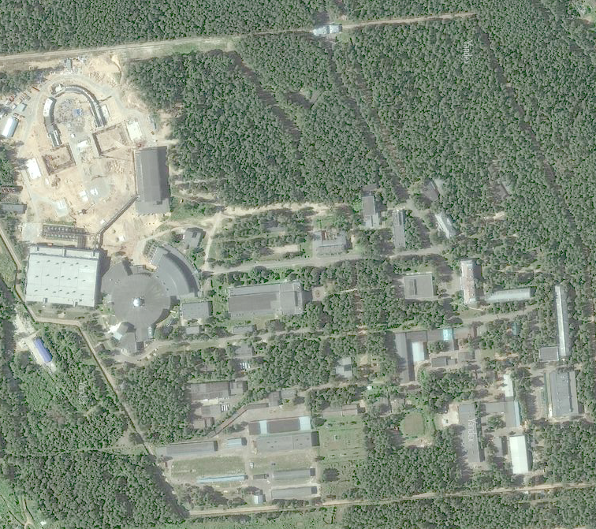
Start of the collider operation 2020

