Slide 1
Particle identification in ground-based gamma-ray astronomy using convolutional neural networks
Evgeny Postnikov, Alexander Kryukov, Stanislav Polyakov (SINP MSU), Dmitry Shipilov, Dmitriy Zhurov (ISU)
The work was supported by RSF, grant №18-41-06003

Slide 2
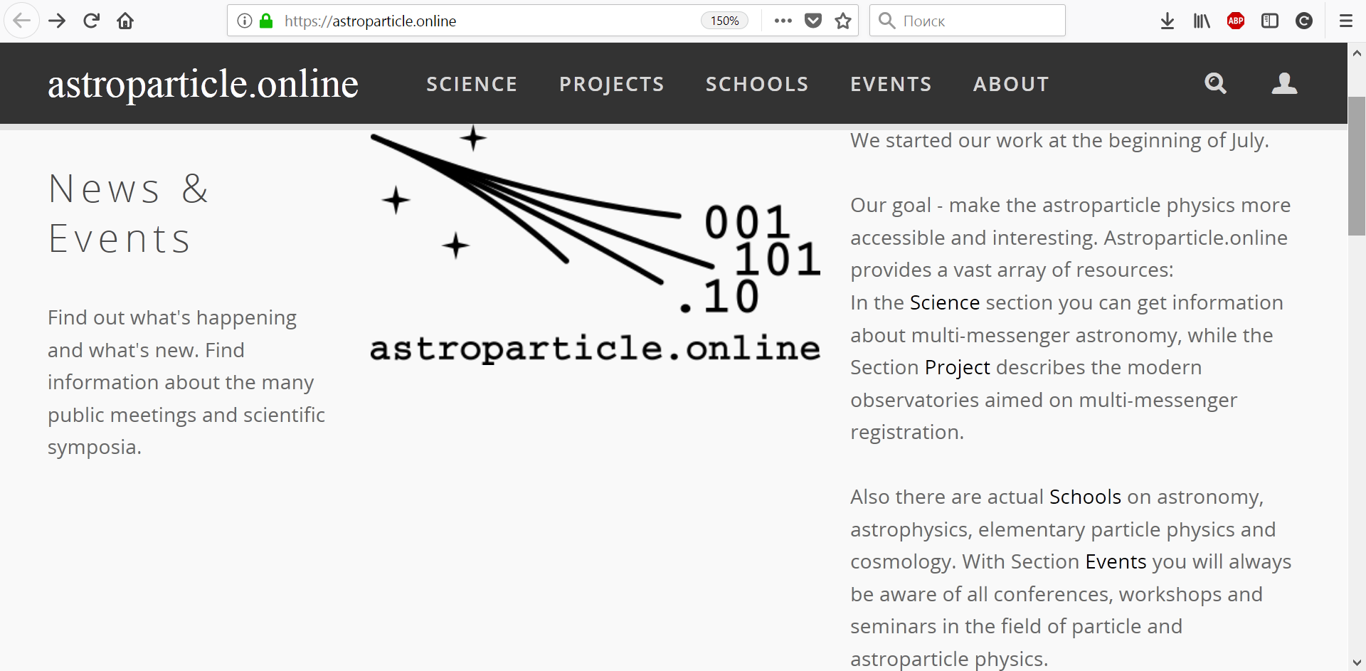
This research is part of the project:

Slide 3
Gamma-ray astronomy
Gamma rays are the most energetic radiation in the universe.
They explore the most exotic and extreme processes and physical conditions.
Objects that emit gamma rays include supernova remnants, active galactic nuclei (supermassive black holes at the centers of galaxies) and potentially even dark matter. Gamma rays are the only direct probe of the extreme conditions in these phenomena.

Slide 4
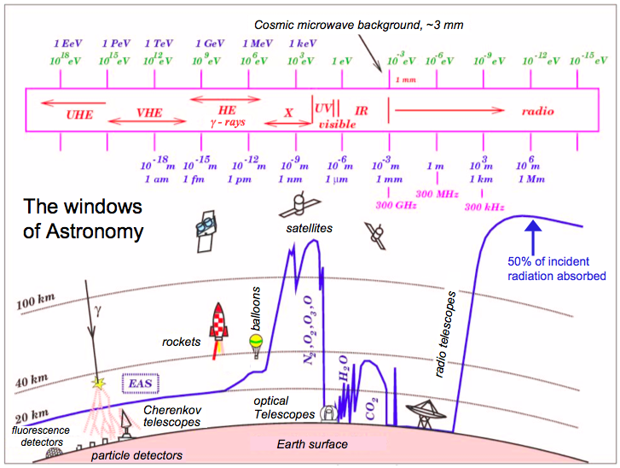

Slide 5
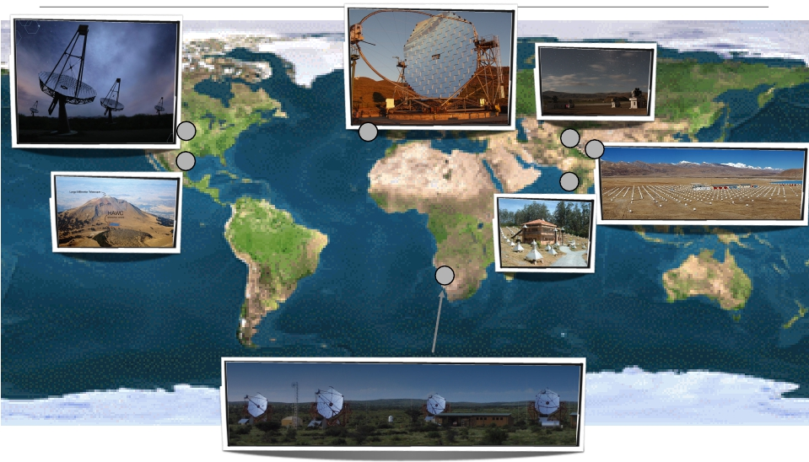
Largest gamma-ray detectors
MAGIC
VERITAS
HAGAR
TIBET-AS /
ARGO-YBJ
GRAPES
HAWC
H.E.S.S.

Slide 6
TAIGA telescope
TAIGA is an array of telescopes (currently only the 1st one installed) designed to detect the very high energy gamma-rays (>1x10¹² eV) through their interaction with the Earth's atmosphere. The gamma-rays produce a shower of particles that travel through the atmosphere, emitting Cherenkov light which is then detected by our telescope (10 m² mirror area) and projected onto the photomultiplier-based camera (560 photomultipliers ∼ 560 pixels of the image).

Slide 7
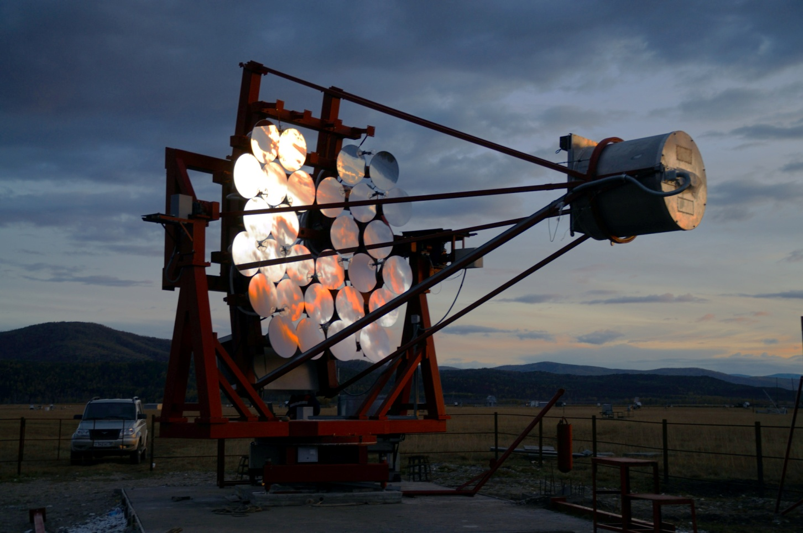
TAIGA telescope

Slide 8
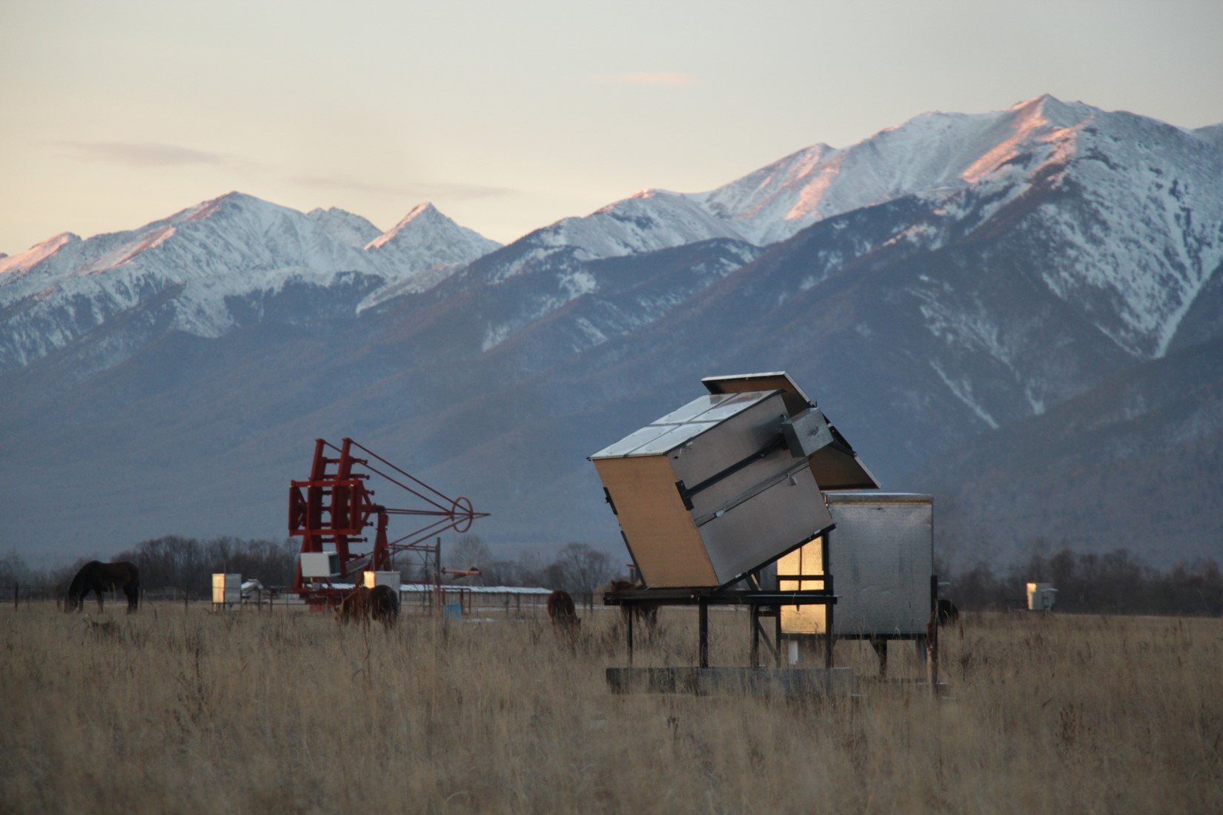
TAIGA telescope on site

Slide 9
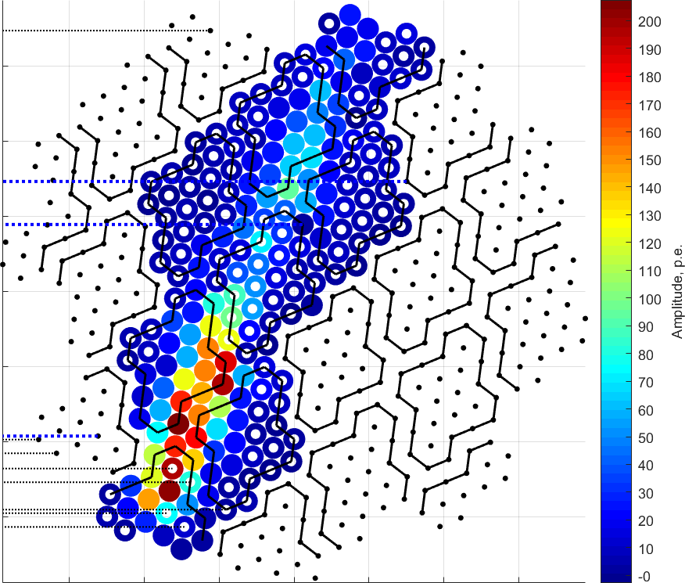
TAIGA telescope image example

Slide 10
Purpose of image analysis
Particle identification:
gamma ray
VS
charged cosmic ray, mostly proton.

Slide 11
CNN applications to IACTs
Only 2 applications so far, both since 2017:
VERITAS telescope: CNN effort via ‘citizen-science’ approach, only muon images VS all other images.
CTA (hundreds of telescopes to be developed): CNN effort via Monte Carlo simulation of the future telescopes, only rectangle pixel grid.

Slide 12
Largest gamma-ray detectors
MAGIC
VERITAS
HAGAR
TIBET-AS /
ARGO-YBJ
GRAPES
HAWC
H.E.S.S.

Slide 13
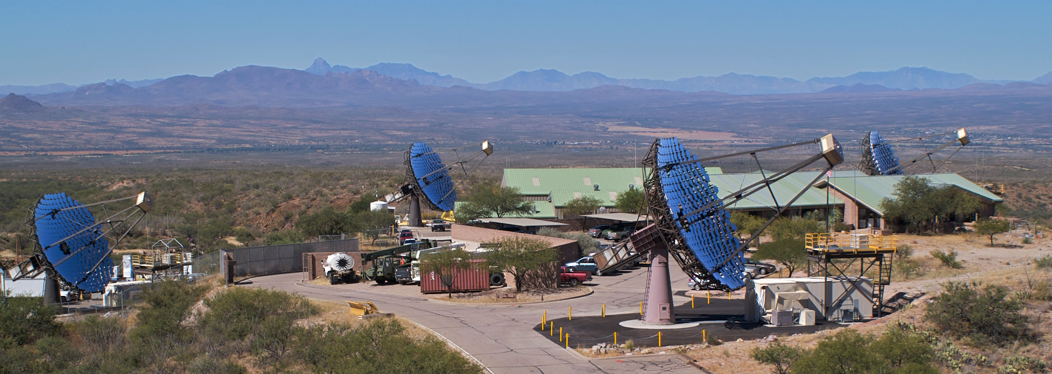
CNN applications to IACTs
VERITAS:

Slide 14
CNN applications to IACTs
Only 2 applications so far, both since 2017:
VERITAS telescope: CNN effort via ‘citizen-science’ approach, only muon images VS all other images. [The analysis of VERITAS muon images using convolutional neural networks. arXiv 1611.09832].
CTA (hundreds of telescopes to be developed): CNN effort via Monte Carlo simulation of the future telescopes, only rectangle pixel grid.

Slide 15
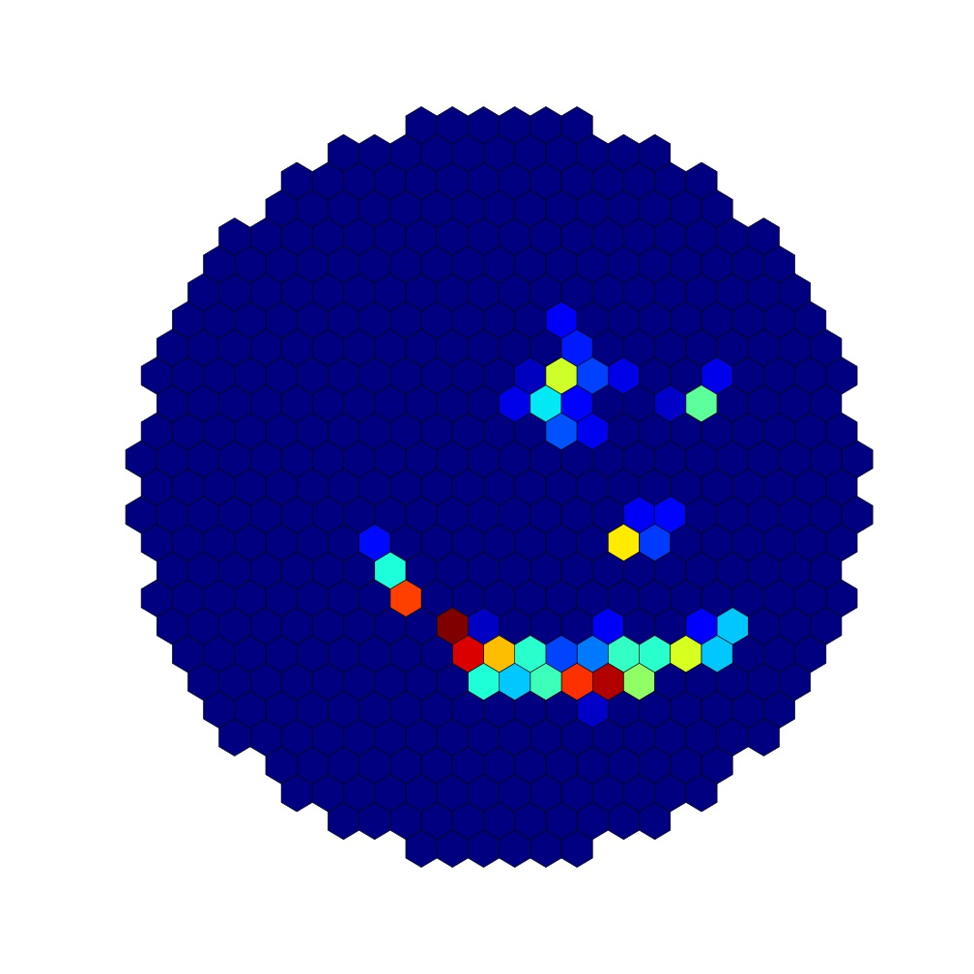
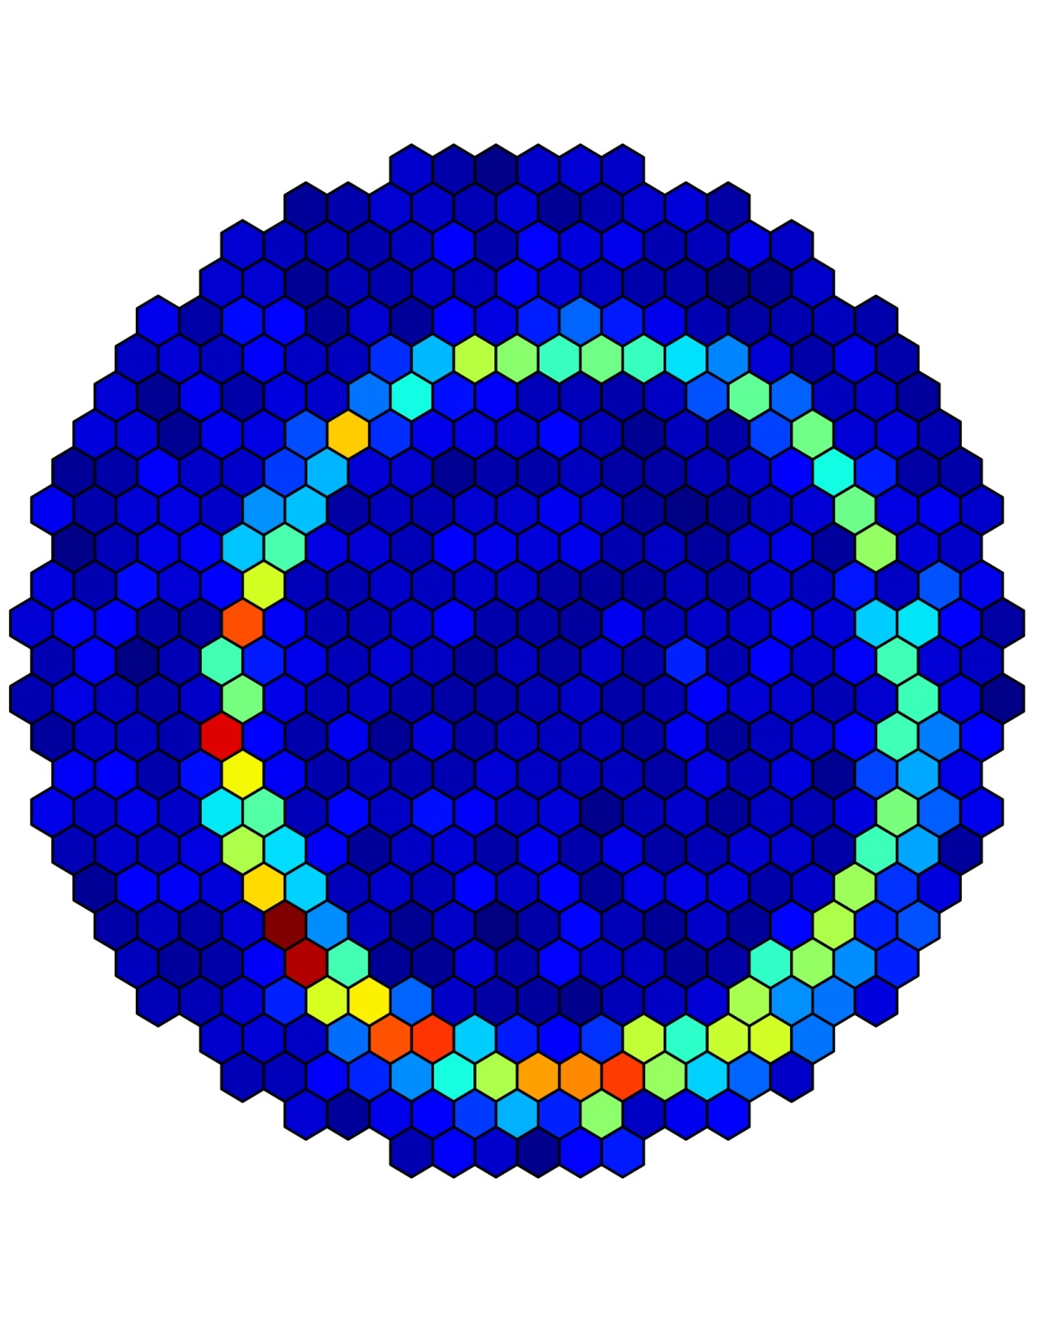
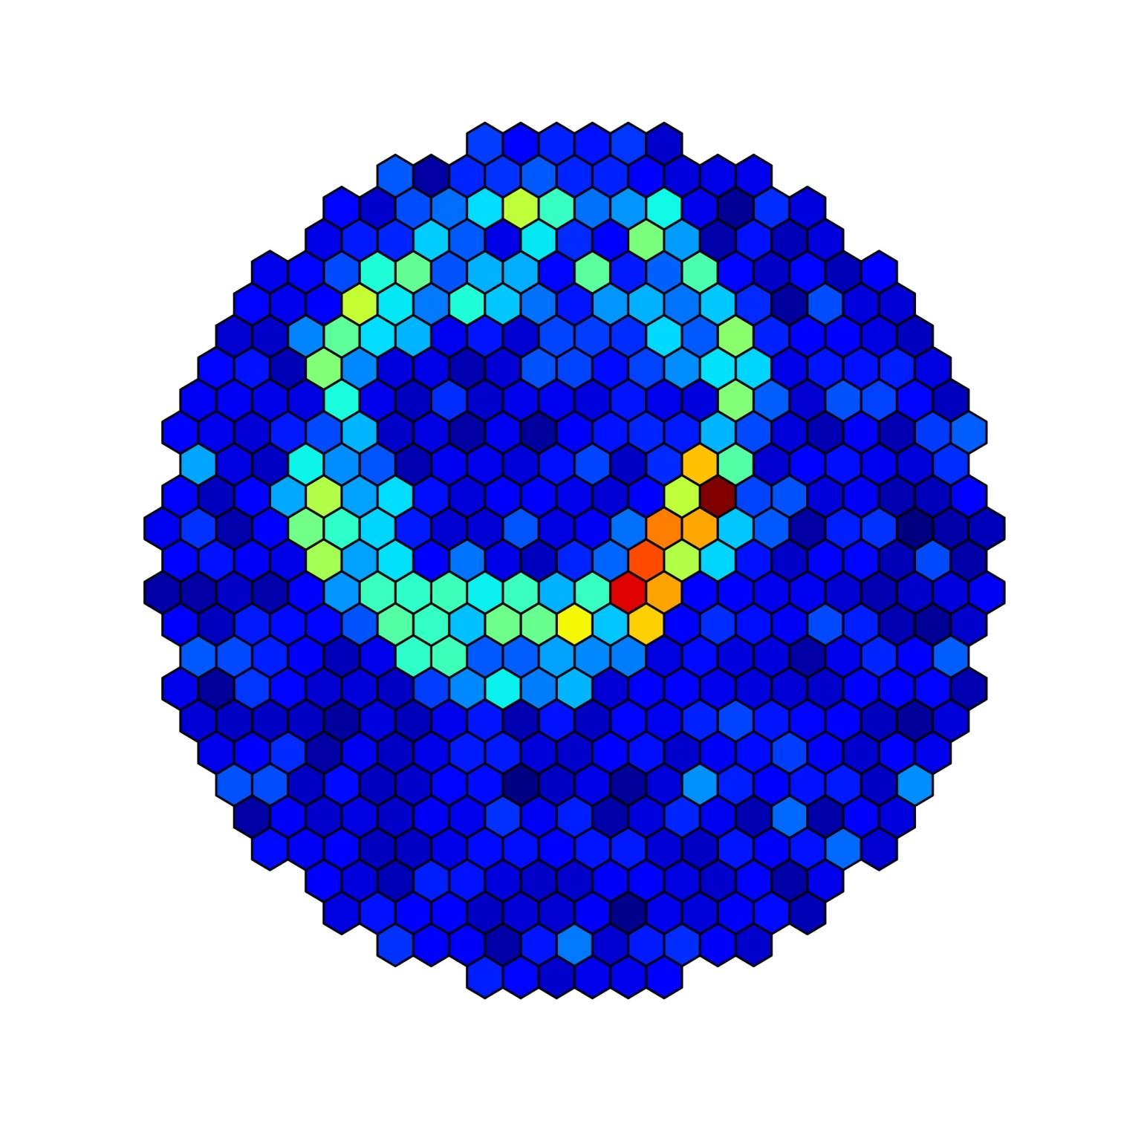
CNN applications to IACTs
VERITAS (muon images):

Slide 16
CNN applications to IACTs
VERITAS:
A citizen-science approach means ‘no Monte Carlo’, but only real data recognized by humans (volunteers) on the Zooniverse: the Muon Hunter project. Anyone can join. [PoS(ICRC2017)826].
zooniverse.org/projects/zooniverse/muon-hunter

Slide 17
CNN applications to IACTs
Only 2 applications so far, both since 2017:
VERITAS telescope: CNN effort via ‘citizen-science’ approach, only muon images VS all other images.
CTA (hundreds of telescopes to be developed): CNN effort via Monte Carlo simulation of the future telescopes, only rectangle pixel grid.

Slide 18
CNN applications to IACTs
CTA: Exploring deep learning as an event classification method for the Cherenkov Telescope Array. [PoS(ICRC2017)809]. [CTA impressions: “CNN are capable of classifying simulated IACT images without any prior parametrization nor any assumption on the nature of the images themselves. The accuracy of the tested models is energy dependent, ranging from 81.4% in the low energy range to 91.6% in the high energy range”. [PoS(ICRC2017)809].
Among drawbacks of this work: only the square pixels instead of hexagonal ones.
An immense number of pixels (>11000) as compared to 560 in TAIGA.

Slide 19
CNN applications to IACTs
CTA simulated gamma-ray (left), proton (right):

Slide 20
The idea behind CNN
The idea of CNN is to behave in an invariant way across images.
Simple translation of the input image data instead of taking some preselected parameters of images (e.g. dimensions and orientation) lets CNN do all work fully automatically (“capable of classifying IACT images without any prior parametrization”, CTA).

Slide 21
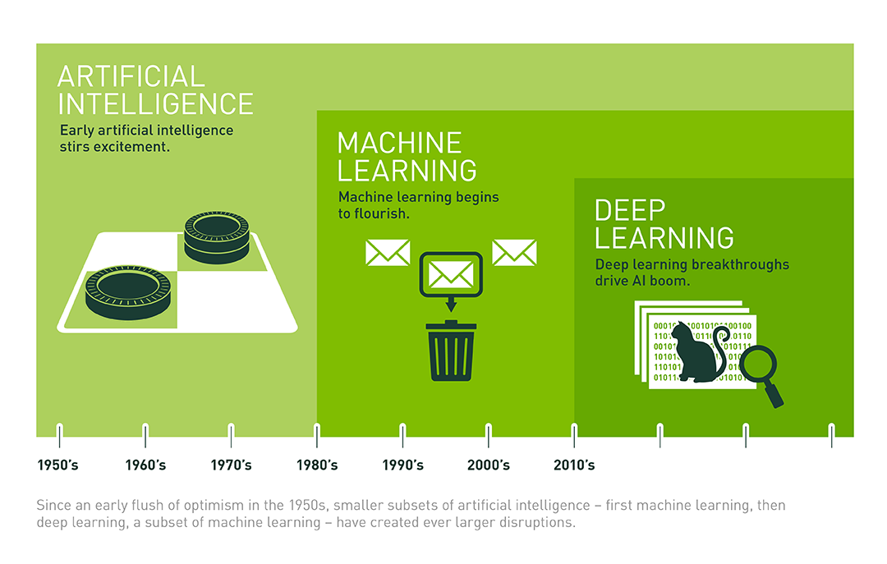
manually choose features and a classifier to sort images
feature extraction and modeling steps are automatic

Slide 22
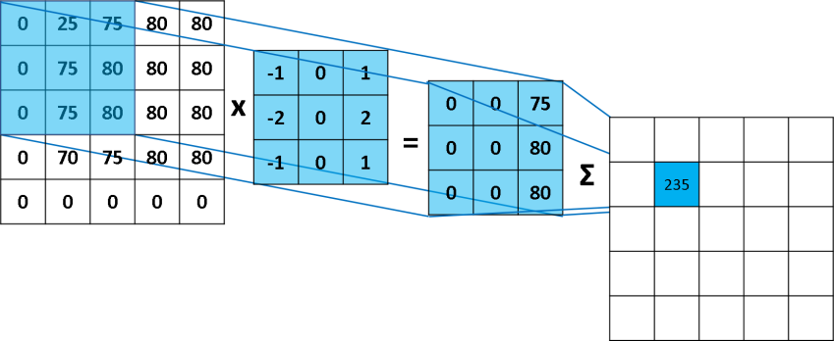
How CNN works
Convolutional layers apply a convolution operation (cross-correlation, or simply filtering) to the input, passing the result to the next layer, and so on.
Special features of feedback avoid overfitting that was the problem for conventional ANN.
How CNN is realized

Slide 23
First effort – MC data ‘as is’
Trying gamma-ray separation from proton background using Monte Carlo images without ‘image cleaning’ at all.
For that purpose special Monte Carlo samples were prepared and given for analysis to both CNN packages (PyTorch, TensorFlow) as well as for a simple dimensions/orientation analysis using only two basic cuts.

Slide 24
Monte Carlo and blind analysis
Training datasets: gamma-ray and proton images (Monte Carlo of TAIGA-IACT, real energy spectrum); night sky background, trigger procedure and detector response added, but neither cleaning nor preselection applied.
Test datasets: after CNN training, datasets (different from training ones) of gamma-ray and proton images in random proportion (blind analysis) were classified by each of the packages: TensorFlow and PyTorch. Each package output was ‘probability’ of any image to be gamma-ray of proton.

Slide 25
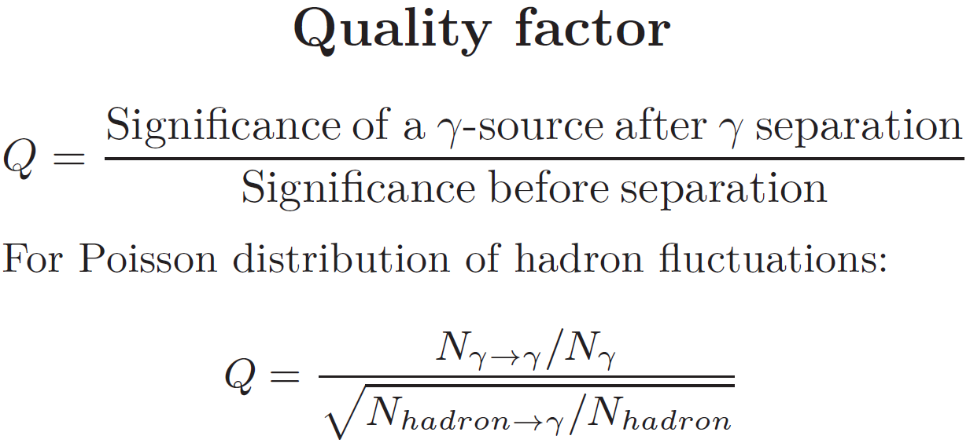
Particle identification quality

Slide 26
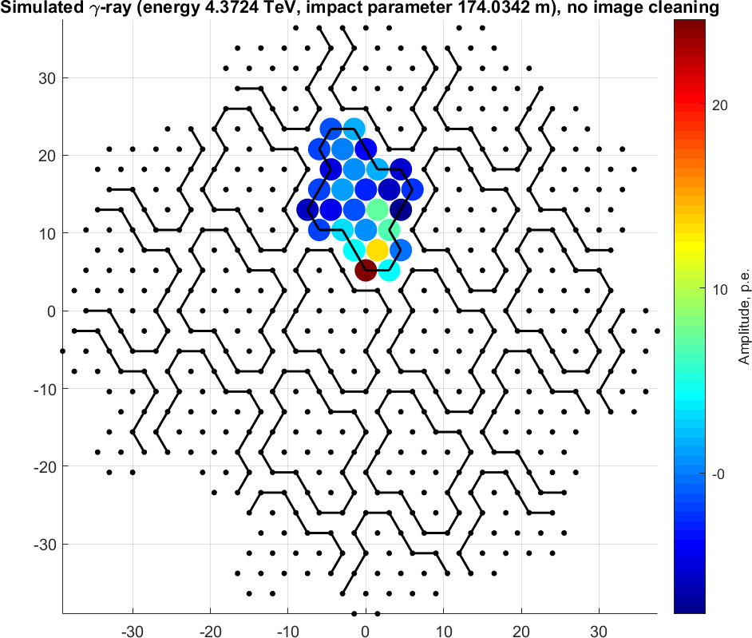
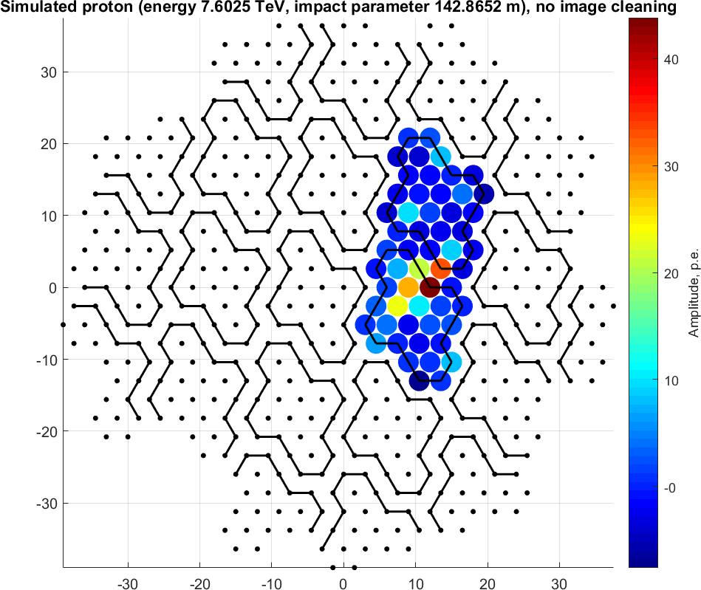
Simulated gamma-ray image example: ‘as is’, no cleaning
TAIGA simulated gamma-ray (left), proton (right):

Slide 27
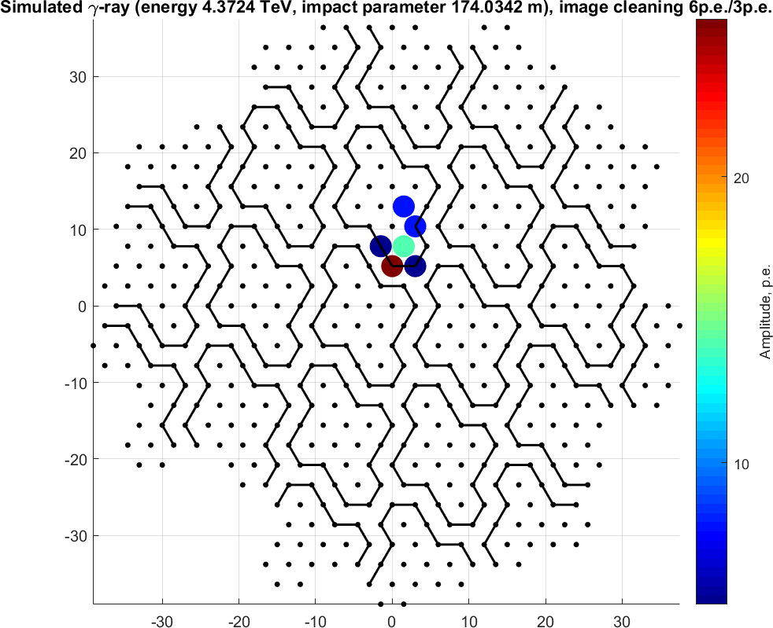
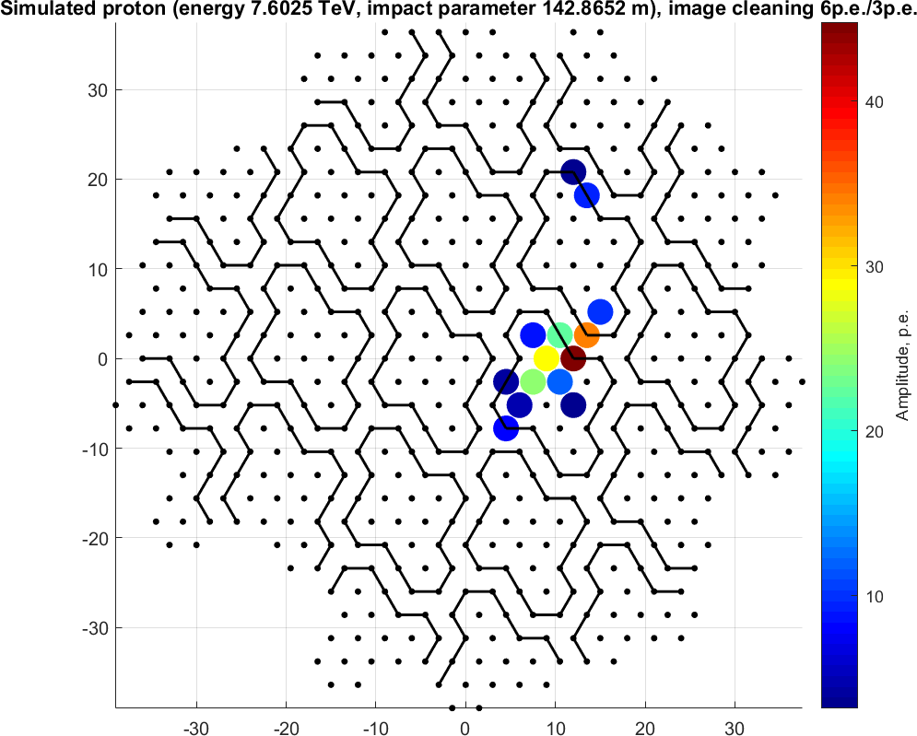
Simulated gamma-ray image example: after soft cleaning
TAIGA simulated gamma-ray (left), proton (right):

Slide 28
Particle identification quality

Slide 29
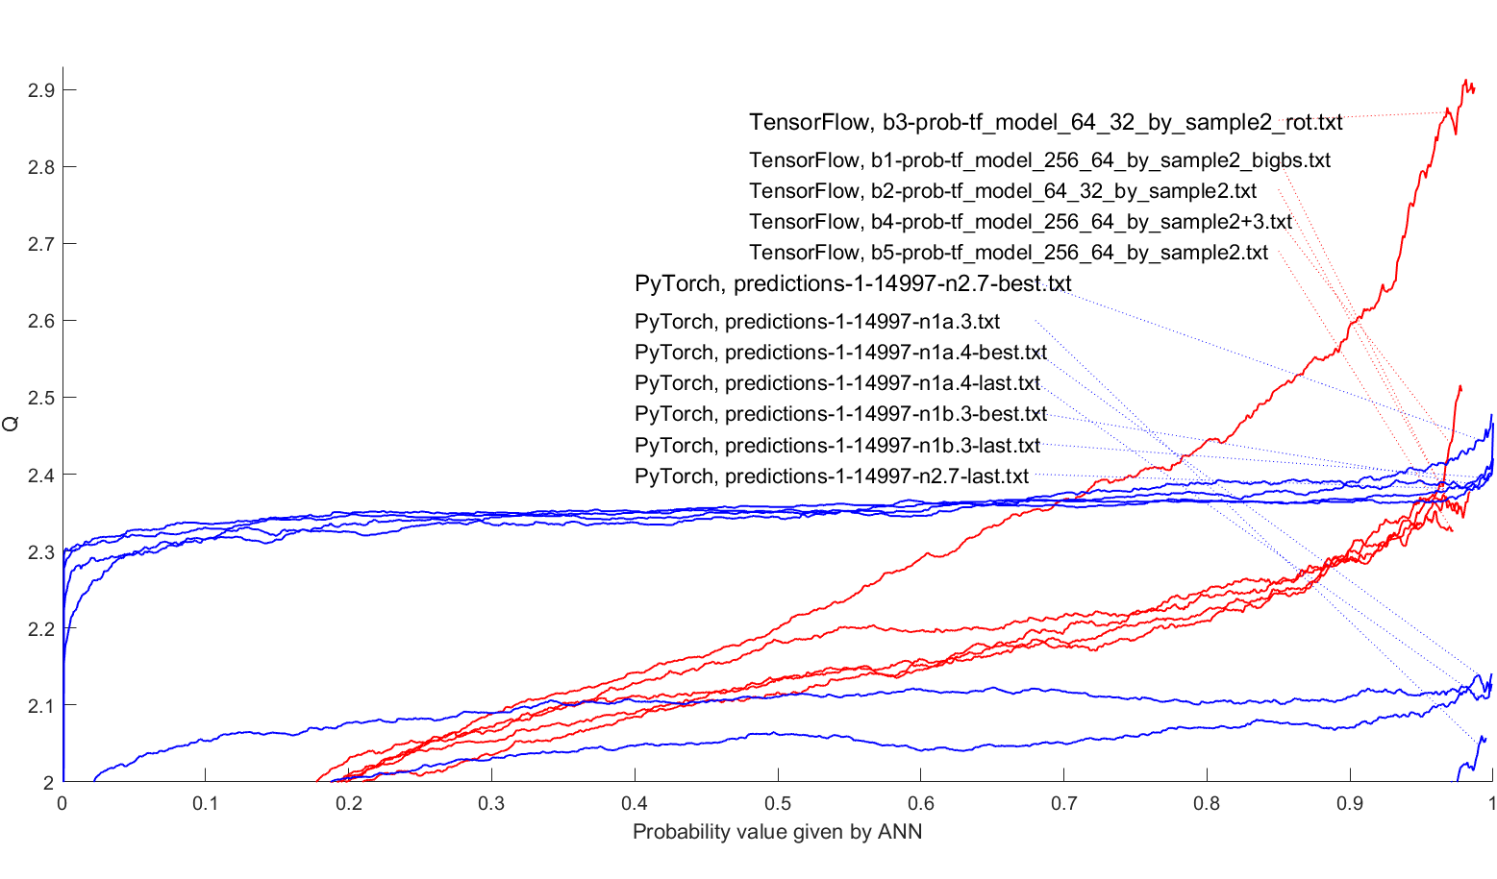
Q vs CNN output parameter (various CNN after same soft cleaning)
After additional rotation of 70% of learning sample by 60⁰, so that a sample size arouse from ~30 000 to ~180 000

Slide 30
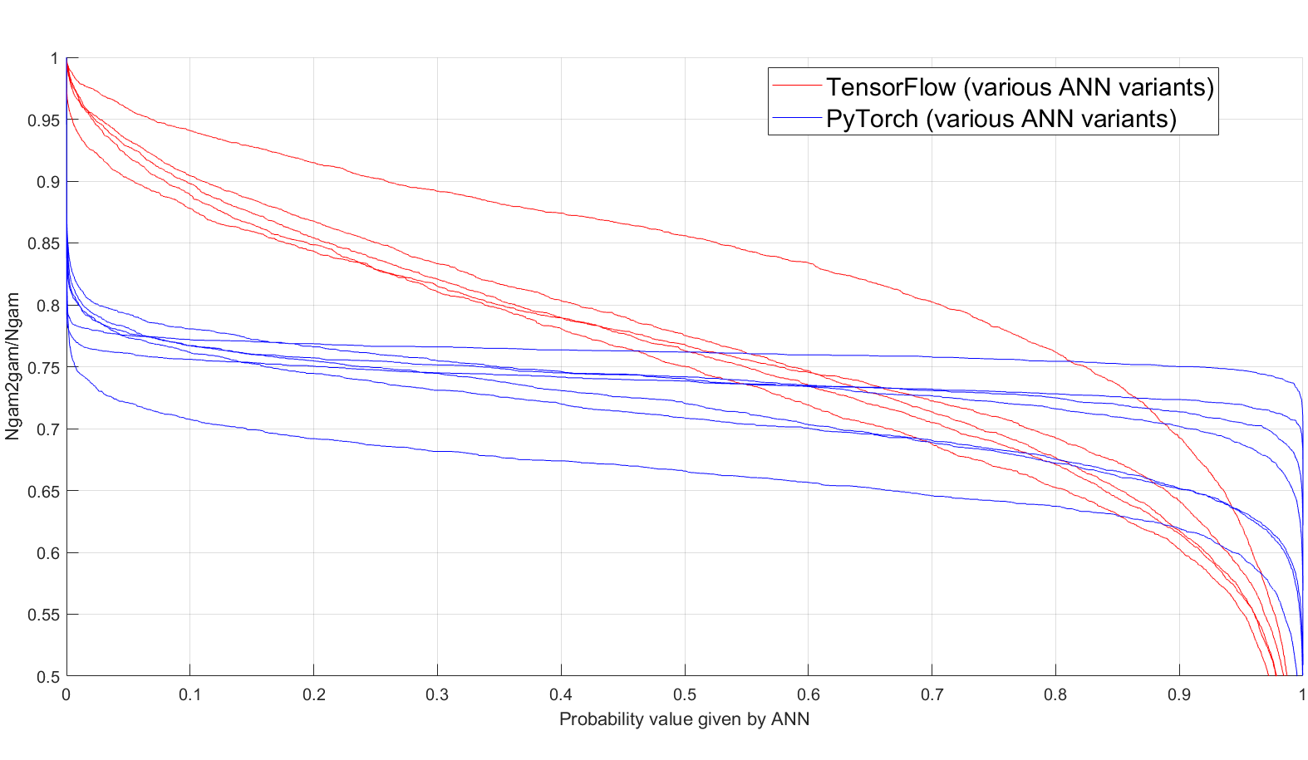
Number of correctly identified γ-rays vs CNN output parameter (Problem of the ‘cut value’ choice)

Slide 31
Preliminary conclusions
The standard image cleaning procedure even in a very soft variant led to significant improvement of Q-factor.
Another yet improvement in quality of identification is due to the additional image rotation in learning sample, which allows increasing sample size.
To get higher Q, probability values should be taken as much as possible (almost 1), but to avoid losing more than 50% of gamma.
Overall, results seem promising.

Slide 32
Backup slides

Slide 33
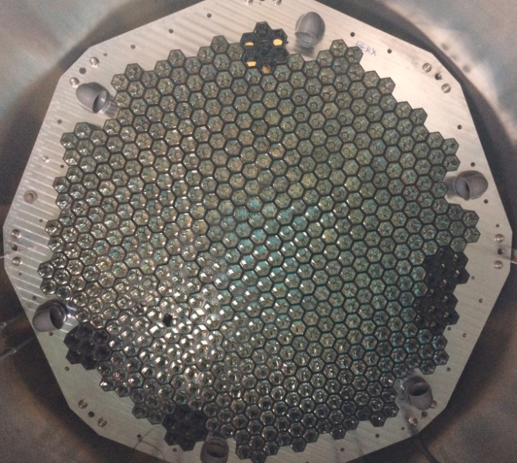
Telescope camera (front view)

Slide 34
Introduction
Modern detectors of cosmic gamma rays are a special type of imaging telescopes (Cherenkov telescopes, IACT) supplied with cameras with relatively large number of photomultiplier-based pixels. For example, the camera of the TAIGA telescope has 560 pixels of hexagonal structure.
Images in such cameras can be analyzed by various deep learning techniques to extract numerous physical and geometrical parameters and/or for incoming particle identification. We implement for this purpose the most powerful deep learning technique for image analysis, convolutional neural networks (CNN).

Slide 35
Introduction
We present the results of tests with two open source machine learning libraries, PyTorch and TensorFlow, as possible platforms for particle identification in imaging Cherenkov telescopes.
Monte Carlo simulation was performed to analyze images of gamma rays and other (background) particles as well as estimate identification accuracy.
Further steps of implementation and improvement of this technique are discussed.

Slide 36
Preliminary conclusions
The standard image cleaning procedure led to significant improvement of Q-factor.
Another yet improvement in quality of identification is due to the additional image rotation in learning sample, which allows increasing sample size.
To get higher Q, probability values should be taken as much as possible (almost 1), but to avoid losing more than 50% of gamma.
Overall, results are promising.

Slide 37
Reason for choice
CNN is a kind of ANN that uses a special architecture which is particularly well-adapted to classify images.
Using this architecture makes CNN fast to train deep, many-layer networks, which are very good at classifying images.
Today, deep CNN or some close variant are used in most neural networks for image recognition.

Slide 38
CNN progress from past to present
CNNs have been applied to visual tasks since the late 1980s. However, they were ‘dormant’ until the mid-2000s when developments in computing power and the advent of large amounts of labeled data, supplemented by improved algorithms, contributed to their advancement and brought them to the forefront of a neural network renaissance that has seen rapid progression since 2012. [Neural Computation 29, 2352–2449 (2017) © 2017 Massachusetts Institute of Technology]
In the last few years, deep learning has lead to very good performance on a variety of problems, such as object recognition, speech recognition and natural language processing. Among different types of deep ANN, CNNs have been most extensively studied. Due to the lack of training data and computing power in early days, it is hard to train a large high-capacity CNN without overfitting. Recently, with the rapid growth of data size and the increasing power of GPU, many researchers have improved the CNNs and achieved state-of-the-art results on various tasks. [Pattern Recognition 77, 354-377 (2018) © Elsevier]

Slide 39
CNN applications
When applied to facial recognition, CNNs achieved a large decrease in error rate: 97.6% recognition rate on "5,600 still images of more than 10 subjects". [Neural Networks, 16 (5): 555–559 (2003)) © Elsevier]
In 2015 a many-layered CNN demonstrated the ability to spot faces from a wide range of angles, including upside down, even when partially occluded with competitive performance. The network trained on a database of 200,000 images that included faces at various angles and orientations and a further 20 million images without faces. [arXiv:1502.02766 and MIT Technology Review technologyreview.com ]

Slide 40
Results on the entire dataset without preliminary data transformation or removal:
Q-factor value Q = N_{gamma2gamma}/N_{gamma}) / sqrt(N_{proton2gamma}/N_{proton}
Q(TensorFlow)~1.48 (with optimal probability value).
Q(PyTorch)~1.74 (with optimal probability value).
Q~1.76 for two cuts of geometrical image parameters (image width and image angle) after soft image cleaning; however, the images that were removed by image cleaning were also taken into account as ‘protons’ – for a fair comparison.

Slide 41
Particle identification quality

Slide 42
Next effort – soft image cleaning
Results after the standard image cleaning procedure with very soft cleaning parameter values:
Q(TensorFlow)~2.99 (with optimal probability value), ~2.81 (with probability value from learning sample).
Q(PyTorch)~2.55 (with optimal probability value).
Q~1.7 for two cuts of geometrical image parameters (image width and image angle).

