Slide 1
File Transfer Service at Exabyte scale
GRID 2018
Andrea Manzi (CERN)
on behalf of the FTS team
Distributes the majority of Large Hadron Collider data across the World LHC Computing Grid (WLCG) infrastructure.
Developed at CERN
FTS distributes the majority of Large Hadron Collider data across the World LHC Computing Grid (WLCG) infrastructure.
Developed at CERN.

Slide 2
Overview
FTS intro
FTS architecture & components
Multi-protocol support & gfal2
WLCG DOMA TPC
CTA integration
Web access & Monitoring
CERN instances
DAQ use case
FTS Public
On going activities
Upcoming release
XDC project
Last Mile Transfers(LMT)

Slide 3
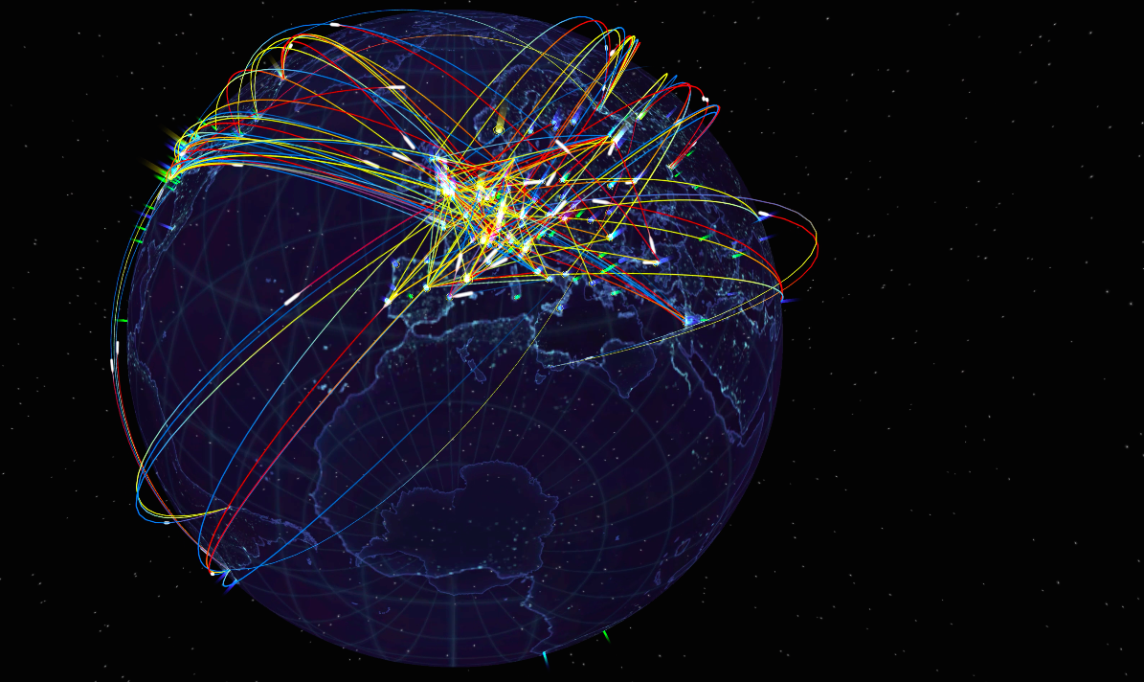
Distributes the majority of Large Hadron Collider data across the World LHC Computing Grid (WLCG) infrastructure
Used also by other Communities (i.e. Lifescience)
In production at CERN since 2014
FTS distributes the majority of Large Hadron Collider data across the World LHC Computing Grid (WLCG) infrastructure.
Developed at CERN.

Slide 4
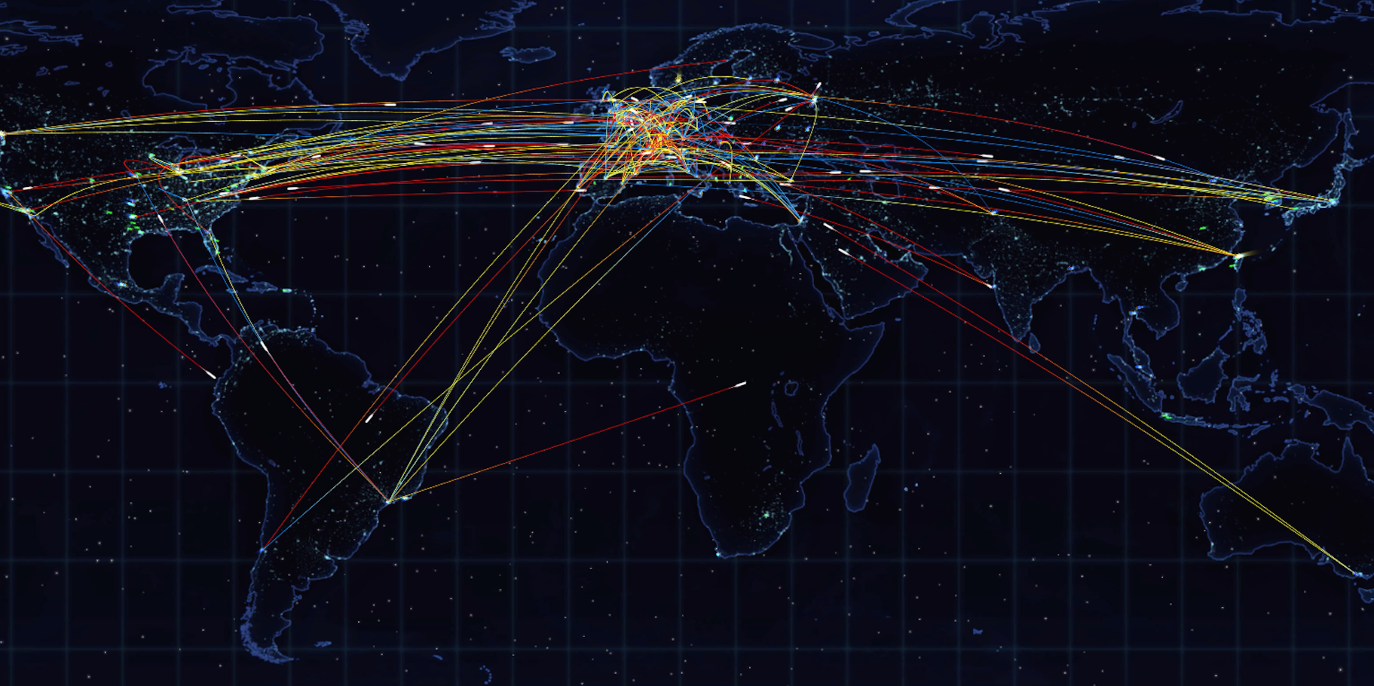
Distributes the majority of Large Hadron Collider data across the World LHC Computing Grid (WLCG) infrastructure.
Developed at CERN
FTS distributes the majority of Large Hadron Collider data across the World LHC Computing Grid (WLCG) infrastructure.
Developed at CERN.

Slide 5
Easy users interaction for submitting transfers. Copy one file from one place to another.
WebFTS portal for end-users, Real Time monitoring and Web Admin
Simplicity
Reliability
&
Integrity
Checksums and retries are provided per transfer.
Multiprotocol support (Http, gsiftp, xrootd, SRM, S3,..)
Different clients to access the service (RESTFul APIs, python bindings).
Transfers from/to different storages (EOS, DPM, Object Storages, STORM, dCache, CTA, ..).
Flexibility
&
Scalability
Intelligence
Parallel transfers scheduling and optimization to get the most from network without burning the storages.
Priorities/Activities support for transfers classification.

Slide 6
FTS intro
FTS architecture & components
Multi-protocol support & gfal2
WLCG DOMA TPC
CTA integration
Web access & Monitoring
CERN instances
DAQ use case
FTS public
On going activities
Upcoming release
XDC project
Last Mile Transfers (LMT)

Slide 7
Horizontal scalability
Optimizes parallel transfers
Optimizer
Server
Server
Scheduler
Transfers
from tapes
Bring online
Bring online
…
Fts-Url-Copy
REST
REST
FTS distributes the majority of Large Hadron Collider data across the World LHC Computing Grid (WLCG) infrastructure.
Developed at CERN.
Gfal2
(HA Proxy)
MySQL
Multi-protocols support
Client Access

Slide 8
Transfer Scheduler
For each link transfers are prioritized according to:
Transfer Priority
provided by the users
Activities shares
Slots weights associated to transfers activities ( labels assigned to transfers )
VO shares
Links weights associated to VOs
Links are randomly scheduled within VO now
Plan to give more priority to links having Sources /Destinations with high throughput

Slide 9
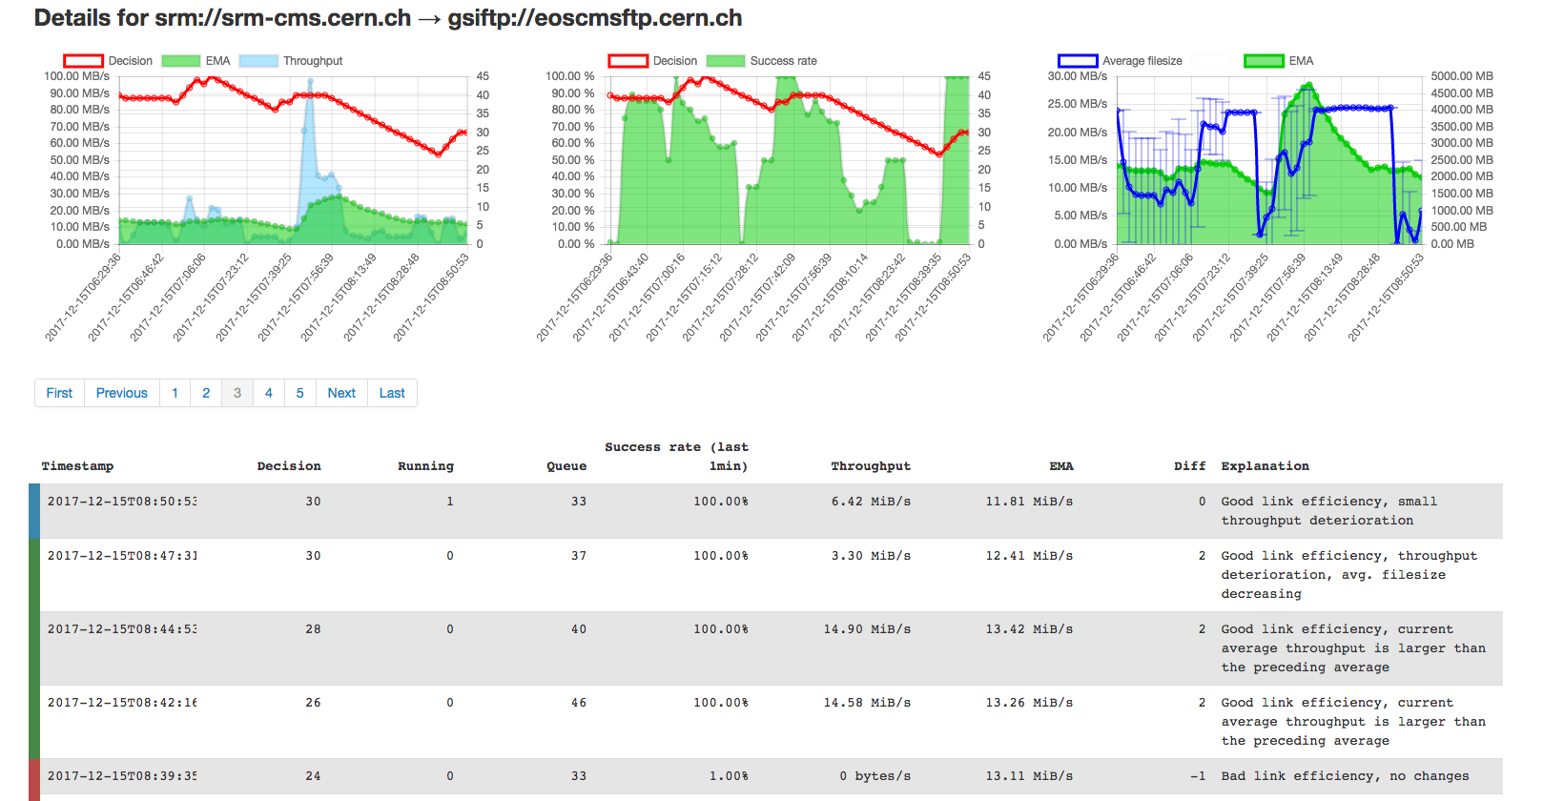
Transfer Optimizer
Number or Streams per transfer are also optimized
based on the file size and the transfer queue (if enough transfers on a link we always use 1 stream per file)

Slide 10
User Tools and APIs
RESTFul APIs
http://fts3-docs.web.cern.ch/fts3-docs/fts-rest/docs/api.html
Python “easy” bindings and CLI
http://fts3-docs.web.cern.ch/fts3-docs/fts-rest/docs/easy/index.html
http://fts3-docs.web.cern.ch/fts3-docs/fts-rest/docs/cli.html
C++ CLI
http://fts3-docs.web.cern.ch/fts3-docs/docs/cli/cli.html
Data Management frameworks integrated
Rucio, Phedex, DIRAC, Dynamo, etc.

Slide 11
Other Main Features
Tape Archives integration
FTS can request to ”bring-online” files to disk from storages supporting Tapes
Multi-hop transfers support
Transfers from A->C, but also A->B->C
Bulk File deletions
Clients can send a list of files to delete and FTS optimizes the interactions with the storages
Messaging integration
Messages produced for job/transfer state change and optimizer decisions

Slide 12
Other Main Feature: Source Replica Selection
Selection of the best source using different algorithms:
orderly(default) : no rank, try replicas in the order provided
queue or auto: rank based on the number of pending files in the queue.
throughput: rank based on the total throughput rate between a source destination pair in the last 1 hour
file-throughput: same as above but ranking for file throughput
pending-data: rank based on the total pending data in the queue between a source destination pair.
waiting-time: rank based on the waiting time for the incoming job in the queue
waiting-time-with-error: using the failure rate info, calculate the amount of data that will be resent. Rank based on the waiting time plus the time for resending failed data
duration: rank based on the waiting time with error plus the time required to transfer the file

Slide 13
FTS intro
FTS architecture & components
Multi-protocol support & gfal2
WLCG DOMA TPC
CTA integration
Web access & Monitoring
CERN Instances
DAQ use case
FTS public
On going activities
Upcoming release
XDC project
Last Mile Transfers (LMT)

Slide 14
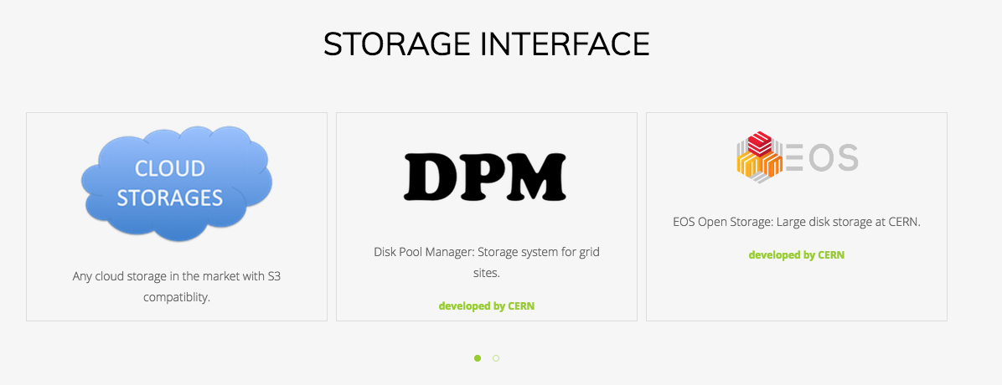
Multiprotocol support: gfal2
HTTP, GSIFTP, XROOTD, SRM, S3, GCLOUD, ..
TPC (3rdParty) copy or protocol translation (streaming)
https://dmc-docs.web.cern.ch/dmc-docs/index.html

Slide 15
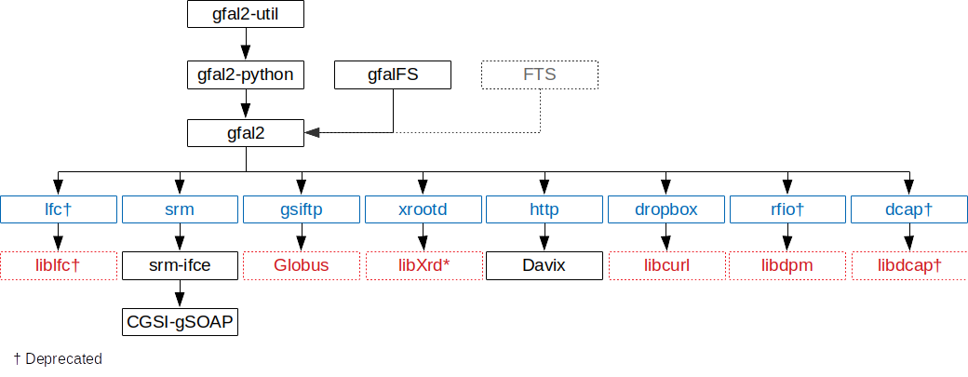
gfal2 components diagram
The WLCG data management client

Slide 16
Globus gridftp End of Support
99.9 % of FTS bulk transfers are via gridftp now!
Possible alternatives are under discussions in the context of WLCG DOMA TPC working group
XRootD or HTTP or both
Discussion with the storage providers
Gfal2/FTS have a primary role
https://twiki.cern.ch/twiki/bin/view/LCG/ThirdPartyCopy

Slide 17
CTA Integration
CTA is the new Archive solution under development at CERN to replace Castor
Extends EOS with tape
functionality
SRM free
Tape “bringonline”
exposed via XRootD
protocol ONLY
Gfal2 xrootd plugin
extended for this
No need for experiments to implement this new interface, everything is handled transparently by FTS.
https://indico.cern.ch/event/587955/contributions/2936822/

Slide 18
FTS Intro
FTS Architecture & components
Multi-protocol support & gfal2
WLCG DOMA TPC
CTA integration
Web access & Monitoring
CERN Instances
DAQ use case
FTS Public
On going activities
Upcoming release
XDC project
Last Mile Transfers

Slide 19
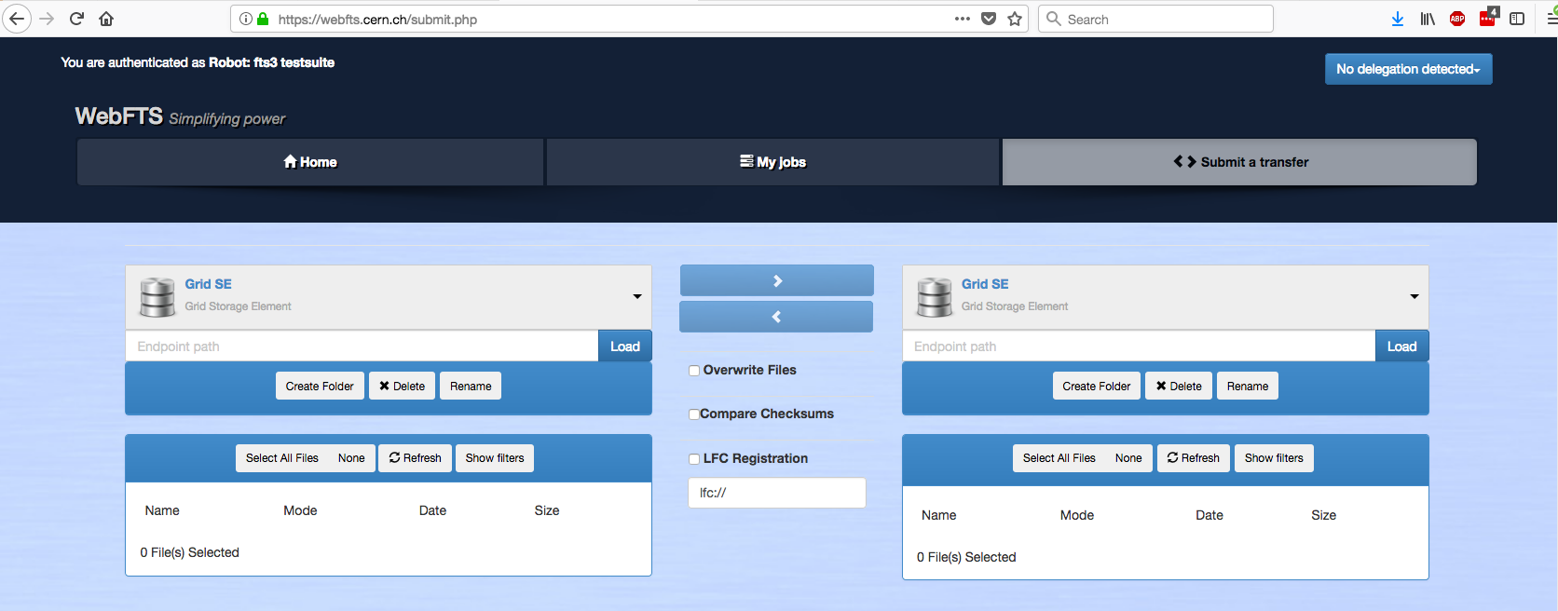
WebFTS – Transfer management from your browser

Slide 20
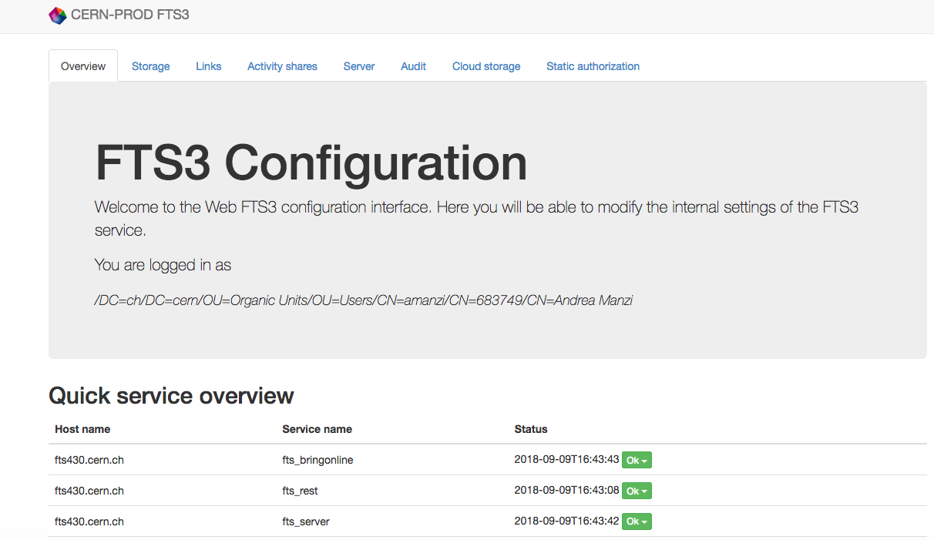
Web Admin

Slide 21
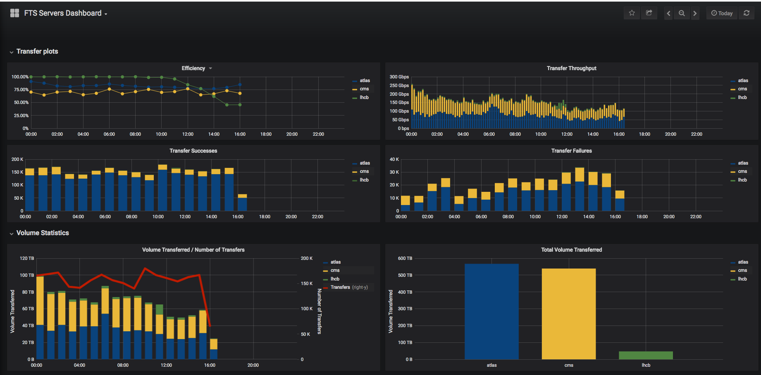
Real Time Monitoring: Grafana

Slide 22
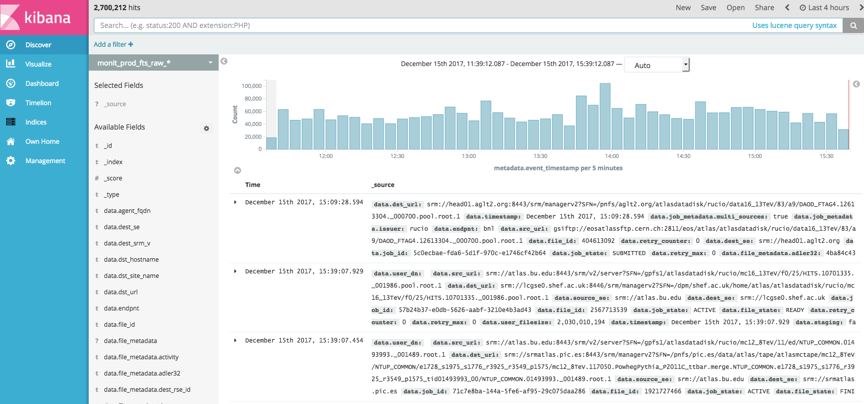
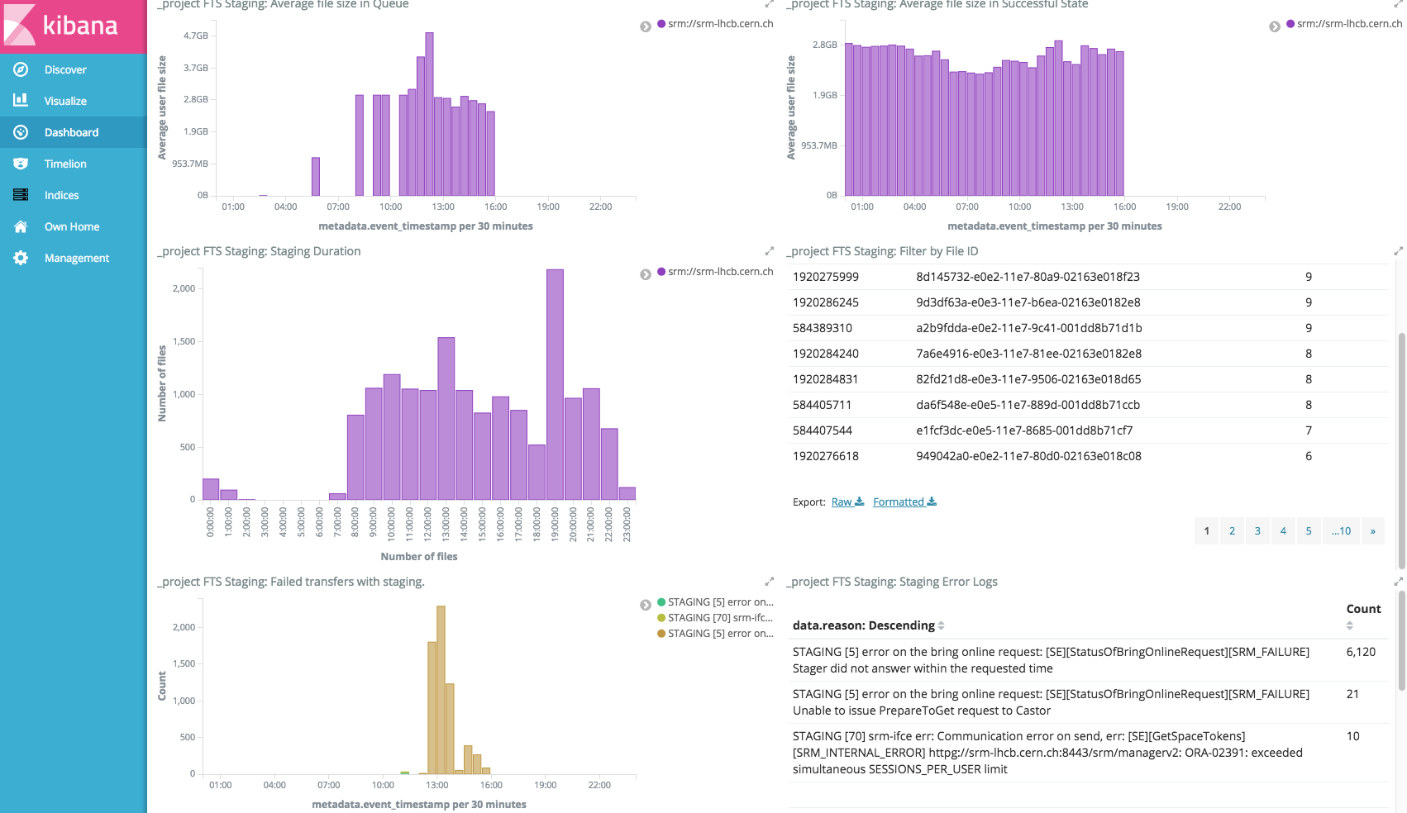
Real Time Discovery: Kibana

Slide 23
FTS intro
FTS architecture & components
Multi-protocol support & gfal2
WLCG DOMA TPC
CTA integration
Web access & Monitoring
CERN instances
DAQ use case
FTS public
On going activities
Upcoming release
XDC project
Last Mile Transfers (LMT)

Slide 24
CERN DAQ use case
In production for the NA62 experiment since mid 2017
~3PB transferred to Castor
Dedicated CERN “DAQ” FTS instance
Different SLA compared to other instances
Gridftp server or our “Ready to go” docker images to ensure TPC from DAQ nodes
FTP server
GridFTP server with host certificates auto-generated (https://letsencrypt.org)
GridFTP server with preconfigured host certificates
https://github.com/cern-fts/ready2go

Slide 25
CERN FTS Public
New Production cluster available since February
https://fts3-public.cern.ch/fts3/ftsmon
Stable environment for non–LHC VOs
ILC, AMS, Compass, NA62, Auger, Dune
WebFTS backend supporting more VOs
belle, biomed, dream, icecube, vo.access.egi.eu
Under dissemination by EGI, open to new users

Slide 26
FTS intro
FTS architecture & components
Multi-protocol support & gfal2
WLCG DOMA TPC
CTA integration
Web access & Monitoring
CERN instances
DAQ use case
FTS public
On going activities
Upcoming release
XDC project
Last Mile Transfers (LMT)

Slide 27
Upcoming Release: FTS 3.8.0
Automatic gridftp session reuse
To minimize authentication overheads when moving small files
FTS REST enables it automatically if the job average file size is less than a configured threshold
Scitokens and Macaroons support for HTTP transfers
Thanks to B. Bockelman from Uni. Nebraska
MultiHop scheduler integrated within the main scheduler service
Implement proper links reshuffling
Links starvation is still possible in some cases

Slide 28
EU Project XDC
2 years software development project started in Feb
http://www.extreme-datacloud.eu/
‘Developing scalable technologies for federating storage resources and managing data in highly distributed computing environments’
Funded FTS activities
Integration with OIDC (OpenID Connect)
CDMI protocol integration to support QoS transitions

Slide 29
OpenID Connect integration
FTS supports only X509 authentication and delegation now
Clients delegate their X509 certs in order to contact the storages
OpenID Connect integration tasks
Enable authentication via OpenID on FTS-REST
Implement Token Exchange protocol to “delegate” tokens
Native Support for Storages implementing OpenID (dCache)
Integration with Token Translation Services to get X509 out of a token, in order to still support X509 authentication

Slide 30
Storage QoS via CDMI interface
dCache and EOS (part of XDC as well) will expose a QoS interface compatible with CDMI
Possibility to change the QoS of files (e.g. replica number)
FTS (and gfal2) are being extended in order to steer the QoS
More general use case of the “bringonline” from tape
New QoS daemon
Integration with high level clients (e.g. Rucio) is also under design

Slide 31
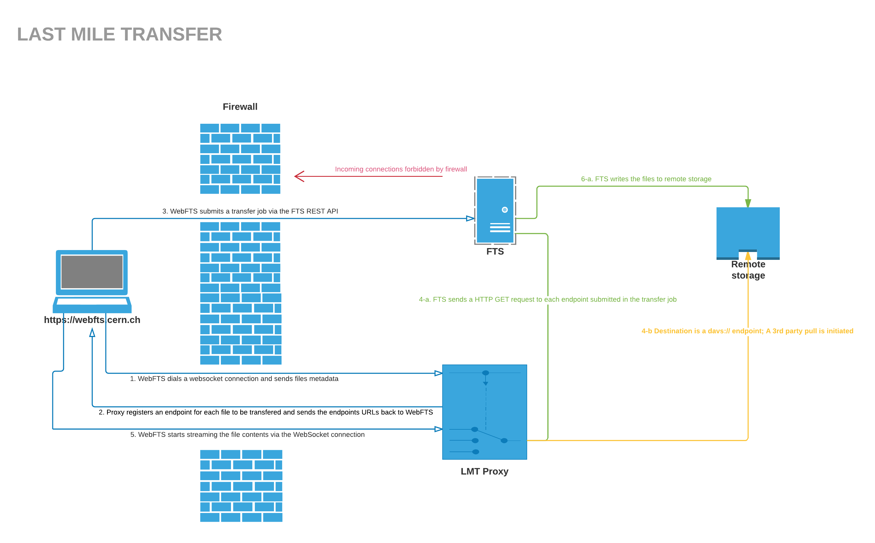
“Last Mile Transfers”
Allow transfers from your local PC/Laptop to any Storage supported by FTS
New Proxy service interfaced by WebFTS
No need to install a
local client, everything is
done in the user browser
No firewall limitations
Streaming or TPC transfers
https://indico.cern.ch/event/587955/contributions/2936900/

Slide 32
FTS Support
fts-support@cern.ch
Links
https://fts.cern.ch
http://fts3-docs.web.cern.ch/fts3-docs/
https://github.com/cern-fts
All components are available in EPEL6/7 rpms repos and as Docker images

Slide 33
Большое спасибо!

