Slide 1
Experience with ITEP-FRRC
HPC facility
GRID2018
NRC KI – ITEP
I.Korolko, V.Kolosov, M.Prokudin

Slide 2
FAIR-Russia supercomputer project
Project was suggested by GSI and ITEP scientists and
supported in 2011-2014
by ROSATOM corporation and Helmholtz association.
(85% ROSATOM + 15% Helmholtz + green cooling)
The main aim was to build 10K cores facility
Which was done in 4 years and about 130M roubles
Container, cooling system (green technology) came from GSI

Slide 3
Aims for FAIR-Russia supercomputer
Optimization of FAIR detectors (CBM, Panda and others)
Development of reconstruction algorithms for FAIR
Lattice QCD calculations (former M.Polikarpov laboratory)
CBM experiment - study of “cold” and dense barionic matter
up to 10 MHz event rate (T0 is not known – 4D reconstruction)
up to 1500 secondary particles per Au+Au central collision
No hardware trigger system – need to analyze all events

Slide 4
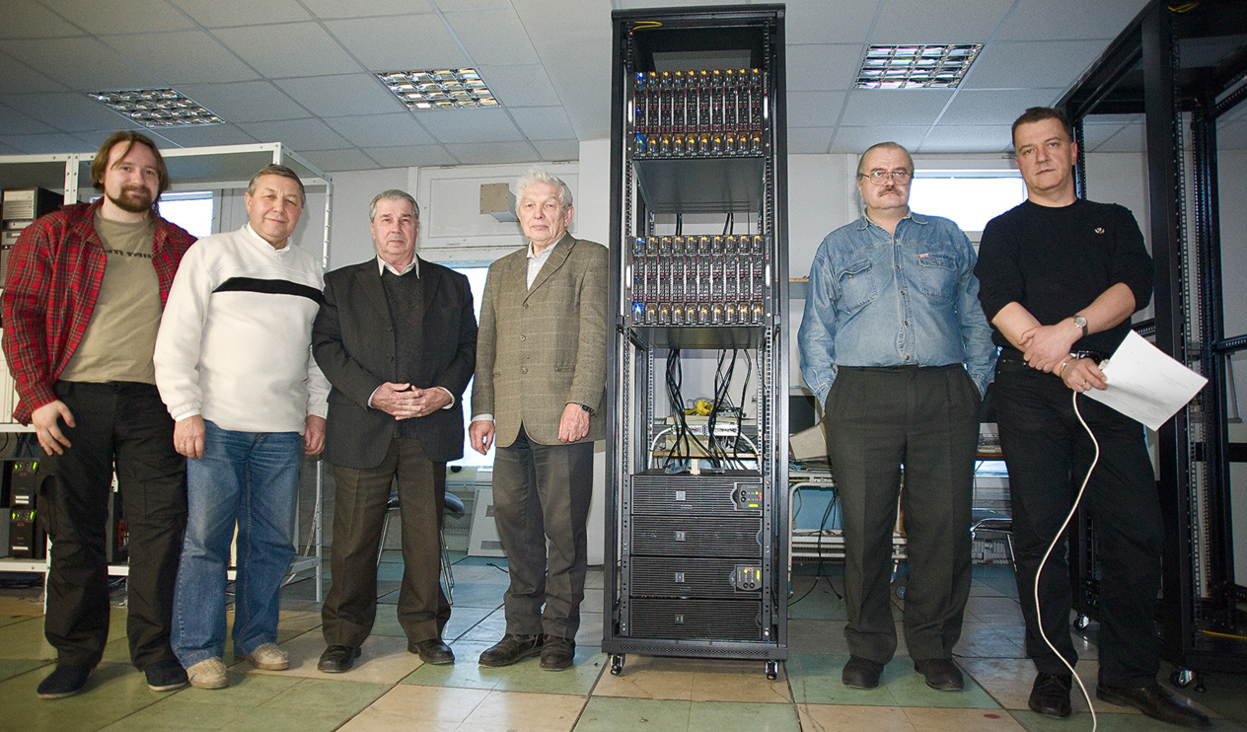
2011 – commissioning of 1st stage
1st stage was mounted in ITEP computer center in December 2011
2560 CPU cores (16 cores AMD) – intensively used by first users

Slide 5
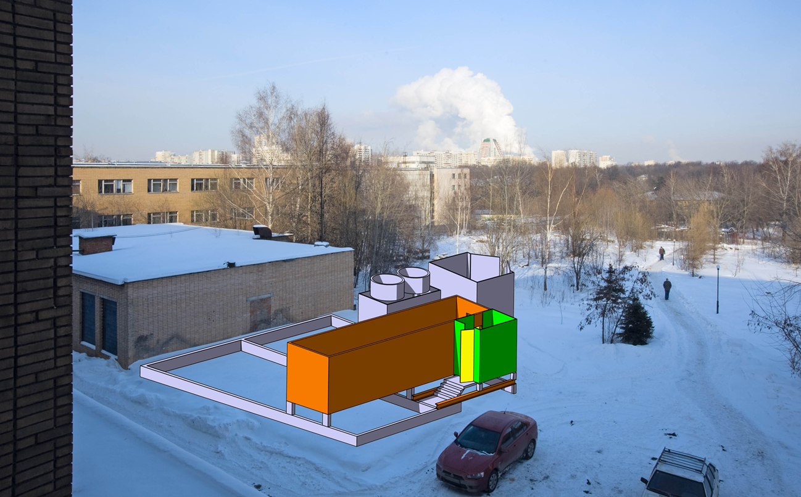
2011-2012 preparation of facility site
2011-2012 preparation of place for container and cooler

Slide 6
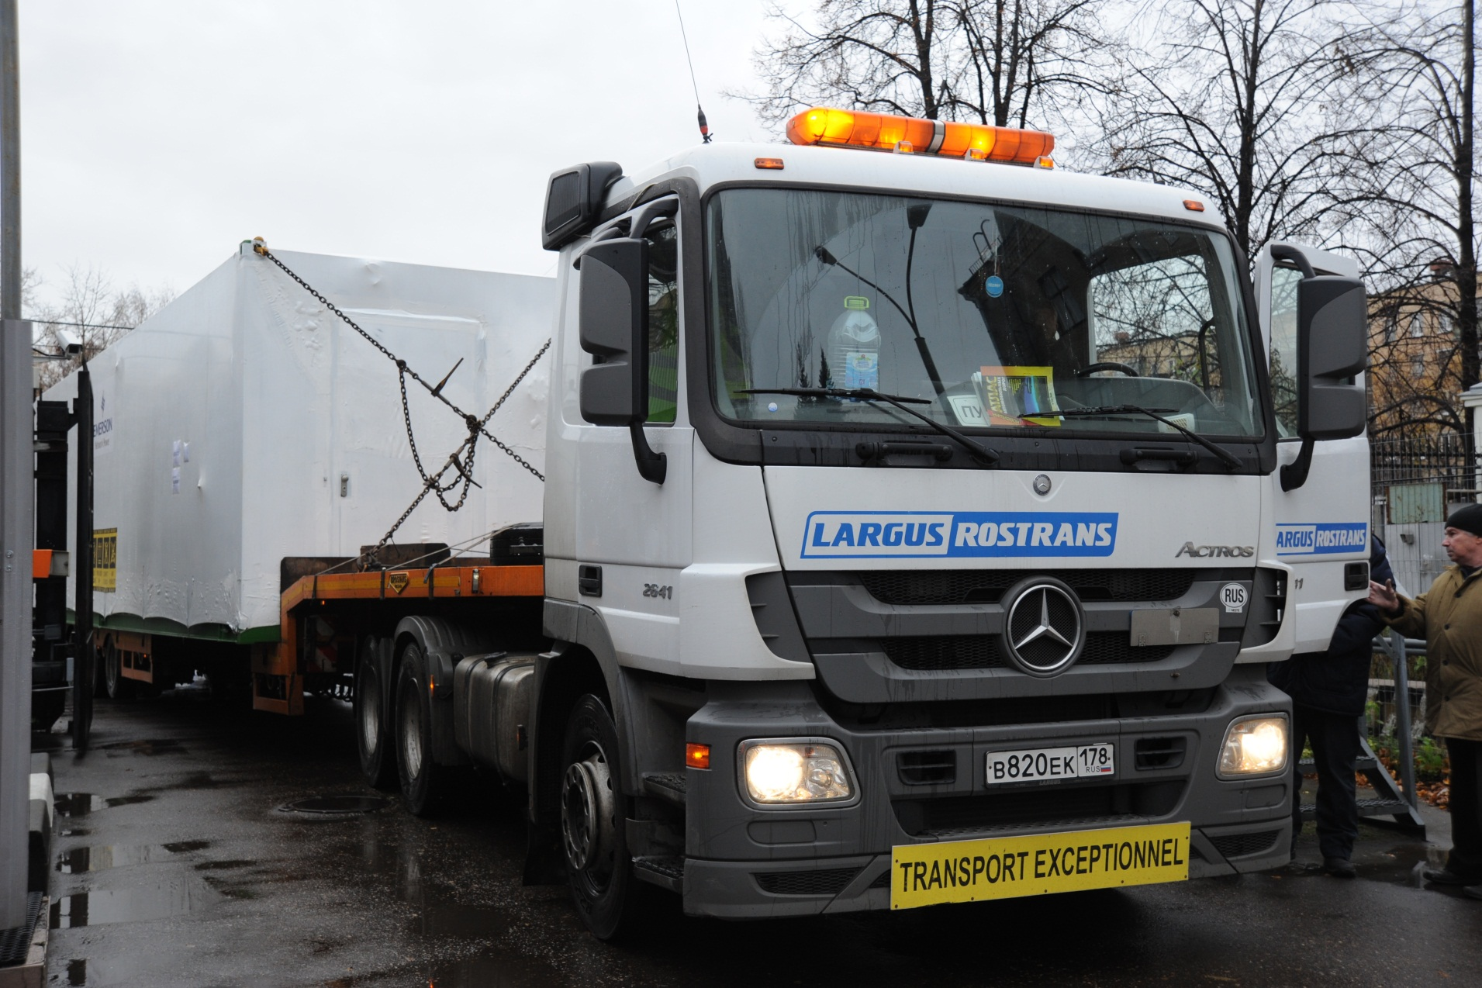
2012 – delivery of container and cooler
October 2012 – container and cooler were delivered and installed in ITEP

Slide 7
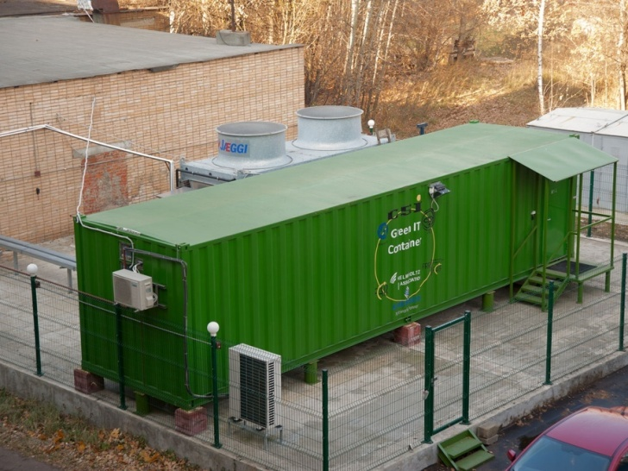
2013 – container and cooling are ready

Slide 8
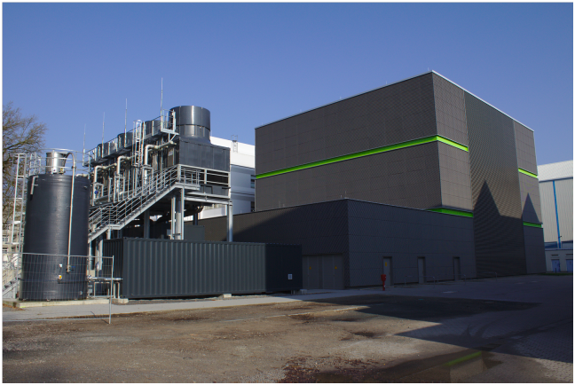
Green Cube at GSI (February 2016)
Green container in ITEP is a small brother of Green Cube at GSI

Slide 9
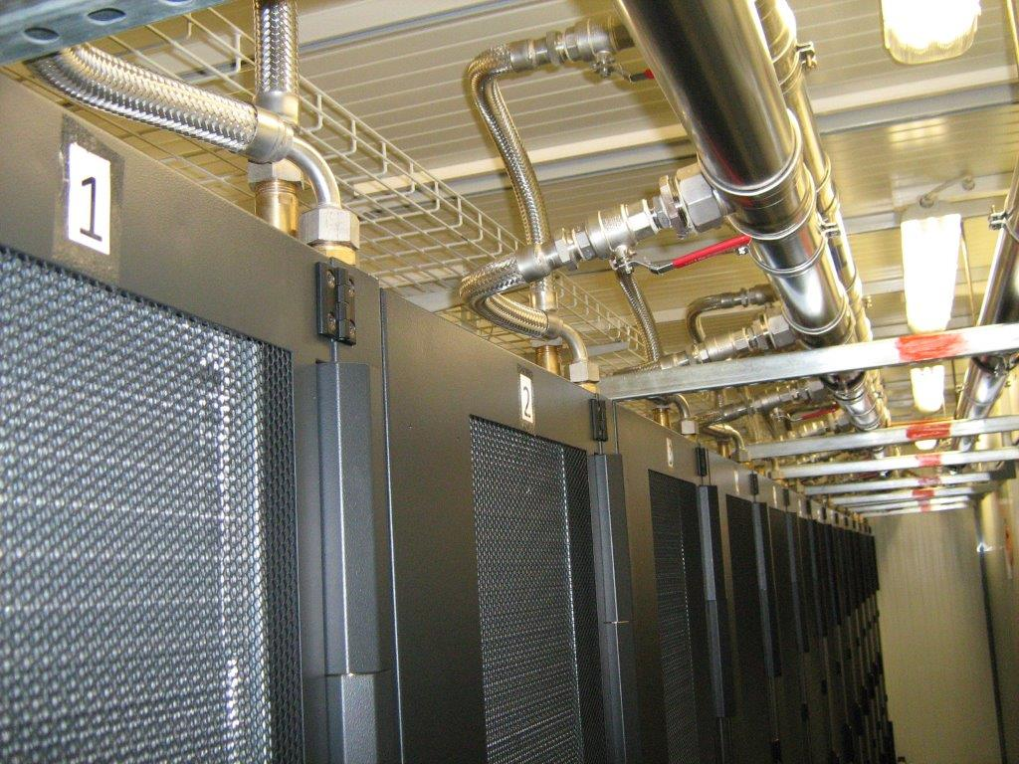
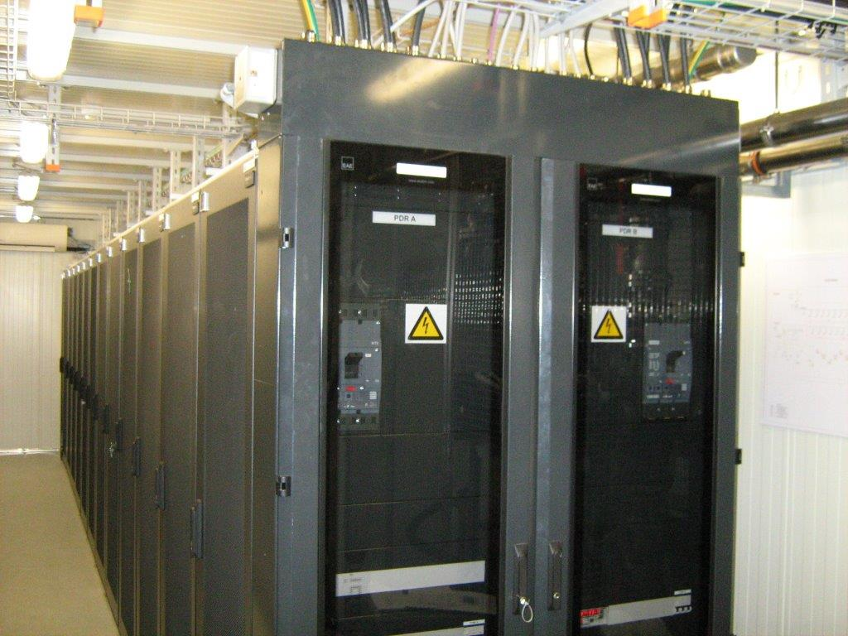
Effective (green) water cooling
Hot water is collected from passive rear doors and then is pumped to the street cooler

Slide 10
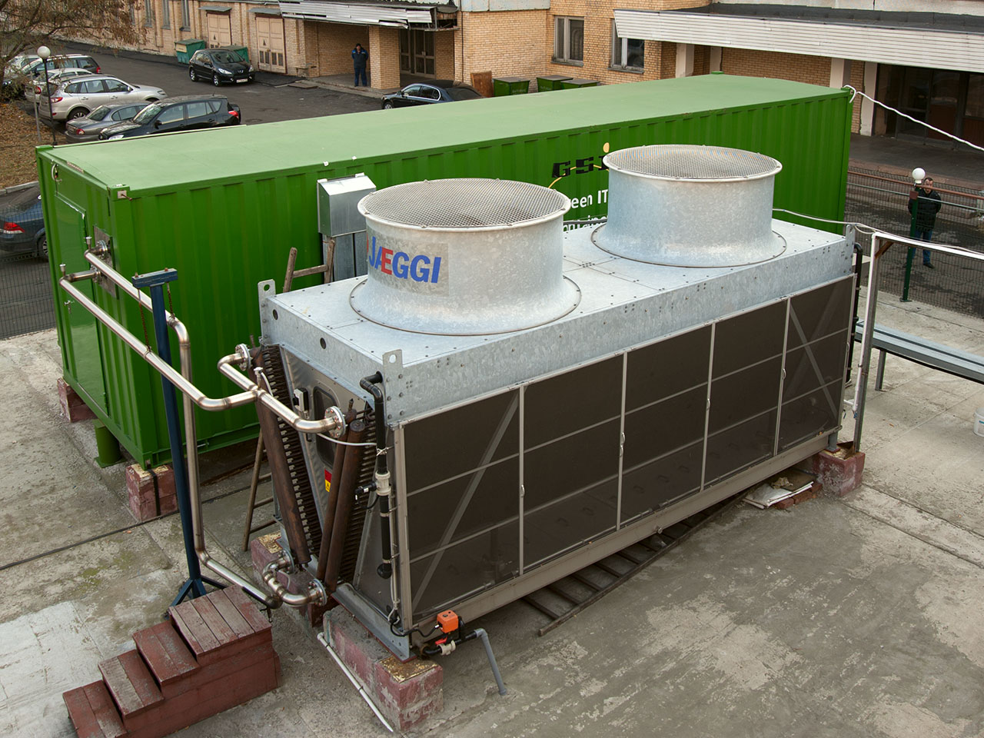
Effective (green) water cooling
JAEGGI cooler with massive copper heat exchanger which is irrigated with water
during hot summer period (need to decrease water hardness – special water station)
Poplar blossom is a headache…

Slide 11
Cooling efficiency
One year time interval: September 2017 – September 2018
Below 30 degrees (at the entrance of computer boxes), but bin size is too rough

Slide 12
Cooling efficiency
3 summer months: June 2018 – August 2018 ~10% of electricity is spent for cooling
We would add chiller for reliability and safety…. (and special roof from the direct sun)

Slide 13
Computing hardware
CPU: 16 x 20 x 2 x AMD 6272 16 cores x 2.1 GHz (10240 cores)
2 Gb RAM per core
GPU: 40 x Nvidia Kepler K20X (8 servers)
Mass storage system:
1080 Tb lustre distributed filesystem
CPU power: 58 TFlops
GPU power: 40 TFlops
Peak power consumption: 180 kW
Cooling power: 18 kW
Online: 98% (last 3 years)
3 stops, each about a week due to cooling maintenance
System load: more than 90%

Slide 14
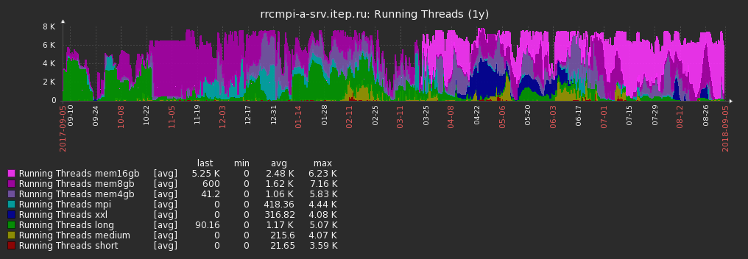
System load
One year time interval: September 2017 – September 2018
Almost all the time system is full
Users (Lattice QCD) prefer to have more memory – up to 16 GB per job
(last year we have switched off 25% of CPUs to save electricity)

Slide 15
Lessons we have learnt
1. NEVER believe in advertising hype – try to test hardware yourself (16 cores = 8 pairs)
2. Three year warranty looks OK (10 broken blades were found after 2 years already)
3. Today quality decreases while the prices go up (fans in power supplies)
try to buy 20-30% reserve power supplies and fans for them
4. In 2011 2 GB per core looked OK, today it is not enough
modern 32 core processors – do we really need them… (lattice QCD needs)
5. Special servers for data analysis (need more experience)
6. Green cooling technology is OK but for small systems we would add 2 things:
- roof from the sun (up to 10 kW additional heating)
- chiller for hottest summer time (2 months)
7. Think about possibility of future upgrade from the first days of project (we did)

Slide 16
Ready for upgrade
It is time to upgrade the hardware of ITEP facility.
About 30% of hardware could be reused (Infiniband, network equipment, racks)
We need to buy new blades and file servers only
For the same electricity we can increase:
- CPU power by a factor of 5-6
- capacity of mass storage system by a factor of 5

