Slide 1
Text segmentation on photorealistic images
Valery Grishkin, SPbSU,
valery-grishkin@yandex.ru
Alexander Ebral, SPbSU
Nicolay Stepenko, SPbSU
Jean Valery, SPBSU

Slide 2
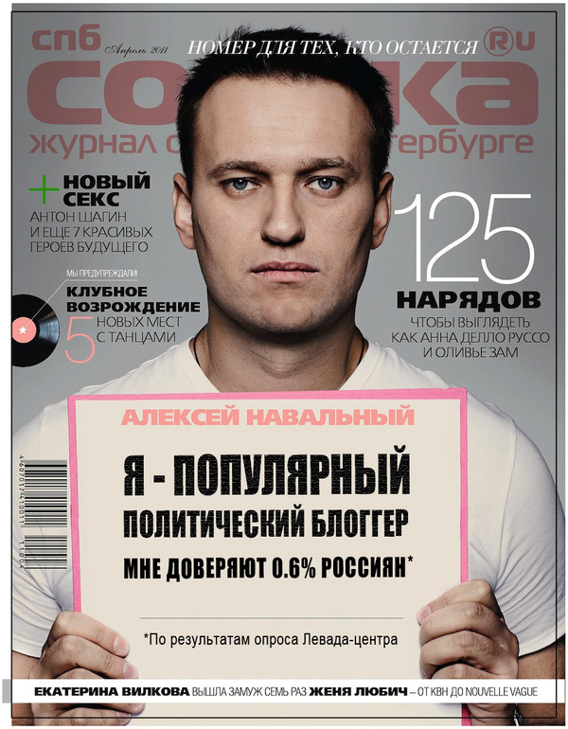
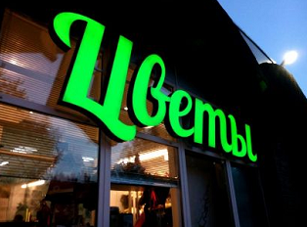
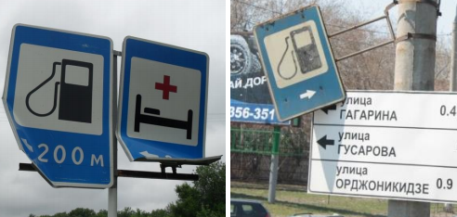
Photorealistic images with text

Slide 3
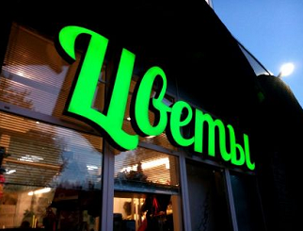
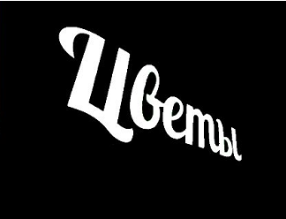
Text detection and text segmentation
Region classification
(Viola-Jones, SVM, Random Forest)
Semantic segmentation
(Convolution Neural Networks)

Slide 4
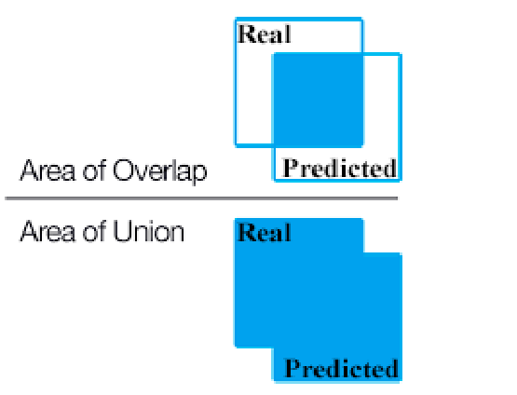
СNNs for semantic segmentatoion
Metrics MIoU- Mean Intersection of Union
$$MIoU=\frac{\sum_{m=1}^{k}{\frac{S_{overlap}^{m}}{S_{union}^{m}}}}{k}$$
$S_{overlap}^{m}=S_{pred }^{m}∩S_{real }^{m}$
$S_{union}^{m}=S_{pred }^{m}∪S_{real }^{m}$
CNN | MI0U % | Year
Fully Convolutional Networks | 67 | 2014
Dilated (Atrous) Convolutions | 75 | 2015
DeepLab v3 | 86 | 2017
Data set Pascal 2012:
4 categories - people, transport, animals, household items.
All classes - 21

Slide 5
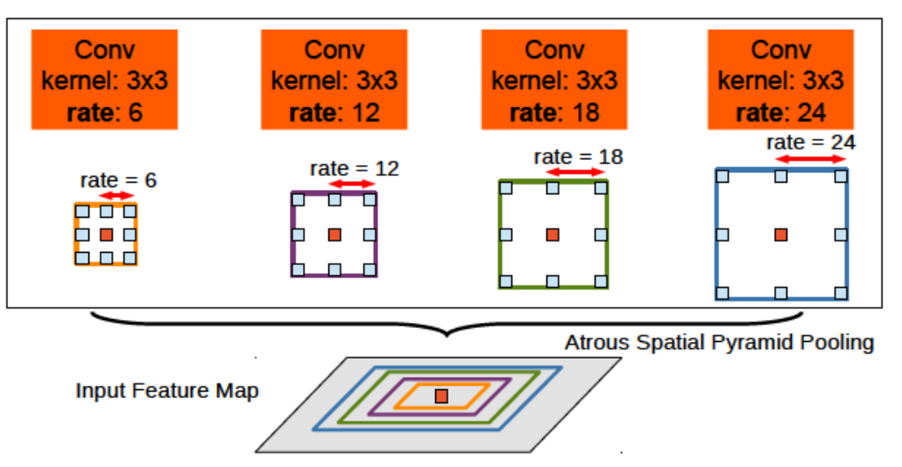
DeepLab V3
Block
ASPP

Slide 6
DeepLab modification
Classes of the Pascal 2012 data set are quite significant areas of closed areas of the image. The text symbols consist of individual thin lines or small areas.
The convolutions of the DeepLab V3 network are configured so that the resolution of the input image differs from the output sixteen times.
This approach is unacceptable for text segmentation, because the geometric structure of the symbols is simply not preserved.
Therefore, in a modified network, the resolution of the input image to the resolution the output should not be more than 4-5.
We suggest using a network containing only one block of the Resnet type. This block contains 2 layers of convolution, and the pulling reduces the dimension of the original image by 4 times.

Slide 7
DeepLab modification
Using a block of the Resnet type allows you not to lose the data that turned into 0 on convolutions. This reduces the loss of some of the fine lines that make up the text, which can affect the overall quality of segmentation.
The ASPP block contained four convolutions: one with a 1 × 1 kernel, three extended ones with a 3 × 3 kernel. For extended 3 x 3 convolutions, the following values of {2, 4, 6} are chosen as the steps between the convolution scales, in contrast to the original network, where the sequence of steps {6, 12, 18} is used.
The decrease in steps is 3 times done because that the text consists of thin lines, and the convolution with the 3 × 3 kernel and step 6 covers a 15-pixel wide line, which looks sufficient to segment the text.

Slide 8
DeepLab modification
ASPP block
rate = 2 rate = 4 rate = 6
Convolution
block

Slide 9
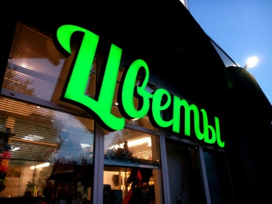
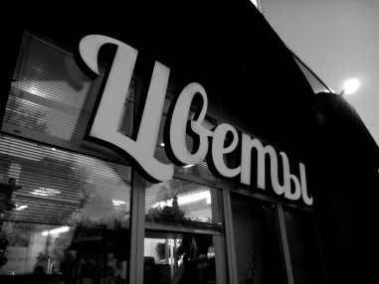
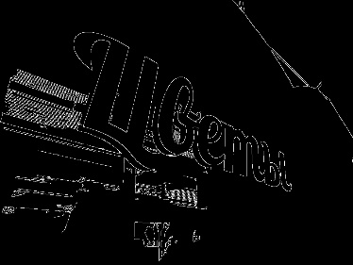
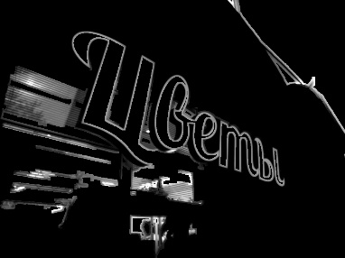
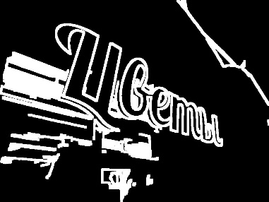
Preprocessing
Gray scale
Edge detection
X
Dilate

Slide 10
Training set generation
The text contained in the image can have any:
Background (5000 imfges); Size;
Font (30 True Type Fonts);
Angle (-30 – 30);
Color;
Position in the images
The text is generated from the symbols of the Russian alphabet (low case), using the dictionary of nouns. It also includes numbers and punctuation marks. The alphabet size is 49 characters. The text color is chosen different from the background in brightness.
Symbols are printed on a transparent image (alpha = 0). The mask for learning is also created - another image is formed, where instead of the pixel brightness value, the class of each pixel is recorded.

Slide 11
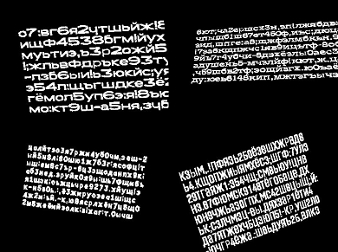
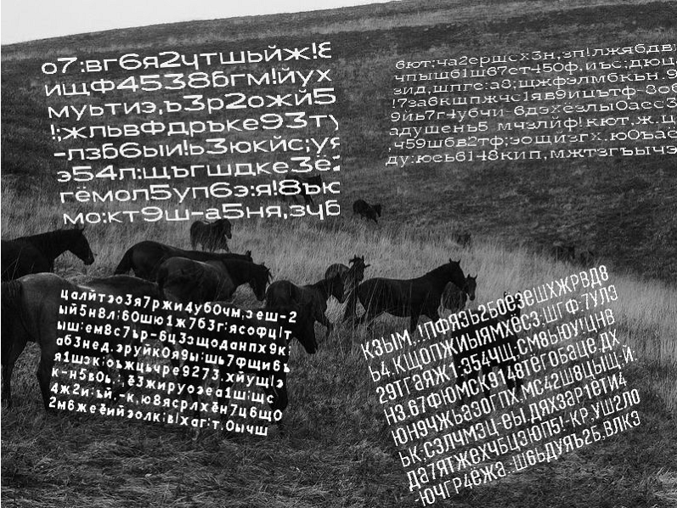
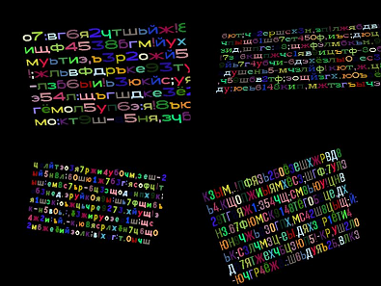
Training set generation
Binary mask
Generated image
Multi-class mask

Slide 12
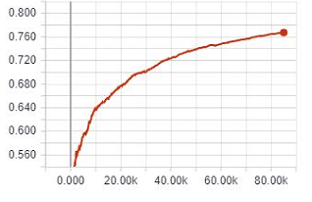
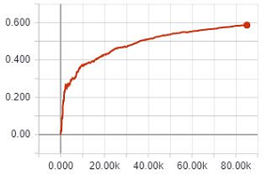
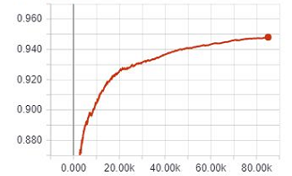
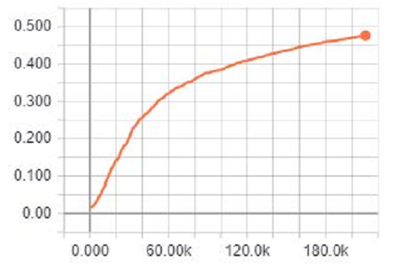
Results
Binary segmentation
$MIoU_{max}=76,7\%, MIoU_{text}=58,6\%$, $MIoU_{back}=94,8\%$
Multi-class segmentation
$$MIoU_{max}=47,6\%$$
Training set – 4000 images
Verification set -1000 images

Slide 13
DeepLab modification
Binary segmentation
Real mask
Predicted mask
Multi-class segmentation

Slide 14
Thank you for your attention
https://github.com/AlexEbral/text-seg

