Slide 1
Baryon-Anti-Baryon Asymmetry, Dark Matter and Color Confinement, A possible Common Denominator
David E. Álvarez Castillo
Joint Institute for Nuclear Research
Mariana Kirchbach
Autonomous University of San Luis Potosí
Helmholtz International Summer School on
“Matter under Extreme Conditions”
August 28, 2018

Slide 2
Outline
Charges in closed spaces
Cot potential as color dipole
Dynamical conformal symmetry and color confinement
Dirac equation with cot potential
Form factors and proton charge
Outlook and perspectives

Slide 3
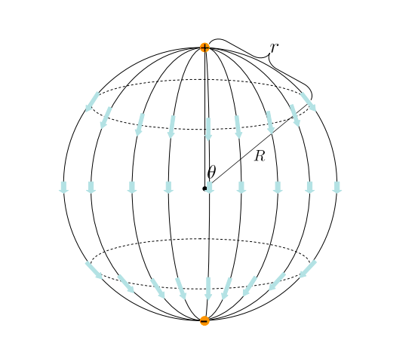
Closed spaces can host exclusively charge-anticharge dipoles

Slide 4
Three dimensional spherical space
L. D. Landau, E. M. Lifshitz, H. G. Schopf and P. Ziesche, “Textbook On Theoretical Physics. Vol. 2: Classical Field Theory
Pouria Pedram, Modification of Coulomb's law in closed spaces. Am. J. Phys. 78 (2010) 403

Slide 5
Confinement in terms of potentials
Trigonometric Scarf Potential
Cornell Potential
Super-symmetric Quantum Mechanics Potentials

Slide 6
Confinement in terms of potentials
l(l+1)/r² → l(l+1)csc²(r/R)/r²
With the following substitution
Quantum motion in the 3D hypersphere S³

Slide 7
Free Dirac equation on S³
Quasi-radial spinors

Slide 8
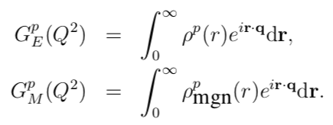
Proton electric charge and magnetic-dipole form factors

Slide 9
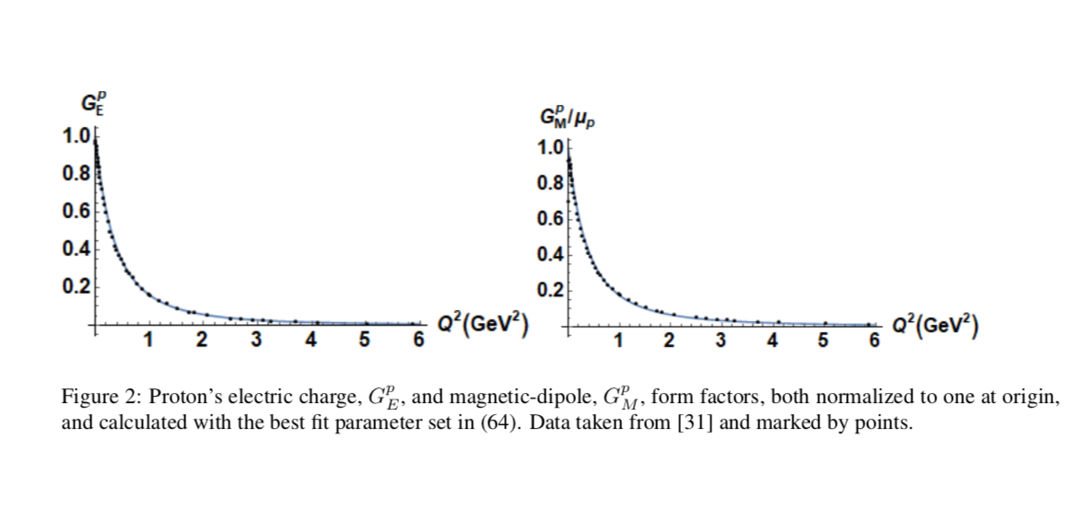
Proton electric charge and magnetic-dipole form factors

Slide 10
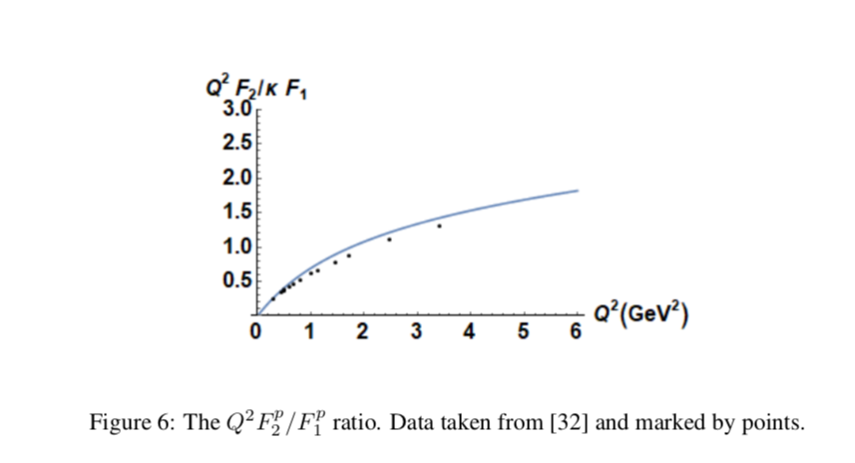
Proton electric charge and magnetic-dipole form factors

Slide 11
Deconfinement
Closed space configurations completely neutral could remain inert in electromagnetic fields and acquire features of dark matter.
In considering the closed space as the hyperspherical geodesic of an open dS4 geometry in the spirit of de Sitter Special we here propose to interpret the deconfinement phenomenon as transitions from the closed to open dS4 geodesics.
The curvature of the space, negative vs positive the metric tensor that corresponds to either open or closed spaces goes with either absence of charge symmetry as is the case of the matter-antimatter asymmetry, or, with the complete color - anticolor balancing out defining the QCD confinement
Possible common denominator between Baryon-Anti-Baryon Asymmetry, Dark Matter and Color Confinement

Slide 12
References
L. D. Landau, E. M. Lifshitz, H. G. Schopf and P. Ziesche, “Textbook On Theoretical Physics. Vol. 2: Classical Field Theory
Pouria Pedram, Modification of Coulomb's law in closed spaces. Am. J. Phys. 78 (2010) 403
V. Balasubramanian, M. Berkooz, A. Naqvi and M. J. Strassler, JHEP 0204, 034 (2002)
M. Kirchbach and C. B. Compean, Eur. Phys. J. A 52, no. 7, 210 (2016) Addendum: [Eur. Phys. J. A 53, no. 4, 65 (2017)]
A. P. Raposo, H. J. Weber, D. E. Alvarez-Castillo and M. Kirchbach, Central Eur. J. Phys. 5, no. 3, 253 (2007)
R. Aldrovandi, J. P. Beltran Almeida and J. G. Pereira, Class. Quant. Grav. 24, 1385 (2007)
Gracias

