Slide 1
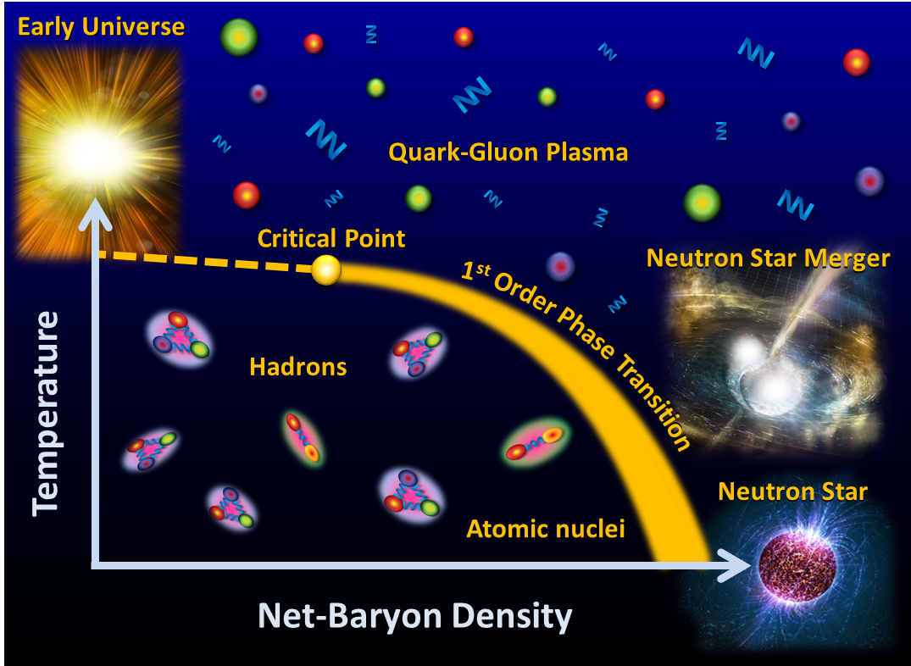





Cosmic Matter in the Laboratory –
Experiments at FAIR and NICA
Peter Senger
Helmholtz - DIAS International Summer School
“Matter under Extreme Conditions in Heavy-Ion Collisions and Astrophysics”,
August 20 -31, 2018, Dubna
1

Slide 2
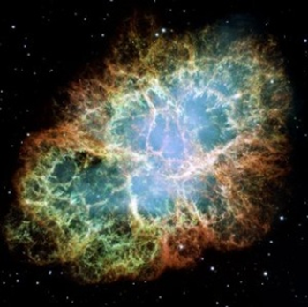
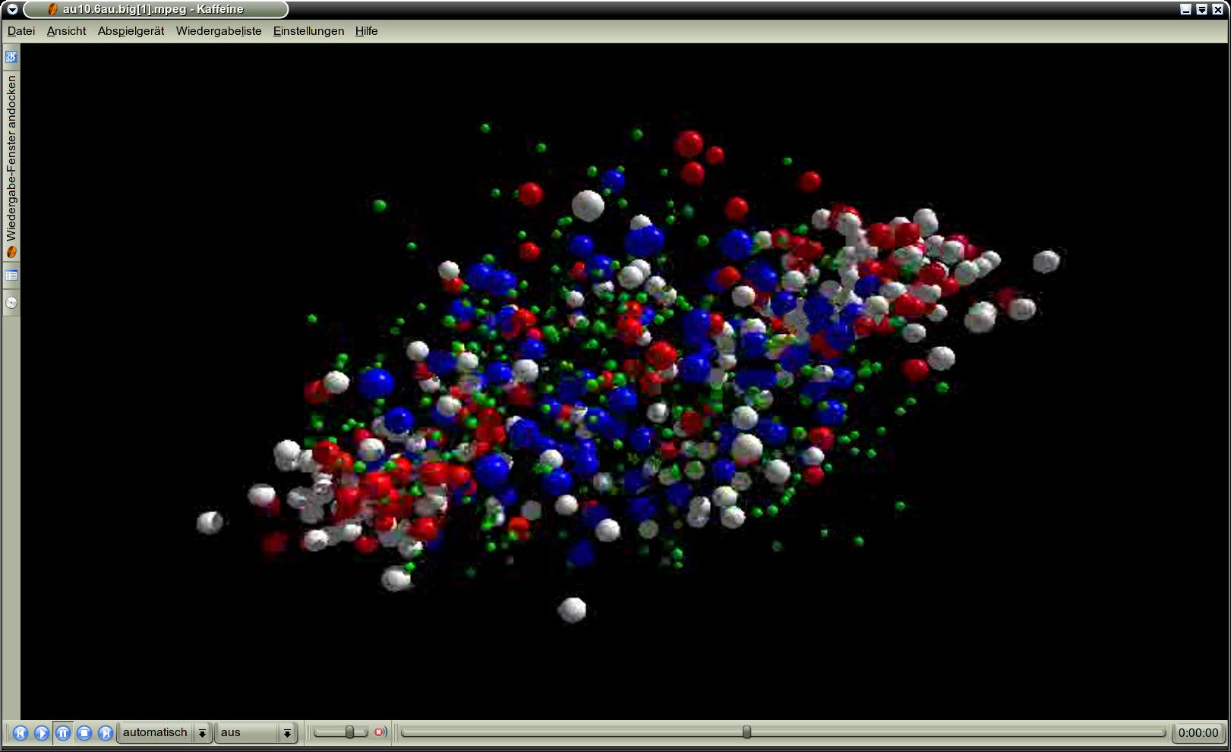
neutron
matter
Outline:
➢ Evolution of matter in the universe
➢ Exploring dense nuclear matter in the lab
- Phase transitions
- Chiral symmetry restoration
- Nuclear matter equation of state
Upcoming facilities
- Experimental considerations and challenges
- FAIR and NICA

Slide 3
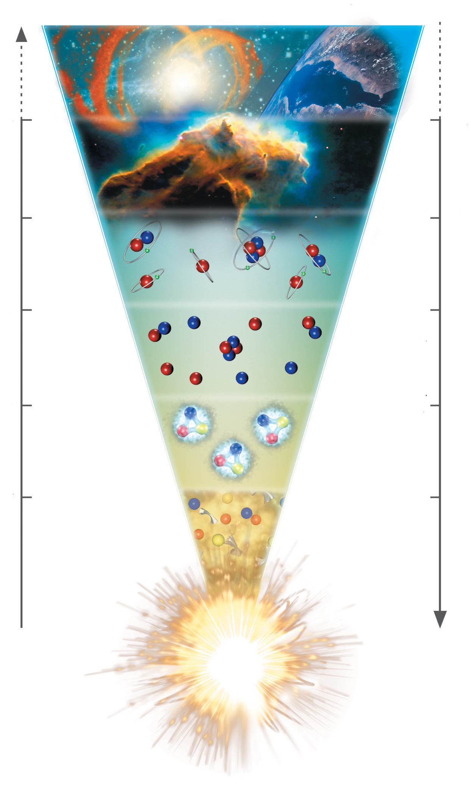
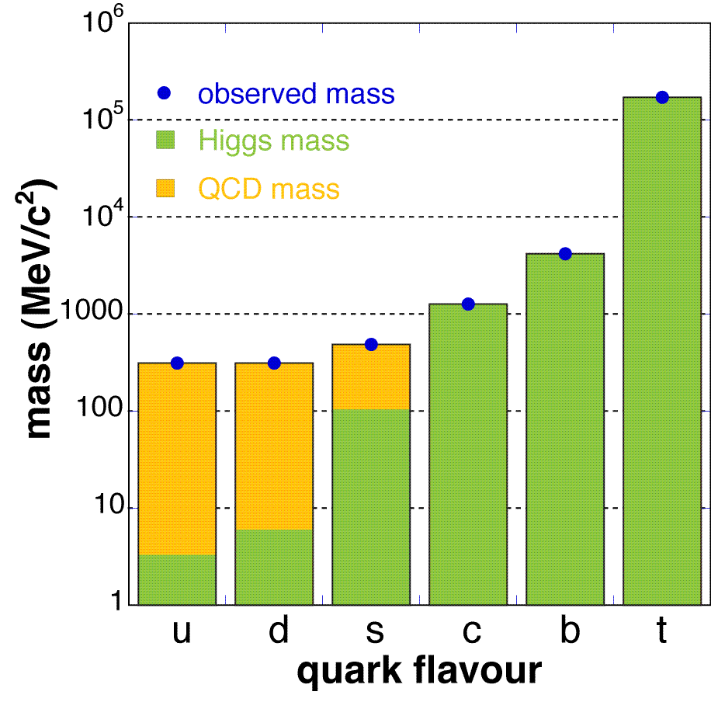
The evolution of matter in the universe
15 billion years
3 K
1 billion years
20 K
time
300.000 years
3000 K
temperature
3 minutes
10⁹ K
1 millisecond
10¹² K
1 microsecond
Generation of quark
masses: Explicit breaking
of Chiral Symmetry
(Higgs mechanism)
m_{u} ≈ 2 MeV,
m_{d} ≈ 5 MeV,
m_{s} ≈ 150 MeV
-13.8 Billion years
distance

Slide 4
The evolution of matter in the universe
15 billion years
3 K
1 billion years
20 K
time
300.000 years
3000 K
temperature
3 minutes
10⁹ K
1 millisecond
10¹² K
1 microsecond
The soup of the
first microsecond:
quarks, antiquarks,
electrons, positrons,
gluons, photons
-13.8 Billion years
distance

Slide 5
The evolution of matter in the universe
15 billion years
3 K
1 billion years
20 K
time
300.000 years
3000 K
temperature
3 minutes
10⁹ K
1 millisecond
10¹² K
1 microsecond
Hadron formation: Spontaneous/dynamical
Chiral Symmetry breaking:
Hadrons acquire mass by
coupling to the virtual
quark-antiquark pairs
of the chiral condensate
-13.8 Billion years
distance

Slide 6
The evolution of matter in the universe
15 billion years
3 K
1 billion years
20 K
time
300.000 years
3000 K
temperature
3 minutes
10⁹ K
1 millisecond
10¹² K
1 microsecond
Annihilation of particles
and antiparticles, only
10⁻⁹ of particles survived
-13.8 Billion years
distance

Slide 7
The evolution of matter in the universe
15 billion years
3 K
1 billion years
20 K
time
300.000 years
3000 K
temperature
3 minutes
10⁹ K
Formation of light nuclei (d, He)
1 millisecond
10¹² K
1 microsecond
-13.8 Billion years
distance

Slide 8
The evolution of matter in the universe
15 billion years
3 K
1 billion years
20 K
time
300.000 years
3000 K
Formation of
light atoms
temperature
3 minutes
10⁹ K
1 millisecond
10¹² K
1 microsecond
-13.8 Billion years
distance

Slide 9
The evolution of matter in the universe
15 billion years
3 K
Evolution of stars
1 billion years
20 K
time
300.000 years
3000 K
temperature
3 minutes
10⁹ K
1 millisecond
10¹² K
1 microsecond
-13.8 Billion years
distance

Slide 10
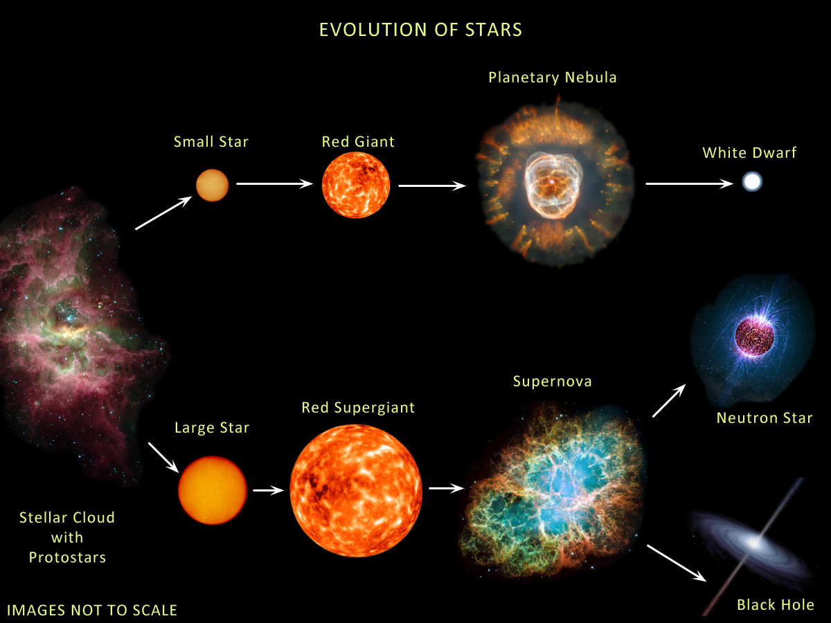
The evolution of stars
M < ≈ 8M → white dwarf
8M< M < 15M → neutron star: 1.4M< M_{core}< 2M
M >≈15M → black hole: M_{core} >≈ 2M
Courtesy of Anna Watts

Slide 11
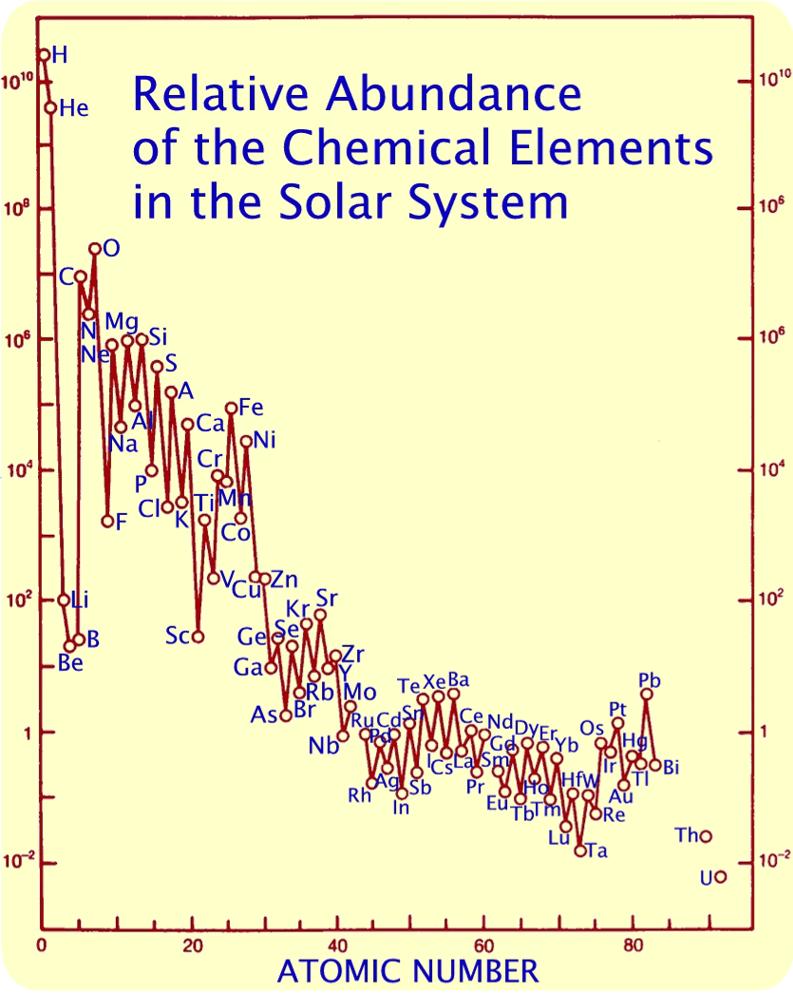
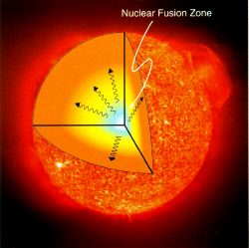

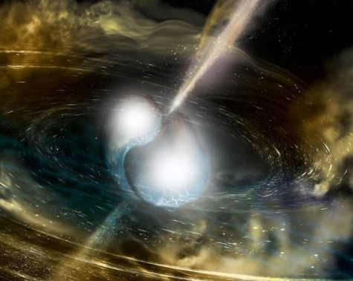
The Origin of Elements
Neutron capture
in Red Giants
(s-process) or in
supernovae or neutron star mergers (r-process)
Nukleosynthesis
after the Big Bang
Krebs Nebel
Nuclear fusion in stars

Slide 12
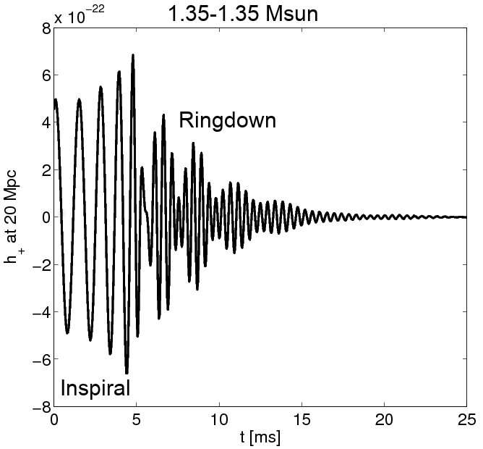
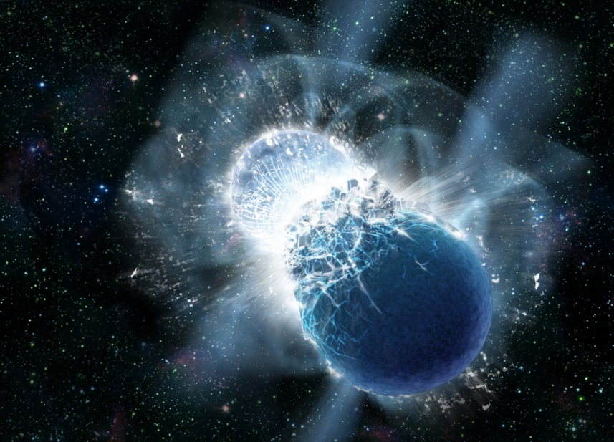
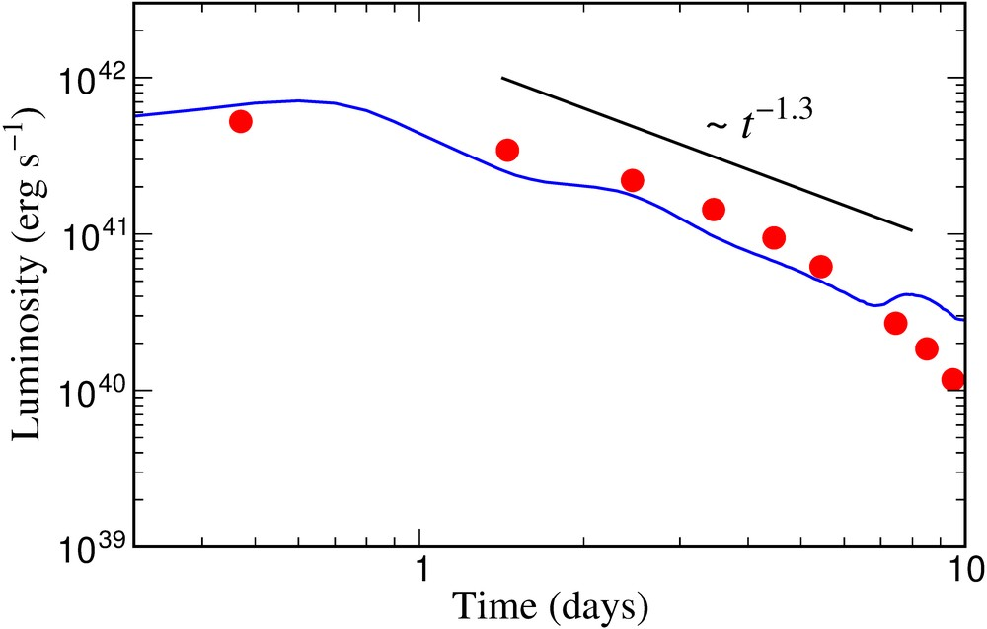
Astrophysical site of heavy element production
(r process) in the universe: Neutron star merger !
A. Bauswein
Neutron star merger
Metzer, Martinez-Pinedo, Arcones et al. (2010)
Astrophys. J. 848, L17 (2017)
Gravitational
Wave Signal
Electromagnetic “Kilonova” Signal
Copyright: Dana Berry, SkyWorks Digital, Inc
Electromagnetic “Kilonova” signal due to “r process” in neutron star merger theoretically predicted by GSI scientists in 2010.
Confirmation by recent astronomical observations after gravitational wave detection from GW170817 (August 2017).
Source of heavy elements including gold, platinum and uranium.
Sun

Slide 13
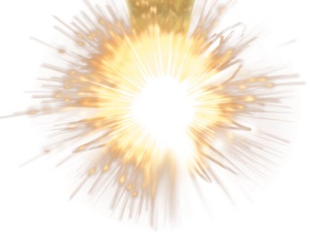
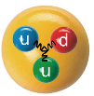




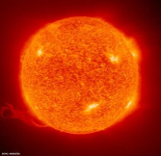
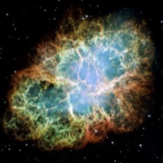
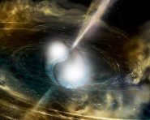
Genesis from the
physics perspective
Big Bang
Energy → Matter + Antimatter
u d e⁻
(elementary building blocks of atoms)
Strong force, origin of hadron mass
H, He-nuclei
Fusion and s-process in massive stars
⁴He, ............ ²⁰⁹Bi (∼50% of elements)
Supernova explosions
Neutron stars
Neutron star collisions
⁴He, ....... ²⁰⁹Bi (∼50%), ....²³⁶U...²⁶⁰Md (100%)

Slide 14
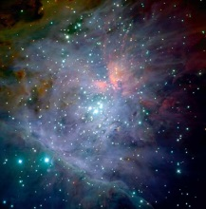
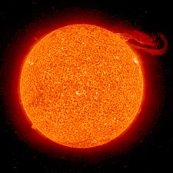
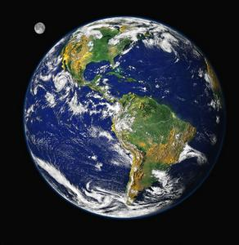


Genesis from the
physics perspective
Big Bang
Energy → Matter + Antimatter
u d e⁻
(elementary building blocks of atoms
Protostellar
clouds
Strong force, origin of hadron mass
H, He-nuclei
Fusion and s-process in massive stars
Sun
⁴He, ............ ²⁰⁹Bi (∼50% of elements)
Sun system
Supernova explosions
Earth
Neutron stars
Chemistry
Biology
Neutron star collisions
⁴He, ....... ²⁰⁹Bi (∼50%), ....²³⁶U...²⁶⁰Md (100%)

Slide 15
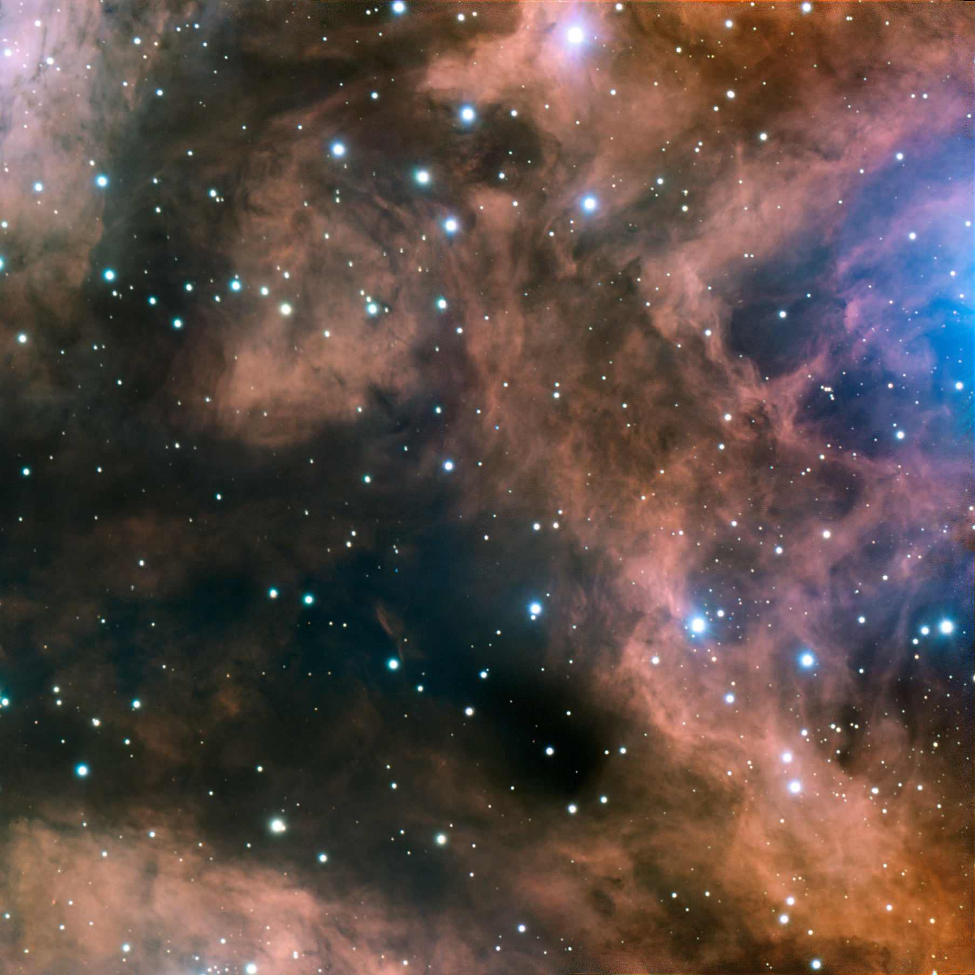
Fundamental questions
What is the origin of the mass of the universe?
What is the origin of the elements ?
Why do we not observe individual quarks ?
Does matter differ from antimatter ?
What is the structure of neutron stars?
How dangerous is cosmic radiation in space ?
→ to be explored at the future international
Facility for Antiproton and Ion Research (FAIR)

Slide 16

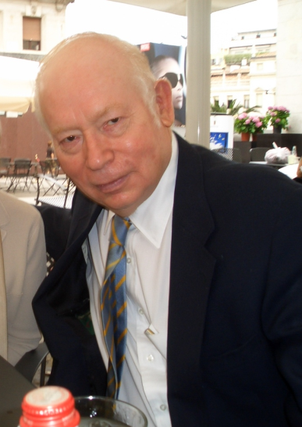
Frank Wilczek (Nobel Prize 2004):
„But perhaps the most interesting and surprising thing about QCD at high density is that, by thinking about it, one discovers a fruitful new perspective on the traditional problem of confinement and chiral-symmetry breaking”.
Steven Weinberg (Nobel Prize 1979):
„Go for the messes – thats were the action is“
(One of his four golden rules for scientists)

Slide 17
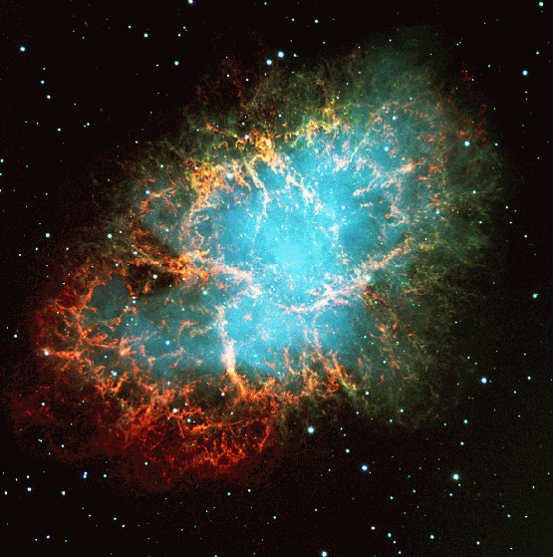
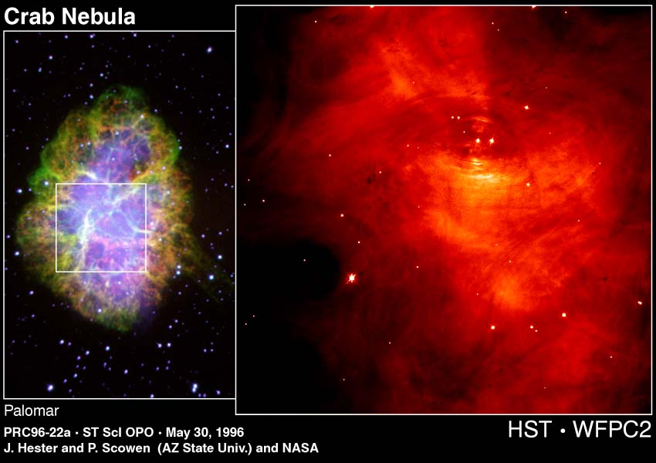
Nuclear matter at high densities
Discovery of the first pulsar in 1968
Crab nebula:
ashes of a core collapse supernova observed in 1054 by Chinese astronomers.
The “visiting star” was as bright as the Venus for more than 20 days.

Slide 18
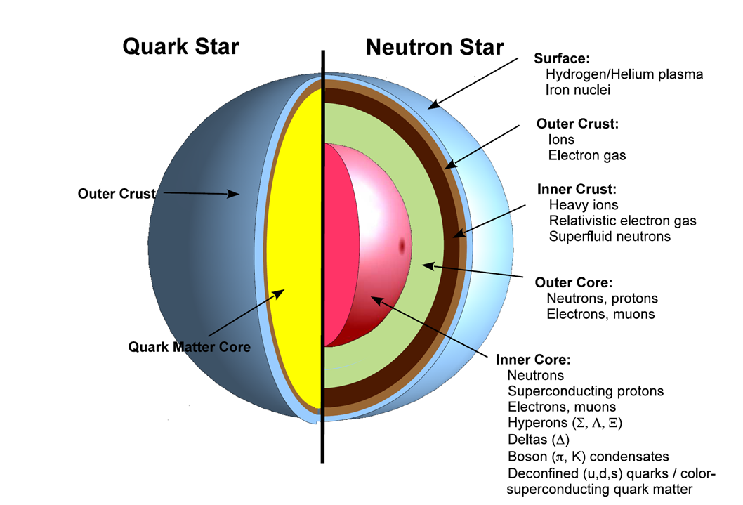
?

Slide 19
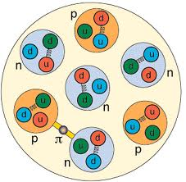
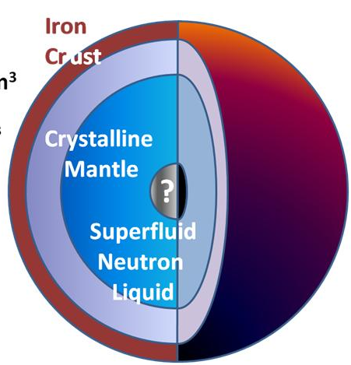
Density estimates
Atomic nucleus:
Radius R = 1.2 fm A^{1/3} (σ_{reac} = π R²)
Volume V = 4/3 π R³ = 4/3 π 1.2³ A fm³
Nucleon density ρ₀ = A/V = 3/ (4 π 1.2³) fm⁻³ ≈ 0.14 fm⁻³
Mass of nucleon m = 1.67 ⋅ 10⁻²⁴ g
Mass density of cold nuclear matter ρ₀ ⋅ m ≈ 270 Mio t/cm³
Limits of nucleon density:
Au-nucleus: R ≈ 7 fm, V ≈ 1400 fm³
Nucleon: R ≈ 0.8 fm, V ≈ 2 fm³
200 Nucleons: V ≈ 400 fm³
At 3 – 4 ρ⁰: nucleons overlap, Fermi see of quarks?
Neutron star:
Radius R ≈ 10 km,
Volume V ≈ 4200 km³
Mass M ≈ 2 solar masses = 2 ⋅ 2 ⋅ 10³³ g
Average mass density ρ = M/V ≈ 1000 Mio t/cm³ ≈ 3.6 ρ⁰ ⋅ m
Core density 5 – 10 times nuclear density

Slide 20


Baryon densities in central Au+Au collisions
I.C. Arsene et al., Phys. Rev. C 75, 24902 (2007)
5 A GeV
10 A GeV
8 ρ₀
5 ρ₀
∼ 2 ρ₀
∼ 5 ρ₀
20
courtesy Toru Kojo (CCNU)

Slide 21
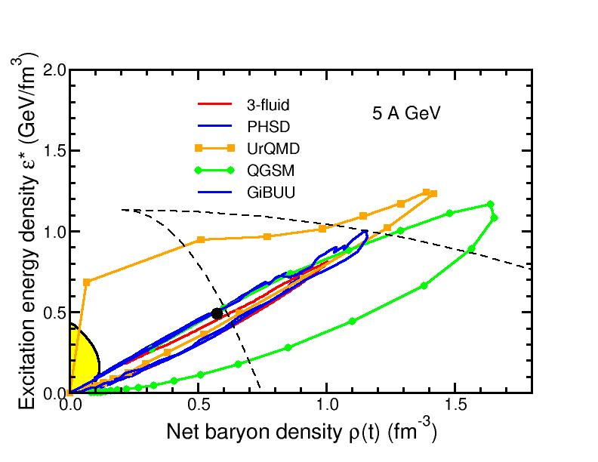
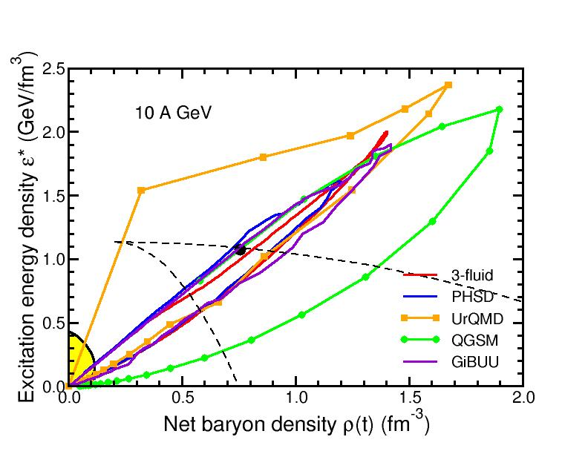
Baryon densities in central Au+Au collisions
I.C. Arsene et al., Phys. Rev. C 75, 24902 (2007)
5 A GeV
10 A GeV
8 ρ₀
5 ρ₀
phase
coexistence
phase
coexistence

Slide 22
Exploring the QCD phase diagram

Slide 23
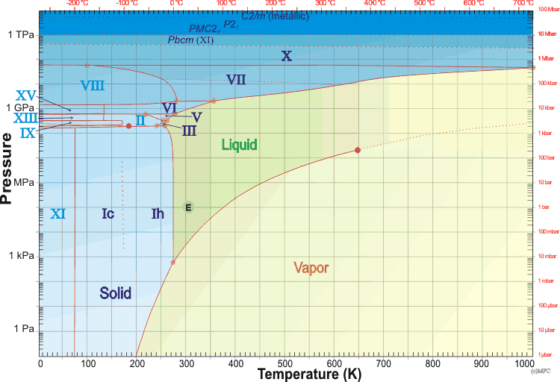
The phase diagram of water
critical point
10⁵ Pa
triple point

Slide 24
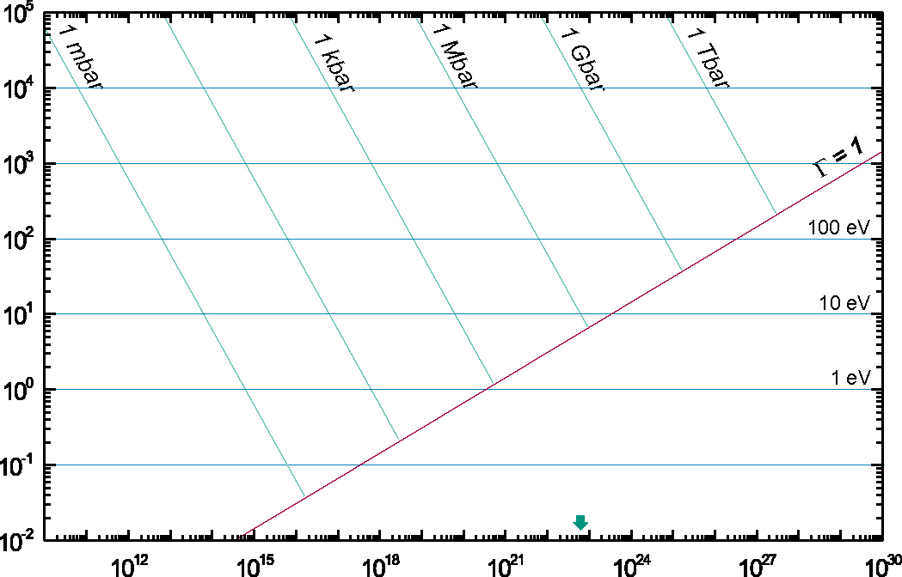
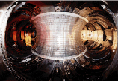
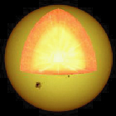
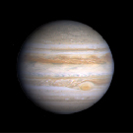
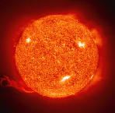
Phase diagram of electro-magnetic plasmas
10⁵ Pa
10¹¹ Pa
Temperature [eV]
Magnetic Fusion
Inertial
Cofinement
Fusion
10⁸ K
Sun Core
Ideal plasmas
Strongly coupled
plasmas
10⁵ K
Jupiter
Sun Surface
solid state
density
Density [N_{atoms}/cm³]

Slide 25
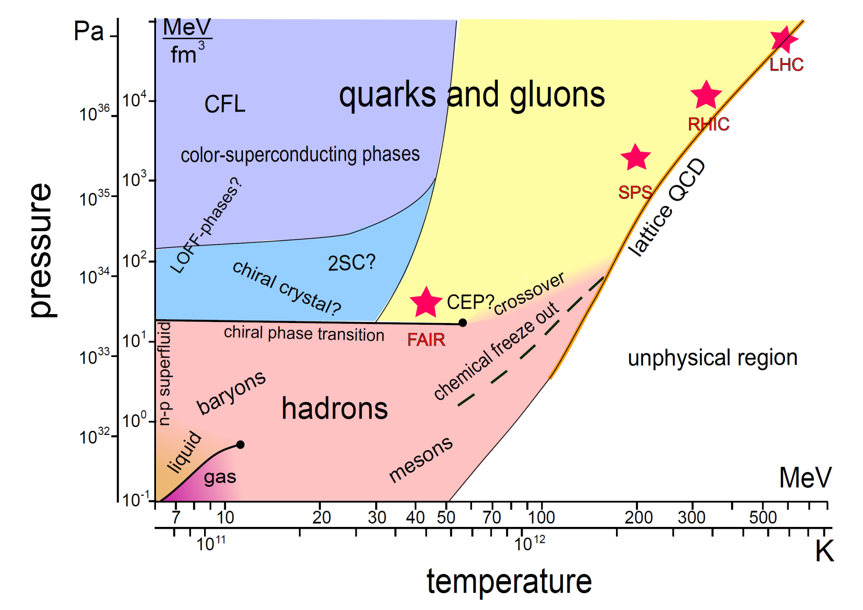
The phase diagram of „nuclear“ matter
J. Wambach, K. Heckmann, M. Buballa, Act. Phys. Pol. B, Vol. 5 (2012)

Slide 26
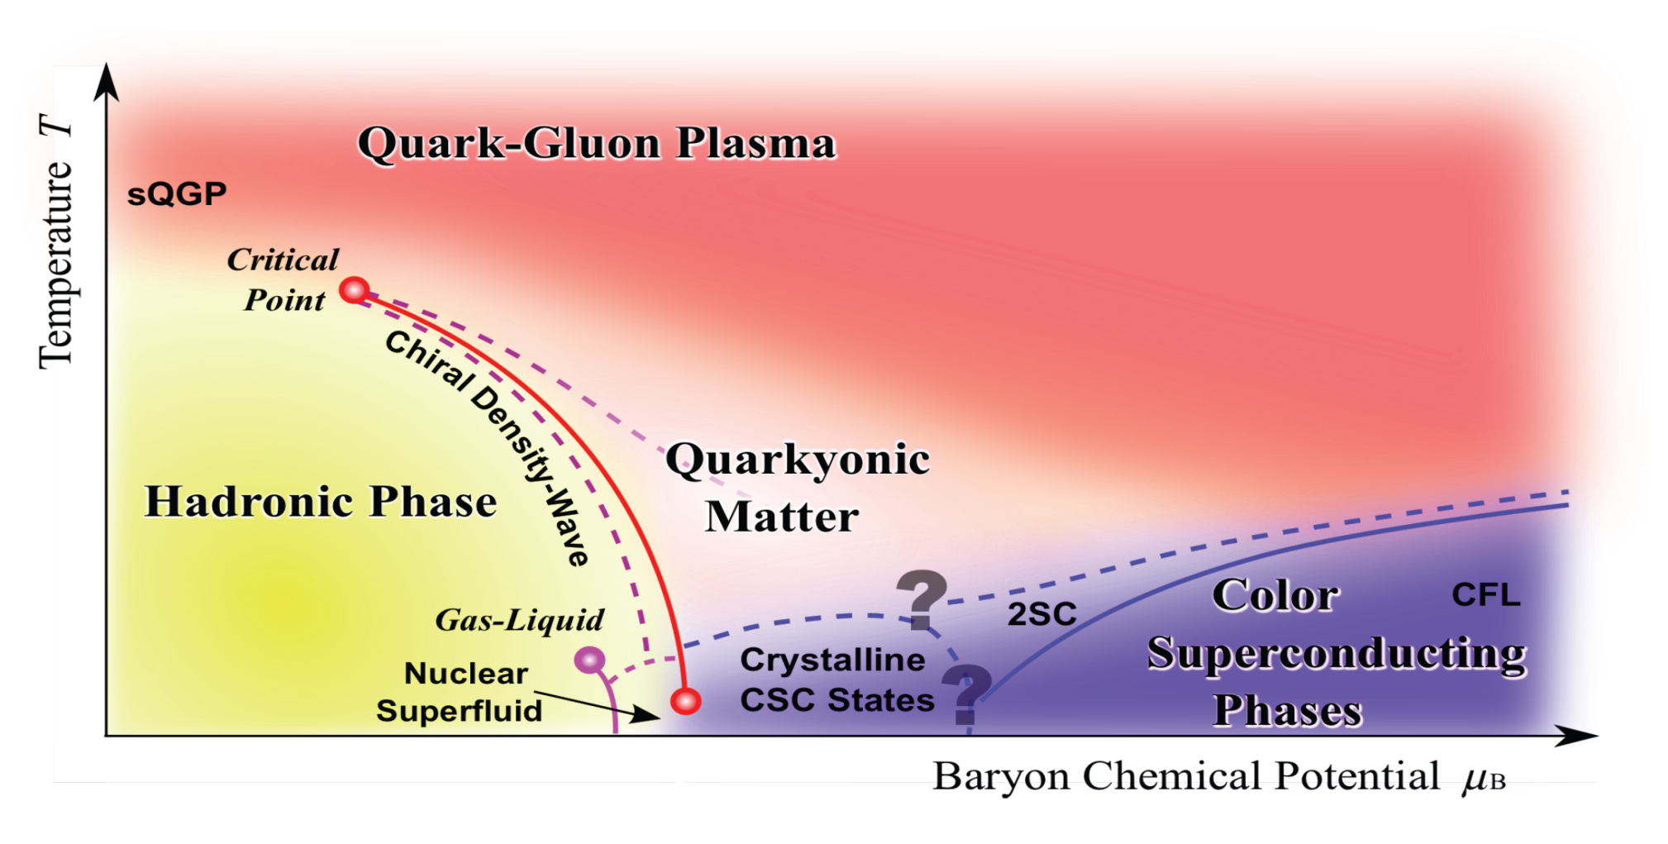
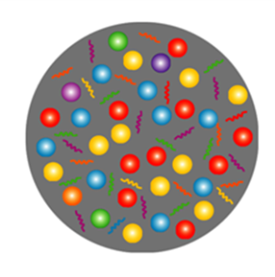
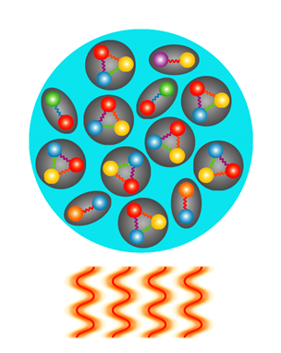
Exploring the QCD phase diagram
Courtesy of K. Fukushima & T. Hatsuda
At very high temperature:
➢ N of baryons ≈ N of antibaryons
Situation similar to early universe
➢ L-QCD finds crossover transition between
hadronic matter and Quark-Gluon Plasma
➢ Experiments: ALICE, ATLAS, CMS at LHC
STAR, PHENIX at RHIC

Slide 27
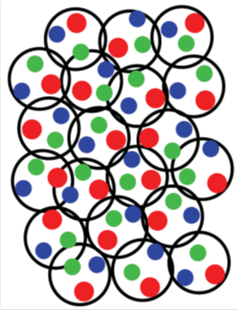
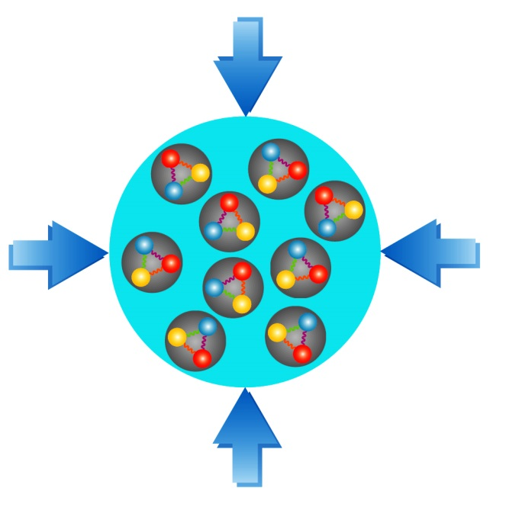
Exploring the QCD phase diagram
Courtesy of K. Fukushima & T. Hatsuda
At high baryon density:
➢ N of baryons >> N of antibaryons
Densities like in neutron star cores
➢ L-QCD not (yet) applicable
Models predict first order phase transition
with mixed or exotic phases
Experiments: BES at RHIC, NA61 at CERN SPS,
CBM at FAIR, NICA at JINR

Slide 28
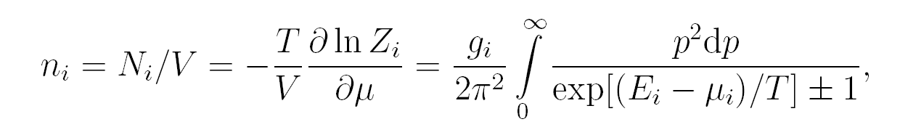
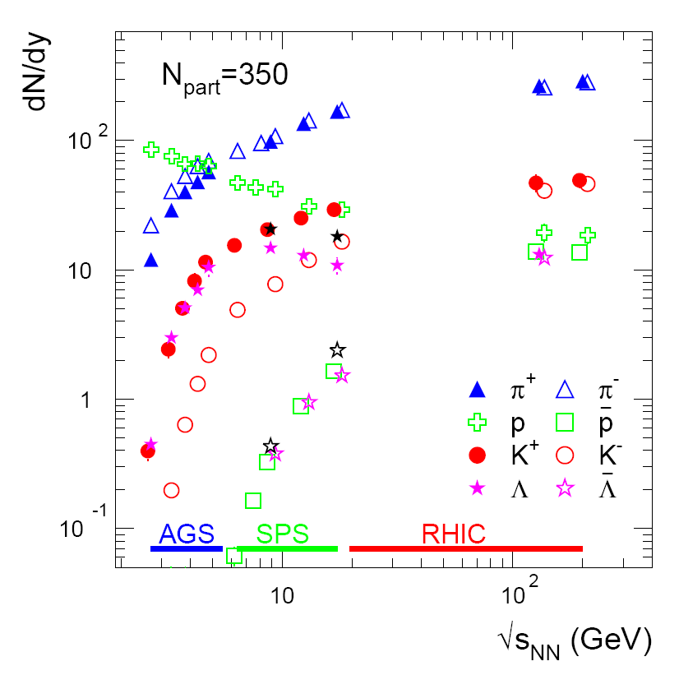
Linking hadron production in heavy-ion collisions
to the QCD phase diagram: statistical model
Particle density:
Assumptions:
➢ chemical equilibrium
simultaneous freeze-out of all particles

Slide 29
Linking hadron production in heavy-ion collisions
to the QCD phase diagram: statistical model
R_{meson} = R_{baryon} = 0.3 fm
G. Agakishiev et al., arXiv:1512.07070
A. Andronic et al., arXiv:1611.01347

Slide 30
Excluded volume effects on thermal fits
V. Vovchenko, H. Stoecker, J. Phys. G 44, 055103 (2017)

Slide 31
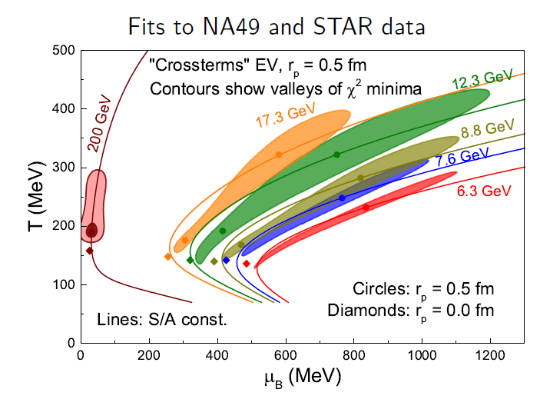
Excluded volume effects on thermal fits
r_{p} = 0.5 fm
r_{i} ∼ m_{i}^{1/3}
V. Vovchenko, H. Stöcker, Phys. Rev. C 95, 044904 (2017)

Slide 32
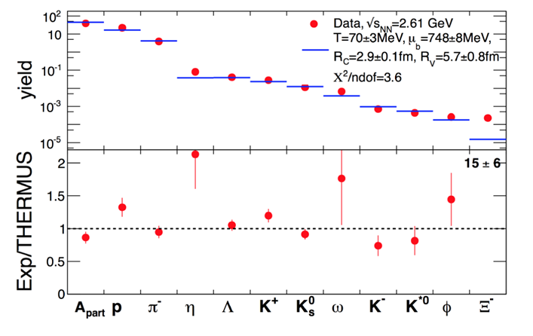
QCD phase diagram: Observables
Phase transitions from partonic to hadronic matter
excitation function of strangeness: Ξ⁻(dss),Ξ⁺(dss),Ω⁻(sss),Ω⁺(sss)
→ chemical equilibration at the phase boundary
Particle yields and thermal model fits
HADES: Ar + KCl 1.76 A GeV
G. Agakishiev et al., arXiv:1512.07070
A. Andronic et al., arXiv:1611.01347

Slide 33
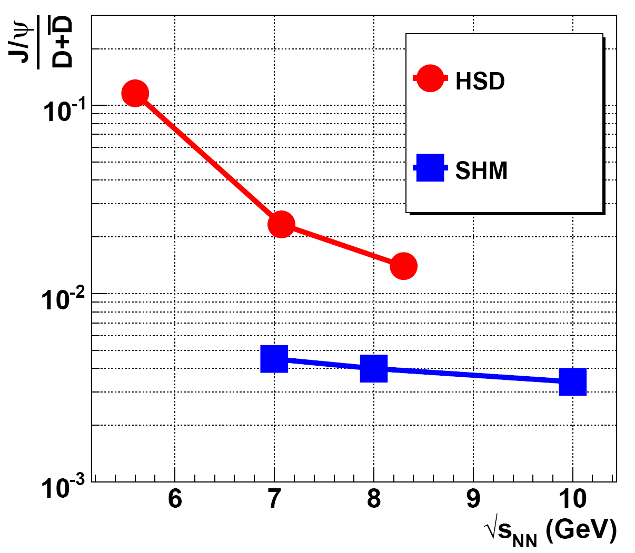
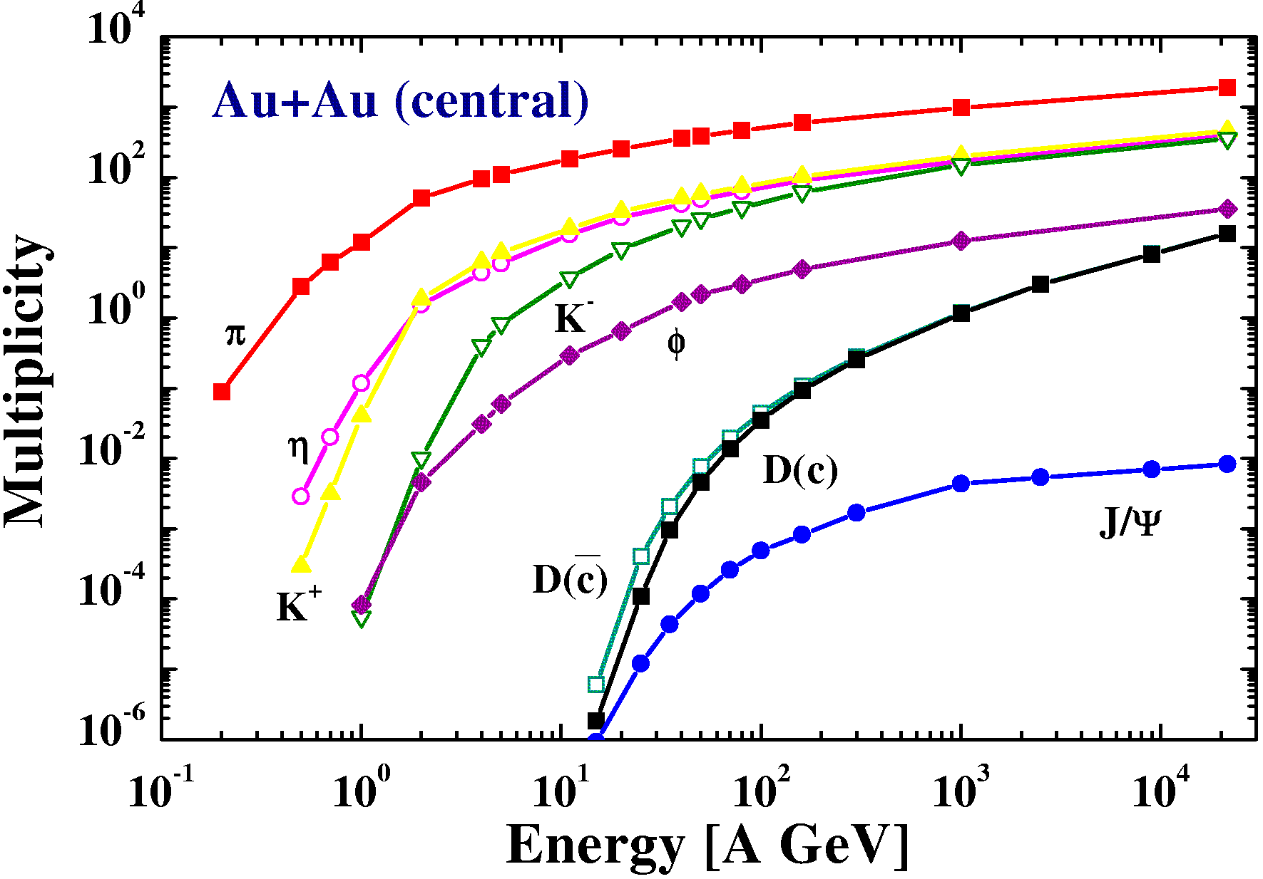
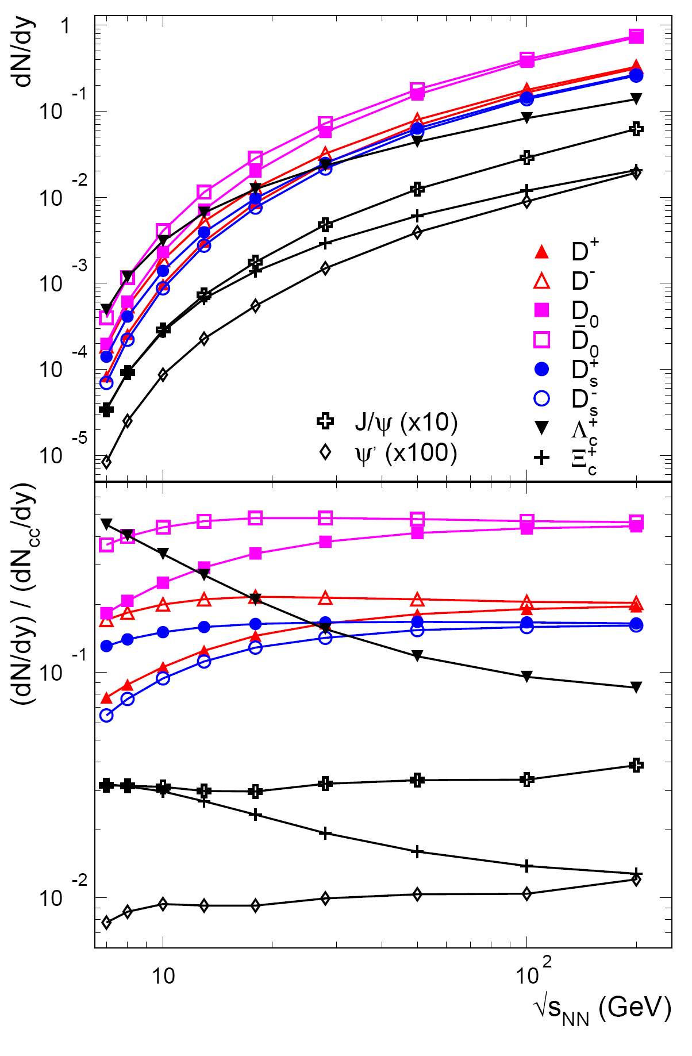

QCD phase diagram: Observables
Phase transitions from partonic to hadronic matter
excitation function of charm: J/ψ, D±, D
Statistical hadronization model (SHM)
(c-cbar production in partonic phase)
Hadronic model (HSD)
A. Andronic, P. Braun-Munzinger,
K. Redlich, J. Stachel, Phys.Lett.B659:149-155,2008
O. Linnyk, E.L. Bratkovskaya, W. Cassing, H. Stöcker, Nucl.Phys.A786:183-200,2007
effects of finite size,
surface, lifetime,
collisional broadening
might wash out sharp structures.
Experimental challenges:
Micro-vertex tracking
for D mesons (IT)
high signal/background
ratio for lepton pairs
No data at
FAIR/NICA energies
NN → D Λ_{c} N
NN → DD NN
NN → J/ψ NN

Slide 34
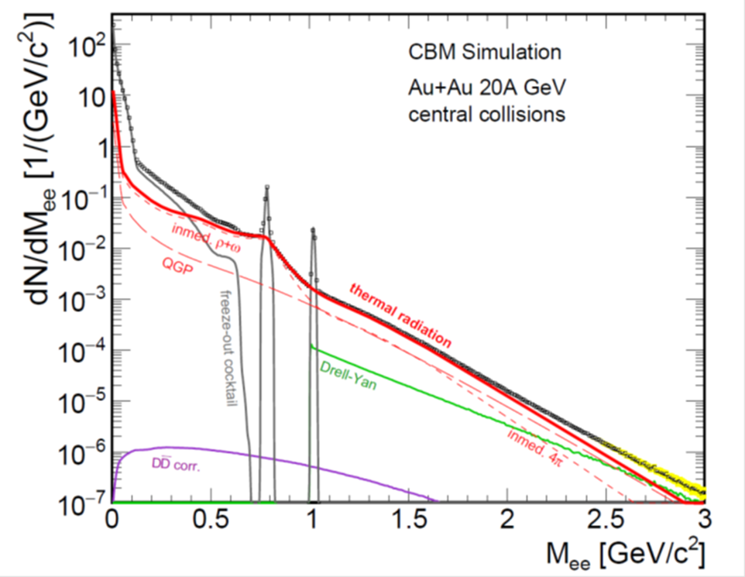
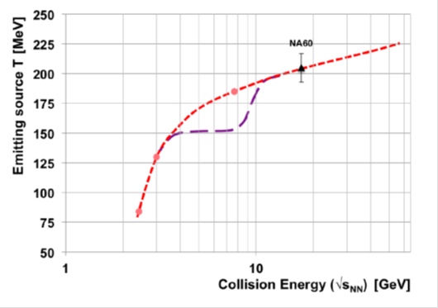
QCD phase diagram: Observables
Phase transitions from partonic to hadronic matter
➢ excitation function of strangeness: Ξ⁻(dss),Ξ⁺(dss),Ω⁻(sss),Ω⁺(sss)
→ chemical equilibration at the phase boundary
excitation function of charm: J/ψ, D±, D
Phase coexistence
excitation function (invariant mass) of lepton pairs:
thermal radiation from QGP, caloric curve
Invariant mass distribution of lepton pairs
Slope of dilepton invariant mass spectrum
1 GeV/c² < M_{inv} < 2.5 GeV/c²
No data at
FAIR/NICA energies
The CBM Collaboration, arXiv:1607.01487

Slide 35
QCD phase diagram: Observables
Phase transitions from partonic to hadronic matter
➢ excitation function of strangeness: Ξ⁻(dss),Ξ⁺(dss),Ω⁻(sss),Ω⁺(sss)
→ chemical equilibration at the phase boundary
➢ excitation function of charm: J/ψ, D±, D
Phase coexistence
excitation function (invariant mass) of lepton pairs:
thermal radiation from QGP, caloric curve
➢ anisotropic azimuthal angle distributions: “spinodal decomposition”
Spinodal decomposition of the mixed phase: net baryon number density fluctuations
C. Herold, M. Nahrgang, I. Mishustin, M.Bleicher
Nuclear Physics A 925 (2014) 14
Jan Steinheimer, Jorgen Randrup
Phys. Rev. C 87, 054903 (2013)
Eur. Phys. J. A (2016) 52: 239
No data at
FAIR/NICA energies

Slide 36

QCD phase diagram: Observables
Phase transitions from partonic to hadronic matter
➢ excitation function of strangeness: Ξ⁻(dss),Ξ⁺(dss),Ω⁻(sss),Ω⁺(sss)
→ chemical equilibration at the phase boundary
➢ excitation function of charm: J/ψ, D±, D
Phase coexistence
excitation function (invariant mass) of lepton pairs:
thermal radiation from QGP, caloric curve
anisotropic azimuthal angle distributions: “spinodal decomposition”
Critical point
event-by-event fluctuations of conserved quantities (B,S,Q)
“critical opalescence”
4th moment of net-proton
multiplicity distribution:
critical fluctuations
STAR preliminary
No data at
FAIR/NICA energies

Slide 37




Origin of hadron masses
u
d
u
Proton
Proton mass 938 MeV/c²
Mass of u,u,d quarks: 9.1 ± 1 MeV/c²: interaction with Higgs field
QCD contributions to hadron mass:
- energy of quarks and gluons
- broken chiral symmetry
Tsung-Dao Lee (Nobel Prize 1957):
„The challenge for the next century physics is:
explain confinement and broken (chiral) symmetry“

Slide 38


Confinement
Coupling strength between two quarks
confinement potential
high
temperature
high
density

Slide 39
The chiral symmetry of QCD
left-handed quarks
right-handed quarks
Possible for massive quarks only!
inertial system with opposite velocity
Chiral symmetry ➔ quarks are massless
Broken chiral symmetry ➔ quarks are massive

Slide 40


The chiral symmetry of QCD
Chiral symmetry is broken in nature:
Explicit breaking (Higgs mechanism):
m_{u} ≈ 2 MeV, m_{d} ≈ 5 MeV, m_{s} ≈ 150 MeV
Spontaneous/dynamical breaking:
Hadrons acquire mass by coupling
to the virtual quark-antiquark pairs
of the chiral condensate
Orange: chiral condensate

Slide 41
The chiral symmetry of QCD
Spontaneous chiral symmetry breaking:
splitting of chiral partners such as π-σ, N-N*(1535),
ρ (770 MeV) - a₁(1260 MeV)
ρ vector meson
a₁ axial vector meson
R. Barate et al. (ALEPH Collaboration), Eur. Phys. J. C4 (1998) 409
ρ→ππ, e+e-, μ+μ-, ....
a₁ → ρπ, ...., πγ

Slide 42
The chiral symmetry of QCD
ALEPH data
Chiral symmetry restoration: degeneration of chiral partners
Ralf Rapp arXiv:1306.6394v1

Slide 43

Chiral symmetry restoration: Observables
μ+μ- pairs (NA60 experiment)
Step 1: Substraction of combinatorial background and known sources of μ⁺μ⁻ pairs in the region of low invariant masses
R. Arnaldi et al. [NA60 Coll.], Phys. Rev. Lett. 96, (2006) 162302

Slide 44
Chiral symmetry restoration: Observables
Step 2: Comparison to model calculations
Efficiency corrected dimuon excess yield in min. bias In+In collisions at 158 A GeV
Experiment:
R. Arnaldi et al. [NA60 Coll.], Phys. Rev. Lett. 96, (2006) 162302, Eur. Phys. J. C 61, (2009) 711
Theory:
R. Rapp, J. Wambach and H. van Hees, in Relativistic Heavy-Ion Physics, edited by R. Stock,
Landolt Börnstein (Springer), New Series I/23A (2010), arXiv:0901.3289 hep-ph

Slide 45

Chiral symmetry restoration: Observables
Future experiments at FAIR and NICA
Precise measurements of
➢ in-medium spectral distributions of hadrons: ρ,ω,φ →e⁺e⁻(μ⁺μ⁻)
➢ dileptons at intermediate invariant masses: 4 π → ρ-a₁ chiral mixing
No data at
FAIR/NICA energies

