Slide 1
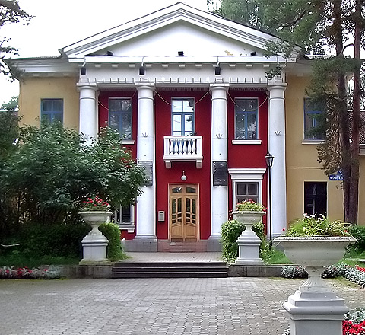
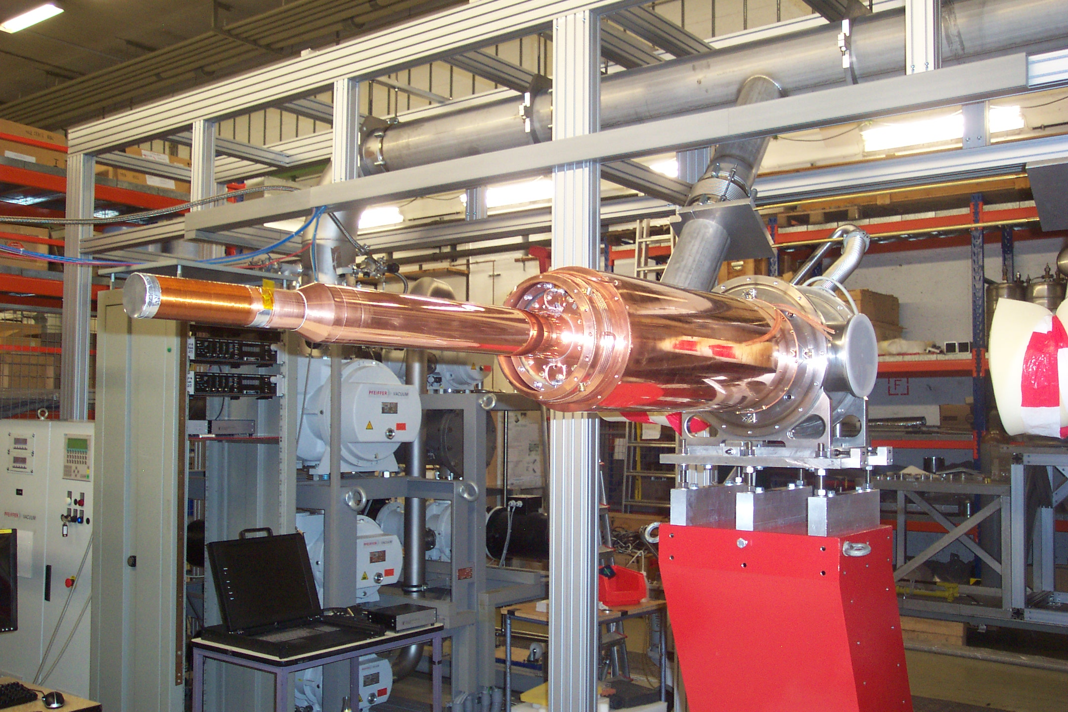
Institut
für Kernphysik
The A2 real photon facility at MAMI
1.-Physics topics: Investigation of structures and interactions of hadrons
2.-Experimental setup I: γ- beam and detector - Tagger + Crystal Ball@MAMI
3.-Experimental setup II: Frozen Spin Target
4.-Experiments with FST: Precision measurements of the Nucleons Excitations Determination of Fundamental Properties
Dubna 2018
March 5th - 9th
Andreas Thomas
for the A2 Collaboration

Slide 2
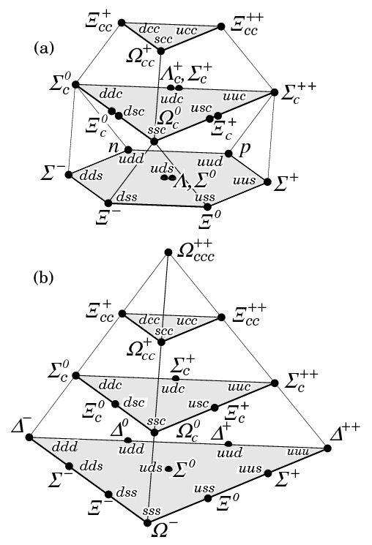
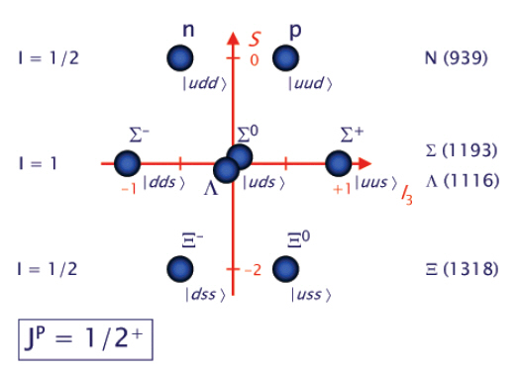
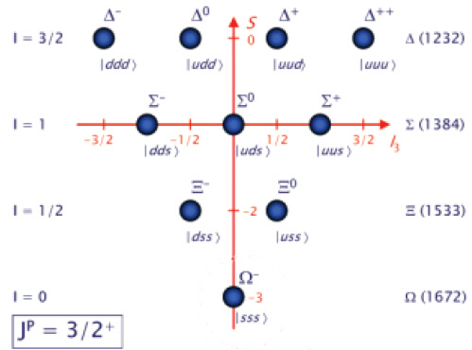
Introduction Physics:
Quark Model
Classification of Baryons
qqq; only uds
Oktett
Dekuplett
Simple Constituent quark picture:
Proton p(938): |uud> ~ |hhi> Spin 1/2
Delta Δ(1232): |uud> ~ |hhh> Spin 3/2
M1-Transition
(Small 2.5% E2)

Slide 3
Introduction: Excitation Spectrum of the Nucleon
H
He
Hg
Löhrig, Metsch, Petry, Eur.Phys.J. A10 (2001) 395-446
Atom
Nucleon
The light baryon spectrum in a relativistic quark model

Slide 4
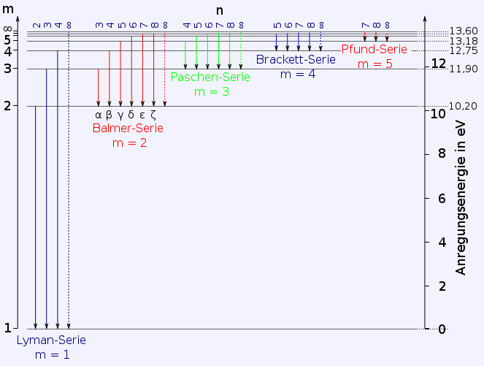
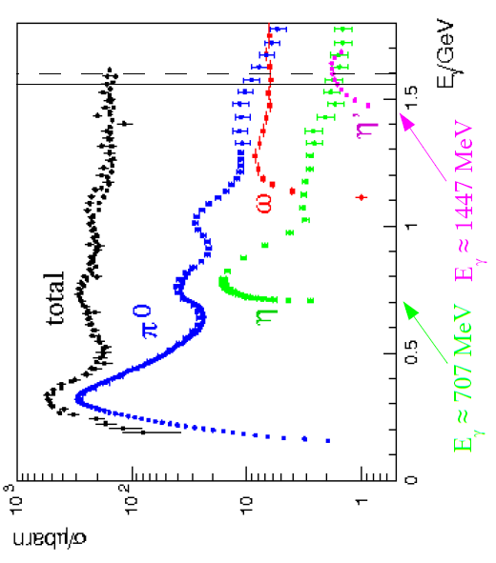
QED
E[eV]
QCD
E[GeV]
S₁₁(1535)
P₃₃(1232)
Hydrogen
t ~ 10⁻⁸ s
ΔE ~ 10⁻⁶ eV
Scale ~ 10⁻¹⁰ m
Nucleon
t ~ 10⁻²³ s
ΔE ~ 200 MeV
Scale ~ 10⁻¹⁵ m

Slide 5
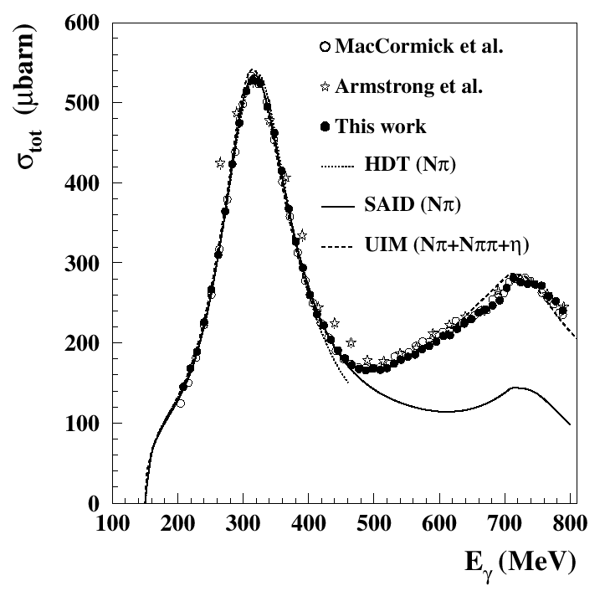
What is the nature of the Nucleon Resonances?
-Excitation inner deg. of freedom
-Molecule
-Quark – Diquark Structure
-Dynamical Generation
- …….?
Unpolarised total photoabsorption cross section
Phys. Rev. Lett. 87, 022003 (2001)
Phys. Rev. Lett. 84, 5950 (2000)
Nucl. Phys. A642, 561 (1998)
Phys. Rev. C 53, 430 (1996); SP01
Nucl. Phys. A645, 145 (1999)

Slide 6
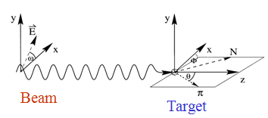
Nature and Properties of nucleon resonances
Polarisation observables used to disentangle broad, overlapping resonances.
Beam
γ
P
lin
P
lin
P
circ
unpol
γ
γ
γ
⎛
π
⎞
⎛
+
π
−
π
⎞
Target
⎜
0
,
⎟
⎜
,
⎟
⎝
2
⎠
⎝
4
4
⎠
⎛
d
σ
⎞
Σ
P
unpol
⎜
⎟
-
-
⎝
d
Ω
⎠
Beam
P
x
-
-
H
F
Target
P
T
P
-
-
y
P
z
-
-
G
E

Slide 7
Pion Production
Eta Production
Experiment: polarization observables and different channels essential
(Mainz, Bonn, JLAB ….)
Theory: several models and PWA groups (MAID, BNGA, SAID, JuBo…)

Slide 8
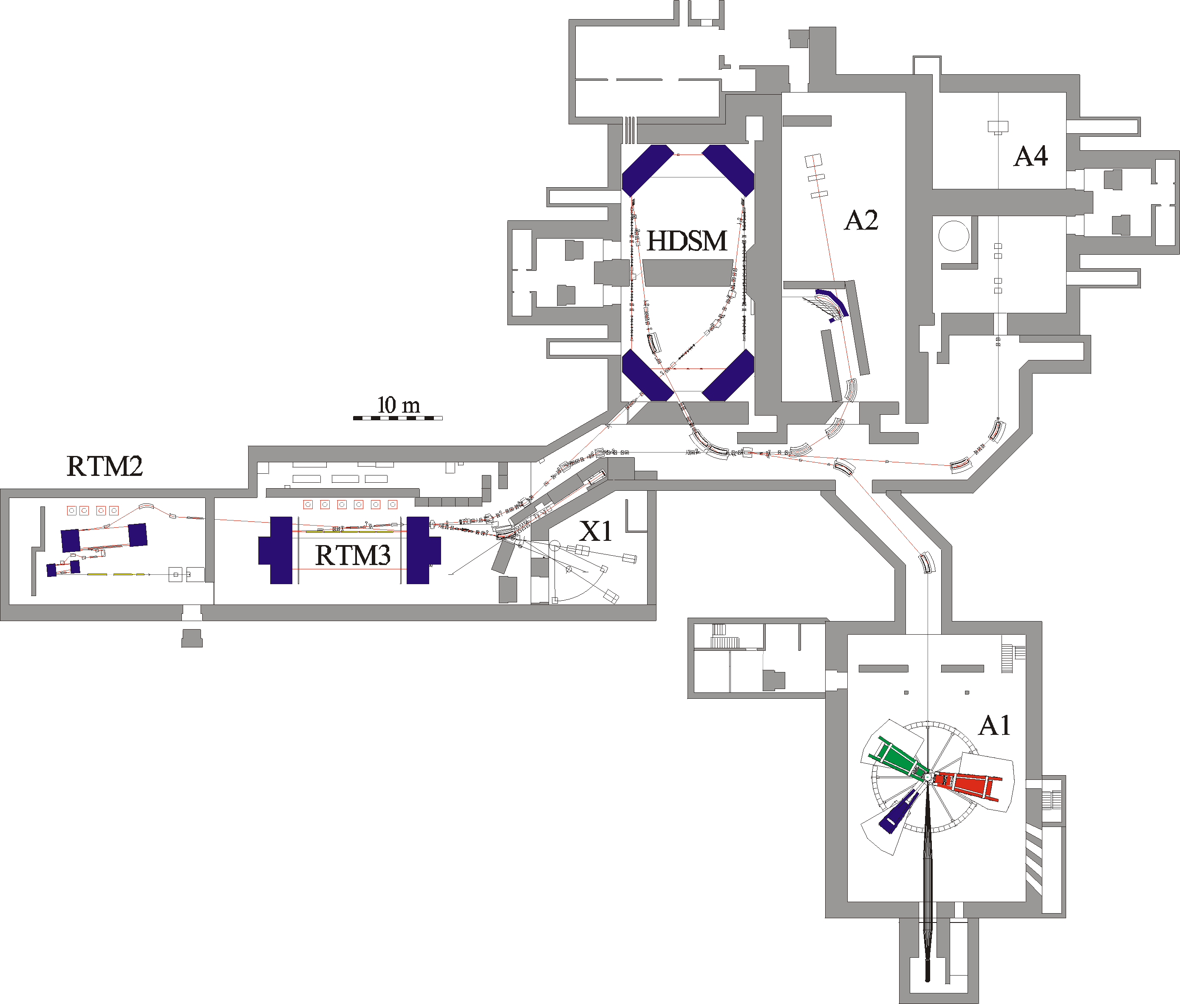
Parameter
1604MeV, σ_{E}=0.100MeV
max. 40μA polarised
ε_{h}=9 nm rad, ε_{v}=0.5 nm rad
~6500h/year as MAMI B !

Slide 9
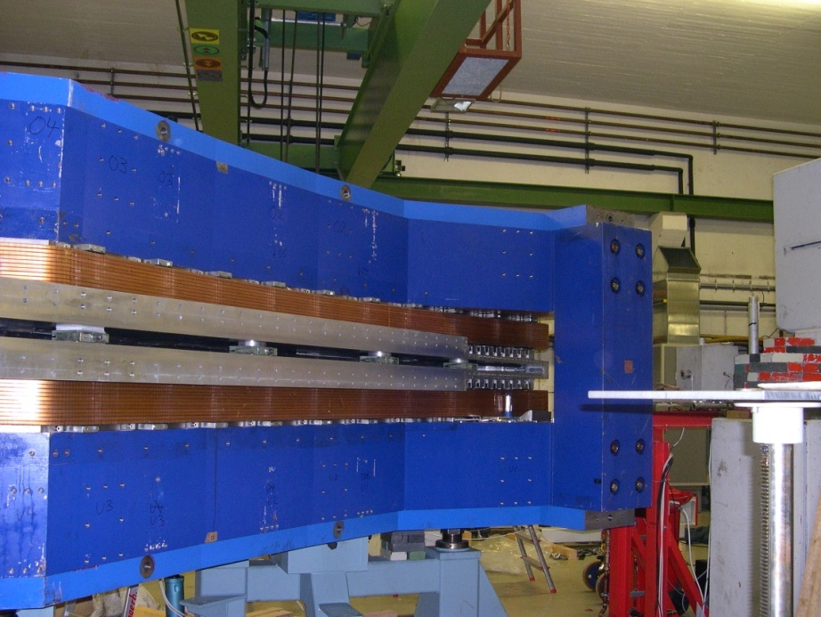
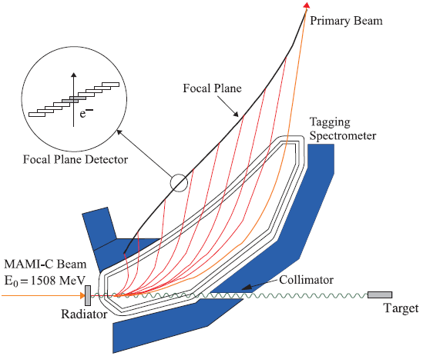
A2 Tagging system (Glasgow, Mainz)
1.
Production and energy measurement of the Bremsstrahlung photons.
Glasgow Tagging Spectrometer
EPJ A 37, 129 (2008)
2.
Determination of the degree of polarization of
the electron beam (Moeller Polarimeter).
Circularly pol. photons.
3.
Coherent production of linearly polarized
photons on a diamond radiator

Slide 10
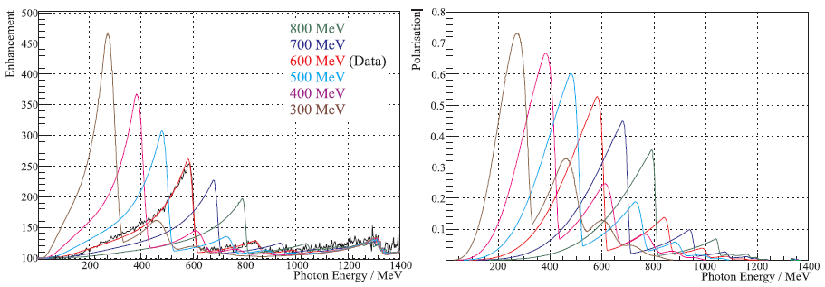
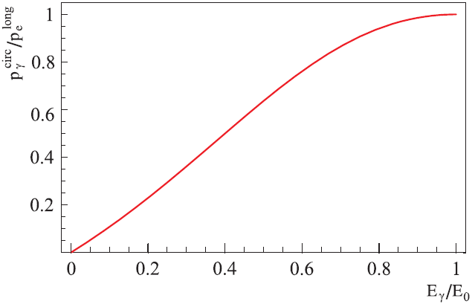
Polarized Photons @ MAMI C
Linear
Polarization
E_{γ} = 75 ... 1480 MeV
ΔE_{γ} = 4 MeV
N_{γ} = 2 . 10⁵ s⁻¹ MeV⁻¹
Circular
Polarization
Transfer
High Polarization
High Photon Flux

Slide 11
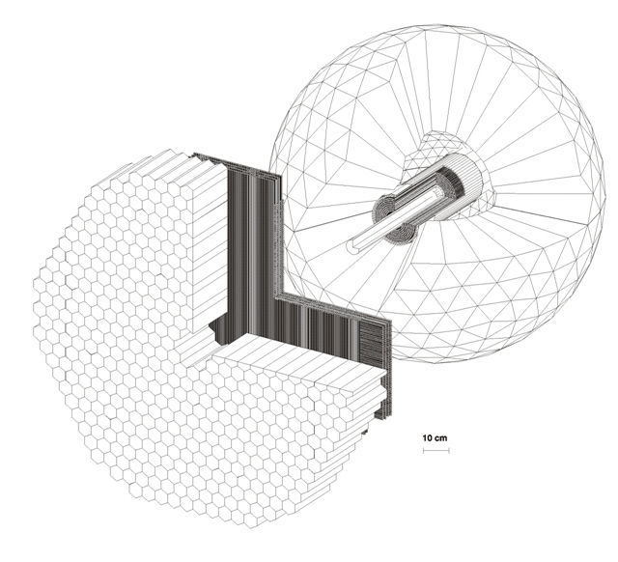
4π photon Spectrometer @ MAMI
TAPS:
366 BaF₂ detectors
72 PbWO₄ detectors
Max. kin. energy:
π⁺⁻ : 180 MeV
K⁺⁻ : 280 MeV
P : 360 MeV
Crystal Ball:
672 NaJ detectors
Max. kin. energy:
μ⁺⁻ : 233MeV
π⁺⁻ : 240 MeV
K⁺⁻ : 341 MeV
P : 425 MeV
Vertex detector:
2 Cylindr. MWPCs
480 wires, 320stripes
PID detector:
24 thin plastic detectors
γp ◊ S11 ◊ pη
π⁰π⁰π⁰
γγγγγγ

Slide 12
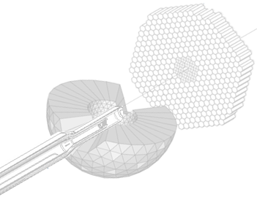
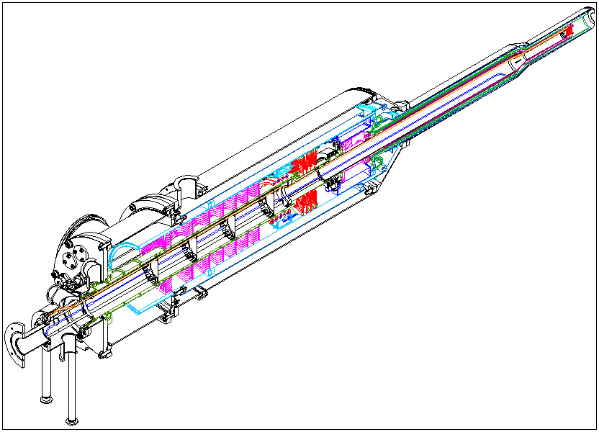
Mainz/Dubna Dilution refrigerator
Mixing chamber(25mK)
Still (0.7K)
Evaporator (1.5Kelvin)
Separator (4.2Kelvin)

Slide 13
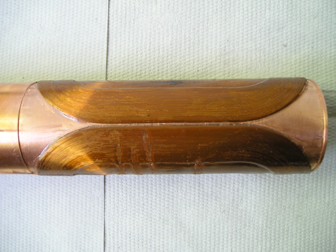
Magnet Technology
DNP at 200mK and 2.5T with 70GHz microwaves.
Frozen spin target (25mKelvin, 0.6T).
Secondary particles punch through holding coil.
All directions of polarization.
Transverse (Saddle coil)
and
Longitudinal (Solenoid)
Internal
Holding Field (1.2K, 0.6T)

Slide 14
Single and Double Polarized Experiments
Excitation Spectrum
1.- Longitudinal PT: a) E and G of Meson Photoproduction off protons b) E and G of Meson Photoproduction off neutrons
2.- Transverse PT: a) T and F of Meson Photoproduction off protons b) T and F of Meson Photoproduction off neutrons
Additional measurements on Fundamental Properties
1.- Transverse PT: Transverse asymmetries T and F in π−photoproduction in the threshold region → m_{u} - m_{d}
2.- Long. and trans. PT: Spin Polarizabilities and Polarizabilities in Compton process

Slide 15
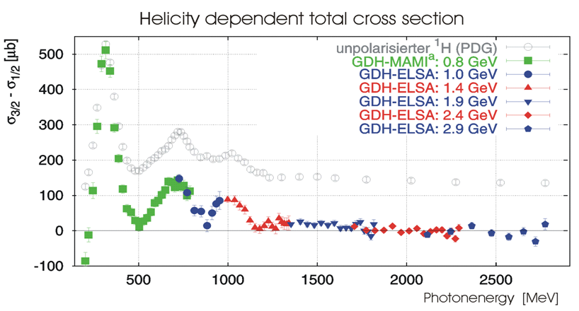
Helicity Dependence E of Meson Photoproduction on the Proton and Neutron
1998-
2003
Mainz and Bonn
2010-
2016
New
Mainz
Exp.
with CBall
Gerasimov-Drell-Hearn sum rule (GDH)
Simultaneous measurement of E and G

Slide 16
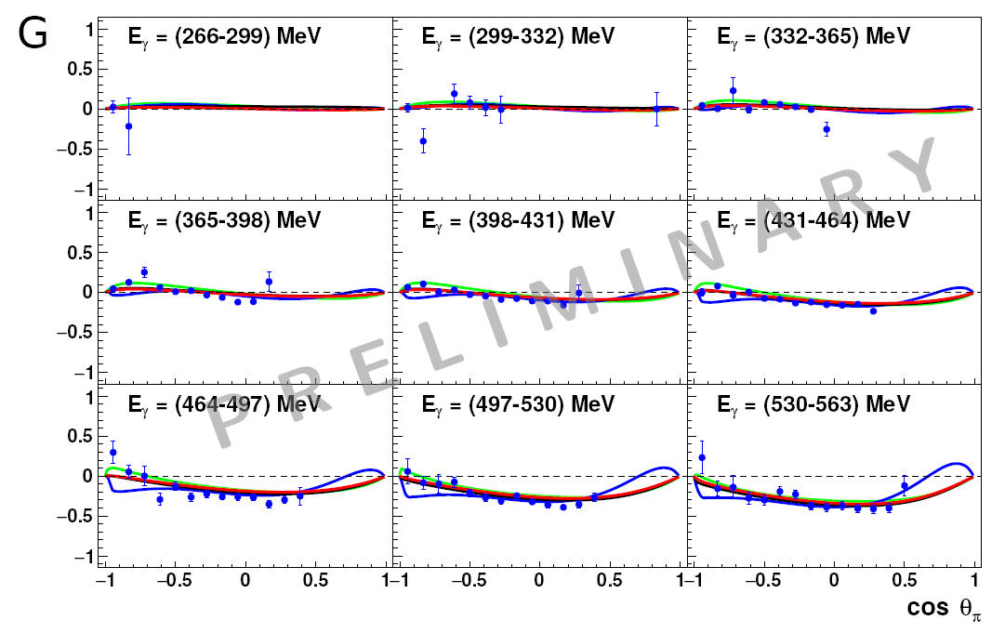
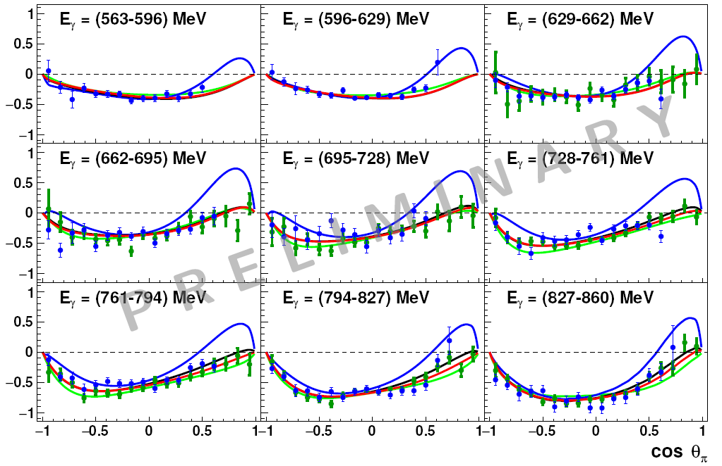
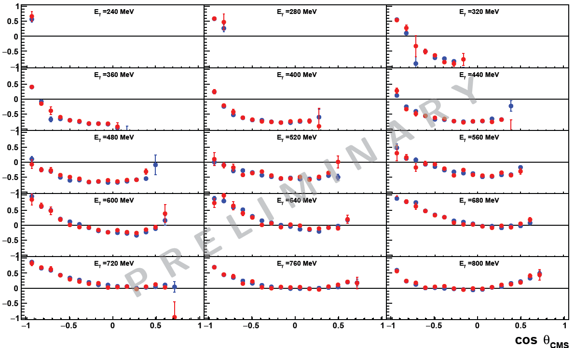
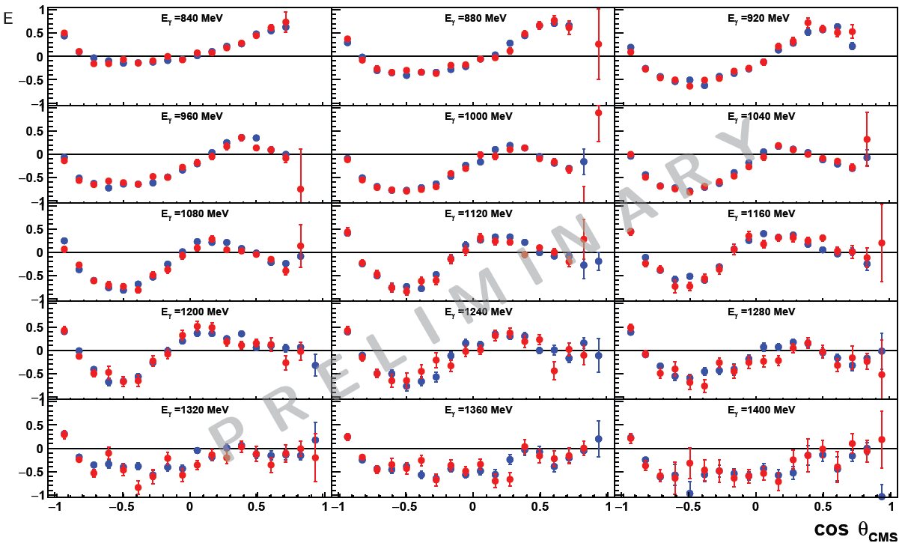
Simultaneous measurement of G and E for π⁰ production (F.Afzal, K.Spieker)
G
E

Slide 17
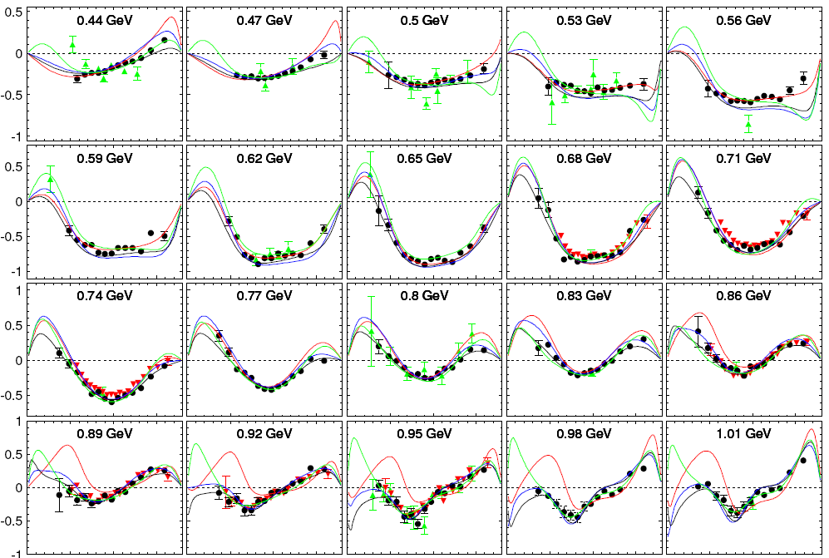
T in π⁰−photoproduction
Red line: MAID 2007
blue line: SAID PR15
green line: JUBo2015-B
black line: BG2014-2
J. R.M. Annand et al.
Phys. Rev. C 93, 055209 –
2016
Black Circles – new MAMI Measurement, red triangles Bonn CBELSA, green triangles older data.

Slide 18
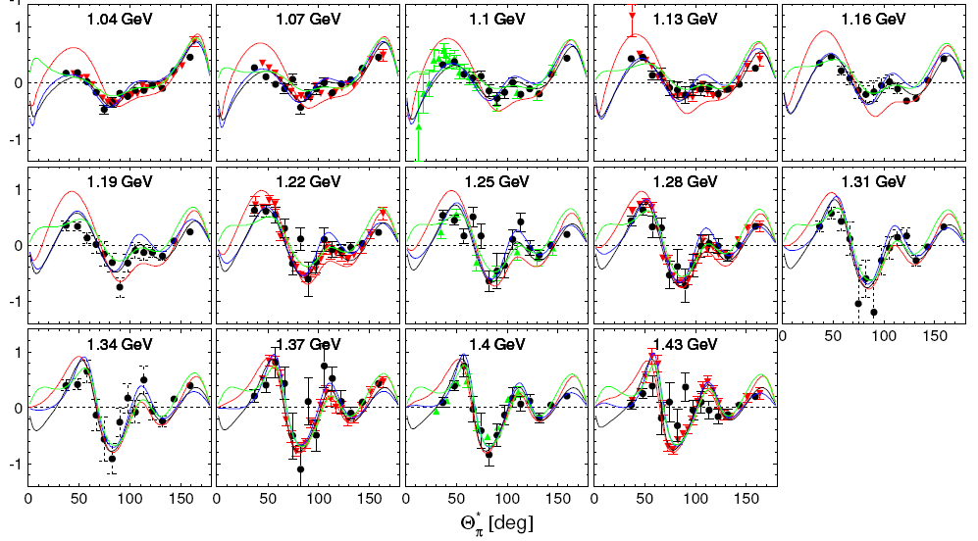
Red line: MAID 2007
blue line: SAID PR15
green line: JUBo2015-B
black line: BG2014-2
T in π⁰−photoproduction
Black Circles – new MAMI Measurement, red triangles Bonn CBELSA, green triangles older data.

Slide 19
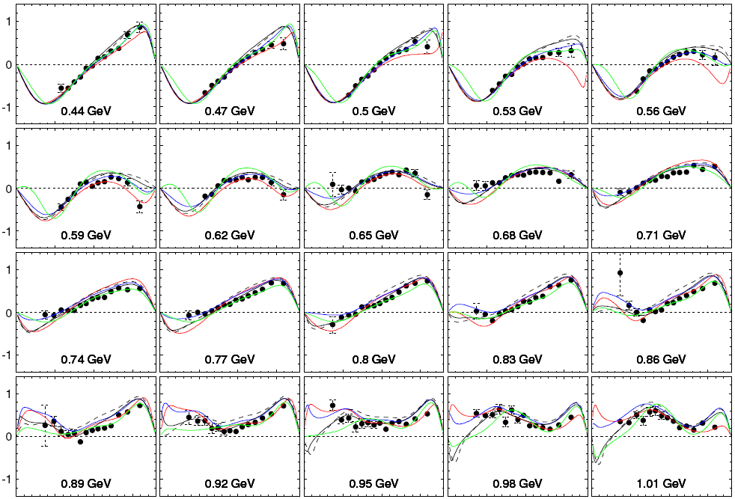
F in π⁰−photoproduction
γp ◊ pπ⁰
Red line: MAID 2007
blue line: SAID PR15
green line: JUBo2015-B
black line: BG2014-2
Black Circles – new MAMI Measurement.

Slide 20
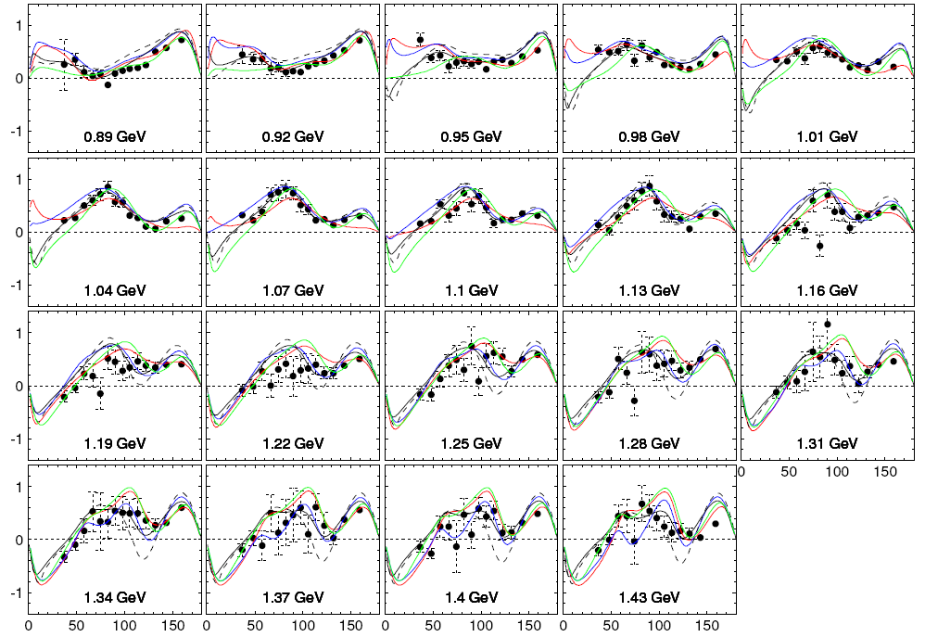
F in π⁰−photoproduction
γp ◊ pπ⁰
Red line: MAID 2007
blue line: SAID PR15
green line: JUBo2015-B
black line: BG2014-2
Dashed li: BG2011-2
In BG2014-2 new data
for T, P and H were included
as well as our new precise
cross section data.
Adlarson et al.,
Phys. Rev. C 92, 024617 (2015)
Black Circles – new MAMI Measurement.

Slide 21
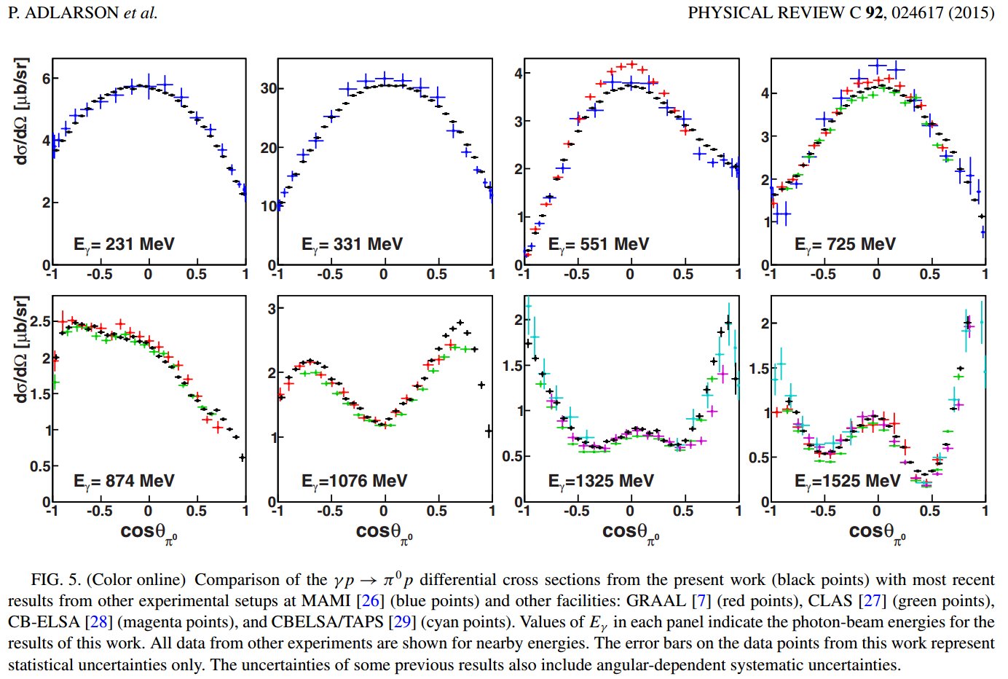

Slide 22
arXiv:1604.05704
We find that the new data force the multipoles to get closer to each other, the variance is reduced by about a factor of two.
Even more important seems to be that the multipoles converge to similar values in the region of leading resonances while the “background" and the contribution of higher-mass resonances remain less constrained by the new data. Clearly, the aim is to get very similar answers
also in the mass range which contains higher-mass resonances. This task will require more precise data, in particular more precise data on polarization observables.

Slide 23
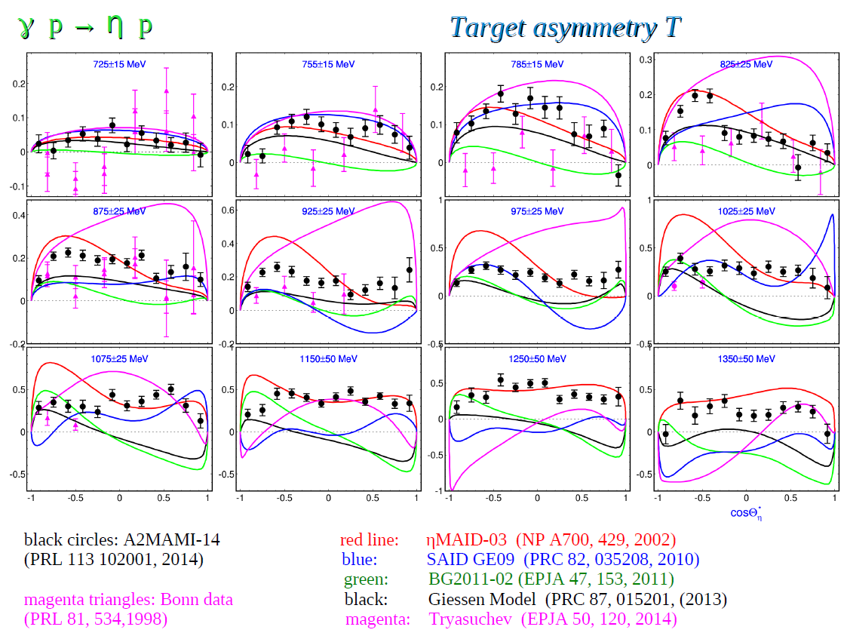
Eta and Eta‘ Production – Interpretation using ETAMAID [V.Kashevarov]

Slide 24
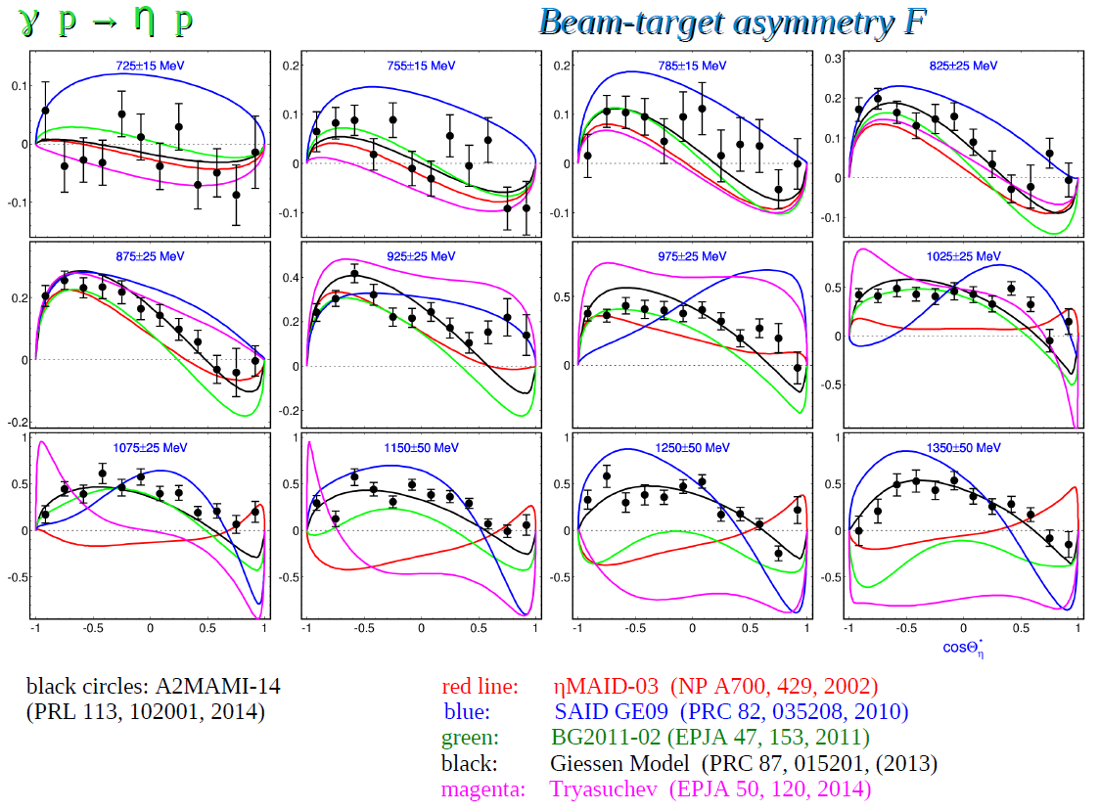
New Measurement of transverse asymmetries at Bonn ELSA 2017/18.

Slide 25
Proton Polarizabilities
− − − − − − − − − − − − −
π+
π+
π+
Pion
cloud
π+
π+
π+
π+
π+
+ + + + + + + + + + + + +
Electric polarizability: proton between charged parallel plates

Slide 26
Proton magnetic polarizability
S S S S S S S S S S S S S S S
π+
π+
Diamagnetic + Paramagnetic
pion cloud
u
u
π+
d
π+
Paramagnetic
Δ(1232)
N N N N N N N N N N N
Magnetic polarizability: proton between poles of a magnetic

Slide 27
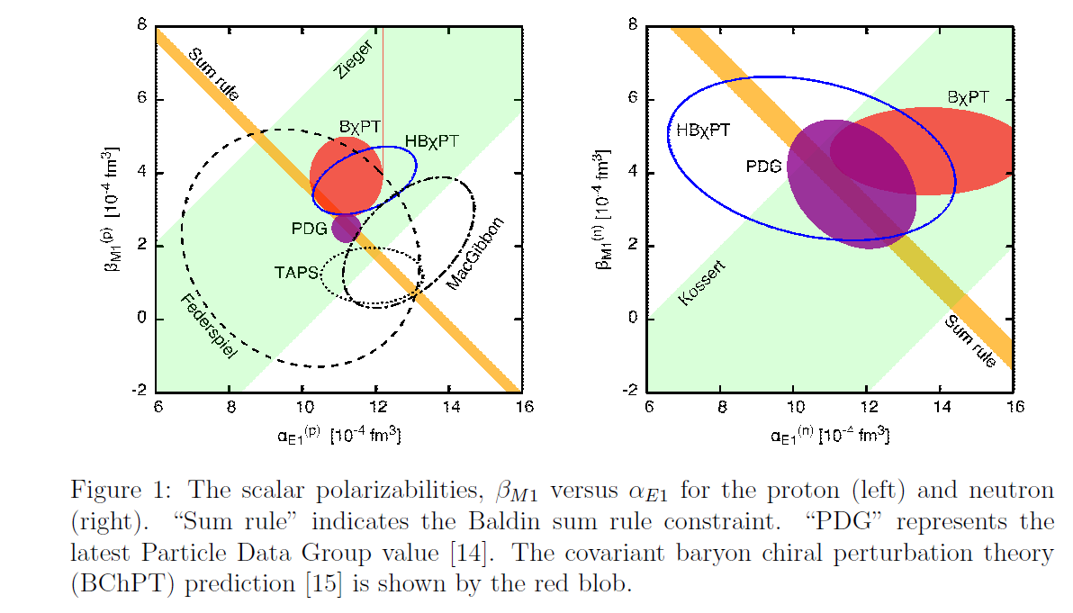
Proton Polarizabilities
New measurement of the Proton Scalar Polarisabilities via beamasymmetry in Compton process started in November 2017.
[E.Mornacchi]

Slide 28
Spin Polarizabilities
Spin Vector polarizabilities describe spin response to an incident photon
Four vector pol. (γ_{E1E1} γ_{M1M1} γ_{E1M2} γ_{M1E2}) appear at 3rd order in eff. Hamiltonian
Only two linear combinations of vector polarizabilities measured:
The Forward S.P. γ₀ was determined in GDH-Experiment at ELSA and MAMI (DAPHNE) :
The Backward S.P. γ_{π} was determined from dispersive analysis of backward angle Compton scattering. [B. Pasquini et al., Proton Spin Polarizabilities from Polarized Compton Scattering (2007).]

Slide 29
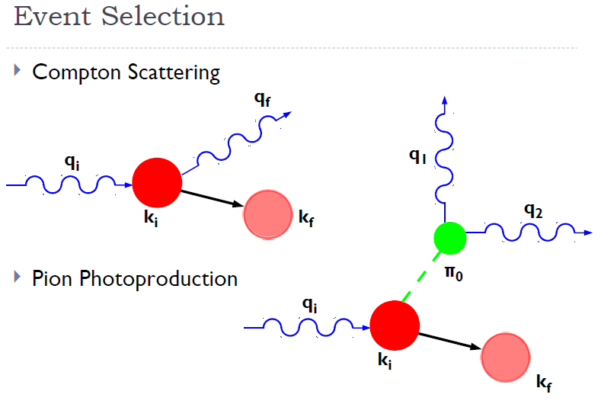
Pion photoproduction off of a proton is 75-100 times more likely than Compton (in the 240-280 MeV range) →
Kinematic overdetermination used for cuts (missing mass, proton angle, …).
Test with ‘substraction target’.
Measurements of the Proton Spin-Polarizabilities with Double-Polarized Compton Scattering
P.P.Martel et al., PRL 114 (2015) 112501
Main problems:
Low energetic recoil protons do not escape from the target and do not reach the detector.
Events are produced on the background nuclei (Carbon, coherent, incoherent, κ~13%). ).
Σ_{2x} 300 hours measurement
Σ_{2x} 300 hours measurement
Curves from:-
B. Pasquini, D. Drechsel, M. Vanderhaeghen,
Phys. Rev. C 76 015203 (2007)
B. Pasquini, D. Drechsel, M. Vanderhaeghen,
Phys. Rept. 378 99 (2003)

Slide 30
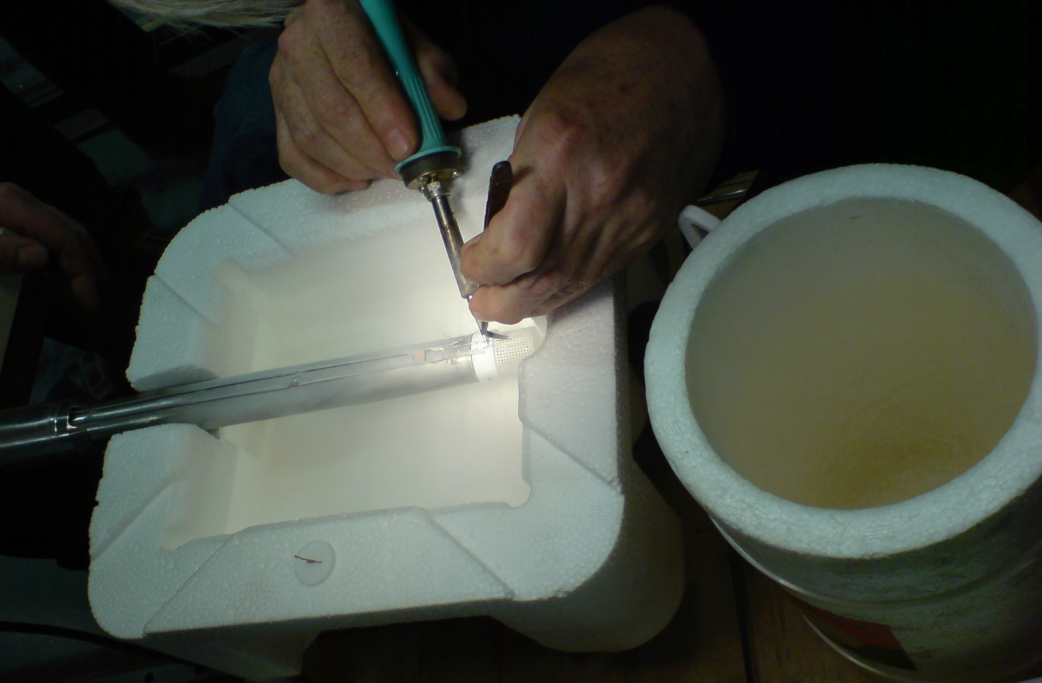
Target Material Frozen Spin Target
Butanol
2cm
X-ray picture with
Beamspot and
NMR coil

Slide 31
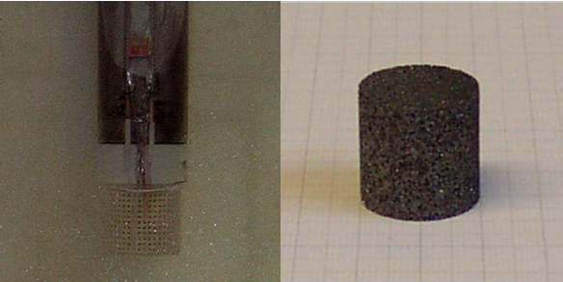
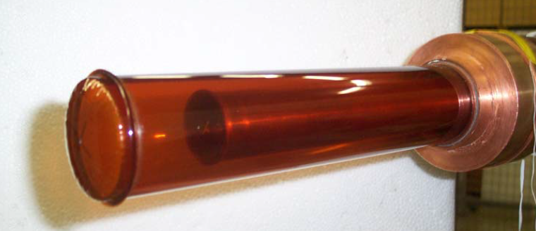
Additional challenges for the analysis of experiments with Frozen Spin Target → Dilution Factor.
Butanol
Carbon
Hydrogen

Slide 32
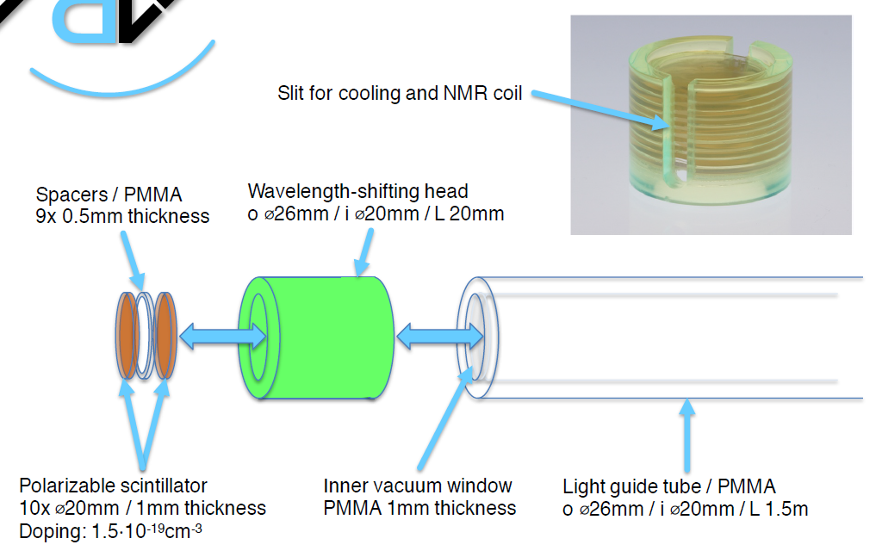
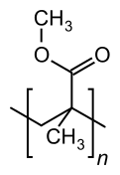
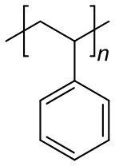
New Developement:
Active Polarized Target
[M.Biroth]

Slide 33
Conclusions
Data taking with CBall TAPS detector system started 2010 at MAMI C.
All directions of polarization were measured. Analysis is ongoing.
With a variety of new measurements of spin observables it comes to a convergence of the multipoles in the region of leading resonances.
The active polarised proton target was in operation in our 4π detector system in 2016.
Outlook
Proton Scalar Polarisabilities via beamasymmetry in Compton process.
Scalar Polarisabilities with hydorgen target in 2018.
R&D for polarised active szintillator target for threshold production and Compton will continue. Analysis of first data is on the way.
Measurement of 4 Vector Spin Polarisabilities in Compton process.
New Measurement of transverse asymmetries at Bonn ELSA 2017/18.

