Slide 1

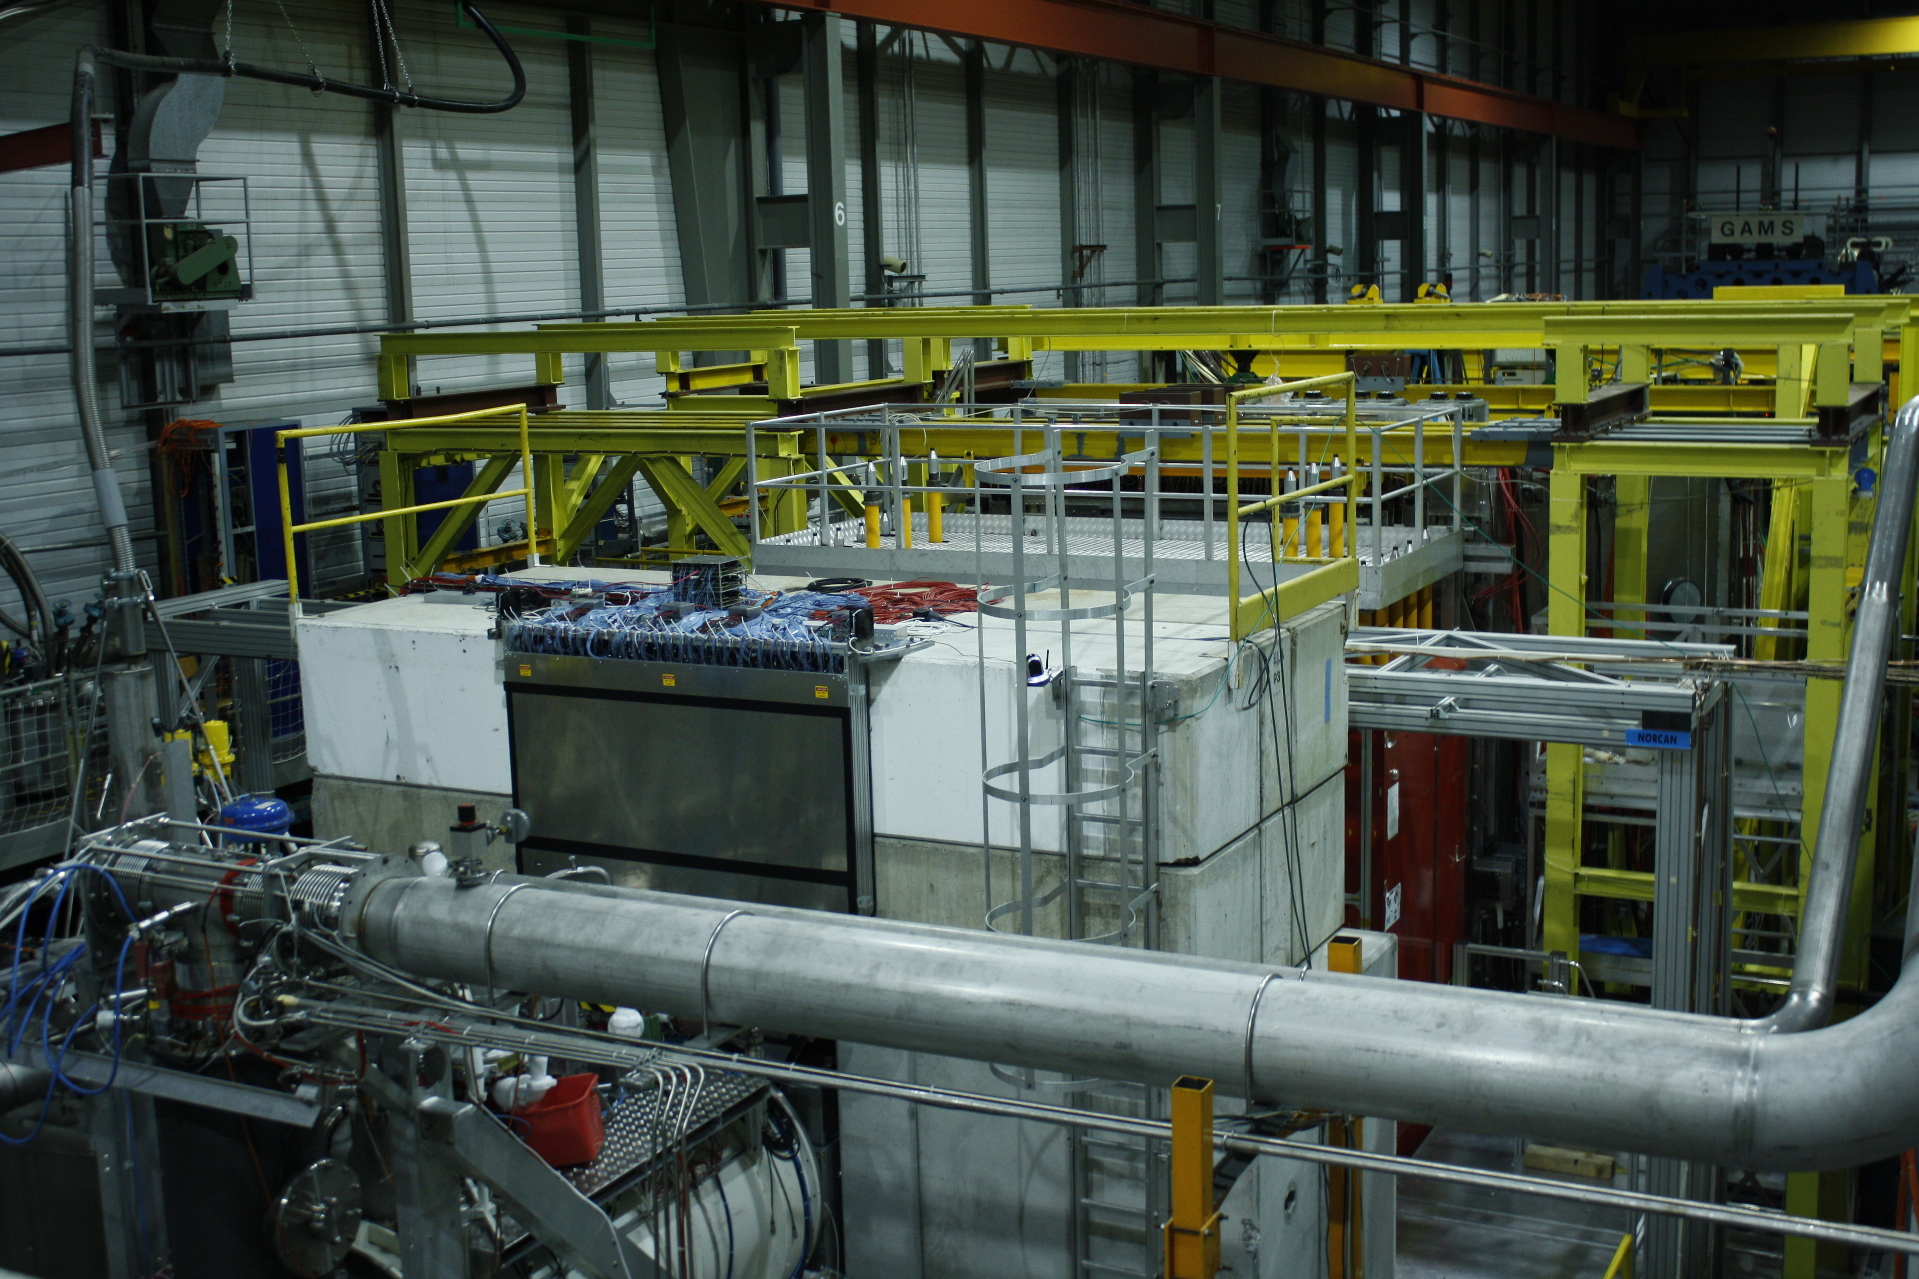
COMPASS ➔ A New QCD facility at SPS (CERN) M2 beam line
Oleg Denisov CERN/INFN-Torino

Slide 2
Outline
Intro: COMPASS – QCD facility at CERN SPS
A new QCD facility at SPS (CERN) M2 beamline
  Hadron structure study in DY, DPP and DVCS
  Hadron spectroscopy (strange sector)
  Hadron spectroscopy with low energy antiproton beam
  Absolute antimatter production cross-section measurements
New hardware
Time-lines and LoI status
Summary
Materials are provided by: C. Roberts, V. Andrieux, M. Chiosso, C. Riedl, B. Grube, J. Friedrich, A. Guskov, S. Wallner, B. Ketzer etc.

Slide 3
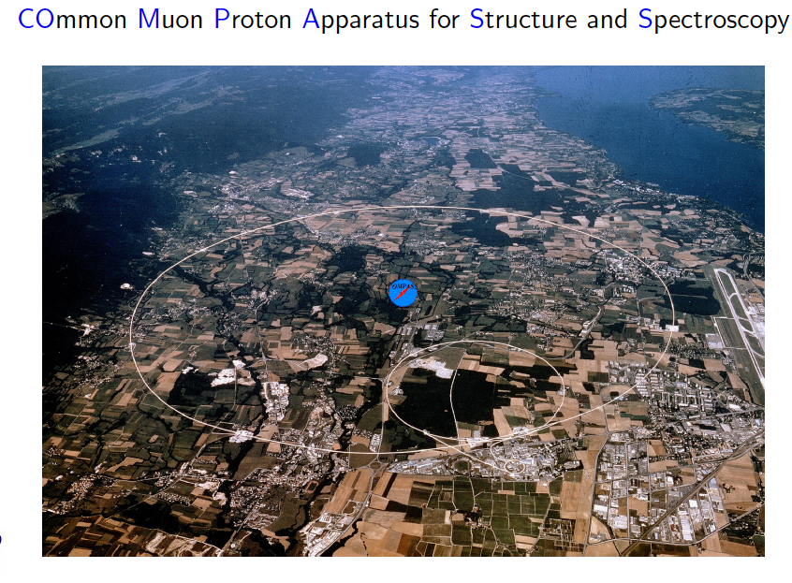
COMPASS QCD facility at CERN (SPS)
~240 physicists, 12 countries + CERN, 24 institutions

Slide 4
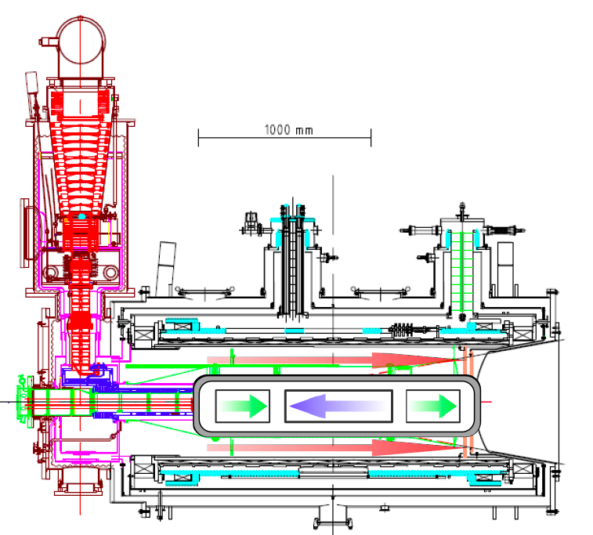
COMPASS Spectrometer at SPS M2 beam line (CERN)
Universal and flexible apparatus.
Most important features of the two-stage COMPASS Spectrometer:
Muon, electron or hadron beams with the
momentum range 20-250 GeV and intensities
up to 10⁸ particles per second
Solid state polarised targets (NH₃ or ⁶LiD) as well
as liquid hydrogen target and nuclear targets
Powerful tracking (350 planes) and PiD systems (Muon Walls, Calorimeters, RICH)

Slide 5
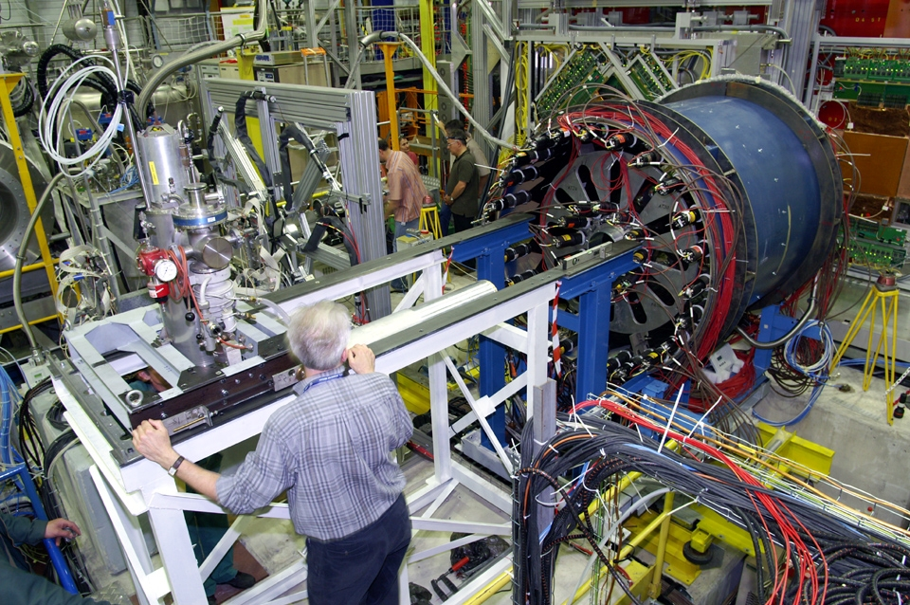
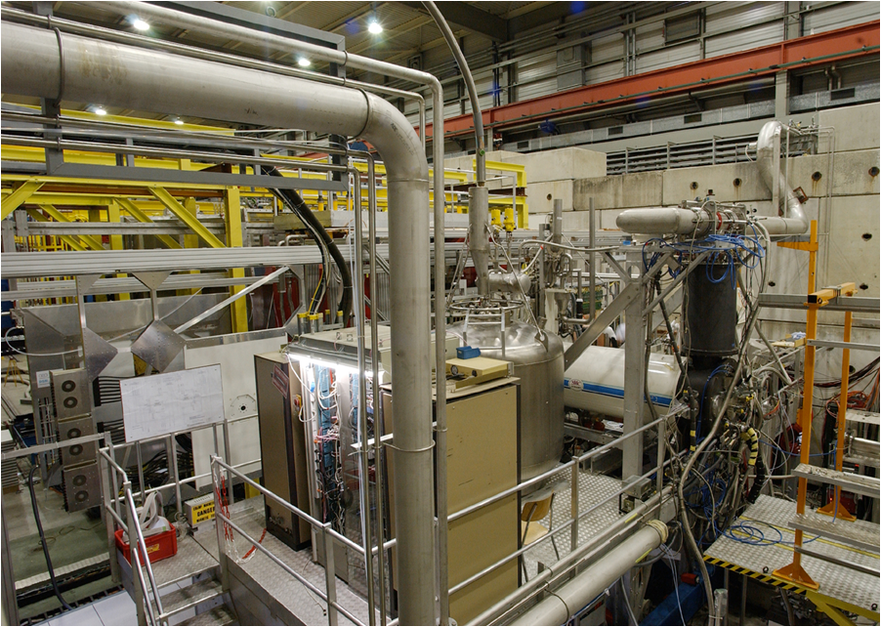
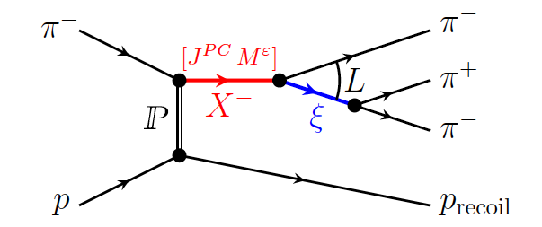
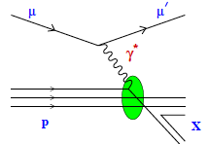
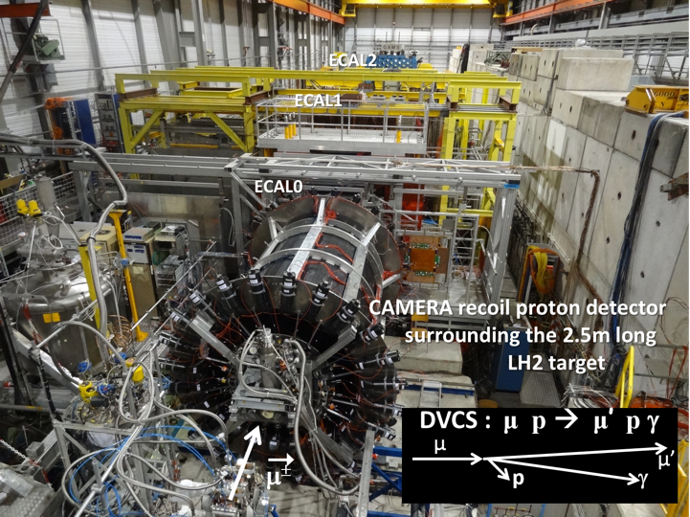
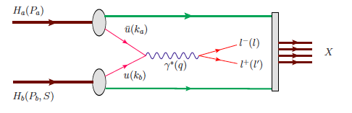
COMPASS QCD facility at SPS M2 beam line (CERN)
(secondary hadron and lepton beams)
Exotic states, chiral dynamics
COMPASS-I
1997-2011
Hadron Spectroscopy & Polarisability
Polarised SIDIS
3D hadron structure, 
Proton spin decomposition  (spin crisis) 
COMPASS-II
2012-2020
Polarised Drell-Yan
DVCS (GPDs) + unp. SIDIS

Slide 6
Diffractive dissociation I main results
2008-2009 data taking, 190 GeV/c hadron beam on a hydrogen target.
3π data sample ~50x10⁶ exclusive events – factor 10 to 100 to previous experiment
Potential illustration – discovery of a new axial-vector meson a₁(1420) in 1⁺⁺0⁺ f₀(980)π P wave (PRL).
A lot of work has been invested to develop new methods in order to cope with huge data sample.
An extensive papers that describes the PWA method and the results from this analysis has recently been published (PRD 95 (2017) 032004, arXiv:1802.05913, sub. PRD). Major step forward in the field: 100 bins in m_{3π} (0.5 to 2.5 GeV/c²⁾ and 11 in t’ (0.1 to 1.0 (GeV/c)²), 88 waves up to spin 6.
Analysis steps:
1. p-w decomposition: 88x88 spin-density matrix for each t’ (f.-m. transfer squared) and m_{3π} bin (mass-independent fit)
2. For selected wave set (14 waves, 60% of total intensity) fit of the spin-density matrix by a resonance models (B.-W. + coherent non-resonant term)

Slide 7
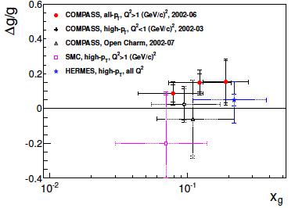
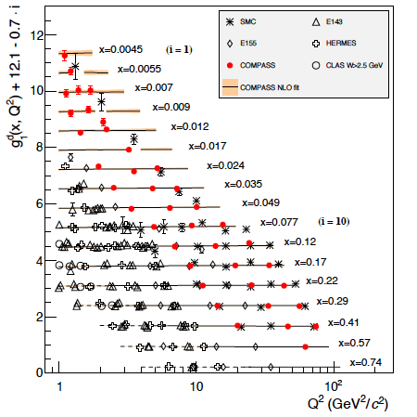
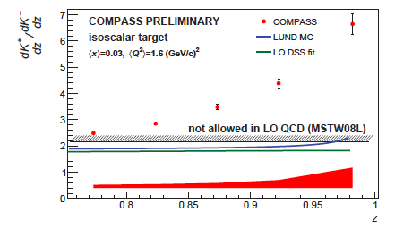
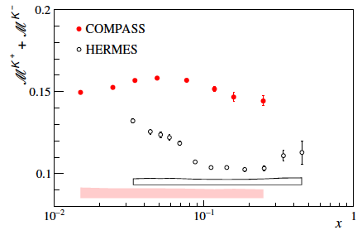
(SI)DIS longitudinal/transverse
g₁^{d} ( PLB 769 (2017) 034, together with the results on the proton spin structure function g^{p}₁ , this results constitute the COMPASS legacy on the measurements of g₁ structure function.
Δg/g final result PJC 77 (2017) 209
Charged kaon multiplicities (2006 160 GeV ⁶LiD) – published in PLB 767 (2017) 133
Recently new results were produced on the kaon multiplicity ratio K⁺/K⁻, at high z, 0.75 < z < 1 (hep-ex/1802.00584, sub. PLB)

Slide 8
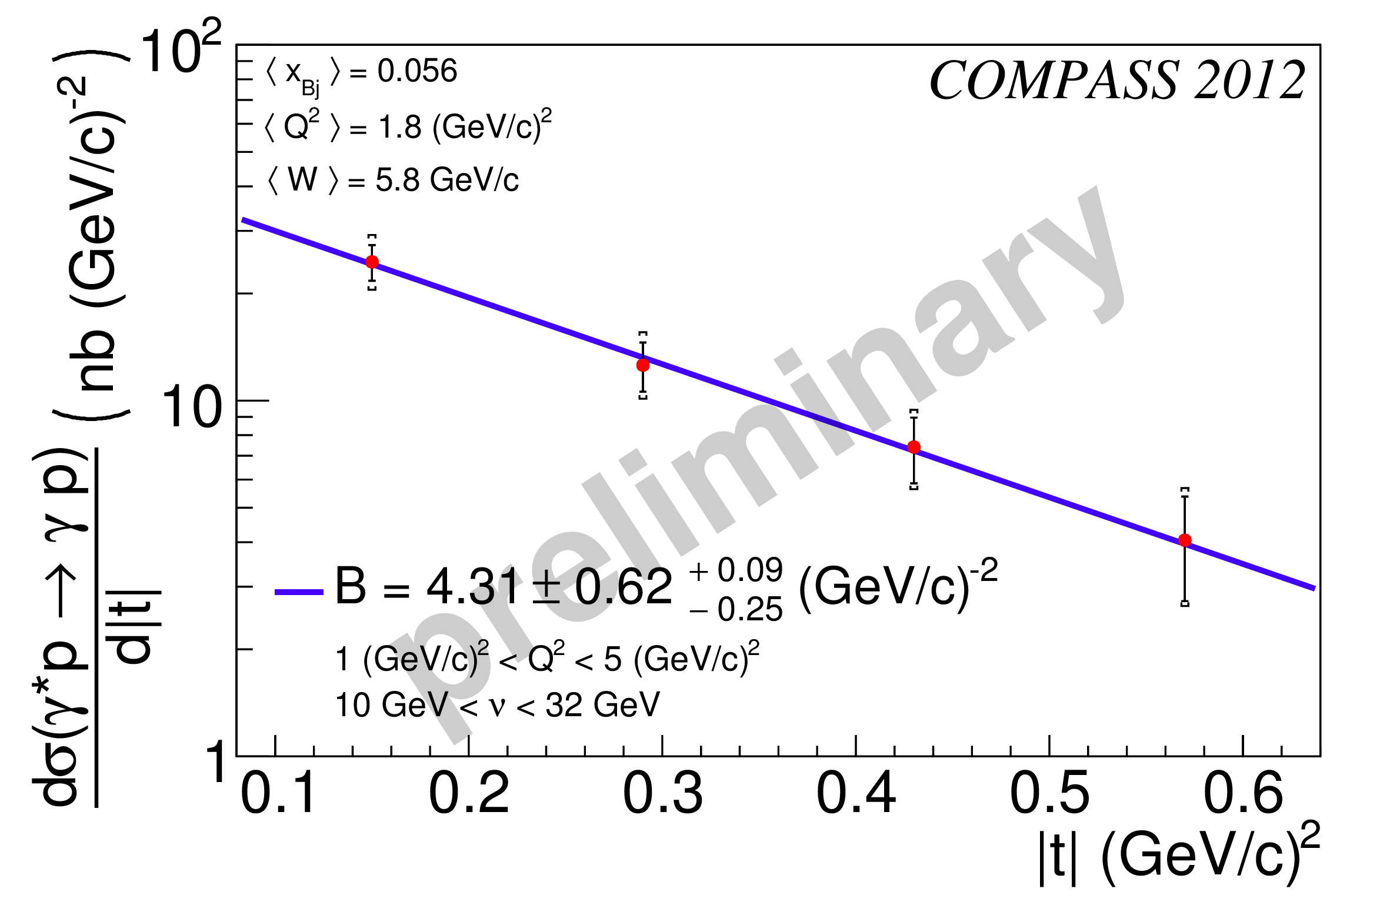
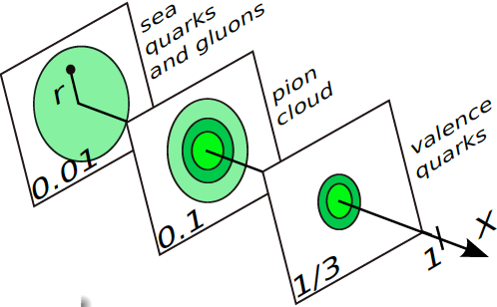
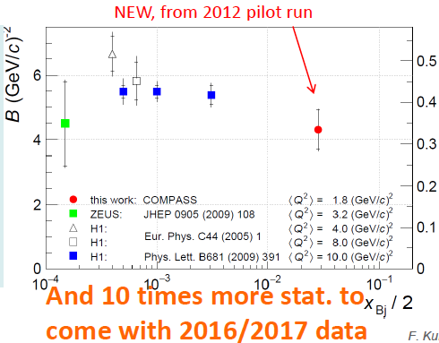
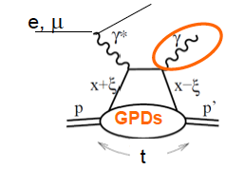

GPD 2012 results
(first DVCS results were published this year)
Ref: hep-ex/1802.02739, sub. PRL

Slide 9
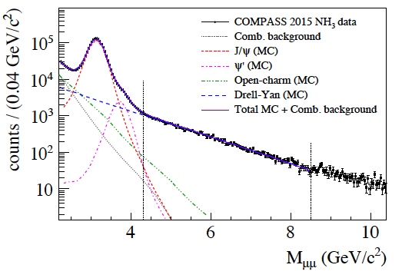
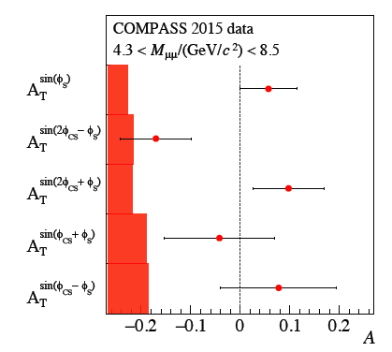
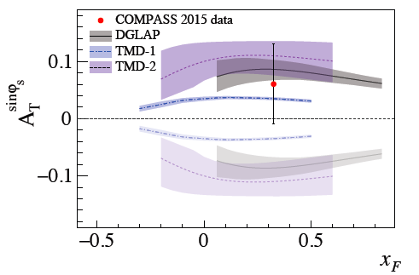
COMPASS Drell-Yan Run 2015 results I
First ever polarised Drell-Yan data
First ever polarised Drell-Yan paper
(PRL 119 (2017) 112002)

Slide 10
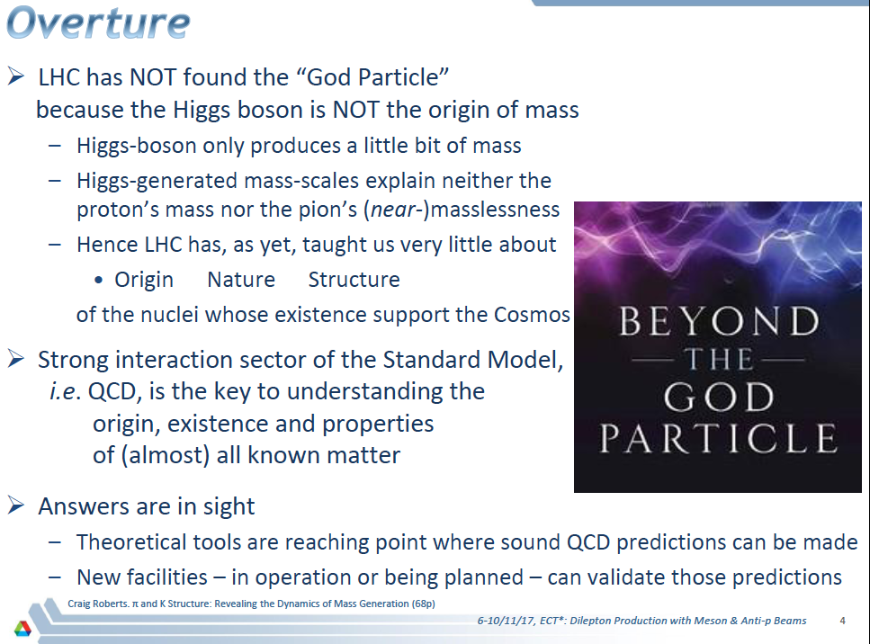
QCD Preamble

Slide 11
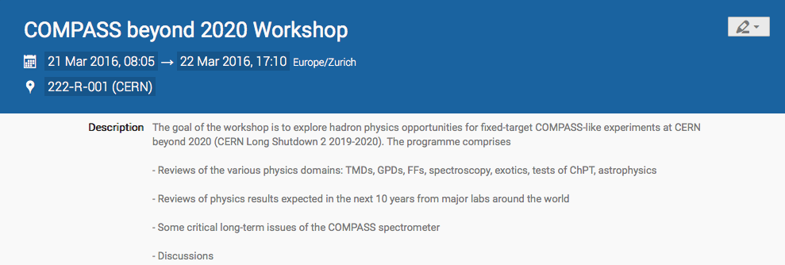
M2 Fixed Target QCD Facility Beyond 2020 I
- Good attendance (>100 physicists), large interest
11 “outside” review talks – Jefferson Lab, RHIC, Fermilab, KEK (Japan) BEPC II (IHEP, Beijing), NICA (JINR, Dubna), CERN (After, LHCb), GSI (Panda), J-PARC (Japan), EIC – China;
7 COMPASS talks (chronol.) – SIDIS, GPDs, Chiral Dynamics, astrophysics (dark matter), Drell-Yan, hadron spectroscopy;
2 “round-table”-like discussions on possible future with hadron and muon beams;
Outcome of the Workshop:
  RF Separated antiproton/kaon beam would provide a unique opportunity for future fixed target COMPASS-like program at CERN
  Existing muon and hadron beam allows to extend current COMPASS program by doing unique or first class measurements of exclusive processes, SIDIS and Drell-Yan

Slide 12
M2 Fixed Target QCD Facility Beyond 2020 II
The outcome of the COMPASS Beyond 2020 Workshop was used as a basis for
a talks given at Physics Beyond Collider workshops in September 2016, March and November 2017 (see for more details PBC web page:
http://pbc.web.cern.ch/)
Possible physics program for the fixed target experiment at M2 line was extensively discussed then at the COMPASS-organized International workshop
In Cortona, Italy:
http://iwhss17.to.infn.it/
As a result of these discussions we decide to proceed in two steps:
First to ask for short extension of the COMPASS-II experiment (~1 year)
Second is to start preparation of the New Long Term Future Physics Program and to initiate creation of a new Collaboration

Slide 13
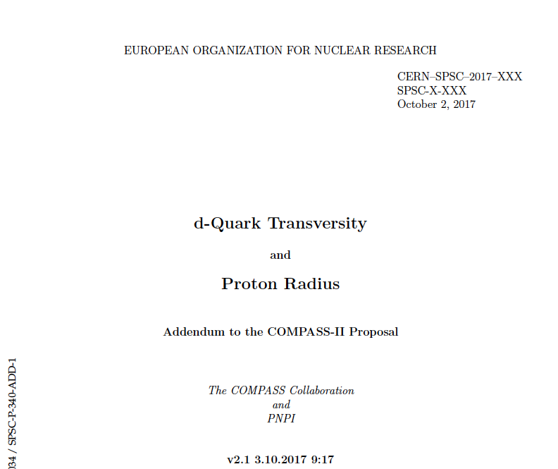
Short term COMPASS future
Short term future – Addendum to the COMPASS-II Proposal (extension of the COMPASS-II experiment for running after LS2 (2019-2020)) was submitted to the SPSC January 2018.
COMPASS 2021 deuteron run is approved by CERN Research Board on June 7th 2018

Slide 14
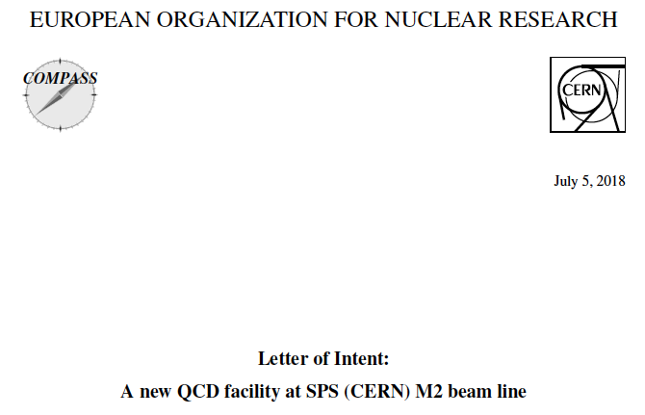
COMPASS-II ➔A new QCD facility at SPS
Long term future COMPASS-like experiment LoI (new physics) is under preparation now. The goal is to bring together new Collaboration enthusiastic about opportunities of doing physics at CERN with conventional and newly designed RF separated kaon and antiproton beams. The total duration of the program reaches up to 10 years of running with hadron and muon beams.
Indications by European Strategy Group is expected at the beginning of 2020 (May?).

Slide 15
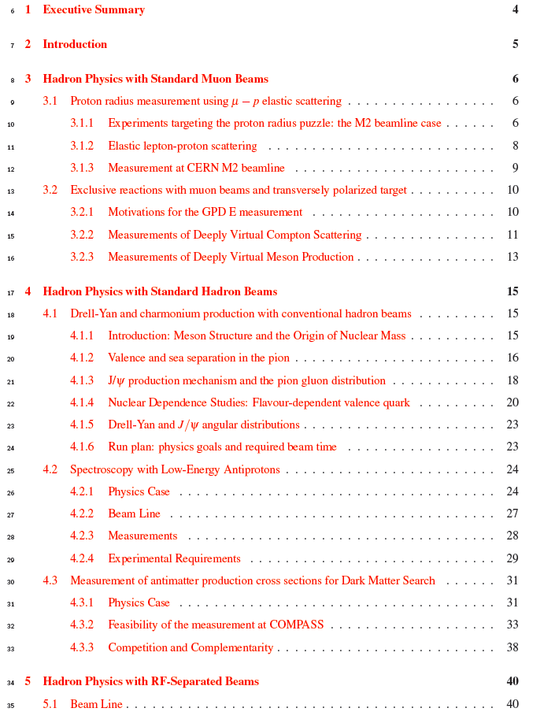
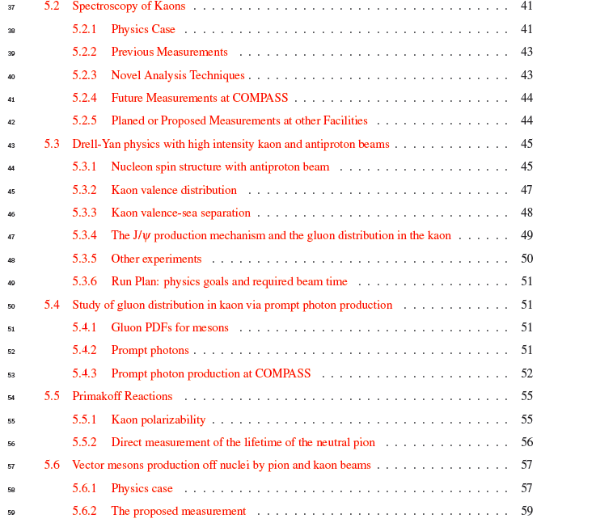
LoI content: Physics
The content of the LoI has been reported at
several PBC meetings in 2016 and 2017.
10 projects for the moment, at first stage we are going to use available hadron/muon beam, at the second – RF separated kaon and antiproton beam.
All beams we are going to use are unique
worldwide

Slide 16
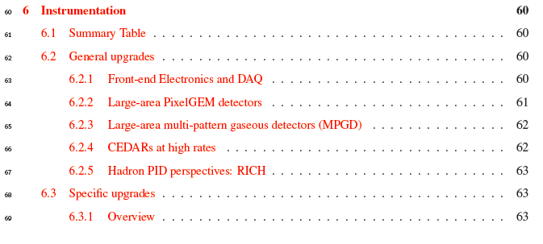
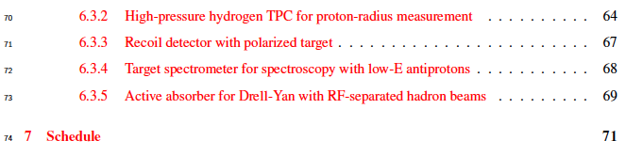
LoI content: Instrumentation
It is difficult to give exact cost estimate right now: it stays in the range 10-20 MCHF

Slide 17
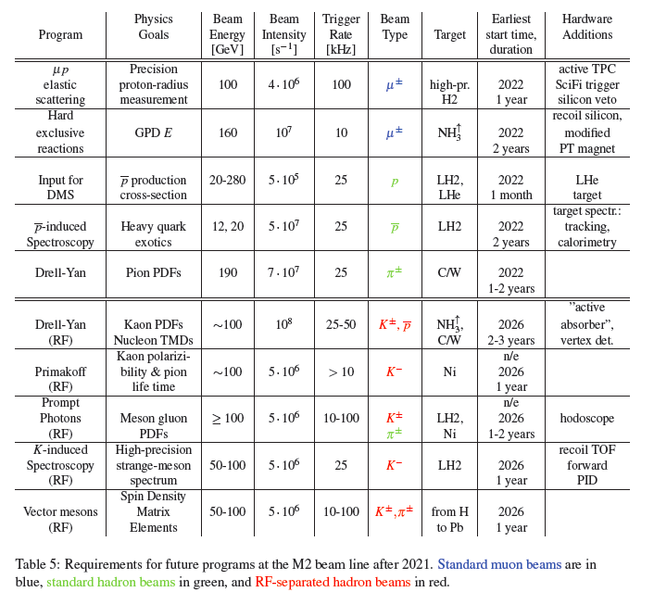
Summary table – beam requirements

Slide 18
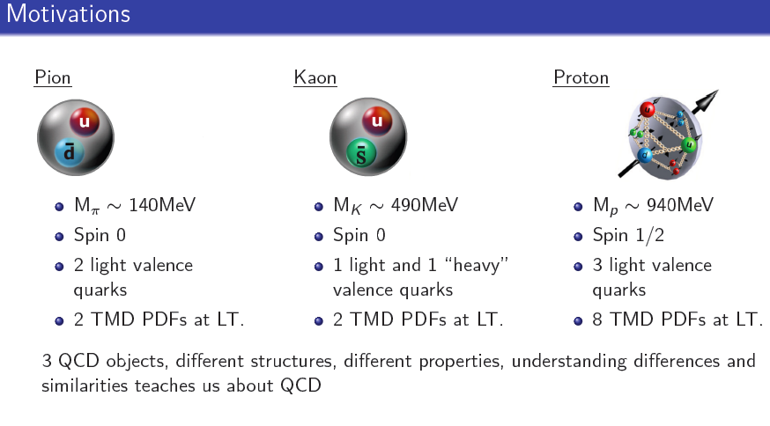
Existing pion beam hadron structure

Slide 19
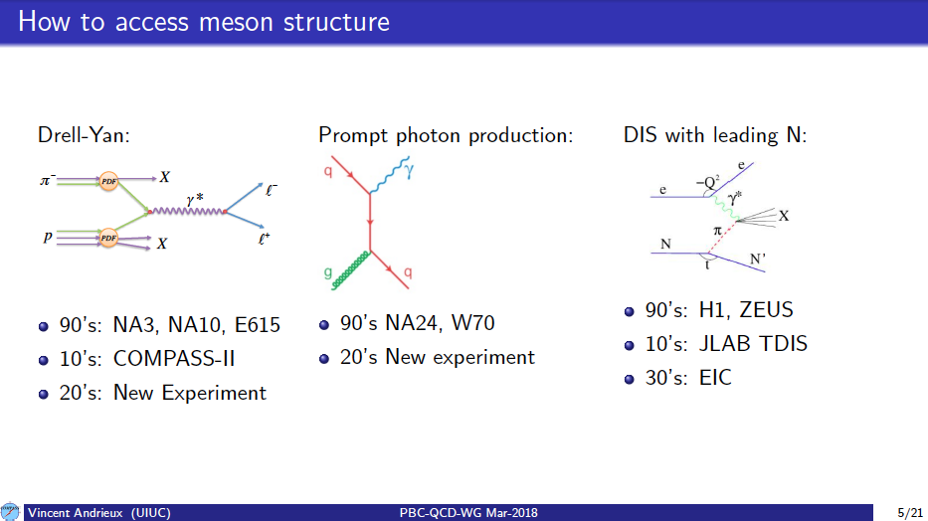
Existing hadron beam
We learned very little so far about meson structure

Slide 20
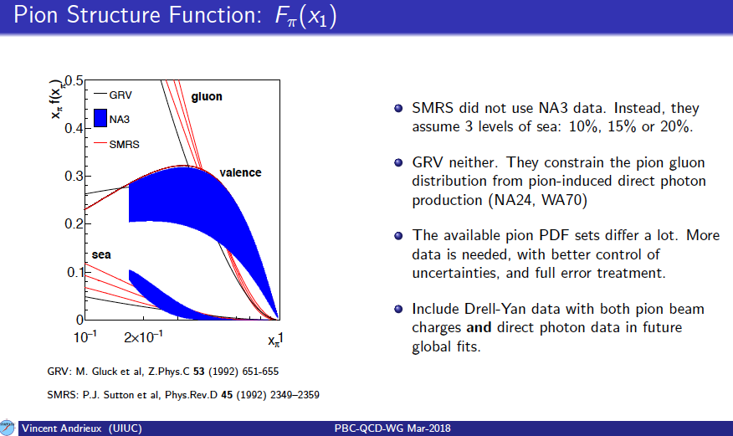
Existing hadron beam
Drell-Yan (I): pion structure

Slide 21
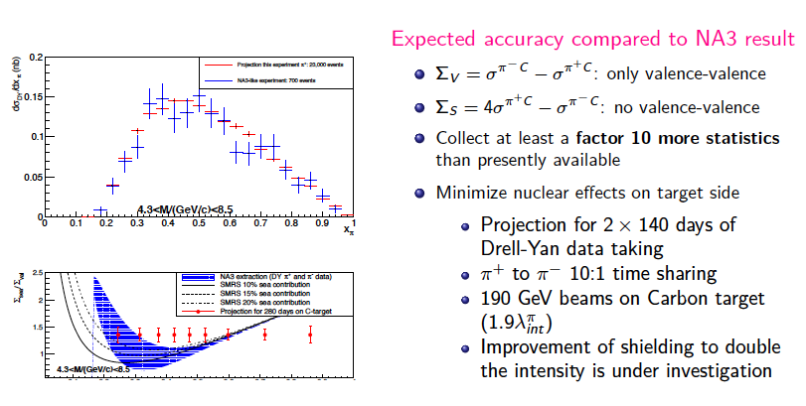
Existing hadron beam
Drell-Yan (II): competitiveness

Slide 22
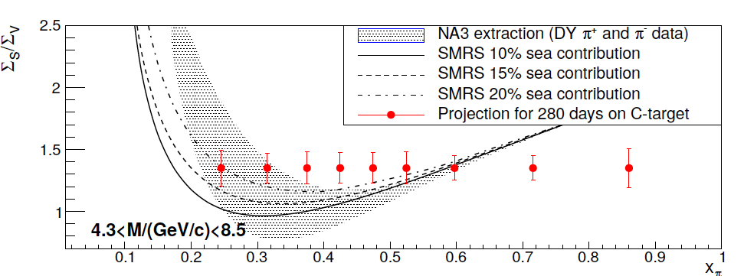
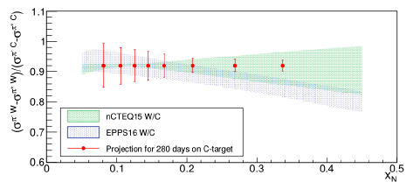
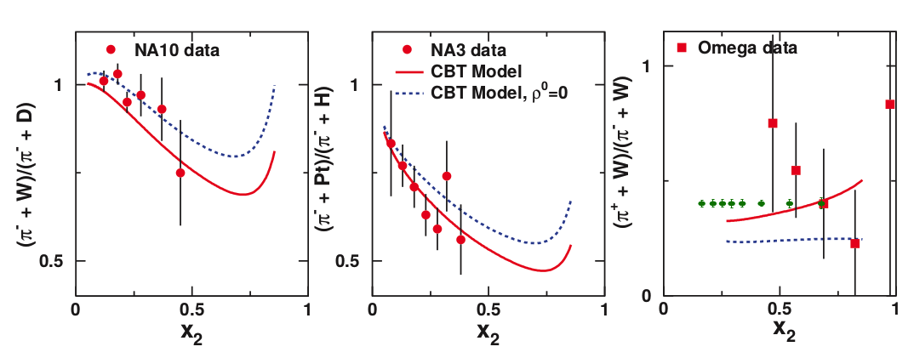
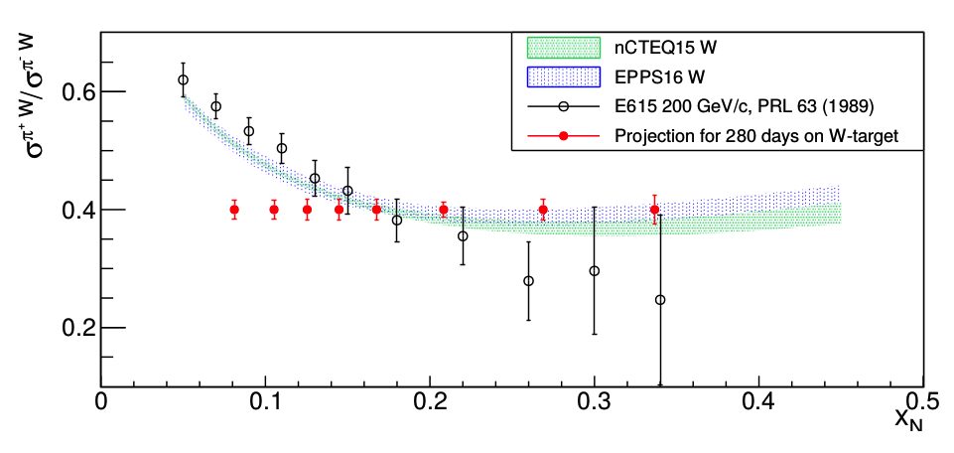
Existing hadron beam
Drell-Yan (III)
Statistical uncertainties projections for COMPASS-like experiment (1 or 2 years of running depending on beam intensity: 7x10⁷ or 1.4x10⁸ /s )
Time sharing 1:10 h⁻/h⁺ beam
sea/valence ratio in pion
EMC effect pion projectile (red - flavour dep.)
Nuclear PDFs (existing DY data already in)
Nuclear PDFs (valence)

Slide 23
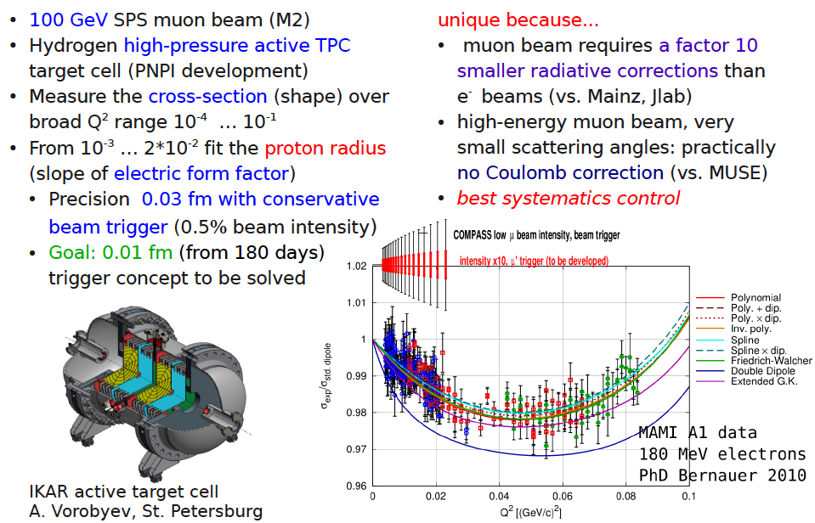
Existing muon beam:
Proton radius measurement in elastic mu-p scattering

Slide 24
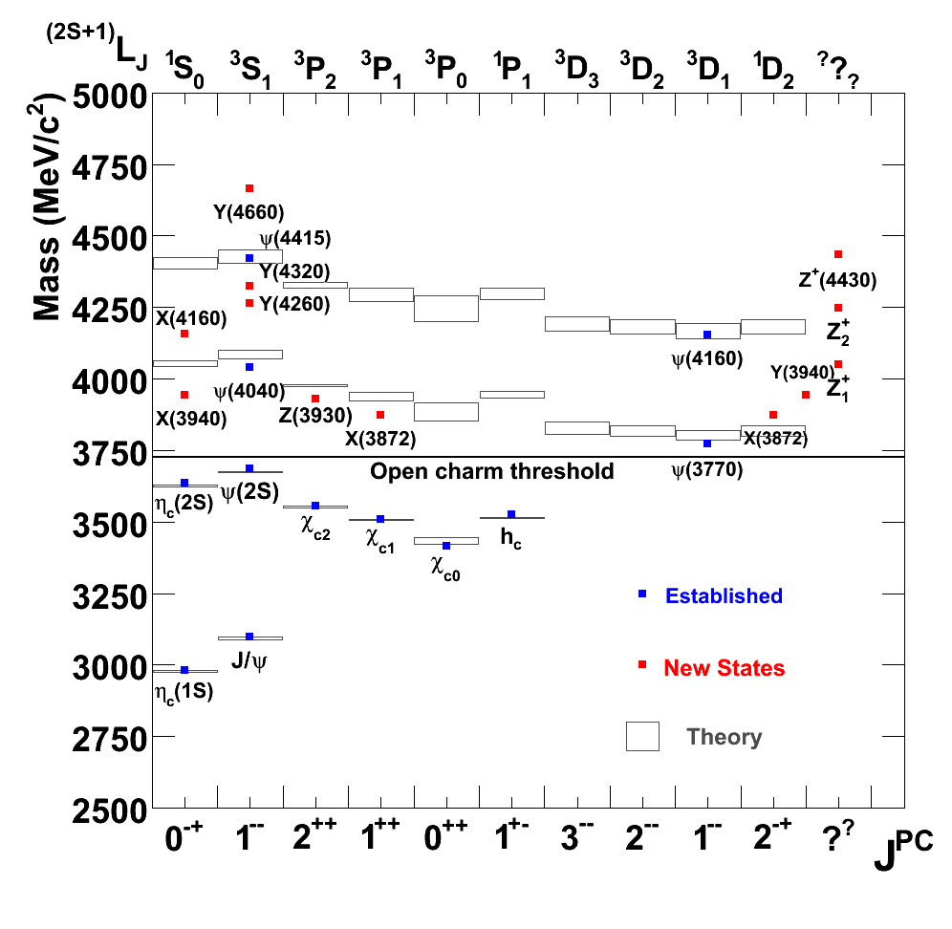
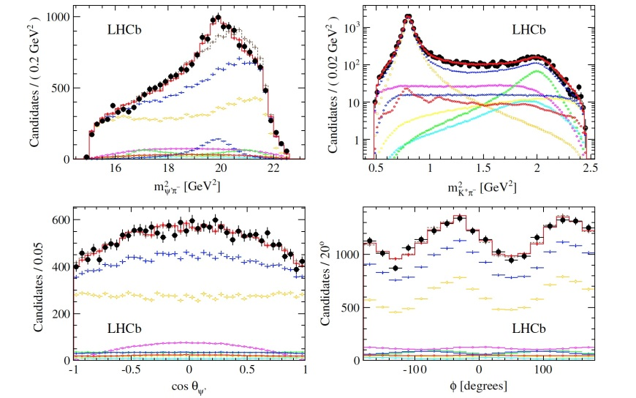
Existing beam line, antiproton-enriched beam
Charmonium spectra
Many new (narrow) states discovered in recent years
Assignment not clear
Some definitively not charmonium-like
LHCb: Z(4430)⁻: 13.9 σ
[V. Santoro, Hadron 2015]
[LHCb, PRL 112, 222002 (2014) ]

Slide 25
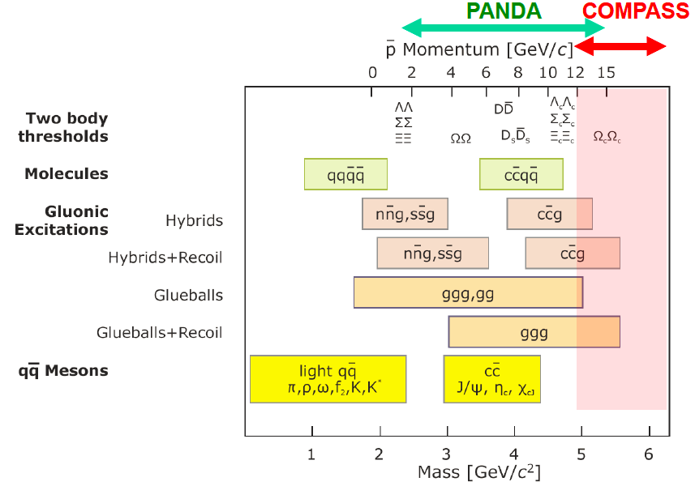
Existing beam line, antiproton-enriched beam
Charmonium-like mesons
M2 SPS beam line has to be retuned to extract
Antiproton beam (momentum ~ 20 GeV)
Method: antiproton-proton
annihilation
Goal: charmed hybrids and exotics
study in the mass range higher than
reachable in PANDA
Complementary to LHCb
(p-pbar annihilation – gluon rich
environment and it allows high spin
states)
Otherwise no competitors
for the next at least 10 years

Slide 26
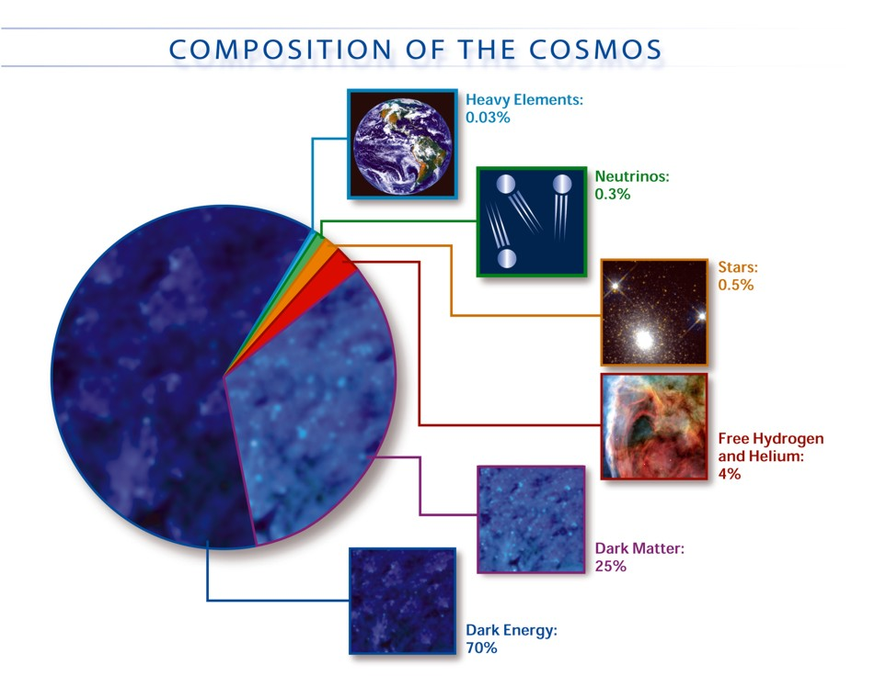
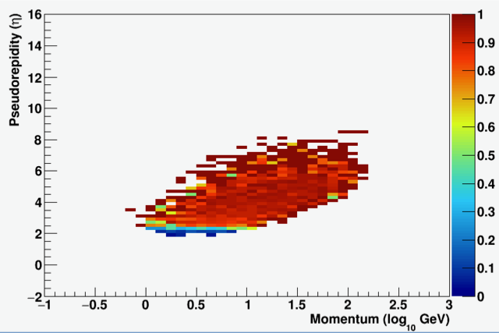
Existing proton beam:
Search for Dark Matter
Absolute cross section measurement p+He--> pbar+X
New AMS(2) data – the antiparticle flux is well known now (few % pres.)
(http://dx.doi.org/10.1103/PhysRevLett.117.091103)
Two type of processes contribute – SM interactions (proton on the ISM with the production for example antiprotons in the f.s.) and contribution from dark particle – antiparticle annihilation;
In order to detect a possible excess in the antiparticles flux a good knowledge of inclusive cross sections of p-He interaction with antiparticles in the f.s. is a must, currently the typical precision is of 30-50%.
COMPASS++ from a few tens of GeV/c up to 250 GeV/c, in the pseudorapidity range 2.4 < h < 8.
We performed simulation with TGEANT (GEANT4 based COMPASS MC), using FLUKA generator or the internal TGEANT generator:
2009 COMPASS hadron setup, 190 GeV beam.
New tCOMPASS associated members
for this project:
AMS: Paolo Zuccon (MIT), Nicolò Masi (Bologna)
Theoretical Physicist: Fiorenza Donato (Torino)
Goal is to measure the double differential (momentum
and pseudorapidity) anti-p cross production from p+p
and p+He at different proton momenta (50, 100, 190,
250 GeV/c).

Slide 27
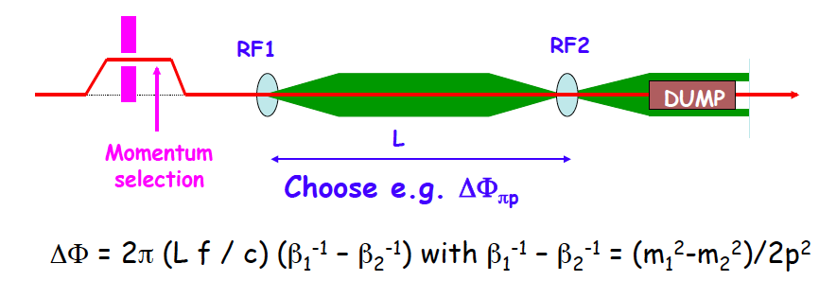
RF separated antiproton/kaon beam
“Normal” h⁻ beam composition:
~97% (π) ~2.5%(K) ~0.5% (pbar)
Assumptions:
– 8 x 10⁷ antiprotons for 10¹³ ppp (10 seconds) (optimistic estimate by Lau Gatignon);
– we assume here 4 x 10¹³ protons.
Antiprotons RF separated beam: 3.2 x 10⁷ /s - Gain is a factor of 50 compared to the standard h⁻ beam for Drell-Yan experiment (~1% of h⁻ beam 6x10⁷ /s dominated by π⁻)
Using the same assumption for RF separated kaon beam, possible kaon beam intensity is 8 x 10⁶ /s - Gain is a factor of 80 compared to to the standard “spectroscopy” h⁻ beam
High intensity RF separated beam will provide unique opportunities for
Hadron Spectroscopy and Drell-Yan physics

Slide 28
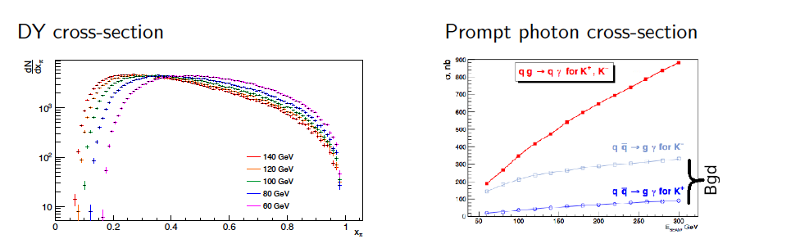
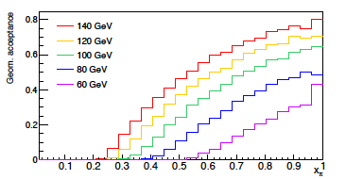
RF separated hadron beam
Meson structure study in DY and PP processes
Highest possible beam momentum is
Essential for both Drell-Yan and Prompt
Photons program

Slide 29
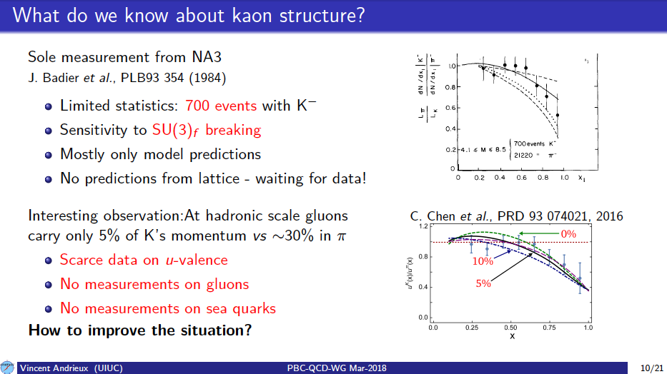
RF separated hadron beam
Meson structure study in DY and PP processes
Kaon structure

Slide 30
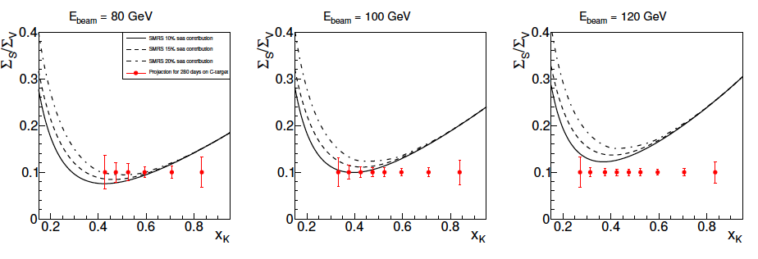
RF separated hadron beam
Meson structure study in DY and PP processes
Projection for valence/sea quarks separation in Kaon
First measurement of sea in Kaon
There is still a room for optimization
Assumed K⁺/K⁻ beam intensity 2x10⁷ /s
280 days of running

Slide 31
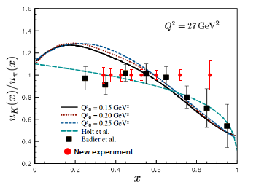
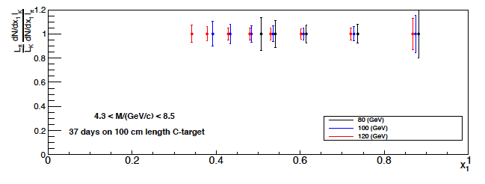

RF separated hadron beam
Meson structure study in DY and PP processes
Valence u-quark quarks in Kaon compared to pion

Slide 32


RF separated hadron beam
Meson structure study in DY and PP processes
At the moment there is no experimental information about gluon contribution in kaon. Calculations based on Dyson-Schwinger equations predict 6 times smaller contribution at hadronic scale in respect to pion (Phys. Rev. D93 (7) (2016) 074021)
Pythia-based MC simulation for prompt photons production was used for preliminary estimation of kinematic range accessible at COMPASS. It was compared with corresponding ranges accessible by previous experiments with pion beams.
Full MC simulation for prompt photons and minimum bias events was performed for K+ beam of 100 GeV/c and the COMPASS setup configuration of 2017 DVCS run. Possibilities to identify signal and reject background were tested. Some optimization of the setup from point of the material budget was tested.
NO competitors

Slide 33




RF separated hadron beam
Strange sector meson spectroscopy with Kaon beam

Slide 34



RF separated hadron beam
Strange sector meson spectroscopy with Kaon beam
Measurement of kaon Compton scattering via the Primakoff effect and an RF separated beam for determination of the kaon polarisability, and kaon-photon induced strange meson production

Slide 35

QCD facility – future fixed target experiment at M2
Spectrometer upgrades

Slide 36

QCD facility – future fixed target experiment at M2
Spectrometer upgrades

Slide 37


QCD facility – future fixed target experiment at M2
Spectrometer upgrades for Drell-Yan measurements with RF-separated beam

Slide 38
Current status & content of the LoI
LoI is open for new ideas and participants
~75 pages long document will be ready for distribution in the next 2 weeks
  We will leave it open for new ideas / participants for few months (do not exclude late new ideas/participants)
  We plan to submit it in the SPSC committee in September 2018
  In parallel we will go on with the Proposal preparation (submission is planned by the end of 2019)

Slide 39

Summary
“Beyond 2020” workshop (CERN, March 2016) and IWHSS (Cortona, Italy, April 2017) ➔ success, strong interest in the hadron physics community
RF separated antiproton/kaon beam will provide unique opportunity for meson spectroscopy and meson structure study
Existing muon and hadron beams allows to enrich current COMPASS program
New Collaboration should be founded in the next few years – JOIN!
New QCD facility physics program is 100% complementary to NICA SPD (exclusive processes)

Slide 40
Thank you!

Slide 41
SPARES

Slide 42


SIDIS transverse
Sivers and TSA in the Drell-Yan Q² bins
Sivers TMD PDF has a very particular feature - it contributes with opposite sign to SIDIS and DY. It is considered to be an essential prediction of Quantum Chromodynamics (QCD) going to be tested by COMPASS. If Sivers function comparison SIDIS⬅➔ DY is done at the same Q² we drop the uncertainties from the unknown QCD evolution of the Sivers TMD.

Slide 43



Exotic X(3872) lepto-production update
X(3872) is the first charmonium-like exotic hadron discovered by the Belle collaboration in 2003 and studied than in other experiments. Various interpretations exists: tetra-quark, DD*- molecule, hybrid ccg state, glue-ball or else.
Additional information on its width would help to shed light on its nature.
COMPASS muon beam data 2003➔2010
Study J/ψπ⁺π⁻ subsystem of exclusive final state J/ψπ⁺π⁻π±
Ψ(2S)
X(3872)
COMPASS di-pion mass spectrum is different compared to the Atlas observation.
5.3σ
4.7σ
Ref: hep-ex/1707.01796

Slide 44


DVCS 2012 results – exclusive π⁰
The exclusive meson production cross-section was extracted as a function of ϕ_{π0} (8 equidistant bins) in a single bin of t and in five bins of t after integration in ϕ_{π0}.
Comparison to the Goloskokov and Kroll model
shows a factor of approximately 2 lower cross-section as it is measured in experiment with respect to the model predictions.

Slide 45


Change over for Polarised Drell-Yan run
➔
Group | function |  | comment | Contacted?
Various TE-CRG-ML | Helium, piping, magnets |  | Reserve people, Check availability | yes
EN-EL | Electricity, cabling |  | 400V, 48V, AUL | yes
TE-EPC-LPC | Power supplies |  | Ready Jan. 2018 | yes
DT-DI | Programming, connection |  |  | yes
EN-HE | Platform, rotation, shielding |  |  | yes
TE-CRG-OD | Helium consumption Cold box Dewar LN₂ |  | Check for larger Dewar Check piquet service | yes
EN-EA | CEDAR/magnet support |  |  | Asking soon

Slide 46
SIDIS (kaon) multiplicities
Charged kaon multiplicities (2006 160 GeV ⁶LiD) – published in PLB 767 (2017) 133
The 3-dimensional data set (x, y and z) ➔ an important input for future NLO pQCD analyses
of world data in terms of FFs.
Important message – HERMES and
COMPASS data are in tension.
Can not be explained only by different
Q² range, the discussion is going on.
Recently new results were produced on the kaon multiplicity ratio K⁺/K⁻, at high z, 0.75 < z < 1. Surprisingly our data go far beyond the LO upper boundary value of (u+d)/(ū+đ) calculated at x=0.03 using MSTW08L as well as beyond the actual predictions of the K⁺/K⁻ multiplicity ratio using Lund model or LO DSS fit (hep-ex/1802.00584)

Slide 47




DVCS 2012 results II
Two competing processes (Bethe-Heitler and DVCS)
Contribute differently in the different x(ν)-ranges

Slide 48


DVCS 2012 results V: t-slope
Ref: hep-ex/1802.02739

Slide 49

Existing muon beam
Polarised DVCS
Generalised Parton Distributions (GPD) E and access to Orbital Angular Momentum
Recoil detector to be inserted in the COMPASS PT magnet
Muon beam, access to GPD E processes to be
measured:
  DVCS ( μ p↑ ➔ μ p γ )
  DVMP ( μ p↑ ➔ μ ρ (ω) γ )
Projections: ➔
Competitors: No competitors
in COMPASS kinematic range
(small x_{Bj})

Slide 50


COMPASS Drell-Yan Run 2015 results II
First ever polarised Drell-Yan paper (PRL 119 (2017) 112002)
Total number of J/ψ (NH₃) is ~ 1.500.00
Total number of HM DY (4.3 GeV/c^{2 <} M_{μμ} < 8.5 GeV/ c² ) (NH₃) is ~35.000

Slide 51
COMPASS Drell-Yan Run 2015 results V
Results on TSA & Sivers sign change
Mean TSAs. Systematic uncertainties are shown as error bands next to the vertical axis.
The measured mean Sivers asymmetry and the theoretical predictions for different Q² evolution schemes from Anselmino (DGLAP), Echevarria (TMD1) and Sun (TMD2). The dark-shaded (light-shaded) predictions are evaluated with (without) the sign-change hypothesis.
Polarised Drell-Yan data taking will be continued in 2018 with the goal to reduce an overall statistical error by a factor of 2

Slide 52



Existing muon beam:
Proton radius measurement in elastic mu-p scattering
Proton radius puzzle since 2010
(Pohl et al, Nature 466, 213)
Laser spectroscopy of muonic hydrogen
data are rather in agreement now with
electronic hydrogen spectroscopy data
(new determination of the Rydberg constant
can be used to reinterpret all electronic
hydrogen data) and e-p scattering data.
New experiment on μ-p scattering is a
missing peace in proton radius puzzle

