Slide 1
Deployment application for the COMPASS DAQ
Faculty of Nuclear Sciences and Physical Engineering
Czech Technical University
Jan Hrušovský
Jan.hrusovsky@cern.ch
12. 10. 2018
SPIN PRAHA 2018

Slide 2
Depployment proces - total
Deploying the RCCARS – Run, Control, Configure and Readout Software
20+ individual projects
Various dependencies -> specific order of the projects

Slide 3
Depployment proces – one project
Deploying each individual project
Set the right environmental $VARIABLES
Set valid $PATHS
qmake project.pro –par1 –par2
make makefile –par1 –par2
Total of 4 operations per each project

Slide 4
Depployment process – previous solution
Everything was performed manually
50+ operations in the terminal
Errors can occur in the end -> start over
Total time of deployment: 1-2 days

Slide 5
Depployment process – previous solution
Everything was performed manually
50+ operations in the terminal
Errors can occur in the end -> start over
Total time of deployment: 1-2 days

Slide 6
Depployment process – previous solution
Everything was performed manually
50+ operations in the terminal
Errors can occur in the end -> start over
Total time of deployment: 1-2 days
=> Application needed!

Slide 7
Application requirements
User-friendly application
Settings for every individual project
Specification of the order of deploying
Possibility to save all of the settings
Option to use different RCCARS versions
Save outputs from terminal
Technology: C++ with the Qt Framework

Slide 8
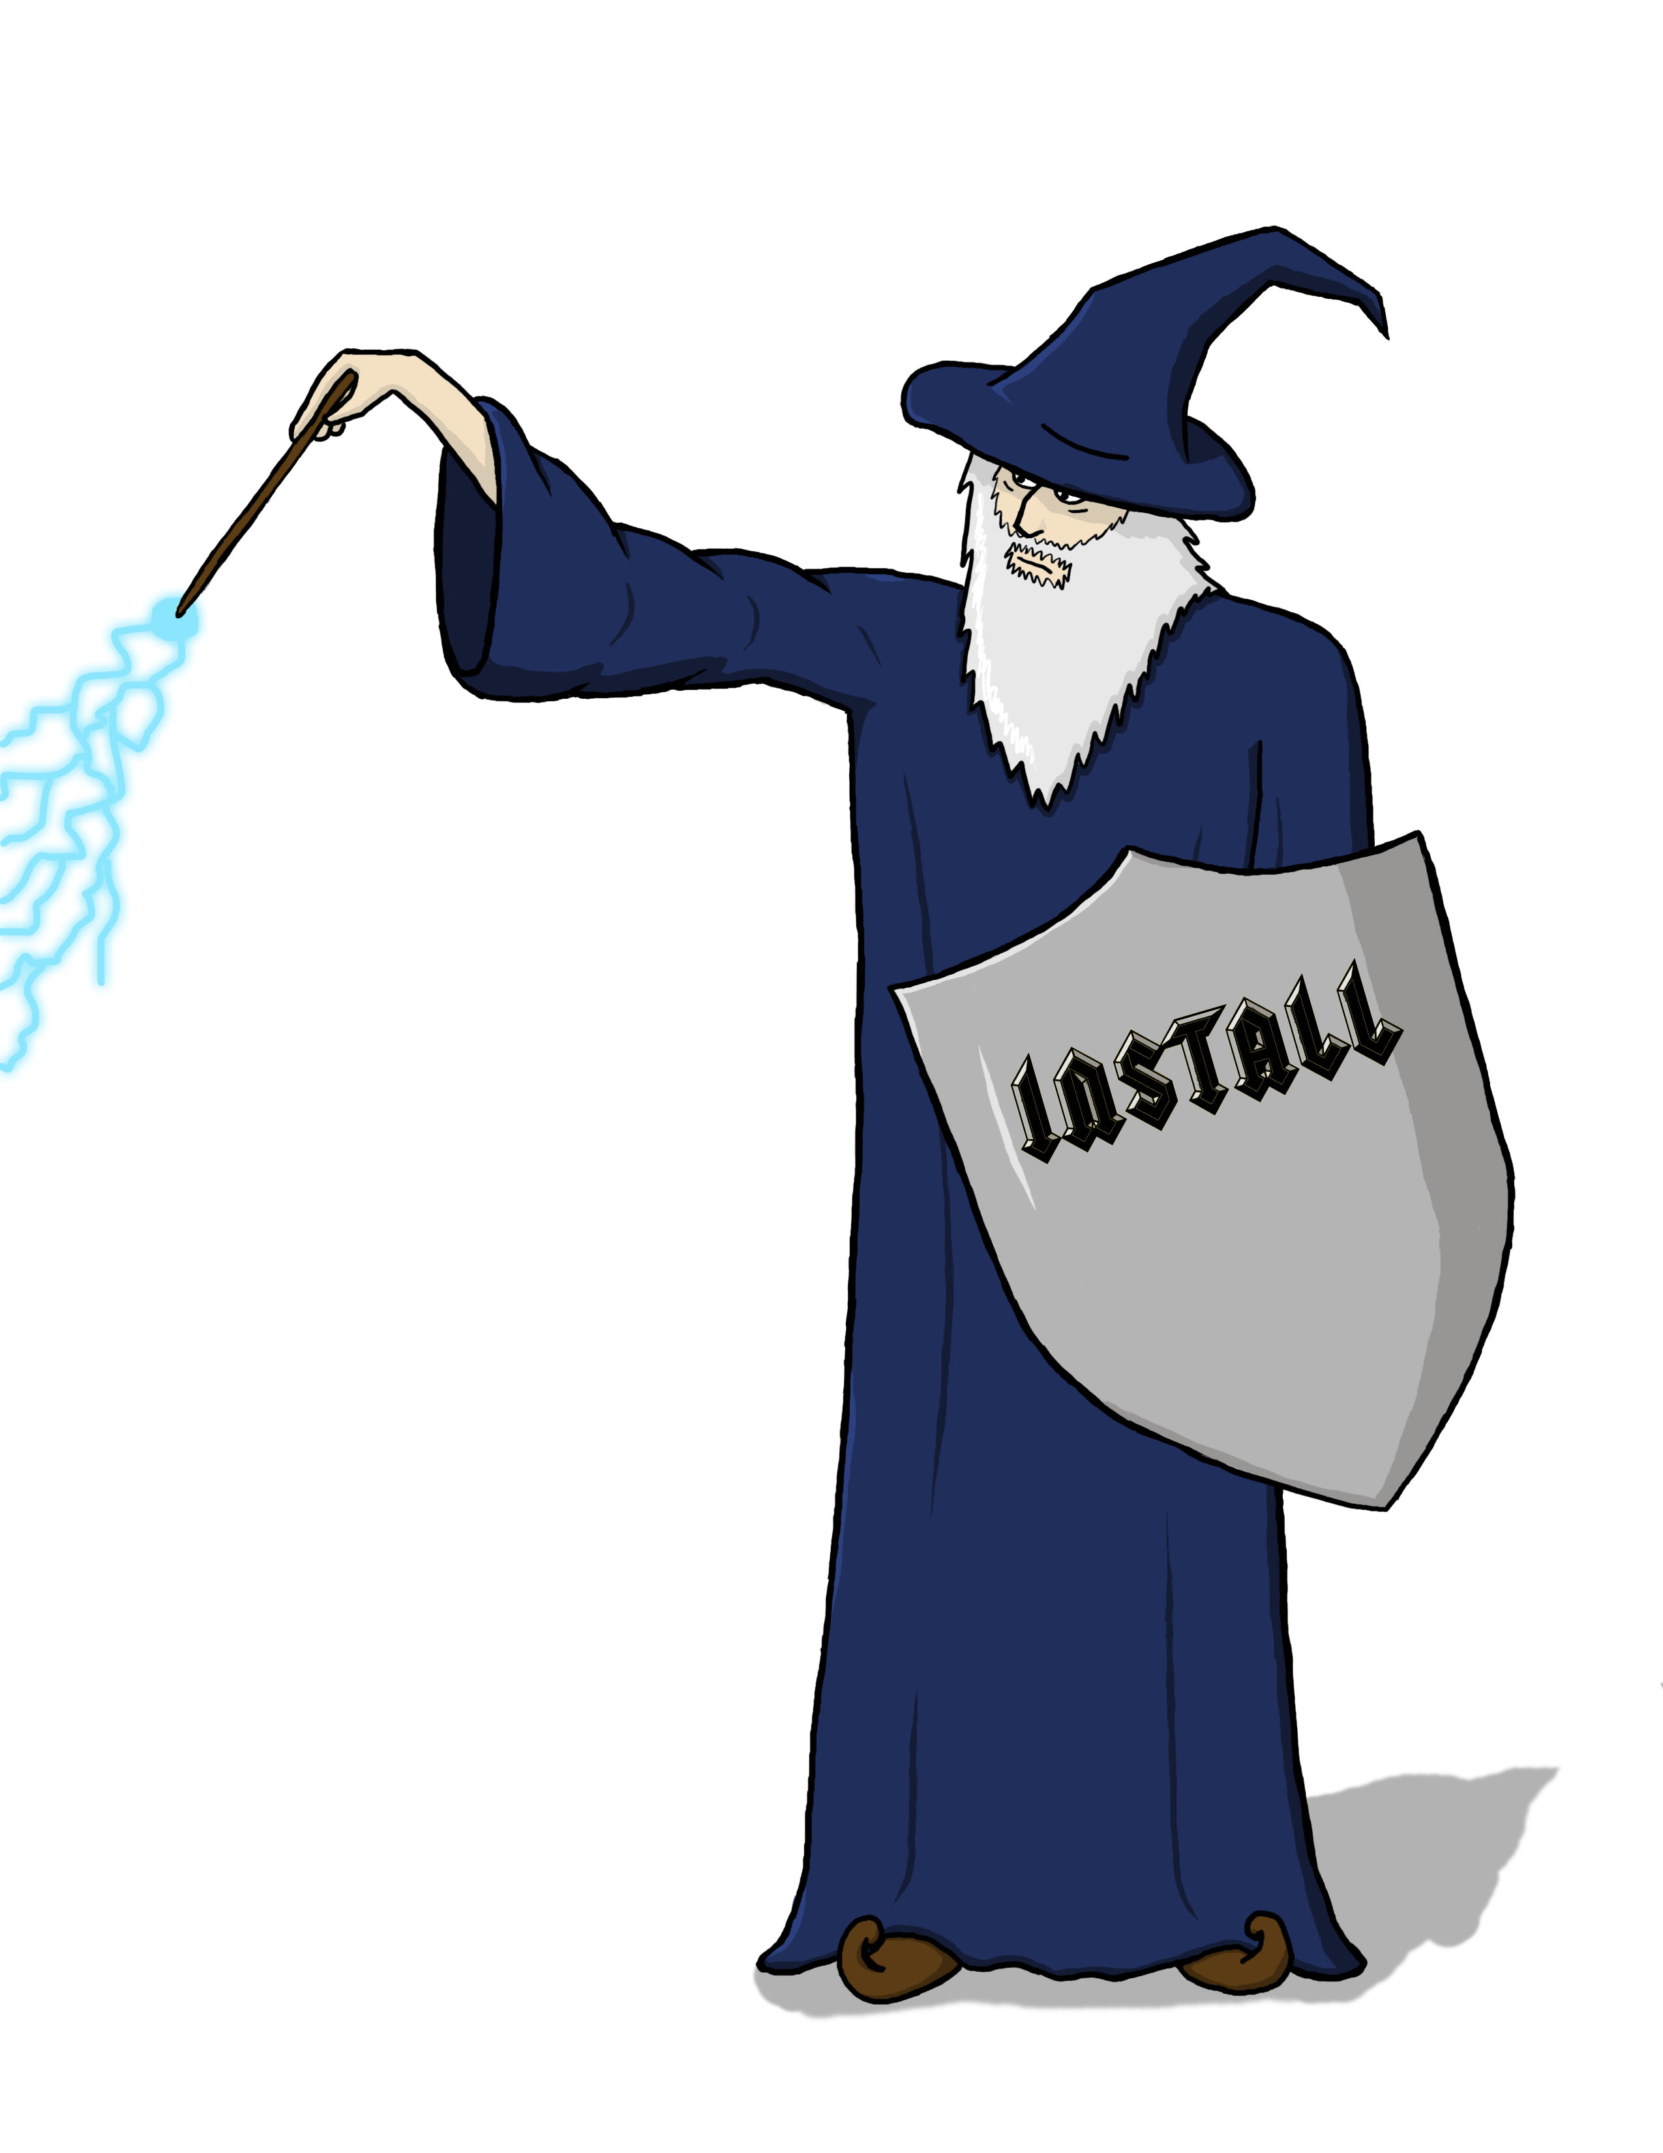
Result
Simply install shield wizard – ish application!

Slide 16
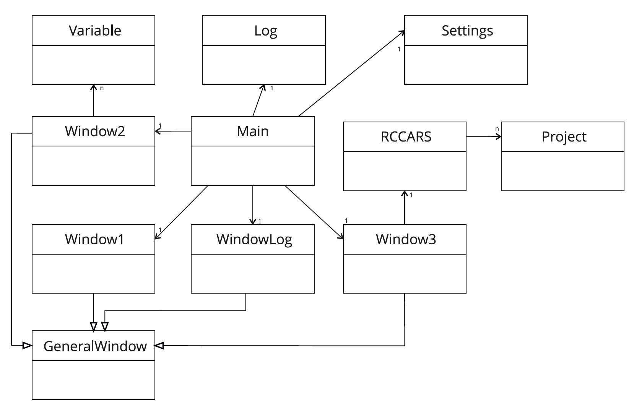
Implementation

Slide 17
Implementation
Application written in Qt 4
Files saved in XML
All commands are stored in seperate .cpp file
➔ user can easy change them

Slide 18
Requirements
Qt Framework 4.0+
Everything else depends on the projects (i.e. connection to CERN libraries)

Slide 19
Conclusion
!Versatility!
Easy to use
Requirements arise from projects only
Saves time (1-2 days to 30 min)

Slide 20
Thank you for your attention!

