Slide 1


Notes about spin at NICA
I.Koop, A.Otboyev, S.Mane*, P.Shatunov
Yu.Shatunov
Budker Institute for Nuclear Physics
Novosibirsk
Praga
June 2018

Slide 2

Spin problems
Polarized proton source
Acceleration in Nuclotron
Polarized beams
transfer to collider
Spin control in collider
Polarimetry
Luminosity

Slide 3
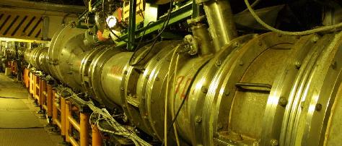
The Nuclotron ring of 251.5 m in perimeter is installed in the tunnel with a cross- section of 2.5 m x 3 m
 |  | Dipole | Quadrupole
1. | Number of elements | 96 | 64
2. | Mass, kg | 500 | 200
3. | Aperture, mm | 110x55 | 120x63
4. | Length of the iron yoke, mm | 1370 | 430
5. | Physical length, mm | 1462 | 450
6. | Number of turns in the winding | 2x8 | 4x5
7. | Length of superconducting cable in the winding, m | 62 | 24
8. | Induction at nominal current of 6 kA, T | 1.98 | -
9. | Gradient at nominal current of 5.6 kA, T/m | - | 33.4
10. | Stored energy, kJ | 19.8 | 6.9
11. | Dynamical heat releases per cycle, W :
 | at ^{dB}/_{dt} = 2 T/s, B_{m} = 2 T, f = 0.5 Hz | 21 | 12
 | at ^{dB}/_{dt} = 4 T/s, B_{m} = 2 T, f = 1.0 Hz | 53 | 21

Slide 4
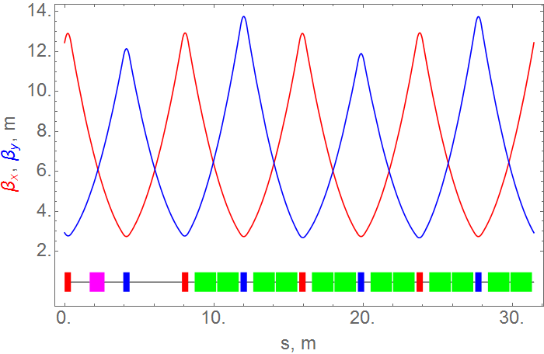
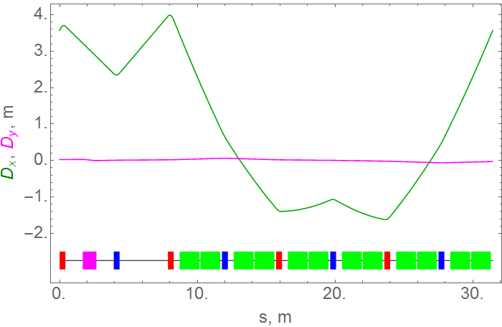

Nuclotron optics
Betatron tunes

Slide 5
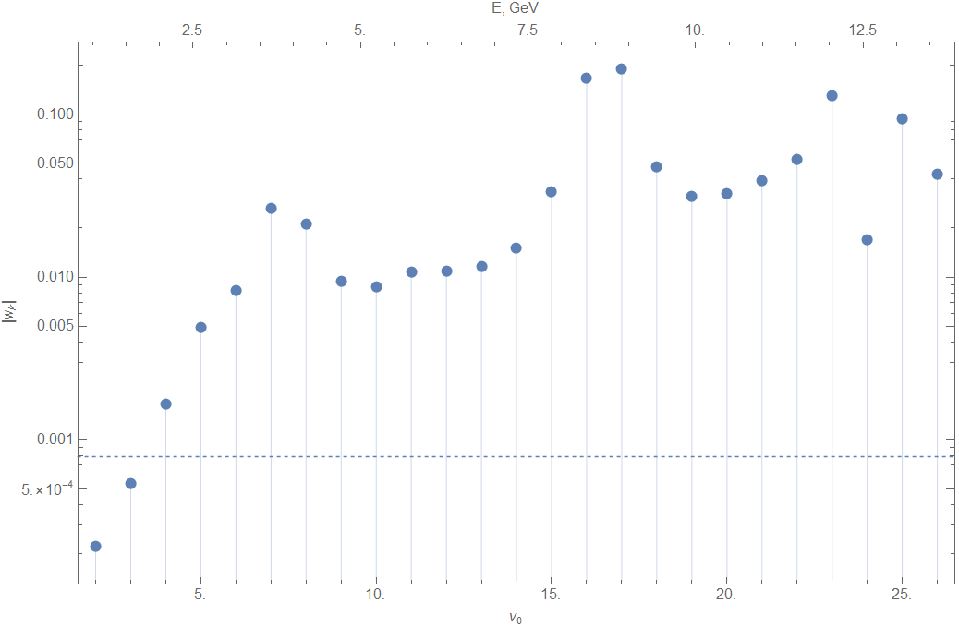
Imperfection resonances
ASPIRRIN code
E (GeV)
2.5 5 7.5 10 12.5
5 10 15 20 25

Slide 6
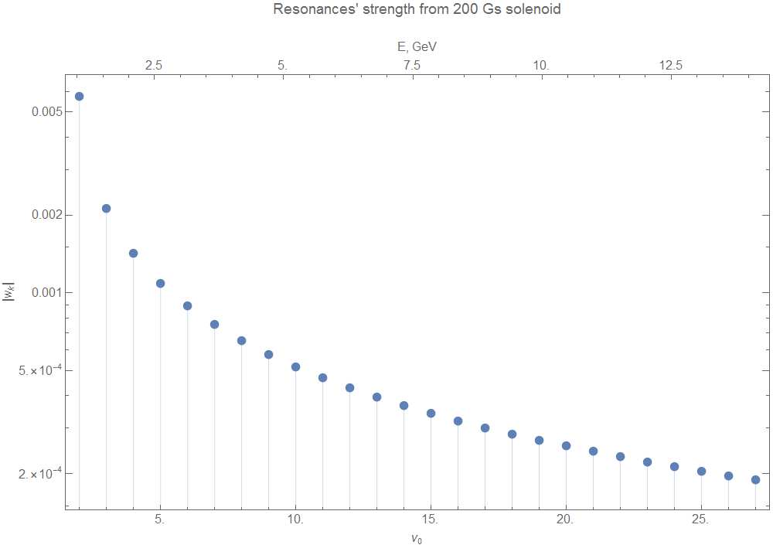
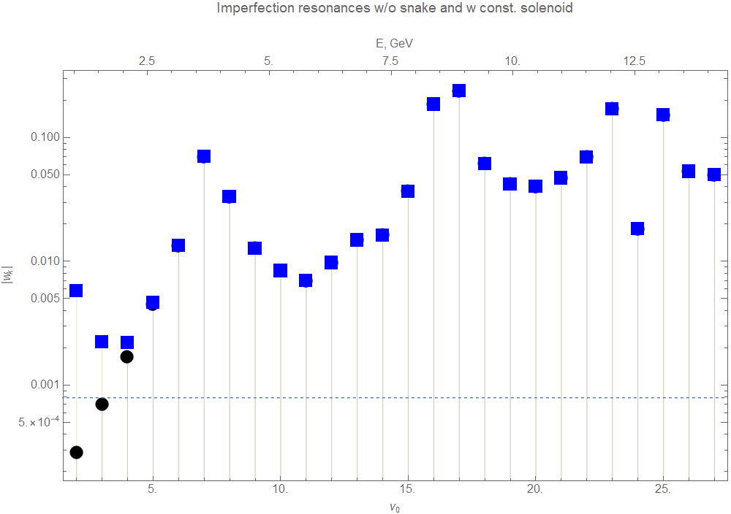
Parcial Siberian snake
Partial Siberian snake
Solenoid field 200 Gs m - const
ASPIRRIN code
Partial Siberian snake +

Slide 7
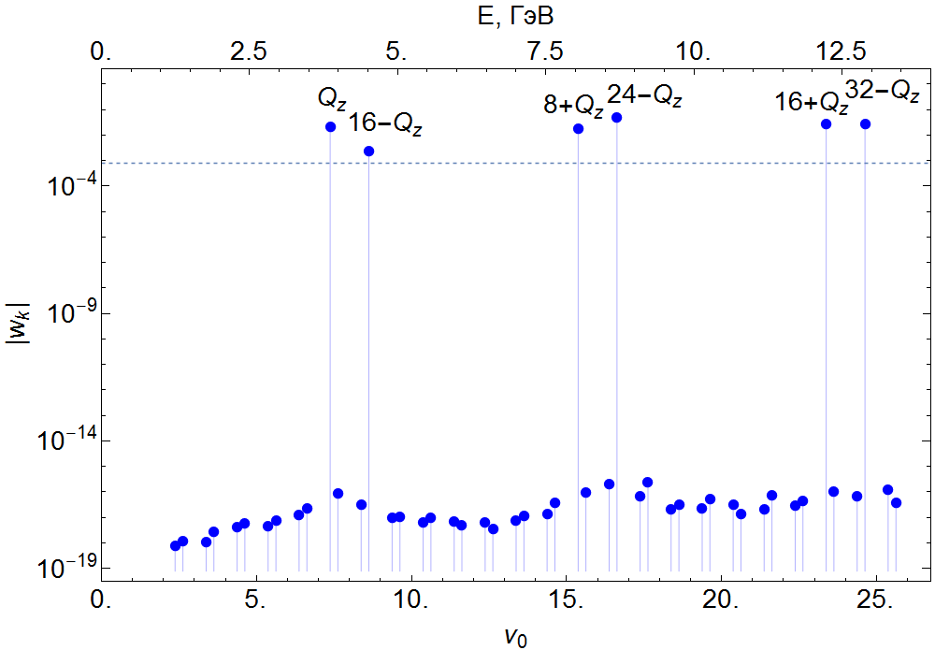

Intrinsic resonances
ASPIRRIN code

Slide 8
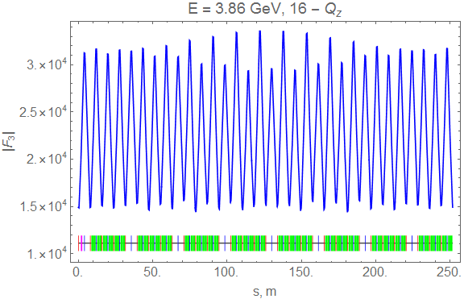
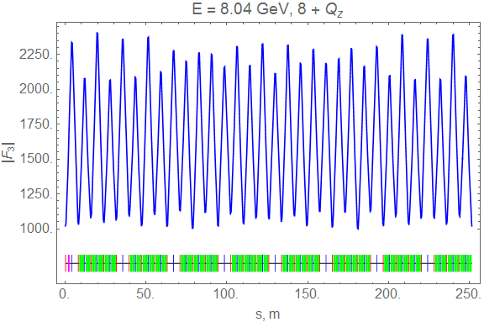
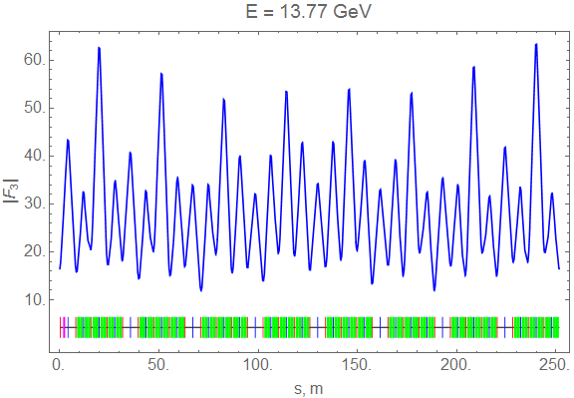
Intrinsic resonances and spin response functions
ASPIRRIN code

Slide 9
Tracking simulation
EILMS code

Slide 10
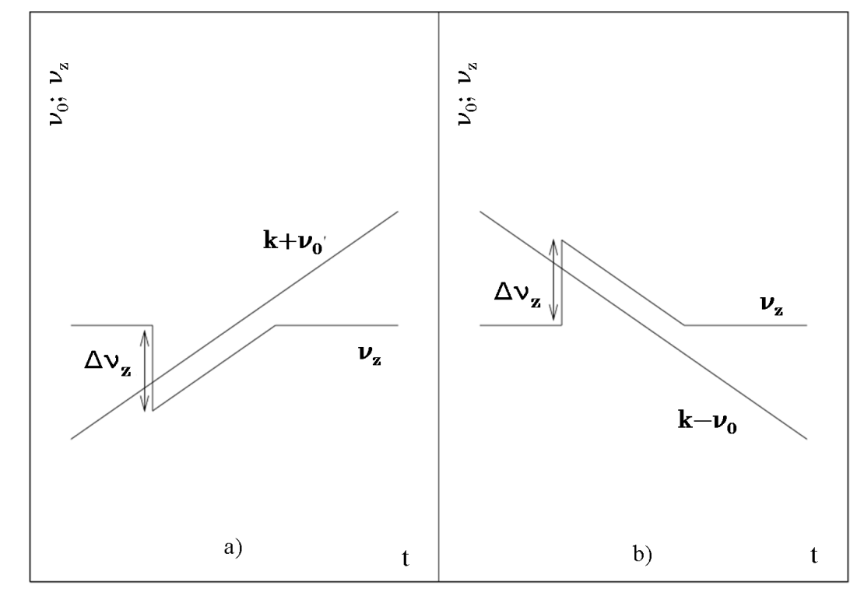
Polarized protons acceleration:
EILMS code
Adiabatic crossing

Slide 11
Polarized protons acceleration:
EILMS code

Slide 12
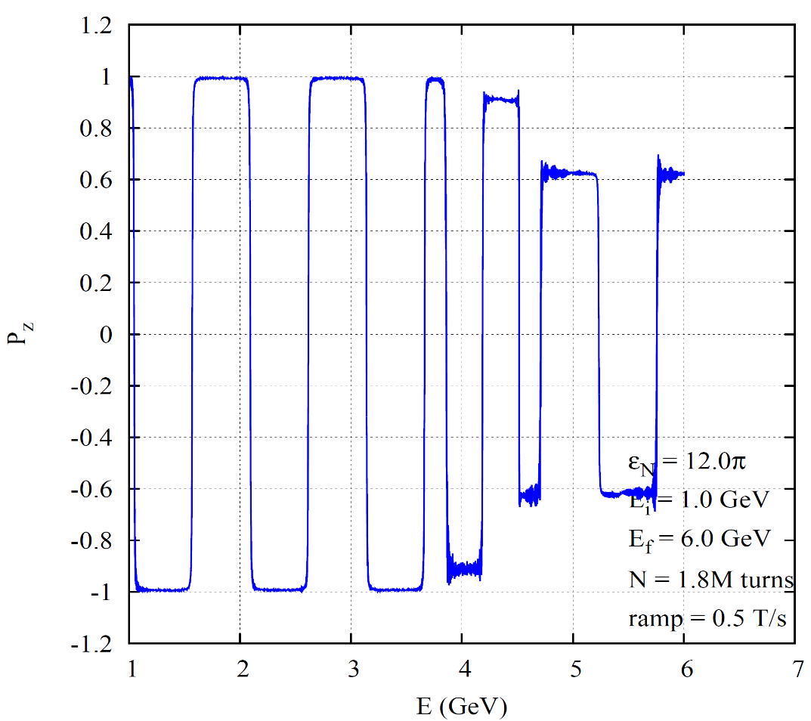
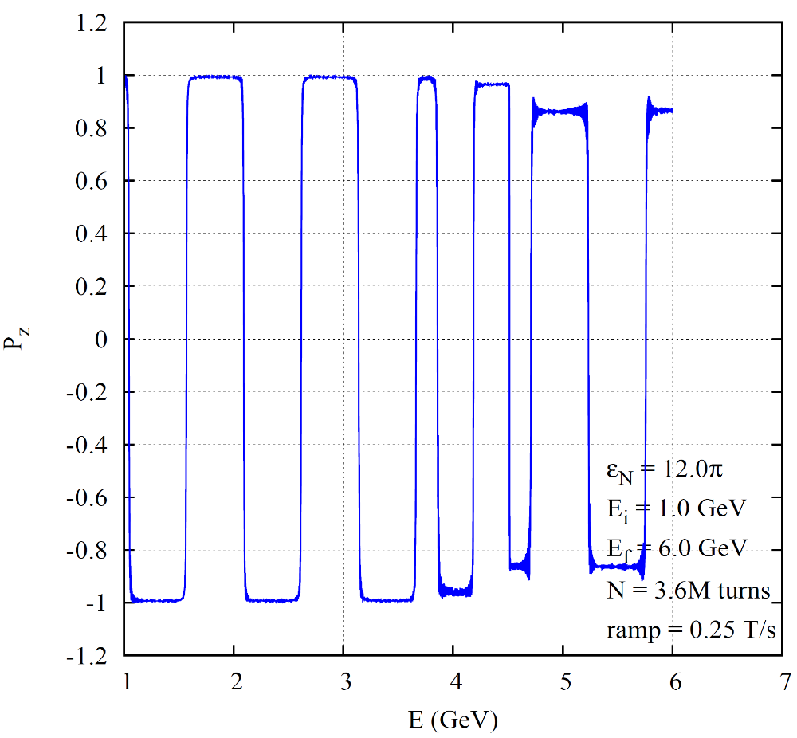
Polarized protons acceleration:
EILMS code

Slide 13
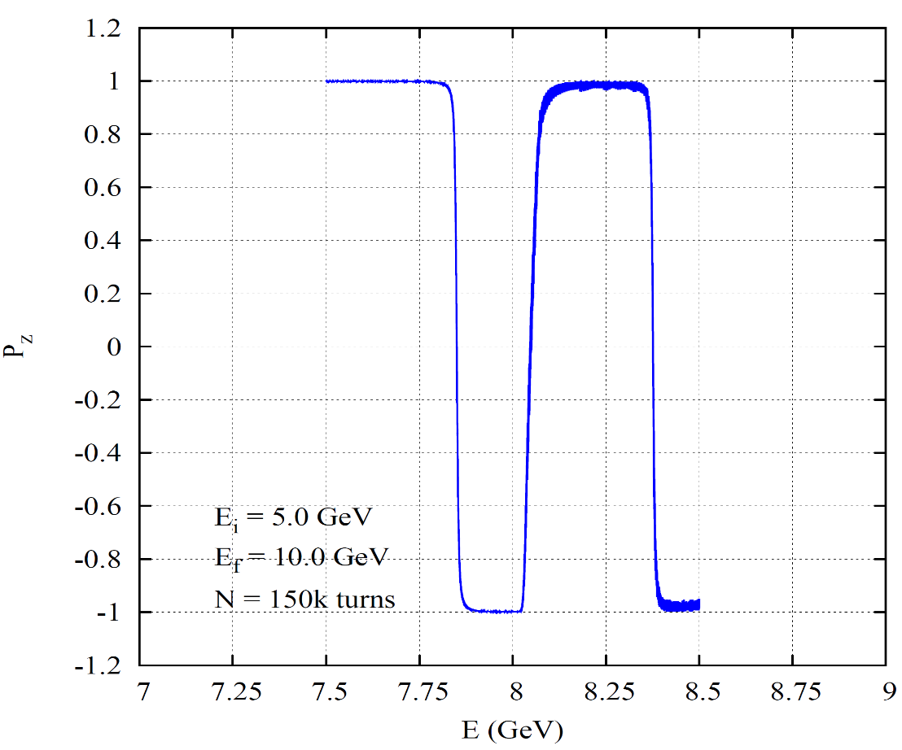
Polarized protons acceleration:
EILMS code
AC dipole:

Slide 14
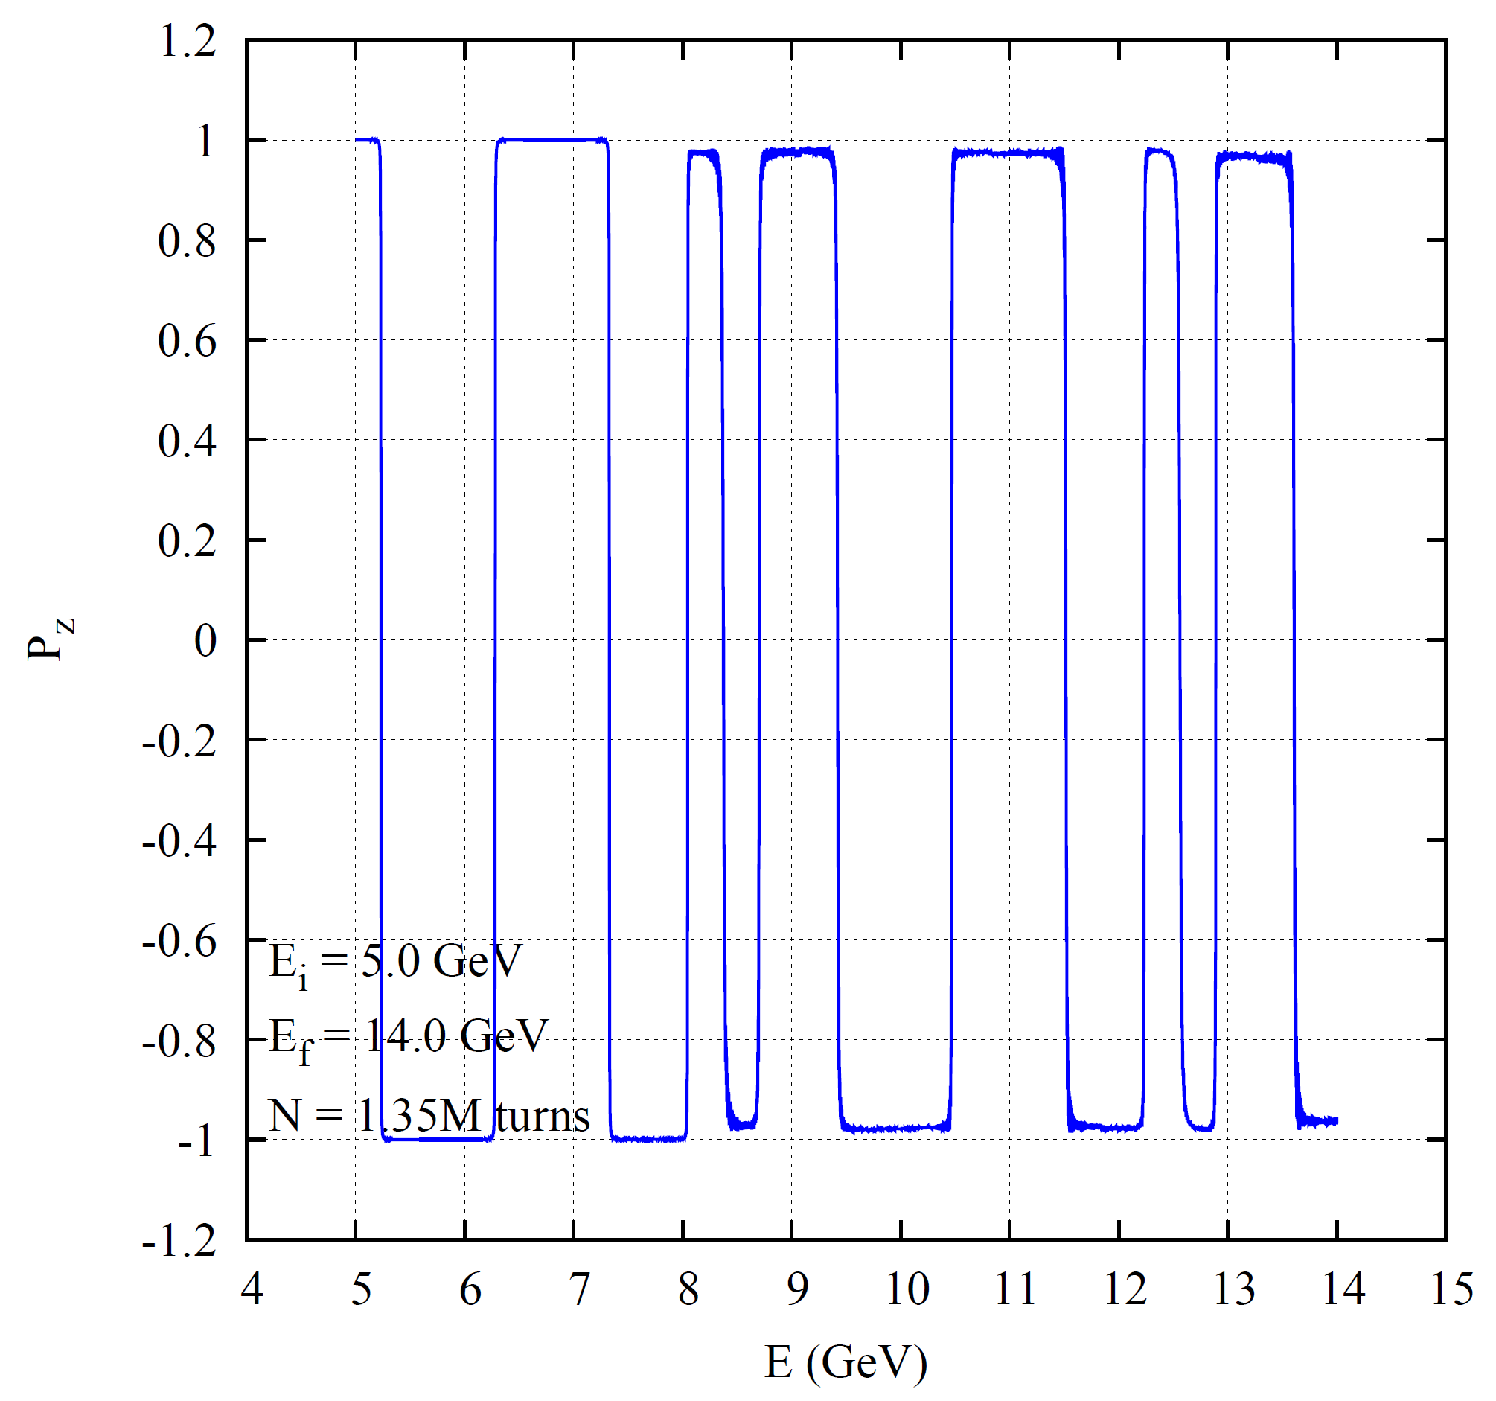
Polarized protons acceleration:
EILMS code

Slide 15
Nuclotron - summary
Polarized protons can be accelerated
at Nuclotron up to 14 GeV with small polarization losses.
Q-jump or adiabatic crossing should
be applied on the resonanses
Slower ramp and bigger emittance can help.
Luminosity?
an

Slide 16
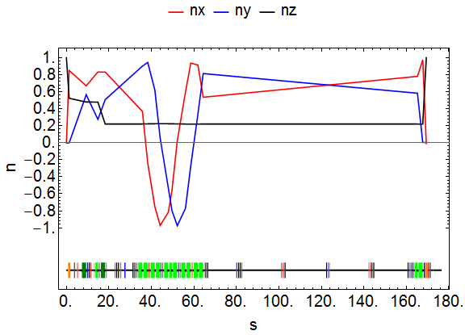
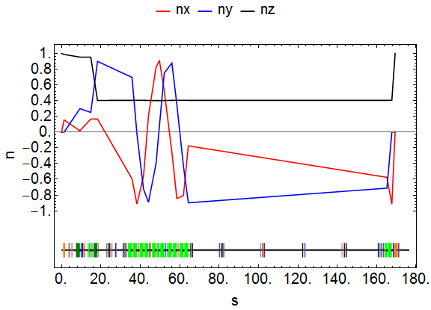
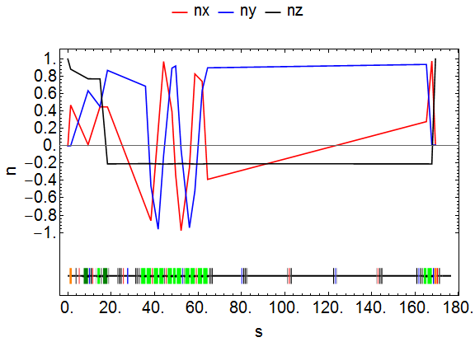
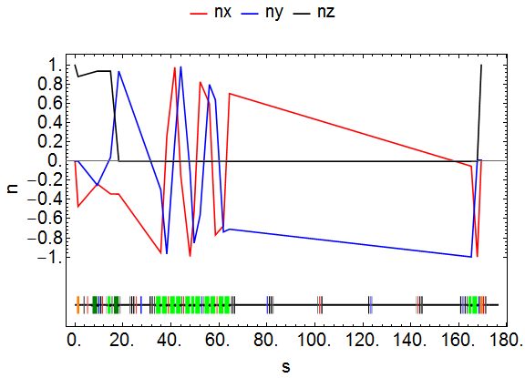

Polarized beam transportation to NICA (protons)
7 GeV
5 GeV
12 GeV
10 GeV

Slide 17
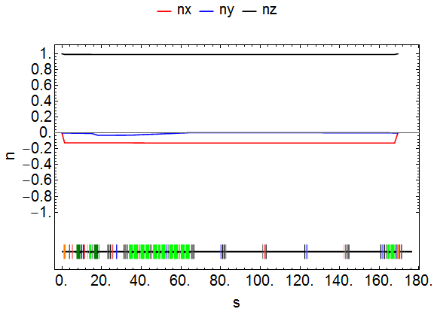

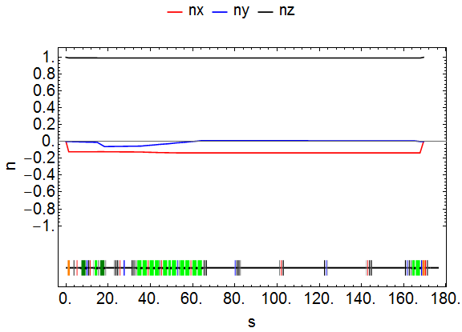

Polarized beam transportation to NICA (deuterons)
5 GeV
7 GeV
10 GeV

Slide 18
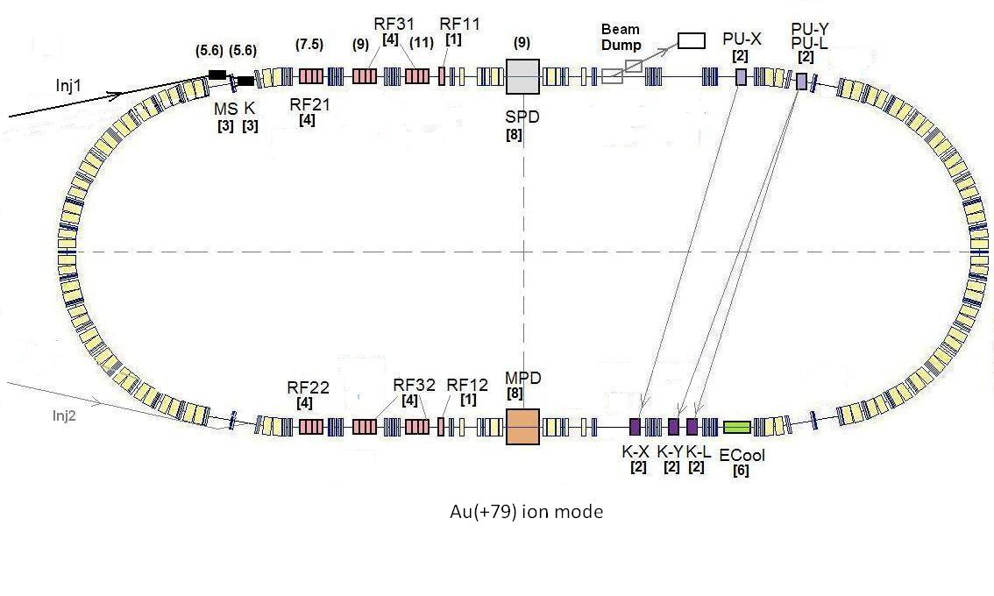
NICA polarization?

Slide 19
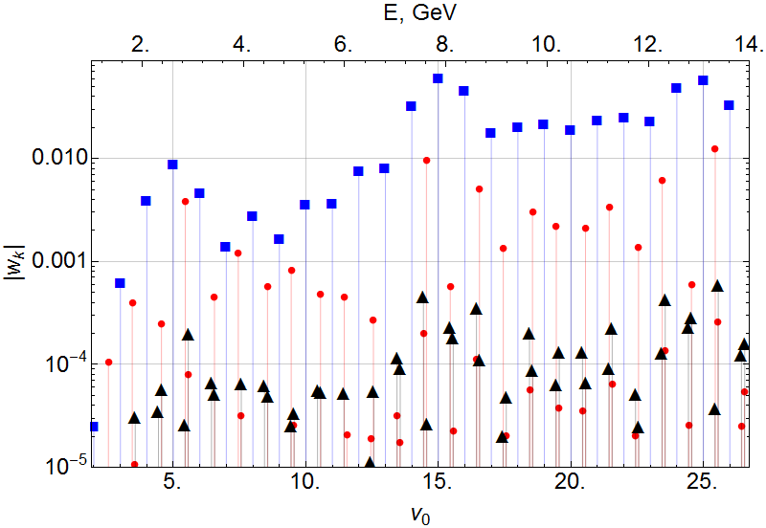

NICA spin resonances (proton)
ASPIRRIN code

Slide 20

Longitudinal polarization at NICA (protons)
at E_{exp}=E(ν₀ = k)
CO alignment to
Spin harmonic matching w_{k} <10⁻³
snake
Partial Siberian snake
Solenoid 3 ÷ 6 Tm
w_{k}(ν₀ = k)∼(2÷7)⋅10⁻²
Operation mode at E=E_{exp} (ν₀ = k)
1. Snake “off”
2. Injection of vertical polarized beam at
E=E_{exp} -∆E =E_{in}(ν₀ = k - ε) (ε ∼ 2÷3 w_{k} )
3. Snake “on” and E E_{exp} (slow)
k – odd
longitudinal polarization in opposite IP
k - even
longitudinal polarization in both IP

Slide 21
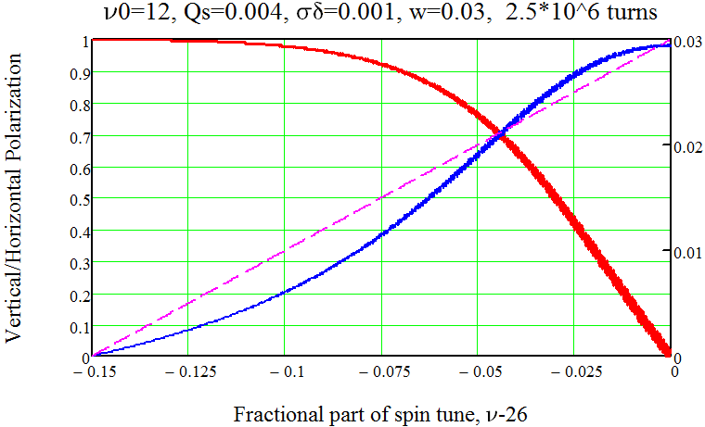
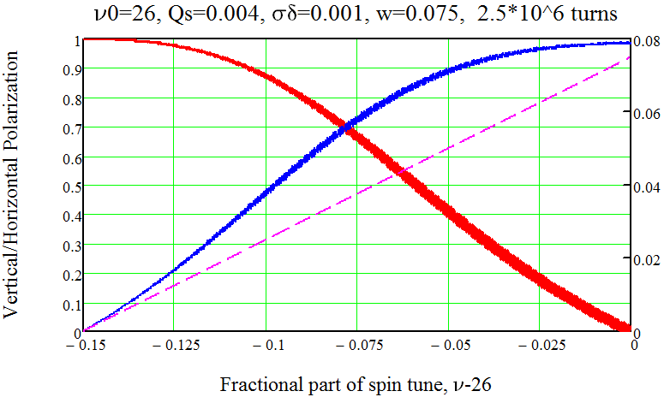

Simulation of snake operation
Synchrotron oscillation: Q_{y}=0.004;

Slide 22
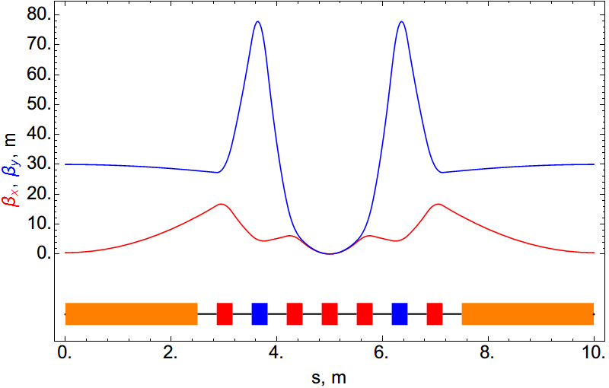
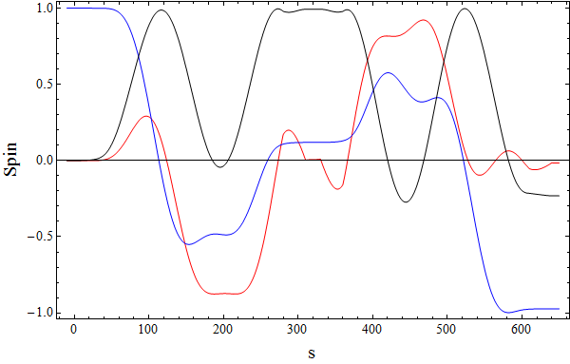
Full Siberian snake (protons)
snake
S_{y}
S_{z}
10 T
10 T
S_{x}
0 1.5 3.0 4.5 6.0 7.5 9.0

Slide 23
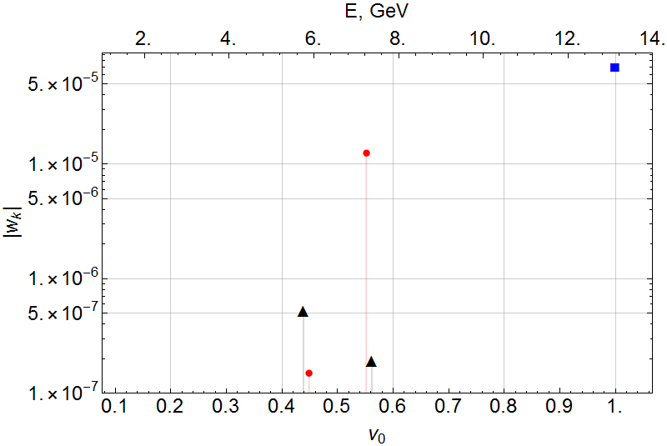
NICA spin resonances (deuteron)
ASPIRRIN code

Slide 24
Longitudinal polarization at NICA (deuterons)
Partial Siberian snake
Solenoid 0.5 Tm
w_{k}(ν₀ = 1)∼1⋅10⁻²
snake
Operation mode at E=E_{max}(ν₀ = 1)
1. Snake “off”
2. Injection of vertical polarized beam at
E=E_{exp} -∆E =E_{in}(ν₀ = k - ε) (ε ∼ 3 w_{k} )
3. Snake “on” and E E_{max} (slow)
longitudinal polarization in opposite IP

Slide 25
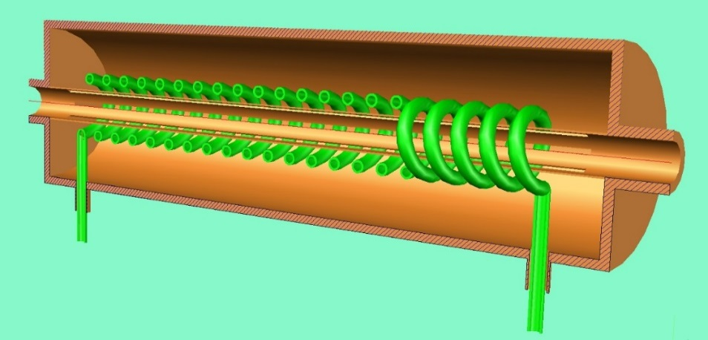
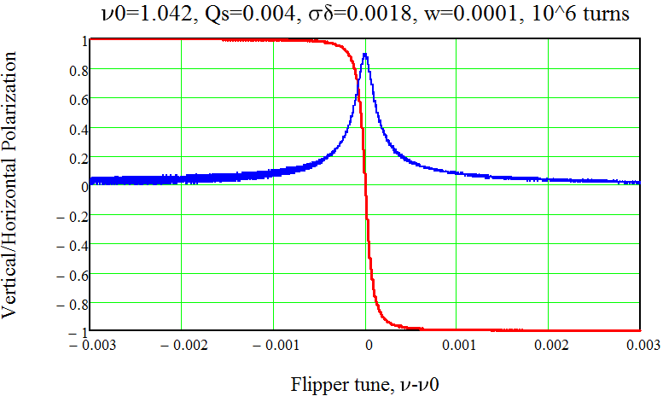
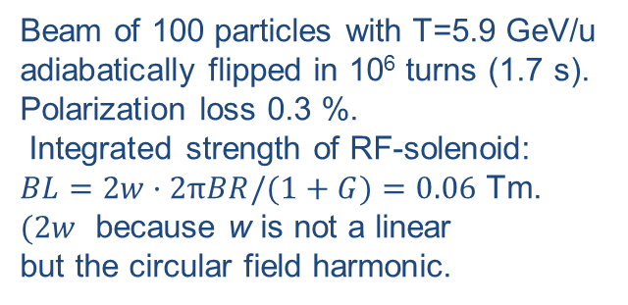
RF spin flipper for NICA
Flipping Deuteron Beam by RF-flipper
Beam of 100 particles with T=5.9 GeV/u
adiabatically flipped in 10⁶ turns (1.7 s).
Polarization loss 0.3 %.
Integrated strength of RF-solenoid:
$BL=2w·2πBR/(1+G)=0.06$ Tm.
$(2w$ because w is not a linear
but the circular field harmonic.
At the resonant frequency all spins are rotating in
the horizontal plane with

Slide 26
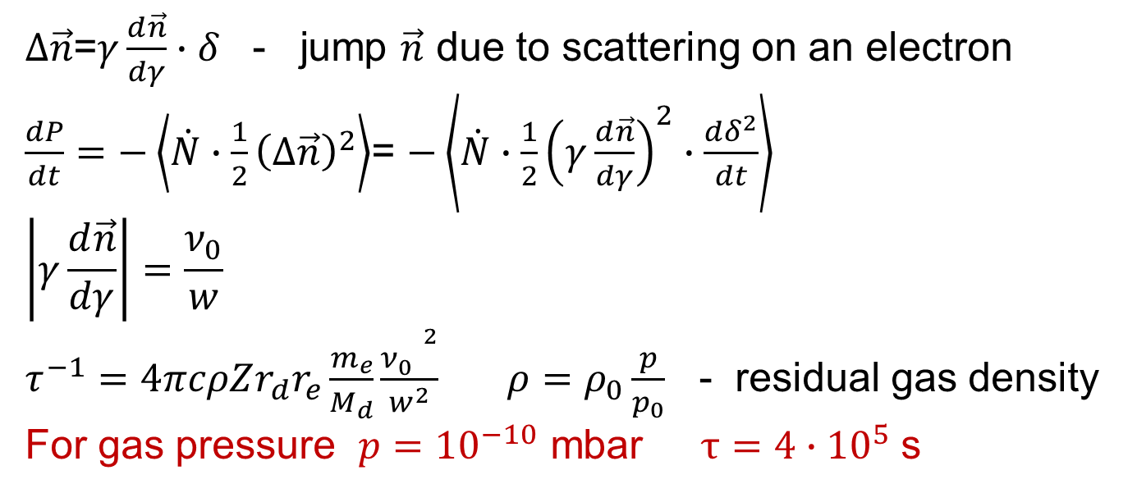
Deuteron beam depolarization by δ-electrons
$∆\vec{n}$=$γ\frac{d\vec{n}}{dγ}∙δ$ - jump $\vec{n}$ due to scattering on an electron
$\frac{dP}{dt}=−\left\langle \dot{N}∙\frac{1}{2}{\left(∆\vec{n}\right)}^{2}\right\rangle$= $−\left\langle \dot{N}∙\frac{1}{2}{\left(γ\frac{d\vec{n}}{dγ}\right)}^{2}∙\frac{dδ^{2}}{dt}\right\rangle$
$$\left|γ\frac{d\vec{n}}{dγ}\right|=\frac{ν_{0}}{w}$$
$τ^{−1}=4πcρZr_{d}r_{e}\frac{m_{e}}{M_{d}}\frac{{ν_{0}^{}}^{2}}{w^{2}}$ $ρ=ρ_{0}\frac{p}{p_{0}}$ - residual gas density
For gas pressure $p={10}^{−10}$ mbar $τ=4∙{10}^{5}$ s
For proton:

Slide 27
Thanks for attention!

Slide 28
Luminosity considerations
Coulomb scattering cross-section:
bunches.
●
Assumptions:
●
●
●
round beams
●
electron cooling will squeeze beams to the space charge limit
●
space-charge effect
Limitations:
●
instabilities in electron cooler:
●
beam-beam effect

Slide 29
Luminosity considerations for HESR collaider
(12 bunches; β* = 30 cm)
Luminosity, cm⁻² s⁻¹
Kinetic energy, GeV

Slide 30
Thanks for attention!

