Slide 1
Progress towards the realization
of the MPD project
Within the JINR theme 02-0-1065-2007/2019
Vadim Kolesnikov
(VBLHEP)
On behalf of the MPD team
Programme Advisory Committee for Particle Physics
49th Meeting
June 18-19, 2018

Slide 2
Outline
Introduction
Progress in MPD project realization:
MPD TDR preparation
MPD mass-production: readiness status
Progress in MPD simulation
Summary

Slide 3
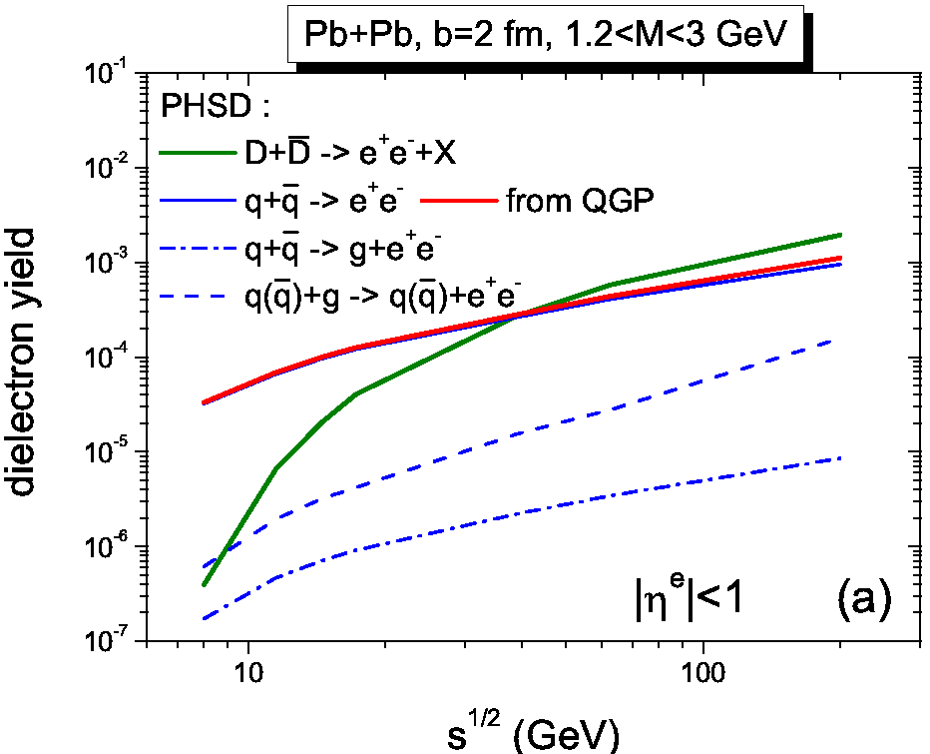
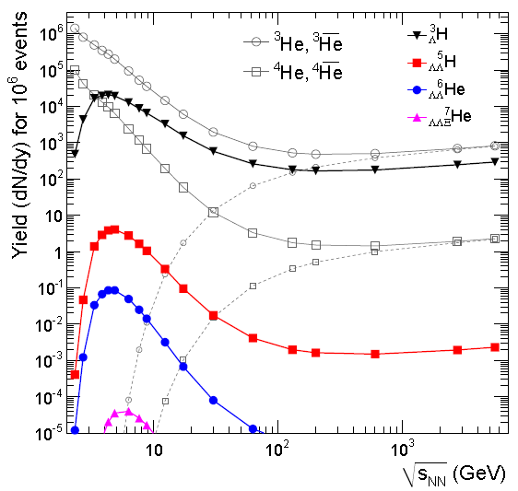

NICA niche in heavy-ion collisions
QCD matter under extreme conditions (NICA niche – high μ_{B})
Highest net-baryon density – essential to probe deconfinement and CSR
Maximum of the strangeness/entropy ratio and hypernuclei production
Non-trivial excitation function for high moments of p-pbar and proton’s v1 slope
Increase of (anti)hyperon polarization → high vorticity QCD matter
Small contribution from correlated charm in dilepton spectra
arXiv:1605.07887
arXiv:1701.06657

Slide 4
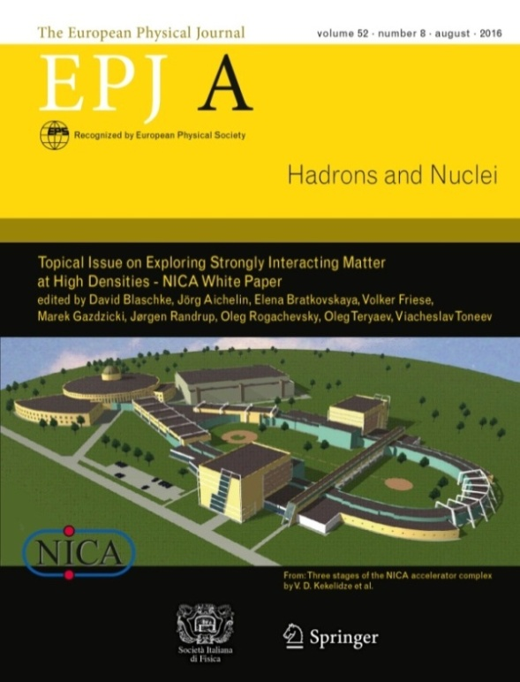
NICA program (White Paper)
Physics targets for the exploration of the QCD phase diagram accessible to NICA & BMN and possible observables for a “mixed phase“ in the release of the “NICA White Paper” as a Topical Issue of the EPJ A (July 2016)
Bulk properties, EOS
hadron phase-space distributions, femtoscopy, flow
In-Medium modification of vector mesons
onset of low-mass dilepton enhancement, IMR dilepton slopes
Deconfinement (chiral) phase transition at high ρ_{B}
enhanced strangeness production
CME, vorticity, Λ polarization
QCD Critical Point
event-by-event fluctuations and correlations
Hypermatter
single and double hypernuclei
Notes:
4

Slide 5
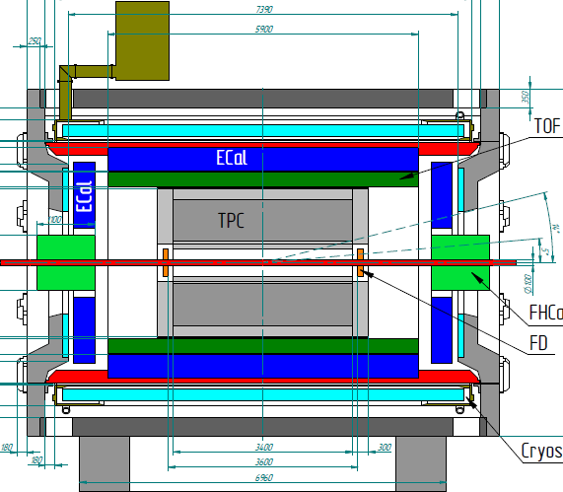
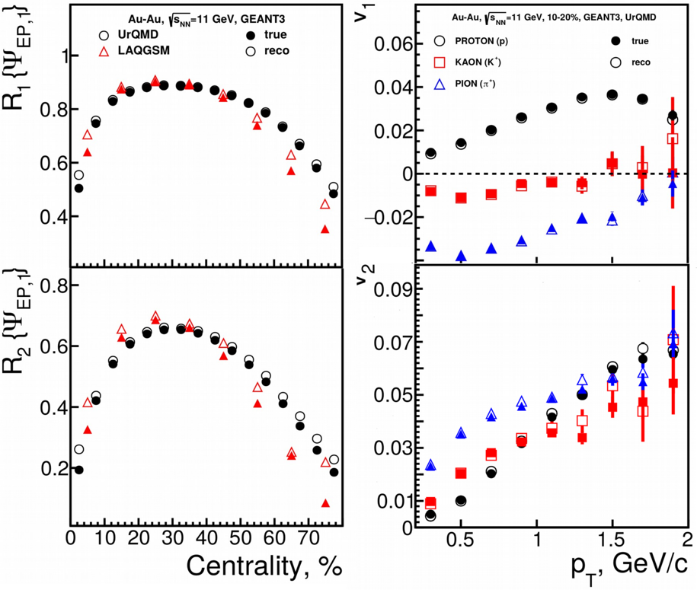
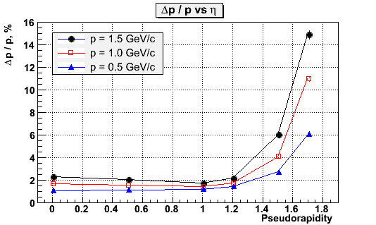
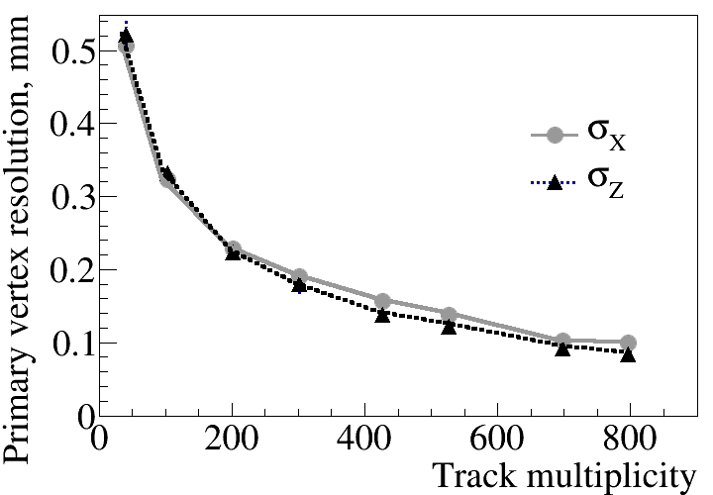
MPD detector at NICA (Stage’1 setup)
η=1.2
TPC tracking: |η|<1.6 (N_{points}>15)
PID: dE/dx+TOF+ECAL |η|<1.2, 0.1<pT<4 GeV/c
FHCAL: 2<|η|<5
Trigger&T0: FFD
5-10% resolution for the
wide centrality range
FHCAL coverage and granularity provides good event plane resolution

Slide 6
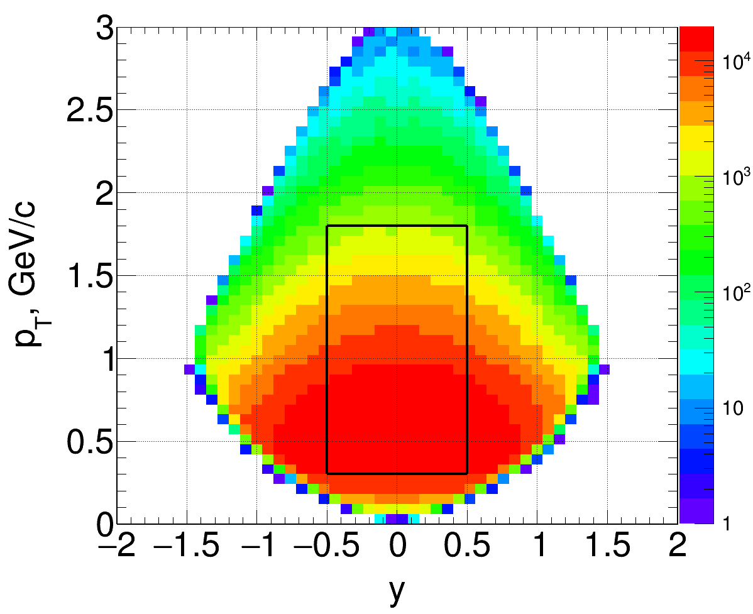
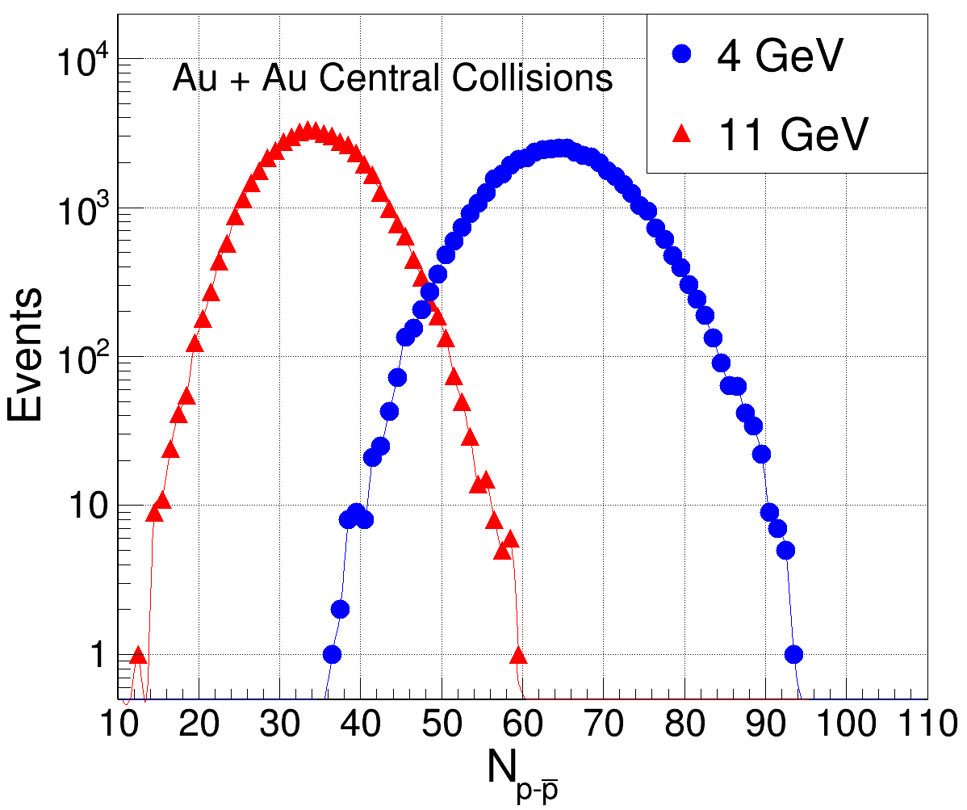
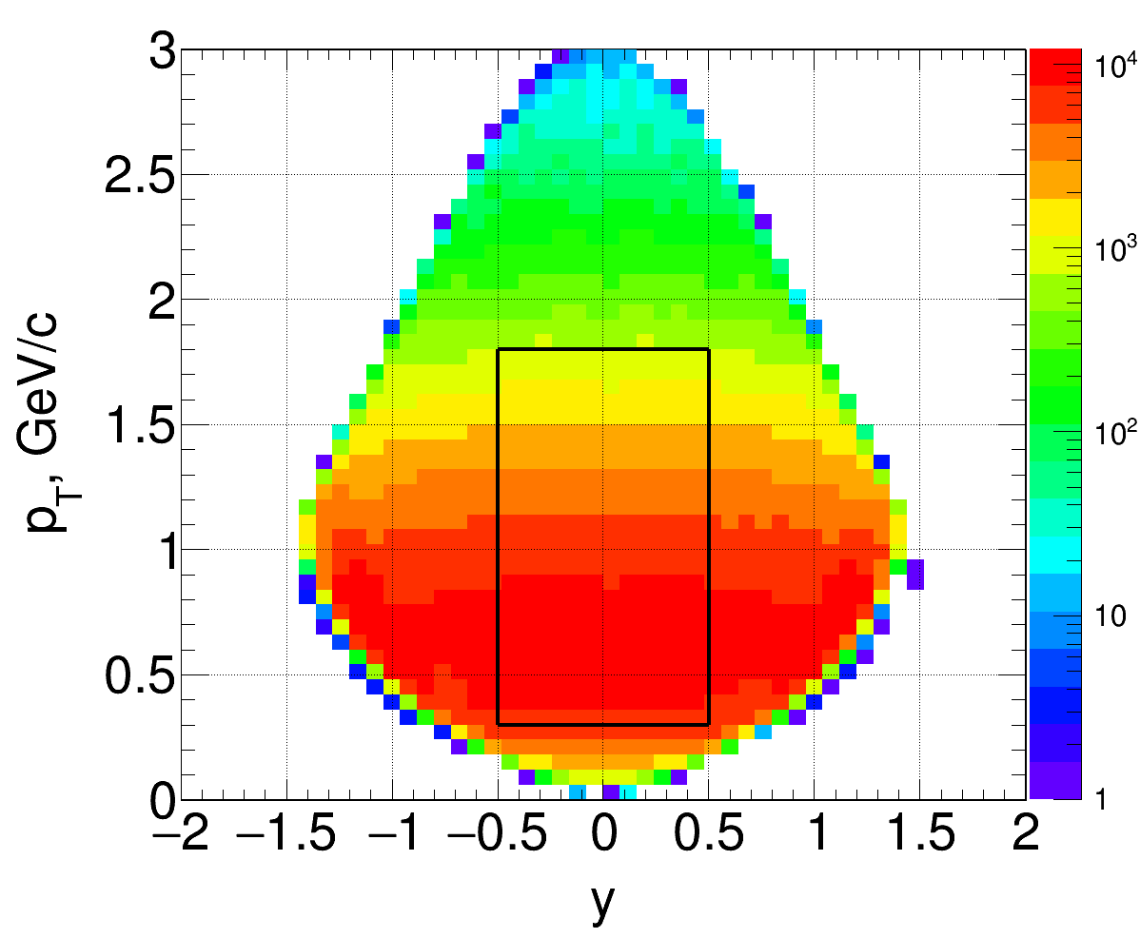
MPD PID (hadrons) and CEP search prospects
Net-protons
Au+Au @ 4 GeV
MPD detector provides a uniform midrapidity phase-space coverage
From 35 to 65 identified p-pbar (central Au+Au, |y|<0.5, pT<1.8 GeV/c)
Net-protons
Au+Au @ 11 GeV
MPD:

Slide 7
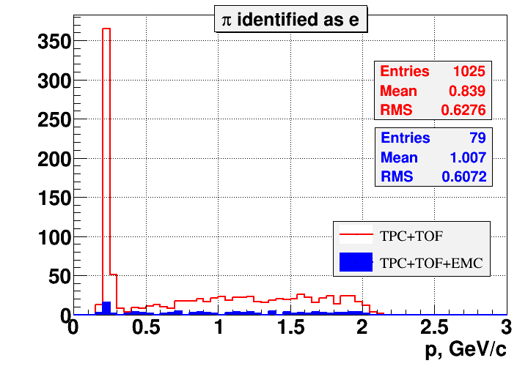
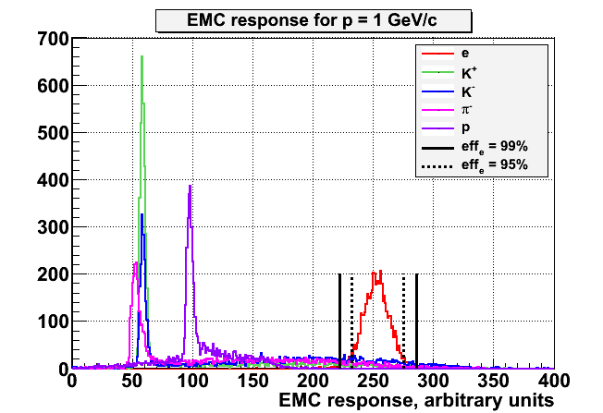
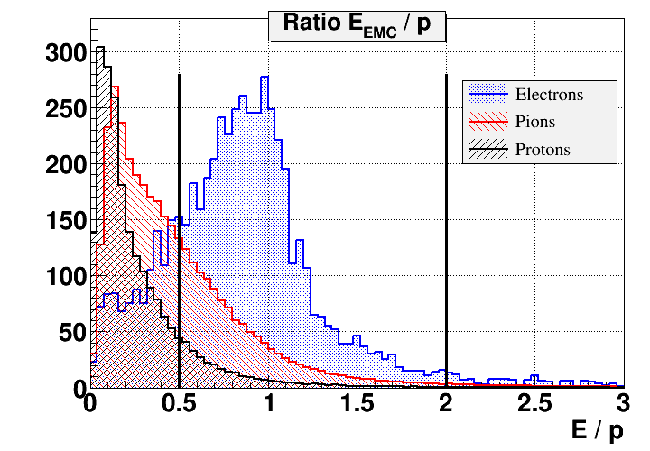
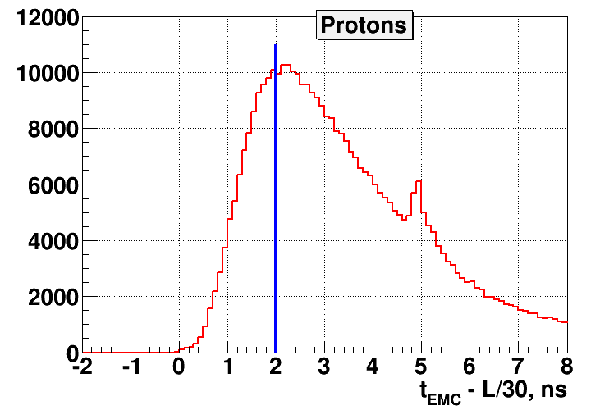
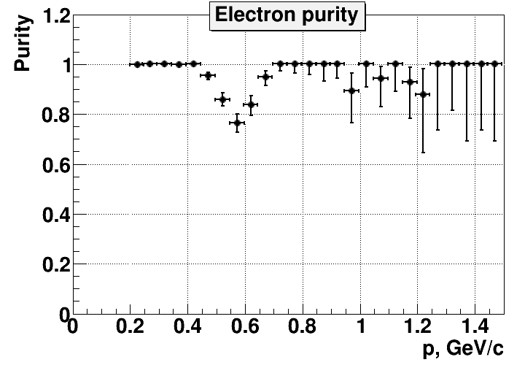
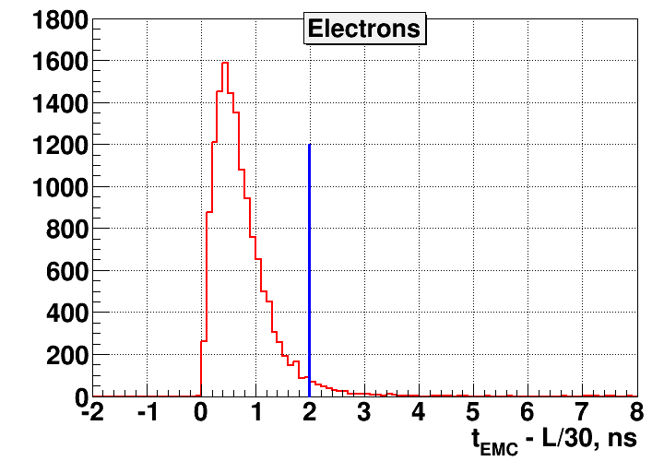
MPD PID performance: dileptons
Further hadron suppression with ECAL
Energy deposit and timing in ECAL
Extra h-suppression
factor with EMC:
up to 30 for protons
up to 13 for pions
up to 12 for kaons
ECAL energy deposit
ECAL E/p
ECAL timing
MPD Au+Au (TPC+TOF+ECAL)

Slide 8
Status of MPD TDRs
http://indico.jinr.ru/Projects/NICA/Detectors/DetectorAdvisoryCommitee
MPD DAC: H. Gutbrod, I. Tserruya, H.-R. Schmidt, N. Xu, L. Musa
MPD system | Date of recent evaluation | Comments
TPC | 30.01.2018 | Recent DAC recommendations and TDR status were discussed
TOF | 30.01.2018 | Recommendations from DAC implemented, ready for green light
FFD | 22.07.2017 | Got green light (22/06/2016)
ECAL | 30.01.2018 | Updated version of the ECAL TDR will be presented on 20.06.2018, still progressing
FHCAL | 22.07.2017 | All recommendations from DAC implemented, ready for green light
DAQ | 16.12.2015 | Version 6 (June’18), still under development
Computing | -- | VBLHEP+LIT project. Version 1.03. Still progressing
Next MPD DAC meeting – 20/06/2018

Slide 9
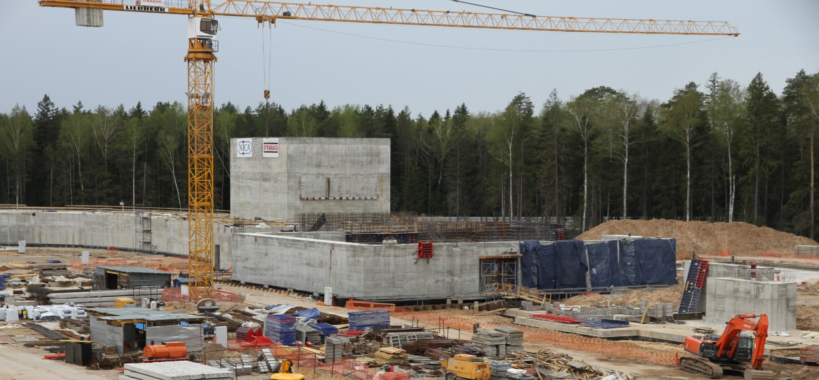
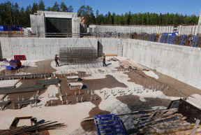
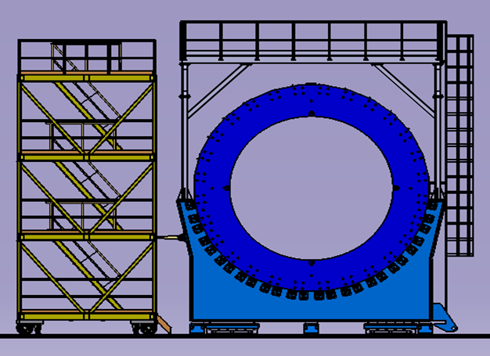
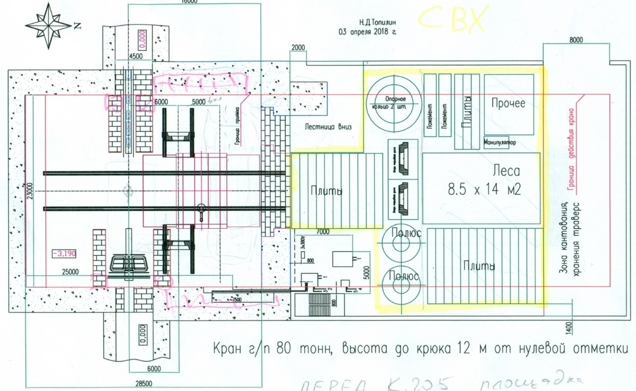
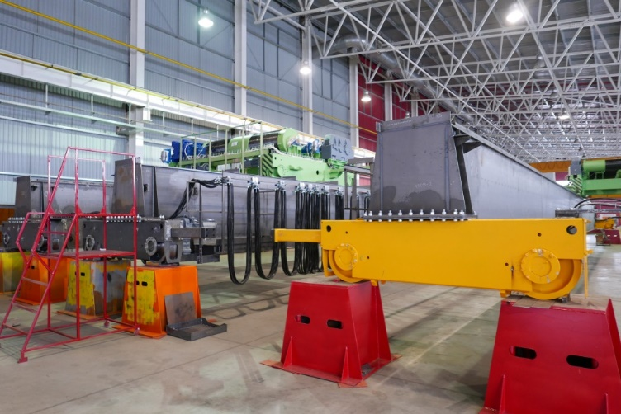
NICA/MPD infrastructure: progress
MPD Hall will be soon ready for equipment installation!
Preparatory works: designing place, tooling and service systems for MPD assembling and maintenance
Working place inside/outside of the MPD Hall
MPD Hall
Place & tooling for MPD assembling
Service & supply systems (cryo, cooling, power, etc.)
Magnet elements placing
before assembling
80/20 tons cranes for MPD.
Delivery to JINR – July 2018
MPD mobile
platform

Slide 10
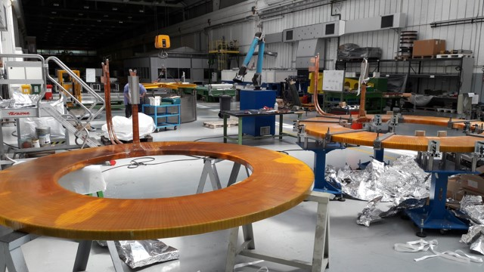
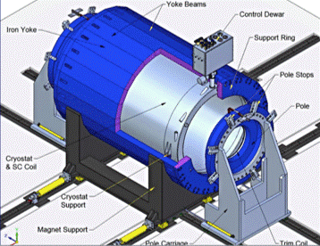
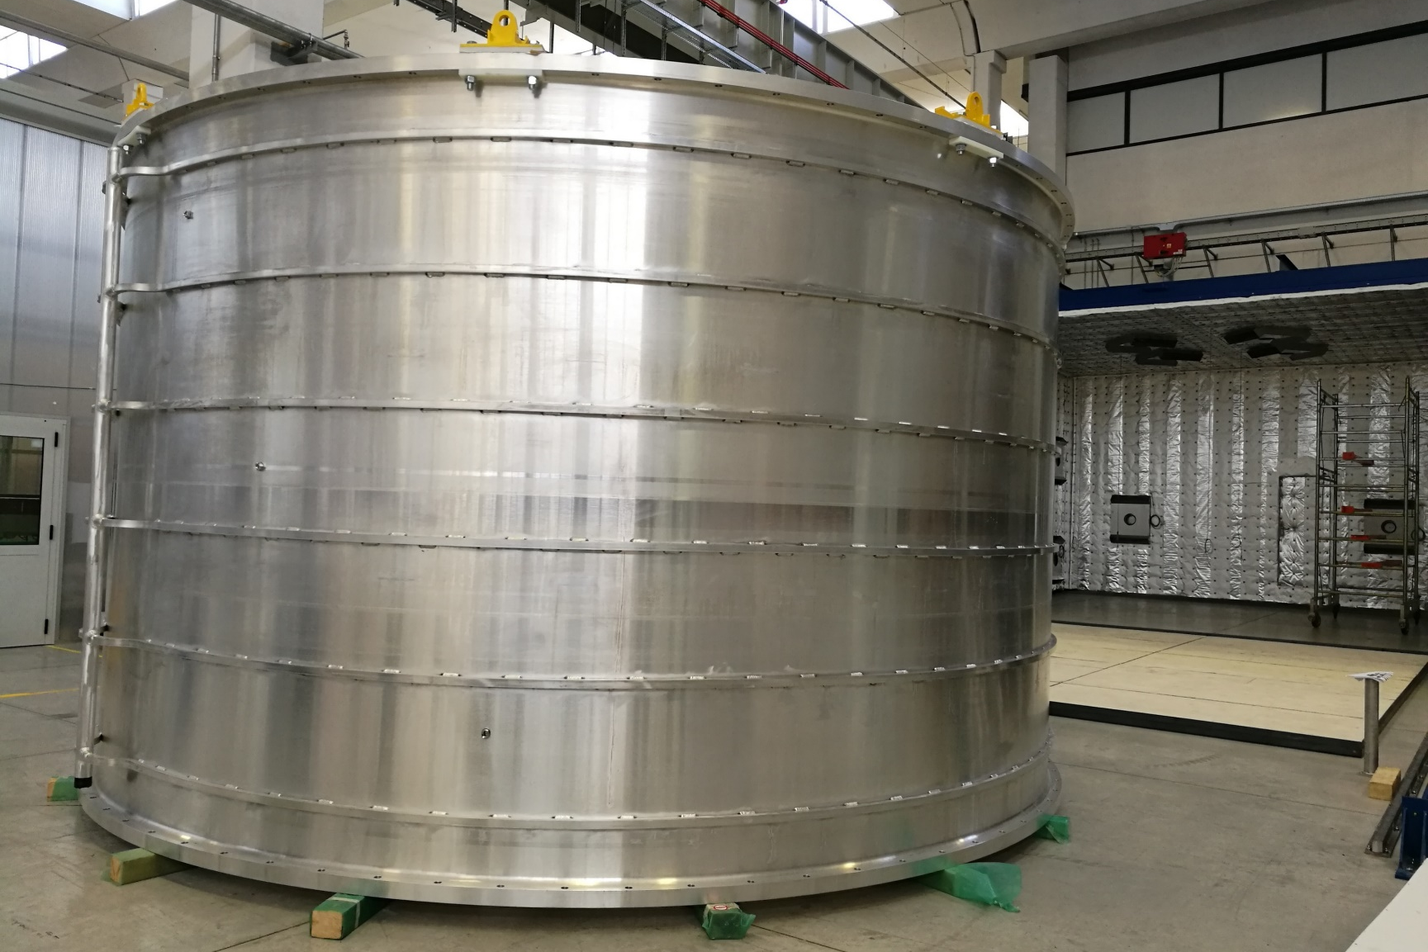
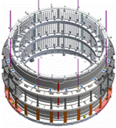
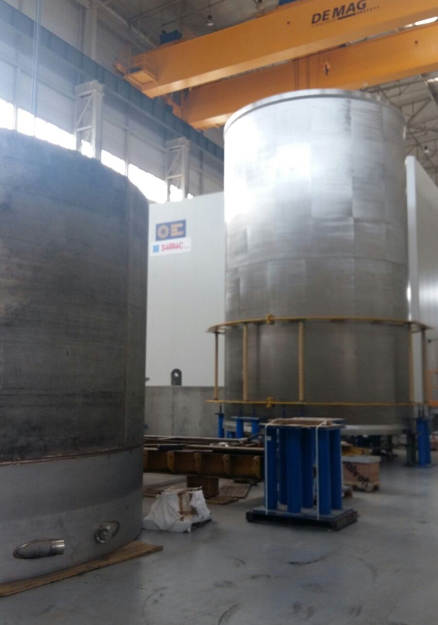
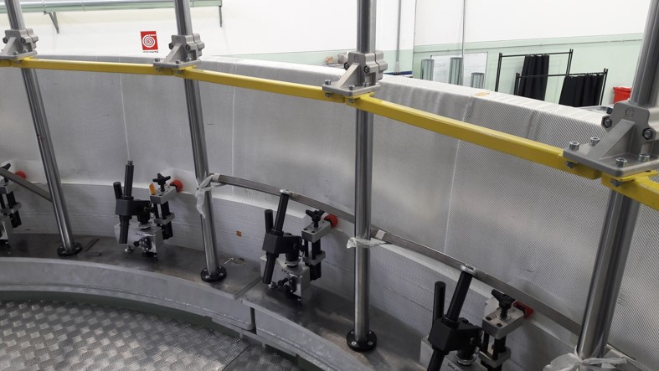
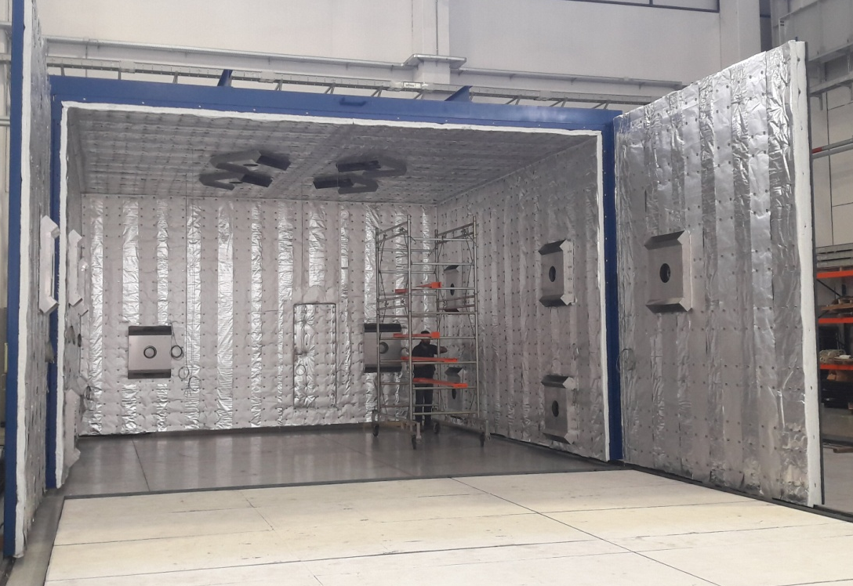
MPD superconducting solenoid: June’18 status
B₀=0.5 T
Weight ~ 900 t
N. Emelianov (VBLHEP)
B inhomogeneity ~3.10⁻⁴
Trim coils (ready)
Solenoid cylinder (all 3 ready)
Current up to 4.4 kA
Voltage up to 35 V
Control assembling & tests (AGS) – August’18-March’19
Control assembling at JINR – May-August 2019
ASG superconductors (Genova, Italy):
Vacuum kiln & tooling
for coil compounding
Vacuum vessel
Winding of SC coil

Slide 11
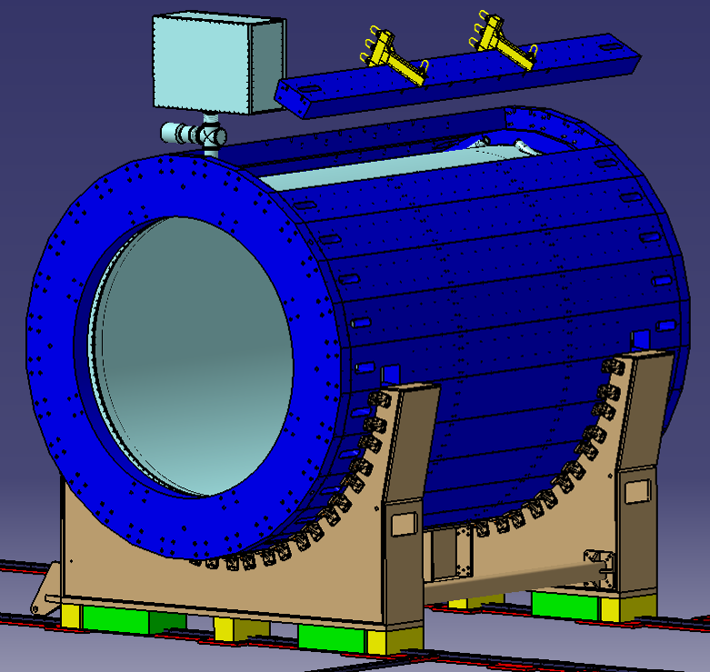
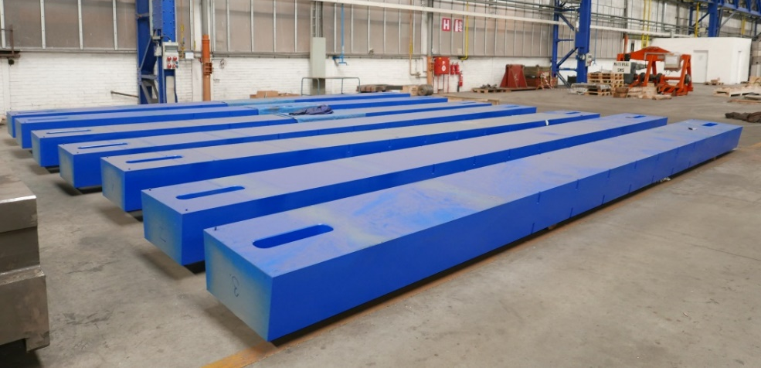
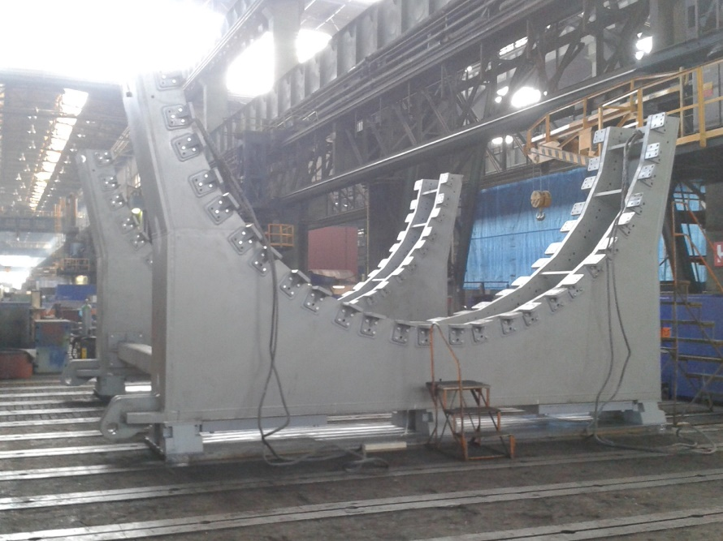
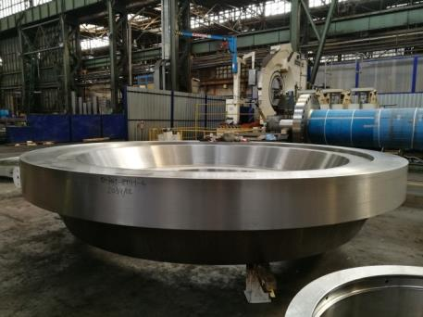
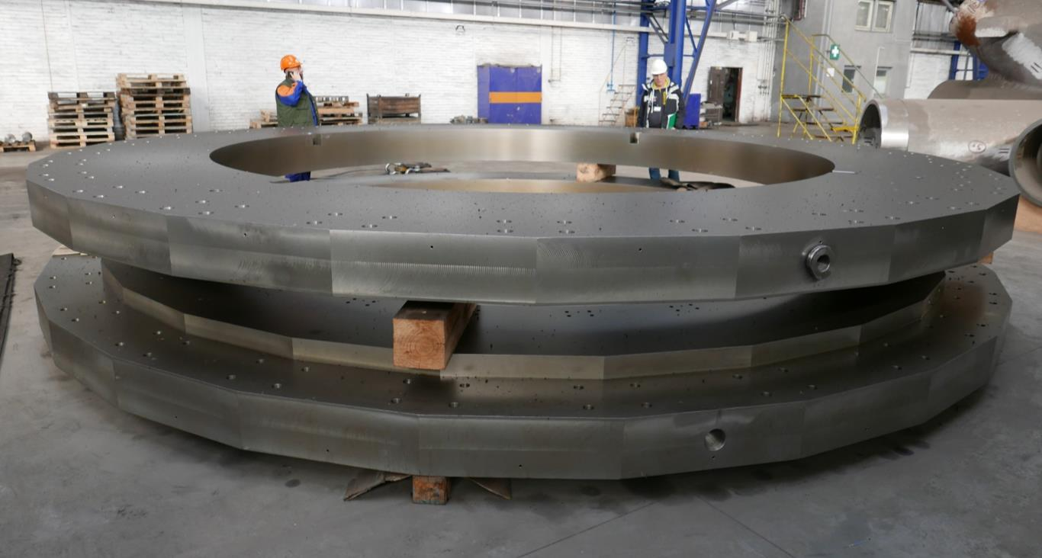
MPD Magnet Yoke: construction status
N. Topilin (VBLHEP)
Yoke assembly plans:
1) Control assembly at VHM - June 2018
2) Delivery to JINR - August-October 2018
Plates
Rings
Lodgment
2 Poles: Ø 4.5 m, 47 tons each

Slide 12
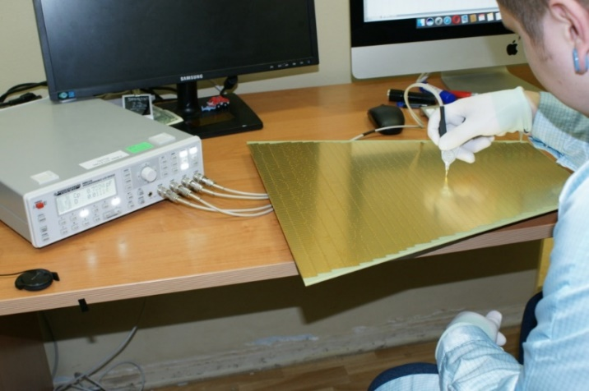
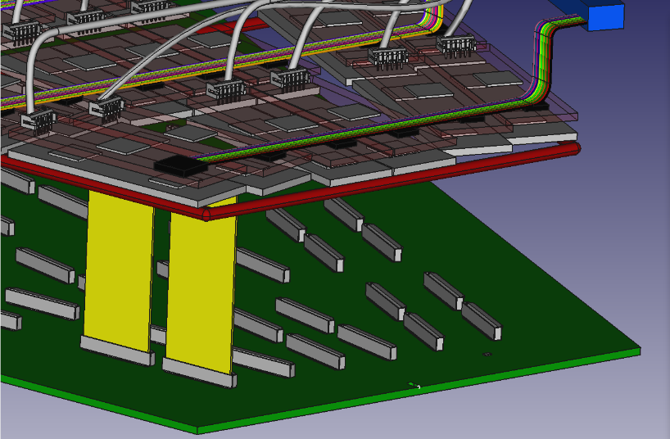
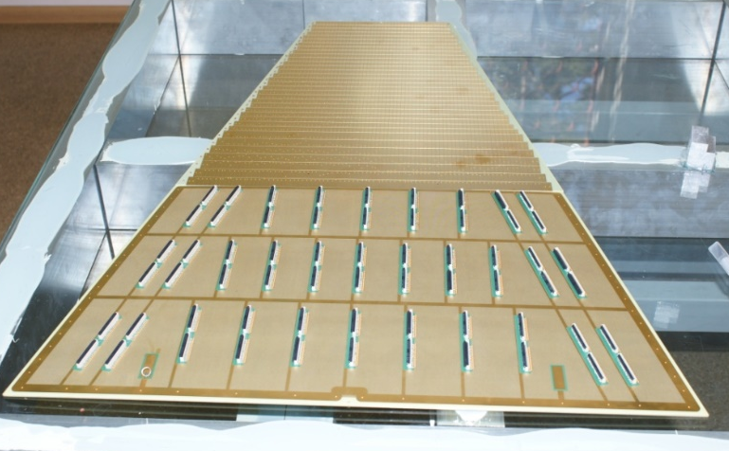
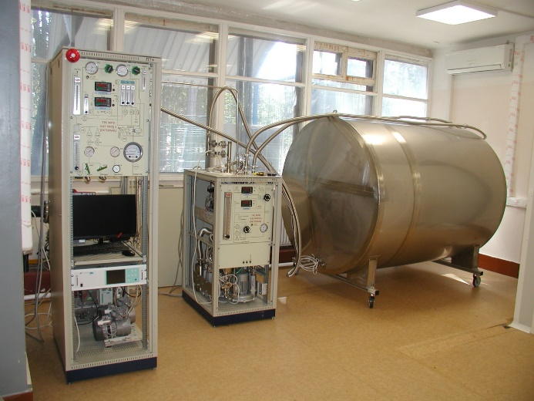
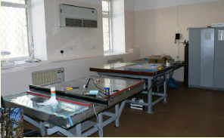
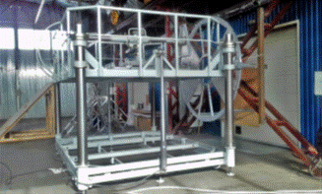
MPD TPC: June’18 status
S. Movchan (VBLHEP)
TPC TDR - minor corrections after recent evaluation
TPC elements & assembling tooling (field cage, rods, manipulators) – in production
Pad planes – in production, flatness issue under control (2 options)
FEE (SAMPA) – design optimization & tests
Service systems (gas, cooling, calibration) – under development
Integration - progressing
TPC pad plane tests
FEE mass-production
in 2019
ROC chamber assembly facility
TPC gas system
ROC manipulator

Slide 13
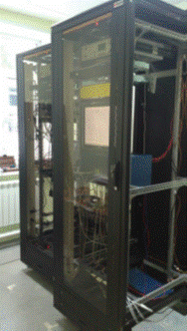
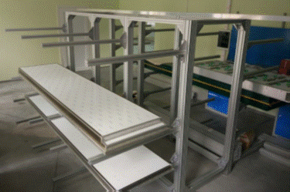
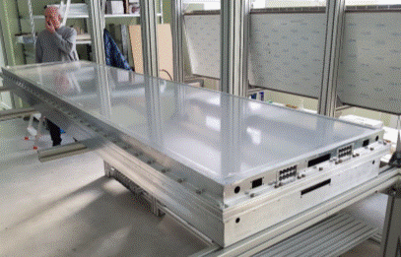
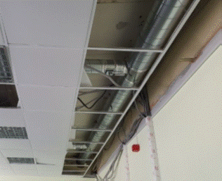
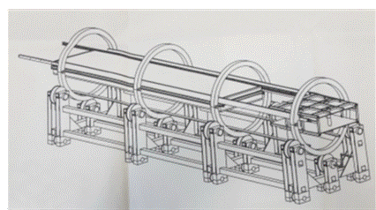
MPD TOF: recent activity
V. Golovatyuk, V.Babkin (VBLHEP)
TOF TDR, few recommendations after recent evaluation
Production of TOF MRPC components
Renovation in the TOF workshop (ventilation)
Preparation of the MRPC test area
Construction of service systems (gas, etc.)
TOF integration, assembling tooling, etc.
MRPC test area
TOF barrel status (readiness in %)
Ordered components (90%)
MRPC modules (25%)
FEE (35%), VME crates(45%), TDCs(10%)
Gas system (50%)
MRPC test area (80%)
LowVoltage (70%), HighVolatge (30%)
TOF gas crate
Workshop renovation
(ventilation)
TOF module
TOF module slipway

Slide 14
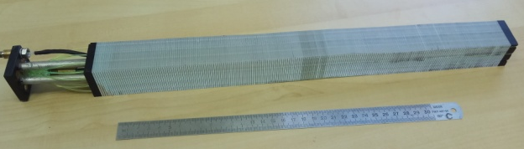
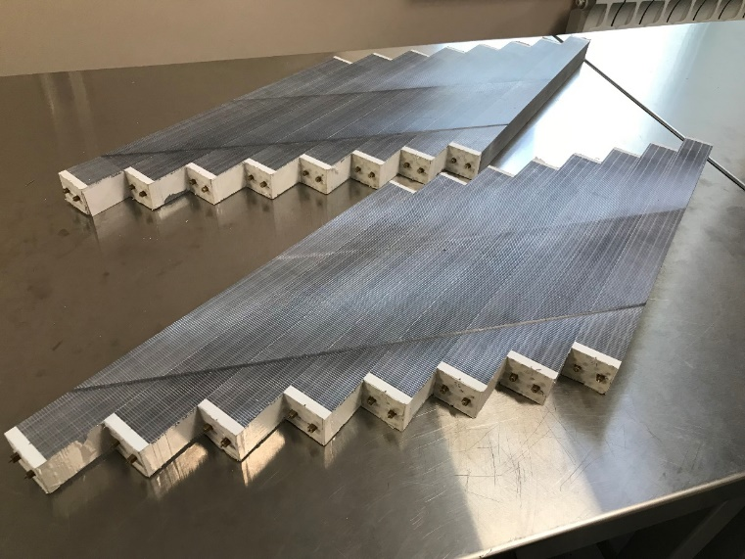
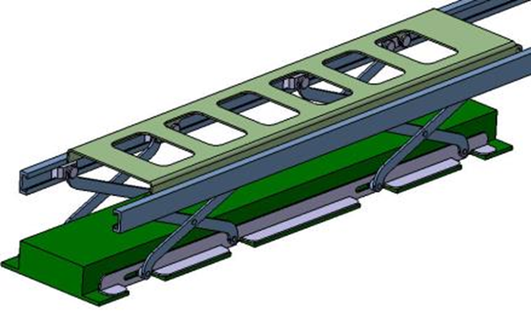
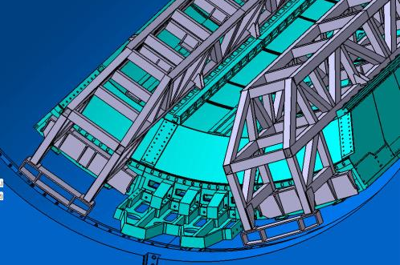
MPD Electromagnetic Calorimeter (ECAL)
I. Tiapkin (VBLHEP), Yi Wang (Tsinghua, China)
Finalizing ECAL geometry (design and simulation) – ITEP team
Mass-production technology testing – 3 workshops at JINR, IHEP, and Tsinghua
ECAL integration scenario – JINR and ProgressTech Ltd.
TDR preparation - All
Pb+Scint. (14 X₀ ,4x4 cm²)
WLS fibers + MAPD
Projective geometry: response uniformity
ECAL module
assembling
E_{γ} = 200 MeV
FEE support
platform

Slide 15
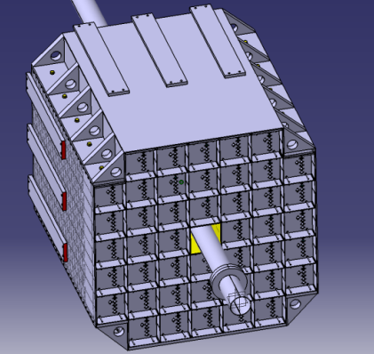
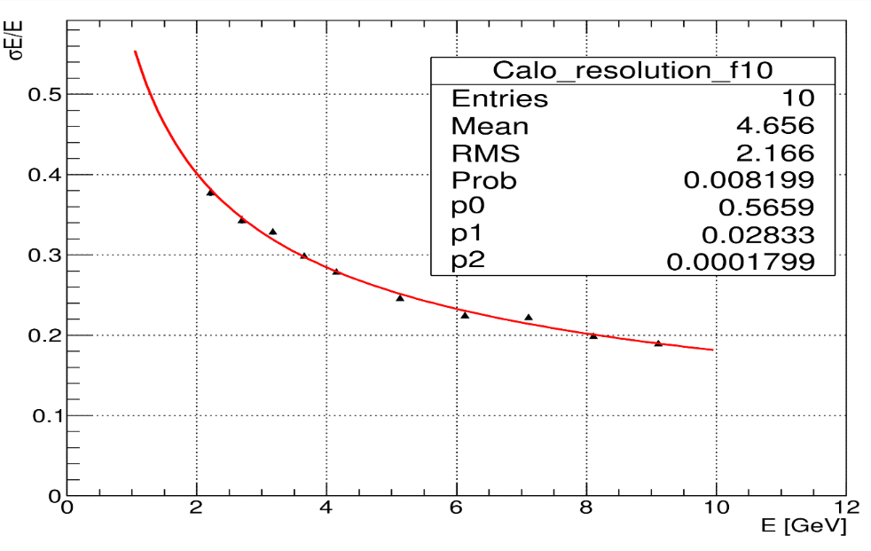


MPD FHCAL Calorimeter
2<|η|<5
A. Ivashkin (INR,Troitsk), A.Taranenko (MEPhI)
FHCAL: 90 Lead/Scintillator modules
(15x15cm² , L~4 λ_{int},WLS+SiPM)
Beam tests: good linearity and sufficient
resolution at NICA energies
Progress prior to June’18:
Successful beam tests in the NICA energy range
Advanced FHCAl simulation
Updated TDR (ready for green light)
Production of modules: ~1/3 ready

Slide 16






Integration of the Multipurpose Detector
N. Topilin, S. Sukhovarov (VBVLHEP)
MPD integration scenario
Mock-up & tooling
Installation of the
power skeleton
Installation of
ECAL "baskets"
Installation of
TOF modules
TPC Installation

Slide 17
MPD performance for event characterization & flow (QM’18 status)
P. Parfenov (MEPhI), N.Geraksiev (VBLHEP)
Event plane with FHCAL, centrality with TPC estimator
TOF+TPC based PID, secondary vertex technique for Λ
Small difference between MC and reco results

Slide 18





MPD performance: multi-strangeness
V. Vasendina, A. Zinchenko (VBVLHEP)
Stage’1 MPD configuration (TPC+TOF)
Selection criteria dictated by the decay topology
Realistic tracking and PID (recent MPDRoot release)
MPD detector at NICA:
Large phase-space coverage for hyperons
Good reconstruction capability for multistrangeness

Slide 19

First (kick-off) meeting of MPD and BM@N
JINR, Dubna, 11-13 April, 2018
https://indico.jinr.ru/conferenceDisplay.py?ovw=True&confId=385

Slide 20


MPD/NICA Collaboration (recent extension)
-C$ℏ$I NA Consortium
  Tsinghua University (THU)
  University of Science and Technology of China (USTC)
  Huzhou University (HU)
  Shandong University (SDU)
  Central China Normal University (CCNU)
  Shanghai Institute of Nuclear & Applied Physics (SINAP), Chinese Academy of Science
  Southern China University (SCU)
  Institute of High Energy Physics (IHEP), Chinese Academy of Science
MexNICA
Mexican consortium of six institutions:
BUAP, CINVESTAV, UAS, UNAM, UNISON, UCOL

Slide 21
Summary
Substantial progress in MPD project realization (Magnet, TPC, TOF, FFD, FHCAL)
Efficient MPD DAC evaluation process: Stage’1 sub-systems carry out regularly,
next meeting on 20/06/2018
The international collaboration around the NICA is growing.
New partners are invited to join NICA
MPD Collaboration first meeting in April, now waiting for Spokesperson/Boards voting..
Thank you for your attention!

