Slide 1
Strokovsky E.A.
Run 55 of the Nuclotron
22.02.2018 – 05.04.2018
total duration: 1018 hours
Beams: C, Ar, Kr from the KRION-6T source.
E.A.S., JINR PAC for Particle Physics, 18.06.2018

Slide 2
Run 55 of the Nuclotron (22.02.2018 – 05.04.2018):
Ion beams (C, Ar, Kr) - from the KRION-6T source
Data taking:
“SRC at BM@N” project
BM@N project
In the “second priority” mode and in the parasitic mode: R&D of other users
All the works are included in the JINR topical plan.
Within the BM@N (Kr) physics part:
works for radiation biology (by LRB of JINR)
E.A.S., JINR PAC for Particle Physics, 18.06.2018

Slide 3
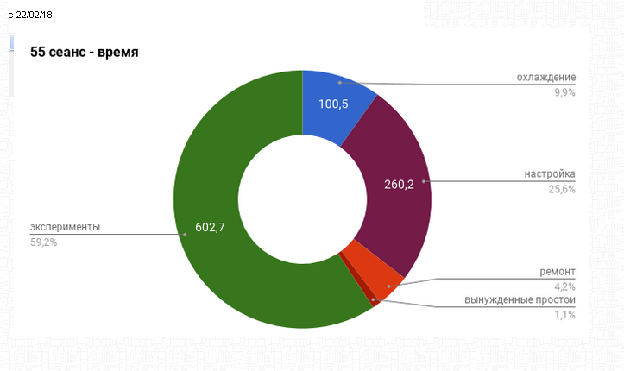
Run 55 of the Nuclotron (22.02.2018 – 05.04.2018)
The total run duration: 1018 hours
Cooling:
9.9%
preparation:
25.6%
accelerator physics
and user’s works
59.2%
repairing: 4.2%
unexpected stops: 1.1%
E.A.S., JINR PAC for Particle Physics, 18.06.2018

Slide 4
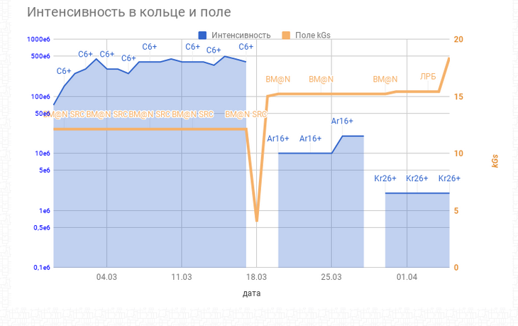
← SRC at BM@N →
← BM@N →
LRB
intensity
Intensity
Field, Gs
← carbon nuclei →
← Ar nuclei →
← Kr
nuclei →
E.A.S., JINR PAC for Particle Physics, 18.06.2018

Slide 5
BM@N results will be presented in the talk by M.Kapishin;
SRC at BM@N results will be presented in the talk by E.Piasetzky.
In total, users are satisfied by the machine work.
E.A.S., JINR PAC for Particle Physics, 18.06.2018

Slide 6
BM@N (an example): monitoring of the beam intensity (spill by spill)
26.03.2018 (Ar ions, BM@N)
5:00
6:00
7:00
8:00
E.A.S., JINR PAC for Particle Physics, 18.06.2018

Slide 7
Users are especially satisfied by the very good result,
obtained by our accelerator physicist,
concerning the time structure of the beam spill.
(see next few slides)
E.A.S., JINR PAC for Particle Physics, 18.06.2018

Slide 8
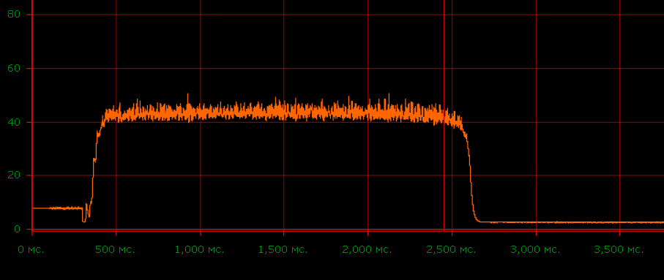
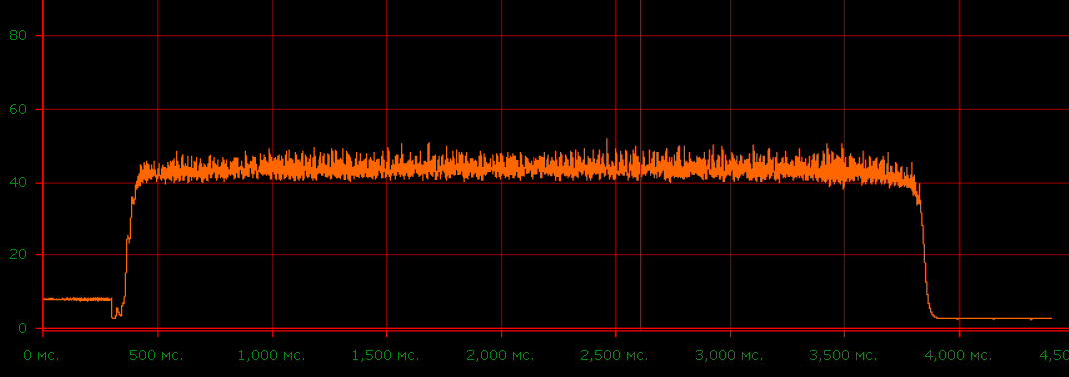
Time structure of the extracted beam spill (I)
14.03.201, 11:05; carbon
60
20
1000
2000
3000
msec
14.03.2018, 15:33; carbon
60
20
1000
2000
3000
msec
E.A.S., JINR PAC for Particle Physics, 18.06.2018

Slide 9
Time structure of the extracted beam spill (II)
14.03.2018; 15:33; carbon
26.03.2018, 9:44; Ar
30
10
1000
2000
3000
8000
For comparison: next 2 slides
E.A.S., JINR PAC for Particle Physics, 18.06.2018

Slide 10
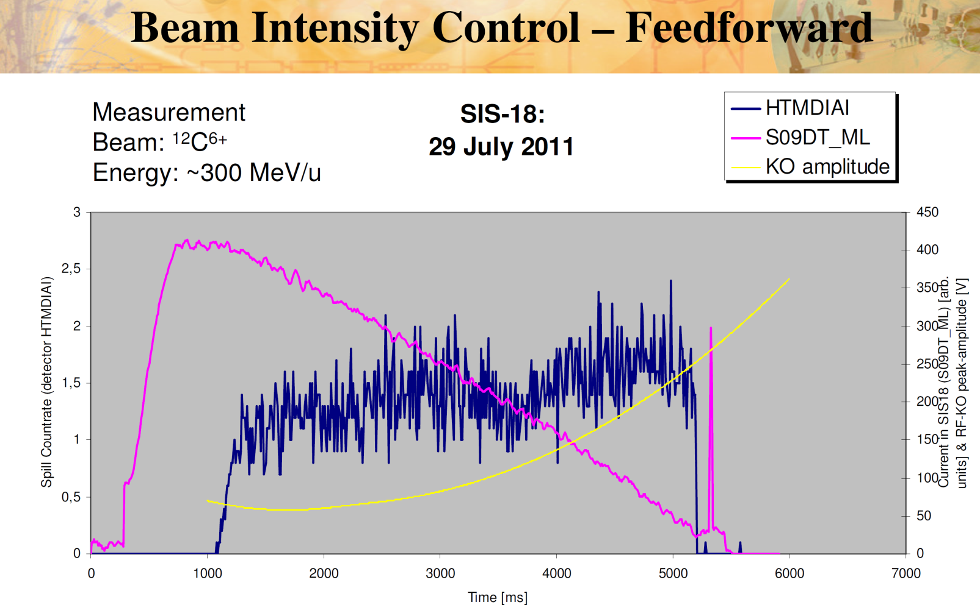
Time structure of the extracted beam spill (III)
from:
14.03.2018; 15:33; carbon
15,0
Other machines
(GSI, 2011 year)
8000
Nuclotron,
March of 2018 year
26.03.2018, 9:44; Ar, Nuclotron run 55
30
10
1000
2000
3000
E.A.S., JINR PAC for Particle Physics, 18.06.2018

Slide 11
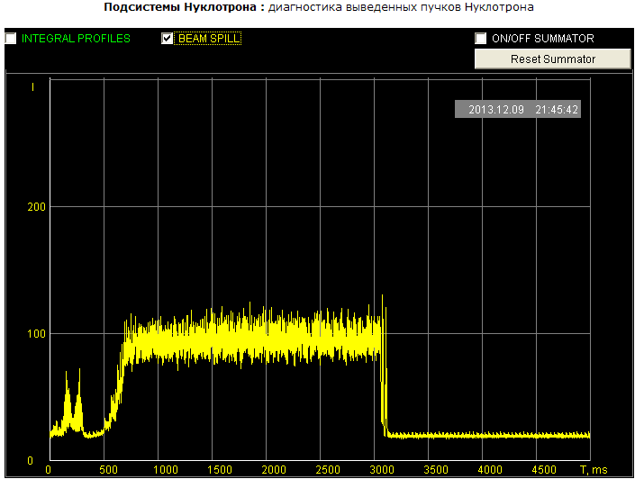
Time structure of the extracted beam spill (IV)
Nuclotron,
Dec. of 2013 year
14.03.2018; 15:33; carbon
15,0
Nuclotron run 48, deuterons
Nuclotron,
March of 2018 year
8000
26.03.2018, 9:44; Ar, Nuclotron run 55
30
10
1000
2000
3000
E.A.S., JINR PAC for Particle Physics, 18.06.2018

Slide 12
Due to the planned long shutdown
(Booster construction and uncertainties related with this)
the annual (VI-th) International User’s Workshop on «Perspectives of experimental research with the Nuclotron beams» is shifted from September-October of 2018 to
March-April of 2019 year.
E.A.S., JINR PAC for Particle Physics, 18.06.2018

Slide 13
Thank you!
E.A.S., JINR PAC for Particle Physics, 18.06.2018

