Slide 1

49th PAC on Particle Physics
JINR, June 18-19, 2018
Implementation of recommendations and work towards optimisation
of the research programme
Itzhak Tserruya

Slide 2
Outline
Highlights of the Recommendations from the 48th PAC – PP
123nd Scientific Council meeting (February 22-23, 2018)
Recent developments
Agenda

Slide 3
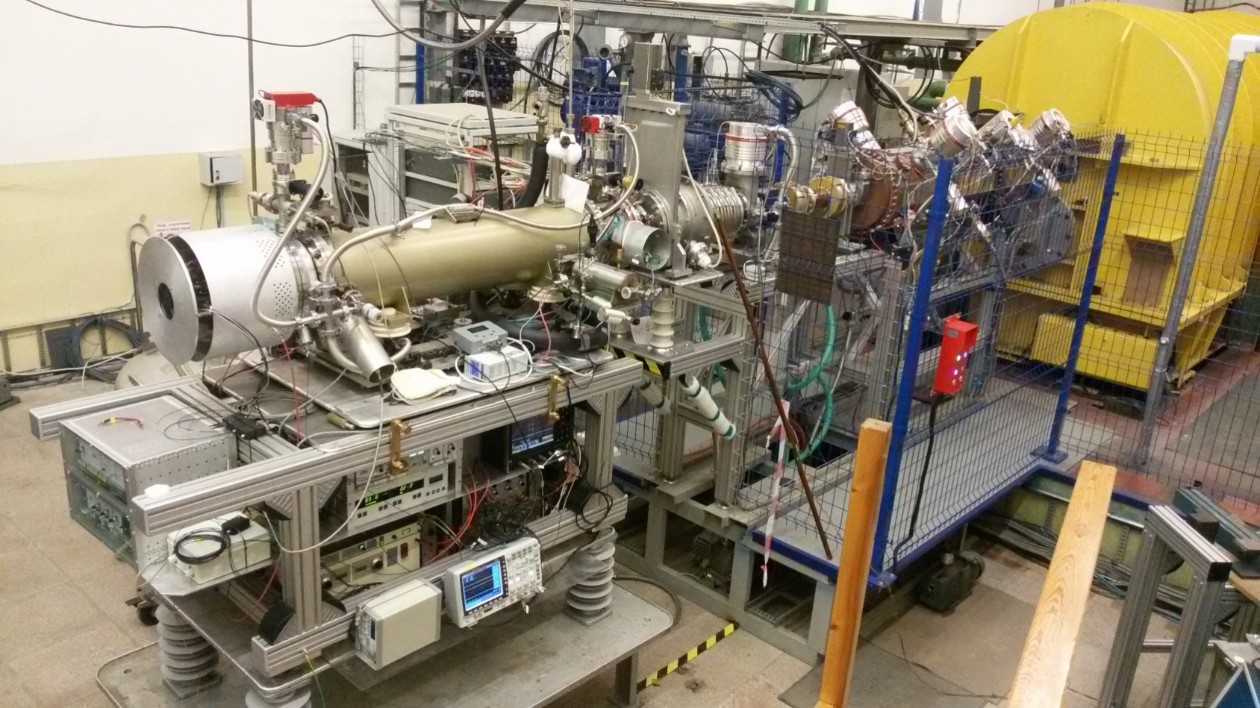
48th PAC-PP highlights: NICA
The PAC congratulates the Laboratory’s staff on the successful preparation of the KRION-6T heavy-ion source.
The PAC appreciates the regular commissioning of new equipment and, in particular, the upgrade of the light ion linac injector LU-20 and the associated substantial increase in beam intensity.
Injector complex

Slide 4
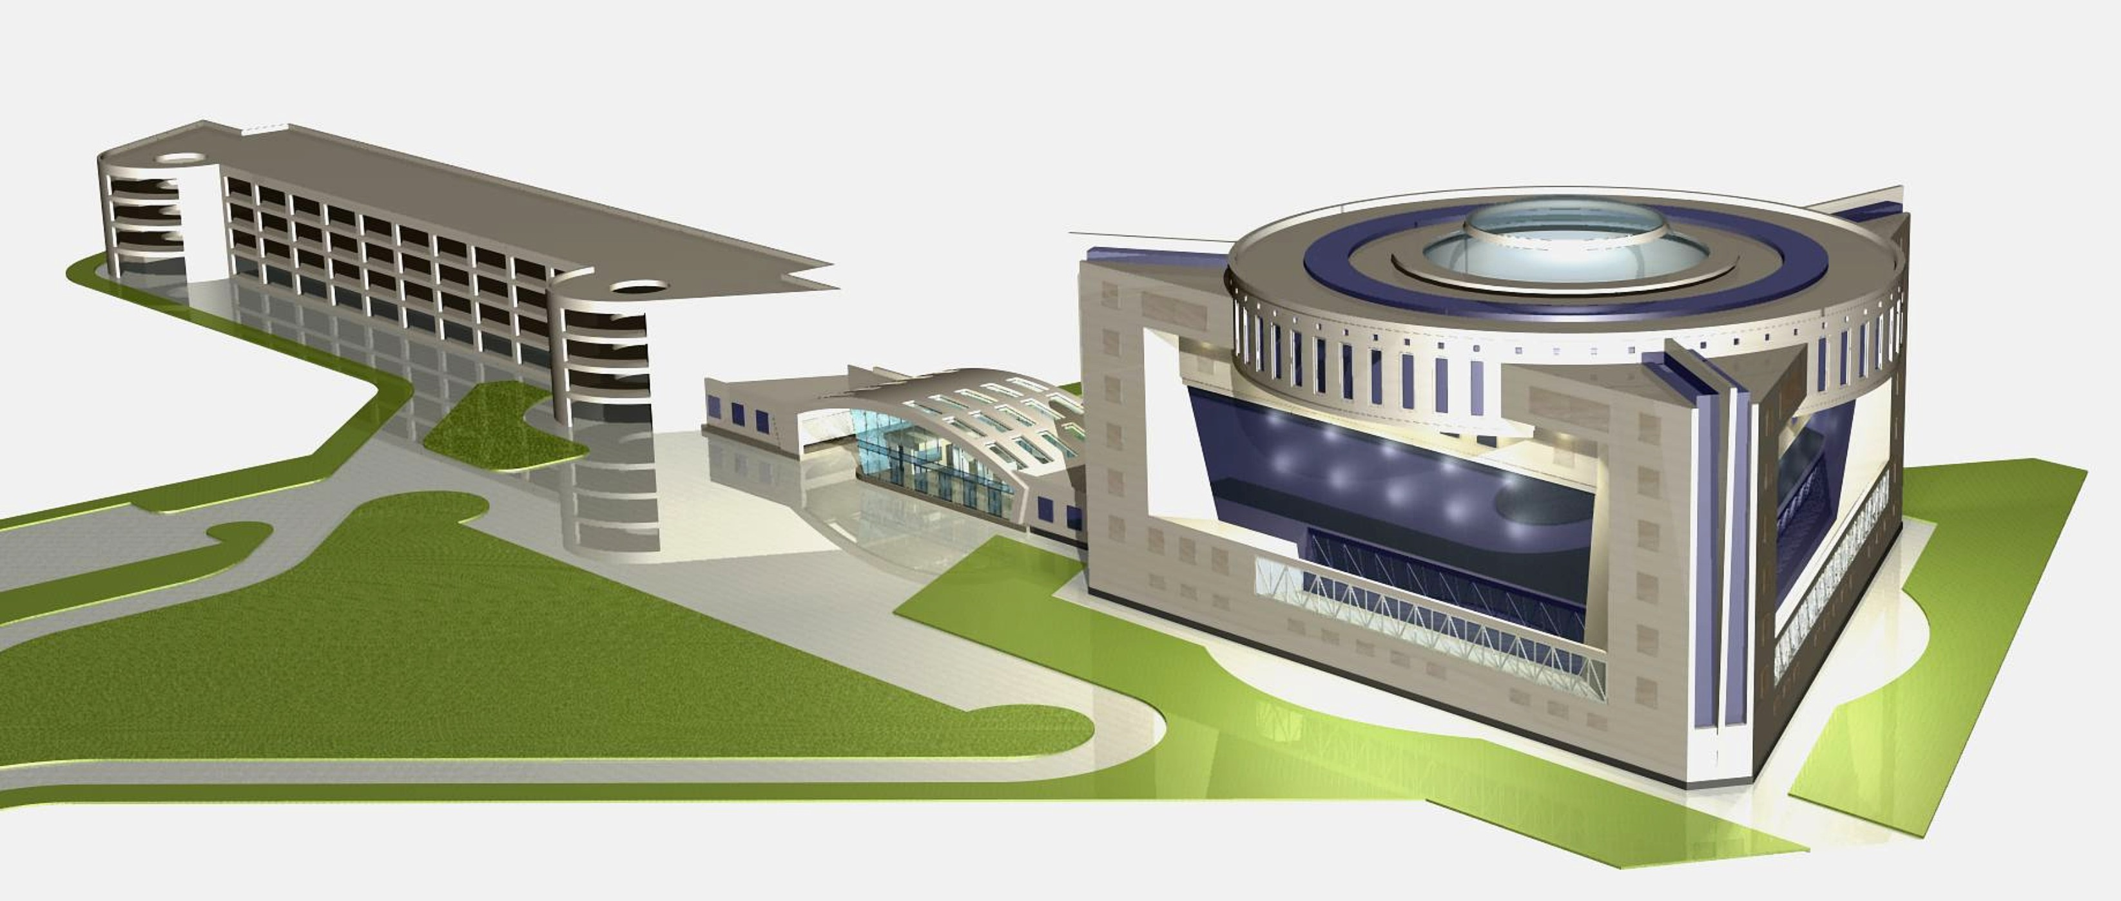
48th PAC-PP highlights: NICA
The PAC heard the report about the forced interruption of the Nuclotron Run 55 due to a failure of the superconducting magnet cooling system and the rapid completion of the repair work.
Run 55 was rescheduled for February 5 – March 23, 2018. Beams of C, Ar¹⁶⁺, Kr²⁶⁺ from the KRION source will be used by BM@N and for SRC.
The Booster installation will start after completion of the run. First technical run of the Booster by the end of 2018.
The PAC is pleased with the progress achieved in the civil construction of the collider complex and with the roadmap for the construction of the NICA Center building.
NICA Center
Design Institute “ARENA”

Slide 5
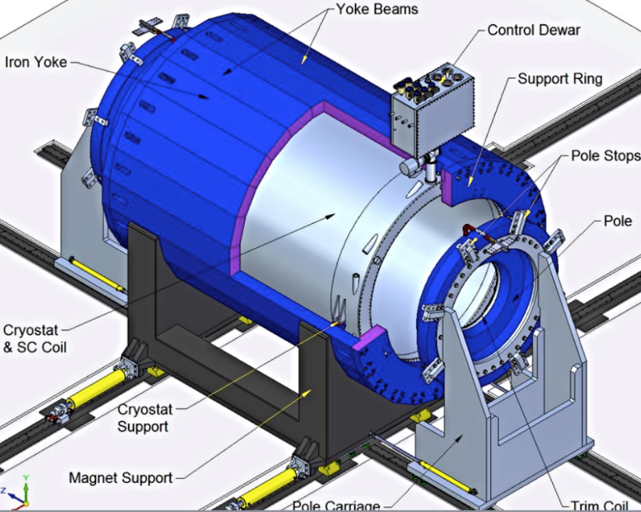
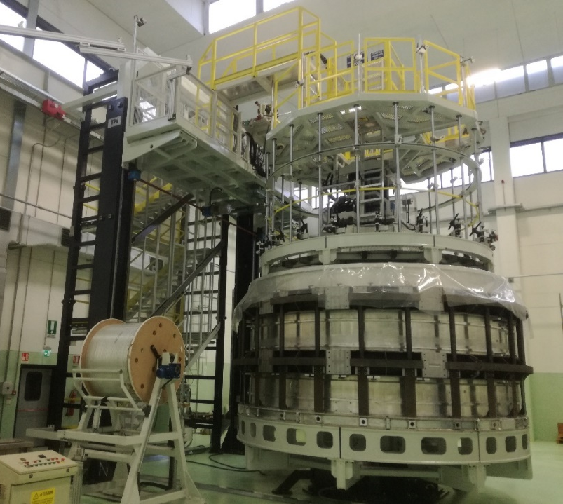
48th PAC-PP highlights: MPD
The PAC appreciates the recent advance in the MPD magnet construction but is concerned about the delay in the magnet delivery to JINR. The Committee urges the team to ensure timely and successful completion of the contract avoiding any further delay.
The PAC is pleased to note that the SAMPA chip has been finally chosen for the TPC front-end electronics and encourages the TPC team to complete the remaining design and prototype work.
It acknowledges the efforts undertaken by the JINR and Laboratory managements to strengthen the participation of Chinese groups in the construction of the MPD electromagnetic calorimeter. The PAC encourages the ECAL team to focus on the optimization of the detector specifications and design in view of finalizing the ECAL TDR.
End of production - November 2018
Delivery to JINR – April-May 2019

Slide 6
48th PAC-PP highlights: BM@N
The PAC welcomes the commissioning of new equipment and the first use of the large-area GEM tracking detectors.
The PAC reiterates its concern about the lack of manpower for in-depth analysis of data collected in recent runs.
Central tracker in March 2018 run (Ar, Kr)
7 planes of GEM detectors (5 of them big size)
3 planes of Si detector in front of GEMs.

Slide 7
48th PAC-PP highlights: MPD & BM@N
The PAC is very pleased with the recent initiatives of VBLHEP to attract new non-JINR collaborators to the MPD and BM@N experiments:
The PAC welcomes the plans to hold a three-day meeting at JINR in April 2018 to officially launch the MPD and BM@N International Collaborations
The PAC strongly encourages the JINR initiative to establish a funding programme to attract and support research conducted at the NICA facility. The proposal is to award research funds to groups (mainly to support students and post-docs) for a 3y period through a competitive process according to the scientific merit of submitted proposals.

Slide 8
Scientific Council (I)
Excerpts from the Resolutions of the 123rd session of the Scientific Council held on February 22-23, 2018:
General considerations:
The Scientific Council is pleased to note the successful development of the JINR research infrastructure, including the NICA megaproject, the Factory of Superheavy Elements (SHE) and the IBR-2 spectrometer complex.
The Scientific Council is also pleased to note that the international visibility of JINR and of its flagship projects is ramping up. The NICA project has already been included in the ESFRI roadmap and in the NuPECC long-range plan, and every effort should be made in order for it to become also part of the European Strategy for Particle Physics.
The Scientific Council reiterates its recommendation that all the ongoing and recently planned neutrino experiments be presented and discussed within a joint meeting of the two PACs leading to a more coordinated neutrino physics programme and therefore allowing implementation of priorities in a more concerted and efficient way.

Slide 9
Scientific Council (II)
Recommendations on the NICA project:
The Scientific Council appreciates the significant progress achieved in the successful preparation of the KRION-6T heavy-ion source, welcomes the regular commissioning of new equipment and supports the timely modernization of existing elements of the accelerator complex, in particular, the upgrade of the LU-20 linac and the associated substantial increase in beam intensity.
The Scientific Council is aware of the forced interruption of the Nuclotron Run 55 due to a failure of the superconducting magnet cooling system. It notes with satisfaction the successful completion of the rapid restoration at the cryogenic helium facility and appreciates the measures taken to prevent recurrence of similar accidents in the future.
The Scientific Council recognizes the steady progress in developing key infrastructure elements including … the preparation for the installation of the booster synchrotron, and the work carried out for the preparation of the collider magnet system. The Scientific Council is pleased with the progress achieved in the civil construction of the collider complex and with the roadmap for the construction of the NICA Centre building.

Slide 10
Scientific Council (III)
Recommendations in connection with the PAC-PP:
The Scientific Council welcomes the plans to hold a three-day meeting at JINR in April 2018 to officially launch the MPD and BM@N international collaborations and strongly encourages the initiative to establish a grant programme to attract and support research conducted at the NICA facility.
The Scientific Council acknowledges the efforts undertaken by the JINR and VBLHEP Directorates to strengthen the participation of China’s groups in the construction of the MPD electromagnetic calorimeter.
The Scientific Council appreciates the recent advance in the MPD magnet construction and shares the PAC’s concern about the delay in the magnet delivery to JINR. The contract should be successfully completed with no additional slippage.
The Scientific Council welcomes the commissioning of new equipment of the BM@N experiment and the first use of large-area GEM tracking detectors. The Council also reiterates its concern about the lack of manpower for in-depth analysis of the data collected in recent runs.

Slide 11
Scientific Council (IV)
Recommendations in connection with the PAC-PP:
The Scientific Council supports the recommendations of the PAC for Particle Physics on the approval of new projects and the continuation of ongoing projects in particle physics within the suggested time scales, as outlined in the PAC recommendations.
The SC endorses, in particular, the proposed plan for the formal establishment of the SPD Collaboration and preparation of the Conceptual Design Report of the SPD detector, backed by local theoretical support, by January 2019.
The Scientific Council supports the continuation of JINR’s participation in the upgrade of the ATLAS and CMS detectors until the end of 2020.
The SC also supports the PAC’s approach in the evaluation of the Borexino/SOX/DarkSide/ project where three distinct experiments with rather diversified physics goals and timelines were put in one proposal. The Scientific Council concurs with the PAC recommendations that the proponents should carry on the data analysis of the Borexino experiment until the end of 2019; with respect to SOX, due to the potential delays mentioned, the proponents should present a detailed status report to the PAC in order to decide on a possible recommendation. Concerning DarkSide 20k, the proponents are asked to present to the JINR Directorate an overall strategy to be considered by the PAC in order to allow for a thorough evaluation of all aspects of the project related to science, contributions and consistency of the group, investments and timeline.

Slide 12
Recent Developments
Very successful Nuclotron Run 55
We look forward to the presentations of Strokovsky on the machine performance, Kapishin on the BM@N performance and Piasetzky on the first SRC measurement.
Official launching of the MPD and BM@N Collaborations
  A 3 d meeting took place at JINR on April 11-13, 2018 to officially launch the MPD and BM@N International Collaborations:
  Very successful meeting with slightly over 200 participants and many newcomers.
  By-laws adopted together with a clear road-map for the establishment of the structure and management teams of the MPD and BM@N Collaborations.
We look forward to the report by VBLHEP Director Vladimir Kekelidze

Slide 13
49th PAC-PP agenda June 18-19, 2018
Highlights of today's meeting:
Update reports on NICA, MPD and BM@N
Report on the first Collaboration meeting of MPD and BM@N
Report on the Nuclotron Run 55
Projects seeking continuation

Slide 14
Thank you !

