Slide 1
Theme 02-1-1086-2009/2020
Report on 2016-2018, continuation in 2019-2021
Strangeness in nucleon and nuclei
The HyperNIS project
Leaders: J.Lukstins, E.A.Strokovsky
V.D.Aksinenko, A.V.Averyanov, A.N.Baeva, A.E.Baskakov, S.N.Bazylev, V.F.Chumakov, D.V.Dementiyev, A.A.Fechtchenko, A.A.Fedyunin, A.M.Korotkova, R.I.Kukushkina, J.Lukstins, A.I.Maksimchuk, O.V.Okhrimenko, A.N.Parfenov, N.G. Parfenova, S.N.Plyashkevich, P.A.Rukoyatkin, R.A.Salmin, S.V.Herzenberger, A.V.Shipunov, M.Shitenkov, A.Sheremetiev, A.V.Shutov, I.V.Slepnev, V.M.Slepnev, A.L.Voronin
(VBLHEP JINR)
N.V.Atanov, B.A.Popov, S.V.Tereschenko, V.V.Tereschenko
(DLNP JINR)
P.I.Kharlamov, M.G.Korolev, M.M.Merkin
(SINP LMSU)
D. Chren, T. Horazdovsky, Z. Kohout, O. Majlingova, B. Sopko
Czech Technical University, Prague, Czech Republic
C. S.Pospisil, V. Sopko, J.Smejkal, P. Manek
Institute of Experimental and Applied Physics (IEAP), Czech Technical University,
Prague, Czech Republic
M.Yosoi, T.Nakano
RCNP, Osaka University, Japan
Notes:
Good afternoon dear colleagues. I would like to present to your attention the HyperNIS project implemented in the frames of Theme 1086 Strangeness in nucleon and nuclei. The project leaders are Juris Lukstins and Eugeny Strokovskii. Here you can see the list of members from Laboratory of High Energy Physics, other laboratories and list of our foreign colleagues.

Slide 2




Goals of the Experiment (First Step)
1. Lifetime, mass value and production cross section of light (hydrogen, helium) hypernuclei (energy dependence of the production cross section)
search for and study of neutron extremely rich drip line hypernuclei and
and are also to be registered
Poorly investigated hypernucleus
No lifetime value up to now!
Notes:
So? What is the goal? The main aim of the HyperNIS project is to search for and study of neutron extremely rich drip line hypernuclei H6-lambda and H8-lambda. Such hypernuclei can be obtained by using of this inclusive reaction in the Li-7 beam for H6-lambda and by using of this reaction in the secondary Li-9 beam for H8-lambda.
Let me underline that in this experiments hypernuclei H4-lambda and H3-lambda also will be registered. It will increase world statistic of life-time measurements for lightest hypernuclei.
He6-lambda can be obtained in the Li6 beam. It’s poorly investigated hypernucleus and lifetime has not got yet.

Slide 3
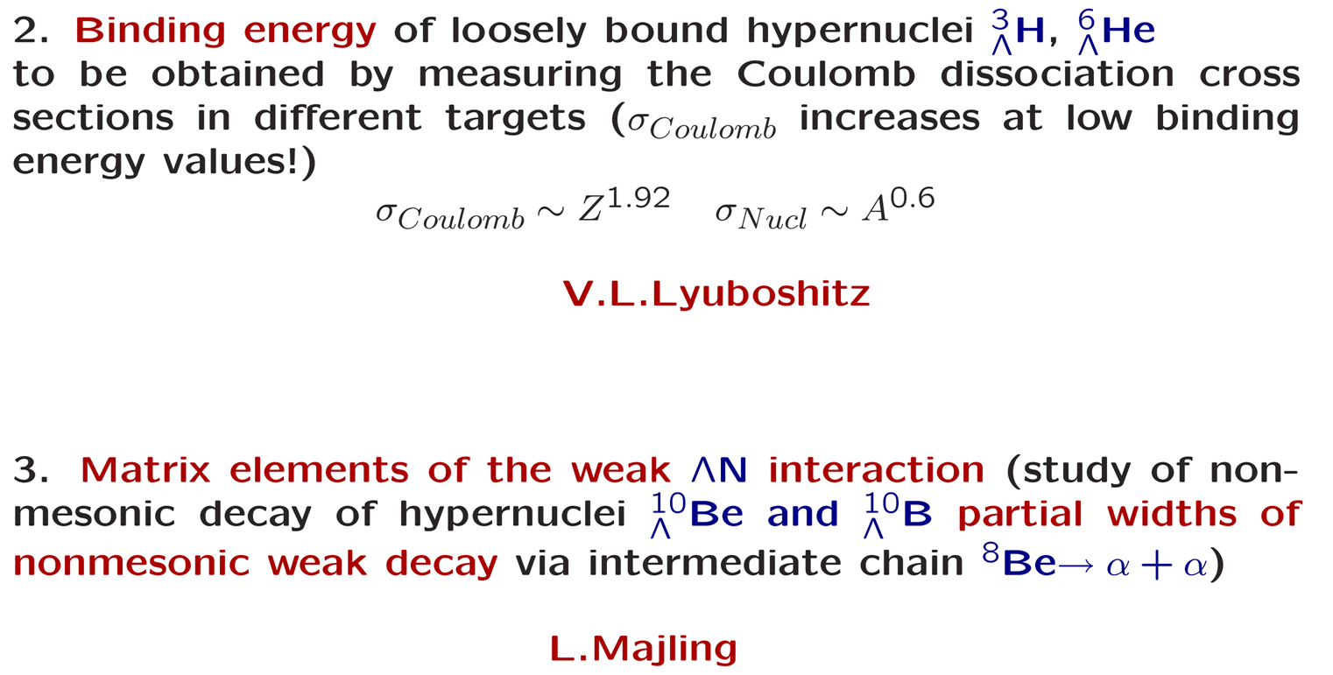
Goals of the Experiment (Future Steps)
Notes:
Actually we have long investigation program. At the next steps we would like to get binding energy of loosely bound hypernuclei like H3-lambda and He6-lambda in the Hypernuclear beams by measuring the Coulomb dissociation cross sections in different targets. Also we can try to calculate matrix elements of the weak Lambda-N interaction by using of Lyubomir Majling ideas.

Slide 4
Topics of Hypernuclear Physics at Sendai Conference (2015) Hypernuclear and Strange Particle Physics
Hypernuclear Charge Symmetry Breaking
Hypernuclear structure (production spectroscopy)
YN scattering – spectroscopy (strong).
YN weak interaction – our proposal!
Hyperon puzzle in neutron stars – neutron rich hypernuclei and S=-2 hypernuclei!
Hypertriton lifetime, short lifetimes of hypernuclei!
HyperNIS topics - neutron rich hypernuclei, lifetimes of hypernuclei, YN weak interaction, hypernuclei electromagnetic interactions
Notes:
Why do we do this?
It’s really actual problem of modern hypernuclear physics. The most discussed topics of the last hypernuclear conference at Sendai are shown here. As you can see HyperNIS project is aimed on the same tasks.

Slide 5
A.Sakaguchi* at Sendai
Conference:
“The level structure of still has ambiguities only with the FINUDA result, and complementary measurements are necessary. The production mechanism by the DCX (double charge exchange) reaction and the structure of the neutron-rich hypernuclei are not well understood, yet. More detailed analysis of the already obtained experimental data and further experimental studies of other neutron-rich hypernuclei are necessary.”
* Proc. 12th Int. Conf. on Hypernuclear and Strange Particle Physiscs (HYP2015)
JPS Conf. Proc. 17, 011007 (2017), https://doi.org/10.7566/JPSCP.17.011007.
Probability of fragmentation of ⁷Li is much higher than DCX
(Dubna experiment)
Notes:
As a conclusion of the conference Sakaguchi said that the level structure of H6-lambda still has ambiguities only with the FINUDA result, and complementary measurements are necessary. I should remind that Instead of DCX which is very rare process we use the reaction fragmentation of 7Li. Probability of such process is much higher than DCX

Slide 6
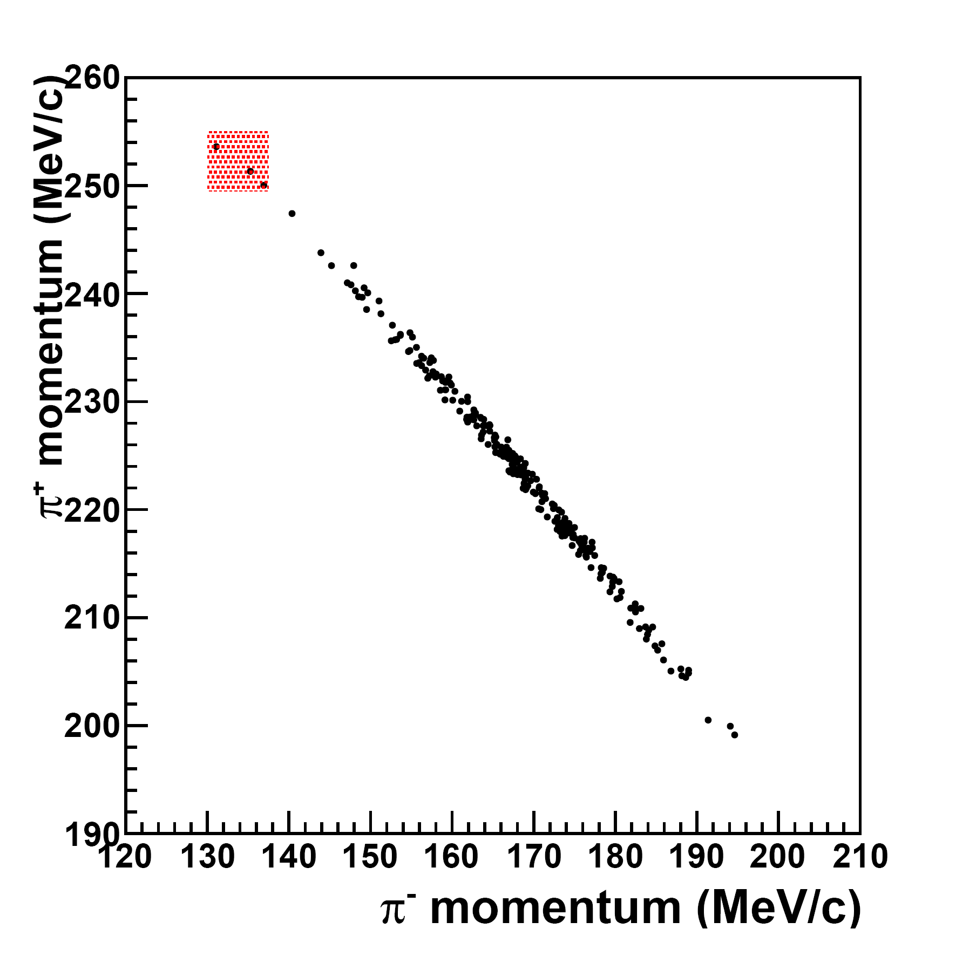
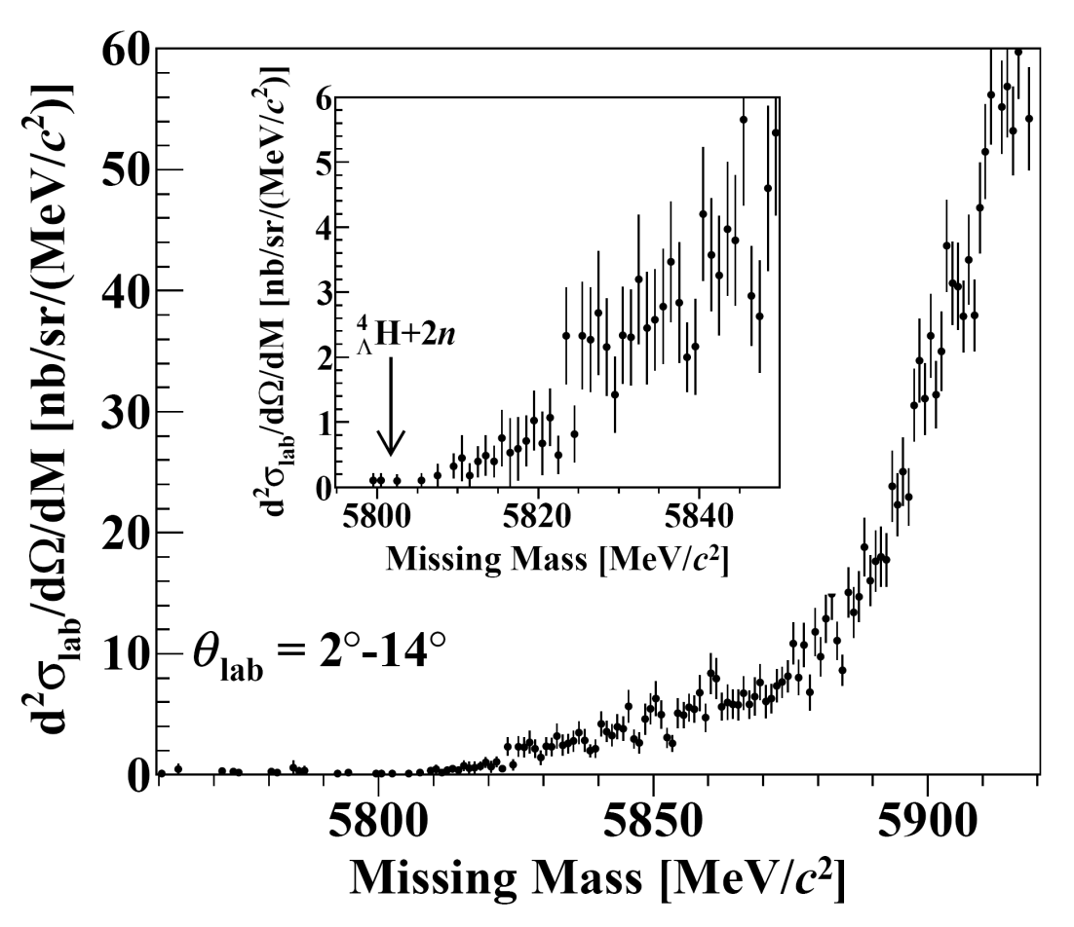
Frascati points
J-PARC E10-experiment
π ⁻ + A → K⁺ + _{Λ}A
Three candidate events of hypernuclei were observed by FINUDA collaboration (arXiv:1112.4529v1 [nucl-ex] 19 DEC 2011)
As Gal predicted, the background is too big to indicate hypernucleus signals
ArXiv:1310.6104v2 [nucl-ex] 6Feb 2014
K⁻ + A → π⁻ + _{Λ}A
Notes:
So, what is the problem here?
Presently only FINUDA experiment results have 3 event-candidates for the role of H6-lambda. They are here. While the experiment E10 (J-PARC) didn’t detect any H6-lambda. Here I have to add that Gal had predicted that the background is too big to indicate hypernucleus signal. Both of the experiments have some disadvantages, which can be partially excluded in our project.

Slide 7

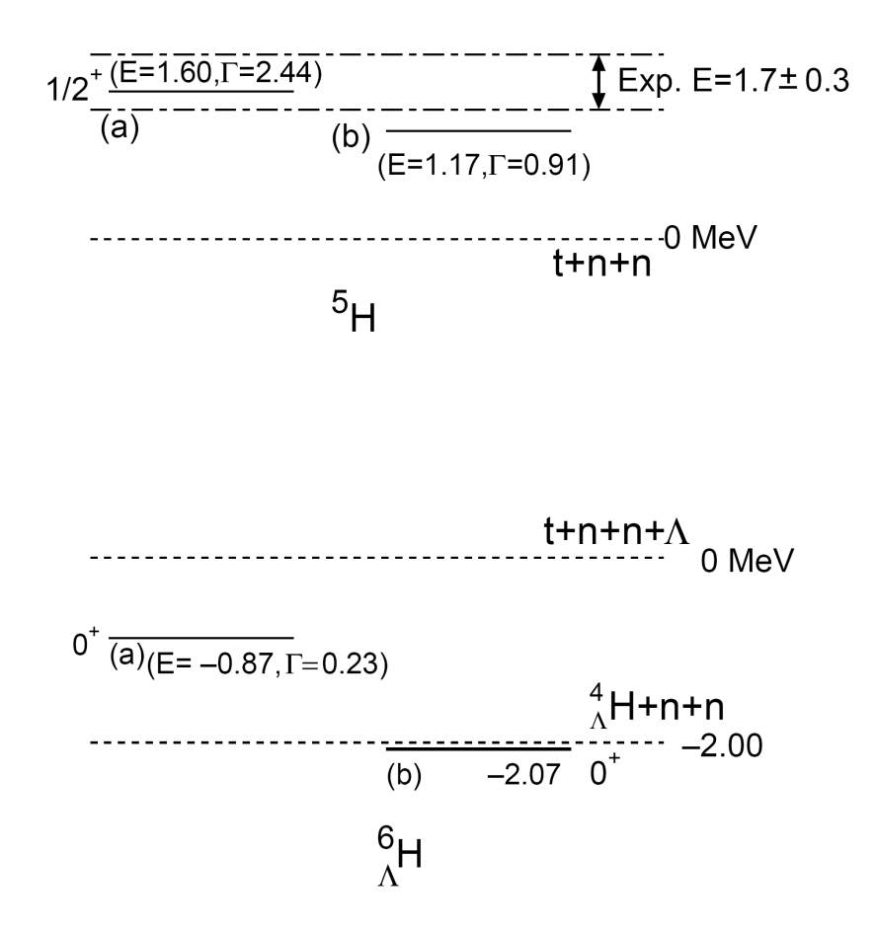
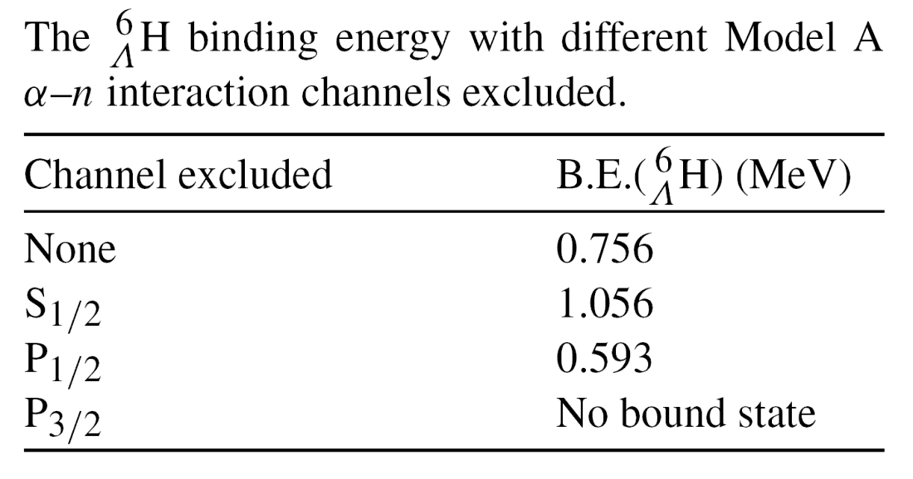
Four-body Structure of Neutron-rich Hypernucleus
E. Hiyama, S. Ohnishi, M. Kamimura,
and Y. Yamamoto
B.F.Gibson, I.R.Afnan, Nuclaer Physics A(2013)
http://dx.doi.org/10.101016/j.nuclphysa.2013.02.017
ArXiv:1304.0317v1 [nucl-th] 1 Apr 2013
Notes:
Among the theoretical works there is also no common opinion. Emiko Hiyama showed that there are no any stable states of H4-lambda,n,n system. From the other side Gibson et al. found bound states of such systems with main state energy about 700 KeV which is not a lot, but still positive. As I said there are no precise data about H6-lambda and we can solve this problem.

Slide 8
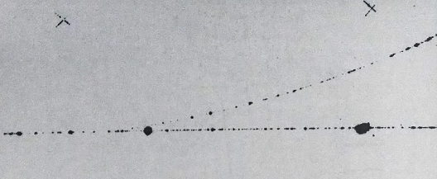
How to get Hypernuclei?
Hypernuclei production, two approaches
● Target nucleus → hypernucleus at rest(?):
1) Kaon beam (Podgoretsky) K⁻ + A → π⁻ + _{Λ}A
2) Stopped kaons (Frascati) K⁻ + A → π⁻ + _{Λ}A
3) Pion beam (J-lab) π⁺(π⁻) + A → K⁺+ _{Λ}A
4) electron beam e + A → e + K + _{Λ}A
● Beam nucleus or fragment → hypernucleus:
1) Method elaborated A + C → _{Λ}A + X
at Dubna
Decay point
Typical image of hyper hydrogen decay in the streamer chamber selected by special trigger
π⁻
⁴He
Avramenko S.A. et al. Magnetic Spectrometr GIBS, P13-98-111, Dubna, 1998.
Notes:
Well, we have a problem. How to pass it?
There are two different approaches to produce hypernuclei. One of them was proposed by Podgoretsky and has few implementations. Some of them are shown here. The main idea is to obtain hypernuclei from the target nuclei. But the another method we used was elaborated at Dubna. Following such inclusive reactions hypernucleus is obtained from the beam nucleus and can decays outside the target. Remember our streamer chamber experiment. It is a photography of a Typical image of hyper hydrogen decay in the streamer chamber. H4-lambda came from the left and disintegrated here into a pion and Helium four fragment. The decay point is on about 20 cm distance from the target.

Slide 9

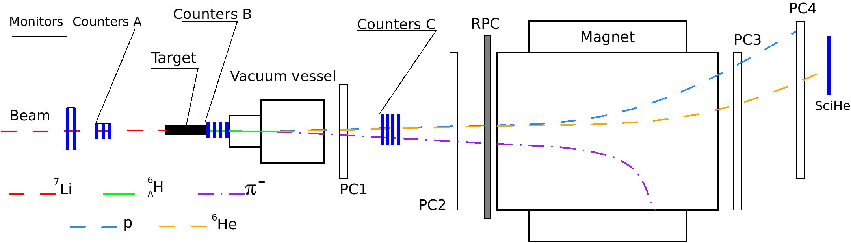
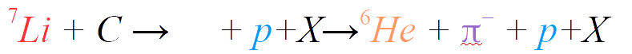

Scheme of Experimental Setup
HyperNIS spectrometer for production with ⁷Li beam. Target
(carbon 12x3x3 cm, 20.4 g/cm²); A,C — groups of scintillation counters; B – group of Cerenkov counters; PC1–PC4 — groups of proportional chambers (tracker); RPC — wall of TOF detectors.
GEM
Notes:
For example in the reaction fragmentation we use now Li7 nucleus comes from the left and falls to the Carbon target. Counters of group A tell us that it was Li7. Cerenkov Counters B show that we have 2 single-charged particles after the target. If Hypernucleus decays into the vacuum vessel than the decay vertex is reconstructed by proportional chambers one and two. Vacuum vessel allows us to collect only free decays without interactions. GEM detectors are planed but not installed yet. Counters C register He6 and single-charged particle. The trigger system is based on charge increasing. It allows us to suppress the background at the level 10 to the 4. Wall of TOF detectors is used to measure momentum of slow pions. Magnet, proportional chambers 3 and 4 and the last counter is for fragment determining.
The last counter is additional argument for He6 identification.

Slide 10
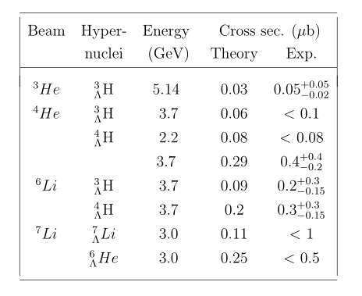
Necessary Run Length
The study of hypernucleus (years 2019-2021):
Optimal statistics for the goal is about 500 detected events.
Ideal Nuclotron beam (Spill – 5 sec, Intensity – 400-500 *10³ sec⁻¹) – expected 600 per day
Last Run (Spill – 3 sec, Intensity – less 200*10³ sec⁻¹) – 150-200 per day???
If binding energy of is very low production cross section can be lower than for
by factor of 3-4
Optimal (minimal) first run time length is 200 hours
Notes:
It’s enough to get 10 events of 6H-lambda to say does it exist or not. But optimal statistics for the study of H6-lambda is about 500 events. If we assume that the cross section of H6-lambda is similar with H4-lambda and we have ideal Nuclotron beam then 600 of H6-lambda per day are expected. However last run we worked Nuclotron beam parameters were not so good. If binding energy of H6-lambda is very low production cross section can be lower than for H4-lambda by factor of 3 or 4. So, optimal first run time length is 200 hours. Table shows the production cross sections for lightest hypernuclei. Experimental values are from Dubna experiments. Calculations also were made for Dubna experiments.

Slide 11
Last years results
During the Nuclotron run 50 the ⁷Li beam was for the first time delivered to the spectrometer. Background suppression factor much higher than 10⁴ was reached.
The spectrometer was significantly upgraded during the last years:
Most important improvement consisted of R&D and production of new front-end electronics for proportional chambers instead of the 30 years old FEE.
A new High Voltage supply system was introduced for trigger photomultiplier tubes and for the proportional chambers.
A new electronic gas supply system for RPC allows one to improve time resolution. Gas supply system for proportional chambers is also upgraded.
Notes:
And what do we have for the goal reaching?
We have the spectromert which is intensively upgraded last years. Most important improvement consisted of R&D and production of new front-end electronics for proportional chambers instead of the 30 years old FEE. A new High Voltage supply system was introduced for trigger photomultiplier tubes and for the proportional chambers. A new electronic gas supply system for RPC allows one to improve time resolution. Gas supply system for proportional chambers is also upgraded

Slide 12
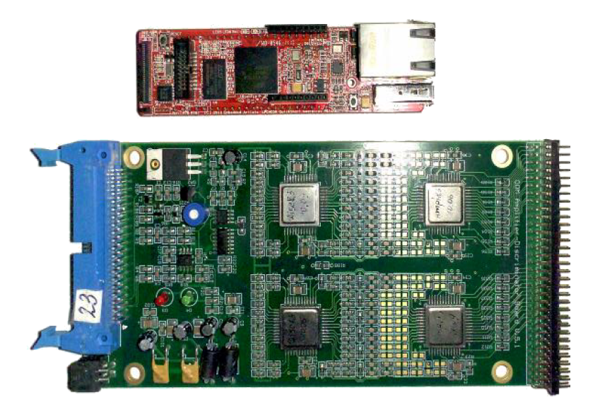
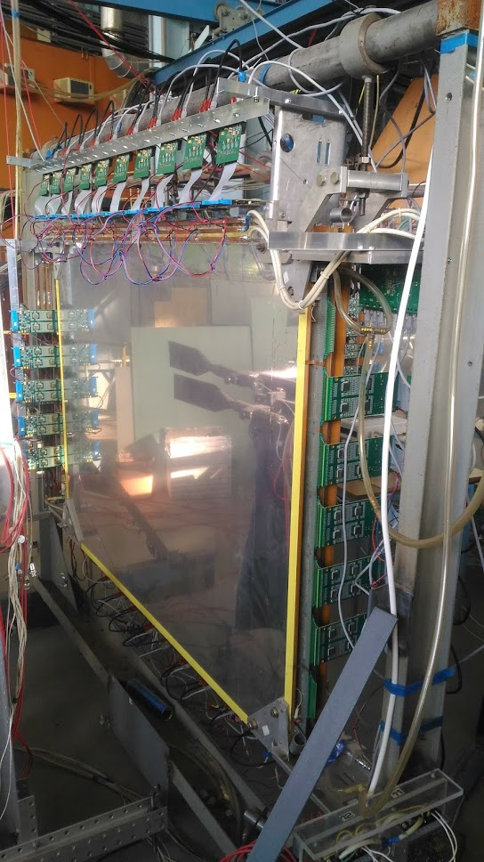
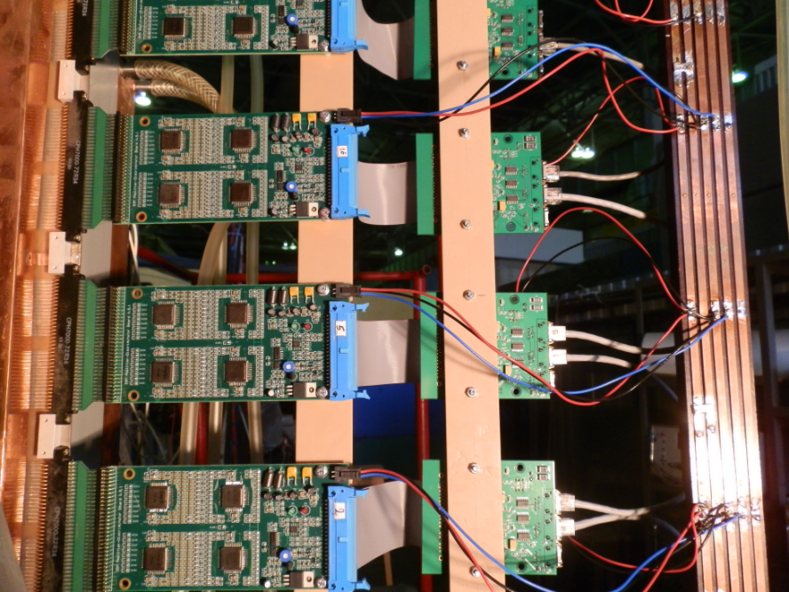
Hardware upgrade of FEE
Notes:
How does it look like you can see here. This is the amplifiers. It is concentrator. Proportional chambers gathered the new FEE are shown here.

Slide 13
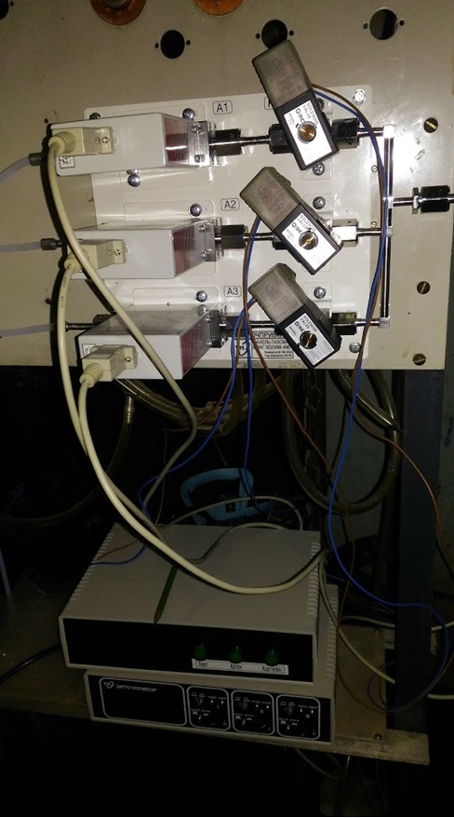
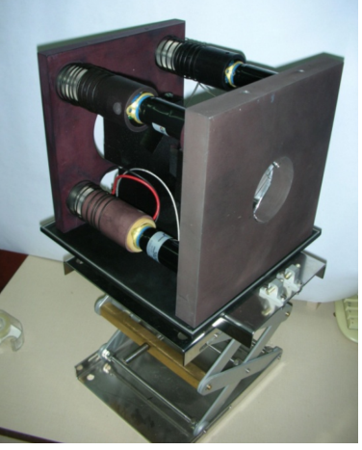
New Equipment Which is Already Installed
Block of 4 Cerenkov counters with subsequent quartz 4 mm radiators. High density graphite (1.7 g/cm³) target is placed close to radiators.
Electronic gas supply system of RPC
Notes:
Block of 4 Cerenkov counters with subsequent quartz 4 mm radiators is shown here. High density graphite (1.7 g/cm 3 ) target is placed close to radiators. New Electronic gas supply system of RPC is shown here.

Slide 14
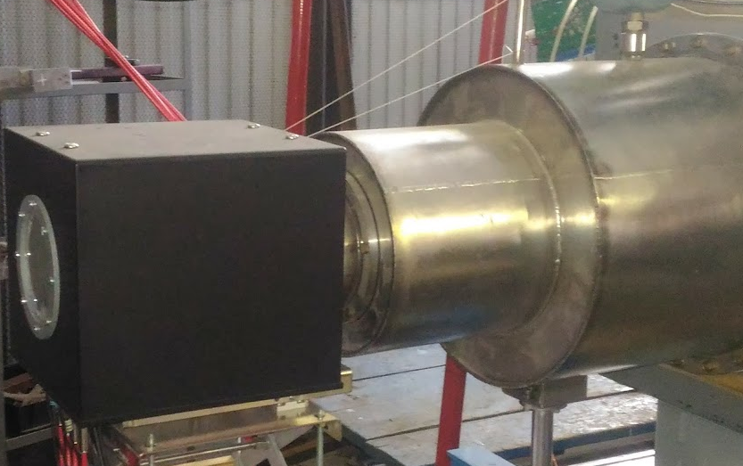
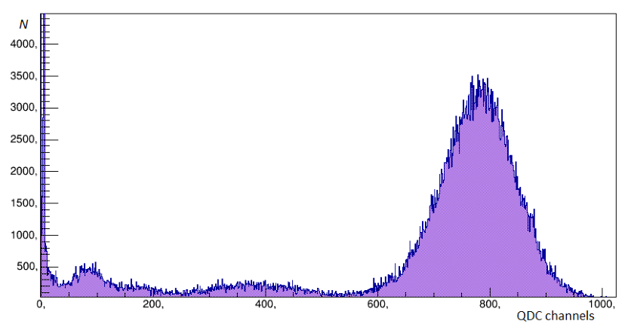
Amplitude resolution of Cerenkov counter
Block of Cerenkov counters installed near the vacuum vessel
⁷Li beam
Notes:
Block of Cerenkov counters installed near the vacuum vessel and the amplitude distribution of one of Cerenkov counters obtained in the Lithium beam are shown here.

Slide 15
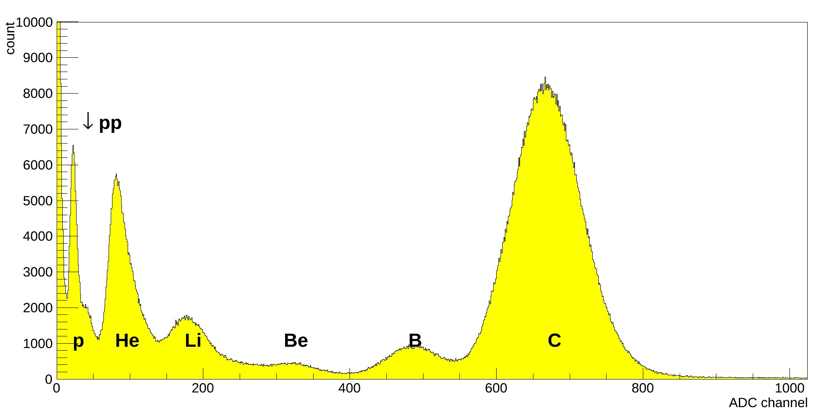
Amplitudes of Scintillation Counters
Amplitude spectrum of signals from a counter of the trigger system, obtained with the carbon (¹²C) beam. Background suppression above factor at least 10⁴ can be obtained with 4 counters in coincidence.
Notes:
Amplitude spectrum of signals from a Scintillation counter of the trigger system, obtained with the carbon (¹²C) beam is shown here.

Slide 16
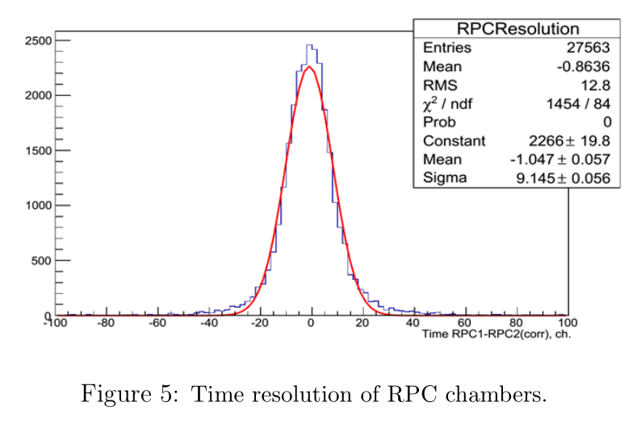
Time resolution of TOF system
Time resolution of TOF system is about 200 psec
Notes:
Time resolution of TOF system is about 200 psec. It’s quite enough for our task.

Slide 17
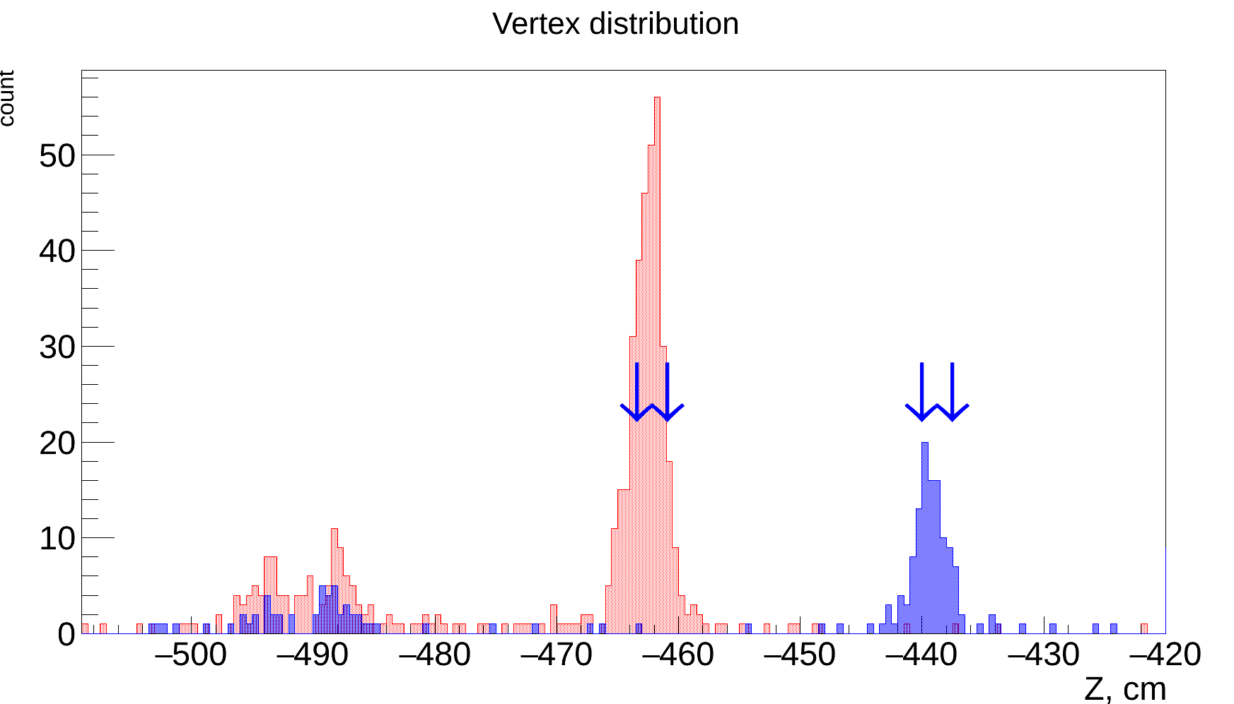
Vertex Reconstruction Procedure
Two different positions of an Al target (red and blue) reconstructed with two track vertex reconstruction procedure. Arrows shows target width.
Position of two trigger counters are also seen.
Notes:
Two different positions of an Al target (red and blue) reconstructed with two tracks vertex reconstruction procedure are shown here. Arrows show the real target width. Position of two trigger counters are also seen. Blue square shows the real position of the vacuum vessel. The distributions are obtained from the real data.

Slide 18
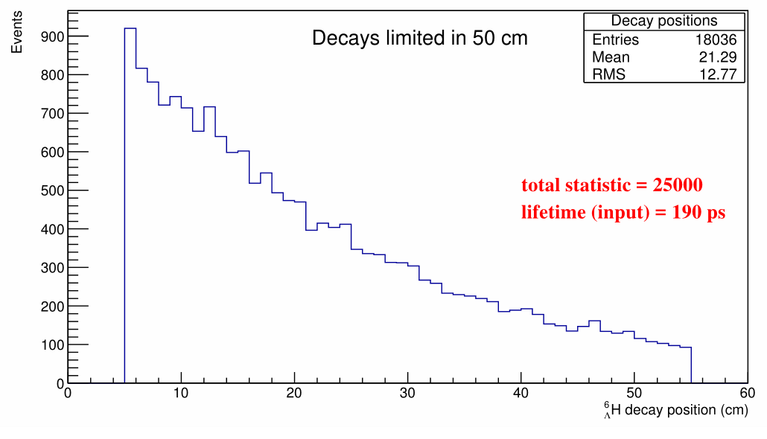
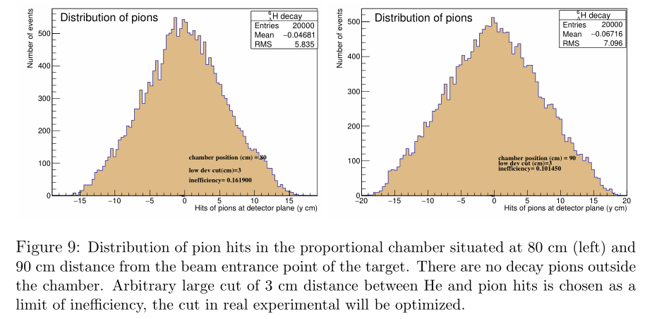
Simulations
Expected decay points inside of 50 cm distance. Since 25000 events analyzed and about 18000 hypernuclei decay inside of 50 cm distance it is 70% of the statistics if the first point is in 5 cm distance from the target.
Notes:
All calculations we need to optimize the spectromernt are done. For example, Simulation of expected hypernuclei decay points shows that 70% of the statistics are inside of 50 cm distance if the first point is 5 cm distance from the target. It means that the most part of hypernuclei will decay inside the vacuum vessel. Also, distribution of pion hits in the proportional chamber situated at 80 (left) and 90 (right) cm distance from the target is shown here. There are no decay pions outside the chamber.

Slide 19

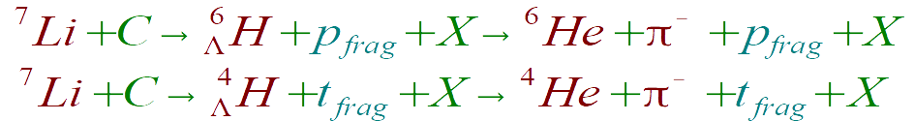
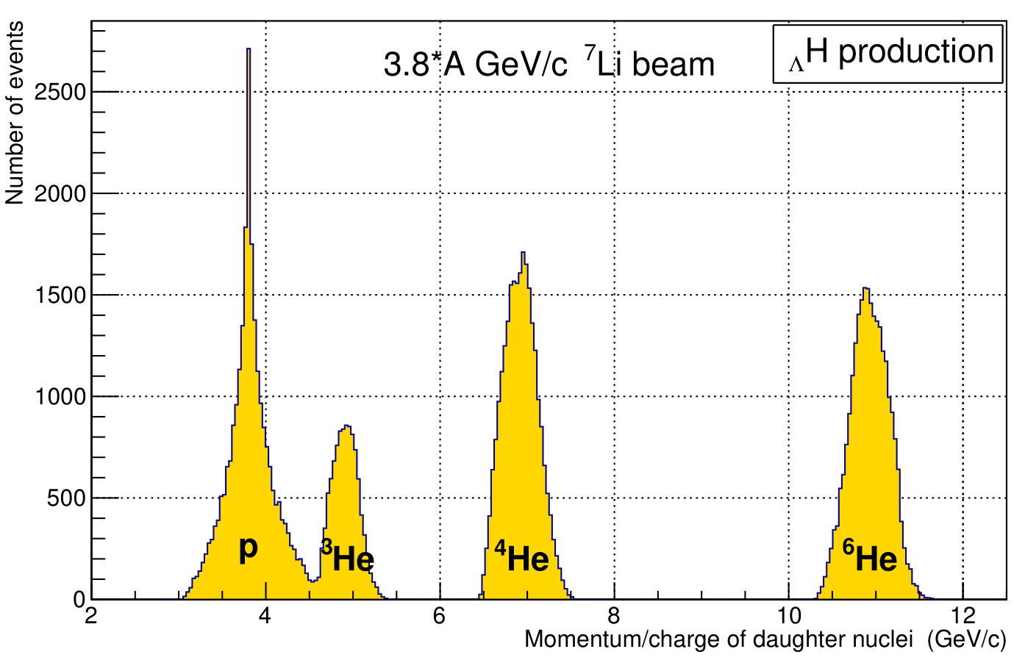
Separation of Daughter Nuclei of
Notes:
Our trigger system is tuned to detect production and decay of H Hypernuclear isotops. Dew to H4-lambda is studied enough that process will help us to check whether our setup works well or not. Also, world statistics of H4-lambda life time will be increased by the HyperNIS experiment. Simulation of separation of daughter nuclei from this processes by magnet is shown here. It is clearly seen that we can separate the fragments.

Slide 20
Full Time Equivalent
Name | FTE |  | Name | FTE
Averyanov A.V. | 0.9
Aksinenko V.D. | 0.8 |  | NEO AFI Department | 0.8
Baeva A.N. | 0.25
Fechtchenko A.A. | 0.7 |  | NEO STS Department | 0.4
Gercenberger S.V. | 0.8
Korotkova A.M. | 0.3 |  | Dzhelepov Laboratory of Nuclear Problems | 0.6
Krivenkov D.O. | 0.7
Lukstins J. | 0.5
Maksimchuk A.I. | 0.6
Okhrimenko O.V. | 1.0
Plyashkevich S.N. | 1.0
Parfenova N.G. | 0.5
Salmin R.A. | 1.0
Strokovskii E.A. | 0.5
Total FTE:
11.35
Notes:
Ok, what is the team of HyperNIS project?
Total Full Time Equivalent is 11.35. Most part of FTE is department of nuclear intrinsic strangeness physics. Also other departments from LHEP take a part in the HyperNIS project implementation. Dzhelepov Laboratory of Nuclear Problems takes a part too.

Slide 21
Cost estimate for the project. Form №29
№ | Name of the expenses item | Full cost (in thousand of the $) | 1-st year (2019) | 2-nd year (2020) | 3-rd year (2021)
 | Direct expenses for the project | 157 | 93 | 32 | 32
1. | Accelerator (Nuclotron), hours | 500 | 0 | 200 | 300
2. | Computer (type)
3. | Computing
4. | Design office (hours) | 0 | 0 | 0 | 0
5. | Mechanical workshop (n. hours) | 700 | 500 | 100 | 100
6. | Materials | 15 | 5 | 5 | 5
7. | Equipment | 82 | 68 | 7 | 7
8. | R&D costs paid by contracts
9. | Trip costs, including: | 60 | 20 | 20 | 20
 | a) countries out of the rouble zone | 54 | 18 | 18 | 18
 | b) countries inside the rouble zone | 6 | 2 | 2 | 2
 | c) on protocols/agreements
Notes:
This table shows the cost estimate for the project. Significant costs in the next year connected with Purchase and installation of GEM detectors.

Slide 22
Summary
The HyperNIS spectrometer is ready for hypernuclear experiments. Li and C beams are necessary!
The very first experiments are devoted to and problem – do they exist?
HyperNIS research program is adequate for the method elaborated in Dubna – chosen tasks are interesting and necessary for hypernuclear physics, hard to be solved at particle beams.
Thank you for attention
Notes:
So, we have come to the conclusions.

Slide 23
Back up slides

Slide 24
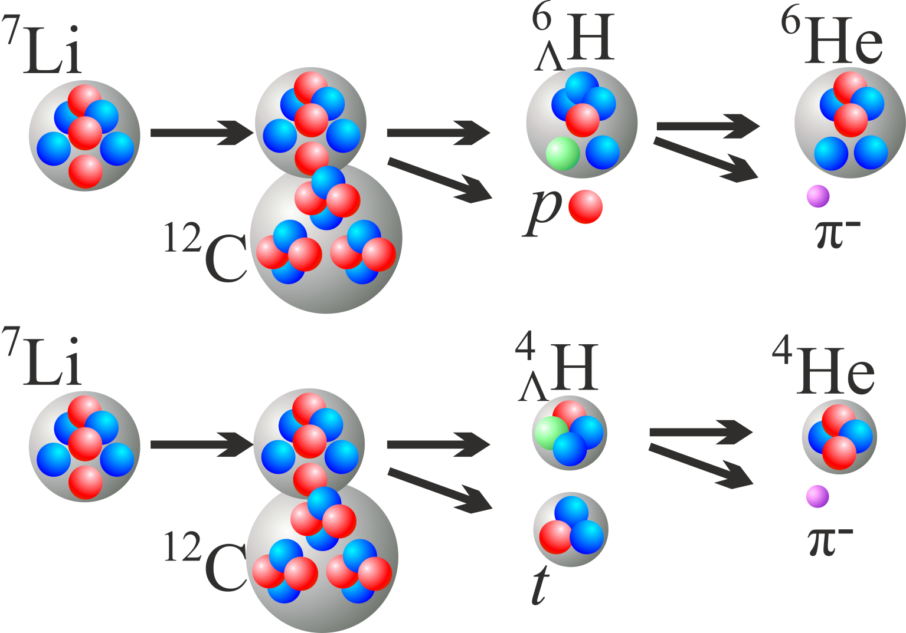
Hypernuclei Production Reaction at NUCLOTRON

Slide 25
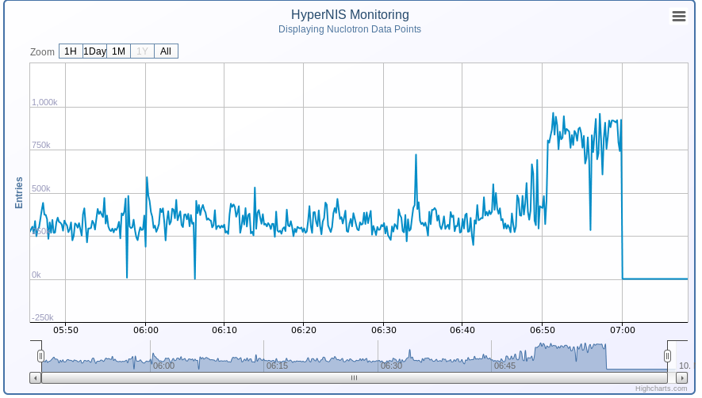
On-line Monitoring of the Beam and Counters
It is a screen shot of the beam particle counter vs spills. NUCLOTRON has a break at 7:00

Slide 26
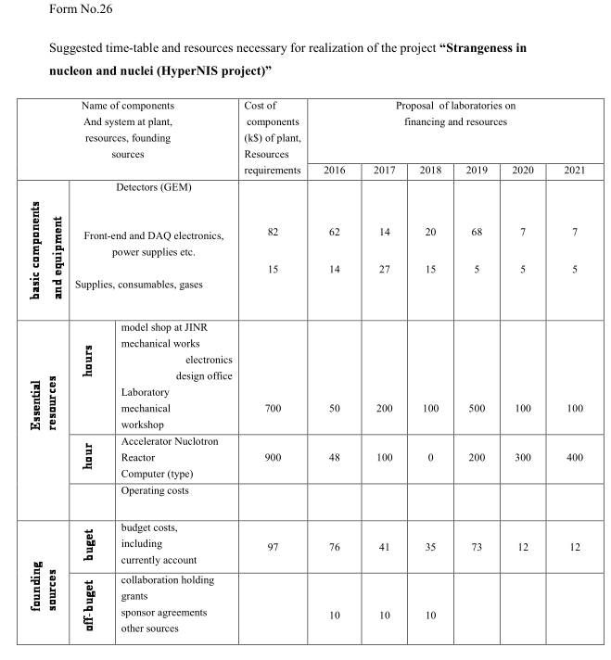

Slide 27
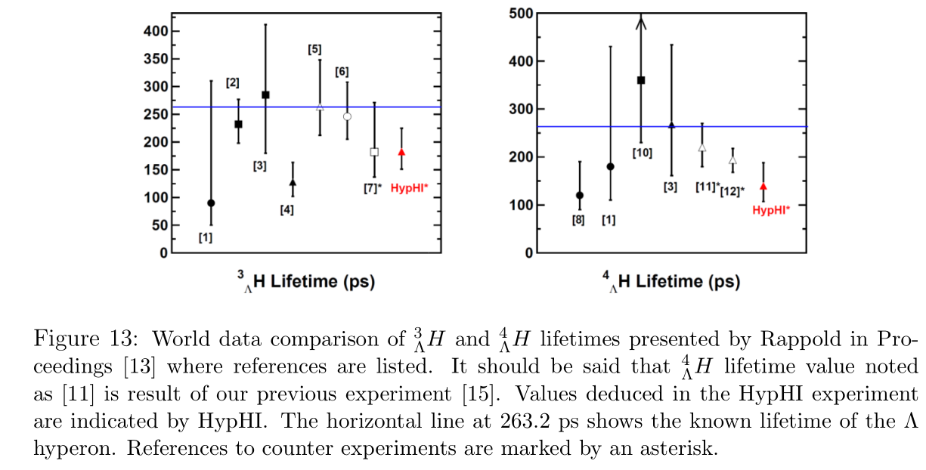

Slide 28
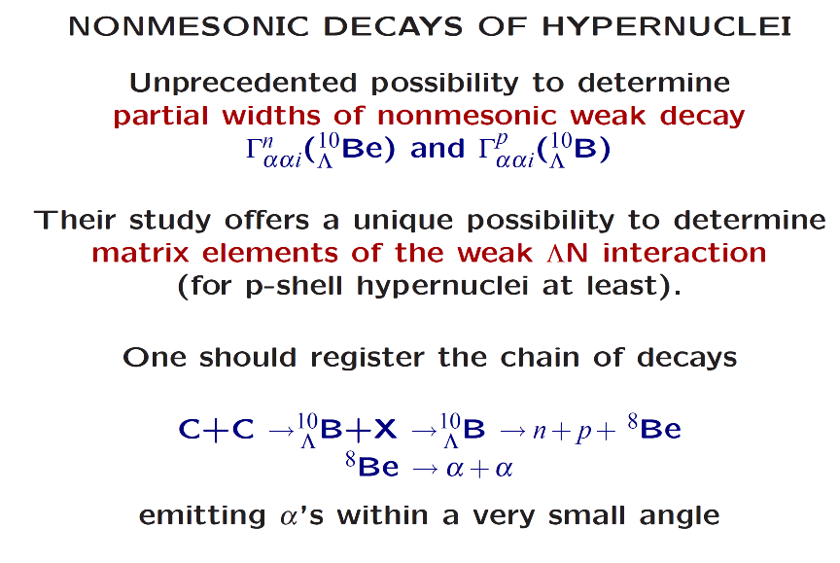

Slide 29
Neutron-rich Hypernuclei
Hypernuclei with a large neutron excess have been theoretically predicted
(L. Majling, NPA 585 (1995) 211c).
The Pauli principle does not apply to the Λ inside the nucleus + extra binding energy (Λ “glue-like” role) a larger number of neutrons can be bound with respect to ordinary nuclei.
Neutron-rich hypernuclei and neutron stars.
Stefano Gandolfi and Diego Lonardoni, The EOS of neutron matter and the effect of Λ hyperons to neutron star structure, Proc. 12th Int. Conf. on Hypernuclear and Strange Particle Physics (HYP2015) JPS Conf. Proc. 17.101001 (2017)
Ignazio Bombaci, The Hyperon Puzzle in Neutron Stars, Proc. 12th Int. Conf. on Hypernuclear and Strange Particle Physics (HYP2015) JPS Conf. Proc. 17.101002 (2017)

Slide 30
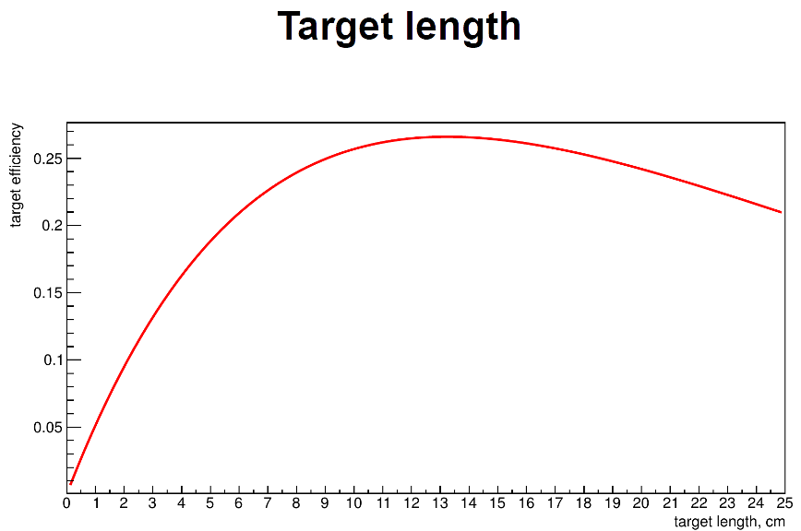

Slide 31
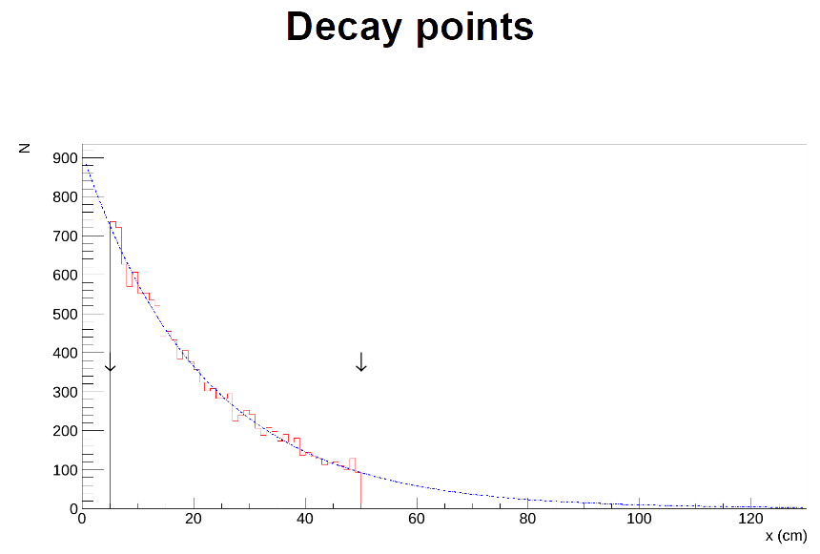

Slide 32
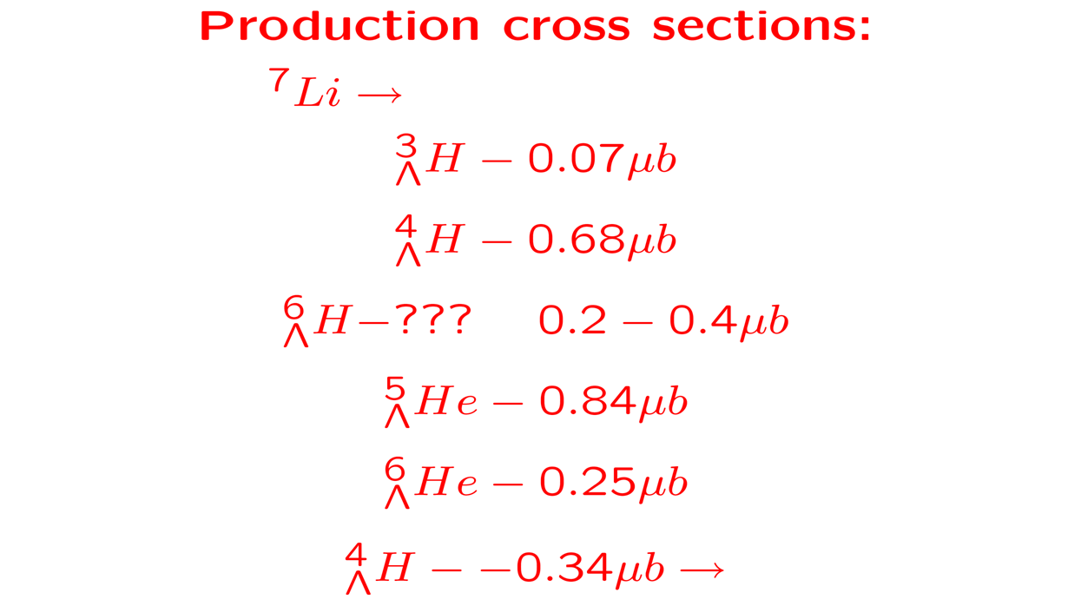


Slide 33
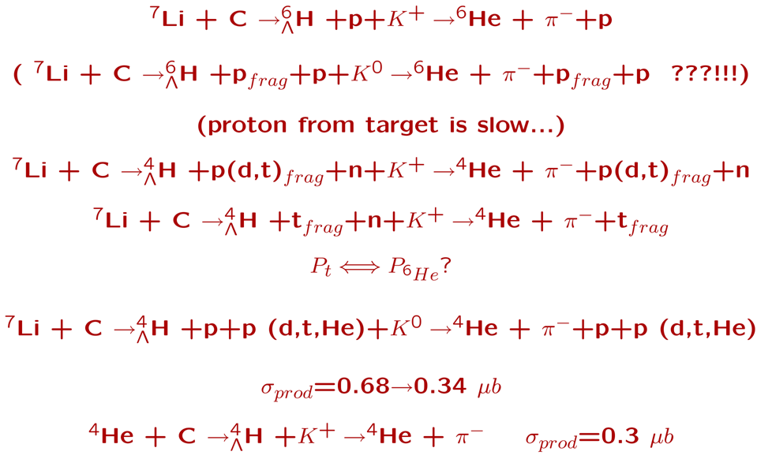

Slide 34
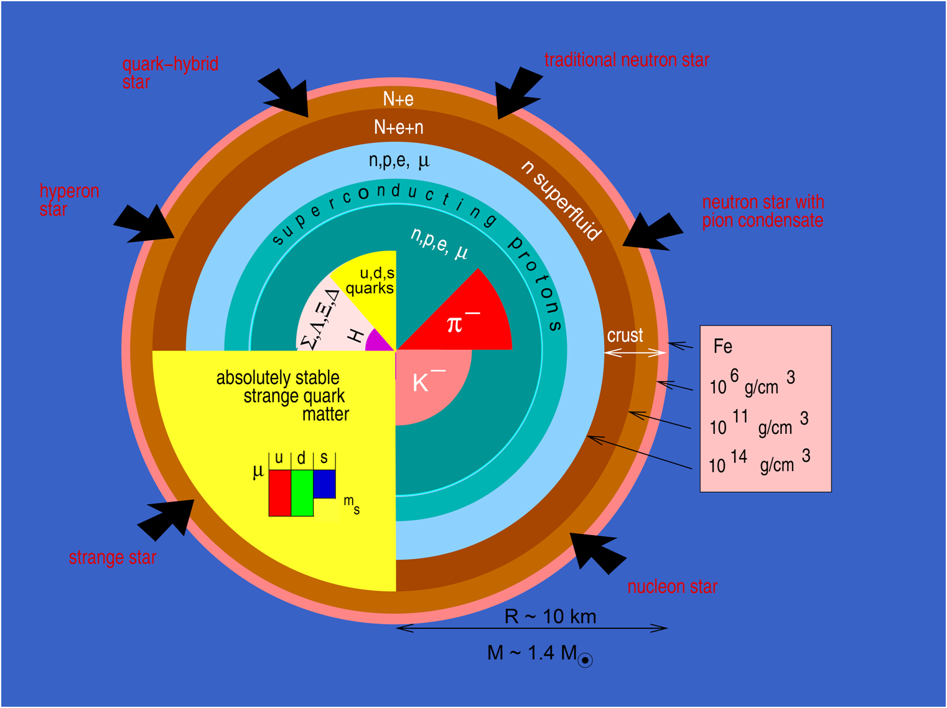

Slide 35
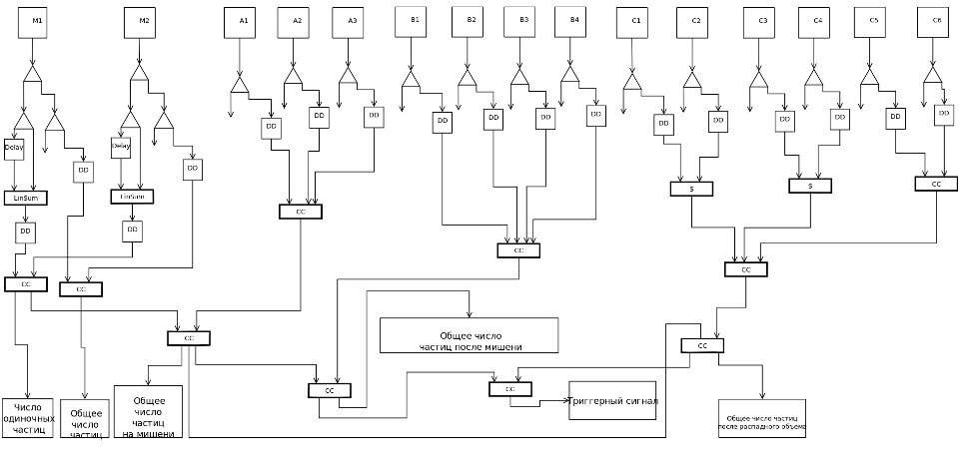

Slide 36
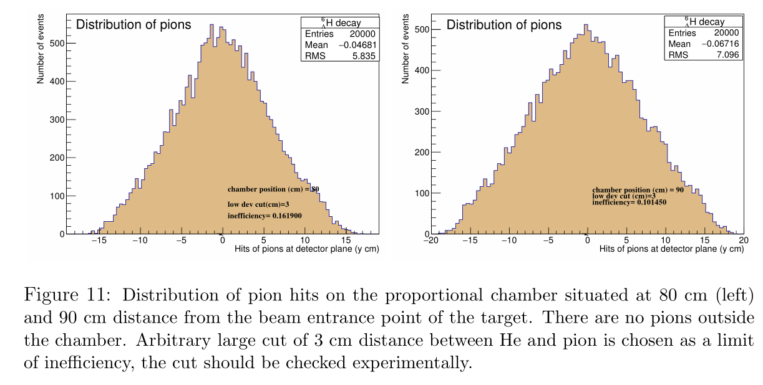

Slide 37
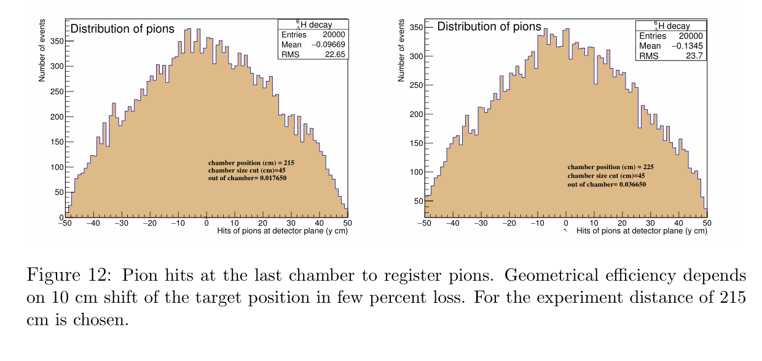

Slide 38
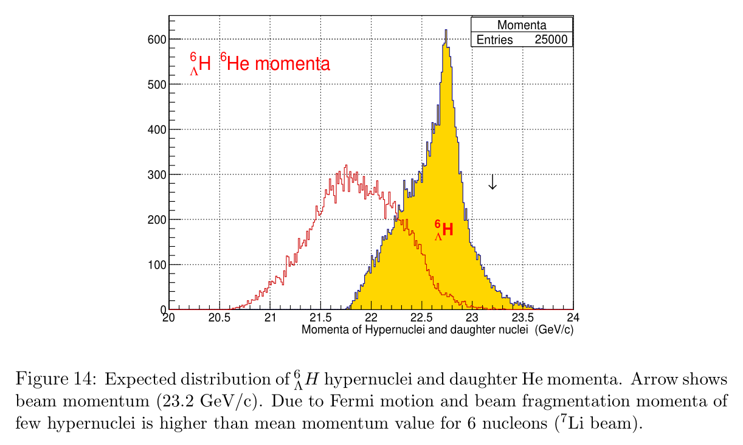

Slide 39
