Slide 1
PAC for Condensed Matter Physics,
48th Meeting
Development of a facility for measurements with
test electron beams at DLNP. LINAC-200.
in the framework of theme 04-2-1126-2015/2020
Novel Semiconductor Detectors for
Fundamental and Applied Research
M. Gostkin

Slide 2
Project authors
Project leader: Kobets V.
Deputy project leader: Gostkin M.
Scientific project leader: Shirkov G.
DLNP (23 people): Acosta E., Baranov V., Brukva A., Budagov Yu., Garanzha N., Glagolev V., Gostkin M., Gritsay K., Davydov Yu., Demin D., Dyatlov A., Zhemchugov A., Kobets V., Korovyakov V., Krasnoperov A., Nozdrin A., Porokhovoy S., Sorokin A., Shabratov V., Shirkov G., Shokin D., Skripnik A., Yunenko K.
LHEP: Sledneva A.
University Centre (5 people): Belozerov D., Verlamov K., Gikal K., Zlydenniy D., Nozdrin M.

Slide 3
One of the main tasks of JINR is
R&D of new types of particle detectors
New collider experiments (ILC, CLIC, CEPC, HL-LHC, NICA)
Search of neutrinoless muon conversion into electron (mu2e, COMET)
Applied research: biology, material science and medicine

Slide 4
Sources of elementary particles
Cosmic rays
Radionuclide sources
Beams of charged particles from accelerators
Advantages:
Tunable energy and intensity
Possibility of their reliable identification
Precise timing and coordinate information
There are no any electron testbeams at JINR now!

Slide 5
Available electron test beams
Scientific center | Particles | Energy [MeV] | dP/P [%] | Number of lines
BTF (Frascati, Italy) | e ± | 25-750 | 1 | 1
ELPH (Tohoku, Japan) | e ± | < 850 | 1 | 1
BEPC-II (China, Beiging) | e ⁻ e ± (sec.) | 1100 - 1500 400 - 1200 | 1 | 3
FTBL (KEK, Japan) | e ⁻ | 500-3400 | 0,4 | 1
DESY-II (Germany) | e ⁻ | 1000-6000 | 1 | 3
CERN PS (Switzerland) | e, hadrons, μ | (1-15)*10³ |  | 4
CERN SPS (Switzerland) | e, hadrons, μ | (10-400)*10³ |  | 4
FTBF (FNAL, USA) | e ⁻ , π ⁻ , μ | (1-66)*10³ |  | 1
SLAC (USA) | e ⁻ e, hadrons (sec.) | 13,6*10³ (0,1-13,6)*10³ | 0,1-1,3 | 1
IHEP (Protvino, Russia) | e, hadrons, μ | (1-45)*10³ |  | 4
BINP SB RAS (Novosibirsk, Russia) | e ⁻ | 100-3500 | 1,8-2 | 1
PI RAS S-25R (Troitsk, Russia) | e ⁻ | 300-1300 |  | 0
EPI (Armenia) | e ⁻ | 75 6000 |  | 1

Slide 6
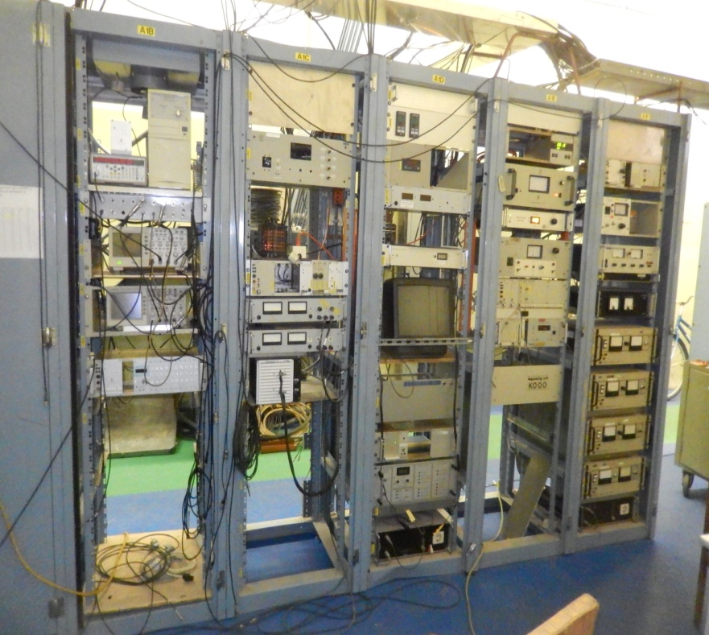
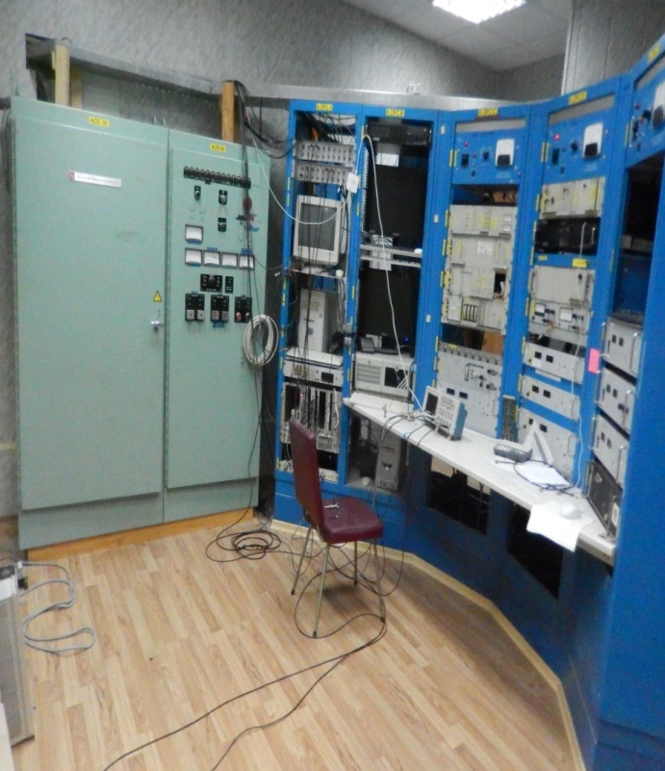
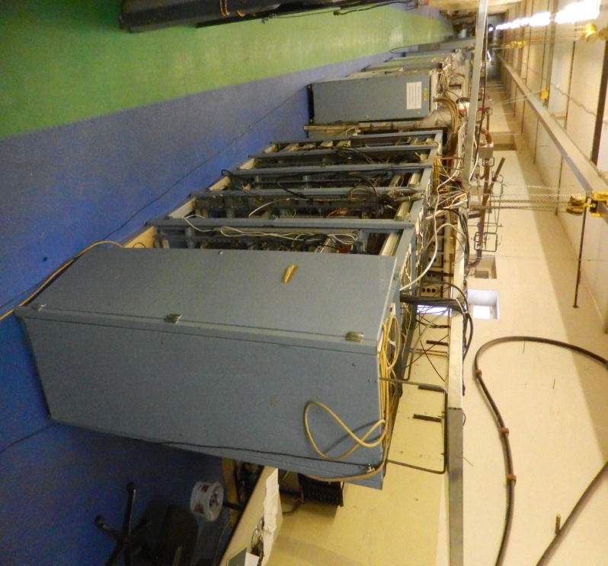
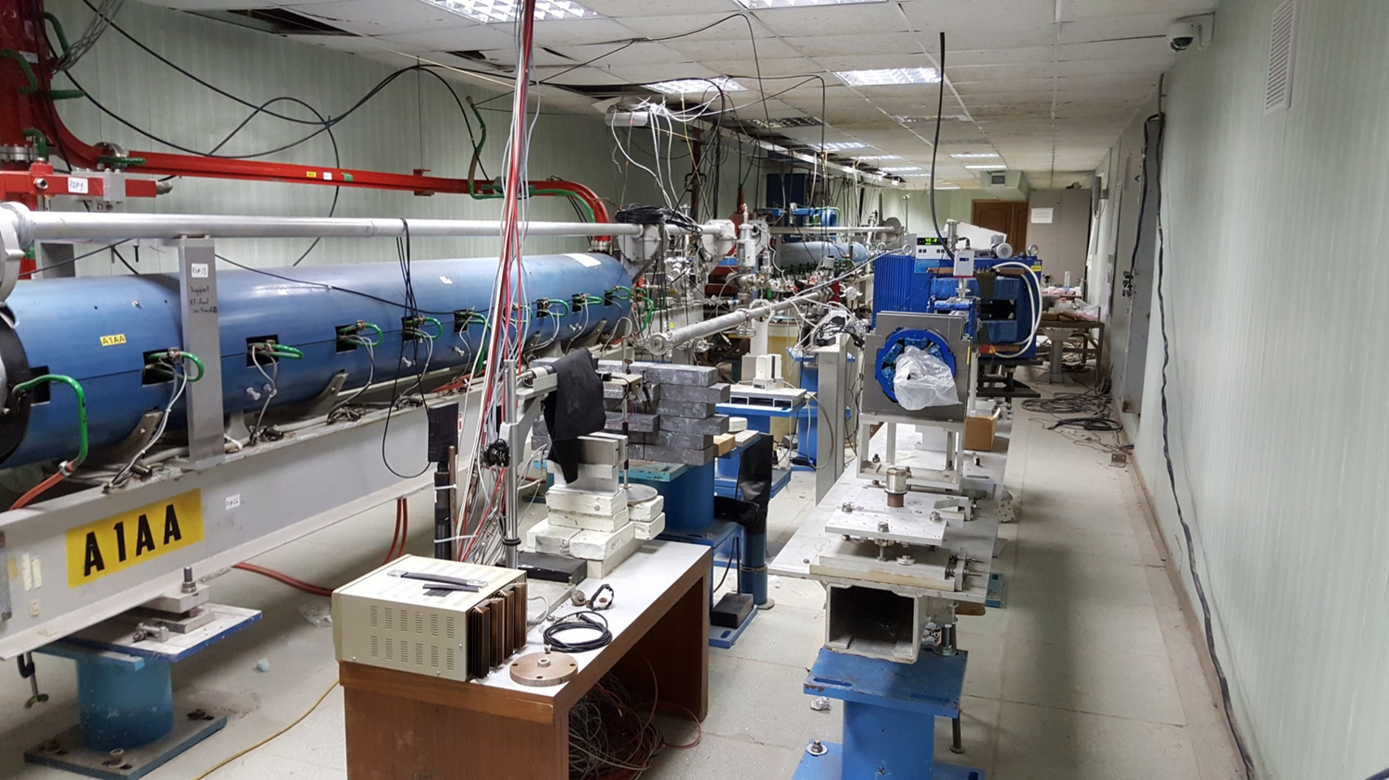
LINAC-200

Slide 7
History
1975 – Medium Energy Accelerator (MEA), energy 800 MeV have been done for NIKHEF by Haimson Research corporation.
1980 - commissioning at 700 MeV
1990 - modernization
1998 – decommissioning
1999-2000 moving to JINR as part of the project DELSY
2011 – a beam of 20 MeV was obtained
2014 – on behalf of the committee of plenipotentiaries, the JINR University center began to develop an educational program based on the accelerator
August 2017 – physical start-up at 220 MeV.

Slide 8
The linear electron accelerator LINAC-200
an injector
a buncher
12 accelerating stations
Energy – up to 800 MeV (possible 2 GeV)
The structure of the beam is pulsed, with pulse length of 0.1-3 μs
The current in the pulse can be set in a wide range of values, from 60 mA to almost zero values
The frequency of pulses is set in the range from ~10 to 100 Hz, which corresponds to the electron intensity from 1 to 10¹³ e⁻ /s

Slide 9
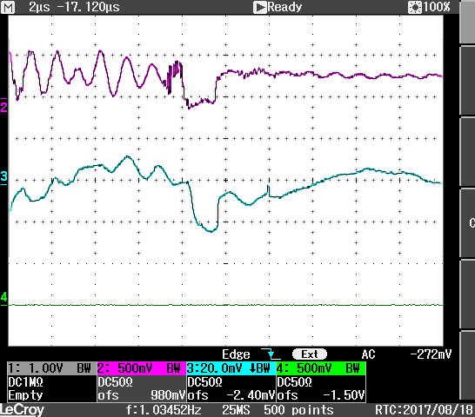
Physical start-up of A04 station
August 2017
upper line - current of electron beam after the 1st accelerator station, the energy of 20 MeV,
lower line – the current after the 4th accelerator station,
the energy of 220 MeV.)

Slide 10
Project goal
physical start-up → test beams
Finalize commissioning
Tuning of the accelerator and development of test beams with energy up to 220 MeV
The increase of energy up to 800 MeV and development of high-energy test beams

Slide 11
Status of the accelerator
Main elements of the accelerator (accelerating structure,
modulators, klystrons) is in good condition and has sufficient
resource (>30000 hours) for long-term operation
Some technological systems need to be upgraded
or replacement.
 | cost (kUSD)
Vacuum system-pump replacement | 240
The development of accelerator control system (ACS) | 60
Beam diagnostics tools | 30

Slide 12
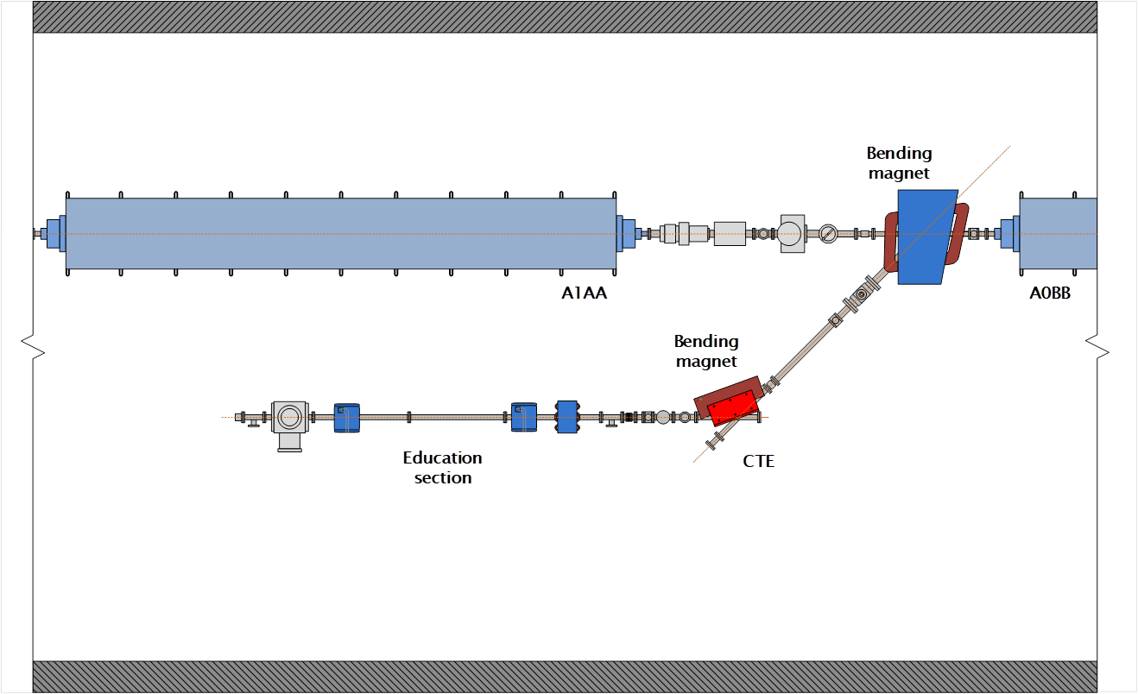
Channels for output of the electron beam
Currently, there are two channels for beam output from the drift gap after the A01 accelerator station (energy 5-20 MeV). One of these channels is intended for the implementation of educational programs. The second channel allows studies with a electron test beam.
beam
20 MeV

Slide 13
Channels for beam output
after A01 station | 20 МeV
after A03 station | 130 МeV
after A04 station | 200 МeV
after A06 station | 350 МeV
after A08 station | 500 МeV
«training» after A01 station | 20 МeV
The energy spread < 1%.
Size of the focal spot < 1 mm
Uniform illumination in the area of 20 cm x 20 cm
The beam intensity from 1 to 10¹³ e⁻/s
Beam stability < 5% when carrying out measurements

Slide 14
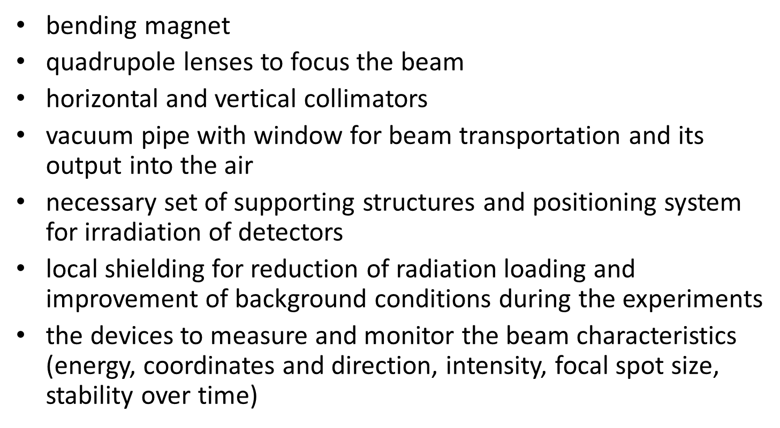
Testbeam equipment
Testbeam construction (4 beams) | Cost (kUSD) (3 years)
Magnets and collimators | 54
Detectors | 36
Vacuum pipes, valves and windows | 60

Slide 15
Short term plan of detectors R&D
The requirements for the beam depend on the problems to be solved:
Research of radiation hardness of detectors, electronics, materials
FCAL-collaboration, MEDIPIX, mu2e
- high intensity
- uniform illumination of a large area
Studies of crystals CsI, LYSO, BaF2, straw detectors, et al. - mu2e, COMET
The low intensity, which allows to minimize the imposition of signals (pile up) and measure the response of the detector to single electrons. When working with crystals with a flash time of several tens of nanoseconds on LINAC-200 at a frequency of 50 Hz, it is necessary to work with a beam with an intensity of several tens of electrons/s, giving 10-20 triggers per second.
The lowest possible background from scattered electrons, gamma rays, neutrons.
Energy spread at the level of 1-3%
R&D for NICA – semiconductor detectors, MPGDs etc.

Slide 16
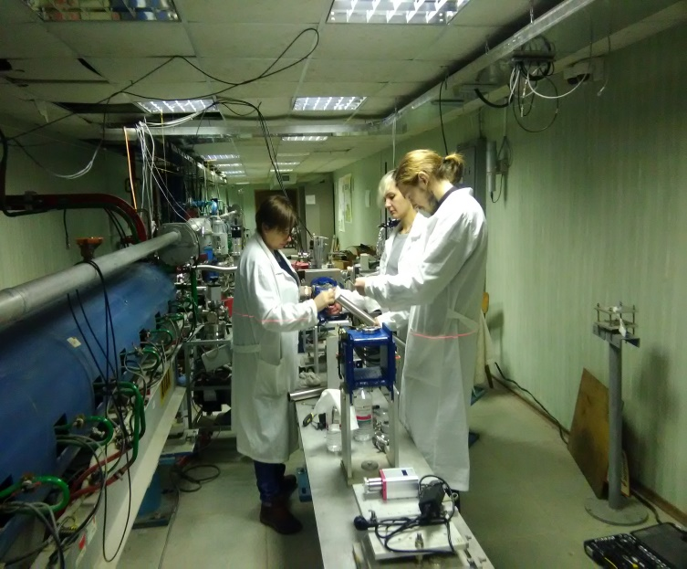
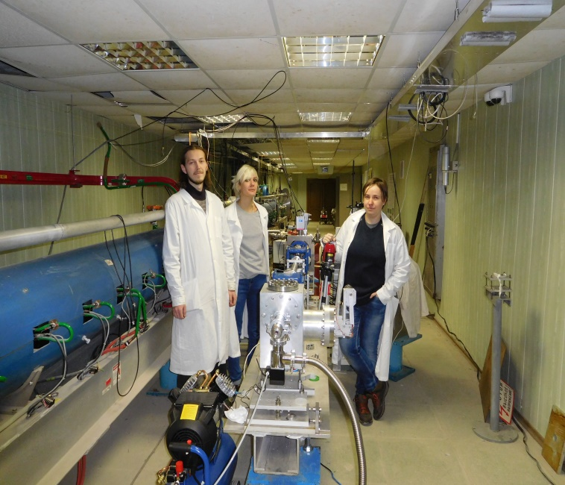
Educational program.
The following practical activities can be performed at the "training" beam of the LINAC-200 facility:
Operation of vacuum equipment;
study of magnetic optics (bending magnet, quadrupole lenses, sextupole);
beam diagnostics, emittance measurement.
At the LINAC-200 facility it is possible to carry out trainings to study the response of various particle detectors.
In future, laboratory classes to measure electron scattering on nuclei, research of giant resonances, etc. are planned.

Slide 17
Work plan.
2019
The upgrade of the vacuum system at A01-A04 stations.
The development and deployment of the ACS
Equipping the two existing testbeams with the standard set of detectors
Delivery of at least 200 hours of beam time for detector R&D
Start of practice at the "training" beam
2020
Installation and commissioning works at A05-A08 accelerating stations
Construction of the testbeams after A03 and A05 stations
Delivery of at least 300 hours of beam time for detector R&D
2021
Installation and commissioning works at A09-A12 accelerating stations
Construction of the testbeams after A08 and A11 stations
Delivery of at least 500 hours of beam time for detector R&D

Slide 18
 | total | 2019 | 2020 | 2021
Materials | 75 | 25 | 25 | 25
Equipment | 720 | 240 | 240 | 240
Travel costs | 10 | 2 | 4 | 4
JINR budget (kUSD) | 805 | 267 | 269 | 269
Equipment | 720 | 240 | 240 | 240
A05-A12 station commissioning | 240 | 80 | 80 | 80
clystron coils recovery | 60 | 20 | 20 | 20
cooling and heat setting system | 180 | 60 | 60 | 60
Accelerator upgrade | 330 | 110 | 110 | 110
Vacuum pumps replacement | 240 | 80 | 80 | 80
Monitoring and control | 60 | 20 | 20 | 20
Beam diagnostics | 30 | 10 | 10 | 10
Testbeam construction (4 beams) | 150 | 50 | 50 | 50
Magnets and collimators | 54 | 18 | 18 | 18
Detectors | 36 | 12 | 12 | 12
Vacuum pipes, valves and windows | 60 | 20 | 20 | 20

Slide 19
Conclusion
Electron accelerator Linac-200 produced first 220 MeV beam in 2017
We propose to use the machine as a base of the new testbeam facility, to enhance the detector R&D at DLNP and other scientific groups of JINR laboratories and from JINR Member States
Several testbeams with the energy up to 800 MeV and wide range of beam intensity are planned
Invaluable opporunity for practical training of young accelerator engineers and particle physicists
Thank you!

Slide 20
Financial Resources Needed for Project realization (Form №29)
No | TASKS | Total value | 2019 | 2020 | 2021
 | Direct costs of the Project.
1 | Accelerator, reactor | -- | -- | -- | --
2 | Computer | -- | -- | -- | --
3 | Materials | 75 | 25 | 25 | 25
4 | Equipment | 720 | 240 | 240 | 240
5 | R&D | -- | -- | -- | --
6 | Travel resources
 | a) ) in non-ruble area | 5 | 1 | 2 | 2
 | b) in ruble area | 5 | 1 | 2 | 2
 | Total direct cost : | 805 | 267 | 269 | 269

