Slide 1
Programme Advisory Committee
for Condensed Matter Physics
47th meeting (22 – 23 January, 2018)
Dénes Lajos Nagy

Slide 2
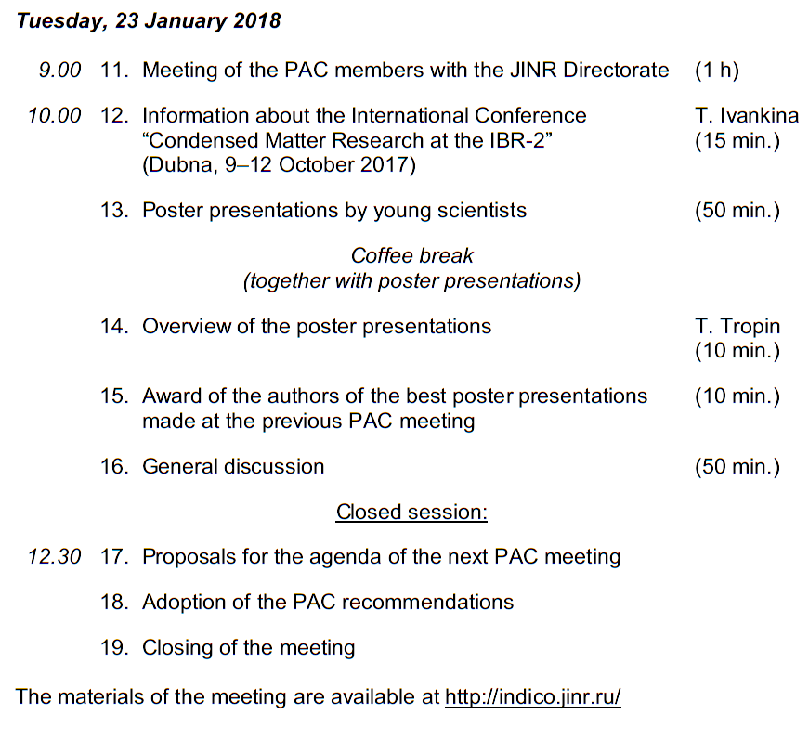
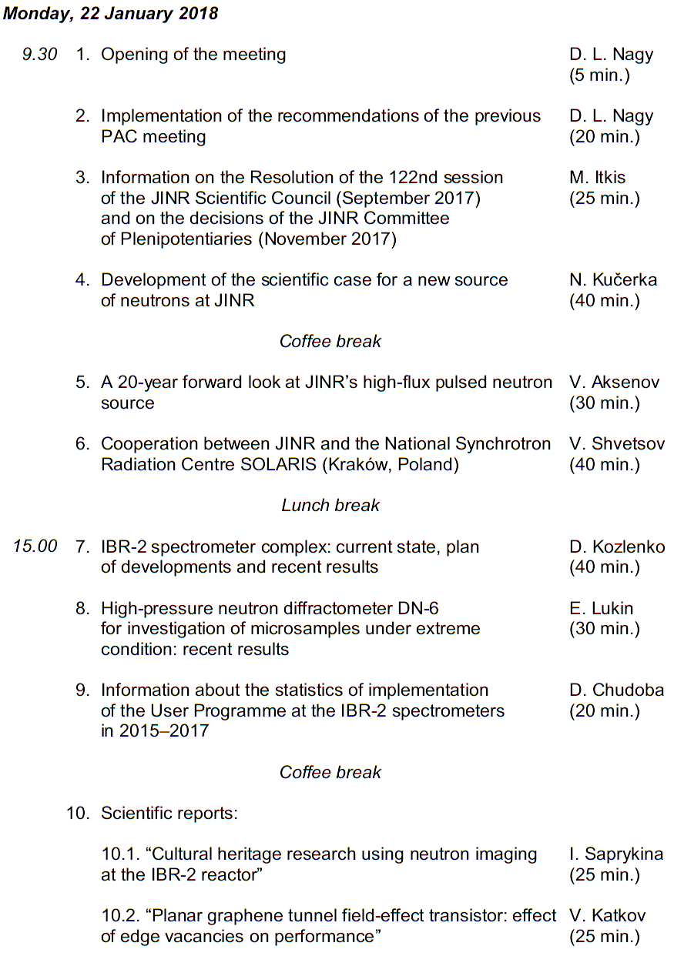
Agenda of the 47th PAC meeting
Highlights of the PAC-CMP meeting:
Discussion of the scientific case for a new source of neutrons at JINR
Cooperation between JINR and the National Synchrotron Radiation Centre SOLARIS
FLNP User Programme and information on IBR-2 instruments

Slide 3
Development of the scientific case for a new source of neutrons at JINR
Niche of Neutrons
Hard Matter
Soft & Life
Matter
Nucleus
New Physics
V.L.Aksenov PAC on CMP, January 2017,Dubna
p.3

Slide 4
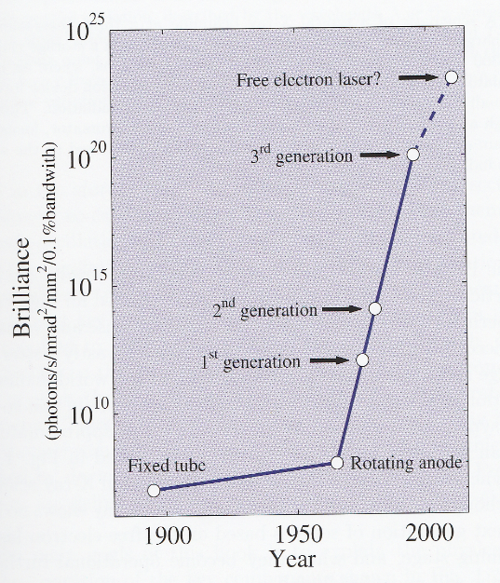
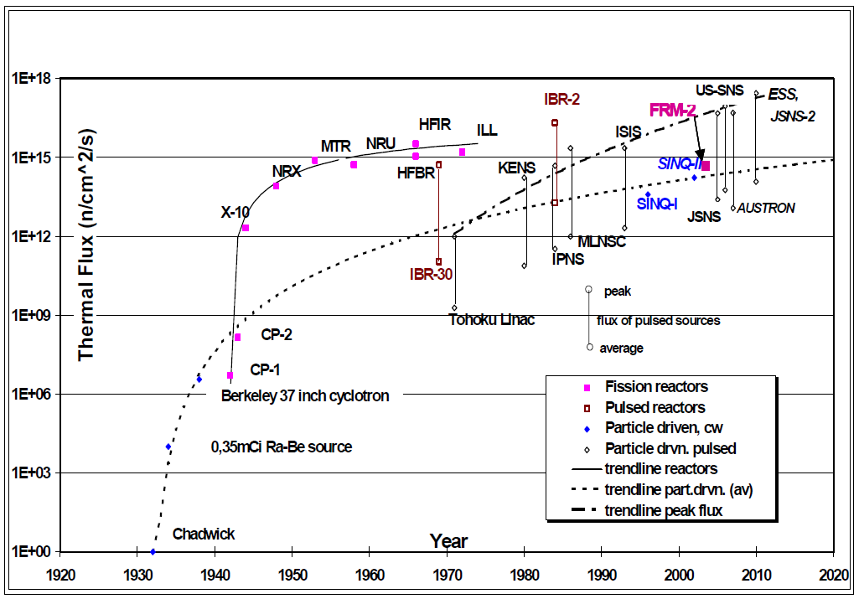
Flux Advancements
X-ray sources
Neutron sources
J. Als-Nielsen, D. McMorrow, Wiley (2001)
Report of a technical meeting held in Vienna, 18–21 May 2004 , IAEA-TECDOC-1439 (2005).

Slide 5
Parameters in Focus
Efficiency Determining Factors
neutron optics
spectrometer performance (resolution, background)
data collection speed
flux@sample [n/cm²/s¹] >10⁸
background <5-10%
frequency 5-10 Hz
wavelengths 1-20 Å
resolution <5%
pulse width 200-400 μs
vs. ~10 μs
Diff.+SANS+Refl. Inelastic

Slide 6
Dubna Neutron Source of the Fourth Generation
V.L.Aksenov PAC on CMP, January 2017,Dubna
p.6

Slide 7
The Scientific Council took note of the progress in the discussion of the scientific case for a new JINR neutron source replacing the IBR-2 reactor after its shut-down and welcomes the continuation of this programme in close connection with FLNP’s scientific plans.

Slide 8
Basic arrangement of Np booster (without reactivity modulator)
The PAC appreciated the report “A 20-year forward look at JINR's high-flux pulsed neutron source” presented by V. Aksenov.
The PAC took note of the principles of construction and the parameters of a neutron source –– a superbooster.
Ni
Proton linear accelerator
1.2 GeV
P+
Deficiency:
Limited multiplication factor – 25.
Be
Be
Be
Fission power of the target
W≈10 MW (10^18 n/s)
at Ipeak ≥ 0.5 A (?!) – unreal
by V. Aksenov

Slide 9
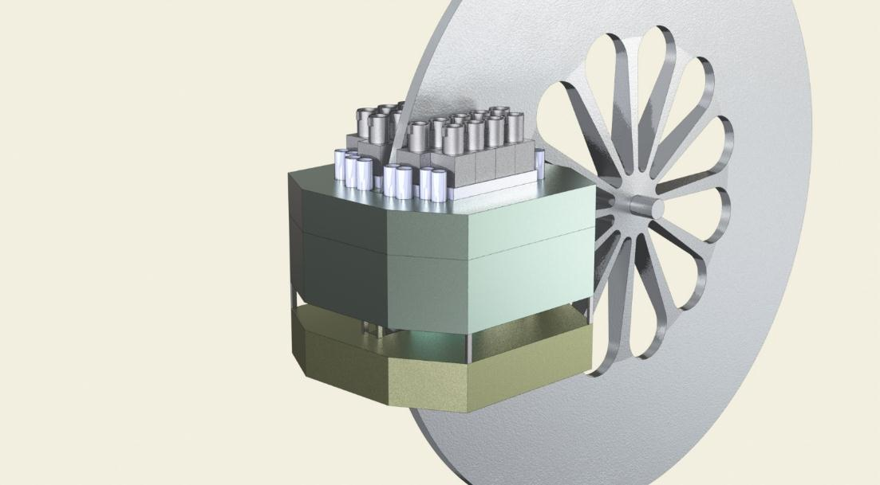
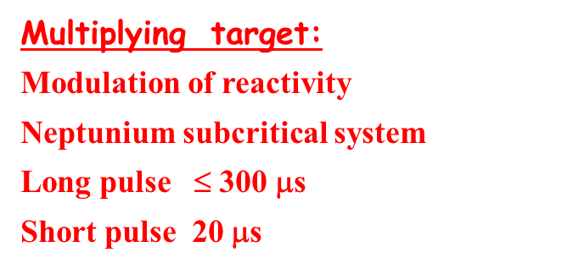
Neptun Superbooster (DNS-4)
Linear p-Accelerator
with Variable Pulse Duration
+
Multiplying Target Station with periodic modulation of reactivity (subcriticality 0.05-0.002)
n¹₀
Ep =1.2 GeV, Δt = 20-100 μs
I max = 50 mA , ν = 5-20 Hz
W ≤ 100 kW
P+
n¹₀
W = 10-15 MW
by V. Aksenov

Slide 10
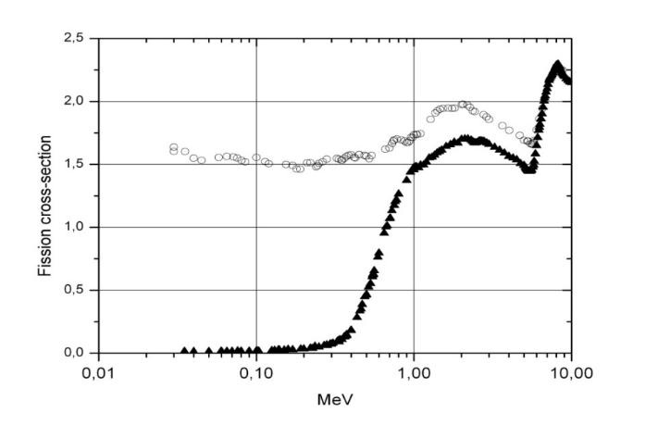
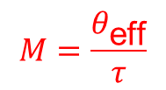
Why Neptunium–237?
10 ⁻²⁴ cm²
5 advantages over Pu-239,
each quite important :
Pu-239
Np-237
I. Short life time of prompt neutrons τ_{Np} = 10 ns
τ_{Pu} (IBR-2) > 65 ns.
Optimal multiplication factor
2. Lower background between pulses (due to lower effective delayed neutron fraction)
3. Potencial for reactivity modulation by VOID
(hydrogen is effective absorber of fast neutrons)
4 Facility operation time to fuel reloading is as long as 10-20 fold of that for plutonium core
5. Not nuclear weapon material
Fission threshold 0.4 MeV
Np²³⁷ is a product of atomic power plants; T_{1/2} = 2.14⋅10⁶ years
by V. Aksenov

Slide 11
 | Moderator type | Peak differential neutron flux 10¹⁴ n/cм²/s/sr/Ӑ (Brightness) | Peak neutron flux , 2π eqv. 10¹⁴ n/cм²/s | Time averaged flux 2π equivalent. 10¹⁴ н/cм²/с
IBR-2 | Grooved, wide | 9 | 58 | 0.09
 | Grooved, height 4.5 см | 12 | 77 | 0.16
J-Park | Coupled | 10 | 65 | 0.3
ESS | Butterfly height 6 см | 8 | 50 | 2.0
 | Height 3 см | 12 | 75 | 3.0
PIK, Russia | Stationary, D₂O moderator | 1.6 | 12 | 12
DANS | Grooved | 130 | 800 | 2.0
by V. Aksenov

Slide 12
Suggested timeline
The suggested timeline of the preparatory phase of JINR’s new neutron source with estimated deadlines includes:
establishing an international working group (IWG) in 2018;
organizing international workshops by FLNP and scientifically coordinated by the IWG from 2018 until the conceptual design report will be concluded;
publishing a short (up to 50 pages) kick-off document elaborated by the IWG on the idea of the new facility until mid-2019;
elaborating and publishing a detailed scientific case until early 2020;
elaborating a detailed conceptual design report until the end of 2020;
elaborating the administrative and financial model for the construction, commissioning, operation and decommissioning phases until 2021;
taking decision on the construction of the new facility until 2023.

Slide 13
The Scientific Council took note one of the possible concepts of a new source, presented at the meeting of the PAC for Condensed Matter Physics, where the subcritical assembly of ²³⁷Np with a mechanic reactivity modulation controlled by a pulsed proton accelerator (superbooster) is considered as an option of the future facility.
Summarizing, the Scientific Councils recommended continuation of work to study other options for the facility with a clear analysis of the parameters of the new source in terms of strengths, weaknesses, opportunities and threats with respect to the envisaged long-term user programme.

Slide 14
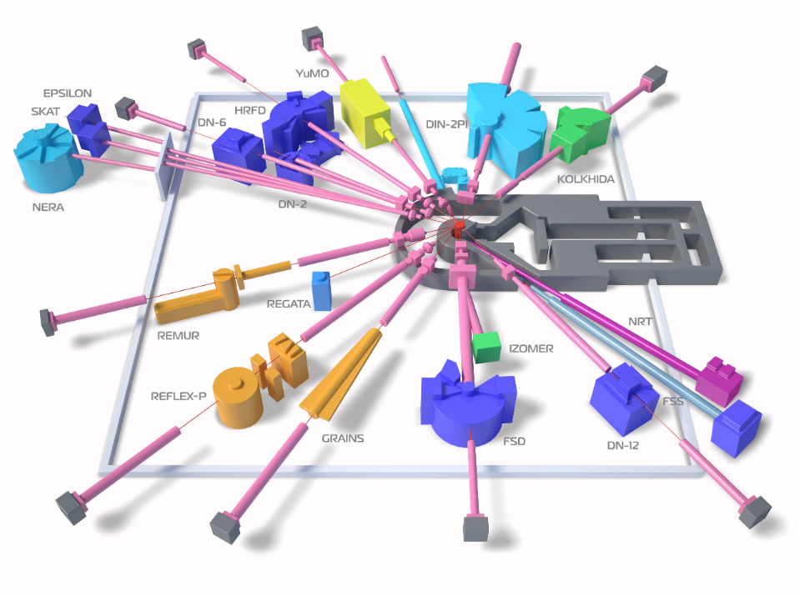
Status reports on upgrades of IBR-2 instruments
Diffractometers:
HRFD, DN-6, RTD, DN-12, FSD, SKAT/Epsilon, FSS
IBR-2M Spectrometers Complex
Reflectometers:
REMUR, REFLEX, GRAINS
Small Angle Scattering Spectrometer: YuMO
Inelastic Neutron Scattering Spectrometers:
NERA, DIN-2PI
Radiography and Tomography: NRT
New Instruments:
DN-6, GRAINS, NRT, FSS
2011:
11 instruments in operation
2018:
15 instruments in operation
Reconstruction:
REFLEX – SESANS

Slide 15
The Scientific Council highly appreciated the ongoing upgrades of the existing IBR-2 spectrometers and development of new ones, which results in improvement of their parameters and extension of research areas, as well as making them more attractive for potential users.
It supported the plans towards the further development of the IBR-2 spectrometer complex, which take into account the reactor’s specific features (high flux, long pulse, availability of cryogenic moderator) and will assure the maintenance of the instruments at the level comparable with other leading research centres in the world as well as the extension of research areas and improvement of research quality.

Slide 16
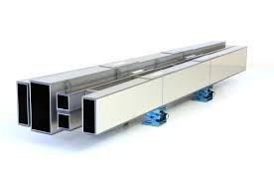
High-pressure neutron diffractometer DN-6 for investigation of microsamples under extreme condition: recent results
New focusing guide design (2016-2017)
Design: vertical parabolic tapered neutron guide
Guide profile:
-Profile (hor./vert.): parallel/parabolic tapered (linar appr.)
Cross section:
-Entrance: 180.00 mm(h)x 15.00 mm(w)
-Exit: ~60 mm (h)x 15.00 mm(w)
Reflectivity:
-Top/bottom R_{ave}=92%
-Sides R_{total}~99,5%
First three units:
Coating: Ti/Ni
-Top/bottom m=3
-Sides m=1
Last unit:
Coating: Ti/Ni
-Top/bottom m=5
-Sides m=1

Slide 17
The Scientific Council especially noted the progress in upgrading the DN-6 high-pressure neutron diffractometer for investigations of microsamples under extreme conditions, sharing the PAC opinion that the ongoing improvement of this instrument should remain one of the priority activities towards development of the whole IBR-2 spectrometer complex at the moment.
The Scientific Council supported the further development of DN-6 and its subsequent introduction to the User Programme.

Slide 18
FLNP User Programme
The Scientific Council highly appreciated FLNP’s efforts to run the User Programme at an internationally recognized level.
The Scientific Council considered the User Programme to be the key instrument for securing the position of IBR-2 as one of the leading neutron sources in the world and encourages the FLNP Directorate to further support this highly important activity, taking into account the PAC‘s recommendations on the need to upgrade the proposal assessment web applications being utilized within a professional system supporting the work of proposers, reviewers and the FLNP management as well as on a strict need of submitting experimental reports by all successful proposers as the necessary feedback.

Slide 19
Cooperation between JINR and the National Synchrotron Radiation Centre SOLARIS
The Scientific Council supported the PAC’s recommendation to the directorates of JINR Laboratories working in the field of condensed matter physics to elaborate the details of envisaged cooperation based on a more detailed scientific case in terms of well-established user demands and the existing synchrotron radiation landscape.
The Scientific Council welcomed the PAC’s recommendation to the JINR Directorate, to establish, together with the Jagiellonian University, a working group from both organizations with the participation of interested representatives of scientific centres of JINR Member States and provide it with the necessary financial support in order to develop the concept of the laboratory and its future research programme.

Slide 20
Thank you for your attention

