Slide 1

48th meeting of the PAC for Condensed Matter Physics
from Thursday, 14 June 2018 to Friday, 15 June 2018
Nuclear physics at a new Dubna neutron source
Egor Lychagin

Slide 2
48th meeting of the PAC for Condensed Matter Physics
from Thursday, 14 June 2018 to Friday, 15 June 2018
Reasons to discuss NUCLEAR PHYSICS PROGRAM at PAC for CONDENSED MATTER PHYSICS:
The new source has been discussed here several times.
To show that the nuclear researchers will need several neutron beams at a new source.
We hope that we are all interested in a very cold neutron source and we have to unite our efforts.

Slide 3
48th meeting of the PAC for Condensed Matter Physics
from Thursday, 14 June 2018 to Friday, 15 June 2018
Possible scheme of a new source:
The other scheme was presented in the previous report by Prof. Yu.N.Pepelyshev

Slide 4
48th meeting of the PAC for Condensed Matter Physics
from Thursday, 14 June 2018 to Friday, 15 June 2018
Principal features of the source
based on the linear proton accelerator
subcritical target with multiplication
Main parameters of the source
Average thermal neutron flux density Φ_{n} not less than 10¹⁴ n/(cm²⋅s)
Instantaneous flux in pulse Φ >10¹⁶ cm⁻²⋅s⁻¹
Pulse width 200 ÷ 300 μs and 20 ÷ 30 μs
Repetition rate 10-30 Hz

Slide 5
48th meeting of the PAC for Condensed Matter Physics
from Thursday, 14 June 2018 to Friday, 15 June 2018
List of nuclear physics experiments/fields discussed by Local Nuclear Physics Work Group depending on the pulse width and intensity:
1-100 ns …
The need additional target and other proton beam structure
100-400 ns …
20 ÷ 30 μs
search for the new and known investigations of T-odd effects in neutron-nuclear resonances;
measurements of parity-violating effects in the lowest neutron resonances;
precise measurements of neutron cross sections in low-lying resonances;
measuring of neutron-neutron scattering cross section;
measuring of neutron life-time;
200 ÷ 300 μs
UCN physics at high density source (separate long list);
research using VCN (will be shown below);
Does not need
the pulse structure
UCN physics at an intense source (long list);
search for symmetry breaking in fission and reactions with light nuclei;
Investigations of exotic neutron rich nuclei;

Slide 6
48th meeting of the PAC for Condensed Matter Physics
from Thursday, 14 June 2018 to Friday, 15 June 2018
VCN is the instrument to get new quality of measurements
extremely broad applications
in various domains: solid state, soft
matter, surface physics, magnetism, chemistry, biology, precision studies of the neutron decay and in studies of fundamental symmetries
UCN → VCN → CN
are widely used in precision
particle physics experiments
neutrons (v=8÷200 m/s) are very attractive for:
search for extra-short-range interactions at neutron scattering;
experiments with neutrons in a whispering gallery;
beam experiment to measure the neutron life-time;
search for neutron-antineutron oscillations;
…
spin-echo technique;
reflectometry;
high-resolution inelastic scattering;
small angle scattering;
diffraction;
…

Slide 7
48th meeting of the PAC for Condensed Matter Physics
from Thursday, 14 June 2018 to Friday, 15 June 2018
Advantages of VCN:
long time observation;
large angles of reflections from mirrors;
larger phase shift and as result more sensitive to contrast variation;
large capture cross-section and big contrast at transmission;
large wavelength;
…
VCN would give new quality of measurements
Disadvantage of VCN:
Small flux intensity (as for UCN it is only a part of spectrum)

Slide 8
48th meeting of the PAC for Condensed Matter Physics
from Thursday, 14 June 2018 to Friday, 15 June 2018
There are a lot of papers concerning the VCN applications and perspectives:
R.Golub “The production of very cold neutrons” Physics Letters A Volume 38, Issue 3, 31 January 1972, Pages 177-178
V. V.Golikov, V.I.Lushchikov, and F.L.Shapiro “Production of very cold neutrons” Zh. Eksp. Teor.Fiz.64, 73-81(January 1973)
Roland Gähler, Anton Zeilinger “Wave‐optical experiments with very cold neutrons” American Journal of Physics 59, 316 (1991)
E. M. Rasel, K. Eder, J. Felber, R. Gähler, R. Golub, W. Mampe, A. Zeilinger (1994) “Interferometry with very Cold Neutrons”. In: van der Merwe A., Garuccio A. (eds) Waves and Particles in Light and Matter. Springer, Boston, MA
van der Zouw G., Weber M., Felber J., Gahler Roland, Geltenbort P., Zeilinger A. (2000). “Aharonov–Bohm and gravity experiments with the very-cold-neutron interferometer.” NIM A: 440. 568-574
R. Georgii , N. Arend , P. Böni , D. Lamago , S. Mühlbauer & C. Pfleiderer “Scientific Review: MIRA: Very Cold Neutrons for New Methods” Neutron News Volume 18, 2007 - Issue 2 , Pages 25-28
V.V. Nesvizhevsky “Reflectors for VCN and applications of VCN” REVISTA MEXICANA DE F´ISICA S 57 (1) 1–5 (2011)

Slide 9
48th meeting of the PAC for Condensed Matter Physics
from Thursday, 14 June 2018 to Friday, 15 June 2018
Dedicated workshops:
«Workshop on Applications of the Very Cold Neutron Source»
21-24 August 2005 at IPNS-ANL
«Present Status and Future of Very Cold Neutron Applications»
13-14 February 2006 Paul Scherrer Institute - Switzerland
«Very Cold Neutron Source for the Second Target Station Workshop» 27-28 April 2016 Oak Ridge National Laboratory, SNS Building 8600

Slide 10
48th meeting of the PAC for Condensed Matter Physics
from Thursday, 14 June 2018 to Friday, 15 June 2018
Developing of new technology: reflectors for very cold neutrons.
It allows one to increase the intensity of VCN
V.V. Nesvizhevsky, E.V.Lychagin, A.Yu.Musychka, A.V.Strelkov, G. Pignol, K.V. Protasov “The reflection of very cold neutrons from diamond powder nanoparticles” // NIM A 595, (2008) 631-636
Lychagin E.V., Muzychka A.Yu., Nekhaev G.V., Nesvizhevsky V.V., Pignol G., Protasov K.V., Strelkov A.V. “Storage of very cold neutrons in a trap with nano-structured walls” Physics Letters B 679 (2009) 186–190
R. Cubitt, E.V. Lychagin, A.Yu. Muzychka, G.V. Nekhaev, V.V. Nesvizhevsky, G. Pignol, K.V. Protasov, and A.V. Strelkov (2010). “Quasi-specular reflection of cold neutrons from nano-dispersed media at above-critical angles.” NIM A 622: 182-185.
A. R. Krylov, E. V. Lychagin, A. Yu. Muzychka, V. V. Nesvizhevsky, G. V. Nekhaev, A. V. Strelkov, and A. S. Ivanov “Study of Bound Hydrogen in Powders of Diamond Nanoparticles” // Crystallography Reports, 2011, Vol. 56, No. 7, pp. 102–107
V. V. Nesvizhevsky, M. Dubois, Ph. Gutfreund, E. V. Lychagin, A. Yu. Nezvanov, and K. N. Zhernenkov, " Effect of nanodiamond fluorination on the efficiency of quasispecular reflection of cold neutrons", Phys. Rev. A 97, 023629

Slide 11
48th meeting of the PAC for Condensed Matter Physics
from Thursday, 14 June 2018 to Friday, 15 June 2018
Well known neutron reflectors
Supermirror
Fermi potential
Graphite
Elastic reflectivity for isotropic neutron flux

Slide 12
48th meeting of the PAC for Condensed Matter Physics
from Thursday, 14 June 2018 to Friday, 15 June 2018
Diamond nanoparticles as neutron reflectors
Very cold neutron reflector (E<10⁻⁴ eV)
¹n₀
Large scattering probability
Large scattering angle
Small penetration
Possible to have an efficient reflector at any incident angle
Cold neutron reflector (E<5·10⁻³ eV)
¹n₀
Small scattering probability
Small scattering angle
Deep penetration
Possible to have an efficient reflector only at gliding angle of neutron incidence
¹n₀

Slide 13
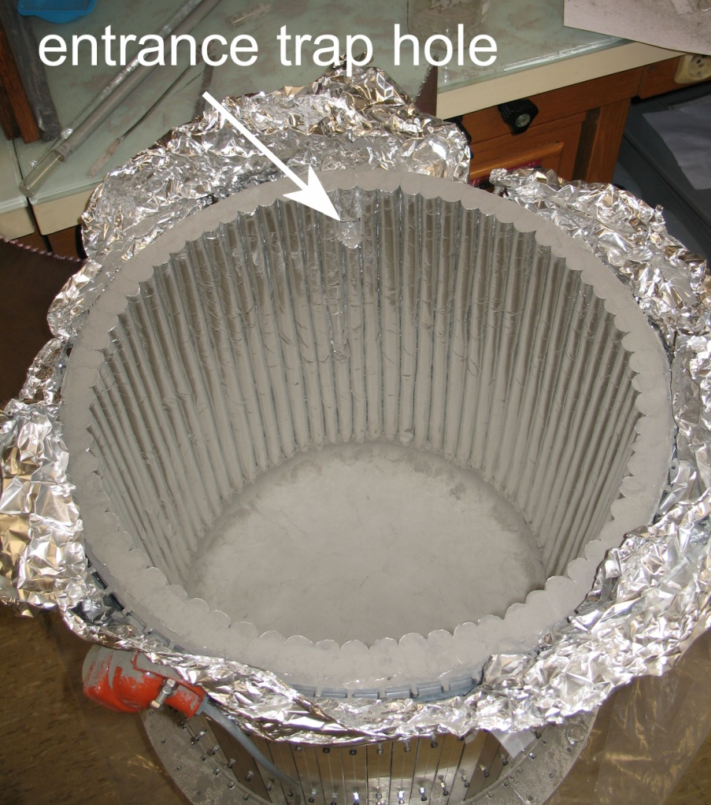
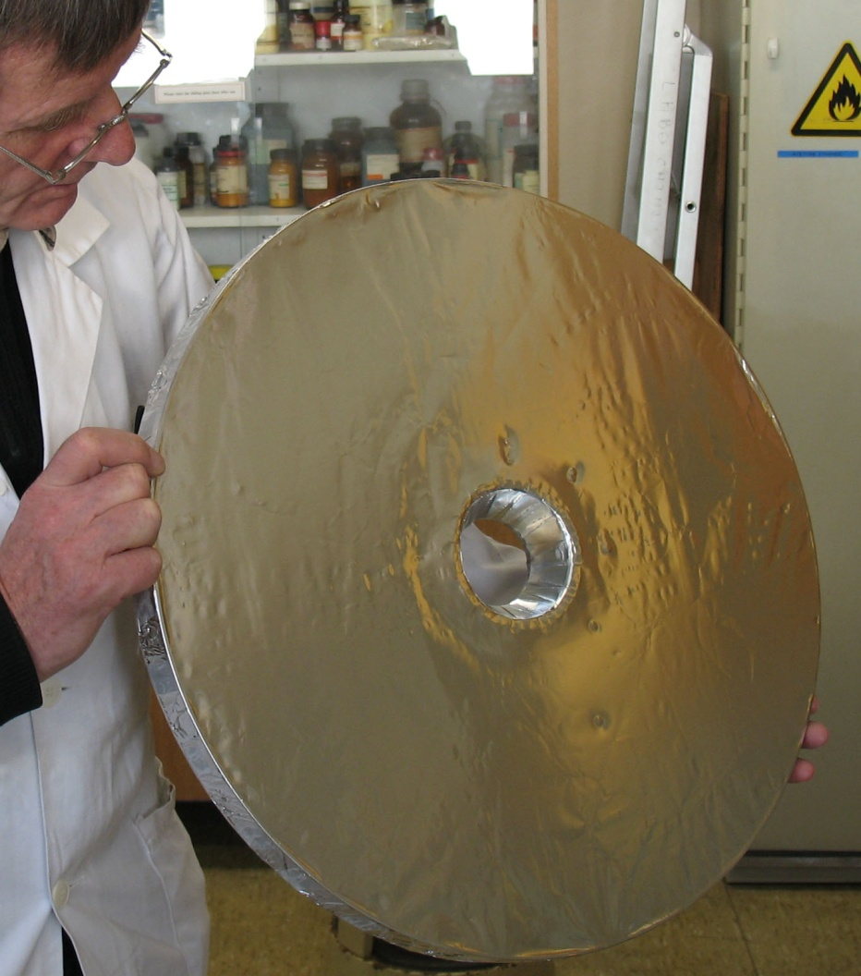
48th meeting of the PAC for Condensed Matter Physics
from Thursday, 14 June 2018 to Friday, 15 June 2018
Measurement of VCN storage in a diamond nanopowder trap
Neutron reflection probability via neutron velocity:
Diamond Nanoparticles
Theory
Experiment
Supermirror
Graphite
Fermi potential
Lychagin E.V., Muzychka A.Yu., Nekhaev G.V., Nesvizhevsky V.V., Pignol G., Protasov K.V., Strelkov A.V. “Storage of very cold neutrons in a trap with nano-structured walls” Physics Letters B 679 (2009) 186–190

Slide 14

48th meeting of the PAC for Condensed Matter Physics
from Thursday, 14 June 2018 to Friday, 15 June 2018
Diamonds of detonation synthesis (Nanodiamond) is the best choice
Advantages: big “contrast”, small size of particles, low neutron capture
Disadvantages: - hydrogen admixture: ~10% of nuclei
- admixture of metal impurities and activation in neutron fields
as the result
Fluorination is a method to clean particles from hydrogen
Non-degased sample
Degased sample
Fluorinated sample
$$C_{430±30}H$$

Slide 15
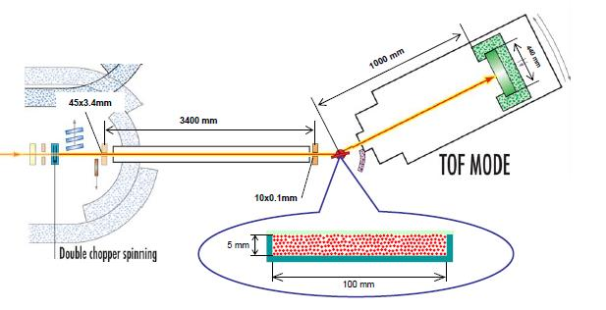
48th meeting of the PAC for Condensed Matter Physics
from Thursday, 14 June 2018 to Friday, 15 June 2018
Improvement for CN after fluorination
ILL D17
The result was reported at ISINN-25 by K.Zhernenkov and published
V.V. Nesvizhevsky, M. Dubois, Ph. Gutfreund, E.V. Lychagin,
A.Yu. Nezvanov, and K.N. Zhernenkov
Physical Review A 97 023629 (2018)
Detector’s pattern
The general probability of neutron scattering (within the angular acceptance of the D17 position-sensitive detector) as a function of the neutron wavelength, for the incidence angles of 1deg., 2deg., 3deg.

Slide 16
48th meeting of the PAC for Condensed Matter Physics
from Thursday, 14 June 2018 to Friday, 15 June 2018
Experimental VCN extractions from the model source
Preliminary results
The gain factor is about
10 times
It can be improved by
further powder cleaning
against impurities

Slide 17
48th meeting of the PAC for Condensed Matter Physics
from Thursday, 14 June 2018 to Friday, 15 June 2018
With fluorinated powder we are somewhere near the tip of the arrow
Diamond Nanoparticles
Theory
Experiment
Supermirror
Graphite
Fermi potential
Further improvement is related with deagglomeration, cleaning against nitrogen and metal impurities

Slide 18
48th meeting of the PAC for Condensed Matter Physics
from Thursday, 14 June 2018 to Friday, 15 June 2018
Conclusions
Nuclear physics has a wide research program for a new neutron source and will require neutron beams.
We definitely would like to have an intensive UCN source.
Very cold neutrons are a very promising tool for research in the field of solid state physics as well as in particle physics.
Diamond powder could be used as efficient reflector for VCN (at any angles) and for CN (at gliding angles).
It has been demonstrated that there are new reflectors for efficient VCN extraction from the source.
It is needed to include UCN and VCN sources to the list of new neutron source tools. New developments for VCN reflectors should be taken into account to construct the VCN source.
Thank you for your attention

Slide 19
48th meeting of the PAC for Condensed Matter Physics
from Thursday, 14 June 2018 to Friday, 15 June 2018

Slide 20
48th meeting of the PAC for Condensed Matter Physics
from Thursday, 14 June 2018 to Friday, 15 June 2018

Slide 21
48th meeting of the PAC for Condensed Matter Physics
from Thursday, 14 June 2018 to Friday, 15 June 2018

