Slide 1
INVESTIGATION OF SUBSURFACE LAYERS OF SOLIDS WITH THE HELP OF CHARGED PARTICLE BEAMS ACCELERATED AT THE EG-5 ELECTROSTATIC GENERATOR
A.P. Kobzev

Slide 2
PRINCIPLE OF OPERATION OF THE VAN DE GRAAFF ACCELERATOR

Slide 3
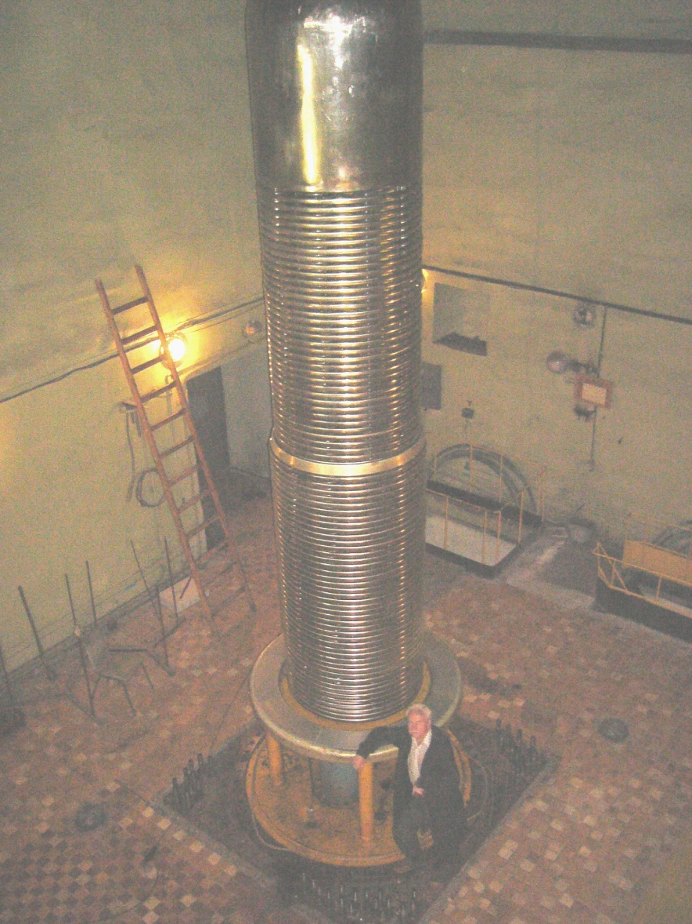
EG-5 ACCELERATOR
Main characteristics of the EG-5 accelerator:
Energy region - 0.9 – 3.5 MeV;
Beam intensity – 30 μA for H, 10 μA for He;
Energy spread - <500 eV;
Precision of energy – 2 keV;
Number of beam lines – 6;

Slide 4
ANALYTICAL METHODS
    Rutherford backscattering spectrometry (RBS);
    Elastic recoil detection (ERD);
    Nuclear reaction analysis (NRA);
4. Particle induce X-ray emission (PIXE);

Slide 5
RUTHERFORD BACKSCATTERING SPECTROMETRY
If a particle of mass M1 is scattered in electrical field of nuclear of mass M2 at angle θ, its energy is K-part of initial energy E0. Applying the principle of conservation of energy and momentum, one can obtain next equation for kinematic factor K:

Slide 6
RUTHERFORD BACKSCATTERING SPECTROMETRY

Slide 7

RUTHERFORD BACKSCATTERING SPECTROMETRY
The yield of scattered particle is calculated with using the differential scattering cross section what is given by Rutherford’s formula. In laboratory system of coordinate this formula is presented in next view:

Slide 8
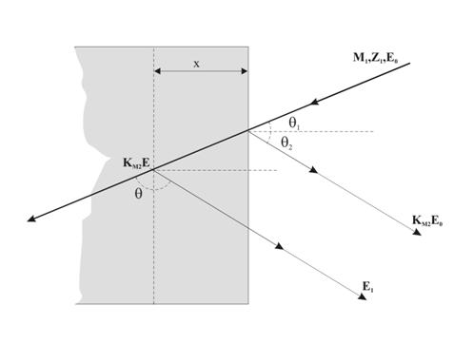
RUTHERFORD BACKSCATTERING SPECTROMETRY
If the ion is scattered at the depth X, it will losses energy as well along the inward path ΔEin as outward path ΔEout

Slide 9
RUTHERFORD BACKSCATTERING SPECTROMETRY
Such way one can calculate the thickness according to the energy width of the channel δE in the multichannel analyzer. The number of particles getting to the channel from Q incident particles is :
H(E1) = Qσ(E,θ)ΔΩ δE/([S]cosΘ1)
where ΔΩ – solid angle of the detector.

Slide 10
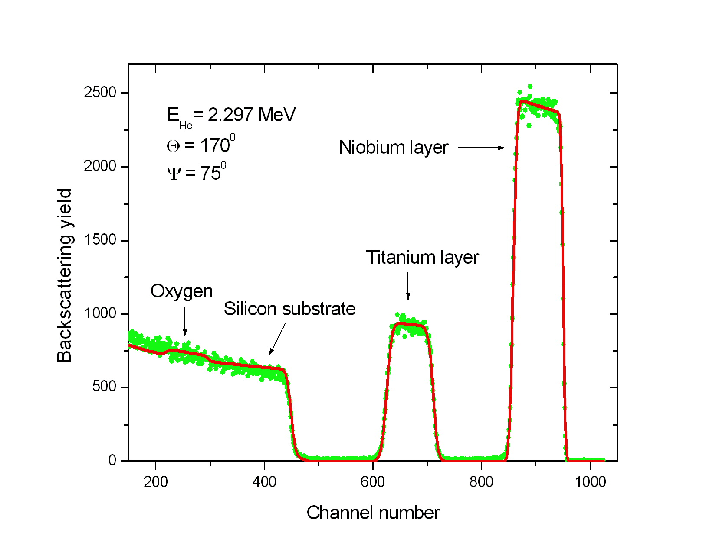
RUTHERFORD BACKSCATTERING SPECTROMETRY

Slide 11
POSSIBILITIES OF RBS METHOD
ELEMENT | Ti | Nb
MINIMUM THICKNESS, nm | 30 | 10
MAXIMUM THICKNESS, nm | 1800 | 1500
REAL THICKNESS, nm | 264 | 169,5
SENSITIVITY, at/cm2 | 2x10xx16 | 1x10xx16

Slide 12
POSSIBILITIES OF RBS METHOD
Element | Concent. At %
C | 84.1
O | 13
Al | 0.8
P | 0.5
Ca | 0.28
Fe | 0.55
Br | 0.05
Ru | 0.66
Pb | 0.06

Slide 13
MULTYLAYER SRUCTURE

Slide 14
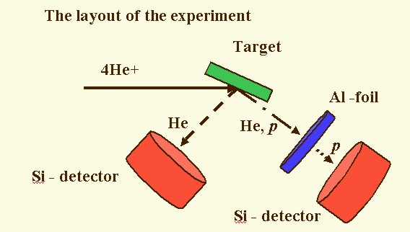
ELASTIC RECOIL DETECTION METHOD

Slide 15
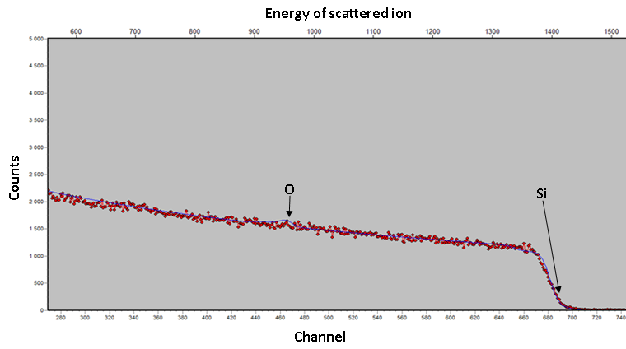
RBS spectrum for the sample, containing H and D

Slide 16
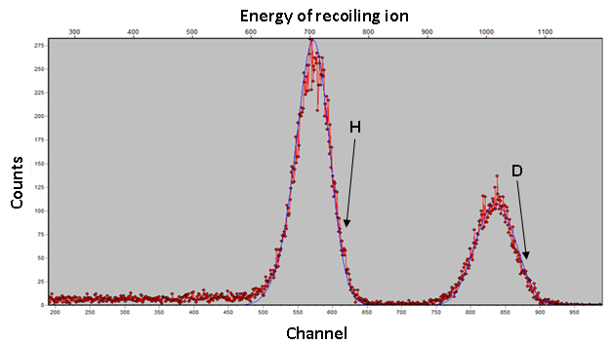
ERD spectrum for the same sample

Slide 17
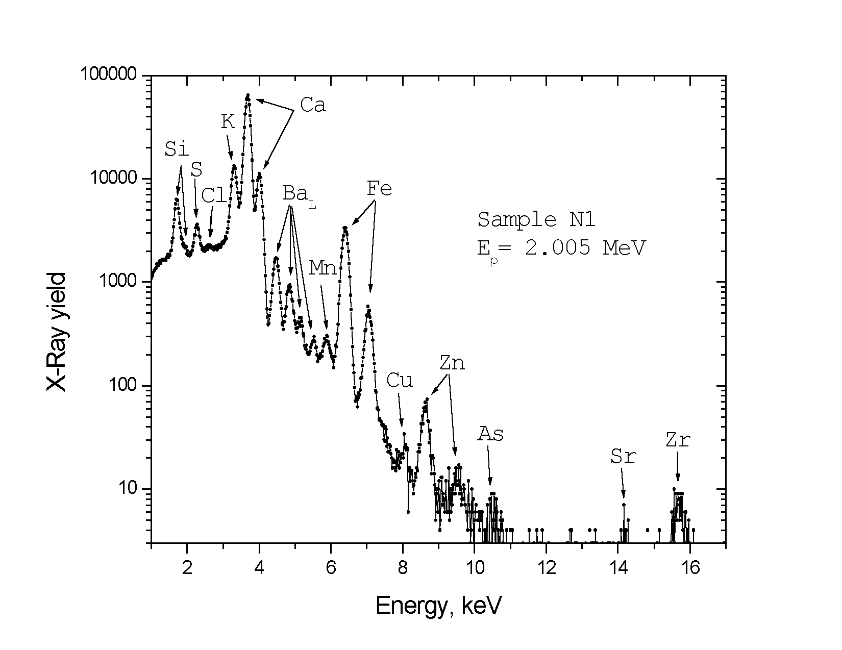
Aerosol analysis by PIXE & RBS

Slide 18
Aerosol analysis by PIXE & RBS

Slide 19
Aerosol analysis by PIXE & RBS
Element | Concentration At. % | Method | Element | Concentration At. % | Method
C | 41 | RBS | K | 0.1 | PIXE
N | 20.5 | RBS | Ca | 0.53 | RBS
O | 28 | RBS | Mn | 0.007 | PIXE
F | 2.6 | RBS | Fe | 0.14 | RBS
Na | 2.5 | RBS | Cu | 0.002 | PIXE
Mg | 1.3 | RBS | Zn | 0.01 | PIXE
Al | 1.3 | RBS | As | 0.001 | PIXE
Si | 1.8 | PIXE | Sr | 0.0006 | PIXE
S | 0.2 | RBS | Zr | 0.005 | PIXE
Cl | 0.01 | PIXE | Ba | 0.01 | PIXE

Slide 20
FIELDS OF INVESTIGATION USING UNDAMAGING ANALYTICAL METHODS
1. Microelectronic devices (IEE SAS Bratislava);
2. High temperature superconductors (Rostov-on-Don University, TPU Tomsk, PhTI San-Petersburg, RF);
3. Implanted samples (UMCS, Lublin, Poland);
4. Multilayer structures (neutron mirrors, polarizers) (PNPI Gatchina, RF);
6. Amorphous Si/Ge multilayer structures (INR HAS, Debrecen, Hungary);
8. Aerosol from air (Ulhan-Bator University, Mongolia);
9. Migration of hydrogen in titanium (TPU, Tomsk, RF);

Slide 21
COOPERATION WITH FOREIGN INSTITUTES
This time 3 foreign scientists (from Poland, Slovakia and Vietnam) work in our sector.
Possibility of creation the microbeam at the EG-5 accelerator are investigated with help Sumy State University, Ukraine;
About 80 papers was published in different journals with the co-authorship of scientists from different Institutes of many countries.

