Slide 1
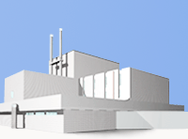
Department of Neutron Activation Analysis & Applied Research
Division of Nuclear Physics
Frank Laboratory of Neutron Physics
Joint Institute for Nuclear Research
STATE-OF-THE-ART AND FUTURE PROSPECTS
OF NEUTRON ACTIVATION ANALYSIS AT THE IBR-2
REACTOR OF THE JOINT INSTITUTE FOR NUCLEAR
RESEARCH IN DUBNA, RUSSIA
Marina Frontasyeva, Sergey Pavlov, Inga Zinicovscaia
marina@nf.jinr.ru
PAC, June 2018

Slide 2
Neutron activation analysis is an isotope specific analytical technique for the qualitative and quantitative determination of elemental content
P. Bode, J. J. M. de Goeij, ‘Activation Analysis’, Encyclopedia of Environmental Analysis and Remediation, J. Wiley & Sons, New York, 1998, ISBN 0-471-11708-0, pp 68–84
The method is based upon the conversion of stable atomic nuclei into radioactive nuclei by irradiation with neutrons and the subsequent detection of the gamma radiation emitted during the decay of these radioactive nuclei. Activation by neutrons may result in radionuclides from all elements (that have radioactive daughter products) present in the sample, with sometimes strongly different production rates

Slide 3
Introduction:
History, Projects, Statistics, Awards

Slide 4
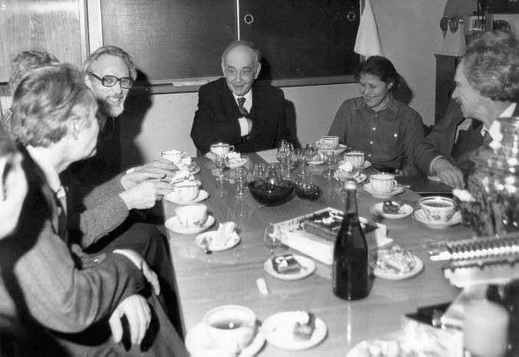
NAA was established in LNF in
1963-1965

Slide 5
    «Сегодня у физики две важнейшие задачи – забота о здоровье людей и об экологии. Во всем мире сейчас физика переориентируется на эти цели»
    Декан физфака МГУ Владимир Трухин
    (20 апреля 2005, «Московский комсомолец»)
«Physics today has two main goals - care about
the man’s health and the environment. All over the
world physics is re-oriented for these goals»
Dean of the MSU Faculty of Physics
Professor Vladimir Trukhin
(April 20, 2005, «Mosckovsky Komsomolec» )
Notes:
My supervisor Dr. Frontasyeva likes this quotation, and it really reflects the world’s tendency in physics.

Slide 6
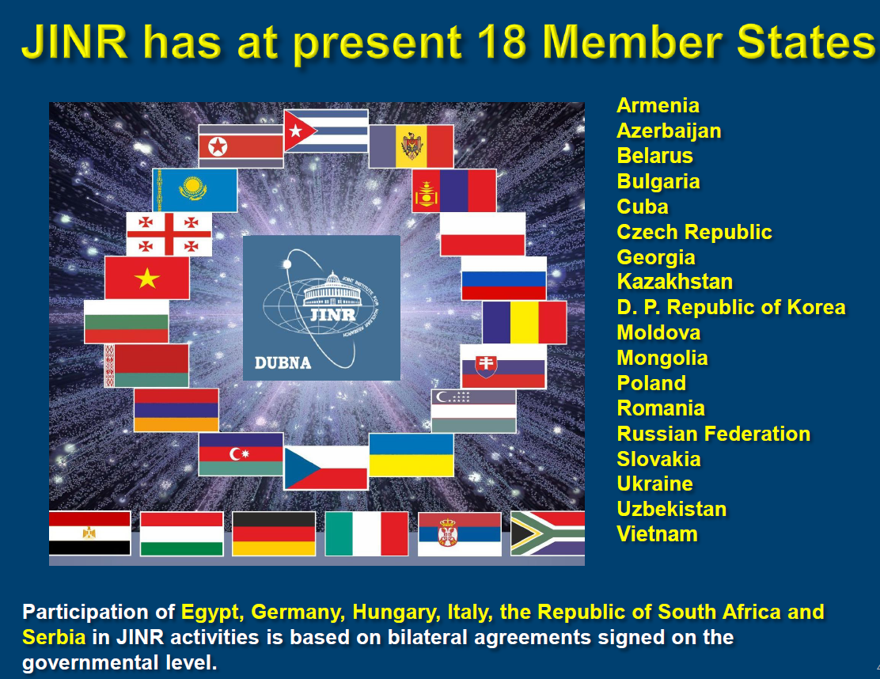
International Intergovernmental Organization

Slide 7
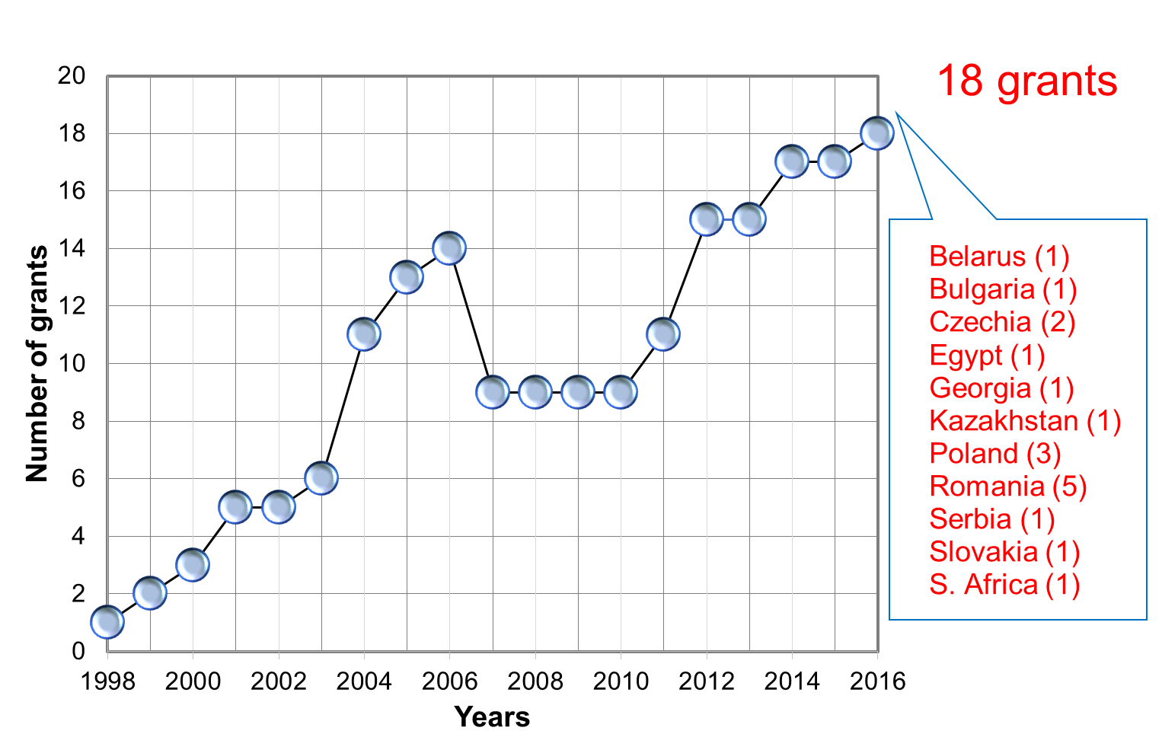
Grants of Plenipotentiaries of JINR member-states

Slide 8

IAEA Co-orditated Research Project
Study of Temporal Trends of Pollution in Selected Coastal Areas by the Application of Isotopic and Nuclear Tools. CRP -K41016
1st CRM – 2016 in Brazil; 2nd – Monaco (June 25-29, 2018)
Regional IAEA Technical Cooperation project
Enhancing Coastal Management in the Adriatic and the Black Sea by Using Nuclear Analytical Techniques (Vienna, February 26-28, 2018)
Our title: Study of Temporal Trends of Pollution in the Russian Coastal Area of the Black Sea by Nuclear and Related Analytical Techniques

Slide 9

SNAA&AR – Subcontractors
AIR BORDER
Common Czech-Polish Measurements of Airborne Transboundary Pollution
Intereg CZ - PL, European Regional Development Fund (CZ.11.4.120 / 0.0 / 0.0 / 15_006 / 0000118)
Uniform Approach to the Air Pollution Management System for Functional Urban Areas in Tritia Region
European Regional Development Fund (CE1101)
Coordinator: Assoc. Prof. Petr Jancik and his team (Ostrava University, Czech Republic)

Slide 10
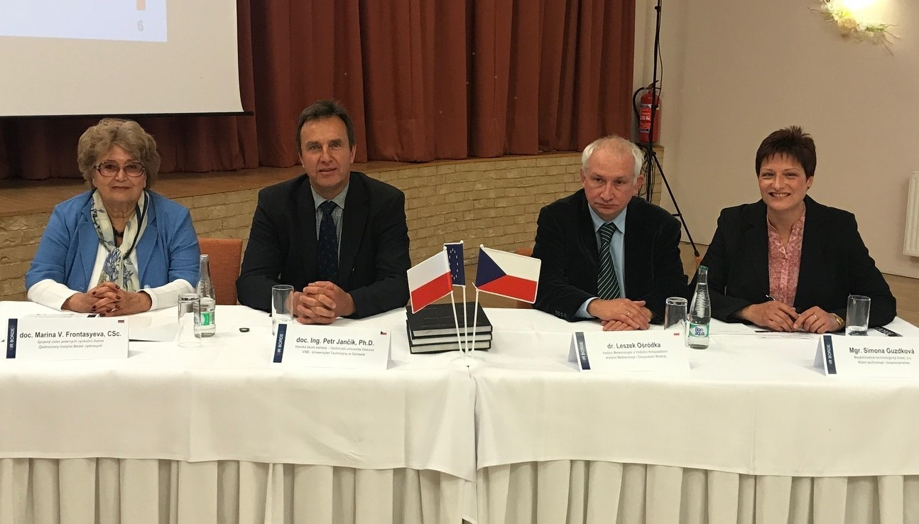
Kick-off Meeting in September 2017, Ostrava

Slide 11
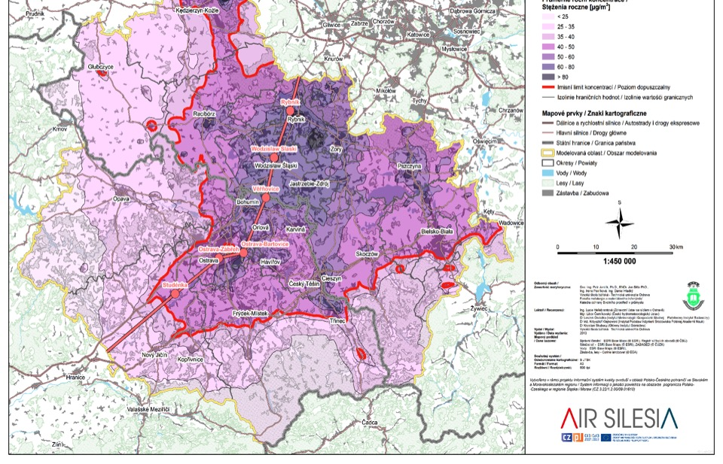
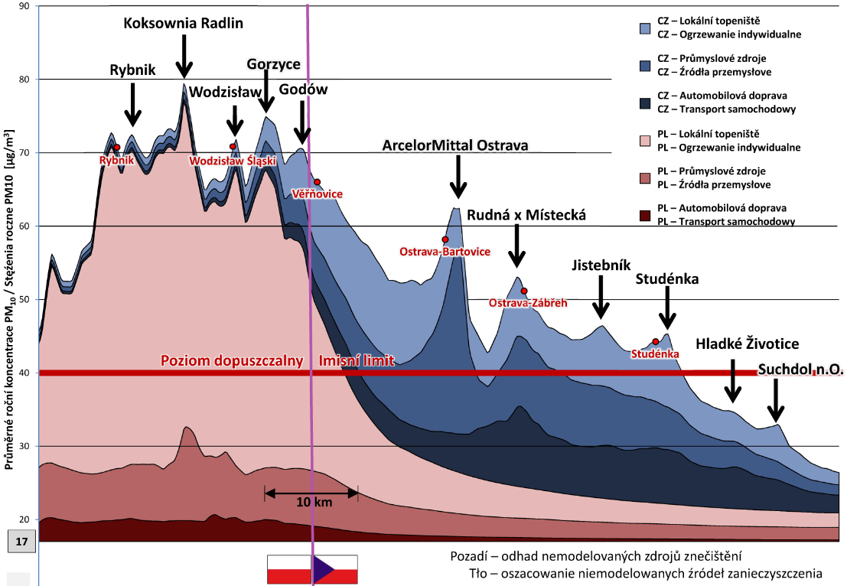
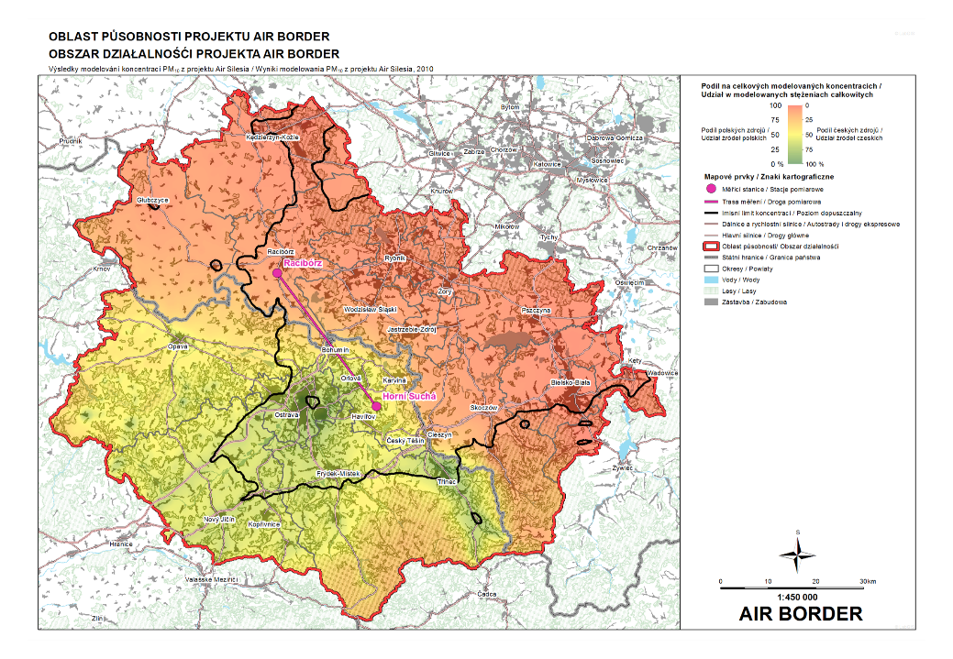
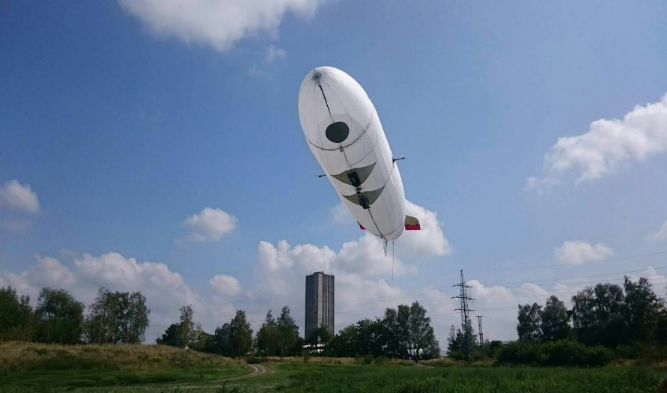
AIR SILESIA

Slide 12
National Project of Kazakhstan with RF on air pollution study in selected areas of Kazakhstan (NAA and AAS in Dubns)
RFBR – in collaboration with A.N. Frumkin Institute of Physical chemistry and Electrochemistry of RAS (Bioechnology of Water treatment)

Slide 13
БРФФИ-ОИЯИ
BRFBR-JINR
State Scientific and Production Association "Scientific and Practical Center of the National Academy of Sciences of Belarus
for Materials Science"
Influence of synthesis conditions and neutrons of the fission spectrum on the physical properties of fine-grained diamonds
Investigation of crystallization processes and characteristics of cubic boron nitride obtained using a hybrid catalyst of the Li-Fe-N system
Investigation of the processes of crystallization of cubic boron nitride in the Li3N-BN system in high-pressure devices of the "toroid" type (2016-2019)

Slide 14
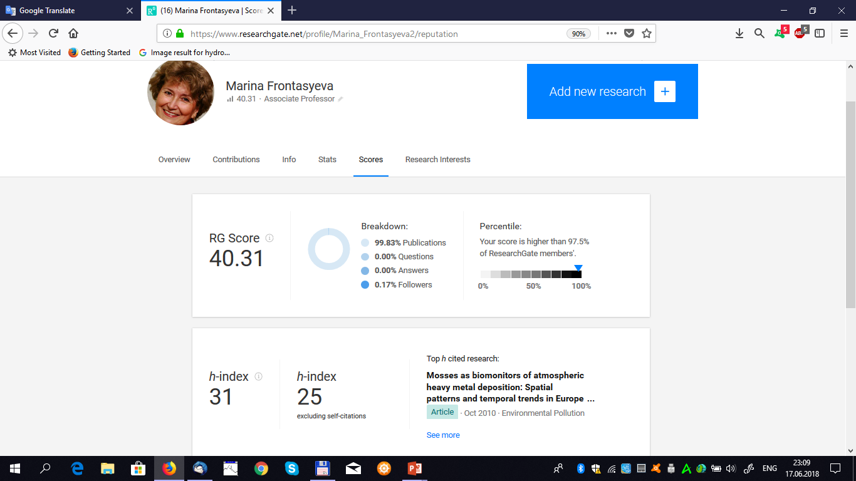

Research Gate

Slide 15
Staff: 34-35 persons
Azerbaijan (1), Belarus (1), Bulgaria (2 (3)), Czech Rep.(6),
Egypt (1 (2)), Georgia (1), Mongolia (3), Romania (1), Tajikistan (1)
Vietnam (3), the rest are RF
    Dr., PhD − 5
    Leading Engineer − 1
    Senior Engineers − 3
    Technician − 4
    PhD students − 9

Slide 16
JINR Award (II PRIZE of 2017) for the cycle of 7 papers in the field of applied research
Neutron activation analysis for
ecological state assessment of
coastal ecosystems of the
Black Sea
“

Slide 17
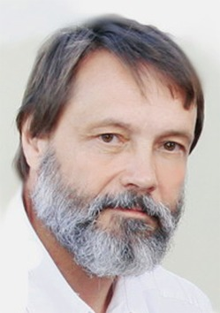
A.N. Kamnev
Professor, Doctor of Biological Sciences, Full Member (Academician) of the Russian Academy of Natural Sciences, APSN (Academy of Pedagogical and Social Sciences), WANCB (Worldwide Academy of Sciences of Integrated Security)
Editor-in-chief of the Information and Analytical Internet Journal "Issues of Modern Algology"
Author and supervisor of the summer marine scientific adventure program "Oceania“ for children.
Internet resource http://camps.ru and http://ecocamp.ru
.
http://plantphys.bio.msu.ru/staff/kamnev.htm
Notes:
The Earth has existed for more than four billion years and has sustained life for three billion. Human beings have existed for just 200,000 years, yet our impact on the planet is so great that scientists around the world are calling for our period in the Earth’s history to be named ‘the Anthropocene‘ – the age of humans. The changes we are now making have exacted a heavy toll on the natural world around us, and now threaten the planet’s ability to provide for us all.

Slide 18
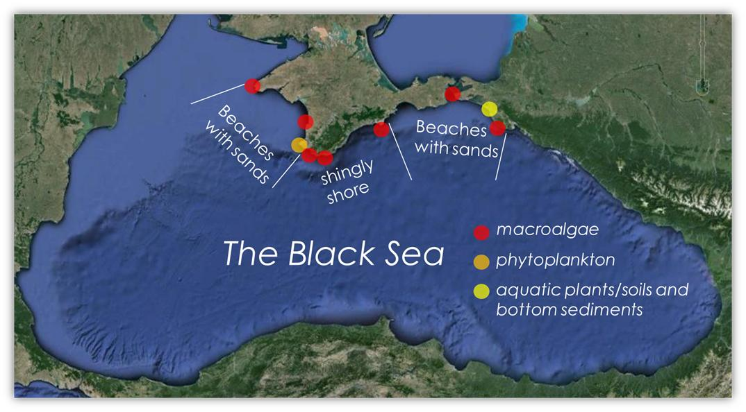
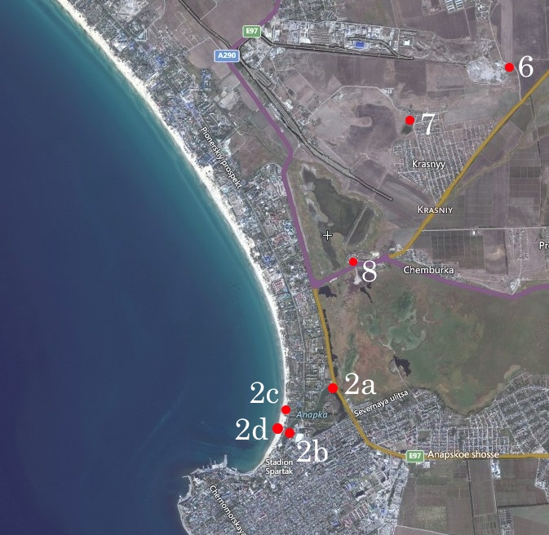
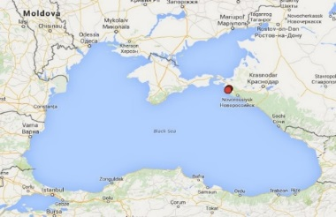
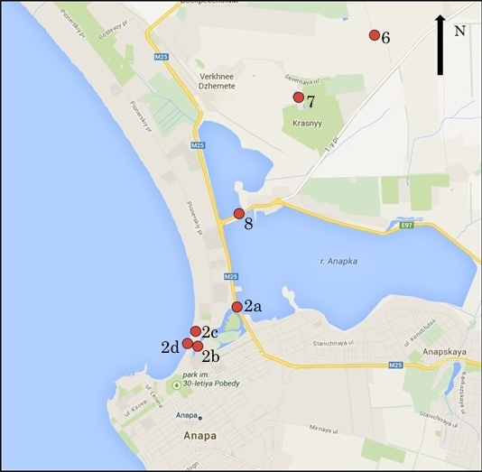
Experimental sites
Coastal transect: from dump to beach
Anapa recreational coastal zone
Aquatic plants: cane Phragmites australis, sedge Carex canescens
Macroalgae: Cladophora sericea
Bottom sediments and soils
The Black Sea
river flow
The Anapa Bay

Slide 19
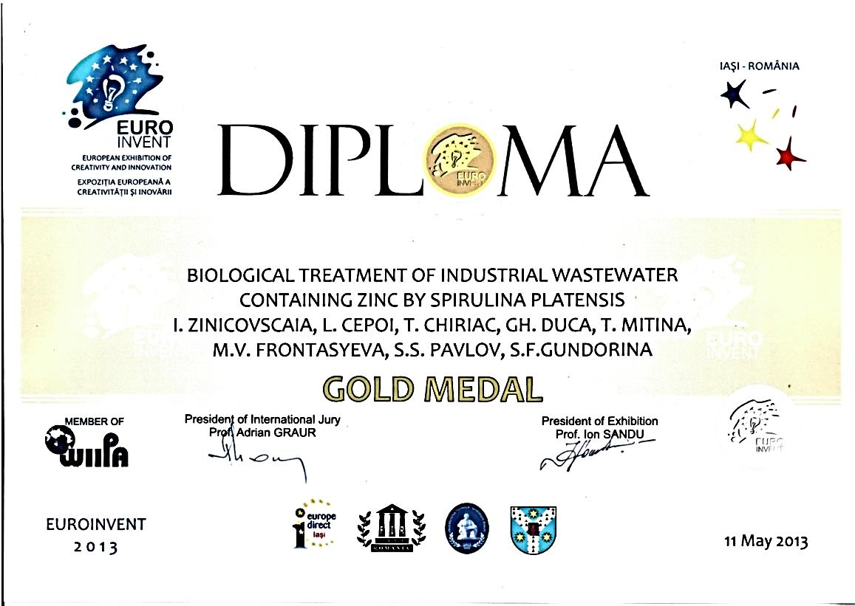
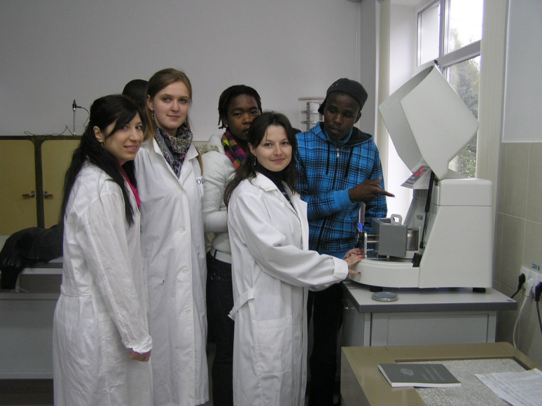
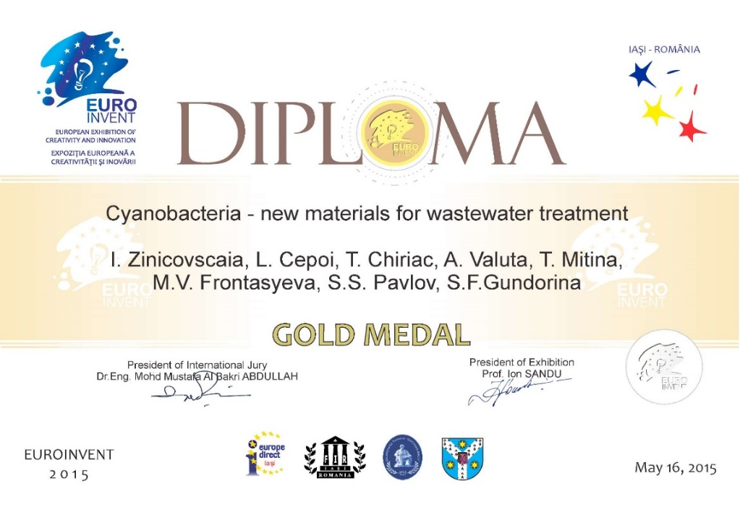
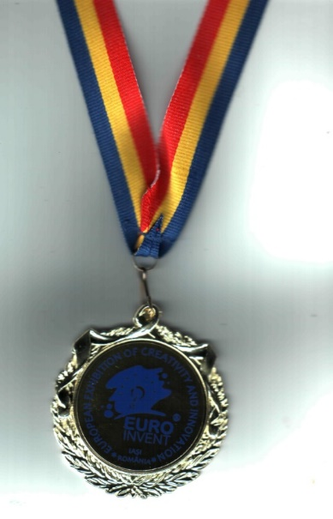

Slide 20



M.V. Frontasyeva, S.S. Pavlov
Frank Laboratory of Neutron Physics ,
JINR, Russian Federation
I. Murusidze, D. Pataraya, E.N. Ginturi
Andronikashvili Institute of Physics, Tbilisi , Georgia
I. Zinicovscaia, L. Cepoi,
Institute of Chemistry of the Academy of Science of Moldova,
Chisinau, Moldova
T. Kalabegishvili, E. Kirkesali

Slide 21
Upgrade of installation REGATA at IBR-2 reactor

Slide 22
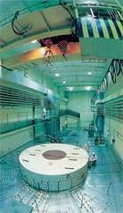
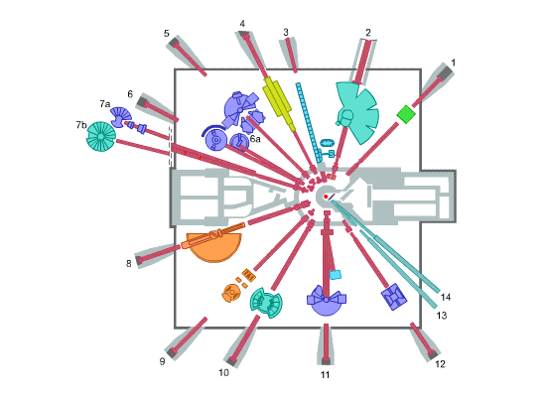
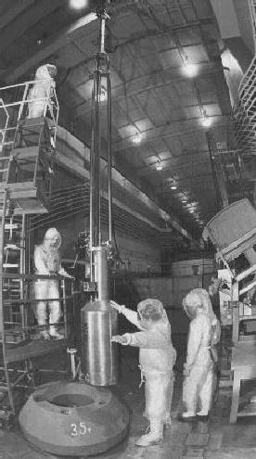
IBR-2 Pulst Fast Reactor and Radioanalytical complex REGATA
REGATA
Notes:
REGATA installation for irradiation of samples is allocated at the ground floor of the pulsed fast reactor IBR-2.

Slide 23
Neutron energy spectra and irradiation channels
    Neutron energy spectra
    in irradiation channels CH1() and CH2 (curve)
The main characteristics of the irradiation channels at 1.5 MW
Notes:
23
Pay attention to the low temperature in irradiation channels! Very convenient for studying biological objects!

Slide 24
NAA + AAS
NAA ~ 55 elements
~ 55 elements

Slide 25
TITLE OF RESEARCH CONTRACT:
Automation of Reactor Neutron Activation Analysis
Part of the IAEA’s Coordinated Research Project (CRP):
Development of an Integrated Approach to Routine
Automation of Neutron Activation Analysis
(Ref. F1.20.25 / CRP1888)

Slide 26
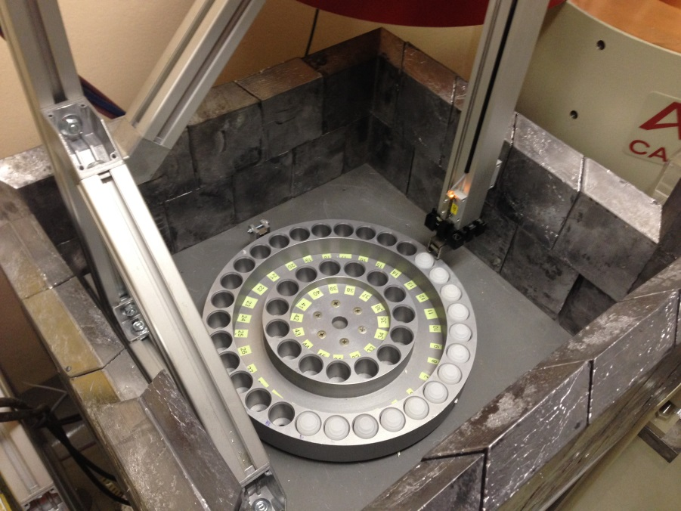
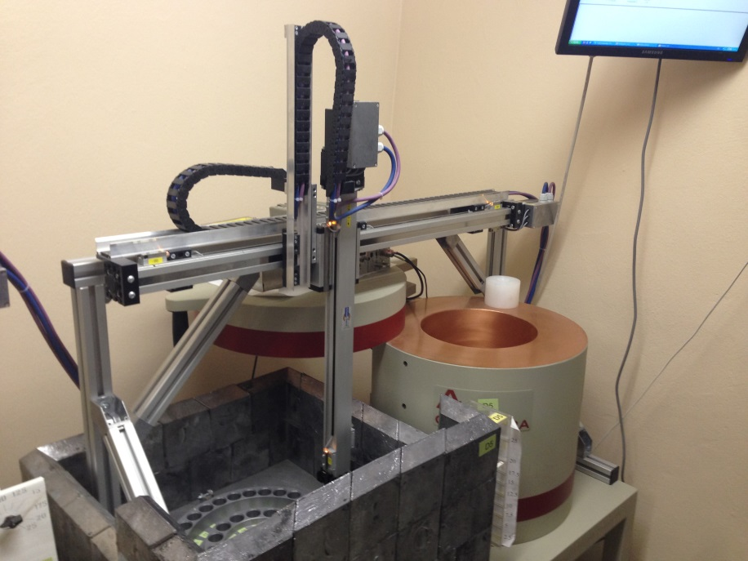
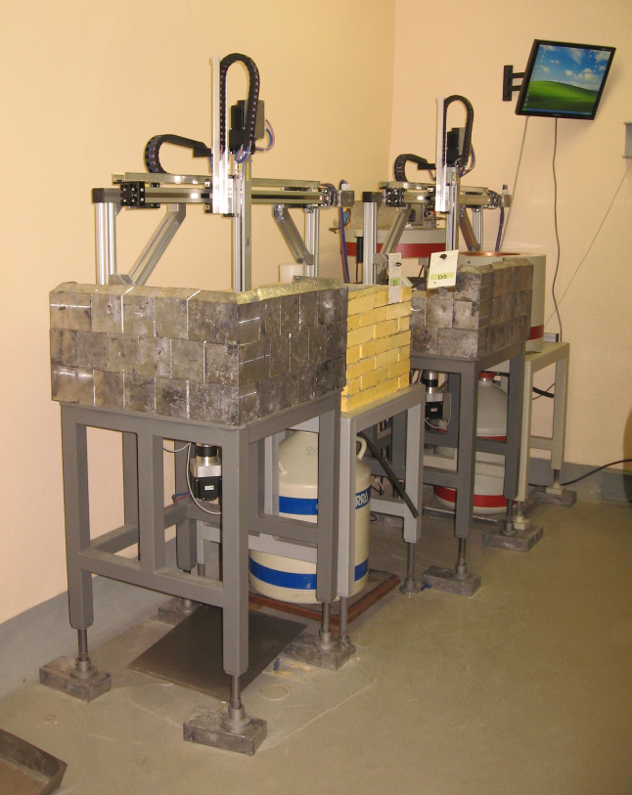
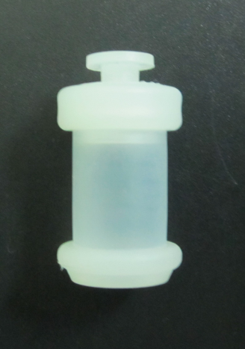
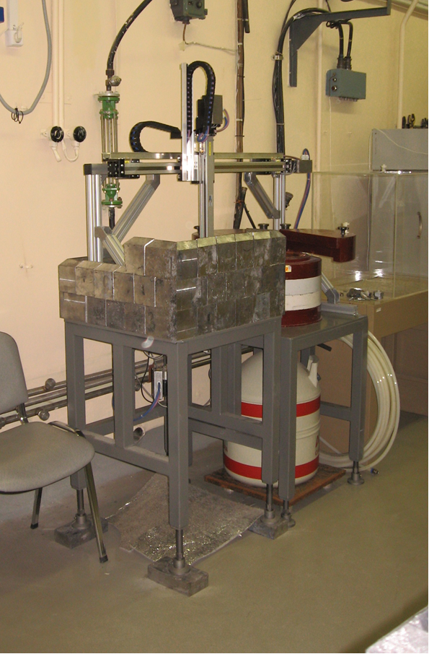
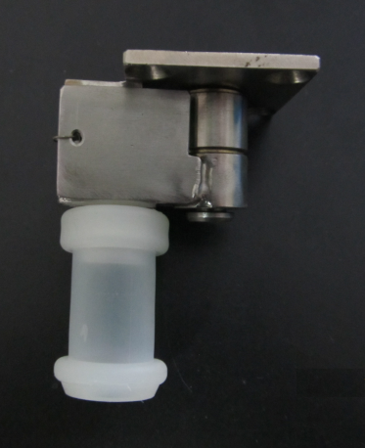
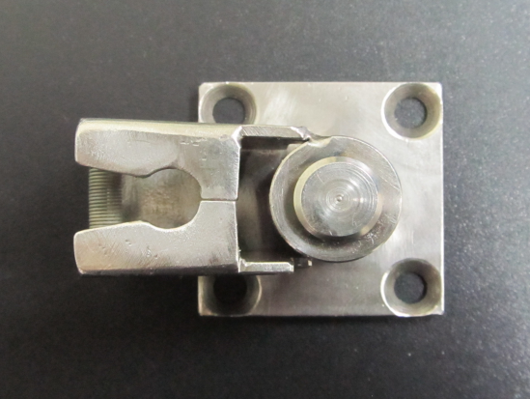

Slide 27
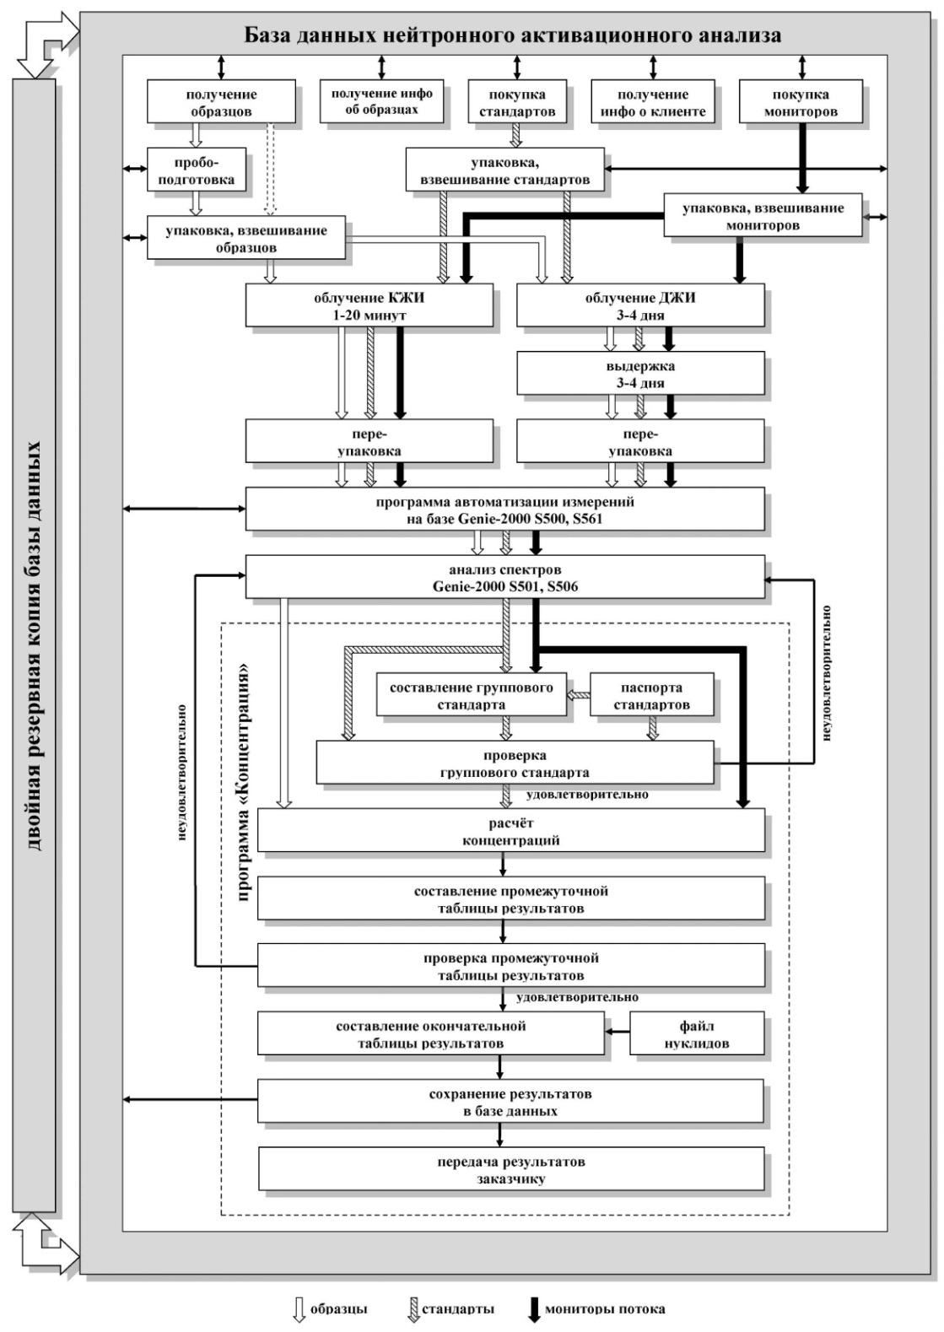
NAA DATABASE
Software package for NAA at IBR-2
Notes:
As a result of experience, modernization of software package for NAA is permanently going on to enhance the quality of analysis and convenience of work of the personal. In 2-3 months we expect that the 4th sample changer will be put into operation. Three new spectrometers with 100% efficiency is purchased ans is on the way to the Lab. The total number of spectrometer is 6 (no place to put more!). Sergey Pavlov undertook tremendous efforts to find material for transport containers with high radiation resistivity and low activity after irradiation.

Slide 28
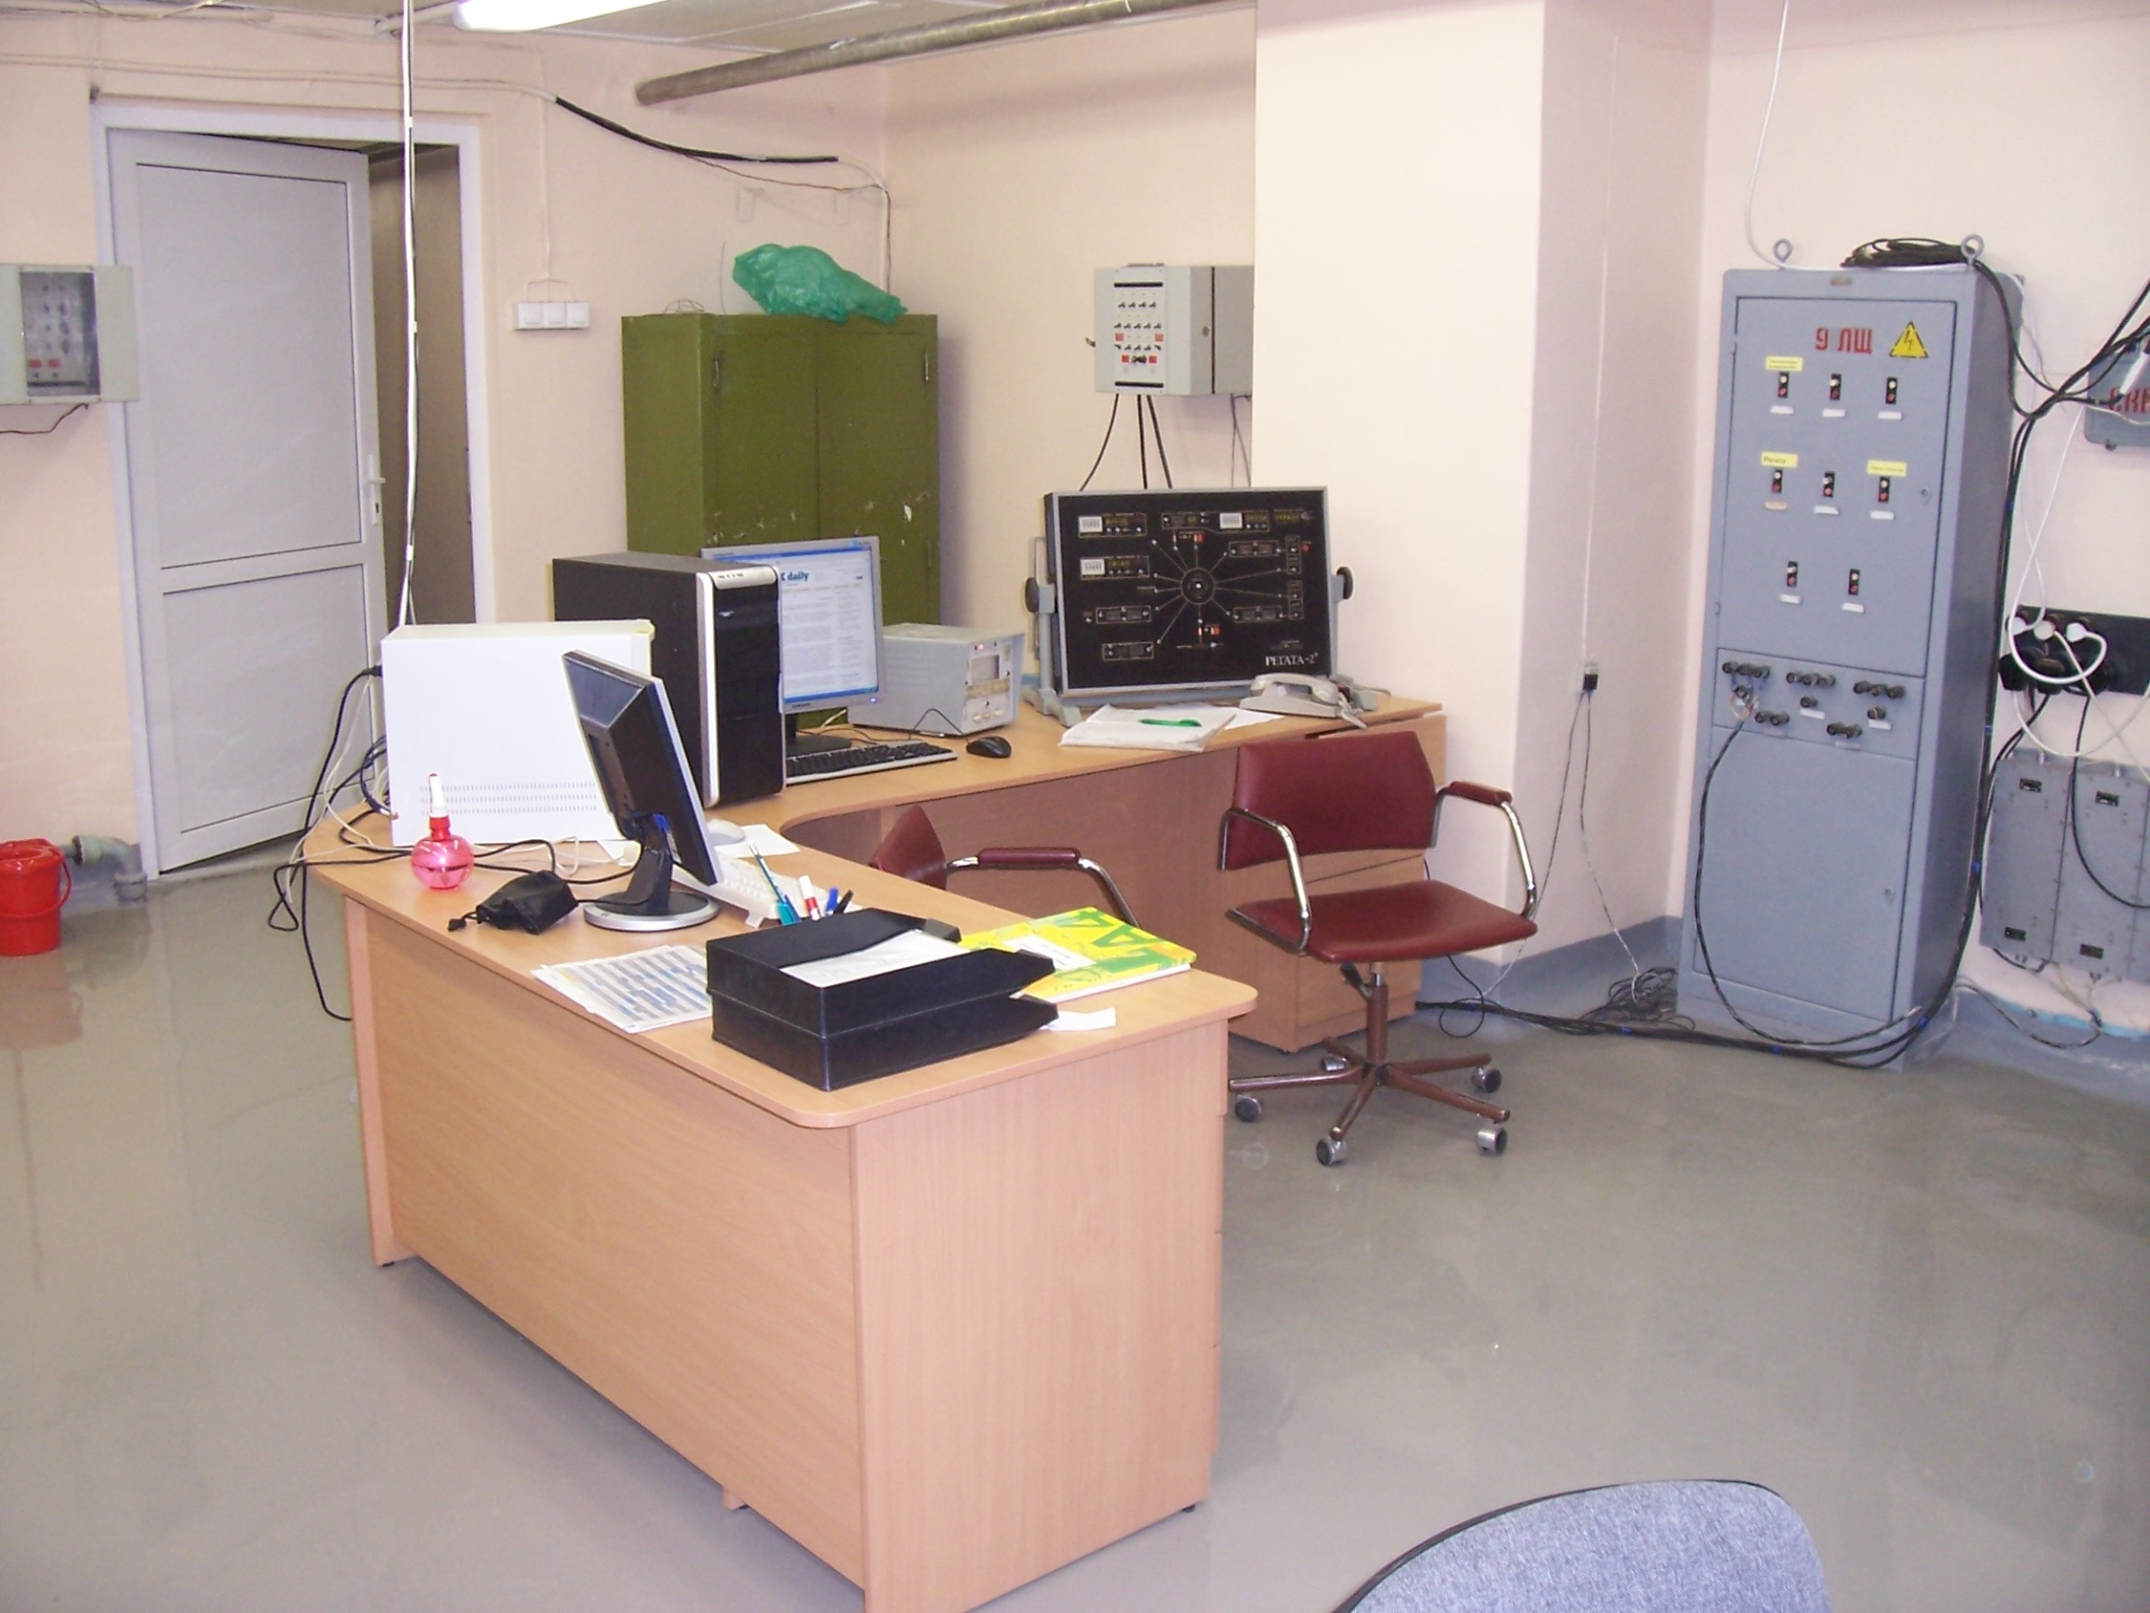

Slide 29
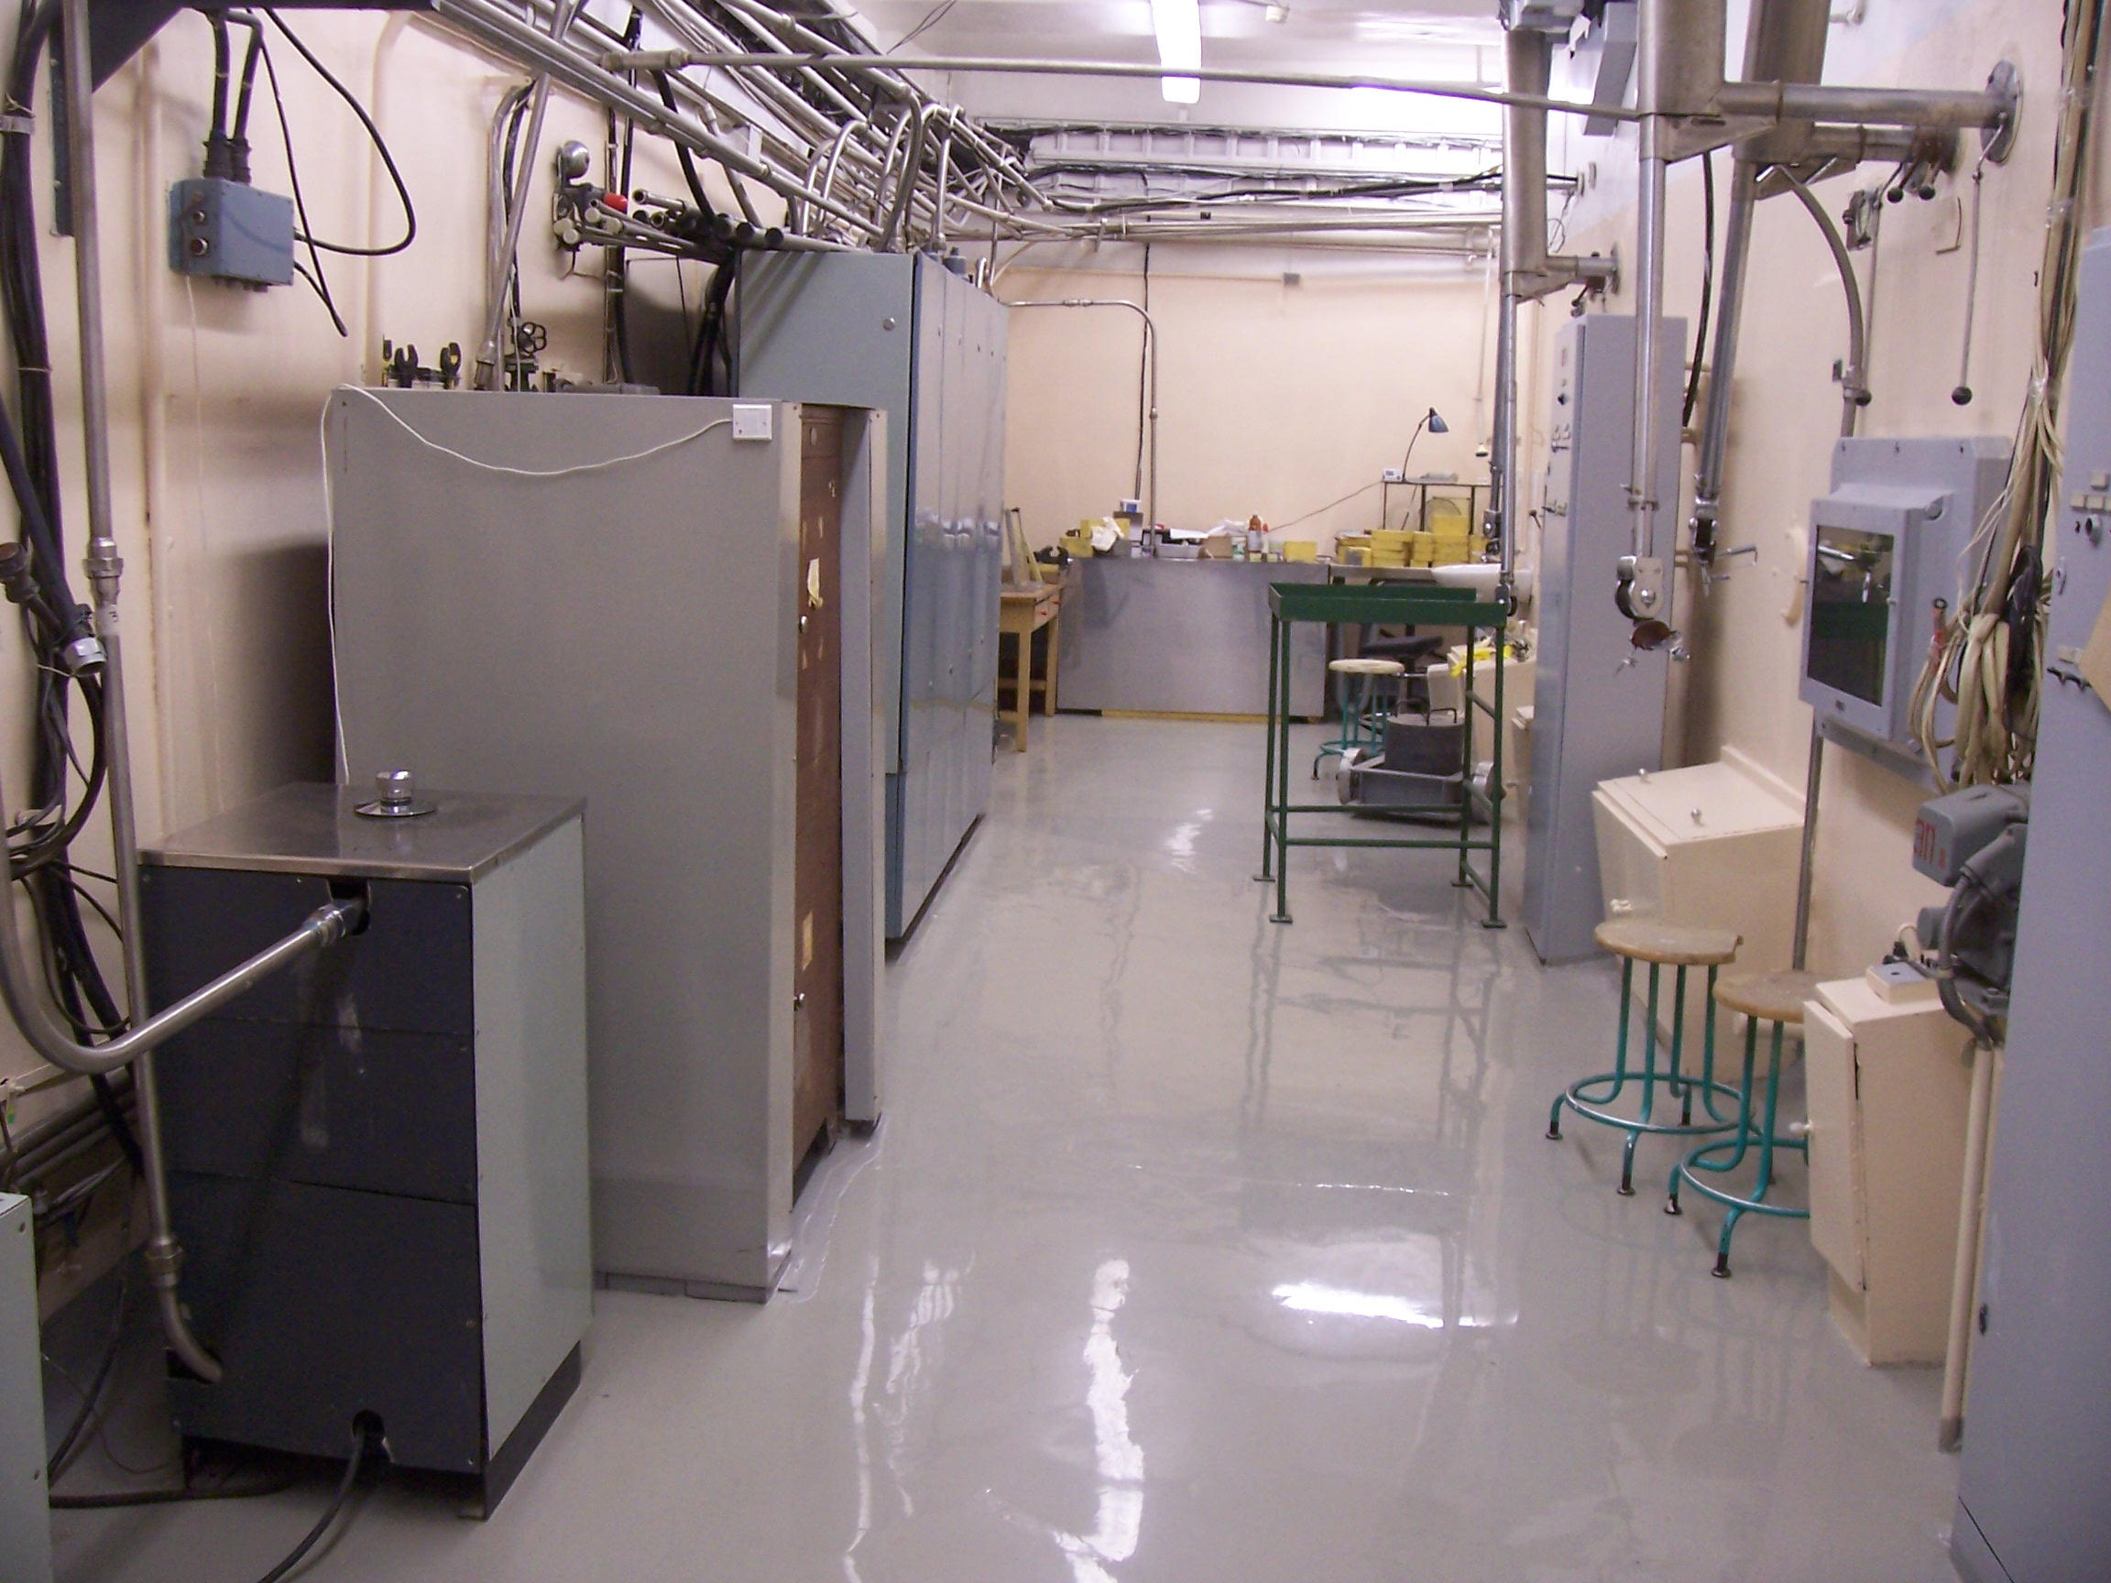

Slide 30
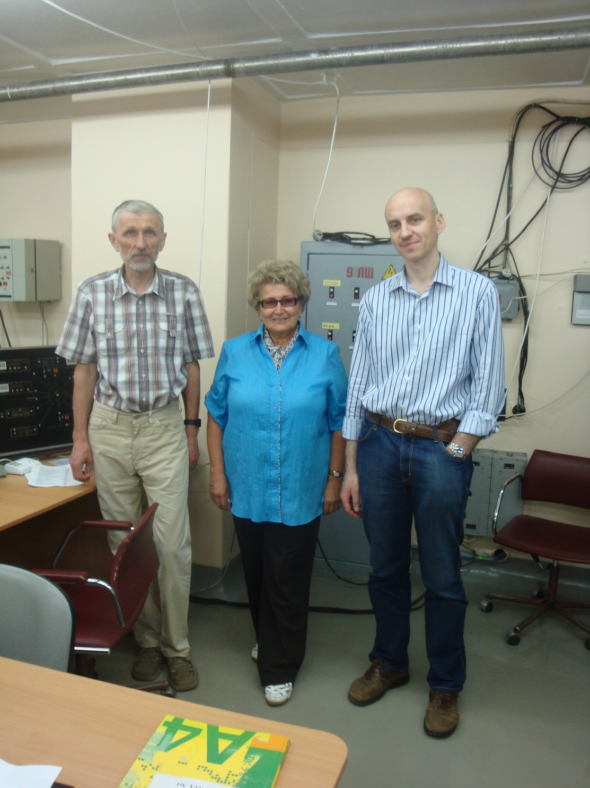
Inspection visit of IAEA representative, Mr. Danas Ridikas,
coordinator of IAEA CRP “Development of an Integrated Approach to Routine Automation of Neutron Activation Analysis”
(he is coming to BioMAP-8 in July 2018)

Slide 31
NAA for Life Sciences:
recent achievements
in air pollution studies and biology (medicine)

Slide 32
Life Sciences
Biomonitoring
UNECE ICP Vegetation
Antro-pology
Food products
Medicinal plants
Bio-nano-
technology
Cosmos
Geology
Environment
Notes:
Из этого слайда видно, в каких разнообразных направлениях идут исследования в векторе в области наук о жизни. В каждом из направления получены очень интересные результаты. За неимением времени я приведу лишь 3 примера:

Slide 33
International Program for the monitoring and evaluation of effects of air pollutants on vegetation (ICP Vegetation), established under the Convention on Long Range Transboundary Air Pollution by Economic Commission for Europe (UNECE)
Notes:
in 1987, the international cooperative programme on effects of air pollution on crops (icp crops) was established as a subsidiary body of the Working Group on effects of the
Unece convention on long-range transboundary air pollution (ltrap), established in 1979.

Slide 34
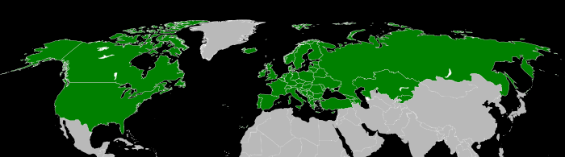
Map showing Convention on Long-Range Transboundary Air Pollution signatories as of July 2007
http://en.wikipedia.org/wiki/Convention_on_Long-Range_Transboundary_Air_Pollution

Slide 35
Priority LRTAP Convention
(see Decision 2010/18 and 2011/14)
Improve ratification and compliance of Protocols by countries in Eastern Europe, the Caucasus and Central Asia and South-Eastern Europe to improve air quality
Increase participation and activities of all Convention Bodies (including ICP Vegetation) in those countries
Hence, decision to transfer coordination European moss survey to the Russian Federation to enhance network activities as supported by JINR
Results will be reported to ICP Vegetation Task Force
Notes:
As follows from the Long Range Transboundary Air Pollution Convention, priority areas of interest for the UN are Eastern Europe, the Caucasus, Central Asia and South-Eastern Europe. Moreover, JINR provides financial support of air pollution studies in the JINR member states through the system of grants.

Slide 36

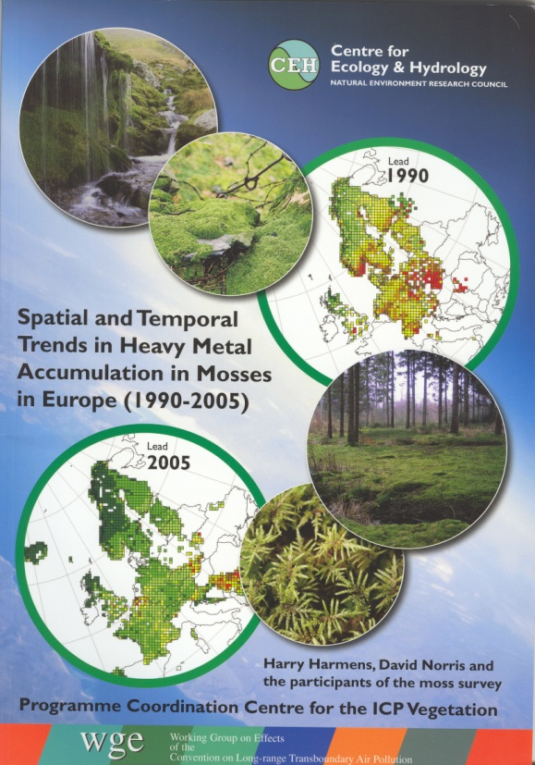
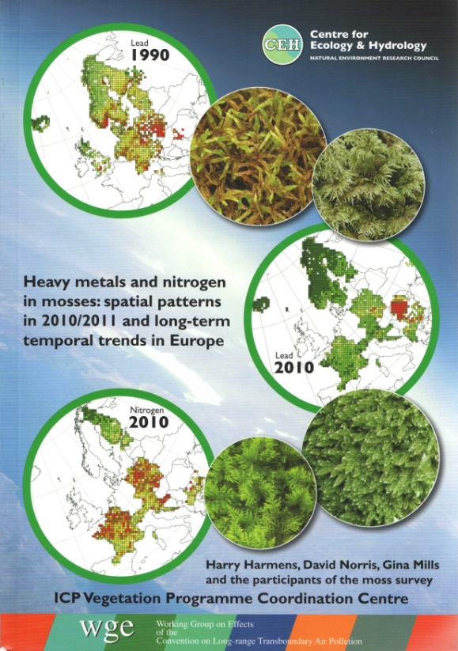
UNECE
CONVENTION ON
LONG-RANGE TRANSBOUNDARY
AIR POLLUTION
adopted in 1979
entered into force 1983
United Nations Economic Commission for Europe
International Cooperative Programme on Effects of Air Pollution on Natural Vegetation and Crops
Working Group on Effects - 1981

Slide 37
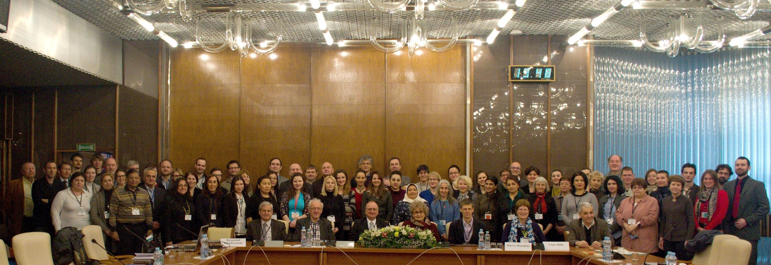
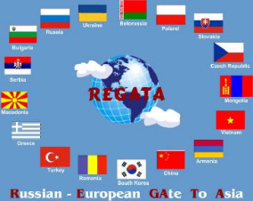
The 29th Task Force Meeting of the UNECE ICP Vegetation, March 2016
http://icpvegetation.ceh.ac.uk/
New JINR member-states have jointed the UNECE International Cooperative Program on Air Pollution in Europe in 2015/2016:
Armenia, Azerbaijan, Georgia, Moldova, Kazakhstan and Tajikistan
Notes:
Sector of Neutron Activation Analysis and Applied Research (SNAA&AR) in spring of 2016 carried out a very important annual Task Force Meeting of the United Nations dedicated to air pollution studies in Europe and now in Asia based on moss analysis. Slovakia, Poland, Romania, Czech Republic, Georgia and Kazakhstan are supporting their participation in this program by grants of the Plenipotentiaries of their countries. All-in-all, representatives of 30 countries attended this meeting, with the largest number of participants in the history of these events. It is worth to note that five more JINR member-states have jointed this Program coordinated since 2014 by JINR.

Slide 38

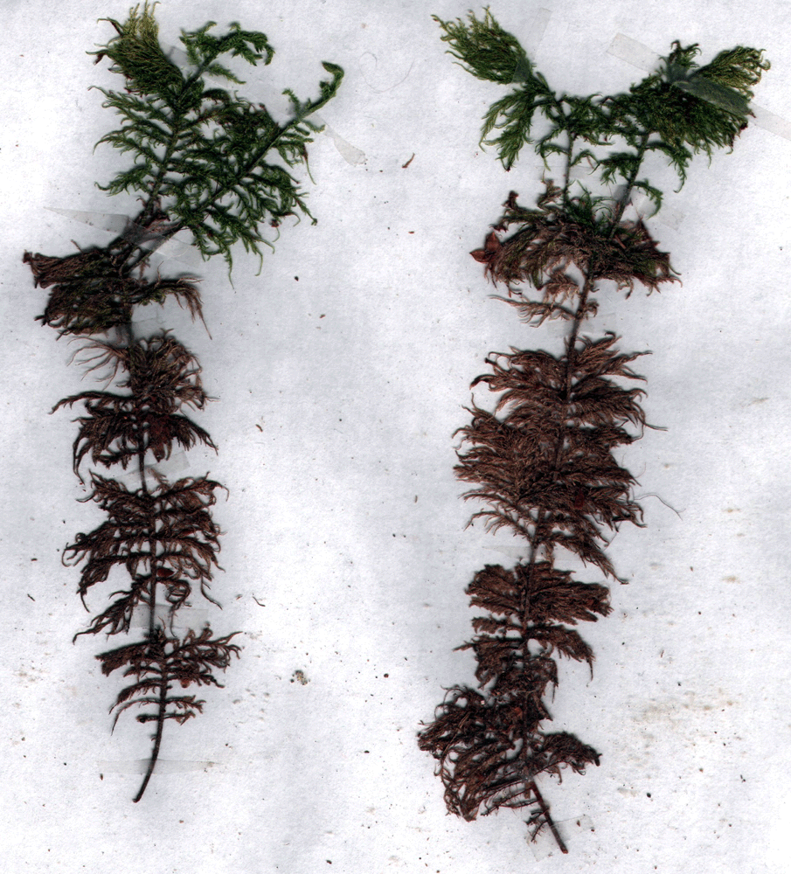
Moss biomonitor
Hylocomium splendens
1
2
3
4
5
Annual segments
Notes:
Examples

Slide 39
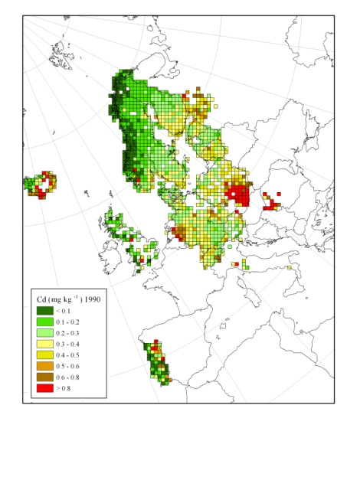
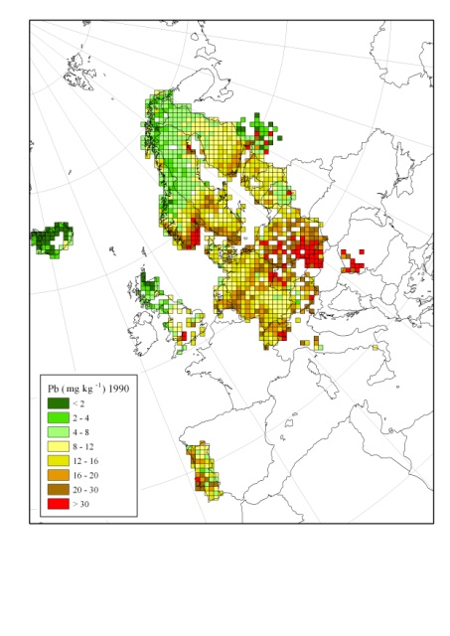
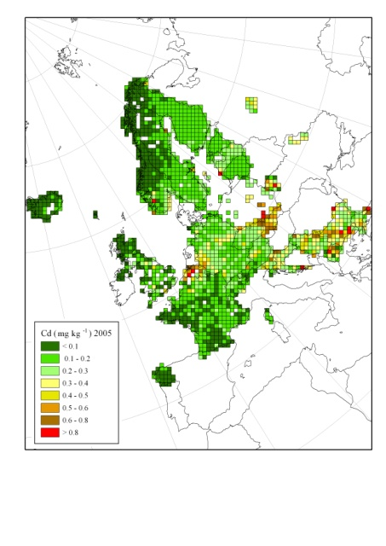
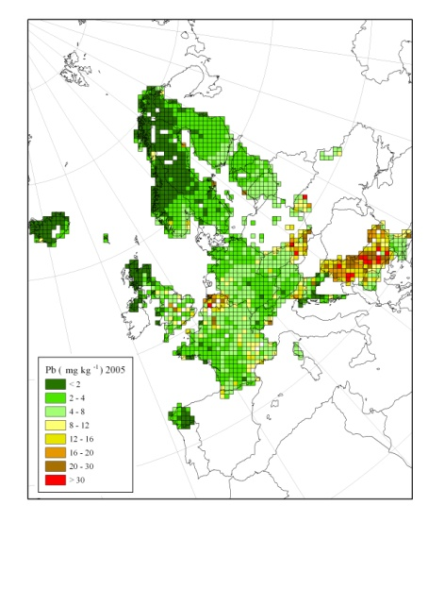

Cadmium
Lead
Mosses provide a complementary method to assess spatial patterns and temporal trends of atmospheric heavy metal deposition:
Carpet forming mosses obtain trace
elements and nutrients directly from
the atmosphere.
In recent years, the lowest
concentrations of heavy metals in
mosses were found generally in
northern Europe and the highest
concentrations in Belgium and
eastern Europe .
Europe-wide the concentration in
mosses of arsenic, cadmium, lead
and vanadium has declined the most
between 1990 and 2005, with hardly
any reduction being observed for
chromium and mercury.
Temporal trends were country-specific.
Spatial patterns and temporal trends
for cadmium and lead agree quite
well with those modelled by the
European Monitoring and Evaluation
Programme (EMEP).
-72%
-12%
-2%
1990
1990
-20%
Cadmium
Lead
-20%
-62%
-45%
2005
2005
-29%
-52%
-72%
ICP Vegetation Programme Coordination Centre
Notes:
39

Slide 40
Participation moss survey 2015/16
HM: 34 (25); N: 12 (15); POPs: 8 (6) - In brackets: 2010/11 survey
Rest of Europe (15) |  | SEE Europe (8) | EECCA (9) | Others (2)
Austria^{N,POPs} | Norway^{POPs} | Albania | Armenia | Canada^{N,POPs}
Czech Rep. | Poland^{N} | Bulgaria | Azerbaijan | Mongolia
Estonia^{N} | Slovakia | Greece | Belarus
France^{N} | Spain | Macedonia | Georgia
Germany^{N,POPs} | Sweden^{N,POPs} | Romania | Kazakhstan
Iceland | Switzerland^{N,POPs} | Serbia | Moldova
Ireland^{N,POPs} |  | Slovenia^{N} | Russian Fed.
Italy-Bolzano^{N} |  | Turkey | Tajikistan
Latvia^{N,POPs} |  |  | Ukraine
^{N} = also nitrogen data; ^{POPs} = also POPs data
  Launch final report at 8th BioMAP¹ workshop in Dubna, July 2018
  ¹ Biomonitoring of Air Pollutants, with emphasis on trace elements

Slide 41
Collaboration with Laboratory of Information Technologies of JINR
DATA MANAGEMENT SYSTEM OF THE UNECE ICP VEGETATION MONITORING NETWORK
created at the cloud platform of JINR
Prof. Gednnadiy Ososkov and Dr. Aleksandr Uzinskiy
http://moss.jinr.ru

Slide 42
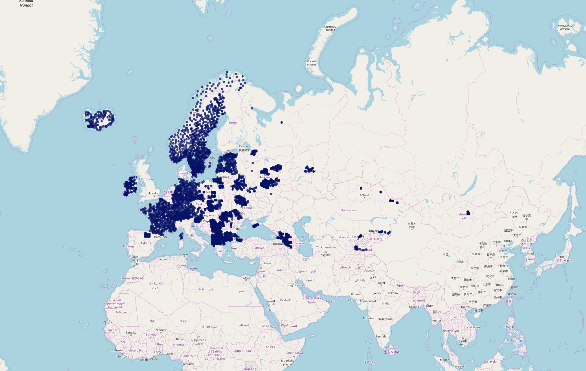
Moss survey 2015/16
5073 sampling sites

Slide 43
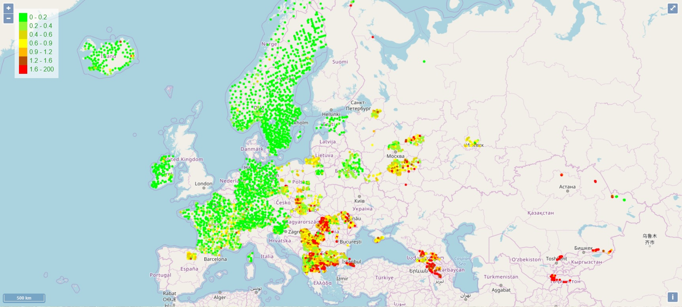
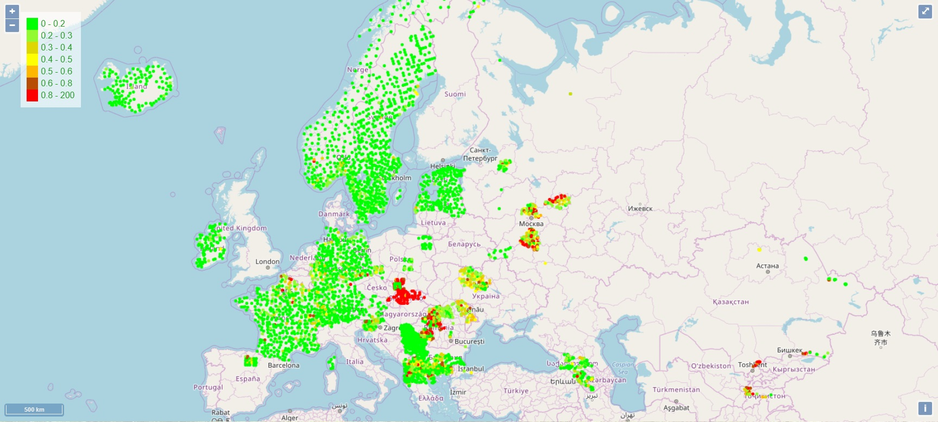
As
Cd

Slide 44
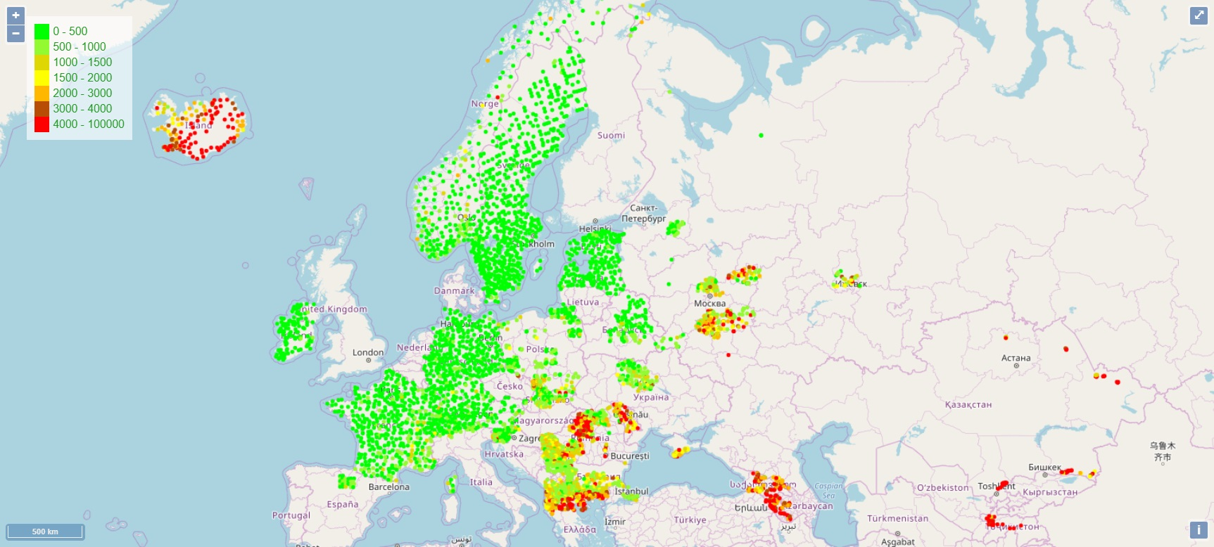
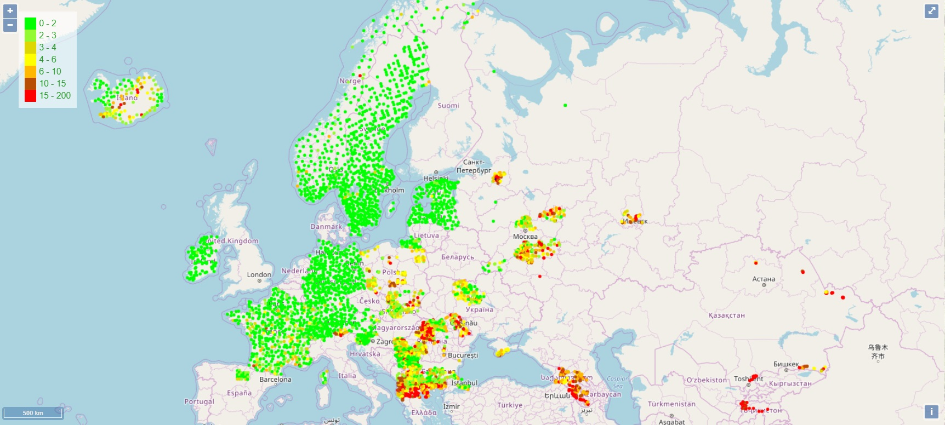
As
Fe
Cr

Slide 45
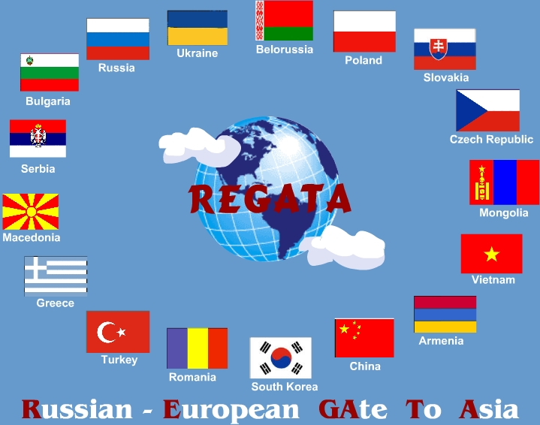
Project REGATA
(1995-2000-2005-2010-2015-2020)
Title
Heavy metal atmospheric deposition study in selected European and Asian countries using nuclear and related analytical techniques
Participating countries:
Russia, Armenia, Azerbaijan, Belarus, Bulgaria, Georgia, Poland, Romania, Slovakia, Greece, Kazakhstan, Macedonia, Moldova, Serbia, Croatia, Albania, Turkey, Mongolia, Vietnam, South Korea, Tadjikistan, Thailand

Slide 46
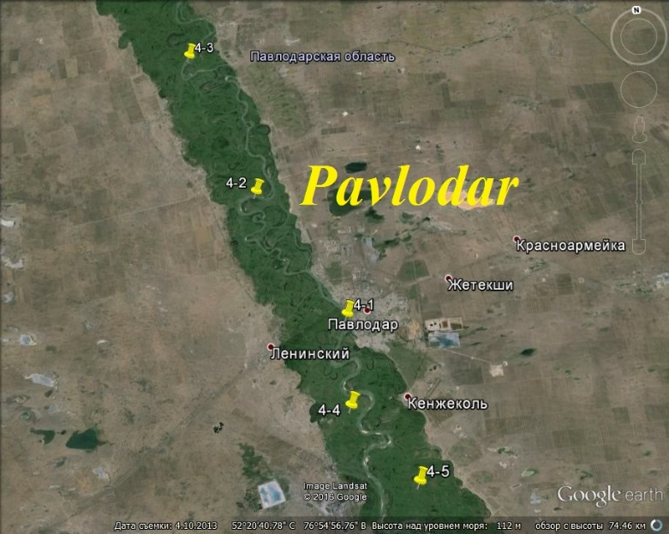






Grant of Plenipotentiary of Kazakhstan in 2014 and 2015. National grant in 2017

Slide 47



Armenia 2016
Center for Ecological-Noosphere Studies of the National Academy of Sciences, Yerevan, Armenia
info@cens.am

Slide 48




Azerbaijan

Slide 49



Georgia 2015/2016
Black Sea
Georgia Shota Rustaveli National Science Foundation grant (2015-2017)
Grant of Plenipoten-tiary of Georgia in JINR, 2016, 2017
Tbilisi

Slide 50



Georgia 2016

Slide 51

BioMAP-8
Dubna, Russia
You are welcome!

Slide 52
NAA of extraterrestrial materials

Slide 53




COSMIC DUST

Slide 54



Caucasus, Georgia
Sample No. 8
Elements | Weight, % | Atom %
O K | 57.12 | 70.83
Mg K | 1.46 | 1.19
Al K | 14.00 | 10.29
Si K | 21.63 | 15.28
K K | 2.30 | 1.17
Fe K | 3.49 | 1.24
In total | 100.00

Slide 55

446
Arctic, Northern Norway
427
428
418
411

Slide 56


No. 428
Element | Weight % | Аtomic %
O K | 43.33 | 71.62
Al K | 0.93 | 0.91
Si K | 0.99 | 0.93
K K | 1.00 | 0.67
Mn K | 53.76 | 25.88
Итоги | 100.00

Slide 57

ATMOSPHERIC DEPOSITION OF COSMIC DUST STUDIED BY MOSS ANALYSIS
M. V. Frontasyeva, V. A. Tselmovich, and E. Steinnes
Joint Institute for Nuclear Research
Shmidt's Institute of Physics of the Earth, RAS
Norwegian University of Science and Technology
It is a well established phenomenon that extraterrestrial dust particles (micrometeorites) survive atmospheric entry and reach the Earth’s surface. Collection of extraterrestrial dust for research focuses on the environments where terrestrial sedimentation rates and input of artificial particles of anthrogenic origin is minimal, including deep-sea sediments, Antarctic ice and snow, as well as natural planchettes of mosses and peat-bog cores.

Slide 58
Cognitive abilities in mice before and after chronic oral administration of silver nanoparticles
Alexandra L. Ivlieva, Elena N. Petritskayaª, Dmitriy A. Rogatkinª, Vyacheslav A. Demin^{b}, Alexey A. Glazkova,
Inga Zinicovscaia^{c,d,e}, Sergey S. Pavlov^{c},
Marina V. Frontasyeva^{c}
ªMoscow Regional Research and Clinical Institute
named after M. F. Vladimirskiy,
^{b}National Research Centre «Kurchatov Institute»,
^{c}Joint Institute for Nuclear Research, Dubna
Accumulation of nanoparticles in brain was accesses by neutron activation analysis

Slide 59


FirA – search for the platform; B – reaching the platform; C – the task
Different types of behavior. Examples of the trajectories:
1-3 – directed search; 4-6 – random search; 7-9 – thigmotaxis*
*the motion or orientation of an organism in response to a touch stimulus

Slide 60
  Educational Programmes

Slide 61


Summer School – South Africa
June 3-22, 2018
iThemba LABS, Western Cape University, North-West University, University of Fort Hare

Slide 62
В 2018 году выполнены:
три магистерских дипломных работы
Кристина Ярмалоян (Армения), Омар Чалигава (Грузия), Айша Далелова (Казахстан)
Выполняются:
девять кандидатских диссертаций. Нямсурэн Балжинням (Монголия); Юлия Алексеенок (Беларусь), Константин Вергель (ЛНФ): Александра Кравцова и Павел Нехорошков (ИнБЮМ, Крым, РФ), Игорь Румянцев (Химико-технологический университет в Иваново, РФ%; Альберт Санизло (Венгрия, Университет Обуда); Никита Юшин (ОИЯИ, РФ)
2015 Македонии, Университет Св. Кирилла и Мефодия, Скопье, кандидатские диссертации Ламбе Барандовски и Златко Панчевски, выполненные в Дубне с использованием нейтронного активационного анализа: 2016 «наша Зина» (Ntombizikhona Beaulah Ndlovu) (ЮАР, Университет в Стелленбоше), Поль Изе (Paul Eze) (ЮАР, Western Cape University); 2017 Шанико Аллайбеу (Албания)
Notes:
И в заключение стоит отметить большую работу сектора по подготовке молодых специалистов в РФ, а также в странах-участницах, так и не-участницах ОИЯИ.

Slide 63

January 12-14 , 2015
Zlatko Pancevski and Lamber Barandovski: PhD defenses
Skopje University, Macedonia

Slide 64


In the framework of the Project on air pollution in South Africa a student of Stellenbosch University, Western Cape, Ntombyzikhona Ndlovu (“our Zina”) successfully defended her Ph.D. thesis in April 2016. It was partly carried out in SNAA&AR, at the reactor IBR-2 using instrumental neutron activation analysis.
Notes:
This picture shows you the cover of a PhD thesis by Ntombyzikhona Ndlovu who got a Russian Name “Zina”, and her JINR Supervisor from FLNP Dr. Frontasyeva.

Slide 65

Shaniko Allajbeu
University of Tirana, Albania (2018)
“Air pollution in Albania”
Photo taken in Budva, Montenegro, at JINR School on Nuclear Methods in Environmental Sciences and Medicine (April 2018)

Slide 66


Slide 67

Thank you for attention!
You are welcome to join our collaboration!

