Slide 1
NICA Booster: status of mounting preparation
A. Galimov
NICA Machine Advisory Committee,
meeting at Joint Institute for Nuclear Research, Dubna, Russia
June, 7-8, 2018

Slide 2
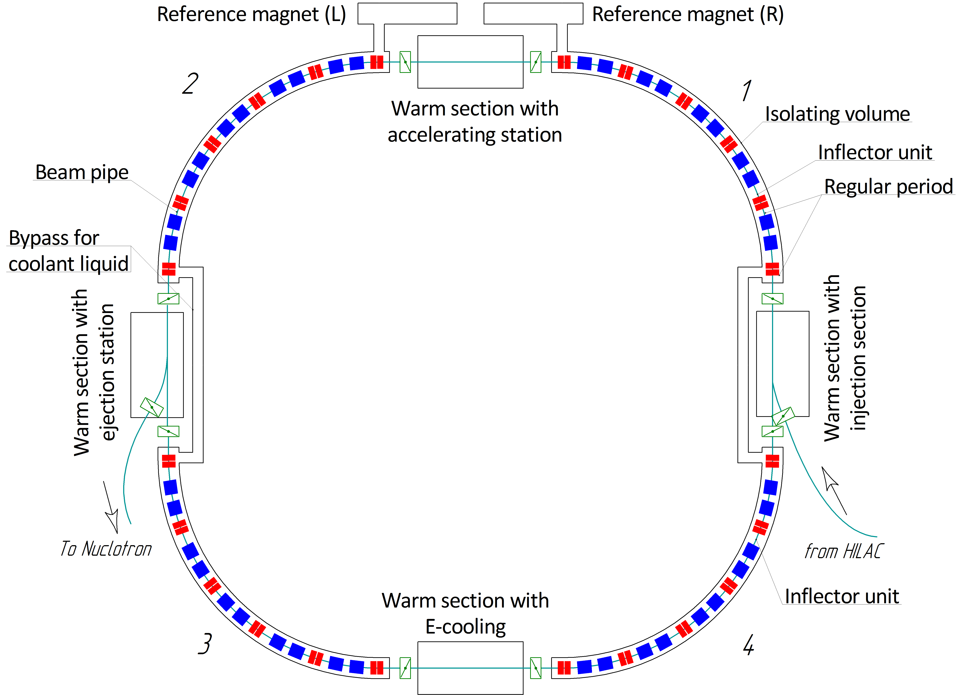
Scheme of the booster
Assemblies | Q-ty, pcs
Dipoles | 40
Quadrupole doublets | 24
Kit for assembling magnet joints | 45
Bypass for coolant liquid | 2
Warm sections | 4
Section with reference magnet (L, R) | 2
Feed box (L, R) | 2
Vacuum stations (insulation volume) | 26
Vacuum stations (cold beam pipe) | 24

Slide 3
Booster assembling (time-schedule)
Booster assembling |  | 2018 |  |  |  |  |  |  |  | 2019
 |  | V | VI | VII | VIII | IX | X | XI | XII | I | II | III | IV | V | VI | VII | VIII | IX | X | XI
“Cold” sections
 | Quadrant 1
 | Quadrant 2
 | Quadrant 3
 | Quadrant 4
 | Bypasses and ends
 | Reference magnets
“Warm” sections
 | E-cooling |  |  |  | - commissioning
 | Injection section
 | Beam extraction section
 | Accelerating station
Systems assembling
 | Vacuum system
 | Power supply
 | Cryogenic system
 | Thermometry system
Technological commissioning
Commissioning
with beam

Slide 4
Documentations and engineer systems
approved documentation (schemes, layouts, instructions, flow charts, etc.) geodetic network - ready; bridge cranes of build - ready; energy supply (380/220V, 50Hz); water system (cooling equipment); movable clean zones for beam pipe and vacuum stations assembling; instruments (helium leak testers, movable pumping stations, laser tracker tools and etc.); interior of Booster tunnel and b.1 completion (floor, walls, light and etc.); compressed air system 6 bar (suppling equipment); storing places of complete products; places for preparing units and element; places for staff; tailored logistics | Status in hand ready; ready; in hand in hand in hand ready in hand in hand in hand in hand in hand in hand

Slide 5
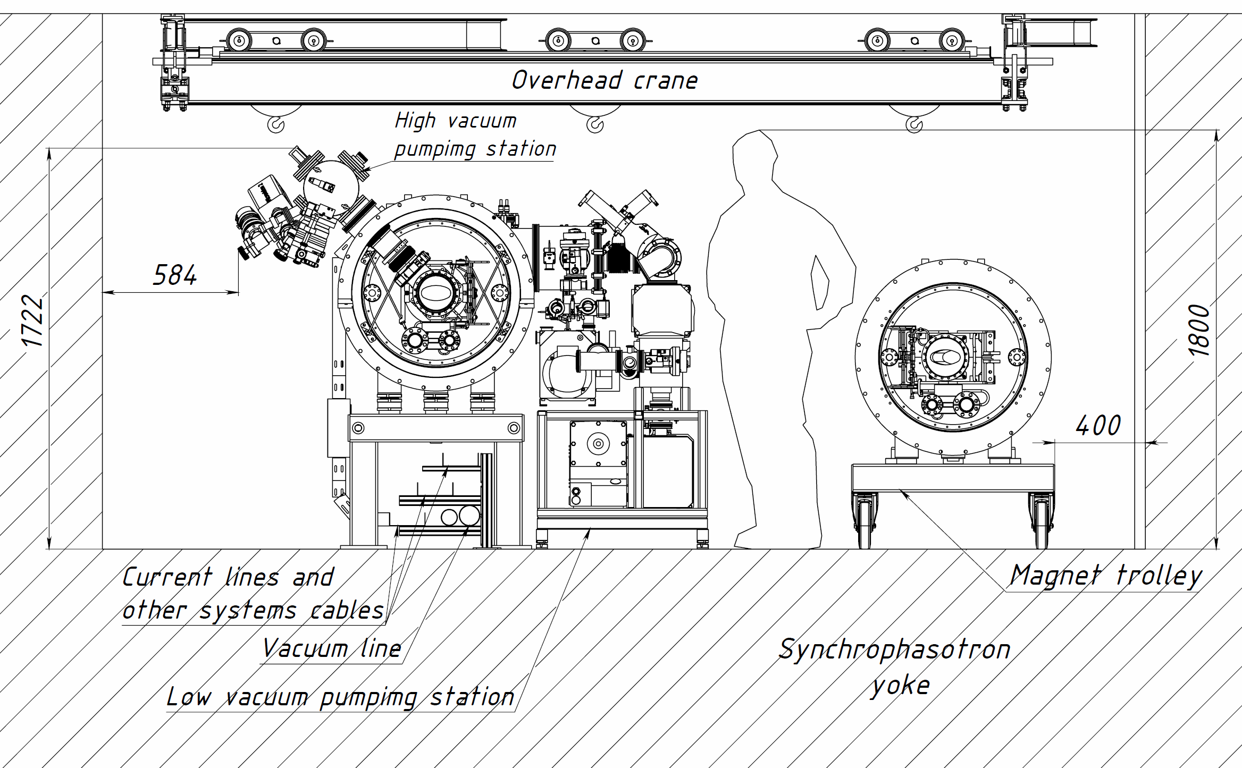
The booster tunnel cross section

Slide 6
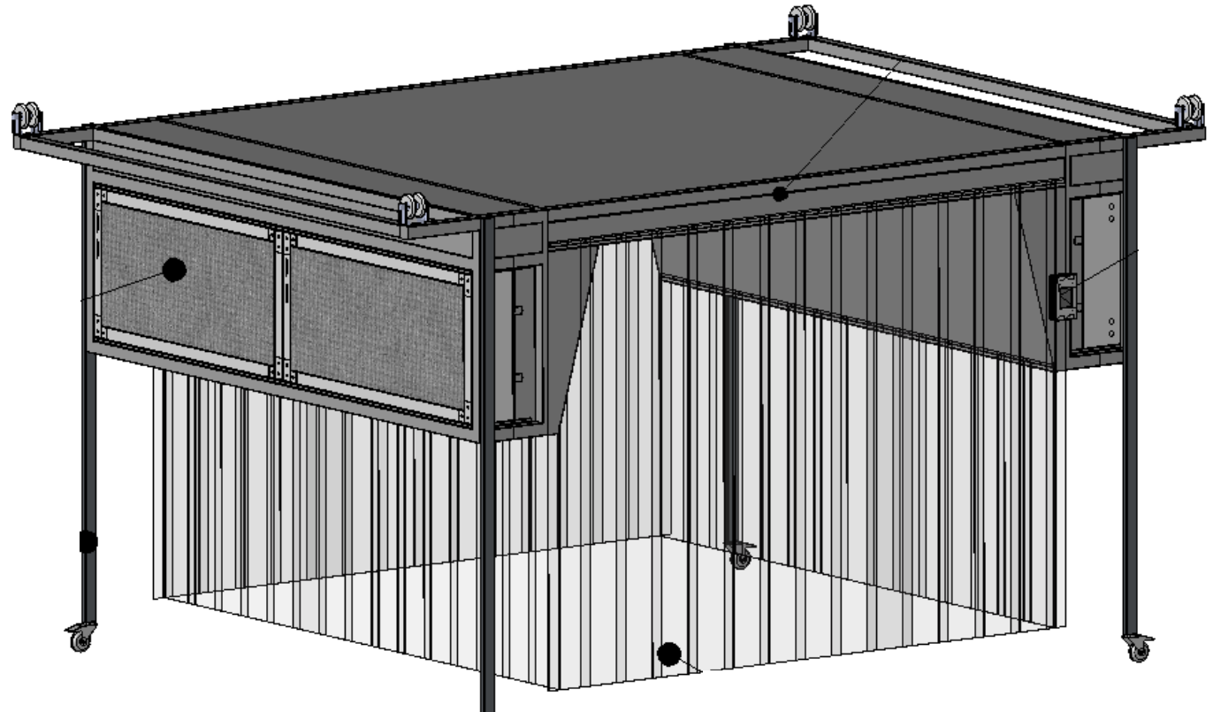
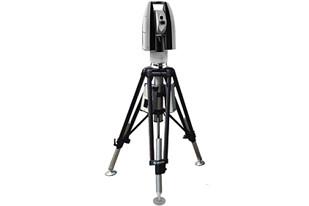
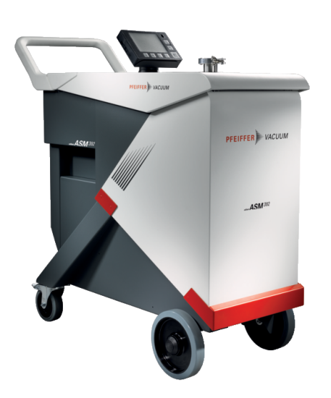
Required equipment and instruments
Laser tracker
Mobile clean zone
Leak detectors

Slide 7
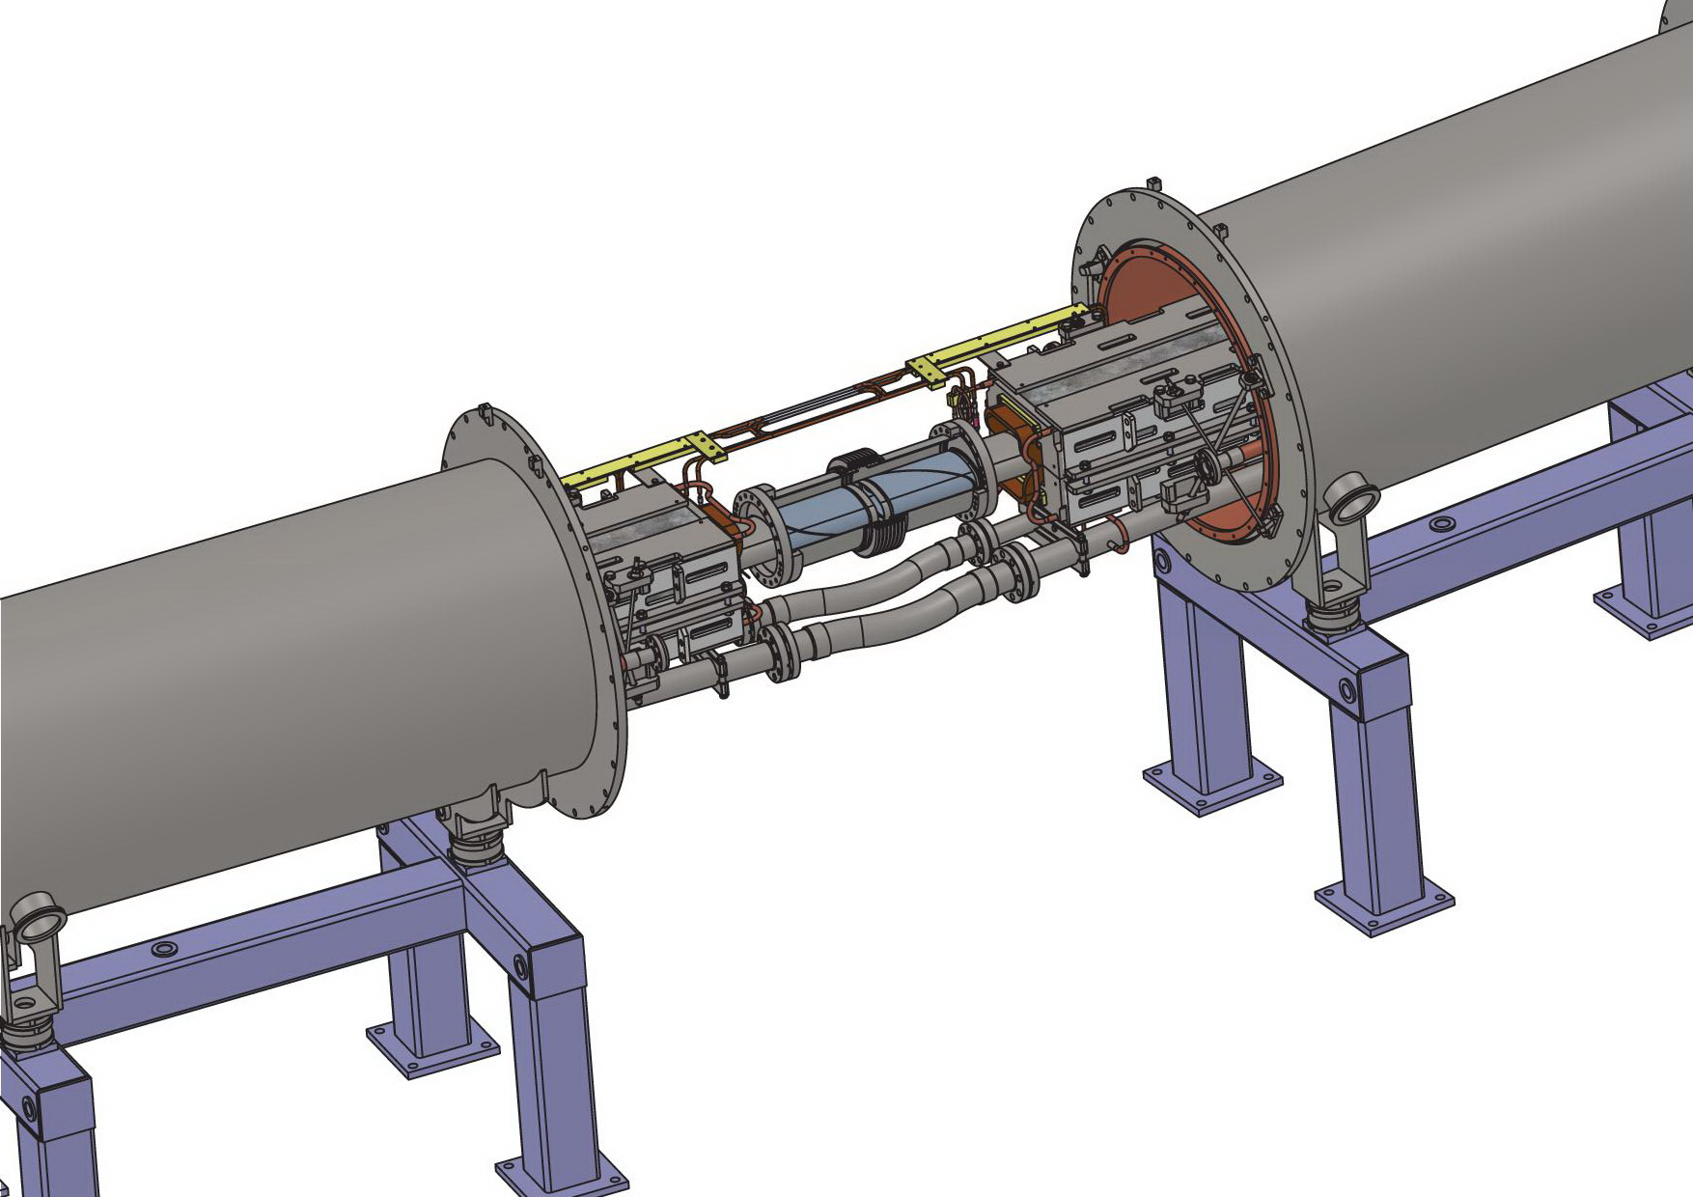
The typical joint (dipole-dipole assembling)
Beam pipe
Bus-bars
Dipole unit
Dipole unit
Bellows hoses
Supports

Slide 8
Dipole-dipole joint
Thermal shield
Vacuum chamber

Slide 9
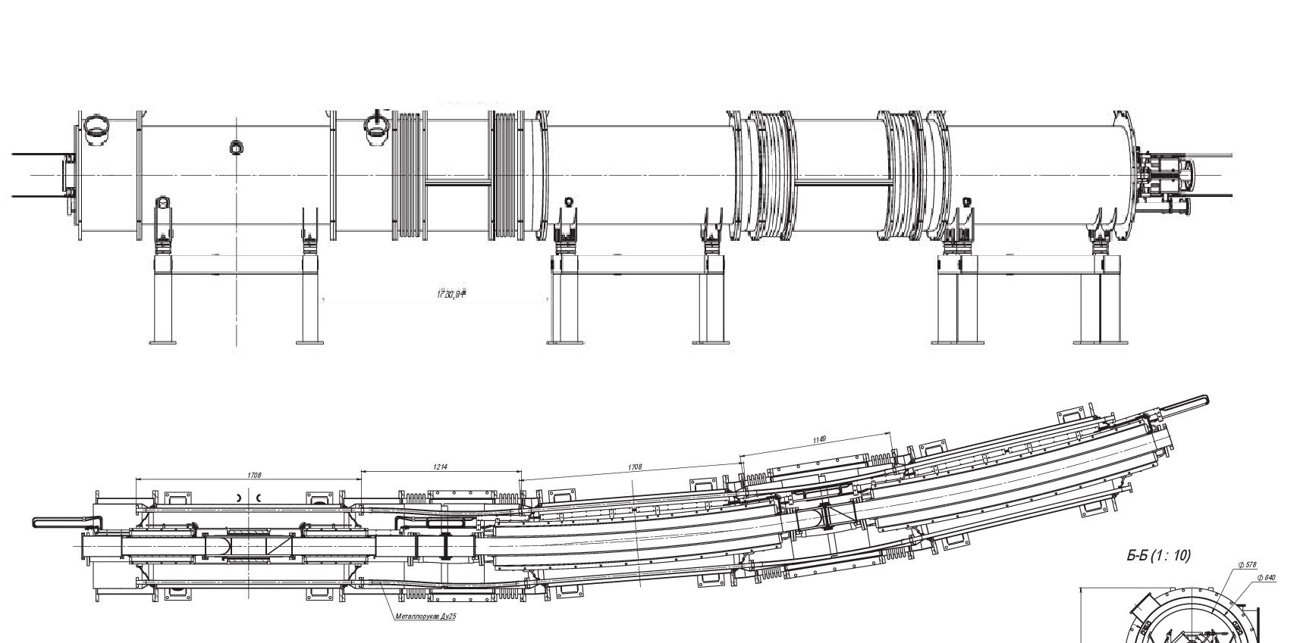
Regular periods
Quadrupoles unit
Dipole unit
Dipole unit

Slide 10
Arrangement of Booster dipole magnets
The closed orbit distortion for bending magnets ranking on injection current 625 A is about 0.45 mm and for extraction current 9745 A and the same ranking this distortion is about 1.6 mm, see figure (right) below.
The arrangement of Booster dipole magnets in tunnel is done. The best way for bending magnets ranking is to use the pair of magnets with short and long effective length (total amount of this pairs is 20 pcs.).

Slide 11
Assembly workflow (part 1)
Regular period
Magnet 1
Magnet 2
Magnet 3
1
Alignment of yoke inside vacuum chamber (2w × 2h × 64m = 256pm (16days)
2
Transfer magnet on position (3w × 0,5h × 64m = 96pm (4days)
3
Mounting magnet in tunnel (2w × 0,5h × 64m = 64pm (4days)
4
Assembling of He and N2 lines M1-M2 (2w × 1h × 60m = 120pm (8days)
Assembling of He and N2 headers M2-M3
5
Soldering of bus-bars M1-M2 (1w × 4h × 60m = 240pm (30 days)
Soldering of bus-bars M1-M2
6
Alignment in position (2w × 2h × 64m = 256pm (16days)

Slide 12
Assembly workflow (part 2)
Quadrant
END1
Regular period 1
Regular period 2
Regular period 3
Regular period 4
Regular period 5
END2
Transfer unit on position and mounting
Transfer unit on position and mounting
Assembling of He and N2 headers END1-1-2-3-4-5-END2
Soldering bus-bars END1-1-2-3-4-5-END2
Helium leakages tests of manifolds connections (2w × 1h × 60joints = 120pm (4days)
7
Mounting insert between the beam pipes (2w × 2h × 60joints = 240pm (8days)
8
9
Mounting turbo-pump stations (2w × 4h × 8 stations= 32pm (8days)

Slide 13
Assembly workflow (part 3)
Quadrant
END1
Regular period 1
Regular period 2
Regular period 3
Regular period 4
Regular period 5
END2
Helium leakages tests of beam pipe connections (2w × 16h × 12 time= 384pm (24days)
10
Thermal shield and nitrogen manifolds assembly (2w × 2h × 60 time= 240pm (24days)
11
Electrical tests (2w × 2h × 4 time= 16pm (1days)
12
Vacuum shell assembly (2w × 3h × 60 joints = 300pm (19 days)
13
Mounting insulation volume vacuum system (2w × 8h × 26 stations = 416pm (26 days)
14
Pump and helium leakages tests (2w × 24h × 4 quadrants = 196pm (16 days)
15
Electrical tests under vacuum (2w × 1h × 4 quadrants = 8pm)
16
Pumping of beam pipe (2w × 56h × booster = 112pm (5 days))
17
Notes:
probability

Slide 14
Man powers for regular periods
Step of workflow | Magnet mounting, vacuum chamber and nitrogen shield assembling | Leakage test, beam pipe and He manifold flange assembling | Alignment | Soldering and voltage test | Сrane operator
1 | 128 |  | 128
2 | 64 |  |  |  | 32
3 | 64
4 |  | 120
5 |  |  |  | 240
6 | 128 |  | 128
7 |  | 120
8 |  | 240
9 |  | 32
10 |  | 384
11 | 240
12 |  |  |  | 16
13 | 300
14 |  | 416
15 |  | 196
16 |  |  |  | 8
17 |  | 112
SUM (≈3100) | 924 | 1620 | 256 | 264 | 32

Slide 15
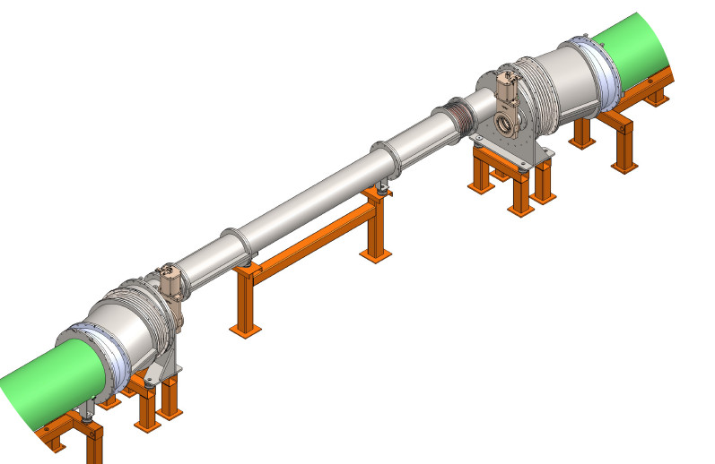
Bypass unit of I and III warm sections
Quadrupole unit
Transfer tube
Cold-warm section
Cold-warm section
All-metal gate
All-metal gate
Quadrupole unit
15

Slide 16
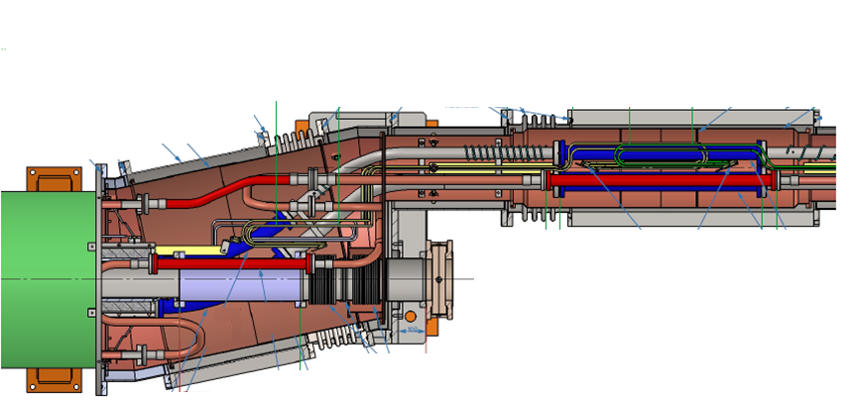
Cold-warm section assembling
Vacuum chamber
Helium channels
Nitrogen channels
All-metal gate
Beam pipe
Pick-up station
Quadrupole doublet magnet

Slide 17
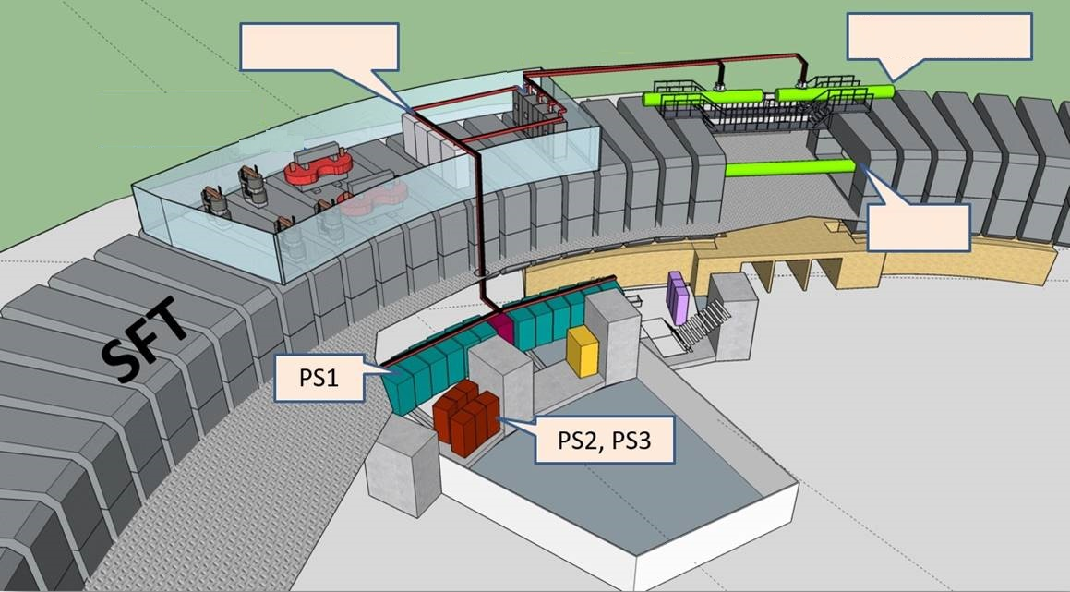
Power supply, reference magnet and acceleration station area
Power supply
device
Reference magnets
Booster

Slide 18
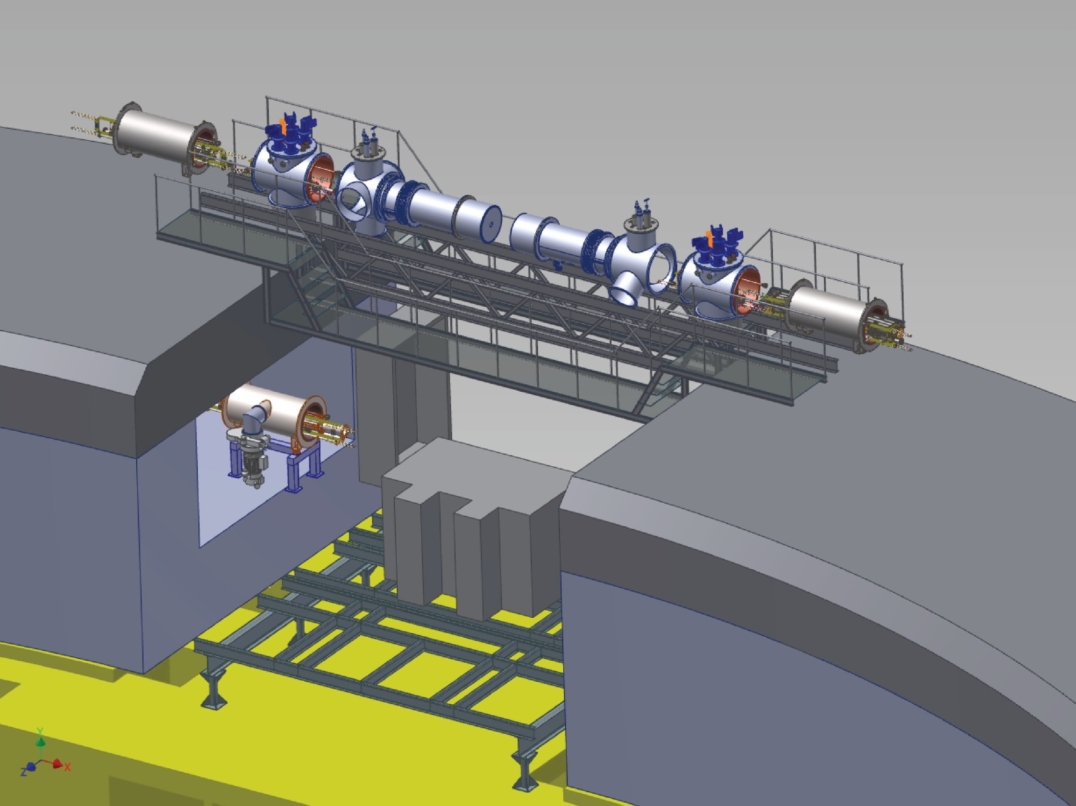
Section with reference magnet
Feedbox “L”
Cryogenic feeder “L”
Cryogenic feeder “R”
Reference magnet
Feedbox “R”
Reference magnet
Platform
Booster “2”
Accelerating stations

Slide 19
Irregular periods assembly workflow
Booster assembling |  | 2018
 |  | V | VI | VII | VIII | IX | X | XI | XII
“Cold” sections
 | Quadrant 1
 | Quadrant 2
 | Quadrant 3
 | Quadrant 4
 | Bypasses
 | Reference magnets
Bypass 1,2 (6w × 80h = 224pm (10days)
18
Reference magnets and feed boxes (6w × 96h = 328 pm (14 days)
19
10
Pump and helium leakages tests (2w × 60h = 120pm (5 days)
20
Technological commissioning (10 days)
21
Notes:
probability

Slide 20
Man powers for booster cold part assembling
Step of workflow | Magnet mounting, vacuum chamber and nitrogen shield assembling | Leakage test, beam pipe and He manifold flange assembling | Alignment | Soldering and voltage test | Сrane operator
1-17 | 924 | 1620 | 256 | 264 | 32
18 | 160 | 32 |  | 16 | 16
19 | 224 | 48 |  | 32 | 24
20 |  | 120
SUM ≈3800 mp | 1308 | 1820 | 256 | 312 | 72
Managers, engineers and workers (4 months or 120 days or 960 hours, 8h/day)
Technicians (7+6) | 1,4 (2+1) | 1,8 (2+2) | 1+1 | 1+1 | 1+1
Engineers (1+1) | 1+1
Managers | 1
Notes:
contain

Slide 21
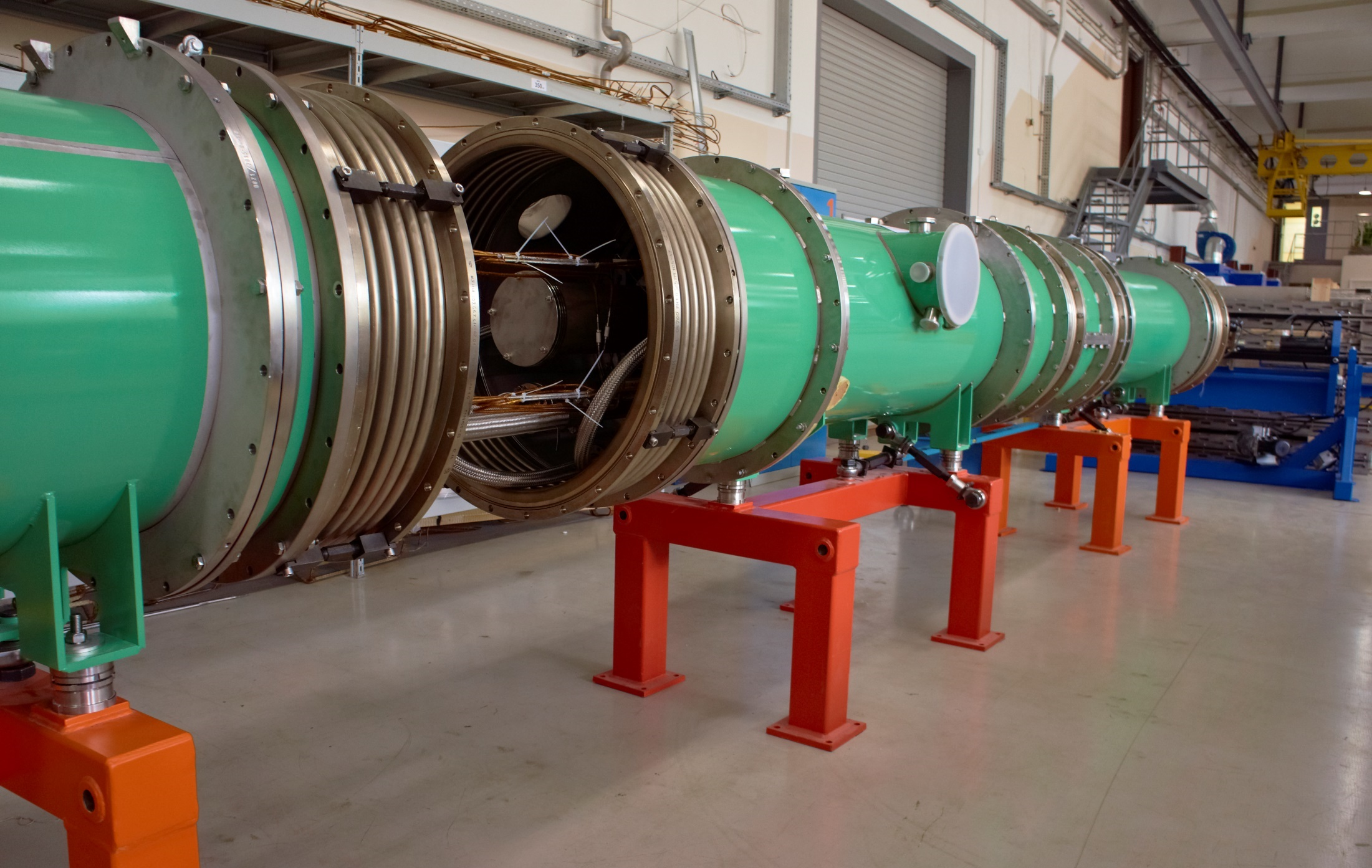
Thank you for attention

