Slide 1
NICA control system — progress and tasks
Evgeny Gorbachev on behalf of team LHEP, JINR

Slide 2
Content
Main principles and layout
Control System infrastructure and services
Status of the subsystems development and production.
Conclusions.

Slide 3
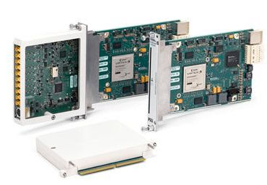
Main principles and layout
Middleware: TANGO controls – multiplatform CORBA based distributed object-oriented control system framework.
Frontend layer: National Instruments modular PXI platform - acquisition boards, analog and digital I/O, signal generators, digital multimeters, counters and timers, high speed digitizers, industrial interfaces, reconfigurable FPGA modules: FlexRIO, CompactRIO and others.
Client layer: web applications - cross-platform, flexible, fast and convenient. Data exchange with TANGO via custom Websockets and REST TANGO device servers. The access to the Web client functionality is restricted by custom Access Control system.

Slide 4
High availability of the CS services
High availability of CS services and fast failover in case of hardware problems are provided by hardware measures (uninterruptable power supplies (UPS), reliable enterprise class hard drives) + data redundancy ( replication) + backups (VMs and databases):
Virtual machines are running on Proxmox VE cluster with VM images stored on redundant shared storage. Any VM can be started on any node.
Currently we have 6 Supermicro servers + 1 HP server for daily backups.
Tasks: collider operation will require more servers for running VMs and especially for the data storage. It’s foreseen another 2 servers for VMs and 3 servers for the data storage.

Slide 5
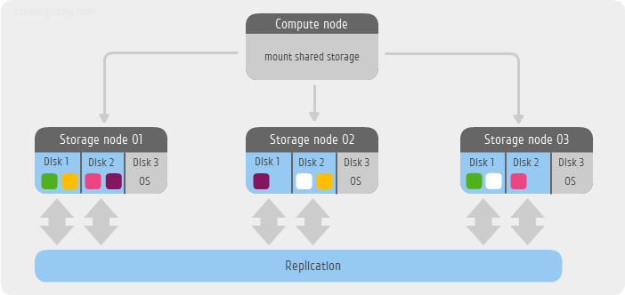
Shared storage
Crucial component of virtualization to provide high availability of virtual machines (VM).
Good performance is the key point, it will have to manage read/write operations of number of VM images.
Have to be redundant to provide data consistency in case of hardware or network failure
Need to be scalable – should be able to add more storage space without loosing performance.
CEPH provides redundancy, excellent performance and scalability. The data is replicated and distributed between nodes dynamically.
10Gb public network
10Gb cluster network

Slide 6
Scalability of the CS resources
A system whose performance improves after adding hardware, proportionally to the capacity added, is said to be a scalable system. (Wikipedia)
The scalability can be achieved by adding nodes to cluster. CEPH retains most characteristics at scale or even improves. Adding more nodes to run more VMs:
Capacity increases
Throughput increases
IOPS increase
CPU cores and RAM increase
Tasks:
Install another 10Gb Cisco Nexus5k switch to provide reliability of the cluster network. Currently it is a single point of failure.

Slide 7
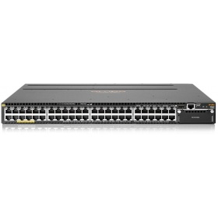
Network infrastructure
4 racks with total 8 switches Aruba 3810M, 48G. Each has 48 RJ-45 10/100/1000 ports.
Switches are stacked in pairs to increase the reliability.
Use of an IP range unroutable outside JINR.
Provide access from the external world via VPN.
Collider network: 12 racks with 24 Aruba switches are foreseen.
Tasks:
purchased only half of the required quantity of switches for Booster.

Slide 8
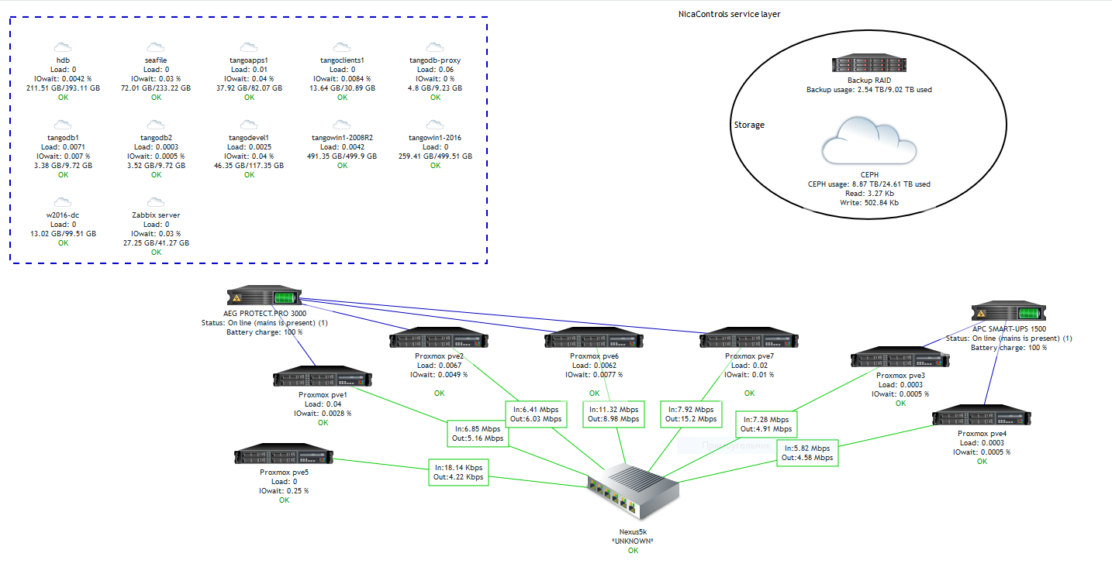
Monitoring and logging
Zabbix to monitor hypervisors (physical servers, VMs, CEPH and backup storage, network, UPSs, TANGO devices) - ready.

Slide 9
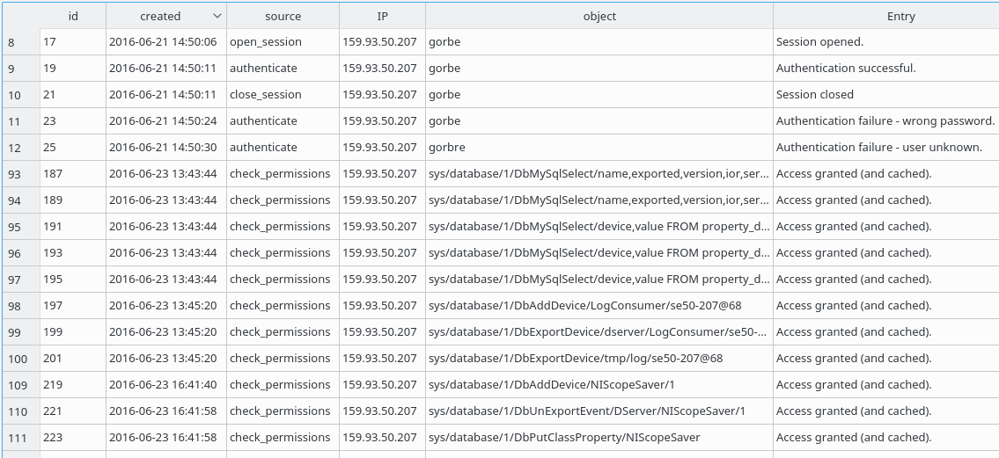
Monitoring and logging
Centralized logging service for TANGO devices has been developed.
Logs of all TANGO database changes – can be very useful for identification of the reason of problems.
Flexible interface for administrators to search or filter information in logs.

Slide 10
Access control
Access control is required to safely run a distributed control system, especially when using web clients.
Network configuration:
accelerator network will use private address range 192.168.*.* which is routed only inside JINR.
Firewall configuration for the most sensitive TANGO services.
TANGO native client-side access-control.
Additional custom access control service on the server side: allow device servers to check permissions of the client.
Centralized management of user’s permissions.
Centralized access logs.
Simple usage for both TANGO device server and client application. No modifications to Tango library.

Slide 11
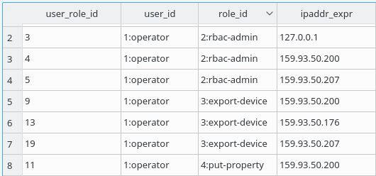
Access control
Role Based Access Control (RBAC).
Authentication by location (IP address).
MySQL regular or wildcard expressions in rules and addresses.
TANGO database protection.

Slide 12
Data archiving
HDB++ archiving system:
Stores TANGO attributes values into a database (SQL or noSQL).
Publish/subscribe paradigm via TANGO archiving events – storing only valuable information.
Highly scalable - multiple archivers to distribute load over few databases, servers and disk storages.
Currently is used on Superconducting Magnets Test Bench – storing about 500 TANGO attributes every second.
Tasks:
Consider tests of noSQL backend (Apache Cassandra) – probably can get better performance than MySQL which is used now.
Estimate archiving data volume and storage rate to predict required storage space and data retention period.

Slide 13
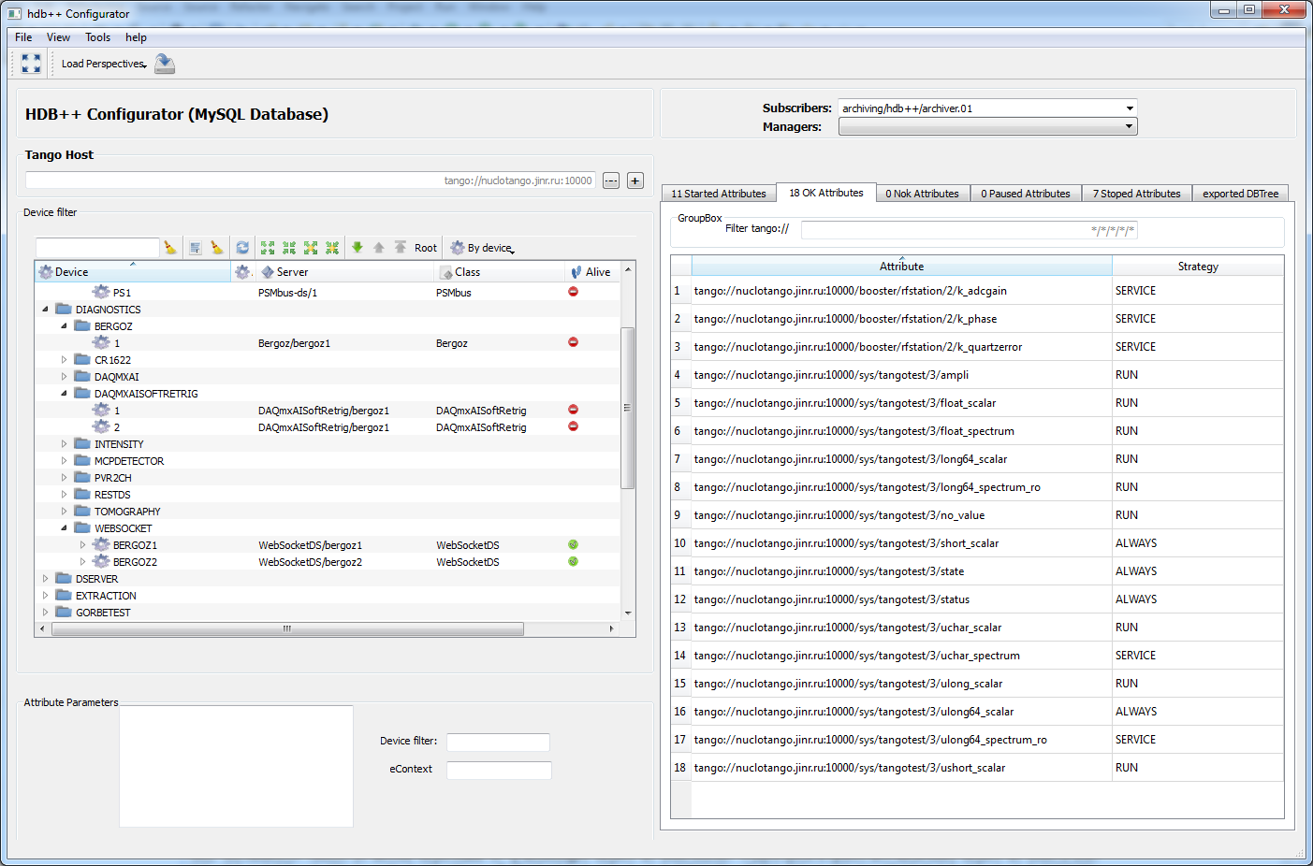
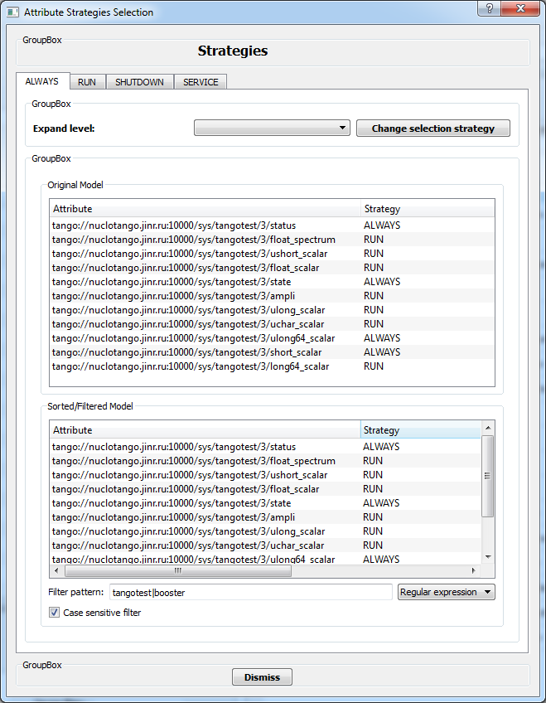
Data archiving
HDB++ configuration application has been developed. It allows to
manage all aspects of the archiving: add/remove/start/stop attributes, monitor archiving, distribute archiving to different subscribers.

Slide 14
Data archiving
An universal web application is under development for viewing data stored in HDB++ combined with online data from any TANGO attribute. It can be used to retrieve and analyze an arbitrary data stored in HDB++: vacuum pressures, temperature measurements, beam diagnostics and so on.

Slide 15
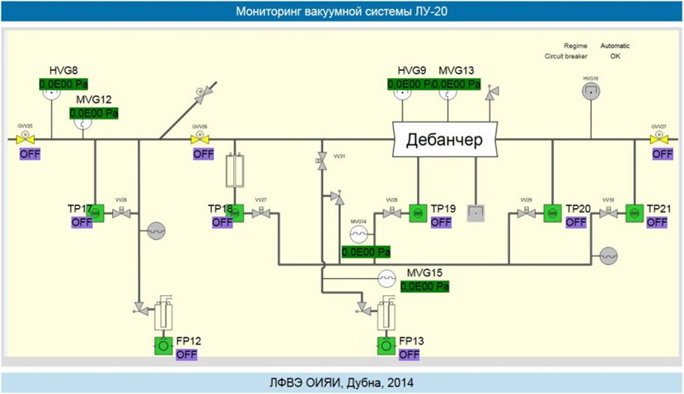
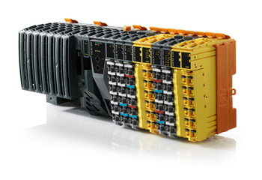
Booster vacuum control system
The Booster vacuum control system is under development now.
B&R equipment and software.
Distributed system – 12 racks, each rack has its own controller.
Local control panel in each rack.
Archiving to HDB++ (need to define the number of channels).
Interface to TANGO control system – OPC-TANGO gateway module (ready).

Slide 16
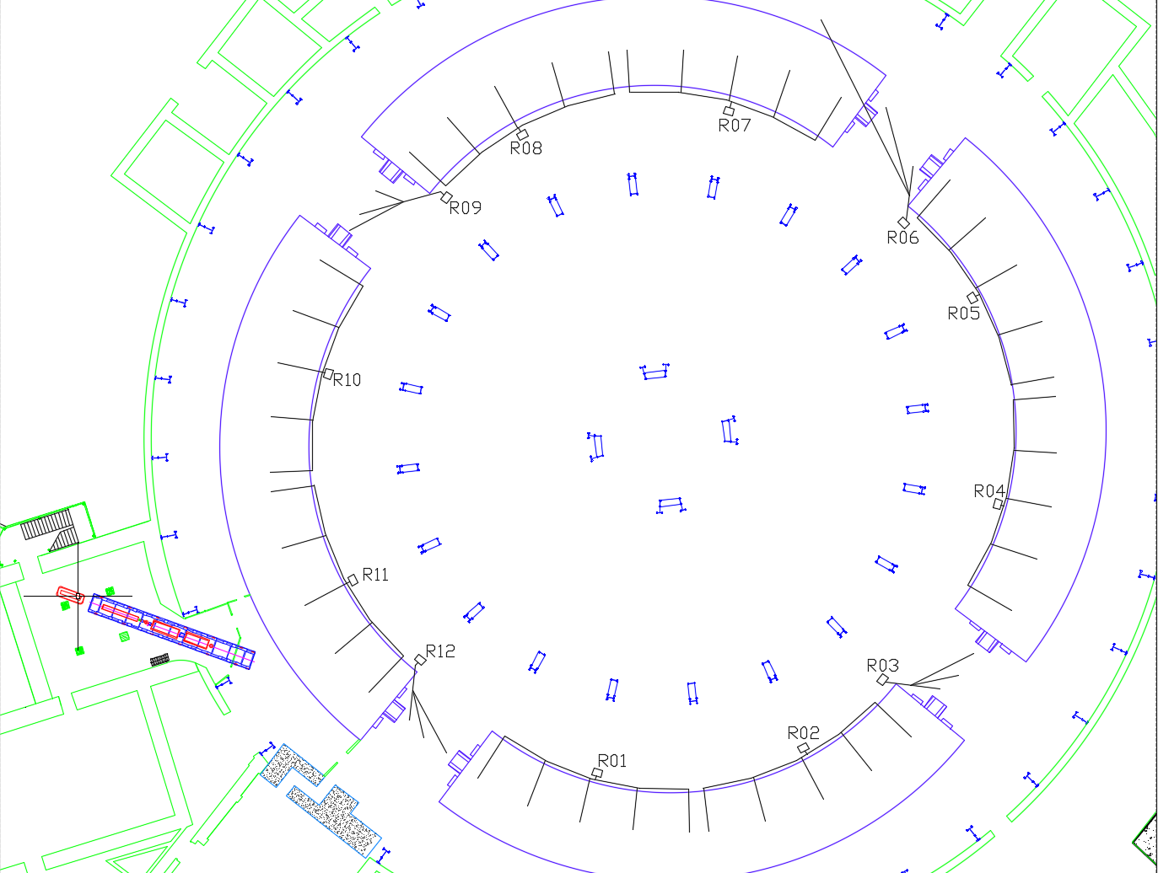
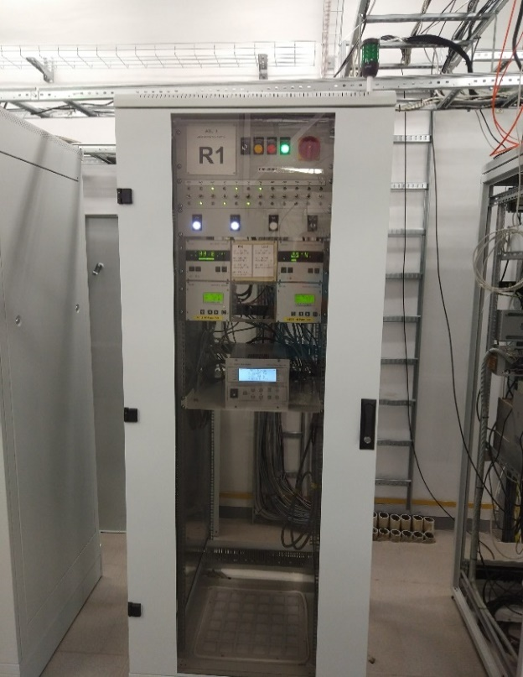
Booster vacuum control system
Regular structure – R01, R02, R04, R05, R07, R08, R10, R11
RF station – R03
Injection – R12
Extraction – R06
E-cooling – R09

Slide 17
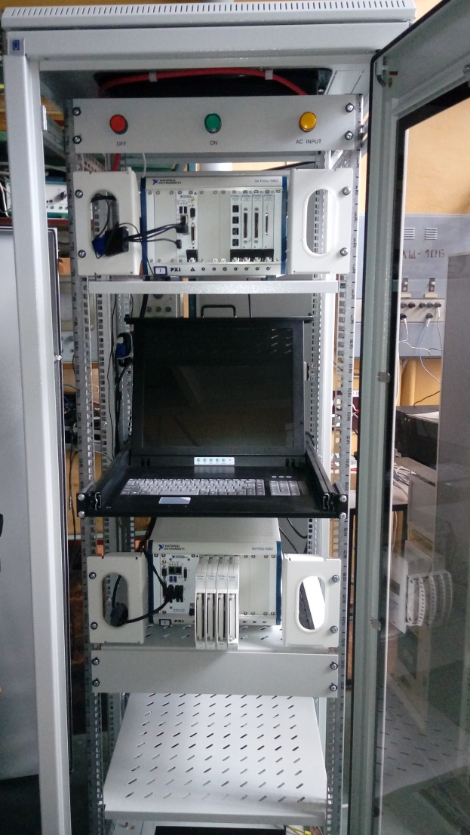
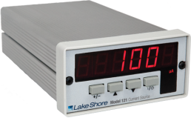
Booster thermometry system
Booster equipment:
4 cabinets with NI PXIe-1082 chassis.
5 NI PXI-4357 modules (24-bit ADC, 20 channels) in each cabinet.
Lakeshore 121 DC current sources.
400 measurement channels in total.
HDB++ archiving – up to 400 values per second
Hardware is fully assembled.
TANGO devices are developed.

Slide 18
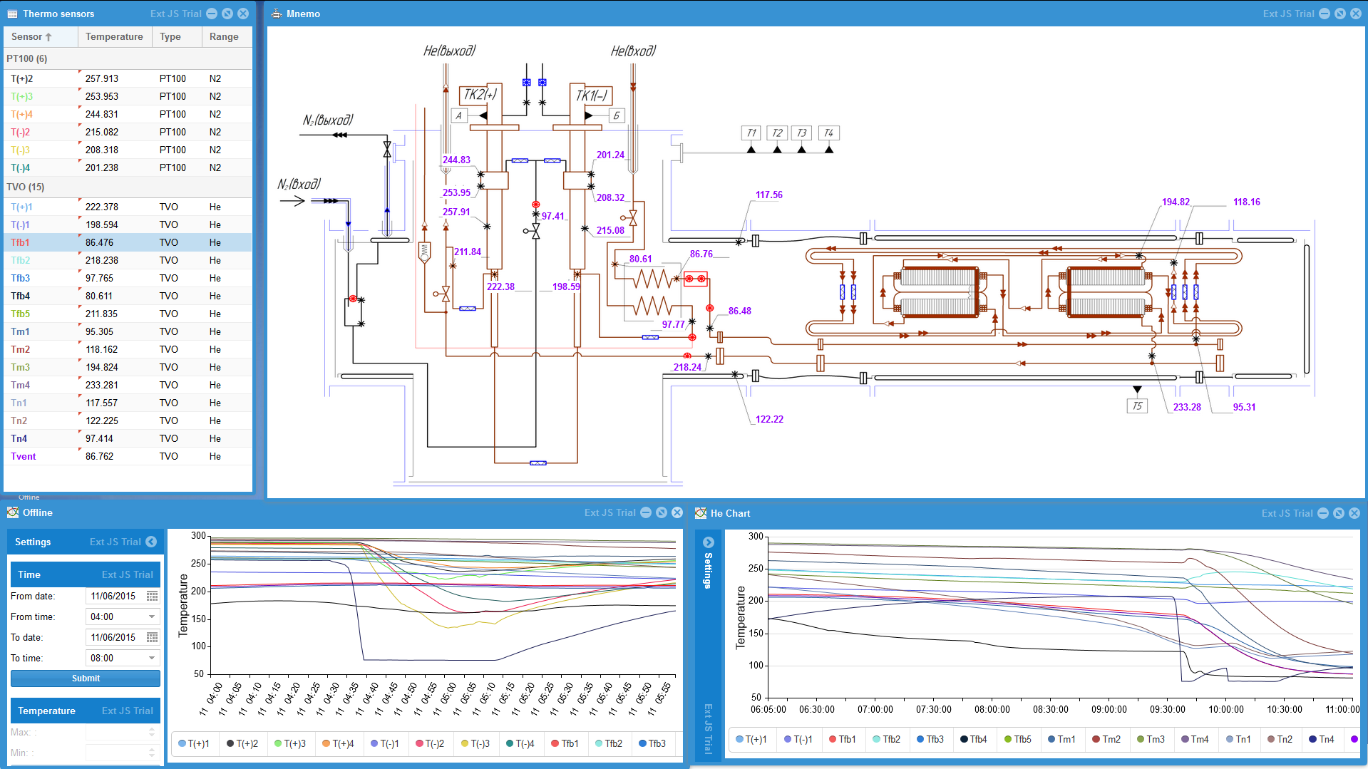
Booster thermometry system
Tasks:
Development of the web-based thermometry application for Booster.
Installation and cabling.

Slide 19
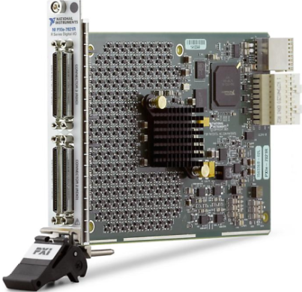
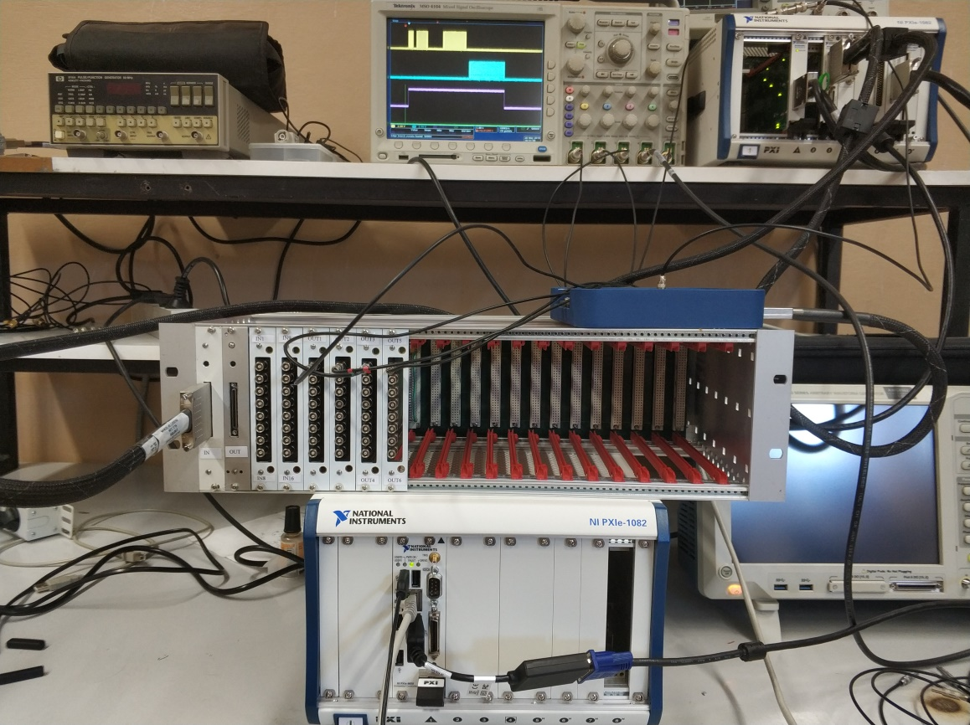
Booster magnetic cycle control
The main task of the system is to produce cycle synchronization signals and series of pulses (B-series) representing main field and it’s first and second derivatives to control magnets and quadruple lenses power supplies.
The hardware consists of:
PXI Digital Reconfigurable I/O module NI PXIe-7821R: Kintex 7 160T FPGA, 128 DIO, 512 MB DRAM
3U Euro rack providing digital bus on the backplane and power supply.
A set of digital I/O modules: TTL and optical inputs and outputs.
The hardware and TANGO software almost ready.
Tasks:
Finish tests on the test bench.
Develop Web application.

Slide 20
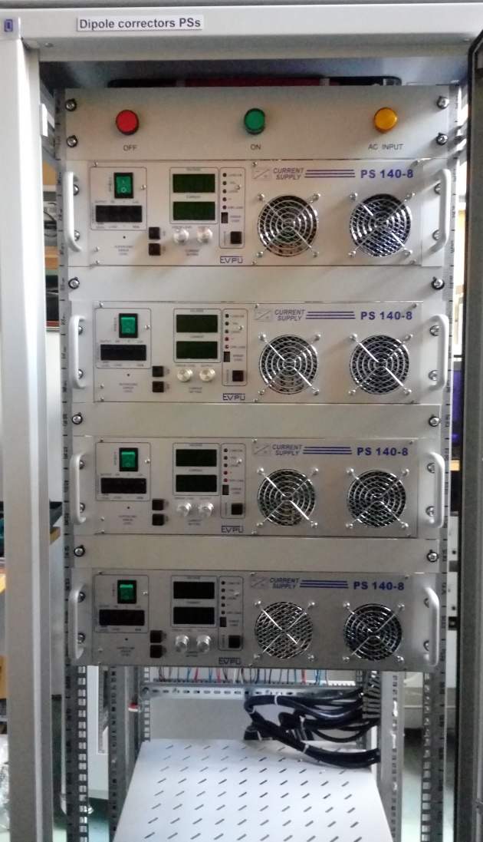
Booster beam orbit correction system
Dipole correctors for Booster:
12 racks with 48 PS 140-8 power supplies (ready).
4 NI PXIe-1082 control chassis (ready):
NI PXI-8433 RS485 interface
NI PXIe-6733 16 bit function generators
TANGO device servers (ready).
Tasks:
Multipole correctors power supplies for Booster:
8 racks with 24 PS 140-8 power supplies.
Web application for correctors control

Slide 21
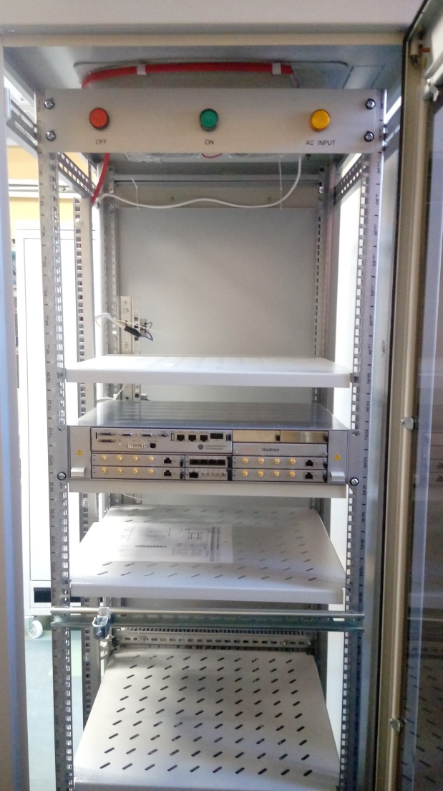
Booster beam diagnostics control
Tasks:
4 cabinets, each with
2 Libera Hadron devices
8 Power supplies for Amplifier 110
1 cabinet with acquisition electronics for Bergoz parametric and fast current transformers.
TANGO device server for Libera hadron (expected at the end of June)
Web applications for beam orbit measurements, tune measurements.

Slide 22
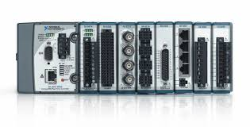
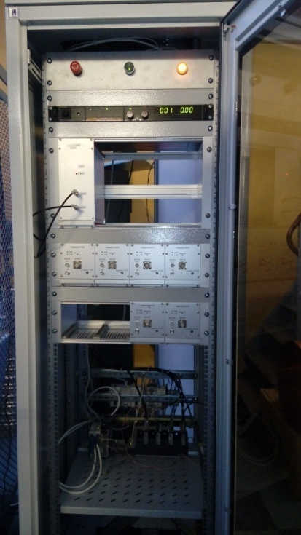
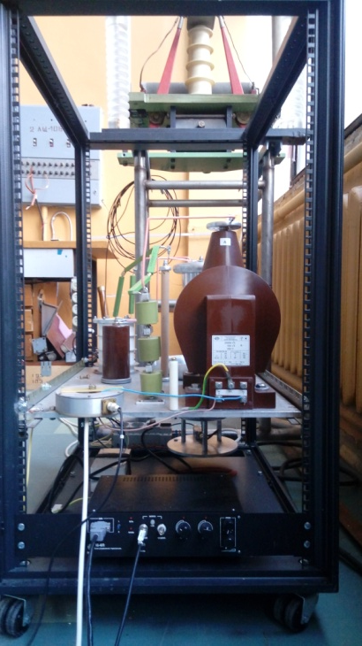
Booster injection
Startup configuration (1 inflector plate) is ready:
cRIO-9068 chassis
NI 9239 – analog input module
NI 9269 – analog output module
NI 9401 – slow digital I/O module
NI 9402 – fast digital I/O module
NI 9862 – CAN interface module
TANGO device servers
Tasks:
Scale the system to the full configuration (5 inflector plates)
Develop a web application

Slide 23
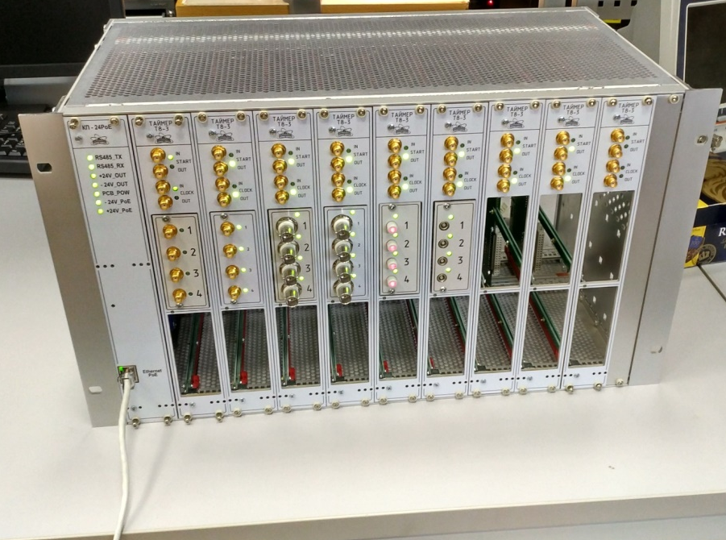
Timing and synchronization
Mixed event (White Rabbit) and signal system:
White rabbit for common time and frequency.
JINR and Novosibirsk timing modules for signal synchronization.
Tasks: timers, optical I/O, controllers, B-timer.
Development of timer module for signal synchronization system:
External Clock input 40 MHz
40 MHz Clock output (Master mode)
External trigger Start input
Start output (Master mode)
8 output channels per module
Inverse output mode
32-bit timer for the delay
32-bit timer for the pulse width
50Ω SMA, SMB, Lemo,
BNC , Optical SFP+ support.

Slide 24
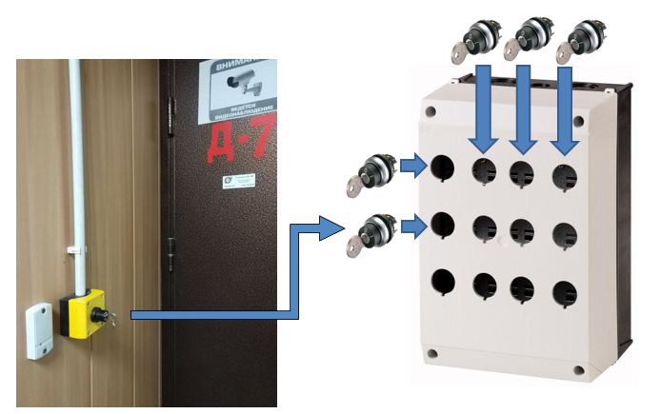
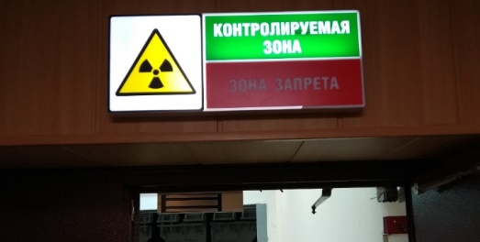
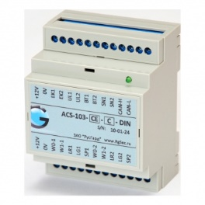
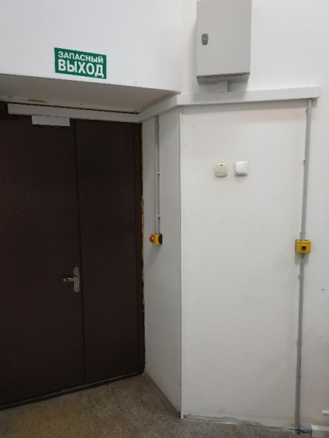
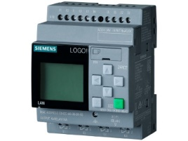
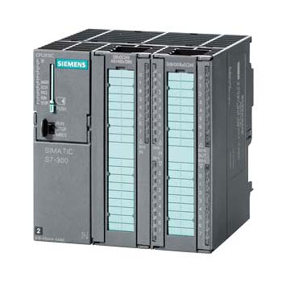
Physical access control system
Display near a door
RusGuard controller
RFID card reader Matrix II, a key and key holder
Siemens Logo controller
A door from inside
Central controller CPU315-2pn/dp

Slide 25
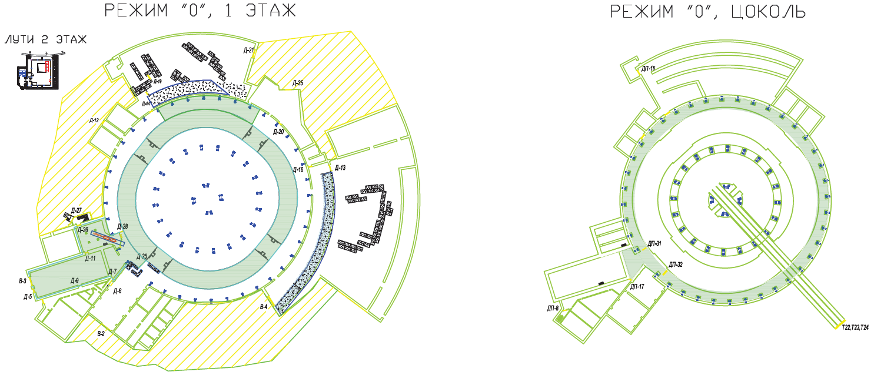
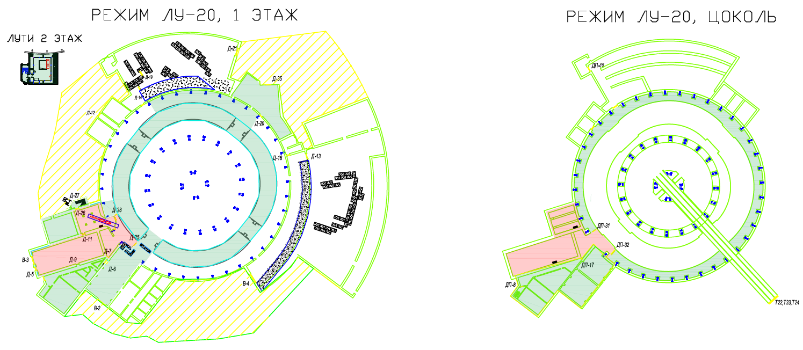
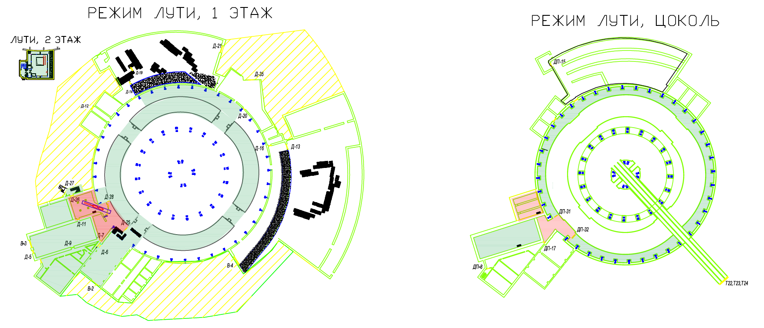
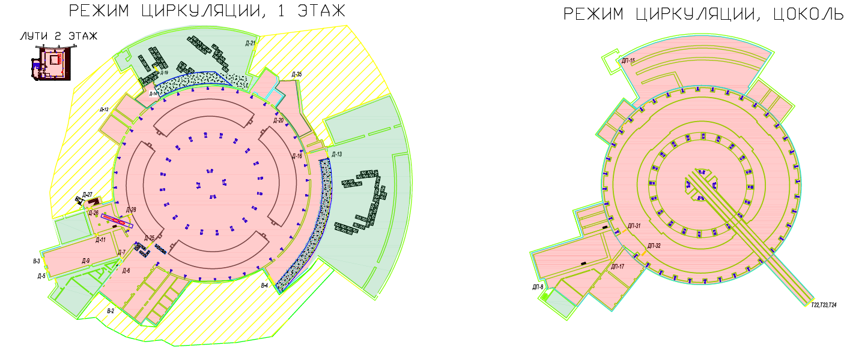
Physical access control system
Different regimes of the accelerator complex operation.
Tasks:
Interface to TANGO control system.
Control application to allow an operator to switch regimes of operation.

Slide 26
Transfer channels control systems
Booster-Collider channel (Novosibirsk): magnet power supplies and beam diagnostics are TANGO-compatible.
Nuclotron-Collider channel (SigmaPhi): TANGO control system for magnets power supplies and vacuum is being developed by CosyLab. TANGO devices for beam diagnostics (Instrumentation Technologies) are ready.
Tasks: HiLAC-Booster channel (JINR) power supplies and beam diagnostics control system.

Slide 27
Other systems
Booster E-cooling system.
Preliminary TANGO interface via TCP/IP sockets.
Booster RF system:
TANGO interface to the local control system is ready but not tested during RF system operation.
Tasks:
Finish and debug interfaces to TANGO control system.
Develop GUI web applications

Slide 28
Booster control system status
System | Hardware | TANGO integration | GUI
Control system computing cluster | Yes | - | -
Control system services | Yes | Yes | Yes
Networking equipment | 50% | - | -
Vacuum control system | No | Yes | No
Thermometry | Yes | Yes | 50%
Magnetic cycle control system | 80% | Yes | Yes
Beam orbit correction | Yes | Yes | No
Injection | Yes | Yes | No
Beam diagnostics control | 50% | Yes | No
Timing and synchronization | 20% | No | No
Physical access control | Yes | No | Yes
E-cooling | Yes | 20% | No
RF-system | Yes | Yes | No

Slide 29
Conclusions
Most of the Booster subsystems hardware are ready but some of them require attention.
Many systems missing finished Graphical User Interface (GUI). However, standard TANGO ATK panels can be used.
Most of the collider control systems will be similar to Booster ones but scaled to the size of collider.

Slide 30
Thank you for your attention!

