Slide 1
Machine — Detector Interface
A. Smirnov, V. Golovatyuk (JINR)
MAC for NICA
June 07–08, 2018

Slide 2
Collider vacuum chamber sizes
interaction point
Elliptical chamber

Slide 3
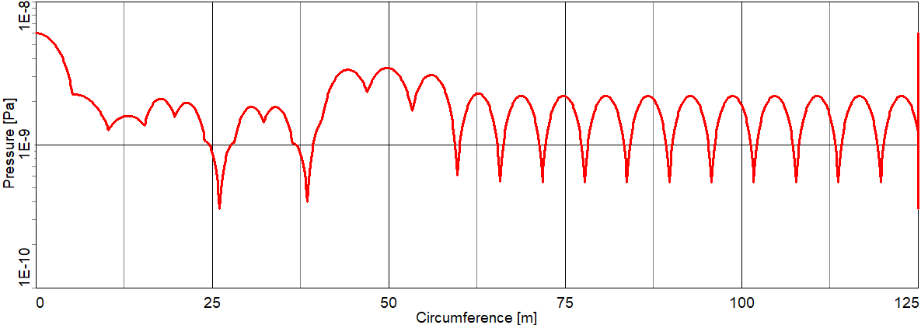
Simulation of pressure distribution (1/4 of collider)
interaction point: P ~ 1e-10 Torr

Slide 4
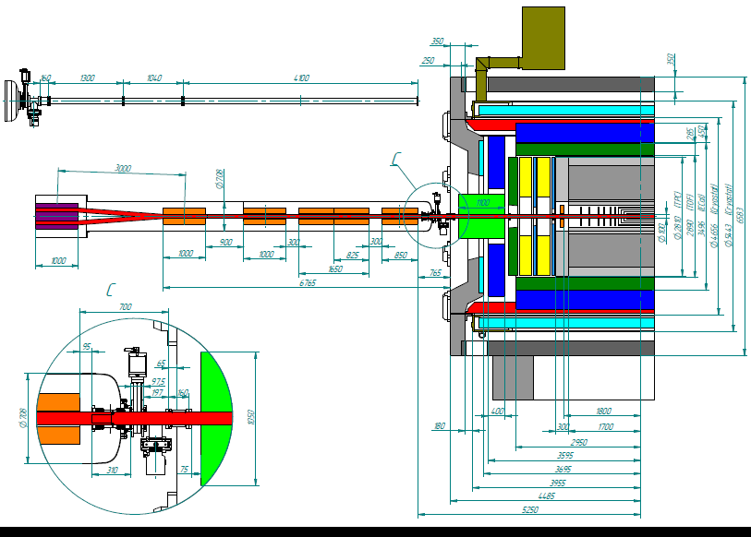
Scheme of MPD (half size)
all-metal valve and pumping station

Slide 5
MPD vacuum chamber
Beryllium insertion
500
«Kompozit», Korolev, Moscow region
Al1201
Argon welding with Al spacer
ꬿ59,6×0,8
Bimetallic flange
Misalignment 3 mm
Interaction point
ꬿ80
ꬿ100
1600
All-metal valve
5000
8970*
- Beryllium (ТВ56)
Backing T_{max} = 250⁰C
- Aluminium alloy (AW-2219)
- Stainless steel (316L/316LN)

Slide 6
Beam vacuum chamber divided on three parts
st.steel/Al part
central Be/Al part
st.steel/Al part
8970
aluminum part
beryllium part
aluminum part
2160

Slide 7
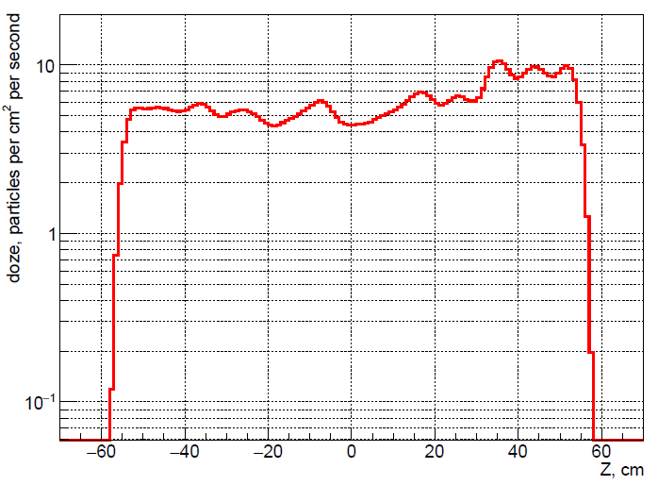
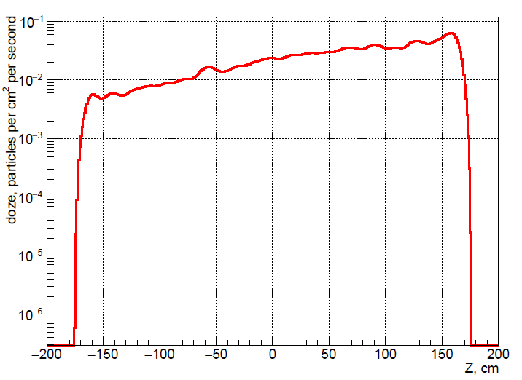
The background from the Beam – Rest gas interaction
Geant with real geometry and materials of all elements (preliminary results)
First Layer of Inner Tracker on R=5,5 cm
Inner Layer of TPC on R=38 cm
the number of interactions/cm² s
the number of interactions/cm² s
~10 cm⁻² s⁻¹
~0.1 cm⁻² s⁻¹
S = 4*10³ cm²
No = 4*10⁴ s⁻¹
S = 8*10⁴ cm²
No = 8*10³ s⁻¹
beam direction
particles per cm² per second
Beam:
Beam from one side - 22 bunches, N = 10⁹ per bunch, E = 4,5 GeV/n
Rest gas:
P = 10⁻¹⁰ Torr,
rest gas composition: H₂ -90%+ CO - 5%+ CH₄ -5%
Collisions:
For L = 10²⁷ cm⁻² s⁻¹ Au-Au collision number is estimated 7*10³ s⁻¹
One collision produces the number of elementary particles ~1000-1500
Particles:

Slide 8
Layout in MPD hall
working point
parking point
vacuum chamber with inner tracker
before insertion
removable part of radioactive shield

Slide 9
Conclusions
Due to the geometry of the vacuum chamber, the pressure in the chamber is about 1E-10 Torr.
In this case, the background signal from the collisions of the beam ions with the residual gas can be comparable to the number of useful events.
However, detectors are able to distinguish these events if the background value does not overload the detectors.
To achieve a pressure of 1E-10 Torr there is no need to bake out the chamber inside the detector.
In this case, the process of assembling the vacuum chamber inside the detector is significantly simplified

