Slide 1
NICA collider optics overview

Slide 2
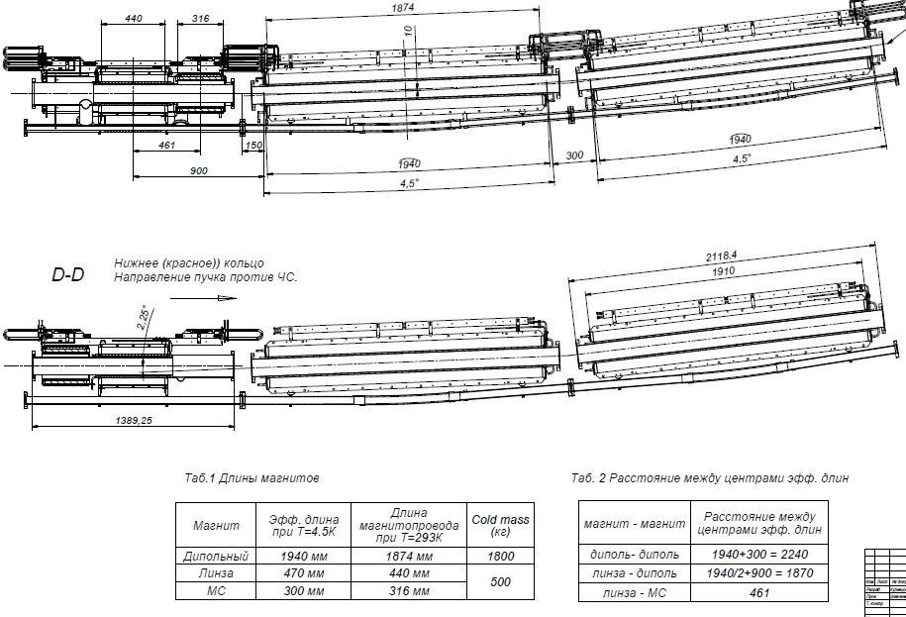
NICA collider magnets design
Lattice

Slide 3
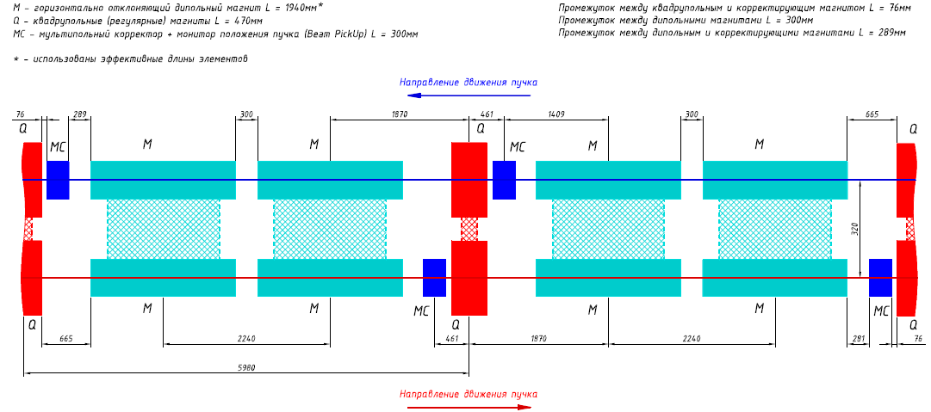
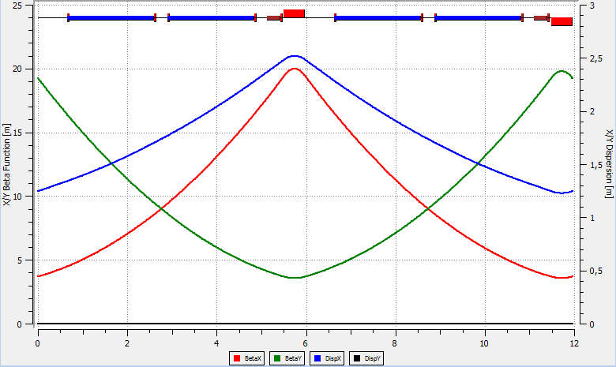
FODO-cell lattice for 2 rings
Lattice

Slide 4
Dx=0 outcomes from arc
Lattice
qF1 = - 20 %
qF1 = - 4 %
qF1 = - 4 %
qF1 = - 20 %
Ring-Arc
4 magnets
Collider:
4 magnets

Slide 5
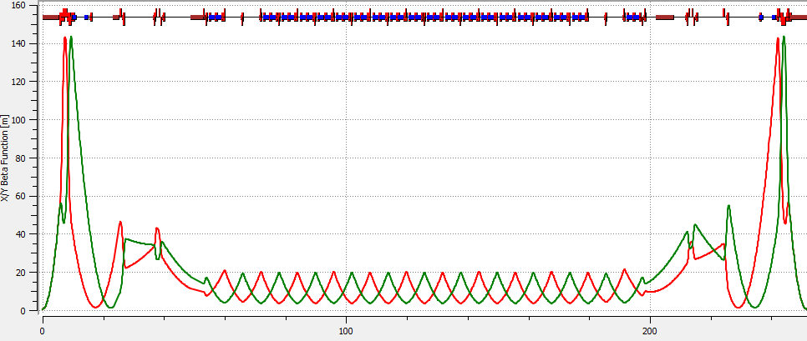
Half-Ring
Lattice
Beta-IP = 0.6m
Beta-max=145m

Slide 6
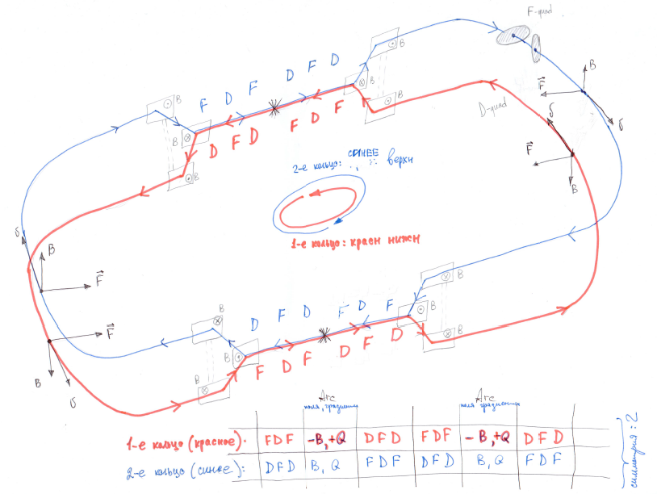
Ring + vertical beam separation
Lattice
Two Beams ⬄ symmetric optics
Ring symmetry =2
for both beams

Slide 7
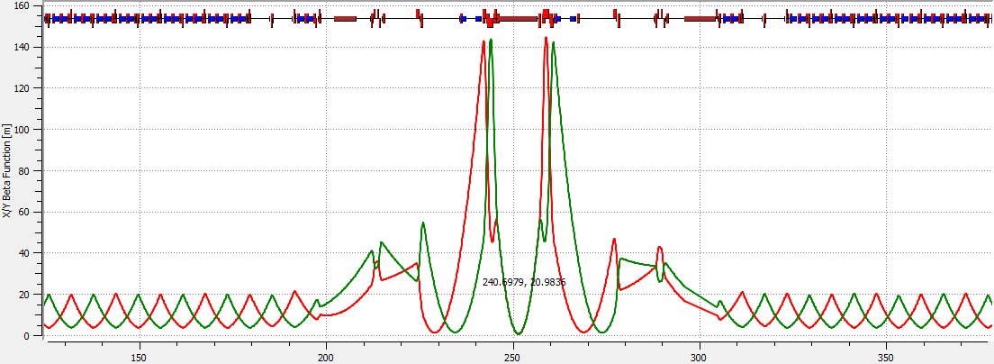
Lattice
Two Beams ⬄ symmetric optics
Ring + vertical beam separation
Ring symmetry =2
for both beams

Slide 8
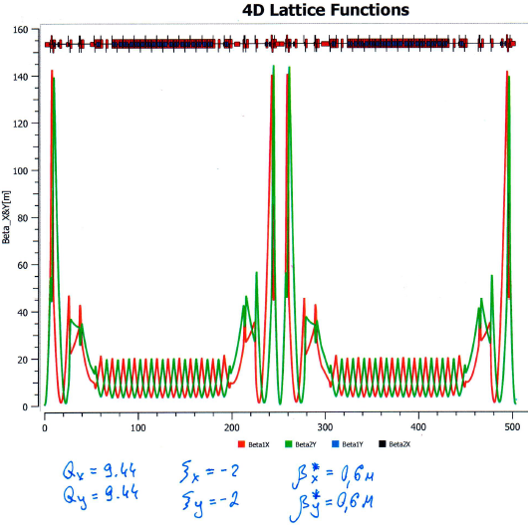
Ring-9 –
quads lengths adjusted to power all magnets in series
Lattice

Slide 9
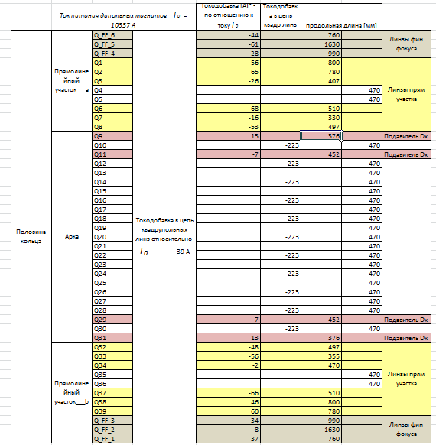
Quads currents and eff length
Lattice

Slide 10
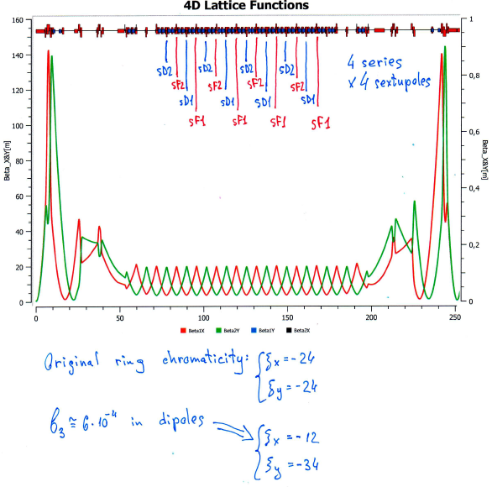
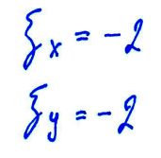
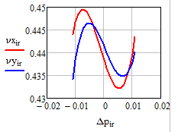
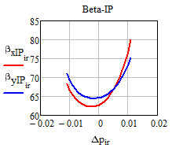
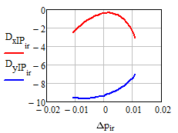
Chromaticity correction
sF1=43 T/m^2
sD1=173 T/m^2
sF2=43 T/m^2
sD2=173 T/m^2

Slide 11
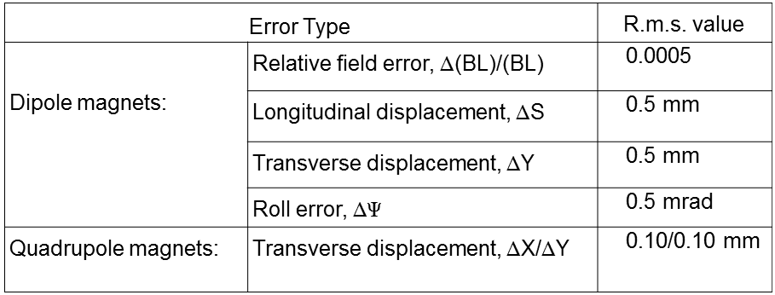
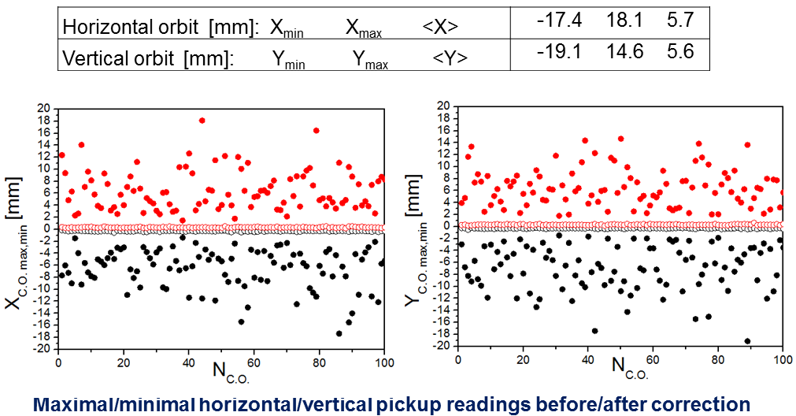
Orbit correction

Slide 12
Orbit correction
Bx=0.15 T
By=0.15 T

Slide 13
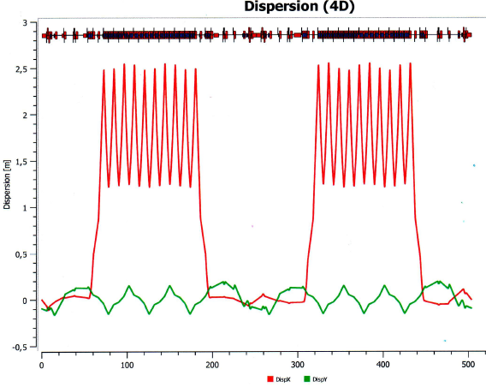
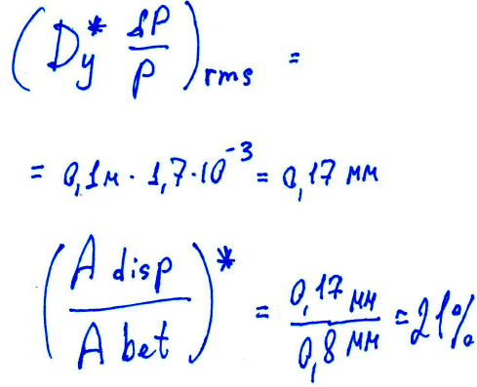
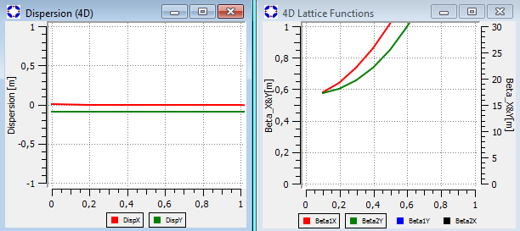
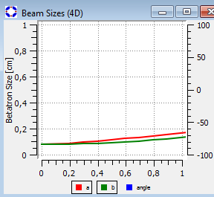
Dy –correction
- skipped

Slide 14
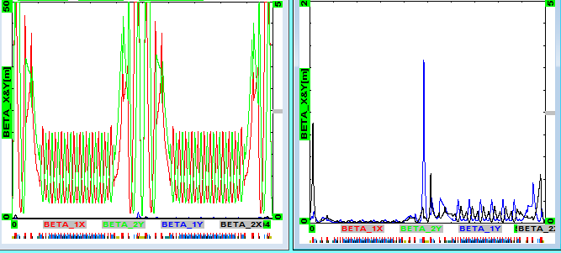
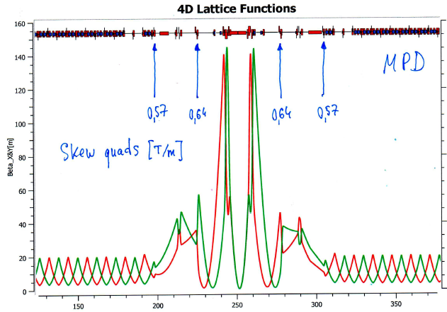
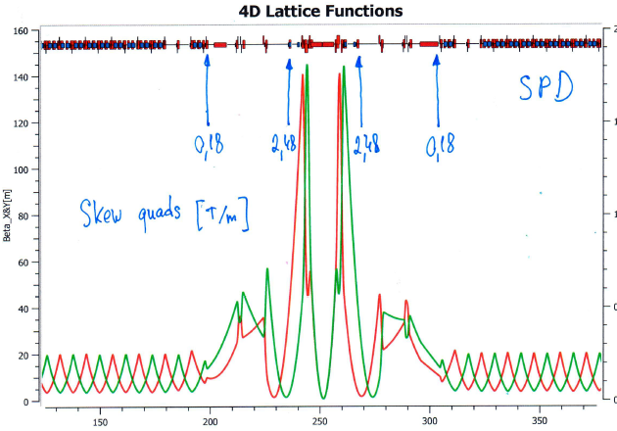
X-Y Coupling suppression
4 skew quads /
half ring [T/m]:
-2.48
0.18
0.57
0.64

Slide 15
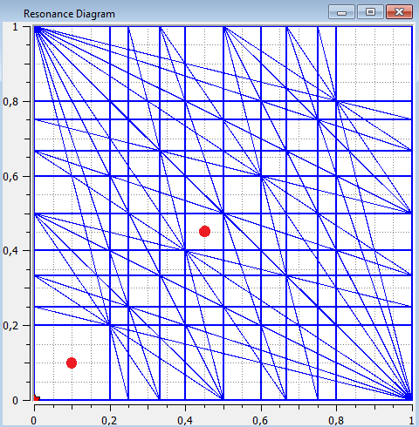
Ring tune
9.10 9.44
3 % of focusing strength

Slide 16
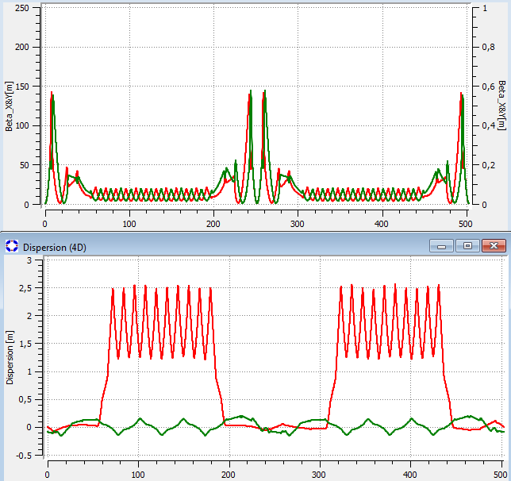
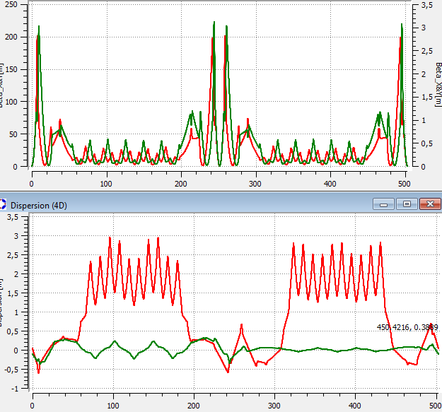
9.44 9.10
Ring tune

Slide 17
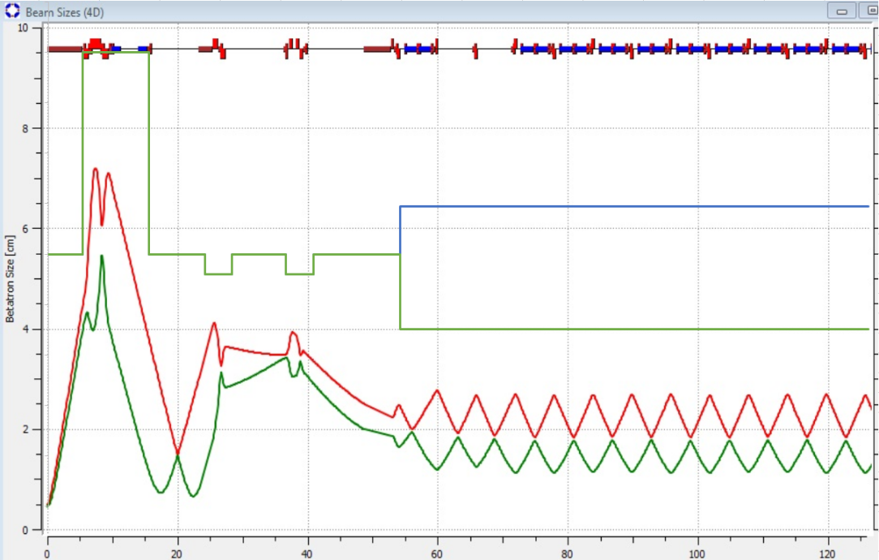
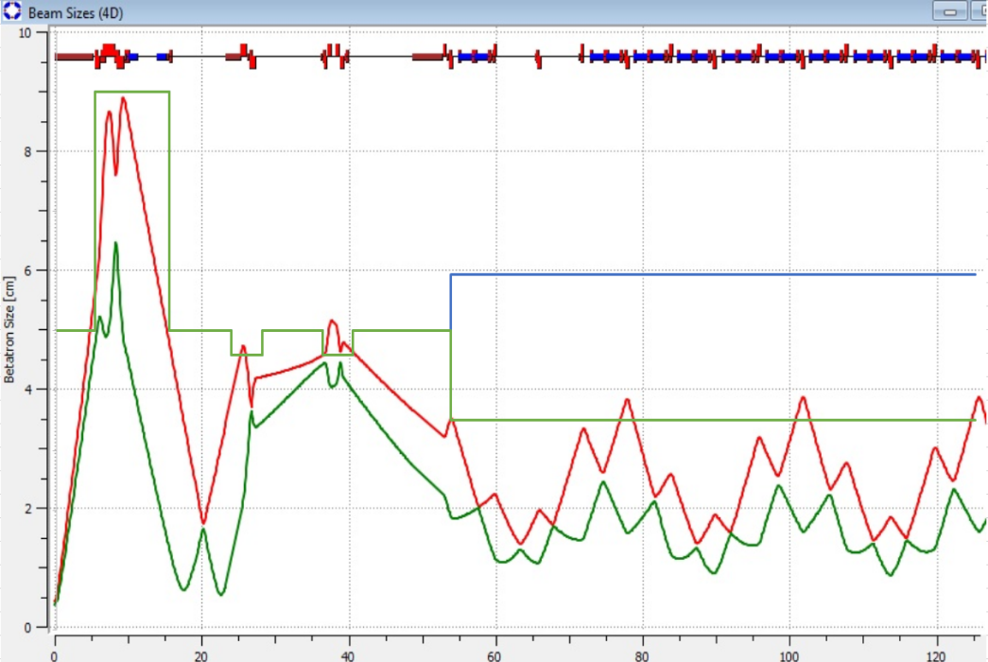
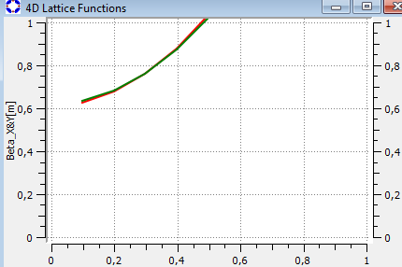
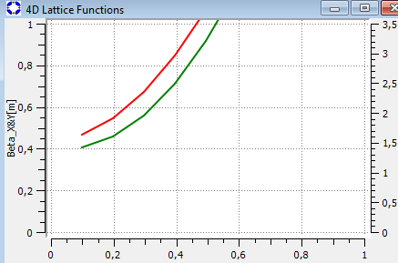
9.44 9.10
Ring tune
-303 А – to all quads (except FF) +9А to D-quads in arcs

Slide 18
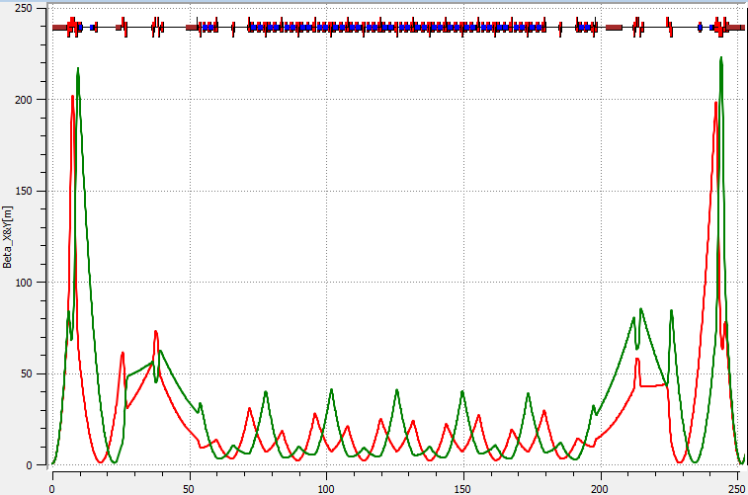
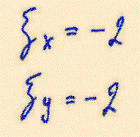
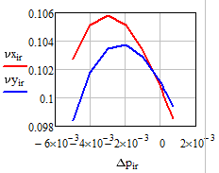
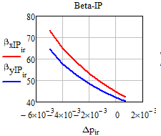
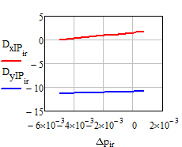
9.10
Chromaticity correction
preliminary
sF1=48 T/m^2
sD1=185 T/m^2
sF2=48 T/m^2
sD2=185 T/m^2

Slide 19
9.44
Ring dynamic aperture
preliminary
oF1=150 T/m^3
oF2=60 T/m^2
oF1=150 T/m^3
oF2=60 T/m^2
9.10
DA = 1.5 GA

Slide 20
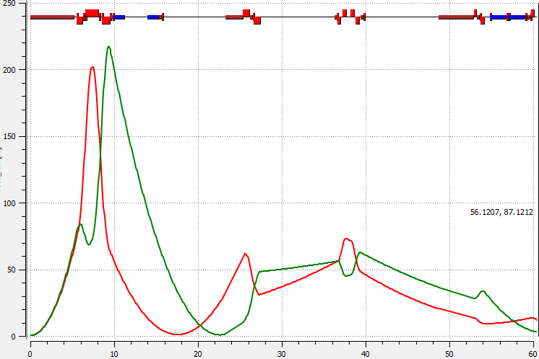
Ring dynamic aperture
oF1=150 T/m^3
oF2=60 T/m^2
oF1=150 T/m^3
oF2=60 T/m^2

Slide 21
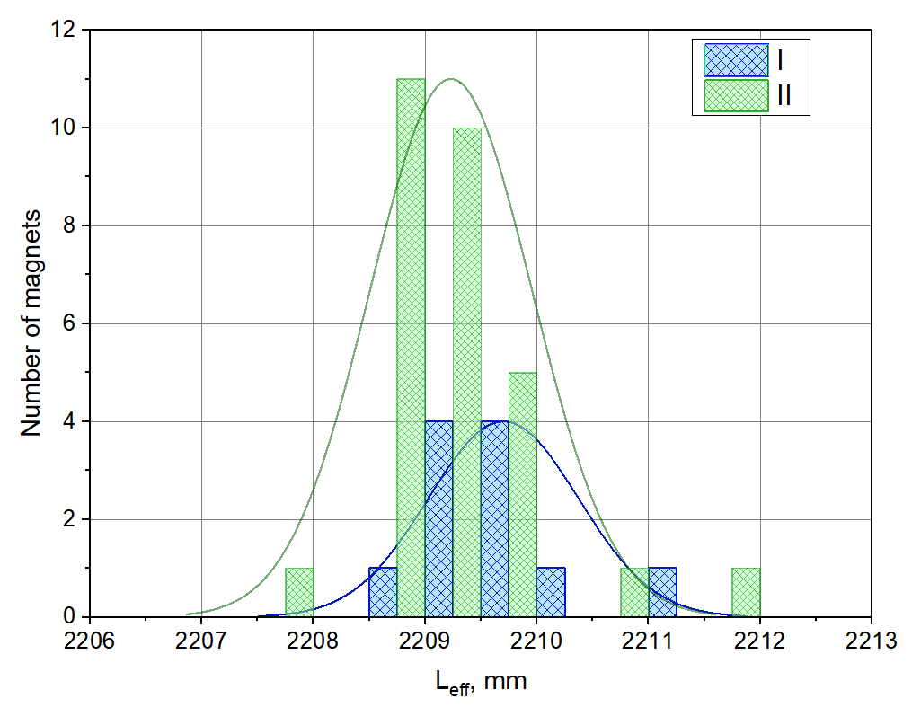
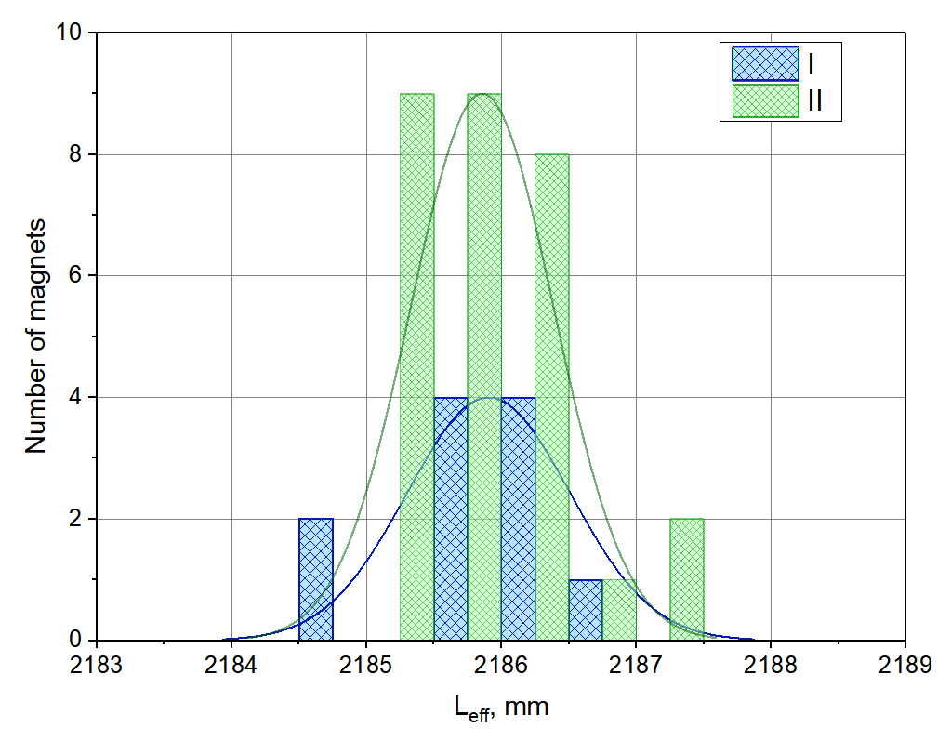
Dipoles
Magnetic measurements’ results for Booster magnets
@ Injection field 0.117 T --- 625 А
Leff
@ Maximal field 1.8 T --- 9745 А

Slide 22
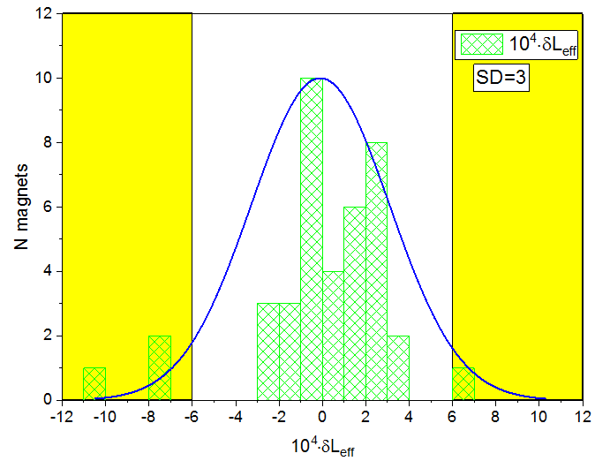
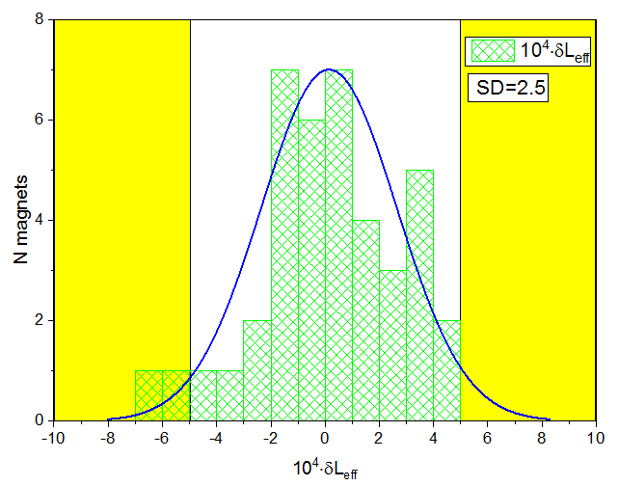
Magnetic measurements’ results for Booster magnets
@ Injection field 0.117 T --- 625 А
Dipoles
Leff
@ Maximal field 1.8 T --- 9745 А

Slide 23
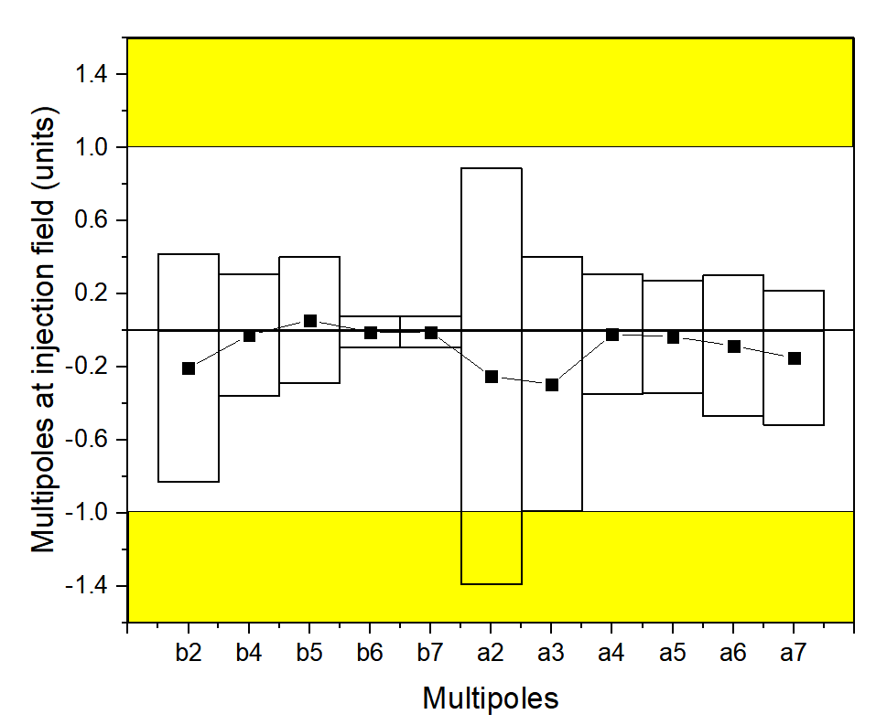
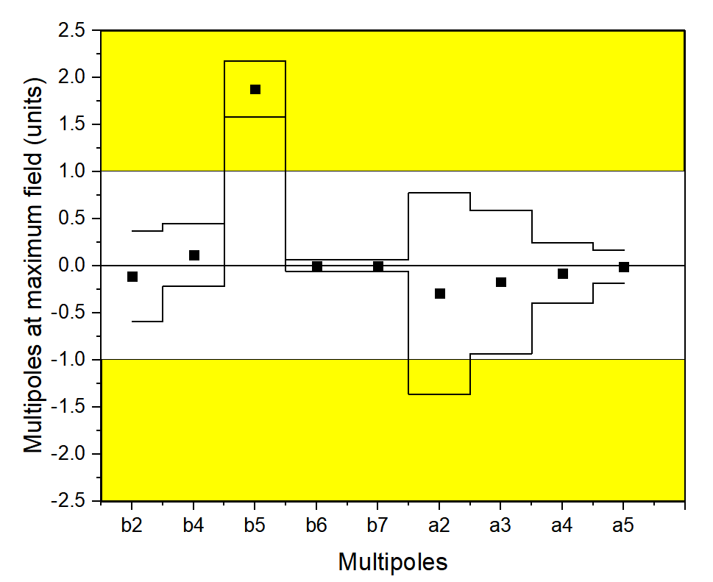
Dipoles
Magnetic measurements’ results for Booster magnets
@ Injection field 0.117 T --- 625 А
an, bn
@ Maximal field 1.8 T --- 9745 А

Slide 24
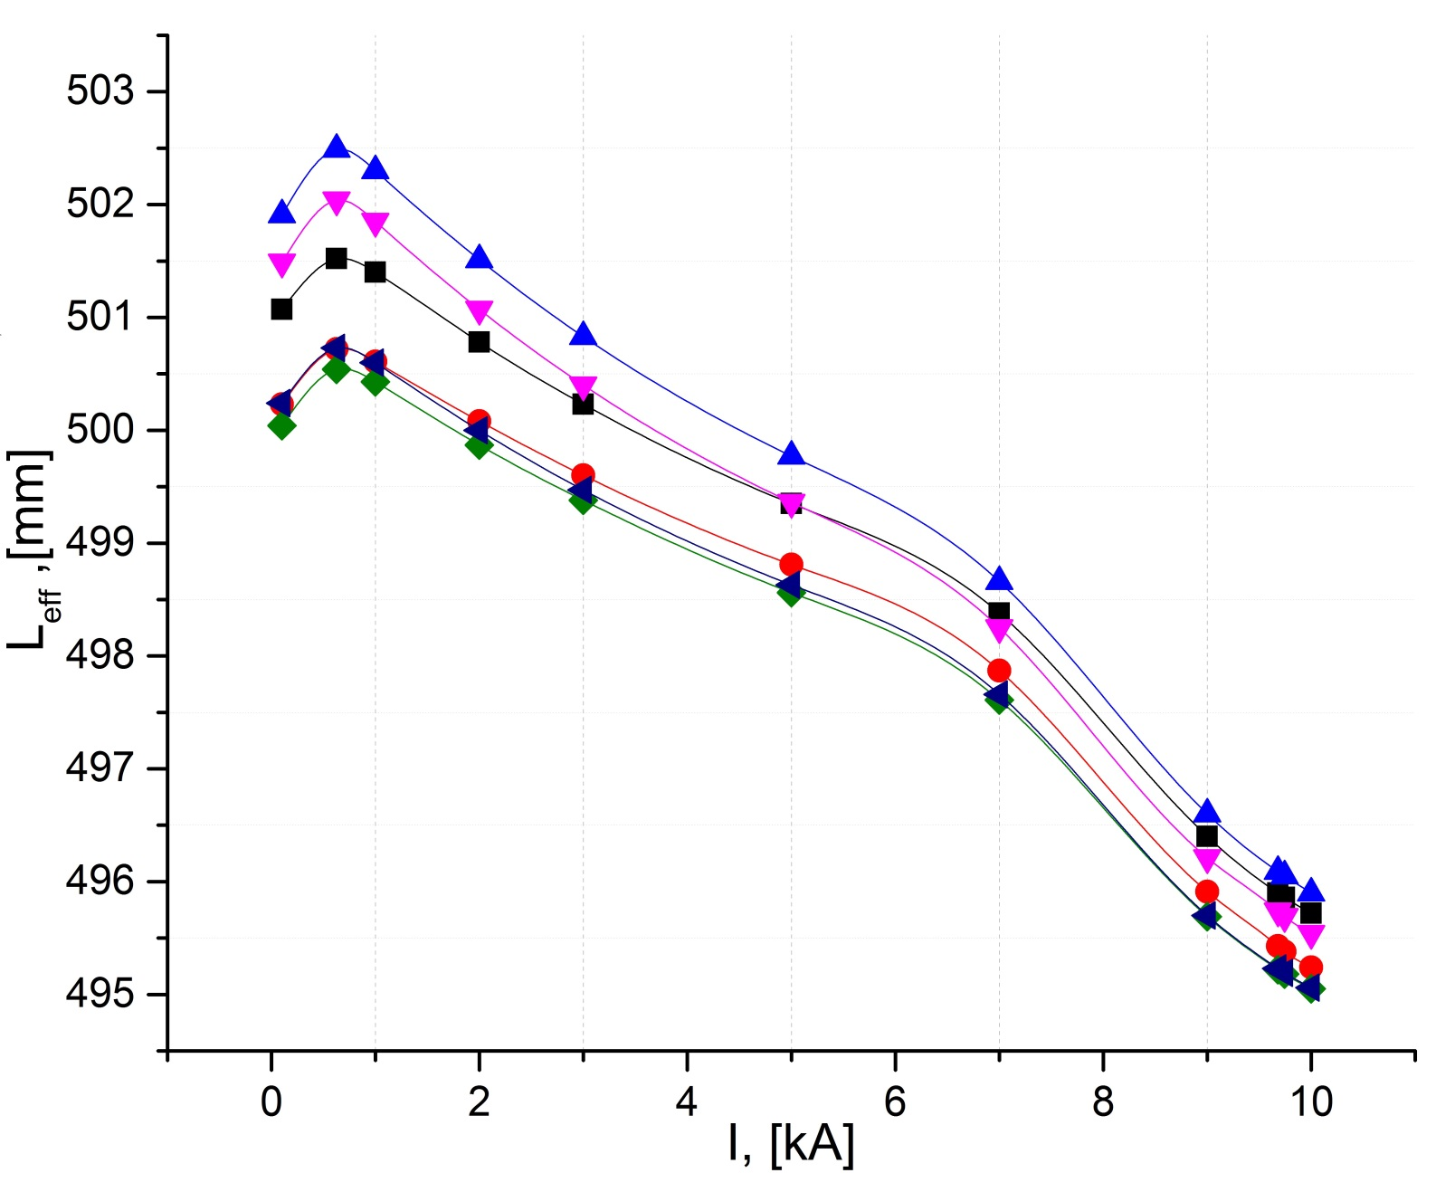
Quadrupoles
Magnetic measurements’ results for Booster magnets
Leff
Результат | 17*10Е-4
Допуск | 5*10Е-4
0,84 [mm]

Slide 25
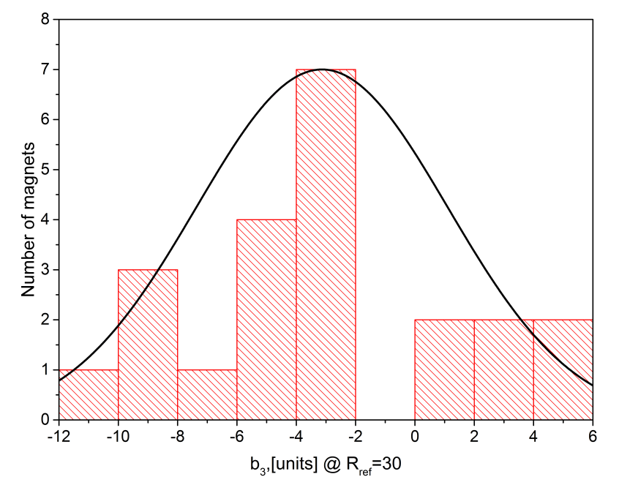
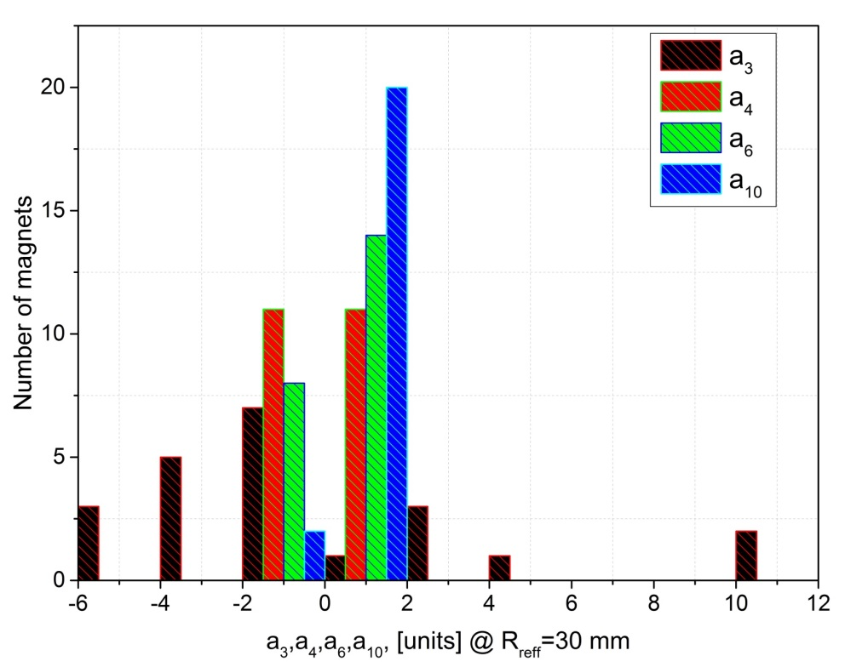
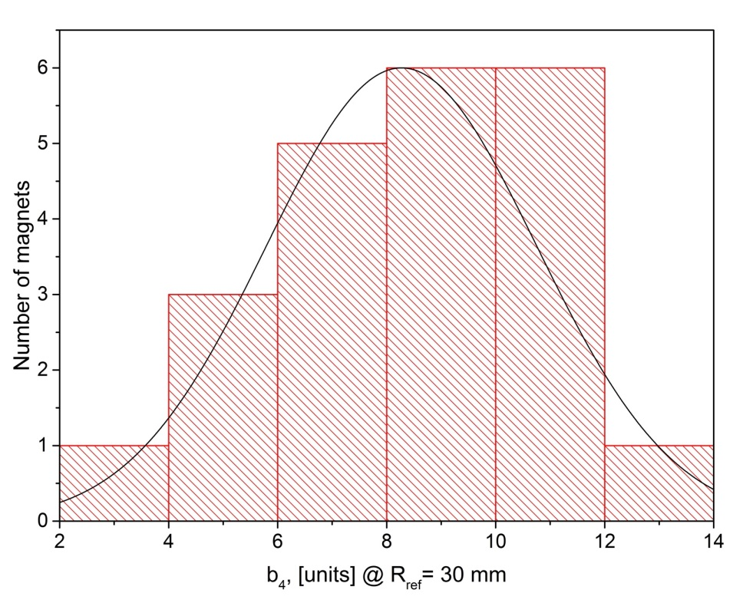
Magnetic measurements’ results for Booster magnets
b3
Quadrupoles
b4
an, bn

Slide 26
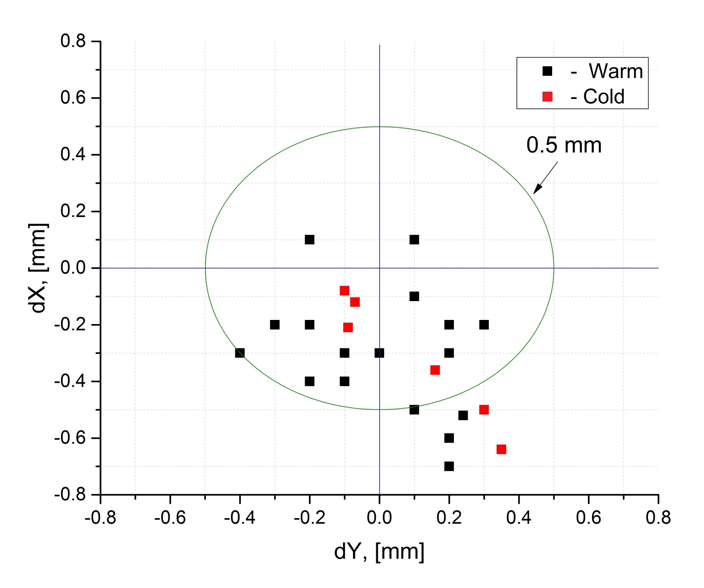
Magnetic axis position
Magnetic measurements’ results for Booster magnets

Slide 27
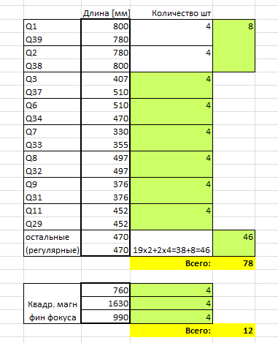
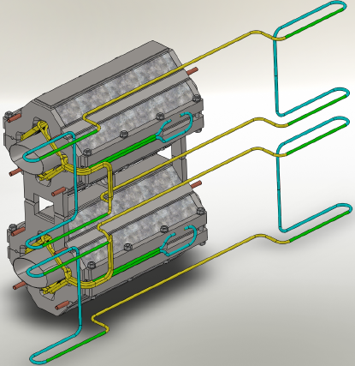
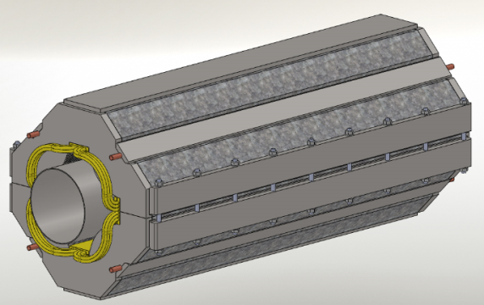
Set of collider’s quads for production

Slide 28
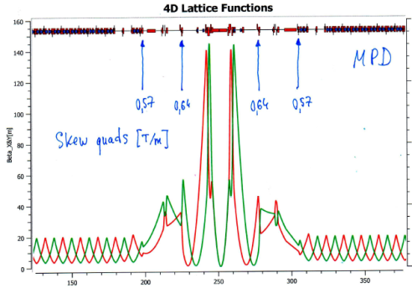
Correction magnets setup
Chromaticity correction
X-Y coupling correction
Fringe fields correction
sF1=43 T/m^2
sD1=173 T/m^2
sF2=43 T/m^2
sD2=173 T/m^2
oF1=150 T/m^3
oF2=60 T/m^2
oF1=150 T/m^3
oF2=60 T/m^2
[T/m]: -2.48
0.18
0.57
0.64
9.44
9.44
sF1=48 T/m^2
sD1=185 T/m^2
sF2=48 T/m^2
sD2=185 T/m^2
[T/m]: -2.51
0.26
0.59
0.61
oF1=150 T/m^3
oF2=60 T/m^2
oF1=150 T/m^3
oF2=60 T/m^2
Orbit correction
9.10
9.10
+
Bx=0.15 T
By=0.15 T

Slide 29
Correction magnets setup

Slide 30
Correction magnets setup
MC in Arcs
MC in Straight sections
Спасибо!

Slide 31
9.10 9.44
Ring tune

