Slide 1
Radiation Monitoring of the GEM Muon Detectors at CMS
L. Dimitrov, P. Iaydjiev, G. Mitev, I. Vankov
Institute for Nuclear Research and Nuclear Energy, BAS, Sofia

Slide 2
Introduction
The higher energy and luminosity of future High Luminosity (HL) LHC, determines a significant increasing of the radiation background around the CMS subdetectors, and especially in the higher pseudorapidity region. Under such heavy conditions, the RPC (used in muon trigger) most probably could not operate effectively. A possible better solution is the so-called GEM (Gas Electron Multiplier) detector, whose tests at the CMS will be started in near future.
The CMS program foresees to equip each of the presently vacant insertion slots in inner endcap stations (1,6 < η < 2,1) with 36 so-called GEM super chambers (two chambers, mounted face-to-face at distance of 20 mm): the installation in the first of them (labeled GE1/1) will be during the second LHC Long Shutdown in 2017–2018 and in the second one (labeled GE2/1) – during the third LHC Long Shutdown scheduled beyond 2020. For a first test only 4 super chambers will be installed in GE 1/1 station during the 2016-2017 LHC Year-end Technical Stop.
A control system for quantitative measurement of the dose, deposited in the GEMs during their operation at CMS, is developed and will be described in this talk.

Slide 3
Locations for the GEM detectors
η
θ°
0.1
84.3°
0.2
78.6°
0.3
73.1°
0.4
67.7°
0.5
62.5°
0.6
57.5°
0.7
52.8°
0.8
48.4°
0.9
44.3°
1.0
40.4°
1.1
36.8°
8
η θ° 1.2 33.5°
R (m)
DTs CSCs RPCs GEMs
7
MB4
RB4
1.3 30.5°
Wheel 0
Wheel 1
Wheel 2
RE1/3
MB3
ME1/3
1.4 27.7°
6
RB3
RE2/3
RE3/3
RE4/3
ME2/2
ME3/2
ME4/2
1.5 25.2°
5
MB2
RB2
1.6 22.8°
RE2/2
RE3/2
RE4/2
1.7 20.7°
1.8 18.8°
1.9 17.0°
2.0 15.4°
2.1 14.0°
2.2 12.6°
2.3 11.5°
2.4 10.4°
2.5 9.4°
MB1
RB1
4
ME1/2
Solenoid magnet
RE1/2
3
ME2/1
ME3/1
ME4/1
GE2/1
2
HCAL
GE1/1
ME1/1
ECAL
Steel
1
3.0 5.7°
Silicon
tracker
4.0 2.1°
5.0 0.77°
z (m)
0
0
1
2
3
4
5
6
7
8
9
10
11
12
Fig 1. Transverse section of the CMS detector showing the present muon system including RPCs, DTs and CSCs. The proposed locations for the GEM detectors in the two inner endcap stations are indicated by the red boxes.

Slide 4
Sensors 1
RADMON is a universal dosimetry device, developed and produced at CERN TS-LEA department [1,2]. Different combinations of semiconductor radiation sensors can be installed in it.
The aims are to measure, during operation, the Total Ionizing Dose (TID) and the 1MeV equivalent particle fluence ( ᶲeq) . TID measurements are performed with Radiation-sensing Field Effect Transistors (RadFETs). The recorded signal from these devices is the shift of the transistor threshold voltage (Vth) obtained at constant readout current. The Vth is converted to Dose (Gy) following a power-law calibration curve ( Vth = a × Dose^{b}). The coefficients a and b have to be determined during a calibration run under the same conditions as the measurement runs. The RadFET sensors for the LHC experiments at CERN are of two types: Thick-Oxide RadFETs (manufactured by CNRS-LAAS, France): — Range up to 10 Gy (1.6 µm gate oxide thickness) — Readout current of 100 µA injected over 1 s; — Accuracy of ± 10%. Thin-Oxide RadFETs (produced by REM, UK): — Range up to 20 kGy (0.25 µm) and 200 kGy (0.13 mm); — Readout current of 160 µA injected over 5 s; — Accuracy of ± 10%

Slide 5
Sensors 2
ᶲeq measurements are performed with forward biased p-i-n diodes . The recorded signal from these devices is the shift of the diode forward voltage (V_{F}) readout under pulsed current injection. The V_{F} is converted to equivalent particle fluence (cm⁻²) following a linear relationship. The dose output signal is received measuring the diode’s voltage V_{D} when forcing a constant bias current pulse in forward direction The p-i-n diodes specified for the LHC experiments at CERN are of two types: High-Sensitivity Silicon Diode (manufactured by CMRP, Australia): — Range up to 2×10¹² cm⁻² ( V < 10 V); — Sensitivity of 1.7×10⁸ cm²/mV; — Readout current of 1 mA injected over 50 ms; — Initial Vth ~ 3.5 V; — Accuracy of ± 10%. BPW34F Silicon Diode (manufactured by OSRAM, Germany): — Range from 2×10¹² cm⁻² to 2×1014 cm⁻² at V = 25 V; — Sensitivity of 9.1×10⁹ cm²/mV; — Readout current of 1 mA injected over 50 ms; — Initial Vth ~ 0.5 V; — Accuracy of ± 20% For our purpose, we like to use the usual configuration of two RadFETs and two p-i-n diodes.

Slide 6
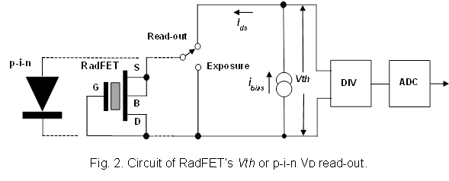
Sensors 3
The dose value is received measuring the RadFET’s Vth or p-i-n diode’s VD when forcing a constant bias current pulse, using the circuit of fig. 2. In both cases, the accumulated dose corresponds to the difference between the final and initial value of the voltages (ΔVth or Δ VD).

Slide 7
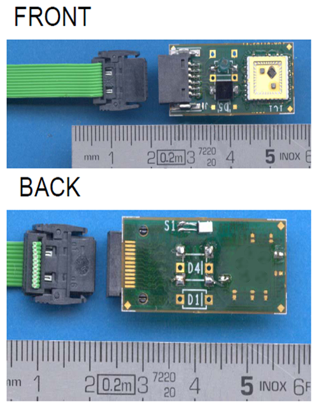
Radmon
To allow easy handling and to provide a standard connectivity for all sensors, the PH/DT2 group at CERN
designed and produced an integrated sensors carrier (fig. 3) to host the above mentioned sensors. This carrier is made of a thin (~500 µm) double-sided PCB.
A thermistor is also installed on this RADMON PCB because the both reading-out voltages (Vth and VD) are dependent on the temperature. The thermistor’s resistance is measured in the same manner as the sensor’s voltages and the read-out temperature can be used for data correction to increase the accuracy.
Fig 3. RADMON view

Slide 8
Block diagram
The Main Controller unit is managed by a microcontroller – PIC24HJ64GP504 and contains three RADMON nodes. Up to four RADMONs can be connected to one node (through a passive splitter).
5 V
MAIN CONTROLLER
S
P
L
I
T
T
E
R
6
RADMON 1
DC-DC
36 V
RADMON NODE 1
6
24
RADMON 2
DAC
U_curr_set
6
RADMON 3
6
RADMON 4
SPI
PIC 24HJ64 GP504
ADC IN
ADR
BUS
7
RADMON NODE 2
S
P
L
I
T
T
E
R
6
RADMON 5
CANBUS
6
24
RADMON 6
M
U
X
6
RS 485
RADMON 7
6
RADMON 8
S
P
L
I
T
T
E
R
6
RADMON 9
RADMON NODE 3
6
24
RADMON 10
6
RADMON 11
6
RADMON 12
Fig 4. Block diagram of the RADMON Control and Read-out System

Slide 9
RADMON node
U_curr_set
RADMON NODE
36 V
HSCS*
HV
RADMON 1
V/I*
RadFET 1
D
E
C
O
D
E
R
Address
on/off
V/I
RadFET 2
on/off
V/I
Pin Diode 1
on/off
V/I
Pin Diode 2
on/off
2.5V
V/I
Rt⁰
on/off
t°
RADMON 2
RADMON 3
ADR
BUS
RADMON 4
Address
RADMON NODE MULTIPLEXER
*HSCS - high side current sensor
*V/I - voltage to current converter
to MUX
Fig. 5. Block Diagram of one RADMON node

Slide 10
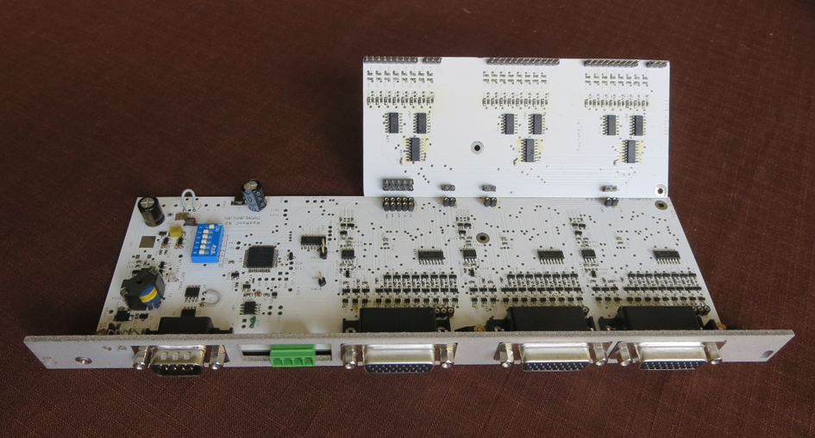
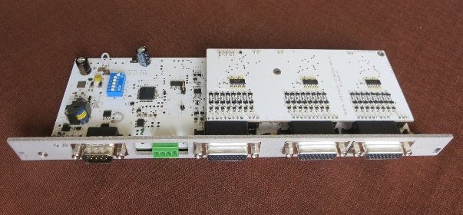
Boards
Fig. 6. Mechanical design of the RADMON control and read-out system
Front panel dimensions are 6U x 4HP (266.7 x 20.32 mm²)

Slide 11
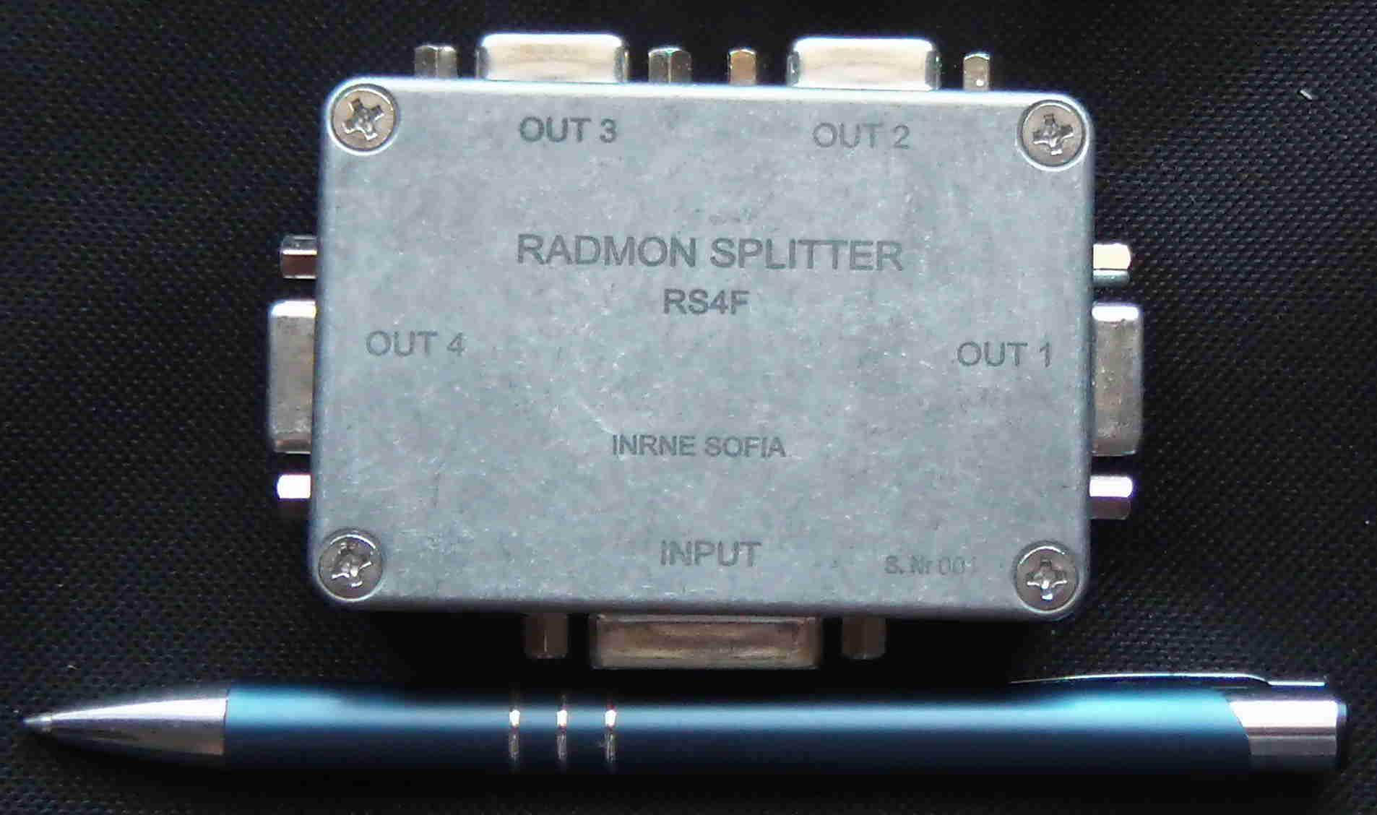
Splitter
Fig. 7. Splitter
According to recently requirements all splitters will be replaced by patch panel in final design.

Slide 12
Conclusions
A universal system for irradiation control is designed and built. First intended for radiation dose of the CMS muon GEM detectors measuring, it can be used for photon and particle radiation control at different places and objects of interest.

