Slide 1

Simulation concept of
NICA-MPD-SPD Tier0-Tier1 computing facilities
XXV Symposium on Nuclear Electronics and Computing - NEC'2015
Montenegro, Budva, Becici, 28 September – 02 October, 2015
V. Korenkov, A. Nechaevskiy, G.Ososkov, D. Pryahina, V. Trofimov, A.Uzhinskiy
LIT JINR
ososkov@jinr.ru
Supported by RFBR № 14-07-00215

Slide 2
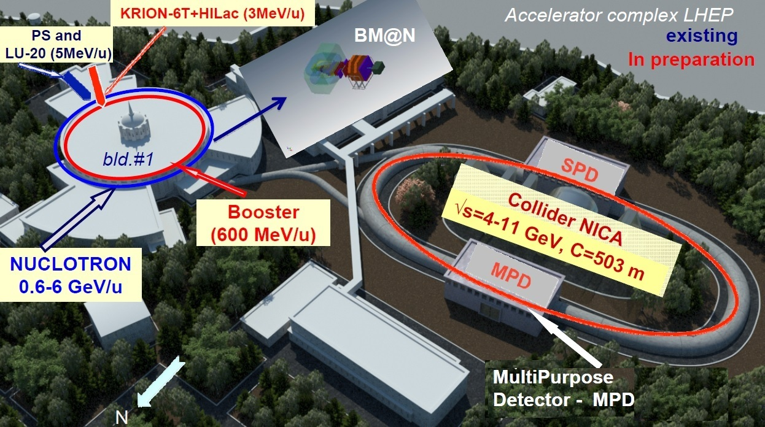
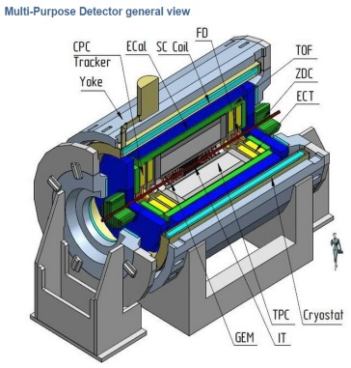
NICA-MPD-SPD
General view of the NICA complex with the collider
experiment MPD and experiments MPD, SPD, BM@N

Slide 3
New computing challenges for Big Data scale
Potentially new physics is expected at the LHC 2nd run and the new JINR NICA megaproject
Working at TB scale the MPD-SPD experiments will face with great challenges in distributed computing:
large increase of CPU and network resources;
combined grid and cloud access;
Intelligent dynamic data placement
distributed parallel computing;
renewal most of simulation and analysis software codes.
These problems are inherent to such the JINR projects as the running Tier 1 for CMS and the planning Tier 0/1 for NICA
Currying out such unique projects supposes great efforts for the design and development of sophisticate grid-cloud systems intended to store, distribute, and process super-big volumes of experimental data
2

Slide 4
Simulation of grid-cloud systems
Substantial optimality study is needed to avoid possible and quite expensive mistakes on design and development stages of any grid-cloud system
The study of grid-cloud system optimality is based on the optimality criterion which minimizes the equipment set (cost) under unconditional fulfilment of SLA (Service Level Agreement)
Such studies can be efficient when it is based on scrupulous simulations of
computing resources (number of compute nodes, the architecture of a computer system, installed software, CPU consumption)
Data flow
Job stream with knowledge of
Job types (simulation, analysis, reconstruction)
Statistical information about distribution of their arrival and execution times
Efficient simulation of grid-cloud systems should take into account the functioning quality of this system to evaluate its performance and to forecast its future taking into account dynamics of its evolution.
3

Slide 5
Basic simulation concepts
The best way to evaluate dynamically the system functioning quality is using its monitoring tools
The simulation program is to be combined with real monitoring system of the grid/cloud service through a special database (SDB)
To ensure a developer from writing the simulation program from zero on each development stage it is more feasible to accept a twofold model structure, when it consists from
a core – its stable main part independent on simulated object and
a declarative module for input of model parameters defining a concrete distributed computing center, - its setup and parameters obtained from monitoring information, as dataflow, job stream, etc
SDB intention is just to realize this declarative module work and provide means for output of simulation results
Web-portal is needed to communicate with SDB assigning concrete simulation parameters and storing results in SDB

Slide 6
What simulations should give us on the design stage of a grid-cloud system
Evaluate grid-cloud system performance and reserves under various changes:
Different workloads
System configuration
Different scheduling heuristics
Hardware malfunctions
Balance the equipment needed for data transfers and storage by minimizing cost, malfunction risk and execution time;
Optimize resource distribution between user groups;
Predict and prevent a number of unexpected situations
Test the system functioning to find bottlenecks.
5

Slide 7
How it was realized
Our team has already the experience with simulation grid structures inspired by GridSim library (http://www.buyya.com/gridsim) and job scheduler ALEA (http://www.fi.muni.cz/~xklusac/alea).
The new simulation program called SyMSim (Synthesis of Monitoring and SIMulation) was developed according to the above basic concepts and succesfully tested for the JINR CMS Tier 1 center with robotized tape library.
To accomplish that
New classes are invented to declare the data store specific for the tape robot library;
Input job stream is formed via data base;
Data exchange process is modified from packet flow simulation into file transfer simulation;
Software means for handling simulation results are provided.

Slide 8
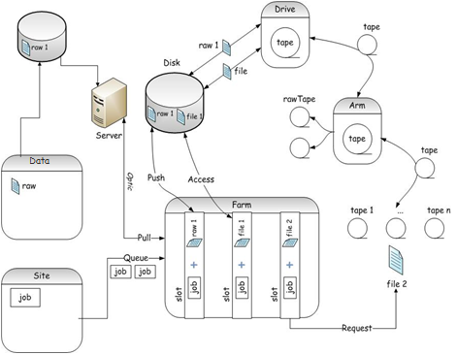
Tier1 Dataflow simulation
The problem is to simulate a data storage system with robotized tape library, where RAW data are to be transferred from disks of a great HEP experiment. In reality we were charged to design such data storages for the CMS Tier 1 at JINR.
ss
How it works on T1 site:
From disk to tape:
- If slot and file are available,
job is executed at the farm;
From tape to disk:
- If file stored in tape library.
job reserves a slot, but is waiting
for necessary file on the disk:
the robot moves tape cartridge to the drive, cartridge's file system mounting to the drive, file is copied to the disk.
JINR T1
Site Т0
at CERN
Scheme of the job and data flow at JINR Т1

Slide 9
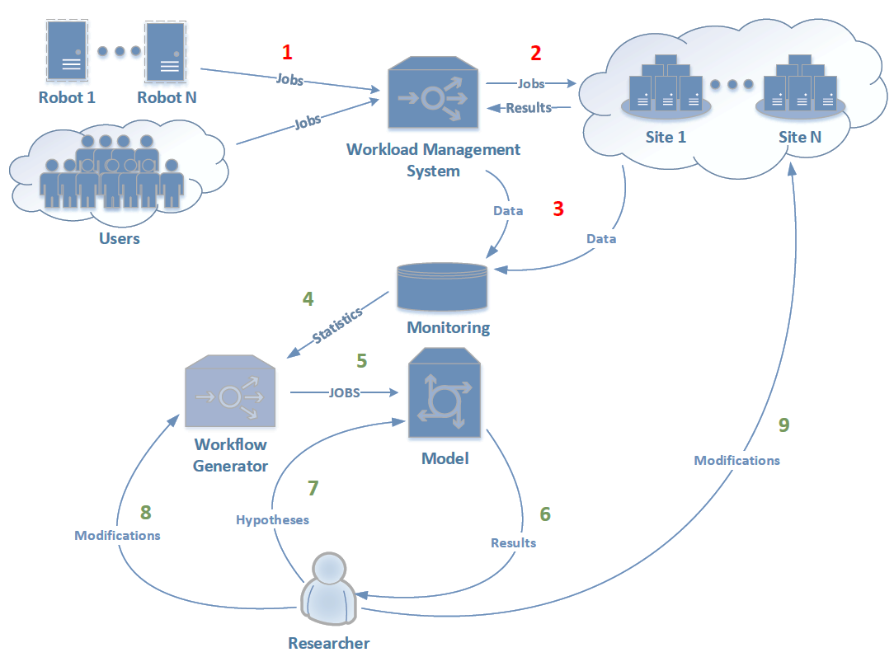
SyMSim working scheme for the CMS Tier 1 at JINR
Real Grid/Cloud
1. Jobs are submitted to the Workload Management System from different sources
2. Jobs are submitted to the Sites
3. Information about execution and queues are passed to the monitoring system
Simulation
4. Statistics data accumulated from T1 are used to generate simulation workflow
5. Simulated Job stream is submitted to the model
6. Researcher gets results from model and analyzes them
7. Researcher modifies the workflow parameters
8. Researcher initializes procedure of the site configuration changes
9. New simulation cycle starts
SyMSim working scheme for the CMS Tier 1 at JINR
with robotized tape library

Slide 10
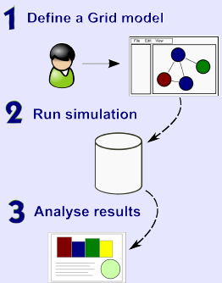
Our simplifications
Hardware of T1 computing center is fail-proof
Each job is used the only file
Raw files are removed from disks after writing on tape
FIFO queue to execute
There is not yet multi-threading
Job stream is stationary
Sequence of computing experiment
Specify the model parameters -
the number of jobs and their arrival rate
Load the description of hardware architecture
Generate dataflow and workflow
Run simulation
Analyse results
9

Slide 11
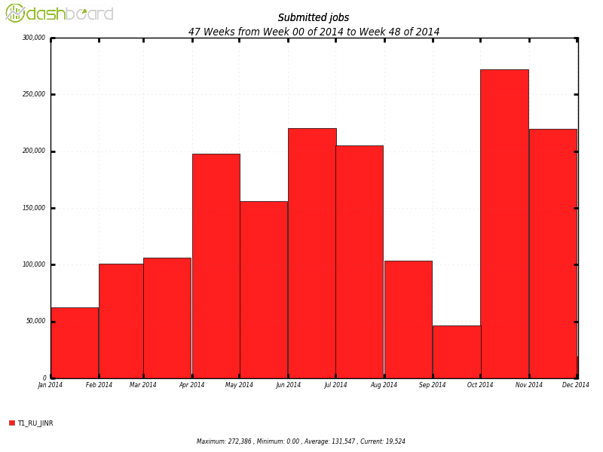
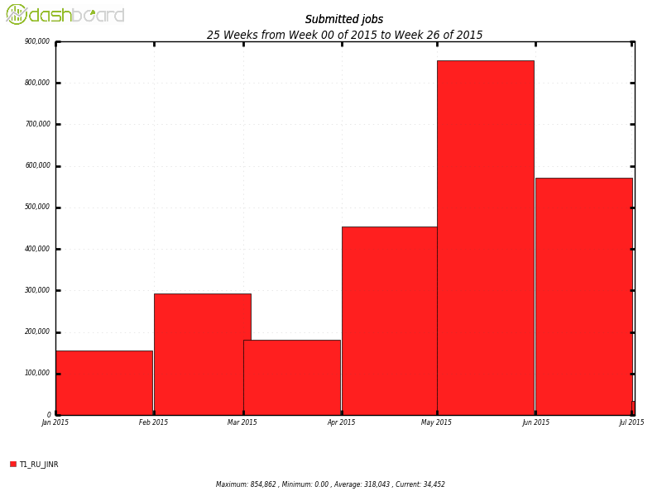

JINR Tier 1 statistics obtained from monitoring
CPU - 2400
Disks - 2400 TB these parameters from real T1 were set to the model
Tapes - 5 PB
Statistics was taken from
~ 2 mil. Submitted Jobs (2014) ~ 3 mil. Submitted Jobs (6 month of 2015)
Notes:
10

Slide 12
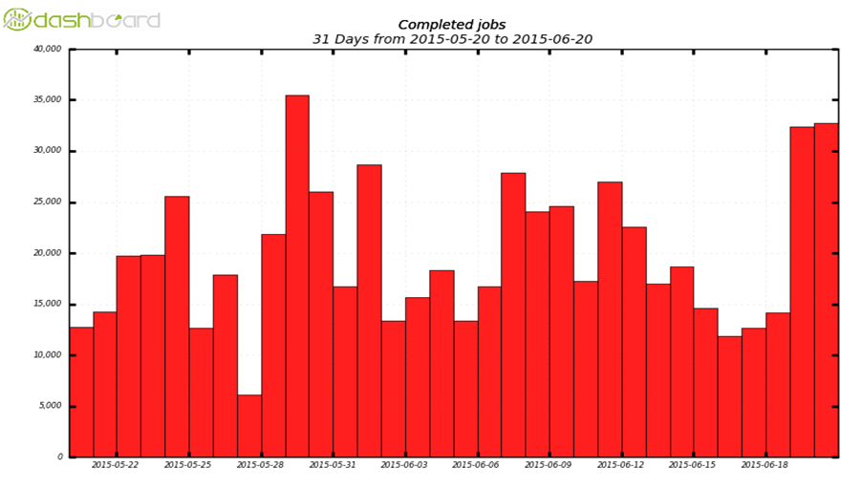
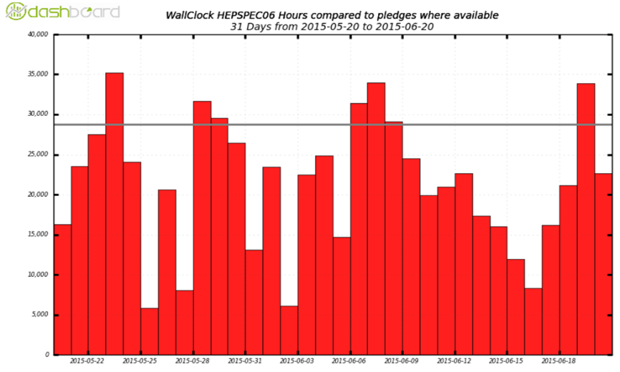
Examples of Real and Generated Workflow
Completed jobs (simulated)
Completed jobs (real)
X = 24000 S = 6100
WallClock HEPSPEC06 (simulated)
X = 19700 S = 6700
WallClock HEPSPEC06 (real)
X = 22000 S = 6400
X = 21300 S = 8100
These two examples among some others were used for the positive validation of the running CMS T1 model and encouraged us to simulate the more sophisticate and planning yet the T0/T1 system of NICA project.

Slide 13
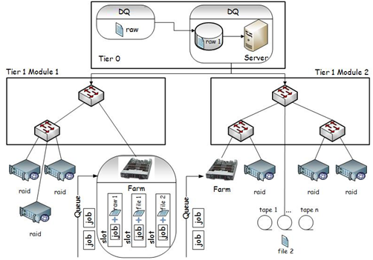
Simulation evolution: from CMS Tier1 to NICA Tier0-Tier1
Tier 0 module denotes the center of data gathering from the experiment (either MPD or SPD). Obtained raw data are to be stored on disks. One of planned problems is to recommend the volume of the disk store and a temp of data transfer to the robotized library which is the part of Tier 1 center. This two-level structure is interconnected by a local area network
DQ on this scheme denotes not only DAQ of the corresponding experiment, but includes also the means of communications and buffer cleaning. (AN).
Data storage and processing scheme of Tier0-Tier1 level
Initial information to start simulation are parameters of
setup of
designed hardware
data flow,
job stream
their characteristics are taken from
Real data of CMS Tier1 monitoring and TDR DAQ МPD

Slide 14
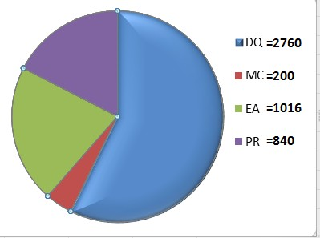
Simulation of T0/T1 1
Reminder: The simulation program is to be combined with a real monitoring system through a special database (SDB), which intention is just to input of model parameters and output of simulation results
Web-portal is needed to communicate with SDB assigning concrete simulation parameters and storing results in SDB
Database design
Database contains the description of the grid structure, each of its nodes, links between nodes, running jobs information, execution time, the monitoring results of the various subsystems of the grid and the simulation results.
Details are expounded in Dasha
Pryahina talk on Student School
Database main tables
Experiments —contains information about the experiments;
Simulation_Parameters — describes starts (runs) simulation program;
Configurations — contains a description of the simulation configuration;
Jobswaiting — contains a description of a job flow (the model of input data);
Results — program results.
Four types of jobs are generated
Data acquisition (DQ) – simulated “raw” data to be stored
Monte-Carlo (MC) – do not need input data
Express analysis (EA) – jobs use recently obtained files
Reconstruction processing (PR) – jobs consume the most
of resources

Slide 15
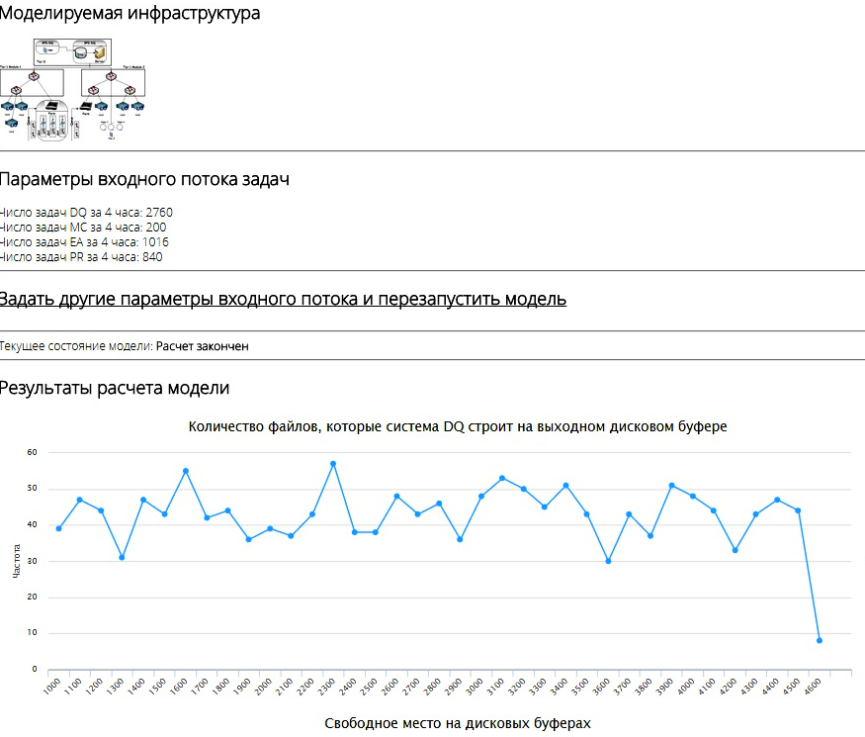
Simulation of T0/T1 2
Web-portal functions
Interaction with the database.
Present current model structure and generated workflow description.
Set new workflow with different parameters (number of DQ, MC, EA, PR jobs) generation.
Simulation results representation (graphics, diagrams).
Snapshot of SyMSim web-portalt
Simulation algorithm is designed that at the initial time all buffers are empty, the processor is not loaded and data are not transferred. Therefore the initial transition process must be excluded from the analysis. It also happens when the current job flow stops.
The result of the simulation program is a sequence of records in the database, which reflects all the events occurring at the system.

Slide 16
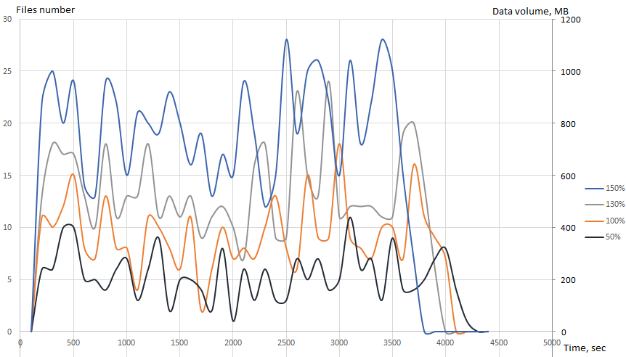
Examples of simulation results 1
Example 1
Estimated rate of NICA-MPD project experimental data to be transferred to Tier 1 data center is about 24 PB by one month of the MPD detector work
Simulation result shows what happened in the grid/cloud system if the data volumes are grow up to 1,5 times for example. This simulation result allows one to understand how the intensity of the input stream determines the reserves of the system capacity
Fig.1 Number of DAQ data files stored on output disk buffer for growing data volumes

Slide 17
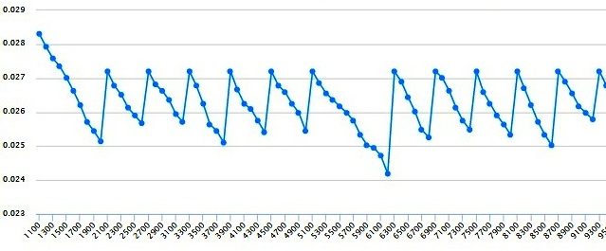
Examples of simulation results 2
Example 2
What buffer size is needed to store input files on tapes
without losses
Zigzag shape of
this curve is due to
regular buffer cleaning. The sharp slump in the middle is caused by end-of-tape delay
TB
t=system time
Fig.2. Disk available space (in terabytes)
Results in fig.1-2 show that due to clever buffer cleaning the buffer should not be too big, so we can place it in RAM operational memory

Slide 18
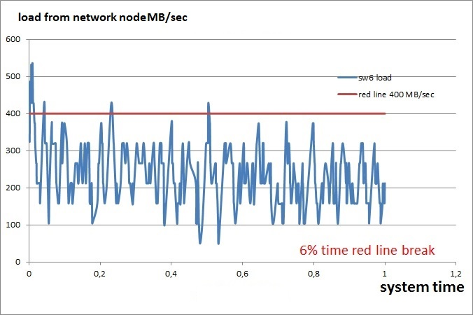
Examples of simulation results 3
Example 3
Probability of the system overloading due to disk space lack
Fig.3. the load in MB/sec from one of network nodes to a disk
17

Slide 19
Conclusions
The program SyMSim for simulation of grid-cloud structures is developed and tested on a simplified model of JINR Tier1 site.
The originality of proposed simulation approach consists in combining a simulation program with a real monitoring system of the grid/cloud service through a special database in frame of the same program.
The next simulation was accomplished for T0/T1 computing facilities of JINR NICA MPD-SPD project. It confirms good potential of our simulation approach, but also showed some of its incompletenesses needed to be retreated.
SyMSim structure is sufficiently general and flexible to allow to replace our present simplifications into more real conditions in future developments.
It can also be used to solve design problems and the subsequent development of data repositories, not limited to the physical experiments area.

Slide 20
Some references
Synthesis of the simulation and monitoring processes for the development of big data storage and processing facilities in physical experiments // Computer Research and Modeling, T7, №3, 2015
Grid and cloud services simulation as an important step of their development // Systems and Means of Informatics, Volume 25, Issue 1, 2015
Site: symsim.jinr.ru
E-mail: symsim@jinr.ru
19

Slide 21
Thank you for the attention!
symsim.jinr.ru symsim@jinr.ru
20
Notes:
20

