Slide 1
Web-Based Builder of Digital Educational Resources
Ksenia Klygina et al.
NEC’ 2015

Slide 2
The goal of the web-based builder of digital educational resources is to provide educators with resources which allow to solve a wide range of science educational tasks by the complex use of an unique library of media resources and a set of web-services.
The library of media resources consists of more than 5000 high quality unique media objects related to school Biology. It includes pictures and photos, videos and animations, 3D models, interactive models and interactive schemes, quizzes and virtual laboratory works.
The library is provided with a web-based services for creating your own media resources: presentations and quizzes.
Notes:
The idea of this project appeared in discussions with school teachers and other educators. And we understood one thing. If a teacher wants quickly make a good presentation of his lesson by using pictures, animations, interactive models, quizzes etc. he faces the problem. He gets 2 difficult moments. One is that he doesn’t know how to include in his presentation such media objects as videos, animation, interactive models and virtual laboratory demonstrations. The other thing is to find high quality methodologically arranged educational resources.
The goal of our project to provide educators with resources which allow to solve a wide range of science educational tasks by the complex use of an unique library of media resources and a set of web-services.

Slide 3
The library of the web-based builder includes the following types of media resources:
pictures and photos
videos
animations
interactive 2D and 3D models
interactive tables and schemes
quizzes
virtual laboratory works

Slide 4
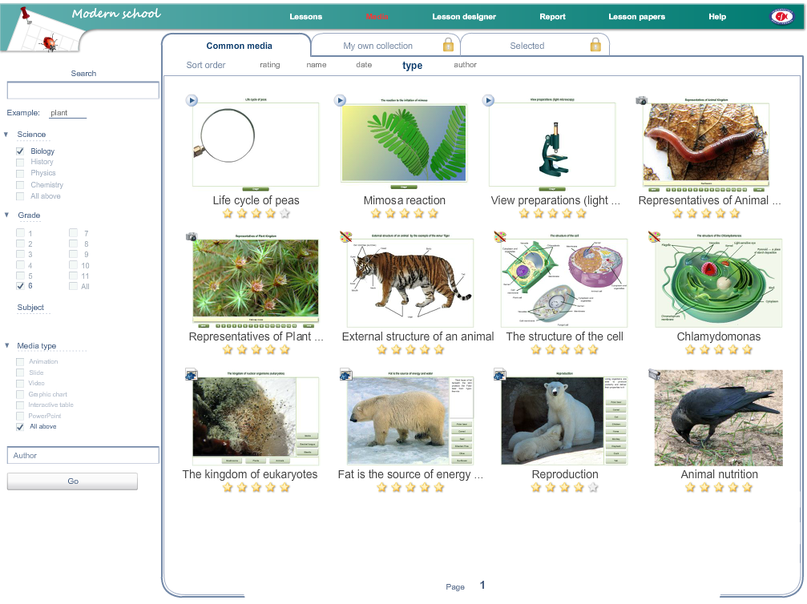
Library of digital educational resources
Notes:
Here you can see the general look of the library of digital educational resources. Here you can see and choose for your use the resources by the use of different sorting filters. You can sort the list of resources by subject, school grade, media type, or find the object by typing a search word. All materials also have their ratings, so you can see what resources are more popular among other users.

Slide 5
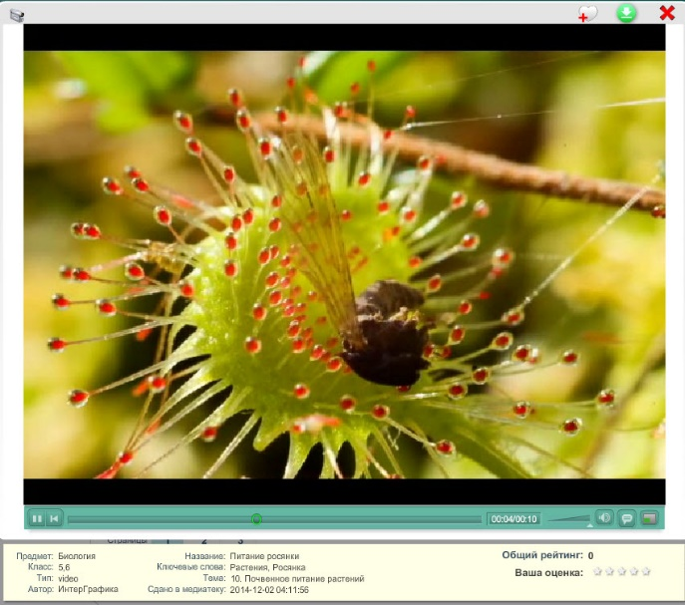
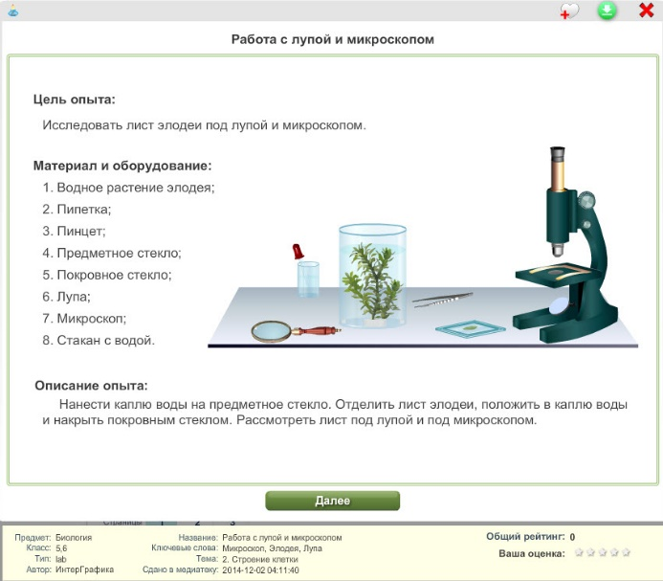
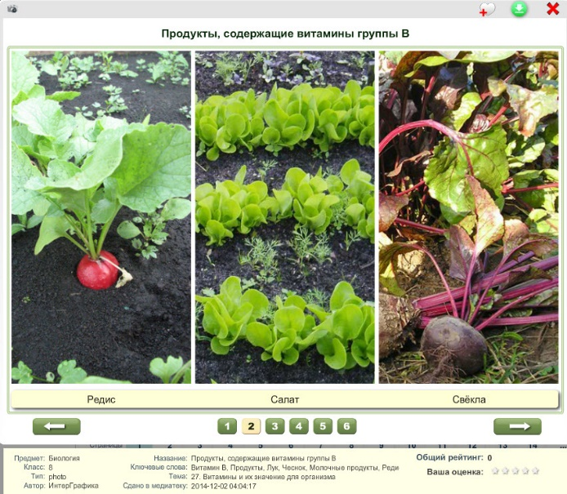
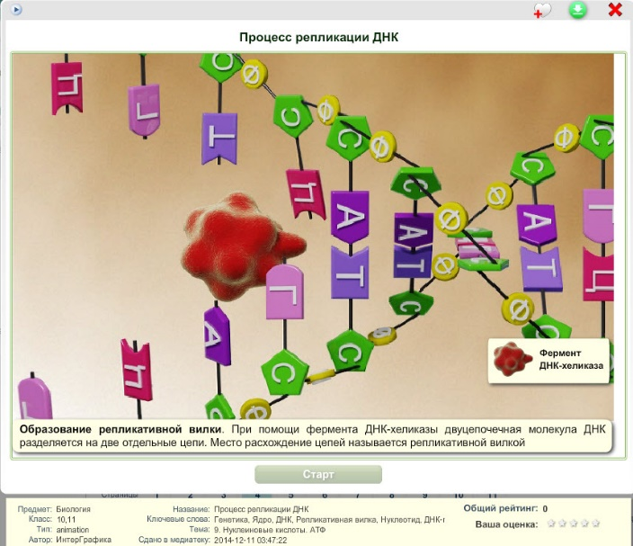
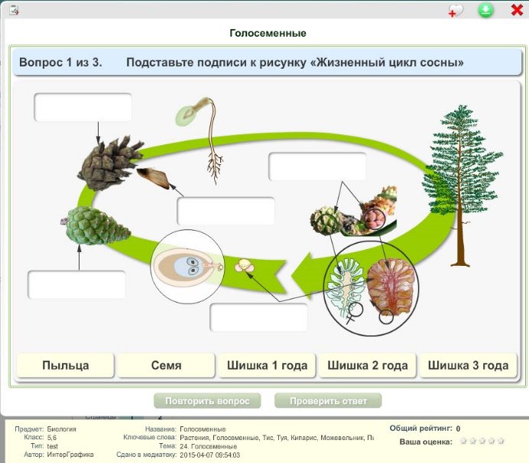
Examples of media resources
Video
Photo slides
Virtual
lab
3D animation
Quiz
Notes:
Here you can see examples of some media resources. Here you can see a video with sundew eating its victim. Each video is supplied with the built-in video player. The next picture illustrates a virtual laboratory work, where in interactive mode you can manipulate with the laboratory equipment and get some practical experience. Here you can see photo slides which are arranged in the logical blocks on the studied theme. I also would like to note that all photo materials were taken by our employers. You also can see here an example of 3D animation of DNA replication. An the quiz where you need to arrange all stages of pine tree development in the proper way.

Slide 6
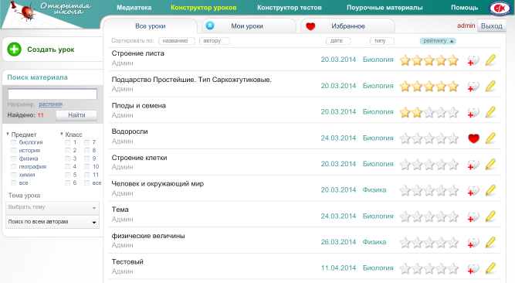
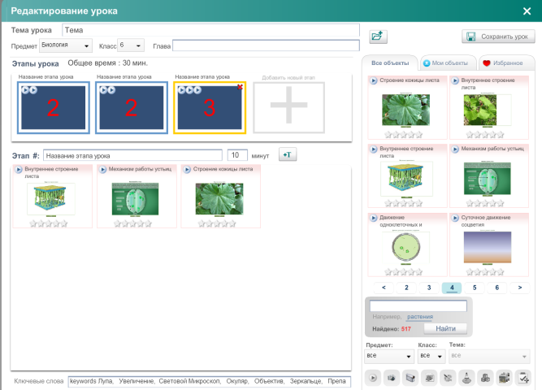
Web-service “Presentation builder”

Slide 7
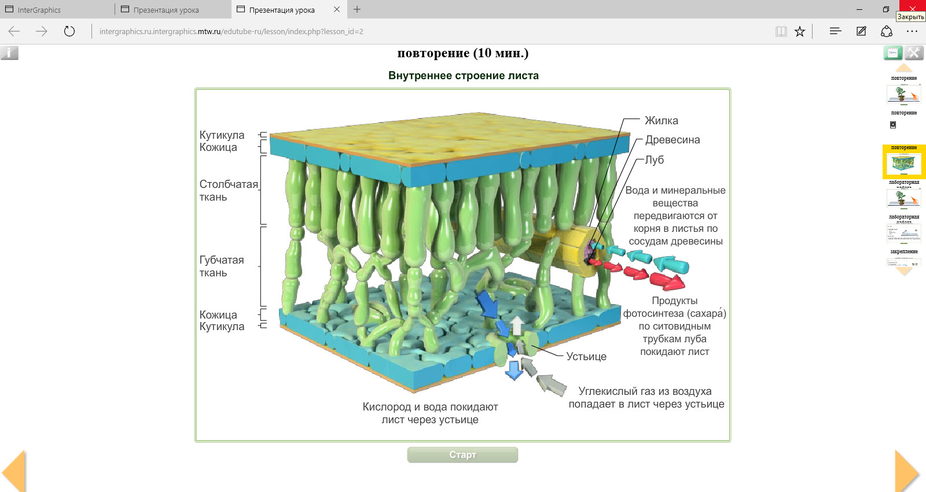
Web-service “Presentation builder”
Notes:
Here you can see ready presentation which has 2 level navigation system. One let you to follow your presentation page by page as in the power point environment. The other level of navigation allow you to see snapshots of resources inside the presentation and choose the one you need. I also would like to note, that all interactive materials keep all their interactive tools.

Slide 8
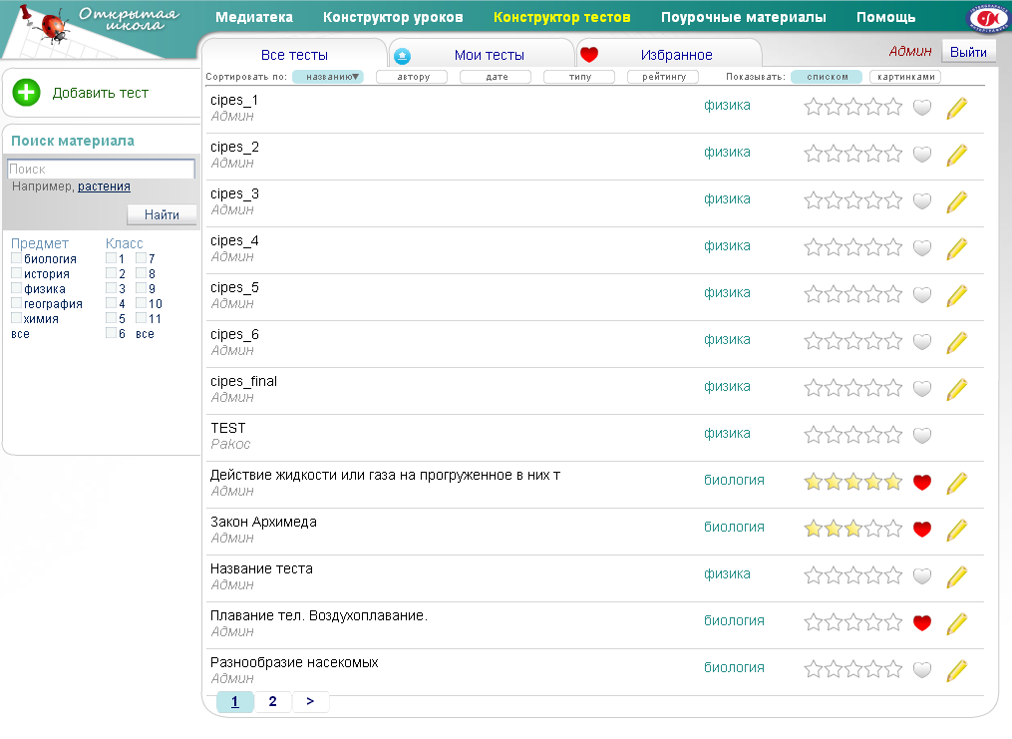
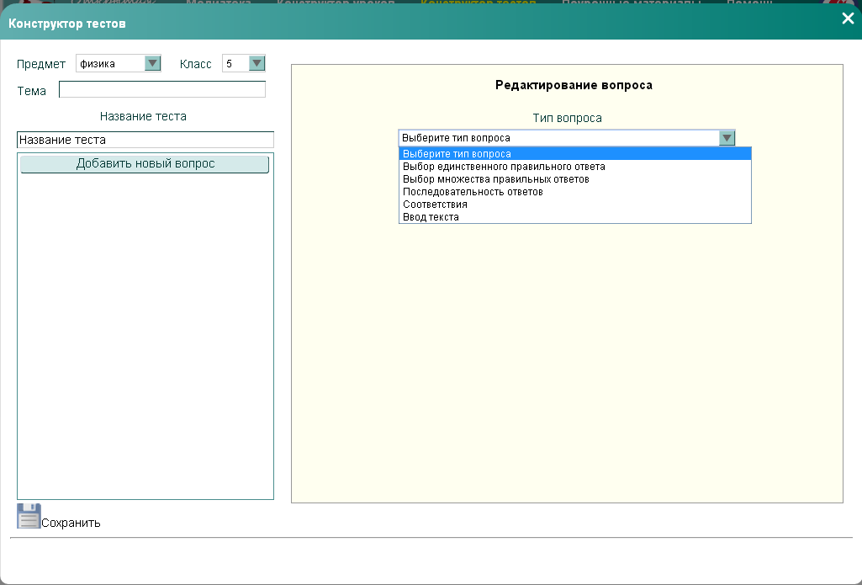
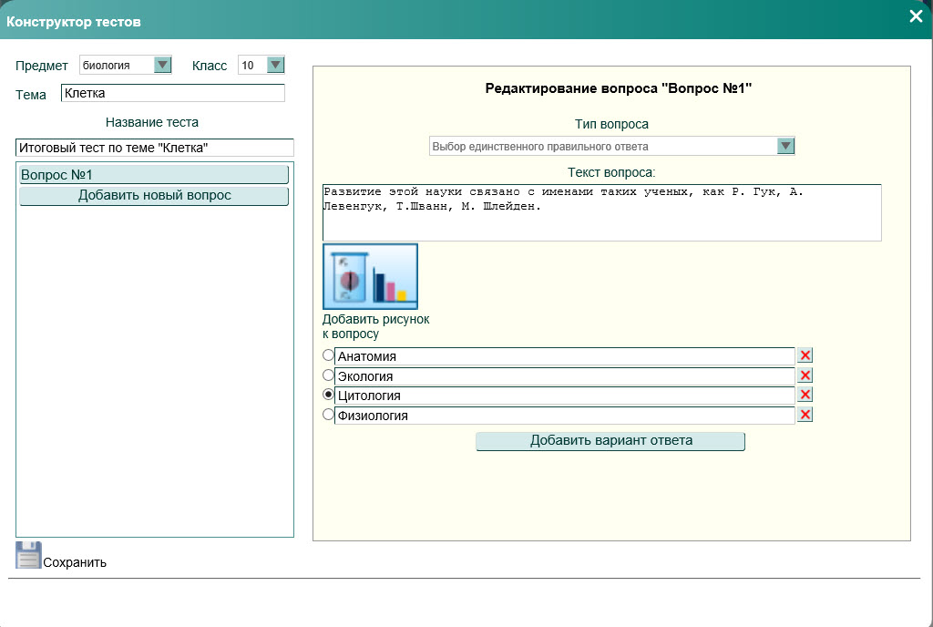
Web-service “Quiz builder”

Slide 9
Exhibitions and Mobile Applications

Slide 10
From the Web-builder to MOOCs

Slide 11
We have developed the full spectra of educational resources for school grades: from 5 to 9 on the following subjects:
Biology
Physics
Chemistry
Geography
History of Russia
World History

Slide 12
Massive Open Online Courses
A massive open online course (MOOC)
is an online course aimed at unlimited participation and open access via the web. In addition to traditional course materials such as filmed lectures, readings, and problem sets, many MOOCs provide interactive user forums to support community interactions between students, professors, and teaching assistants.
One of the most massive MOOC platforms. More than 13 million students and more than 2 million passed courses.
One of the most elite MOOC platforms. EdX is based in Cambridge, Massachusetts and is governed by MIT and Harvard.

Slide 13
MEPhI MOOC at https://www.coursera.org

Slide 14
MEPhI MOOC at https://www.coursera.org
Creation of Scientific and Technical Texts (Department “Russian as a foreign language”)
For foreign students in Russia
Start date: October 12, 2015
Elements of Atomic and Nuclear Physics (Center of Atomic Energy)
For bachelor degree students
Start date: November 1, 2015
Physics as a Global Project (Department of general physics)
Physics for non physicists
Start date: December 20, 2015

Slide 15
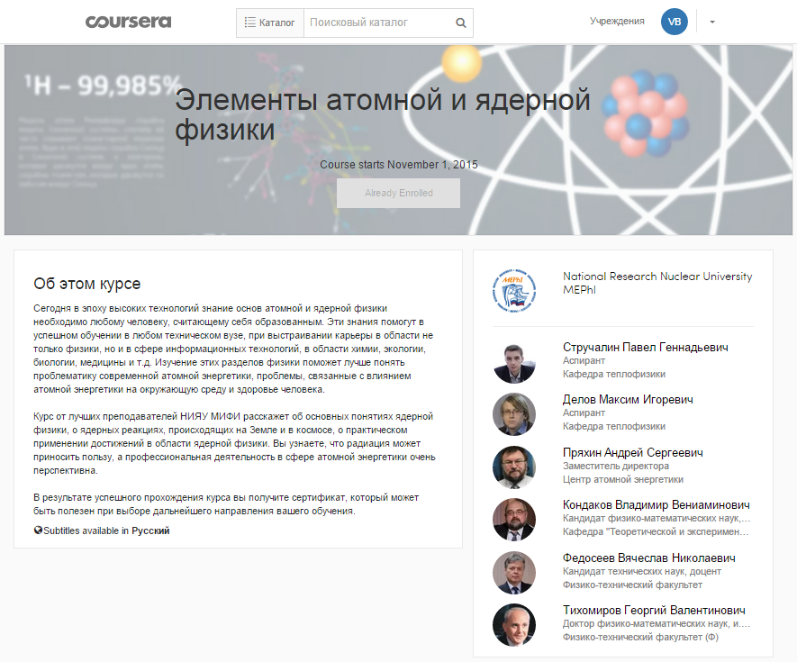
MEPhI MOOC at https://www.coursera.org

