Slide 1

Professional simulations of neutron spectrometers and experiments by
VITESS software package
Primary authors : Dr. MANOSHIN, Sergey (FLNP JINR)
Co-authors : Dr. BELUSHKIN, Alexander (FLNP JINR) ; Dr. BODNARCHUK, Viktor (FLNP JINR) ;
Dr. ALEXANDER, Ioffe (JCNS FZ-Juelich) ; Dr. ERHAN, Raul (FLNP JINR, Horia Hulubei
Institute of Physics and Nuclear Energineering)
Presenter : Dr. MANOSHIN, Sergey (FLNP JINR)

Slide 2
NEW VITESS MODULES*
Scientific interests of JCNS/FLNP have been defining the choice of developed modules
New NSE technique based on time dependent magnetic fields: RF flippers, adiabatic gradient flipper, spin turners with rotating and linear rising magnetic fields,…)
2) Polarized neutron technique (Spin echo spectrometry for example)
Focussing SANS: refractive lenses or focussing guides and elliptical mirrors
4) Backscattering spectroscopy: phase space transformer
* Future modules = developed within last few years,
but not release officially in the VITESS versions

Slide 3
VITESS polarized neutron suite
Developed by the central VITESS Team (HMI)
Coil flipper
Polariser_sm
Polariser_He3
Polarizer_mirror
Precession field
Developed by the JCNS/Dubna Team
Rotating field, import_magnfield
Drabkin Resonator
Adiabatic Gradient flipper
RF flipper
Pulsed field (linear and triangular)
New modules and/or versions of modules already come for JINR and JCNS using:
Rotating field – now is a complex module (significant changes since 2005)
Import_magnfield: to move simulations from „ideal systems“ to „real systems (close to experimental one)“: input of extermal data (B(x,y,z) - measured or simulatated by MagNet, ANSYS, RADIA, Maxwell, etc.)
Prism shaped constant magnetic fields are included as well (for SESANS)
Pulsed field (linear-dependent and triangle magnetic fields)
Time gate – the gating of the neutron detector
Adiabatic gradient flipper, Drabkin resonator and RF flipper

Slide 4
VITESS polarized neutron suite:
completed tasks
1) Radio-Frequency (RF) flipper
2) Adiabatic gradient flipper
3) Generic NSE (constant magnetic fields [Mezei]), NRSE (RF magnetic fields [Golub & Gähler])
4) Generic SESANS (constant magnetic fields [Rekveldt]) and SERGIS (RF magnetic fields [Felcher])
5) NSE with rotating fields ([A. Ioffe]) including SESANS
6) NSE with linear dependent magnetic fields ([A. Ioffe]) including SESANS
7) MIEZE technique [Golub & Gähler],
8) Drabkin resonator [Drabkin] , Multiple-polarizing cavities

Slide 5
A general principle for simulations of time-dependent magnetic fields a) Presentation of the field area with N sub-layers and K×M in-plane domains.
(b) Magnitudes of the simulated outgoing spin components in dependency on N (to achieve the “saturation”)
Simplified FEM method
a)
b)

Slide 6
RF (radio-frequenced) flipper
RF-field = Two counter rotating fields
Spin precession S in the
magnetic field B
(classical treatment)
B₀
where ν - velocity of neutron, d – thickness of flipper in the X-direction, γ - gyromagnetic ratio.
B
RESONANCE
CONDITIONS
s
x

Slide 7
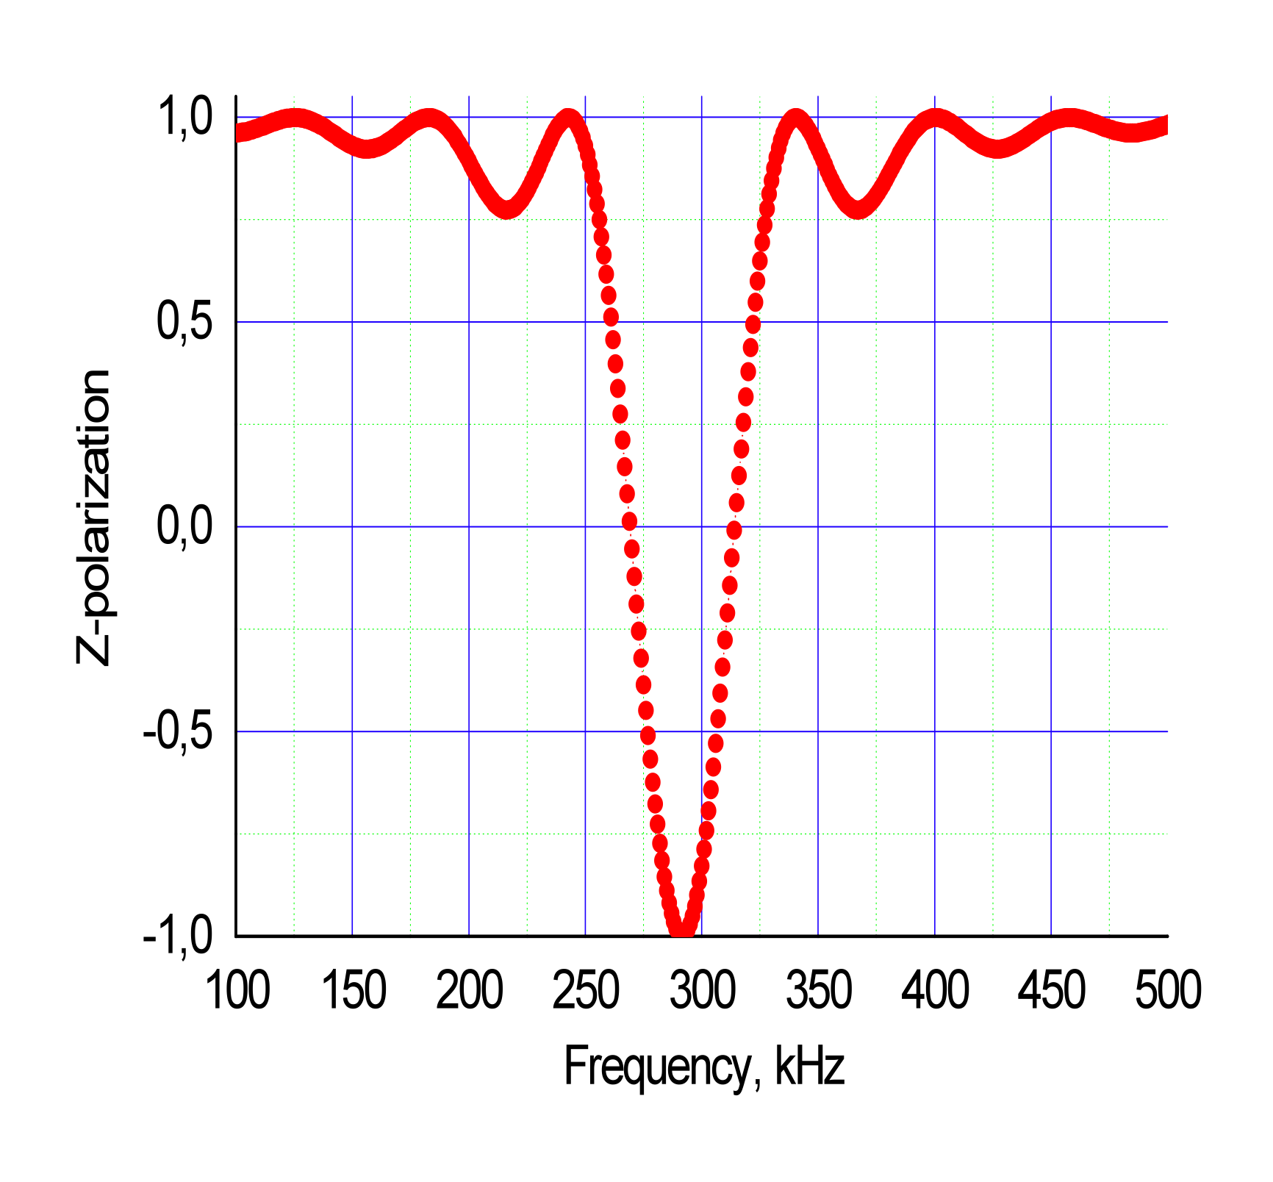
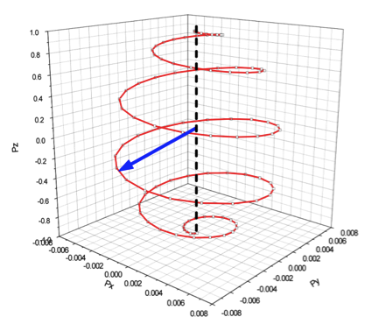
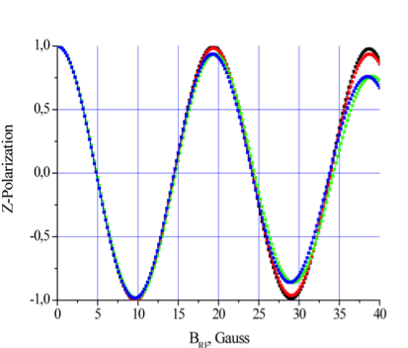
RF flipper simulations
Black line - Δλ/λ=6%
Red line -Δλ/λ=10%
Green and blue
lines - Δλ/λ=20%
Up
Thickness 3 cm
B = 100G
λ = 2.35Å
Down
a)
b)
c)
(a) The resonance curve for the RF flipper with resonance frequency of 290 kHz.
(b) Resonance curves for different monochromatizations of the neutron beam of Maxwell distribution. The blue curve corresponds to the flat spectral distribution.
c) The evolution of the spin vector in the RF-flipper.

Slide 8
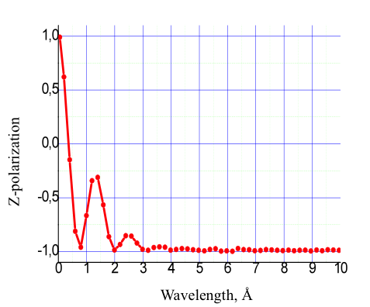
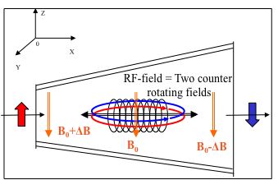
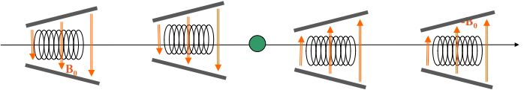
Adiabatic gradient flipper and NSE spectrometer
The reversal of the neutron polarization in the adiabatic gradient spin flipper:
,.
10cm long magnetic field area (B=100G, ΔB=15G)
5cm long RF coil: f=289 kHz, B_{RF}=15G.
The NSE signal for λ=4Å neutron beam (Δλ/λ=10%).
NSE spectrometer using adiabatic gradient flippers

Slide 9
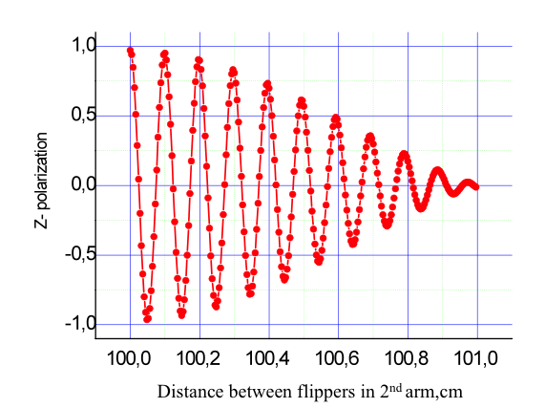
VITESS polarized neutron suite:
simulations of the NRSE spectrometer
4 RF-flippers:
thickness a=3cm
Bo=171G
B_{RF}=5.6G
f=500kHz
Incoming neutron beam:
λ=4Å and Δλ/λ=10%.
NSE signal

Slide 10
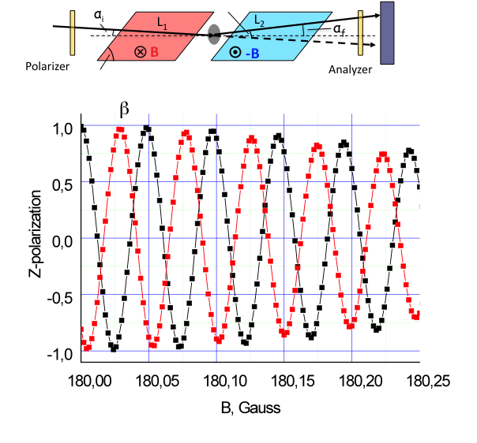
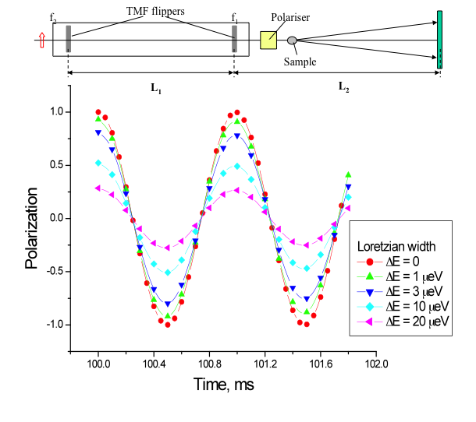
VITESS polarized neutron suite:
SESANS and MIEZE
β
Sample
β
First flipper f=50kHz
Second flipper f=51kHz
Neutron beam λ=4Å (Δλ/λ = 20%).
The NSE signal an uncollimated incident beam.
Black curve -straight beam
Red curve - beam deflected on 0.006°
The MIEZE signals for a quasielastic
scattering samples
Red curve – elastic scattering case

Slide 11
SESANS (SERGIS) with RF flippers
L₂
θ
α
L
B=0
L
B=0

Slide 12
Rotating magnetic field NSE spectrometer
Initial polarisation Pz=1
Spin flipper F1
Spin flipper F2
Spin flipper F3
Spin flipper F4
z
z
x
L₁
y
L₂
Final
polarisation Pz
y
Sample
NSE signal obtained for f = 50 kHz and
L₁ = L₂ = 1 m. Neutron wavelength
λ₀ = 20 Å (Δλ/λ₀ = 20%).
The foils’ thickness d = 0.001 cm and
the field magnitude B = 3392 Oe are
selected to satisfy the spin flip condition
= π only for the central wavelength
λ₀ = 20 Å. The result of the simulations
of the spin-echo signal show the
well-known spin-echo signal
of a high quality

Slide 13
VITESS module “Lenses“
A neutron refractive lens
Refractive index for neutrons:
n = 1 – δ, δ ~ 10⁻⁵, n < 1
Hence concave lenses must be generally used to focus neutron beams
Algorithm: calculations from the “first principles”: - the Snell’s law - subsequent calculations of neutron refraction (the Snell’s law) on the lens surfaces:
the intersection point at the 1st surface,
the normal to the 1st surface,
the incident angle on the 1st surface,
the refraction angle by the Snell*s law, the intersection point at the 2nd surface,
the propagation length in the lense, the attenuation factor,
the refraction angle at the 2nd surface
Notes:
13

Slide 14
McStas component “LENS”
(H. Frielinghaus et al.,submitted to J.Appl. Cryst.)
describes the basic functionality of the neutron lens
The set of N lenses is considered as one equivalent lens with focal length F/N (F- the focal length of the single lens)
Gravitational effects inside/between the lenses are neglected
VITESS module “Lenses“
(S.Manoshin, A.Ioffe , NIM A586 (2008) 81)
Calculations from the “first principles”
Gravitational effects included (both inside and outside of lenses)
Arbitrary number of subsequent lenses
Accounting for shape deviations and surface waviness
Attenuation of neutron fluxes inside the lens can be taken into account
Visualization of trajectories (under Linux – PGPLOT lib)
Trajectories can be saved in a file
Parabolic and spherical geometries of lenses are included
Incorporated refraction indices for 15 materials
Notes:
14

Slide 15
Additional modules for module lenses
Several additional modules have been written to make simulations easier
Module “ImageSearch” – automatically finds the cross-section with minimal FWHM in the focused beam.
Two optimisation methods are incorporated: Golden section search and Brent’s method (parabolic interpolation)
2) Module “Grating” – simulate the amplitude diffraction grating as an object
3) Module “Monitor1sans” – intensity distribution in polar coordinates Intensity= F(r,θ) and in Q– space (Intensity= F(Q) )

Slide 16
VITESS Module “Lenses” visualization
Two concave surfaces
Visualisation:
Points are intersections with lens‘ surfaces
N

Slide 17
Another example of simulations and visualization
1st and 2nd surfaces:
radius of curvatures = 1.27cm
Radius of a lense = 1.0 cm
Thickness of a lense = 0.01 cm
Refraction coefficient = 0.5
Visualisation is useful for the check of geometry

Slide 18
Example of simulations
R₁
R₂
r
O
X
X
Radial distributions of the intensity for different positions along OX
Focal plane
d
Focusing !

Slide 19
Beam size effects: diaphragm before the stack of lenses
10 sphrerical lenses
Distribution in the focal plane in polar coordinates
Sphrerical abberation!
Incoming wavelength 20 Å
Incoming divergence = 0

Slide 20
Beam size effects: diaphragm before the stack of lenses
3 parabolical lenses
Distribution at the focal plane in polarcoordinates
Incoming wavelength 20 Å
Incoming divergences = 0

Slide 21
New module: Phase Space Transformer (PST)
Top view
Y
Intensity gain vs. the crystal velocity for the system “PST transformer with crystal”
Crystal
Center of disk:
“position center X”, “position center Y”, “position center Z”
0
X
Z
Horizontal offset, deg
Incident neutron beam
“position center X”,
Diffracted neutron beam
PST: transforms the beam divergence in the wavelength band
(e.g. to improve the monochromatization of the diffracted neutron beam by the price of increased beam divergence).

Slide 22
New module: Phase Space Transformer
Rotating disk with 4 crystals
Z
Y
Rotating disk
0
X
Radius
Radius
Crystal
Incoming neutron beam
Reflected neutron beam

Slide 23
New module: Phase Space Transformer
Rotating disk with 4 crystals
Z
Height
X
Width
Radius
Radius
0
X’
Crystal

Slide 24
Modules Phase Space Transformer
Module „PhaseSpace“: existing VITESS module monochromator_flat can be used to simulate the monochromator crystal
Any external VITESS module can be used to simulate monochromator
Any number of crystals at the disk
Simulation of the translational motion of crystals
Simulation of the rotating disk with crystals
It is possible to use any crystal monochromator using Module „PST“

Slide 25
Acknowledgments
This work was supported the European Commission under the 7th Framework Programme through the 'Research Infrastructures' action of the 'Capacities' Programme, Contract No: CP-CSA_INFRA-2008-1.1.1 Number 226507-NMI3
This effort was supported by grants of the Romanian Plenipotentiary at JINR-Dubna.
Thanks for valuable scientific advices:
Dr. A.V. Belushkin – FLNP, JINR-Dubna
Dr. V. Bodnarchuck – FLNP, JINR-Dubna
Thanks for the additional efforts of:
Dr. R.V. Erhan – NIPNE and JINR-Dubna
A. B. Rubtsov – JINR-Dubna

Slide 26


Thank you!

