Slide 1

PAC on Particle Physics
49th Meeting
Report to Scientific Council
JINR, September 20, 2018
Itzhak Tserruya

Slide 2
49th PAC-PP agenda June 18-19, 2018
Highlights of the 49th PAC-PP meeting:
Update reports on NICA, MPD and BM@N
Report on the first Collaboration meeting of MPD and BM@N
Support to groups involved in NICA
Report on the Nuclotron Run 55
Projects seeking continuation

Slide 3
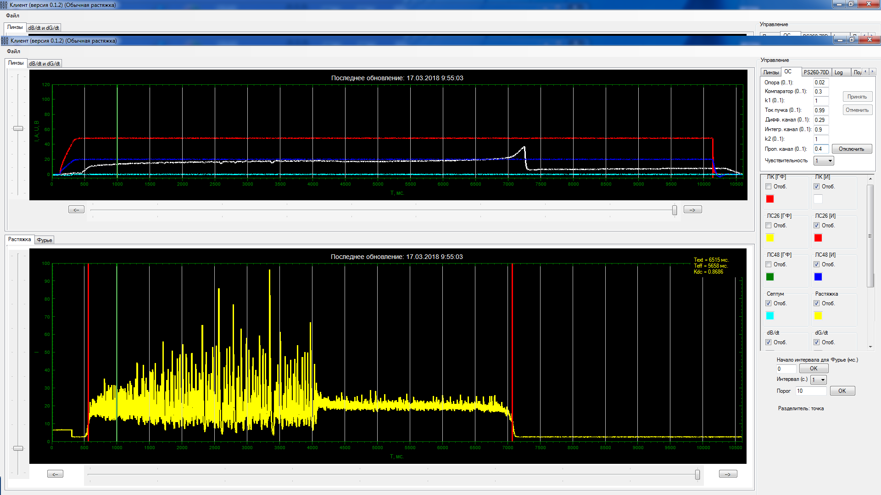
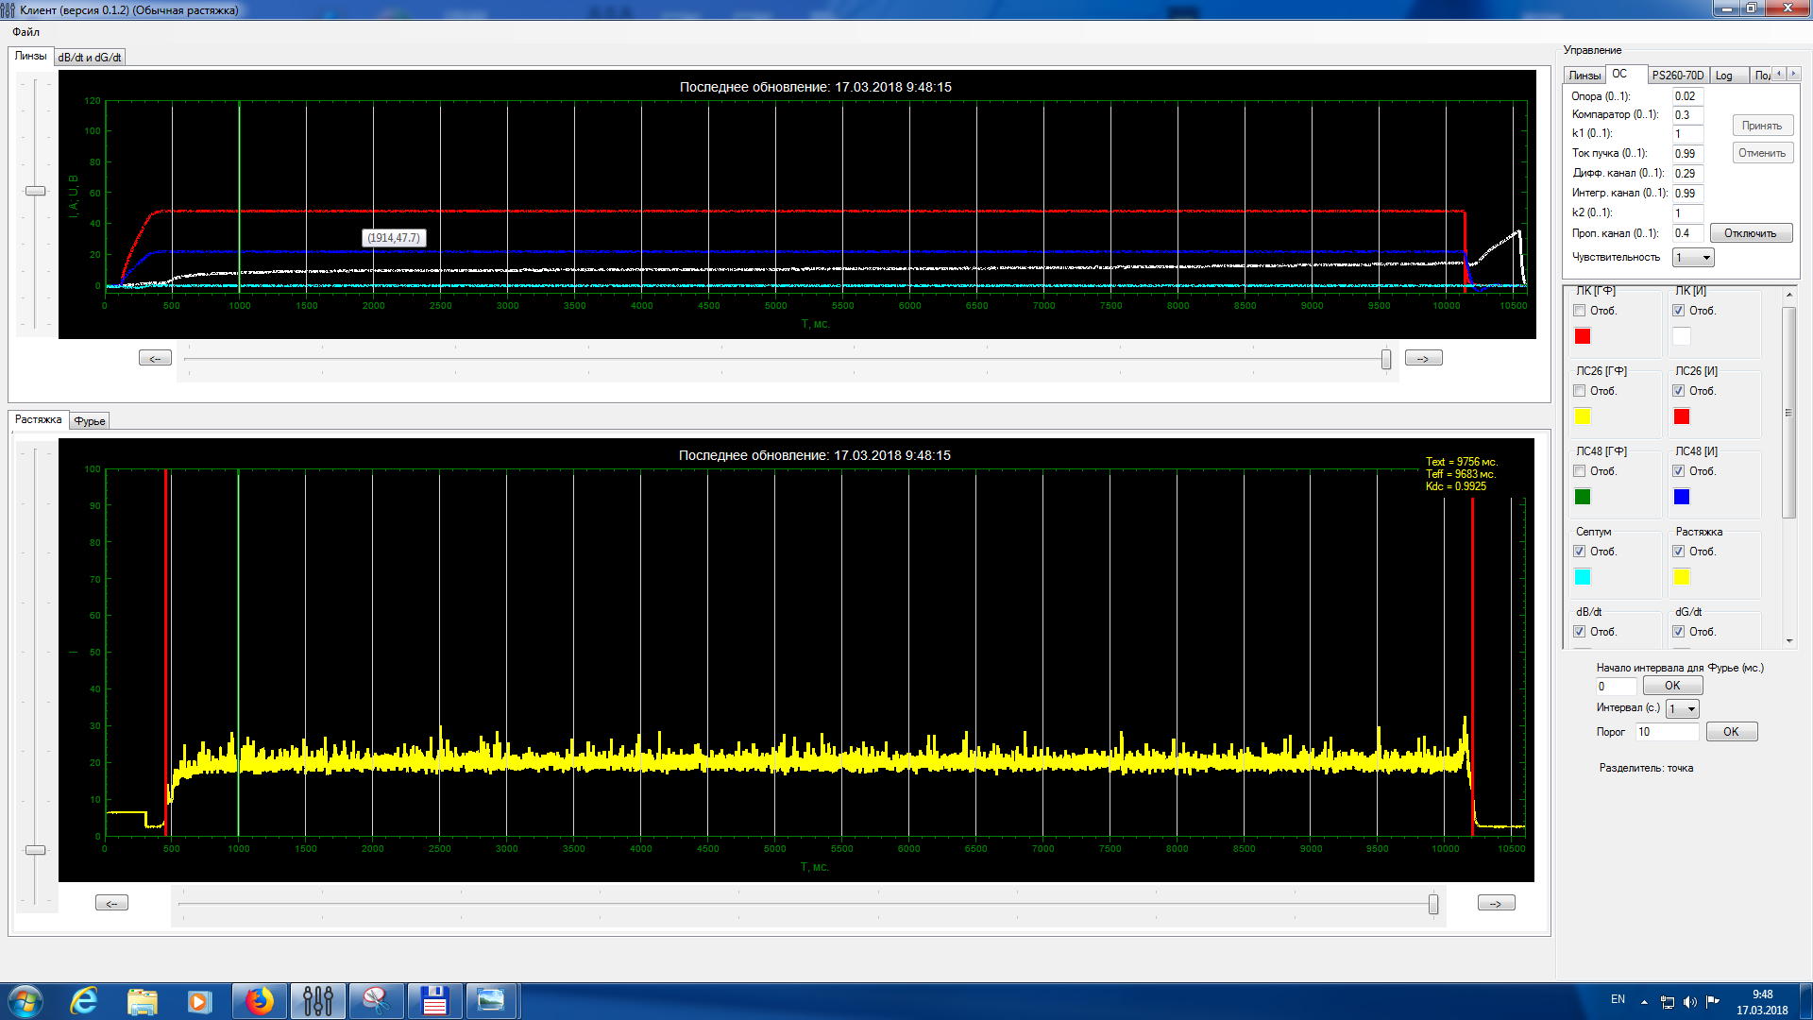
Report on the Nuclotron-NICA project
A. Sidorin
The PAC was very pleased to hear the report on the progress towards realization of the Nuclotron-NICA project.
The PAC particularly notes the successful operation of the KRION-6T heavy-ion source and the significant improvements in the quality of the beam structure and the preparations for the Booster assembly .
The PAC encourages the accelerator team to improve on the emittance of the extracted beam.
RF kicker is Off | kicker is On
Slow extraction
⁷⁸Kr, 2.8 GeV/u, 2*10⁵ T_{spill} = 10s, k_{dc}= 99,3%

Slide 4
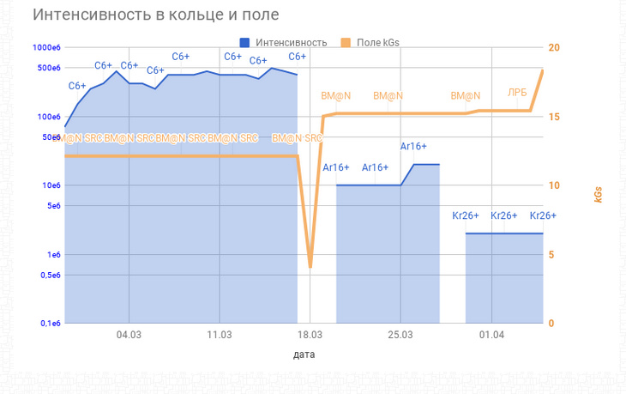
Nuclotron beam use – Run 55
E. Strokovsky
The PAC congratulates the Nuclotron staff for the successful completion of Run 55.
The users of the argon and krypton beams have shown good performance
The PAC expects physics results to be presented at the next meeting.
← SRC at BM@N →
← BM@N →
Intensity
Intensity
Field, Gs
field, kGs
date
← C →
← Ar →
← Kr →

Slide 5
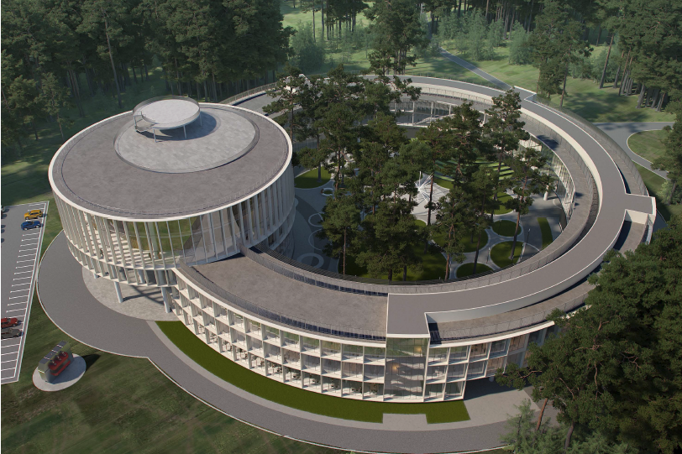
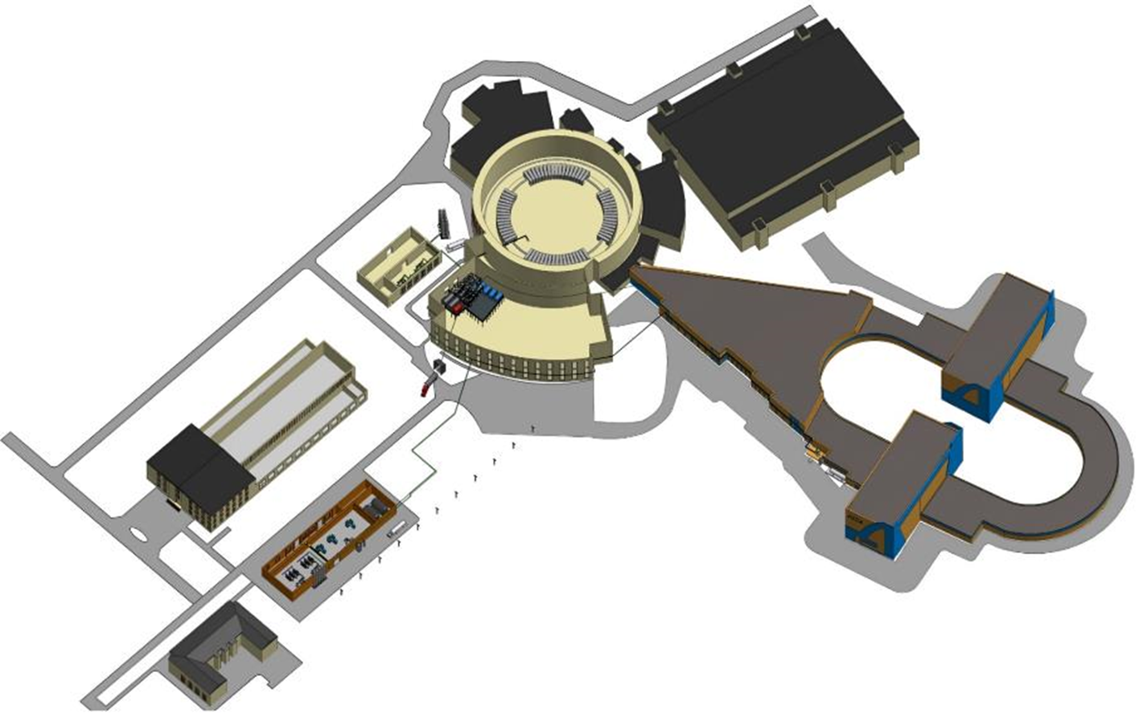
Infrastructure Developments
N. Agapov
The PAC acknowledges the progress achieved in the civil construction of the NICA collider complex, the efforts of the VBLHEP and JINR managements toward its timely completion and welcomes the steady progress in various other areas of this flagship project.
New buildings
Western half-ring
NICA innovation center
MPD
Collider building
SPD
Compressor Hall
Eastern half-ring

Slide 6
Strategic long-range plans
N. Russakovich and R. Tsenov
The PAC heard with interest the reports concerning the long-range plans of JINR’s development in the area of particle physics and in the area of relativistic heavy-ion and spin physics.
The PAC highly appreciates the JINR Directorate’s efforts towards establishing priorities and shaping up the strategic plans for the future of JINR.
The Committee looks forward to being informed about further developments and proposals to be considered at the next meetings.

Slide 7
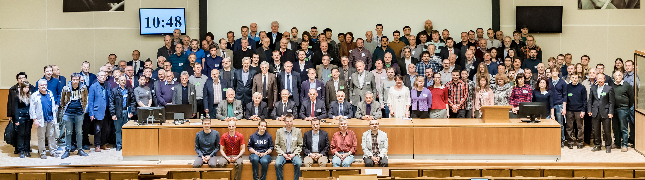
1st Collaboration meeting of MPD and BM@N
V. Kekelidze
The First Collaboration Meeting of the MPD and BM@N experiments took place at JINR on 11–13 April 2018. The PAC congratulates the NICA management for this significant milestone.
The PAC is pleased to note the great interest of the international scientific community in the MPD and BM@N experiments as reflected by the attendance of about 200 participants at the meeting and by the large number of new groups that are joining the Collaborations.
The PAC endorses the clear road map for the establishment of the structure and management teams of the MPD and BM@N Collaborations.
The PAC supports the JINR management’s efforts to secure funding for NICA collaborators.

Slide 8
Recent Developments
The Russian Foundation for Basic Research (RFBR) launched on September 3, 2018 a grant program to support research at NICA. Grants of 3-6 MRubles per year for a duration of 3 years will be granted starting on Jan. 2019.
JINR grant program for NICA research
Complement the RFBR program with a JINR grant program to support non-Russian groups, in particular member state groups, working on NICA.
Award research grants (mainly to support students and post-docs) for a 3 y period through a competitive process according to the scientific merit of submitted proposals.
2nd Collaboration meeting of MPD and BM@N at JINR on October 29-30
Main goals:
  election of spokesperson and chairperson of Institutional Board
  Admission of new institutions
  Status of MPD and BM@N experiments

Slide 9
MPD
Vadim Kolesnikov
The PAC appreciates the ongoing efforts for the preparation of the technical design reports for the MPD subsystems, in particular for the FHCAL detector developed by the teams from INR (Troitsk) and MEPhI (Moscow).
The PAC urges the MPD team to finalize the ECAL TDR, including results of simulation for the recently adopted projective geometry, and to present a detailed scenario for the ECAL timely construction and commissioning as soon as possible.
Electromagnetic Calorimeter (ECAL)
I. Tiapkin (VBLHEP), Yi Wang (Tsinghua, China)
Projective geometry: response uniformity

Slide 10
BM@N
Mikhail Kapishin
The PAC notes the successful commissioning of new equipment, including large area GEM detectors and the first silicon stations of the vertex detector.
The PAC acknowledges the improved detector performance and large statistics of experimental data collected in the recent Nuclotron run with argon and krypton beams, and in the first run with carbon beam for the short-range correlations studies.
The PAC urges the team to concentrate on the analysis of the collected data, on the completion of the detector configuration, and on the installation of the vacuum pipe through the experimental set-up.
BM@N set-up

Slide 11
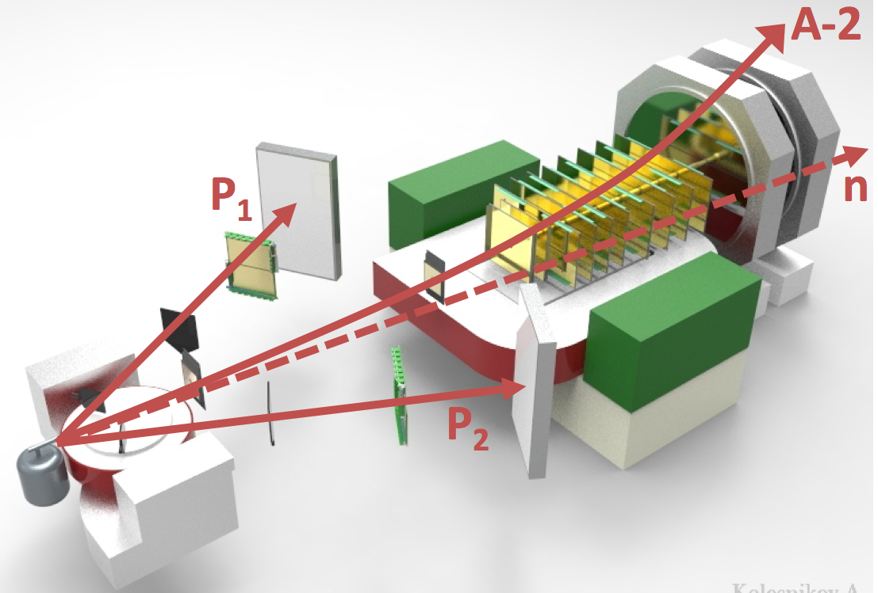
Short-range correlations
Eliezer Piasetzky
The PAC heard with interest the report on the first measurement of short-range correlations in a carbon nucleus using reverse kinematics in the BM@N set-up.
The PAC congratulates the Collaboration for the rapid realization of this project and looks forward to the results of the physics analysis.
SRC@ BM@N experimental set-up

Slide 12
Recommendations on projects approved for completion in 2018 and proposed for continuation
NA61 – V. Kireev
It is proposed to continue studying hadron production and nuclear fragmentation processes in hadron-nucleus and nucleus-nucleus reactions. The PAC is pleased that the present project has been prepared taking into account recommendations of the 47th meeting of this PAC. However, the PAC considers that the travel budget, which represents most of the requested fund, is relatively high in particular keeping in mind that there will be no run in 2019 and 2020. Assuming that the travel request will be significantly reduced, the PAC recommends continuation of JINR’s participation in the NA61 experiment until the end of 2021 with second priority.
NA62 – D. Madigozhin
The experiment aims at measuring the very rare kaon decay K⁺→π⁺νν. The PAC appreciates the results of the 2016 dataset analysis, the observation of the first candidate event of π⁺νν decay and the publication of the first results on searches for heavy neutral leptons. To mitigate the effect of beam properties (background and intensity) that could impact on the final sensitivity of the experiment, the Collaboration is taking a series of corrective measures that are expected to still keep this unique experiment at the forefront of its research field. Therefore, the PAC recommends continuation of JINR’s participation in the NA62 experiment until the end of 2021 with first priority.

Slide 13
Recommendations on projects approved for completion in 2018 and proposed for continuation
HyperNIS – D. Krivenkov
The first part of the experimental programme is the study of the lightest neutron-rich hypernuclei. The HyperNIS spectrometer upgrade has been successfully completed. Noting the importance of background studies, the PAC supports the proposed hypernuclei experiment to be carried out at the Nuclotron with light-ion beams of sufficient intensity and recommends continuation of the HyperNIS project until the end of 2021 with first priority.
ALPOM-2 – N. Piskonov
To increase the analysing power, the set-up has been upgraded with installation of a large-size calorimeter. For the first time, data have been obtained on the azimuthal asymmetries for the charge exchange polarized-n+CH2→n+X reactions, as well as for C, CH (scintillator) and Cu polarimeter analysers. As expected, the charge-exchange analysing power is much larger for heavy targets than for the forward process, np→pn. The PAC considers these results to be very important for JLab experiments and recommends continuation of the ALPOM-2 project until the end of 2021 with first priority.
DSS – M. Janek
The PAC recognizes the significant progress in obtaining experimental data on the analysing power in deuteron-proton elastic scattering. The advances in development of the deuteron and proton beam polarimetry for NICA by using the new source of polarized ions are also acknowledged. The Committee encourages the Collaboration to find funding for an appropriate upgrade of their experimental set-up to increase the phase space covered by the experiment. The PAC recommends continuation of the DSS project until the end of 2021 with first priority.

Slide 14
Recommendations on projects approved for completion in 2018 and proposed for continuation
STAR – Y. Panebrattsev
The PAC appreciates the results obtained by the JINR group in the study of antiproton-antiproton and Lambda-Lambda correlations performed with high statistics, the analysis of scaling properties of the charged hadrons spectra, and the JINR team’s participation in the event plane detector upgrade. The Committee also notes the preparations for the “Beam Energy Scan Phase II”. The PAC encourages the team to share its experience with the MPD team and recommends continuation of JINR’s participation in the STAR experiment until the end of 2021 with first priority.
HADES – V. Ladygin
HADES is a versatile detector focused on the precise spectroscopy of e⁺e⁻ pairs produced in proton, pion and heavy-ion induced reactions in the beam kinetic energy range of 1-3.5 GeV. The main experimental goal is to investigate properties of dense nuclear matter created in the course of heavy-ion collisions and ultimately to learn about in-medium modification of hadron properties. The PAC encourages the JINR team to shift its focus to the measurement of dileptons at NICA. The PAC recommends continuation of JINR’s participation in the HADES experiment until the end of 2021 with second priority.
Precision laser metrology for accelerators and detector complexes – M. Lyablin
The PAC recognizes the important results achieved by the JINR group in collaboration with CERN. The PAC notes the further plan of the project’s integration in the CERN network of PLIs, but considers that the group should implement its expertise in the NICA project. The PAC recommends continuation of this project until the end of 2021 with second priority.

Slide 15
Proposal of a new project
ARIeL: Physics at future e⁺e⁻ colliders – I. Boyko
The main goal of the project is to develop the physics programmes for future electron-positron colliders, like CEPC, CLIC, FCC and ILC. These include precise measurement of the Higgs boson mass, measurement of the top polarization, study of the WW and ZZ couplings. The experimental part of the project has been developed within the CERN CLIC Collaboration. Although theoretical calculations performed within the project could be useful for any future electron-positron collider, there are serious points of concern: uncertainties on the choice of the future machine(s) beyond the HL-LHC; limited capacity of the CLIC to address Higgs studies; a harsh international competition on the proposed studies which would affect the expected impact of this research. The PAC recommends approval of this project until the end of 2021 with third priority.

Slide 16
Reports and proposals on themes approved for completion in 2018
International Advanced School of Theoretical Physics (DIAS-TH) – A. Filippov
The PAC appreciates the activities focused on the education of young scientists and students and the regular organization of dedicated training courses, lectures, workshops and schools. The PAC recommends continuation of the DIAS-TH activities within this theme until the end of 2023 with first priority.
Closing the theme “Theory of Fundamental Interactions” and proposal to open a new theme entitled “Fundamental Interactions of Fields and Particles” - D. Kazakov
Given the high quality of the scientific productivity of the groups and the sound plans for future research, the PAC recommends approval of the new theme with first priority.
Closing the theme “Modern Mathematical Physics: Strings and Gravity, Supersymmetry and Integrability” and proposal to open a new theme entitled “Modern Mathematical Physics: Gravity, Supersymmetry and Strings” - A. Isaev
Given the high quality of the scientific productivity of the groups and the sound plans for future research, the PAC recommends approval of the new theme with first priority.

Slide 17
Presentations by young scientists
The PAC reviewed 9 poster presentations in particle physics by young scientists from DLNP, LIT and VBLHEP Laboratories.
The PAC selected the poster “How robust is a third family of compact stars against pasta phase effects?” presented by A. Ayriyan to be reported at this session of the Scientific Council.

Slide 18
Next PAC-PP Meeting – June 18-19, 2018
The next meeting of the PAC-PP will be held on January 21-22, 2019
The following items are proposed to be included in the agenda:
  Follow-up on the to-do-list from this PAC meeting
  Consideration of new projects
  Reports and recommendations on the projects to be completed in 2018
  Status Report on the Nuclotron-NICA project
  Status Report on infrastructure issues including Nuclotron
  Report from the Coordinator of the Nuclotron experimental programme
  Status report on the MPD project including simulation results
  Status report on the BM@N project including simulation results and first beam test of the SRC programme
  Posters from young physicists

Slide 19
Thank you!

