Slide 1

New FHCAL for BM@N heavy ion experiments
F.Guber
INR, Moscow
on behalf of the FHCal group
2nd Collaboration meeting of the MPD and BM@N experiments at the NICA Facility,
October 29-30, 2018

Slide 2
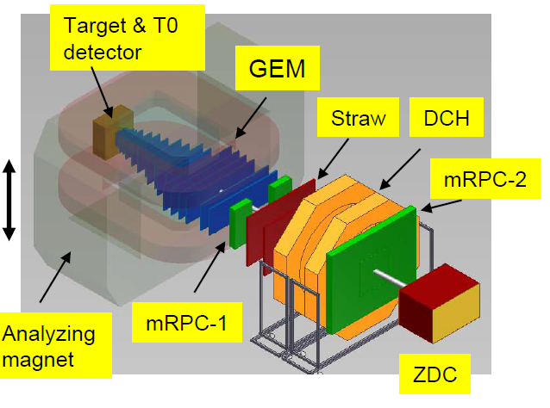
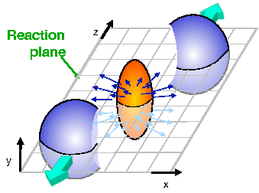
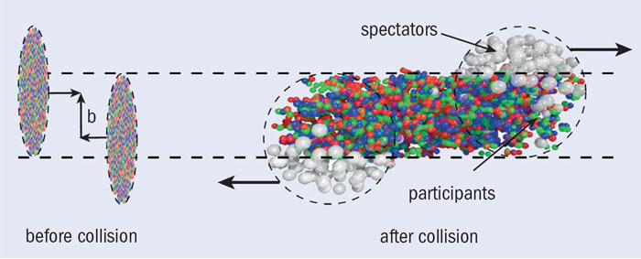
ZDC at BM@N
Main tasks of ZDC at BM@N:
Measurement of centrality and reaction plane
orientation in nucleus-nucleus collisions.
ZDC already had been used at BM@N experiments with ⁶C, ¹⁸Ar and ³⁶Kr beams.
C (T=3.5 GeV/n),
It is planned to replace existing ZDC by new forward hadron calorimeter FHCAL which should provide also selection of most central events on trigger level in nucleus-nucleus interactions .

Slide 3
Structure of ZDC and motivation of use new FHCAL
Central part – 36 nodules (7.5x7.5cm²).
Outer part 68 modules (15x15cm²).
64 layers (5mm (scint.) + 10mm (Pb)
High radiation doses are expected in ZDC central modules in future experiments with heavy ion beams which will lead to degradation of ZDC performance.
Significant hadron shower leakage is expected in ZDC due to the use of small modules in the ZDC center and use WLS plates for the light collection in modules.

Slide 4
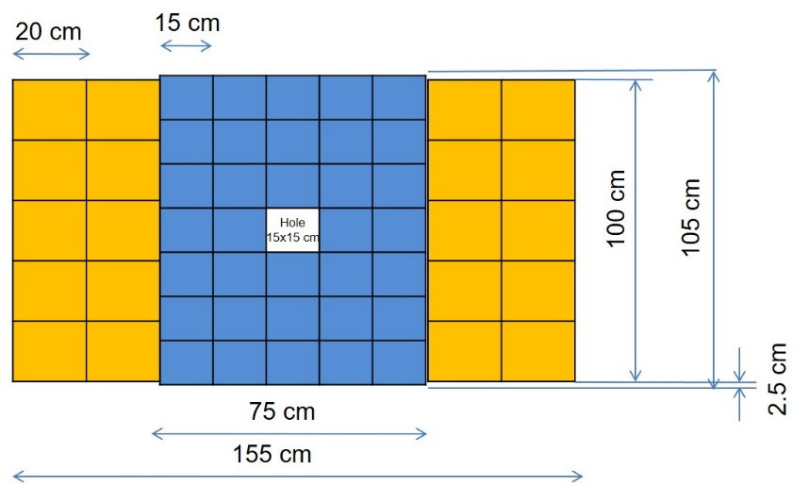
New FHCAL for heavy ions beam runs at BM@N
FHCAL – new forward hadron calorimeter calorimeter with transverse and longitudinal segmentation;
- would assembled from existing 20 PSD CBM modules, 200 x 200 x 1650 mm and
35 FHCAL MPD modules (16_BM@N+19_MPD), 150 x 150 x 1000 mm.
- Total weight- 17 tons.
1650
PSD CBM module - 60 Pb/scint layers (4mm (scint.) + 16mm (Pb), 4:1 sampling ratio.
Light readout - by 10 MPPCs from 10 longitudinal sections.
FHCAL MPD module - 42 layers of Pb/scint, the same sampling ratio.
Light readout - by 7 MPPCs from 7 longitudinal sections.
Longitudinal segmentation (about ~0.6λ_{int} of each section) provides:
information about longitudinal shower profile;
possibility to use cosmic muons for calibration without any additional trigger detectors.
The use of the CBM and MPD modules in FHCAL BM@N will give the possibility to study Its response in real experiment before the CBM and the MPD experiments starts their operation.

Slide 5
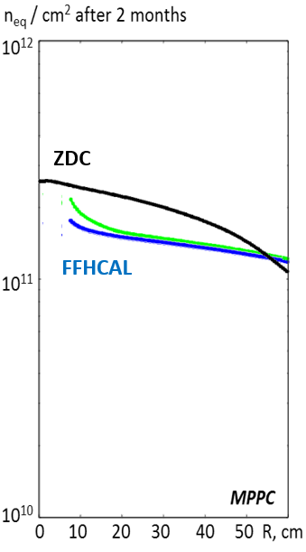
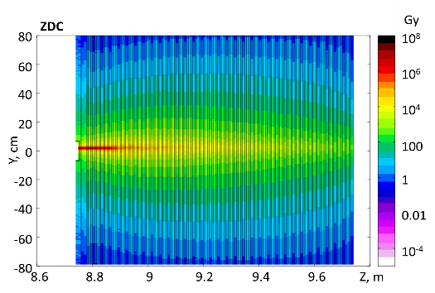
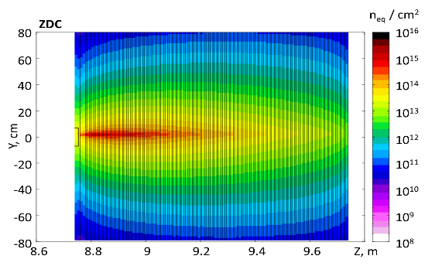
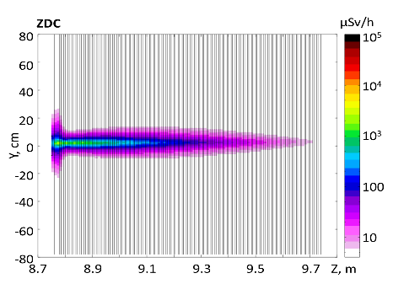
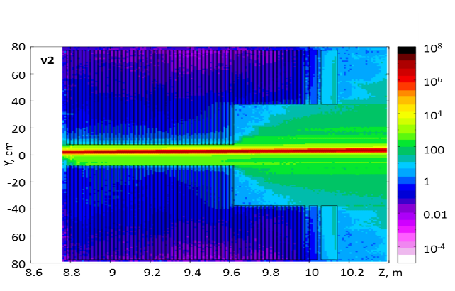
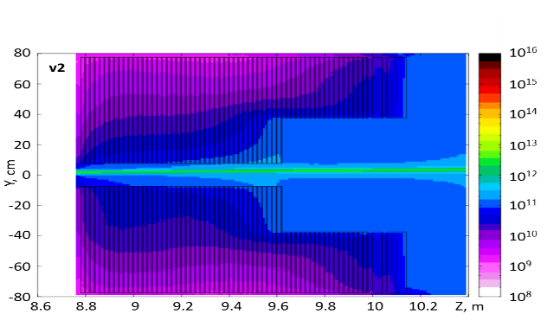
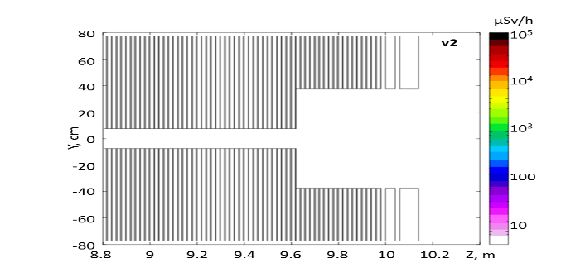
Results of Fluka simulations of the ZDC and the FHCAL irradiation
radiation doses from ionizing and non-ionizing particles in the FHCal expected for 2 month of continues operation with gold beam at beam energy 4 AGeV and beam rate 2x10⁶ ions per second.
- activation of calorimeter after 1 month of beam shutdown.
- Neutron fluence on the MPPCs position
A.Senger. GSI
Ionizing doses (Gy)
Non ionizing fluence (n_{eq} /cm²)
Activation (μSv/h)
ZDC
FHCAL

Slide 6
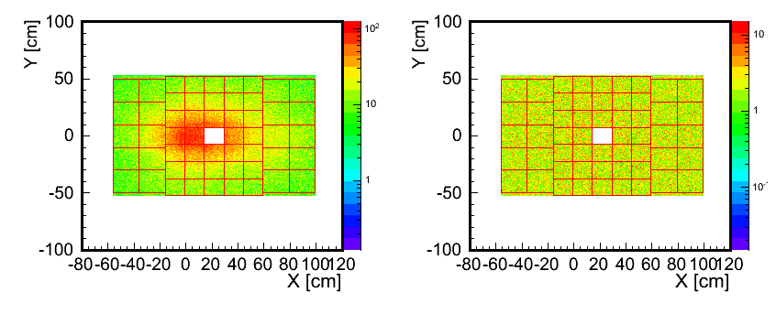
FHCAL BM@N simulation
Reaction Au+Au@4.5 AGeV was generated with LAQGSM code,
bmnroot framework with FTFP_BERT physics list.
FHCAL - 9 m from the target.
Beam smearing on the target was applied (σ_{x} = σ_{y} = 0.3cm).
Distribution of all particles on the entrance surface of the FHCAL
min. bias events
10% most central events
14 % of particles energy
goes through the hole
2 % of particles energy
goes through the hole

Slide 7
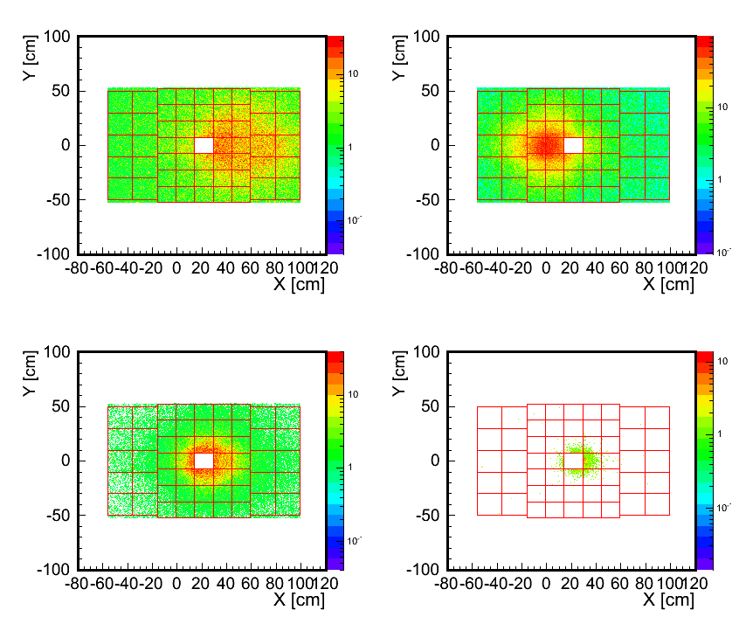
Particle distributions for minimum bias events on the FHCAL entrance surface
(Calorimeter is shifted at 217 mm in X direction to have beam axis in the center of the beam hole)
Protons Neutrons
Percentage of particles in the hole:
Protons 3%
Neutrons 4%
Fragments
A<=4 14%
A>4 92%
Fragments (A<=4) Fragments (A>4)

Slide 8
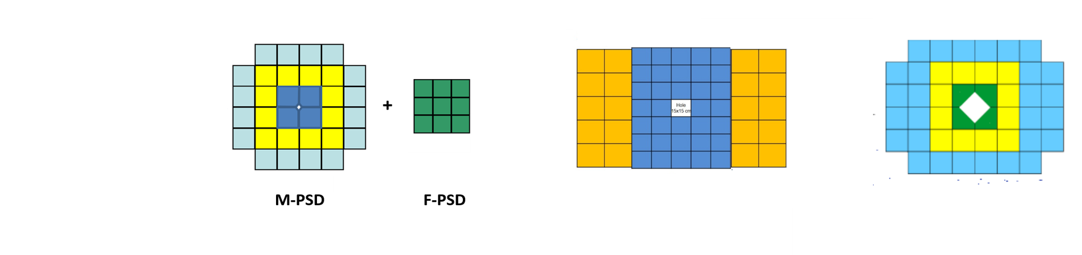
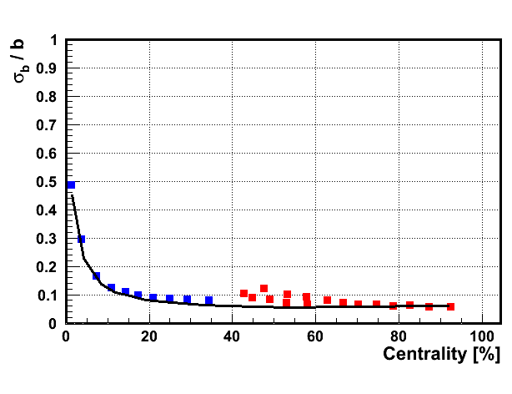
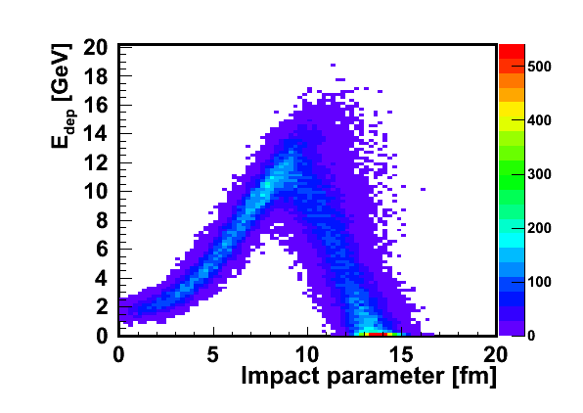
Pb+Pb@29 AGeV Au+Au@4.5 AGeV
QGSM (SHIELD code), FTFP_BERT LAQGSM, FTFP_BERT
4775 ev. 99199 ev.
How to measure centrality with FHCAL?
Calorimeter with beam hole.
Non monotonic E_{dep} vs centrality due to beam hole in FHCAL
Black curve –centrality resolution simulated
for particles which hits entrance surface of
the FHCAL without the beam hole.
Centrality selection on trigger level can not be done by use only E_{dep}
Degradation of centrality resolution in the centrality range 30-60%

Slide 9
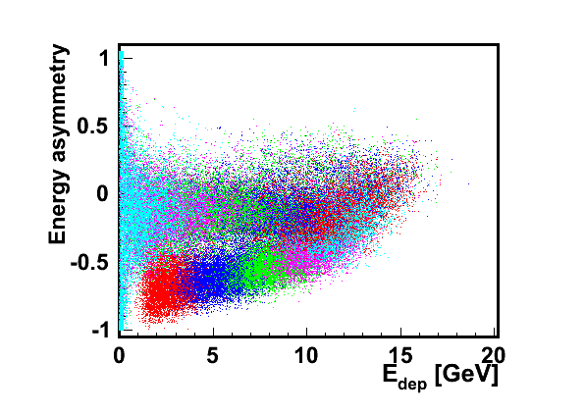
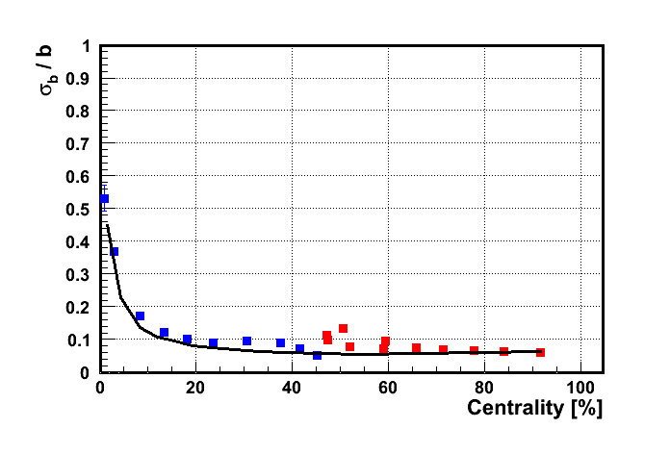
New FHCAL observable
to resolve ambiguities in the centrality measurements
Transverse FHCAL segmentation Energy deposition asymmetry in FHCAL:
E_{dep} (blue) – E_{dep} (yeloow)
A_{E} =
E_{dep} (blue) + E_{dep} (yeloow)
- Cut on the asymmetry gives the possibility to select about 40% of the most central events on the trigger level.
- Independent determination of the centrality can be done by use the A_{E} in FHCAL.
- A_{E} can not improve the centrality resolution.

Slide 10
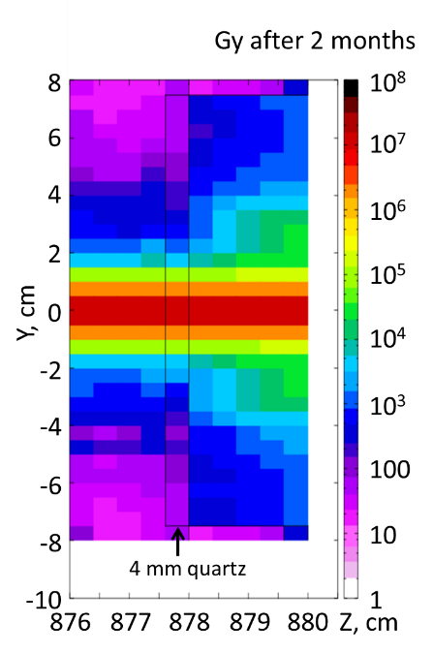
Is it possible to improve FHCAL centrality resolution
by use additional detector in the beam hole?
Use quartz detector to measure charge of fragments?
NA61 used Quartz Detector (QD) with a quartz (GE214P) plate 160x40x2.5 mm³ as the radiator equipped with two photomultipliers (X2020Q) attached to both sides of the quartz plate.
Charge distribution
of QD in NA61
fragmented beam
Estimation of ionizing dose for
quartz plate with thickness 4 mm.
The dose doesn’t exceed 1 Grad
In vey central part of QD
The position of the Pb
peak vs Dmax absorbed by
the ZDC detector
(ALICE ZDC TDR).
Degradation of signal due to radiation
dose can be recovered increasing the gain
of the PMT (MPPCs).

Slide 11
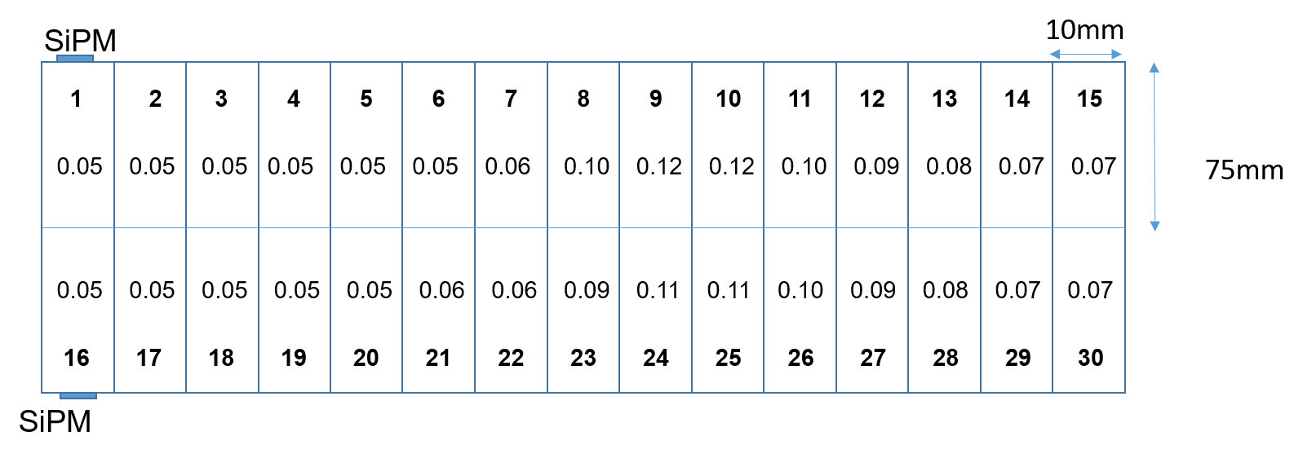
Estimation of FH occupancy
(hits of p, pi+, pi-, fragments)
150 mm
Occupancies for plates 10x75 mm are very small.
The size of quartz plates can be increased to reduce
numbers of detectors.
Optimization is needed.
150 mm

Slide 12
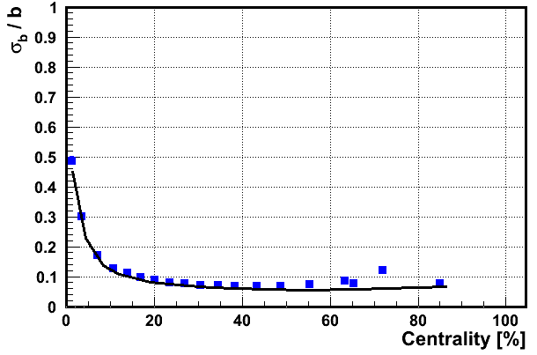
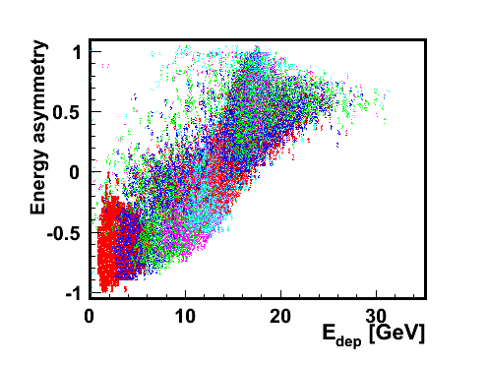
Comparison of centrality determination with FHCAL
and FHCAL plus quartz hodoscope in the beam hole
W/o quartz hodoscope in the beam hole
With quartz hodoscope in the beam hole
FHCAL with quartz hodoscope
in front of beam hole.
Monotonic dependence of the asymmetry vs centrality.
Improvement of centrality resolution for central and semi-peripheral events.
Additional tuning is needed for very peripheral events

Slide 13
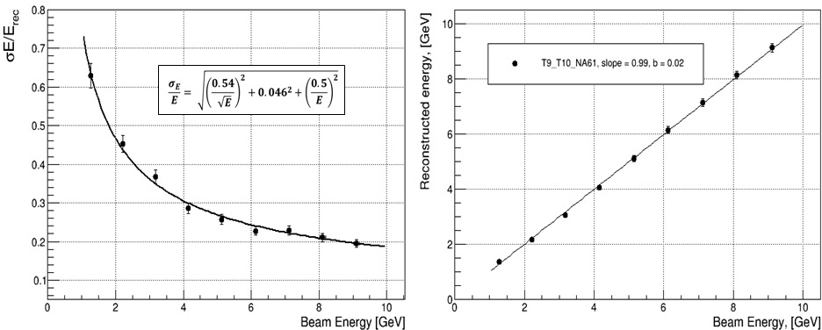
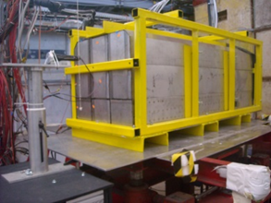
Study of PSD СВМ supermodule performance on Т9/Т10 beams at CERN
PSD СВМ supermodule on T10 test beam at CERN
Energy resolution and linearity response

Slide 14
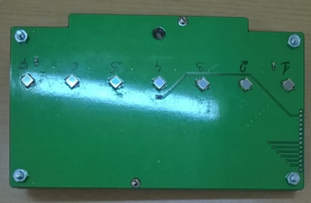
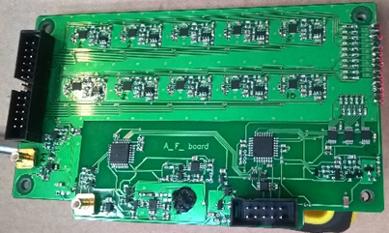
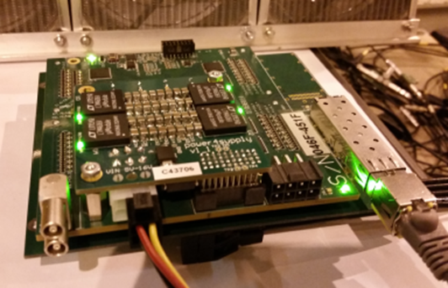
Photodiodes, FEE and readout electronics.
A first samples of FEE with MPPC photodetectors were developed and tested.
Front-End-Electronics:
Photodetectors:
Hamamatsu MPPC: size – 3x3 mm²;
pixel -10x10 µm²;
PDE~12%.
7 channels for FHCal MPD nodules and 10 channels for PSD CBM modules:
two-stage amplifiers; HV channels;
LED calibration source.
Amp
Integrator
ADC
MPPC
FEE
Δt ~ 50 ns
Δt ~ 200 ns
τ ~ 20ns
The readout electronics: FPGA based 64 channel ADC64 board, 62.5MS/s (AFI Electronics, JINR, Dubna).
Full readout chain was tested with cosmic muons and at beam!

Slide 15
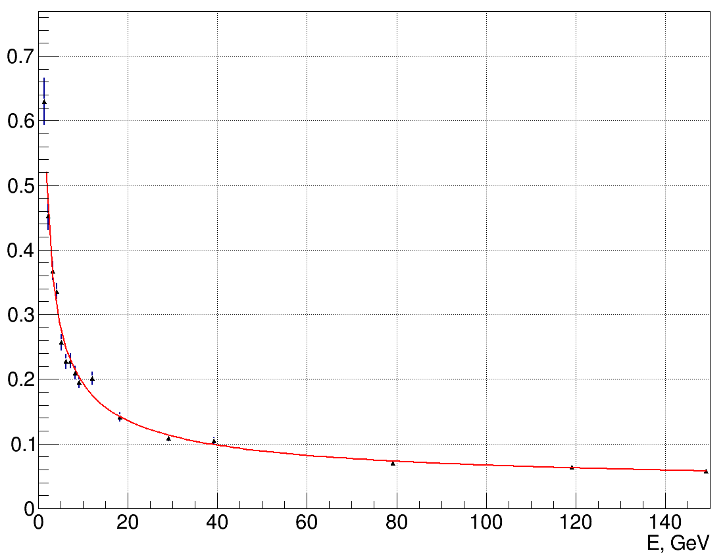

Comparison of measured energy resolution
by ZDC BM@N and by new forward hadron calorimeter
ZDC: energy resolution measured with carbon beam at 3.17 GeV/n
Energy resolution 24.5%
(preliminary)
FHCAL: results of PSD supermodule test at CERN proton beams
$\frac{σE}{E}$=$\sqrt{\left(\frac{0.58}{\sqrt{E}}\right){2 \atop }\text{+}\left(0.03\right)2\text{+}\left(\frac{0.49}{E}\right){2 \atop }}$
Energy resolution
Estimation of energy resolution
for carbon 3.17 GeV/n - 10%

Slide 16
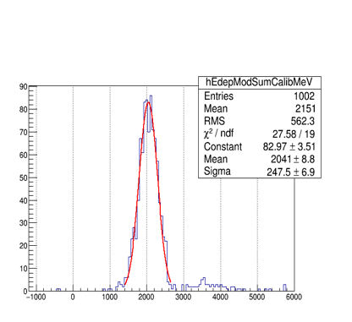
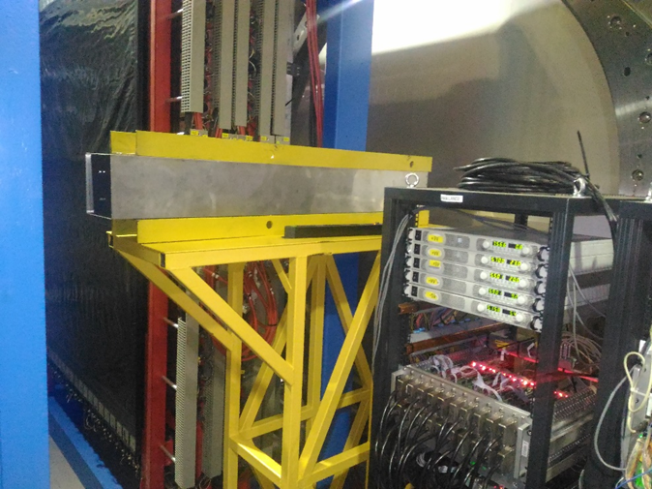
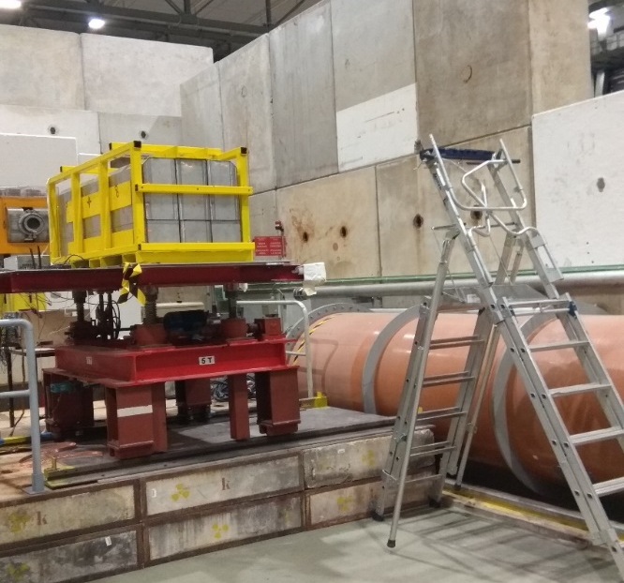
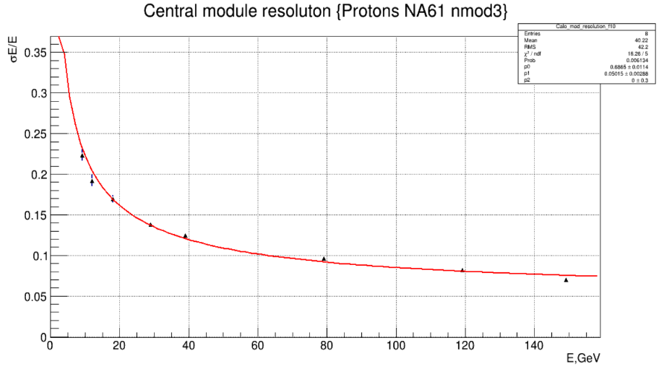

Comparison of PSD CBM single module energy resolution measured
on Ar beam (3.3 Gev/n) at BM@N and on proton beam at CERN
BM@N, Ar,
March 2018
Energy resolution – 12%
(Preliminary)
$\frac{σE}{E}$=$\sqrt{\left(\frac{0.69}{\sqrt{E}}\right){2 \atop }\text{+}\left(0.05\right)2 }$
Energy resolution
CERN, protons,
May 2018
Energy resolution
– 7%

Slide 17
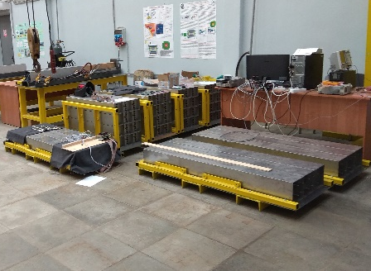
Nearest plans of FHCAL (I)
Transportation of PSD CBM modules (20 pcs),
FHCAL BM@N modules (16 pcs) and FHCal MPD
modules (19 pcs) from INR at JINR.
- April 2019
Delivery of the FHCAL support structure at BM@N.
- Beginning of 2019
35 FHCAL MPD modules (16_BM@N+19_MPD)
20 PSD CBM modules

Slide 18
Nearest plans of FHCAL (II)
FHCAL assembly
- April 2019
FEE and readout electronics
should be available at the middle of 2019. Not ordered up to now.
Integration in BM@N DAQ, cosmic tests and calibration
- up to the end of 2019
Simulations :
optimization of final FHCAL geometry to get
the best centrality and reaction plane angle resolutions,
- Development of methods for FHCAL cosmic muons calibrations
Centrality classification of existing ZDC data
Application for RFBR grant.
Participants:
INR, NEPHI, JINR

Slide 19
Thank you for attention!

Slide 20
Alternative geometry of FHCAL
105 cm
100 cm
160 cm
155 cm
P = 16.2 t.
P = 16.8 t.

Slide 21
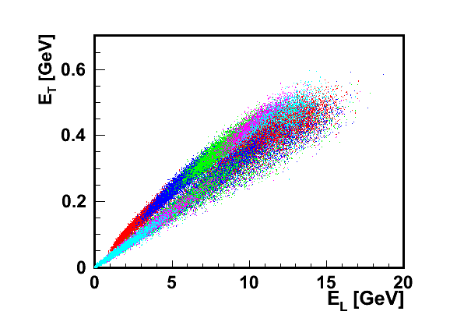
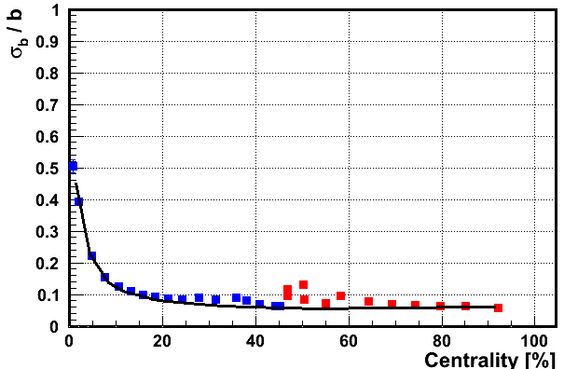
Another new observables calculated from
transverse and longitudinal segmentation of FHCAL modules.
E_{T} and E_{L} –sums of deposited energies in all i-sections in given event multiplied by sin(θ_{i} ) or cos(θ_{i} ).
θ_{i} is the angle between beam axis and line connected the center of corresponding section with the target.
These observables taken into account transverse and longitudinal FHCAL segmentation

Slide 22
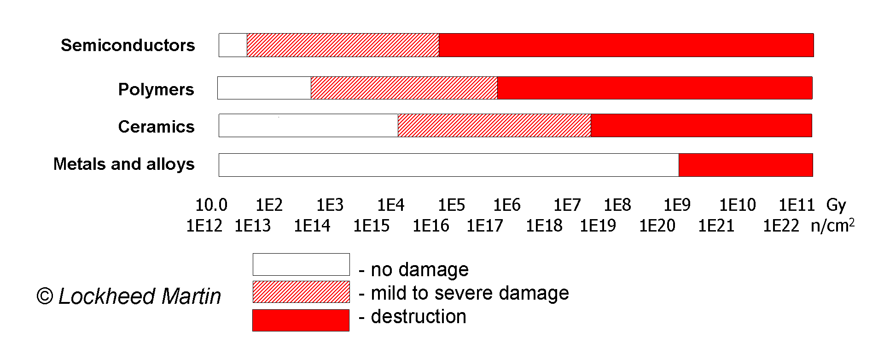
Damages in different materials as function of the applied
ionizing and non-ionizing dose.

Slide 23
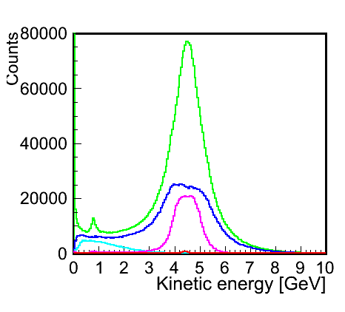
Kinetic energy spectra
of particles on the entrance surface of the FHCAL
Protons
Neutrons
Pions
Fragments (A<=4)
Fragments (A>4)

