Slide 1
Status of the MPD project
V. Golovatyuk

Slide 2
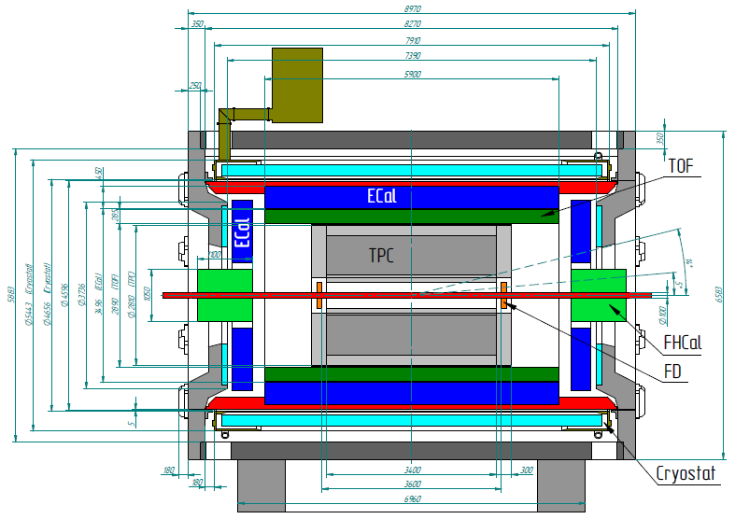
MPD 1st stage
3-D tracking (TPC, ECT)
Low material budget
High event rate (up to ~ 6 kHz)
Powerful PID (TPC, TOF, ECAL)
- π/K up to 1.5 GeV/c,
- K/p up to 3 GeV/c,
- γ, e : 0.1<p<3 GeV/c

Slide 3
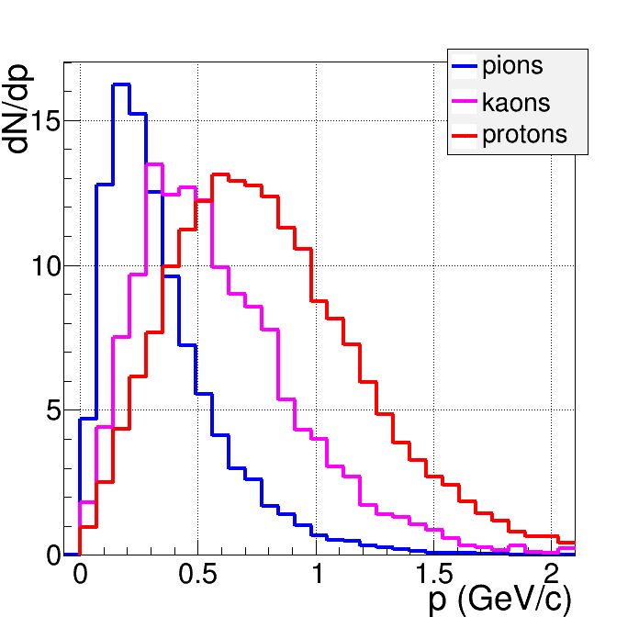
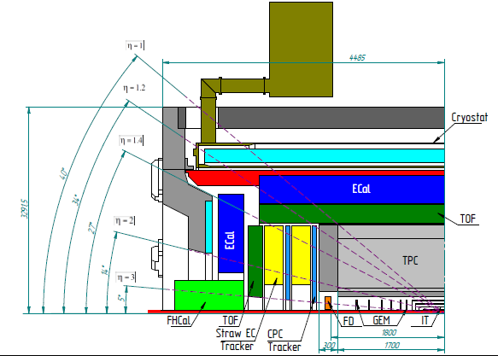
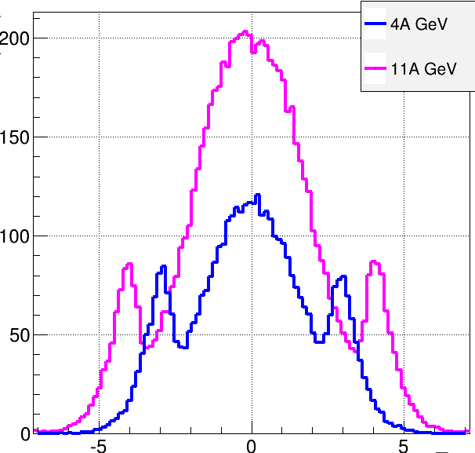
Au+Au collisions at NICA (model predictions)
Charged
b<11 fm
dN/dη
TPC
Forward Tracker
TOF
FFD
FHCal
η

Slide 4
The Status of the main subsystems of the MPD

Slide 5
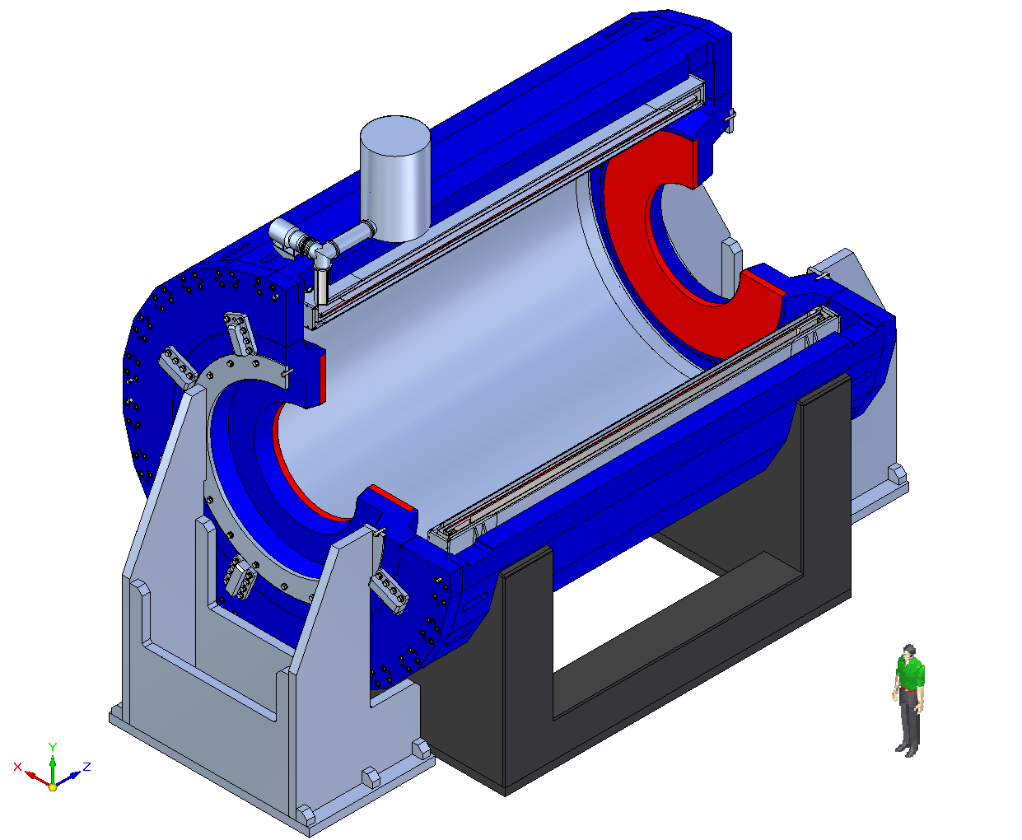
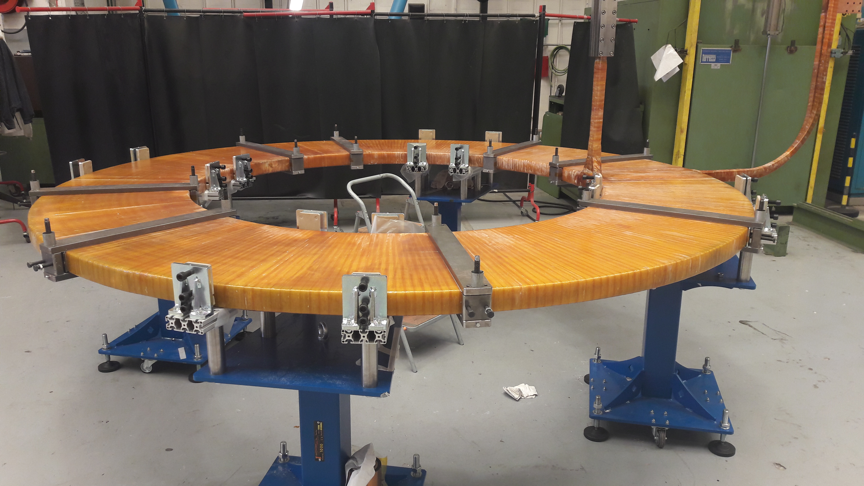
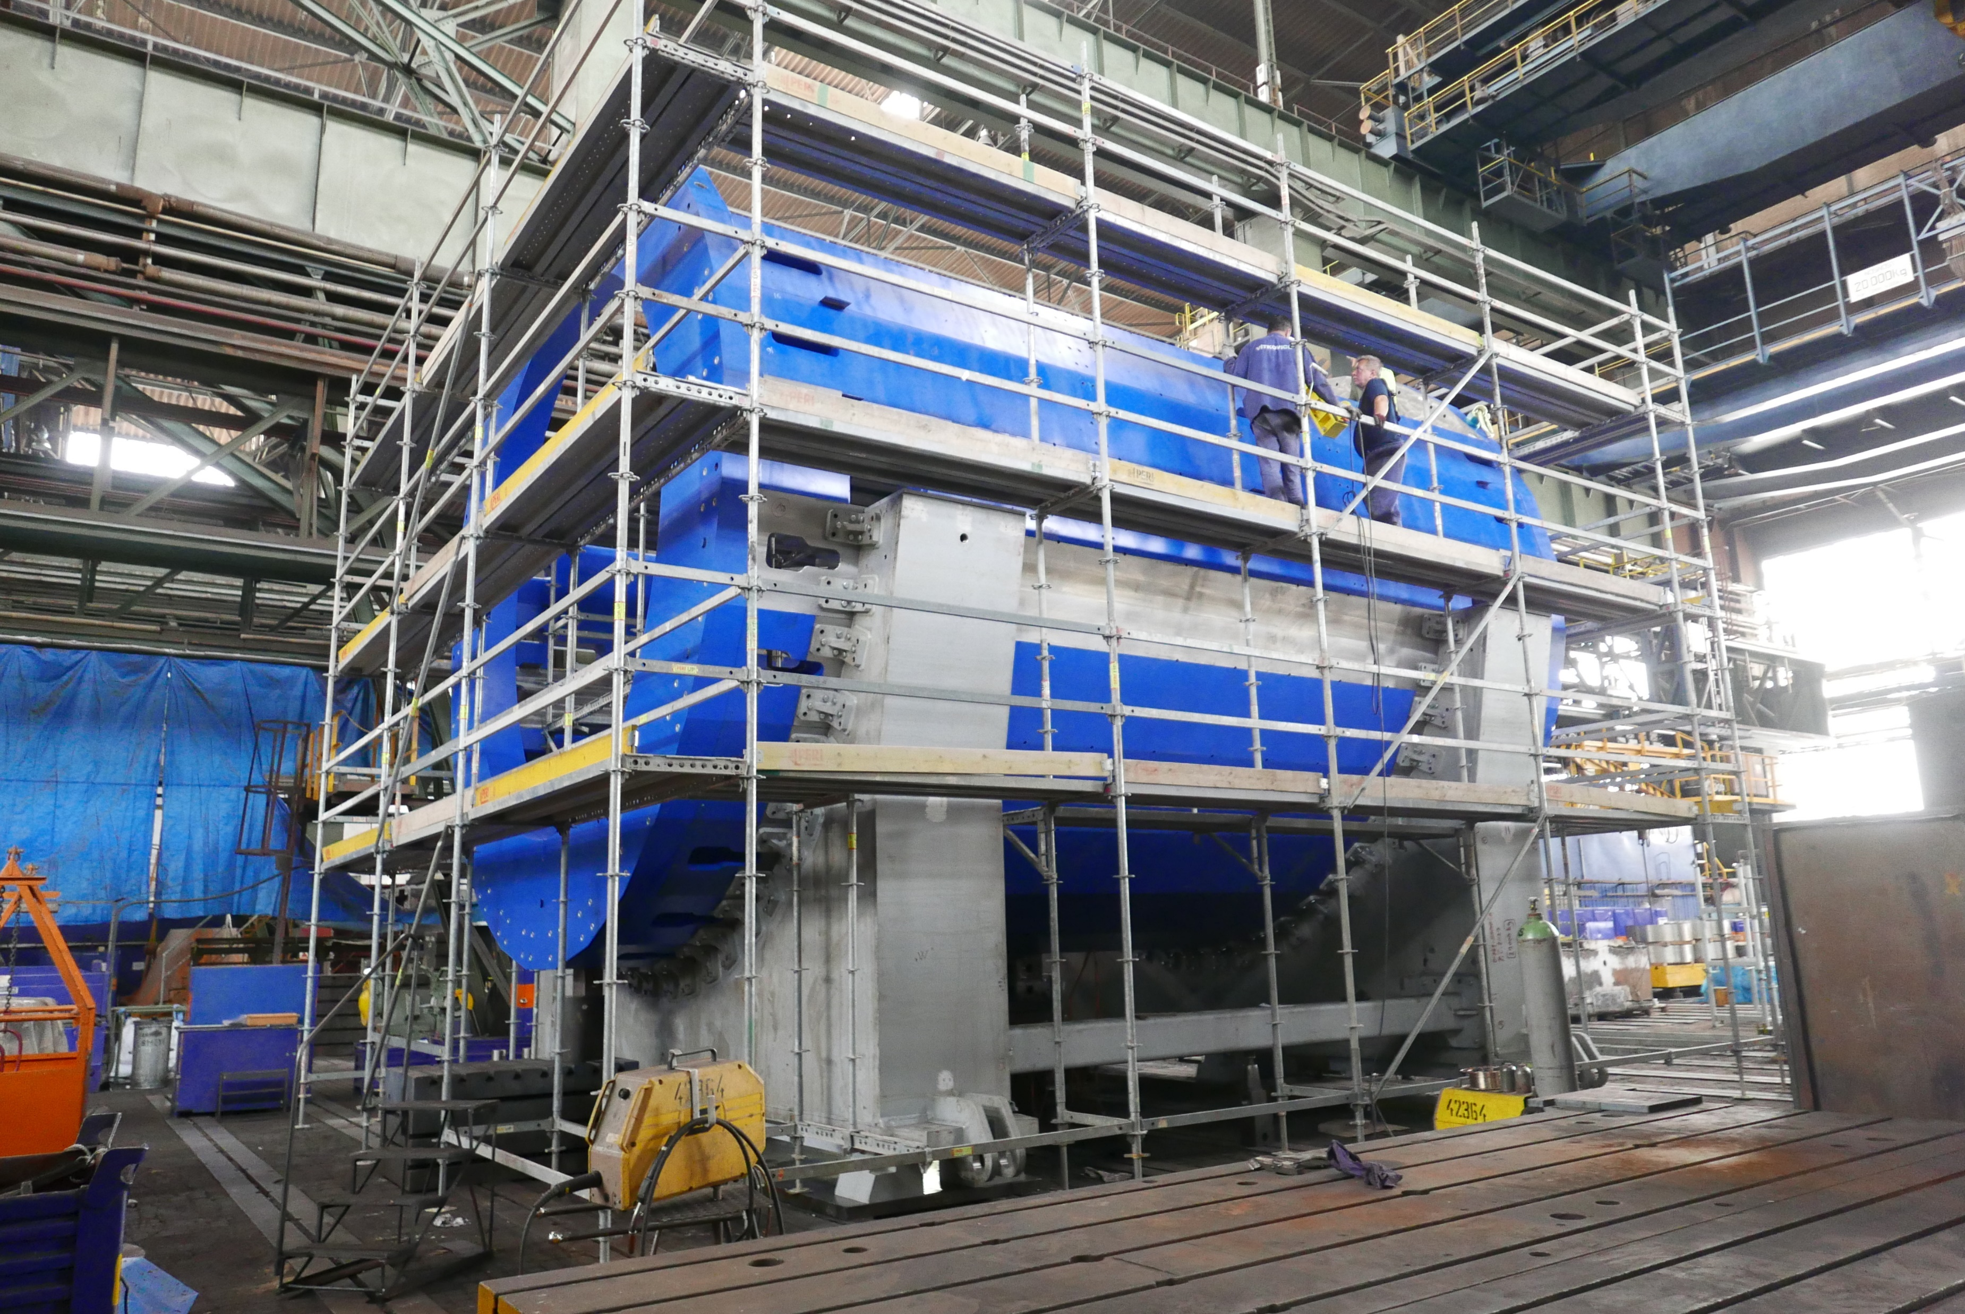
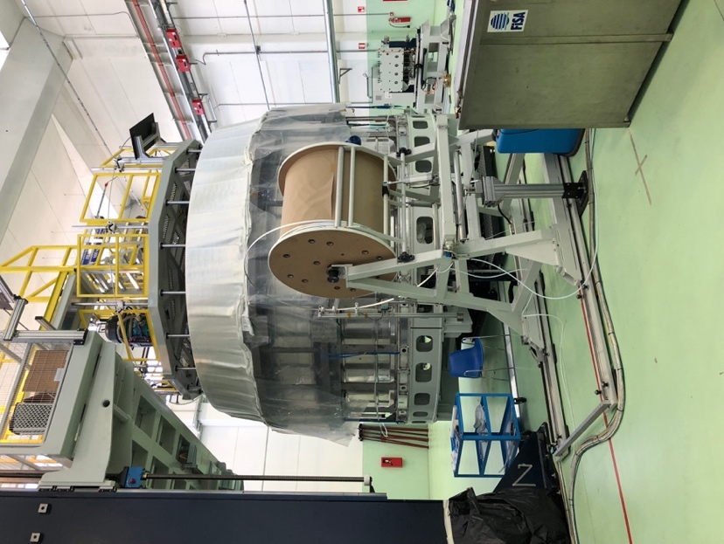
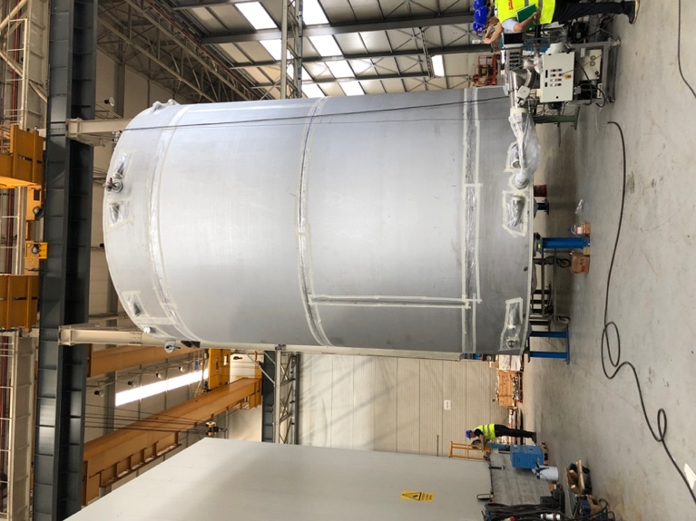
Magnet fabrication: ASG (Genova) & Vitkovice HM
End of 2018 – SC coils are ready
March 2019 – Solenoid is ready
May 2019 – Transportation to Dubna
Oct 2019 – Assembling of Magnet Yoke and Solenoid at JINR
trim coil
yoke control assembly at HM Vitkovice
winding machune
cryostat

Slide 6
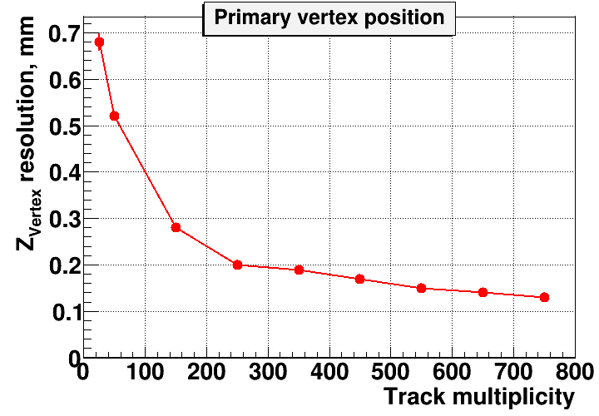
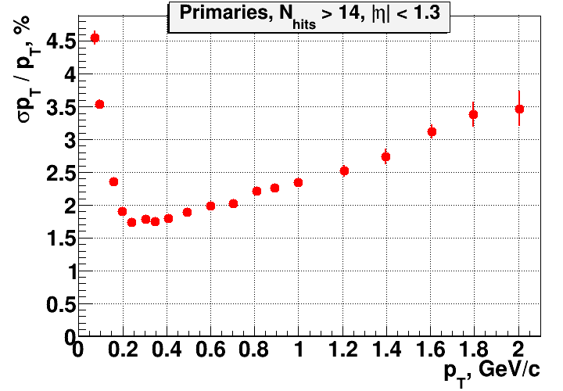
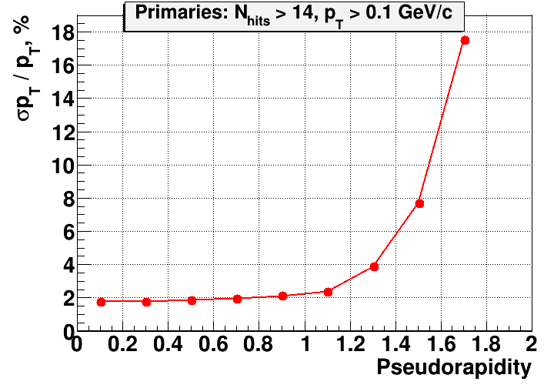
MPD Time Projection Chamber
Item | Dimension
Length of the TPC | 340cm
Outer radius of vessel | 140cm
Inner radius of vessel | 27 cm
Outer radius of the drift volume | 133cm
Inner radius of the drift volume | 34cm
Length of the drift volume | 170cm (of each half)
HV electrode | Membrane at the center of the TPC
Electric field strength | ~140V/cm;
Drift gas | 90% Ar+10% Methane, Atmospheric pres. + 2 mbar
Gas amplification factor | ~ 10⁴
Drift velocity | 5.45 cm/µs;
Drift time | < 30µs;
Temperature stability | < 0.5°C
Number of readout chambers | 24 (12 per each end-plate)
Segmentation in φ | 30°
Pad size | 5x12mm² and 5x18mm²
Number of pads | 95232
Pad raw numbers | 53
Maximal event rate | < 7 kHz ( Lum. 10²⁷ )
Electronics shaping time | ~180 ns (FWHM)
Signal-to-noise ratio | 30:1
Signal dynamical range | 10 bits
Sampling rate | 10 MHz
Sampling depth | 310 time buckets

Slide 7
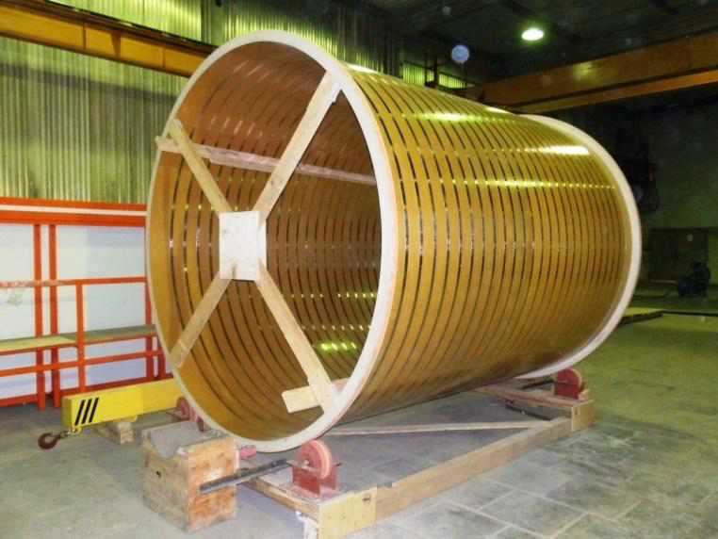
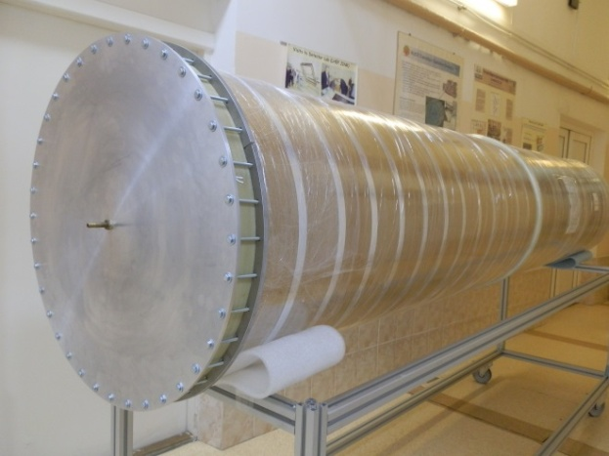
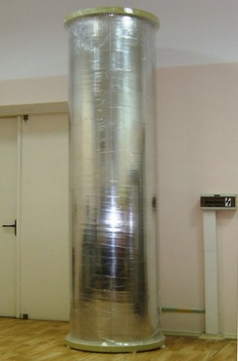
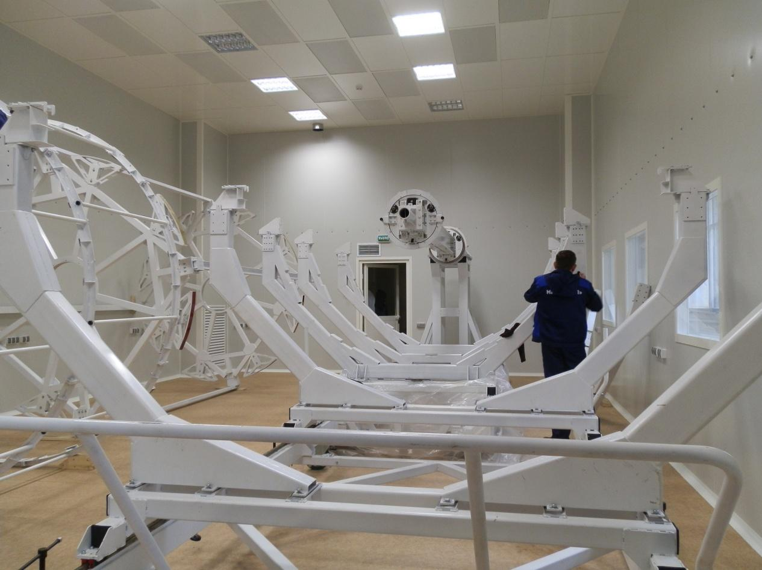
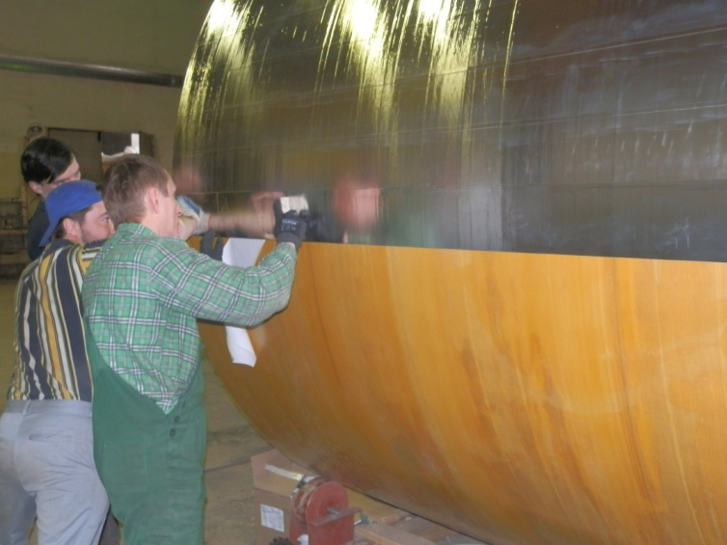
TPC cylinders: C1-C4
C2
C1
Length: 3.4 m
Diameter: 0.676 m
C3
Length: 3.4 m
Diameter: 2.66 m
C4
Length: 3.4 m
Diameter: 0.54 m
Length: 3.4 m
Diameter: 2.814 m
7

Slide 8
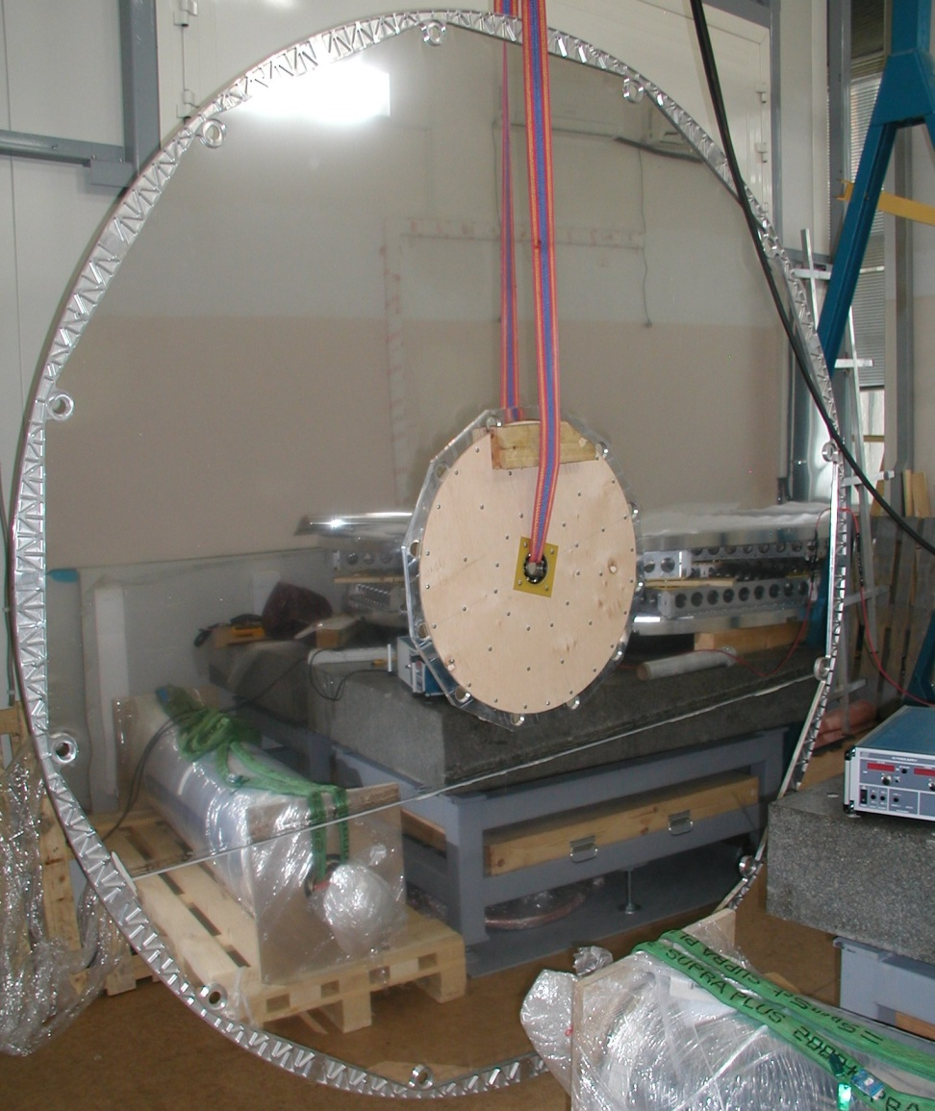
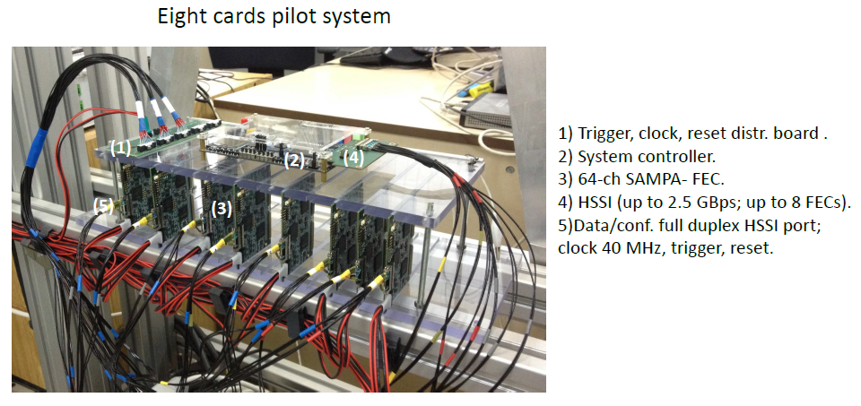
TPC summary
TPC assembly preparation:
clean room – ready
C1-C4 cylinders – ready
flanges (2pc) - ready
field cage rods (30pc+30 pc) – Nov-Dec 2018
serial HV electrode – Oct -> Nov 2018
TPC ass tooling: adjust. and align. – Nov-Dec 2018
mylar strips manufacture – Dec 2018
start TPC assembly - Dec 2018
FE electronics:
512 ch system – tests ongoing
test with ROC chamber. – Dec 2018
SAMPA chips (4500 pc) – payment in progress
ROC chambers:
frames (26 pc) - ready
serial pad planes (30 pc) – ordering started
HV for ROC gate electrode – design started
test chamber with 512 ch r/o system – Dec 2018
8

Slide 9
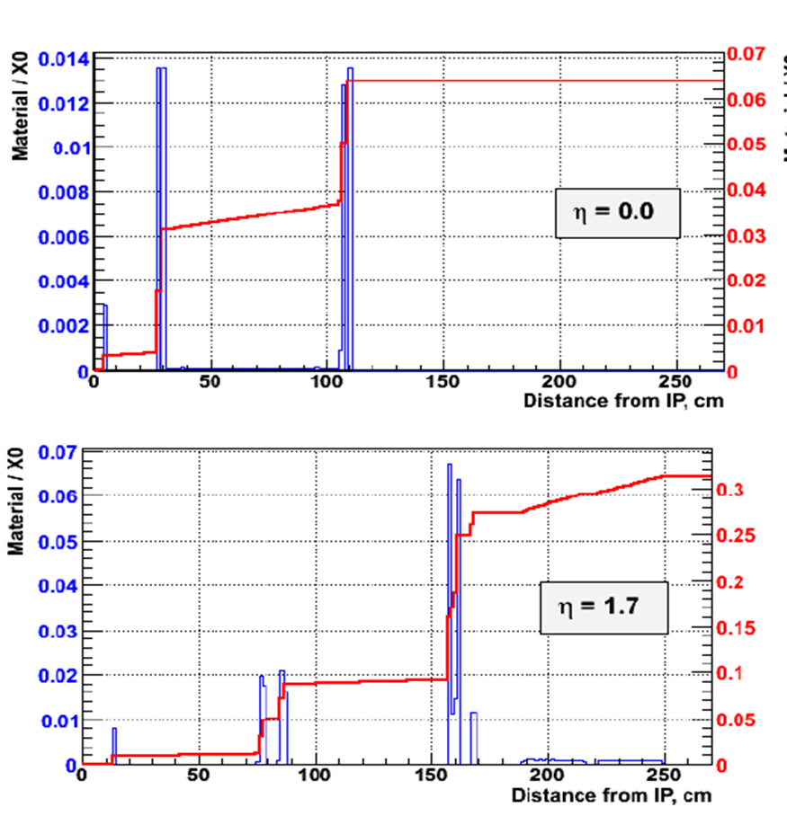
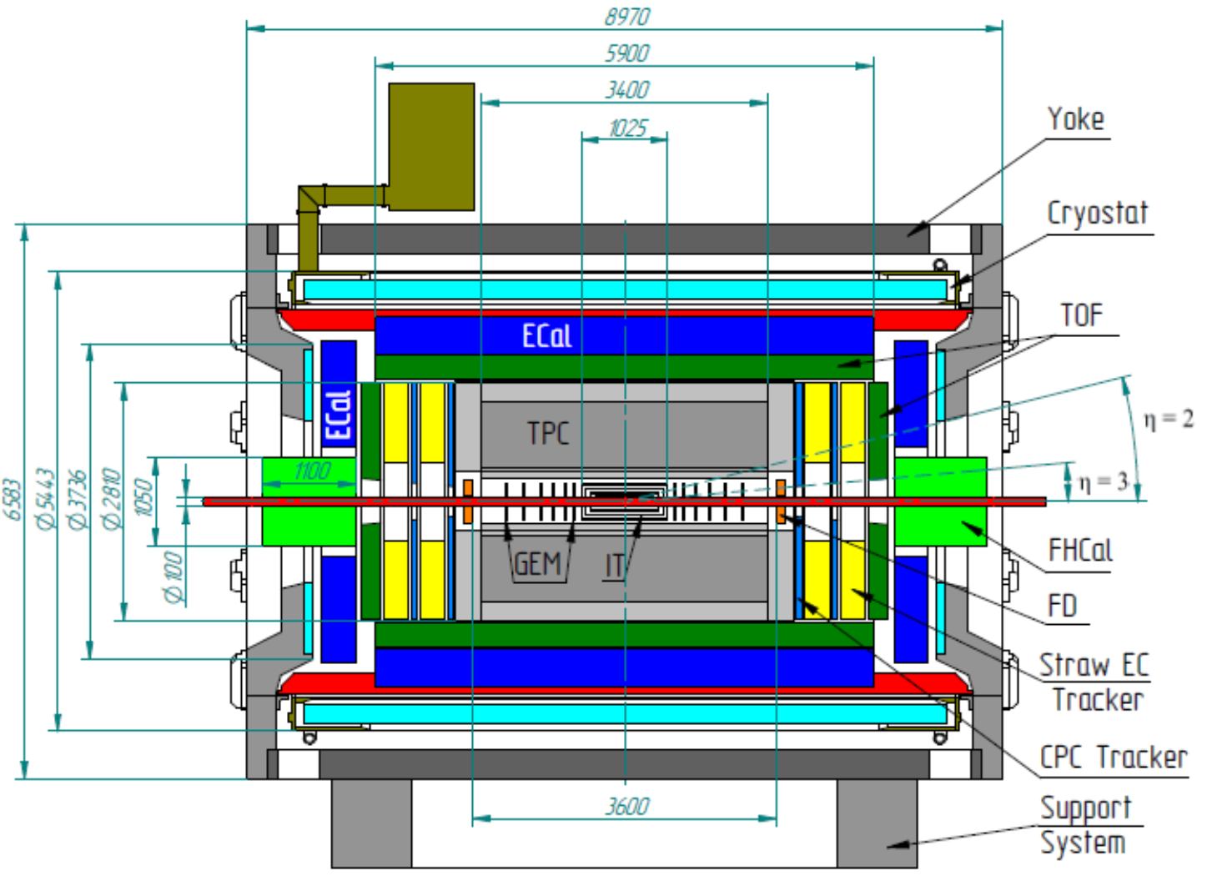
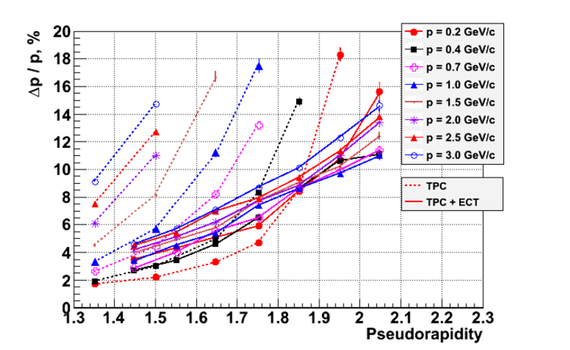
Forward tracker based on thin gap MWPC with pad (strip) readout.
Technical University of Santa Maria in Valparaiso, Chile (S.Kuleshov)
and Petersburg Nuclear Physics Institute, Gatchina (O.Fedin)

Slide 10
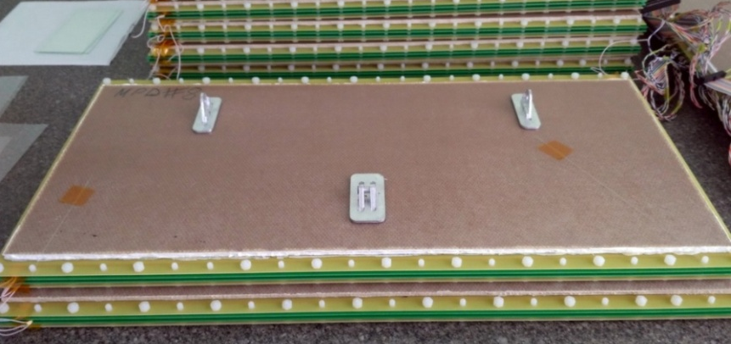
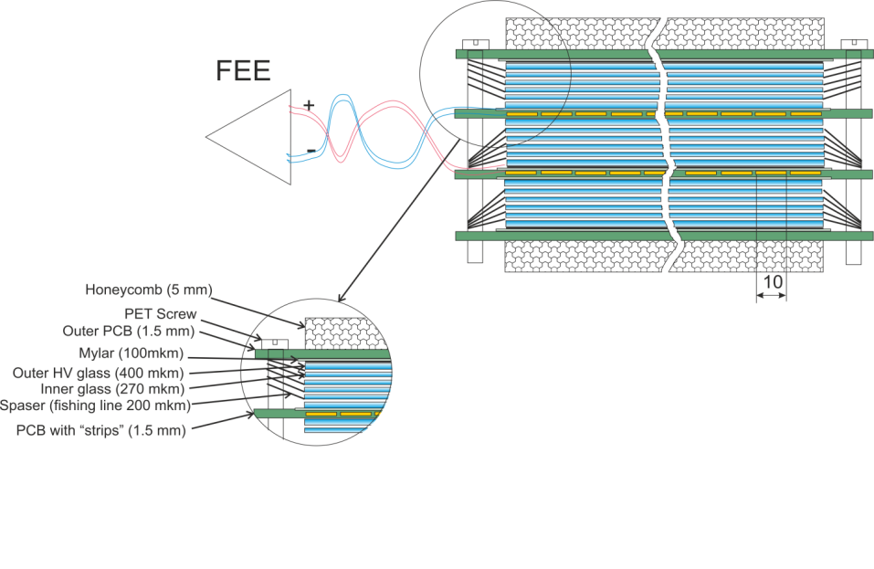
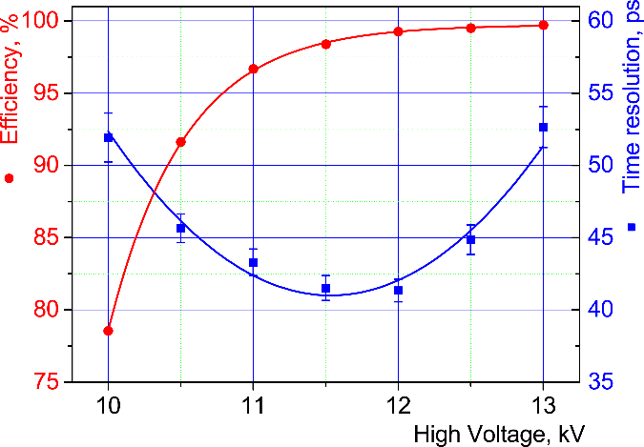
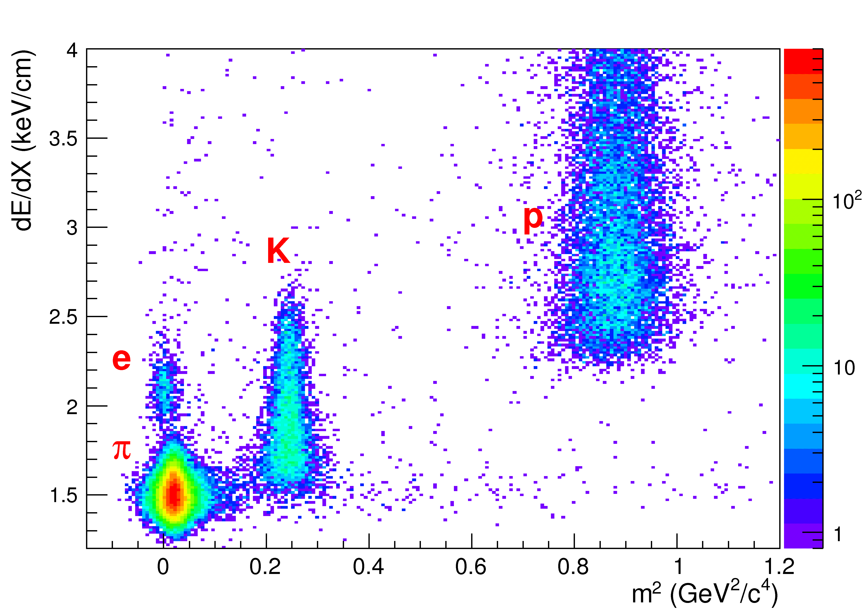
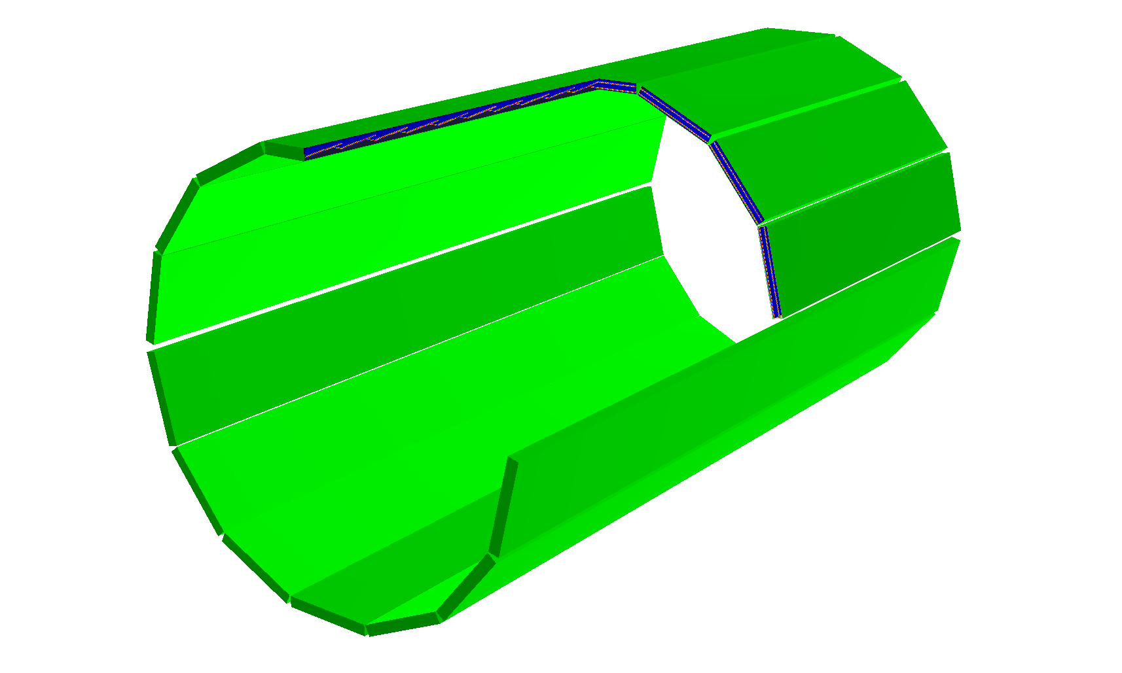
MPD TOF
Dimensions of sensitive area
600 x300 mm²
Main parameters of the TOF system.
 | Number of detectors | Number of readout strips | Sensitive area, m² | Number of FEE cards | Number of FEE channels
MRPC | 1 | 24 | 0.192 | 2 | 48
Module | 10 | 240 | 1.848 | 20 | 480
Barrel | 280 | 6720 | 51.8 | 560 | 13440 (1680 chips)

Slide 11
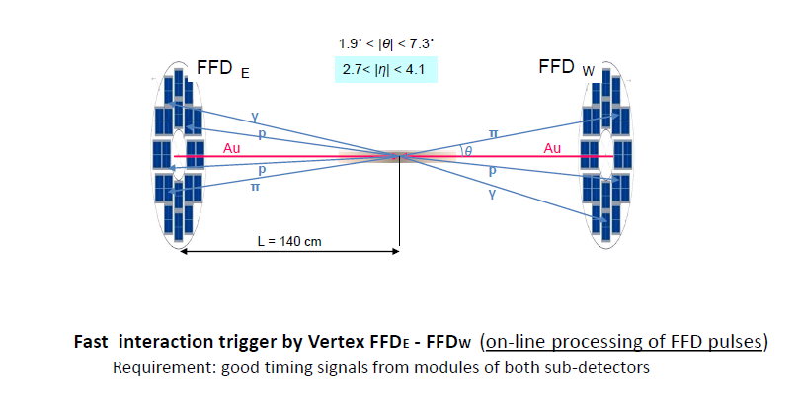
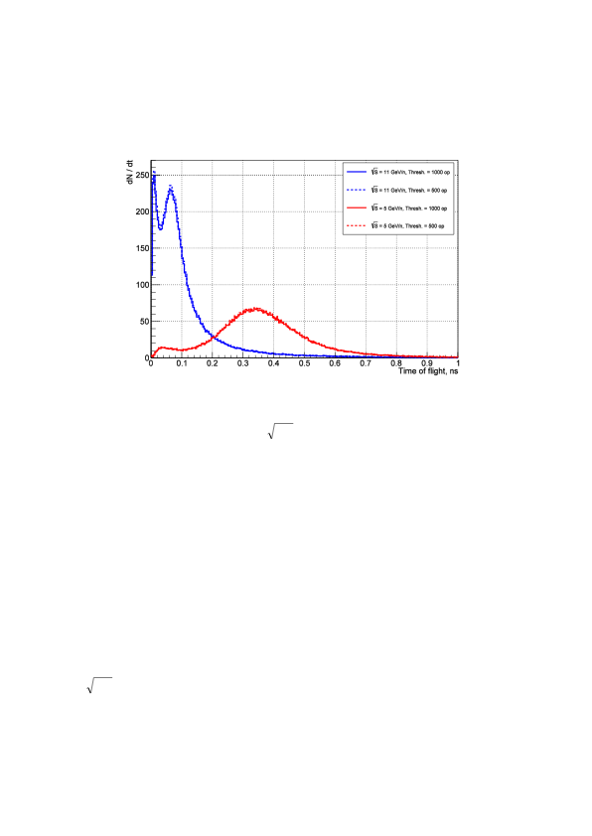
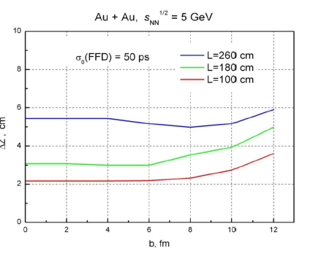
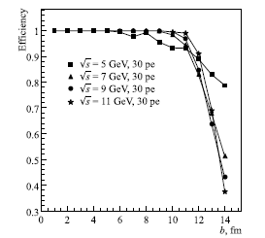
Fast Trigger L₀ for MPD
FFD provides information on
- fast triggering of Au-Au collision
- start signal for TOF
- bunch crossing region position
15 mm quartz radiator
10 mm Lead converter
The FFD sub-detector consists of
20 modules based on
Planacon MCP-PMTs
80 independent channels
The delay of charged particle arrival in FFD modules in comparison with arrival time
of photons for Au + Au collisions at sNN = 5 (red) and 11 (blue) GeV and FFD position of 140 cm.
FFD efficiency for peripheral collisions
The vertex resolution for Au-Au collisions at √s=5GeV/n for three distances from interaction point

Slide 12
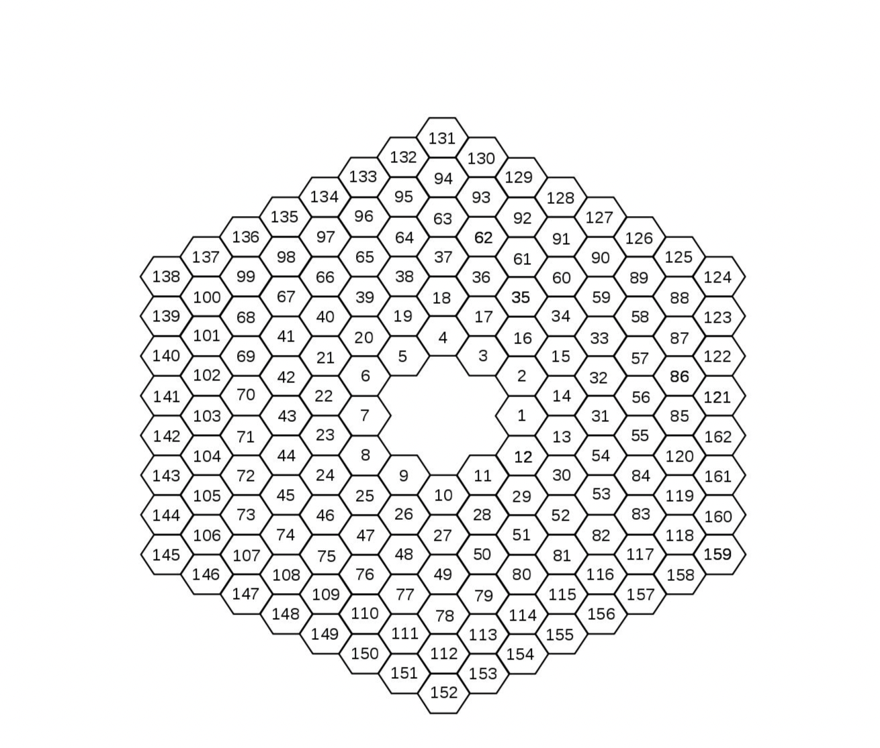
Beam-Beam Monitor (MexNICA Collaboration )
The main purpose of the Be-Be detector is to provide a fast signal T0 with resolution better than 30 ps for TOF system in low energy range of beams collision (⎷s= 4-11 GeV/n) and low mass of colliding particles (down to Carbon-Carbon and proton-proton collisions) where existing Forward Detector is not efficient)
Fast timing scintillation hodoscope with APD readout. Required resolution –better 30 ps)

Slide 14
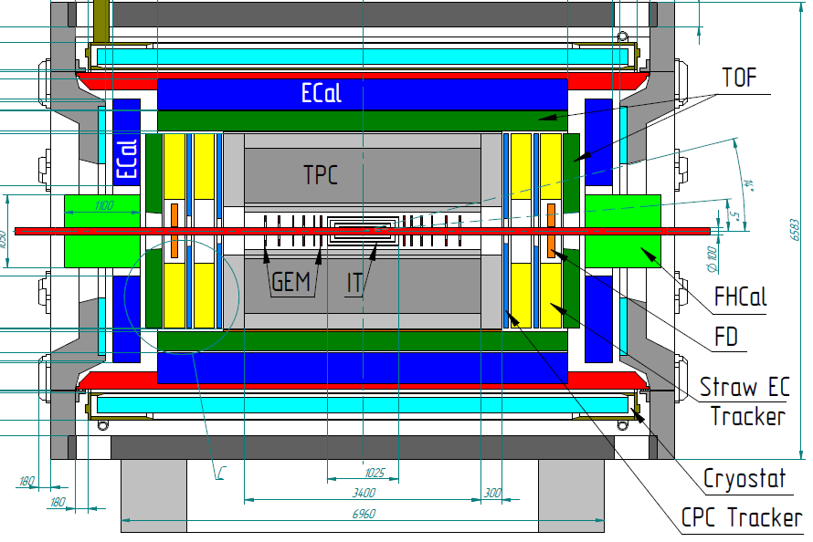
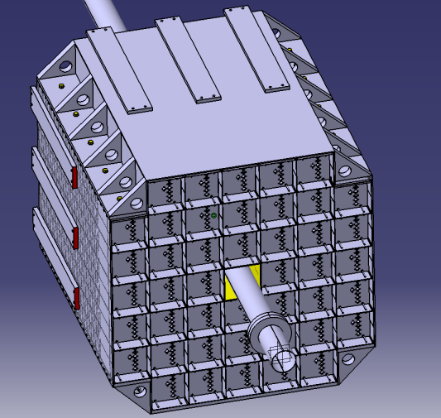
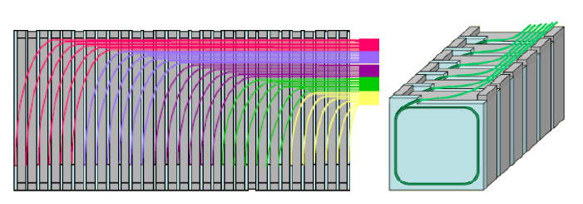
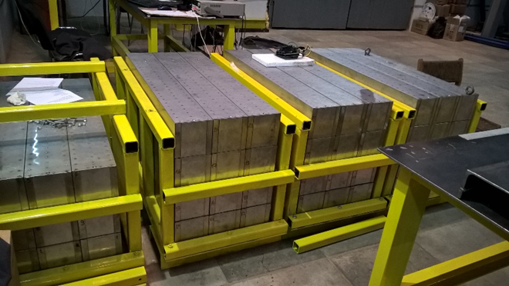
FHCal Forward Hadron Calorimeter
Two-arms at ~3.2 m from the interaction point.
Each arm consists of 45 individual modules.
Module size 150x150x1100cm³ (55 layers)
Pb(16mm)+Scint.(4mm) sandwich
7 longitudinal sections
6 WLS-fiber/MAPD per section
7 MAPDs/module

Slide 15
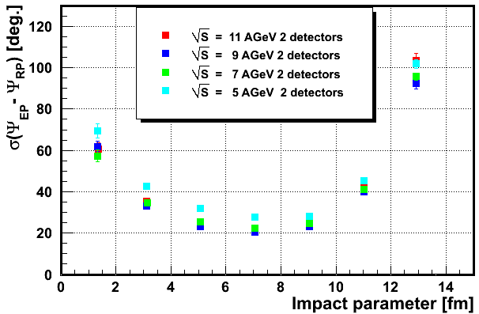
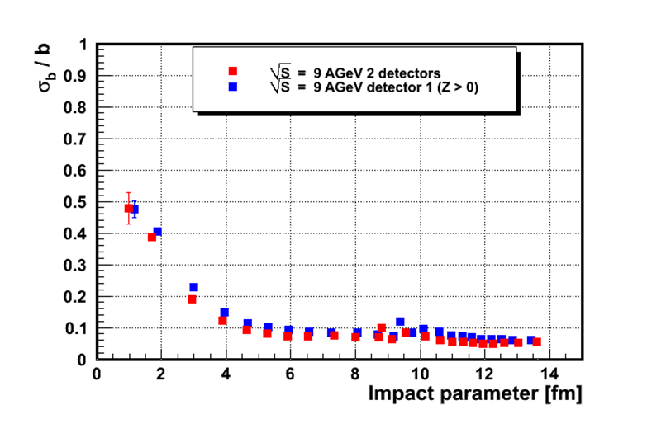
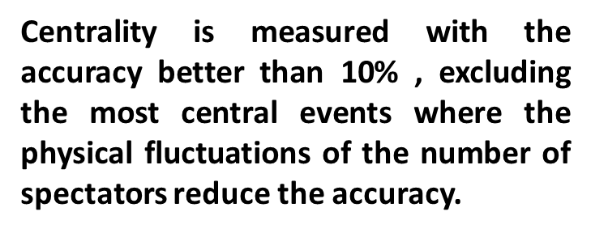

Reaction plane and impact parameter resolution
The accuracy of reaction plane reconstruction is In range 26-31 degrees

Slide 16
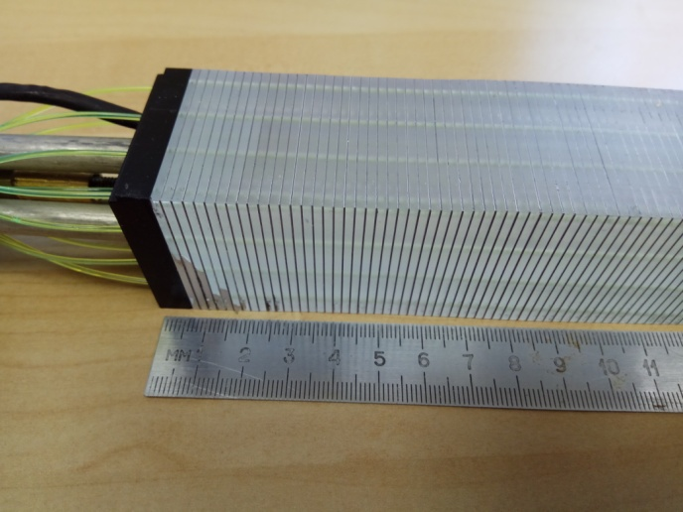
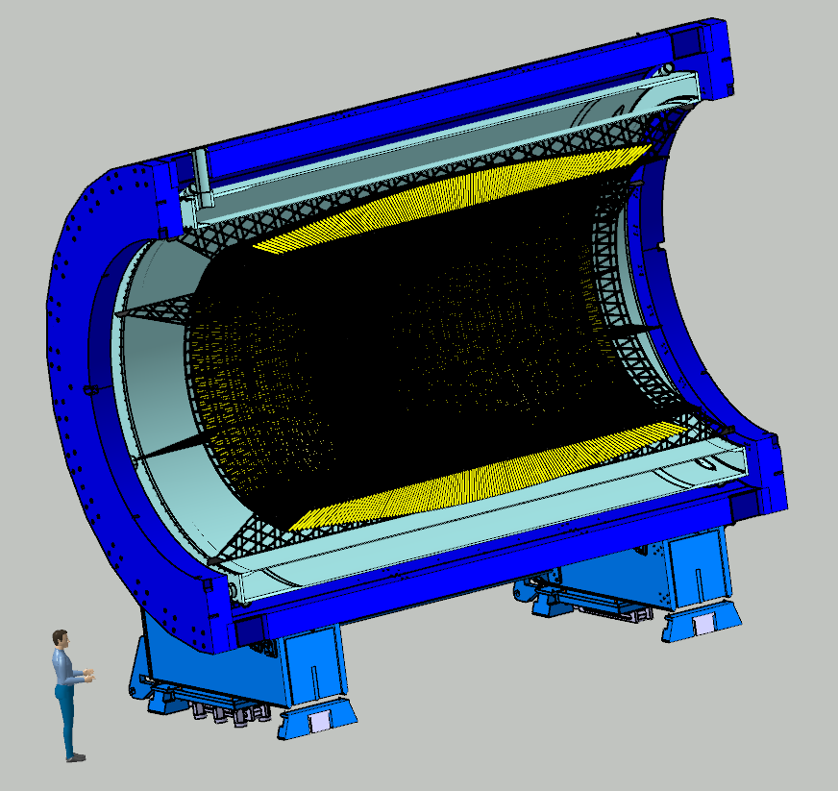
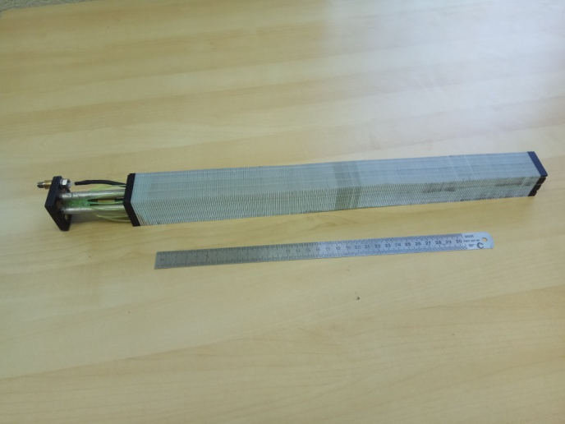
Electromagnetic Calorimeter (ECAL) for Multi Purpose Detector (MPD)
THU – Tsinghua University., Yi Wang
SDU –Shandong University
HU- Huzhou University Fuqing Wang
Prototype of one module
Barrel ECAL ~ 43000 ECAL modules

Slide 17
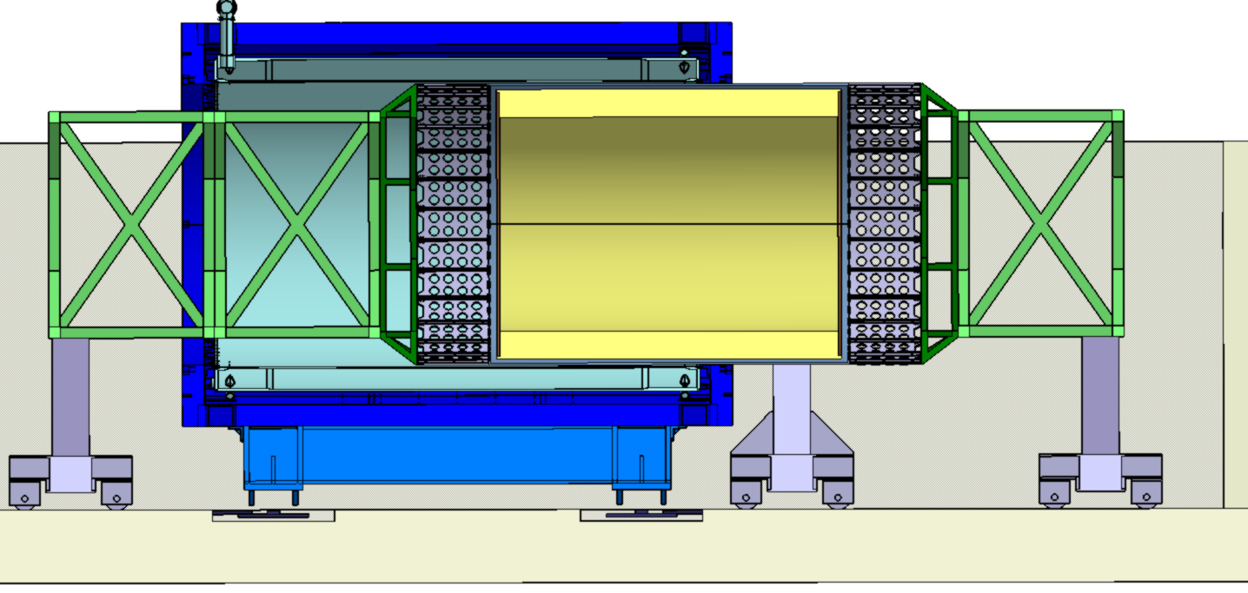
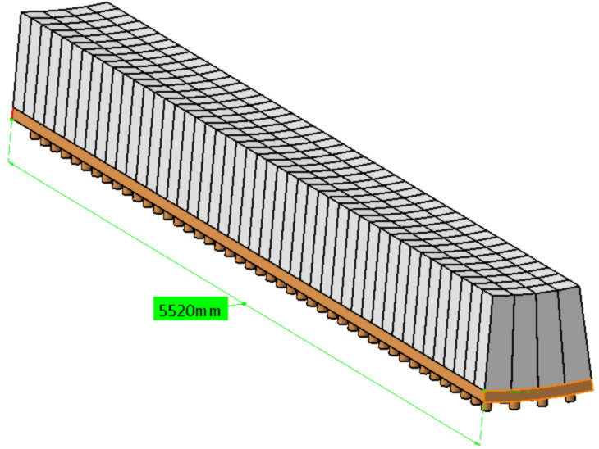
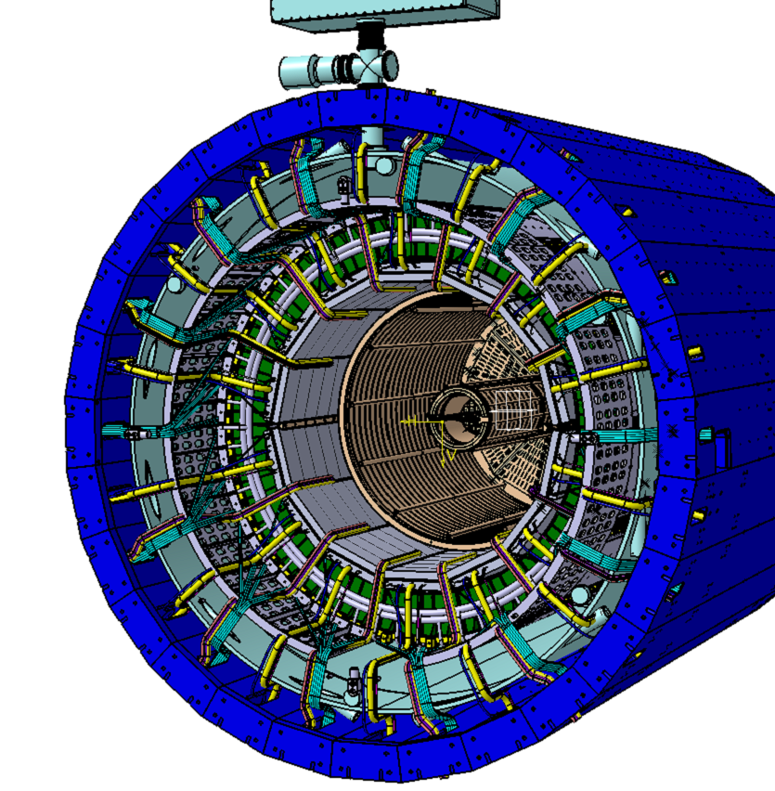
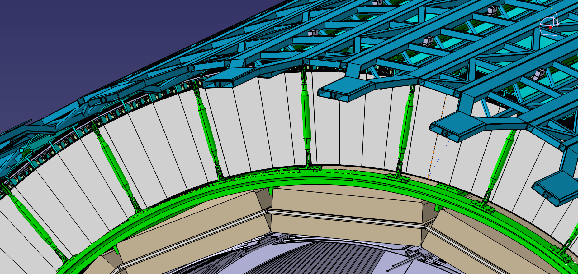
two scenarios of ECal integration
scenario A
scenario B
~ 90 tons
Insertion of the sectors into
the Carbon fiber shell
5 tons
184 towers
5520 mm

Slide 18
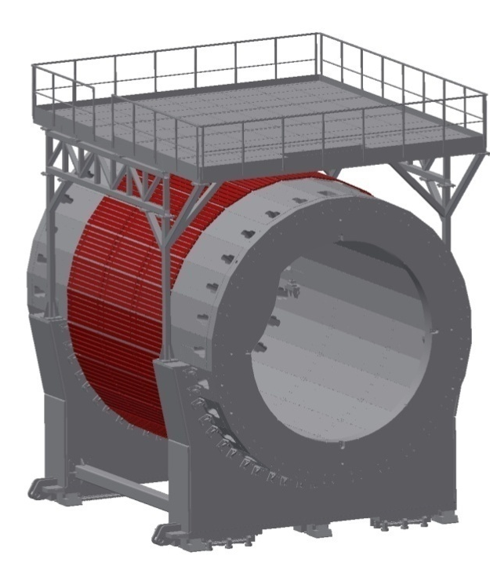
MCORD - MPD Cosmic Ray Detector for NICA
Polish Consortium NICA-PL
The Cosmic Ray Detector is needed for:
- discrimination signals induced by cosmic showers (mainly muons).
- off- beam calibration of the MPD response to muons,
- provide the opportunity for the early tests of the integration of
the Subsystems, Triggering, Experiment Control Systems and others.
Plastic scintillators with light readout as most suitable candidates for a detector module. In the initial stage one need to choose the optimum shape of scintillators, the configuration of photo-detectors and readout electronics.
TH barrel part consists of little bit more than 500 scintillator modules and about 1000 channels of readout electronics (see presentation of Marcin Bielewicz on October 30th)

Slide 19
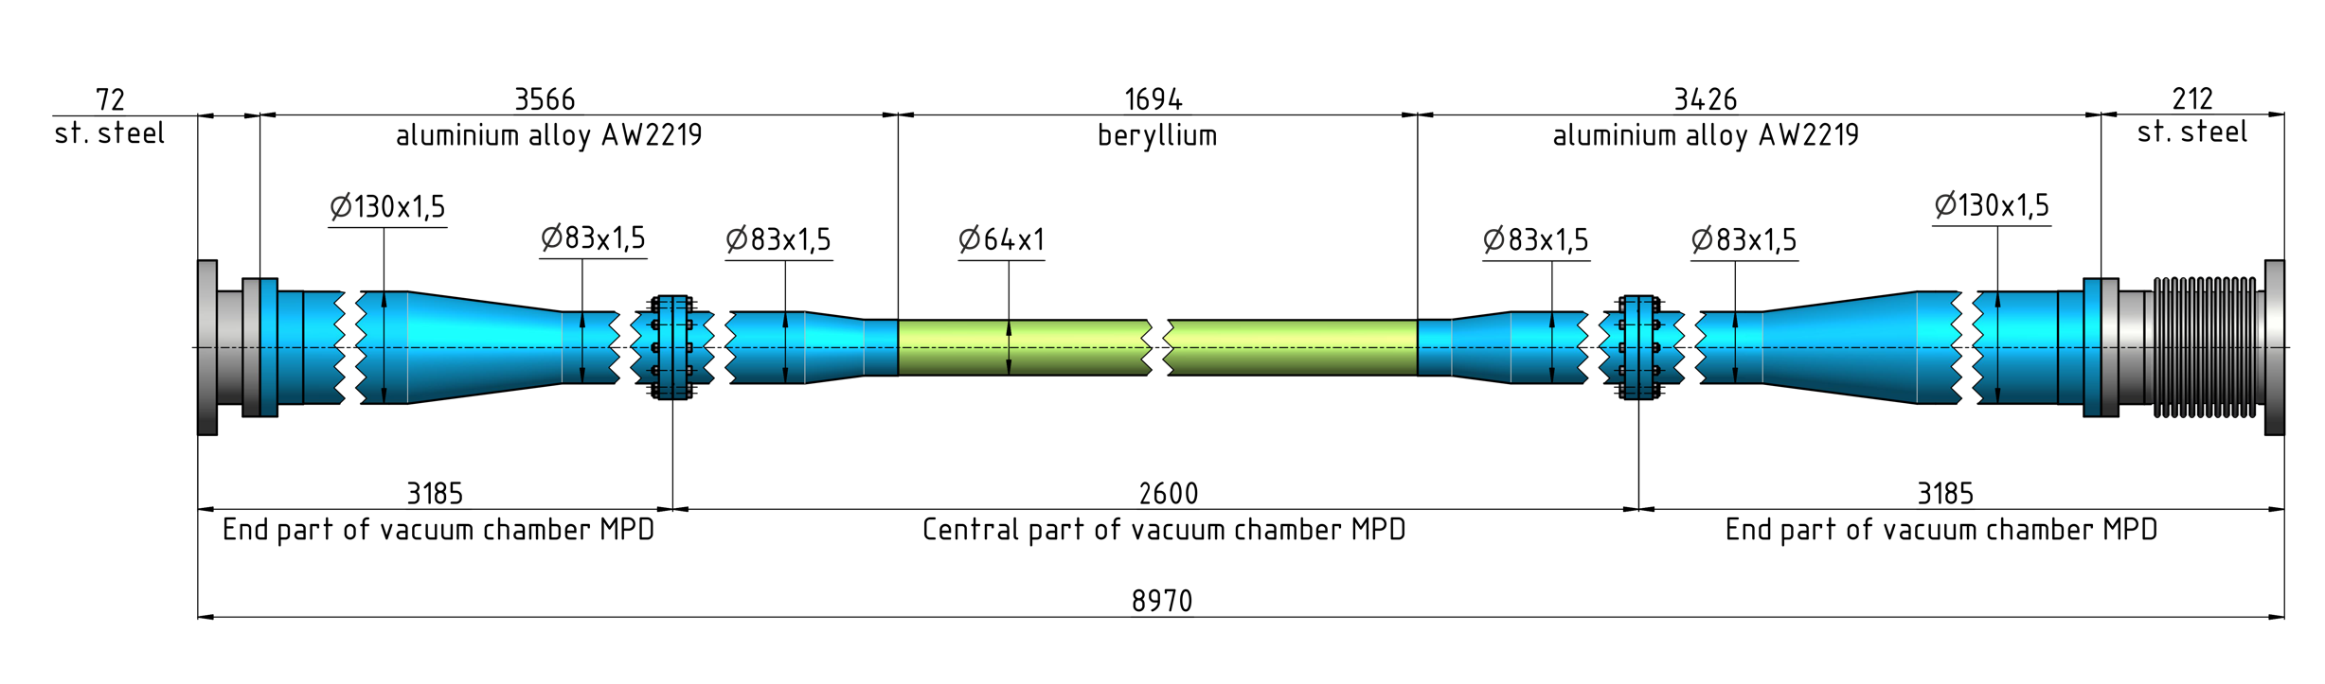
Stage I: 62 mm in diameter

Slide 20
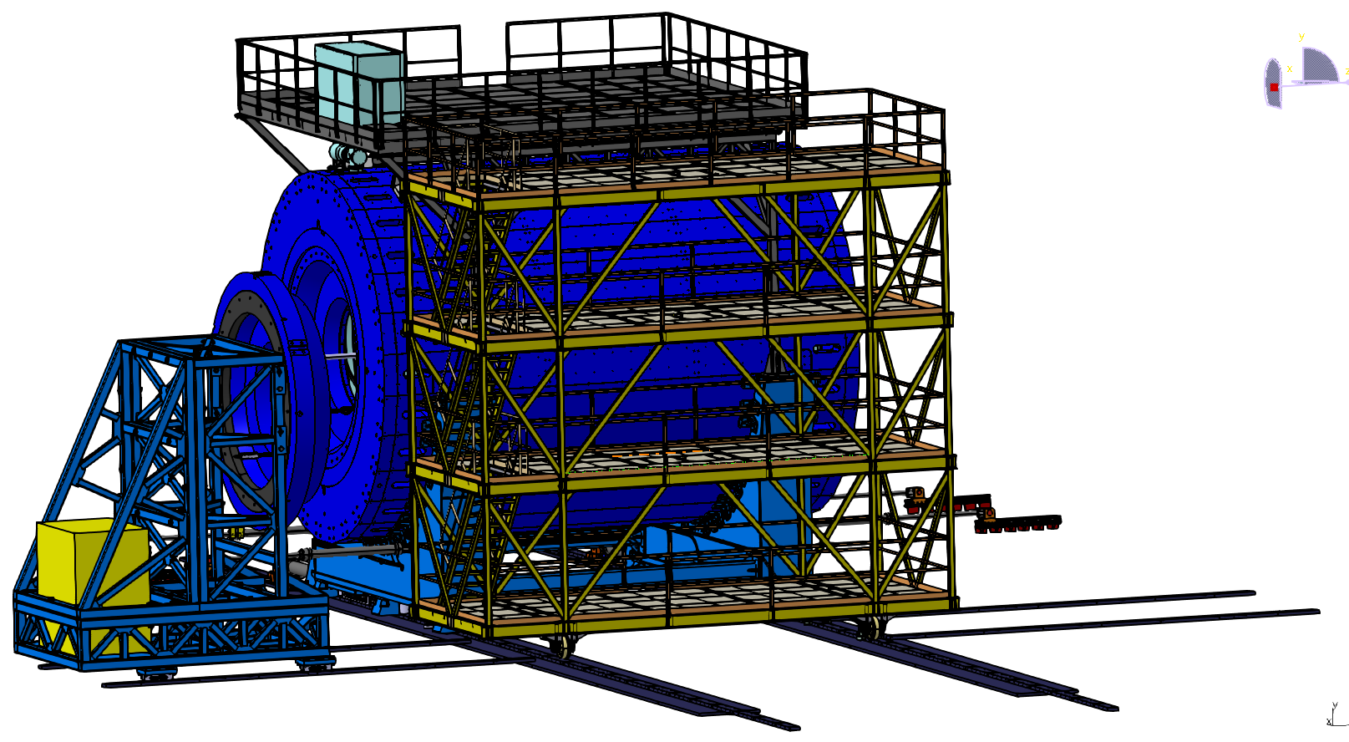
MPD with platforms for electronics and cryogenics
WUT, Warsaw (Coordinator -Marek Peryt) – Rack organization on the MPD platforms
Figure 17; PLATFORM, LEVEL 1-4

Slide 21
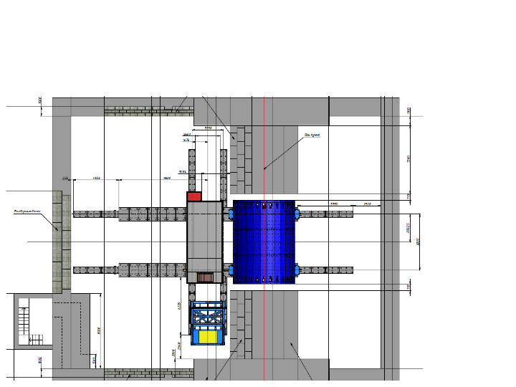

Detector positions in the pit
Detector on the beam
Detector in assembling dock
Beam line

Slide 22


Positions of MPD in the experimental zone
Beam pipe
Detectors for Luminosity tuning
Final focus lenses
Position 1 - Working position, Detector on the beam
Position 2 - Endcaps roll away zone
Position 3 – Detector Assembling area

Slide 23
Summary
Substantial progress in MPD project realization in 2018
(Magnet, Solenoid, TPC, TOF, FFD, FHCal)
The mass production of the detectors elements is under way.
MPD Collaboration → toward the formal foundation
Thank you for your attention!

Slide 24



FFD performance
The start signal resolution for Au + Au collisions at sNN = 5 and 11GeV for the real FFD detector as a function of the impact parameter.
The trigger efficiency as a function of the impact parameter of Au + Au collisions for two energies sNN = 5 and 11 GeV and two thresholds of 500 and 1000 Cherenkov photons.
The time-of-flight resolution for Au + Au collisions at real FFD and TOF detectors as a function of the impact parameter.
sNN = 5 and 11 GeV for the real FFD and TOF detectors as a function of the impact parameter
The vertex uncertainty as a function of the impact parameter of Au + Au collisions, the blue points correspond to sNN = 5 GeV, the red points – to sNN = 11 GeV

Slide 25

ITS for MPD Experimen
Consortium includes JINR, NICA (BM@N & MPD) , FAIR, Russian, Poland and Ukrine Insitutes + CCNU Central China Normal Univ – Wu Han and Feng Liu
IMP- Institute of Modern Physics - Lan Zhou and Nu Xu
USTC – Hefei - Zebo Tang
Λ⁰ → p + π –
Ω¯ → Λ + K¯
└→ p + π –
Ξ¯ → Λ + π –
└→ p + π –
D⁰ → K¯ + π ⁺
MPD ITS based on ALICE type staves
.

