Slide 1
Status of Forward Hadron Calorimeter (FHCal) at MPD
A.Ivashkin
Institute for Nuclear Researches RAS, Moscow
on behalf of the FHCal group (INR, MEPhI, JINR…)
FHCal in MPD/NICA setup;
Tasks of FHCal ;
Approaches in measurement of centrality;
Status of FHCal production;
Tests of FHCal modules;
Open issues.
2nd MPD/BM@N collaboration meeting, October 29-30, 2018.

Slide 2
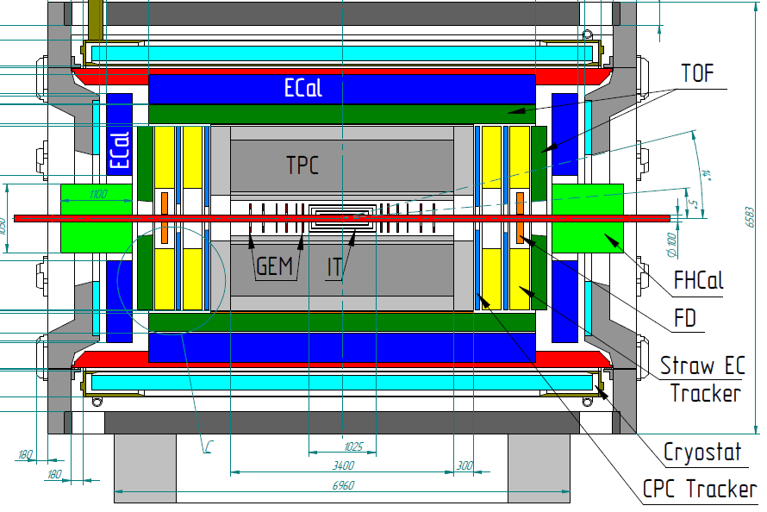
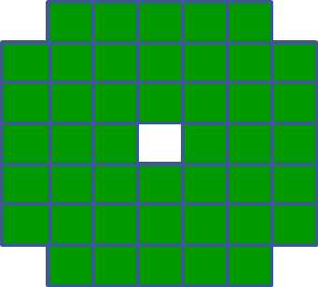
The forward hadron calorimeter in MPD setup
Tasks: detection of spectators to measure:
The centrality of the collision;
The reaction plane orientation.
Physics with spectators.
FHCAL
Two arms of hadron calorimeters at opposite sides in forward regions.
At the distance 3.2 meters from the interaction point.
Available acceptance corresponds to pseudorapidity 2.0<η <5.0
FHCAL consists of 2x44 modules of ~1.1x1.1 m² each part.

Slide 3
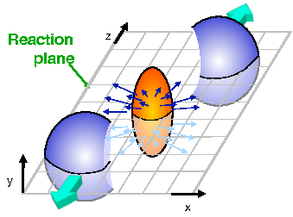
FHCal will detect the spectators to measure the geometry of ion collisions.
Event plane
FHCAL
Spectator spot
FHCal will detect the energy of spectators ☺;
FHCal will detect the space distribution of the spectators ☺.
FHCal will detect the energy of pions in forward region ☹;
By using the spectators energy and space distribution one can determine the centrality and the event plane of collisions.

Slide 4
Structure of FHCal – two left/right arms.
Modular Lead/Scintillator sandwich compensating calorimeter. Sampling ratio Pb:Scint=4:1.
Each arm:
44 modules;
Beam hole;
Weight – 9 tons.
Each module:
Transverse size - 15x15cm² ;
Total length - 106 cm.
Interaction length ~4 λ_{int};
Longitudinal segmentation – 7 sections;
1 section ~ 0.56λ_{int};
7 photodetectors/module;
Photodetectors – silicon photomultipliers (SiPM).
Light from scintillator tiles is captured by WLS-fibers and transported to SiPM.

Slide 5
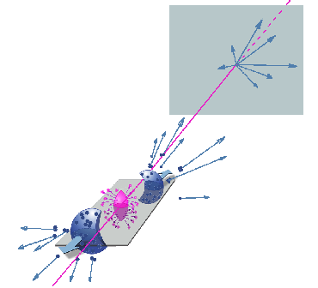
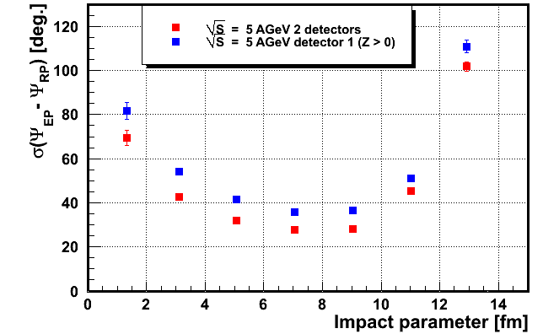
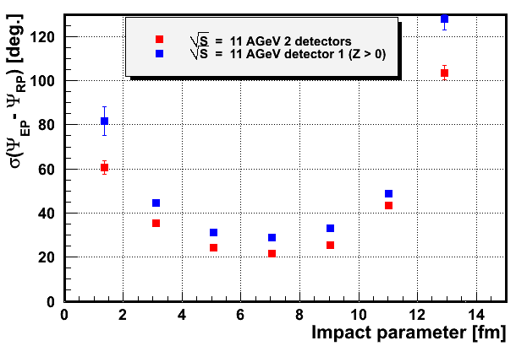
Event plane resolution with FHCal.
Event plane in first FHCal arm.
Event plane in full FHCal.
spectators
The detection of all types of the spectators (protons, neutrons) for both colliding nuclei would ensure nice angular resolution of the event plane!

Slide 6
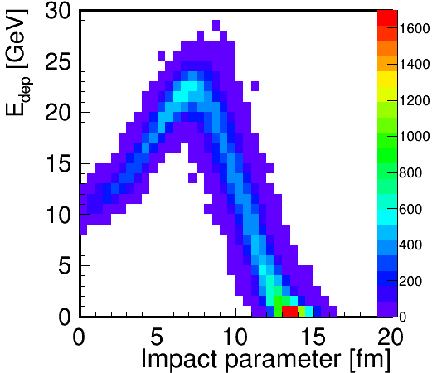
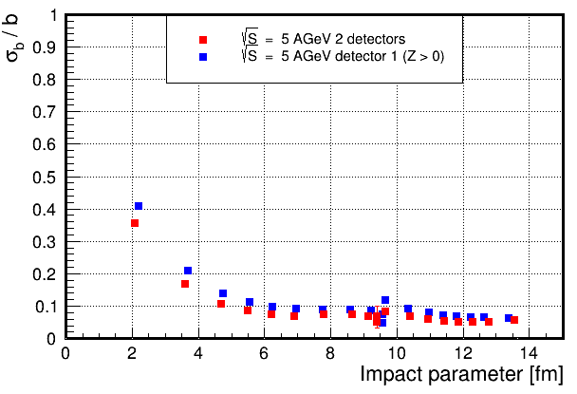
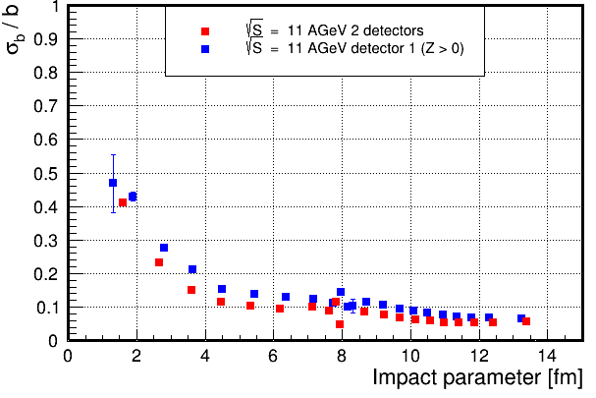
Centrality. Problem with energy depositions in FHCAL.
Effect of beam hole and escape of heavy fragments.
Energy deposition in FHCal isn’t monotonic and can’t resolve the central and peripheral events.
Ambiguity in the centrality measurements might be resolved by using the TPC multiplicity.
But other approaches are preffered.
Resolution of impact parameter for different FHCal energy (centrality) bins.
Other approaches are requested!

Slide 7
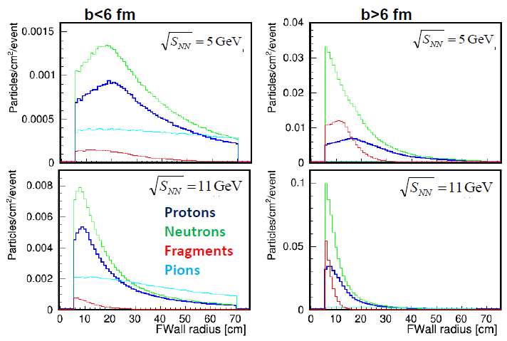
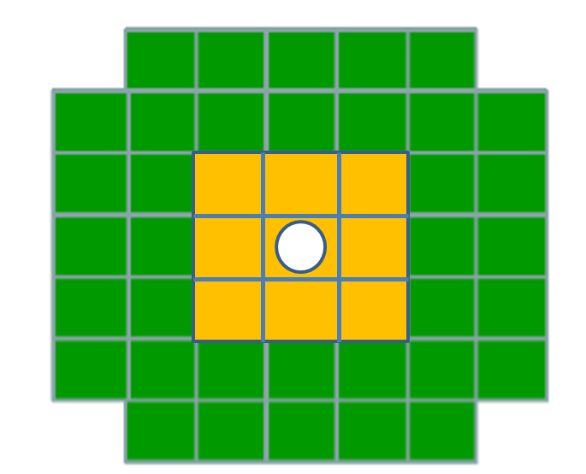
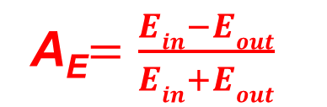
Spectators spots at FHCal surface have different sizes for different centralities.
Occupancy of particles at front of FHCal
b<6 fm
b>6 fm
R, cm
R, cm
Cone for central events
E_{out}
The energy deposition in inner and outer parts of calorimeter must be different for different centralities.
Cone for peripheral
events
E_{in}
Let’s introduce energy asymmetry:

Slide 8
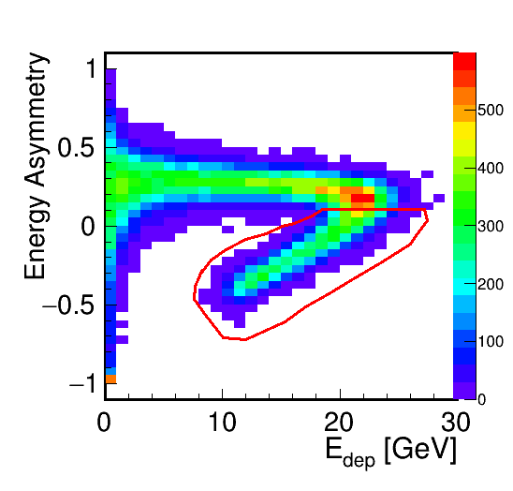
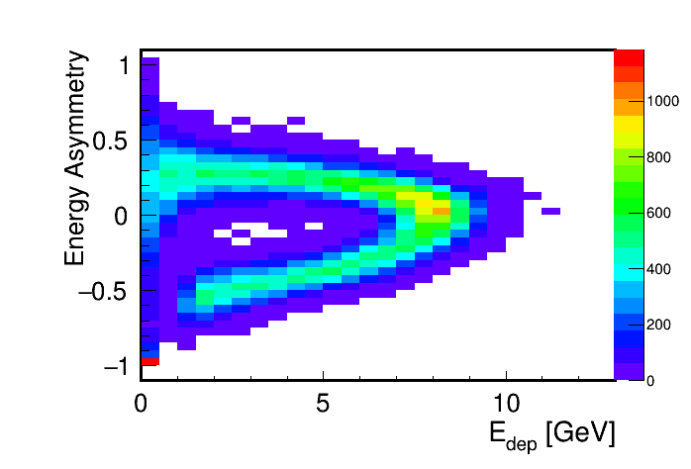
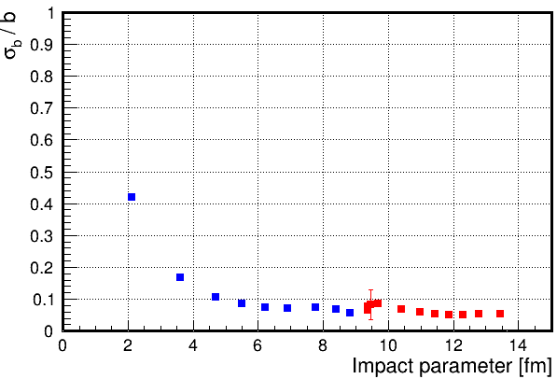
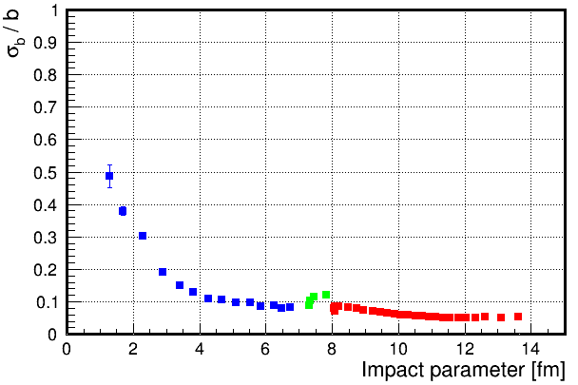
Centrality measurements with two FHCal observables (E_{dep} and A_{E}).
Peripheral events
Peripheral events
0.1
Central events
Central events
With only FHCal the centrality resolution is below 10% excepting the most central, where the fluctuations of spectator energies dominate.

Slide 9
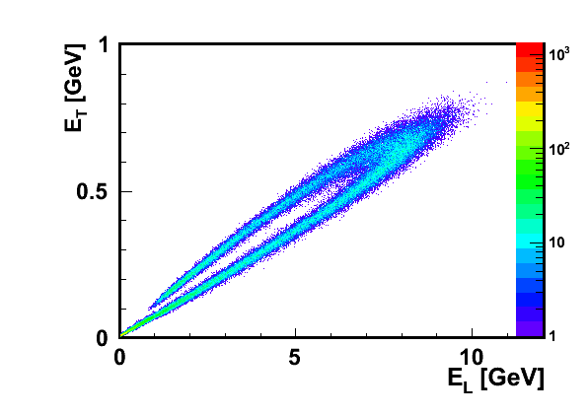
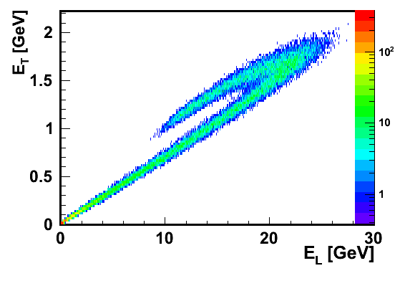


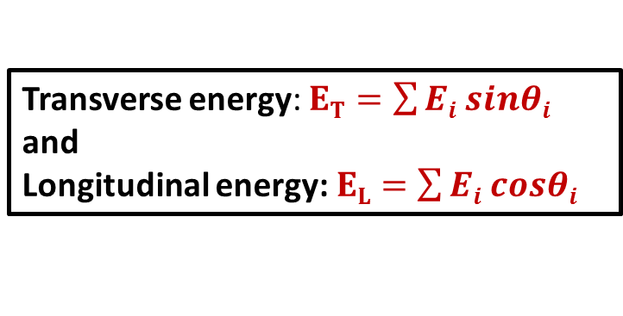

Construction of other observables in FHCal for the centrality measurement.
$$Ei$$
Transverse energy: $ET=\sum{Ei sinθi}$
and
Longitudinal energy: $EL=\sum{Ei cosθi}$
$$θ$$
Cone of spectators
$$Ei$$
A bagel structure in E_{T}, E_{L} correlations.

Slide 10
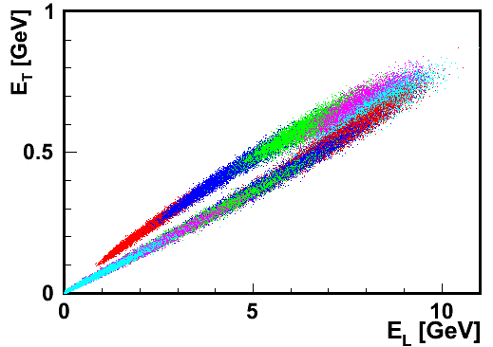
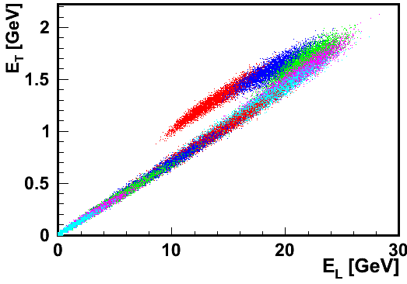
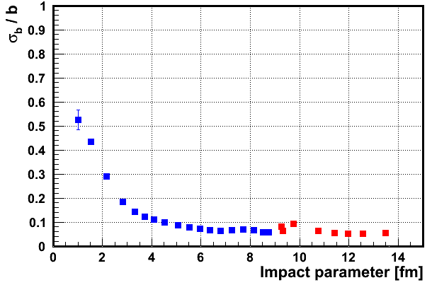
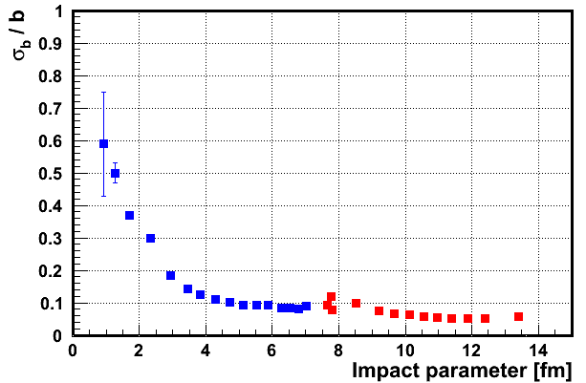
Centrality measurements with E_{T} and E_{L}.
Central events
Central events
Peripheral events
Peripheral events
Each color bin is 10% of centrality.
Each color bin is 10% of centrality.
With only FHCal the centrality resolution is below 10% excepting the most central, where the fluctuations of spectator energies dominate.

Slide 11
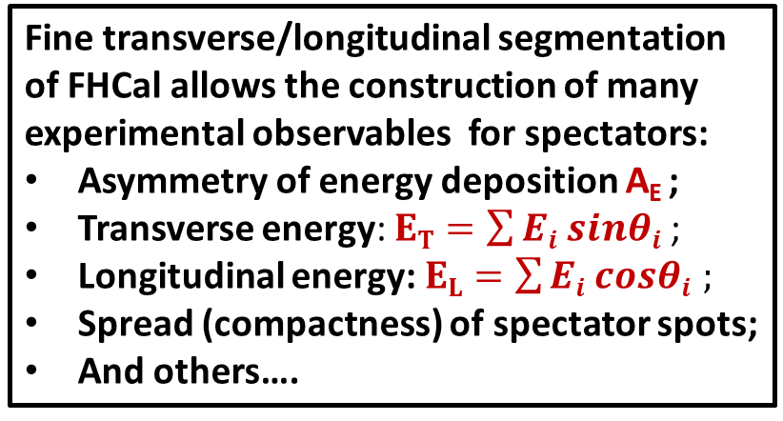
FHCal: Physics case.
Fine transverse/longitudinal segmentation of FHCal allows the construction of many experimental observables for spectators:
Asymmetry of energy deposition A_{E} ;
Transverse energy: $ET=\sum{Ei sinθi}$ ;
Longitudinal energy: $EL=\sum{Ei cosθi ;}$
Spread (compactness) of spectator spots;
And others….
Central events
Peripheral events
These observables would depend on centrality;
These observables would reflect the recoil momenta of the spectators;
These observables would be different in different physics models;
Can spectators probe the fireball ?

Slide 12
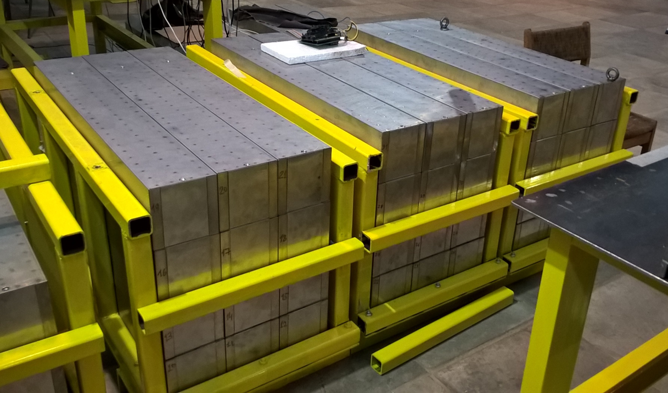
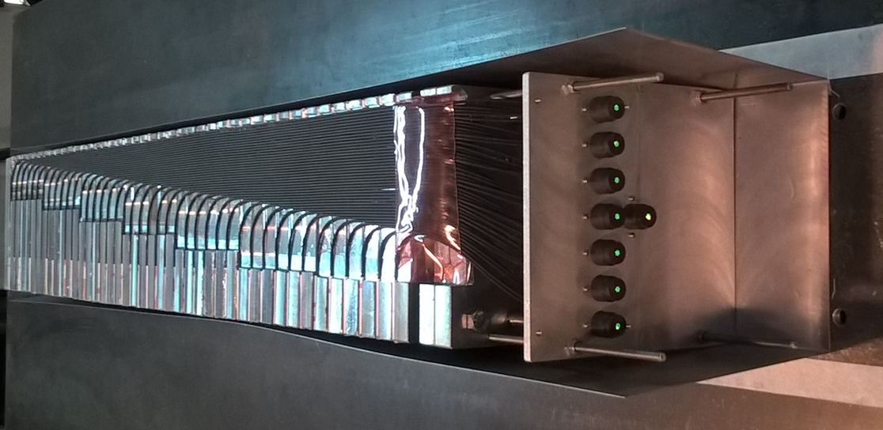
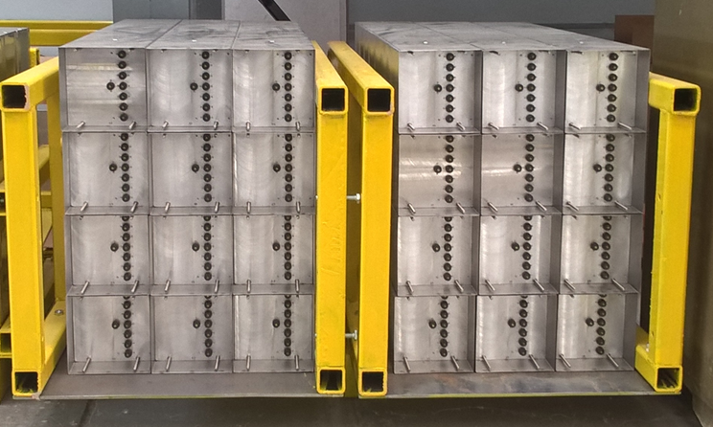
Status of FHCal modules production.
At present, about 2/3 of FHCal modules are ready for the tests.
All FHCal modules will be ready next year.
Tests of modules with cosmic muons are done in parallel with the development of Front-End-Electronics and readout.

Slide 13
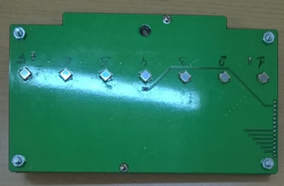
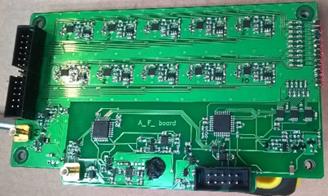
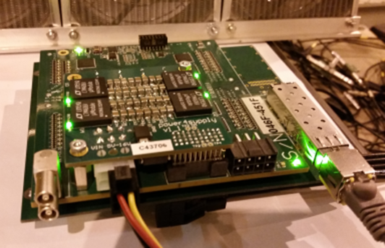
Photodiodes, FEE and readout electronics.
A first samples of FEE with MPPC photodetectors were developed and produced.
Photodetectors:
Hamamatsu MPPC: size – 3x3 mm²;
pixel -10x10 µm²;
PDE~12%.
Front-End-Electronics:
7 channels:
two-stage amplifiers; HV channels;
LED calibration source.
Amp
Integrator
ADC
MPPC
FEE
Δt ~ 50 ns
Δt ~ 200 ns
τ ~ 20ns
The readout electronics: FPGA based 64 channel ADC64 board, 62.5MS/s (AFI Electronics, JINR, Dubna).
Full readout chain was tested with cosmic muons and at beam!

Slide 14
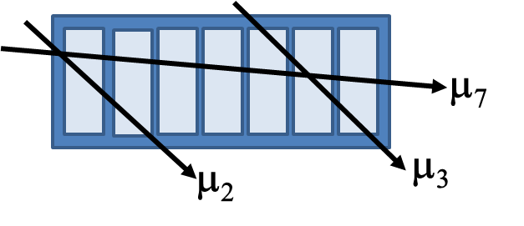
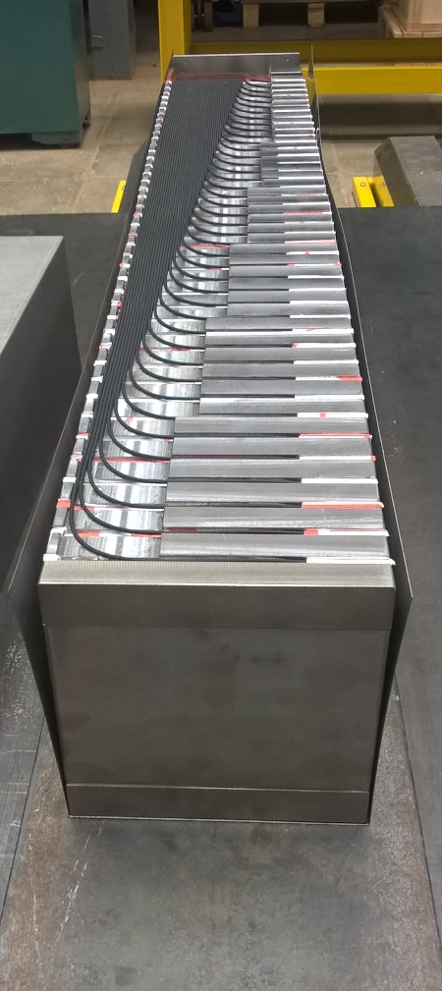
Test of calorimeter modules with cosmic muons.
Geometries of muon tracks in FHCal module.
Tracks passed through 2, 3 or all of 7 sections were studied.
After assembling each module was tested.
Light yield depends on WLS-fiber length.
Light yield [ph.e.]
Section #
Average light yield for 50 modules.

Slide 15
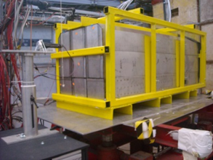
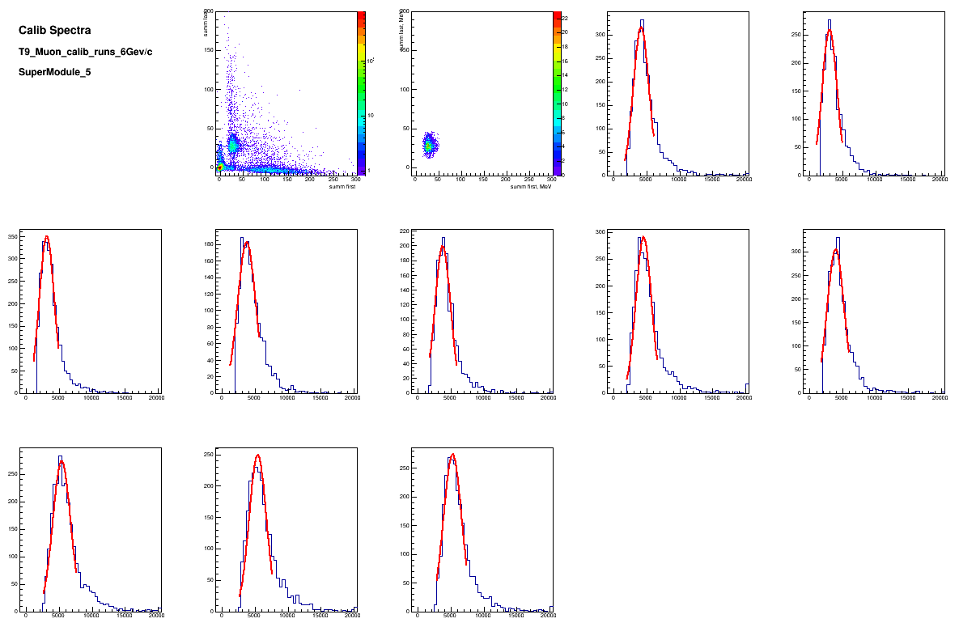
Test of calorimeter supermodule at CERN T9/T10 line.
Proton momentum range: 2-10 GeV/c
Each module has 10 longitudinal sections with 10 SiPMs at the end (CBM option).
Full size 60x60x160 cm³.
Readout electronics – for FHCal.
Calibration of longitudinal sections with beam muons, 6 GeV/c
Identification of muons – equal energy deposition in first and last half of modules.
Muons deposit
~5 MeV
in each section
E₂ [MeV]
Sect. 1
Sect. 2
E₂ [MeV]
E₁ [MeV]
E₁ [MeV]
A [ch]
A [ch]

Slide 16
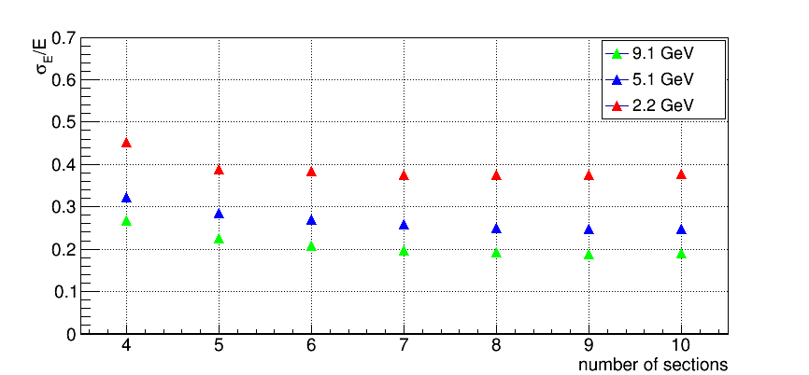
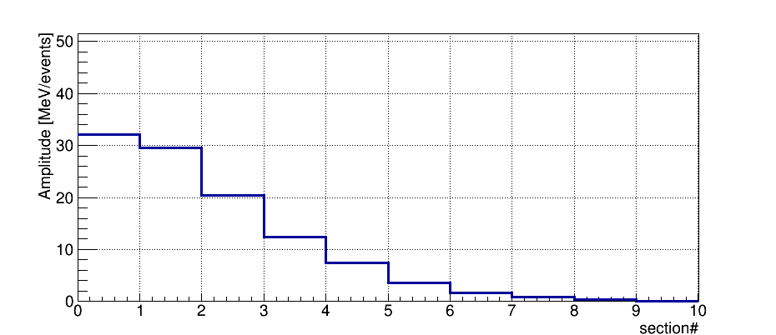
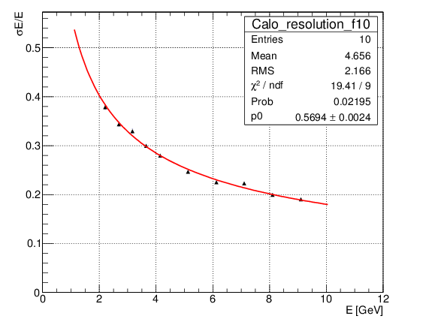

Dependence of energy resolution on supermodule length.
Longitudinal profile of hadron shower.
Dependence of resolution on module length.
p= 6 GeV/c
Length of 4λ_{I} or 7 longitudinal sections is optimum for momentum range 2-6 GeV/c
$$\frac{σE}{E}=\frac{a}{\sqrt{E}}$$
The stochastic term of ~56% is in good agreement with MC results.

Slide 17
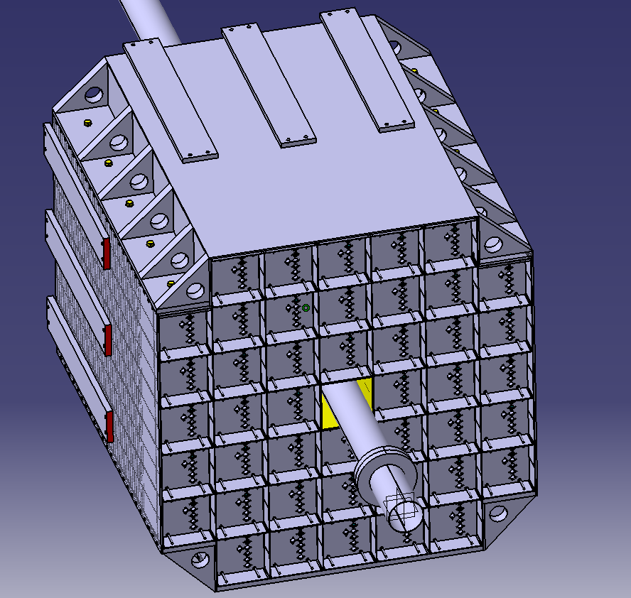
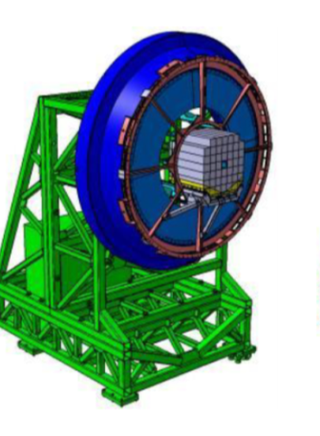
Open issues.
Mechanical support. The concept only.
Mass-production of FEE and readout.
Simulations: detector performance and physics performance.
Calibration with cosmic muons in real setup.
Software for FHCal data analysis.
Beam quality study with FHCal.
Power supplies. Mounting of readout elements. Full integration to MPD.
Operation manpower.
Magnet pole with FHCal.

Slide 18
Thank you!

Slide 19
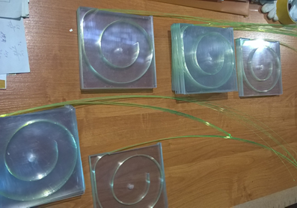
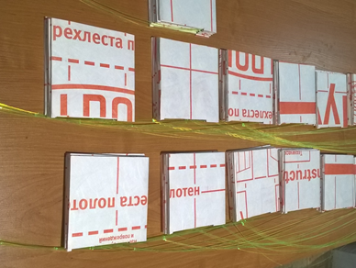
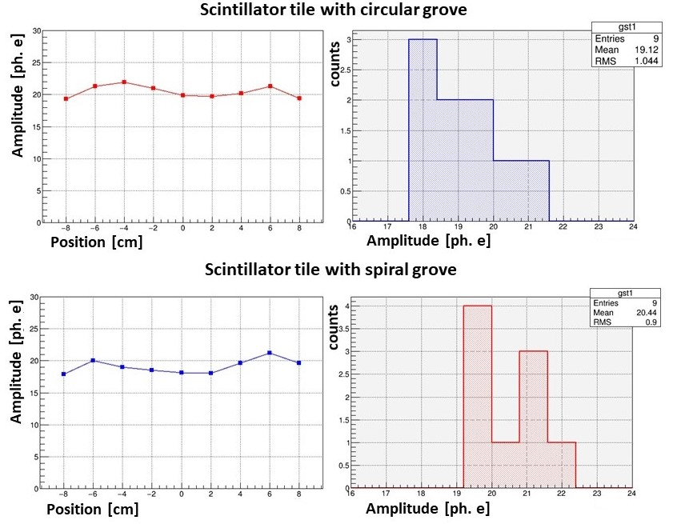
Stages of FHCal production: scintillators.
FHCal scintillator tiles and modules are assembled in workshop of INR, Moscow.
Scintillator tiles with WLS-fibers.
Scintillator tiles in TYVEC reflector.
Tests of different grooves and reflectors
Permanent quality control of scintillator tiles,
WLS-fibers and gluing is performing with ⁹⁰Sr β-source.

Slide 20
Occupancy.

Slide 21
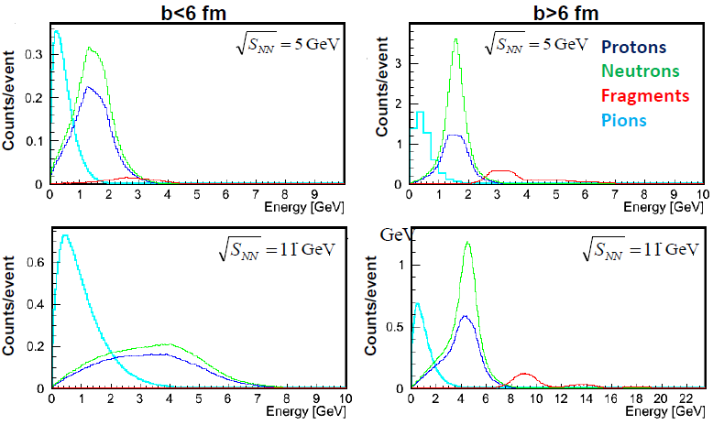
Energy spectra.

Slide 22
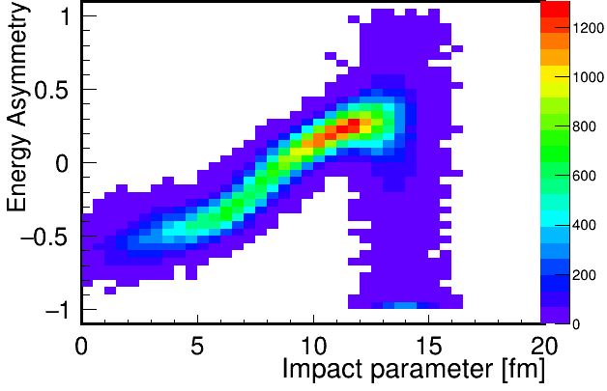
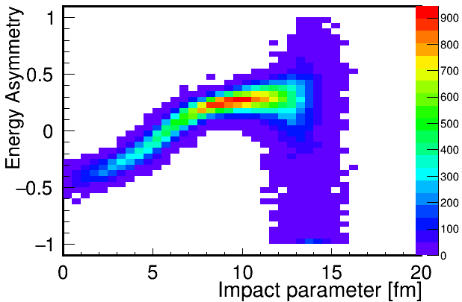
Other FHCal observable for the centrality measurement.
E_{out}
Let’s introduce energy asymmetry:
E_{in}
Dependence of A_{E} on impact parameter.
A_{E} is experimental observable and has clear dependence on centrality. Let’s combine it with energy deposition in FHCal.

