Slide 1


ECAL R&D in Tsinghua University
The 2nd collaboration meeting of the MPD and BM@N experiments
at the NICA facility
Dubna, Ruissa, 29-30 October 2018
HAN Dong(韩冬)
Department of Engineering Physics, Tsinghua University

Slide 2

outline
1
  Introduction
2
  Simulation
3
  Key Technology
4
  Beam Test
5
  Collaboration
6
  Summary

Slide 3
outline
1
  Introduction
2
  Simulation
3
  Key Technology
4
  Beam Test
5
  Collaboration
6
  Summary

Slide 4
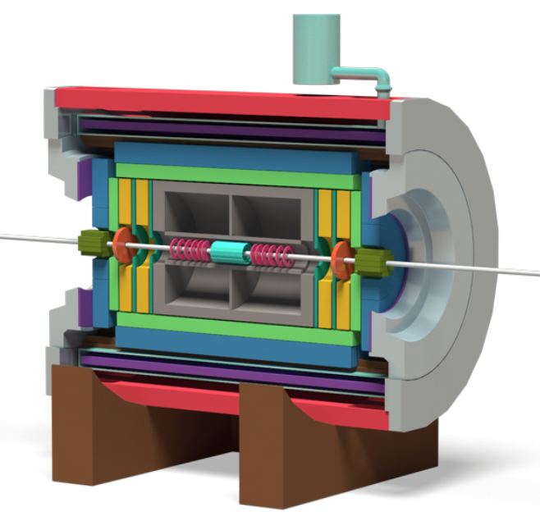
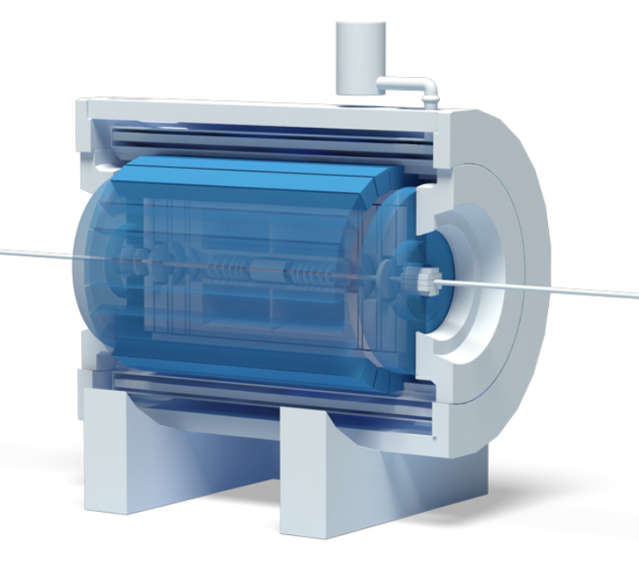
1
  Introduction
MPD: Multi-Purpose Detector
4π spectrometer capable
Total charged particle multiplicity : 1000+
Beams from р to Au
L : 10²⁷ (Au), 10³² (р)[см⁻²с⁻¹]
√ S_{NN} : 4-11 GeV
High Luminosity : 6 kHz
Central Detector
ECal
Notes:
左图为mpd中心探测器的完整结构，有图蓝色部分为电磁量能器，mpd探测器的具体性能特点列举如下。This is the general view of MPD detector, and the blue ones is ECAL. The main task for MPD ECal is to reduce the false identification of hadrons as electrons(positrons) to large extent.
The experimental study of dileptons in heavy-ion collisions is a challenging task. The main difficulty is a huge combinatorial background of uncorrelated lepton pairs which mainly come from πº Dalitz decays and photon conversion in the detector material. A special attention should be paid to reduce this background as much as possible. The main task for MPD ECal is to reduce the false identification of hadrons as electrons(positrons) to large extent.

Slide 5
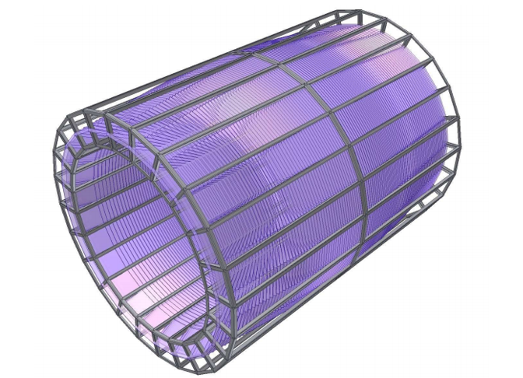
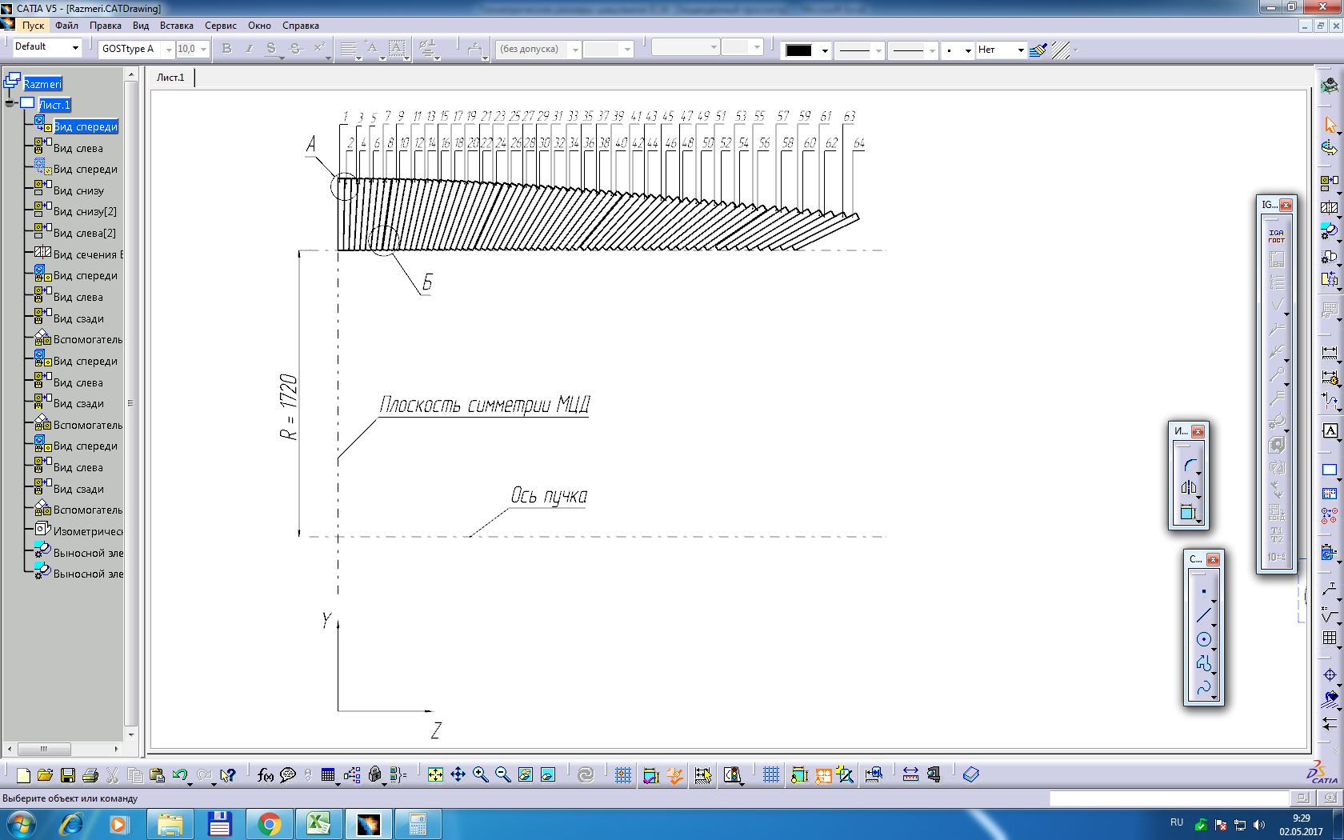
1
  Introduction
The whole barrel part of MPD electromagnetic calorimeter will be constructed from 48 sectors.
Basic requirements
High segmentation;
Large enough distance to the vertex;
Dense active medium with the small Moli’ere radius;
Adequate space resolution;
Small shower overlaps;
The particle occupancy should not exceed 5%;
Calorimeter must be able to operate in the magnetic field up to 0.5T;
Time resolution should be at least below 1ns ;
Notes:
左图为电磁量能器的模拟图，如左图所示，整个barrel共分为48个sectors，右图为其中一个sector的剖面图。电磁量能器的具体性能要求如下。

Slide 6
1
  Introduction
Structure diagram of shashlik Ecal (one tower)
16 WLS fibers
SiPM
396mm 220 layers
one layer：1.5mm scintillator+0.3mm lead
Supporting plat
Lead tile
(powder painting)
Scintillator tile
Parameters of tower
Transverse size, mm² | 40 x 40 | Scintillator thickness, mm | 1.5
WLS fibers | 16 | Molière radius, mm | 62
Number of layers | 220 | Radiation length, X₀ | 11.8
Lead absorber thickness, mm | 0.3 | Effective radiation length, mm | 32.4
Notes:
这是电磁量能器其中一个tower的结构示意图，共有220层铅片和闪烁体片相互堆叠制成，内部共安装有16根波长转换光纤，具体尺寸如表所示

Slide 7
outline
1
  Introduction
2
  Simulation
3
  Key Technology
4
  Beam Test
5
  Collaboration
6
  Summary

Slide 8
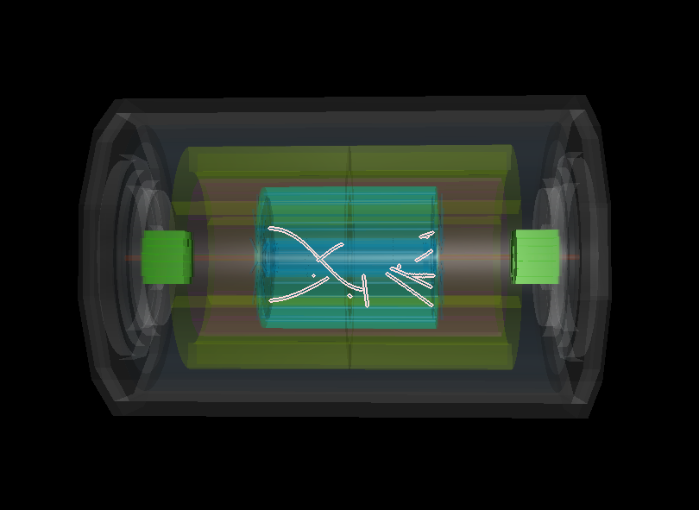

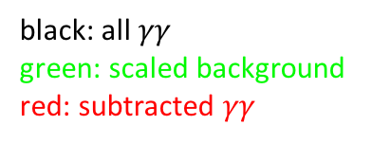

2
  Simulation
Neutral pion Reconstruction
Method
Photon selection
$χ^{2}$ $≤$ 15.0 E$/p≤$ 0.8
Conditions
geometry:stage1
(TPC+TOF+EMC+ZDC)
generator: HYP (5000 $π^{0}$)
Invariant mass reconstruction
Subtract the Background
Event mixed method and scaling
Result
Preliminary
black: all $γγ$
green: scaled background
red: subtracted $γγ$
Notes:
备注：目前$π^{0}重建结果是理想情况下重建，并非实际重离子碰撞，实际情况下的重建需要进一步优化cut条件以及重建方法。$

Slide 9
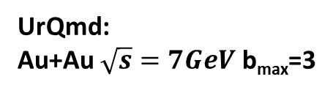
2
  Simulation
ECal Time Cut
UrQmd:
Au+Au $\sqrt{s}=7GeV$ b_{max}=3
Distribution of arrival time, Rho and Z in ECal
Profile along X of Z-Time distribution
With time < 10 ns cut
Notes:
To get a better reconstruction of $π^{0}$, we have to take the EMC information into condition, such as the arrival time and cluster characteristic.
The distribution of arrival time as a function of Z position is shown in the upper left (of the 1st figure), and the distribution of Rho and Z position in EMC is shown in the upper right picture. With a 10ns cut, the corresponding distributions are shown in the lower pictures. The second figure shows the profile of the distribution of time along Z. We can see that the time cut helps a lot in the photon selection, further work is ongoing.
备注：进一步想通过EMC给出的时间信息以及cluster的特性进行photon的筛选，有可能会问到
1）time cut对$π^{0}$重建结果的优化如何，这是我们正在进行的工作，目前还未有结果。
2）为什么选区10ns？ 目前是通过Z Rho的分布初步选取，更详细的工作正在进行，比如大于10ns信号的来源等。

Slide 10
outline
1
  Introduction
2
  Simulation
3
  Key Technology
4
  Beam Test
5
  Collaboration
6
  Summary

Slide 11
3
  Key Technology
Improve NPE output:
1. the process of the end of WLS fiber
2. the painting method of lead plates
3. the wrapping method of modules
Production architecture and tools:
1. compress tools, pressure strength, compress time
2. cutting architecture
3. connection with SiPM
4. QA and QC method (length, weight, cosmic ray, NPE,…)

Slide 12
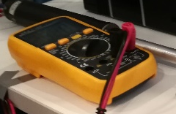

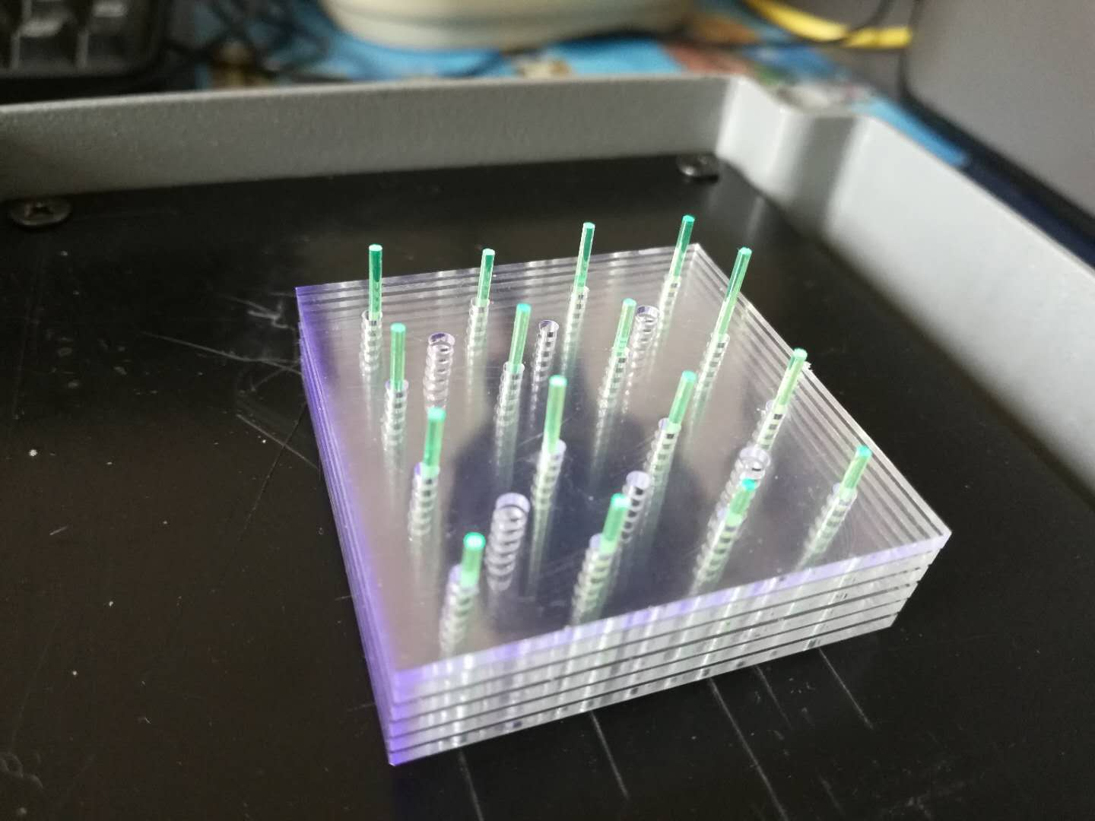
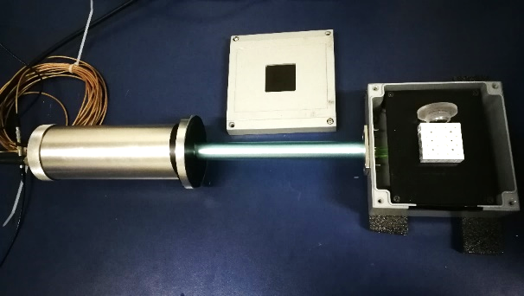
3
  Key Technology - improve NPE output
WLS fiber end reflective materials test setup
Sr-90/Y-90
Reflective materials
β
6 scintillator tiles
V
16 WLSF
PMT
Dark Box
Notes:
我们测试了介于铅板和闪烁体板之间的反射材料的反射性能。实验装置与之前的相似，区别在于更改了铅片与闪烁体片的堆叠方式以便于得到更可靠的实验结果。下图为多种不同的测试使材料

Slide 13
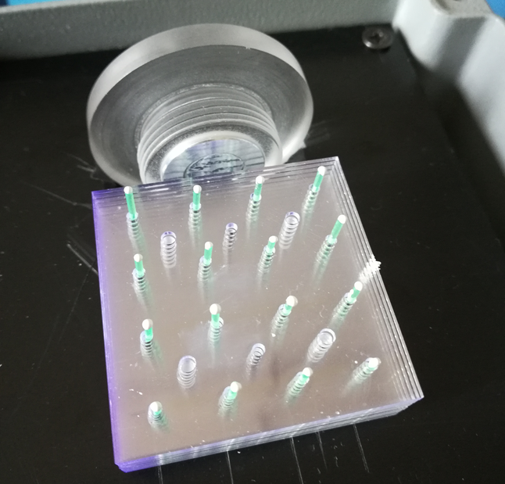
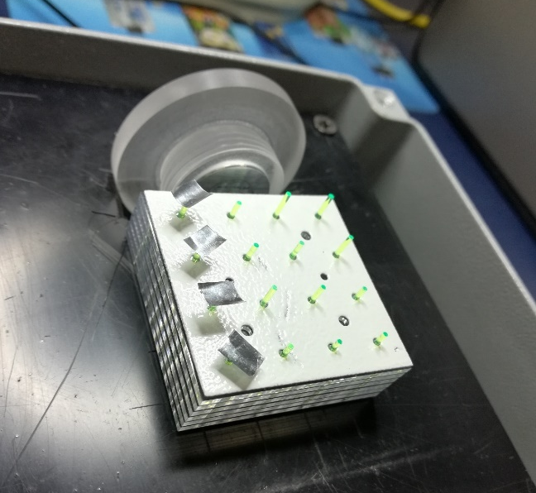
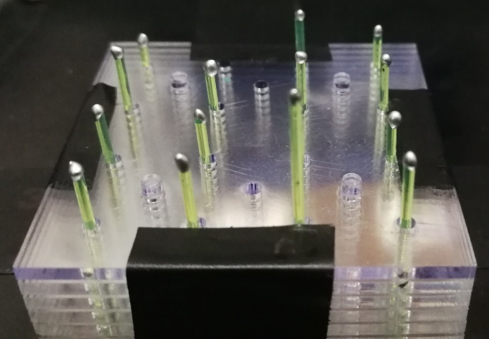
3
  Key Technology - improve NPE output
WLS fiber end reflective materials test result
Silver ink
TiO2 + Epoxy Resin
Used for the 1st and 2nd Chinese module
Silver tape
Materials | Voltage (mV) | Improvement
No reflective materials | 45
Silver ink | 55 | 21%
TiO₂ | 63 | 42%
Silver tape | 72 | 64%
Notes:
同时实验结果可以看到，silver ink可以增加21%的光输出，与之前的测试结果相吻合，tio2与环氧树脂的混合物可以增加42%的光输出，特别地，我们测试了一种银胶带，可以提高64%的光输出。

Slide 14
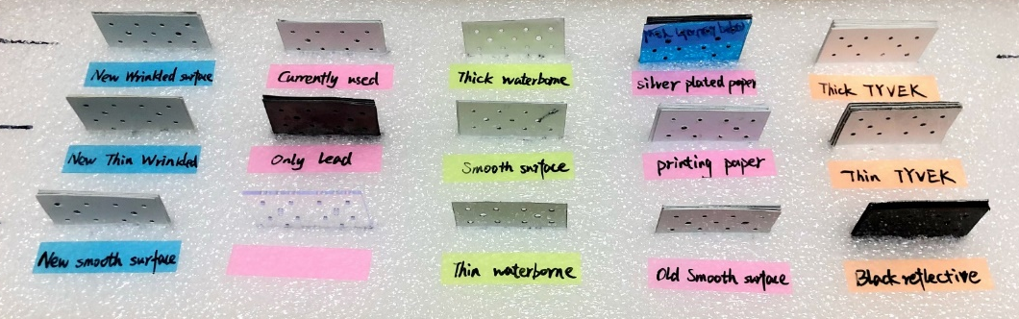
3
  Key Technology - improve NPE output
Lead surface reflective material test setup
Sr-90/Y-90
Lead
Reflective materials
β
scintillator
16 WLSF
PMT
Dark Box
V
Different reflective materials
Notes:
不仅如此，我们还测试了介于铅板和闪烁体板之间的反射材料的反射性能。实验装置与之前的相似，区别在于更改了铅片与闪烁体片的堆叠方式以便于得到更可靠的实验结果。下图为多种不同的测试使材料

Slide 15
3
  Key Technology - improve NPE output
Lead surface reflective material test result
Material | voltage(V) | Reflectivity | Thickness (μm)
Thick TYVEK | 0.495 | 0.870 | 544.5
Thin TYVEK | 0.455 | 0.800 | 181
NO.1 | 0.455 | 0.800 | 104
NO.2 | 0.445 | 0.782 | 62
NO.3 | 0.415 | 0.730 | 62.5
NO.4 | 0.405 | 0.712 | 124
NO.5 | 0.405 | 0.712 | 61.5
NO.6 | 0.405 | 0.712 | 81.5
NO.7 | 0.395 | 0.695 | 70.5
NO.8 | 0.395 | 0.695 | 61
NO.9 | 0.395 | 0.695 | 116
Silver plated paper | 0.395 | 0.695 | 145
Only lead | 0.385 | 0.677 | 0
Black reflective surface | 0.375 | 0.659 | 137
Powder painting
Dubna Prototype
THU Prototype
Notes:
如图所示，我们以thin Tyvek 作为参考，即反射率为80%，从而得到了所有材料的相对反射效率，其中厚tyvek最好，但是厚度不达标，同时，我们还测试了多种喷塑材料，其中厚度达标且反射率较好的材料已经被找到，该材料将会用于接下来的测试，红框标出的是已经制作完成的原型机所使用的材料。

Slide 16
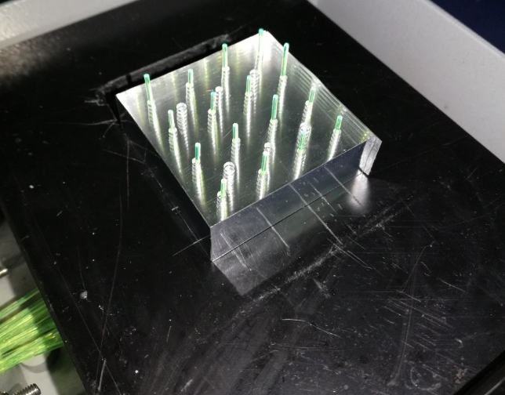
3
  Key Technology - improve NPE output
Test setup of the reflective material on the outside of the modules
Sr-90/Y-90
β
6 scintillator tiles
Reflective materials
(4 sides)
V
16 WLSF
PMT
Dark Box
Notes:
不仅如此，我们还测试了介于铅板和闪烁体板之间的反射材料的反射性能。实验装置与之前的相似，区别在于更改了铅片与闪烁体片的堆叠方式以便于得到更可靠的实验结果。下图为多种不同的测试使材料

Slide 17
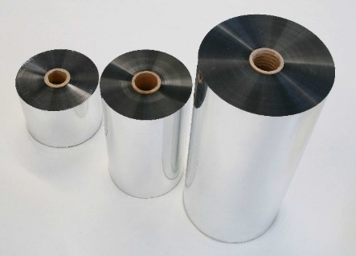

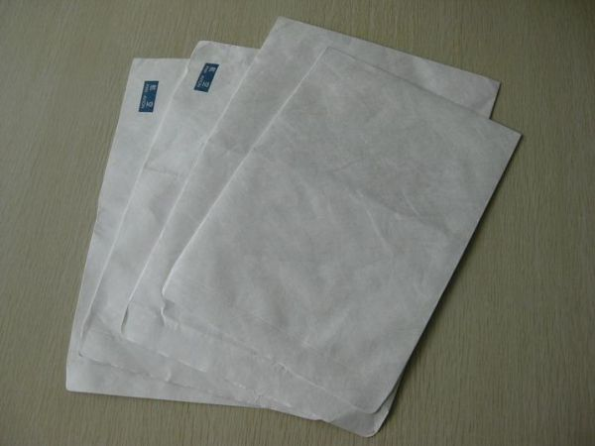
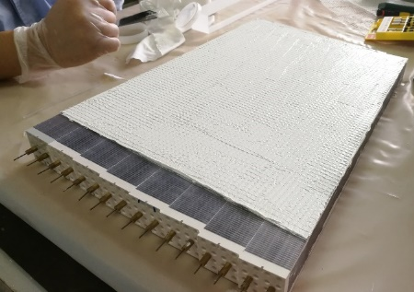
3
  Key Technology - improve NPE output
Test results of the reflective material on the outside of the modules
Materials | Voltage (mV) | Improvement
No reflective materials | 37
Silver paper | 64.5 | 74%
Printing paper | 57 | 54%
Tyvek paper | 66 | 78%
TiO₂ + glue | 59.5 | 61%
Silver paper
Printing paper
Tyvek paper
TiO₂ + glue

Slide 18
3
  Key Technology - improve NPE output
Combining the three tests above , the light yield can be improved by 50% by improving the module’s materials.
 | THU1 & THU2 | Next prototype
Fiber end | TiO₂+glue | Silver tape
Lead surface | Powder painting No.6 | Powder painting No.2
Module surface | TiO₂+glue | Tyvek
Improvement of light yield |  | 50%

Slide 19
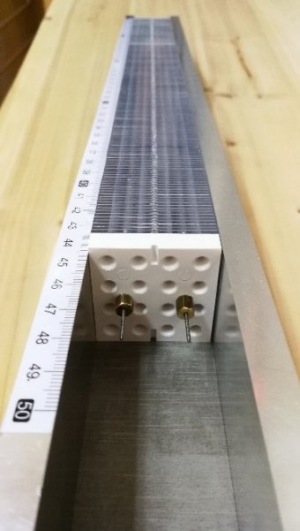
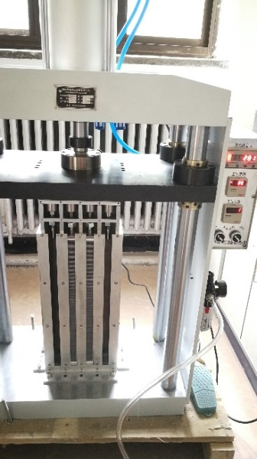
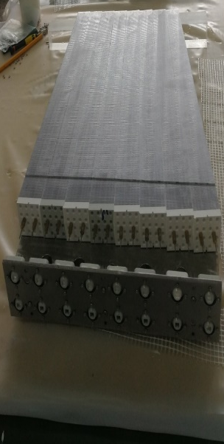
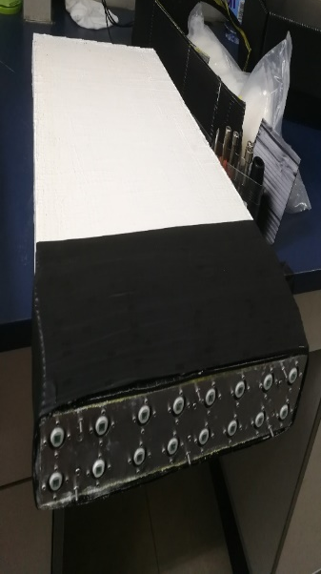
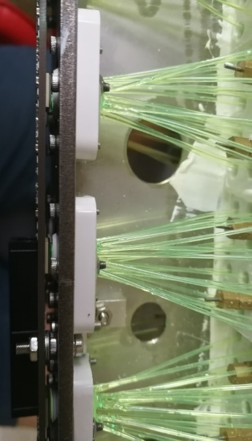
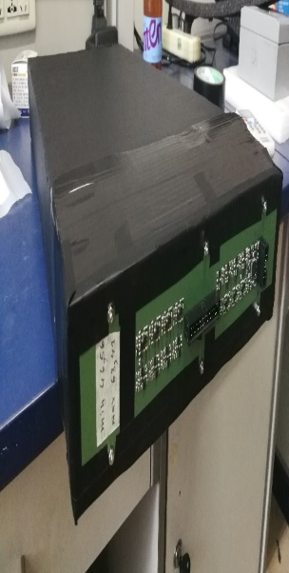
3
  Key Technology-architecture
Assembling steps:
1. Assembling towers one by one.
2. Pressurizing eight towers at the same time. (~60kg / tower).
3. cutting and gluing.
4. WLS fibers assembling (inserting, gluing and cutting).
5. connecting the PCB plate with SiPM detector.
6. wraping.
Step1 Step2 Step3 Step4 Step5 Step6
Notes:
如图为电磁量能器原型机的制作步骤。12345

Slide 20
outline
1
  Introduction
2
  Simulation
3
  Key Technology
4
  Beam Test
5
  Collaboration
6
  Summary

Slide 21
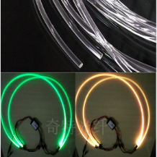
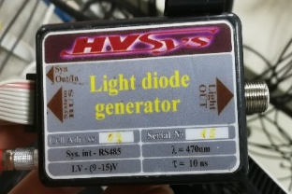
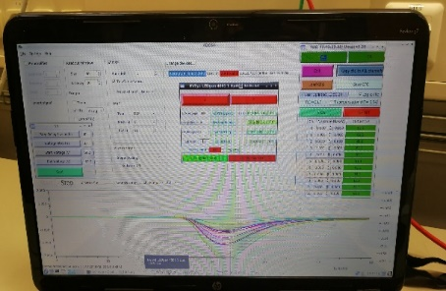
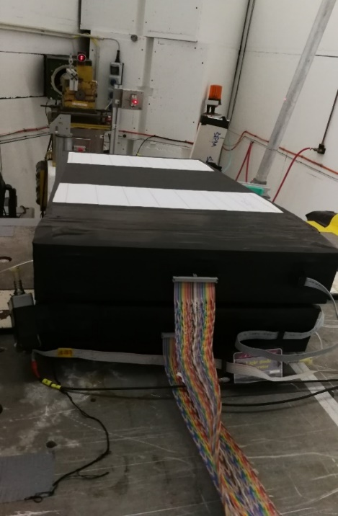
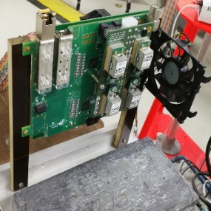
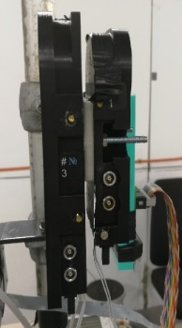
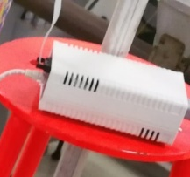
4
  Beam test @ DESY
Schematic diagram of beam test setup
Control Room
Beam Area
trigger
LED
trigger
ECall
SiPM
PC
e⁻
ADC
signal
Switch
HV
Notes:
我们于2018 年8 月完成了2台原型机共计32个tower的制作，并同杜布纳制作的一台原型机一同在DESY进行了束流实验。如图所示为束流实验的结构示意图

Slide 22
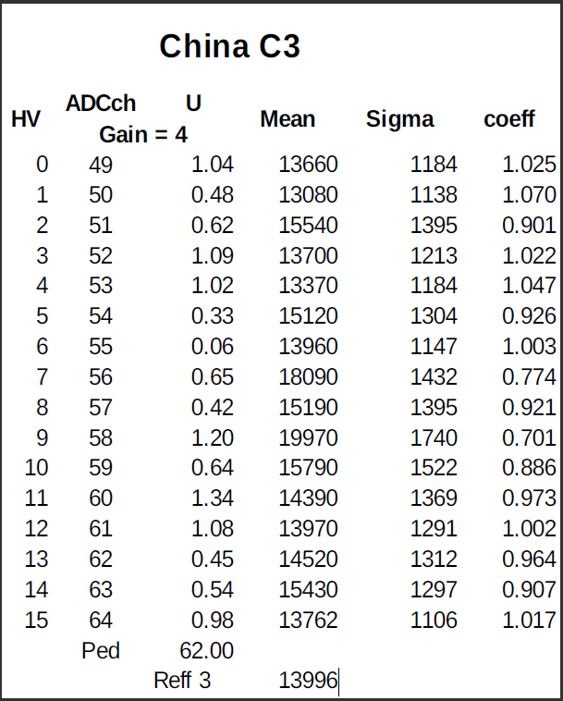
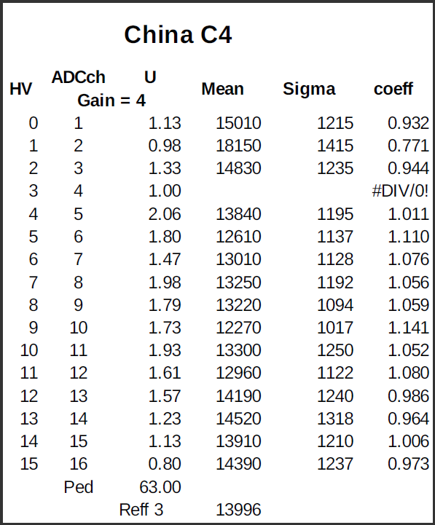
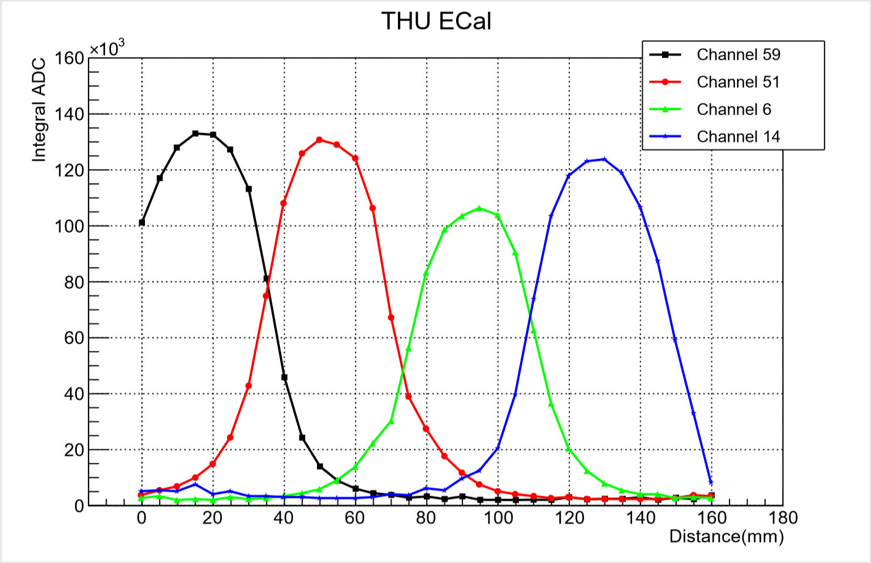
4
  Beam test
Calibration for two THU module (32 towers)
Notes:
首先，我们对两台module即CHINA C3和C4进行了标定与归一化，确定了各路信号的sipm探测器p偏压以及矫正系数，图如所示。

Slide 23
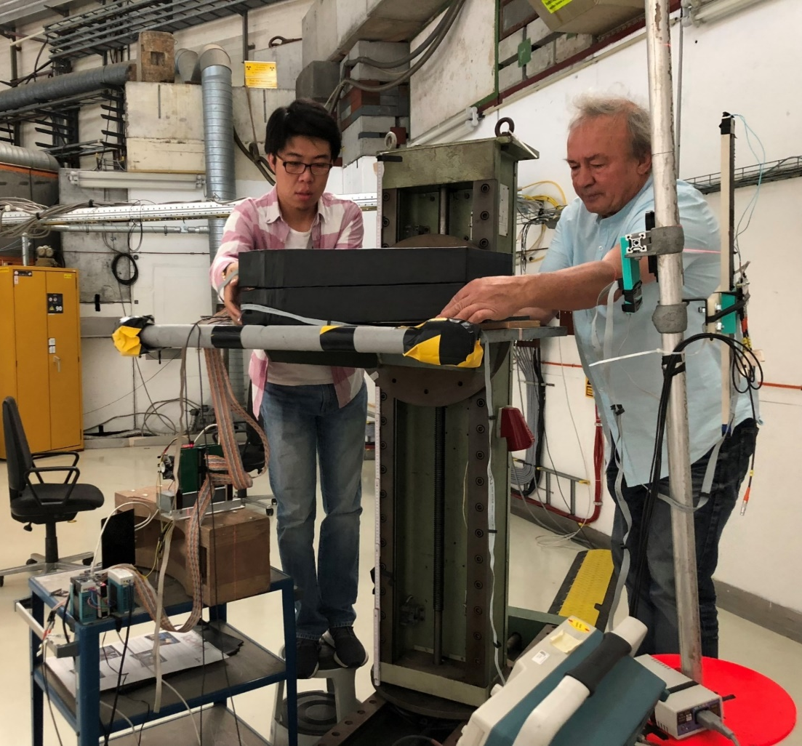
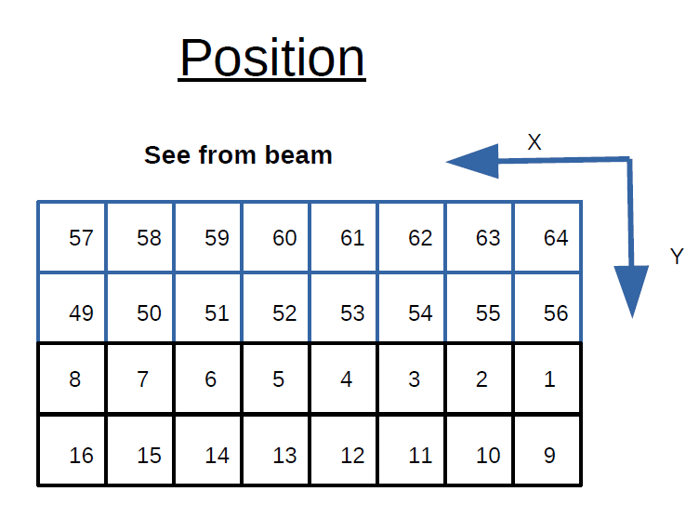
4
  Beam test
Energy scanning at two points (ch51 and Ch05)
Energy Range : 1.0 GeV --- 5.0 GeV
Step Length: 0.2 GeV
Number of Events: 200K+ / point
Notes:
之后便在两个prototype上各选取一个中心点即51路和5路进行了能量扫描测试。具体参数见文字

Slide 24
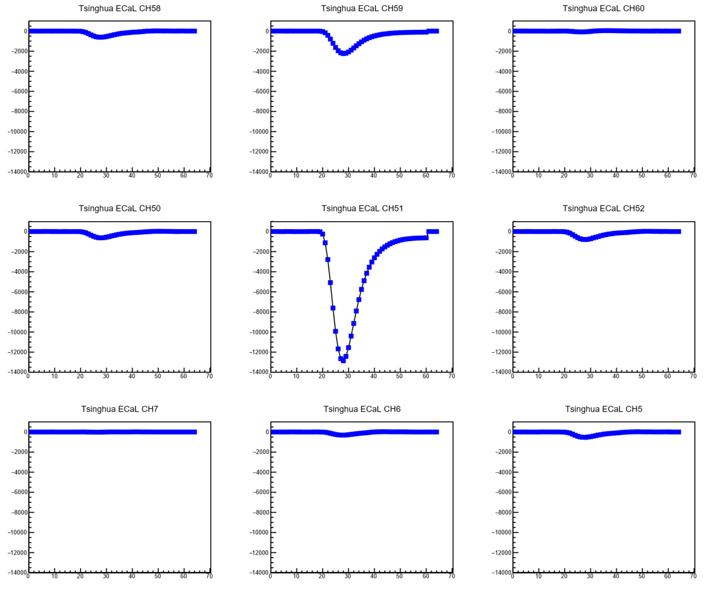
4
  Beam test
Signal waveform
AMP=-612
ω1=-2465
ω2=-3986
∆ω=0.6184
AMP=-2241
ω1=-8372
ω2=-18816
∆ω=0.4449
AMP=-70
ω1=-340
ω2=408
∆ω=-0.8333
Energy: 3 GeV
AMP=-625
ω1=-2408
ω2=-4108
∆ω=0.5861
AMP=-12858
ω1=-51119
ω2=-102992
∆ω=0.4963
AMP=-798
ω1=-3092
ω2=-5522
∆ω=0.5599
AMP=-22
ω1=-69
ω2=91
∆ω=-0.7582
AMP=-309
ω1=-1249
ω2=-1423
∆ω=0.8777
AMP=-534
ω1=-2144
ω2=-3181
∆ω=0.674

Slide 25
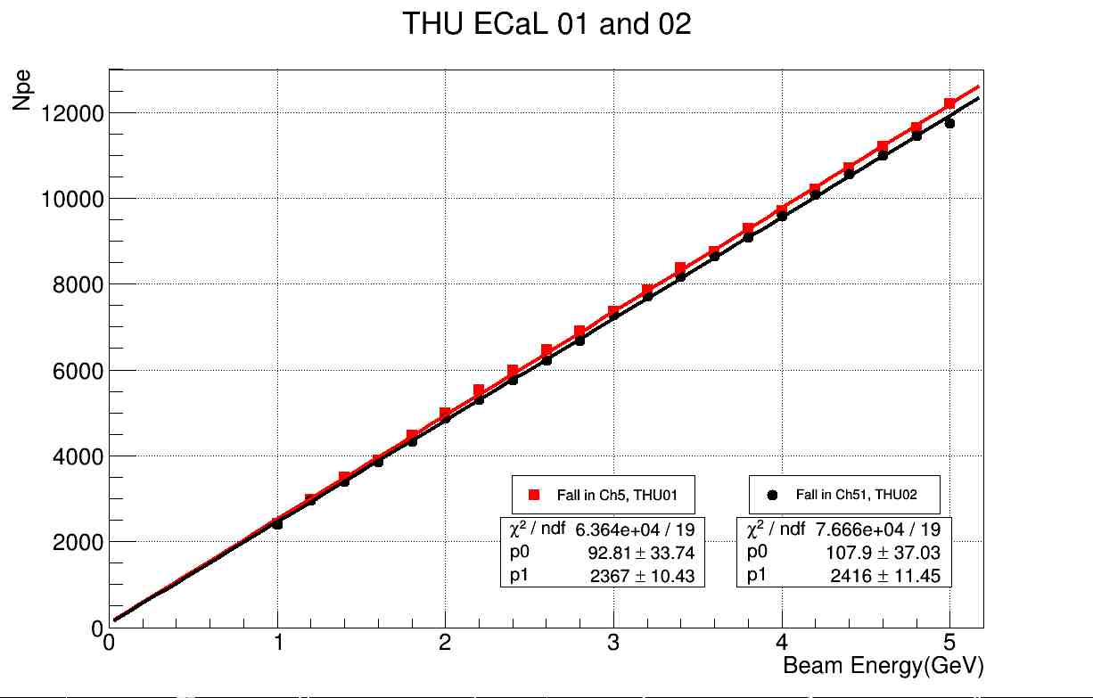
4
  Beam test
Energy Calibration
Notes:
通过分析实验数据，我们最终得到了两个原型机的测试结果。途中横坐标为入射能量，纵坐标为光电子数，不同颜色的线代表不同的prototype.我们可以看到，两个探测器展示了很好的一致性，每1GeV所常升的光电子数均为3000左右，且两个探测器均具有很好的线性。接下来我们将继续分析数据，并根据实验所反映出来的问题进一步改进我们的原型机。

Slide 26
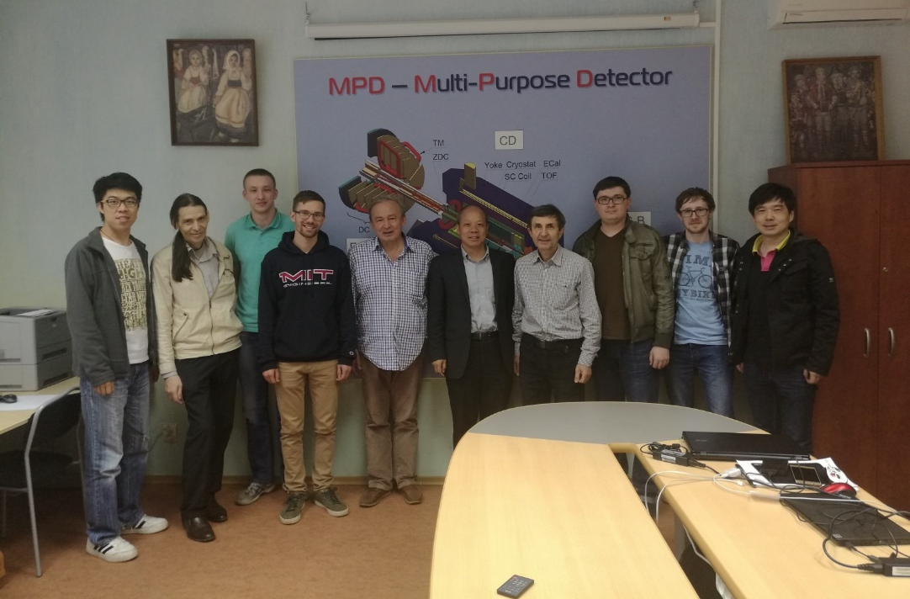
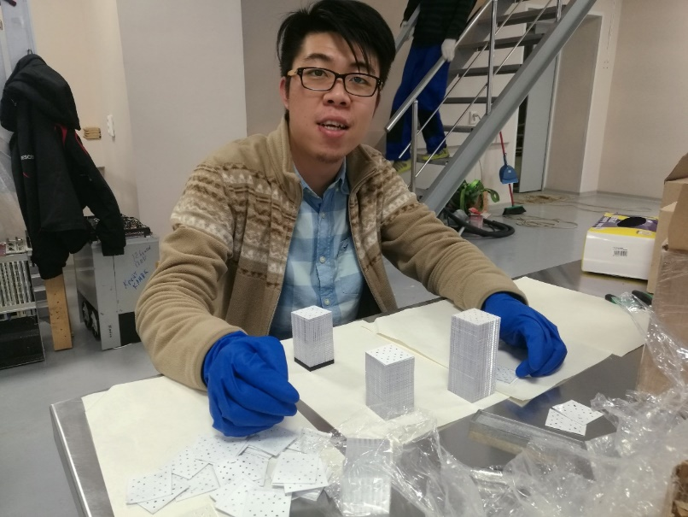
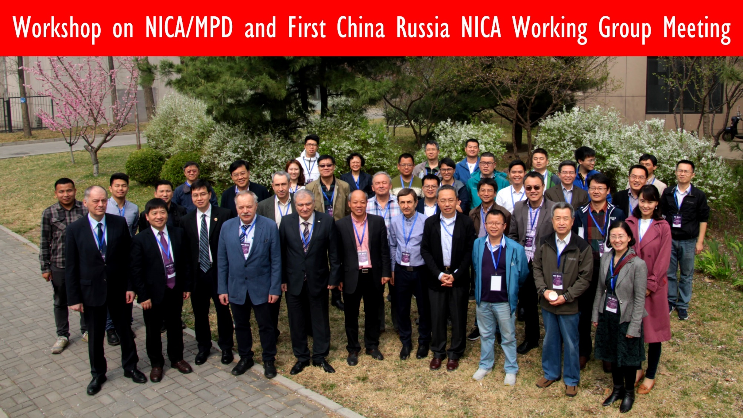
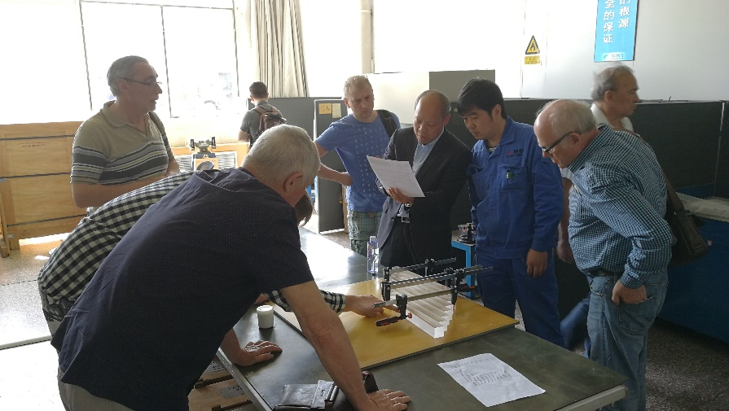
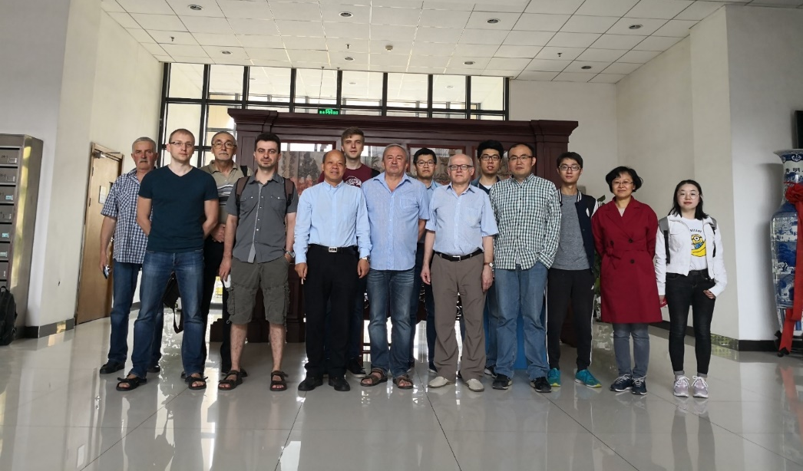
5
  Collaboration
Notes:
这是清华大学多次派出老师与学生前往杜布纳共同完成探测器制作，模拟等相关工作

Slide 27
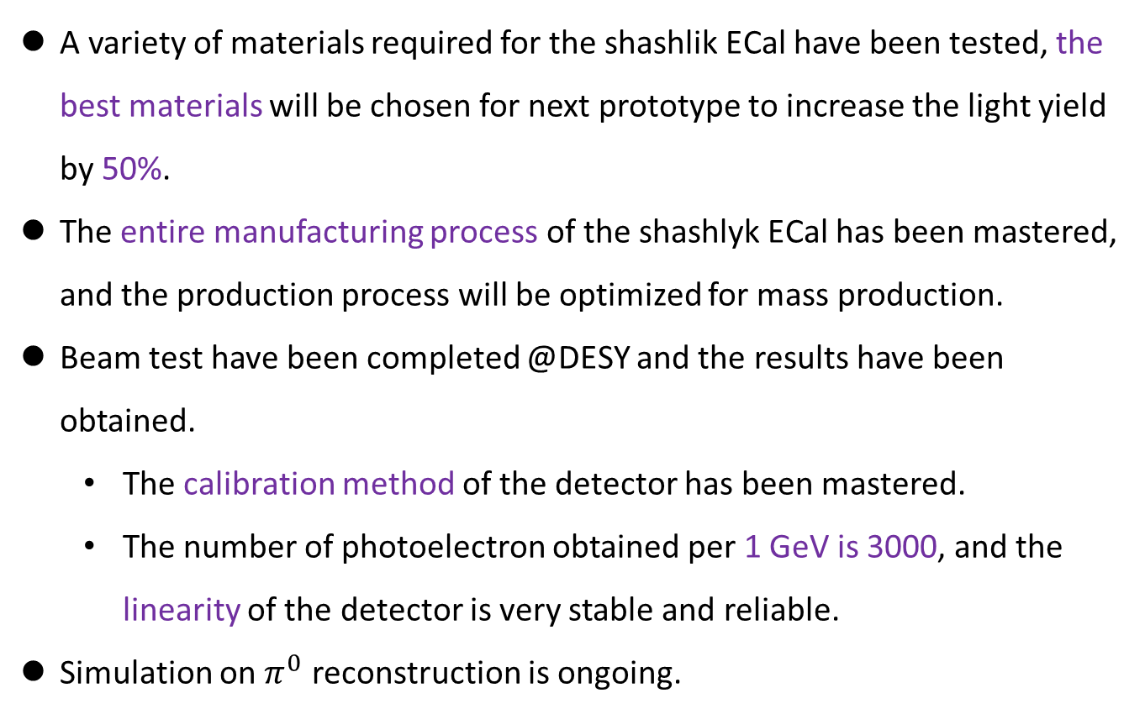
6
  summary
A variety of materials required for the shashlik ECal have been tested, the best materials will be chosen for next prototype to increase the light yield by 50%.
The entire manufacturing process of the shashlyk ECal has been mastered, and the production process will be optimized for mass production.
Beam test have been completed @DESY and the results have been obtained.
  The calibration method of the detector has been mastered.
  The number of photoelectron obtained per 1 GeV is 3000, and the linearity of the detector is very stable and reliable.
Simulation on $π^{0}$ reconstruction is ongoing.
Notes:
总结如下。

Slide 28
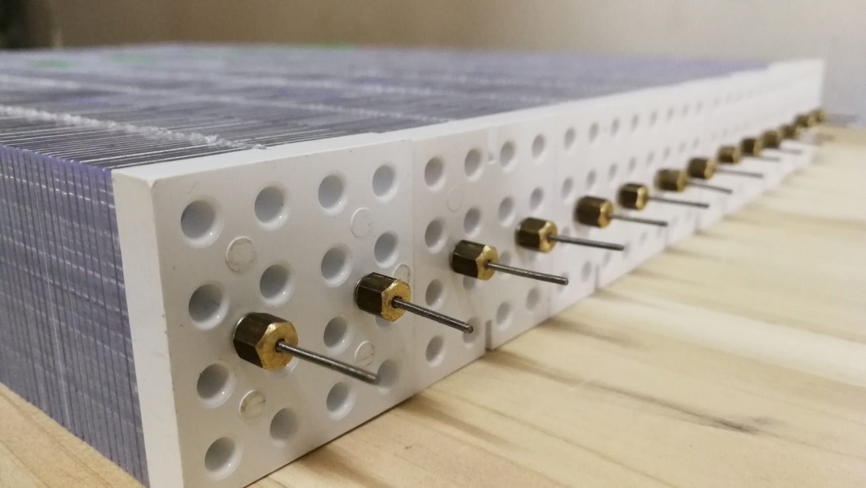
Thanks For your attention
Department of Engineering Physics, Tsinghua University

