Slide 1


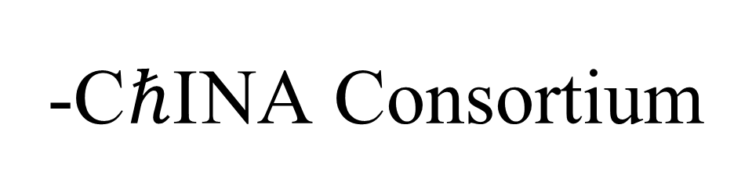
-C$ℏ$I NA Consortium
Fuqiang Wang (Huzhou University)
On behalf of the Chinese institutions

Slide 2
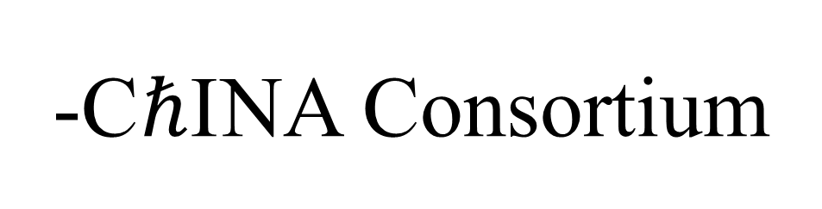
-C$ℏ$I NA Consortium
Collaborating Chinese Institutions
  Central China Normal University (CCNU)
  Huzhou University (HU)
  Institute of High Energy Physics (IHEP), CAS (also BM@N)
  Shandong University (SDU)
  Shanghai Institute of Applied Physics (SINAP), Chinese Academy of Science → Fudan University (also BM@N)
  Southern China University (SCU)
  Tsinghua University (THU) (also BM@N)
  University of Science and Technology of China (USTC)
Two newly admitted Chinese institutions
  Institute of Modern Physics (IMP), Chinese Academy of Science
  China Three Gorge University (CTGU)

Slide 3
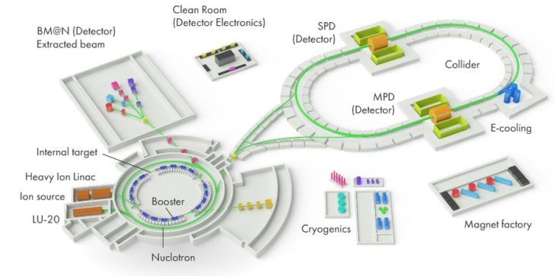
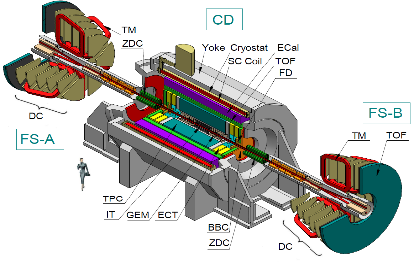
What are we interested?
QCD emergent properties at high baryon density
New state of matter
  Collectivity
  Criticality
  Chirality
Exotic particles
  tetraquark, pentaquark
  dibaryon
  hypernuclei

Slide 4
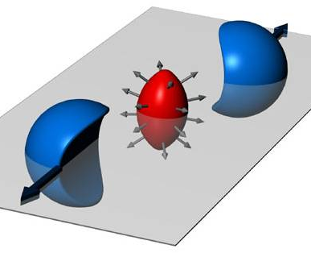
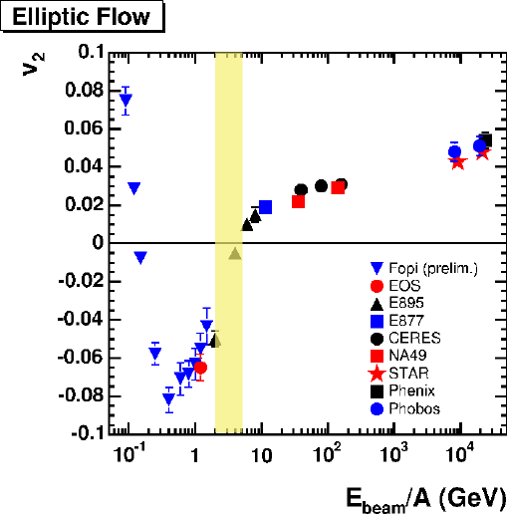
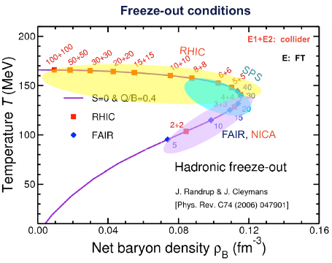
Collectivity
NICA energy region
might be the softest
New state of matter:
Highest baryon density
Soft equation of state?
Hydrodynamic properties?

Slide 5
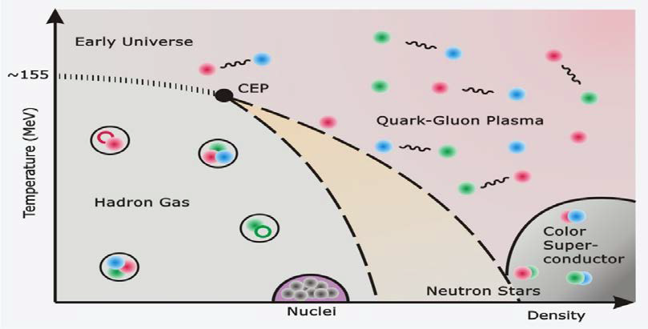
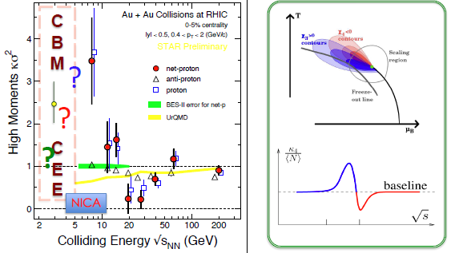
Criticality
NICA energy region
will be critical
Near the critical point, several properties of the system diverge.
Large correlation length
Observables should show large fluctuations.

Slide 6
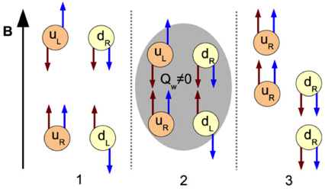
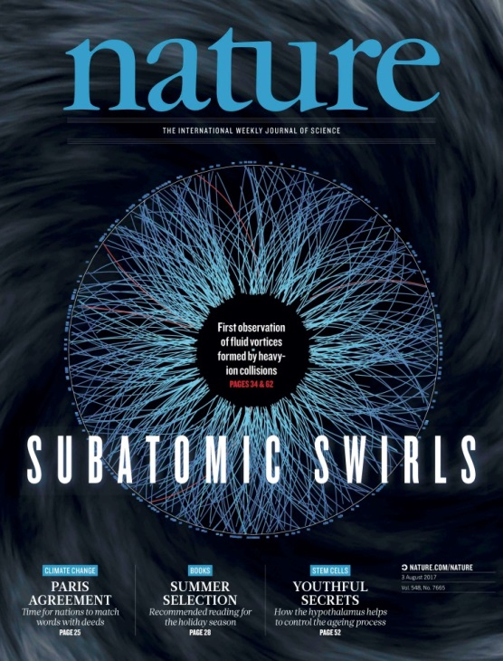
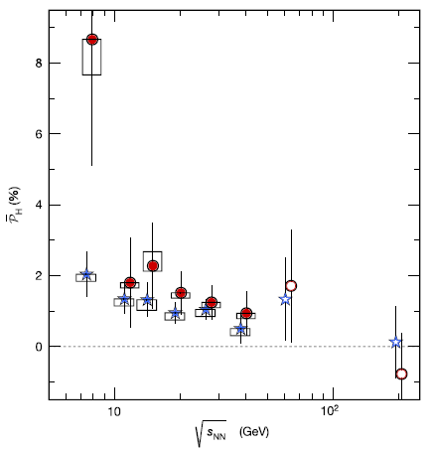
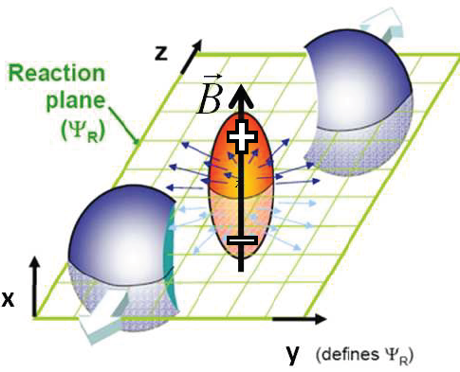
Chirality
NICA energy region
might be the sweetest
Strong magnetic field
Quark degree of freedom, χ-symmetry
QCD vacuum fluctuations,
Topological gluon field
Local P, CP violations

Slide 7
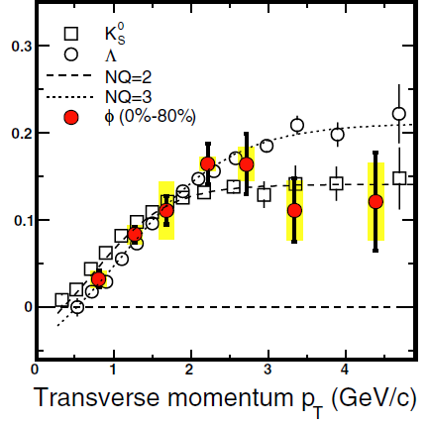
Exotic Particles
Examples: tetraquark, pentaquark, …
Traditionally, compare measurements to model calculations of mass, decay BR’s, etc.
We have a new tool in heavy ion collisions: the Number of Constituent Quark scaling of elliptic flow
? ? ?

Slide 8
Projects
ECAL: R&D, testing, production
ECAL front-end readout chip (TDC) R&D
IT: MAPS and electronics R&D, testing, production
ETOF: detector and electronics R&D
Theory
Physics and detector simulations

Slide 9
Interests
Central China Normal Univ
  hardware: ECAL FE chip; IT
  physics/detector simulation
  analysis: s, c, flow, criticality
Huzhou Univ
  hardware: ECAL testing, prod.
  physics/detector simulation
  analysis: CME, flow, EbyE
IHEP
  theory: QCD diagram, CEP
Shandong Univ
  hardware: ECAL R&D, prod.
  analysis: polarization, dilepton
SINAP → Fudan Univ
  hardware: ECAL R&D, prod.
  ECAL simulation
  ananlysis: hypernucleus, CME, exotics, CEP
Tsinghua Univ
  hardware: ECAL R&D, prod.
  ECAL simulation, calibration
  analysis: flow, extoics
USTC
  hardware: ETOF R&D, elect.
  software: TOF calibration
  analysis: dilepton, polarization, UPC photo-production
Univ of South China
  Hardware: ECAL R&D, prod.
  ECAL simulation, calibration
IMP
  hardware: IT Si detectors, elec.
  analysis: QCD phase, multi-s B
China Three Gorge Univ
  Hardware: ECAL R&D, prod.
  Detector simulations

Slide 10


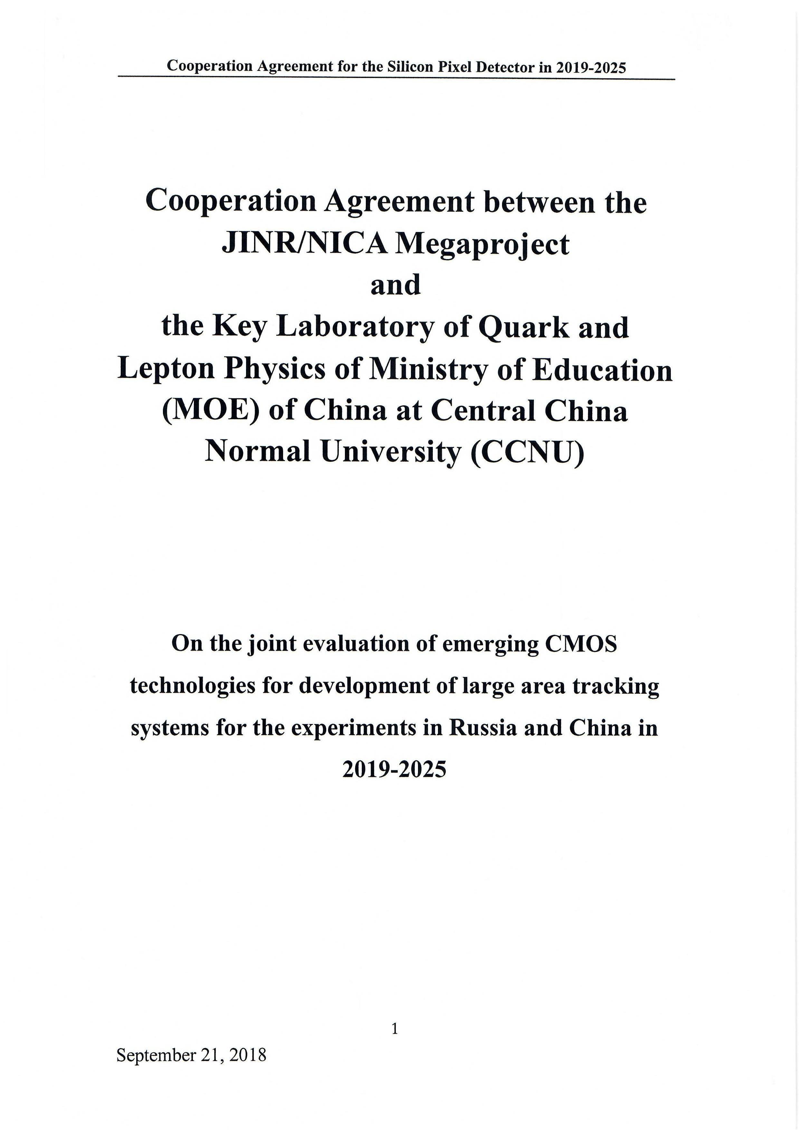
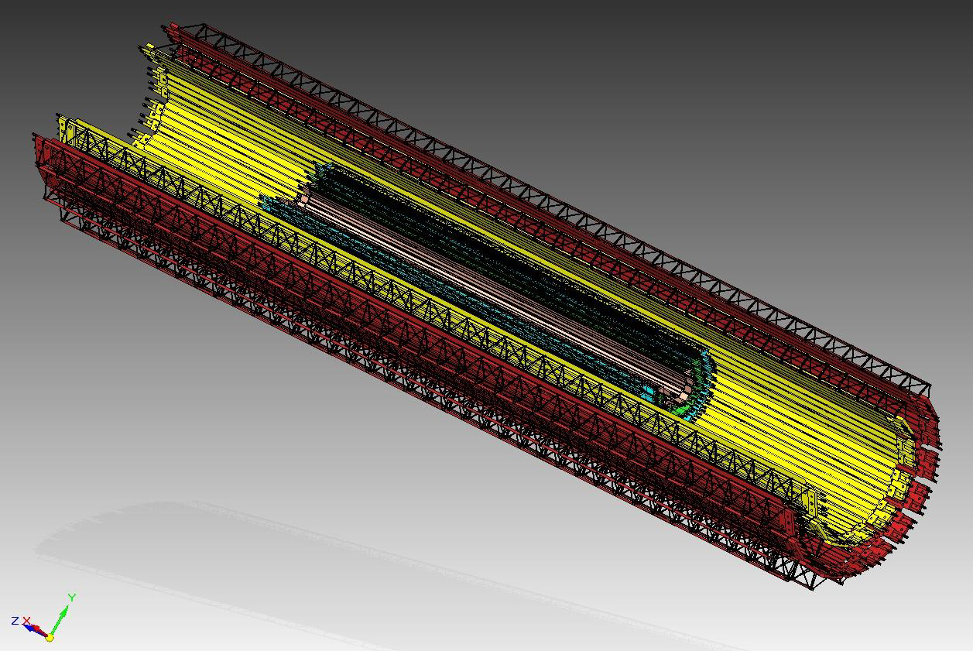
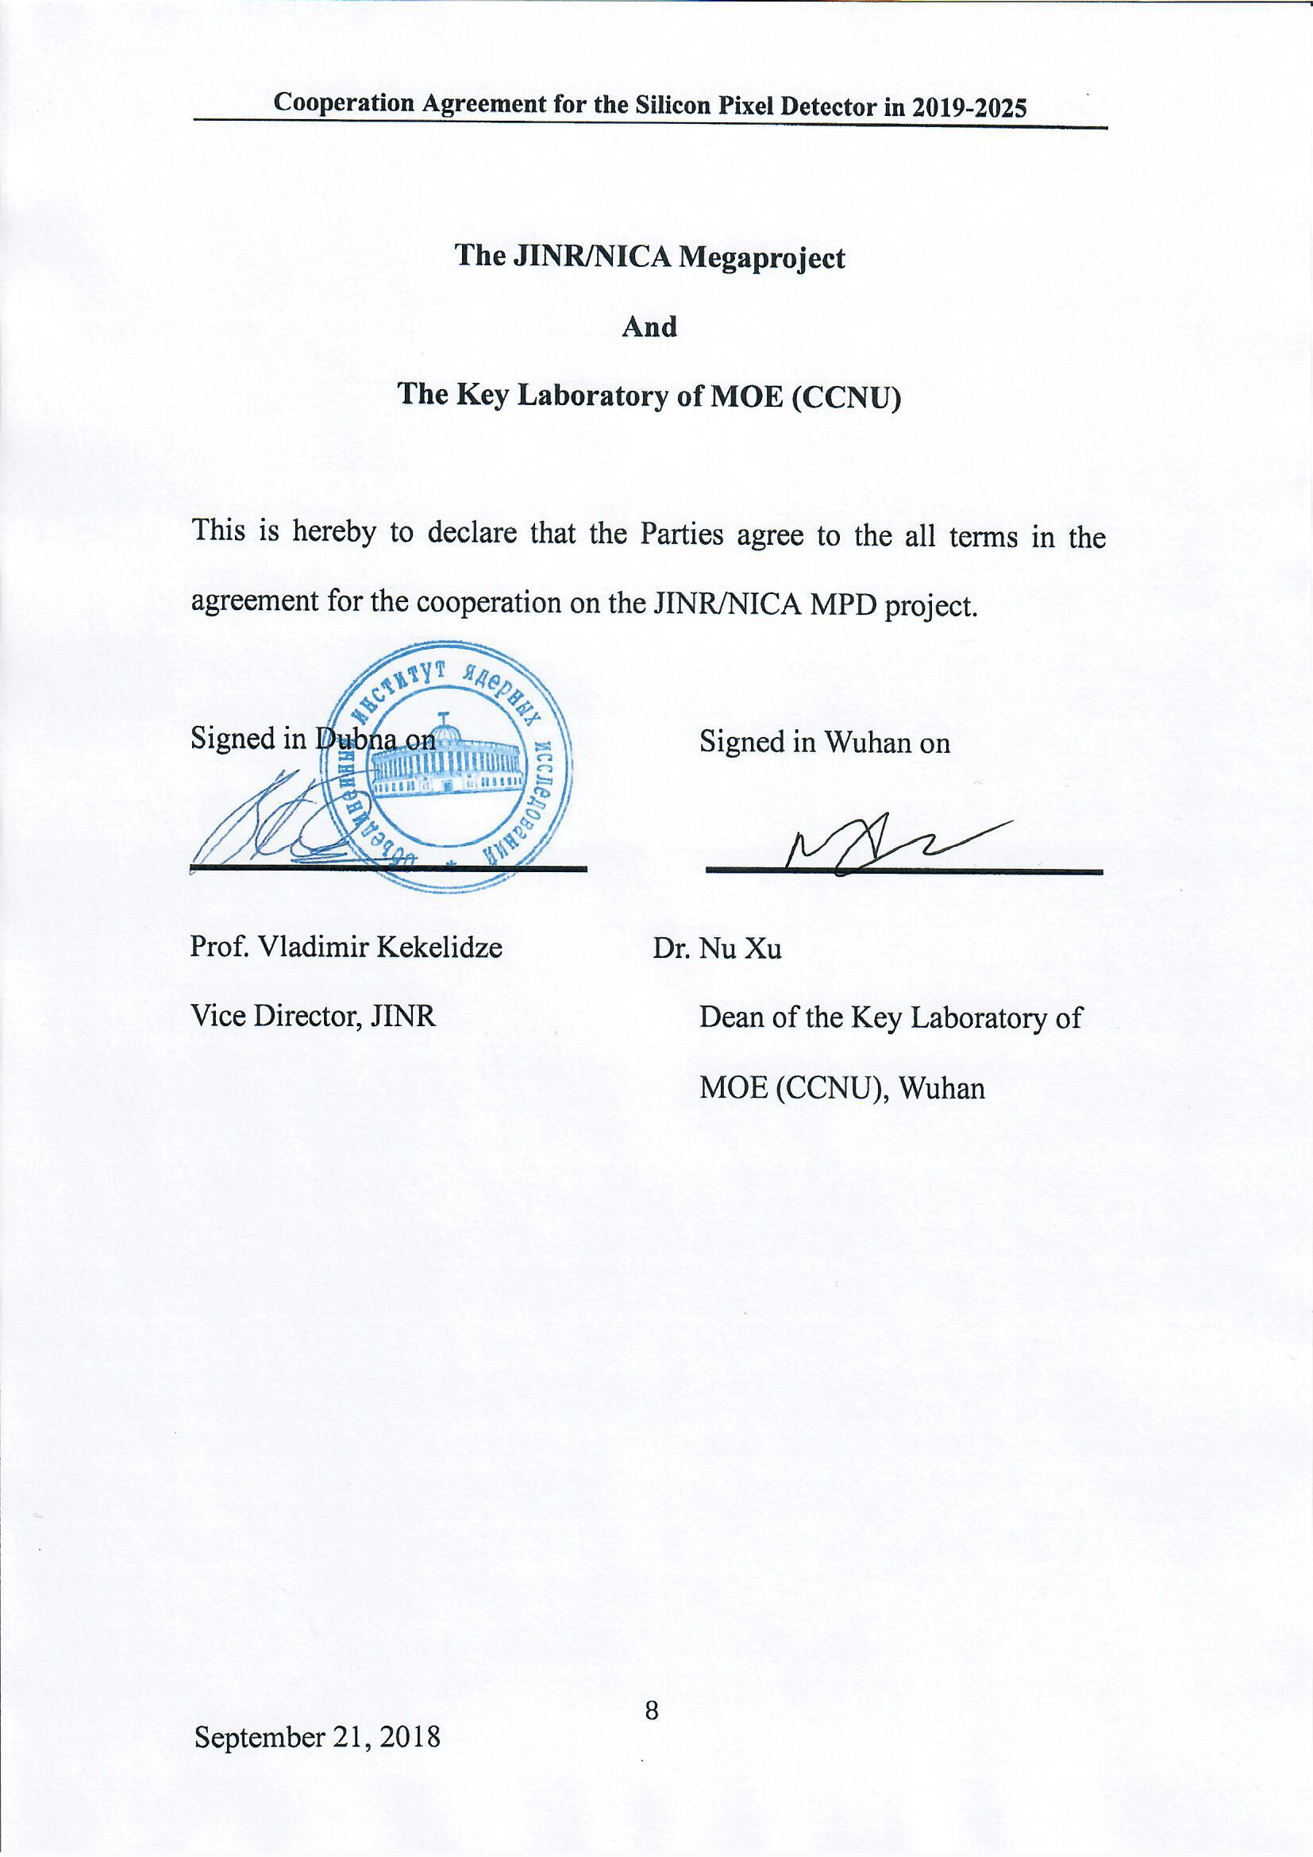
Charm and Multi-Strangeness Measurements with MPD/ITS
Inner Tracking (IT) based on MAPS technology at NICA/MPD will enable charm-hadron measurements and isolate collision vertex at high luminosity environment.
Physics measurements:
Charm production (D⁰, D_{s}, Λ_{c}) in heavy ion collisions at the NICA energies
Clean measurement of multi-strange hadron spectra (di-Omega search, hypernucleus study etc.)
CCNU team participates in ALICE ITS upgrade since 2014, and contributes to pixel chip design, detector module assembly and testing (under series production)
Facilities and team will be transferred to MPD/IT project after ALICE ITS upgrade

Slide 11
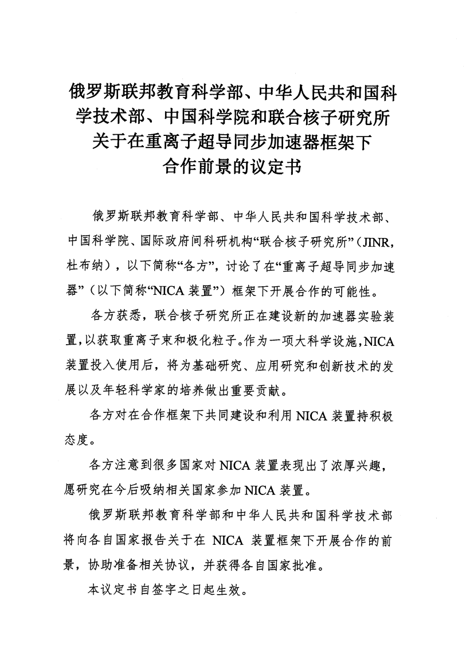
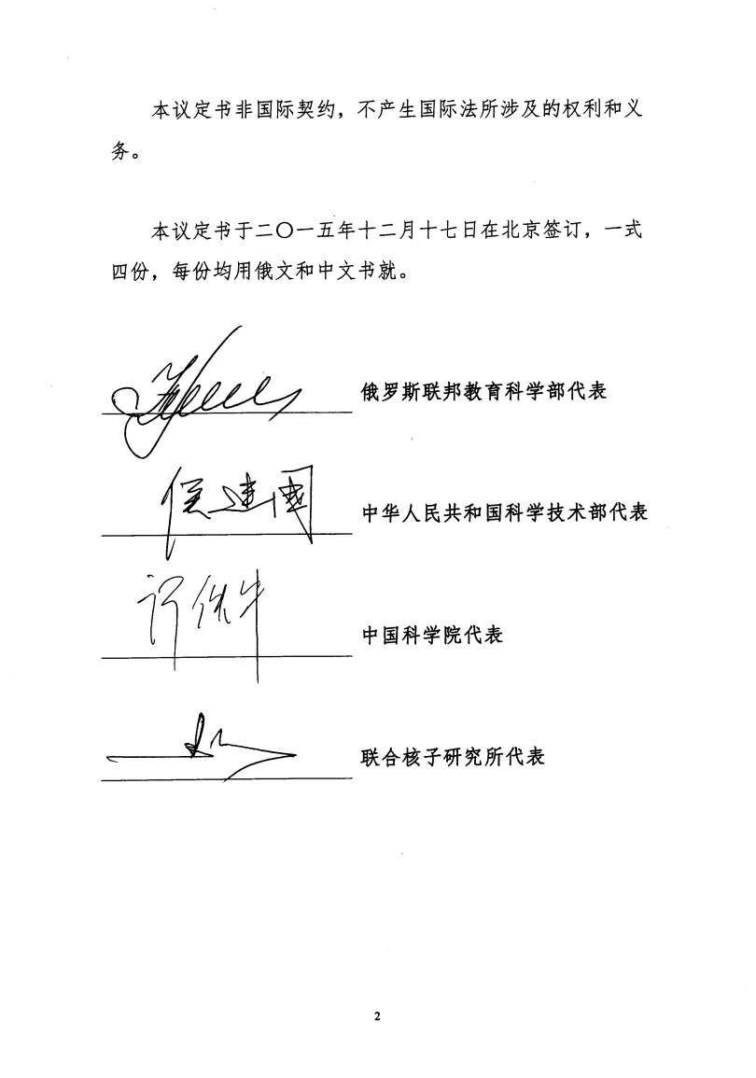
Russia-China Government Agreement on JINR/NICA Collaboration

Slide 12
Funding opportunity
Expert Panel (China & Russia) was formed
January 2018: Expert Panel meeting with Chinese MOST funding agency
April 2018: Expert Panel meeting, Tsinghua
Since the inaugural NICA/MPD collaboration meeting:
June 2018: Expert Panel meeting
End June 2018: Letter of Intent to the Expert Panel
Early July 2018: Expert Panel meeting
Mid July 2018: Revised LoI to Expert Panel
End Sept 2018: Preproposal document to MOST
Mid Oct 2018: Expert Panel / MOST meeting

Slide 13
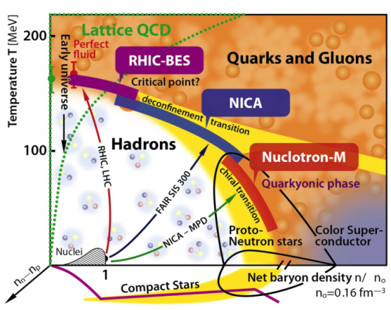

-C$ℏ$I NA Consortium
Rich physics at NICA
  New state of matter
    Collectivity, Criticality, Chirality
  Exotic particles
    multiquark, dibaryon, hypernuclei
NICA Consortium in China
(exp. + theory)
Looking forward to the
experiment & physics …

