Slide 1
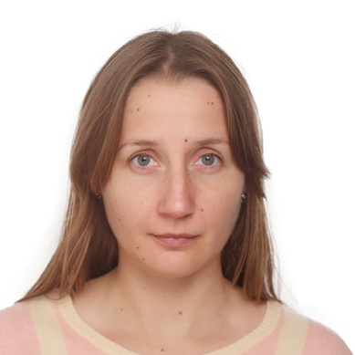
Curriculum Vitae
Maksymchuk Anna
Education:
09.2001-06.2006: Taras Shevchenko National University of Kyiv, Faculty of Physics,
chair of the “Experimental Nuclear Physics”.
Master thesis: “Time of flight detectors for NIS Spectrometer”
Professional carrier:
Since 2006 – HyperNIS experiment (LHEP, JINR)
Responsible for HARP mRPC integration into the HyperNIS experimental setup, TOF system operation during Nuclotron beam runs, data analysis.
Since 2015 – BM@N experiment (LHEP, JINR)
Responsible for GEM/CSC tracking system of the BM@N experimental setup, GEM modules assembly at CERN workshop, GEM working parameters optimization, GEM and CSC modules integration into the BM@N experimental setup, study of the detectors performance at the Nuclotron extracted beams, data analysis.
Since 2014 – within the JINR University Center, seminar classes for the created basic course “Physic of elementary particles” for 4-th year students from MSU and MIPT.
Publications: 13
Talks: 24

