Slide 1
Radiation Physics Laboratory of
Belgorod National Research University

Slide 3
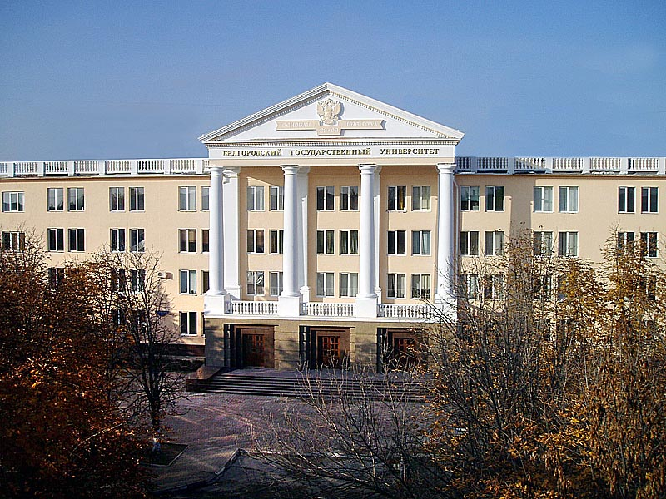
Laboratory of radiation physics
Department of Physics and Engineering
Developing of new approaches for the diagnostics of charged particles beams
Developing of vacuum systems for radiation physics experiments
Radiation proceses during the interaction of accelerated charged particles with matter
Developing of new
X-ray and neutron generators

Slide 4
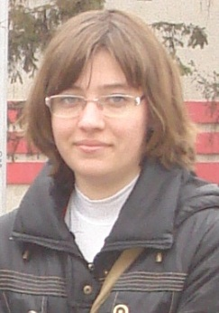
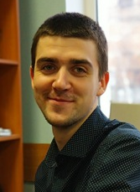
Our team
PhD : 9. PhD students: 7.
Average age is 34 years

Slide 5
Laboratory
Structure and Partners
Laboratory of radiation physics
(1999 - present)
Joint Laboratory of Radiation Processes in Condensed Matter BNRU-LPI
(2014 – present)
Research and development of radiation sources (X-ray and fast neutrons)
Manufacturing of vacuum chambers, e-gun systems and mechanics
Research and development of THz radiation sources
Research and development of compact neutron generators and vessels from high purity materials
Collaboration with LPI, DESY, IHEP (Protvino), SINP (MSU)
Collaboration with SINP (MSU) in frames of Russian space program
Collaboration with TPU, RHUL, JAI
Collaboration DarkSide (INFN, LNGS, Princeton), SINP (MSU)
Manufacturing division “Vacuum systems and technologies”
(2015 – present)
Design-engineering department “Design and development of experimental setups for radiation physics experiments”
(2014 – present)

Slide 6
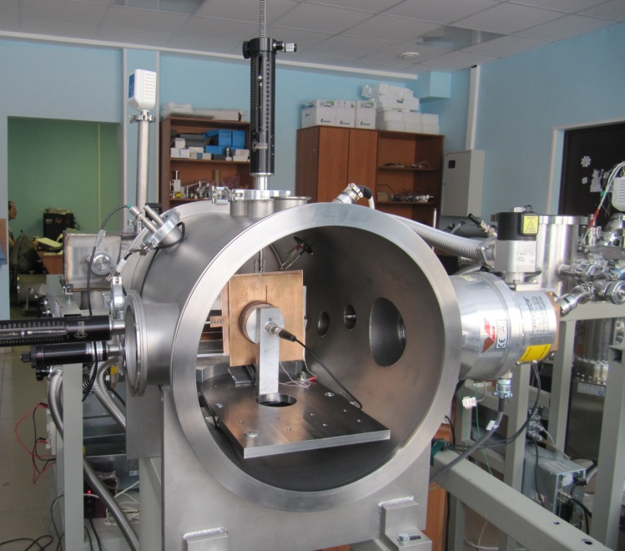
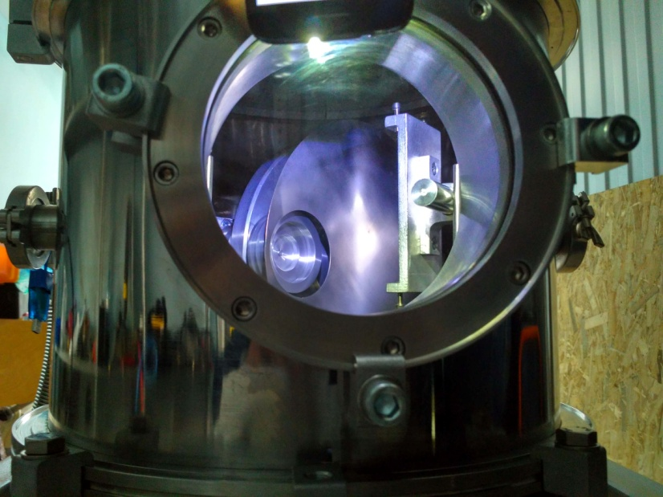
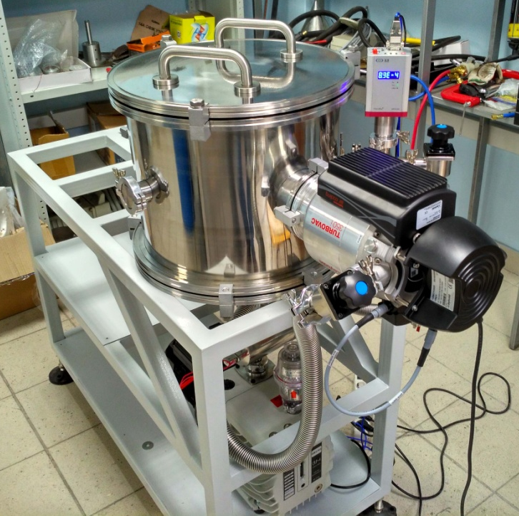
Manufacturing division “Vacuum systems and technologies”
development and manufacturing of vacuum systems for vacuum level up to 10⁻⁹ Torr;
development and manufacturing of vacuum chambers with diameter up to 5 m and length up to 10 m;
3D modeling of vacuum chambers construction;
manufacturing of vessels of pure titanium and titanium alloys;
vacuum leakages test of vacuum chambers;
development of vacuum automotive mechanics and control soft development.

Slide 7
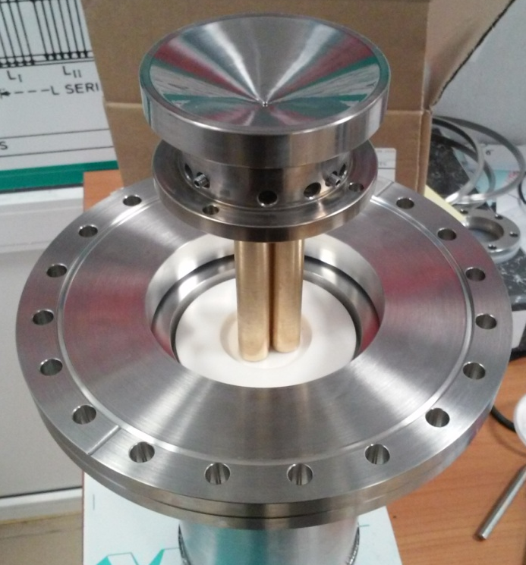
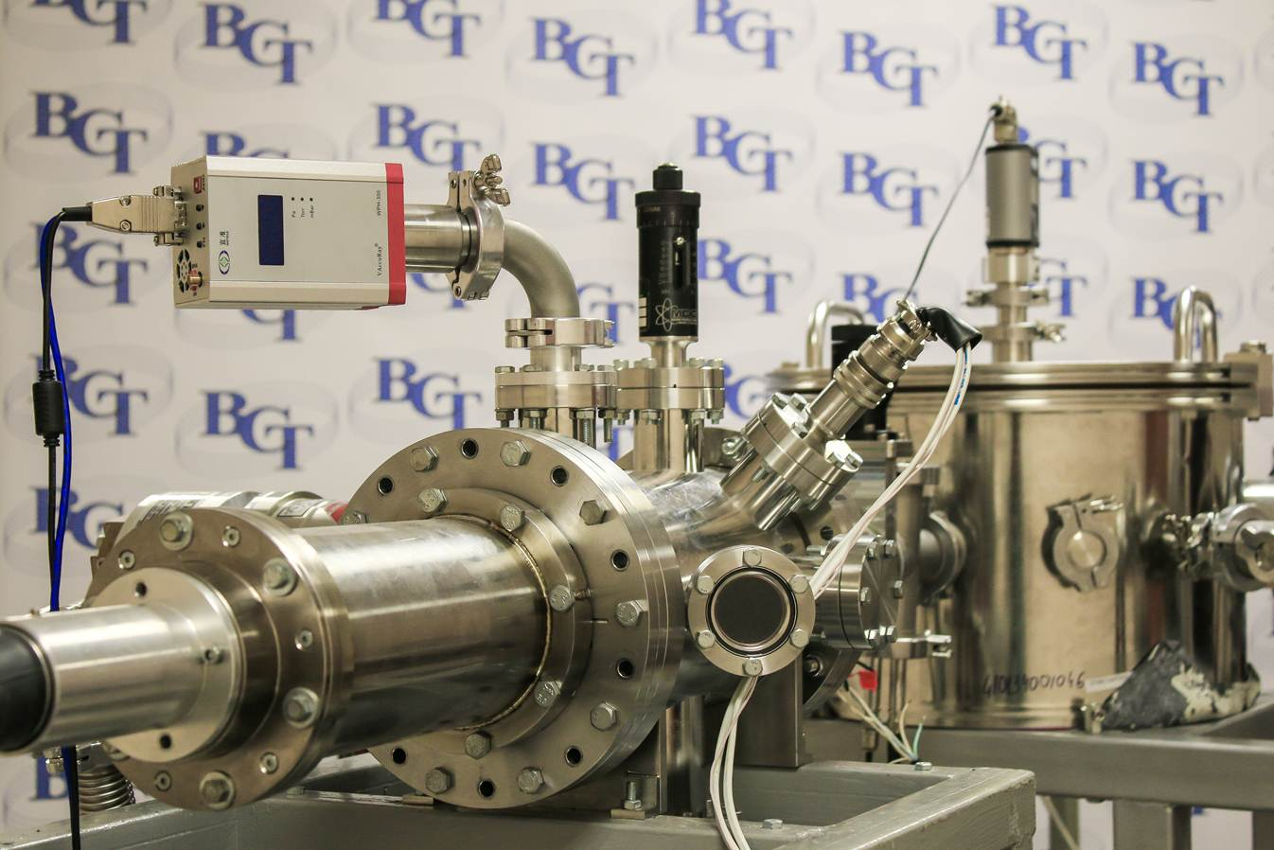
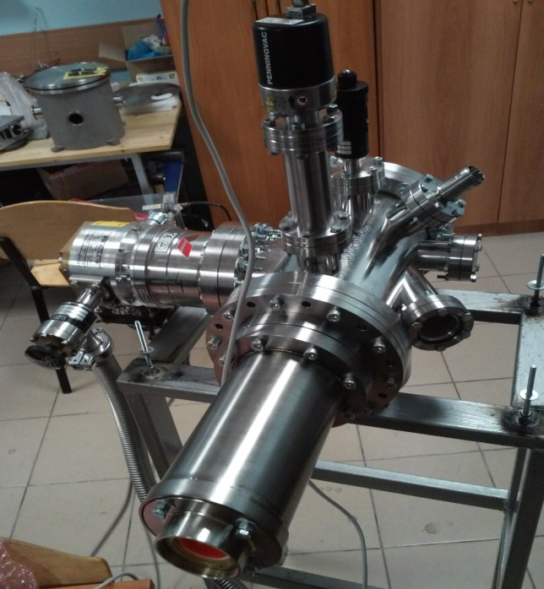
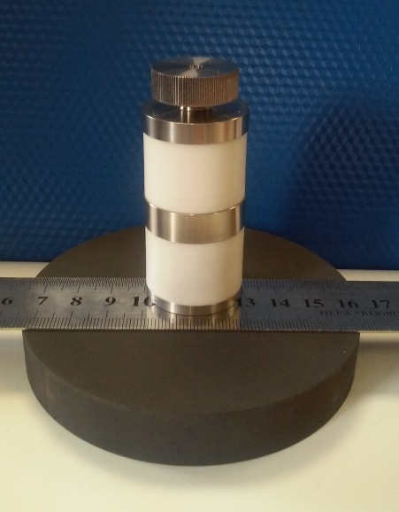
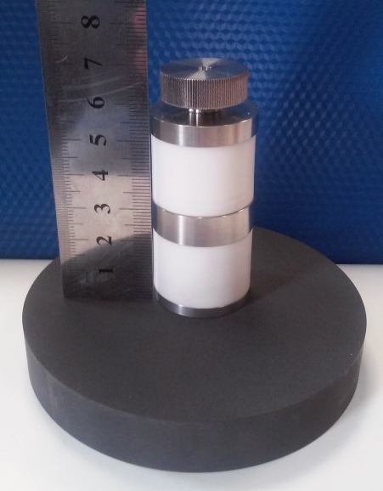
Main topics of engineering activity, design and manufacture:
electron guns, up to 100 kV, 1 mA;
compact neutron and X-ray generators

Slide 8
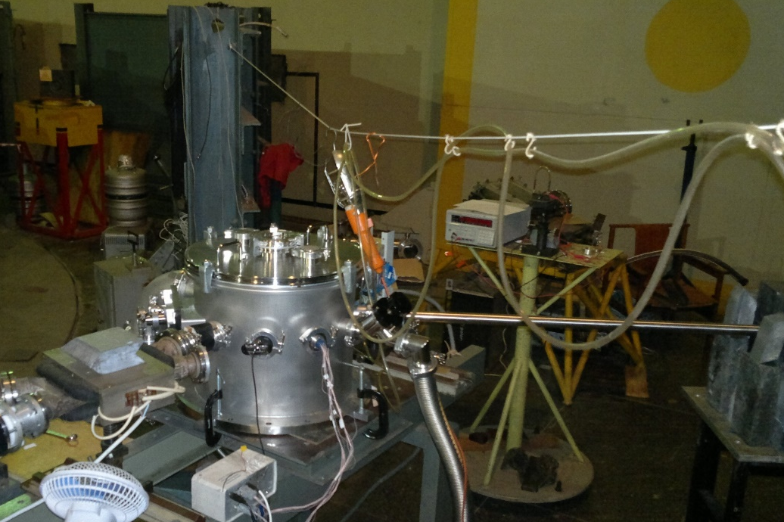
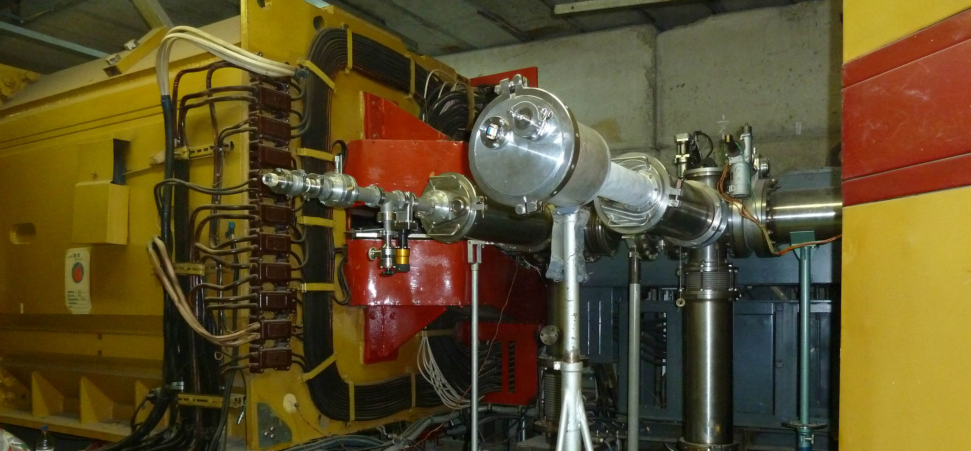
The experimental setup for research of X-ray radiation
mechanisms occurring during interaction of 7 MeV electron beam with a medium.
Department of High energy physics of Lebedev Physics Institute
The experimental setup for research of X-ray radiation
mechanisms occurring during interaction of relativistic protons and C+6 ions with a medium.
Institute of High Energy Physics (Protvino)

Slide 9
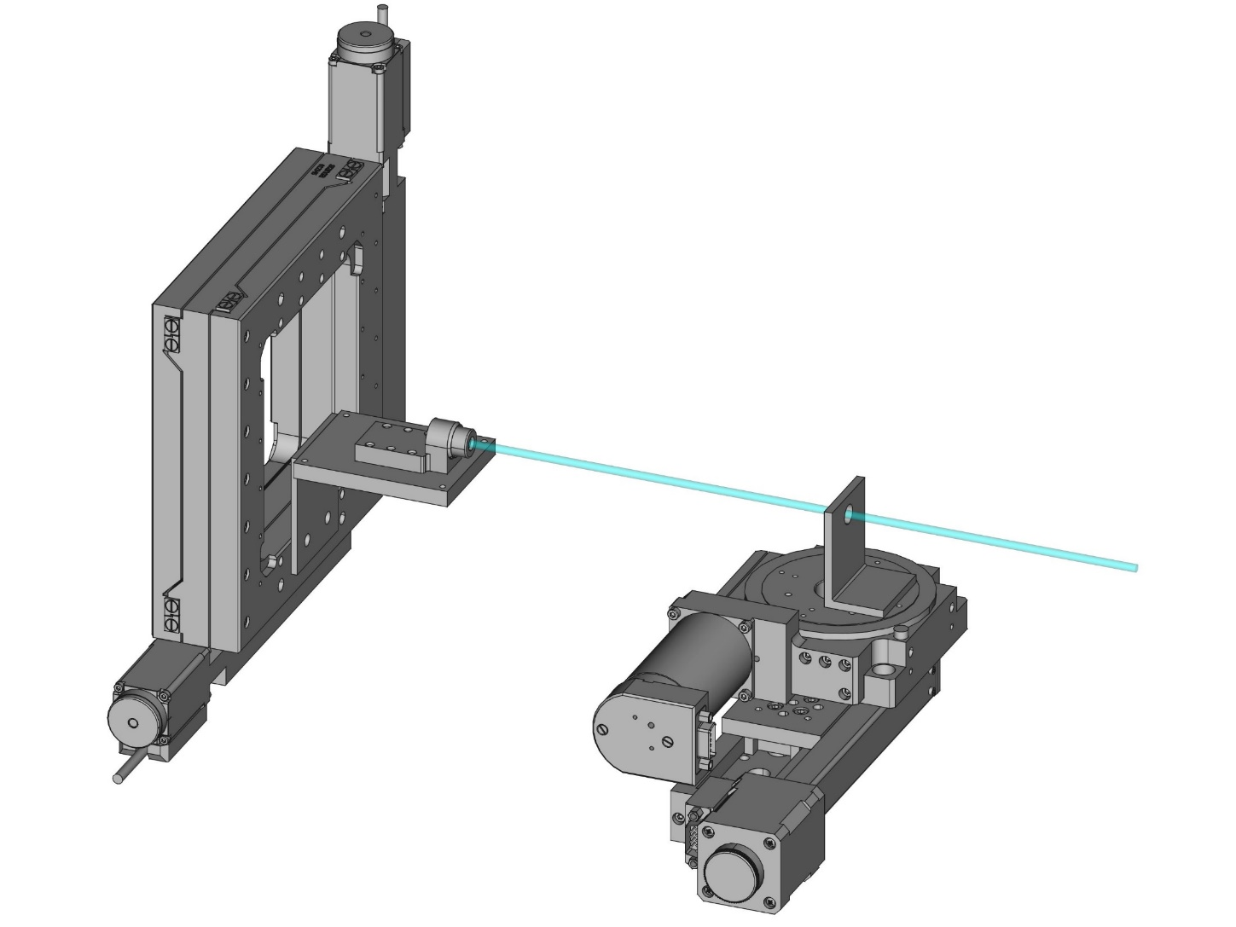
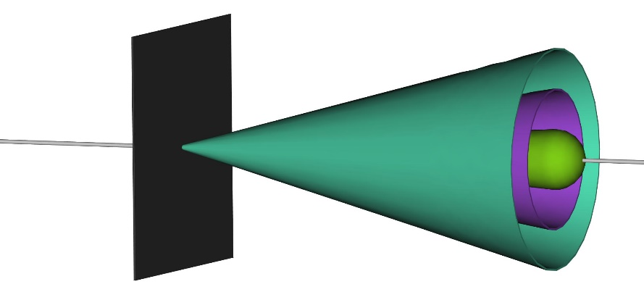
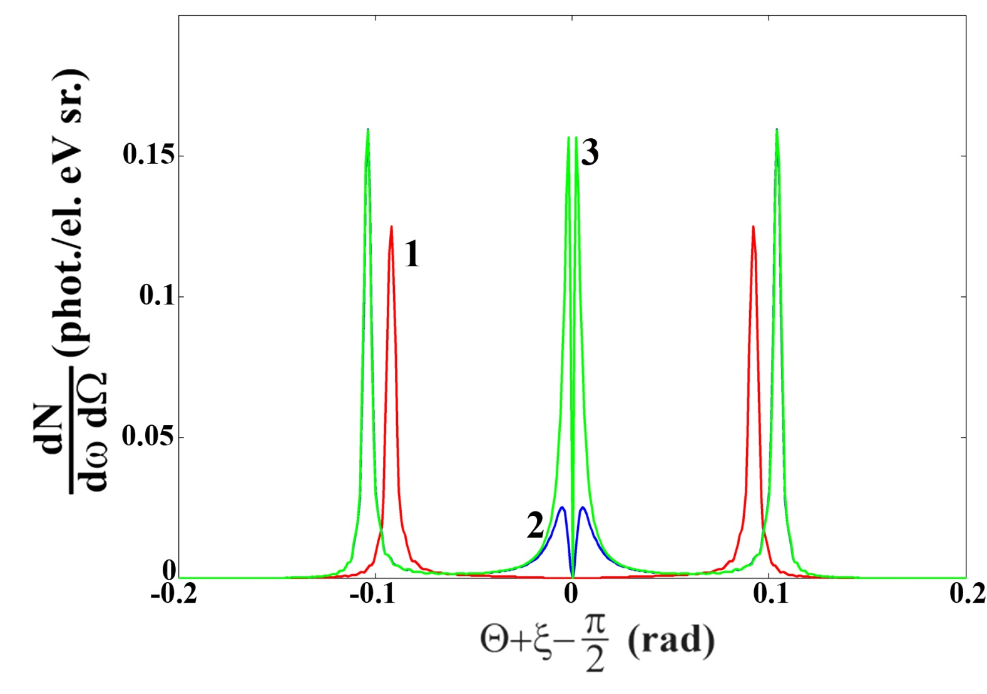
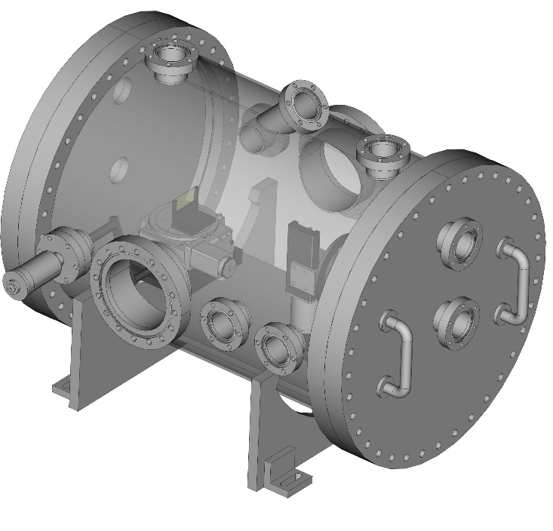
Typical experimental project
development of the experimental setup including results of calculations;
1 – soft X-Ray spectrometer
2 – motorized X-Y translation stage
3 – thin film target
4 – motorized rotation stage
5 – motorized translation stage
6 – e-beam axis
The angular sizes of
radiation distribution:
2
Br : γ⁻¹ < 5 mrad
TR : γ⁻¹ ~ 5 mrad
ChR : $\sqrt{χ′} \text{\sim }\text{70} \text{mrad}$
1
Br
3
TR
ChR
6
calculation of studied process
4
ChR
TR
ChR
5
The contribution of the transition radiation
mechanism to X-ray Cherenkov radiation.
The design of vacuum chamber for the experiment

Slide 10
Contribution of the laboratory to NICA experiment
Participation of BNRU scientists and students in shifts and works of NICA parts assembling;
Detector data analysis jointly with NICA MPD group (request for RFBR grant has been sent jointly BNRU-JINR);
Design, manufacturing and service of NICA vacuum systems.
Our team
Kristina Vokhmyanina, head of BNRU group, PhD – data analysis
Alexander Kubankin, PhD – design and manufacture of vacuum systems
Ramazan Nazhmudinov, PhD – design and manufacture of vacuum systems
Alexander Kluev, PhD student – data analysis
3 students of Institute of engineering and natural sciences.

Slide 11
Thank you so much!

