Slide 1
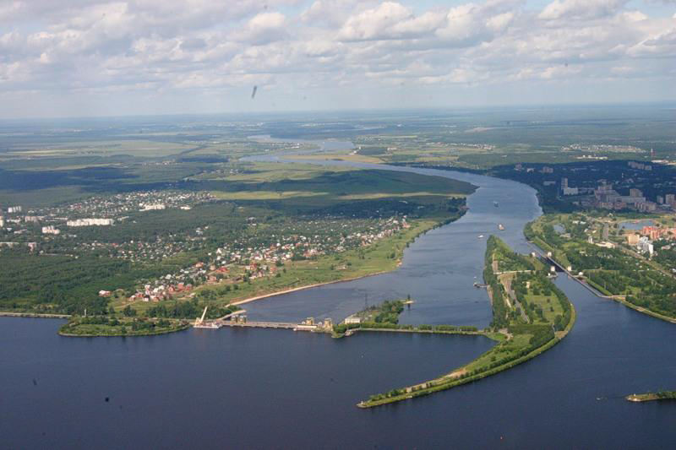
JINR, October 29-30, 2018
Second Collaboration Meeting of the BM@N and MPD Experiments at the NICA Facility
Itzhak Tserruya

Slide 2
Agenda
News
Admission of new Institutions
Elections of IB chair person for BM@N and MPD
Elections of spokesperson for BM@N and MPD
Approval of Project Manager
Next Collaboration meeting

Slide 3
Agenda
News
Admission of new Institutions
Elections of IB chair person for BM@N and MPD
Elections of spokesperson for BM@N and MPD
Approval of Project Manager
Next Collaboration meeting

Slide 4
News
RFBR grants
Grants of 3-6 MRubles per year for a duration of 3 years will be granted starting on Jan. 2019
New MPD website - under construction (I. Slepov, N. Sidorov)
http://mpd.jinr.ru/experiment/
Internal Documents are password protected
BM@N wikipages (Mikhail Kapishin)
http://bmnshift.jinr.ru/wiki/doku.php?id=main
Collaboration status

Slide 5
MPD Collaboration
10 Countries, 26 Institutions, 436 Participants
MPD Institutional Board
Country | Institution | IB member | 2nd Coll. Meeting
AZERBAIJAN | Baku State University / National Nuclear Research Center | Rustamov Anar | Proxy:
BULGARIA | University of Plovdiv | Vanio Tcholakov | Proxy: Nikolay Geraksiev
CHILE | U. Tecnica Federico Santa Maria, Valparaiso | Sergey Kuleshov | Proxy: Itzhak Tserruya
CHINA | Central China Normal University | Feng Liu
CHINA | Huzhou University | Fuqiang Wang | YES
CHINA | Institute of High Energy Physics | Mei Huang | Proxy: Zebo Tang
CHINA | Shandong University | Qinghua Xu | Proxy: Qunfeng Feng
CHINA | Shanghai Inst. of Nuclear and Applied Physics of the CAS | Deqing Fang | Proxy: Wang Xiaodong
CHINA | Tsinghua U., Beijing | Yi Wang | Proxy: Dong Han
CHINA | University of South China | Xiaodong Wang | YES
CHINA | USTC, Hefei | Zebo Tang | YES
CZECH Republic | Nuclear Physics Institute CAS | Kugler Andrej | YES
CZECH Republic | Palacky U., Olomouc | Miroslav Maslan | YES
GEORGIA | Tbilisi State University, Tbilisi | Revaz Shanidze | YES
MEXICO | Instituto de Ciencias Nucleares, UNAM | Alejandro Ayala | YES
MOLDOVA | Inst. of Applied Physics, Chisinev | Baznat Mircea | Proxy: Andrei Khvorostukhin
POLAND | Jan Kochanowski University | Maciej Rybczynski | YES
POLAND | National Center for Nuclear Reseach, Otwock – Swierk | Marcin Bielewicz | YES
POLAND | University of Wroclaw | David Blaschke | YES
POLAND | Warsaw University of Technology, Warsaw | Adam Kisiel | YES
RUSSIA | INR RAS, Moscow | Ivashkin Alexander | YES
RUSSIA | JINR, Dubna | Golovatyuk Viacheslav | YES
RUSSIA | MEPhI, Moscow | Arkadiy Taranenko | YES
RUSSIA | PNPI, Gatchina | Oleg Fedin | Proxy: Vladimir Samsonov
RUSSIA | SINP, Moscow | Merkin Mikhail | YES
RUSSIA | SPSU, St. Petersburg | Grigory Feofilov | YES

Slide 6
BM@N Collaboration
10 Countries, 17 Institutions, 216 Participants
BM@N Institutional Board
Country | Institution | IB member | 2nd Coll Meeting
BULGARIA | University of Plovdiv | Vanio Tcholakov | Proxy: Boyana Dabrowska
CHINA | Institute of High Energy Physics | Mei Huang | Proxy: Itzhak Tserruya
CHINA | Shanghai Inst. of Nuclear and Applied Physics of the CAS | Yugang Ma
CHINA | Tsinghua U., Beijing | Yi Wang | Proxy: Dong Han
CZECH Republic | Nuclear Physics Institute CAS | Andrej Kugler | YES
GERMANY | Tubingen U., Tubingen | Hans Rudolf Schmidt | YES
ISRAEL | Tel Aviv U., Tel Aviv | Eli Piasetzky | Proxy: Itzhak Tserruya
KAZAKHSTAN | Almaty Inst. of Phys. and Technology | Albert Loktionov | Proxy: Natalia Molokonova
MOLDOVA | Inst. of Applied Physics, Chisinev | Mircea Baznat | Proxy: Andrey Khvorostukhin
POLAND | Warsaw University of Technology, Warsaw | Adam Kisiel | YES
RUSSIA | INR RAS, Moscow | Fedor Guber | YES
RUSSIA | JINR, Dubna | Mikhail Kapishin | YES
RUSSIA | Kurchatov Institute, Moscow | Dmitry Blau | YES
RUSSIA | MEPhI, Moscow | Valery Sosnovtsev | YES
RUSSIA | NRC Kurchatov Institute, ITEP, Moscow | Alexey Stavinskiy
RUSSIA | SINP, Moscow | Mikhail Merkin | YES
USA | MIT, Cambridge | Or Hen | Proxy: Itzhak Tserruya

Slide 7
MPD Pre-MoU
Country | Institution | Full name | Pre-MoU
AZERBAIJAN | Baku State University / National Nuclear Research Center | Rustamov Anar | Oct-22
BULGARIA | University of Plovdiv | Vanio Tcholakov
CHILE | U. Tecnica Federico Santa Maria, Valparaiso | Sergey Kuleshov | Jul-27
CHINA | Central China Normal University | Feng Liu | Oct-12
CHINA | Huzhou University | Fuqiang Wang | Oct-12
CHINA | Institute of High Energy Physics | Mei Huang | Oct-12
CHINA | Shandong University | Qinghua Xu | Oct-12
CHINA | Shanghai Inst. of Nuclear and Applied Physics of the CAS | Deqing Fang | Oct-12
CHINA | Tsinghua U., Beijing | Yi Wang | Oct-12
CHINA | University of South China | Xiaodong Wang | Oct-12
CHINA | USTC, Hefei | Zebo Tang | Oct-12
CZECH Republic | Nuclear Physics Institute CAS | Kugler Andrej | Aug-02
CZECH Republic | Palacky U., Olomouc | Miroslav Maslan
GEORGIA | Tbilisi State University, Tbilisi | Revaz Shanidze
MEXICO | Instituto de Ciencias Nucleares, UNAM | Alejandro Ayala | Aug-08
MOLDOVA | Inst. of Applied Physics, Chisinev | Baznat Mircea | Oct-01
POLAND | Jan Kochanowski University | Maciej Rybczynski | Shall send soon
POLAND | National Center for Nuclear Reseach, Otwock – Swierk | Marcin Bielewicz | Shall send soon
POLAND | University of Wroclaw | David Blaschke | Oct-7
POLAND | Warsaw University of Technology, Warsaw | Adam Kisiel | Shall send soon
RUSSIA | INR RAS, Moscow | Ivashkin Alexander | Jul-30
RUSSIA | JINR, Dubna | Golovatyuk Viacheslav | --
RUSSIA | MEPhI, Moscow | Arkadiy Taranenko | Oct-28
RUSSIA | PNPI, Gatchina | Oleg Fedin | Jul-30
RUSSIA | SINP, Moscow | Merkin Mikhail | Aug-01
RUSSIA | SPSU, St. Petersburg | Grigory Feofilov | Jul-30

Slide 8
BM@N Pre-MoU
Country | Institution | IB member | Pre-MoU
BULGARIA | University of Plovdiv | Vanio Tcholakov
CHINA | Institute of High Energy Physics | Mei Huang
CHINA | Shanghai Inst. of Nuclear and Applied Physics of the CAS | Yugang Ma
CHINA | Tsinghua U., Beijing | Yi Wang
CZECH Republic | Nuclear Physics Institute CAS | Andrej Kugler | Aug-02
GERMANY | Tubingen U., Tubingen | Hans Rudolf Schmidt | Aug-09
ISRAEL | Tel Aviv U., Tel Aviv | Eli Piasetzky | Oct-14
KAZAKHSTAN | Almaty Inst. of Phys. and Technology | Albert Loktionov | Jul-30
MOLDOVA | Inst. of Applied Physics, Chisinev | Mircea Baznat | Oct-01
POLAND | Warsaw University of Technology, Warsaw | Adam Kisiel | Shall send soon
RUSSIA | INR RAS, Moscow | Fedor Guber | Jul-30
RUSSIA | JINR, Dubna | Mikhail Kapishin | --
RUSSIA | Kurchatov Institute, Moscow | Dmitry Blau | Jul-29
RUSSIA | MEPhI, Moscow | Valery Sosnovtsev | Oct-22
RUSSIA | NRC Kurchatov Institute, ITEP, Moscow | Alexey Stavinskiy | shall send soon
RUSSIA | SINP, Moscow | Mikhail Merkin | Aug-31
USA | MIT, Cambridge | Or Hen | Oct-14

Slide 9
New Institutions
The following institutions are seeking to join the MPD and/or BM@N Collaborations:
Belgorod National Research University – represented by Alexander Kubankin
Institute of Modern Physics of the Chinese Academy of Science (Lanzhou) to join MPD – represented by Fuqiang Wang
Kurchatov Institute, Moscow, to join MPD – represented by Dmitry Blau
Moscow Institute of Physics and Technology, to join MPD and BM@N – represented by Tagir Aushev
North Ossetia State University, to join MPD - represented by Nelli Pukhaeva
Three Gorges University, China, to join MPD – represented by Fuqiang Wang

Slide 10
IB Chair elections
MPD IB chair candidate:
Fuqiang Wang, Houzhou University
BM@N IB chair candidates:
Andrej Kugler, Nuclear Physics Institute, Czech Academy of Science
Hans-Rudolf Schmidt, Tubingen University

Slide 11
Spokesperson elections
MPD spokesperson candidates:
Adam Kisiel, Warsaw University of Technology
Victor Riabov, PNPI, Gatchina
BM@N spokesperson candidates:
Mikhail Kapishin, JINR

Slide 12
Project Manager
Vladimir Kekelidze, Director of VBLHEP proposes to appoint the following Project Managers:
For MPD: Slava Golovatyuk, JINR
For BM@N: Anna Maksymchuk, JINR

Slide 13
Next steps
Main task and challenge:
Timely completion of the project w/o compromising on quality.
Next Collaboration meeting
Week of April 29, 2019
Week of May 6, 2019
Executive Council
Spokesperson, Deputy Spokesperson(s) and Project Manager
Six members elected by the Institutional Board.
Nominate candidates – 2w
Candidate statements – 2w
Electronic vote – 2w
Two members appointed by the Spokesperson that shall serve at his discretion. Appointments by the Spokesperson shall be approved by the IB.

Slide 14
Next steps
Update IB list
Add new IB members
Improve communication: any IB member should be able to send e-mail to the entire IB list.
Analysis / Software working groups
Common Fund? Membership fee?
What I still need to do:
Minutes of IB
Post all material of the 2nd Coll meeting on website
Update organization page of website
Institutions that did not manage to submit their candidacy this time.

Slide 15
Next steps

