Slide 1
1980… L.Mikaelyan (KI, Moscow): RONS @ SU => Neutrino Diagnostics!
SONGS @ US (finished) ☹
NUCIFER @ FR (in operation)
ANGRA @ BR (still under preparation?)
CORMORAD @ IT (canceled)
PANDA @ JP (prototype)
DANSS @ RU (in operation)
etc.
2011: “Reactor Antineutrino Anomaly”
DANSS @ RU (results)
NEOS @ KR (results)
NEUTRINO4 @ RU (results)
STEREO @ FR (have been started in 2018)
PROSPECT @ US (have been started in 2018)
SoLid @ EU (is being started)
WATCHMAN, NULAT, IDREAM, VIDARR, CHANDLER (…no news…)
SOX (BOREXINO + 144Ce/Pm)
CeLAND (KamLAND + 144Ce/Pm),
BEST (SAGE + 51Cr) (⁵¹Cr in preparation)
DayaBay, Double Chooz, KATRIN, IceCube, ... (not tuned for Short-Range Oscillations)
Notes:
Following pioneer works of Lev Mikaelyan in 1980th, there were several projects on the reactor diagnostics with neutrino. Some of them were quite successful.
After claim of the Reactor Antineutrino Anomaly some of the projects were redirected to searching for short-range neutrino oscillation. A number of new projects appeared (and disappeared) as well. Most of them are located close to the research or industrial reactors, and I will describe briefly their latest news. There are also projects planning to use r/a sources, as well as some well-known existing experiments which are not tuned for short-range oscillations but try to contribute.

Slide 2
some info about reactors
Research reactors
(<100 MW_{th})
Industrial reactors
(3000 MW_{th})
Compact core (< 1m)
Campaign ≈ 1 month
ON : OFF ≈ 2 : 1
Normal safety restrictions
Fuel: (pure) ²³⁵U
Nu spectrum: more simple
Core dim.: ∅3.2 × h3.7 m
Campaign ≈ 18 months
ON : OFF ≈ 10 : 1
Strong safety restrictions
(Liquid scint. forbidden)
Fuel: ²³⁸U + ²³⁵U(3-5)%
n + ²³⁸U -> ²³⁹Pu + …
Nu spectrum: complicated

Slide 3


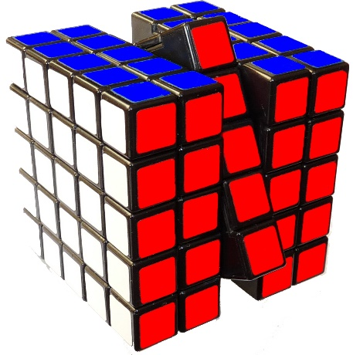
JINR
Dubna
ITEP
Moscow
DA SS
Detector of the reactor AntiNeutrino
based on Solid-state Scintillator
JINST 11 (2016) no.11, P11011; arXiv:1606.02896

Slide 4
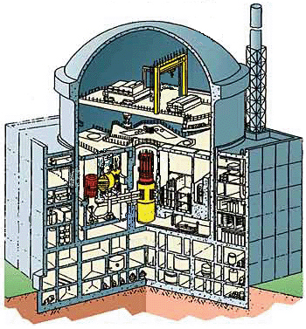
Kalinin NPP, reactor #4 building ( the B-320 project )
Overburden
(reactor, building, shielding, cooling pond, etc.):
~50 m of W.E.
Core of
ВВЭР-1000
(3.1 GW_{th})
Cooling Pond
Technological room A336
just under the reactor
9 m only!
5 ×10¹³ ν/cm²/s
room А336
Notes:
The detector is located in the room just under the reactor cauldron. Being there, we are at about 10 meter from the center of the core and exposed to a huge neutrino flux. Moreover, big amount of hydrogen-containing material above the room shields perfectly against fast cosmic neutrons (which is the main source of background).

Slide 5
There are several ways to demonstrate neutrino oscillations:
Observe deficit or excess of counts with respect to theor. expectation
Observe deviation from the predicted spectrum shape
Observe evolution of the neutrino flux with distance
(model-independent, free of main systematic errors and therefore is the most reliable)

Slide 6
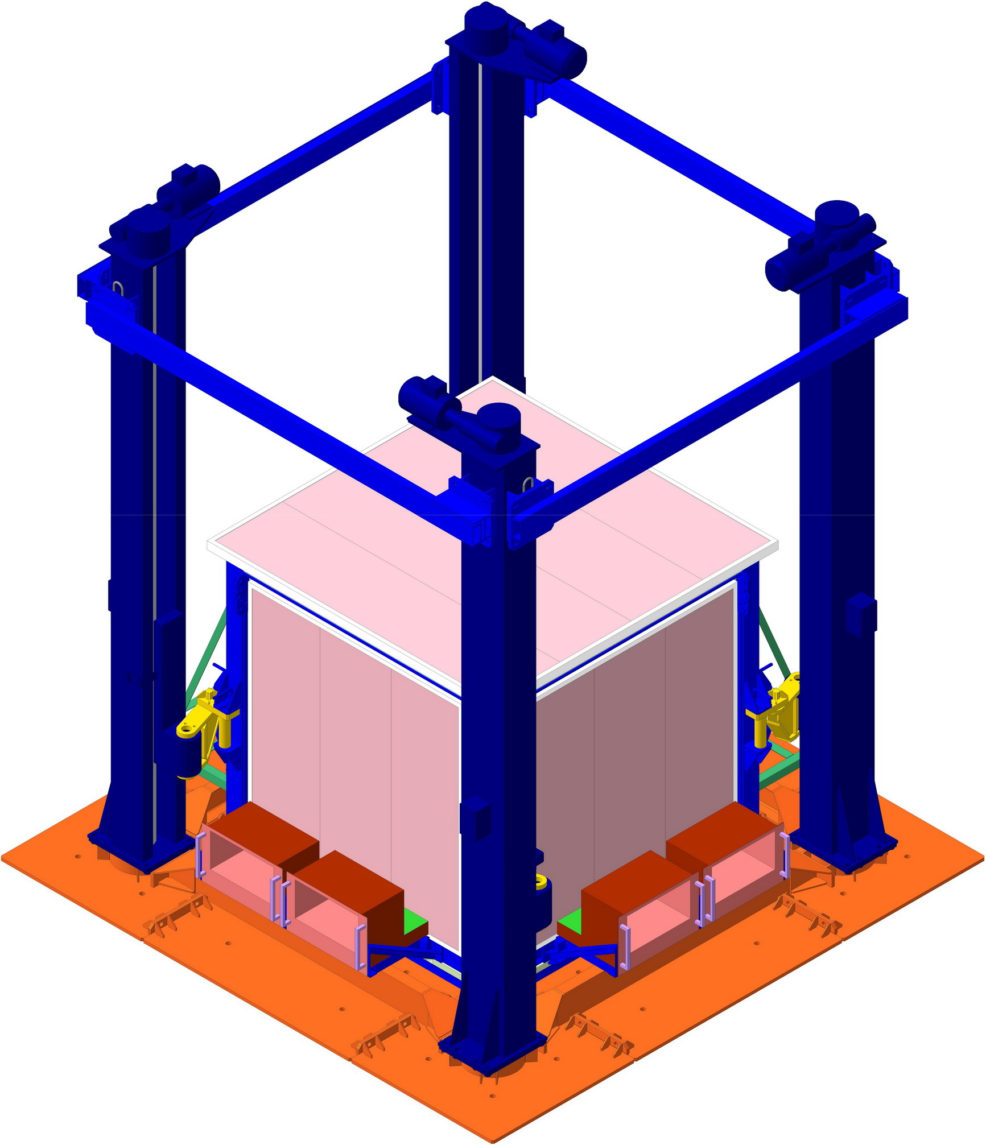
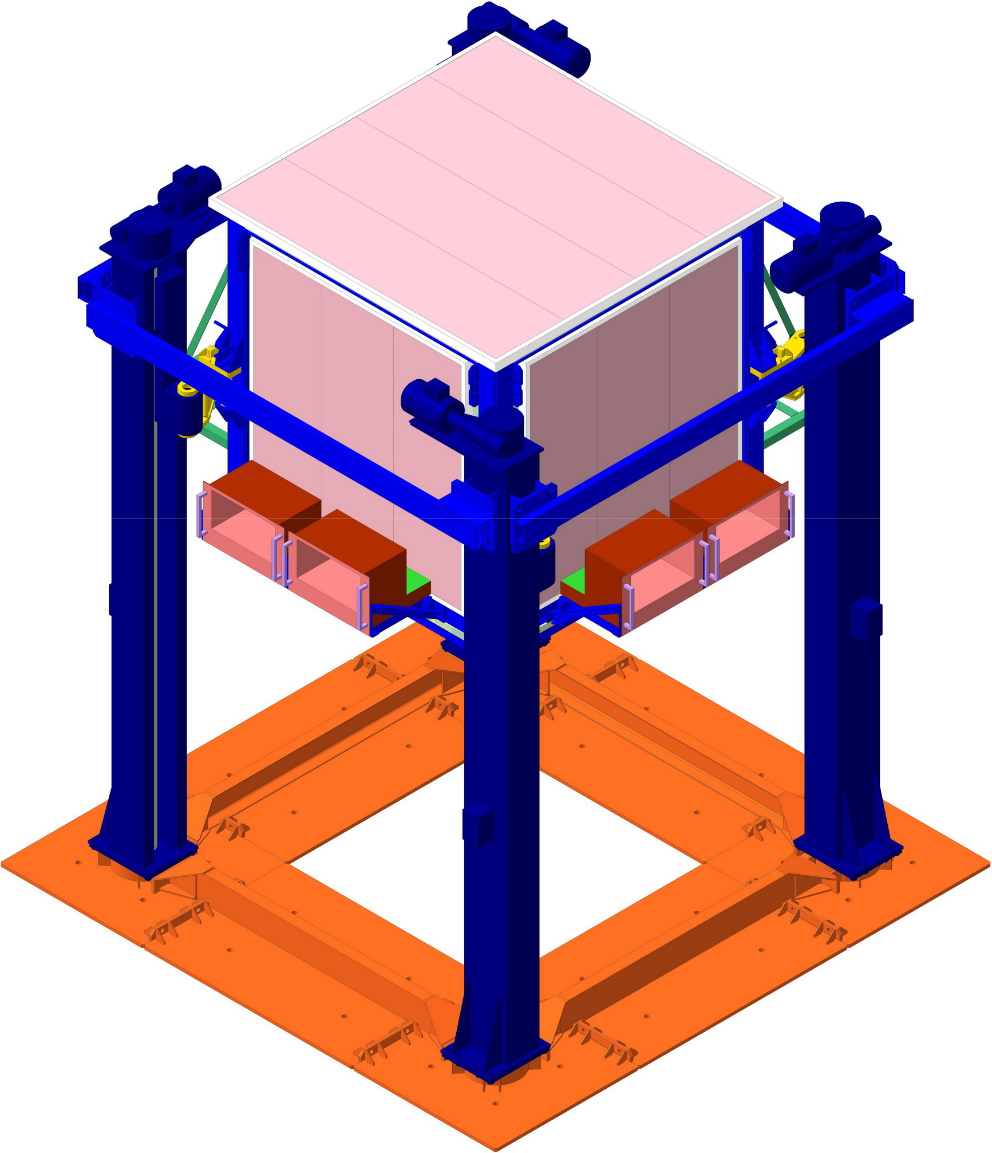
Dn
L=12.7 m
2.7 days
Md
L=11.7 m
2.3 days
Up
L=10.7 m
2.0 days
Dn
L=12.7 m
2.7 days
2 min
2 min
20 tn
Notes:
That is why our detector is moved (3 positions per week) so that the distance to the core is varied by 2 meters

Slide 7
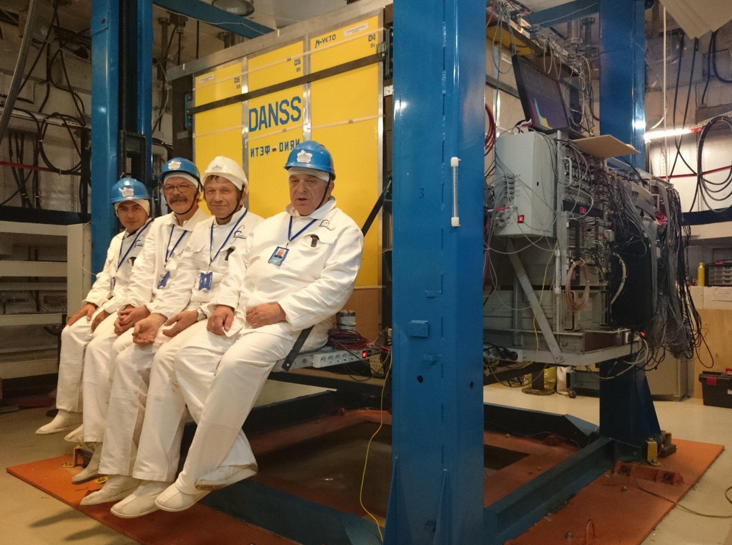
Notes:
Here is a view of the detector on a lifting gear, and one can ride it up and down

Slide 8
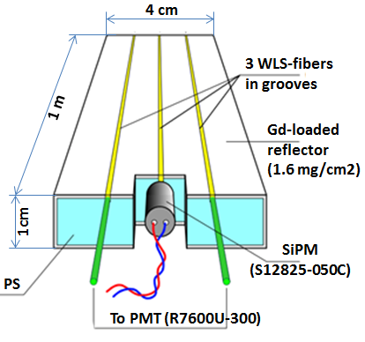
Modular structure provides 3d space pattern of each event
JINST 11 (2016) no.11, P11011; arXiv:1606.02896 [physics.ins-det]
1.1 tonne of PS = 5.1×10²⁸ Hydrogen atoms
Basic element: polystyrene-based scintillator strip
1m
1m
25 Y-Modules
25 X-Modules
1m
2500 independent scintillator strips
coupled to 2500 SiPM and 50 PMT
Notes:
The detector consists of 2500 independent scintillator strips based on polystyrene. Each of them is coupled to individual photo-sensor. Each 50 strips are combined to intercrossing modules coupled to a small PMT. Such modular structure provides 3-dimensial space pattern of each event, so that we could see separately energy deposit of the positron and that of annihilation photons. It helps a lot for the event identification and background suppression during the analysis.

Slide 9
IBD signature: Two light signals from the scintillator
Inverse Beta Decay :
2-50 μs
Flash local in space
Flash distributed in space
e⁺
(n,γ)
PROMPT signal : positron (Ep = Eν − 1.8) + annihilation photons
DELAYED signal : neutron capture by Gd → cascade of gamma-rays

Slide 10
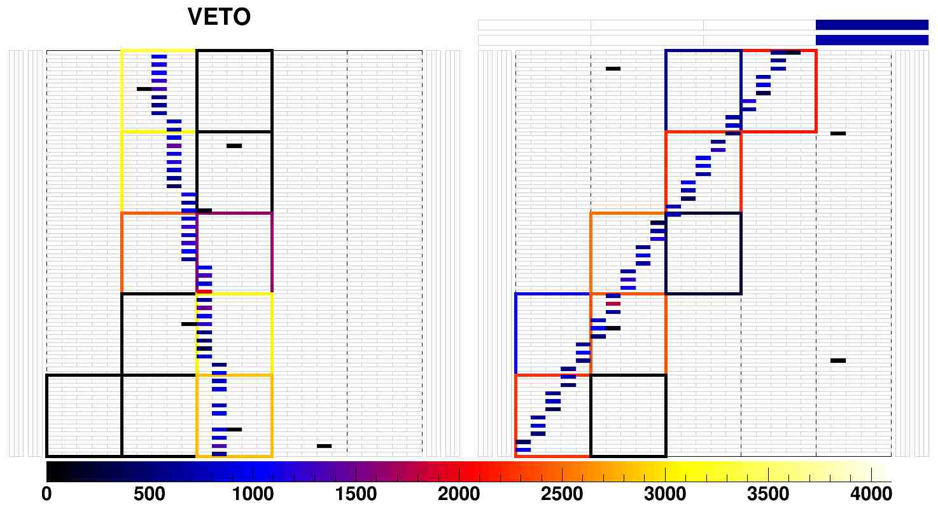
Energy calibration with cosmic muons arXiv:1804.04046[hep-ex] – details of calibration and analysis
Notes:
Energy calibration is done with cosmic muons (we see individual tracks) …

Slide 11
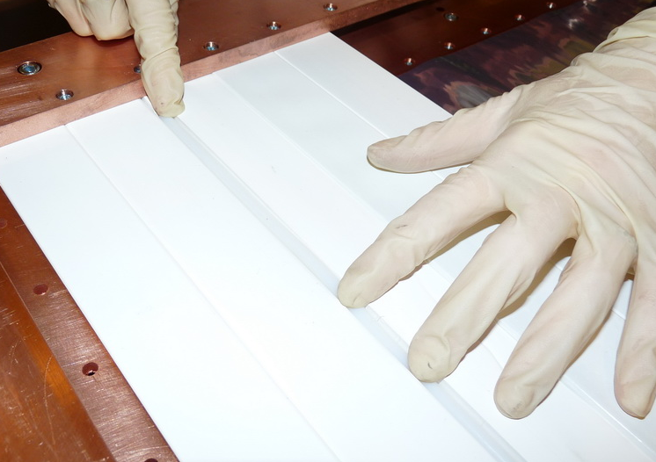
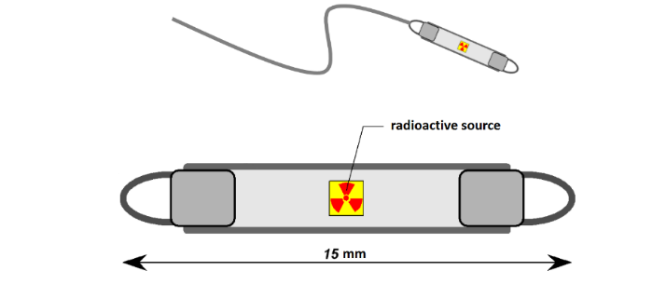
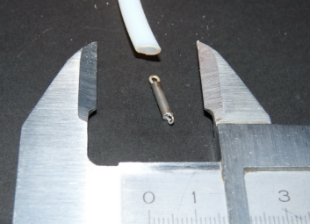
Calibration with ²²Na, ⁶⁰Co, ¹³⁷Cs, ²⁴⁸Cm (few Bq)
Teflon capillary
H(n,γ)
Gd(n,γ)
Notes:
… and with tiny radioactive sources introduced inside the detector body

Slide 12

An example of time distributions
Events / 200 ns / day
50 PMT only
Up , Md , Dn
τ_{m}= 4.01 ± 0.07
τ_{c} =13.68 ± 0.23
Off
N =1.52 ± 0.05
²⁴⁸Cm
N =3.20 ± 0.02
T (P-D), μs
Notes:
Here are time distribution between the Prompt and Delayed signals

Slide 13
An example of energy spectra (partial segmentation)
50 PMT only
4051 Up ev / day
3476 Md ev / day
3022 Dn ev / day
333 Off ev / day
Notes:
… and here – energy spectra measured at 3 distances with 50 PMTs. As you see, the background (when the reactor is OFF) is as low as 10% only. If we include information from 2500 individual sensors, thus increasing the segmentation, then…

Slide 14
An example of energy spectra (full segmentation)
50 PMT and
2500 SiPM
4910 Up ev / day
4101 Md ev / day
3490 Dn ev / day
133 Off ev / day
Notes:
… then identification becomes stronger, and BG decreases down to 3%. (Mention, that most of other competitive projects only dream to reach a Signal/Background ratio of about unity)

Slide 15
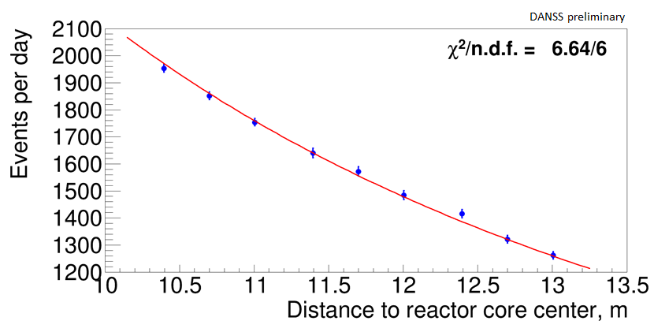
IBD total rate vs effective distance
UP
MIDDLE
DOWN
IBD intensity follows reasonably the 1 / L² dependence.
Effective distance L takes into account real spatial distribution of the detection efficiency and the reactor core burning profile (monitored permanently by the KNPP staff) .
The time variation of reactor core burning profile is taken into account with a precision of 30 min and ~10 cm.
Reactor core center
Time evolution of the core burning profile
Notes:
Now, what about oscillations? We do not see any serious deviation from the L-squared dependence

Slide 16
Notes:
If to plot the spectra ratio Dn over Up – we can see some fluctuations from the flat line which corresponds to the NULL hypothesis. But these fluctuations contradict to the RAA claim at 5-sigma level

Slide 17
Notes:
The same is with Md over Up ratio.

Slide 18
Notes:
Detailed analysis done with a conservative CLs method allows to exclude significant part of the oscillation parameters

Slide 19
Notes:
On the other hand, our best fit is somewhat non-zero…

Slide 20
Notes:
… but its statistical significance is only about 2.8 sigma, and I wouldn’t pay too much attention to that.

Slide 21
Summary
DANSS is taking data since Apr 2016 (data available for analysis – since Oct 2016).
4910 IBD events/day are detected in the closest position
Background: 133 μ-induced events/day (2.7% for Up pos.)
Spectrum dependence on the fuel composition within the campaign is clearly visible and agrees with HM-prediction
A large fraction of allowed sterile oscillation parameters region is excluded in a model-independent way. The RAA point (Δm²=2.3 eV², sin²(2θ)=0.14) is excluded at 5σ level.
The best point at (Δm²=1.4 eV², sin²(2θ)=0.05) has 2.8σ significance.
DANSS data taking and analyses: on-going

Slide 22
Notes:
Now let’s come to Korean experiment NEOS

Slide 23
Notes:
The 1 cubic meter singe-volume Liquid Scintillator detector…

Slide 24
Notes:
… is the only one (except of our DANSS) which is located near an industrial reactor. Unfortunately, the distance is fixed at 24 m. It is not segmented, and the overburden is not enough high, but thanks to a good Pulse Shape Discrimination,…

Slide 25
Notes:
… they have succeeded to get rather low background

Slide 26
Notes:
Comparing the spectrum shape with one measured in Daya Bay experiment, NEOS also provides some parameter exclusion (which unfortunately is not model-independent)

Slide 27
Notes:
Quite soft summary.

Slide 28
Notes:
After our first publications everybody understood that segmentation could be very useful. So, the STEREO team using their experience of NUCIFER, made a 6-cell detector

Slide 29
Notes:
.. Which is located at 10 m from the ILL small research reactor in Grenoble

Slide 30
Notes:
Here you can see the construction…

Slide 31
Notes:
… and some very preliminary results.

Slide 33
Notes:
PROSPECT. American colleagues tried to find appropriate POWER reactor (which could take the place of SanOnofre closed now). They even planned to use atomic aircraft carrier. But as I see, at the moment they develop a new design at a small research reactor. The detector is segmented and is planned to be moved (not moved yet).

Slide 34
Notes:
The build a prototype with LS dopped with 6Li instead of Gd

Slide 35
Notes:
It is really on the way.

Slide 36
Notes:
… and after 33 days they exclude some part of parameters.

Slide 38
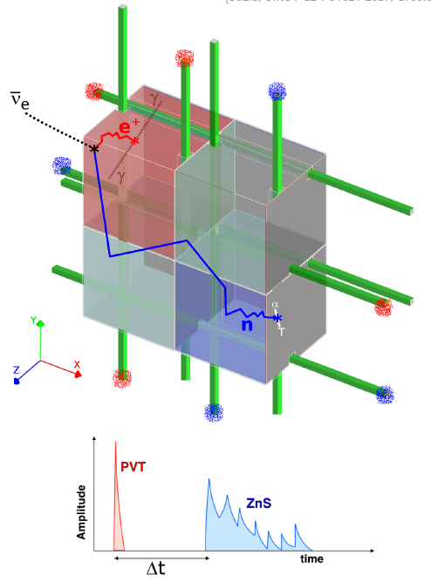
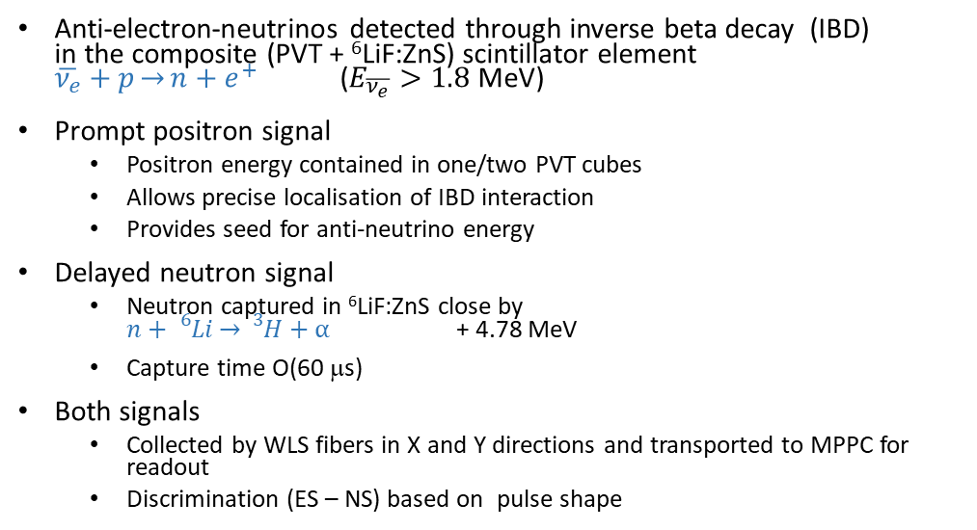
SoLid detection principle
JINST 12 (2017) no.04, P04024
JINST 13 (2018) no.05, P05005
Anti-electron-neutrinos detected through inverse beta decay (IBD)
in the composite (PVT + ⁶LiF:ZnS) scintillator element
$\overline{ν_{e}}+p\overset{→}{}n+e^{+}$ ($E_{\overline{ν_{e}}}>1.8$ MeV)
Prompt positron signal
  Positron energy contained in one/two PVT cubes
  Allows precise localisation of IBD interaction
  Provides seed for anti-neutrino energy
Delayed neutron signal
  Neutron captured in ⁶LiF:ZnS close by
  $n+{}_{}^{6}{Li\overset{→}{}{}_{}^{3}H}+α$ + 4.78 MeV
  Capture time O(60 μs)
Both signals
  Collected by WLS fibers in X and Y directions and transported to MPPC for readout
  Discrimination (ES – NS) based on pulse shape
Notes:
SoLid is also highly segmented and used 6Li for neutron detection.

Slide 39
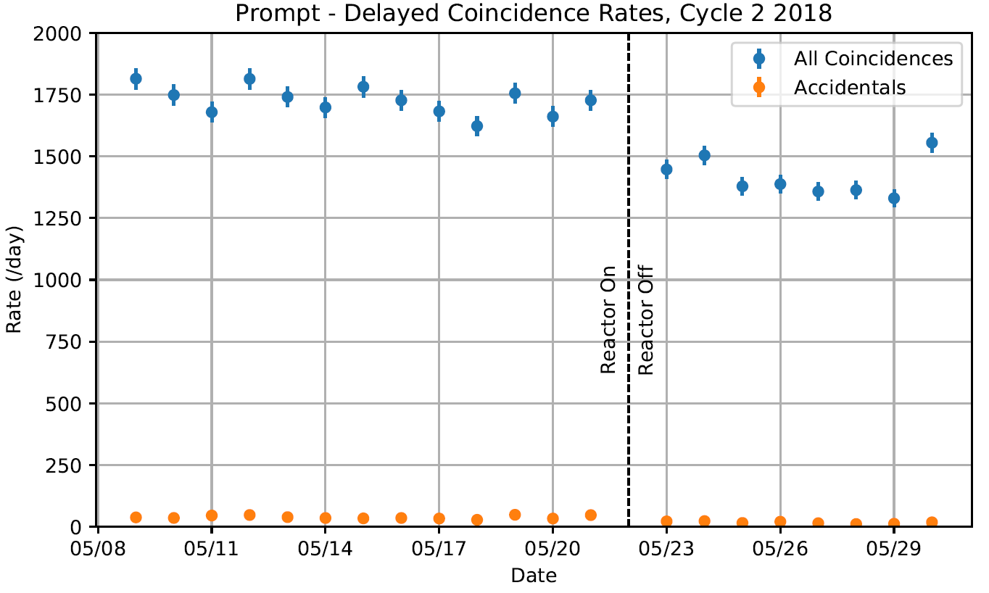
IBD-like Rates
Preliminary rate monitoring, based on:
  Timing, Topology, Muon veto, Energy selection
Significantly higher IBD-like rate during reactor ON
Very low accidental rate
How does it behave?
SoLid Preliminary
Notes:
They claim that ON/OFF count rate differs significantly… What does it mean?

Slide 40
Conclusion
Solid improved design after evaluating performance of full scale prototype module in 2015-2016
Constructed a 1.6 ton detector (Phase1) in 2017 and commissioned it in Nov-Dec 2017
Validated performance with calibration & commissioning data
SoLid is now taking good quality physics data and observes IBD-like events
BR2 will provide us with 6 reactor cycles this year
Physics triggers and DAQ operations are being optimized
Object reconstruction under continuous development and being validated
Backgrounds being measured and IBD selection criteria optimized
First physics results coming real soon!
Notes:
Well, they promis physics soon.

Slide 41
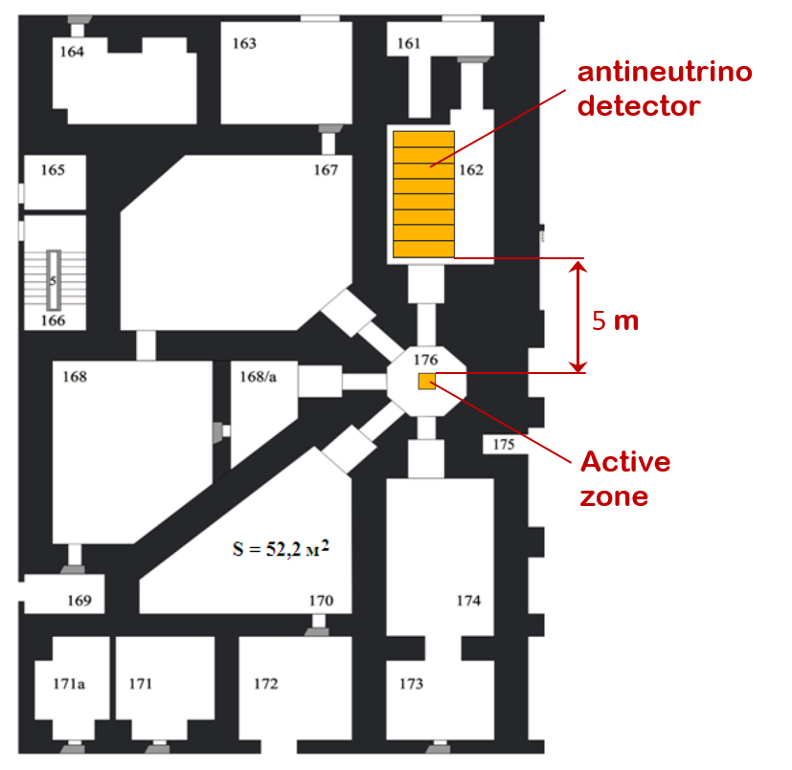
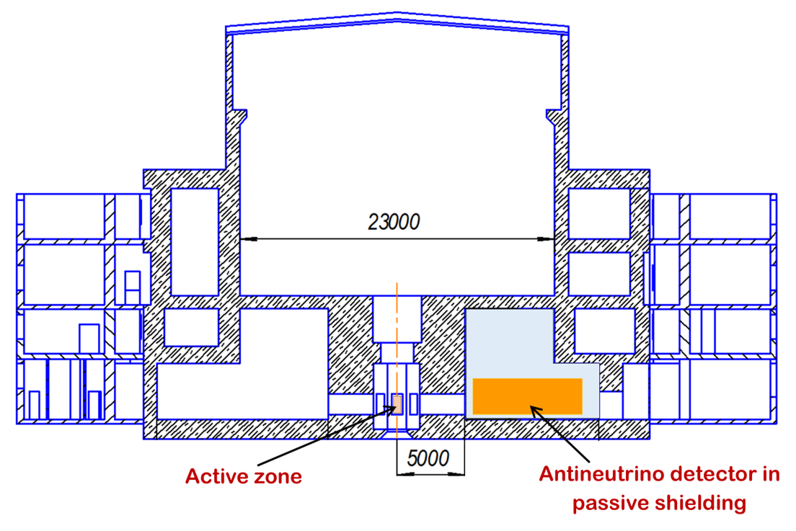
Reactor SM-3
100 MW thermal power
Compact core 42x42x35cm
Highly enriched ²³⁵U fuel
Week protection from cosmic rays (3-5 m w. e.)
Notes:
The most recent news arrived a week ago from NEUTRINO4 experiment driven by A.Serebrov from Gatchina, St. Petersburg. This segmented movable LS-based detector is located close to 100 MW compact reactor SM3 in Dimitrovgrad, RU.

Slide 42
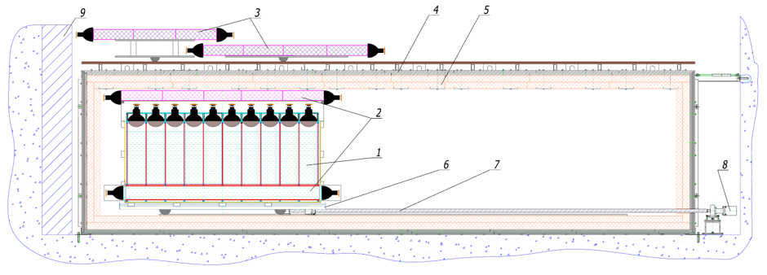
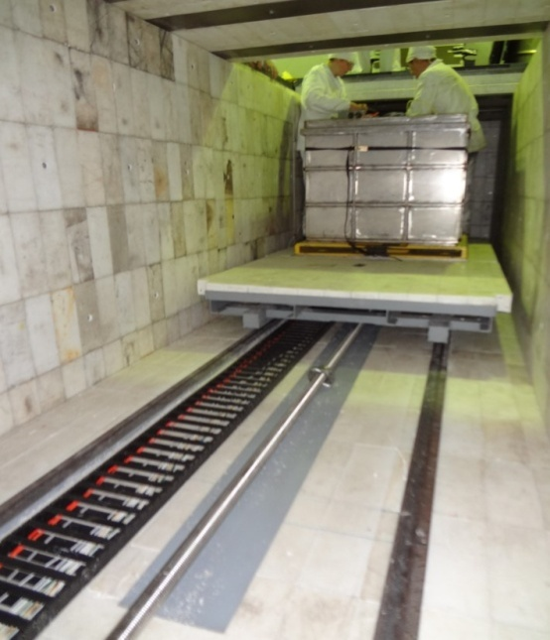
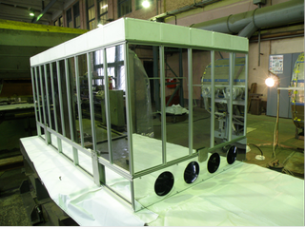
Movable and spectrum sensitive antineutrino detector NEUTRINO4
Core:
42×42× 35 cm
LS: 50 sections 0.235x0.235x0.85м³
Range: 6 – 12 meters
detector (5x10 cells)
internal active shielding
external active shielding
steel and lead
borated polyethylene
moveable platform
feed screw
step motor
shielding
Notes:
Extremely compact core (40x40x40cm only) has 100 MW power. Here one can see the cave with a movable trolley and the construction of cells. Contrary to 3 previous projects, this device is in operation already more than 2 years (like our DANSS).

Slide 43
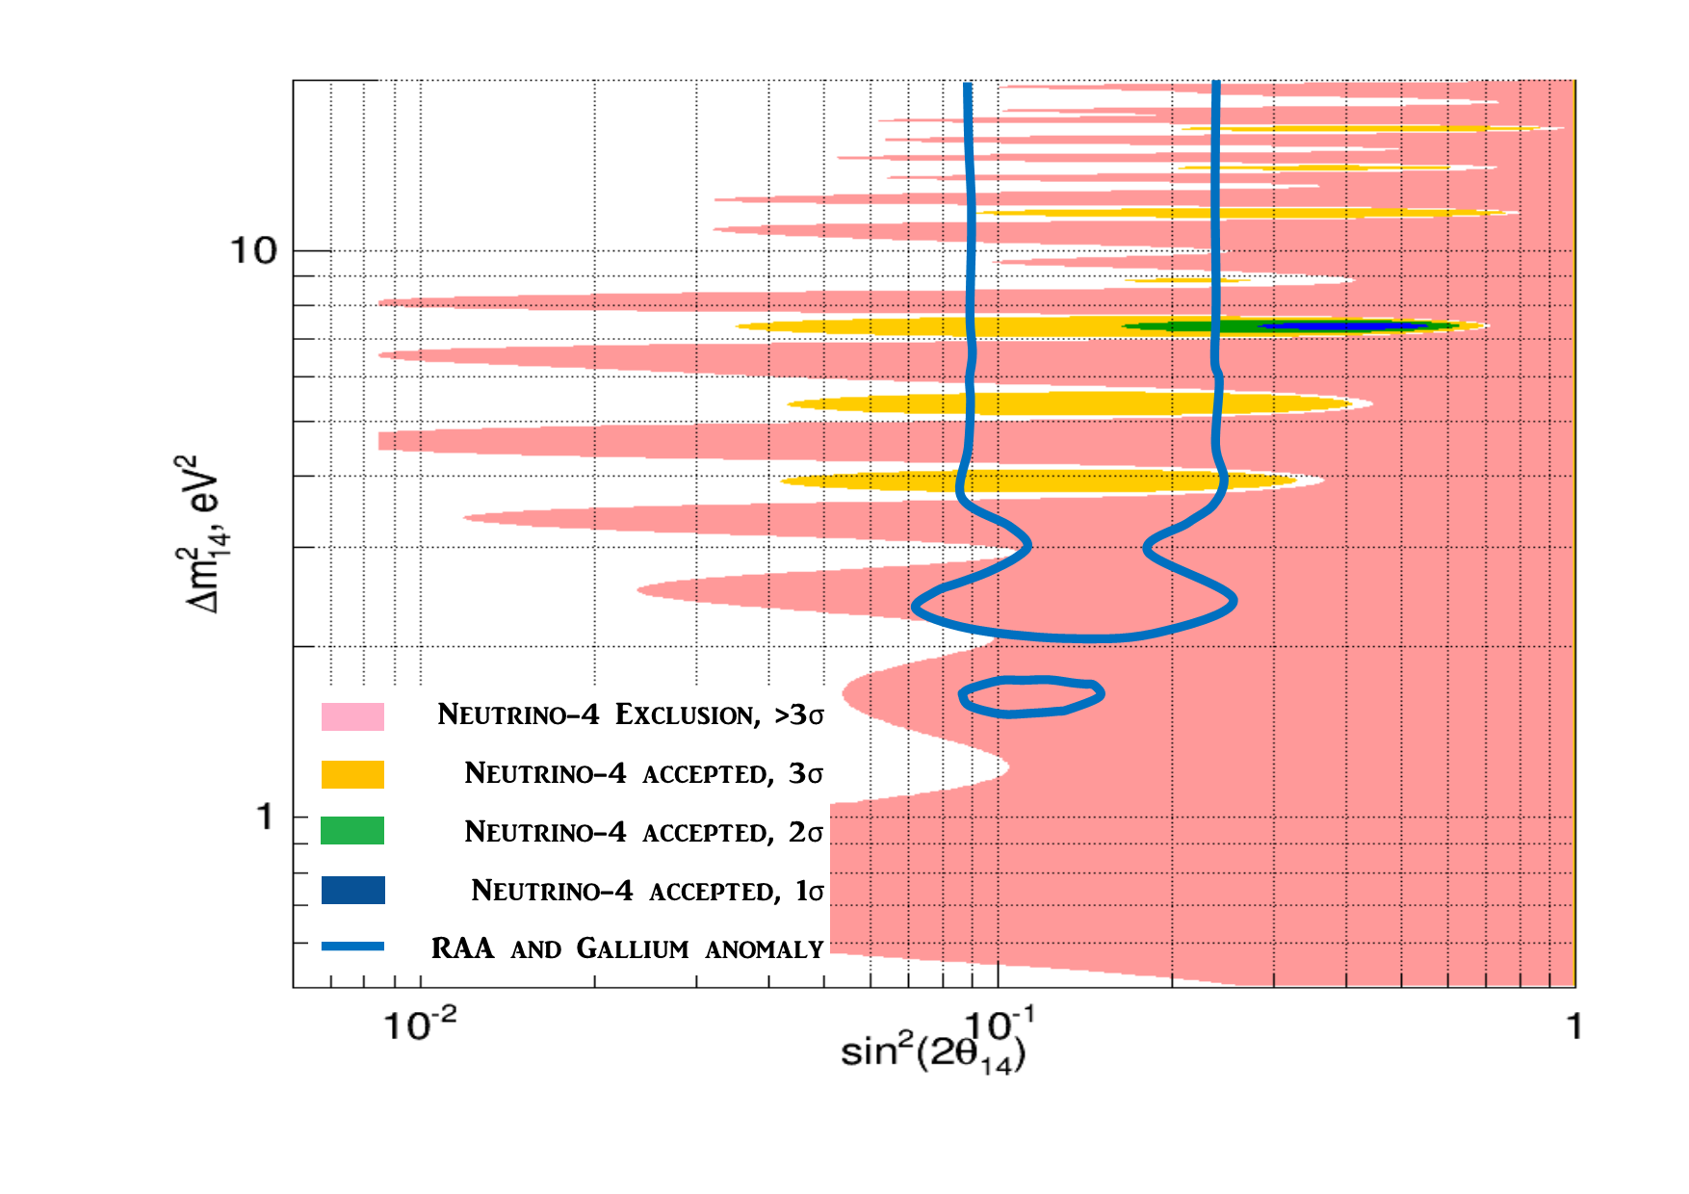
The oscillation effect at C.L. 99.7% (3σ) in the vicinity of
(Δm₁₄)² ≈ 7 eV² sin²(2θ₁₄) ≈ 0.35
Expected from
RAA and Gallium anomalies
Expected from
Neutrino-4
CL 99.7%
Excluded from
Neutrino-4
CL>99.9% CL
Notes:
Using a model-independent analysis, they produce the following results.

Slide 44
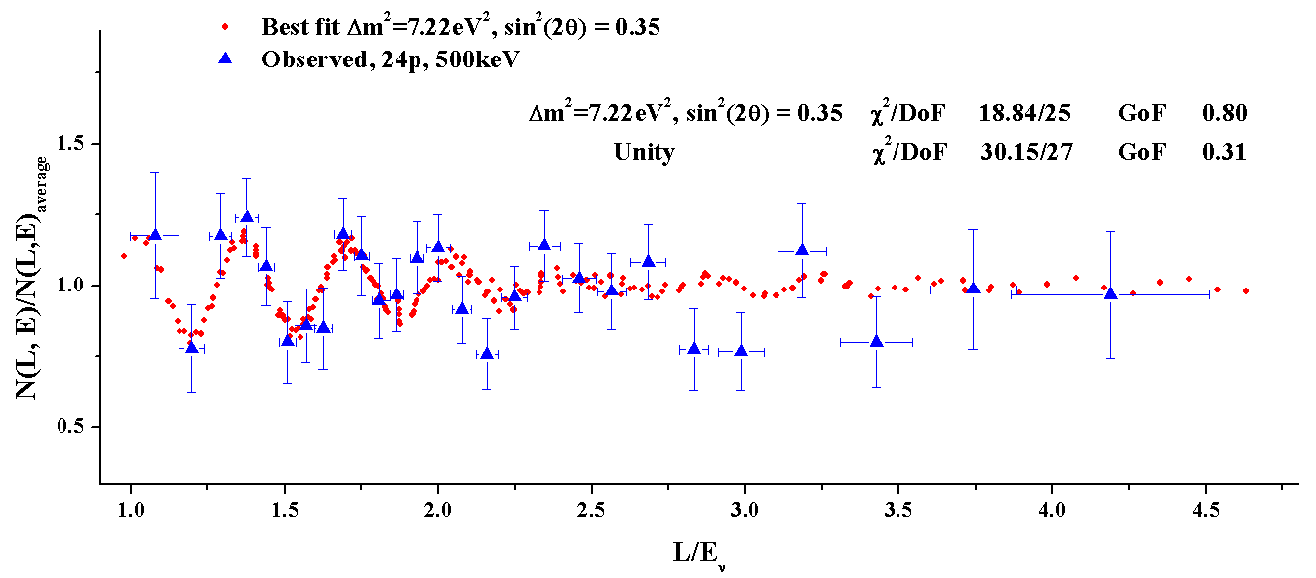
The method of coherent addition of results of measurements allows us
to directly observe the effect of oscillations
Since, according to the equation, oscillation effect depends on ratio L/E, it is beneficial to make experimental data selection using that parameter.
arXiv:1809.10561 [hep-ex]

Slide 45
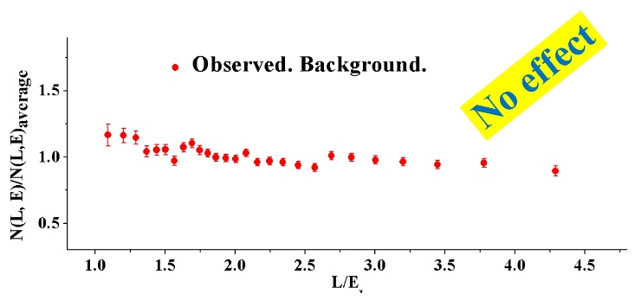
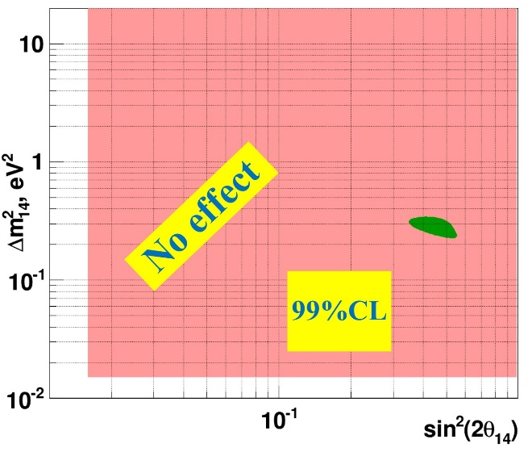
Check on systematic effects
To carry out analysis of possible systematic effects one should turn off antineutrino flux (reactor) and perform the same analysis of obtained data
data analysis using coherent summation method
analysis of the results on oscillation parameters plane
Thus no instrumental systematic errors were observed.

Slide 46
Thank you for attention
(Some spare slides)
↓

Slide 48
Significance of the best regions
BF: 2.8 σ
Results are preliminary:
more syst. effects are under study
“ 3 σ means not a discovery, but just a cause of thinking”
A. Serebrov
Notes:
~

