Slide 1
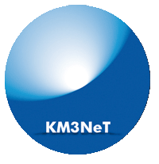
Nanobeacon: A time calibration device for the KM3NeT
David Calvo, Diego Real
VLVNT 2018, Dubna
1

Slide 2
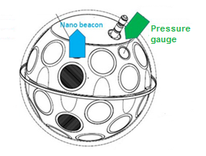
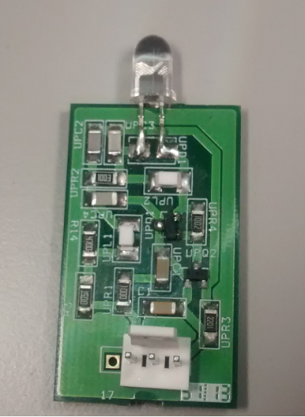
KM3NeT Time calibration: Nanobeacon
The angular resolution is critical in a N.T. to resolve cosmic neutrino sources from the atmospheric background.
The angular resolution relies on a good positioning and time calibration.
Working within the specifications the attainable angular resolution of KM3NeT is better than 0.1º
Nanobeacon
Electronic circuit controlled by I2C
Integrated into the Digital Optical Module
LED emits an ultra-short light pulses
Relative time resolution (among DOMs) depends on:
Transit time spread (TTS), typically s~1-1.5 ns.
Optical properties of the sea water: light scattering + chromatic dispersion (s~1-1.5 ns) for light coming from a distance of 50 m.
Electronics (s<0.5 ns).
Therefore, an overall unavoidable uncertainty of ~2 ns will always be present.
2
VLVNT-18 10-2018

Slide 3
KM3NeT Time calibration: Nanobeacon
The main use of this system is to measure PMT time offsets through intra-line calibration with LED beacons along the same detector line
Experience has shown that a system of external light sources with a well-know emission time is very useful to ensure the timing calibration of the detector and measure water optical parameters
Synchronizing timing offsets between beacon elements is cumbersome and time consuming. An
d time consuming
Providing trigger signals introduces unwanted electrical noise to system
3
VLVNT-18 10-2018

Slide 4
KM3NeT Time calibration: Nanobeacon
Calibration:
One Nanobeacon per DOM
Not expensive and high redundancy
Not triggered by the clock to avoid electronic noise
Frequency of several kHz depending on the DAQ system
Avoid cumbersome synchronization process, only one LED per Nanobeacon
4
VLVNT-18 10-2018

Slide 5
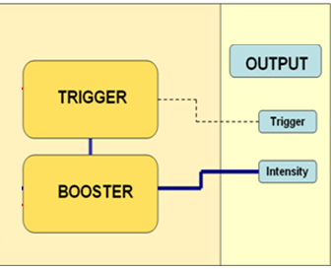
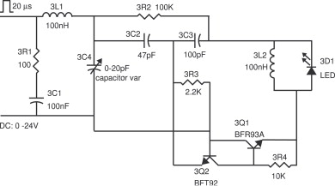
KM3NeT Nanobeacon: Electronics
Select the intensity of flashing (Booster 2.5 V - 30 V)
Select the frequency of the internal trigger (up to 8 kHz)
CLB
DC voltage charges a capacitor
Two ultra-fast transistors discharge the capacitor over the LED
5
VLVNT-18 10-2018

Slide 6
KM3NeT Nanobeacon: Configuration
6
VLVNT-18 10-2018

Slide 7
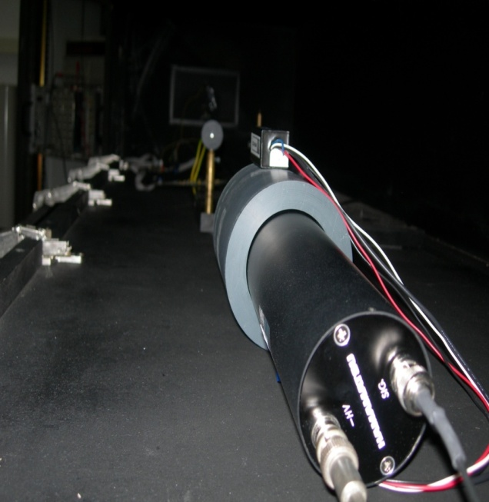
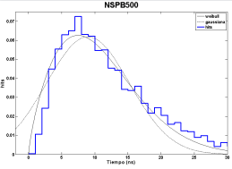
Nanobeacon: Photoelectron setup
Led Optical Pulse reproduced with the photoelectron method:
Dark Box
Oscilloscope with histrogram capability
2 PMTS: H6780-03 and H6156-50
Optical Filter
Nanobeacon property | Performance
Optical rise-time | ~ 2.7 ns
Optical FWHM | ~ 4.5 ns
Wavelength | 470 nm (blue)
Angular distribution | 15º
Intensity | ~150 pJ
Power consumption | < 0.12 W
OSCILOSCOPE
LECROY
H6780-03
PULSER + LED
Δt
H6156-50
DARK BOX
FILTERS
7
VLVNT-18 10-2018

Slide 8
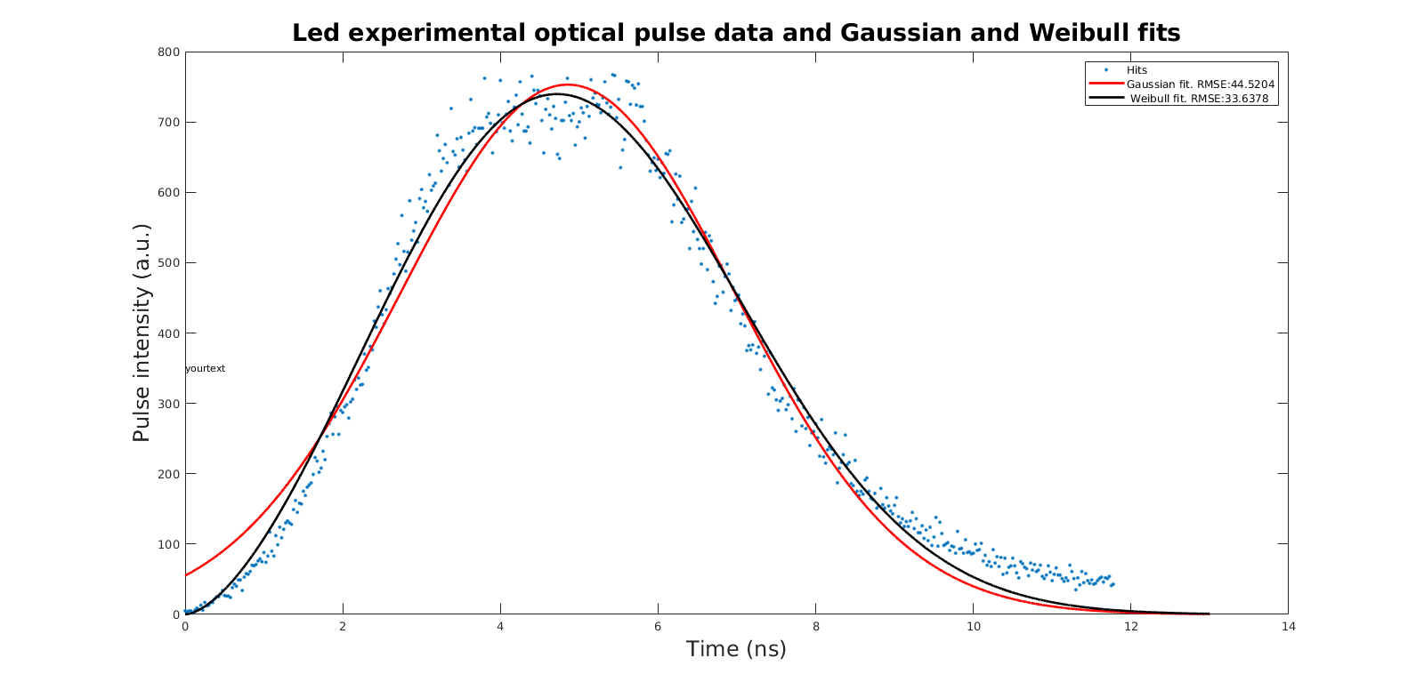
Nanobeacon optical pulse
Led Optical Pulse reproduced with the photoelectron method
Gaussian and Weibull fits – Weibull provides a better fit:
8
VLVNT-18 10-2018

Slide 9
Rise time and FWHM of nanobeacon pulse
Results for 24 LEDs (Model: HLMP-CB1A-XY0DD)
24 V and 1 kHz:
 | RISE TIME (ns) |  | FWHM (ns)
 | Gaussian | Weibull | Gaussian | Weibull
Mean | 3.14 | 2.69 | 4.39 | 4.51
Std. Dev | 0.27 | 0.21 | 0.38 | 0.41
Weibull data should be considered as more accurate:
Rise Time around 2.69 ns
FWHM around 4.51 ns
9
VLVNT-18 10-2018

Slide 10
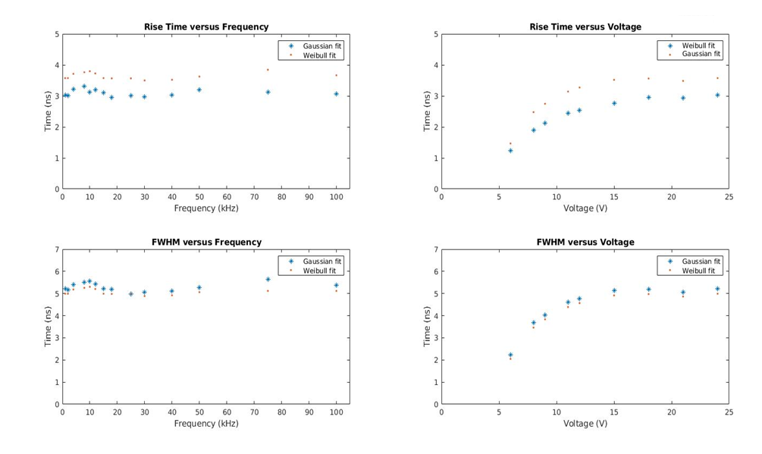
Effects of frequency and voltage
10
VLVNT-18 10-2018

Slide 11
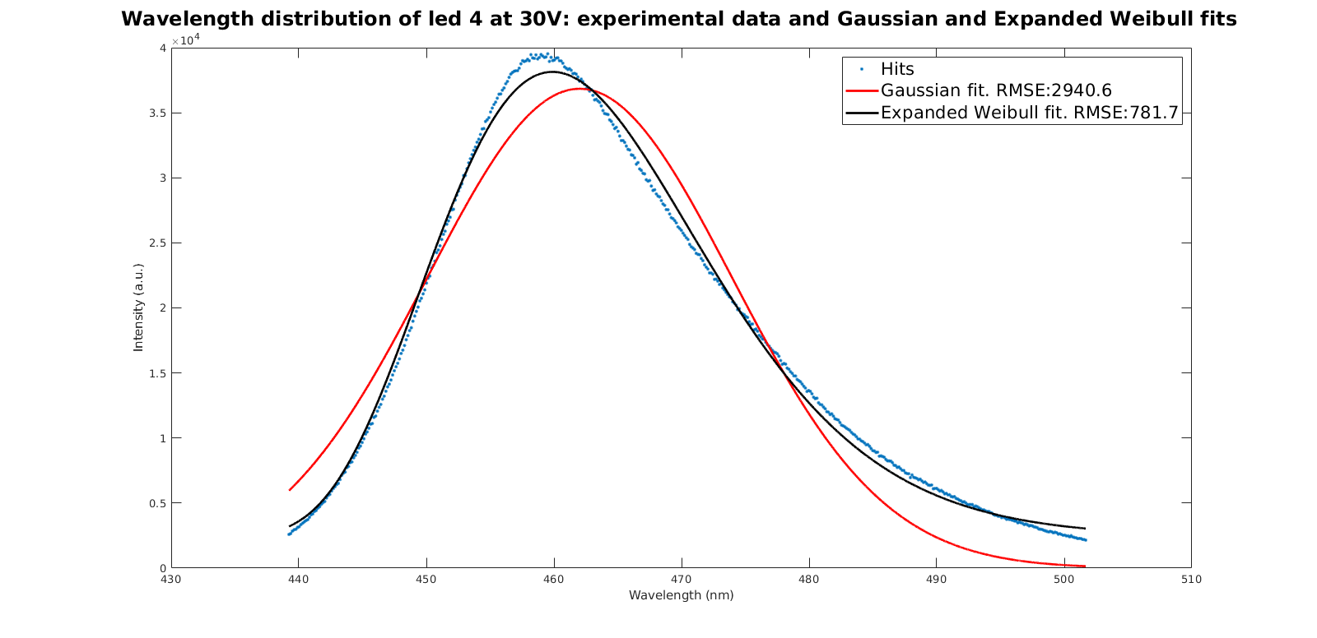
Wavelength distribution (LED:HLMP CBLA-XY)
11
VLVNT-18 10-2018

Slide 12
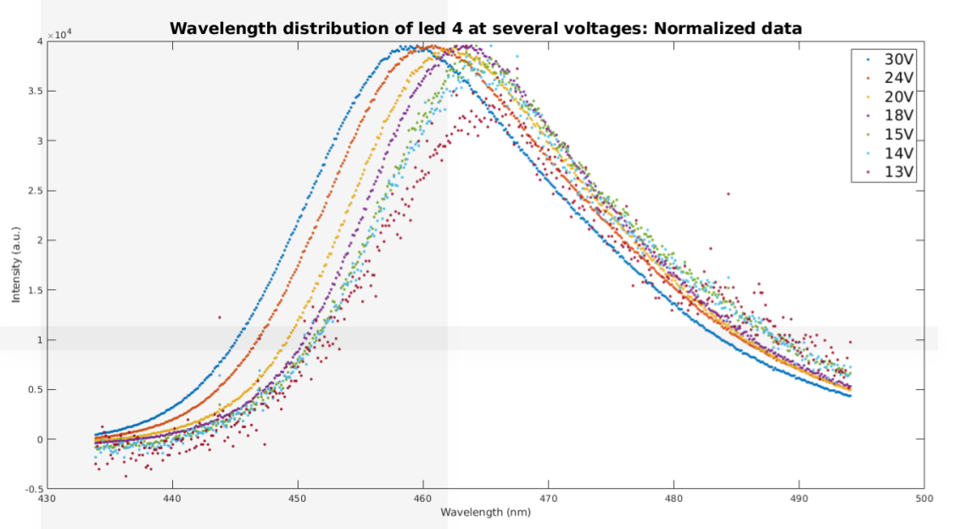
Effects of voltage on wavelength
The wavelength decreases when the voltage is increased
12
VLVNT-18 10-2018

Slide 13
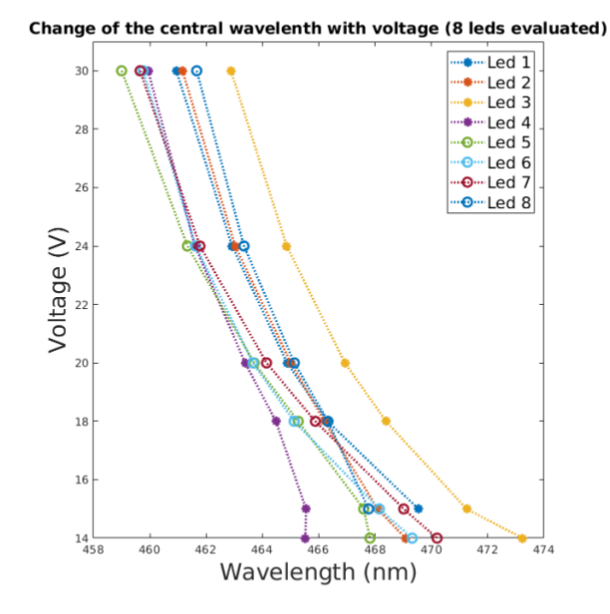
Effects of voltage on wavelength
13
VLVNT-18 10-2018

Slide 14
Summary
Nanobeacon: important calibration device
Characterization of the Pulse shape by photoelectron technique
Frequency has no impact on the pulse of light
Voltage affects:
Wavelenght
Rise time
FWHM
14
VLVNT-18 10-2018

Slide 15
Nanobeacon: A time calibration device for the KM3NeT
David Calvo, Diego Real
VLVNT 2018, Dubna
15

