Slide 1
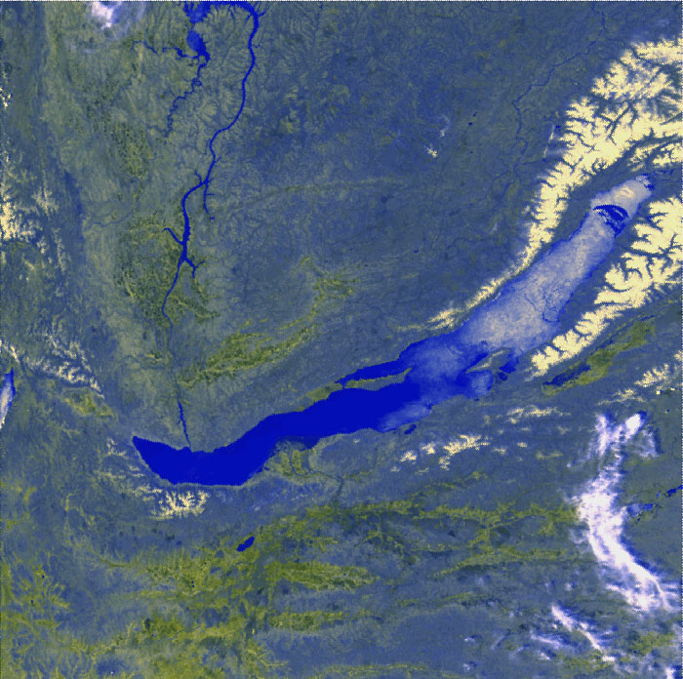
Baikal-GVD: results of cascades
reconstruction
Zh.-A. Dzhilkibaev, INR (Moscow),
for the Baikal Collaboration
QUARKS-2018, October 07, 2018

Slide 2
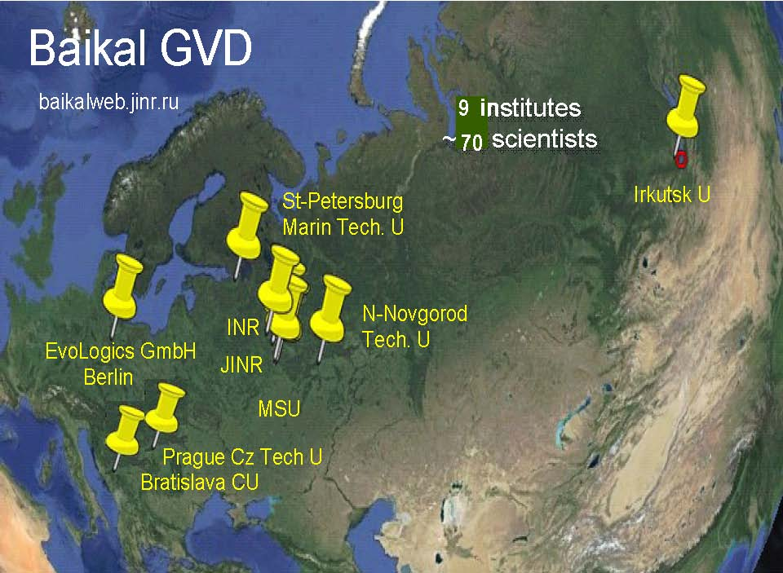

Slide 3
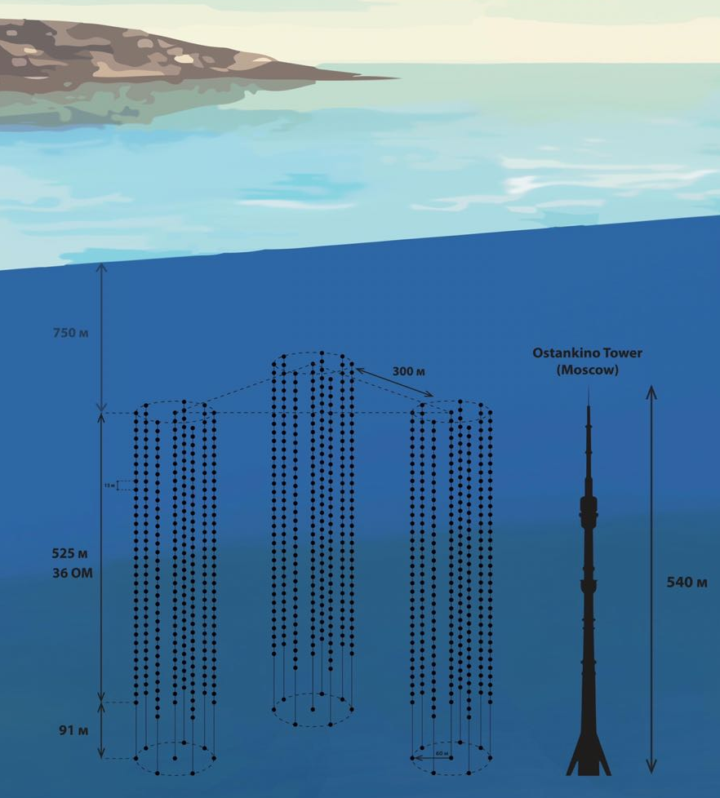
Status-2018 of the Baikal-GVD project
Cluster 1 since 2016
Cluster 2 since 2017
Cluster 3 since 2018
Powerful isotropic laser source
Data transmition
40 Gb per cluster per day to shore
5 Мb/s 40 km radio channel to Baikalsk
Raw data transferred to storage Dubna facility through Internet

Slide 4
Stages of deployment of the GVD-1
Configuration | 2015 | 2016 | 2017 | 2018
The number of OMs | 192 | 288 | 576 | 864
Geometric sizes, m | ∅80×345 | ∅120×525 | 2×∅120×525 | 3×∅120×525
Eff. Vol | 0.03 km³ | 0.05 km³ | 0.1 km³ | 0.15 km³
GVD-2017
Uui
Cluster 3
GVD-2018
Shore cable
Shore cable
Laser
NT200
Cluster 1
Cluster 2
(image: echo location from boat, bathymetry)
Notes:
Early Construction Phase of Baikal-GVD project is concluded in 2015 with deployment of the first GVD Cluster “DUBNA”. This cluster comprised 8 string with 24 optical modules. The first cluster was upgraded to baseline in 2016 (36 OM per string).
The second full-scale cluster was deployed in 2017. The view of two clusters and the topography of the lake bottom presented in this figure.
The third cluster was installed in this year.
The present configuration of detectors presented in this figure.
Three clusters located near to old detector NT200.
Each cluster connected to the shore with hybrid optical – electrical cable.
Laser calibration source located approximately in the center of this configuration.
4

Slide 5
Data analysis is based on reconstruction of cascade parameters
and applying cuts on observables
Iterative procedure - OMs with
residual δt > 15 ns are excluded
and reconstruction is repeated
$_{t}^{2}$ < 2 $÷5$
L_{a} < 10 ÷ 20
$P_{i }$= $\sum{P\left(n/{\overline{n}}\right) }\int_{A_{i}−\frac{α}{2}}^{A_{i}+\frac{α}{2}}{{ ξ}_{i}\left(A,n\right)dA, }$ $\overline{n}= {10}^{8 }×\left(E/{TeV}\right)n_{pe}\left(ρ,z,θ,φ,τ\right)$

Slide 6
Analysis strategy:
Pre-selection of hits – rejection of noise hits:
causality cuts, stronger trigger conditions
Reconstruction of cascade vertex:
cuts on χ_{t}² , OMs residual times, allowed values
of reconstructed coordinates
Energy and direction reconstruction:
cut on L_{a}, analysis of hit/nonhit probability,
cut on a value of reconstructed energy and hit OMs
multiplicity
Hit/nonhit probability:
$$η= l_{max}^{100}− l^{ev}>0$$
$$l^{ev}=−\left(\sum_{i=1}^{N_{hit}}{\ln{p_{i}^{+}}}+\sum_{j}^{N_{tot}−N_{hit}}{\ln{{(1−p}_{j}^{+})}}\right)$$
${ p}^{+}$- OM hit probability

Slide 7
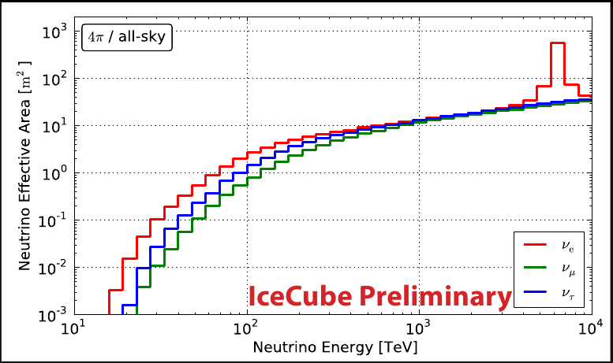
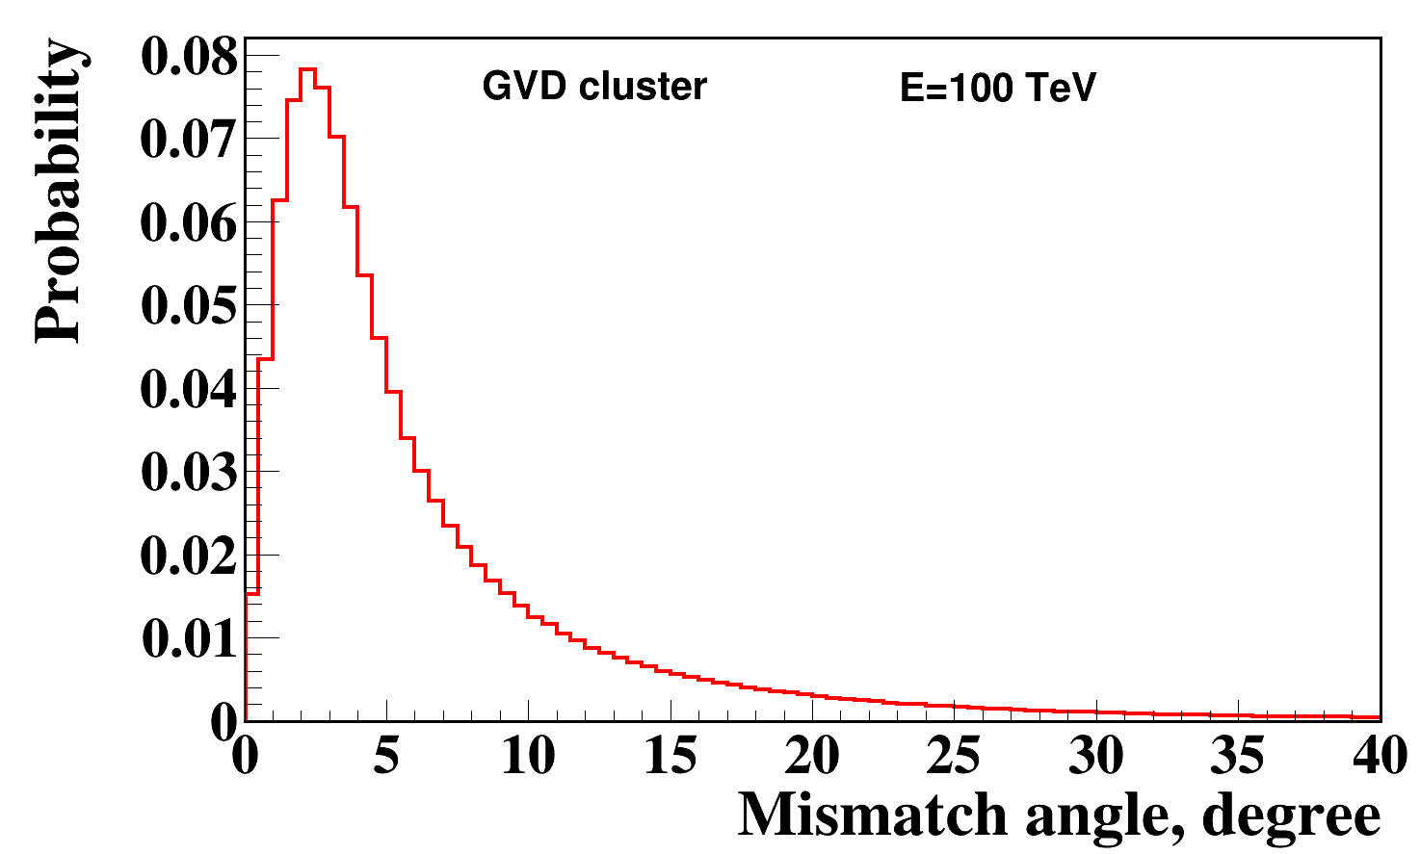
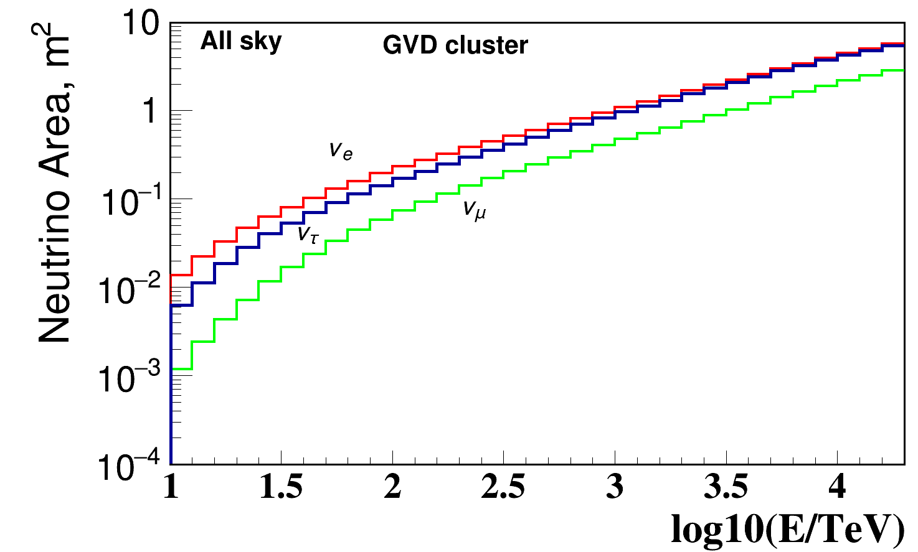
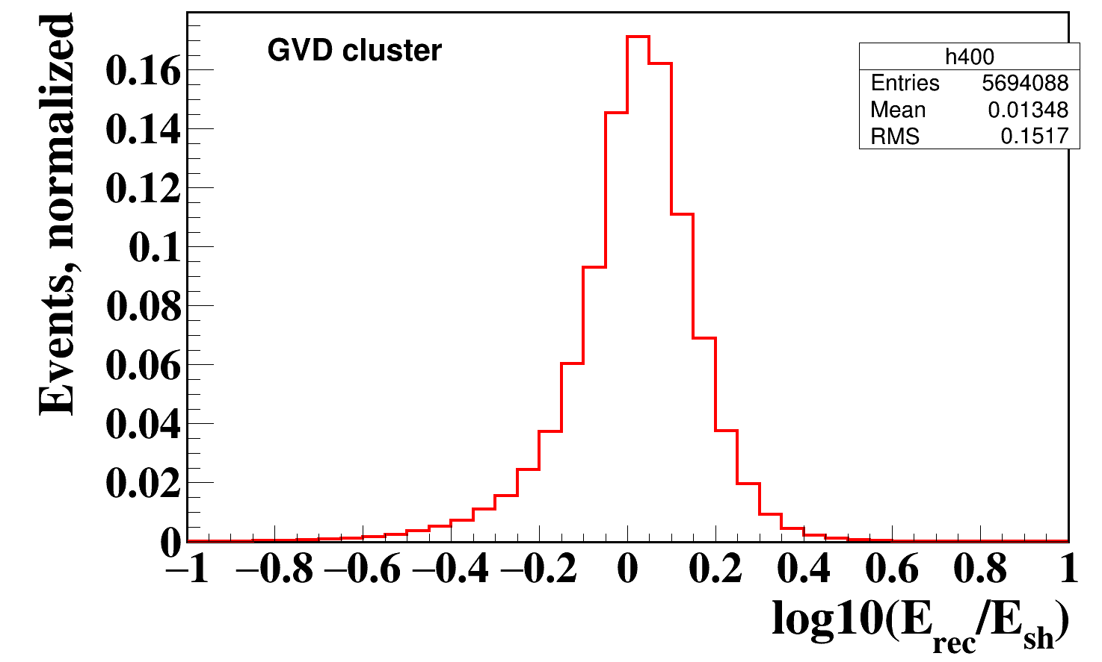
Neutrino Effective Area
Cascades detection with GVD Cluster
IceCube HESE
Distribution of mismatch angles
Directional resolution for cascades:
~ 3°- 4° - median value of mismatch angles
Baseline GVD Cluster
S_{cl} ~ (0.05 - 0.1) S_{IC}
Energy resolution :
δE/E ~ 30%
averaged by E⁻² ν_{e}
spectrum

Slide 8
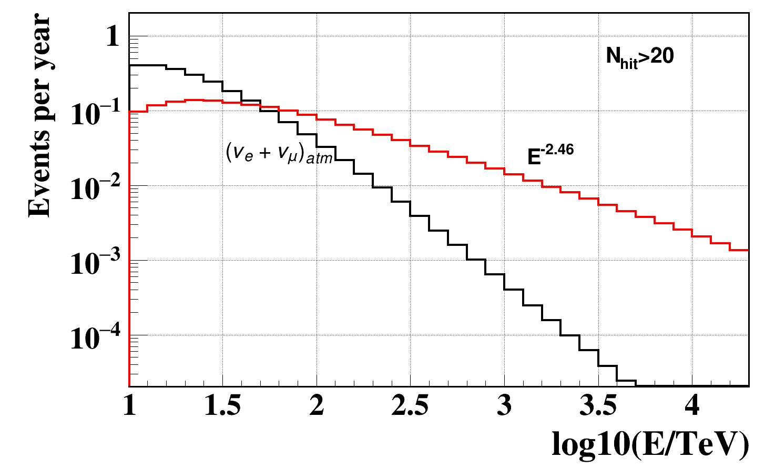
Energy spectrum of astrophysical neutrinos
measured by IceCube:
4.1∙10⁻⁶ E^{-2.46} GeV⁻¹ cm⁻² s⁻¹ sr ⁻¹
Expected number of detected events in GVD Cluster from
astrophysical neutrinos for 1 yr. observation
Event selection criteria (E_{sh} >100 TeV, N_{hit} >20):
~0.6 events/yr are expected

Slide 9
A search for cascades induced by
astrophysical neutrinos
(analysis of 2015 data – PRELIMINARY!)
Total number of accumulated events – 437 970 024 events
(thresholds: low/high = 1.5/4 ph.el.)
Life time – 3 597 921 s = 41.6 days
After causality cuts – 18 840 822 events
(N_{hit} > 3; |t_{i}-t_{j}| < Δr_{ij}/v + δt)

Slide 10
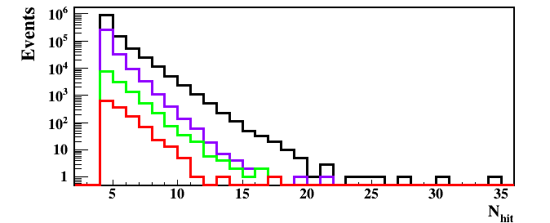
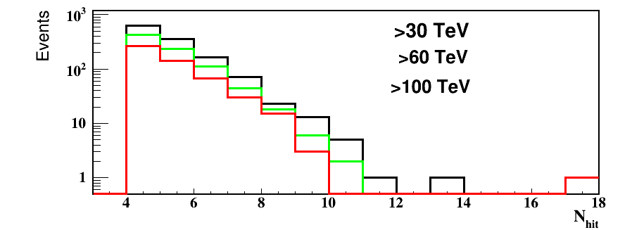
Hit OM multiplicity dependence on cuts
N_{hit} > 20
One event with N_{hit} = 17 OMs (Q>1.5 p.e.)
and E > 100 TeV is delected!
Cuts | Events | Rejection
Reconstruction of coordinates (Q>1.5ph.el.) | 1 171 077 | 1
(χ²_{t} < 2) | 316229 | 1/3.7
(L_{a} < 10)&(η > 0) | 12931 | 1/90
E > 30 TeV | 1291 | 1/900
Cuts | Events | Rejection
E > 30 TeV | 1291 | 1/900
E > 60 TeV | 859 | 1/1360
E > 100 TeV | 539 | 1/2000

Slide 11
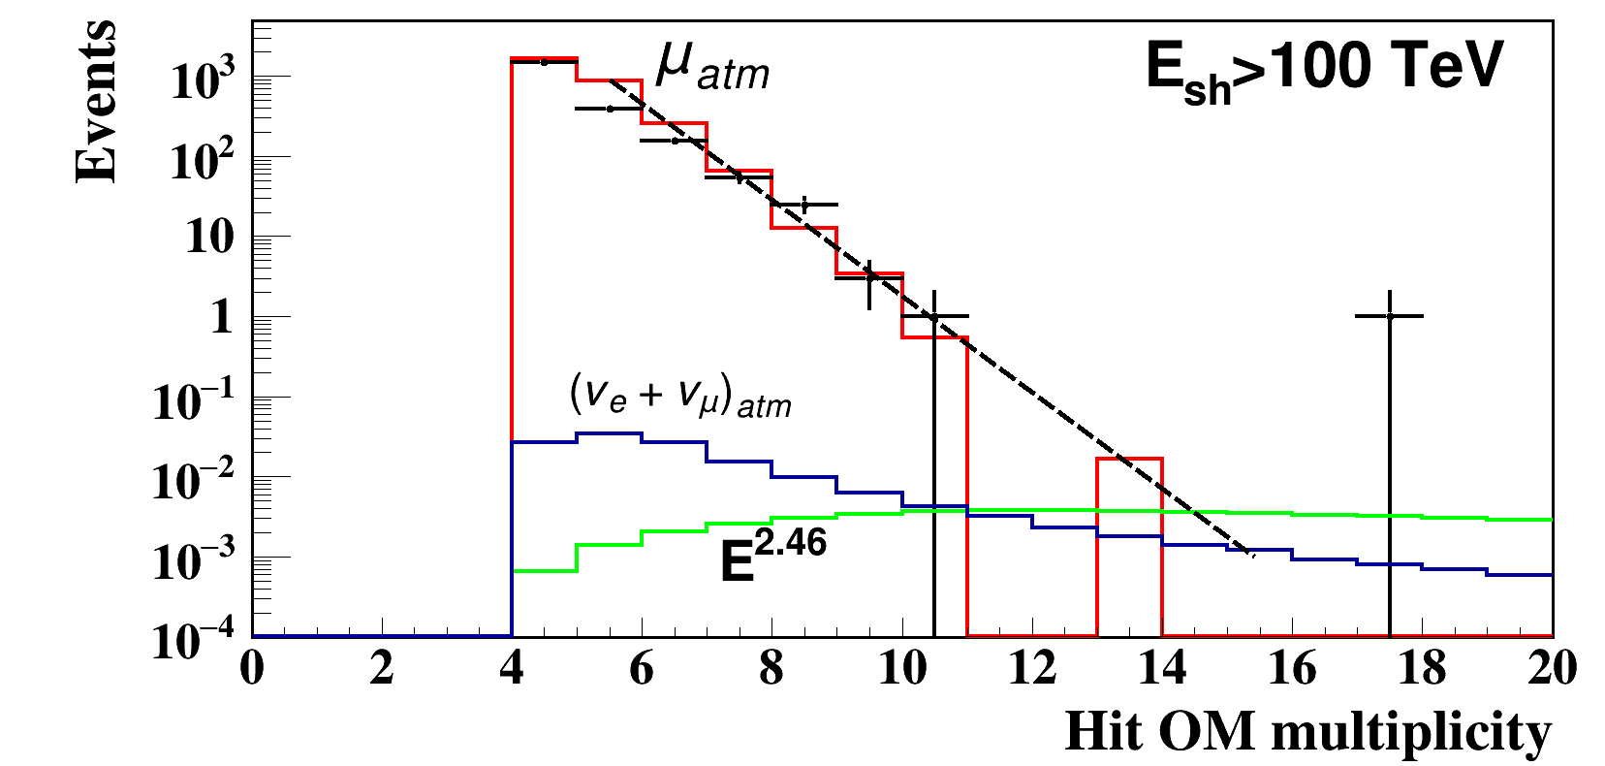
Hit OMs multiplicity after all cuts
E ^{-2.46} atm. ν_{e} atm. ν_{μ} atm. ν (total)
Probability of N_{hit} >16 OM: 0.047 0.0015 0.0026 0.0041

Slide 12
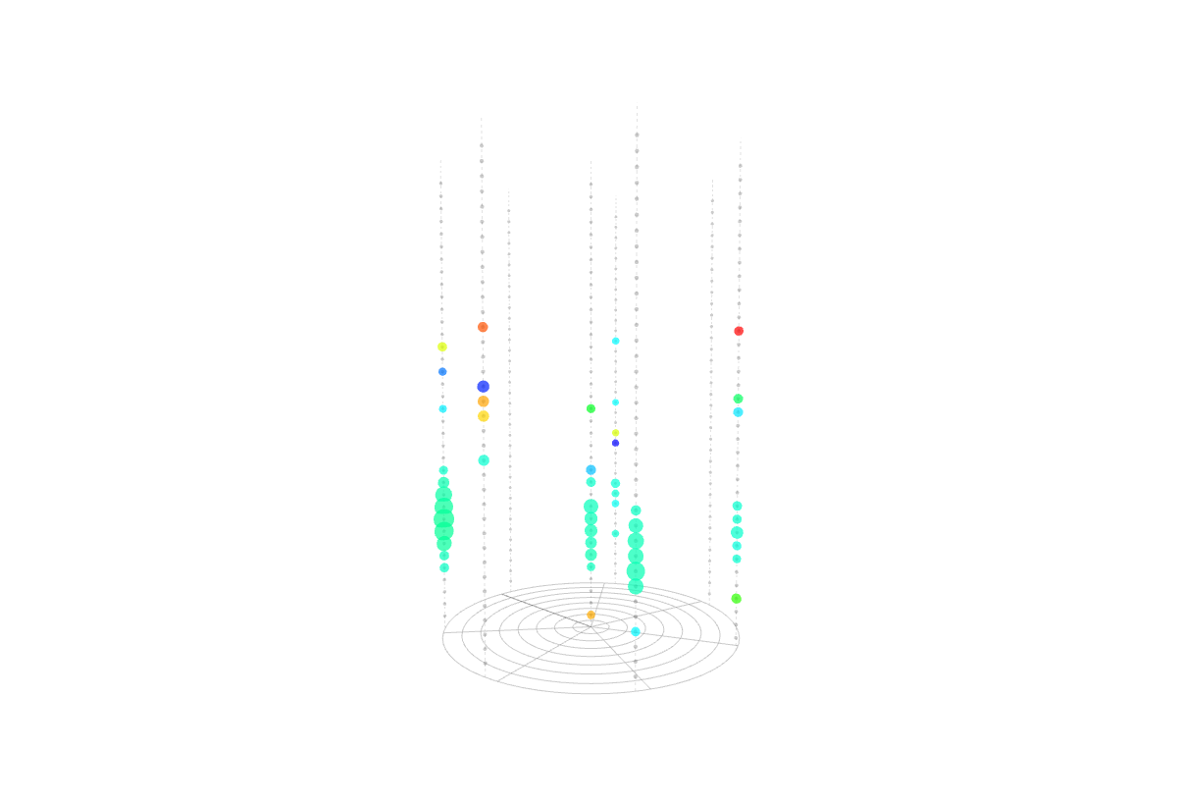
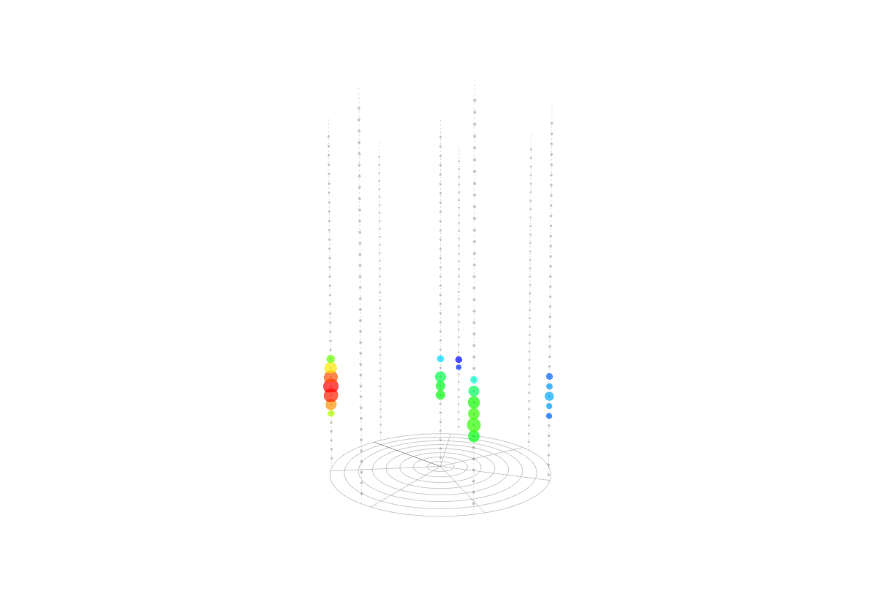
Cascade: E=107 TeV, θ = 56.6°, φ = 130.5°
x=-48.5 m, y=47m, z=-59 m, ρ=68 m
All hit OMs (51 hits)
Selected hits (24 hits)

Slide 13
A search for cascades induced
in GVD-2016 (Preliminary)
Life time – 15 693 192 s = 182.0 days
Total number of accumulated events – 685 523 932 events
(thresholds: low/high = 1.5/4 ph.el. & Q >1.5 ph.el. )
After causality cuts – 327 053 415 events
(N_{hit} > 4; |t_{i}-t_{j}| < Δr_{ij}/v + δt)

Slide 14
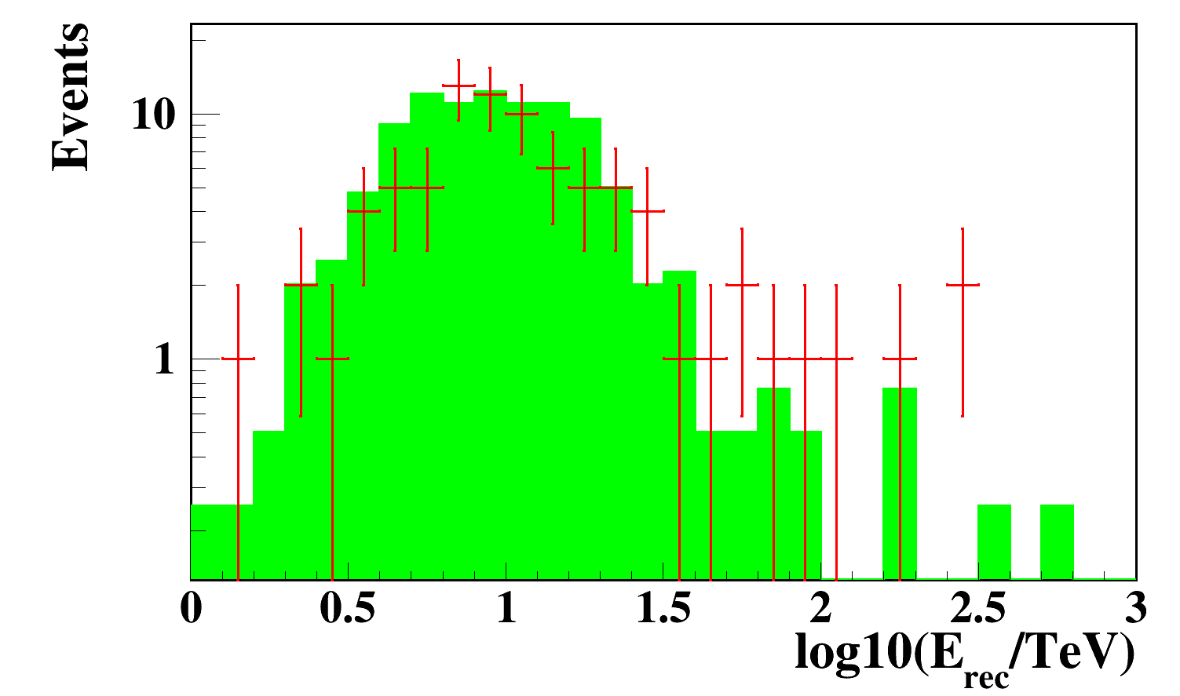
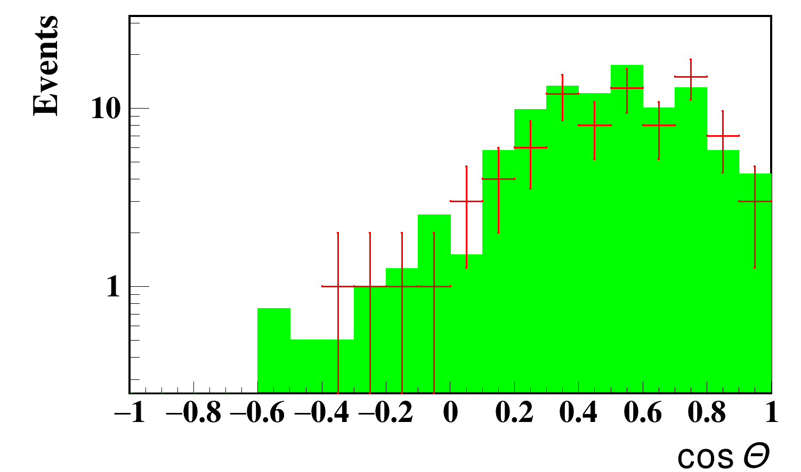
Reconstructed cascades energies
Reconstructed cascade directions
All cuts
All cuts
Atm. μ
Atm. μ
Event selection
Cuts | Events | Rejection
Coordinates reconstruction & N_{hit} >9 | 577495 | 1
χ² _{t}< 4 | 2405 | 1/240
Energy reconstruction
L_{a} < 20 | 374 | 1/6.4
η > 0 | 159 | 1/2.4

Slide 15
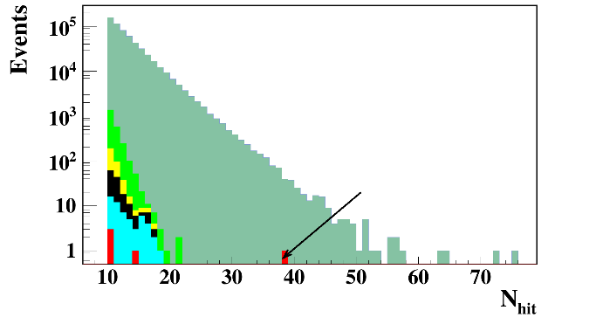
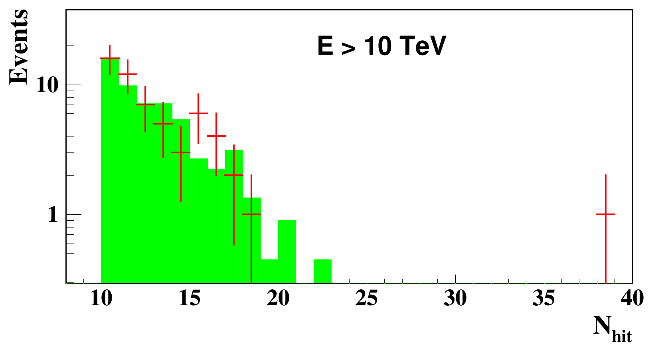
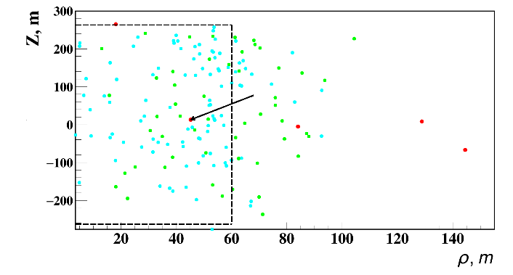
Hit OM multiplicity of events surviving different cuts
Hit OM multiplicity of events with E > 10 TeV
data
atm. muons
Cuts | Events | Rejection
Coordinates reconstruction & N_{hit} >9 | 577495 | 1
χ²_{t} < 4 | 2405 | 1/240
Energy reconstruction
L_{a} < 20 | 374 | 1/6.4
η > 0 | 159 | 1/2.4
E > 10 TeV | 57 | 1/2.8
E > 100 TeV | 5 | 1/11.4
Total rejection factor: |  | 1/115499
Reconstructed cascades positions

Slide 16
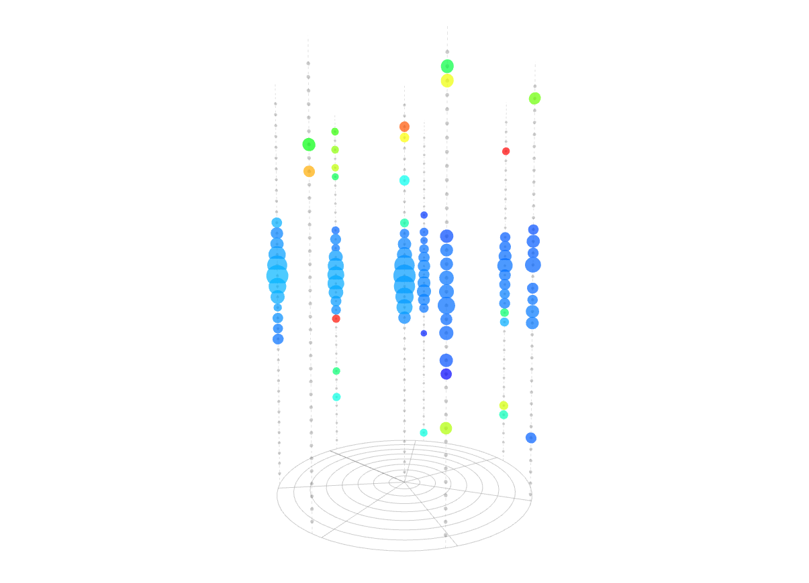
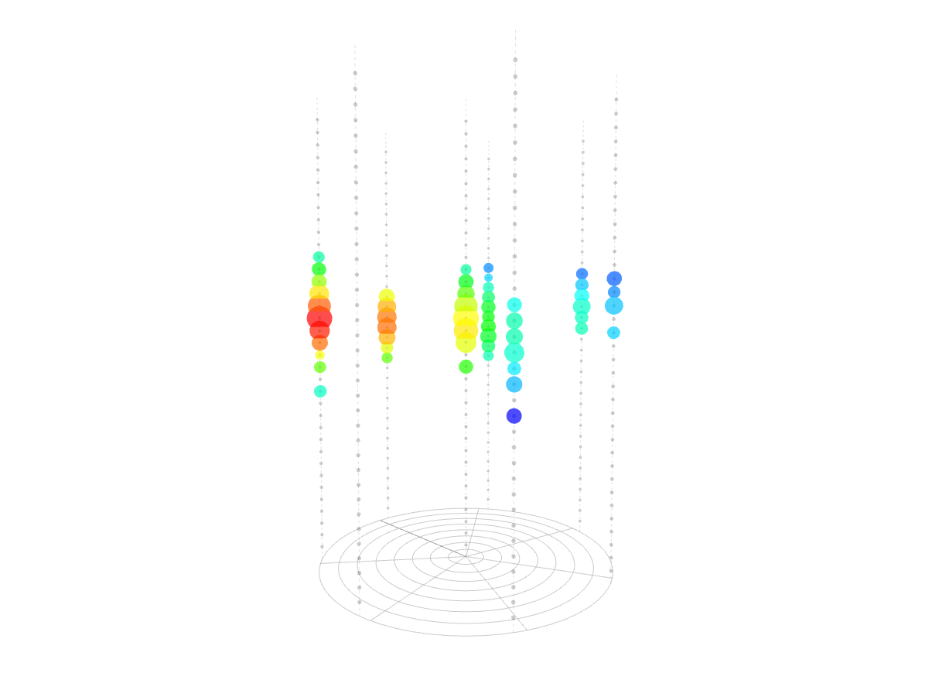
Cascade: E=157 TeV, θ = 57°, φ = 249°
x=-25m, y=-37m, z=11m, ρ=44m
All hit OMs (93 hits)
Selected hits (53 hits)

Slide 17
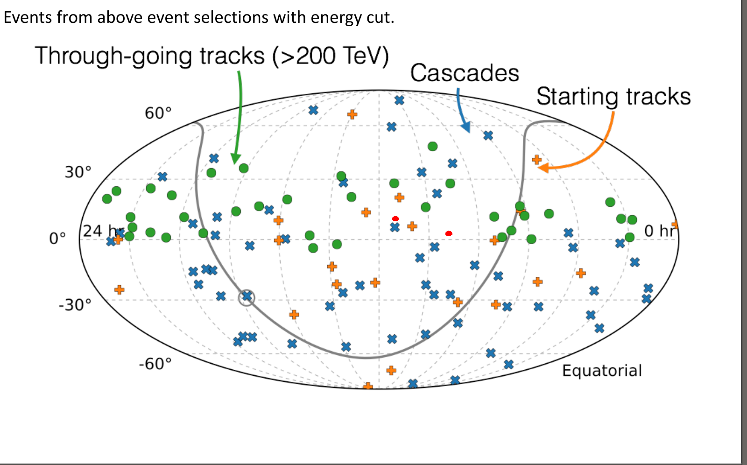
GVD events

Slide 18
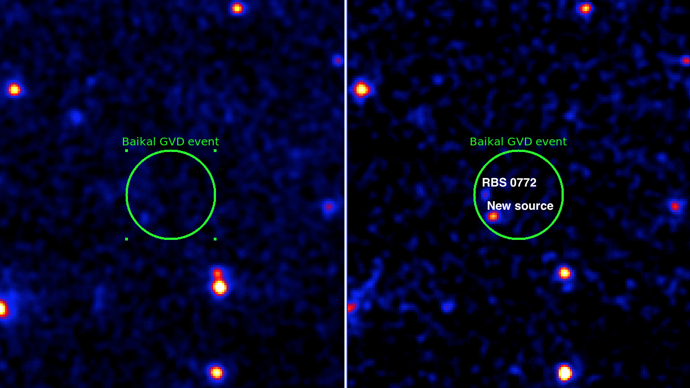
1. MJD 0.573420552199E+05 RA 139.5° Dec 5.56°

Slide 19
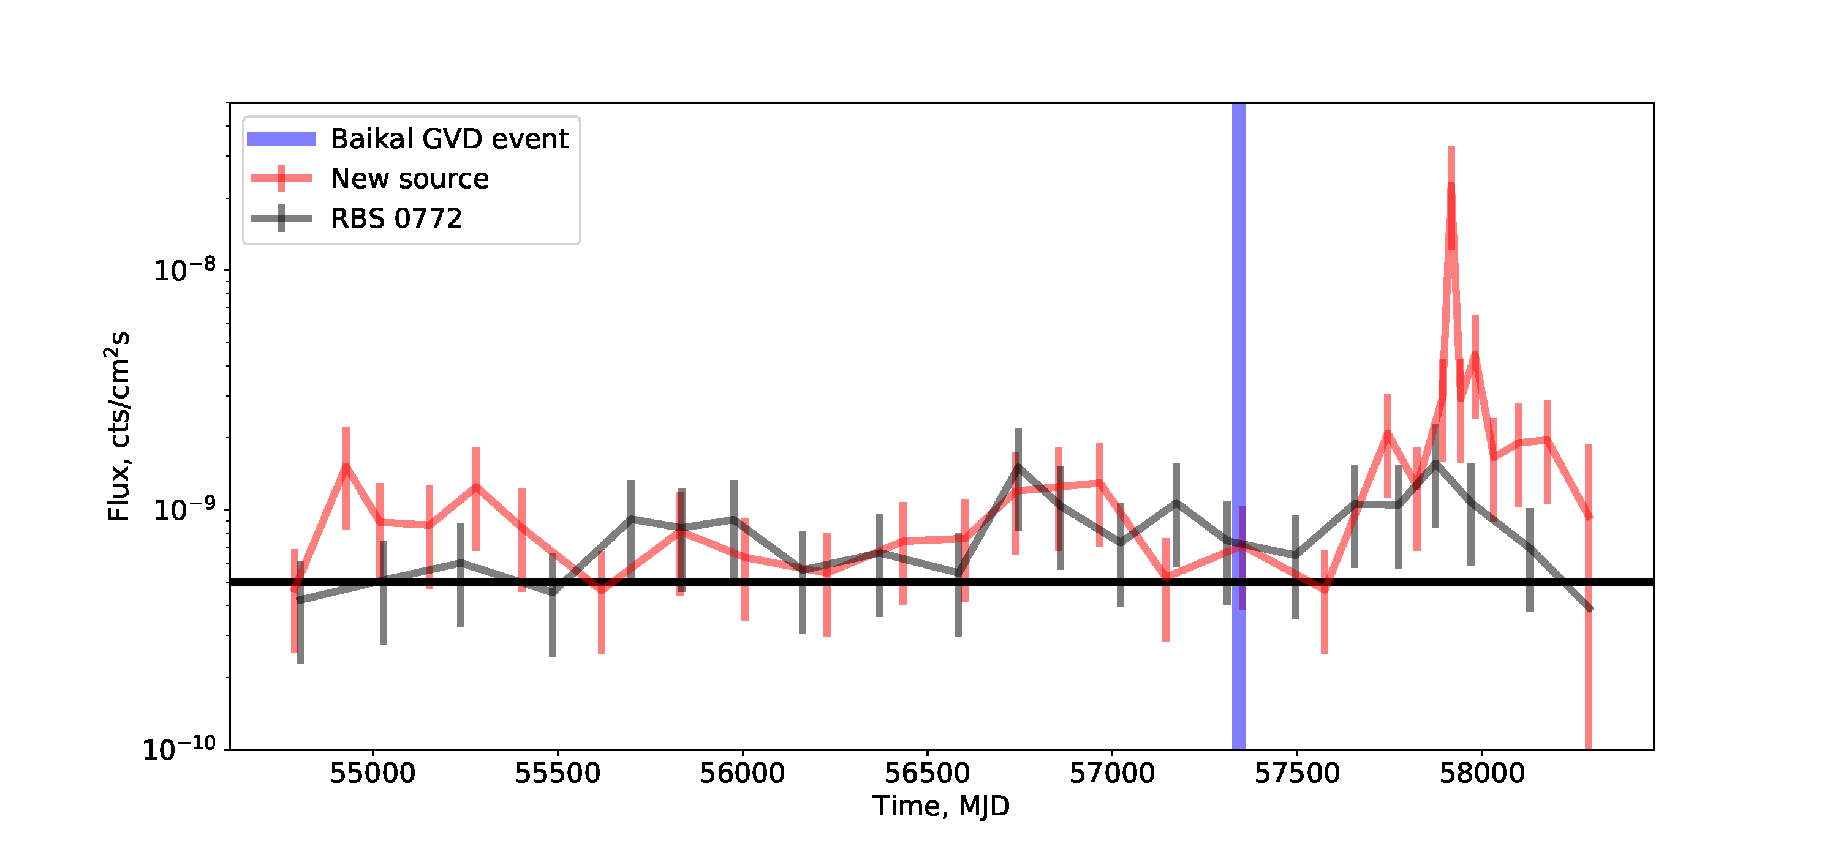
1. MJD 0.573420552199E+05 RA 139.5° Dec 5.56°

Slide 20
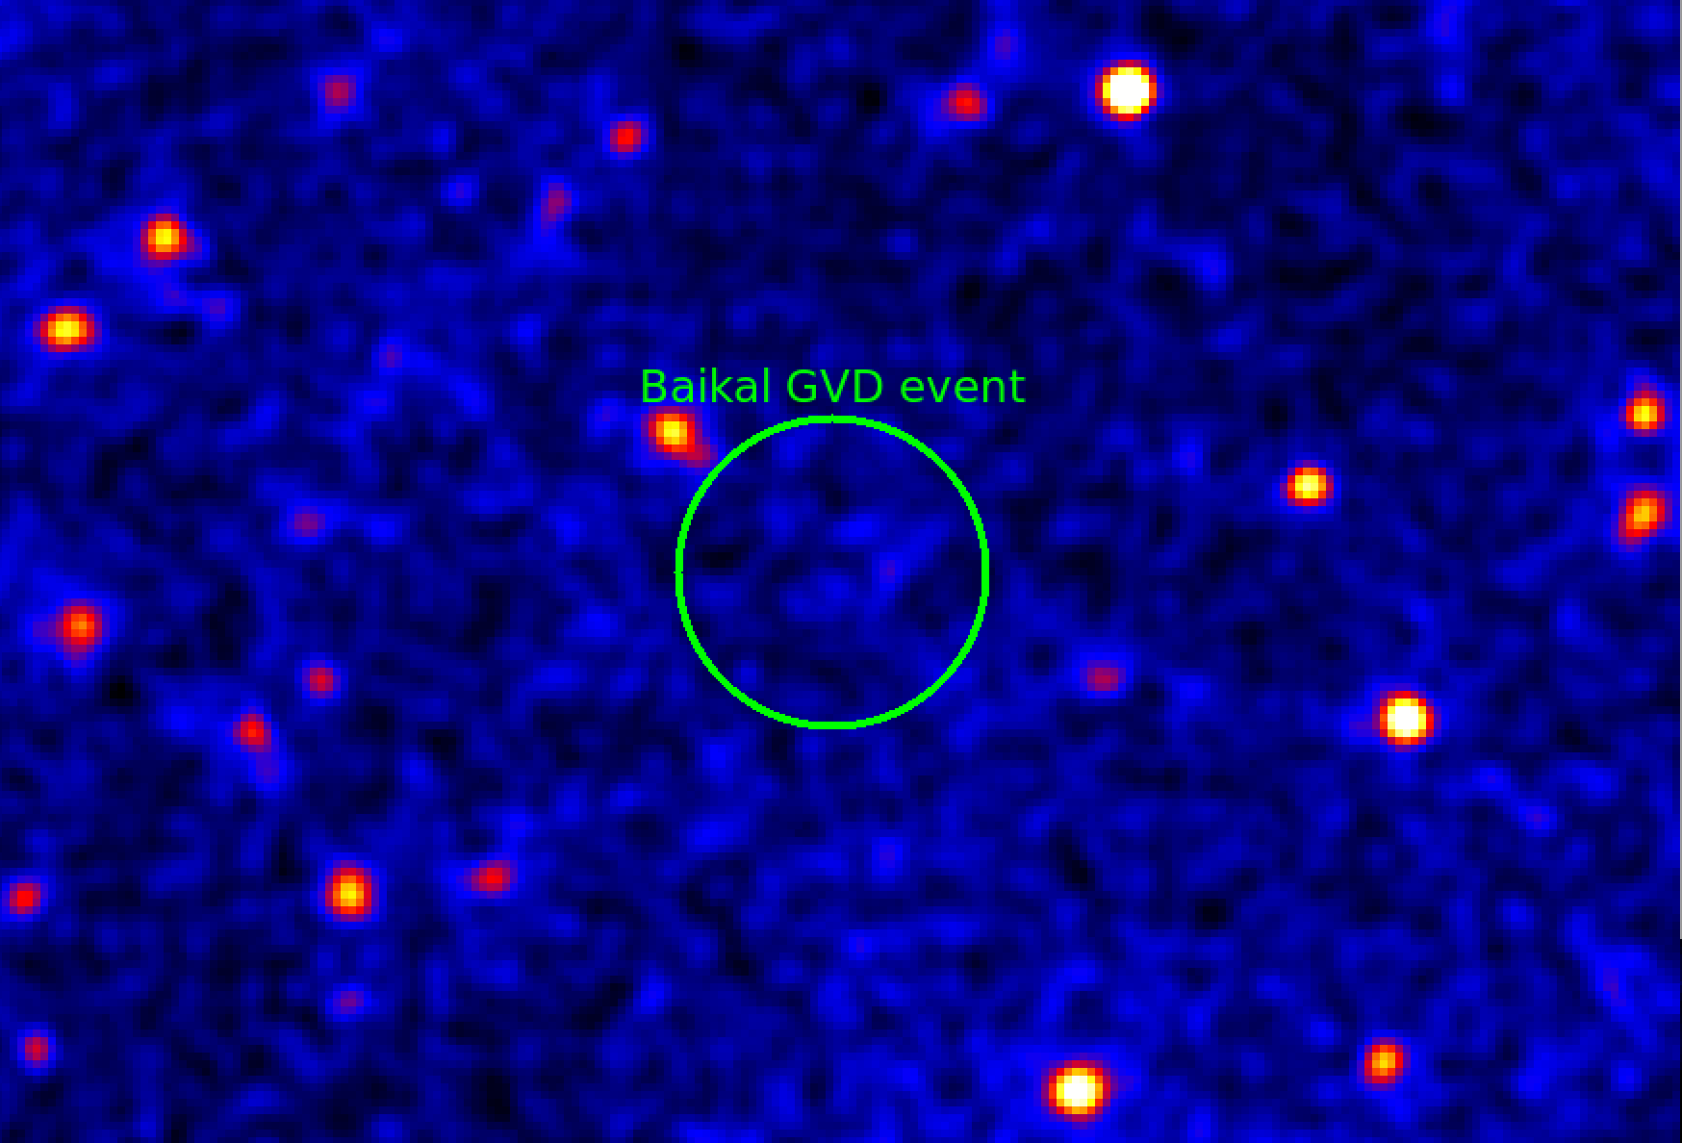
2. MJD 0.575074357292E+05 RA 173.4° Dec 13.95°

Slide 21
Conclusion
Currently, neutrino telescope Baikal-GVD is under construction in Lake Baikal.
Modular structure of GVD design allows a search for HE neutrinos at the
early phases of array construction.
Search for HE cascades was performed using 2015-2016 data and
two promising events have been selected. This result proves the high
potential of GVD for detection of astrophysical neutrinos by cascade
detection mode.

