Slide 1
Very Large Volume Neutrino Telescopes (VLVNT)
2 - 4 October 2018
NEVOD as test facility for future neutrino telescopes
Anatoly Petrukhin
National Research Nuclear University MEPhI
(Moscow Engineering Physics Institute)
Content
Introduction (Why is it necessary?)
Cherenkov water detector NEVOD
Additional detectors
Some results of their work
Possibilities of calibration
Conclusion
Dubna 2018

Slide 2
Introduction
The basic characteristics of water – large angle of Cherenkov light
emission and good transparency for its propagation make it possible to construct
neutrino telescopes (NT) of very large dimensions with a relatively small number
of PMTs or their combinations, so-called optical modules (OM).
One of the important tasks for NT is the separation of: single VHE muons
(> 100 TeV), muon bundles and cascades.
Since length of cascades in the water is about 10 m it is very difficult to
separate these events in NTs with distances between OMs >10 m. Additionally
responses of various OMs at these events can be different.
Therefore corresponding calibration of these modules in the water
Cherenkov detector with close lattice of OMs and small distances between them
( ~2 m ) is required.

Slide 3
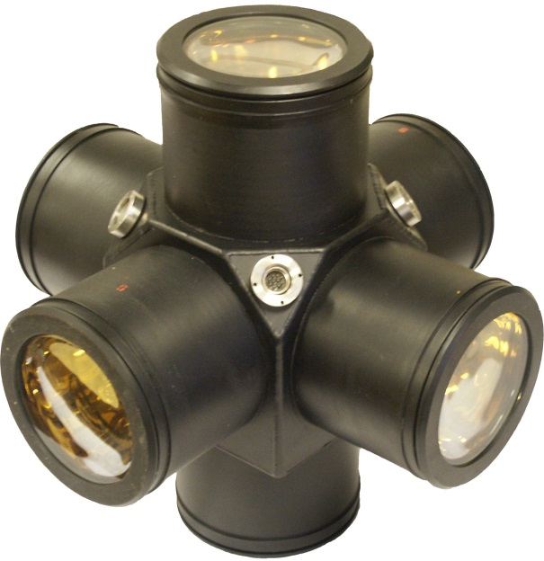
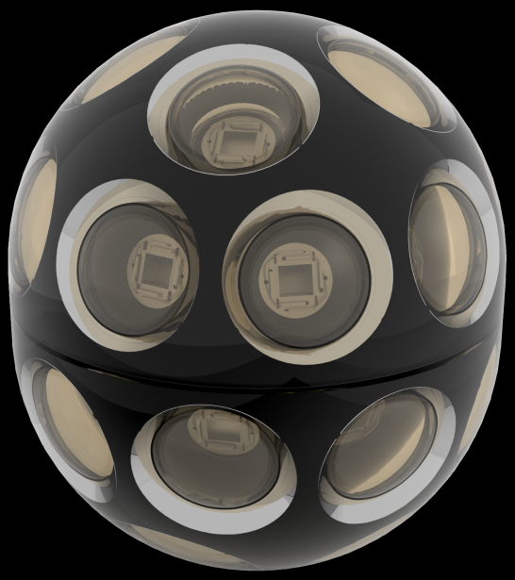
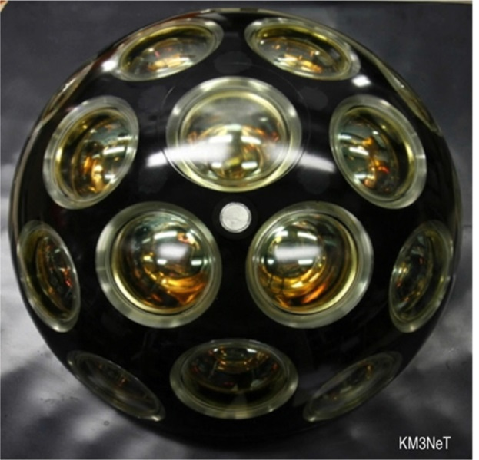
Tendency of CWD optical module development
Amanda (IceCube) - 1
Baikal (2)
ANTARES (3)
NEVOD (6)
IceCube-Gen2 (24)
KM3NeT (31)

Slide 4

The first quasispherical module
(QSM) with 6 PMTs
The idea of construction of quasispherical modules from several PMTs was presented at Cosmic Ray Conference in Kyoto in 1979
(Borog V.V. et al., Proc. 16th ICRC, 1979 10, 380)
Module with six PMTs oriented along the axes of orthogonal coordinate system is the simplest configuration of photomultipliers, the response of which does not depend on Cherenkov light direction.
Besides independence of response of QSMs on Cherenkov light direction quasispherical modules allow to determine this direction using the amplitudes of signals from each PMT.

Slide 5
Cherenkov Water Detector NEVOD-91 (1994)
Sizes 9 x 9 x 26 = 2100 m³
Spatial lattice from 91 QGM with steps 2 × 2 × 2.5 m³.
Russian PMTs – FEU-49, FEU-125 (now, FEU-200)
Placement of CWD NEVOD on the ground level allows investigate all components of cosmic rays reaching the Earth’s surface, including neutrinos from the bottom hemisphere.
Registering System allows measure signals in the dynamic range from 1 to 10⁵ ph.e. for each photomultiplier.
Trggering System allows separate events produced by particles coming from the top, the bottom, and any side.

Slide 6
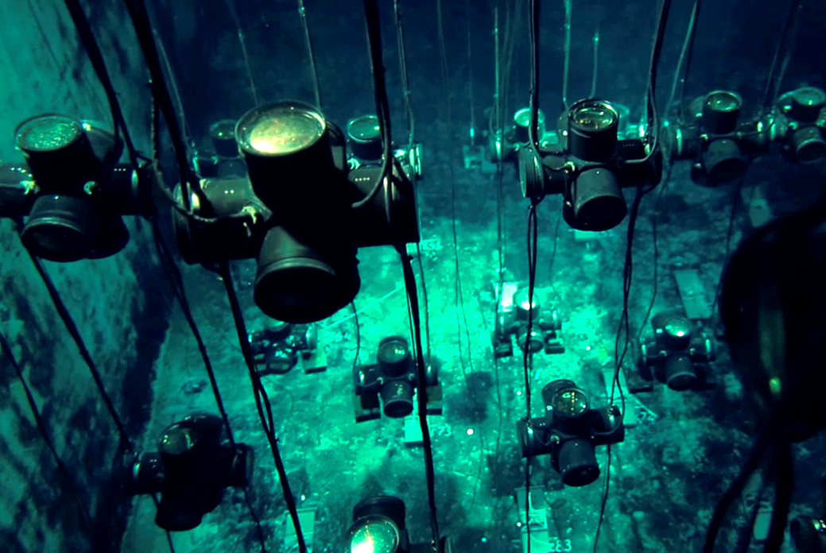
Cherenkov Water Detector NEVOD-91 (1994)

Slide 7
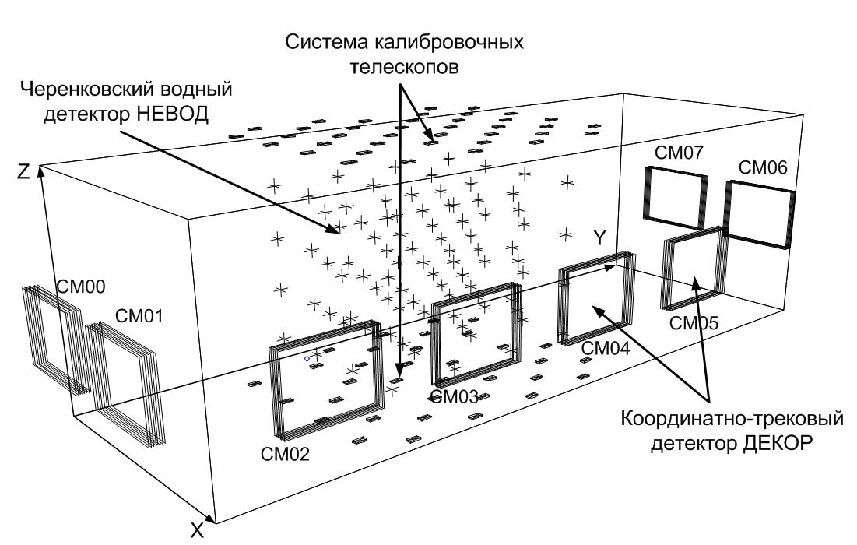
General scheme of NEVOD complex
Calibration Telescope System (CTS)
Cherenkov water detector NEVOD
SM07
SM06
SM00
SM01
SM05
SM04
SM03
Coordinate detector DECOR
SM02
Water tank sizes 9 × 9 × 26 m³
Scintillation counters 20 x 40 x 2 cm³
Size of each supermodule 8.4 m²

Slide 8
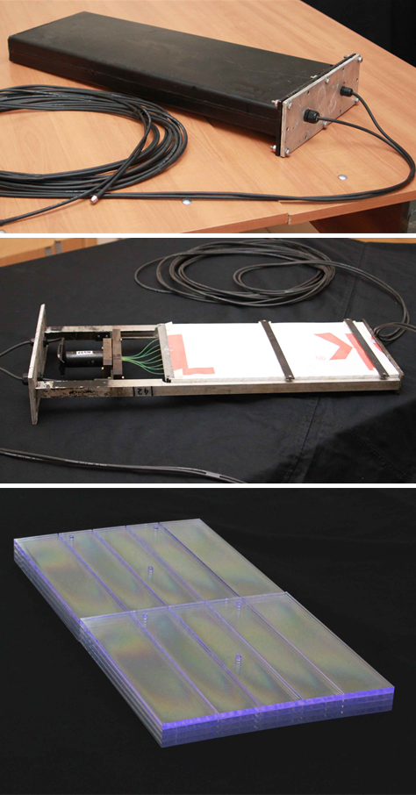
Calibration Telescope System (CTS)
  Scintillation counters with sizes 20 x 40 x 2 cm³ were placed on the top and the bottom of the water reservoir in staggered order, in total 2 x 40.
  Each pair of counters (one on the top and one on the bottom) form a telescope, which gives position and direction of muon with a good accuracy.
  In total, there are 1600 telescopes which allow to calibrate QSMs by Cherenkov light from muons passing at different distances and angles.
  Additionally, CTS can be used as EAS detector:
  Top layer – for electromagnetic component;
  Bottom layer – for muon component.

Slide 9
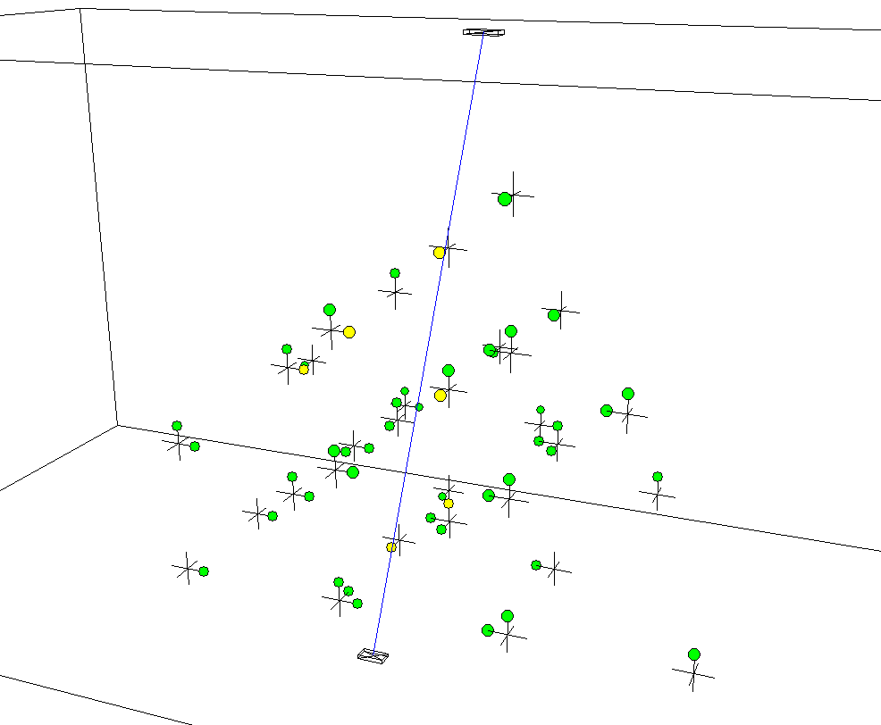
Near vertical muon in CTS

Slide 10
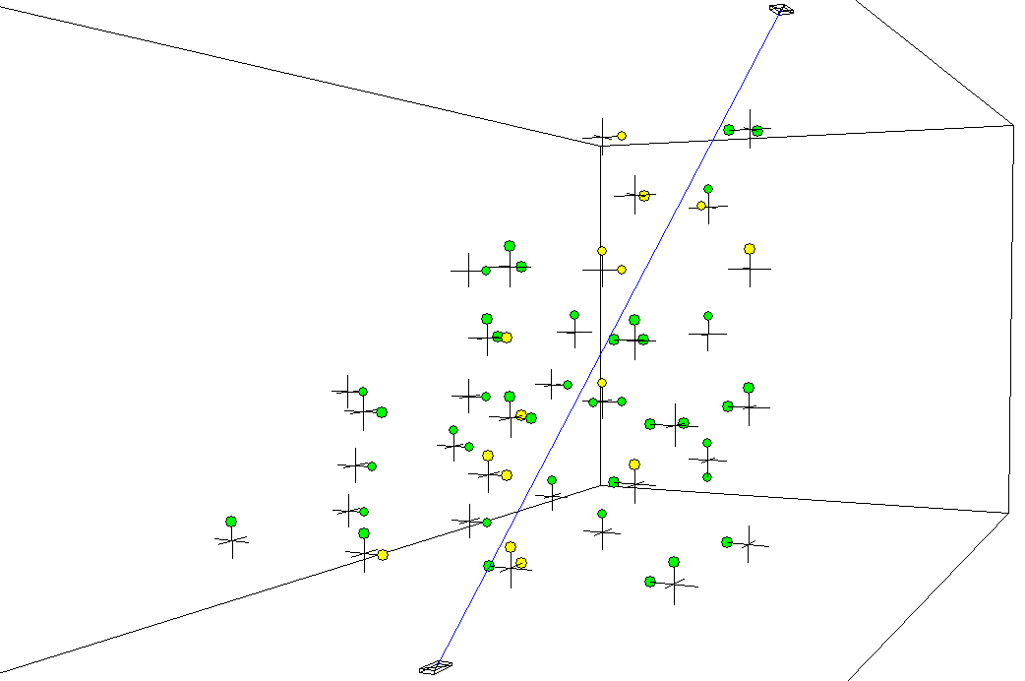
Inclined muon in CTS

Slide 11
Positions of scintillation detectors (top) reconstructed by Cherenkov light

Slide 12
Positions of scintillation detectors (bottom) reconstructed by Cherenkov light

Slide 13
Coordinate-Tracking Detector (DECOR)
  To improve angular accuracy of investigations of cosmic rays, the coordinate-tracking detector (DECOR) consisting of streamer tubes was constructed around CWD NEVOD. It has a modular structure and includes 8 supermodules (SMs).
  Each SM is independent and consists of 8 planes of streamer tubes 1 cm² combined in chambers with 16 tubes each.
  The modules are placed vertically and have the maximal efficiency for the detection of near-horizontal cosmic rays.

Slide 14
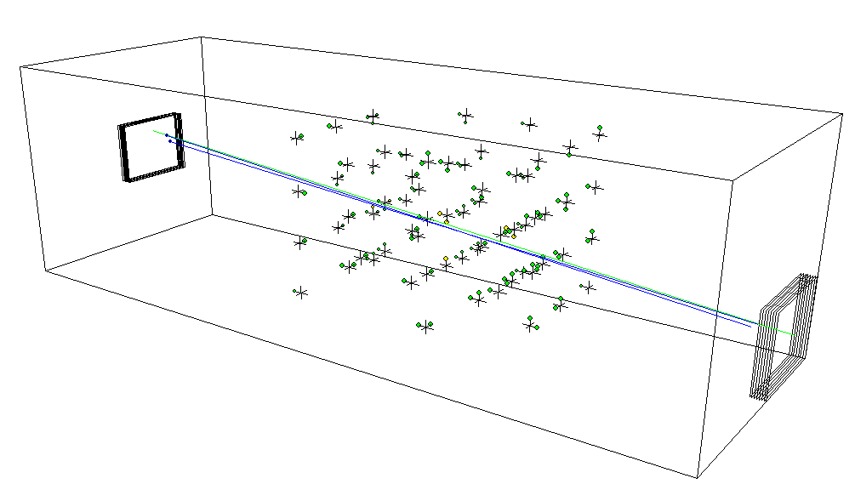
Response of CWD NEVOD on single muons
Response of QSM photomultipliers on single muons is the calibration point for measurements of cascades and energy deposit of muon bundles.
Example of CWD response on single muon.
61 QSM and 107 PMTs were triggered,
Σ_{amp} = 233 ph.e.
Red line – all events triggered by DECOR SMs in short galleries (without track reconstruction).
Black line – single horizontal muons reconstructed by means of DECOR data.
Notes:
…

Slide 15
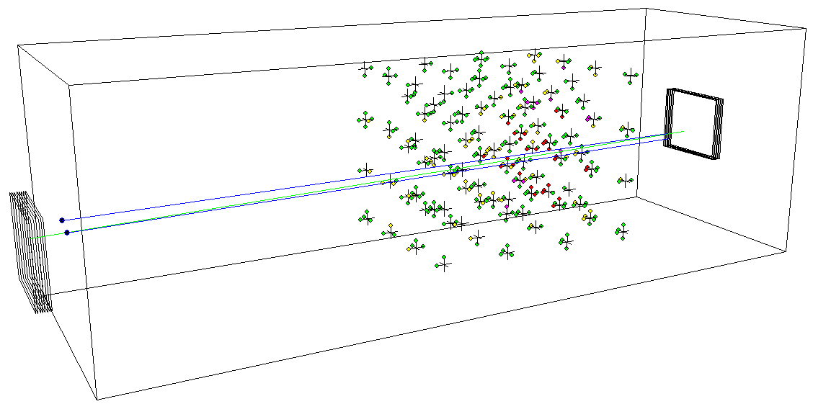
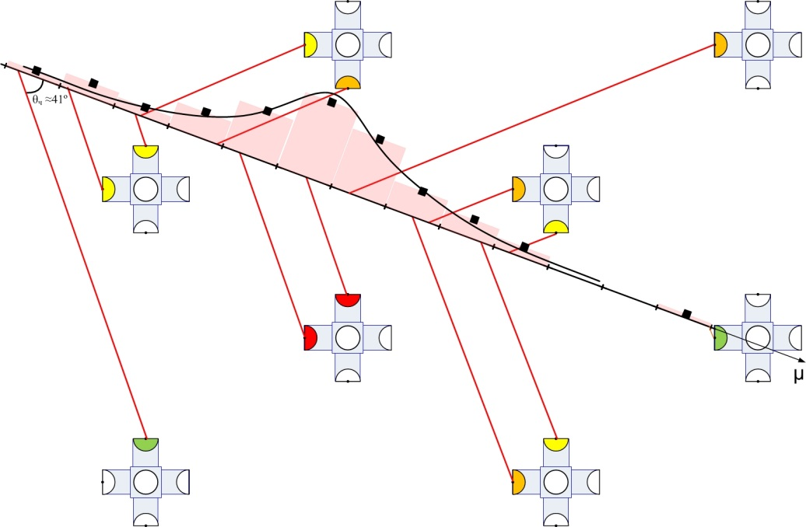
Investigation of cascades
Transition from responses of PMTs to the number of particles radiating Cherenkov light at the axes of cascades was performed in the bins with the size of one radiation length (36cm) each.
.
.

Slide 16
A typical muon bundle event in Side DECOR
( 9 muons, 78 degrees)
Y-projection
X-projection

Slide 17
A “record” muon bundle event
( 130 muons, 80 degrees)
Y-projection
X-projection

Slide 18
Muon bundle event (geometry reconstruction)

Slide 19
Possibilities of CWD NEVOD for OMs calibration
NEVOD facility can be used for calibration of new optical modules
for the largest neutrino telescopes: IceCube, KM3NeT and Baikal.
The purpose of this experiment:
- to carry out mutual calibration of all modules at detection of:
single muons, muon bundles and cascades;
- to study characteristics of the modules and their temporal stability over a long period of time.
The first step will be the calibration of a new mDOM for IceCube Gen-2
It is proposed to do this in the two variants:

Slide 20
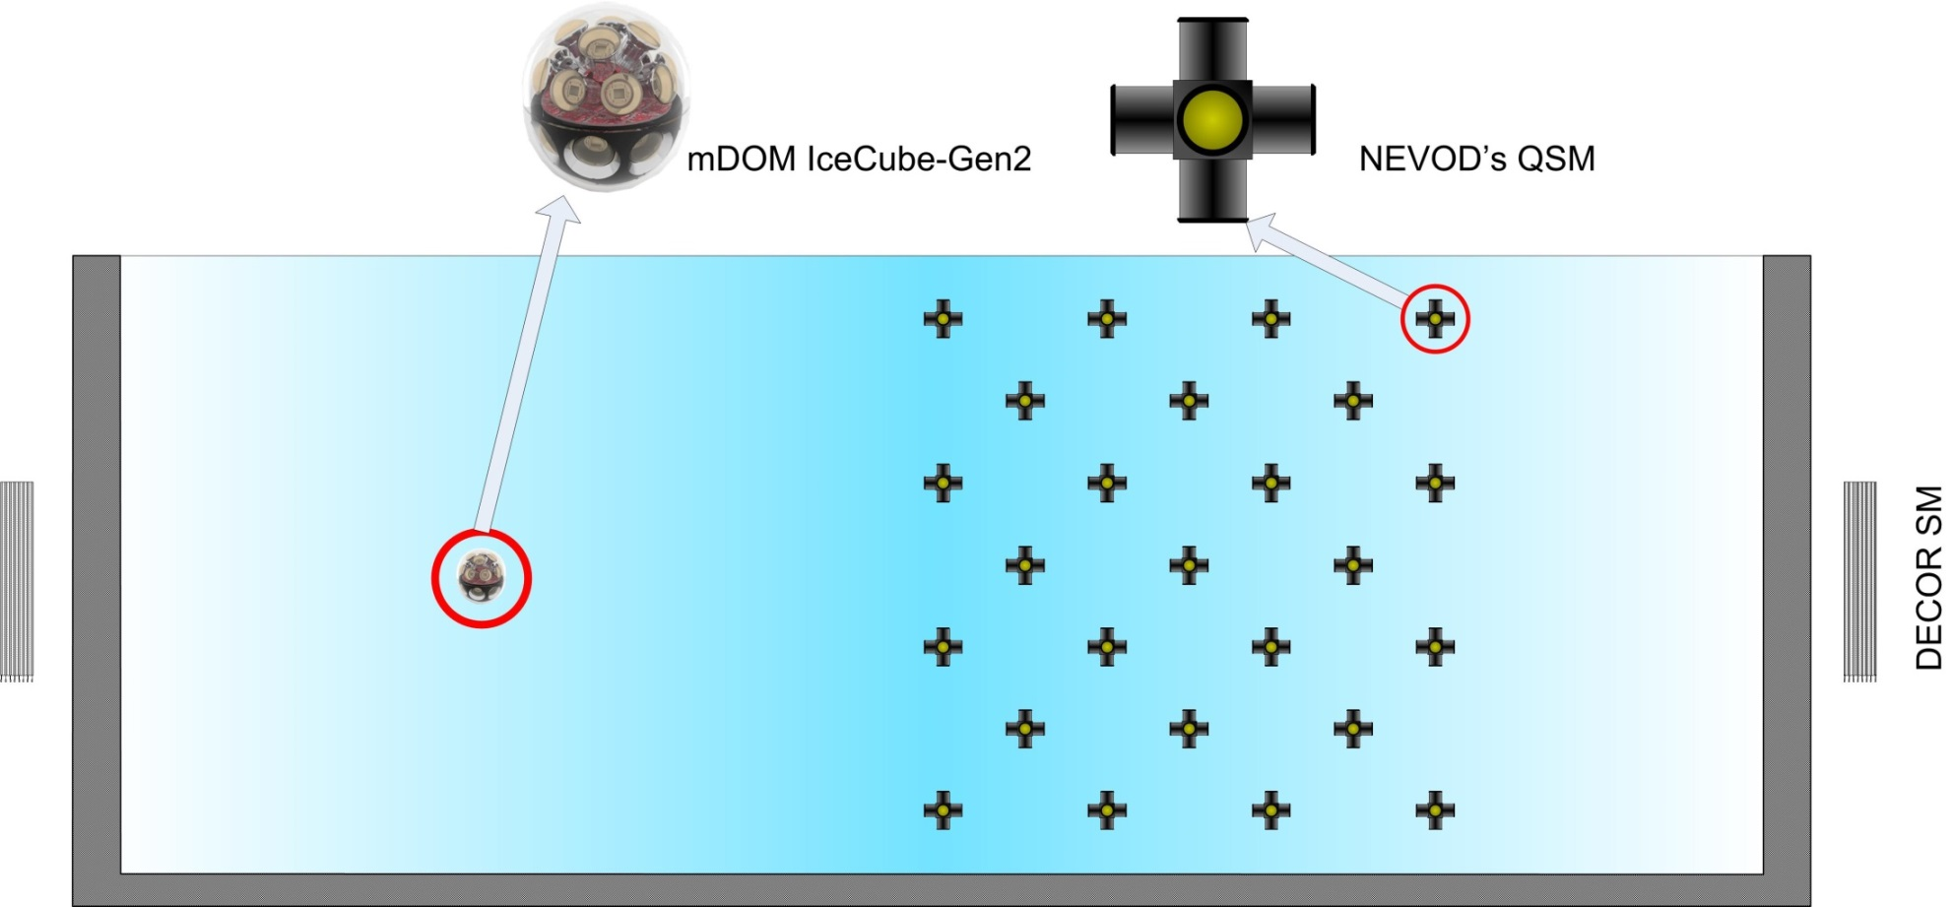
The first variant of mDOM calibration in NEVOD

Slide 21
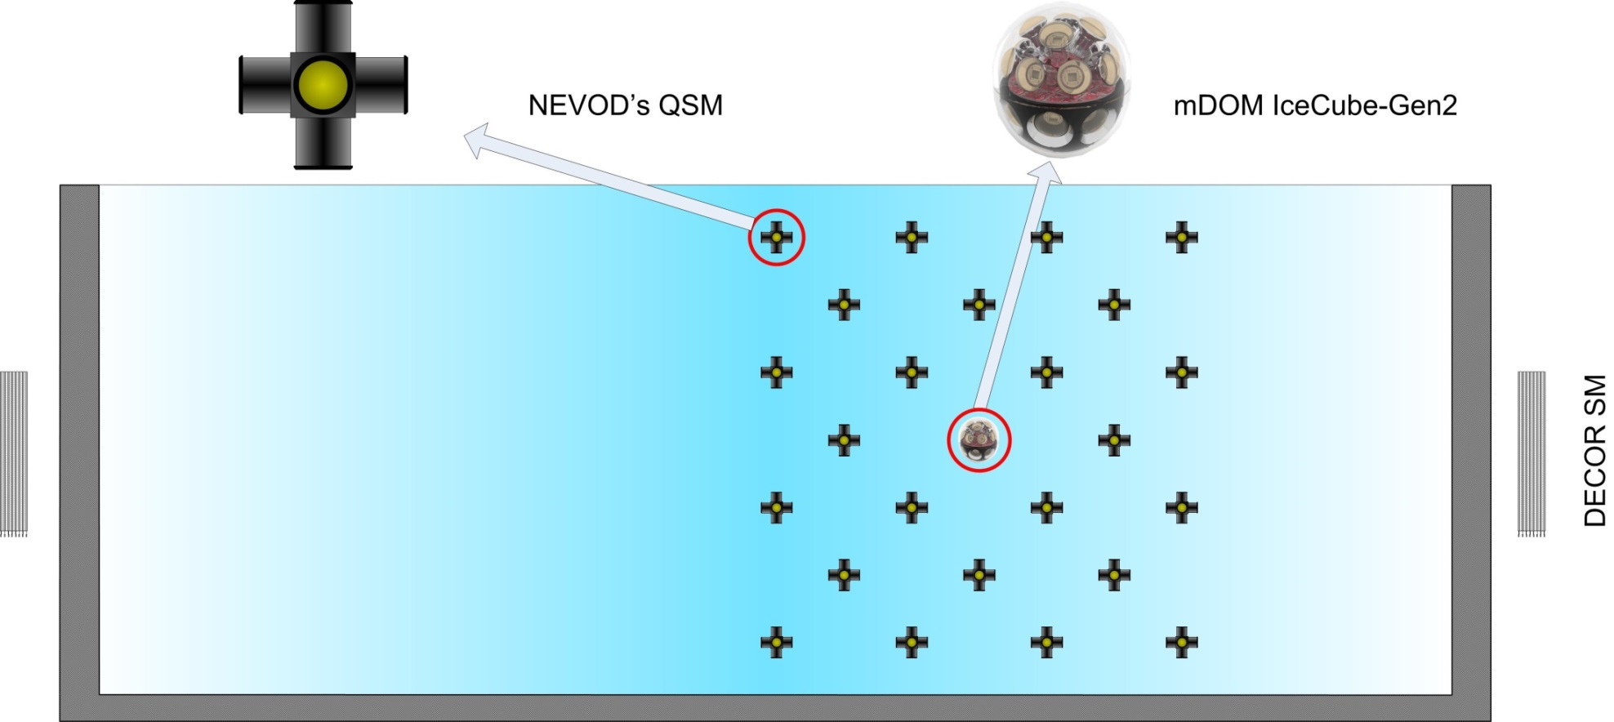
The second variant of mDOM calibration in NEVOD

Slide 22
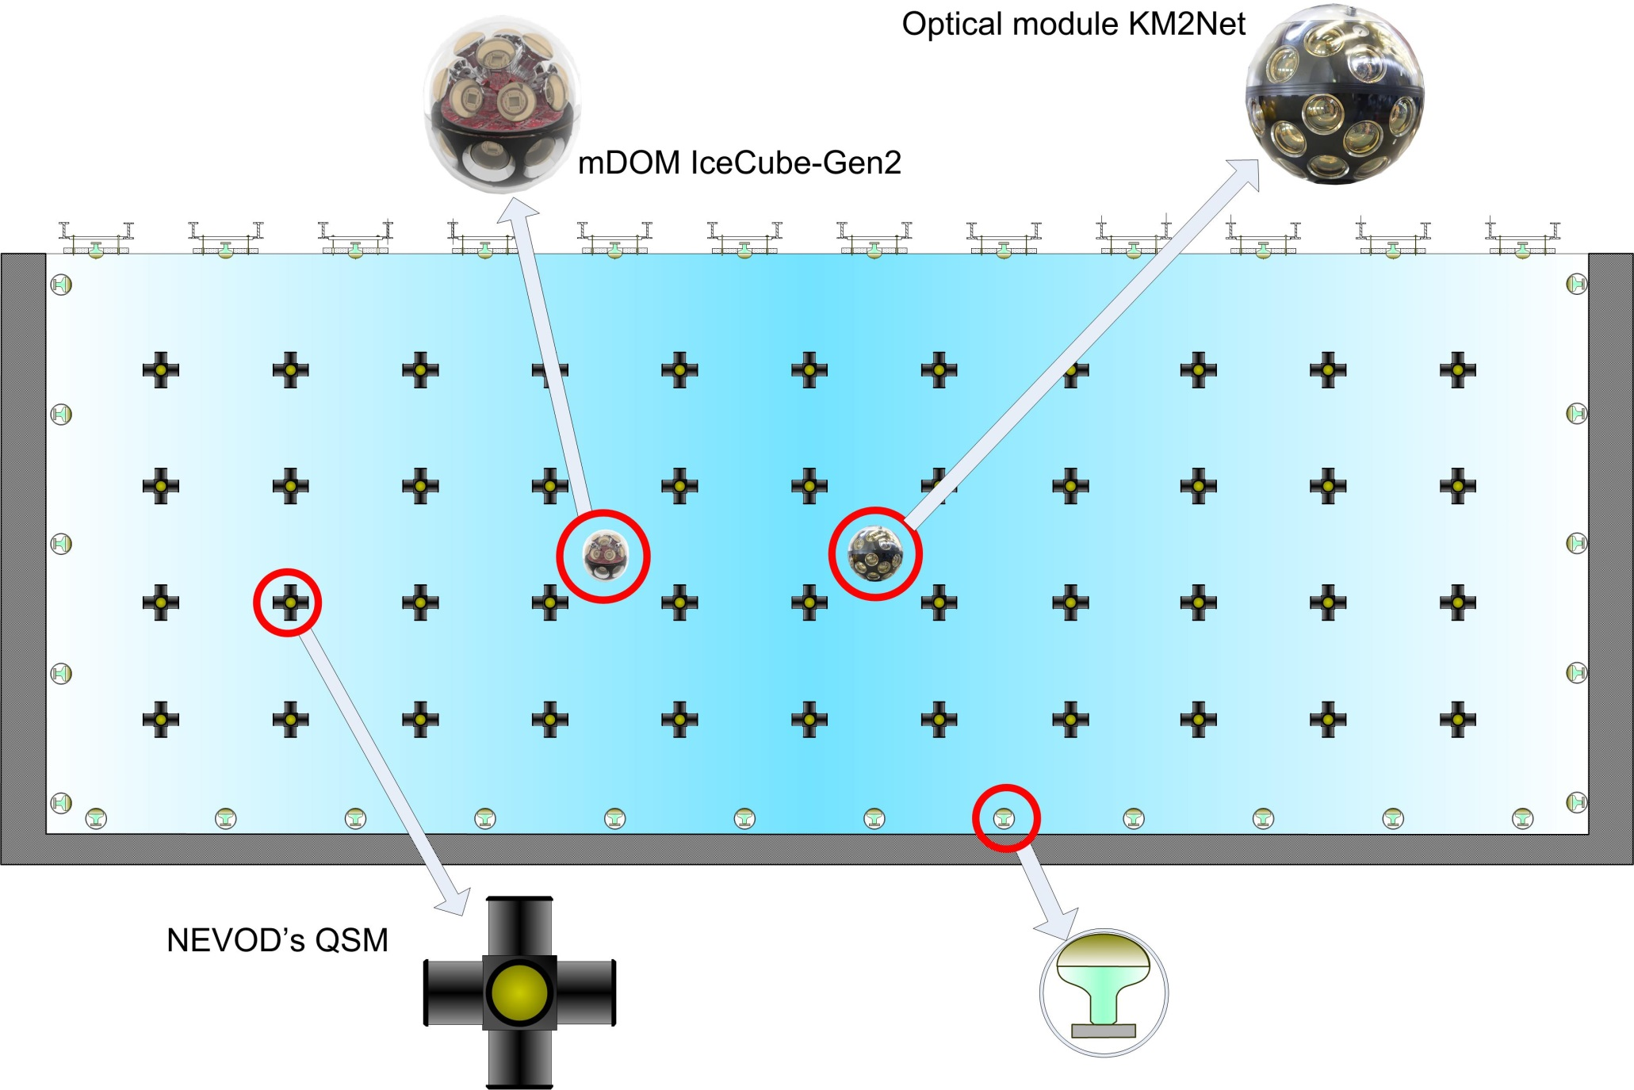
A scheme of new generation of CWD NEVOD
Optical module KM3NeT

Slide 23
Conclusion
NEVOD is the multi-purpose Cherenkov water detector
on the Earth’s surface and can detect single muons, muon
bundles, cascades etc.
New direction of its use is the mutual calibration of optical modules of any kind Cherenkov water detectors in real conditions of detection various events.

Slide 24
Thank you for your attention!

