Slide 1
Direct Dark Matter searches: overview
Evgeny Yakushev
JINR, Dubna
Motivation
How and what to search
Experimental status
Outlook

Slide 2
Dark Matter puzzle
Cosmology
  non-baryonic DM in the early
  Universe [WMAP, Planck, …]
Astrophysics
  Gravitational probes at galactic/cluster
  sizes
  WIMPs present in our Galaxy with density ~0.3 GeV/cm³
Particle Physics
  Thermal relics WIMPs appear as natural consequence of SUSY [LHC]
Indirect Searches
  Annihilation decay products:
  too many phenomena too be decisive (?), many experiments with different approaches
Direct Searches:
  background free measurements
  winter/summer modulation measurements
  Is DM particles of the halo are those can be produced at LHC?

Slide 3
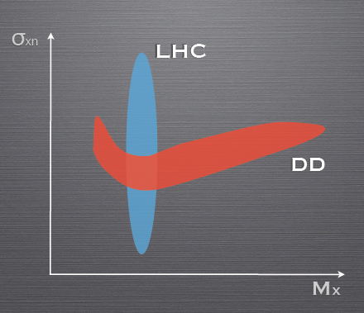
Dark Matter searches

Slide 4
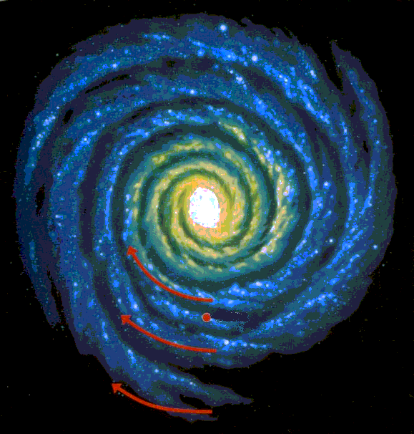
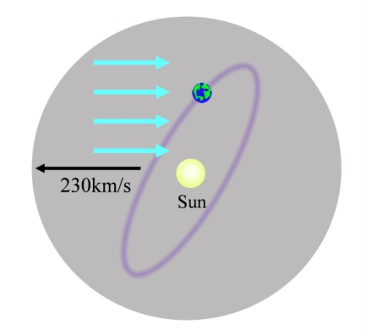
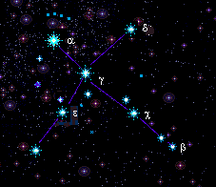
How to detect
According to models of cosmological structure formation, the luminous matter of galaxies is gravitationally bound to a more massive halo of Dark Matter. Its local density is 0.3 GeV/cm³. If Dark Matter indeed consist from WIMPs, its expect to recoil on the ordinary matter moving through Dark Matter halo (Solar System around Galactic Centre).
A process that can be used for WIMP detection is the elastic scattering of WIMP off nuclei. The energy deposited in the detector during the WIMP elastic scattering can be measured.
χ
χ
Wimp χ
from the galactic halo
V ~ 230 km/s
Nucleus A
at rest in the lab
v=0 km/s
θ_{A}
4 M_{A} M_{χ}
E_{R} = E_{χ}
cos²θ_{A}
E_{R} < 100 keV !!!
( M_{A} + M_{χ})²

Slide 5
Astrophysics:
  Lewin&Smith [Astrop 6 (1996) 87] agreement for comparison of experiments
  ρ_{wimp} = 0.3 GeV/c²/cm³
    … even there is the updated value: 0.39±0.02 [Ullio+Catena 0907.0018]
  Spherical isothermal halo : v_{WIMP} ~ v_{SUN} ~ 230 км/сек
  … despite the fact that more complex halo models exist and can more accurately reflect the reality
Nuclear and particle physics:
  Free parameters / theoretical predictions : M_{WIMP}, σ_{WIMP-nucleon}
    Extrapolation WIMP-quark -> WIMP-nucleon:
  Other factors (Coherence):
    ~A² for scalar interaction (SI is dominant for A>~20)
    ~J(J+1) for axial interaction (SD)
    Nuclear form factor (suppresses A² gain for large A)

Slide 6
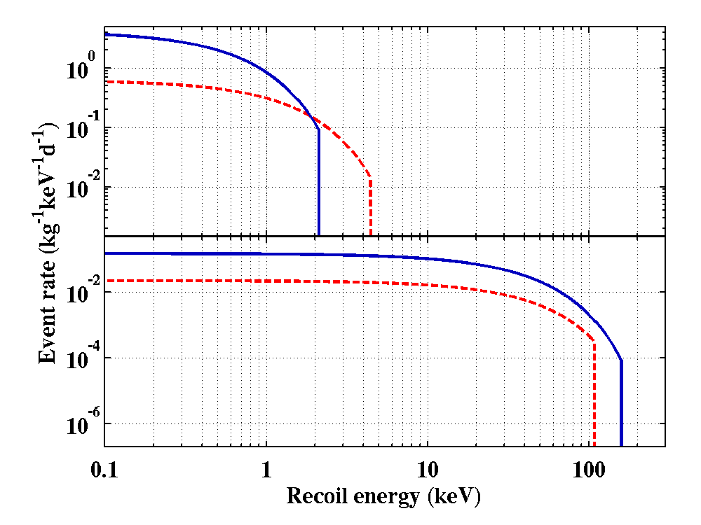
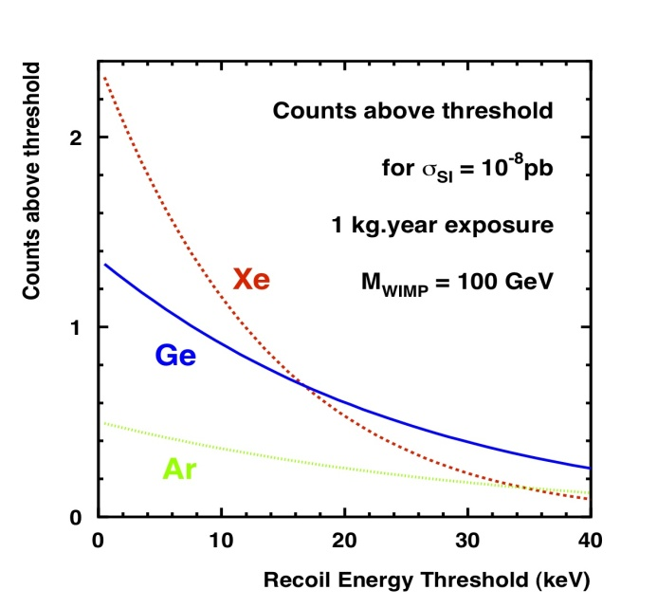
Maxwellian (exponential) distribution for WIMPs
→ Exponential shape for the recoil spectrum,
rather similar to background !!
σ = 1x10⁻⁴¹ cm², v_{escape} = 544 km/s
Ge Target
Si Target
5 GeV/c² WIMP
100 GeV/c² WIMP

Slide 7
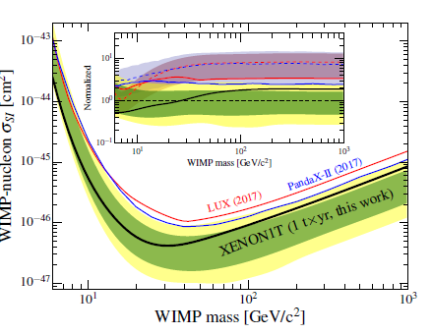
An increasing gain of interest for the search of low-mass, very-heavy WIMPs, other exotics
Non evidence yet for SUSY at the LHC;
New theoretical approaches favoring lighter candidates;
No WIMP signals in the “expected” region;
Controversial results in the region around and below of 10 GeV/c².
Liquid noble gas: large mass, heavy elements, very low background
→ above few 10 GeV/c²
Cryogenic experiments: precise energy measurement, multi-target (incl. light elements), low thresholds
→ below 10 GeV/c²

Slide 8
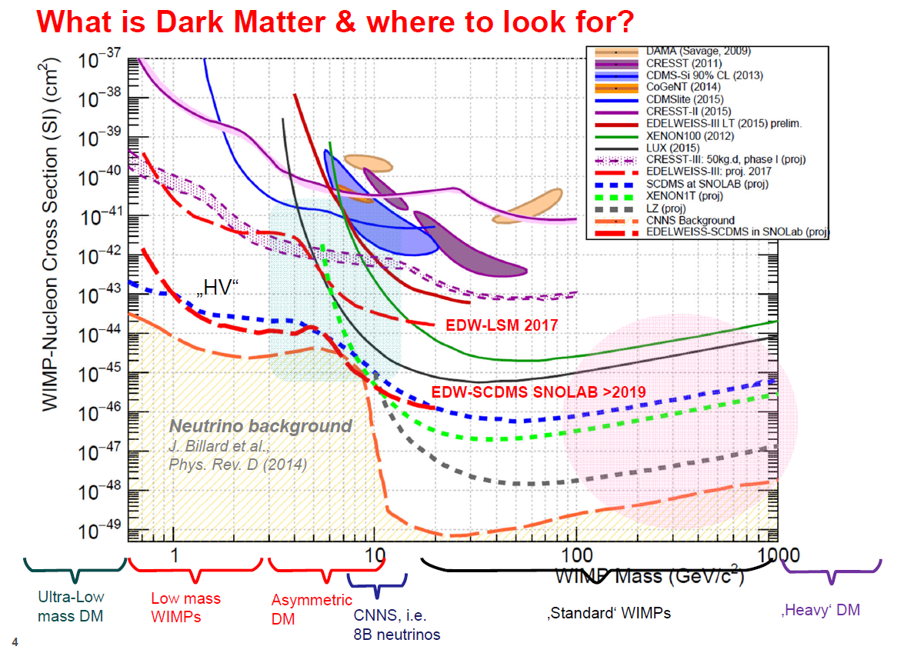
In anyway the expected signal rate for direct search is small !!!

Slide 9
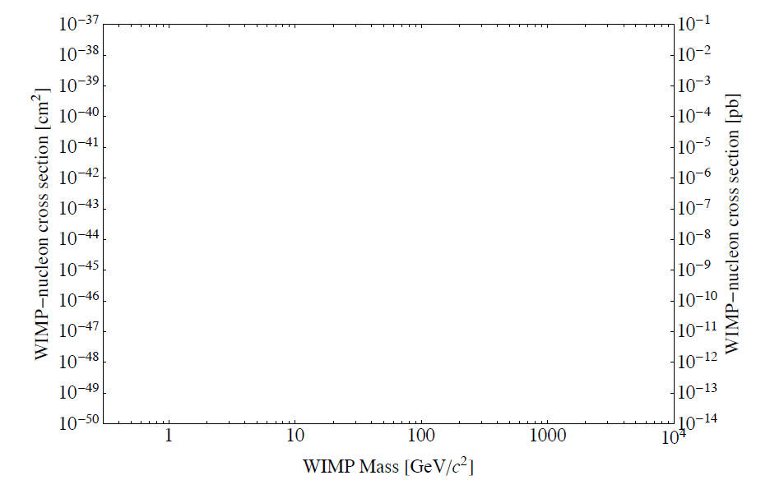
A lot of space...
R. Hill 2016 Aspen Winter Conference

Slide 10
Main experimental challenges are:
event rate is ultra small (below of 1 per 100 kg of matter per day);
energy deposition is tiny (below of 100 keV)
Thus main tasks for experiments are:
Detector mass + long stable data taking + stable predictable detector response
Detectors’ performance (low energy thresholds, good resolutions)
Background reduction
Very performant detector
Low threshold, good resolution
E_{R} < ~100 keV
R₀ < ~0.01 evt/kg/d
Large volume
10 kg – 1 ton
Efficient shielding,
Underground lab,
material selection, …
Background → 0

Slide 11
Background
Cosmic Rays and cosmic activation
Natural radioactivity from rock γ and neutrons
Radioactive dust
Radon in air from U-Th radioactive chains
Natural radioactivity in materials
…
Exotics (neutrino, etc)

Slide 12
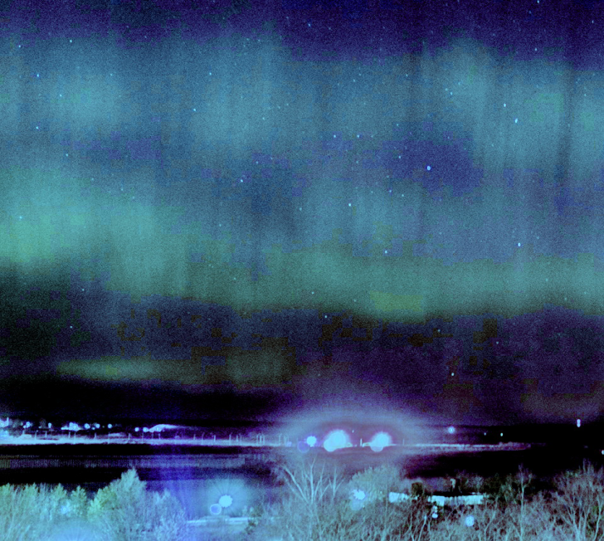
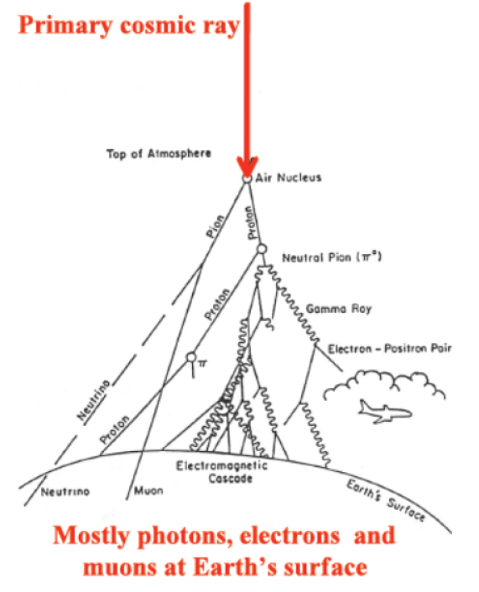
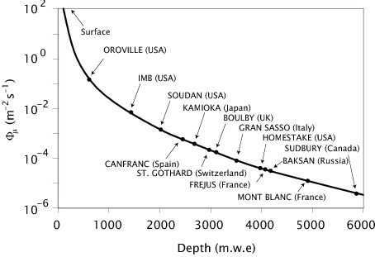
Shield/ underground
Primary cosmic rays composed essentially of all periodic elements:
~ 89% protons, ~ 10% helium nuclei
~1% heavy elements (C, O, Si, …)
At sea level, most are muons with mean energy at 4 GeV, but there are also much higher energies
Also, about 20% are fast neutrons
Only deep underground laboratories can provide effective shield from the cosmic

Slide 13
Background / γ (β)
Natural radioactivity is presented everywhere,
High penetration power
Connected problem – radioactive gases in the atmosphere (Rn, Kr, Ar)
Connected problem – radon progenies, ¹⁴C, …
Ultra pure materials (screening facilities, distillation and purification of liquids, radon free clean rooms for storage / assembly/ run).
Shields (Roman lead, …)
  New bigger detectors provides effective self-shielding
Special methods (γ/nuclear recoil discrimination, fiducial cut, etc)
This days background requirement: <1 event per kg per year
For example human body has: ~100 Bq/kg
Need to reduce by 10⁹ times (minimum)
All construction materials have to be selected by their low radioactivity

Slide 14
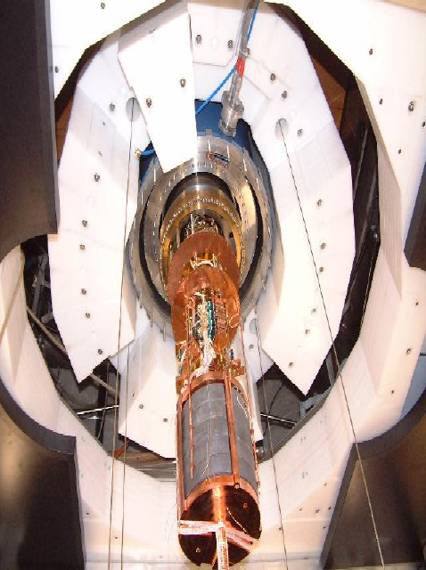
Background / neutrons
Neutron background sources underground:
Low energy neutrons induced by U/Th activities
fission and (α,n) reactions in the surrounding rock/concrete
fission reactions in detector shield
High energy neutrons induced by muons
CRESST
EDELWEISS
Fight with neutron background:
Go underground laboratory / reduce neutron flux by 4+ orders
Material selection
Muon veto system
Passive neutron shield
Multi-detector assembly / neutron background identification

Slide 15
Traditional methods of background suppression are not enough for direct DM search experiments.
Experiment specific reduction/study of the background
(selection of nuclear recoil events, seasonal modulations, …)

Slide 16
Main experimental techniques for direct DM search:
Cryogenic (Ge, Si, …)
Solid Scintillator (NaI, CsI)
Noble Liquids (LXe, LAr)
Others (bubble formation, gas-tracking)
Ionization
CoGeNT
Tracking:
Drift, DM-TPC,
MIMAC, NIT
Bubble Formation:
COUPP, PICASSO,
PICO
Edelweiss, CDMS (Super-CDMS)
LAr: DarkSide-50, ArDM
LXe: XENON, LUX
Light (scintillation)
DAMA/LIBRA
KIMS, XMASS,
DEAP/CLEAN
Heat (phonons)
CRESST-II

Slide 17
Cryogenic Techniques (Combination of phonon measurement with measurement of ionization or scintillation)
Initial recoil energy
Phonon: most precise total energy measurement
Ionization / Scintillation: yield depends on recoiling particle
Nuclear / electron recoil discrimination.
Displace-
ments,
Vibrations
Athermal
phonons
Ionization
(~30 %)
Scintillation
(~3 %)
Thermal phonons
(Heat)

Slide 18
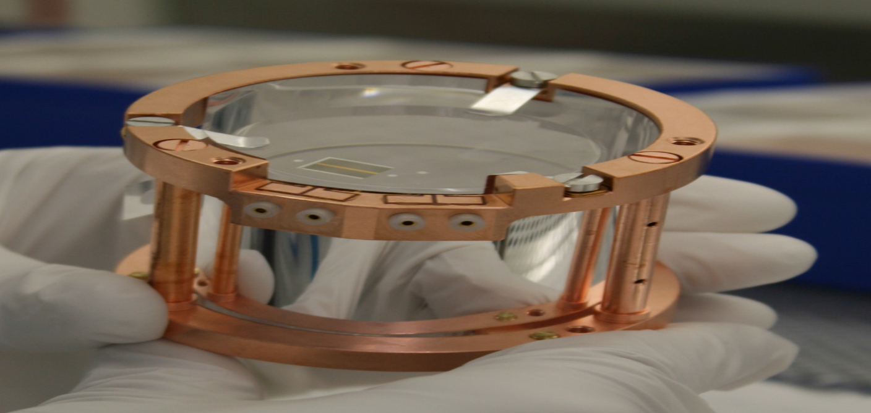
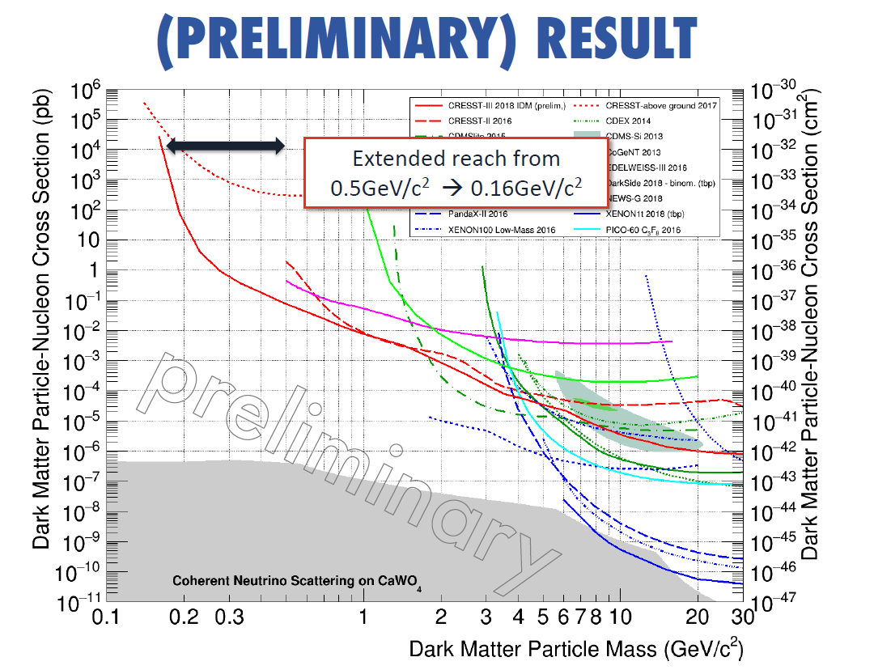
CRESST
reflecting
cavity
Silicon
absorber
tungsten TES
CaWO₄
300 g
tungsten TES
Heat – Light
Energy
Identification
idm2018

Slide 19
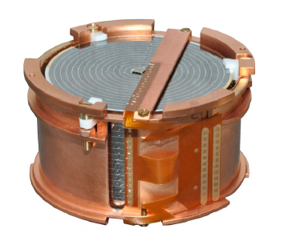
EDELWEISS (Heat and ionization Ge bolometers)
Using of Heat and Ionization HPGe detectors, running in ³He-⁴He dilution cryostat (<20 mK)
Ratio E_{ionization}/E_{recoil} is
  =1 for electronic recoil
  ≈0.3 for nuclear recoil
Event by event identification of the recoil
Discrimination g/n > 99.99%
Detectors with special concentric planar electrodes for active rejection of surface events (miss-collected charge)

Slide 20
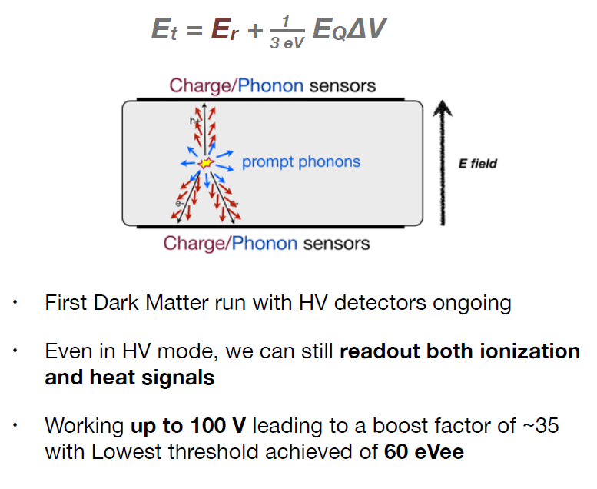
EDELWEISS/CDMS-LT: Neganov-Luke Amplification
Due to the heat dissipated in the substrate by the drifting electron-hole pairs the phonon signal is amplified.

Slide 21
Noble liquid detectors
Xe: large A;
Ar: low cost
High purification (recirculation)
  ³⁹Ar (1Bq/kg): requires >10⁷ rejection for 10⁻⁸pb,
  or depleted Ar (DarkSide)
Background suppression
  Self-shielding in large volume
  Ratio (prompt scintillation)/(ionization)
  Scintillation pulse shape

Slide 22
Noble liquid detectors

Slide 23
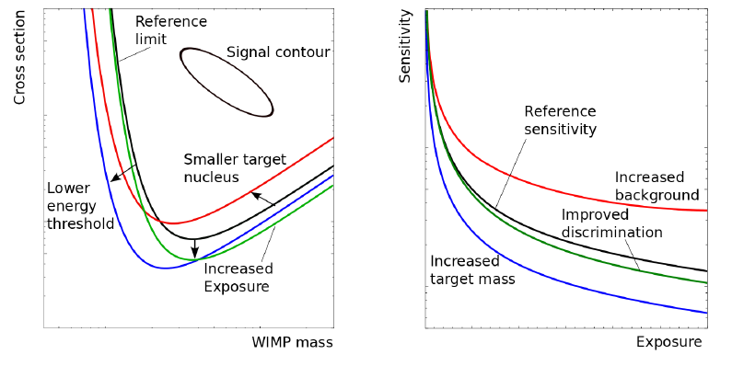
Now we decide what is better like this:
(Teresa Marrodan Undagoitia and Ludwig Rauch)arxiv:1509.08767
Liquid noble gas: large mass, heavy elements, very low background
→ above few 10 GeV/c²
Cryogenic experiments: precise energy measurement, multi-target (incl. light elements), low thresholds <10 GeV/c²

Slide 25
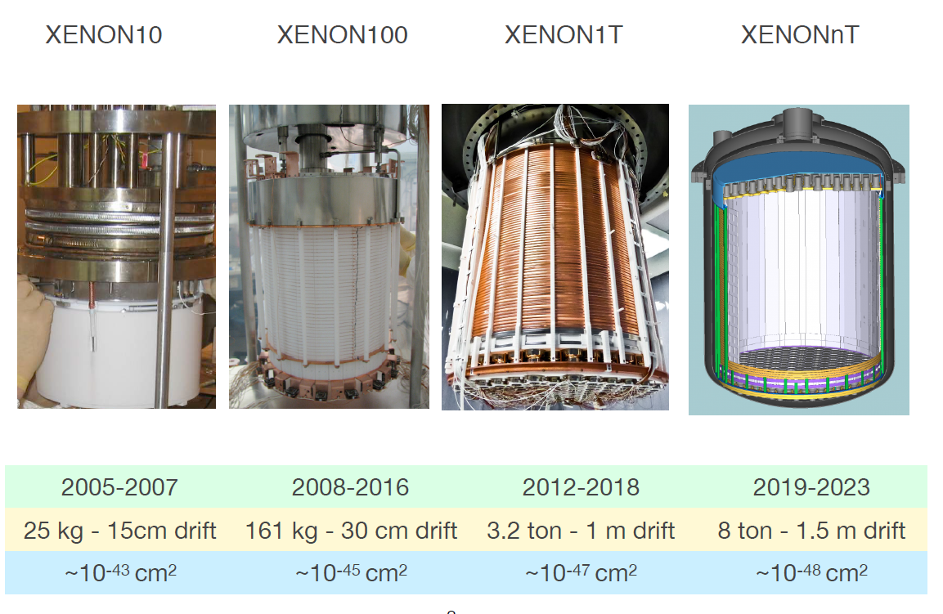

Slide 26
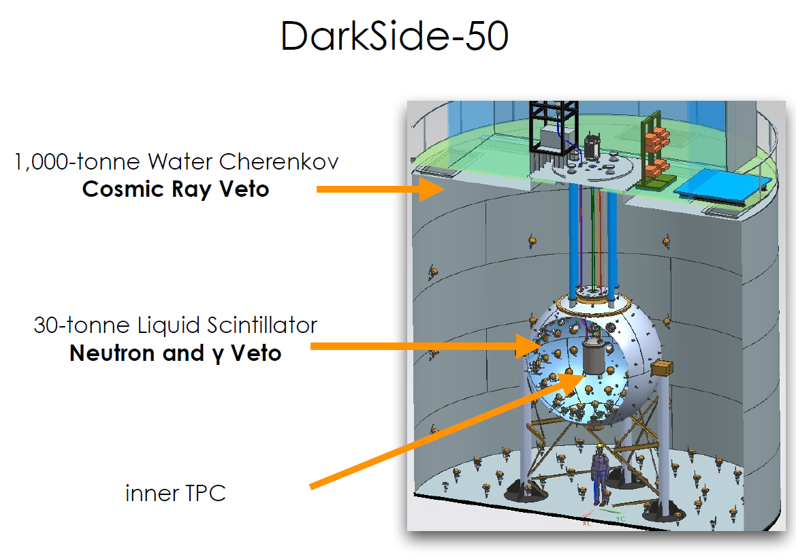
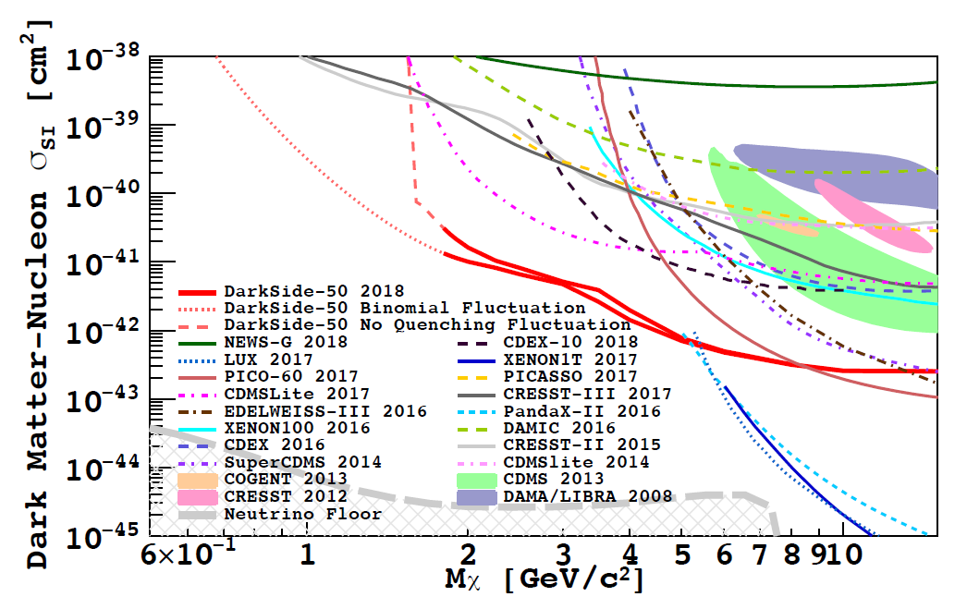

Slide 27
To prove WIMP observation one needs
A characteristic spectrum that depends on nuclear mass and spin;
Annual modulation in both the event rate and the recoil;
Events distributed uniformly throughout the detector;
Experiment-independent DM parameters;
Characteristic properties for DM event

Slide 28
Conclusions:
Direct Dark Matter Searches: crucial to detect presence of WIMPs in our environment; The main challenge: extreme low-backgrounds;
To study DM we need variety of targets (Ar/Xe, Ge+scintillation);
Intense world-wide competition of R&D efforts;
SUSY at LHC potentially can be discovered at any time soon.

Slide 29
What is omitted:
Spin-dependent, ...
Innelastic, ...
Axions, ...
...

