Slide 1
The SHiP project: A facility to search for hidden particles at the CERN SPS (http://cern.ch/ship)
Roumen Tsenov (LHEP),
for the SHiP Collaboration
Notes:
Tittle page and out line

Slide 2
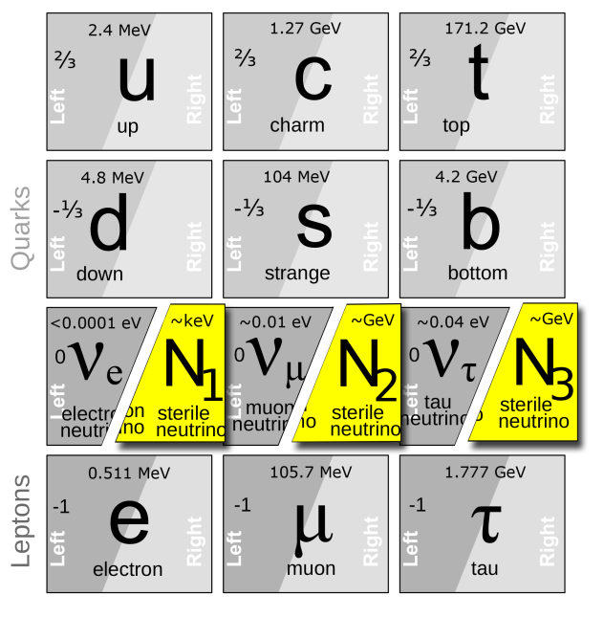
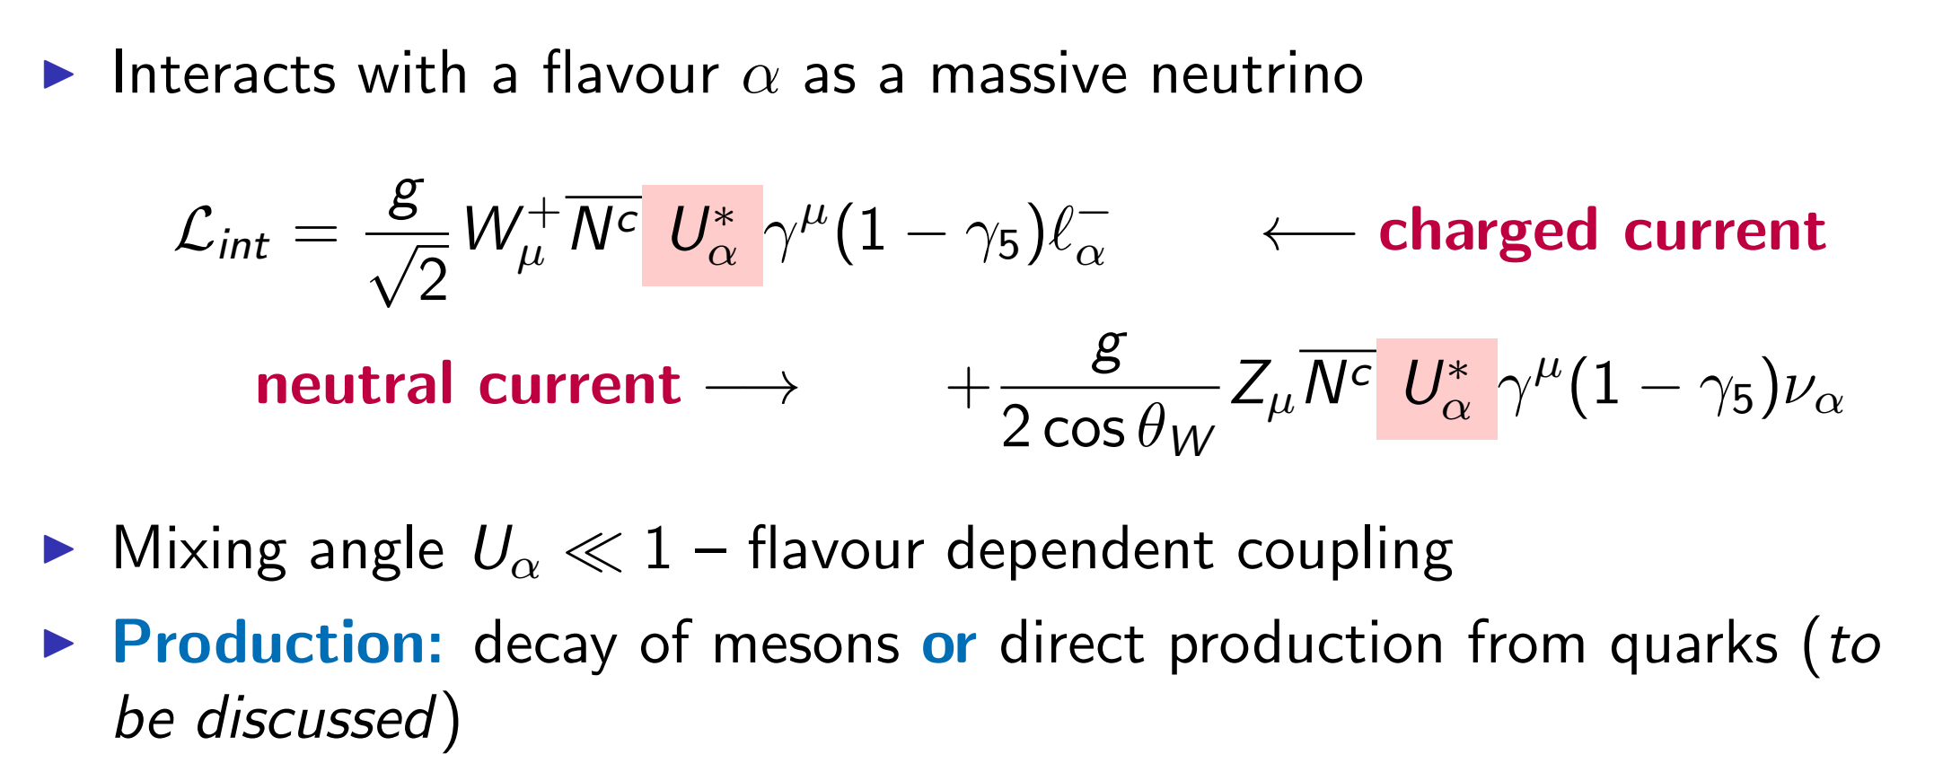
Physics motivation
Existence of Heavy Neutral Leptons (HNL) with ~ GeV masses that
mix with ordinary neutrinos can explain some of the most intriguing BSM phenomena.

Slide 3
Main signal and background decay modes

Slide 4
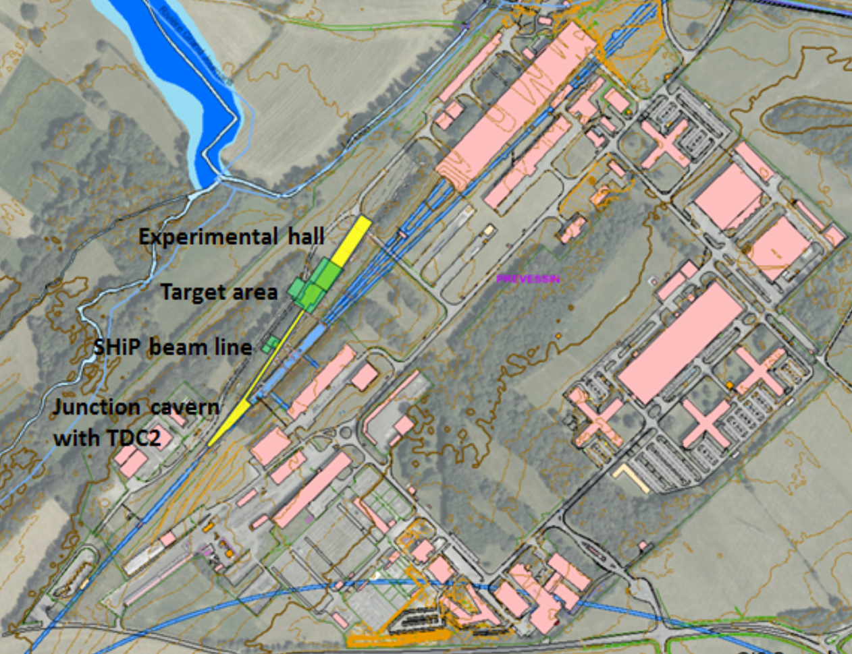
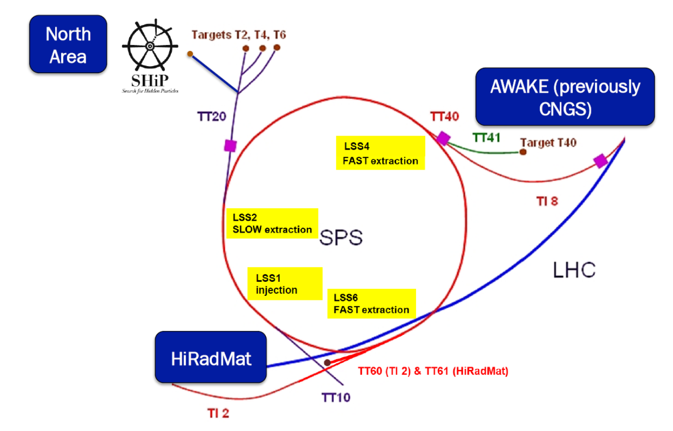
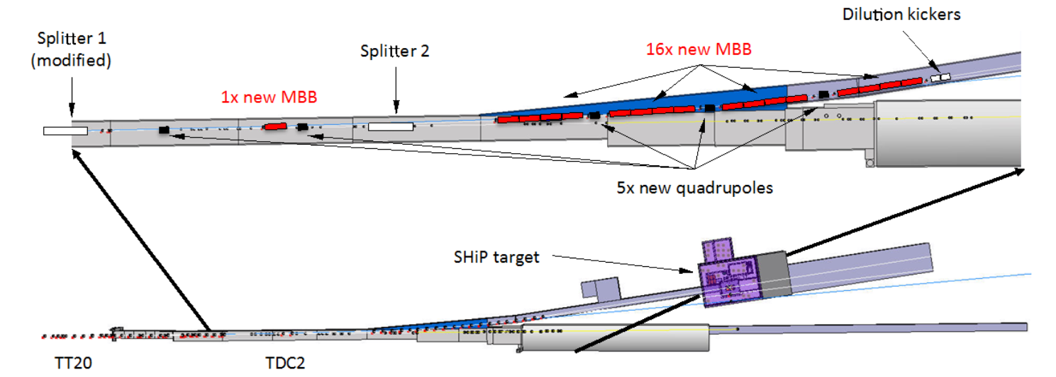
Beam line
4x10¹³ protons per 1 s spill every 7.2 s → 2x10²⁰ protons for 5 years

Slide 5
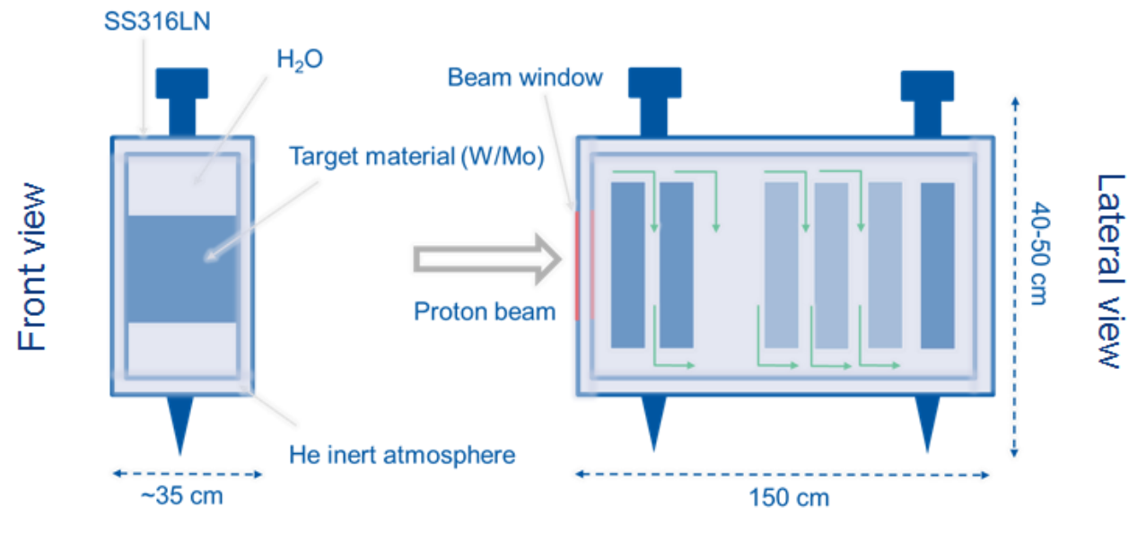
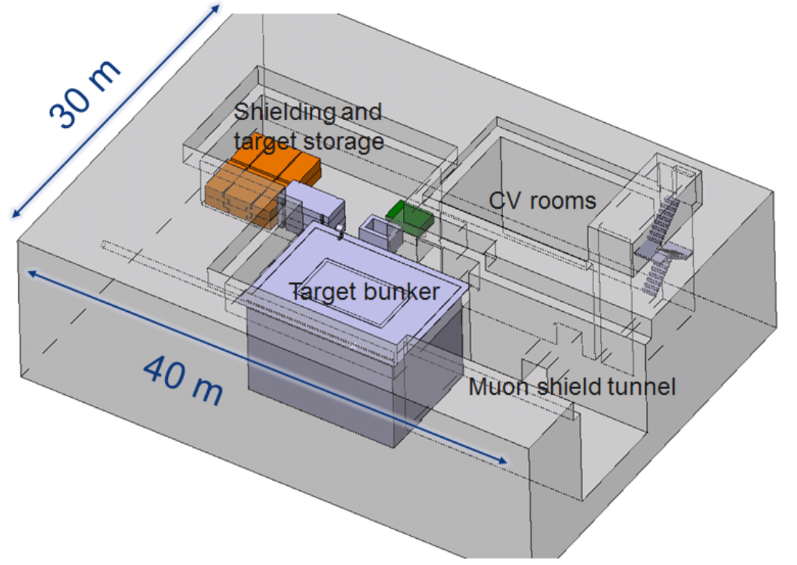
Target station
450 m³ bunker, cast iron walls
350 kW mean beam power to be dissipated, 2.56 MW in the spill

Slide 6
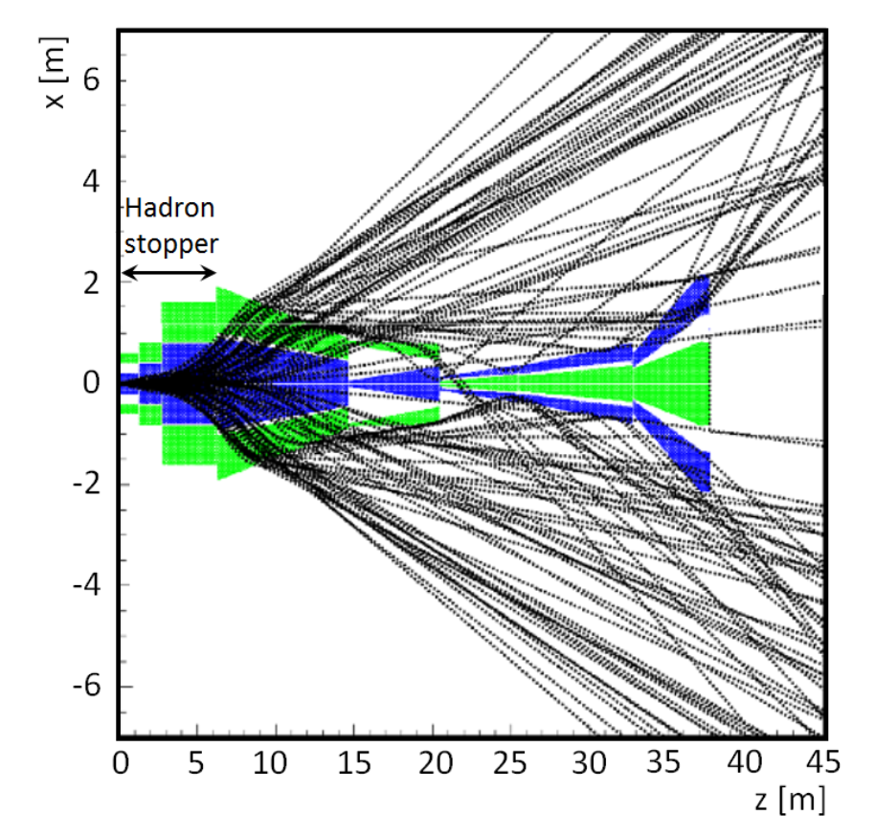
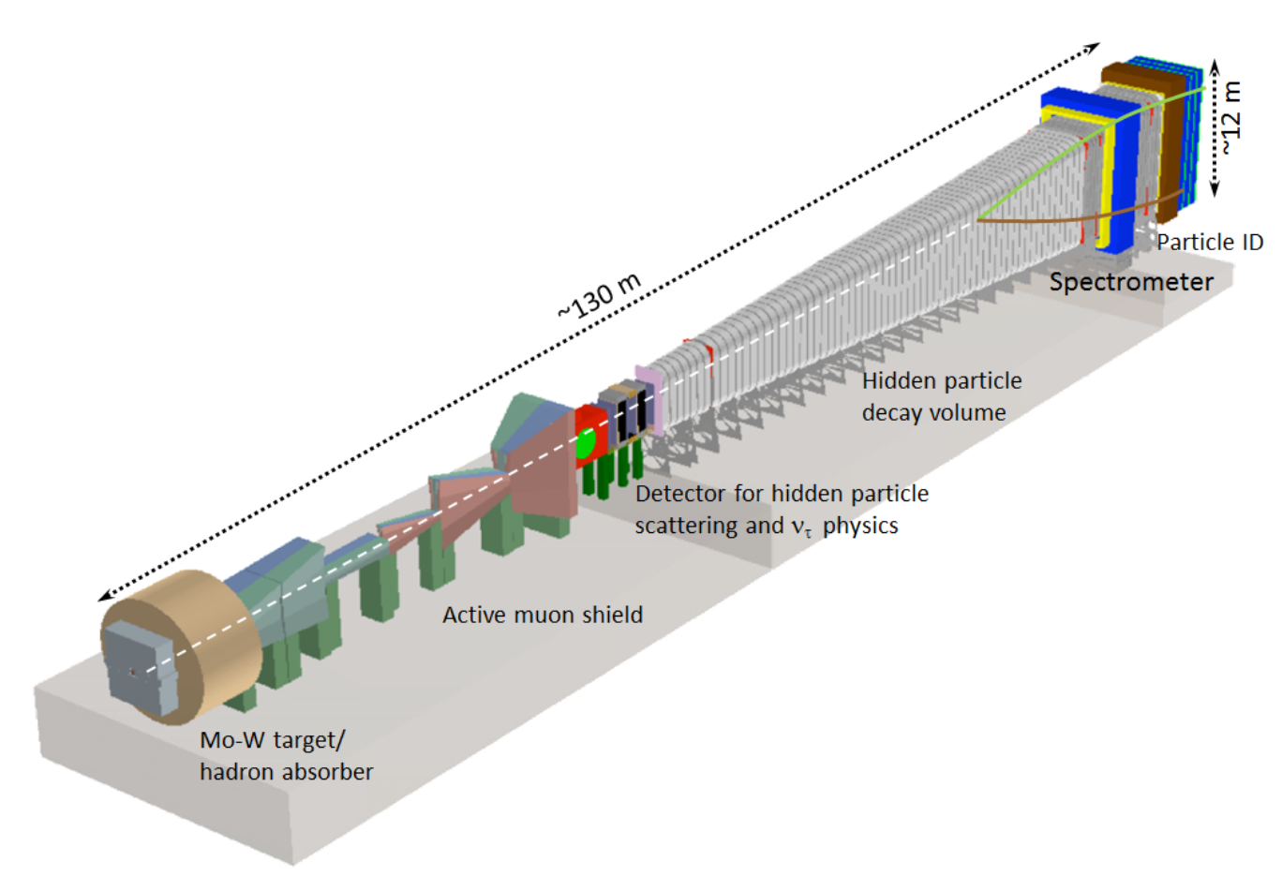
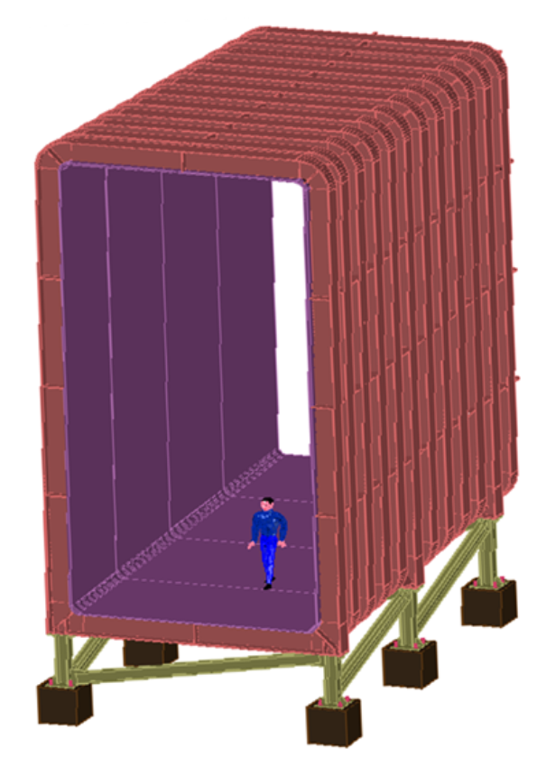
The set-up
10¹¹ muons per spill →
active magnetic (1.7 T) muon shield
→ ≈ 10⁵ muons left
Decay volume:
2.4x4.5 m² → 5x10 m²;
L = 50 m; vacuum ≈10⁻³ bar

Slide 7
Detectors
τ-neutrino detector;
decay volume surrounded by a veto tracker
large dipole magnet with straw tube tracker;
timing detector;
electromagnetic calorimeter;
hadron calorimeter;
muon system.

Slide 8
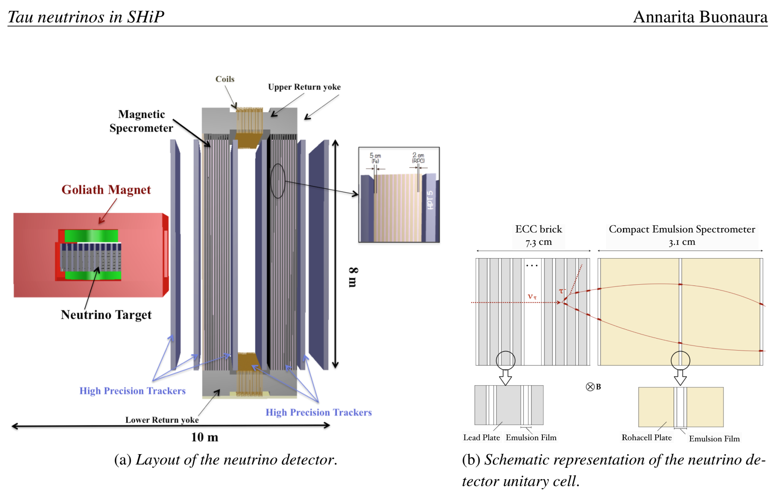
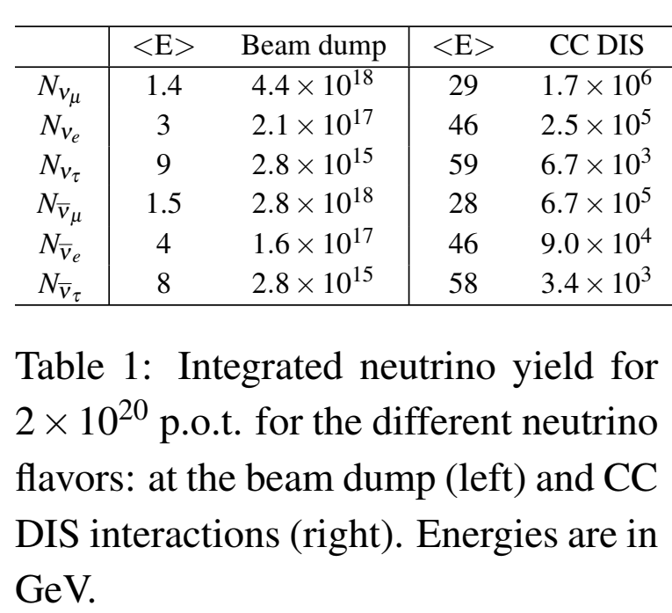
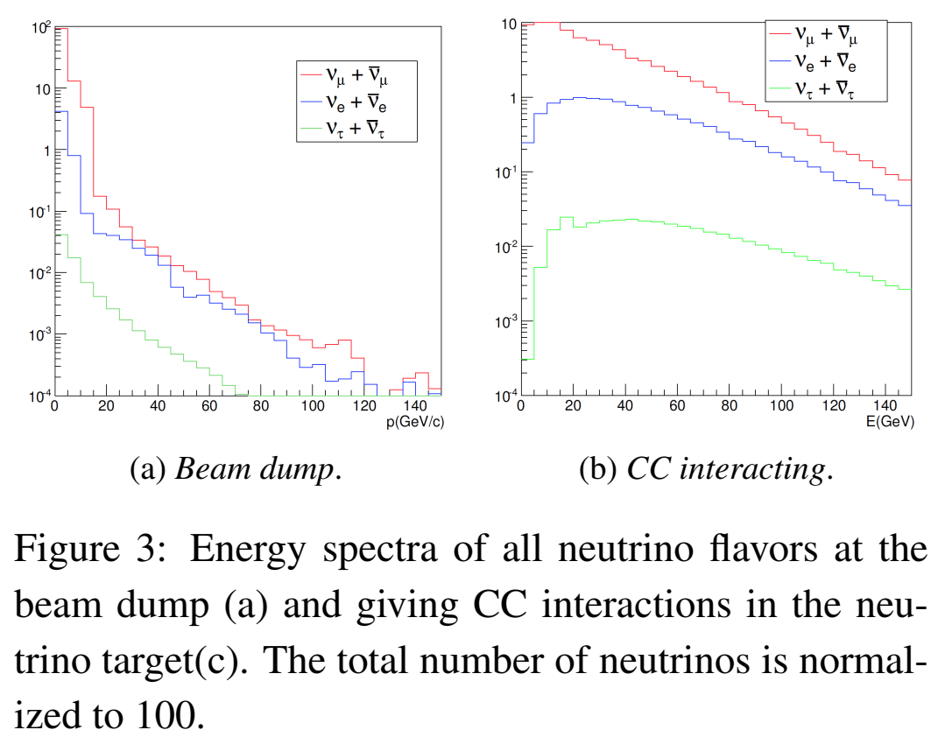
τ – neutrinos in SHiP
Target mass 9.6 tons →
6700+3400 τ+anti-τ neutrino interactions

Slide 9
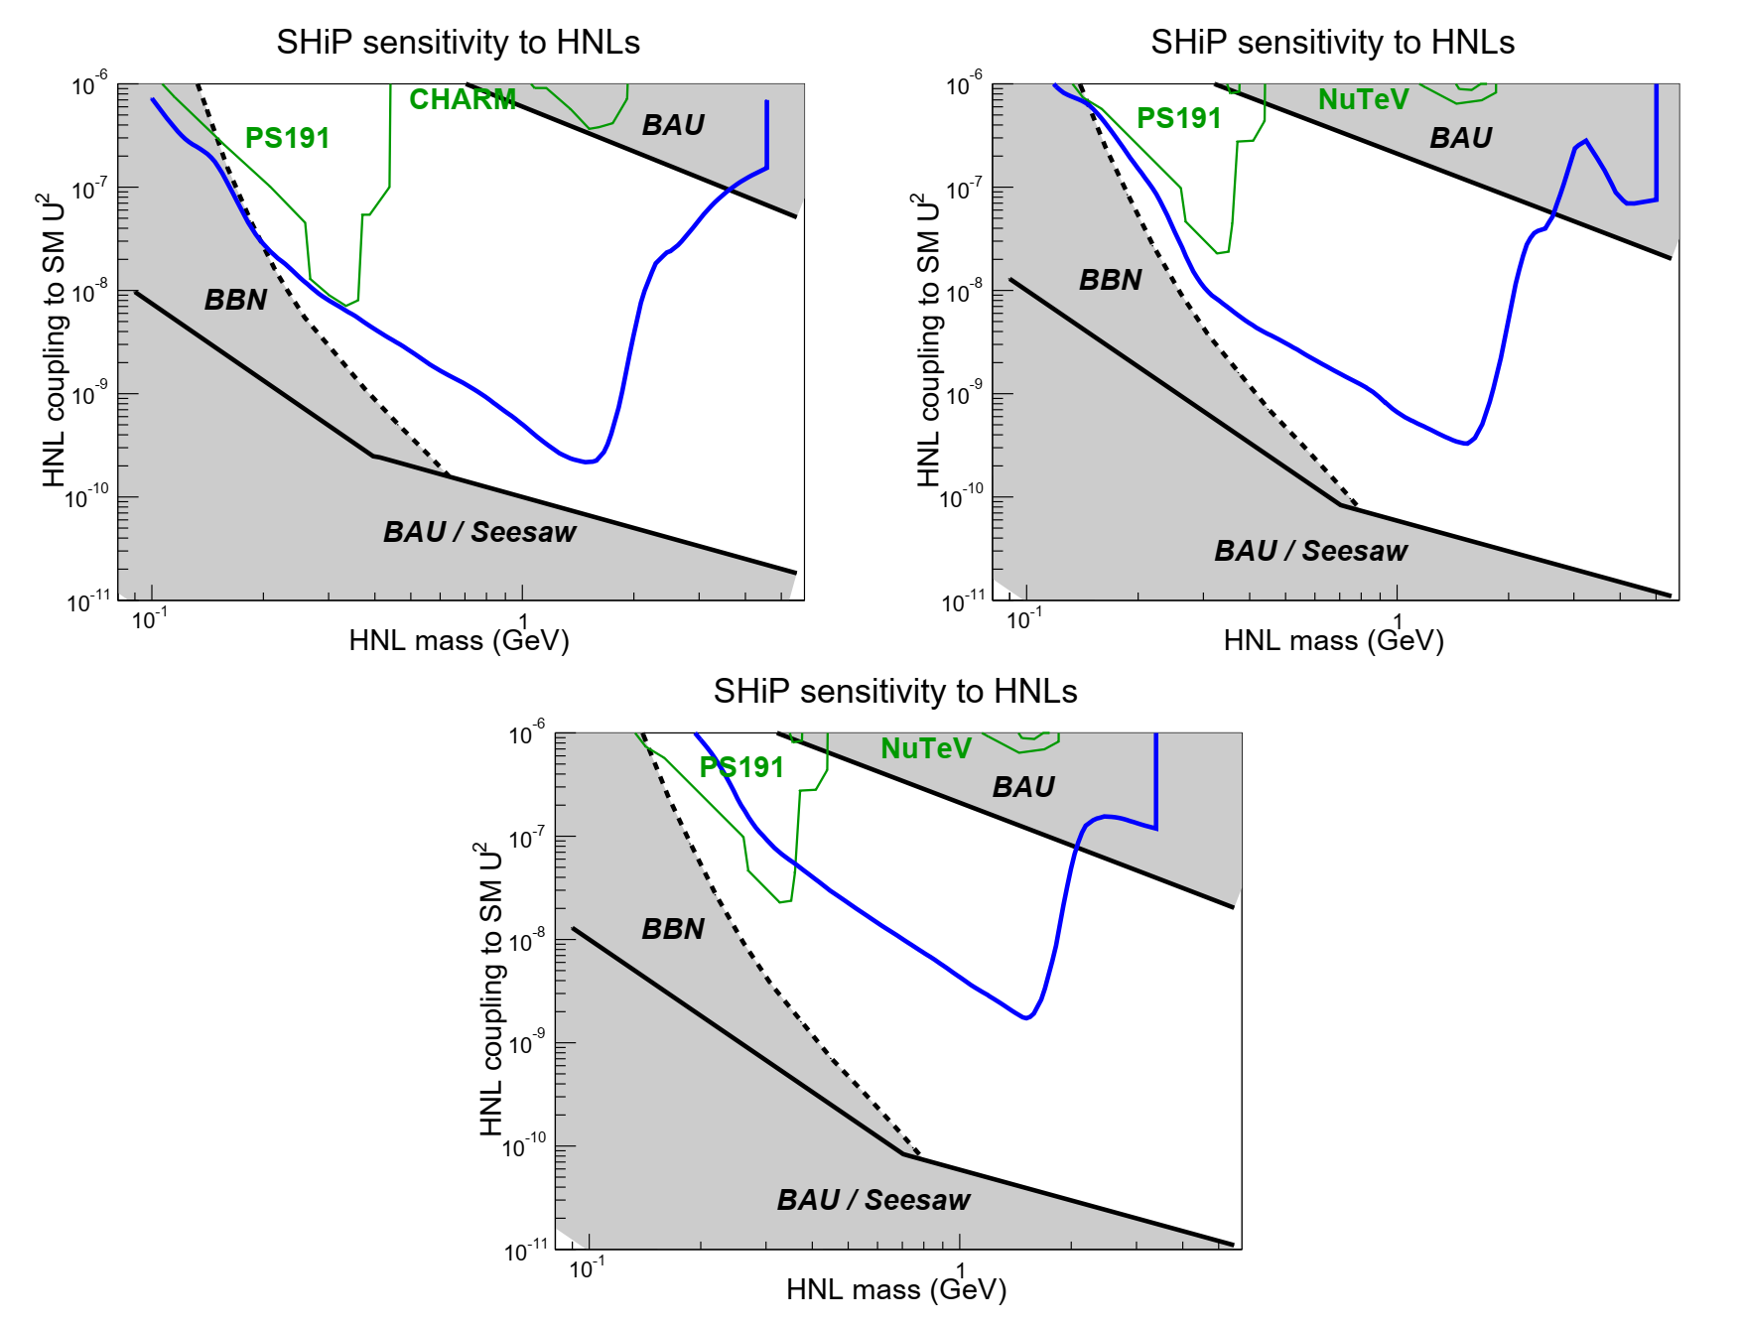
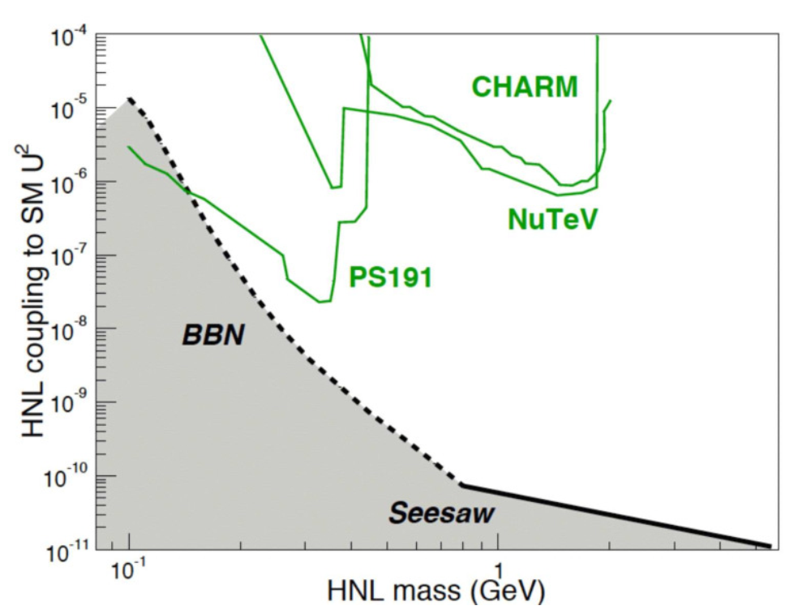
Sensitivities
Past experiments:

Slide 10
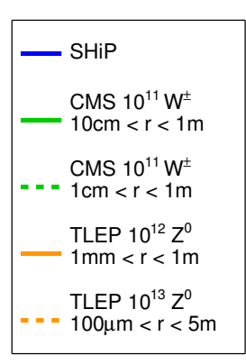
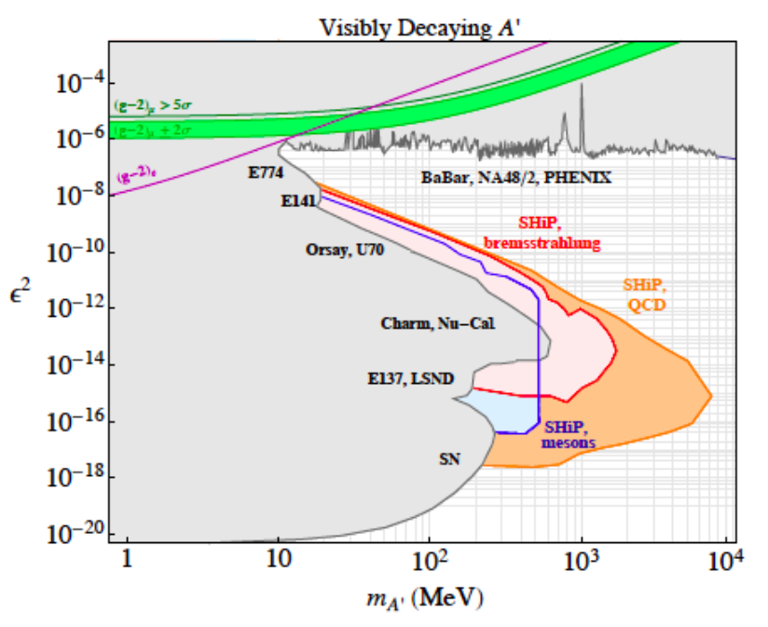
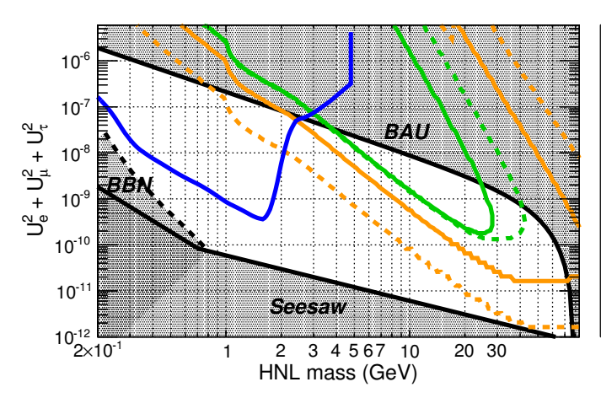
Sensitivities (cont’d)
Dark photons:
HNL – other proposed experiments

Slide 11
Conclusion
Experiment with a rich discovery
potential.
Approval is expected around 2020,
after adoption of the updated
European strategy for Particle physics.
Thanks for your attention!

