Slide 1
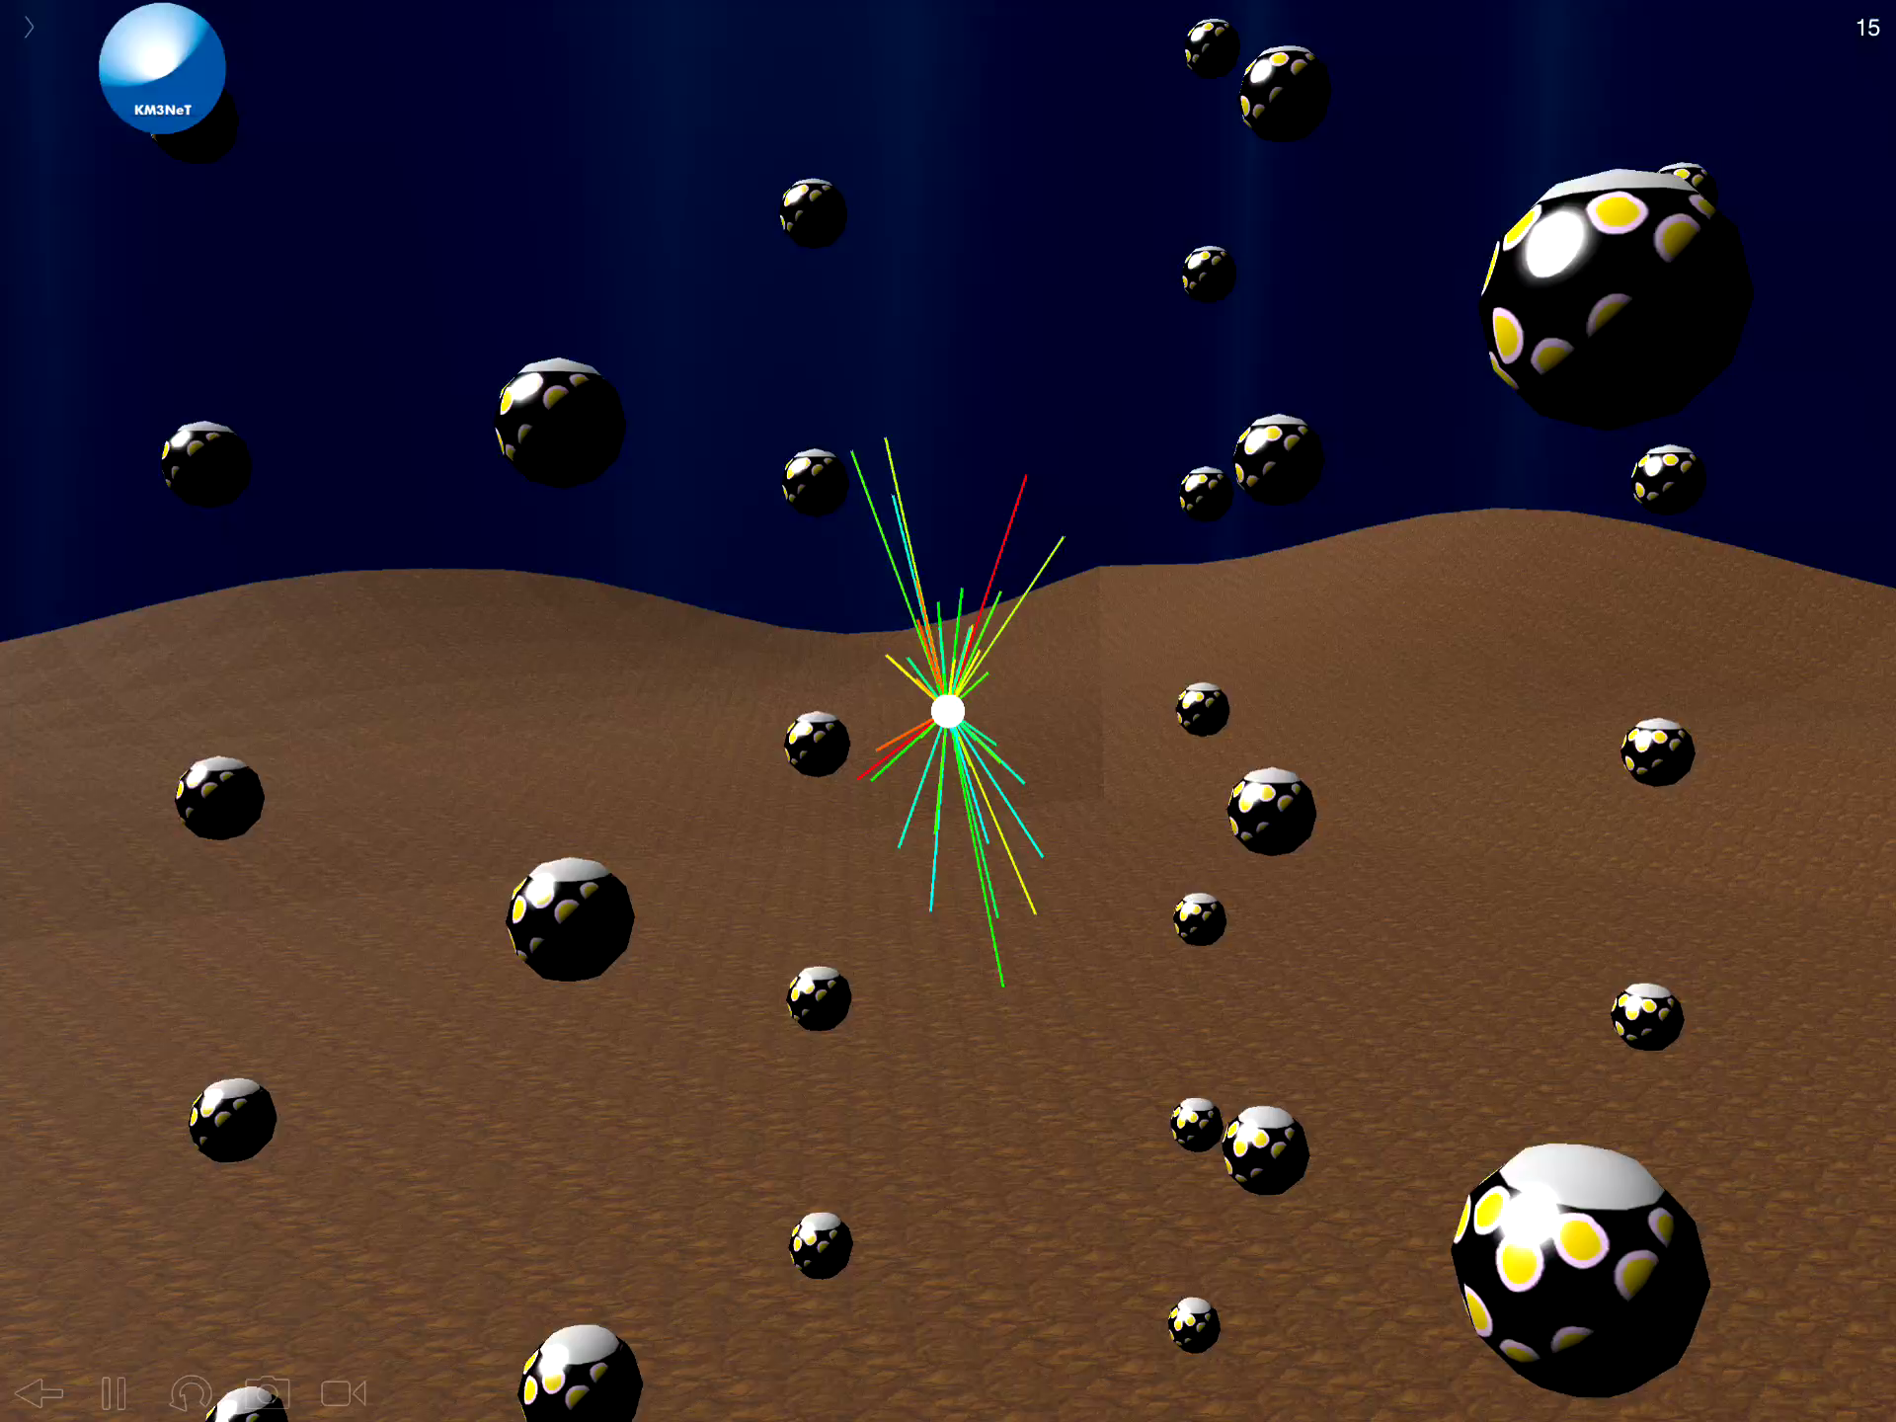
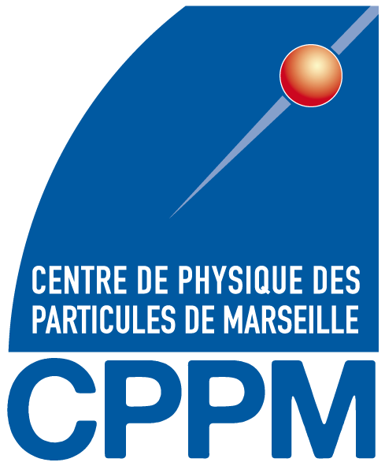
KM3NeT Status
Paschal Coyle
VLVnT 2018, Dubna, 3 Oct 2018

Slide 2
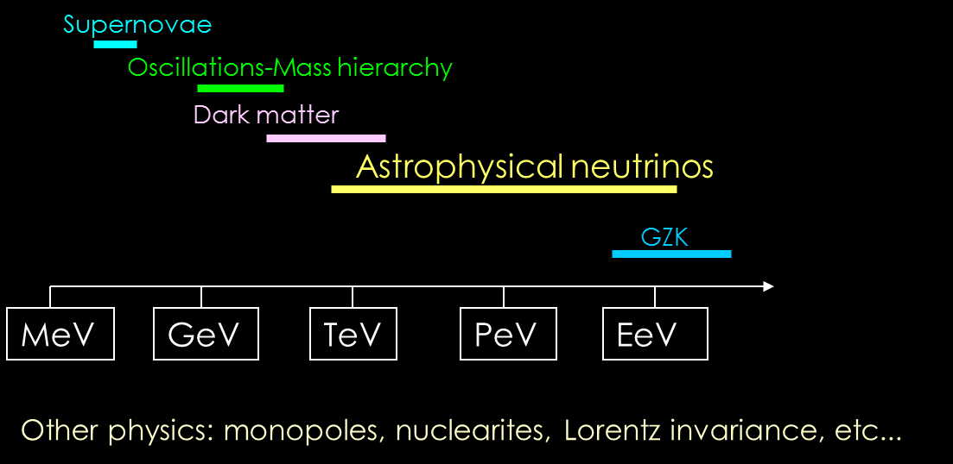
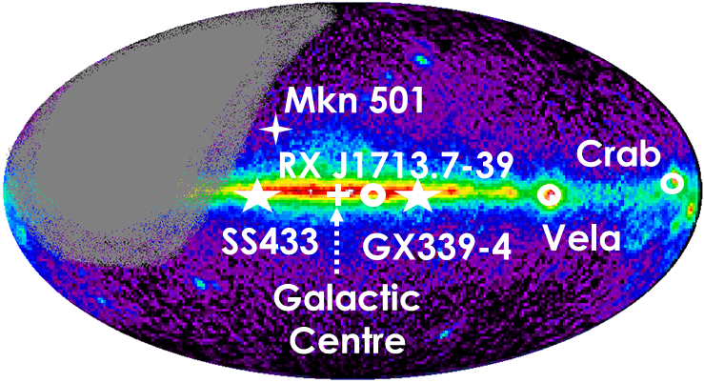
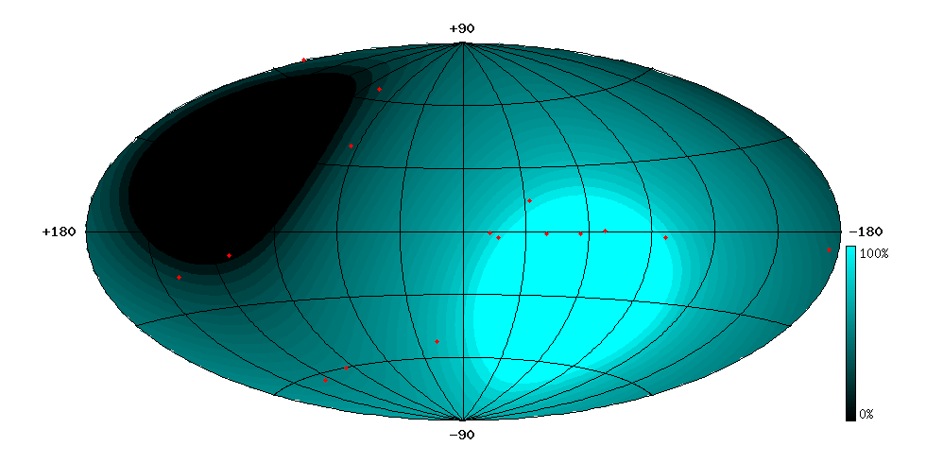
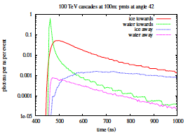
Mediterranean Neutrino Telescopes
Physics motivation and detection principle
  High energy v astronomy and neutrino properties
  Detection: large volume of transparent medium surveyed by photodetectors
Location:
  Northern terrestrial hemisphere:
  Complementary to IceCube
  “Milky-Way optimised”
Medium:
  Deep Sea water
  Very small light scattering (good angular resolution)
  Know and uniform medium
  Natural backgrounds (⁴⁰K and bioluminescence) can be handled
Water
Ice
100 m

Slide 3
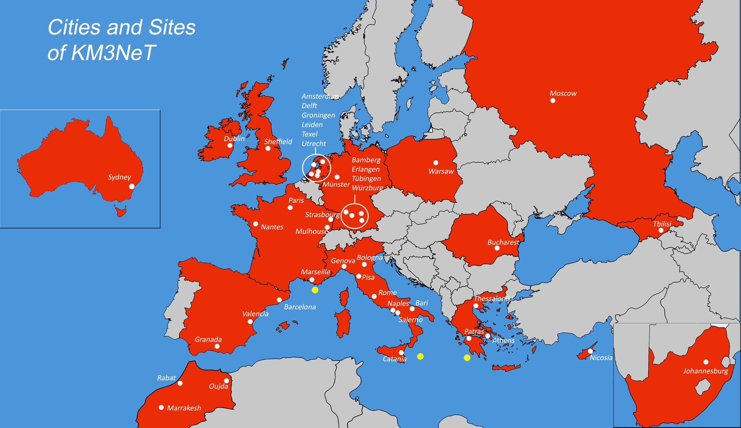

KM3NeT Collaboration
15 Countries
>40 Institutes
>220 Scientists

Slide 4
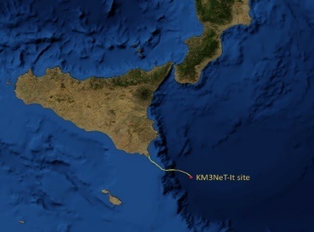
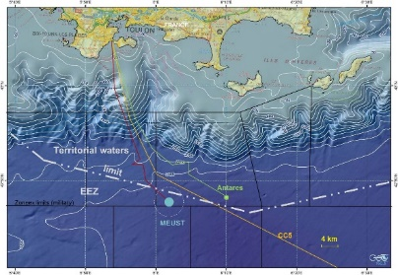
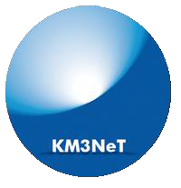
KM3NeT
ARCA
Astroparticle Research with Cosmics In the Abyss
ORCA
Oscillation Research with Cosmics in the Abyss
  ARCA (Astronomy)
    Building Block:
        115 strings
        18 DOMs / string
        31 PMTs / DOM
        Total: 64k*3¨ PMTs
  ORCA (NMH+ ν properties)
    Same technology, denser layout
  Phased construction:
        Phase 1: 24 ARCA + 6 ORCA strings
        (already funded, being deployed)
        KM3NeT 2.0: 2 ARCA +1 ORCA blocks
        (~50% funded)
3500 m
2475 m
Capo Passero, Sicily, Italy
Toulon, Var, France
 | ORCA | ARCA
String spacing | 23 m | 90 m
OM spacing | 9 m | 36 m
Depth | 2470 m | 3500 m
Instrumented mass | 8 Mton | 0.6*2 Gton
ARCA
1 km
1 km
ORCA
200 m

Slide 5

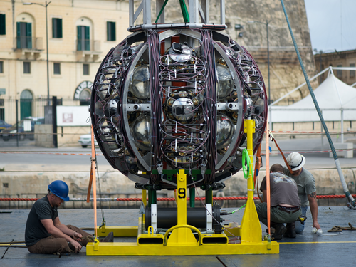
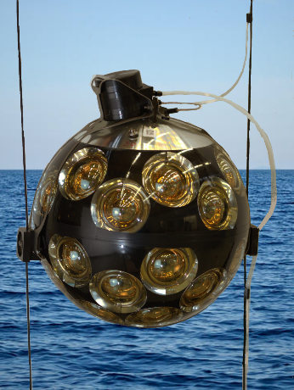
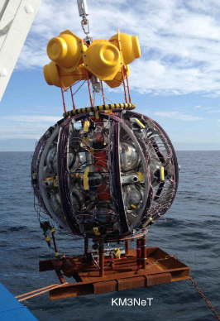
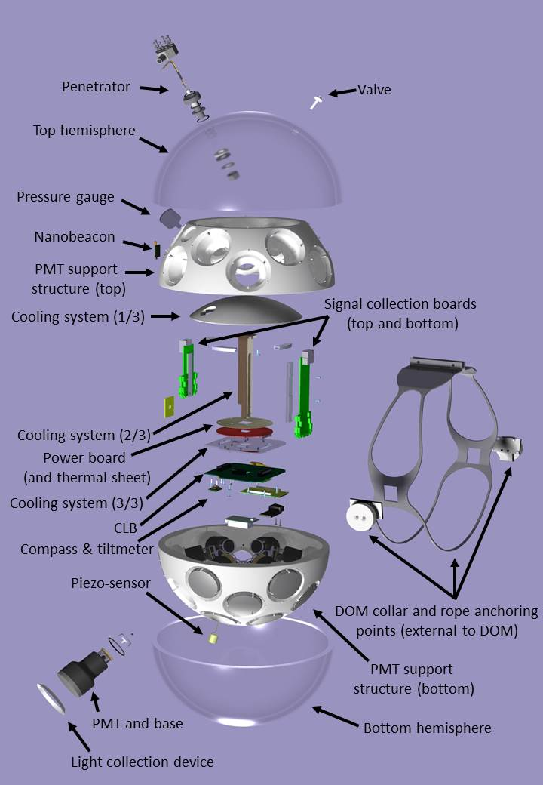

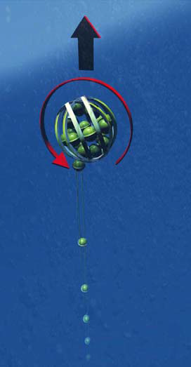
KM3NeT
Technology
String
(Detector Unit)
Deployment
Vehicle
Digital Optical Module
DOM: 31 3” PMTs
Digital photon counting
Directional information
Wide acceptance angle
Cost reduction
~ 800 or 200 m
Rapid deployment
Multiple strings in one sea campaign
J. Phys. G: Nucl. Part. Phys. 43 (2016) 084001
All data to shore
Gbit/s on optical fibre
Hybrid White Rabbit
LED flasher & hydrophone
Tiltmeter/compass
Unfurling by autonomous ROV
Reuseable
High modulus polyethylene ropes
Oil filled PVC tube
Low drag
Low cost

Slide 6
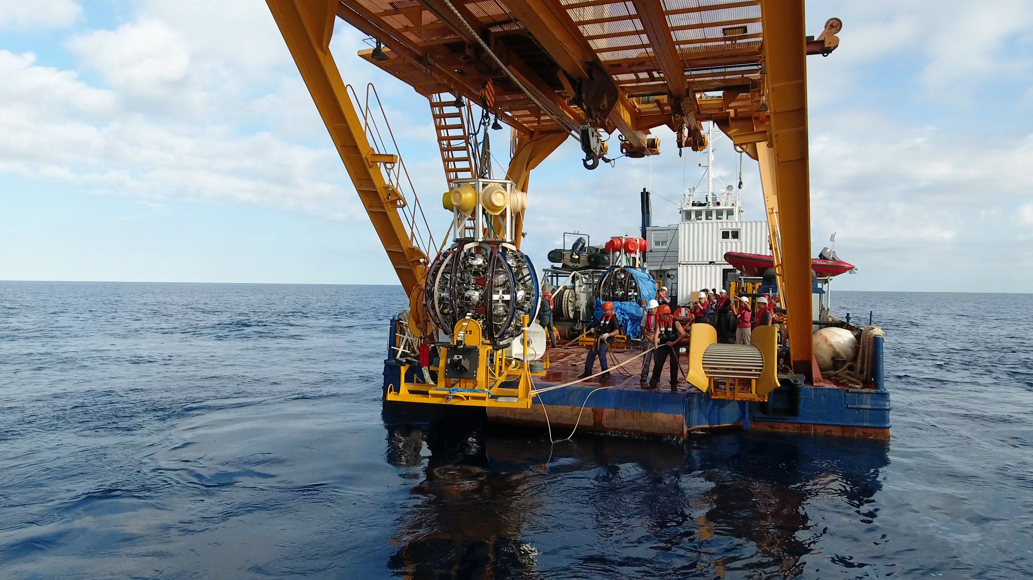
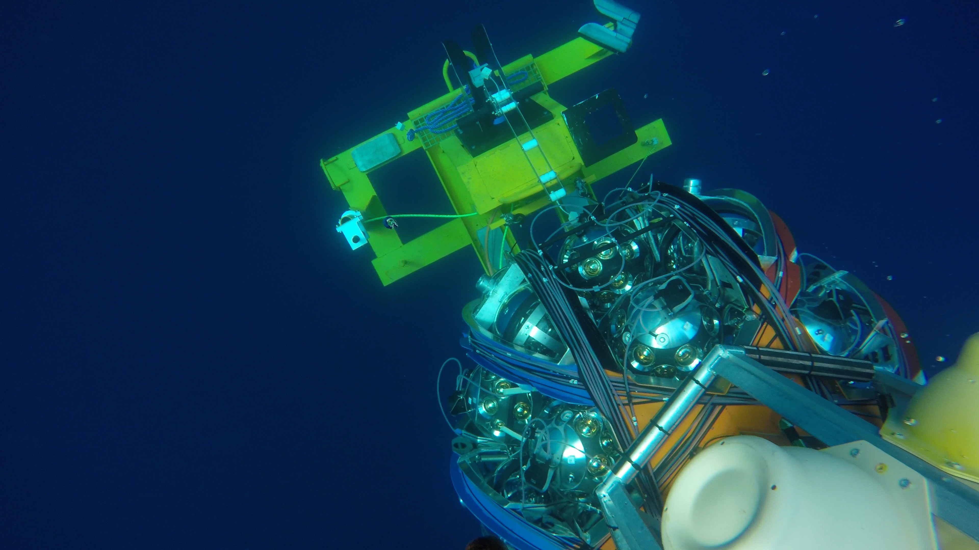
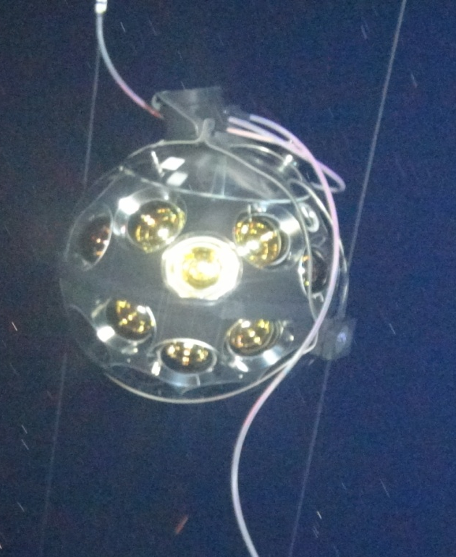
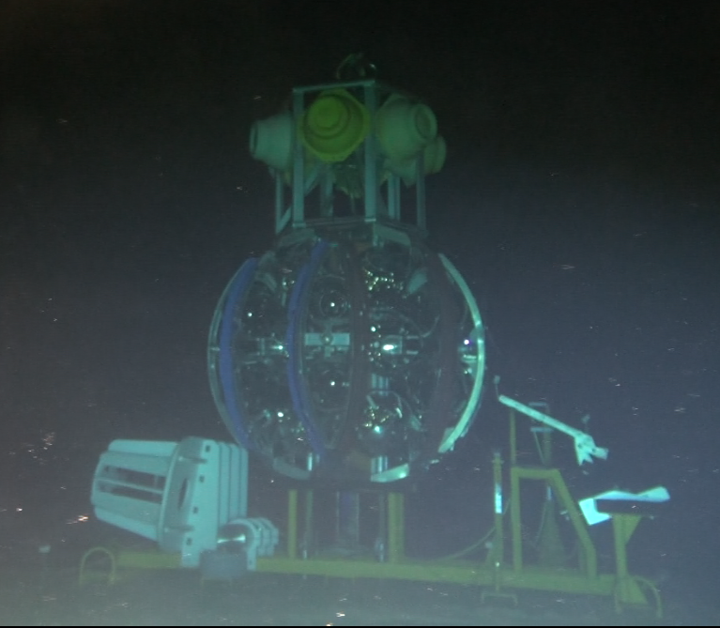
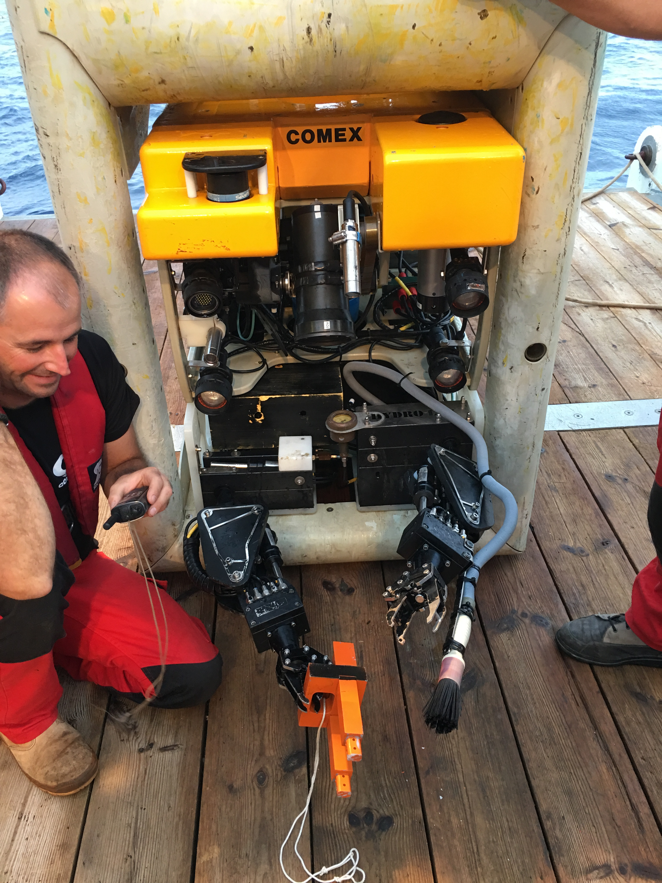
ORCA 1st DU connection (22 Sept 2017)
https://www.youtube.com/watch?v=omlFkdCkbYk

Slide 7
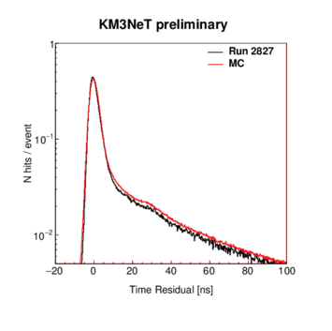
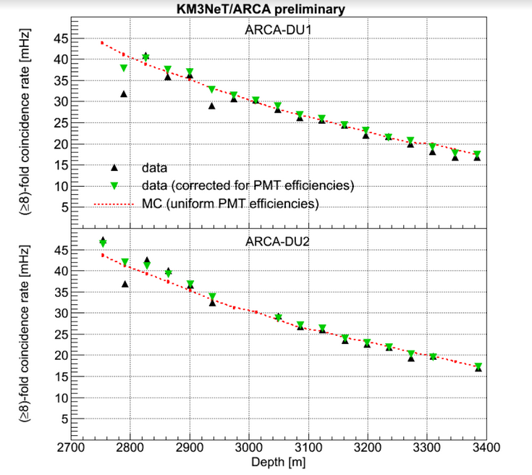
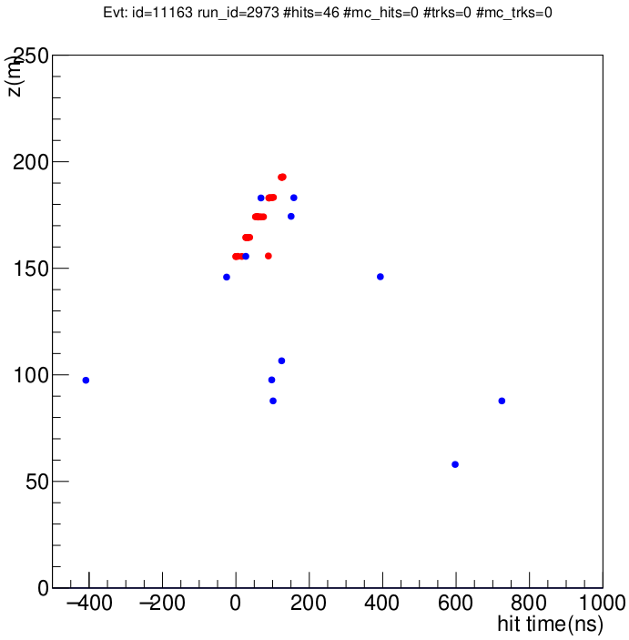
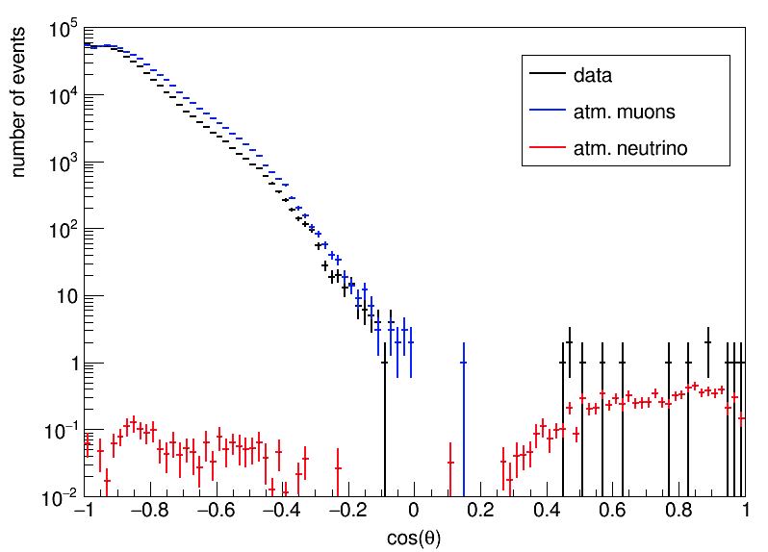
Results from First KM3NeT Detection Units
Two DUs in ARCA site
  Dec 2015 and May 2016
  1 year of operation
One DU in ORCA site
  Sept 2017
  3 months of operation
  Seafloor infrastructure teething problems. Soon to be fixed

Slide 8
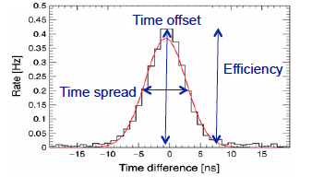
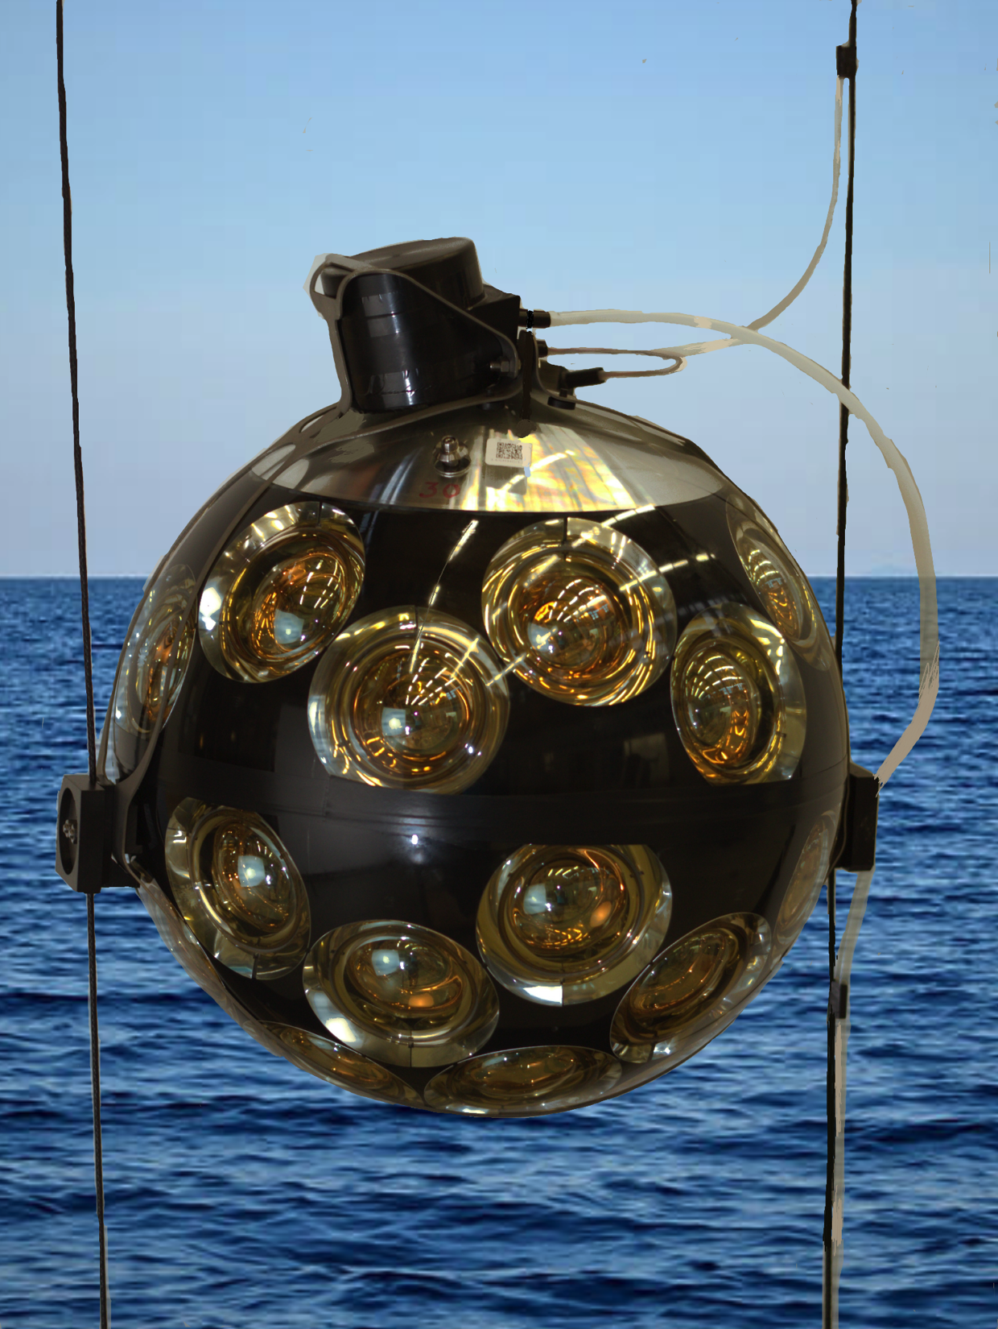

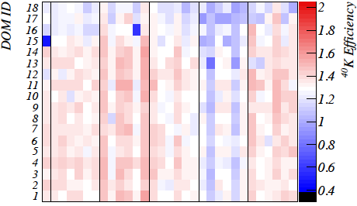


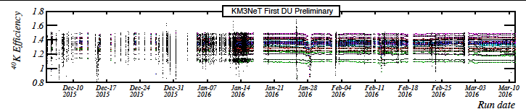
K40 Calibration
^{γ}
^{γ}
⁴⁰K
e⁻ (β decay)
Up to 150
Cherenkov
photons
per decay;
stable ⁴⁰K
concentration
⁴⁰Ca
precise PMT efficiencies vs time and location

Slide 9
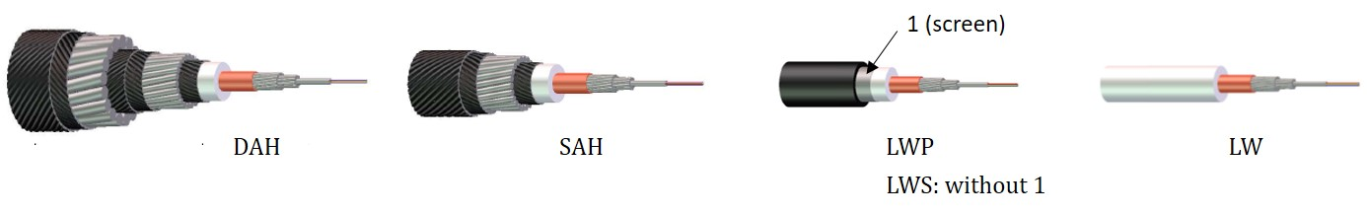
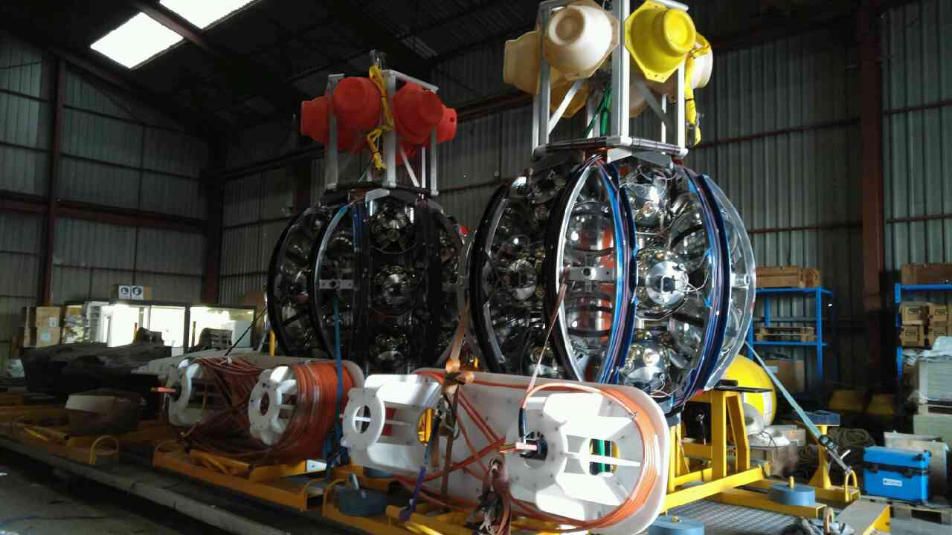


Coming before end of the year….
X
ORCA site
  Replacement of Main Electro Optical Cable
  Connection of 6 ORCA DUs and a Sea Science Module
ARCA site
  Sea operation to reconfigure seafloor to restore operation of the 2 ARCA DUs
LWP
LWS
X

Slide 10
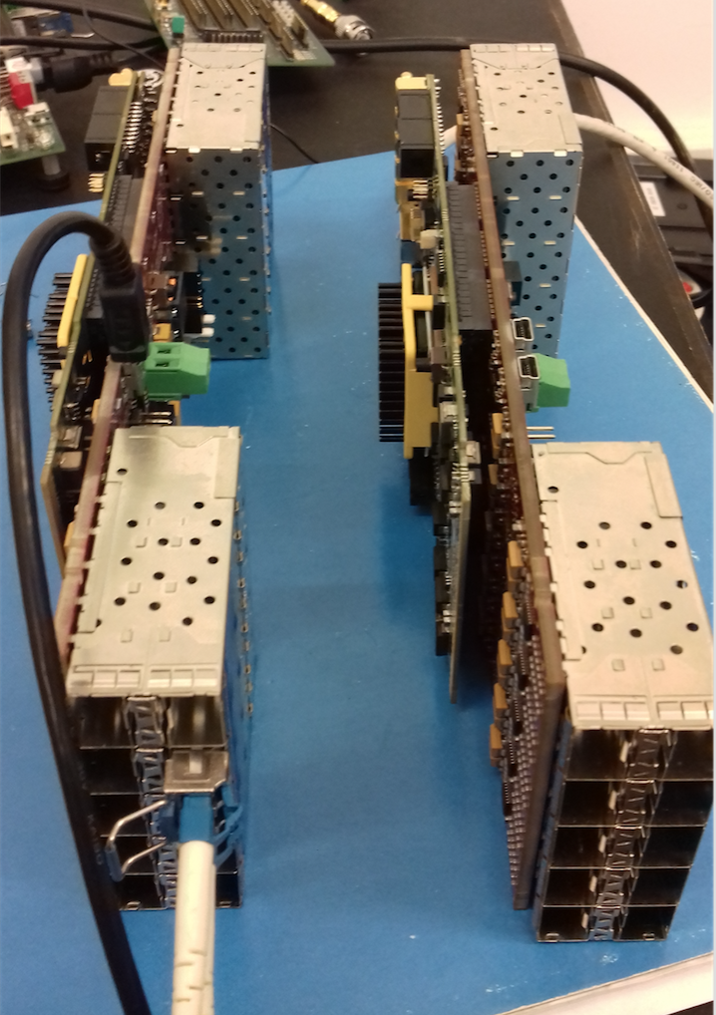
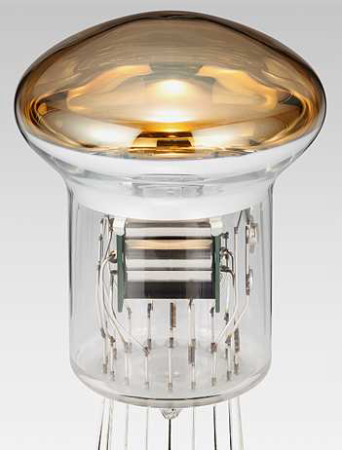
Coming soon after that for Phase 2
White Rabbit switch in the base
  Need less optical fibres in the MEOCs
  (2 MEOCs sufficient for ARCA)
  Automatic time calibration to each DOM
  DOMs colourless: all DOMs the same
New Hamamatsu PMTs (R14374)
tender for 13000 PMTs
Improved TTS 2.4ns-> 1.2 ns
QE 27% @400 nm
(not yet introduced in MC)
Reoptimise ORCA geometry?
horizontal 23m -> 20 m

Slide 11
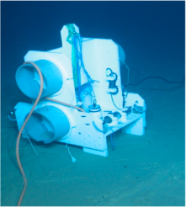
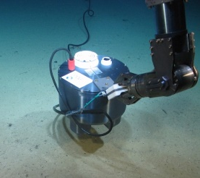
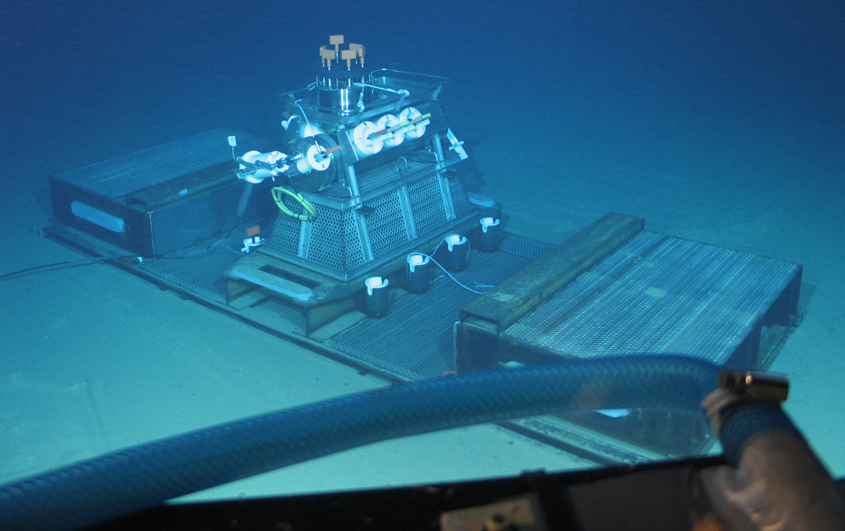
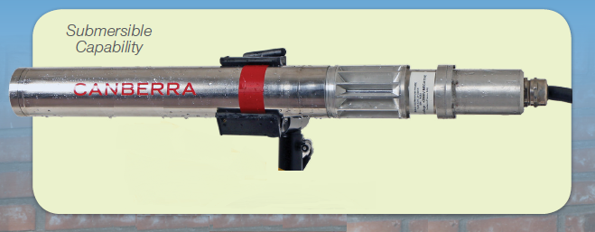
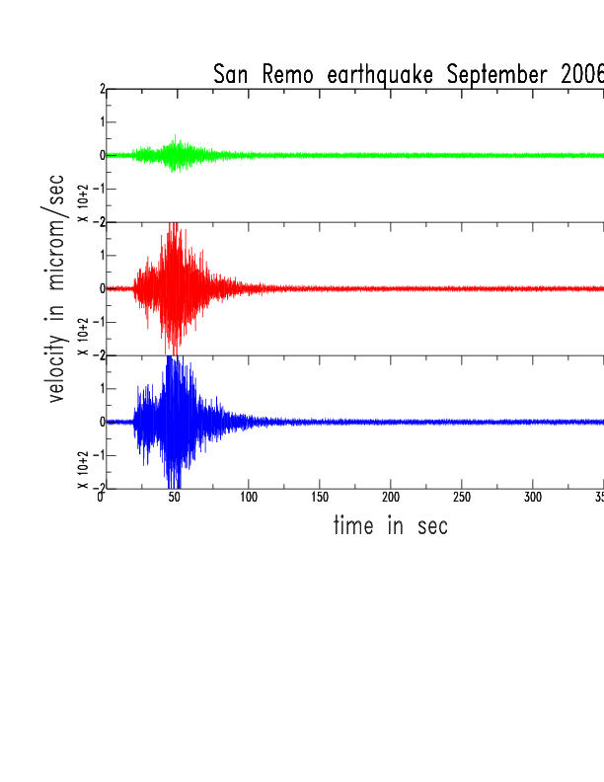

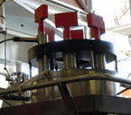
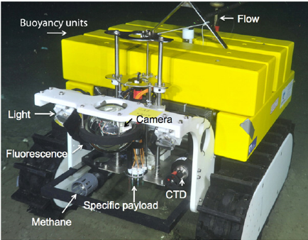
ESS Instrumentation in Preparation
Seismometer
Upgrade of ANTARES SJB
Ge Radioactivity Detector
Stereo Biocameras
DeepSeaNet
Benthic Crawler

Slide 12
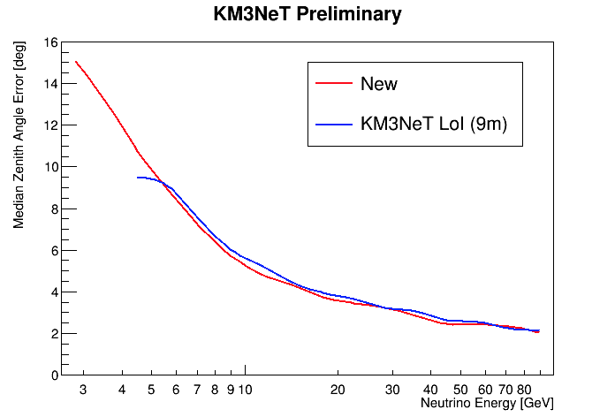
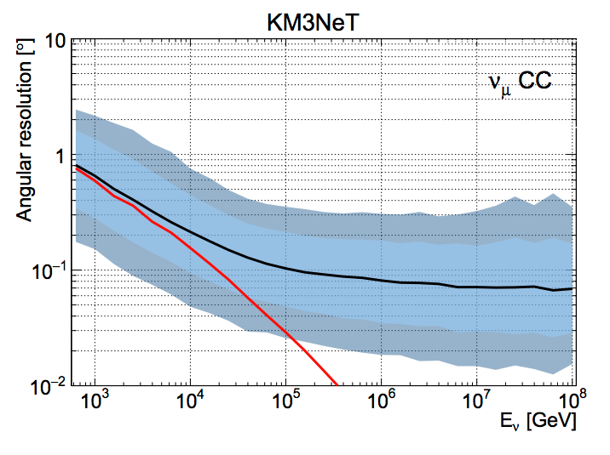
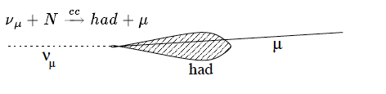
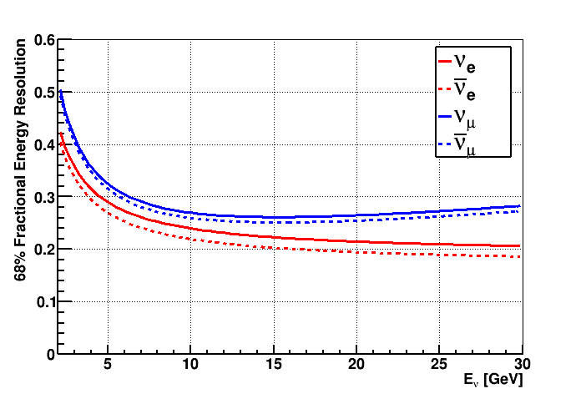
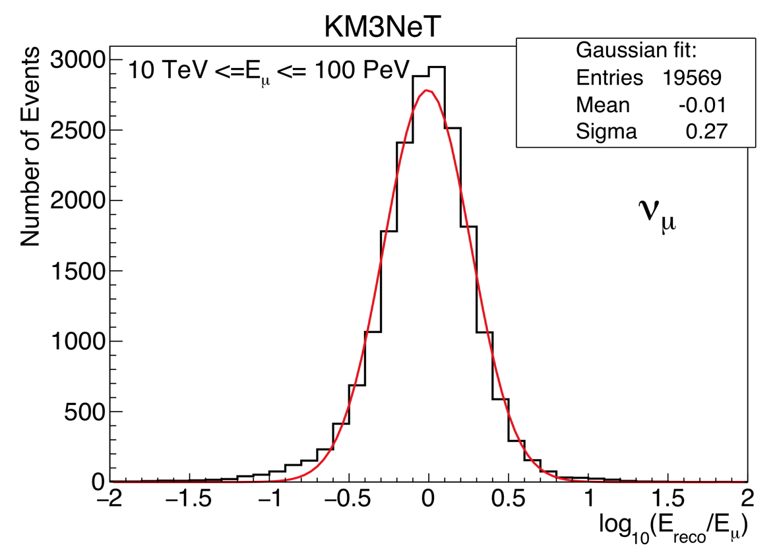
Performance ‒ Track events
ORCA: Direction Resolution
ARCA: Direction Resolution
CC ν_{μ}
<0.1° (E>10 TeV)
90%
1σ
Excellent angular
resolution at
high energies
Better effective
area than showers
ORCA: Energy Resolution
ARCA: Energy Resolution
0.27 in Log E (E>10 TeV)

Slide 13
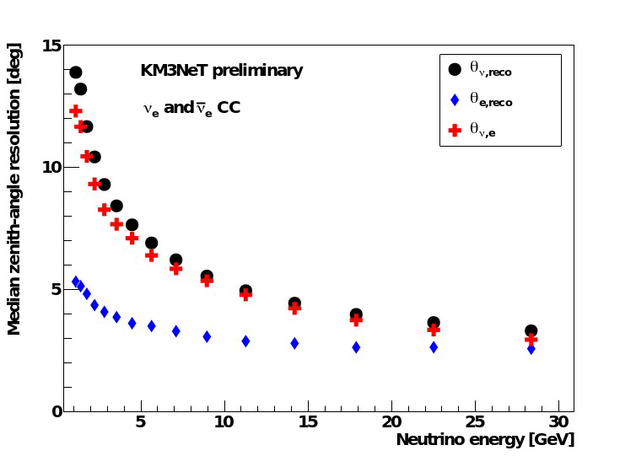
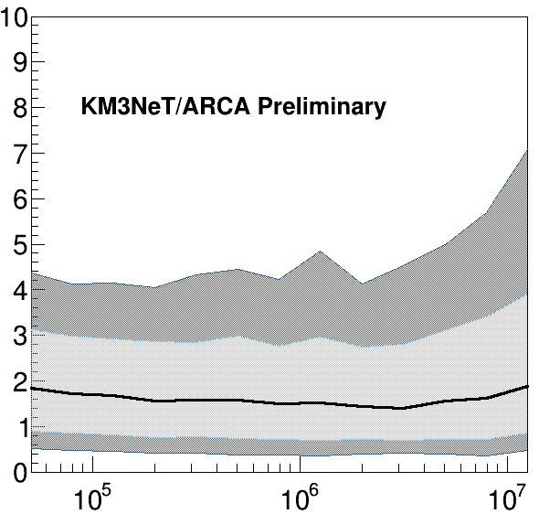
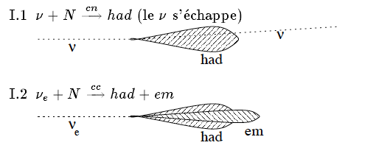
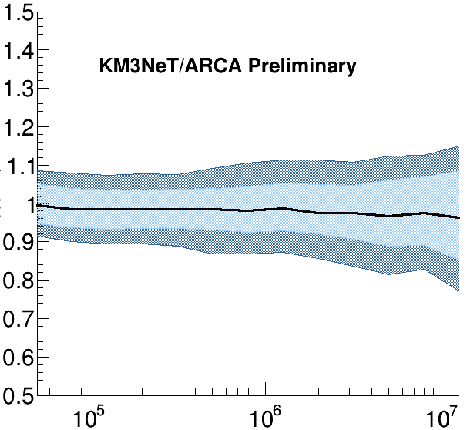
Performance ‒ Shower events
NC ν_{all}
CC ν_{e}
ORCA: Direction Resolution
ARCA: Direction Resolution
<2°
90%
1σ
1σ
Fair angular resolution (low and known light scattering in water)
Excellent energy resolution
ORCA: Energy Resolution
ARCA: Energy Resolution
90%
1σ
5%

Slide 14
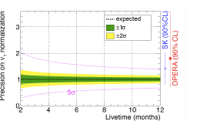
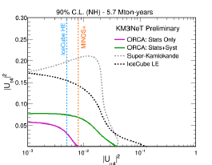
KM3NeT/ORCA- neutrino properties
Mass Ordering
Oscillation parameters
Tau Appearance
Sterile neutrinos

Slide 15


Protvino to ORCA (P2O, P2SO)
Baseline 2588 km
Beam inclination : 11.7˚ (cos θ = 0.2)
Deepest point 134 km : 3.3 g/cm3
First oscillation maximum 5.1 GeV
Sensitivity to mass hierarchy and CP violation
P2O (90kW) for mass hierarchy
3 years ➔5σ
P2SO (450kW, 10* denser) for CPV
3 years ➔5σ
KM3NeT preliminary
NH
IH
δ_{CP}
270°
90°
270°
KM3NeT preliminary

Slide 16

KM3NeT/ARCA- Diffuse Flux
showers
tracks
KM3NeT/ARCA is expected to observe the IC signal in less than 1 year
Precise characterization (spectral shape, flavor composition, anisotropy)

Slide 17

KM3NeT/ARCA-Galactic Plane
ν’s from CR-molecular cloud interactions
KRA_{γ} model of diffuse gammas
  CR local features and gamma observations
  reproduced
  Two ref models: 5 PeV and 50 PeV cutoffs
Fermi-LAT
ANTARES
Phys. Rev. D 96 062001 (2017)
IceCube
KM3NeT
models

Slide 18

IceCube- SkyMap

Slide 19


KM3NeT/ARCA: Generic Point Sources (E⁻² Spectrum)
Preliminary
more than one order of magnitude better sensitivity than ANTARES/IC in the Southern sky
Due to the good angular resolution for shower events, the shower point-source search is also very efficient

Slide 20




KM3NeT/ARCA – Galactic Point Sources
Specific galactic sources
γ→ν flux conversion:
Galactic sources in reach
Constrain hadronic component

Slide 21
Summary
  KM3NeT:
  ESFRI Roadmap 2016, APPEC European Strategy 2017
  ARCA: high-resolution follow up of IC diffuse flux ((5 sigma within 1 year)
  ORCA: Measure neutrino mass hierarchy (3 sigma in 3-4 years)
  +DM, Tomography, Supernovae, Steriles, NSI, LIV, ….
  Technology:
    Cost effective DOM design
    Novel deployment method
    Recoverable
    2 ARCA and 1 ORCA DUs successfully operated
    Design time resolution attained
  In-situ calibration demonstrated
  Atmospheric neutrinos detected
  On the move!
  Mass production of Phase 1 DOMs (400) essentially completed
  Repairs of seafloor infrastructures imminent
  2+6 DUs operational before end of year
  3 years to 2 building blocks
  Exciting possibility of P2O

Slide 22

Thanks

Slide 23

Other Physics….
Supernovae
Earth Tomography

Slide 24




Dark matter annihilation
Sun:ORCA
Galactic Centre: ARCA-Phase1
preliminary
spin-dependent cross section

Slide 25
Water versus Ice: Time PDFs
30 m
100 m
30 m
100 m

Slide 26







Multi-messenger Programme
Advantages:
  A-priori interesting sources or events
  Reduced background:
    Uncorrelated between techniques
    Transient/short time events
    Spatial location
  Fully exploit the v telescopes features:
    Continuous monitoring
    Wide angle survey
    High efficiency, low latency (all-data-to-shore, fast reconstruction)
Send and receive alerts:
  Alerts from:
    Flaring AGNs, X-ray binaries
    GRBs, FRBs
    Gravitational waves
    SN Ib,c
  Alerts sent out if:
    High energy neutrino
    Multiplets
    Preferred direction
GeV-TeV γ-rays
Fermi, HESS, HAWC
Radio-Visible-X
MWA, SUPERB
TAROT, ZADKO, MASTER
Swift
UHE Cosmic rays
Auger, TA
Gravitational waves
LIGO-VIRGO-EGO

Slide 27


KM3NeT Status
Paschal Coyle
VLVnT 2018, Dubna, 3 Oct 2018

Slide 28


KM3NeT- Diffuse Flux
All-sky
KM3NeT/ARCA is expected to observe the IC signal in less than 1 yr.
Precise characterization (spectral shape, flavor composition, anisotropy)
Excellent sensitivity in the galactic plane: identify gal/extra-gal components ?
Galactic plane

