Slide 1
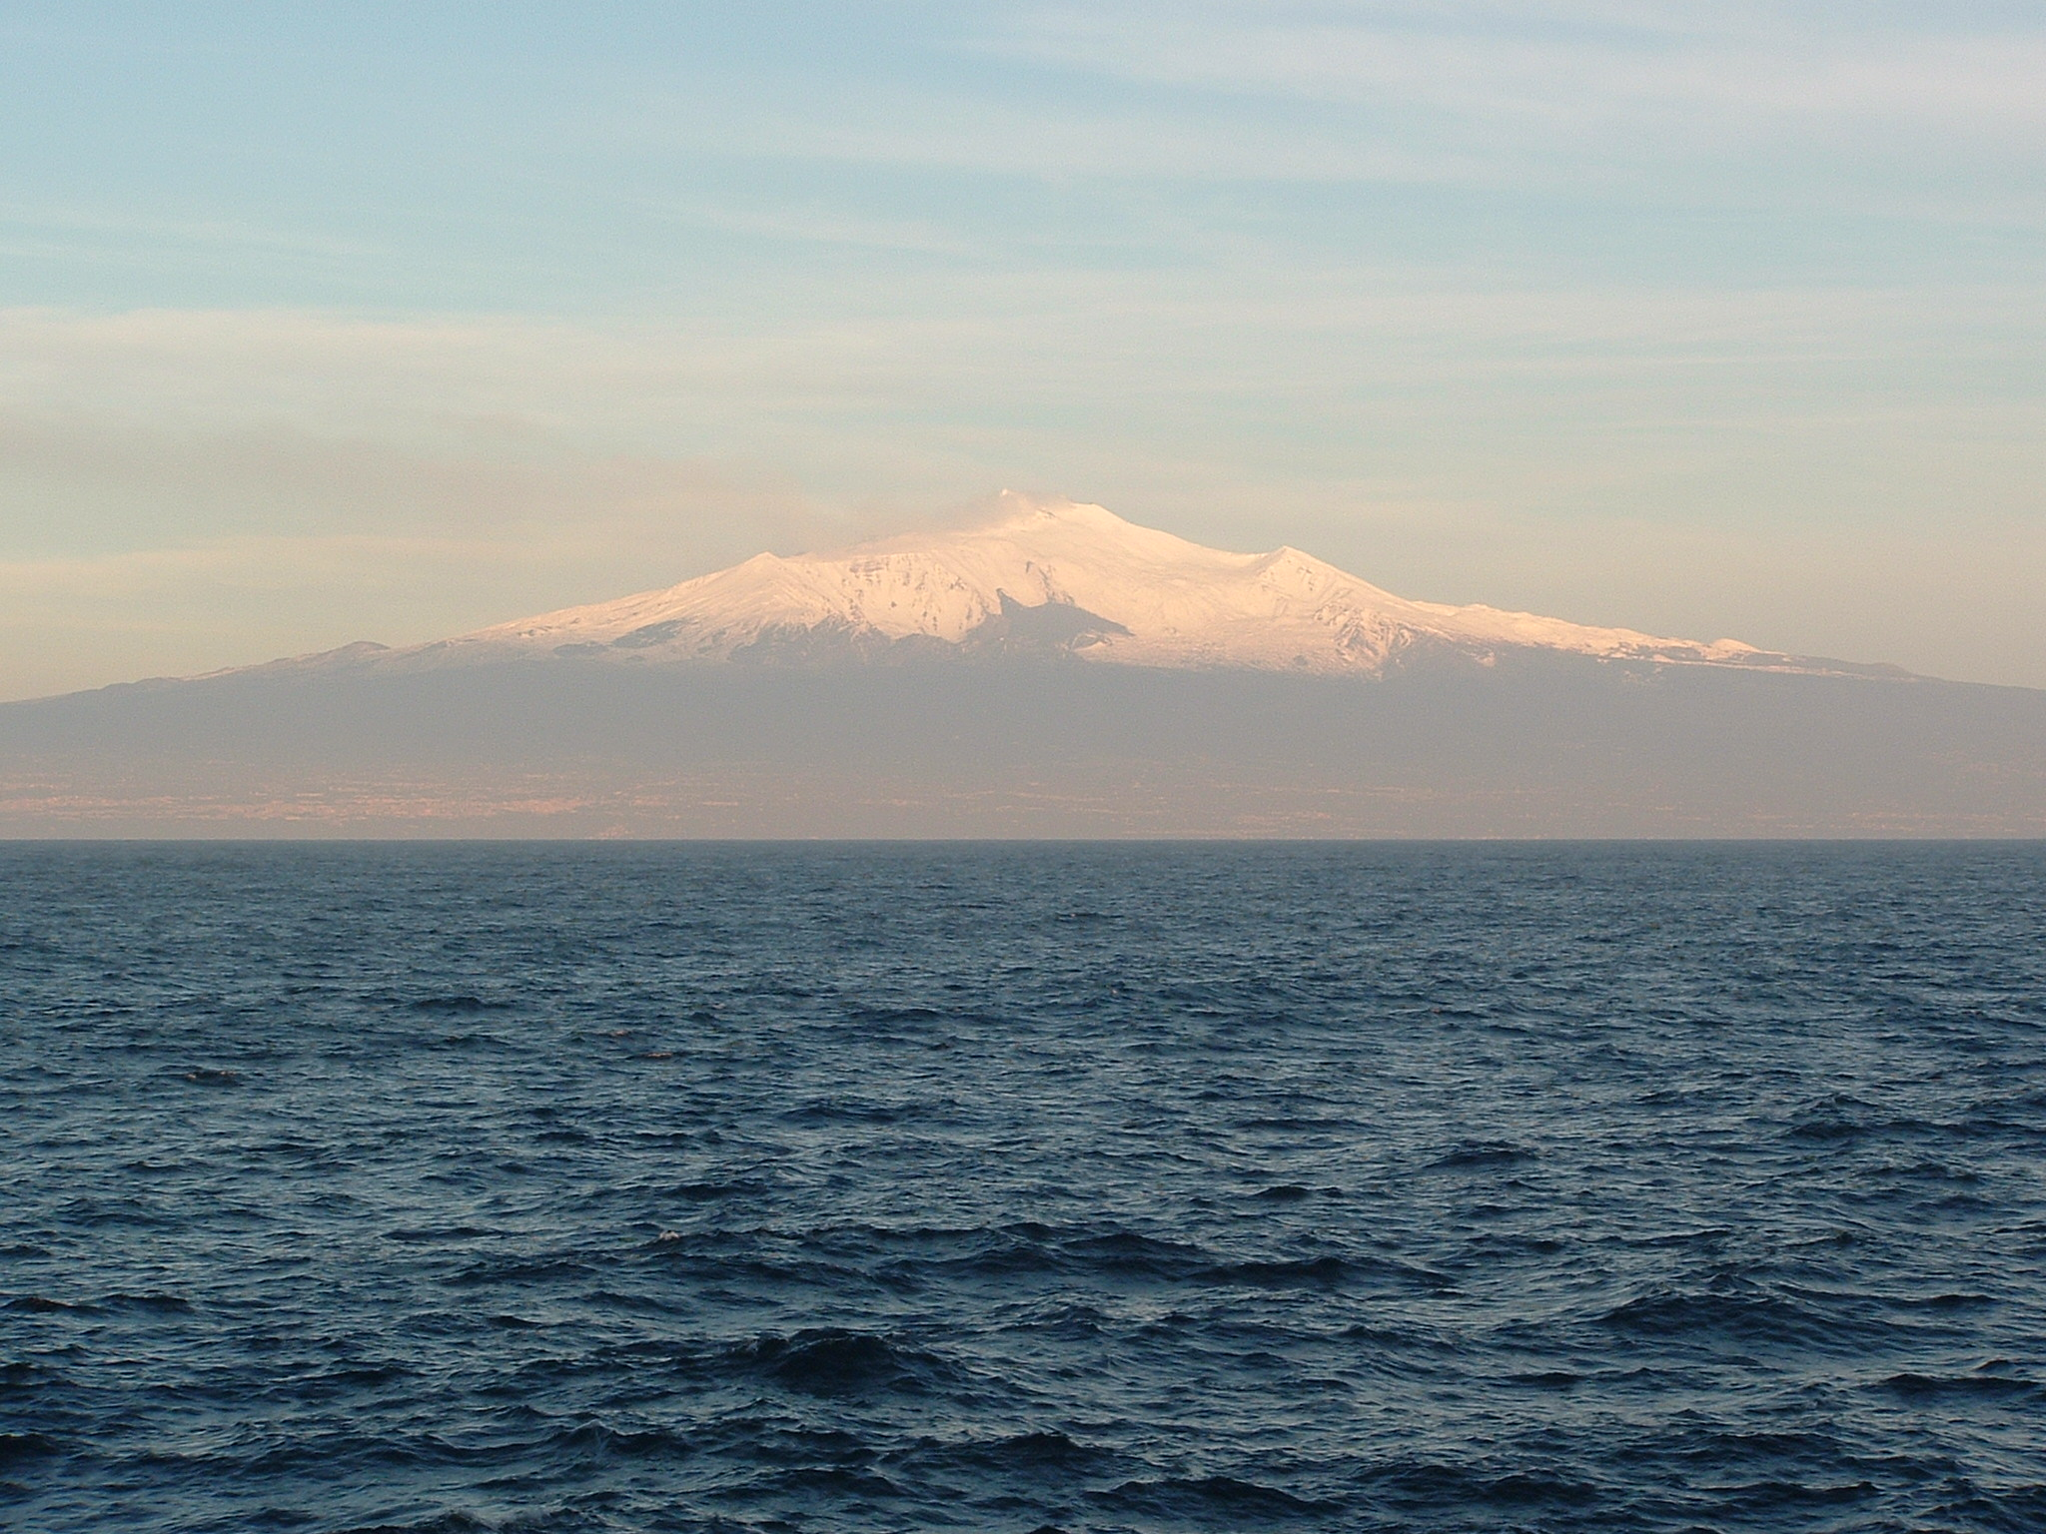
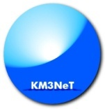

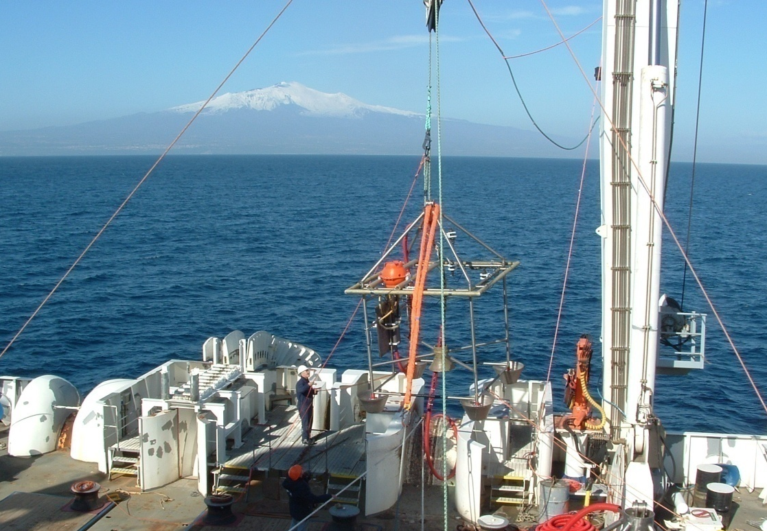
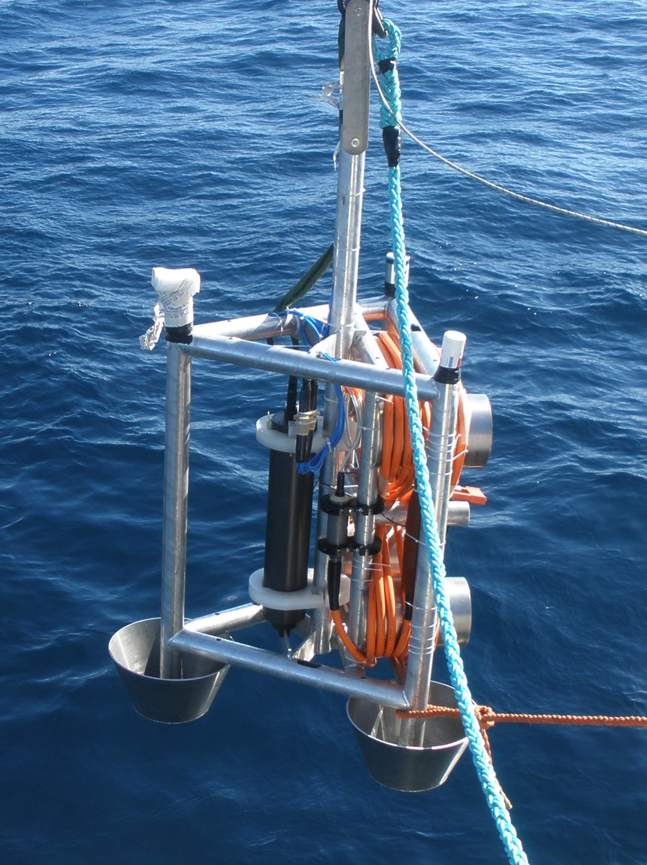
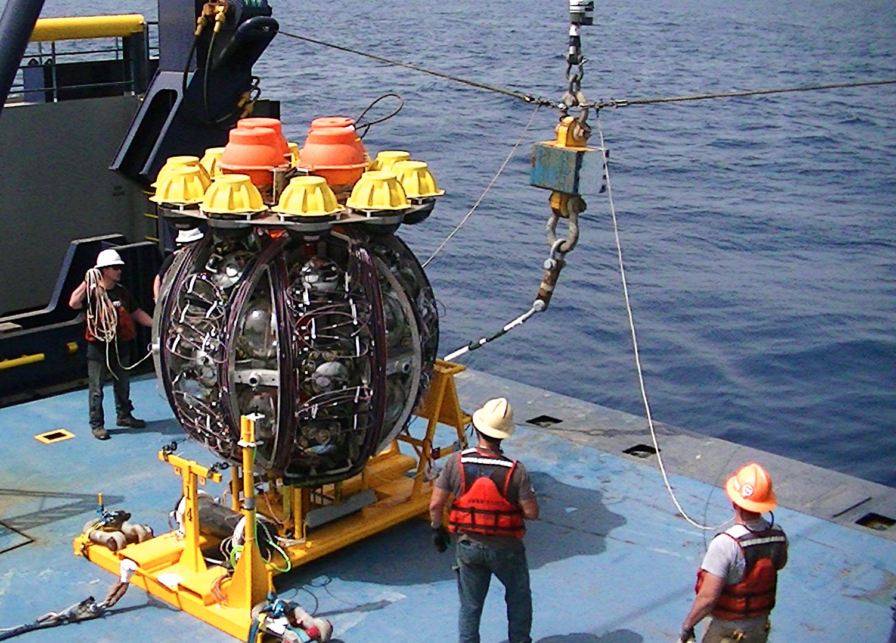
VLVNT 2018
The Italian Site for KM3NeT ARCA
Giorgio Riccobene
INFN –LNS

Slide 2
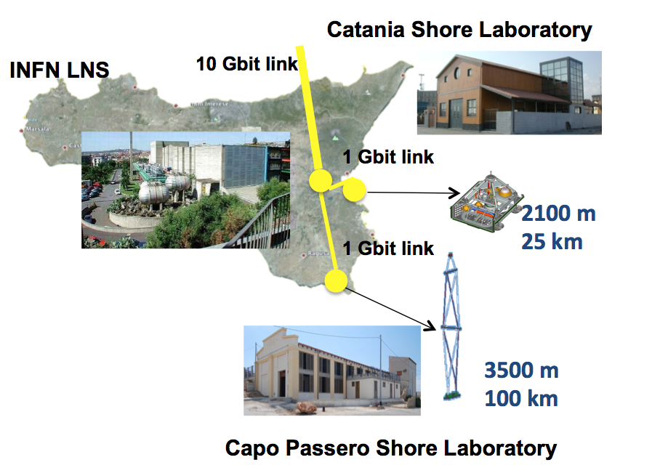
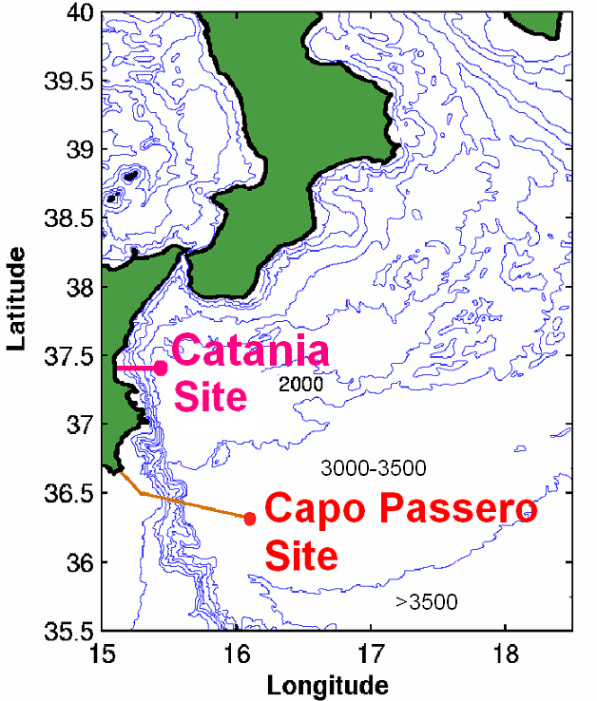
Cabled infrastructures in Sicily
Two deep sea infrastructures built by INFN-LNS in Sicily
Capo Passero Site (KM3NeT-ARCA):
90 km South East offshore Capo Passero, 3500 m depth
Catania Test Site (deep Sea laboratory, first node of EMSO):
25 km East offshore the port of Catania, 2100 m depth
10 fibers
Now updated to 10 Gbit
20 fibers (Phase1)
48 fibers (Phase 2)
Capo Passero Site:
Abyssal Site
Oligotrophic environment
Gate to the Sicilian Channel
Catania Test Site (with INGV, first cabled node of EMSO):
Coastal Site, Close to ports and shipping lanes
East flank of the Etna Volcano, On the Sicilan-Maltese shelf break
Gate to the Messina Strait

Slide 3
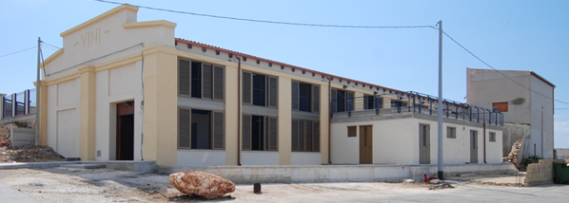
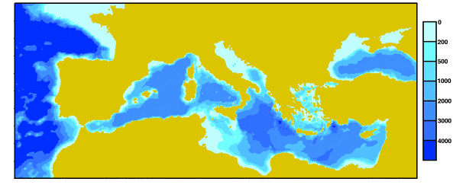
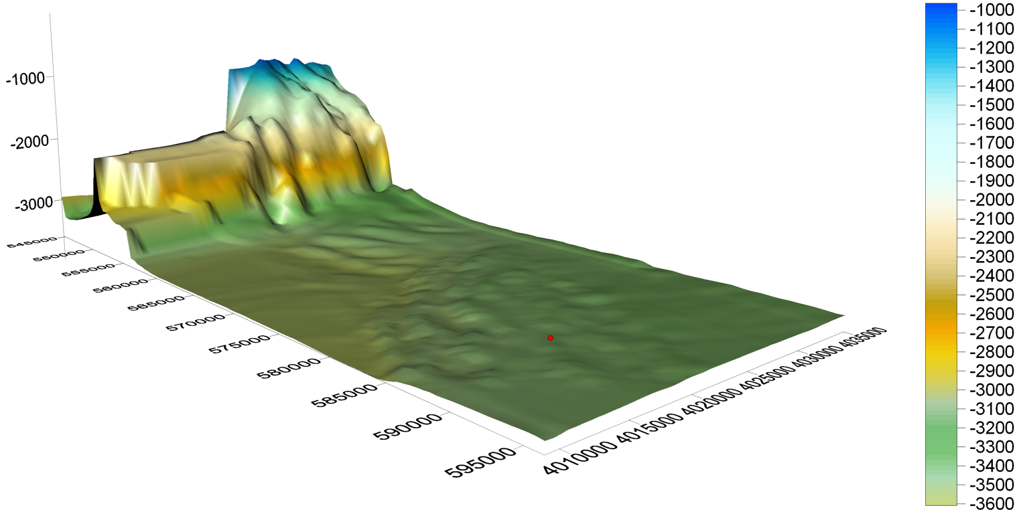
The Capo Passero Site for KM3NeT
More than 30 naval campaigns seeking deep sea sites in the Mediterranean Sea. Capo Passero is an optimal site.
Depth >3500 m, 90 km distance from the shore
Excellent water optical properties (L_{a} ≈ 70 m @λ = 440 nm)
Optical background from bioluminescence extremely low
Deep sea water currents are low and stable (3 cm/s, 10 cm/s max)
Wide abyssal plain: large extension of the detector
Shore Laboratory in Capo Passero harbour
Shore Laboratory:
Electronics Labs
Data Acquisition Room, Control Room
Guest House
Power Feeding Equipment (UPS protected)
10 Gbps direct Optical-fibre link GARR-X
Submarine cable and infrastructure:
96 km - 20 fibres ITU655-NZDSF
Single conductor with DC-sea return
Cable Termination Frame (5 hybrid outputs to JBs)
Medium Voltage Converter: 10kV to 375V
Second cable for ARCA Phase 2: tender assigned
CP Site
The site selected for the km³ detector lies on a flat and wide plateau far from the shelf break (reduced risks)

Slide 4
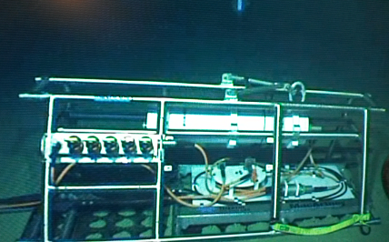
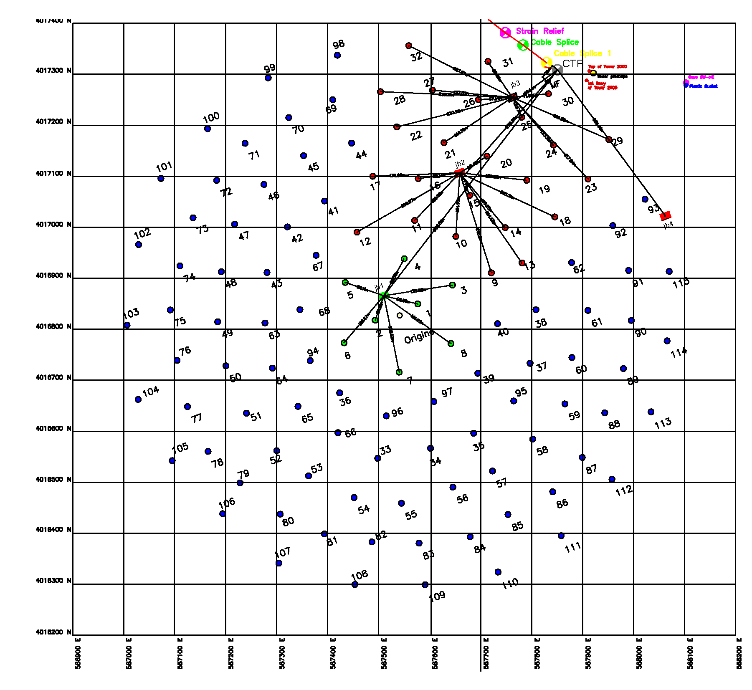
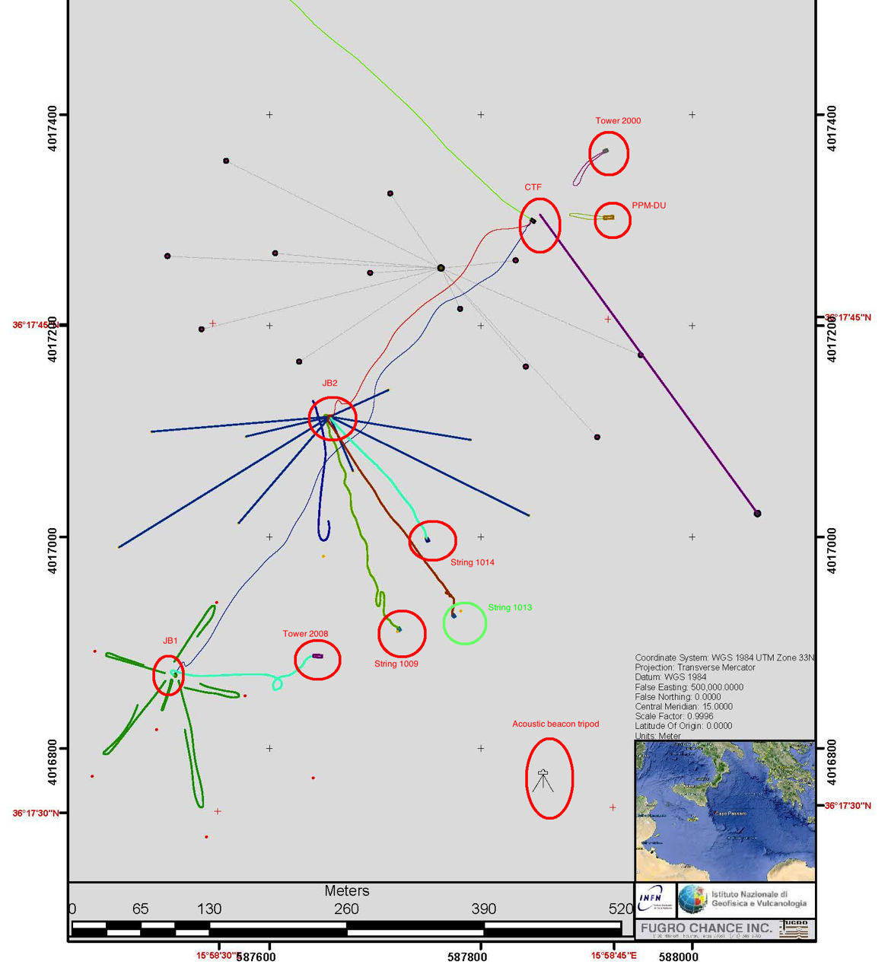
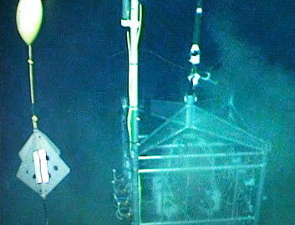
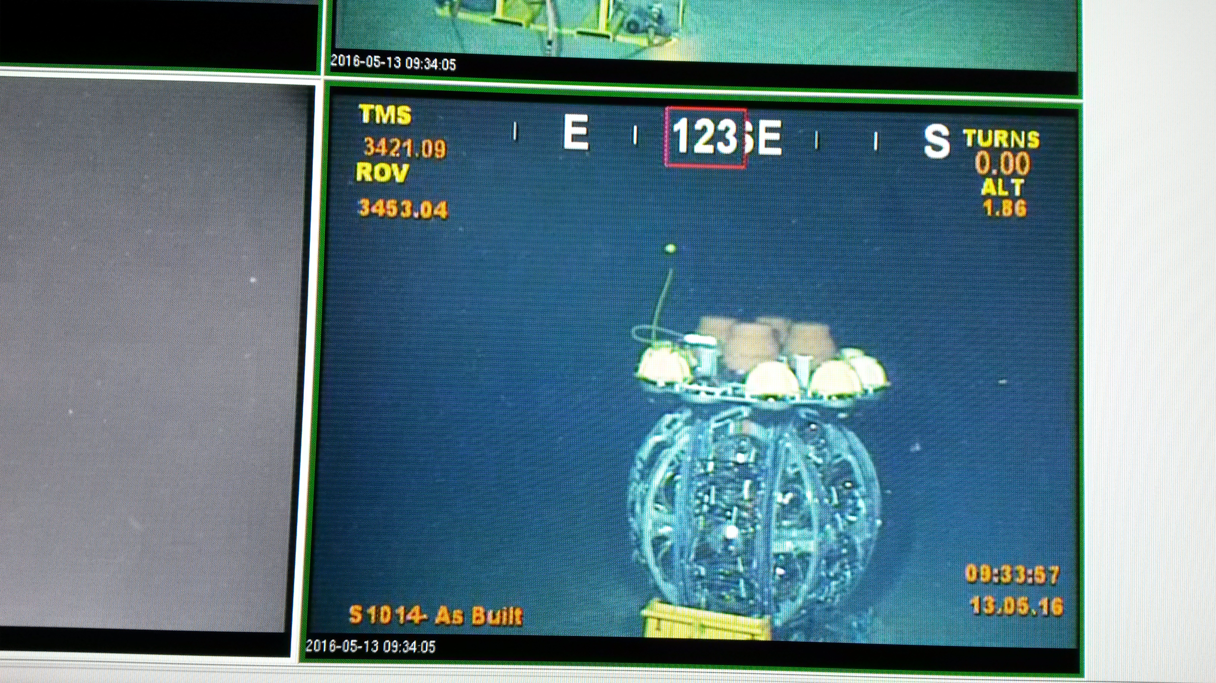
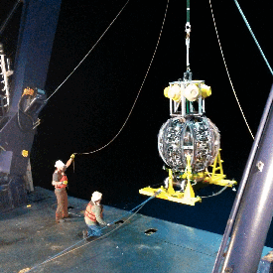
Construction of KM3NeT: Phase 1
24 KM3NeT DUs (Phase 1)
CTF
MEOC
Prototype
JB
CTF
Junction Box
Prototype
Junction Box
ARCA DU002
DU-ARCA 002
EMSO
Junction Box
Access to “Associated science”:
1 acoustic sensor per DOM
1 hydrophone at the base
1 Instrumentation Line
(2 CTD, 2CM, 2SV)
EMSO JB
Junction Box
DU-ARCA 001
ARCA DU001
115 DUs in 2020 (Phase 2)

Slide 5
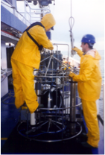
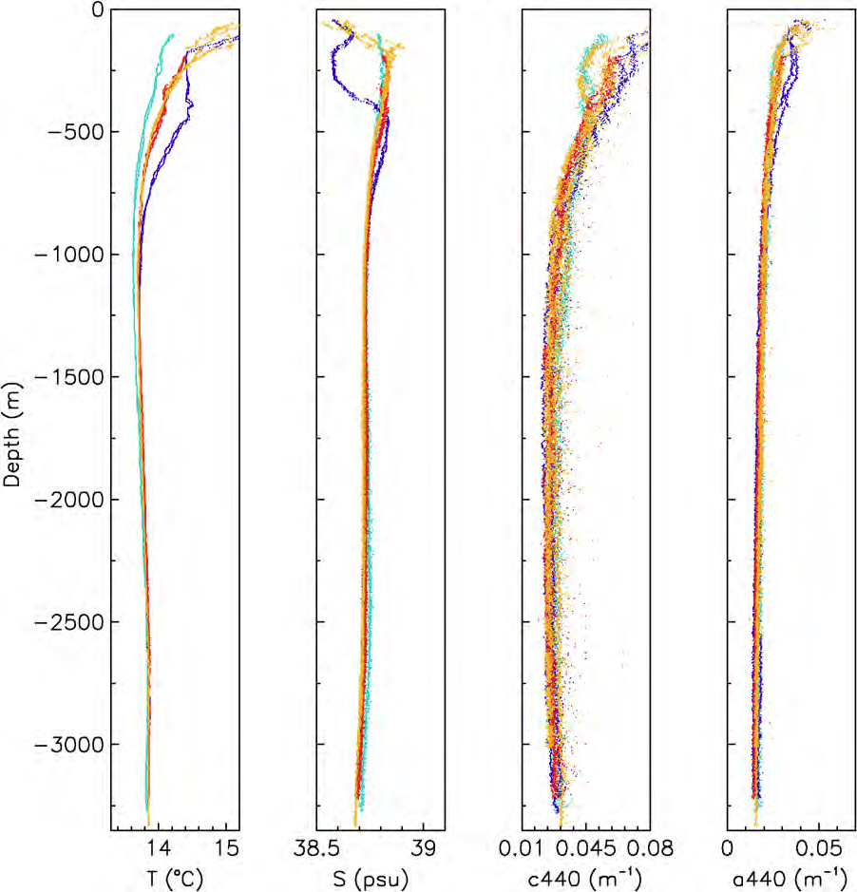
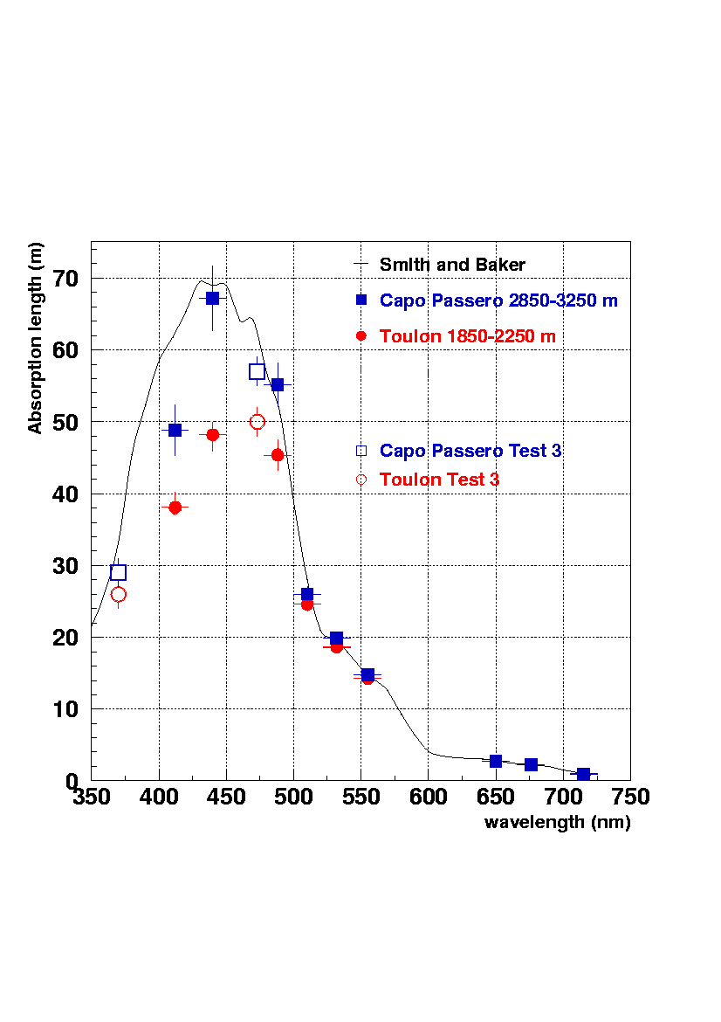
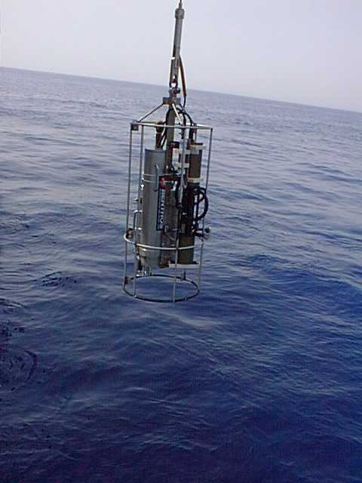
Capo Passero: deep Sea site monitoring
Study of deep seawater optical and oceanographic properties. More than 30 marine campaigns
Mooring lines: current meters, sediment traps, CTDs, biofouling and bioluminescence devices
Profiler (CTD +AC9), Niskins bottles + DNA analysis
In Collaboration with INOGS, CNR and Univ. of Messina
Astroparticle Physics 27 (2007) 1–9
Ligth transmission (absorption, attenuation) vs depth

Slide 6
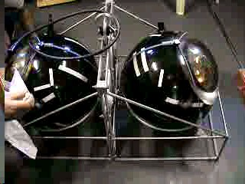
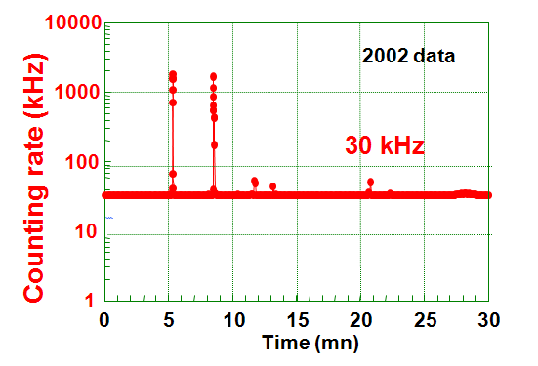
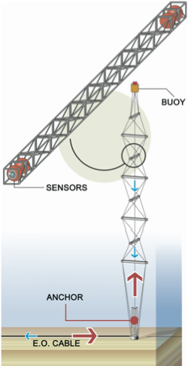
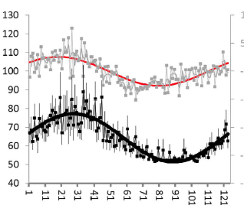
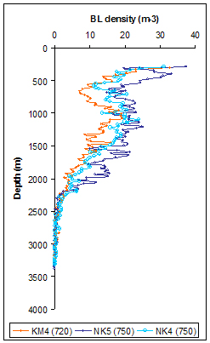

Optical background studies
Data collected since 2000 with different instruments and methods
Stand alone device: 2 x 8’’ PMTs
KM3NeT prototype NEMO mini Tower: 32 Oms (10’’ PMTs)
rate of floor displacement
proxy for current speed
Bioluminescent bacteria concentration and optical background rate (measured with 8’ PMTs, 0.5 s.p.e)
PMT rates [kHz]
Bioluminescence rate
1 day, tidal frequency 20.5 h
Bioluminescent Bacteria concentration
NATURE, March 23, 2017

Slide 7
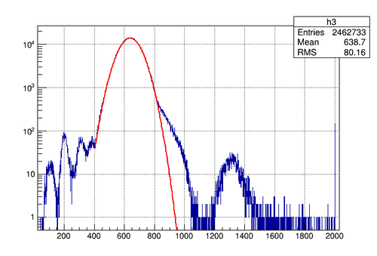
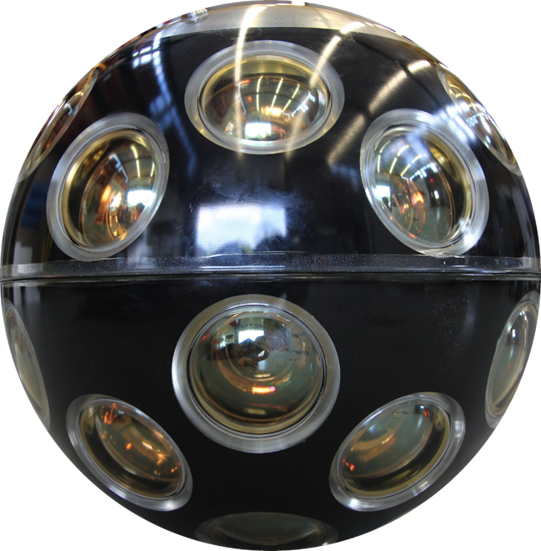
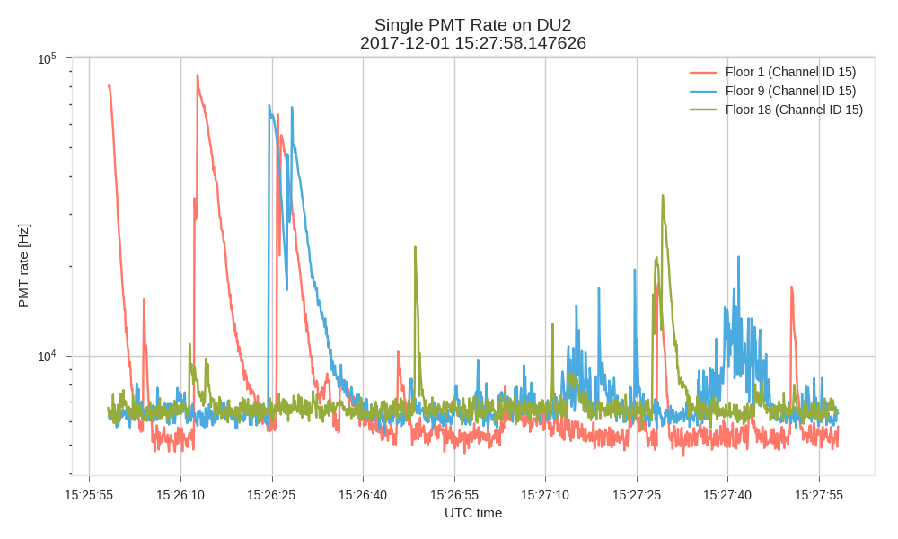
Optical background studies
Data collected since 2000 with different instruments and methods
DU2 - PMT single rate distribution
KM3NeT DUs (since 2015): multi PMT DOM
light
e
2 4 6 8 10 12 14 16 18 20 [kHz]
light
⁴⁰K
⁴⁰Ca
150 Cherenkov photons/decay
stable ⁴⁰K concentration

Slide 8
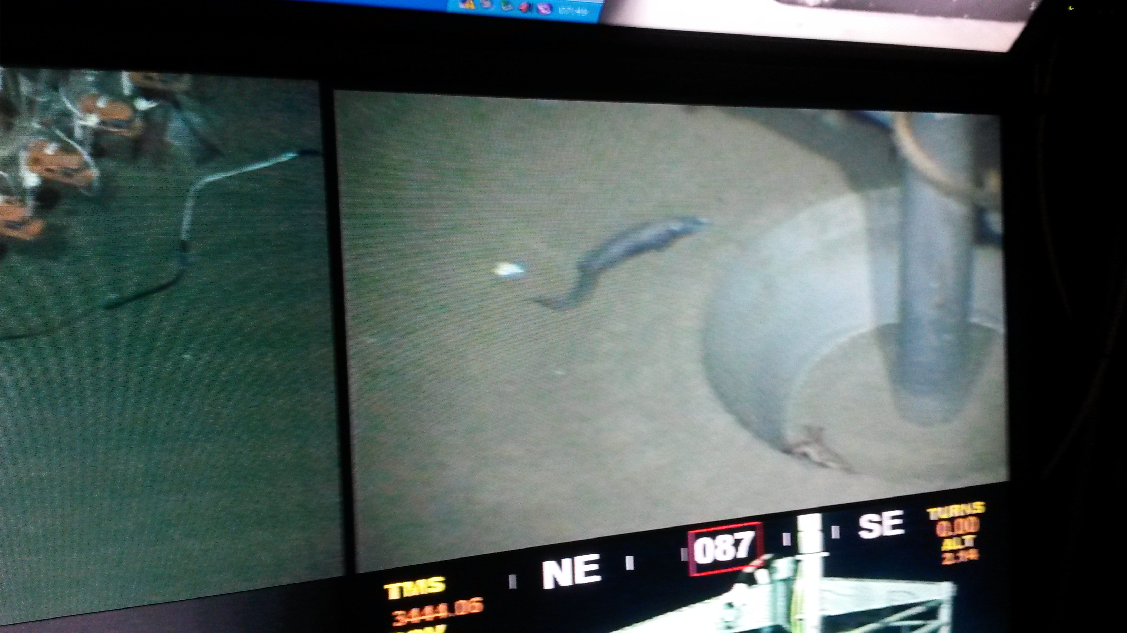
KM3NeT visitors
Marine Biology
M. Priede et al, 2018

Slide 9
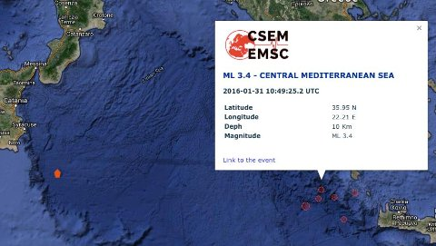
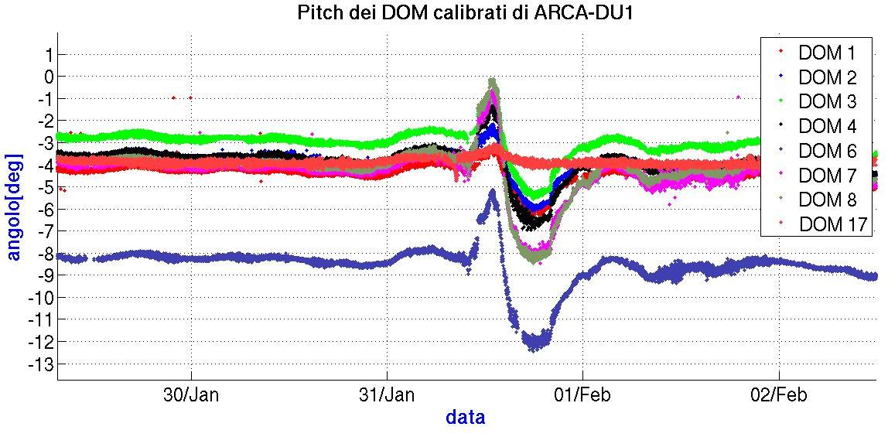

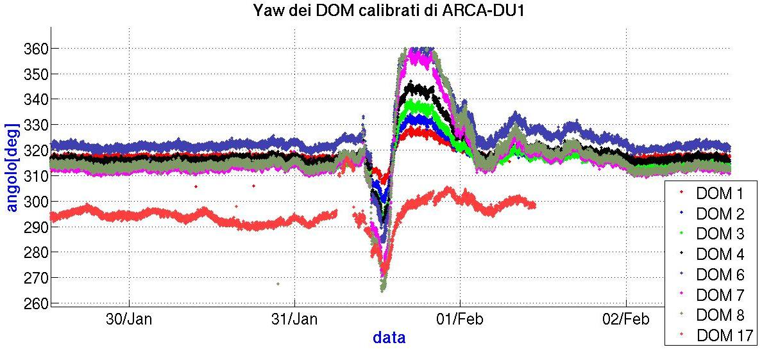
An Earthquake event observed with ARCA
Earthquake M 3.4 31/01 10:49 UTC
The DU starts to move (rotate, and tilt) and continue for about 10 hours.
The higher the DOM, the larger the swing.
Just connected to sea-floor displacement (string mechanics) or also a submarine wave?

Slide 10
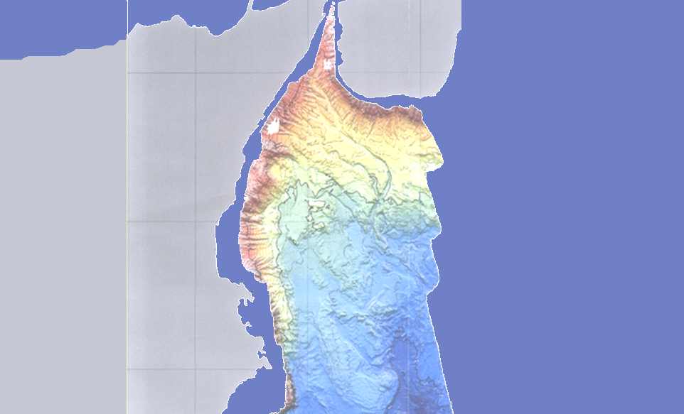
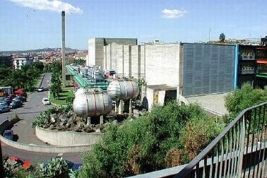
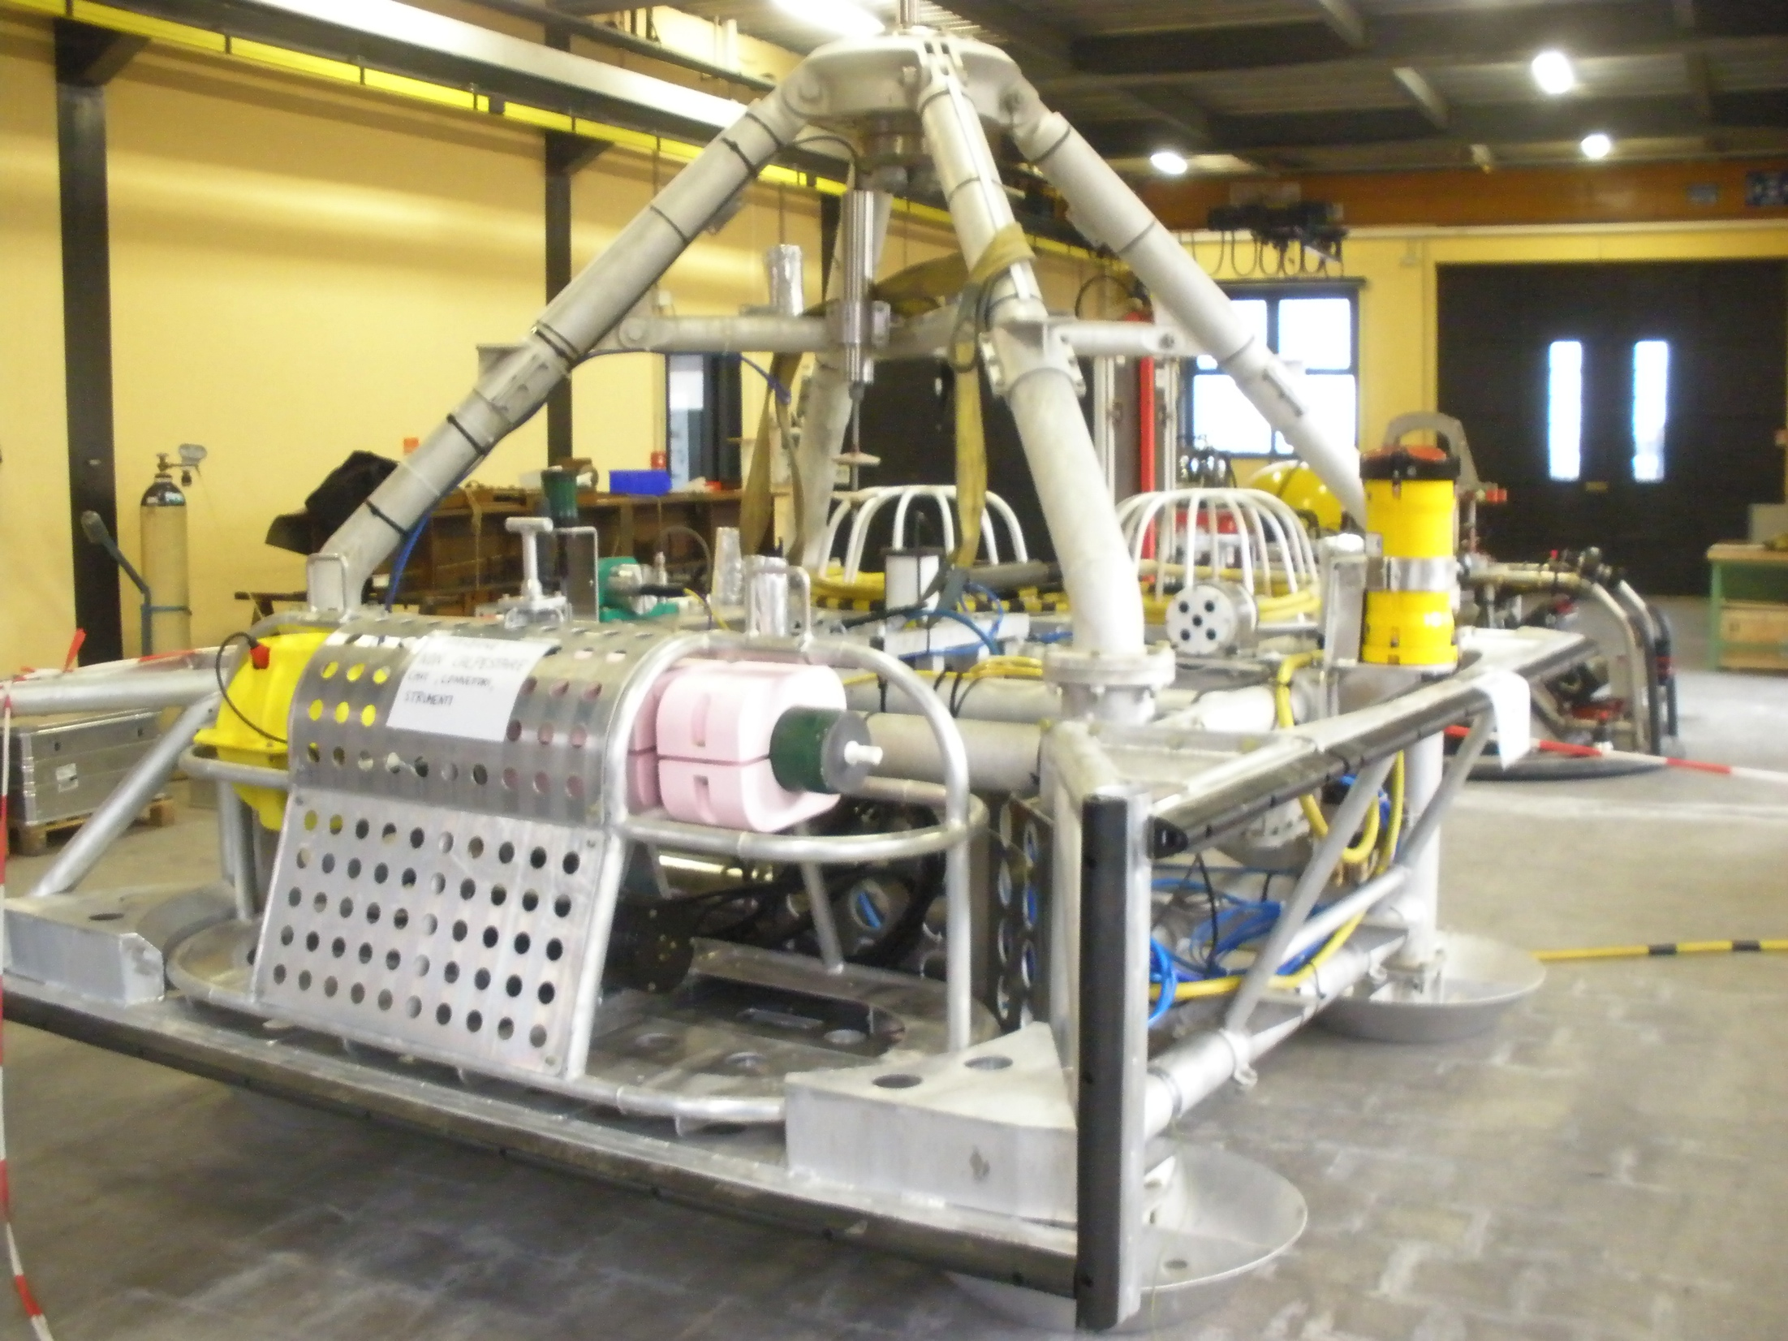
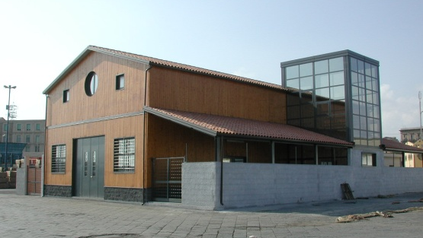

The Catania node
LNS-INFN Catania
NEMO-SN1
2005-2008: Geophysics sensors
2012-2013:
Multidisciplinary node
2 CTDs, CM, seismic hydrophones, LF hydrophones, 4 HF hydrophones, magnetometers
2018 –
New deployment
1 Gbps fiber link
5 km
Test Site North
20 km
Test Site South
5 km
LNS Test Site Laboratory
at the port of Catania
OnDE
2005-2006:
4 High Frequency Hydros
OnDE 2-SMO
2013-today
4 High Frequency Hydros
2018: CREEP (UCL) long term creeping of rocks at high pressure and a real time camera (CSIC)

Slide 11

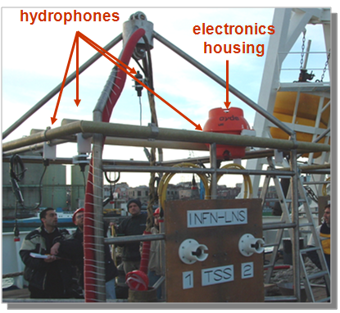
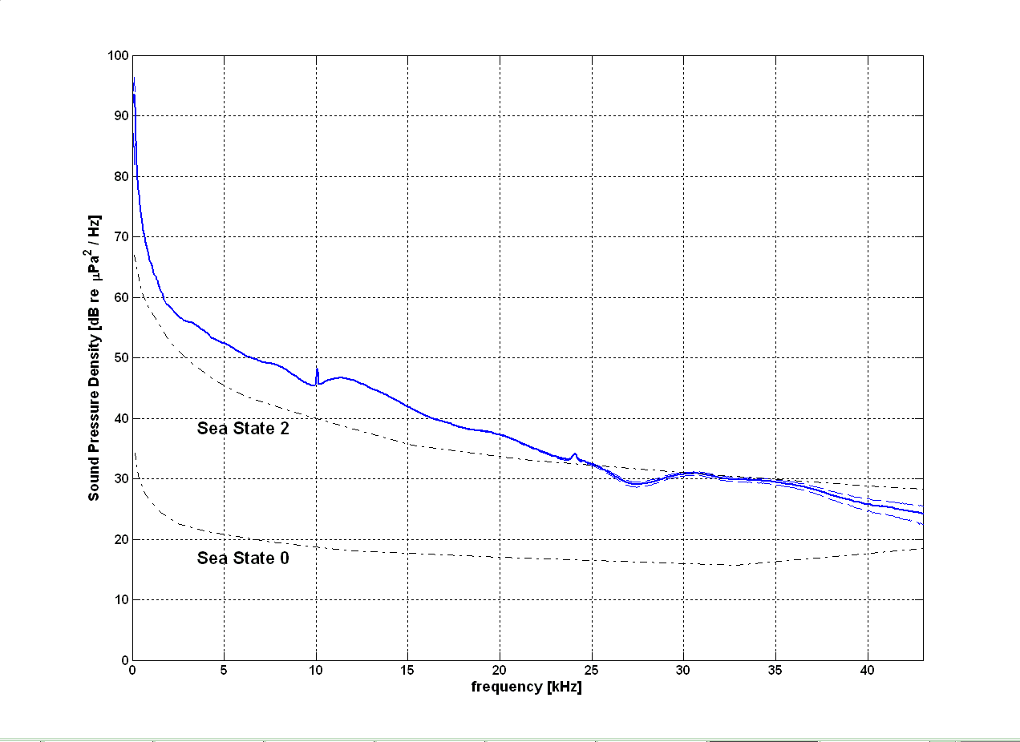

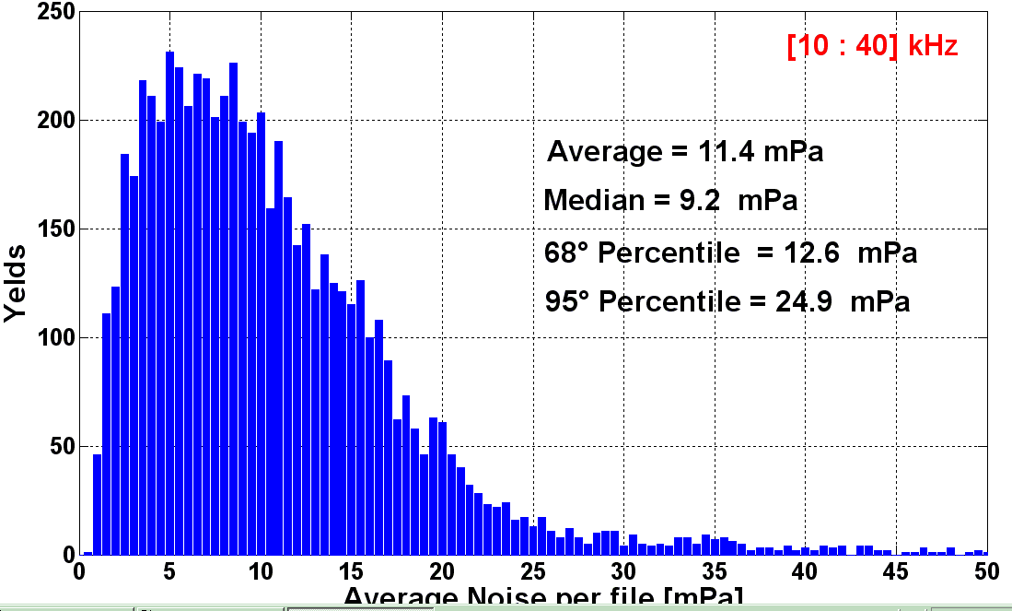

The Ocean noise Detection Experiment
Thetrahedral antenna (1m size):
4 Reson TC4042 hydrophones (special production for 2500 m depth).
Low cost professional audio electronics (96 kHz, 24 bit sampling, ΔΣ)
Hydrophones synchronised and phased.
On-line monitoring and recording on shore. Recording 5’ every hour
Data taking from Jan. 2005 to Nov. 2006 (when NEMO Phase 1 was deployed).
Sea Noise measurement and modelling (presently under study)
Bioacoustics: study of sperm whales population in the East Med Sea
CIBRA
2005-2006: First experiment to perform long-term measurement and monitoring of the acoustic background @ 2000 m depth
Nature (2009)
Average noise spectrum

Slide 12
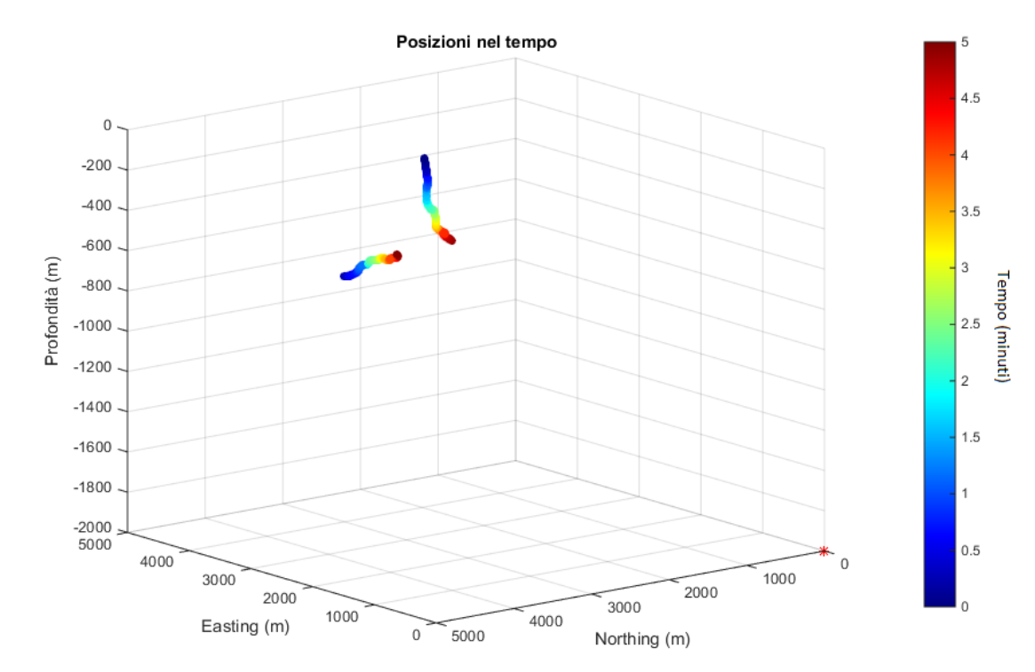
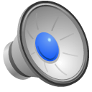

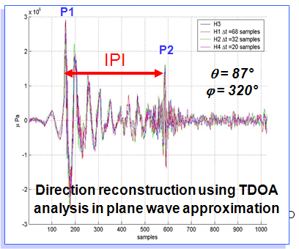
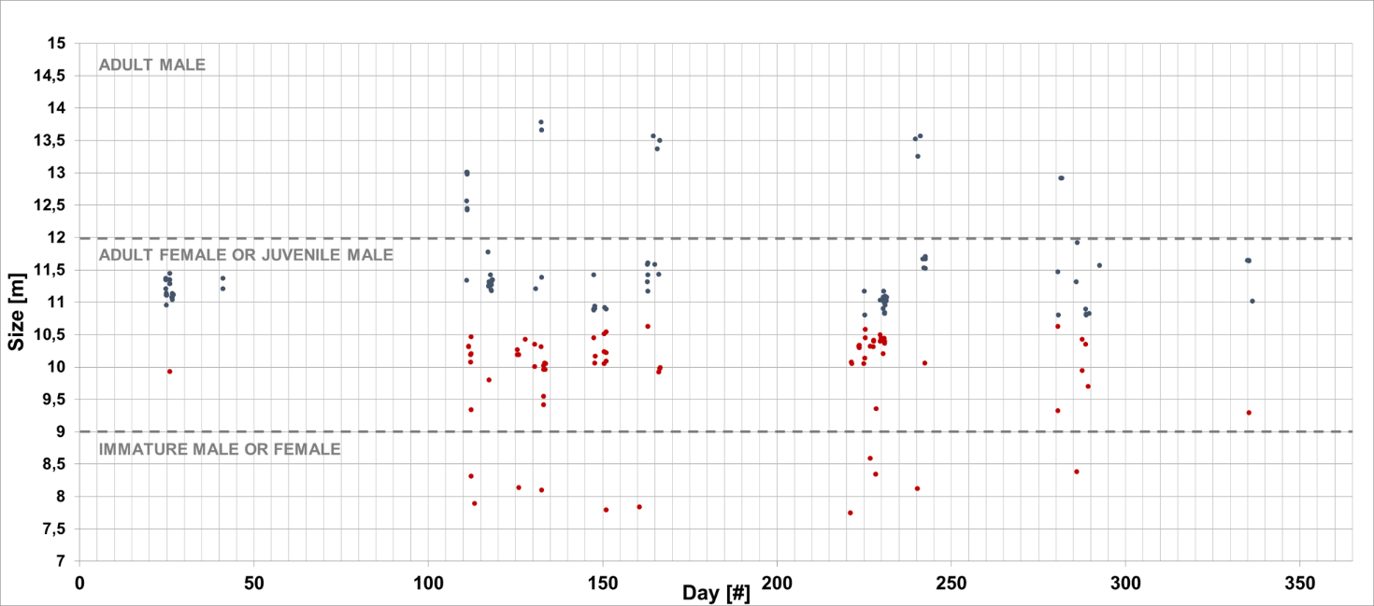

Sperm whale detection
On-line monitoring of acoustic signals with OnDE allowed identification of sperm whales, determination of the population, size and tracking
Dive of 2 sperm-whales
Adult males
Females or young males
Youngs

Slide 13
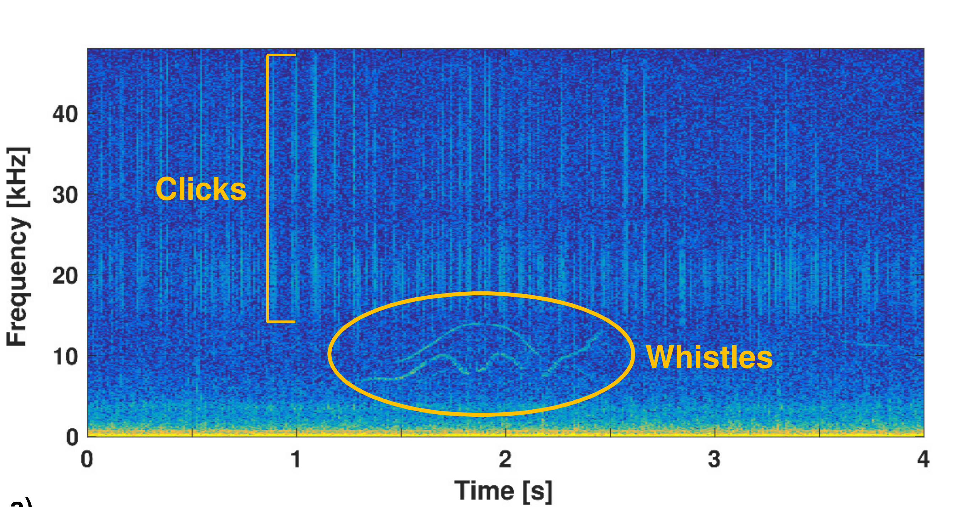
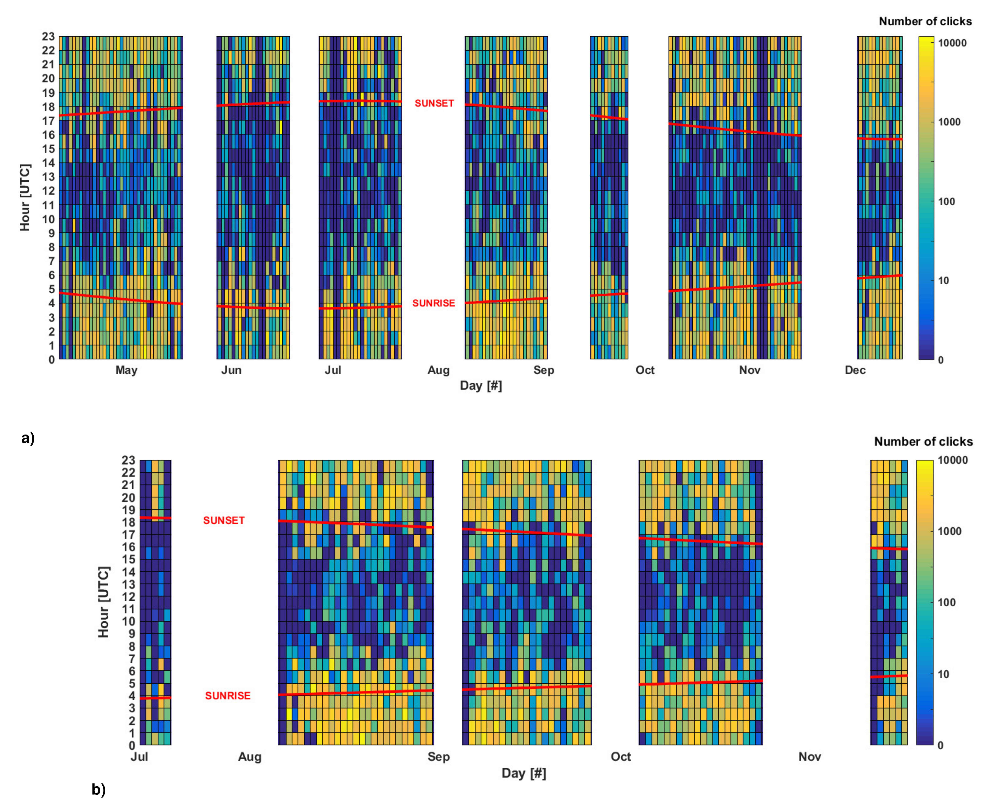
Dolphins’ predation cycle
Automatic identification of dolphins’ echolocation clicks (hunting)
day/nigh cycle assessed with 2 years of data

Slide 14

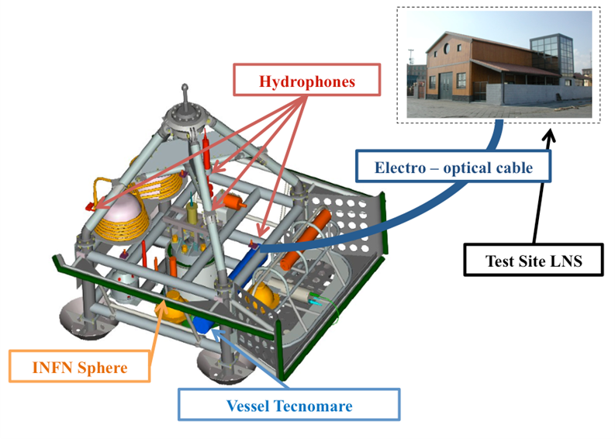
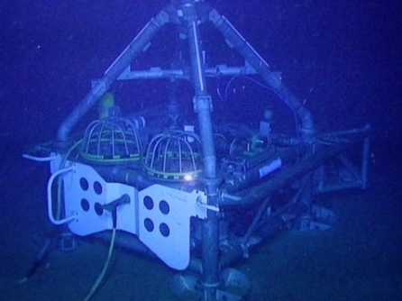
The Submarine Network 1 EMSO Node
First Cabled node of EMSO
Monitoring of volcanic and seismic activity in Sicily: thanks to reduced noise SN1 has improved sensitivity with respect to inland observatories.
Prototype of a Tsunami early warning system
NEMO – SN1
INFN – LNS shore lab
June 2012
May 2013
Low frequency hydrophone
24/24 h recordings, 11 months

Slide 15
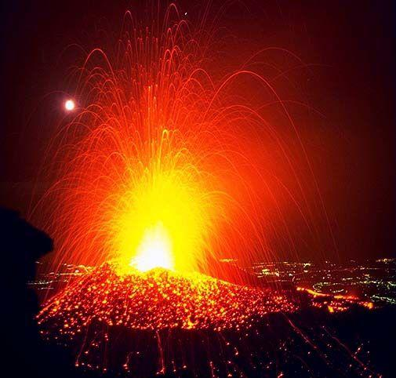
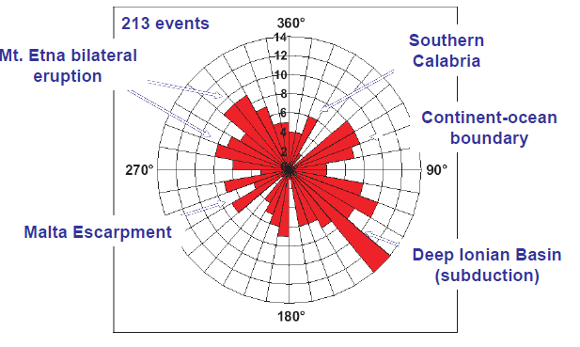
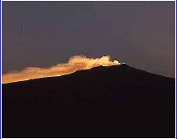

Geophysics and Volcanology
Real-time data acquisition
Sensor Sampling rate
Three-component broad-band seismometer 100 Hz
Hydrophone (geophysics) 100 Hz
Gravity meter 1 Hz
Scalar magnetometer 1 sample / 10 min
Three-axes single-point current meter 2 Hz
CTD 1 sample / 12 min
Seismic activity map reconstructed by NEMO-SN1
SN1 Connection

Slide 16



Fin whale presence
Low frequency hydrophone on SN1
bio-acustics (mysticetes)
acoustic noise monitoring (Marine Strategy Directive)
Identification and monitoring
First data on effect of anthropogenic noise
18-20 Hz Calls
Target Species IUCN

Slide 17




Airgun Signals
Real-time identification of “airguns” (compressed-air cannoons) used for geophysics studies
Noise level increase: 10 dB
Identified source, offshore Greece
Need of transnational policies !
Italian Ministry for the environment
Airgun
Fin whale
Anticoincidence between airgun shoots and fin whale presence

Slide 18





Noise pollution measurements (MSFD)
Real-time monitoring of man-made acoustic pollution in the Central Mediterranean Sea
Ship identification with AIS and acoustic sign signature
Noise maps
100 dB
Noise Spectra
1kHz
MMSI: 247323100
(CARGO)

Slide 19




The Smo-OnDE detector (running)
Real time data acquisition and analyisis (24h/7d)
Improved senitivity and sampling rate, GPS synchronisation
Data available for the implementation of the Marine Strategy Directive in Italy

Slide 20
Thanks for your attention

