Slide 1
INGA ZINICOVSCAIA
Moldavian wine and soil analysis using neutron activation analysis
¹Frank Laboratory of Neutron Physics, JINR, 6 Joliot-Curie Str., 1419890, Dubna, Russia, zinikovskaia@mail.ru
²Horia Hulubei National Institute for R&D in Physics and Nuclear Engineering, 30 Reactorului Str. MG-6, Bucharest - Magurele, Romania
³Institute of Chemistry of the Academy of Science of Moldova, 3, Academiei Str., 2028 Chisinau, R. Moldova

Slide 2
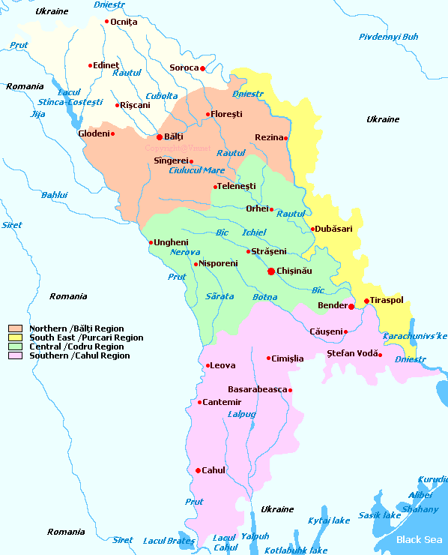
Wine is a beverage of great social and economic significance widely consumed around the world.
The Republic of Moldova is a well-known producer of world-class wines, which play a critical role in the economy of the country.
vineyard area - 148,500 hectares, of which 107,800 hectares are used for commercial production
2

Slide 3
Wines typically contain:
major elements such as Na, Mg, K, and Ca, whose concentration is greater than 10 mg/l;
trace elements such as Al, Mn, Fe, and Zn, whose concentration overpass 10 μg/l;
and ultra-trace elements such as Cr, Ni, As, or Cd, whose concentration is lower than micrograms per liter.
3

Slide 4
Why its important to determine the elemental content of wine?
to asses the effect of soil on wine composition
to asses the effect of anthropogenic activity
on wine composition
to test the wine provenance or region of origin
4

Slide 5
ICP-AES
ICP-MS
AAS
Wine analysis
XRF
IR spectrometry
NAA
5

Slide 6
Cabarnet, Regent, Pinot Noir, Nero, Syzar, Merlot, Malbec, Sauvignon, Riesling, Pinot Gris, Muscat, UniBlanc
Pinot, Chardonnay, Cabernet, Chardonney, Pinot Frank
6

Slide 7
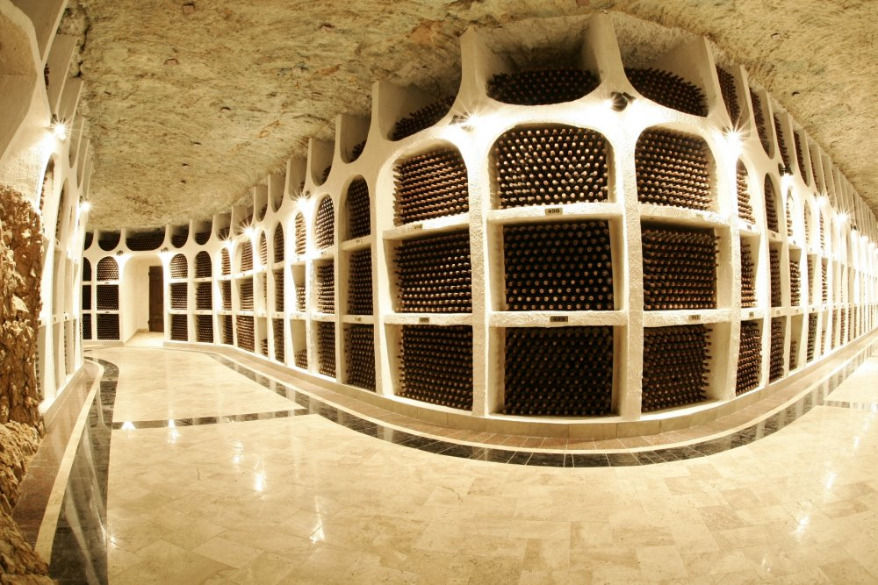
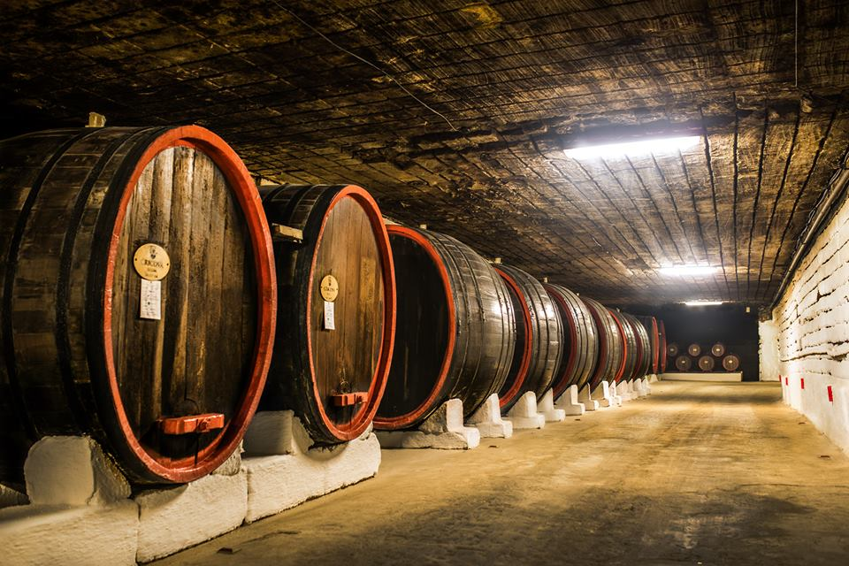
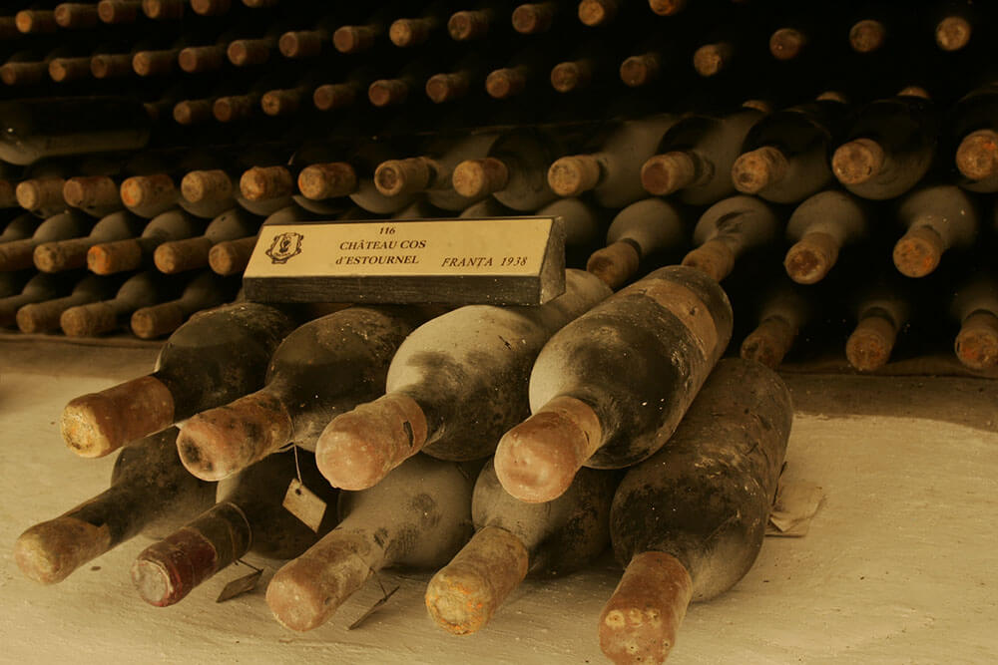
Cricova

Slide 8
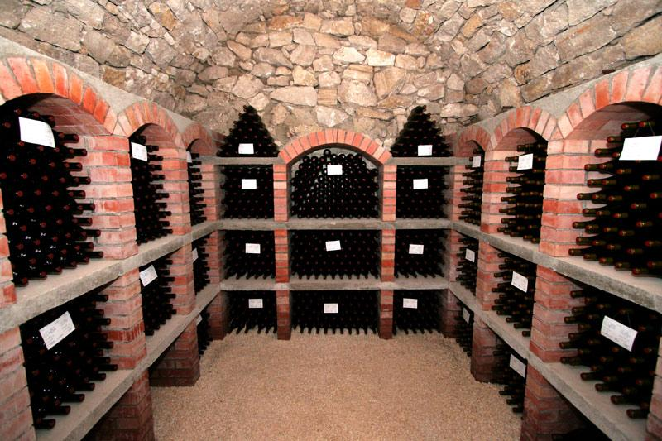
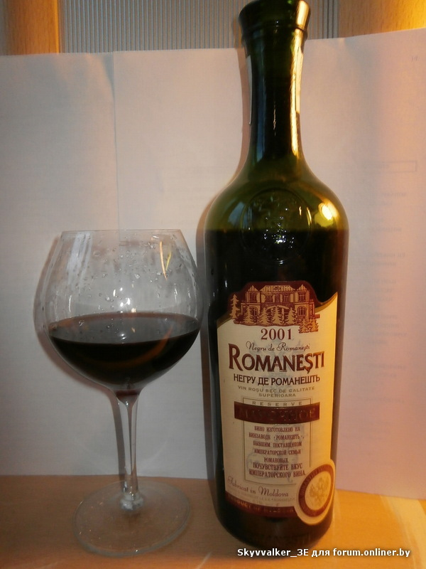
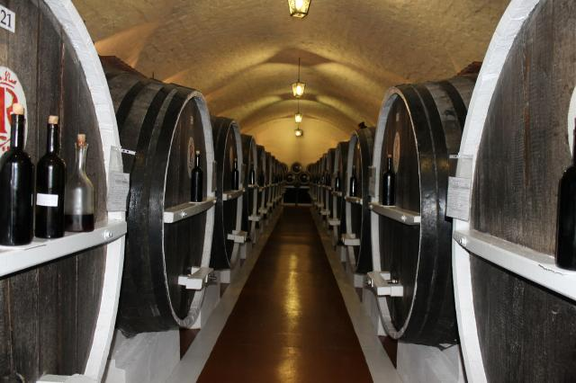
Romanesti

Slide 9
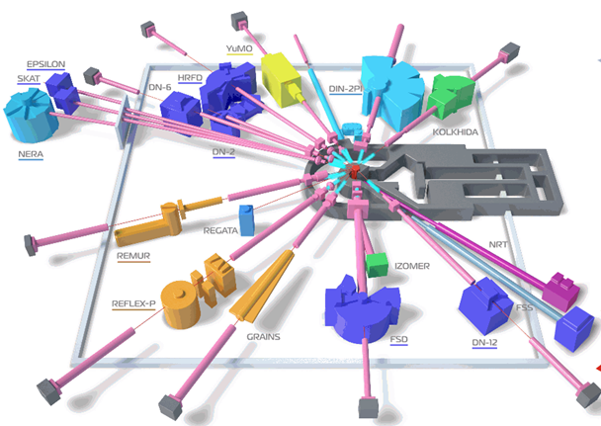
REGATA
9

Slide 10
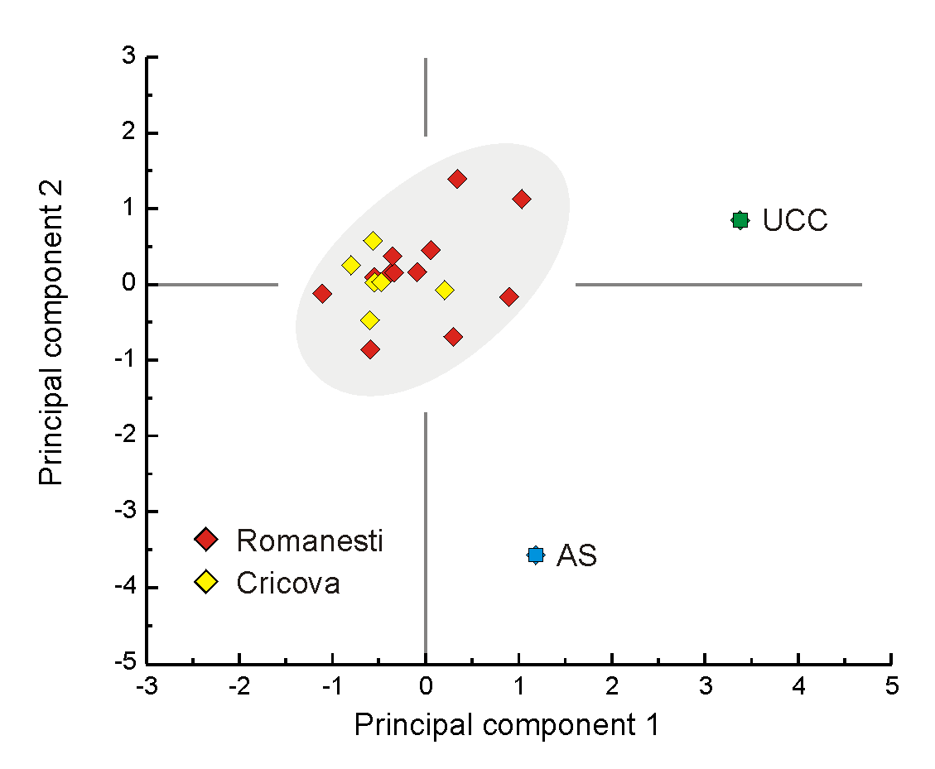
Elemental analysis of soil
The bi-plot illustrating the homogeneity of the soil samples as resulted from the Principal Component Analysis (UCC and AS stay for Upper Continental Crust and Average Soil respectively)
10
Notes:
As expected, between the elemental contents of the soil of the two vineyards there are no significant differences, fact also confirmed by the results of a Principal
Component Analysis

Slide 11
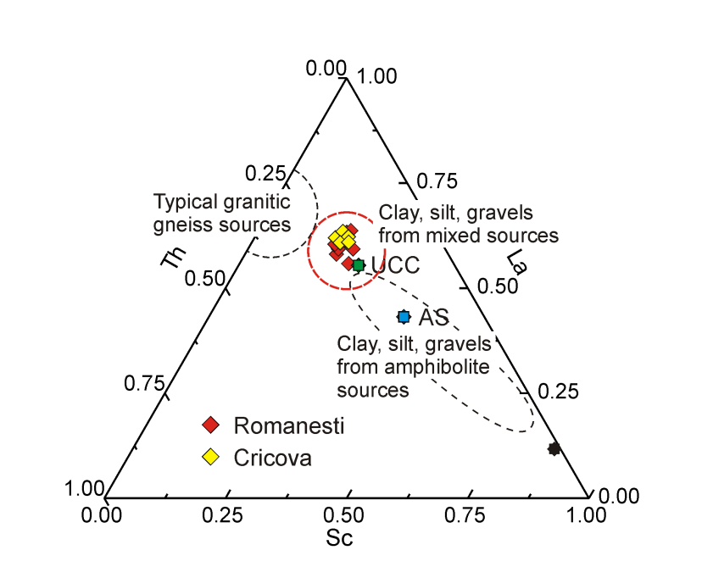
Rb/Sr ratio 1.11 is significantly higher than UCC one of 0.26 (Rudnick and Gao, 2004), AS of 0.33 (Vinogradov, 1959 cited by Shacklette and Boerngen, 1984), indicating a significant chemical weathering
The Sc-La-Th discriminating ternary diagram proving a primary continental origin of the soil material
11
Notes:
Sr, an alkaline earth elements, due to its ionic radius close to Ca, substitutes Ca
in Ca-rich minerals such as limestone, dolomite, plagioclase, hornblende, etc. while
Rb, an alkaline metal coexist with Na and K rich minerals such as plagioclase, K-feldspars, different variety of micas, etc. The Ca-bearing minerals are more sensitive
to chemical weathering than the K-rich one so, with the time, the Ca-Sr couple are
depleted faster then K-Rb one which leads to higher Rb/Sr ratio [26]. Therefore, the
Rb/Sr ratio can be used together with Chemical Index of Alteration [27] or with the
Chemical Index of Weathering [28] as a proxy of the chemical weatherin. To get more information, we have represented the relative distribution of three
incompatible and immiscible elements Sc, La and Th [31] by the means of a ternary
discriminating diagram (Fig. 4a). As it can be remarked, all points are concentrated
around the UCC which indicates a primary continental origin of the soil material.

Slide 12
Average numerical values (± St. Dev.) of the content of Cr, Mn, Co, Ni, Zn and As together with the corresponding limits defined by the Moldavian, Romanian and Russian authorities.
Element | Soil content | Moldova | Russian Federation | Romania
Cr | 91 ± 9 | -- | -- | 30 - 100
Mn | 678 ± 56 | -- | -- | 900 - 1500
Co | 13 ± 1 | -- | -- | 15 - 30
Ni | 35 ± 7 | 75 | 20 - 80 | 20 - 75
Zn | 72 ± 10 | 300 | 55 - 220 | 100 - 300
As | 8.7 ± 1.1 | -- | 2 - 10 | 5 - 12.5
Average numerical values (± St. Dev.) of the Enrichment Factor (EF), Geo-accumulation Index (Igeo), as well as of the Pollution Index of the investigated soils
Element | EF ± St.Dev | Igeo ± StDev | Pollution Index ± StDev
Cr | 1.29 ± 0.12 | -0.62 ± 0.15
Mn | 1.18 ± 0.13 | - 0.75 ± 0.12
Co | 1.01 ± 0.06 | - 0.97 ± 0.13
Ni | 0.84 ± 0.10 | - 1.24 ± 0.24
Zn | 1.33 ± 0.14 | -0.58 ± 0.22
As | 7.14 ± 0.47 | 1.85 ± 0.16
 |  |  | 1.15 ± 0.11
12

Slide 13
The experimental values (± s) of the concentrations of 18 elements in investigated wines determined by NAA, All concentrations expressed in mg/l excepting Co, Ni, As, Br, Sb, Cs, Ba and U whose concentrations are expressed in µg/l.
Element | Romanesti |  |  | Romanesti |  |  | Cricova |  |  | Cricova
 | red |  |  | white |  |  | red |  |  | white
Na | 19 | ± | 9 | 16 | ± | 1 | 11 | ± | 2 | 11 | ± | 3
Mg | 104 | ± | 12 | 87 | ± | 12 | 77 | ± | 5 | 92 | ± | 21
Al | 1.4 | ± | 1.0 | 1.9 | ± | 0.5 | 1.4 | ± | 1.0 | 1.5 | ± | 0.7
K | 690 | ± | 80 | 380 | ± | 230 | 550 | ± | 80 | 460 | ± | 100
Ca | 54 | ± | 14 | 75 | ± | 24 | 66 | ± | 13 | 68 | ± | 21
Mn | 1.35 | ± | 0.14 | 1.22 | ± | 0.25 | 0.93 | ± | 0.14 | 1 | ± | 0.2
Fe | 3.5 | ± | 3.3 | 2 | ± | 1.9 | 1.1 | ± | 0.7 | 0.7 | ± | 0.4
Co | 6.3 | ± | 3.6 | 9.8 | ± | 1.4 | 4.2 | ± | 1.6 | 3.2 | ± | 0.7
Ni | 39 | ± | 10 | 32 | ± | 11 | 18 | ± | 9 | 20 | ± | 5
Zn | 0.44 | ± | 0.23 | 0.55 | ± | 0.04 | 0.92 | ± | 0.41 | 0.49 | ± | 0.08
As | - | - | - | - | - | - | 0.26 | ± | 0.21 | 0.3 | ± | 0.12
Br | 280 | ± | 90 | 92 | ± | 92 | 69 | ± | 25 | 104 | ± | 44
Rb | 1.7 | ± | 0.2 | 1.1 | ± | 0.5 | 1.6 | ± | 0.3 | 1.6 | ± | 10.3
Sr | 1.01 | ± | 0.23 | 0.64 | ± | 0.19 | 0.84 | ± | 0.32 | 0.75 | ± | 0.15
Sb | 0.48 | ± | 0.18 | 0.41 | ± | 0.13 | 0.59 | ± | 0.37 | 0.53 | ± | 0.26
Cs | 3.3 | ± | 0.8 | 3.1 | ± | 2.5 | 7.5 | ± | 2.8 | 6.1 | ± | 1.1
Ba | 276 | ± | 270 | 110 | ± | 30 | 70 | ± | 41 | 87 | ± | 27
U | 0.12 | ± | 0.06 | 0.20 | ± | 0.06 | 0.13 | ± | 0.04 | 0.13 | ± | 0.01
13

Slide 14
Literature data for wines with different origin
Element | Lopez-Artiguez et al (1996) | Cvetkovici et al (2002) | Lara et al (2005) | Fiket et al (2011) | Geana et al (2013) |  | Boscheti 2013 | Alkis 2014
 |  |  |  |  | red | white
Na | 27 -54 | 8.6 - 9.2 |  |  |  |  | 18
Mg | 79-109
Al | 1.0-4.1 |  | 17.0 - 18.0 | 04 - 1.2
K | 435-652 | 730 - 940
Ca | 85-150 | 13 - 78 | 11 - 14
Mn | 0.1-51 |  |  | 0.51 - 1.21 | 0.06 - 1.00 | 0.18 - 1.44 | 1.64 - 6.02 | 0.11 - 0.70
Fe | 2.2-4.9 | 3.4 - 7.1 | 0.6 - 0.7 | 2.9 - 6.7 |  |  |  | 0.7 - 1.7
Co |  | 2.8 - 6.5 |  | 2.8 - 6.0 | 0.3 - 6.0 | 1.3 - 42.0 |  | 0.5 - 6.3
Ni |  |  |  |  | 5 - 217 | 1 - 322 |  | 134 - 573
Zn |  | 0.07 - 1.56 | 0.09 - 0.11 | 0.33 - 0.69 | 0.06 - 1.00 | 0.18 - 1.44 |  | 0.39 - 2.10
As |  | 1.13 - 5.13 |  | 0.69 - 9.66
Br |  | 51 - 140
Rb |  | 0.9 - 2.7 |  |  | 0.1 - 2.01 | 0.2 - 1.8 | 3.7 - 6.6
Sr |  |  |  |  | 0.35 - 1.54 | 0.14 - 1.60 | 0.24 - 2.10
Sb |  |  |  | 0.25 - 1.09
Cs |  | 0.1 - 9.5
Ba |  | 62 - 116 |  | 28 - 154
U |  |  |  | 0.17 - 1.01
14

Slide 15
The discriminating Root2 vs. Root 1 bi-plot illustrating the result of Discriminate Analysis of the 24 sets of wines. It can be remarked that the Romanesti wines are better discriminated with respect to Cricova ones.
15

Slide 16
The numerical values ± combined uncertainty of the transfer factors expressed in mg/l for all investigated wines
Element | Romanesti – red wine |  |  | Romanesti – white wine |  |  | Cricova – red wine |  |  | Cricova – white wine
Na | 4.5 | ± | 2.2 | 3.9 | ± | 0.3 | 2.7 | ± | 0.6 | 2.7 | ± | 0.8
Mg | 5.3 | ± | 1.0 | 4.6 | ± | 0.9 | 3.6 | ± | 0.6 | 4.3 | ± | 1.2
Al | 0.02 | ± | 0.02 | 0.03 | ± | 0.01 | 0.02 | ± | 0.02 | 0.03 | ± | 0.01
K | 36 | ± | 5 | 21 | ± | 14 | 27 | ± | 5 | 32 | ± | 6
Ca | 5 | ± | 2 | 6 | ± | 4 | 7 | ± | 2 | 7 | ± | 3
Mn | 2.0 | ± | 0.3 | 1.8 | ± | 0.4 | 1.3 | ± | 0.2 | 1.4 | ± | 0.3
Fe | 0.1 | ± | 0.1 | 0.1 | ± | 0.1 | 0.04 | ± | 0.03 | 0.03 | ± | 0.02
Co | 0.5 | ± | 0.3 | 0.8 | ± | 0.1 | 0.4 | ± | 0.1 | 0.3 | ± | 0.1
Ni | 1.2 | ± | 0.3 | 0.9 | ± | 0.3 | 0.5 | ± | 0.3 | 0.6 | ± | 0.1
Zn | 6 | ± | 3 | 8 | ± | 1 | 16 | ± | 7 | 8 | ± | 1
As | - | - | - | - | - | - | 0.03 | ± | 0.02 | 0.03 | ± | 0.01
Br | 35 | ± | 12 | 13 | ± | 14 | 8 | ± | 3 | 12 | ± | 5
Rb | 16 | ± | 2.0 | 11 | ± | 5 | 17 | ± | 3 | 17 | ± | 3
Sr | 12 | ± | 4 | 7 | ± | 4 | 7 | ± | 3 | 6 | ± | 2
Sb | 0.5 | ± | 0.2 | 0.5 | ± | 0.2 | 0.7 | ± | 0.5 | 0.7 | ± | 0.3
Cs | 0.6 | ± | 0.2 | 0.6 | ± | 0.5 | 1.7 | ± | 0.6 | 1.4 | ± | 0.3
Ba | 0.7 | ± | 0.7 | 0.3 | ± | 0.1 | 0.2 | ± | 0.1 | 0.2 | ± | 0.1
U | 0.05 | ± | 0.03 | 0.10 | ± | 0.03 | 0.05 | ± | 0.02 | 0.05 | ± | 0.01
16

Slide 17
Conclusion
ENAA was used to determine the content of 35 major as well as trace elements in soils and 18 in wines from two renowned vineyards from the Republic of Moldova: Romanesti and Cricova.
The soil of both vineyards is identical and close to the average composition of the UCC. A more detailed analysis of the distribution of Rb and Sr evidenced a significant degree of chemical weathering as well as a prolonged process of sorting and recycling of the mineral.
The soil content of Cr, Mn, Co, Zn and As, the possible anthropogenic contaminates proved, with the exception of As, the absence of any systematic heavy element pollution.
The ENAA data allowed calculating, for each sample of wine, the corresponding transfer factor which expresses at which extent a considered element is transported from vineyard plant to wine.
Discriminant analysis allowed to classify wine samples in four distinct categories according to sort, red and white, and vineyard
17

Slide 18
Thank you for attention!

